Slide 1
Machine Consciousness
Plausibility, Definitions, Implications
Andrey Ryabtsev, James Morren, Evan Blajev
Mario Klingemann Neural Glitch
The result of altering trained weights randomly in GANs

Slide 2
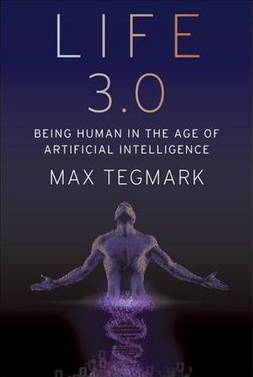
Life 3.0 by
Max Tegmark
Sentience, wakefulness, self-awareness, access to sensory input, ability to fuse information into a narrative
Consciousness = subjective experience
Easy -> Hard challenges (by testability)
How does brain process information? How is it intelligent?
What physical properties distinguish conscious and unconscious systems?
How do physical properties determine qualia?
Why is anything conscious?

Slide 3
Life 3.0
Giulio Tononi: Connectedness of transformations of complex systems (Φ)
Successfully used in determining consciousness
Flawed
Gradual replacement technique
A proof that if the brain can be simulated, then machine consciousness is possible at least to the extent of human consciousness
If difference is noticed, it could be voiced
Alien hand syndrome
Global vs. local processing and experience
Joscha Bach: consciousness is but a passing phase in the history of the universe

Slide 4
Theory of Artificial Consciousness
“Define that which would have to be synthesized were consciousness to be found in an engineered artifact.”
Igor Aleksander 1995
Aspects of consciousness:
Awareness
Memory
Learning
Anticipation
Subjective Experience

Slide 5
The Proof of Machine Consciousness Project
Steven Schkolne
Machines Demonstrate Self-Awareness
Machines Demonstrate Awareness of the Present
Machines Demonstrate Awareness of Future and Past
Machines Know What They Know
Machines Demonstrate Block’s Consciousness
Machines Demonstrate Experience
Machines Demonstrate Qualia

Slide 6
The Proof of Machine Consciousness Project
Machines Demonstrate Self-Awareness
External Self-Awareness
GPS Location
Keeping Time
Internal Self-Awareness
System Interrupts
Machines Demonstrate Awareness of the Present
Awareness of environment
1962’s SAGE System: Computer Network of Radar to monitor US Air-space
Machines Demonstrate Awareness of Future and Past
Low-level planning in the operating system; Scheduling
Darpa Grand Challenge(2004 - 2005): Self driving vehicles traveling 150 miles

Slide 7
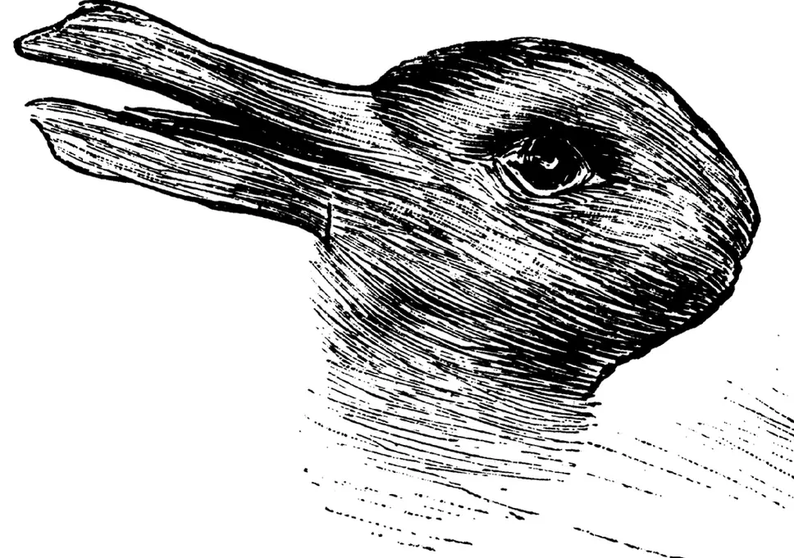
The Proof of Machine Consciousness Project
Machines Know What They Know
Building models from data and improving them
Roomba VSLAM algorithms
Machines Demonstrate Block’s Consciousness
Access Consciousness: Aspects of experiences that are apprehended
Phenomenal Consciousness: Aspects of experiences that can not be apprehended
Machines Demonstrate Experience
Finding inhuman empathy
2015 Atlas robot
Machines Demonstrate Qualia
“Qualia” : aspects of consciousness which are ephemeral, personal, and non-transcribable
Duck-Rabbit illusion
RGB vs. BGR

Slide 8
Legal ramifications of Machine Consciousness
Consider rights such as
the right to not be taken offline
the freedom to choose which processes to run
Do ‘rights’ only apply to machines that are fully self aware, and where will we draw the line as to which machine should have rights?

Slide 9
Discussion Questions:
Can computation be a framework for consciousness?
Is machine consciousness desirable? Avoidable?
Is it possible to detect consciousness without empathy?
How do we integrate humans and conscious machines into a cohesive, fair society?

Slide 10
Sources:
Chalmers, David (2011), "A Computational Foundation for the Study of Cognition", Journal of Cognitive Science, Seoul Republic of Korea: 323–357
Aleksander, Igor (1995), Artificial Neuroconsciousness: An Update, IWANN, Archived from the original on 1997-03-02
Tegmark, Max. Life 3.0: Being Human in the Age of Artificial Intelligence. Penguin Books, 2018.
10156961729430085. “The Proof of Machine Consciousness Project – Becoming Human: Artificial Intelligence Magazine.” Becoming Human: Artificial Intelligence Magazine, Becoming Human: Artificial Intelligence Magazine, 28 Mar. 2018, becominghuman.ai/the-proof-of-machine-consciousness-project-3c572351de18.

