Slide 1
ICTD Capstone Spring 2019
Lecture 30: CSE 490c

Slide 2
Topics
Course retrospective
Capstone design course
CSE 482D ICTD Capstone, Spring 2019
Prereq: CSE 332; CSE 351 (or permission of advisors/instructor)
Meets Diversity (DIV) General Education Requirement

Slide 3
Announcements
Programming Assignment 4 Due December 11
You have received the teaching evaluation link. Complete evaluations by December 9
A high response rate is very important for meaningful results. We will send reminder emails to non-responders during the evaluation period. In addition, studies show that instructor involvement can increase response rates as much as 15-20%.

Slide 4
CSE Capstone courses
Capstone Goals
Projects must be large enough to require teams of several students to work on over one quarter.
Students must apply concepts from more than one sub-area of CSE (at the 300-level and above).
The work must involve a substantial design effort.
Students must present their work using formal oral presentations and written reports.
Efforts must culminate in an interesting, working artifact.

Slide 5
What I expect in a capstone
Group projects
About four people
Different roles
Design and Implementation
Multiple check points and expert review
Working, useful software
Reasonable software process
Presentation of results

Slide 6
The capstone challenge
Too much stuff to fit into nine weeks in the spring
Focus on Design, Development & Implementation
Choose at start of course from a set of project ideas

Slide 7
Potential Capstone Projects

Slide 8
eKichabi for Android Phones
eKichabi is a USSD based yellow pages directory deployed in Tanzania
Develop a smart phone version of eKichabi which provides an upgrade path with additional services

Slide 9
Voice recording of transactional data
Traditional businesses have difficulty recording transactions and separating household from business finances
Can Alexa be used to track financial transactions – e.g., allowing the proprietor to record transactions by voice

Slide 10
ROSCA and UW Pesa
Develop a smart phone implementation of traditional savings products and integrate with UW Pesa

Slide 11
Community Health Worker Payment Gateway
Develop a payment gateway to provide different options for paying health workers
This can build on formative work done with Medic Mobile

Slide 12
Signal processing for voice forums
Develop a voice bases social network for women
Can signal processing be used to distinguish men from women?
Idea might be controversial – but this is to address the “men behaving badly” problem that has been documented on voice networks
Anonymize voices by signal processing
Reporting on sensitive topics

Slide 13
SMS Fraud Filter
Develop a filter for identifying potentially fraudulent SMS messages
Different approaches are possible
Machine learning
Templates to allow quick coding for new classes of frauds

Slide 14
Low-literate attendance application
Develop a smart phone application for managing / tracking attendance of video screenings
Target low literate users

Slide 15
Smart phone support for Cold Chain technicians
WHO/UNICEF/BMGF Interest in helping technicians identify problems with vaccine refrigerators
Develop a system that provides support beyond data collection

Slide 16
Classification of mobile money complaints from Twitter
Customer care help lines are a rich source of data about challenges to mobile money
Develop a semi-automatic system for classifying complaint tweets

Slide 17
ODK 2.0 – DHIS 2 Bridge
Develop an ODK 2.0 application that can integrate into national data reporting on DHIS2

Slide 18
ODK 2.0 Application for Disaster Relief and Migration
Application in collaboration with International Red Cross for managing aid distribution

Slide 19
Chatbot for financial inclusion
Integrated remote help for mobile money use
Potentially could be built on top of UW-Pesa

Slide 20
Literacy training application
Voice application for language training for low literate populations
Respeak users have reported using the application for language practice
Targeted language practice based on similar ideas

Slide 21
Machine learning predictions to improve respeak accuracy
Respeak is a voice transcription crowdsourcing application based on aligning multiple transcripts to improve accuracy
Is it possible to integrate machine learning predictions to improve overall accuracy and workflow

Slide 22
Android phone as a family computer
Develop user profiles to allow a single phone to be managed across the family
Target low income users

Slide 23
Free Basics applications
Low bandwidth applications for digital financial services
Internet.org

Slide 24
Front end for YouTube for job skills
Non-literate artisans are starting to use YouTube for learning new techniques
Develop a front end for YouTube to support this
Non-literate UI
Pull videos from local cache for video sharing

Slide 25
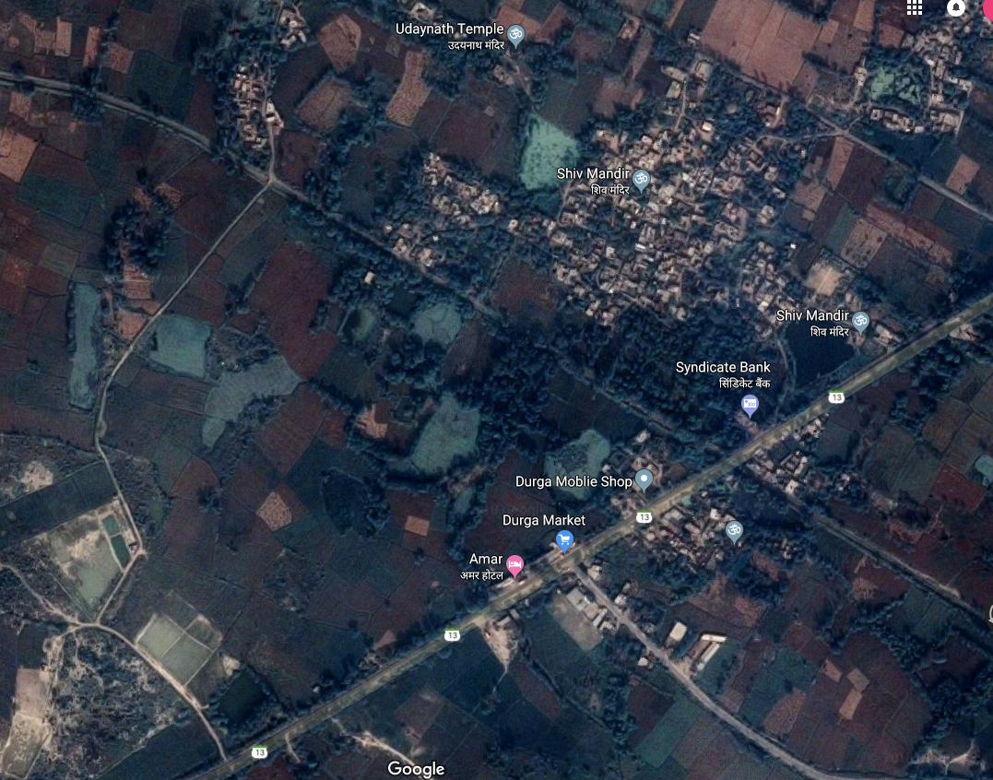
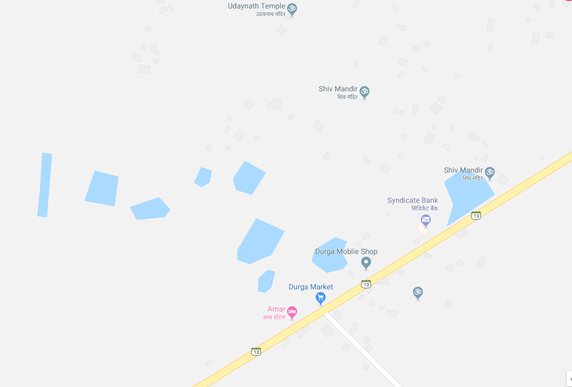
Mapping support for unmapped areas
Local extensions and support for generating maps from images
Support for directions on custom mpas

