Slide 1
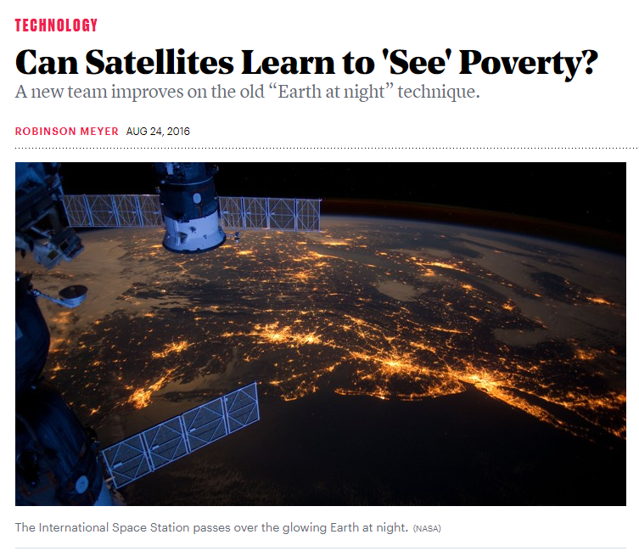
Satellite Imagery
Lecture 29: CSE 490c

Slide 2
Topics
Data Science for Development
AI for Social Good
Today
Satellite Imagery

Slide 3
Announcements
Programming Assignment 4 Due December 11
You have received the teaching evaluation link. Complete evaluations by December 9
A high response rate is very important for meaningful results. We will send reminder emails to non-responders during the evaluation period. In addition, studies show that instructor involvement can increase response rates as much as 15-20%.

Slide 4
Satellite Images
Satellite Imagery much easier to get than CDRs
Public data sets
Medium quality data available from free
High quality data requires paying commercial fees or being a spy agency

Slide 5
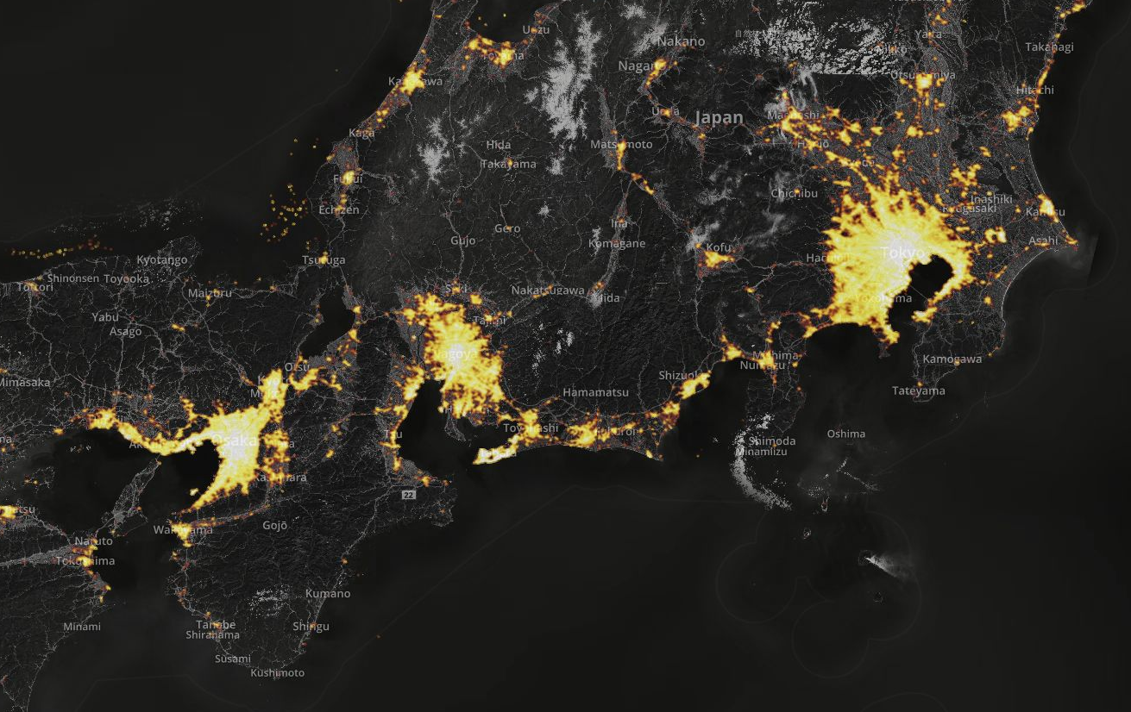
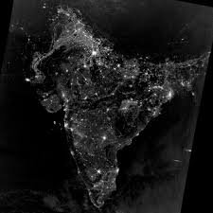
Night light imagery
Relatively easy to pre-process
But some details, such as removing gas flares
Basic question: how well does light correlate with economic activity
Population
Economic level
Quality of electrical grid

Slide 6
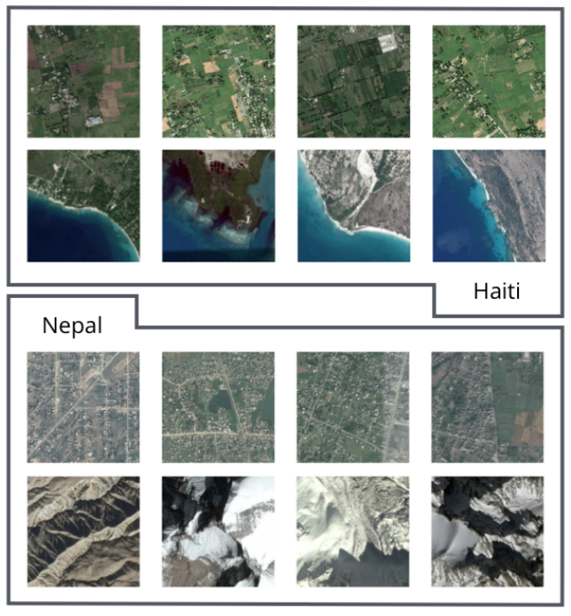
Can Human Development be Measured with Satellite Imagery
Demographic Health Surveys
Wealth
Education
Access to Water
Health Indices
Anthropometric Indices
Electricity and Phones

Slide 7
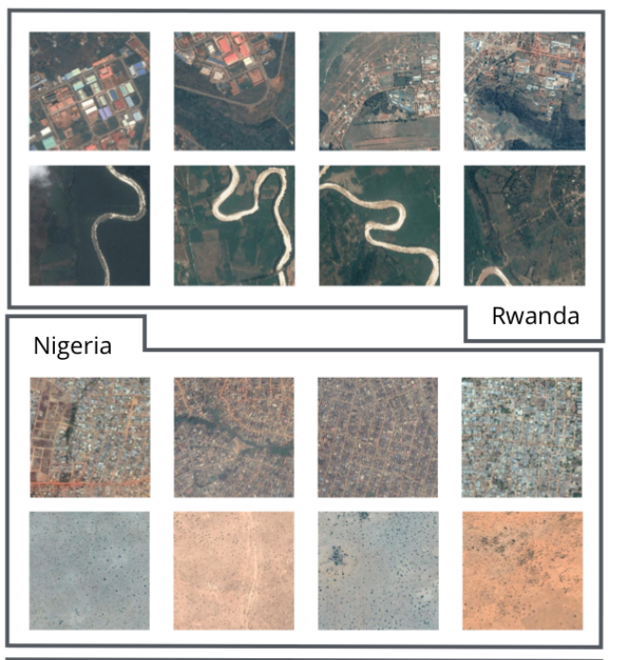
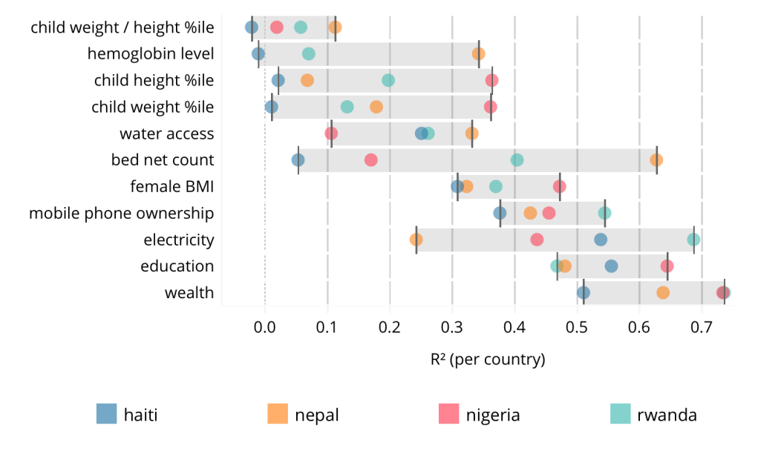
Demographic Prediction
Transfer learning
Methodology
Train Neural Network (CNN) on Geographic Features to predict Night Light
Extract model from CNN
Build regression model for development indicators using model and image features
Separate training for four countries

Slide 8
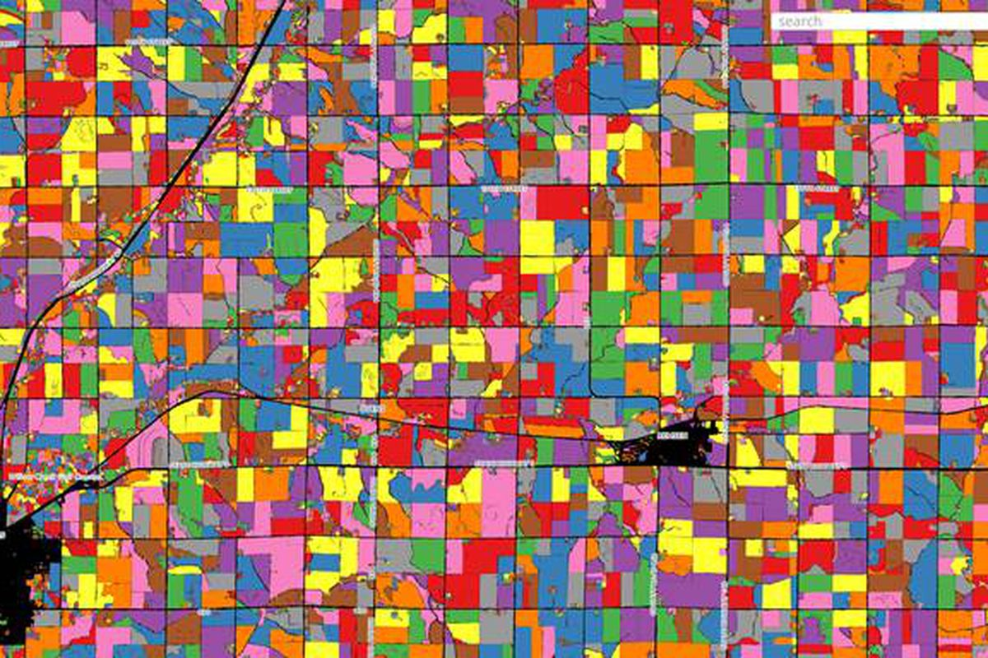
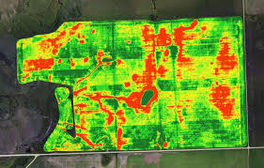
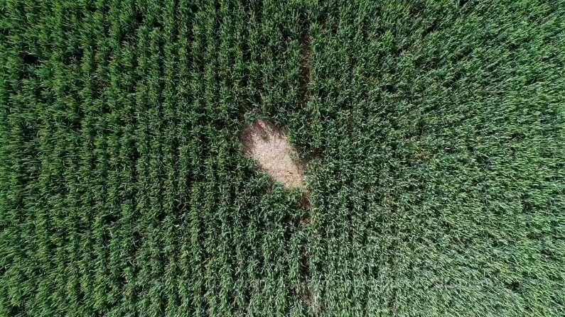
Crop Imaging
Wide range of problems
Crop identification
Yield Prediction
Field Assessment
Technical issues
Different forms of imaging
Image filtering: vegetation indices
Image segmentation and machine learning

Slide 9
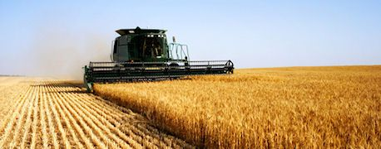
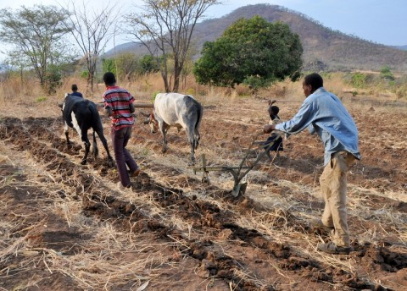
Agriculture Problems
Technology to support agriculture is big business (including satellite imaging)
Most benefits go to rich country agribusiness
How are applications different for poor countries?
Technology transfer versus appropriate technology
System wide interventions, e.g., predicting crop productions is obvious
What about cases where farmers can intervene?

Slide 10
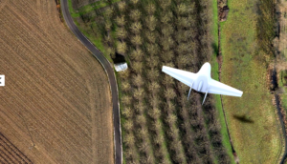
Crop Insurance
Crop insurance is important for developed world agriculture
Insure against crop loss
Insure against price changes
Allows greater risk with high value crops
Insurance rarely available in developing countries
High cost of administration, low value of crops
Difficulty in assessing loss
Startups offering crop insurance in developing countries
Image based assessment of crops for verification and loss inspection

Slide 11
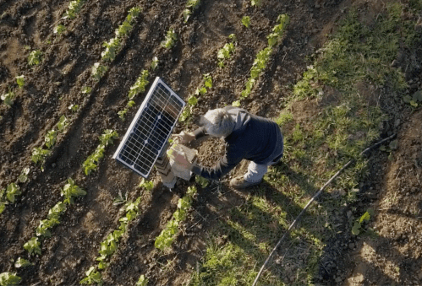
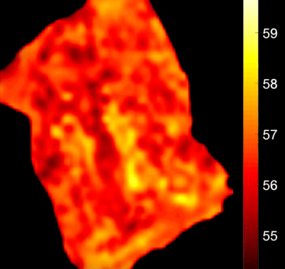
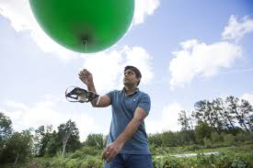
Farm Beats
Microsoft project for Intelligent Agriculture
Sensor and image based analysis
Use of balloons for collecting crop images
Identification of problems in fields that farmers can address
Pools of water, dry areas, weed infestations, cow poop

Slide 12
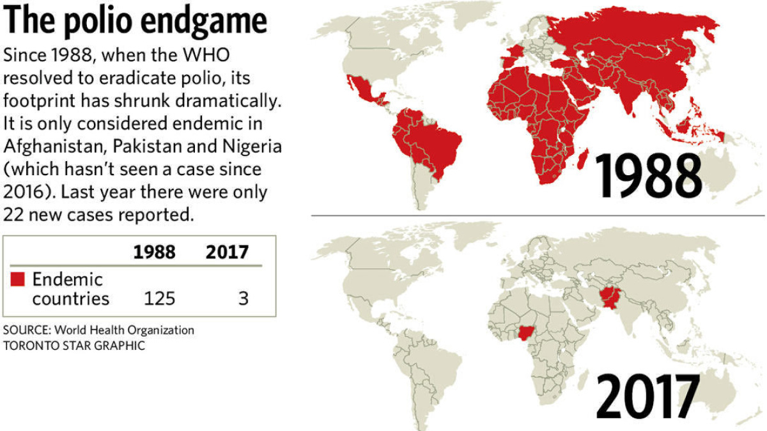
Polio Elimination

Slide 13
Elimination Process
Global Polio Immunization
Intensive monitoring for suspected cases
Immunization campaigns
Identifying the population is a challenge
Poor census data
No maps

Slide 14
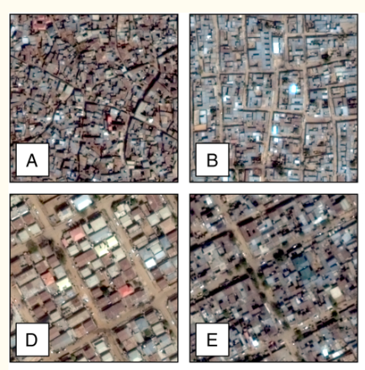
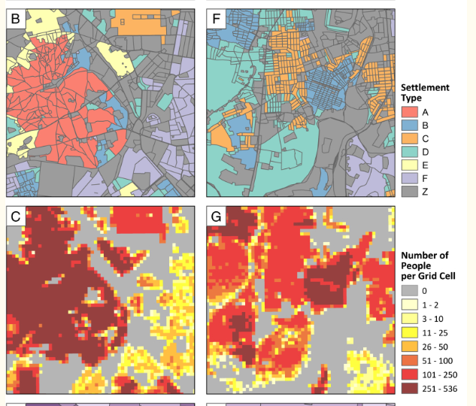
Population mapping in Northern Nigeria
Identify population and settlements
Difficult area
But good for imaging – flat and few trees

Slide 15
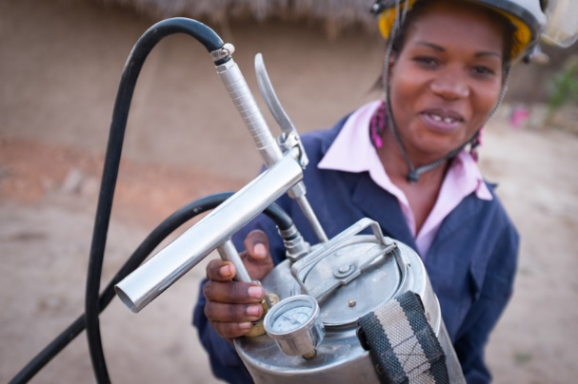
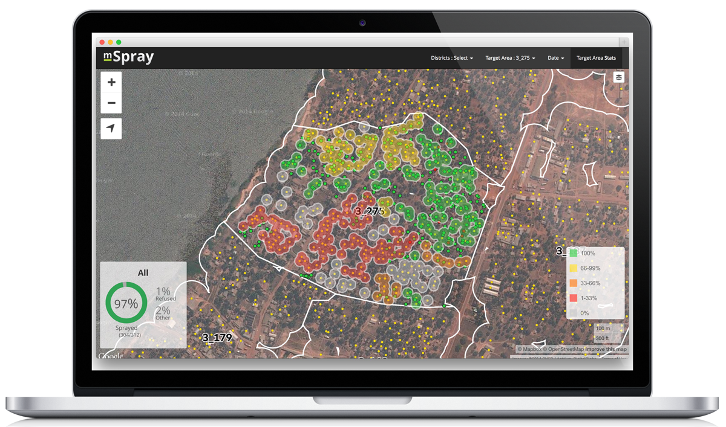
Malaria Follow up
Indoor residual spraying
Spray all households in area of a malaria case
Challenge is mapping and tracking houses
MSpray application (developed by Ona)
House identification for aerial photographs

