Slide 1
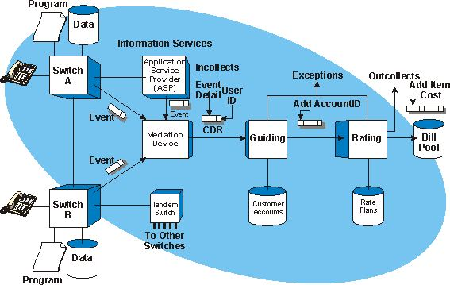
Call Data Records
Lecture 27: CSE 490c

Slide 2
Topics
Data Science for Development
AI for Social Good
Today
Mobile Phone Data

Slide 3
What data does T-Mobile know about you?

Slide 4
Telco Information
Call Data Records (Call Detail Records)
Meta data on individual calls
Cell Tower Logs
Information of handset connections with towers
These are generally managed separately
Call Data Records are maintained for billing

Slide 5
Other information sources
Cell tower locations
Mapping from Tower IDs to geo coordinates
Proprietary or crowd sourced
Mapping of IEMI numbers to handset models
Either exact model or class of phone

Slide 6
Access to cell phone data
Proprietary to Telco
Provide competitive advantage
Possibly for marketing or data services
Linkage with mobile money
Subject to government privacy regulations
Possible access to aggregated data

Slide 7
Data protection
Risk in disclosure of personal information
Various approaches to anonymization
Hashing of phone numbers
Aggregating cell towers
Bucketing of data

Slide 8
What is the distribution of phone types in rural areas
Debate on smart phone vs. basic phone prevalence
Who owns 2G vs 3G vs 4G phones
Cell tower logs
Record of every phone connection to base station
Type Allocation Code (TAC) indicates model
Track simcard and phone separately
Analysis
Phones associated with the community
Sharing of phones
Upgrades and downgrades

Slide 9
Access to data
Vast amount of data with Telcos
But what if you aren’t a telco?
Analysis of community cellular logs from Philippines and Indonesia
Shah et al. (2017) An Investigation of Phone Upgrades in Remote Community Cellular Networks

Slide 10
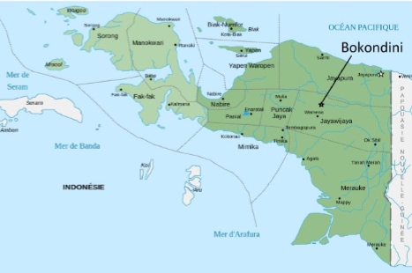
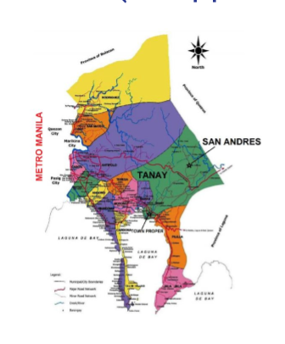
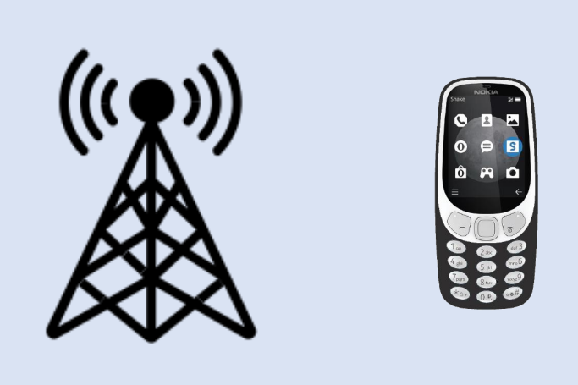
Cell Phone Study
Kushal Shah, Kurtis Heimerl
Call records from community networks
Philippines, 300K records
Papua, 115K records
Log data from all users
Even from users not in the network

Slide 11
Definitions
Local user
SIM registered with local telecom or in the community for at least 10 days
Primary phone
Phone which connects to the network most often during the day
Phone sharing
If phone changes users with operation returning to earlier user
Phone upgrade or downgrade
If a user changes primary phone but does not switch back

Slide 12
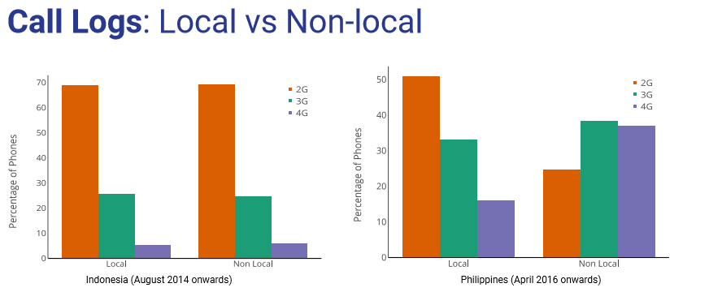
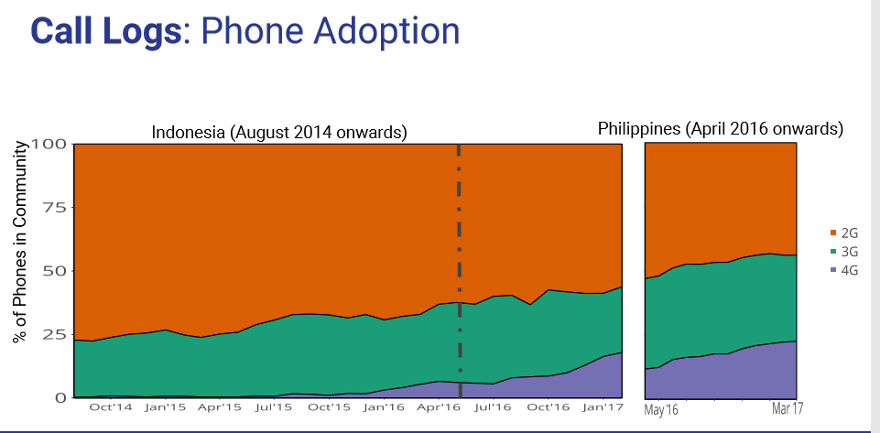
Results

Slide 13
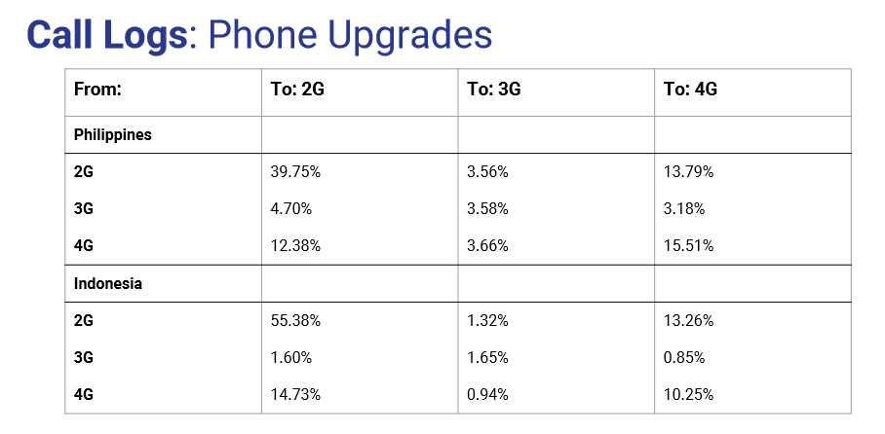
Phone Upgrades

Slide 14
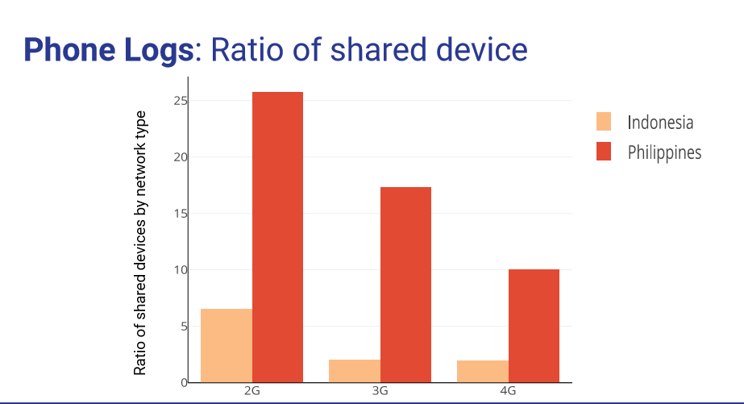
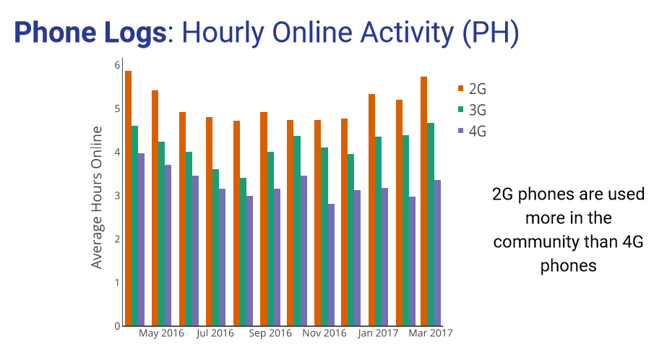
Other results

Slide 15
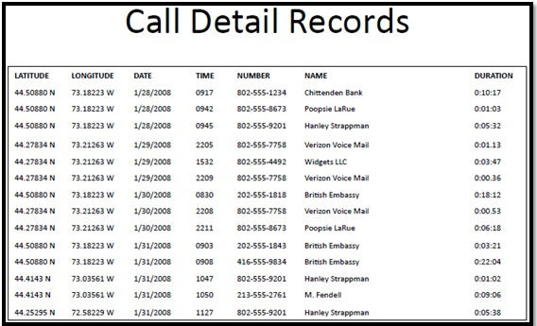
Call Data Records
Meta data associated with calls
Source number
Destination number
Source Tower (ID)
Destination Tower (ID) [might be missing]
Time
Duration
Status

Slide 16
Types of studies
How people use technology
Populations studies (where people are)
Event studies (what happens when)
Epidemiology studies
Economic studies

Slide 17
Working with CDRs
Preprocess data for higher level structure
Align data with other sources
Tower data
Economic / Population Data

Slide 18
Location
Tower information
Computing home location
Multiple algorithms and heuristics
Change in home location
Commuters
Truckers
Migrants

Slide 19
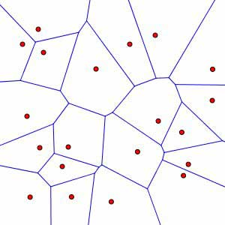
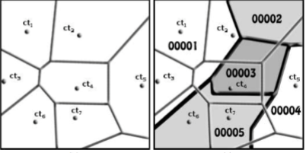
Matching locations to areas
Voronoi Diagram
Closest point regions to each tower
Mapping regions to towers
Area based methods
Pro-rate overlap
Centroid matching

Slide 20
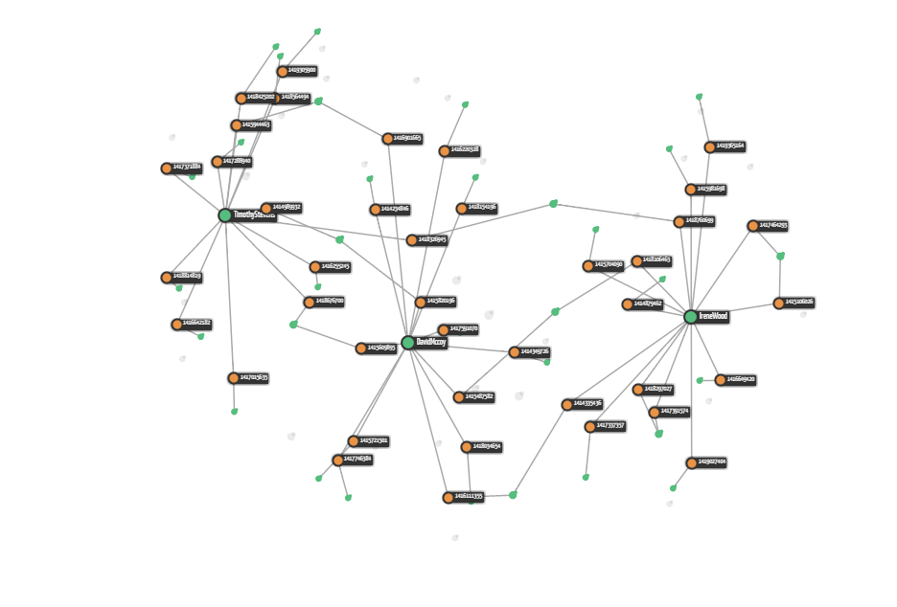
Call Graph
Directed or undirected graph on calls
Measurement of call volume
Detection of high in-degree and out-degree nodes
Identification of social network

Slide 21
Phone use studies
Given demographic information, study phone use behavior
Call volume, call timings (time of day, date), number of contacts
Studies of Sim Card Churn
Inference of demographics from behavior
Mehrotra et al. (2012), Differences in Phone Use Between Men and Women: Quantitative Evidence from Rwanda.

Slide 22
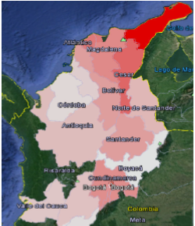
Migration Studies
Movement of people is an area of significant study
Lack of census data make this hard to study
Short term migration
What are the patterns
Is it possible to distinguish between shorter term and permanent migration
Forced migration and droughts
Match to climate data
Question on local versus long distance migration
Technical issues in definitions of movement

Slide 23
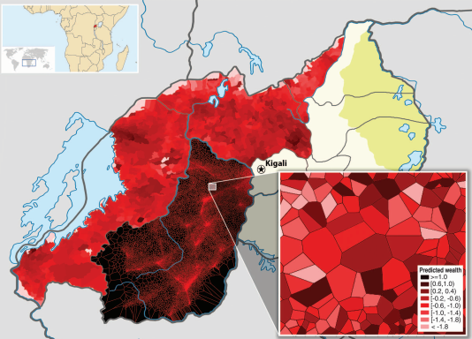
Economic Studies
Blumenstock et al. (2015), Predicting poverty and wealth from mobile phone metadata
Predict economic status at a local (e.g. District) level
Household surveys are expensive. Idea is to use Cell Phone Data to expand surveys
Correlate household surveys with CDR
Compute wide range of properties of CDR
Construct machine learning model to predict household assets (from survey data)
Apply to all call records in the data set

Slide 24
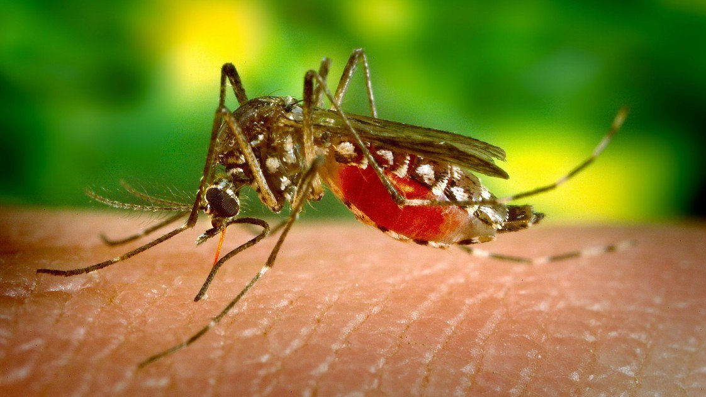
Epidemiology
Correlating human movement data and disease frequency
Substantial work on Malaria and Call Data Records
Key use case is malaria elimination
Understanding if cases are local infections or from other regions
Understand movement from high incidence to low incidence areas
Technical modelling work that combines migration and economic studies

Slide 25
Event studies
Look at impact of events in data sets
High volume of calls related to disasters, elections, holidays
Spike in call volumes has been observed associated with earth quakes
Significant interest in call data records and disaster response
Technical issues related to infrastructure and economic displacement

