Slide 1
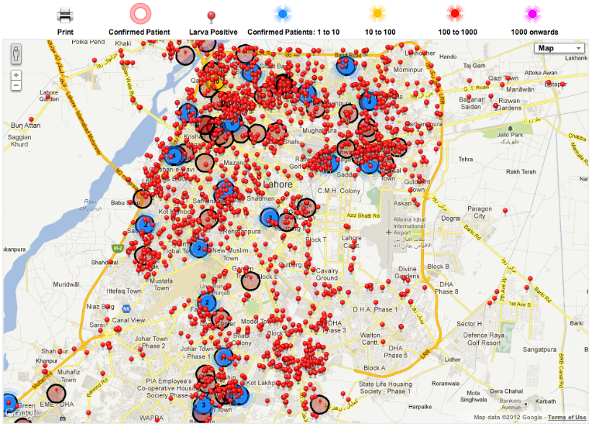
Data for Development
Lecture 25: CSE 490c

Slide 2
Announcements
Homework 7, Due December 3
Programming Assignment 4, Due December 11
Readings for Wednesday / Friday posted

Slide 3
Topics
Data Science for Development
AI for Social Good
Today
Strava Fitness App
Predicting Dengue fever based on helpline calls

Slide 4
Strava Fitness App

Slide 5
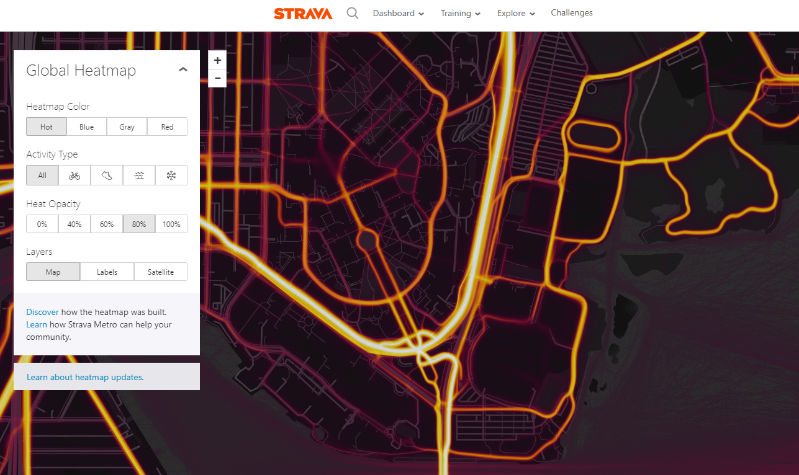
Strava Heatmam https://www.strava.com/heatmap

Slide 6
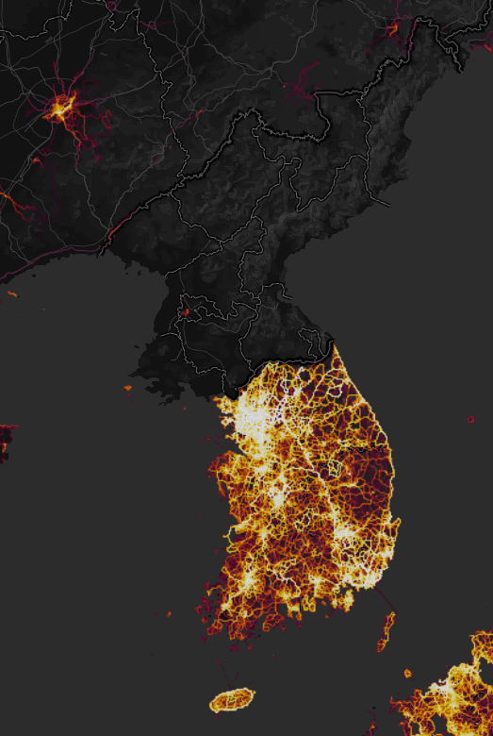
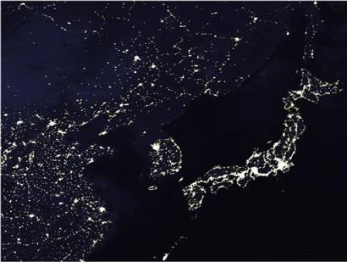
Korea

Slide 7
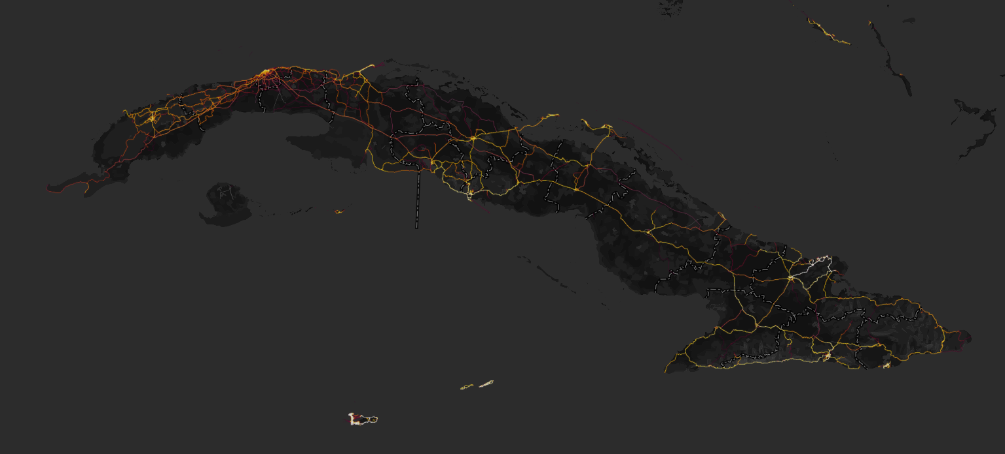
Cuba

Slide 8
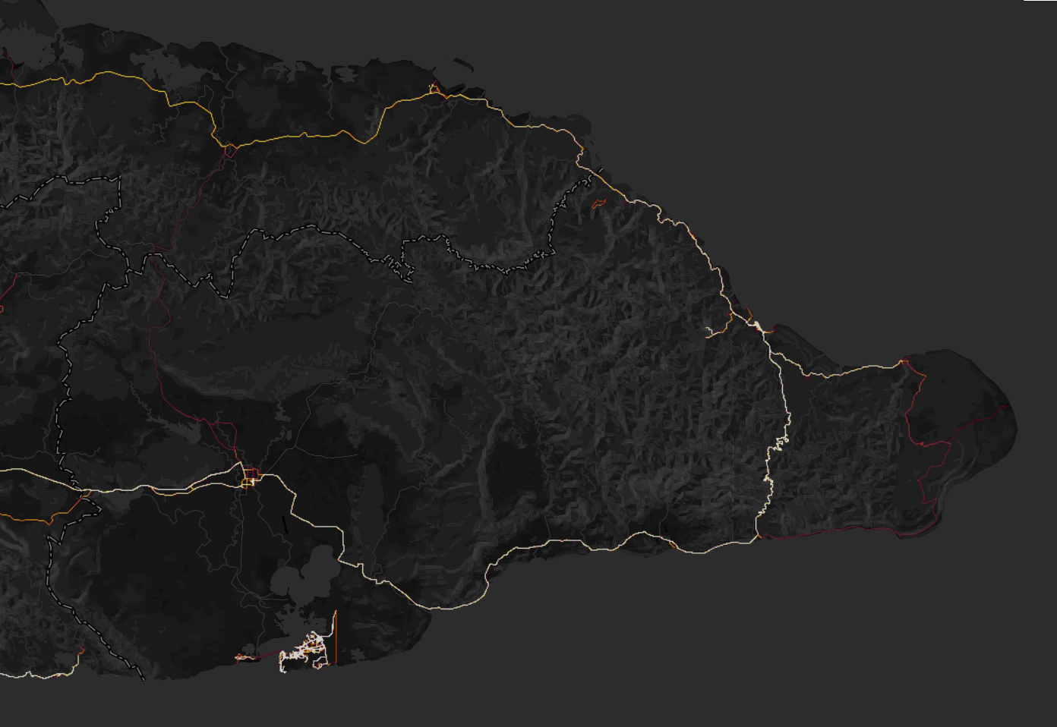
Eastern Cuba

Slide 9
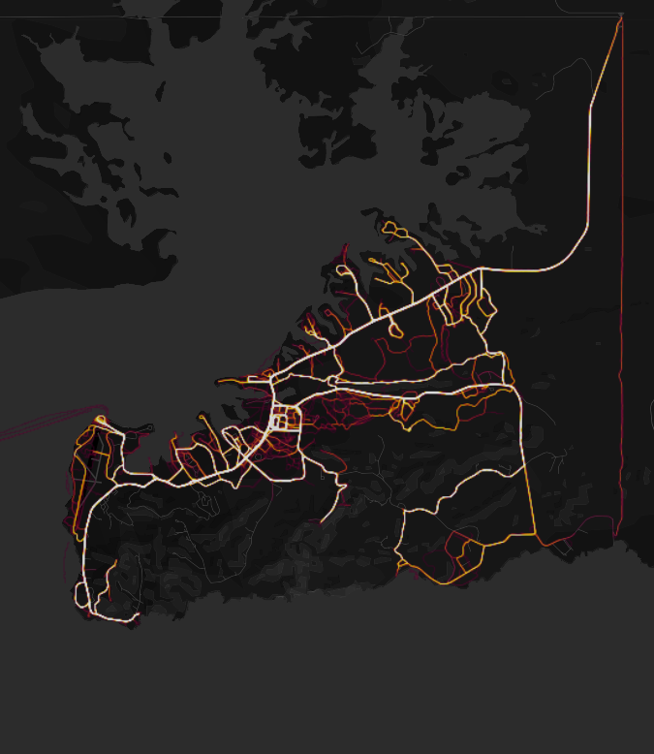
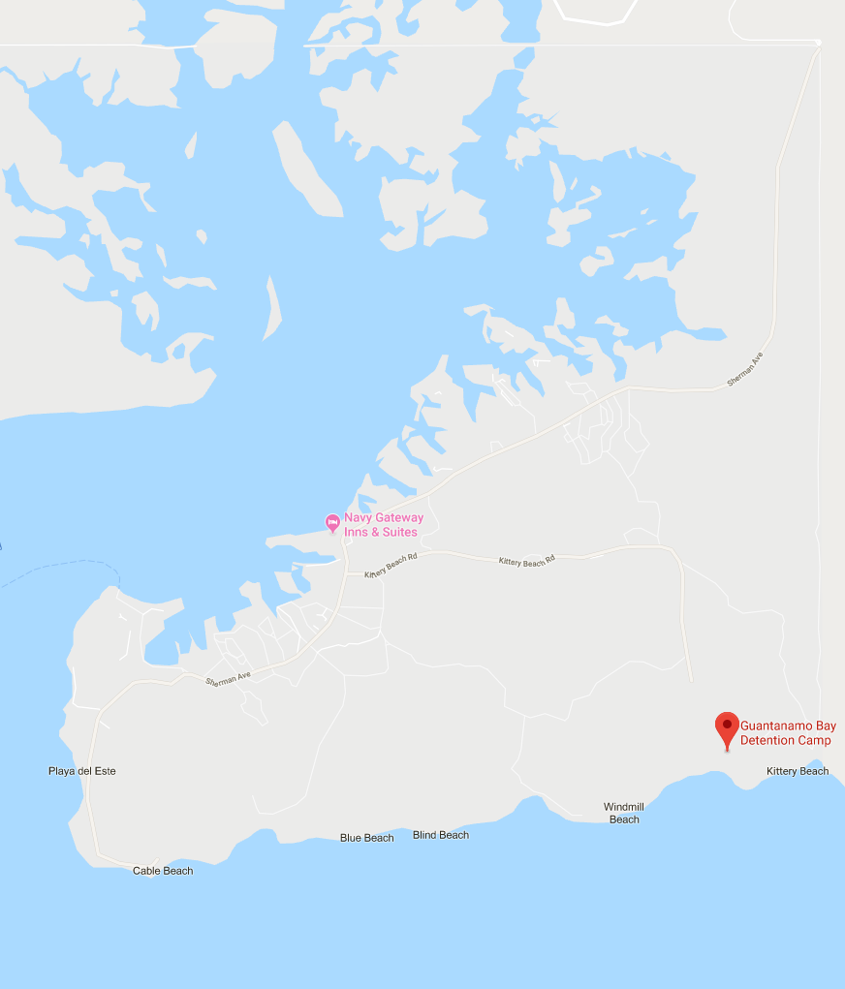
Guantanamo Bay

Slide 10
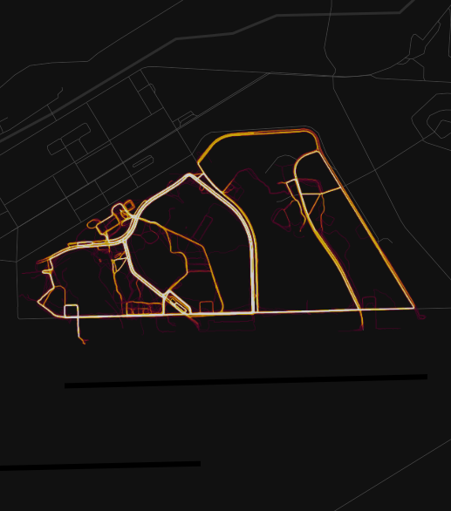
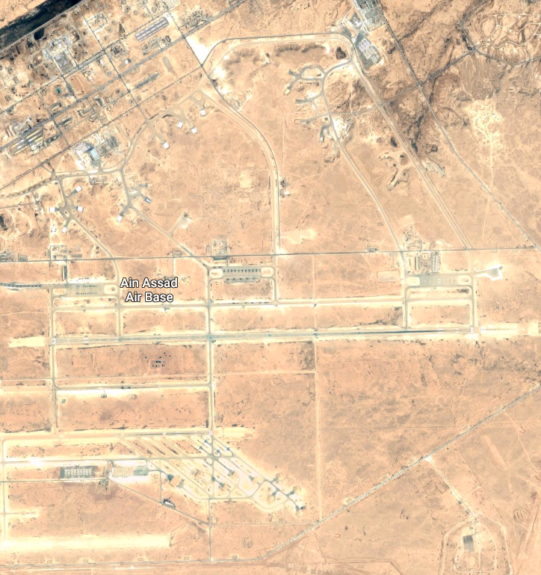
Eastern Iraq

Slide 11
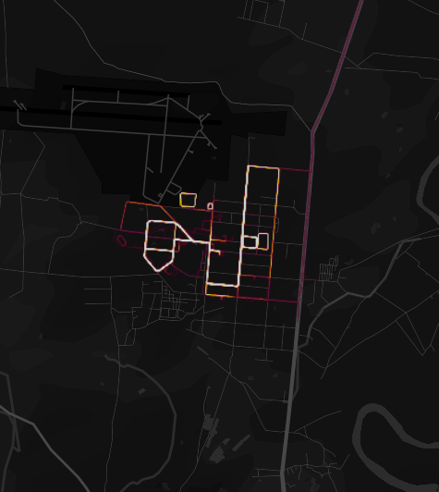
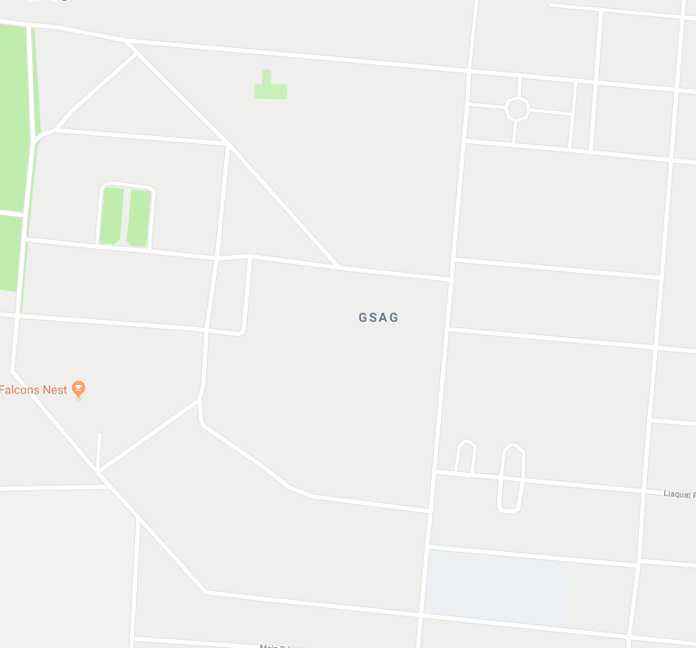
Risalpur, Pakistan

Slide 12
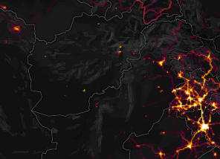
Afghanistan

Slide 13
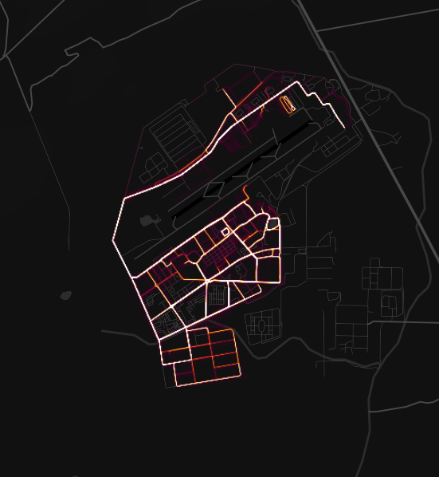
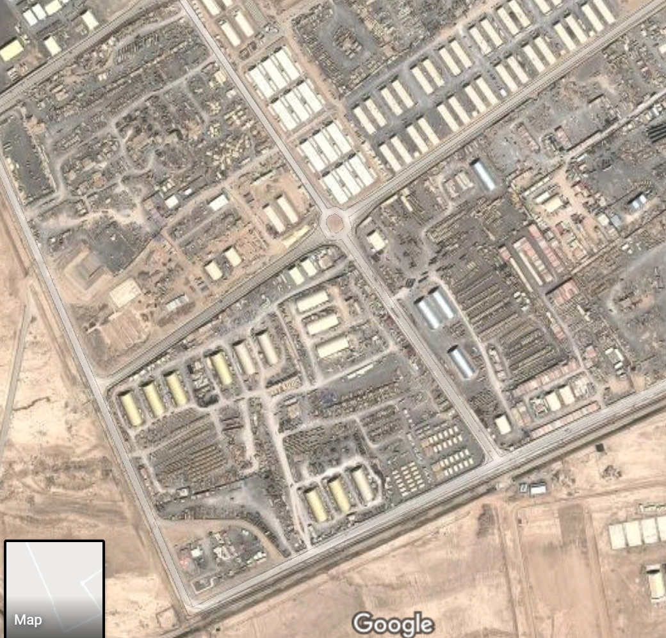
Kandahar Airport

Slide 14
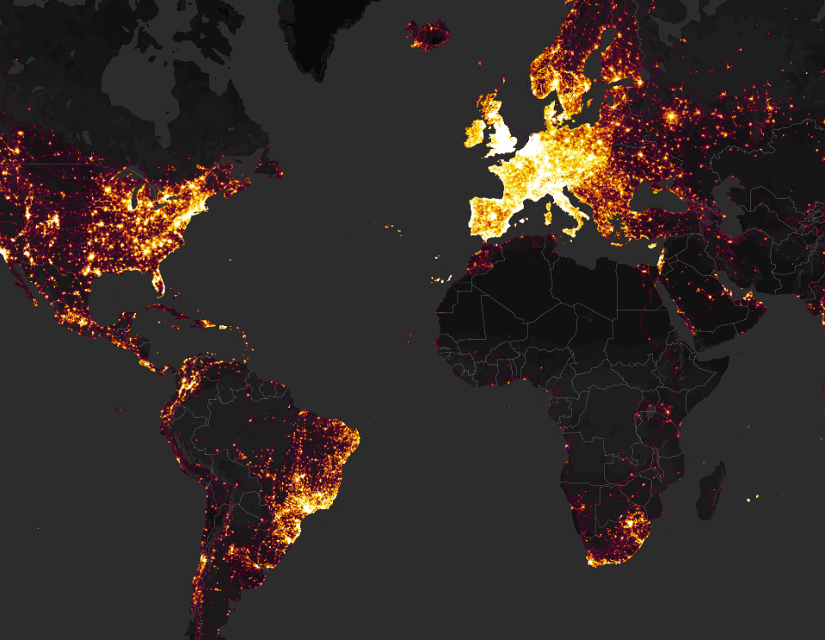
Strava App
Business model
Social networking for exercise
Monthly subscription for various features
Interesting data source
Enormous amount of data
Highly biased towards The West
Proprietary

Slide 15
Data for Development
Interesting facts
Identification of military bases
Earthquake identification for call data records
Economic Studies
Populations and demographic data from call data records
Migration
Policy, government and commercial interventions

Slide 16
Data Sources
Where are there massive data sets?
Satellite image data
Mobile Operators
Call Data Records
Technology monopolies
Proprietary Applications

Slide 17
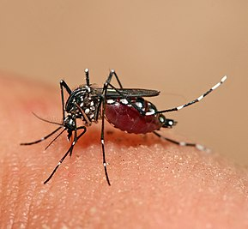
Dengue Fever
Viral disease spread by Aedes mosquitos
Primarily urban
Increasing prevalence
No cure
Many people recover on there own, some cases require hospitalization
Vector control to limit infections
Importance of early detection, localization, monitoring

Slide 18
Challenges in Dengue monitoring
Only a small percentage of cases reach hospitals
By the time data is reported from hospitals, outbreak is well established
Alternate approaches
Internet search queries
Online media reports
Environmental parameters
Telephone hotlines

Slide 19
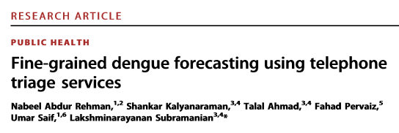
Forecasting dengue fever outbreaks based on telephone hotline
Contribution: Show that hotline calls can be used for localized prediction of dengue cases when combined with an environmental model
Calls provide a two week leading indicator

Slide 20
Setting: Punjab, Pakistan
Dengue epidemic in 2011
21,000 reported patients, at least 350 deaths
Disease strikes during summer monsoon
Big push for dengue control and monitoring
Helpline introduced in 2012
Calls for information on dengue symptoms
Trained operators record caller information and make referrals if necessary
300,000 calls received in 2012-2013

Slide 21
Health Hotline
Notes:
The dengue hotline was revamped in several ways:
-Larger set of complains is added in this service
-Each call is categorized by the call center in predefined list of categories which was determined using past data
-Address of the caller is now being saved in more organized manner
-Call center workers were better trained based on previous experiences

Slide 22
Health Hotline as an Early Predictor
Samanabad Town
Iqbal Town
Gives expected number of patient cases 11 days early
Gulberg Town

Slide 23
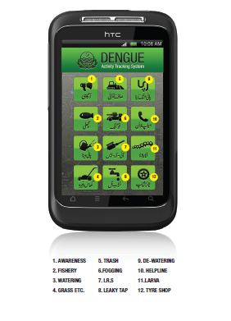
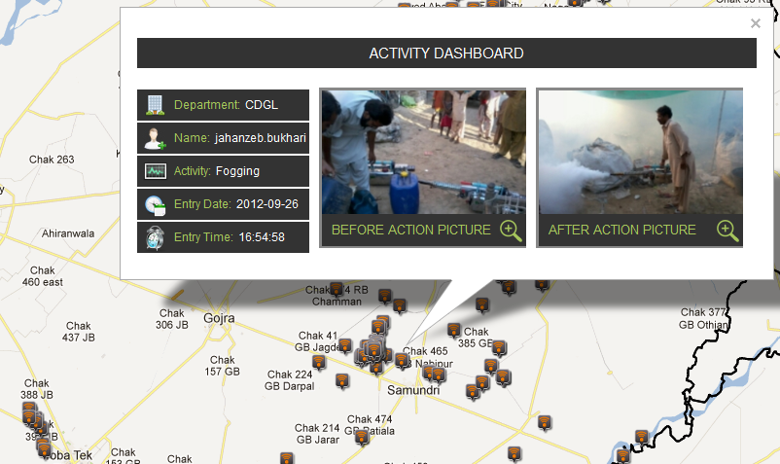
Preventive Activities
Real-time System: Automatically geo-tag pictures of an activity that is then uploaded to a centralized system

Slide 24
Goal: Predict cases at a local level based on call data
How does calls to hotline predict suspected dengue cases
Comparing two measured quantities
Are other variables needed?
Weather information
Awareness campaigns for hotline
Localize across 10 towns of Lahore

Slide 25
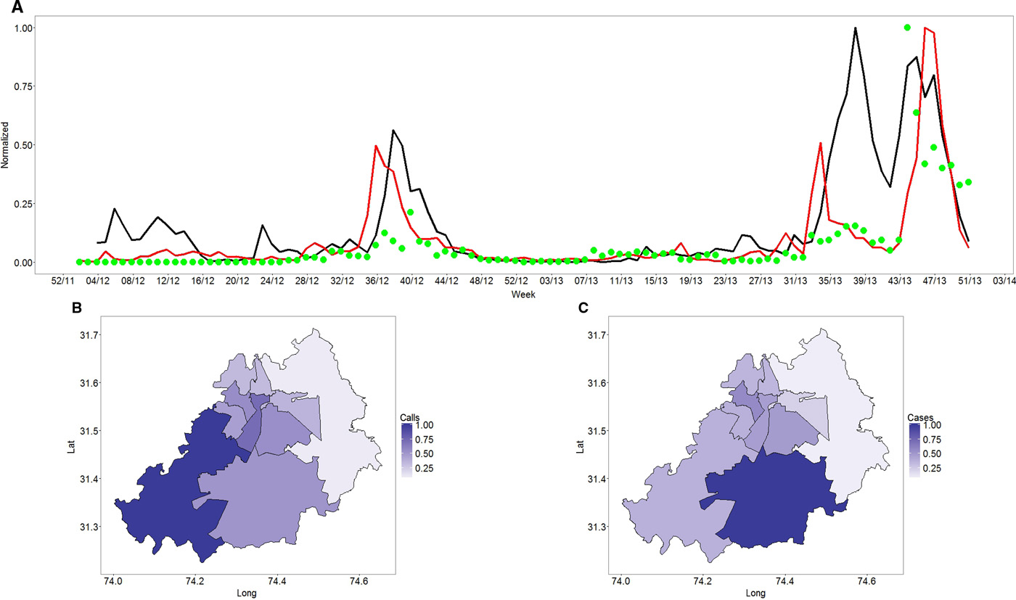
Nabeel Abdur Rehman et al. Sci Adv 2016;2:e1501215
Published by AAAS
Notes:
Trends in call volume and suspected dengue cases measured during 2012 and 2013. (A) Time series of calls (red), suspected dengue cases (black), and awareness campaigns (green points). Scale normalized by dividing by individual maximum values. The x-axis label is in week of the year. (B) Density map of calls across towns in Lahore. (C) Density map of cases across towns in Lahore. The lightest shade represents the least number, and the darkest shade represents the highest number. The legend is normalized by the maximum value. Lat, latitude; long, longitude.

Slide 26
Variables
Variable | Meaning
S(w,t) | Suspected cases week w, town t
C(w,t) | Calls week w, town t
A(w,t) | Awareness campaigns week w, town t
H(w) | Humidity week w
T(w) | Temperature week w
R(w) | Rainfall week w
Predict log S(w + 2, t) as a function of C(w,t), A(w,t), H(w), T(w), R(w)

Slide 27
Methodology
Linear regression
Random forest learning algorithm
Estimates achieved good fit based on root mean square error
Most important term, number of calls

Slide 29
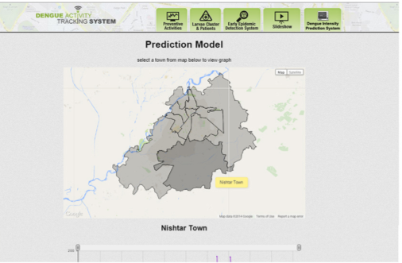
Validation and Deployment
Validation done through standard methods of generating models for randomly constructed subsets and confirming on held out data
Validation and cross-correlations as a supplement to the journal article
Model deployed as part of dengue surveillance system, accessible through a web api

