Slide 1
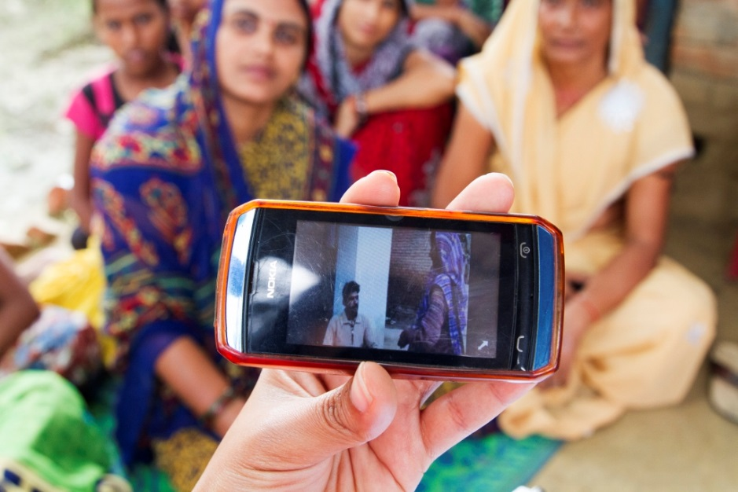
Video Applications
Lecture 23: CSE 490c

Slide 2
Announcement
Office hours for PA 3
Clarice Larson, CSE 332
Monday, 3:30-4:30 pm

Slide 3
Topics
Mobile Videos

Slide 4
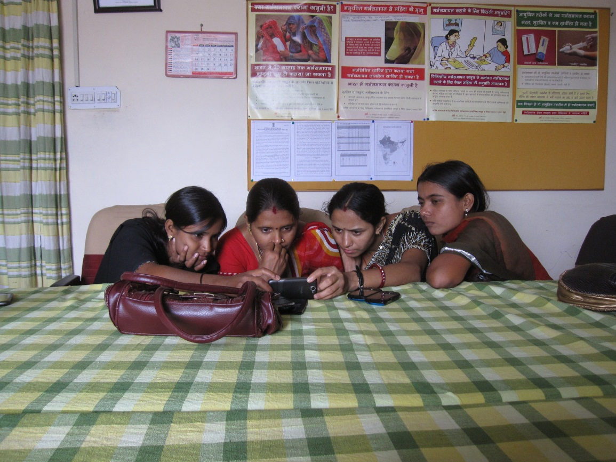
Mobile video for patient education: The midwives’ perspective

Slide 5
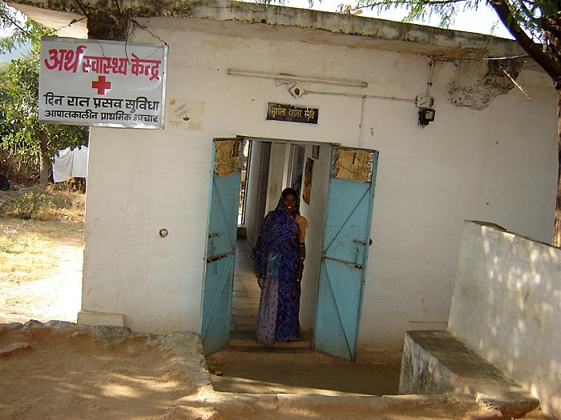
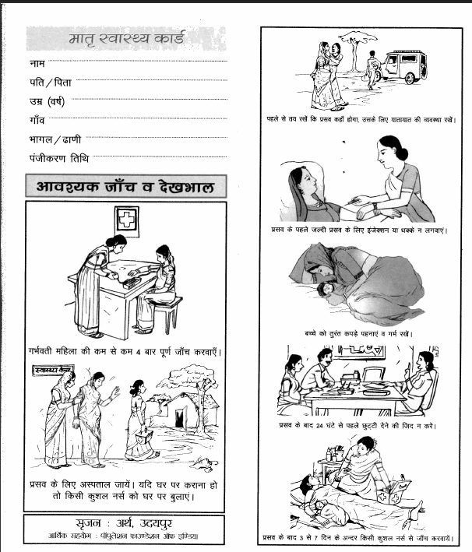
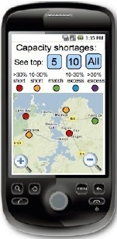
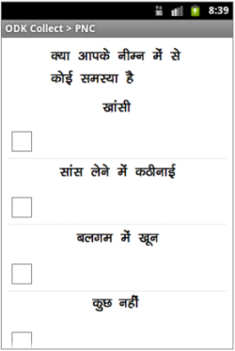
Mobile Midwife Platform
Study in India with an organization focusing on maternal and child health
Mobile devices to support post natal care visits
Data collection
Protocol support
Educational videos
Android phones deployed with nurse midwives

Slide 6
Health videos
Three videos created
Maternal nutrition
Breast feeding
Thermal care
Videos shown during PNC
Launched from ODK form at specific points in visit
Nurse midwives were already expected to address these topics

Slide 7
Mobile device use
One year pilot for data collection and visit support
Nurse midwives had difficulty with data collection and continued to use paper forms
Device logging showed that the videos were shown regularly
Midwives identified video the most successful component of the project
 | Nutrition | Breast-feeding | Thermal care | Total
Video played entirely | 554 (77.1 %) | 497 (77.7 %) | 288 (62.5 %) | 1339 (73.4 %)
Video partially played | 46 (6.4 %) | 52 (8.1 %) | 26 (5.6 %) | 124 (6.8 %)
Video stopped | 110 (15.3 %) | 89 (13.9 %) | 146 (32.7 %) | 345 (19.0 %)
Video play extended | 9 (1.2 %) | 2 (0.3 %) | 1 (0.2 %) | 12 (0.7 %)

Slide 8
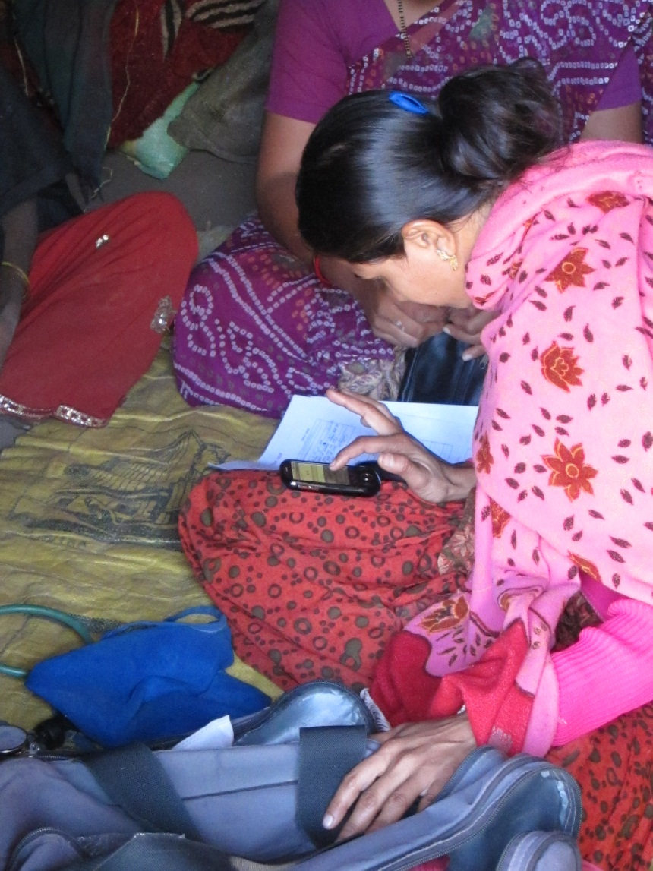
Study methodology for evaluating video
Ethnographic observations of 22 PNC visits
Semi-structured interviews with the 8 nurse midwives
Iterative coding scheme of qualitative data using Atlas.ti
Triangulation with quantitative data from deployment

Slide 9
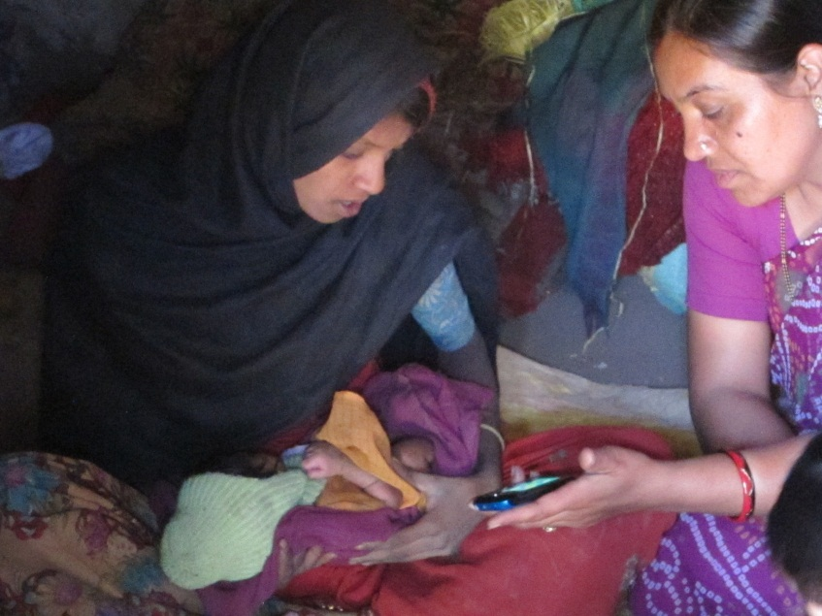
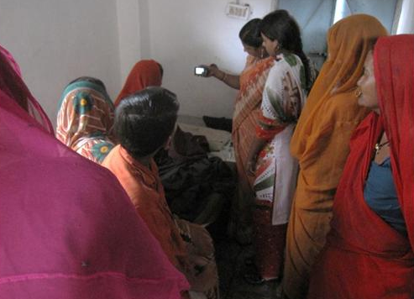
Summary of results
The use of video is feasible in PNC visits
The PNC environment is complicated
Patient education occurs throughout visits with various levels of effort
Multiple settings and participants
Authority and trust
Nurses viewed video as being authoritative and enhancing their communication

Slide 10
Feasibility
Video used consistently on PNC visits
Midwives reported a favorable reaction and identified this as the best feature of the mobile device
Minor difficulties in using videos in the mobile app
“The video that we show is very good – it becomes very easy for the people to understand. There is a big difference between telling something and showing it. On watching the video people understand that yes, this is how it is to be done.”

Slide 11
Complexity
Multiple people might be present for home and clinic PNCs
Process of doing an examination did not fully align with the protocol on the device
Introduction of videos made educational component more explicit
“When we do PNC before, only the patient and I are present . . . Now I am showing the video, now others too come on hearing the sound from the video, so they too remember that yes, we have to do this, so more people come inside, we tell the patient, and everyone hears.”

Slide 12
Multitasking
Nurses used time while video played for other activities
Multiple ways of showing the video
Video was rarely stopped for discussion
Time for playing the video was an issue
“[The good thing about the video] is that the video explains how to feed the baby and gives advice, so we don’t have to talk much. So while they watch the video, we can continue with our work”

Slide 13
Authority
Videos extended nurses ability to deliver complete messages
Some nurses felt that by featuring older nurses the videos had additional authority
No conflicts with the video messaging
“We explained that this too is showing how to feed the baby, the things that you should eat, is it necessary for you to have the tablets or not. We are telling you through the mobile. It is just like the nurse used to tell you. You should take it the same way. We show the video and they feel it is right”

Slide 14
Trust
Video considered to be trustworthy
Nurses had a theory that people understand by seeing
Advantages identified: clarity of message, use of local language, and local participants
“What will the mother think? She thinks the video is correct. A movie has been made, so it is right because there is a lady in it, a patient and a nurse, so she understands. . . She understands on seeing the patient. If there had been only two nurses, she wouldn’t have understood”

Slide 15
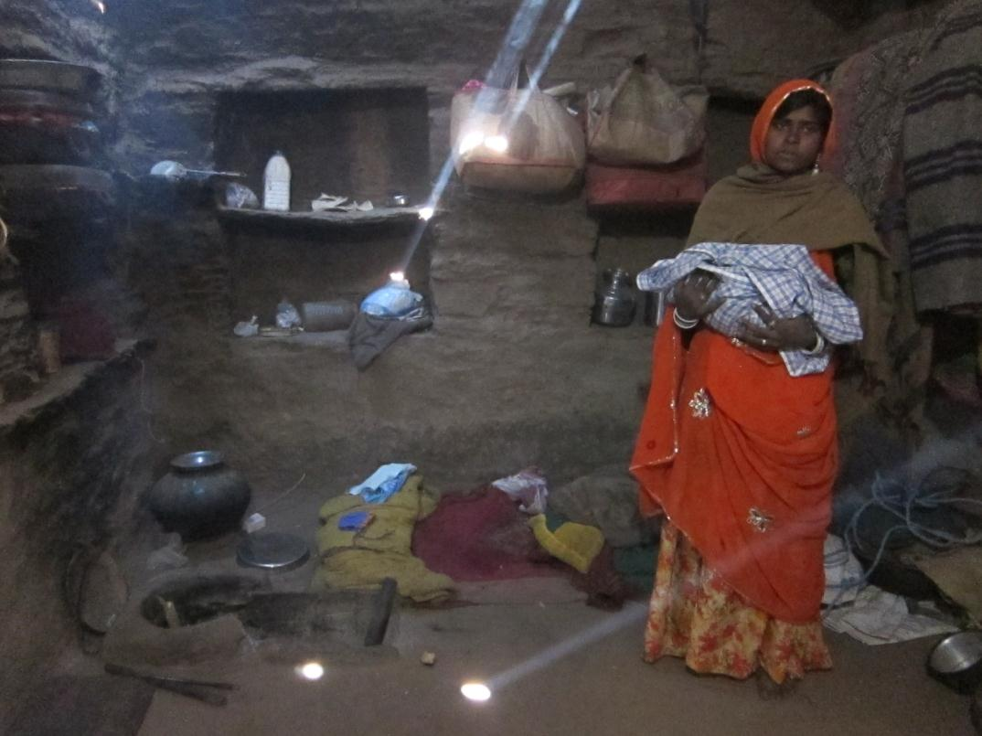
Action Research and Training for Health

Slide 16
Community Led Video Education
Low cost, locally created, educational videos
Series of projects:
Digital StudyHall
Digital Green
Digital Public Health (now Projecting Health)
Tenets of CLVE
Local creation of educational content
Group showings of videos with a moderator
Keep costs low through consumer digital technologies

Slide 17
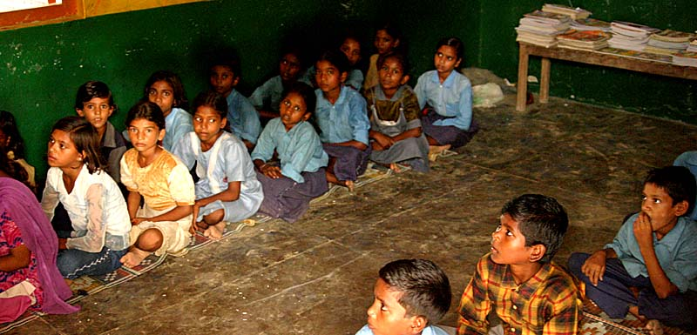
From Digital StudyHall to Digital PublicHealth

Slide 18
Tutored Video Instruction
Video of expert teacher
Presented with the aid of the facilitator
Theory: Interaction with the video better than ‘just watching TV’
Initial work: Gibbons, Stanford, 1977.
Tutored Videotape Instruction
University of Washington
Introductory programming offerings to Community Colleges
Recorded UW lectures used by existing community college instructors

Slide 19
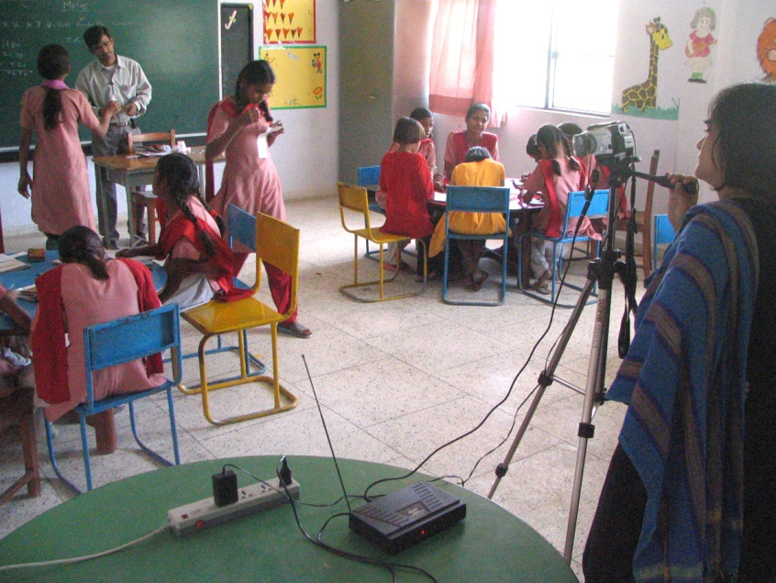
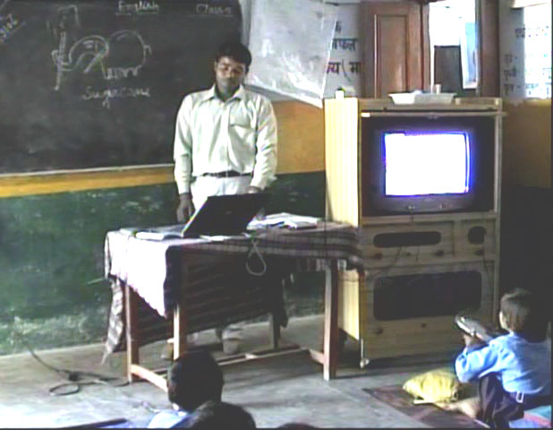
Digital StudyHall
Founded by Randy Wang, ex-Princeton
Collaboration with Urvashi Sahni, Studyhall School
Top private school in Lucknow
DSH Methodology
Create videos of classes taught by expert teachers to low-income students
Train teachers to facilitate videos
Target rural schools

Slide 20
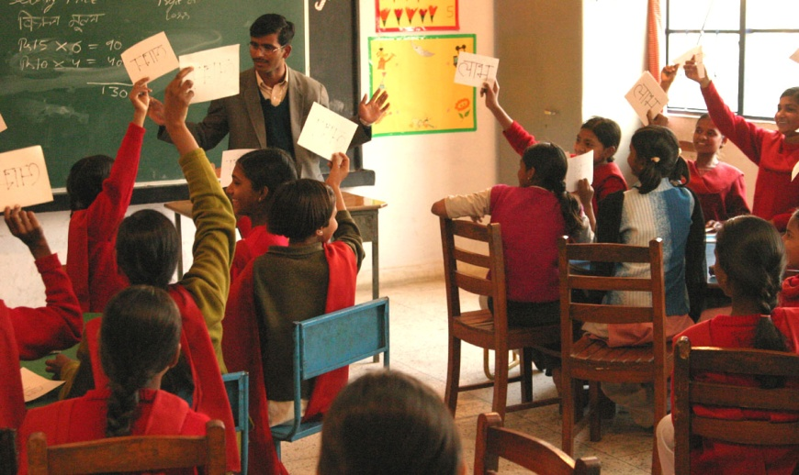
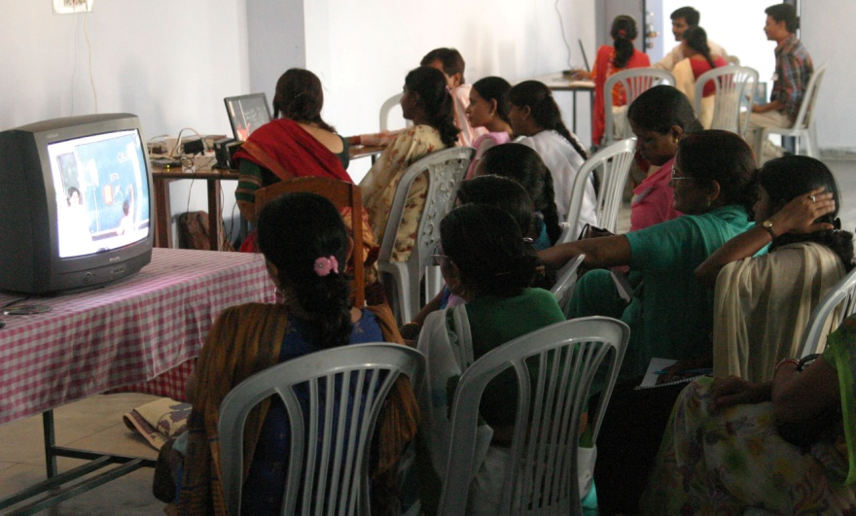
Digital StudyHall methodology
Lesson videos recorded at hub school
Use of interactive pedagogy
Careful matching of students
Tie to regular curriculum
Training of facilitators
Facilitation model
Mix of video use and activities
Cost realism in technology deployment

Slide 21
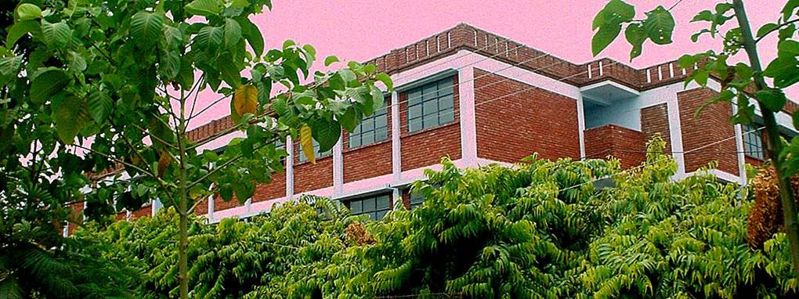
Relationship with implementing organization
Implementing organization: StudyHall, well regarded private school
Implementation team primarily Indian
Adequate buy-in from principals
With official permission
Teachers generally favorable to implementing organization
Trainings, involvement with StudyHall and other teachers a positive
Students had a very positive view of implementing organization
Novelty
Disruption

Slide 22
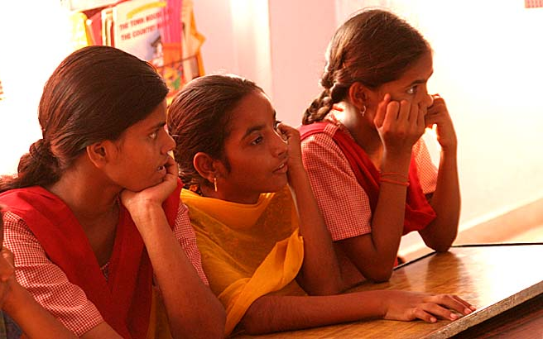
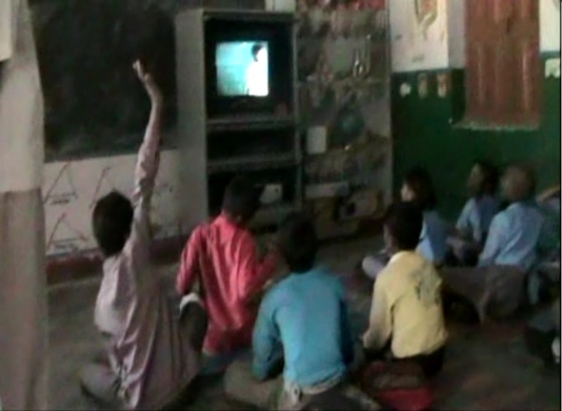
Student view of video students
Content creation
Lessons by expert teachers
Poor, urban students
Students identified with video students
The students said the video students were “just like them.”
Validation of video creation strategy

Slide 23
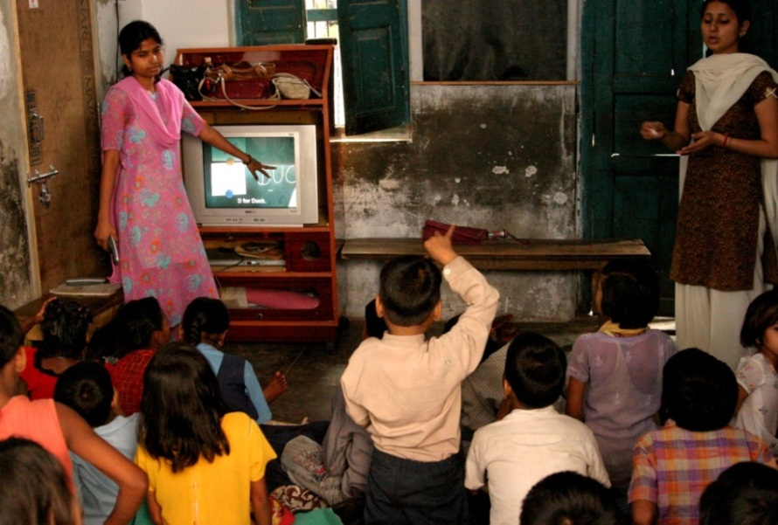
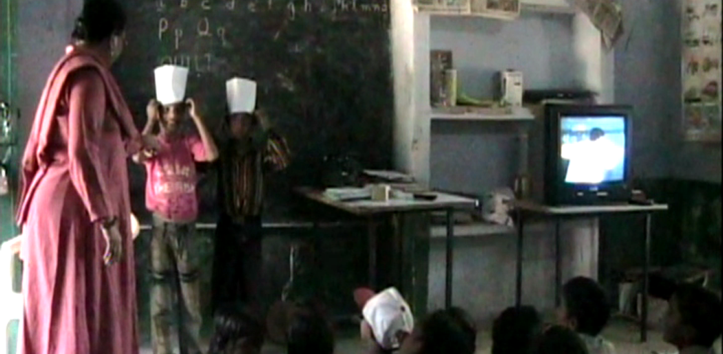
Facilitator understanding and use of methodology
Interactive pedagogy
Activities
Poems, songs, drama
Intervention had goal of changing teaching
Training of facilitators and monitoring visits
Observations confirmed use of interactive techniques
Unexpected
Teachers viewing lessons in advance at home

Slide 24
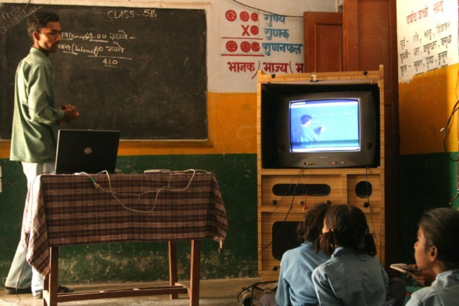
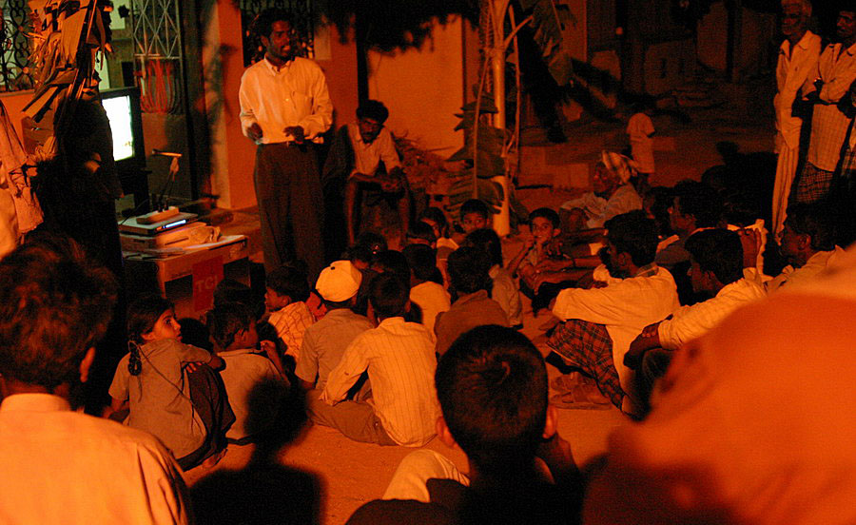
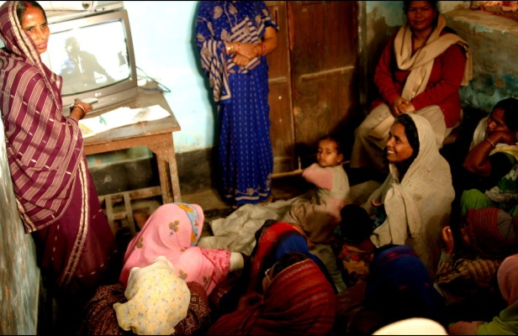
DStar
Original vision – Apply Digital StudyHall methodology to multiple domains
DSH Methodology
Locally created video
Facilitated use
Hub and spoke model
Content archive
Digital Green – MSRI project by Rikin Gandhi
Digital Polyclinic – DSH Lucknow efforts in health
Digital Livelihood – Calcutta, Paul Javid

Slide 25
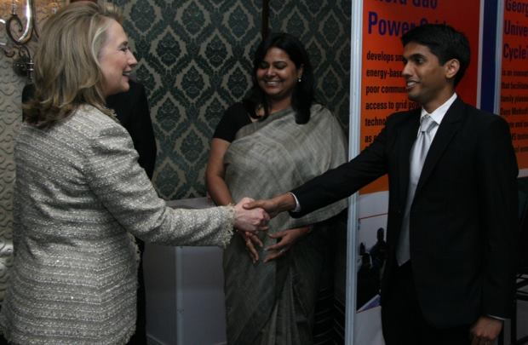
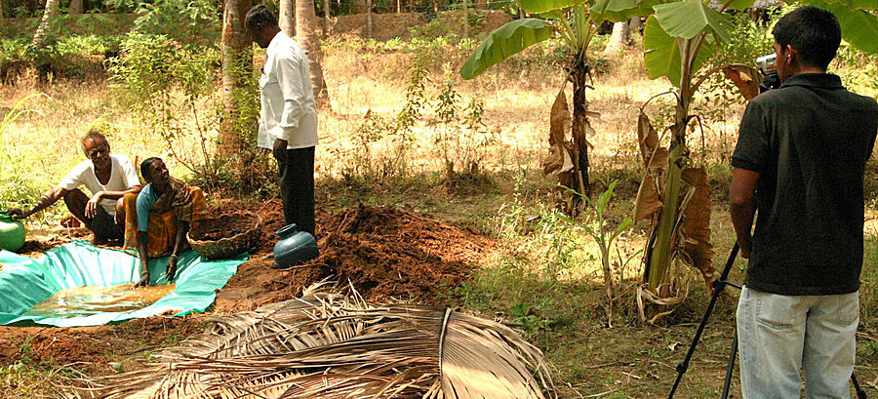
Developed community video education for Agriculture
Started as a project at Microsoft Research
Formed NGO
Taken to scale in several states of India
Digital Green model
Livelihood education conducted by community facing organizations
Agricultural messaging developed by experts
Members of the community filmed demonstrating or talking about the techniques
Videos reviewed for content and quality
Videos shown by facilitators in community group meetings

Slide 26
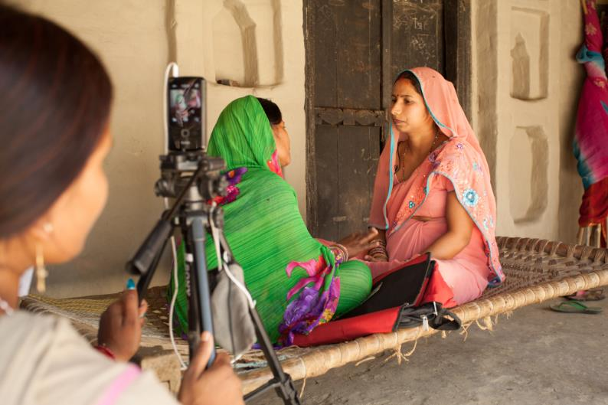
Digital Public Health
PATH / UW / Digital Green collaboration
Application of Digital Green methodology to maternal health
One year pilot starting August 2012
Expanded projects in Uttar Pradesh since 2013
Renamed Projecting Health

Slide 27
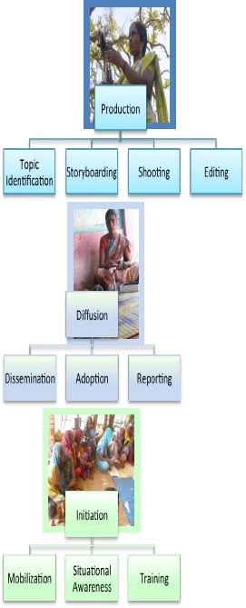
Platform for low-cost community video education
Video based education where content is both created and presented by the community
Localization of content and messaging
Community engagement and empowerment
Enabled by low-cost consumer digital video technology
Source: www.digitalgreen.org

Slide 28
Digital Green and Digital Public Health
Program Component | Digital Green | Digital Public Health
Program structure | Field based organizations with agricultural mission | Field based organizations with health mission
Message creation | Agriculture experts | Health experts and governing bodies
Content creation | Videos produced by field organization and farmers | Videos produced by field organization, health workers and community
Content Delivery | Facilitated use of video in community groups; use of pico-projectors | Facilitated use of video in groups and one-on-one settings
Content Management | Central video repository | Central video repository
Quality control | Review videos for accuracy and content before use | Multilevel review including details of messaging
Reporting | Dissemination and adoption statistics | Metrics to be determined

Slide 29
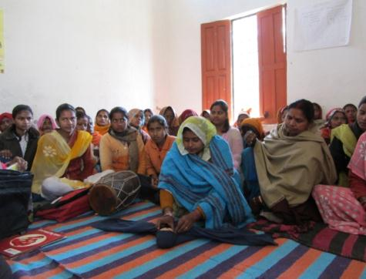
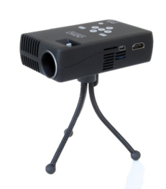
Technology
Direct implementation of Digital Green digital video approach
Goal: no technology innovation
Basic components:
Kodak video cameras
Microsoft MovieMaker for editing
Pico projectors for screenings
Youtube for content distribution

Slide 30
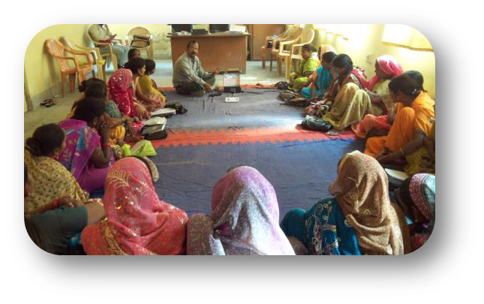
The Projecting Health Process
Identify topic
Produce short video
Identify local actors
Create storyboard and approve
Develop key messages
Share and discuss
Women identify with actors and issues in videos
Women discuss and share their knowledge with others
Women adopt healthier behaviors and practices

Slide 31
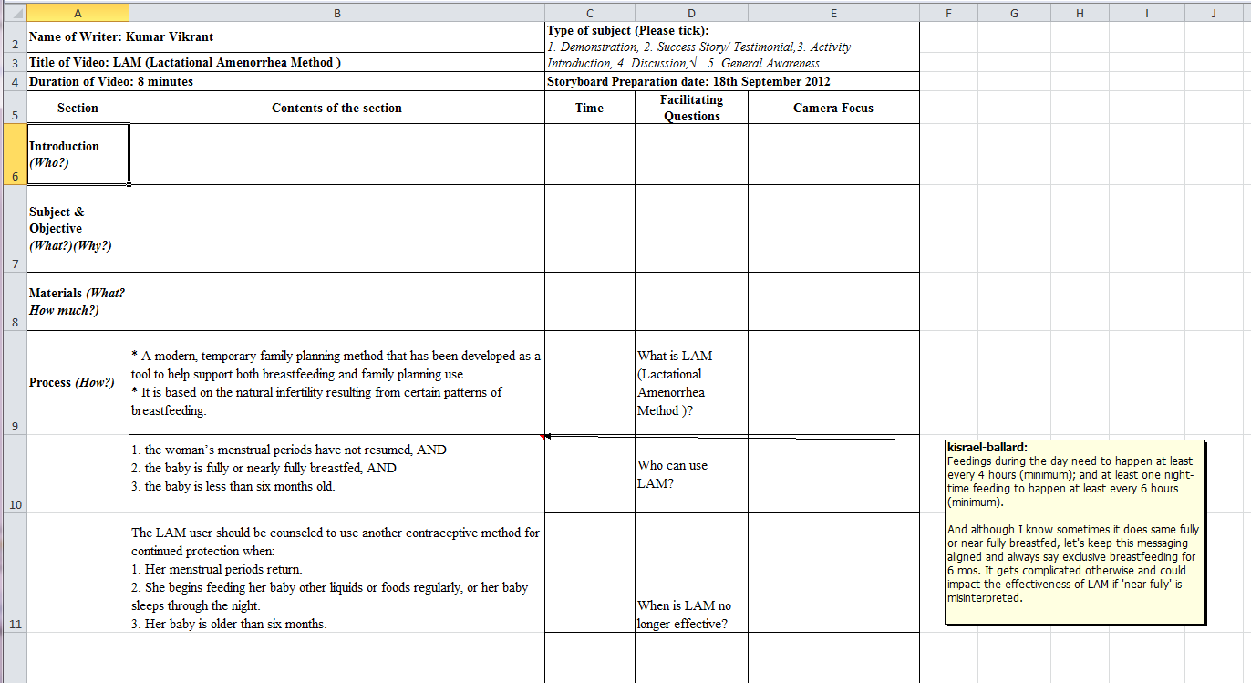
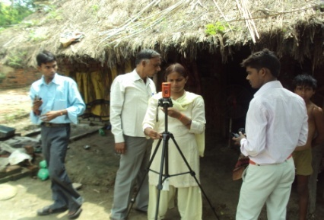
Projecting Health Process

Slide 32
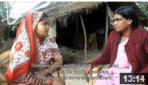
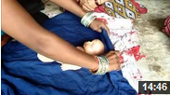
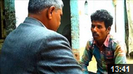
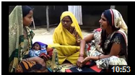
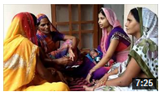
Sample topics
Breastfeeding
Thermal care
Optimal breastfeeding practices
Exclusive breastfeeding
LAM
Thermal care overview
Delay bathing
Family planning
Cord care
Permanent methods
Temporary methods
NSV-No scalpel vasectomy
IUCD Copper-T
Cord care overview
Myths and misconceptions
Birth preparedness
Other
Birth preparedness overview
Maternal danger signs
Maternal nutrition
Newborn danger signs
Immunization
Community-based emergency transportation systems
Notes:
Other
Immunizations
Community-based emergency transportation systems

Slide 33
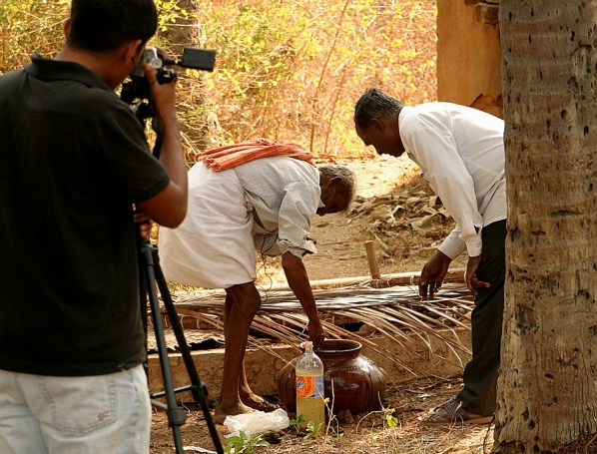
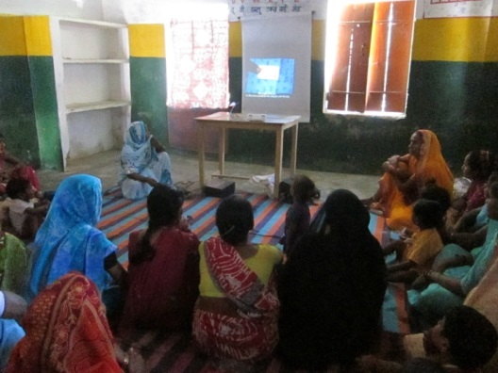
Project Timeline
Digital StudyHall started
PH Exploratory launch
Pilot launched in Ethiopia
Mobile phone exploration pilot
2015
2005
2010
2013
2007
2012
Feasibility study launch
2014
Endline evaluation data collected
2015
Expansion in India with 3IE/BMGF Award
Digital Green founded

