Slide 1
Task Support
Lecture 21: CSE 490c

Slide 2
Announcements
No class Wednesday, November 21

Slide 3
Topics
ODK Sensors
eIMCI
Mobile Videos
Diagnostics

Slide 4
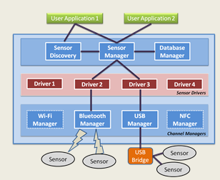
ODK Sensors
Build a user-level sensing framework with sensor drivers
No operating system modifications
Allows convenient reuse between applications
Create a single sensor interface
Access wired, wireless, and built-in sensors
Support multiple sensors over multiple channels
Focus on ease of deployment and development
Distribution through existing app store model
Reduce complexity
Without adverse effects on performance

Slide 5
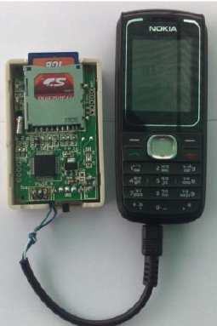
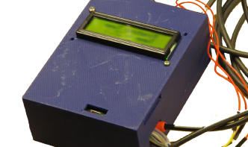
Fone Astra
Sensor connection to low cost phone
Phone for communication and output
$25 board + $25 phone
Temperature monitoring

Slide 6
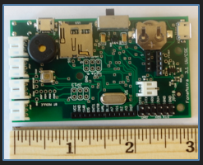
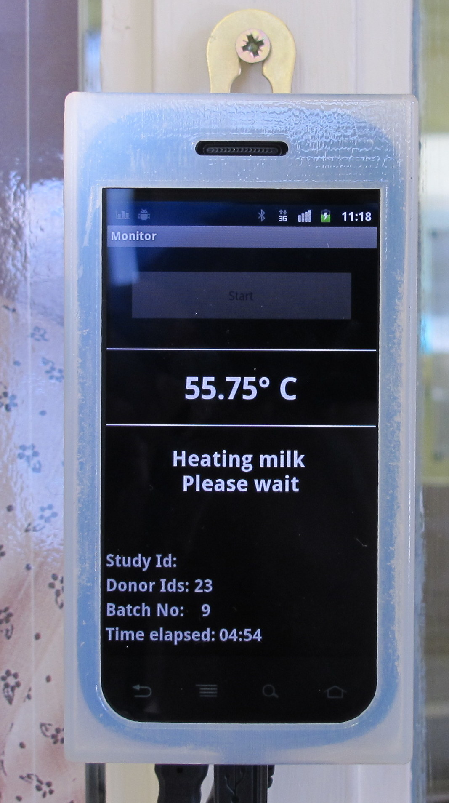
Android Fone Astra
Version 2 of FoneAstra replaced basic phone with Android phone
Communication by bluetooth or USB
Separate power for FoneAstra device
Programmability and UI on phone

Slide 7
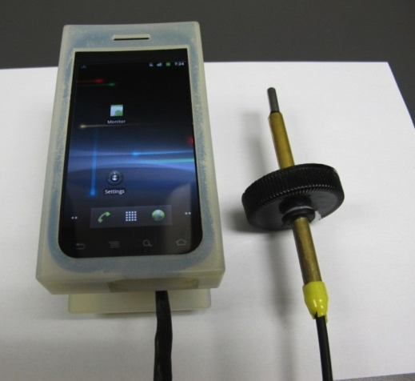
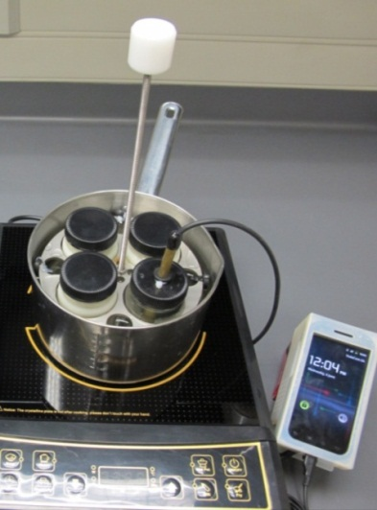
Milk Pasteurization
Human milk pasteurization
Replace high price pasteurizer with hotplate
Temperature monitoring to ensure proper heating and verify quality

Slide 8
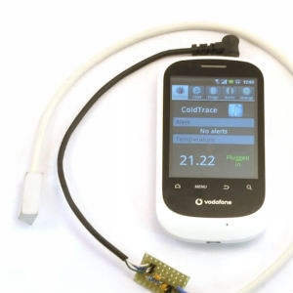
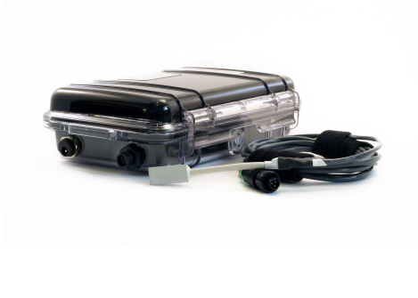
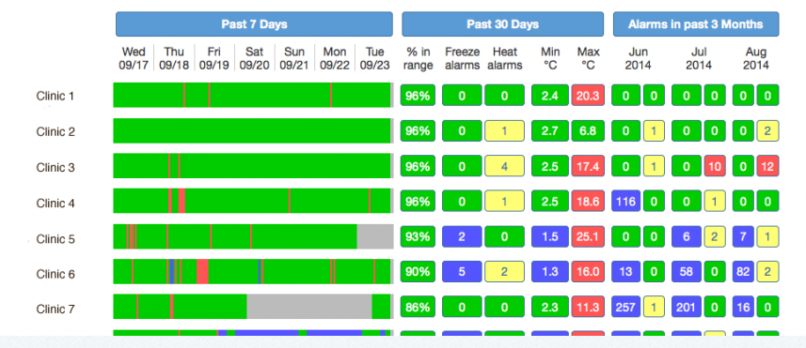
Cold Trace
Remote temperature monitoring
Connection through audio port to Android phone
Deployments now rely on a single model of low cost Android phone
Well engineered product with substantial support
Need for multi sensor device

Slide 9
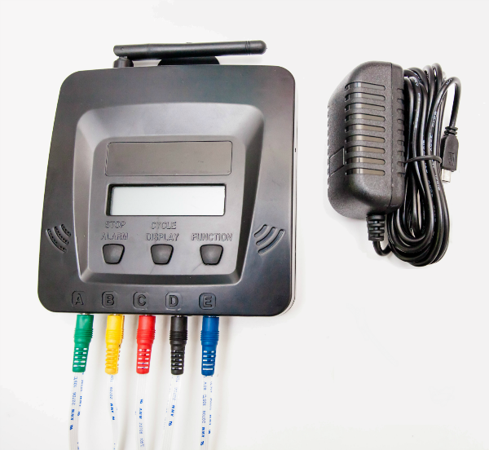
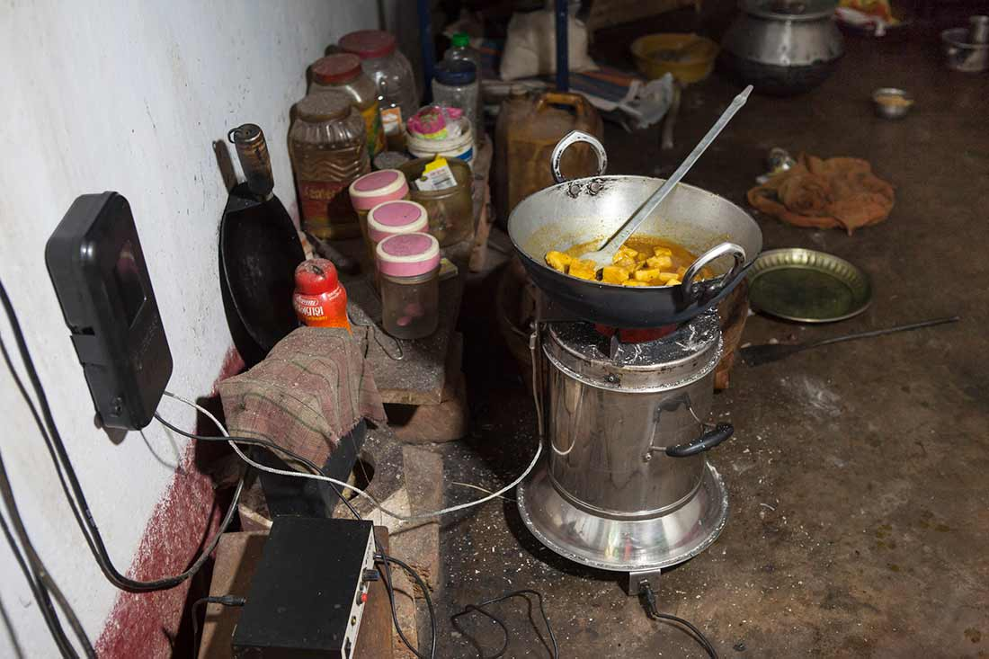
Cold Trace V5

Slide 10
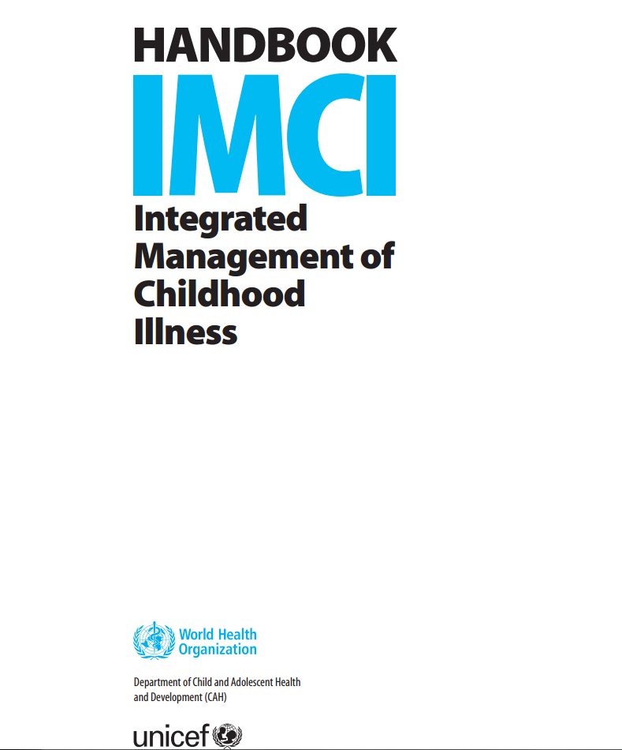
IMCI
WHO Designed protocol on diagnosing/treating childhood illness
Step through diseases with flow chart
Target nurses/health workers
Standardize care

Slide 11
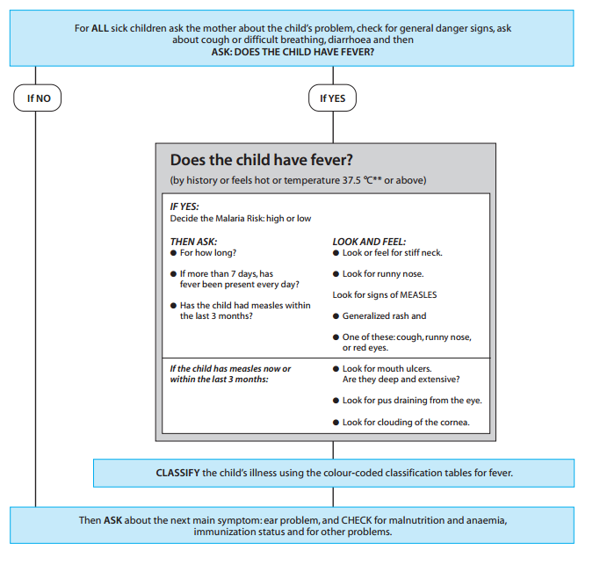
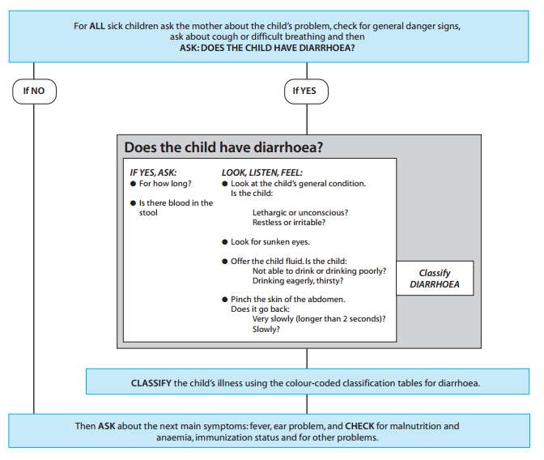
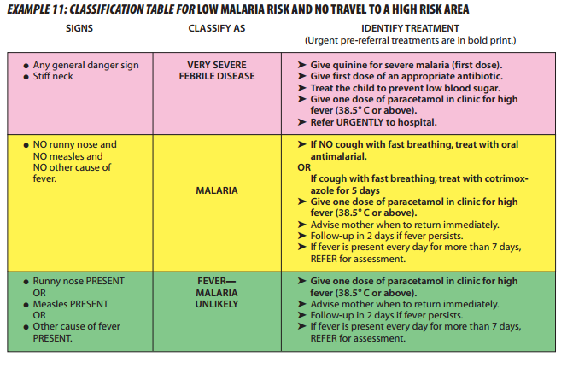
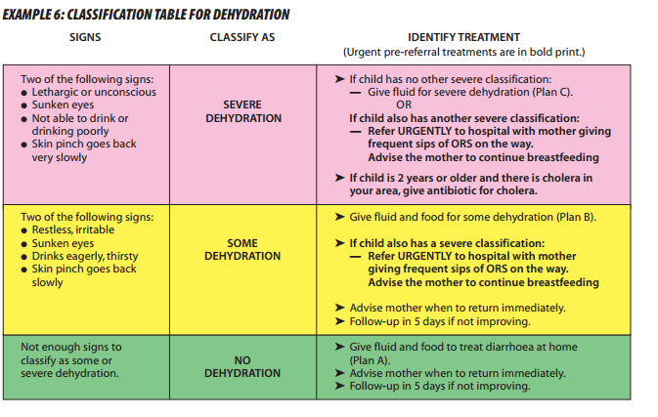
IMCI

Slide 12
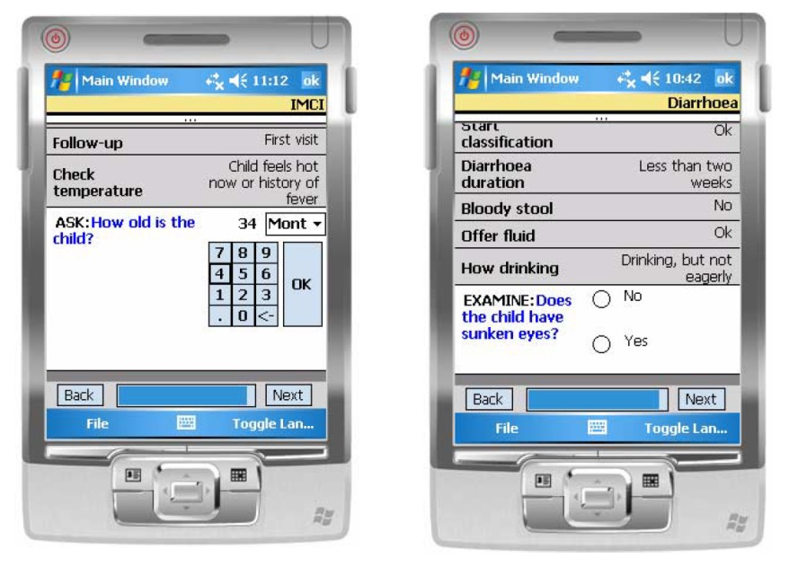
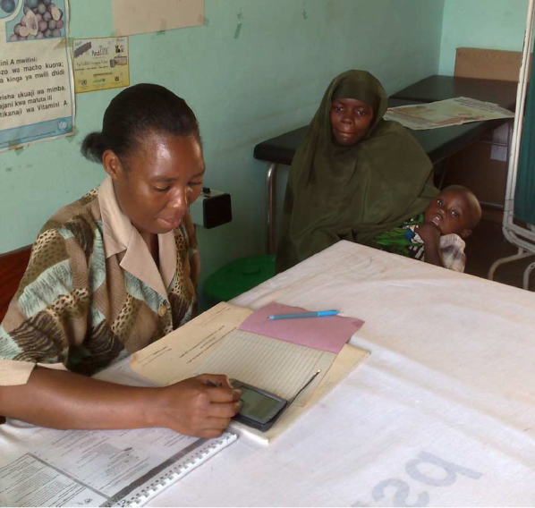
Tanzania e-IMCI Study
Implement IMCI on a PDA, c. 2007
Goal:
Demonstrate improved compliance to IMCI protocol
No increase in time of visits

Slide 13
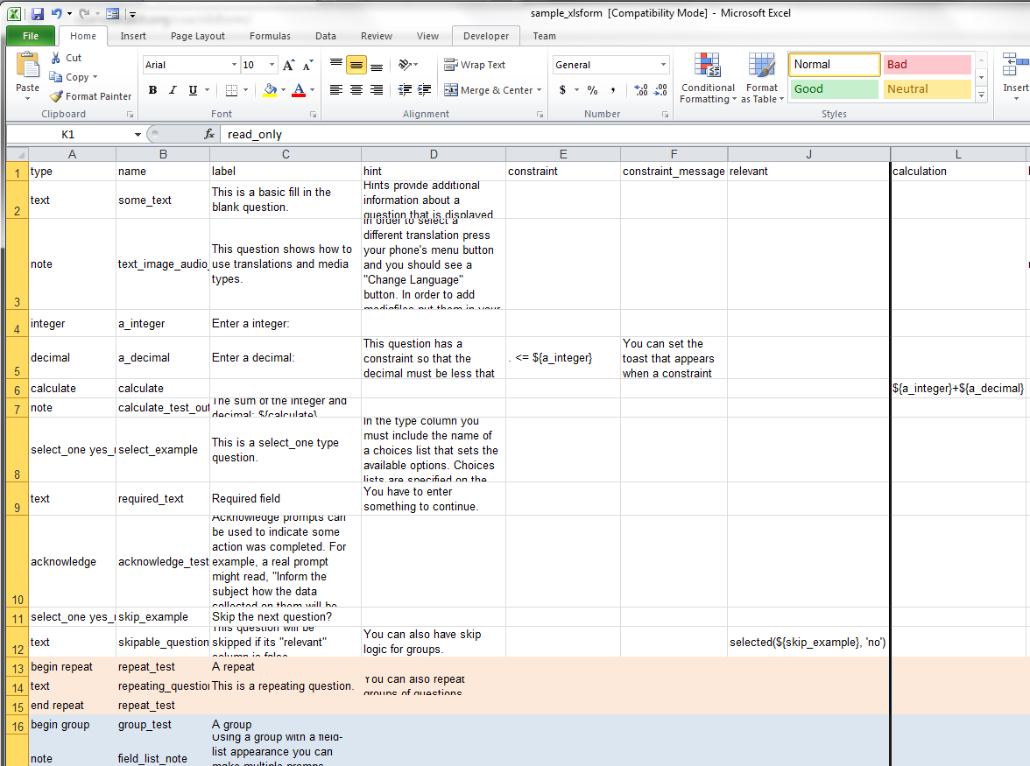
Open Data Kit
Collect
Forms based data collection application running on Android device
XLSForm
Form creation tool reading in Excel spreadsheet
Aggregate
Backend server to receive data

Slide 14
IMCI to ODK
Convert IMCI Protocol to decision tree
Encode in forms
Establish branching logic
Implement in spreadsheet
Compile to ODK
Challenges
Extracting the decision tree
Verification of wording and workflow
Usability
Medical review of IMCI
Difficulty in adapting protocol
Official approval of protocol
Determining correspondence of electronic and paper version

Slide 15
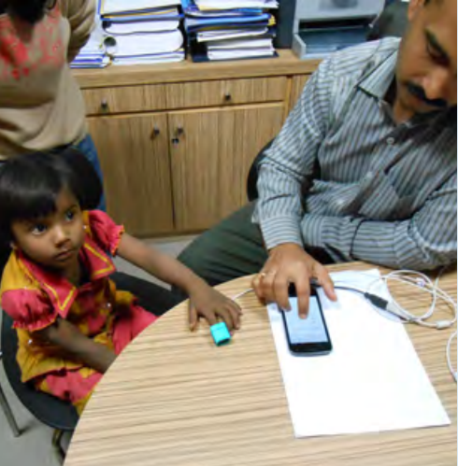
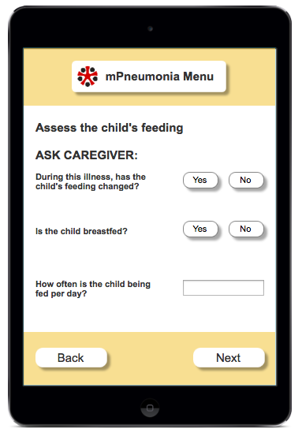
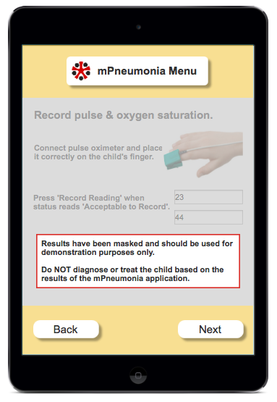
IMCI + Pulse Oximetry
Measure blood oxygen level
Low oxygen levels can indicate pneumonia
Add blood oxygen level into pneumonia questions
Pulse oximeter connected to mobile phone so readings entered automatically

Slide 16
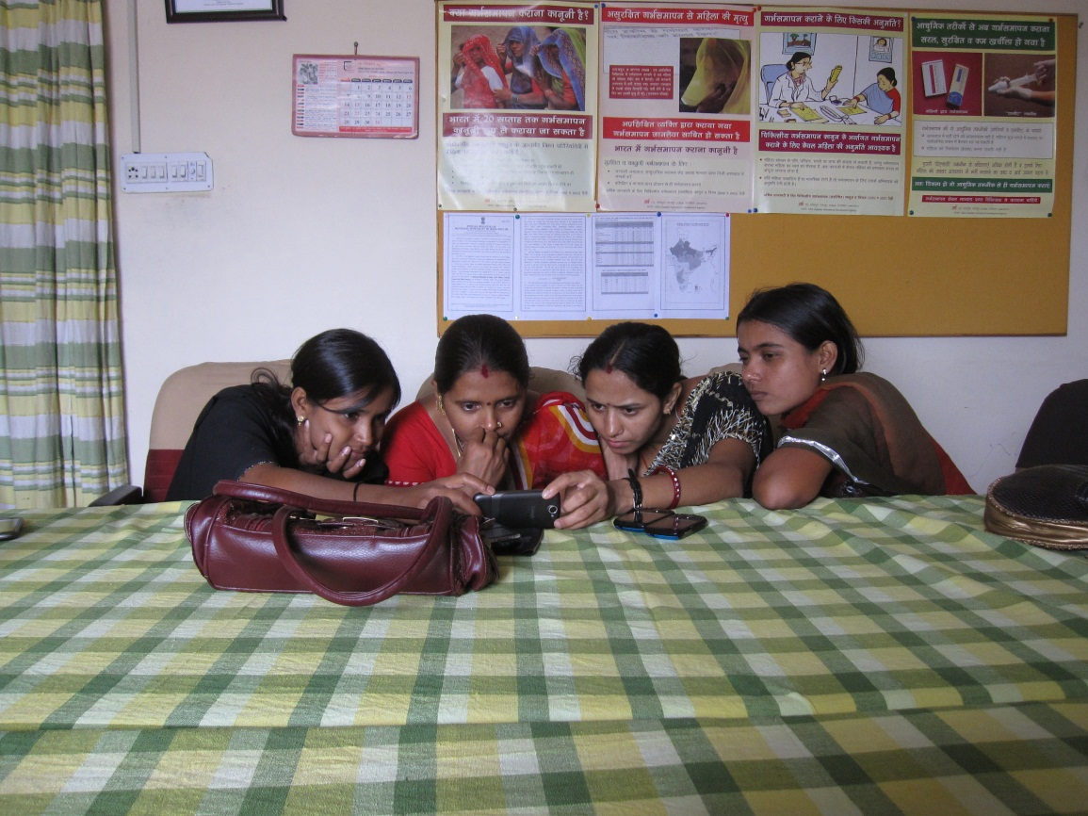
Mobile video for patient education: The midwives’ perspective

Slide 17
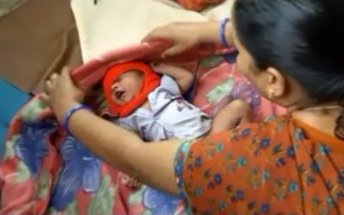
Overview
Study of Nurse Midwife reaction to using mobile videos to support patient education
Based on a one year project conducted in Udaipur, India
Key contribution
Focus on the acceptability of a mobile device to help a midwife’s work

Slide 18
Sustainability
Technical feasibility: the device must work reliably in the field.
Usability: the target users must be able to operate the device.
Acceptability: the users must be willing to use the device in the course of their work.
Maintainability: it must be possible to keep the devices running at low cost.
Affordability: the total cost of the system must be low enough that the health system can pay for it and sees commensurate value.

Slide 19
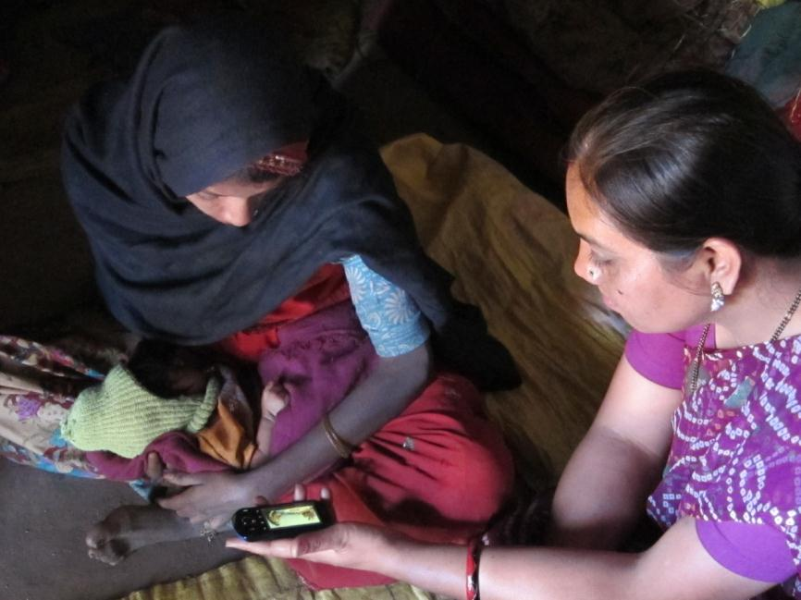
Acceptability
In order for a technology to be adopted, it must provide perceived value to those that are expected to use it

Slide 20
ARTH, Udaipur India
Action Research and Training for Health
Two maternal health clinics for a population of 64,000
Clinic and outreach services by two doctors and eight nurse midwives
Post Natal Care (PNC) visits using ARTH protocol
Two visits
In clinic or home

Slide 21
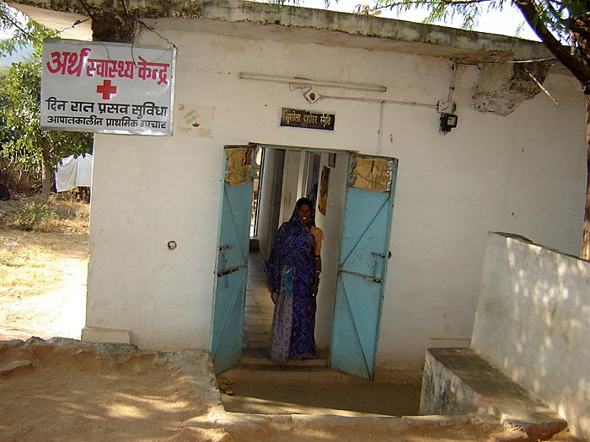
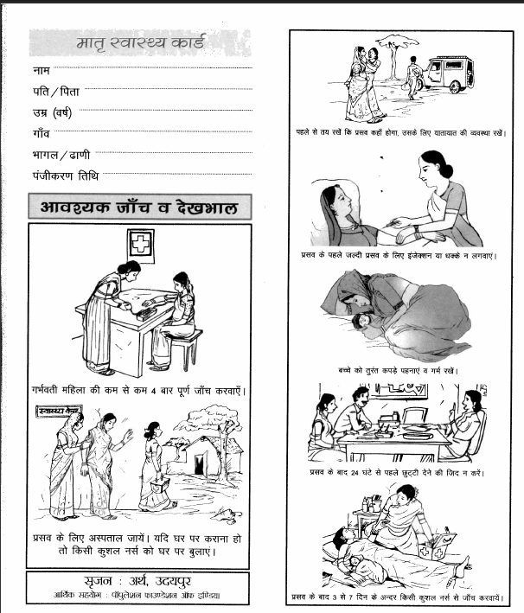
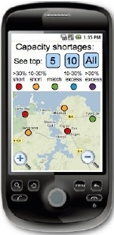
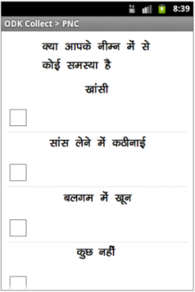
Mobile Midwife Platform
Mobile data collection to support PNC visits
Data collection
Protocol support
Open Data Kit application
Android phones deployed with nurse midwives

Slide 22
Health videos
Three videos created
Maternal nutrition
Breast feeding
Thermal care
Videos shown during PNC
Launched from ODK form at specific points in visit
Nurse midwives were already expected to address these topics

Slide 23
Mobile device use
One year pilot for data collection and visit support
Nurse midwives had difficulty with data collection and continued to use paper forms
Device logging showed that the videos were shown regularly
Midwives identified video the most successful component of the project
 | Nutrition | Breast-feeding | Thermal care | Total
Video played entirely | 554 (77.1 %) | 497 (77.7 %) | 288 (62.5 %) | 1339 (73.4 %)
Video partially played | 46 (6.4 %) | 52 (8.1 %) | 26 (5.6 %) | 124 (6.8 %)
Video stopped | 110 (15.3 %) | 89 (13.9 %) | 146 (32.7 %) | 345 (19.0 %)
Video play extended | 9 (1.2 %) | 2 (0.3 %) | 1 (0.2 %) | 12 (0.7 %)

Slide 24
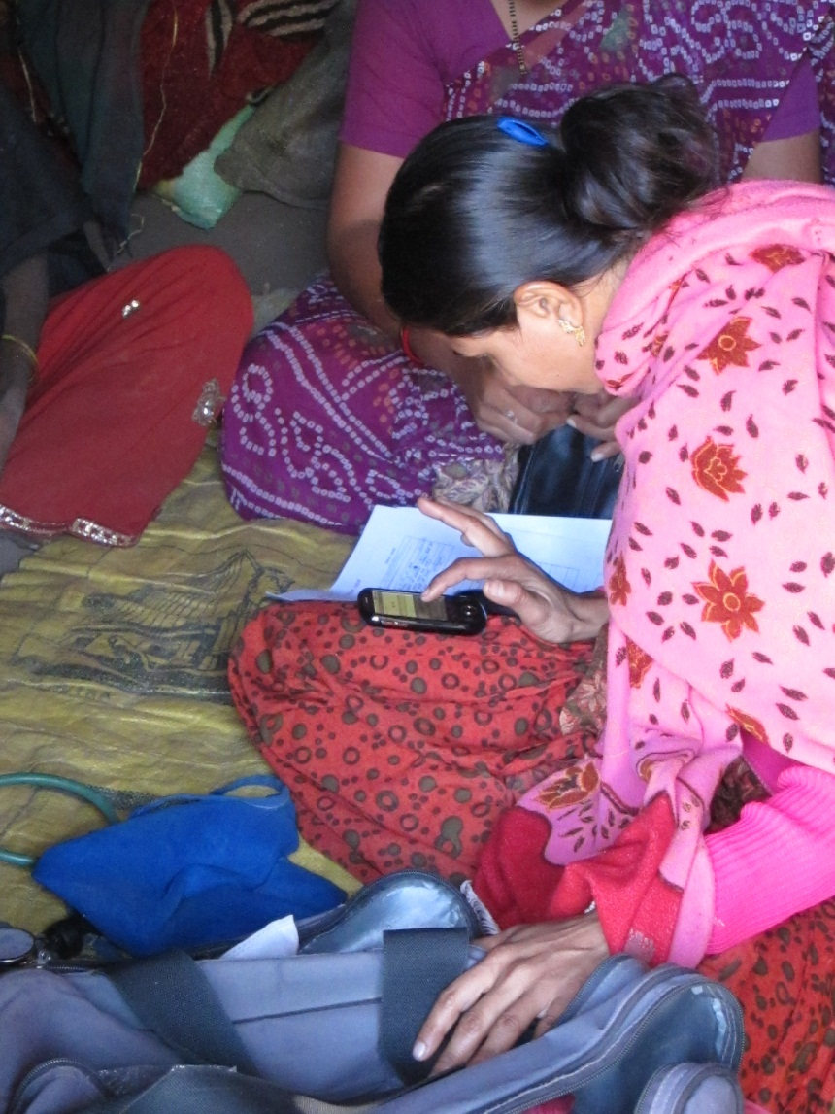
Study methodology for evaluating video
Ethnographic observations of 22 PNC visits
Semi-structured interviews with the 8 nurse midwives
Iterative coding scheme of qualitative data using Atlas.ti
Triangulation with quantitative data from deployment

Slide 25
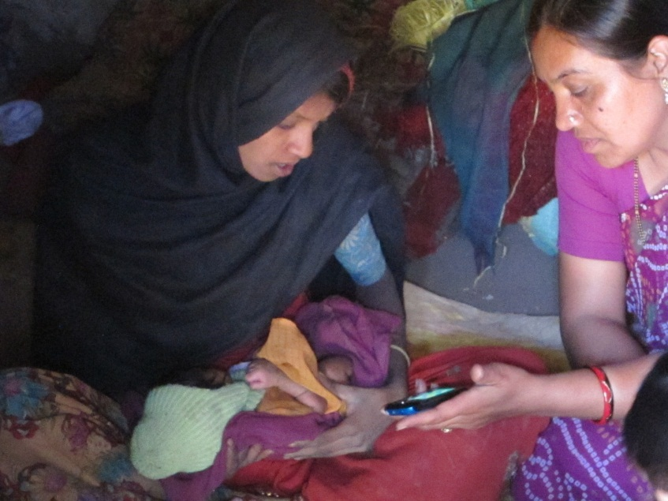
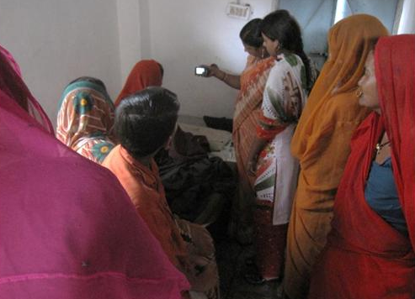
Summary of results
The use of video is feasible in PNC visits
The PNC environment is complicated
Patient education occurs throughout visits with various levels of effort
Multiple settings and participants
Authority and trust
Nurses viewed video as being authoritative and enhancing their communication

Slide 26
Feasibility
Video used consistently on PNC visits
Midwives reported a favorable reaction and identified this as the best feature of the mobile device
Minor difficulties in using videos in the mobile app
“The video that we show is very good – it becomes very easy for the people to understand. There is a big difference between telling something and showing it. On watching the video people understand that yes, this is how it is to be done.”

Slide 27
Complexity
Multiple people might be present for home and clinic PNCs
Process of doing an examination did not fully align with the protocol on the device
Introduction of videos made educational component more explicit
“When we do PNC before, only the patient and I are present . . . Now I am showing the video, now others too come on hearing the sound from the video, so they too remember that yes, we have to do this, so more people come inside, we tell the patient, and everyone hears.”

Slide 28
Multitasking
Nurses used time while video played for other activities
Multiple ways of showing the video
Video was rarely stopped for discussion
Time for playing the video was an issue
“[The good thing about the video] is that the video explains how to feed the baby and gives advice, so we don’t have to talk much. So while they watch the video, we can continue with our work”

Slide 29
Authority
Videos extended nurses ability to deliver complete messages
Some nurses felt that by featuring older nurses the videos had additional authority
No conflicts with the video messaging
“We explained that this too is showing how to feed the baby, the things that you should eat, is it necessary for you to have the tablets or not. We are telling you through the mobile. It is just like the nurse used to tell you. You should take it the same way. We show the video and they feel it is right”

Slide 30
Trust
Video considered to be trustworthy
Nurses had a theory that people understand by seeing
Advantages identified: clarity of message, use of local language, and local participants
“What will the mother think? She thinks the video is correct. A movie has been made, so it is right because there is a lady in it, a patient and a nurse, so she understands. . . She understands on seeing the patient. If there had been only two nurses, she wouldn’t have understood”

Slide 31
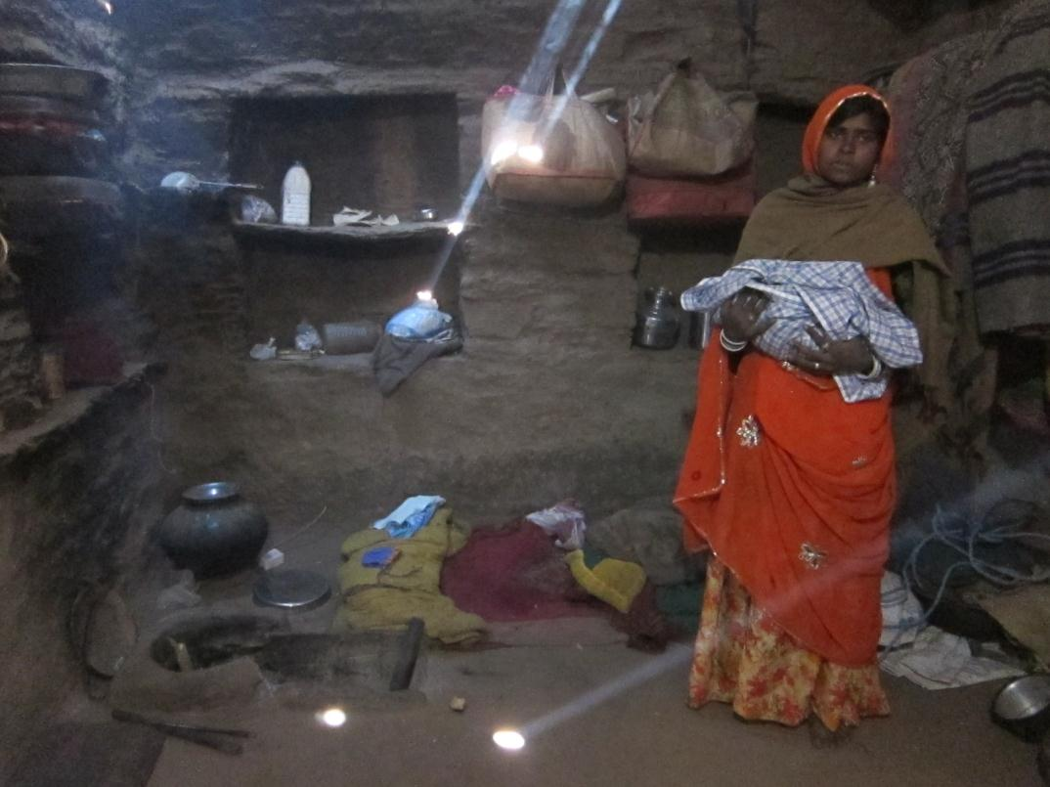
Action Research and Training for Health

Slide 32
Diagnostics
Issues
Cost of test
Precision of test
Accuracy of test
Error profile
Action on positive test
Action on negative test
Goals
Individual treatment
Public health goals
Positive Test
Negative Test
True Positive
False Negative
Have disease
False Positive
True Negative
Don’t have disease

Slide 33
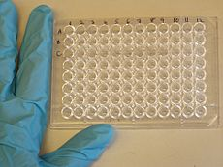
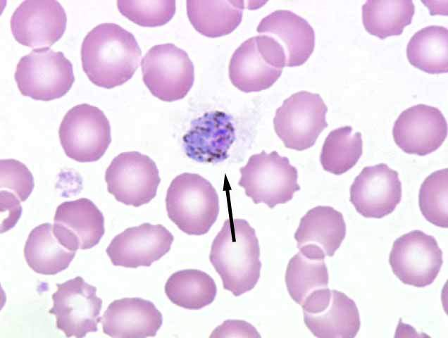
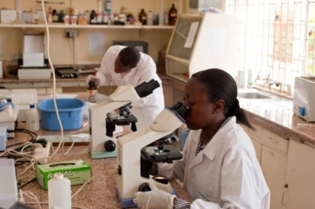
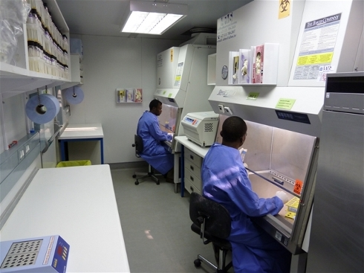
Lab Diagnostics
Highly accurate tests
E.g., Enzyme-linked immunosorbent assay (ELISA)
Microscopy
Requires infrastructure, trained staff, equipment
Issues
Costs
Transport of samples
Delays in processing or notification

Slide 34
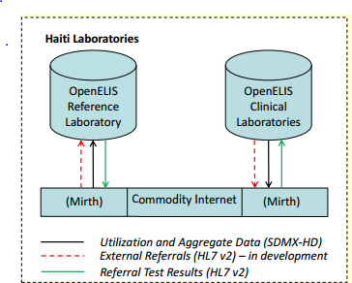
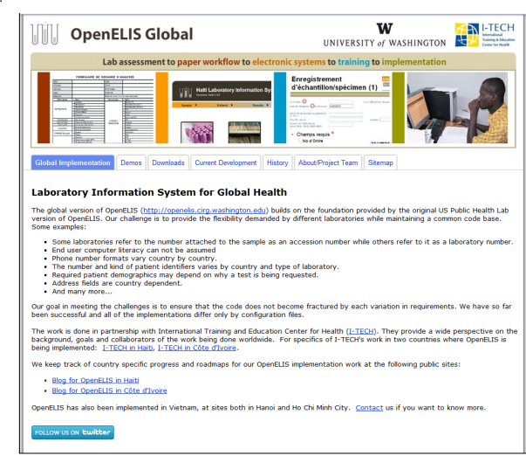
Lab Information System
Internal lab management
Tracking of samples and tests
Interoperability with medical records
Notifications
Probably not much difference between developed and developing world

Slide 35
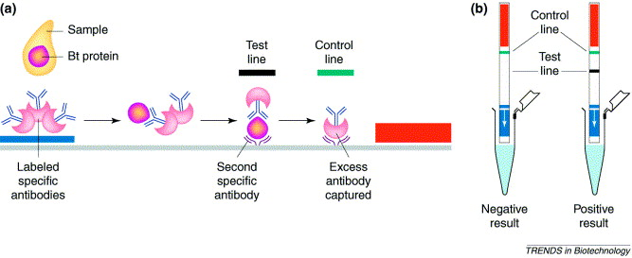
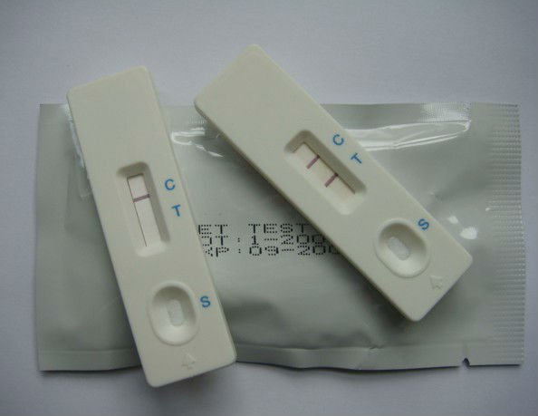
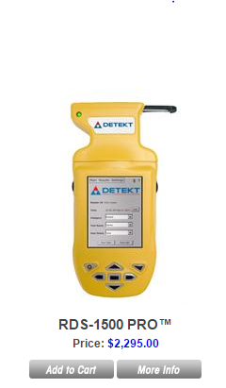
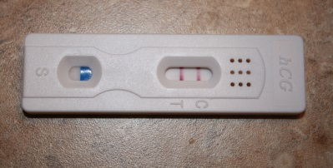
Rapid Diagnostic Tests
Point of Care Tests
Deliver results without sending test to lab
Fast turn around
Limited test preparation
Lateral flow immunochromatographic assays
Large number of tests available
Blood, Urine
HIV, Malaria, Syphilis

Slide 36
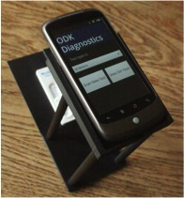
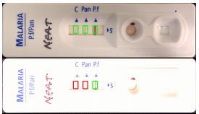
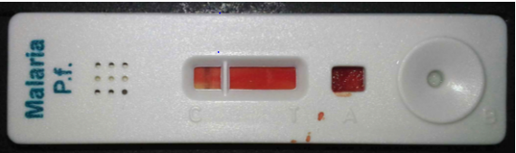
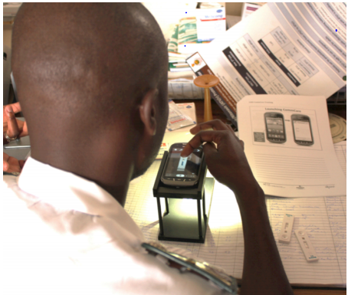
ODK Diagnostics
Image analysis on SmartPhone to read RDT
Computation done locally
Template to adapt to multiple tests
Use cases
Enable lesser trained health workers to conduct tests
Support tests which are not frequently used
Supervision
Quality control
Field trials
Zimbabwe

