Slide 1
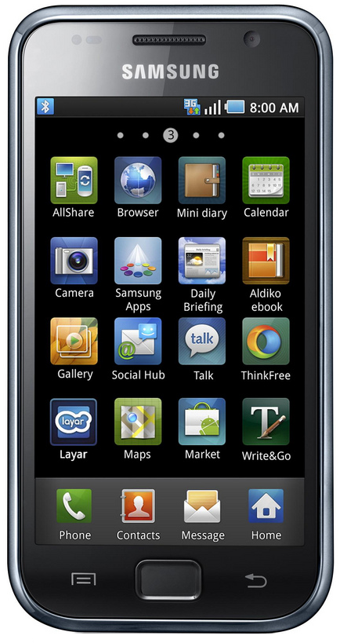
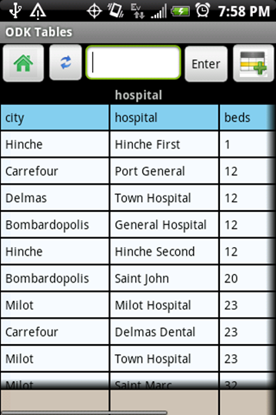
Data Management
Lecture 20: CSE 490c

Slide 2
Announcements
No class Monday, November 12
No class Wednesday, November 21

Slide 3
Topics
ODK 2.0 Design
ODK 2.0 Application
ODK 2.0 Technical Challenges
ODK Research Projects
ODK Clinic
ODK Scan
ODK Sensors

Slide 4
Limitations of ODK 1.0
IMHO the success of ODK 1.0 is due to its focus on a core data collection use case
But what else did people want?
Greater flexibility with user interface
Ability to collect data based on previous data
ODK 2.0 developed as a data management platform requiring greater sophistication in application development and deployment

Slide 5
Open Data Kit learnings and philosophy
Data collection projects require technical people in charge of managing forms, data, and devices
Deployment Architect
The purpose of the Data Collection Platform is to give the Deployment Architect the ability create and manage survey process
The Deployment Architect is not an Android developer
ODK 1.0 Deployment Architect: Forms designer
ODK 2.0 Deployment Architect: Javascript

Slide 6
ODK 2.0 Features
Fully customizable layout of prompts on the Android device
More flexible, user-directed, navigation of a survey
Bi-directional synchronization of data across devices
Data curation and visualization on the device
Row-level access filters

Slide 7
ODK 2.0
ODK Application Designer
ODK Survey
Data Collection app based on HTML, CSS, JavaScript
ODK Tables
Data Curation and Visualization app
ODK Services
Application for syncing data across multiple devices and with server
ODK Cloud Endpoints

Slide 8
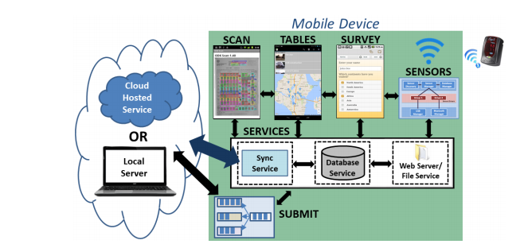
ODK 2.0 Architecture

Slide 9
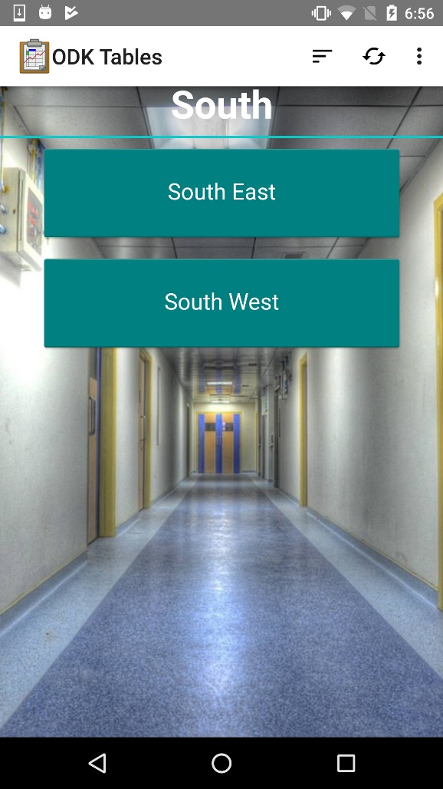
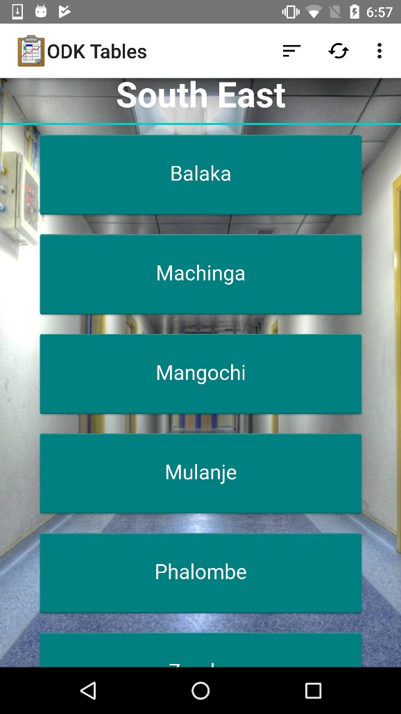
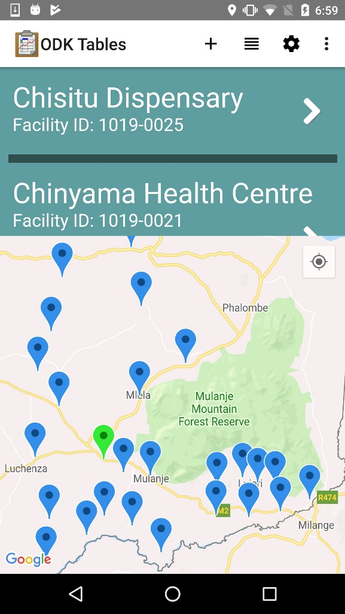
ODK 2.0 Cold Chain Demo I

Slide 10
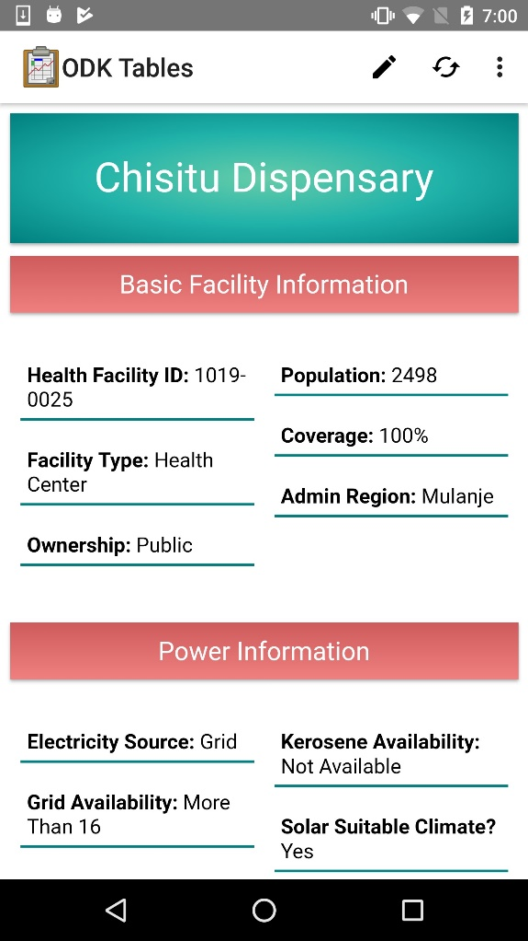
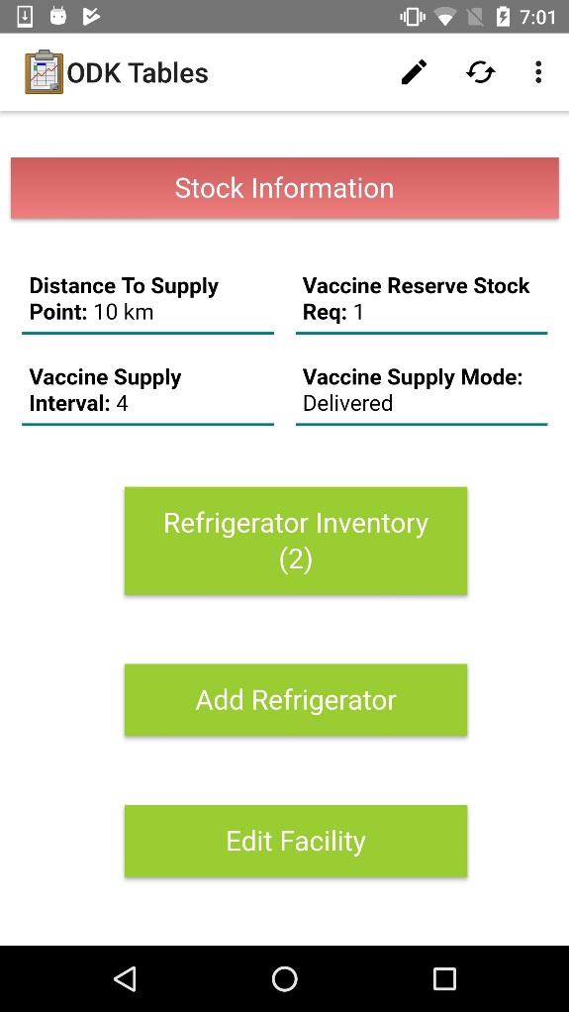
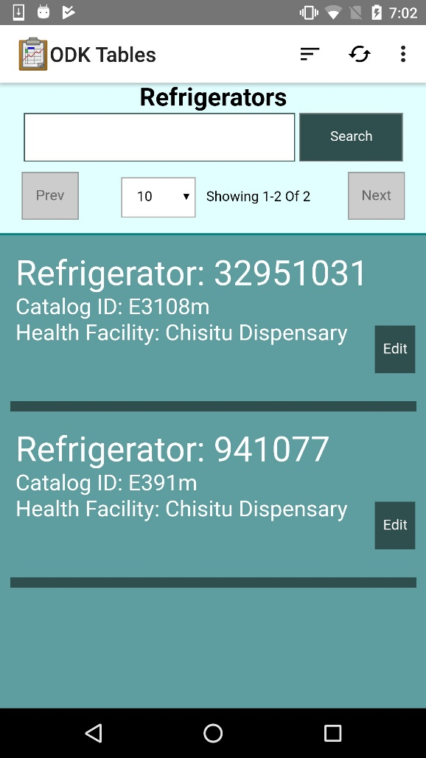
ODK 2.0 Cold Chain Demo II

Slide 11
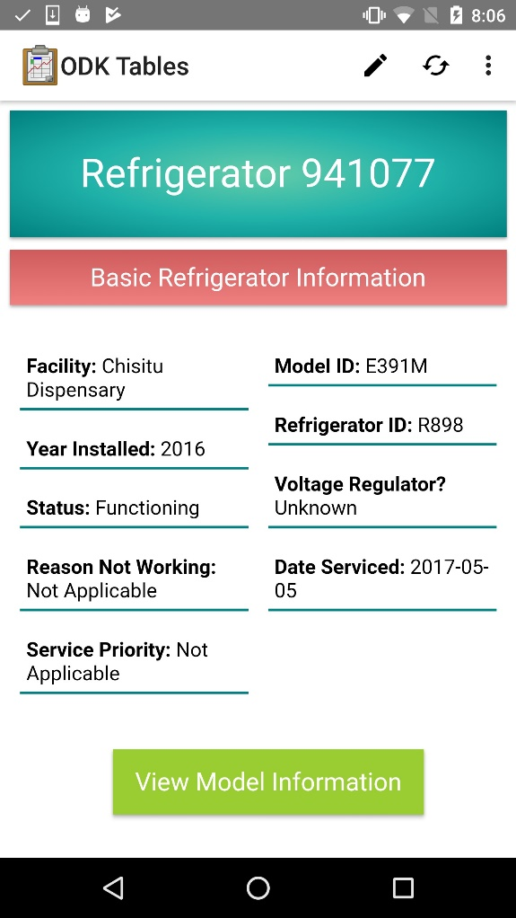
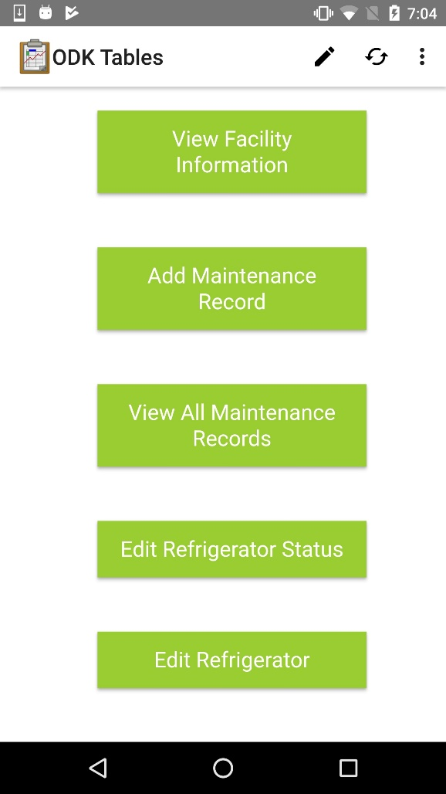
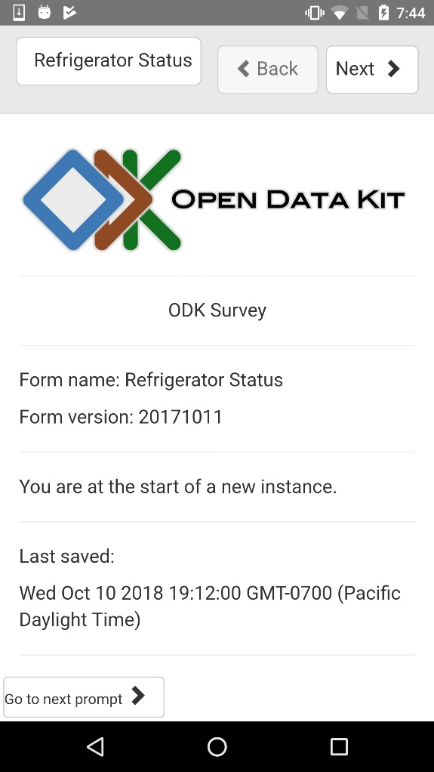
ODK 2.0 Cold Chain Demo III

Slide 12
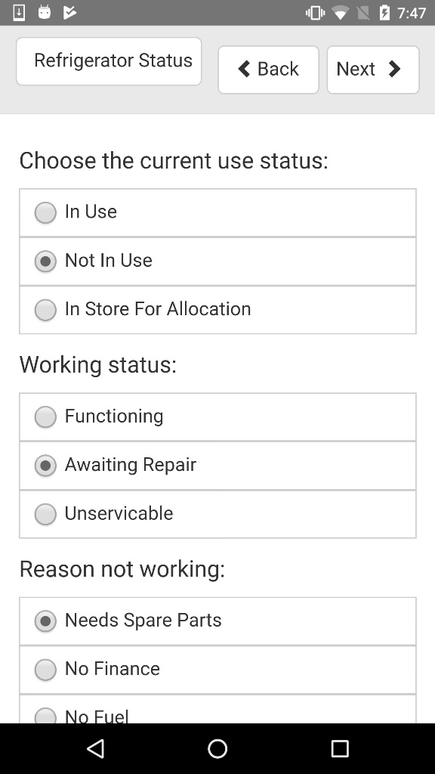
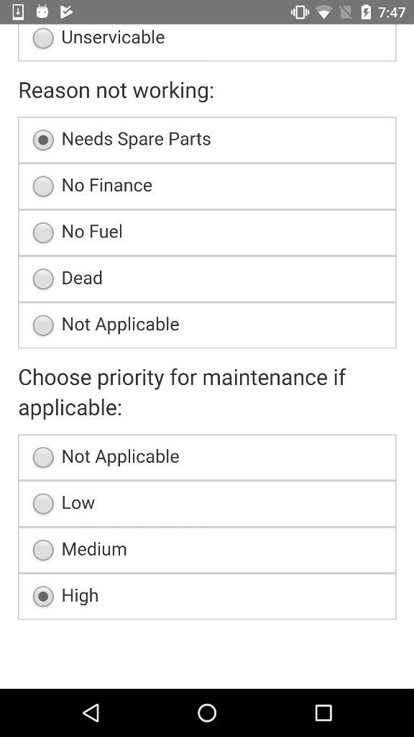
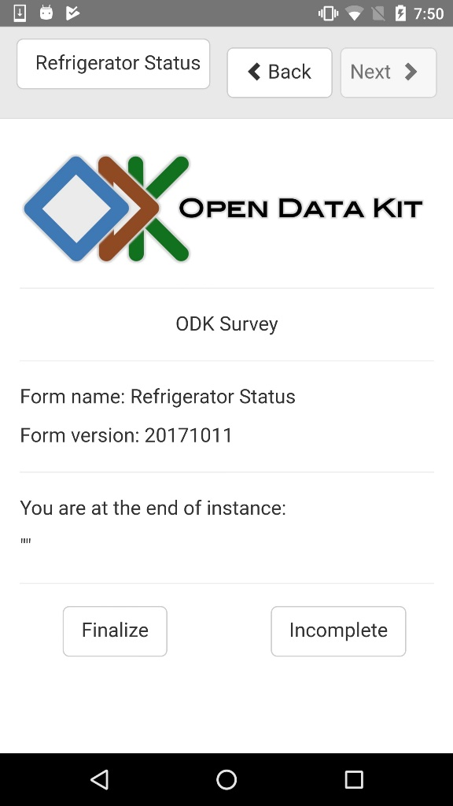
ODK 2.0 Cold Chain Demo IV

Slide 13
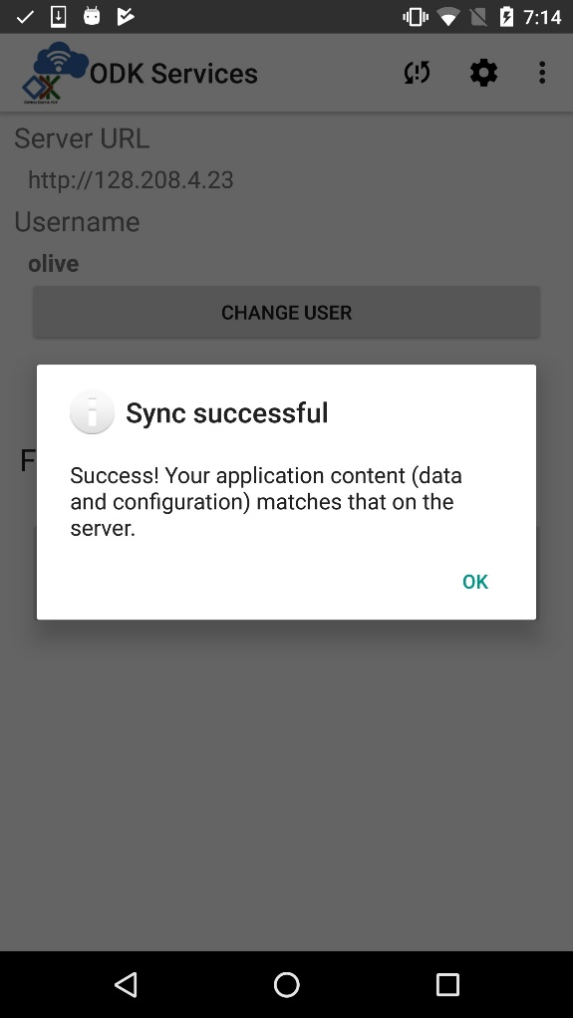
ODK 2.0 Cold Chain Demo V

Slide 14
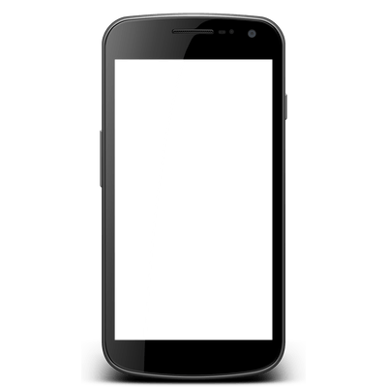
Technicalities: Synchronization
Basic data structure: Table
Synchronization through central database
Important use case is:
Online for download (synchronize) of forms and database
Offline for data collection
Online to upload (synchronize) data
How are conflicts handled?
Flag conflicted rows for manual update
Common case – data collection on distinct rows

Slide 15
Technicalities: Users and groups
Important requirement from users
Different levels of access based on groups
Supervisors and enumerators with responsibilities based upon geographic areas
Read and write access
Permissions based upon groups
Management of users
Rely on standard authentication – LDAP
Managing authentication and groups increases complexity for deployment architect
User management is the critical component of integrating ODK 2.0 with other systems

Slide 16
ODK Research Projects
ODK Clinic
Integrate with Medical Record System
ODK Sensors
Provide drivers to allow sensors as input
ODK Submit
Extend communication model to support a broader range of transport mechanisms to reduce cost
ODK Scan
Use the camera for paper to digital input
Restricted forms of input: bubble forms and numbers

Slide 17
ODK Clinic
ODK Clinic
ODK 1.0 integration with OpenMRS
ODK 2.0 as an Android App for global goods software systems
DHIS 2: Health Data Reporting
Open LMIS: Logistics Management
Key integration points
Data synchronization
User management

Slide 18
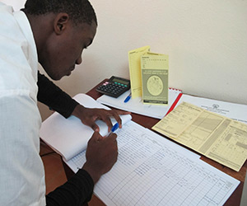
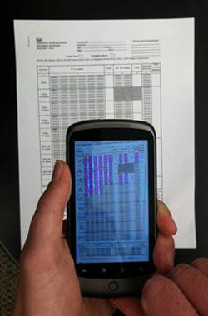
ODK Scan
Problems
Data collection from registers
Data collection from tally forms
Key scenarios
Counting number of immunizations given at a session
Reporting stock counts of medications
Deployment partner
Village Reach
Value proposition
Much faster data aggregation
Reduces steps in workflow

Slide 19
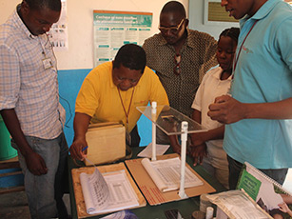
ODK Scan Implementation
Built on an early version of ODK 2.0
Allowed richer user interface including a correction UI
Multiple data elements per screen
More complex data transport model
Restricted to bubble forms and numbers in a 3x2 grid
Forms designed for ODK Scan
Field testing
Importance of using a stand for stability and distance
Image processing steps
Fields on form marked on master form
Registration marks for alignment
Identify data elements
Image recognition on data elements

Slide 20
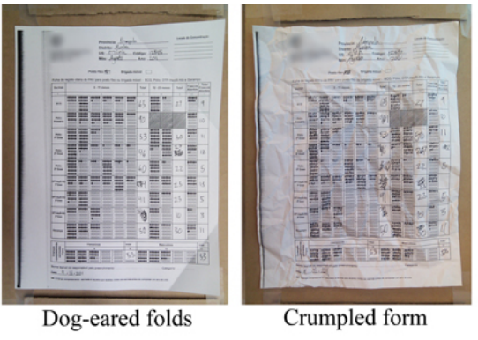
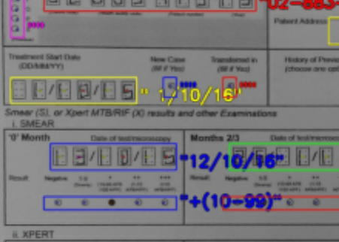
ODK Scan challenges
Forms in bad condition
Lighting and contrast
Image recognition of digits
Identification of regions if paper was warped
Synchronization of images with master database

Slide 21
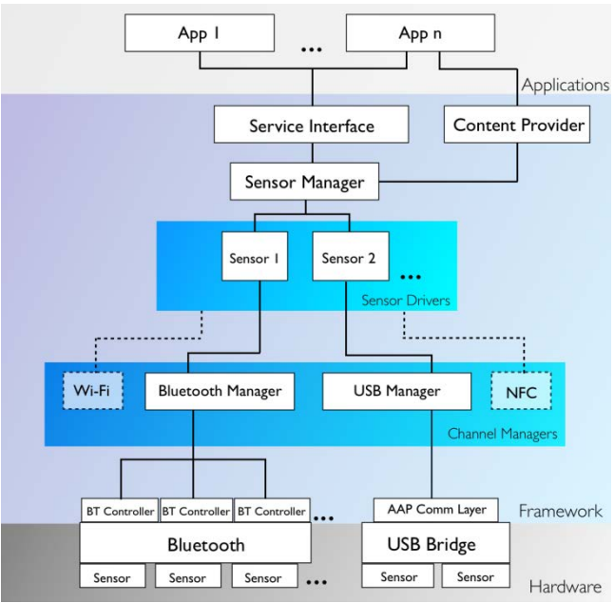
ODK Sensors
What if data is coming from a sensor and not text input?
Model of automatically collected data fits in ODK 2.0
Direct input
Time varying
Event Based
Technical issue
How are the drivers managed
Sensors Architecture

Slide 22
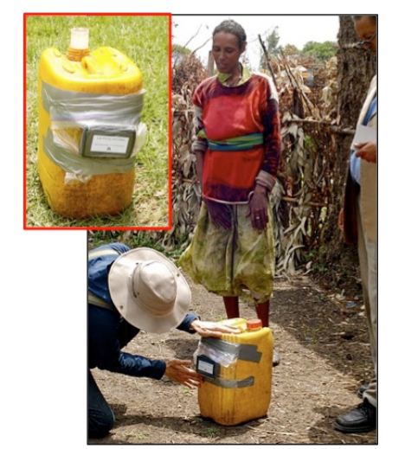
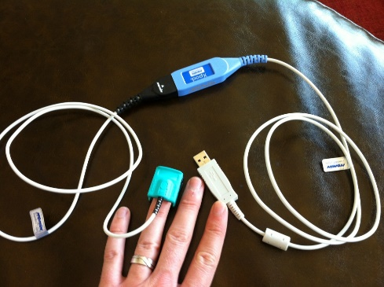
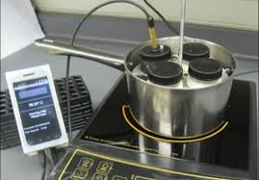
ODK Sensor Applications
Water carrying study
Pulse Oximetry
Managing pasteurization of human breast milk

