Slide 1
SMS Phishing and ROSCAs
Lecture 16: CSE 490c

Slide 2
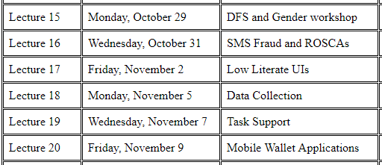
Announcements
New Homework Available
Paper on Low Literate user interfaces
Lecture Schedule

Slide 3
Trip Report, Information Technology University, Pakistan
Meetings with Faculty
Lubna Razaq, Umar Saif, Maryam Mustafa, Agha Ali Raza, Faisal Kamiran
Round table discussions
FinTech and MFI
Community health
Multiple talks
Digital Financial Services class

Slide 4
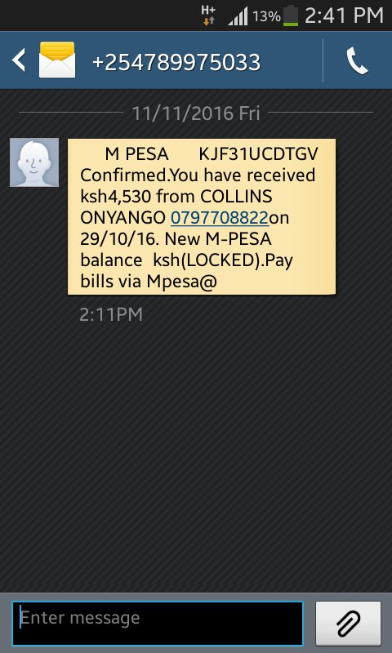
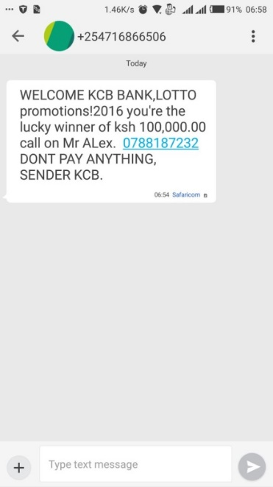
SMS Phishing
Fraudulent SMS are observed around the world
Waseela-e-haq program ki taraf se apkay Rs.25200 rupay aya hain.apka ye number03314311169BISP mein register tha.ap is number per 03017073199 call karein

Slide 5
Research Question: What is the prevalence of SMS Fraud in Pakistan?
Perception of a very high rate of SMS fraud in Pakistan
What is the actual prevalence?
What are the range of fraud types?
How do the frauds take place?
Can we develop a recognizer for fraudulent messages?
Are people susceptible to fraud?
What are the mitigation steps?

Slide 6
Methodology App based collection
Create an Android App to allow users to submit SMS messages
Engineering the App turned out to be challenging
Successful collection from college students
Decided against funding incentives for message submission

Slide 7
Methodology Visits to field
Interview people and have them install App on phones
Low density of Android phones
Suspicion about installing App or forwarding SMS

Slide 8
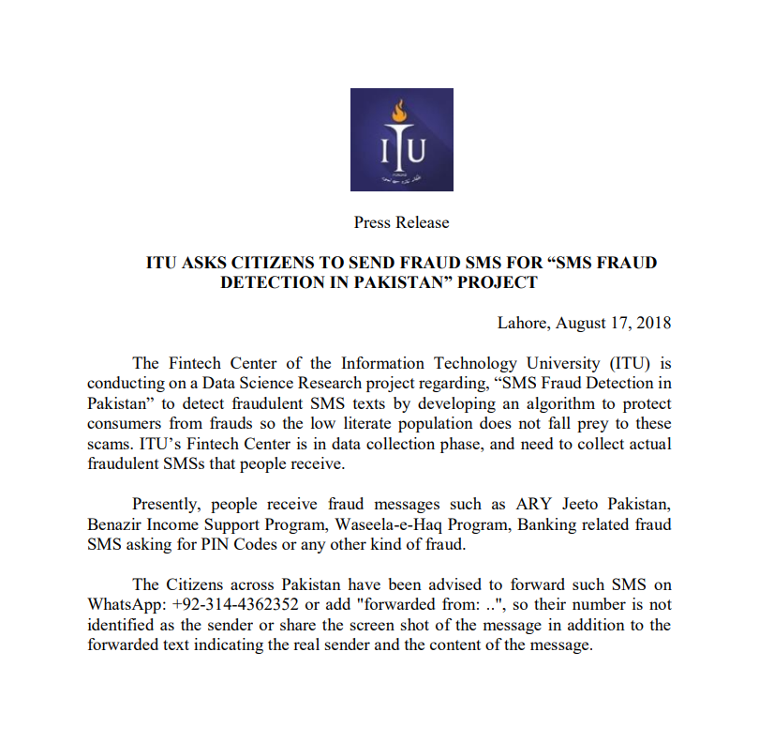
Methodology Send us your spam

Slide 9
Distribution of Fraud Messages
Surprisingly few fraud messages were found
Maybe this is not bad news!
Vast majority of fraud messages were the lottery scam
Jeeto Game Show (75 %)
BISP (20 %)
Mastercard Lottery
Request for a small amount of money from a women’s name
Did not encounter PIN fraud
Did not encounter direct mobile money fraud
Some disagreement on what a fraud SMS is

Slide 10
Field Interviews
Method for Lottery Scam – call phone number and discover that a certain fee is needed to process winnings
Approximately USD 50, on USD 500 winnings
Sent using mobile top ups. Text the numbers from the scratch cards
Middle class recognized these were fraud messages and were just annoyed
Lower income people fell for these frauds
Multiple people reported thinking they were real or knowing people defrauded
Setting where these messages were rare
People in authority (mobile shop owners or people at the mosque) would sometimes identify these

Slide 11
Fighting Fraud SMS
Fraud messages appear to go to random numbers
Spam messages thought to go to harvested numbers
Call back and source numbers on Fraud messages rarely repeated
Phone numbers are a scarce commodity in Pakistan
Limit of five sims per national ID
Anti-fraud recommendation
Establish monitoring of Fraud messages
Rapidly disable numbers through CTA

Slide 12
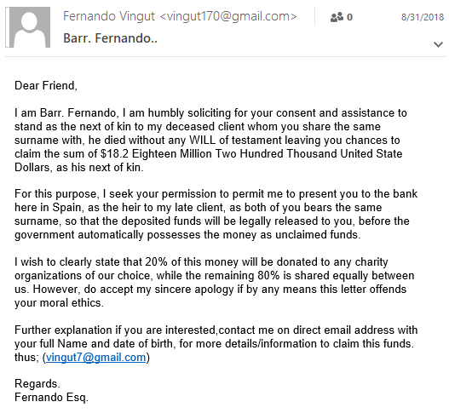
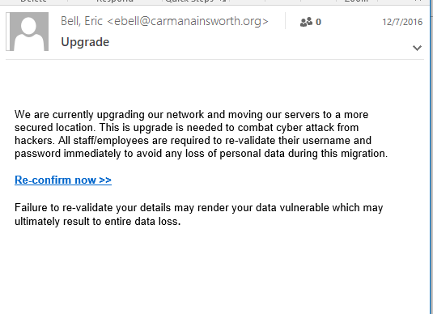
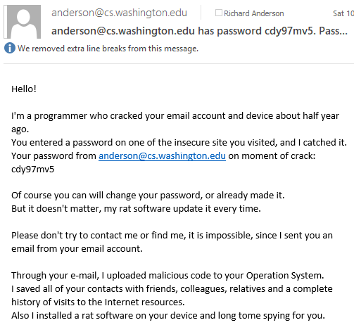
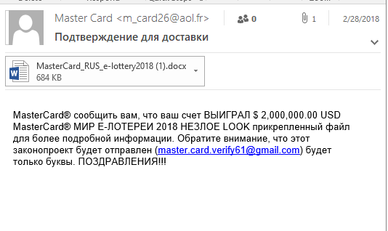
eMail Fraud How does SMS Compare ?

Slide 13
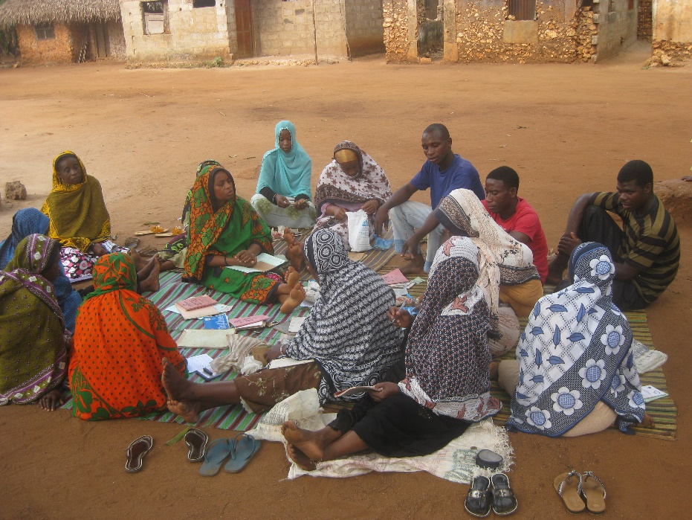
ROSCA
Committees, Tandas, Chama, Ekub, Cundinas, Pandeiros, Juntas, Tontine
Regular Payments into a shared Pot
Very common in Pakistan at all income levels

Slide 14
Digital ROSCA
Develop digital support for ROSCA
Multiple different ways this could be done
Web-based implementation to allow remote participation
Direct implementation inside a mobile money product
App based system to support ROSCA organizer
Interesting problem in digitizing traditional finance

Slide 15
Formative Work
ROSCAs very common in Pakistan across different income groups
Most common in Pakistan are “non-interest” ROSCAs
Islamic prohibition of interest
Some interest bearing ROSCAs are available
ROSCAs are initiated by an organizer
Most interactions are organizer-member
Little interaction between members
Multiple concerns on integration with mobile money
Transaction costs
Official tracking
Biggest needs around managing ROSCA for organizer
Many variations and details on Turn Distribution

Slide 16
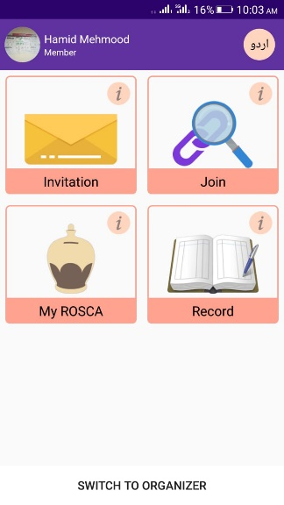
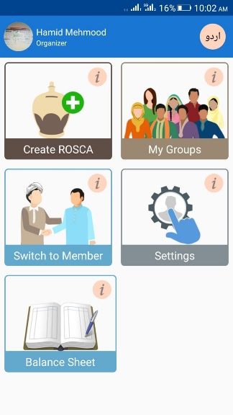
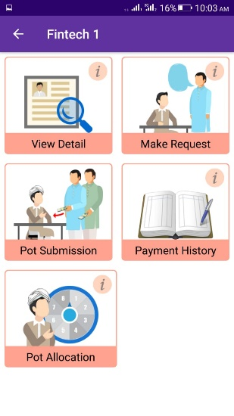
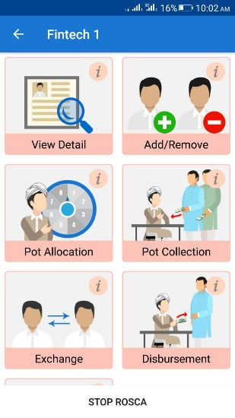
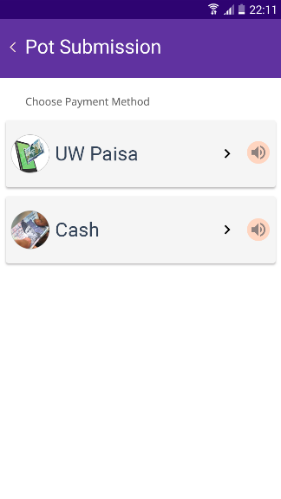
ROSCA App

Slide 17
ROSCA Payments
App designed to support both CASH and Mobile Money
API Integration with UW-Pesa
In principle, this could be adapted to other mobile money systems

Slide 18
Current work: Evaluation
Basic questions
Does it work?
Is it usable
What is the feedback from users
Deeper question
Does the app provide sufficient value to the ROSCA provider to be useful

