Slide 1
Clarice Larson
Notes:
Today I’m going to talk about a project within the DFS group called UW-Pesa. You may want to pay attention as some of the information will directly pertain to your next programming assignment.

Slide 2
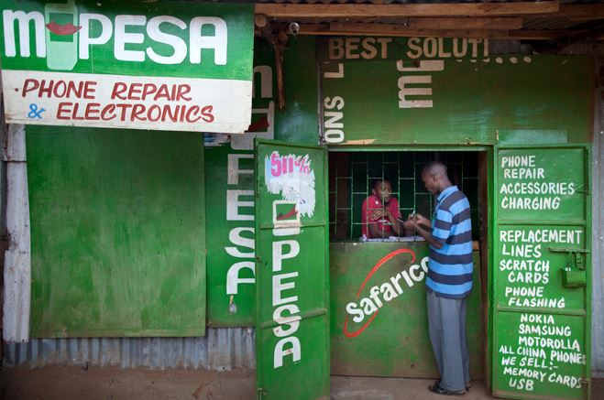
What is Mobile Money?
Financial accounts associated with mobile phone
Over the counter (OTC) agents are available for Cash In, Cash Out
Examples: M-Pesa, Tigo Pesa, Easypaisa
Notes:
Hopefully, these next few slides will seem familiar but if not no worries. Let’s go over them again.
Mobile Money is a technology through which users can store, send, and receive money via an account associated with their mobile phones. Users can deposit money into their accounts by visiting an agent who will perform a cash-in transaction or withdraw cash from their accounts by having an agent perform a cash out transaction. Agents are affiliated with the operating company, which is either a mobile network operator (MNO) or bank.
Cash agents purchase electronic funds from the operators with physical cash. The cash is stored as funds in a bank account which backs the e-money in the system.
Why is mobile money useful? Because mobile money allows users to purchase goods and services or send money without physical cash or visiting a bank. In developing countries where mobile phones are becoming more common, more people can access financial services digitally.

Slide 3
Mobile Money Interfaces
Agent
USSD
Smartphone App (Android, iOS)
SIMApp (via ThinSIM)
Notes:
The main interfaces into mobile money systems are agents, USSD, smartphone apps, and SIMApps. I’ll be demoing 2 UW-Pesa interfaces today.

Slide 4
What is UW-Pesa?
Demo platform for mobile money technologies
Sandbox for experimentation
Not targeting high performance, scalability, strong security
Notes:
What is UW-Pesa?
It’s a platform to demonstrate different technologies used in mobile money systems. By building UW-Pesa, our group is able to learn by doing.
UW-Pesa is also a tool for external education and outreach to demonstrate how people in developing countries use digital financial services.
Since it was built in-house, UW-Pesa is a great sandbox for experimentation. We can use it for prototyping research ideas around usability and workflow testing, security analysis and testing, etc.
This all sounds great, but UW-Pesa is not a production system. Performance, scalability, and strong security were not design considerations during the development of UW-Pesa.

Slide 5
What does UW-Pesa do exactly?
Supports basic ledger services
Creating accounts, account management
Peer to peer transactions
Cash in/Cash out
Can support various interfaces
Web portal
USSD
Smartphone App
SIMApp (via ThinSIM)
Notes:
Basic ledger services and the previously mentioned interfaces are supported by UW-Pesa. I will be showing the web portal and USSD interfaces of UW-Pesa today.

Slide 6
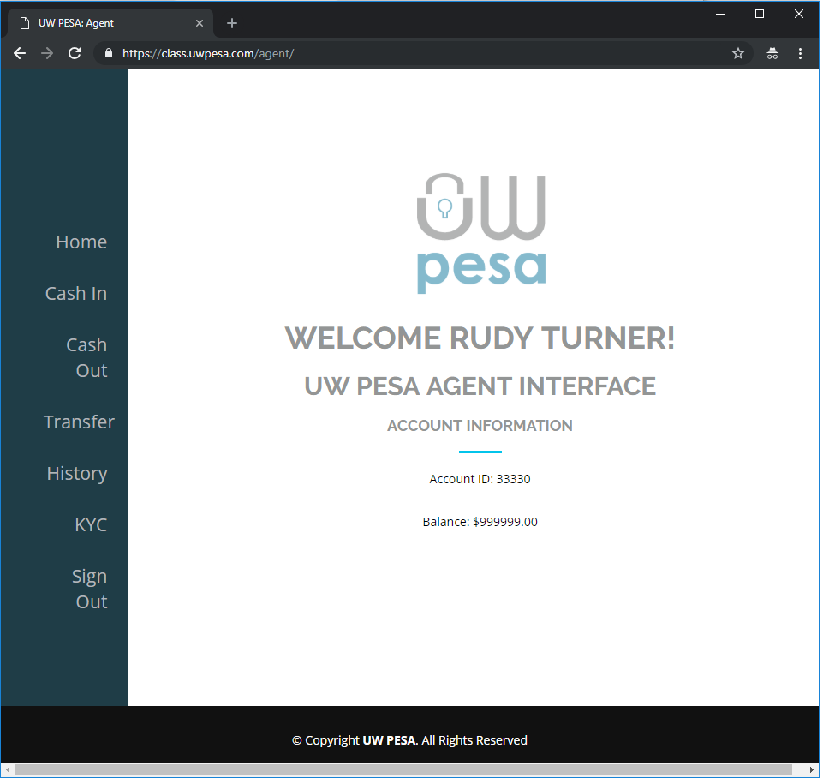
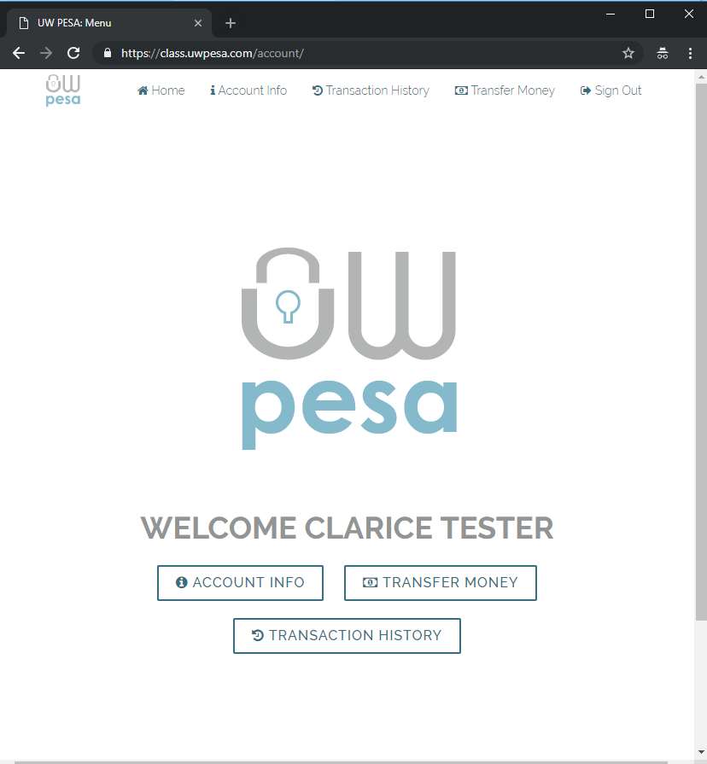
UW-Pesa Web Portal
Agent
User
Notes:
We will see a separate interface for agents and users.

Slide 7
UW-Pesa Web Portal
Server for CSE 490c
https://class.uwpesa.com/
APIs to interact with class.uwpesa.com
https://documenter.getpostman.com/view/5162128/RWgwQvKP
Notes:
Let’s take a look at the web portal now. Also, there is a web page with the APIs that you will need for you next assignment. Disclaimer: the API web page may change slightly before your next assignment. Feel free to sign up and play around with the portal, but remember this is not a production instance.

Slide 8
Brief Overview of USSD
Notes:
Ok, now let’s switch gears and talk a bit about USSD.

Slide 9
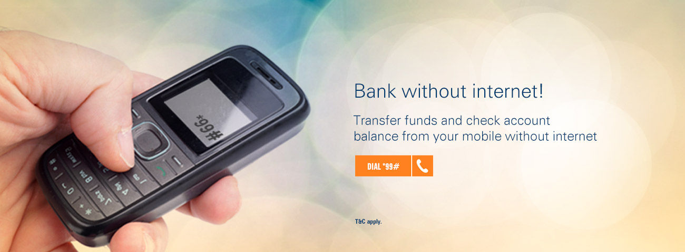
Why is USSD important?
… majority of large scale mobile financial services (MFS) deployments in the developing world use USSD as their primary mechanism for communication between customers and their mobile payments platform.
— CGAP, 2015
Notes:
USSD which stands for Unstructured Supplementary Service Data is how millions of users access mobile financials services. Here is an advertisement by a major bank in India supporting this claim.
<click>
And not just in India, people in many developing countries use USSD.
Because USSD works on every phone and doesn’t require a data connection — it is likely that people will continue to use it into the foreseeable future.
References:
http://www.cgap.org/blog/what-ussd-why-does-it-matter-mobile-financial-services

Slide 10
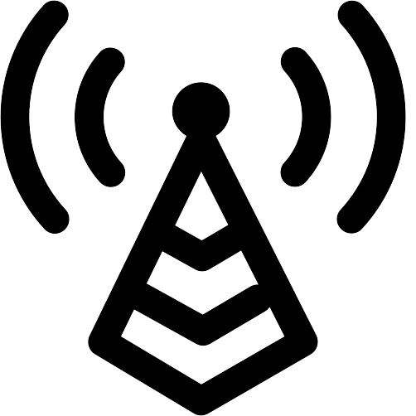
A Typical USSD Flow
Telco Central Office
External Service Provider API
USSD Gateway
GSM Network Core (manages session)
Network Service
Notes:
Here is a diagram how a USSD messages flows through the network. The cellphone connects to the cell tower. The cell tower connects to the telco central office where USSD messages are routed to the USSD gateway and finally to the external service provider API.

Slide 11
Research Complexities
Non-commercial research on USSD is rare due to the complexity of running the entire USSD stack
Using real phones requires integrating with a telco network
Probing the security of a running commercial network is unethical and/or illegal
Running your own network requires a spectrum license
Notes:
How can we do USSD research? It would be unethical if not illegal for a telco to let us probe their network. What should we do?

Slide 12
Becoming a research telco
Cellular networks operate in licensed spectrum
Coordinated in the United States by the Federal Communications Commission (FCC)
Granted a license to run a research network in GSM-900e band on the UW campus
Notes:
We should become a research telco. UW has received an FCC license to operate a research network in the GSM-900e band on campus.

Slide 13
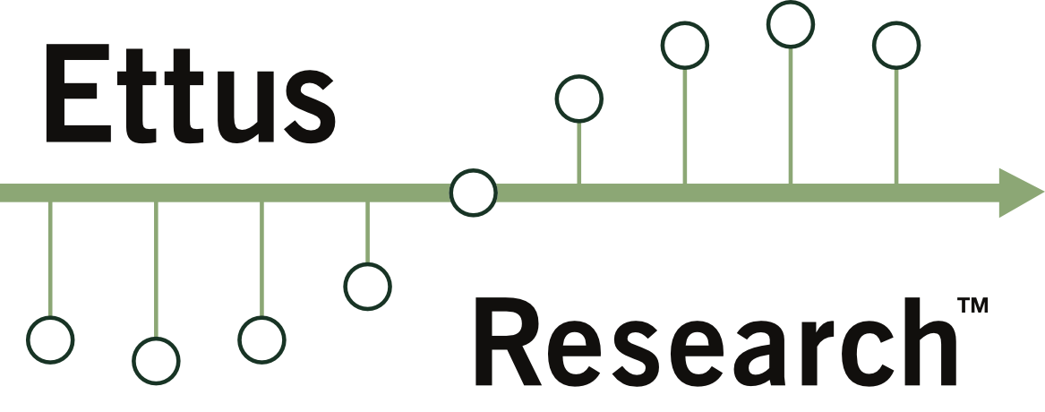
The UW-Pesa Network
UW-Pesa Backend Service
Local Virtual Machine
GSM-900
Custom
Airflow
SUP Connector
Open Source GSM Network (Required Patches)
Commercial Off The Shelf Phones
Software Defined Radio
Notes:
Here is a diagram of our setup. This is all accomplished with a software defined radio and a laptop running the rest of the telco components in a VM.

Slide 14
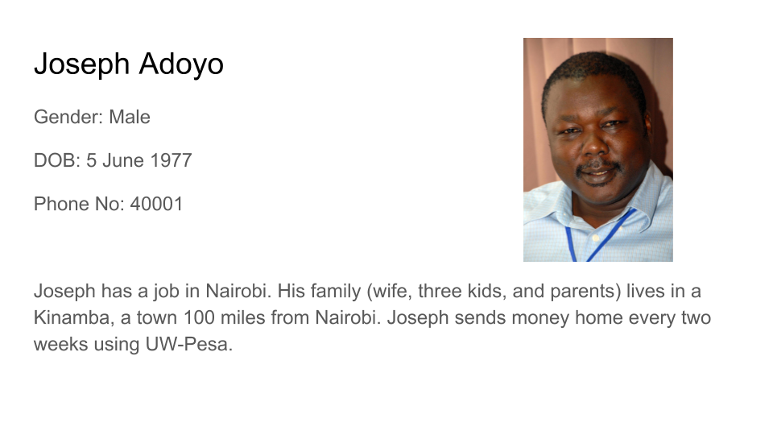
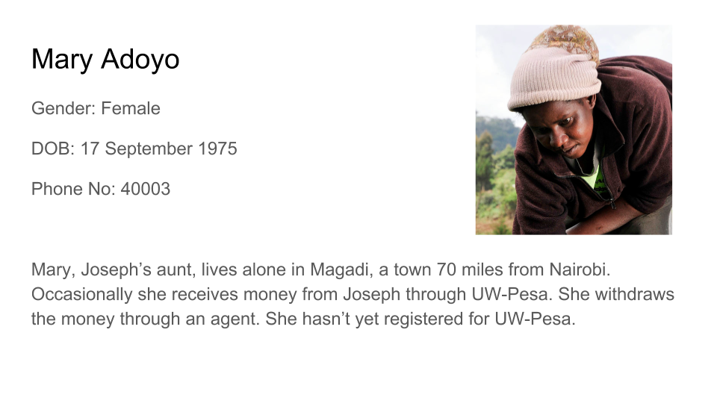
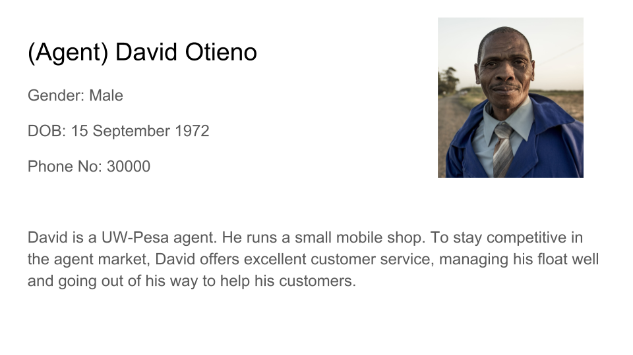
Demo Overview
Notes:
I want to provide some background information for the demo before we start. There are our four characters in Kenya.
Joseph works in Nairobi, and his family lives in Kinamba, a town 200 miles from Nairobi. He sends money to his family, through his son. He also sometimes sends money to his aunt, Mary, who lives in a remote village. And David is the agent in our scenario here.
I am going to go through a few transactions and then give you the opportunity to come up and play the system yourself.

Slide 15
UW-Pesa Team
Faculty
Richard Anderson
Ruth Anderson
Kurtis Heimerl
Postdocs, grad students, staff
Matt Johnson
Clarice Larson
Shrirang Mare
Trevor Perrier
Adam Rea
Jennifer Rose Webster
Undergraduate students
Akshat Aggarwal
Danny Cho
Katherine Van Koevering
Arjun Lalwani
Emily Leland
Stephen Moxley
Rowan Phipps
James Riggleman
Low Yinyin
Sarah Yu
Pradyoth Vemulapati
Notes:
Thanks for listening, and I hope your next programming assignment is fun!

