Slide 1
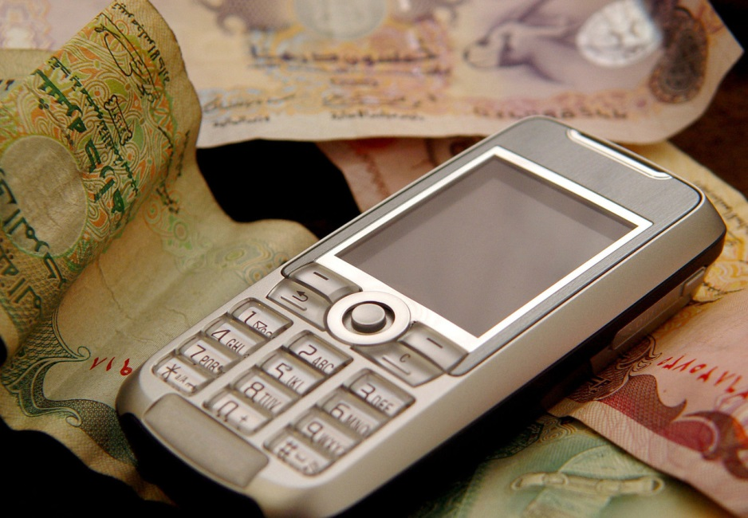
Mobile Money
Lecture 9: CSE 490c

Slide 2
Announcements
Homework due Wednesday
New topic starting Wednesday
Global good software systems
Guest lectures Oct 22, Oct 24, and Oct 26

Slide 3
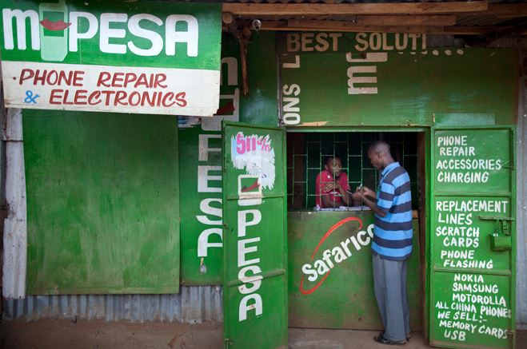
Mobile Money Technology
Financial accounts associated with mobile phone
Over the counter (OTC) agents are available for Cash In, Cash Out

Slide 4
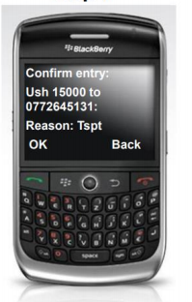
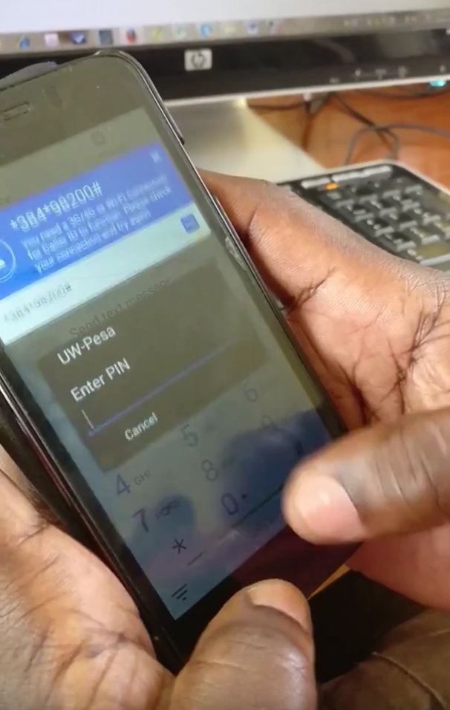
Mobile Money Transactions
Transmit and validate transaction with back end account
Account ID
Transactions details
Amount and receiver
Credentials

Slide 5
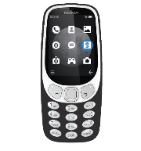
Last Week
SMS
Information in a cleartext message, risk of interception
USSD
Multi round encrypted communication with phone
Sim App
Computations on phone supporting communication
Security of Handset, Cell Tower Connection

Slide 6
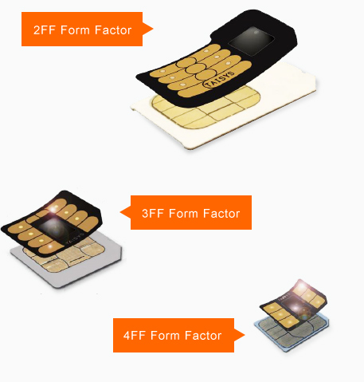
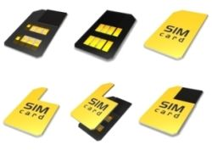
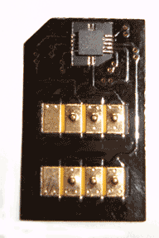
Thin Sims

Slide 7
Thin Sims: What
Field installable
Contains all the functionality of a sim card
Allows third party apps
Free from carrier restrictions
Can read and modify all communication between the phone and the sim card

Slide 8
Communication between Person and SIM

Slide 9
Communication between Person and Thin SIM

Slide 10
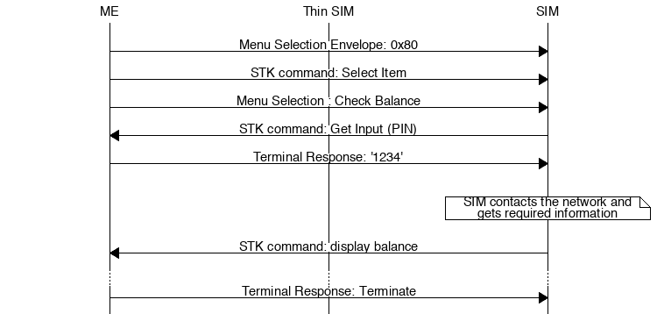
Checking mobile money balance
Notes:
Misleading
(pass vs receive, read, forward)

Slide 11
Thin Sims: WHY
Cell phone unlocking
Distribution of apps
Equity Bank, Mobile Money, Kenya
Community Health Worker application, Medic Mobile
Malicious Installation

Slide 12
Mobile Money and Financial Inclusion
Better access to finance will help people get out of poverty
Reduce the cost of being poor
Create opportunities for financial growth
Increase efficiency of government programs
Protect against financial shocks
Basic financial services
Remittances
Savings
Government payments
Digital payments
Insurance
Bank accounts

Slide 13
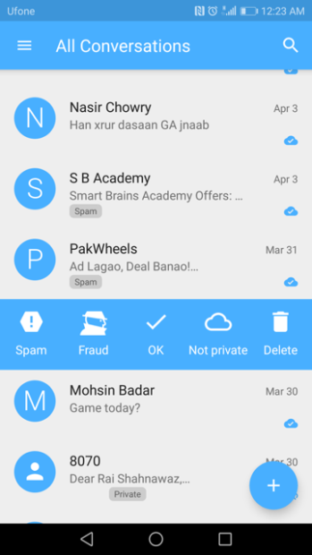
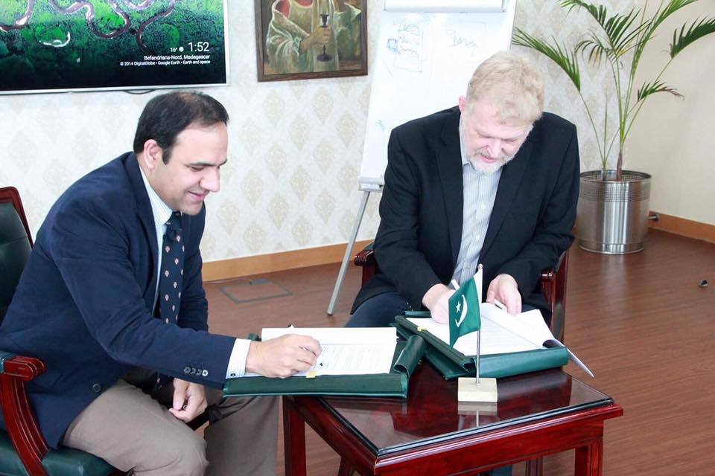
ITU - UW FinTech Center
Waseela-e-haq program ki taraf se apkay Rs.25200 rupay aya hain.apka ye number03314311169BISP mein register tha.ap is number per 03017073199 call karein
Detect SMS Fraud
Study ROSCAs to evaluate potential for digitization
Analyze Telenor mobile phone data to understand handset distribution
Interview of women mobile money agents

Slide 14
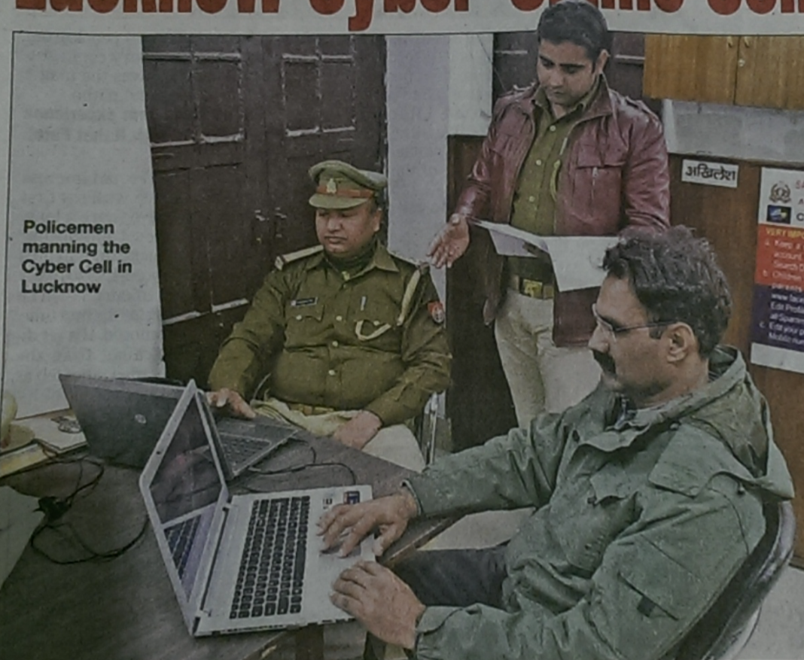
Security
Audits of DFS applications demonstrate many vulnerabilities
Interviews with software developers expose challenges in creating secure applications
Need for security validation tools
Castle, Pervaiz et al. (2016): Let’s Talk Money: Security Challenges of Mobile Money

Slide 15
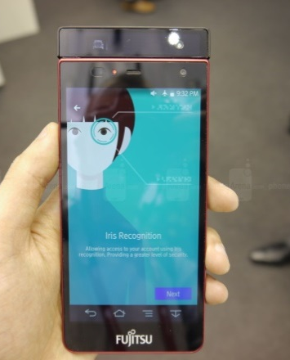
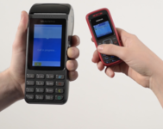
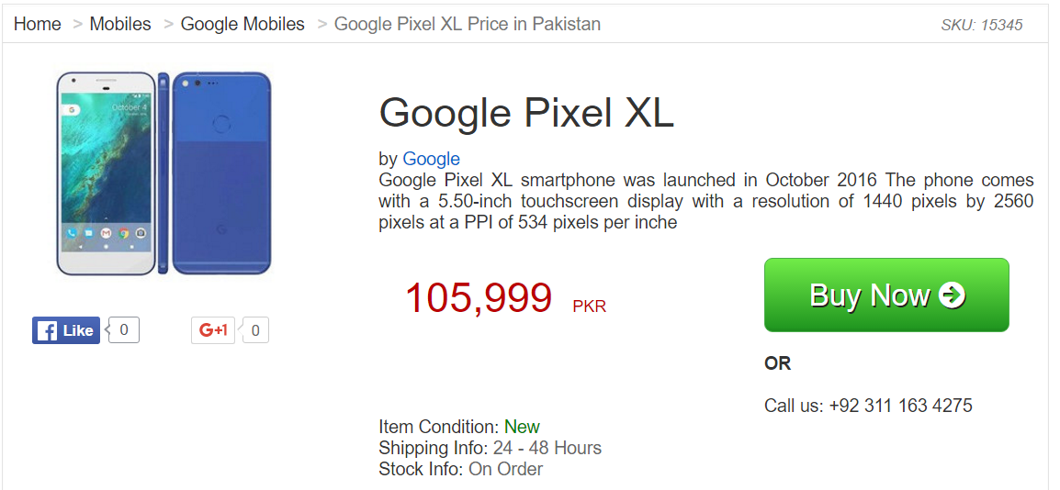
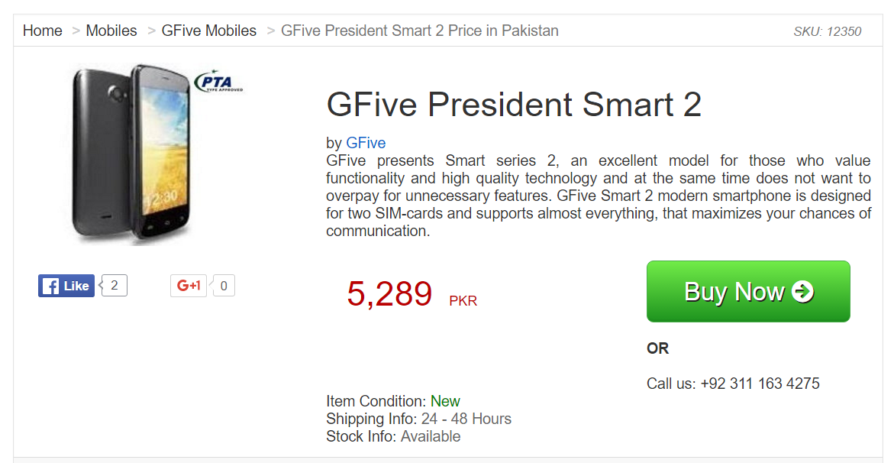
The Android eco-system for DFS
Many uses of Android devices for
Financial applications
Point of sale devices
Biometrics
What are the limitations of low cost Android phones?

Slide 16
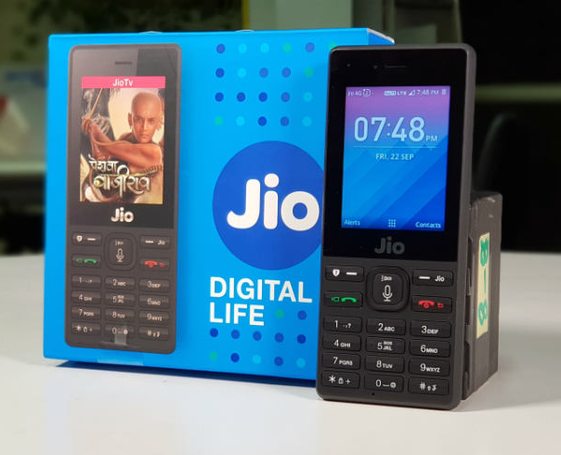
Is there space for a smart feature phone?
Some evidence that feature phones are making a comeback
Distinction between smart phone and feature phone controversial
Introduction of phones such as Jio

Slide 17
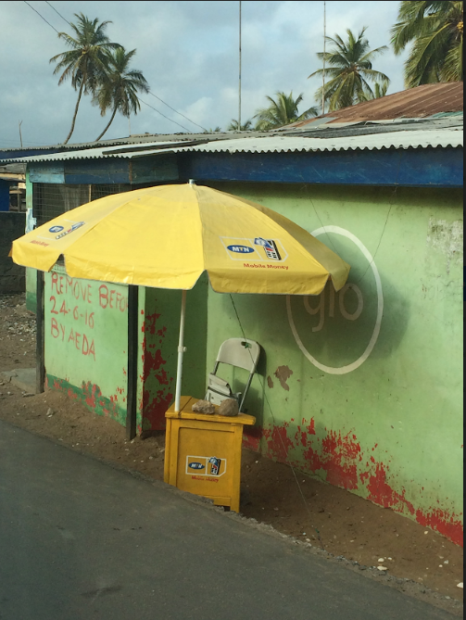
Gender, Financial Inclusion, and Technology and the Family
Interview based studies in Pakistan and other countries
Complex situation relating to family, marriage, technology access, finance management, and national ID
Investigate ‘tipping point’ opportunities for services/financial instruments for women
Theory of readiness: Barriers, technology access and financial transactions

Slide 18
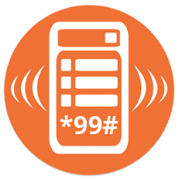
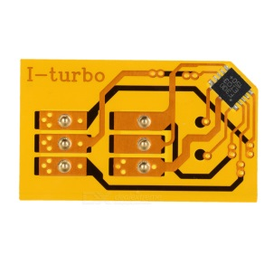
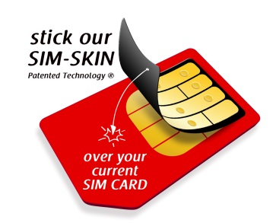
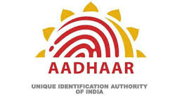
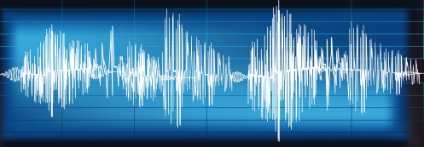
Technology Explorations
USSD
SimApps
ThinSims
Interledger Protocol
Blockchain
Voice biometrics
Fingerprint recognition
India Stack

