Slide 1
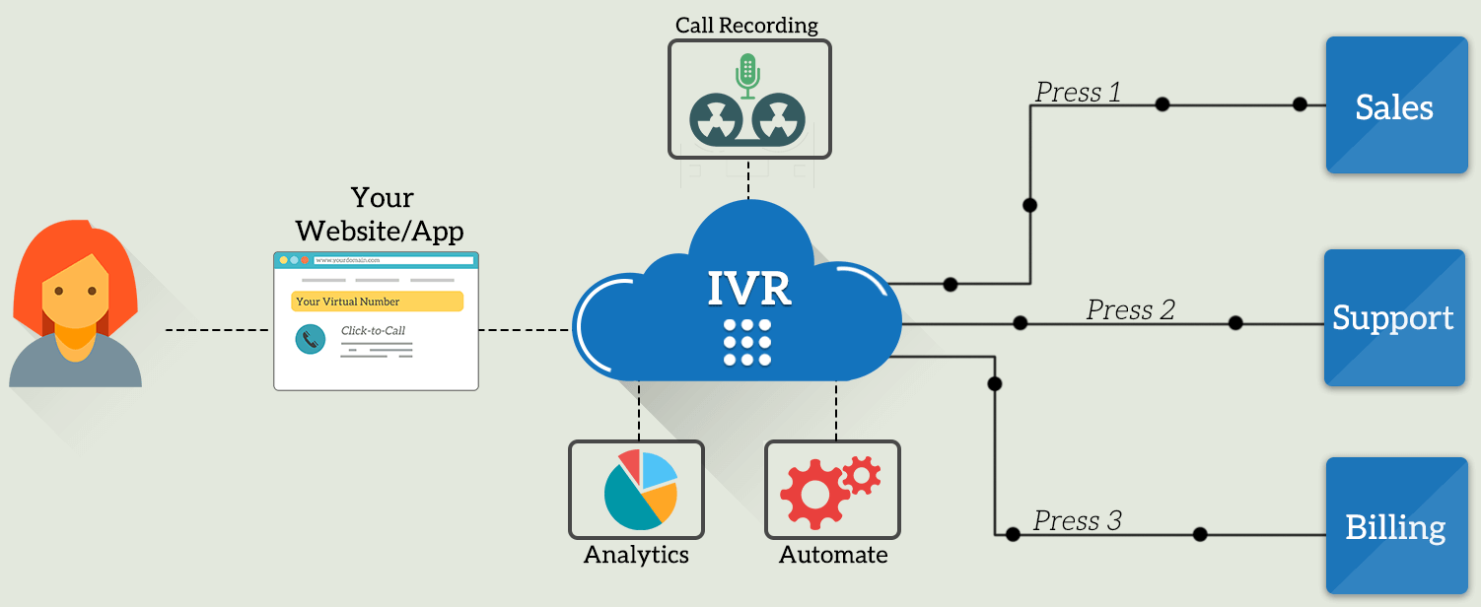
IVR Applications
Lecture 7: CSE 490c

Slide 2
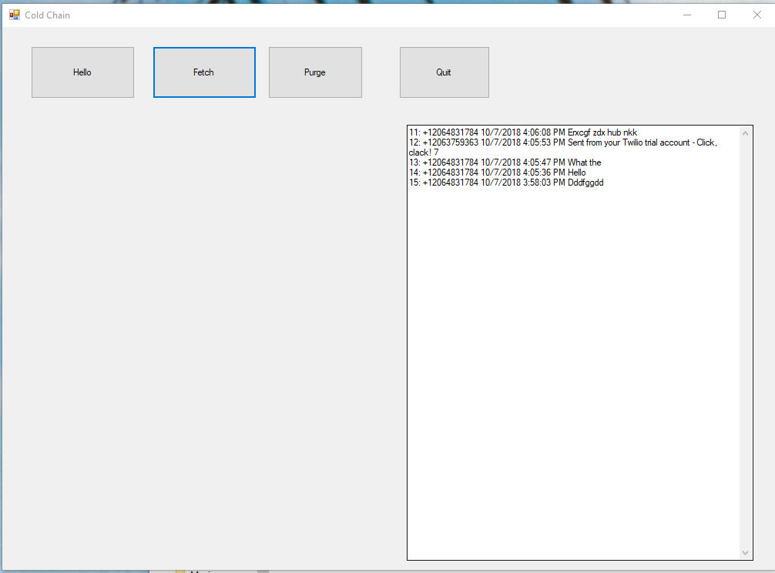
Announcements
Homework 3
One page user manual for SMS Application
Programming Assignment 1
You should have SMS communication working
You should be planning the business logic of the application

Slide 3
Interactive Voice Response (IVR)
Voice versus text
Structure of Voice Applications
Examples

Slide 4
Voice and Text
Advantages of Text
Advantages of Voice

Slide 5
Interactive Voice Response
Applications we hate
Robo calls
Automatic surveys
Customer service help lines

Slide 6
Core Technology
Convert Telephony to software
Asterisk: Open Source Software Implementation of a Private Branch Exchange
Operations
Make calls
Receive calls
Route calls
Record speech
Playback speech
Manipulate speech files
Detect key presses
Automatic Speech Recognition (ASR)

Slide 7
IVR for Social Good
Voice based messaging
Help Lines
Community Information Systems
Redress and reporting
Social Networks

Slide 8
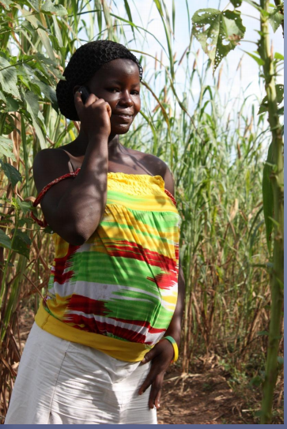
Voice based messaging
Mobile Midwife application
Motech, Ghana, 2010
Strong formative work
SMS and Voice calls
Alerts and reminders
Actionable information
Educational information
Messages in English, Senya, Fante
Topic identification
Expensive to create local language messages
Strong preference for voice messages
Cost issues not resolved

Slide 9
Help lines
HealthLine Pakistan (2008)
Health information by voice
Touch tone
Press 1 for Malaria, Press 2 for Diarrhea, Press 3 for
Speech
What disease do you want to hear about?
“Poor man’s speech recognition”
Phonemes trained on English
Represent Sindhi words with phonemes

Slide 10
Community Information Systems
Awaaz De
Voice Forum
Farmer information recorded by farmers
Farmers call in to leave advice on farming
Other farmers call in to listen to advice
Farmers preferred getting information from other farmers as opposed to agricultural experts
Neil Patel developed Awaaz De as PhD project from Stanford, moved to Gujarat and started a social enterprise

Slide 11
Redress and Reporting
CGNet Swara
Report local problems
Ila Dhageyso
Reporting problems to Government of Somaliland
Government reporting lines
Challenge of processing voice input
Need for taking actions
Governments don’t always want to hear this info

Slide 12
Voice Based Social Networks
Posting voice messages
Jokes, Songs, Poems
Listening to posts of others
Mechanisms for selecting posts, ranking posts
Content moderation is a challenge
User moderation can work
Example systems
Sangeet Swara
Baang
Deployments have had viral growth
Strong uptake by visually impaired

Slide 13
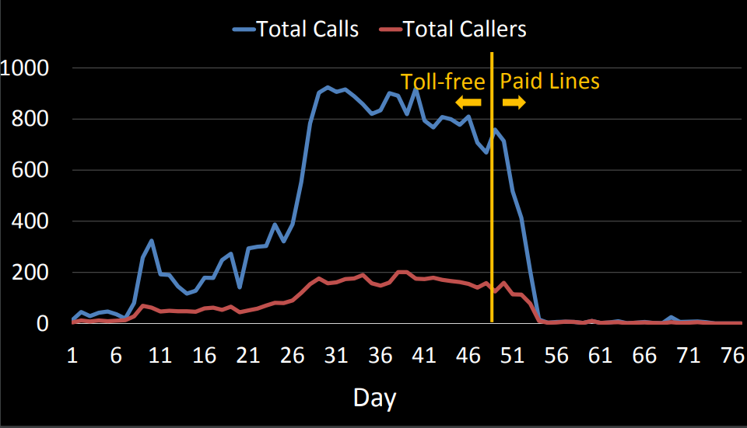
IVR Challenge

Slide 14
Sustainability: Who pays
Cost per connection relatively high
Service is a public good
Government covers the cost
Donors Pay
Subsidies
Service generates income
Advertising models
Linked to income generation
Service supports a business
Job Listings
Service delivers value to operator
Agricultural cooperative
Information reporting

