Slide 1
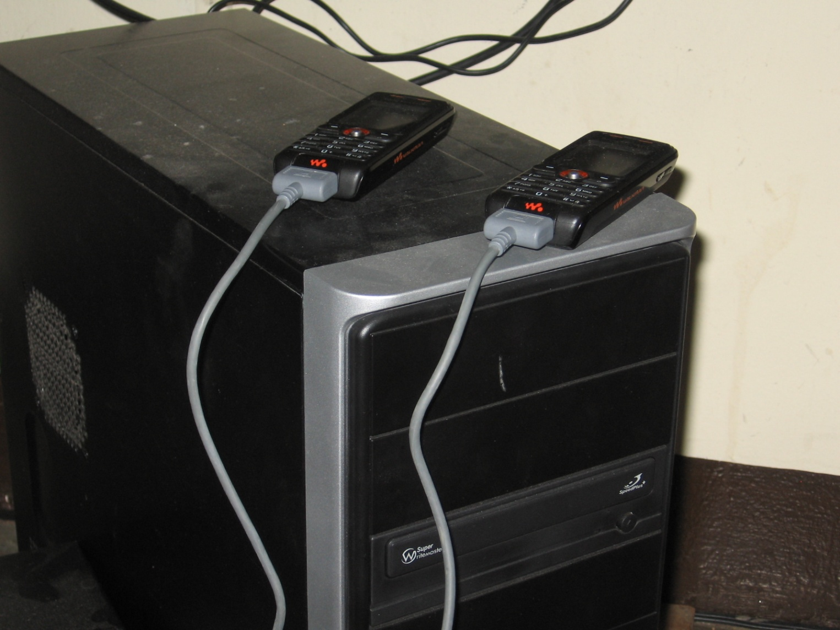
SMS Applications
Lecture 6: CSE 490c

Slide 2
Administrivia
Reading Assignment – CGNet Swara

Slide 3
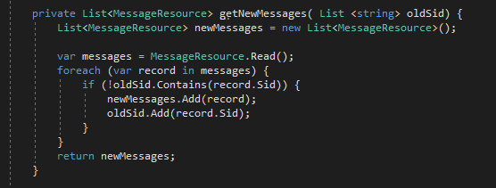
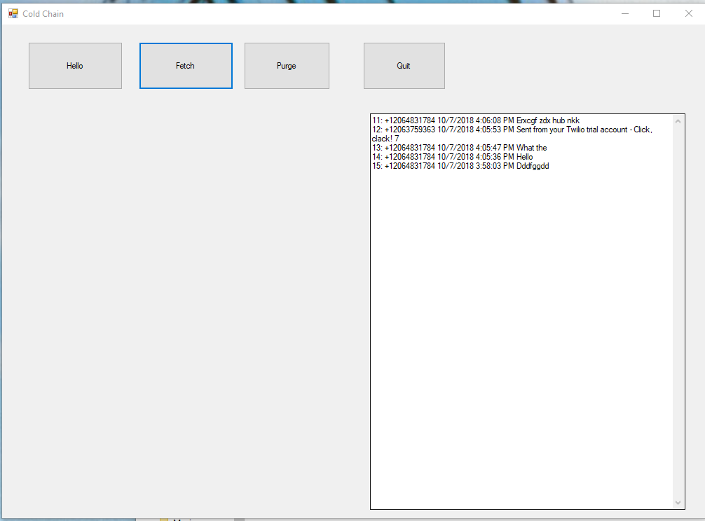
Progress!

Slide 4
SMS Applications
Server capable of sending and receiving SMS messages
Interaction with service through a basic mobile phone
Use cases
SMS Gateway Technology
Practical challenges

Slide 5
SMS Applications
One way push messages
Maternal health messaging
Two way SMS
Adherence reminders
Data Reporting
Monthly report of refrigerators temperature of every vaccine refrigerator in a country
Querying
Market Matching

Slide 6
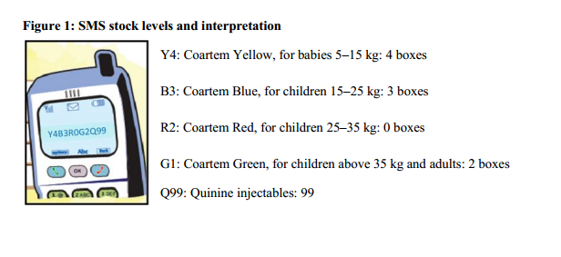
Reporting
Data collection from the field
Regular reporting: Health Indicators from facility reported monthly
Survey: Price of a commodity from different markets
Event reports: Details of Dengue Fever cases
Solution
Send a structured SMS message which is parsed by receiver
Messages can be validated by sender phone number
Example
Malaria stock reporting
SMS for life
Y4B3R0G2Q99

Slide 7
Reporting Apps for Feature Phones
Java Program for data entry
SMS as transport layer

Slide 8
Querying
User sends text and system responds
Market price queries
Send commodity name and market, get current price
One bus away
Send route and location, get bus time
Sports scores
Send team and date, get result
Free form
Send question, get answer
Wikipedia
Send keyword start of entry
News
Send keyword, get headline associated with keyword

Slide 9
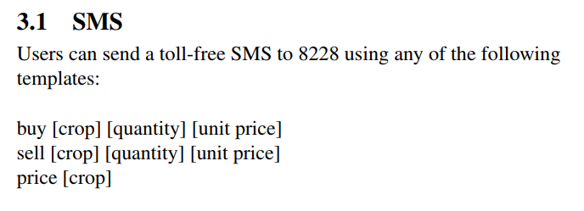
Market matching
Similar to query, but match buyers and sellers
System receives buy and sell messages – many different versions
Kudu:

Slide 10
SMS Gateways
Send and receive SMS messages
Processing of the SMS messages
Managing relationships with TelCo

Slide 11
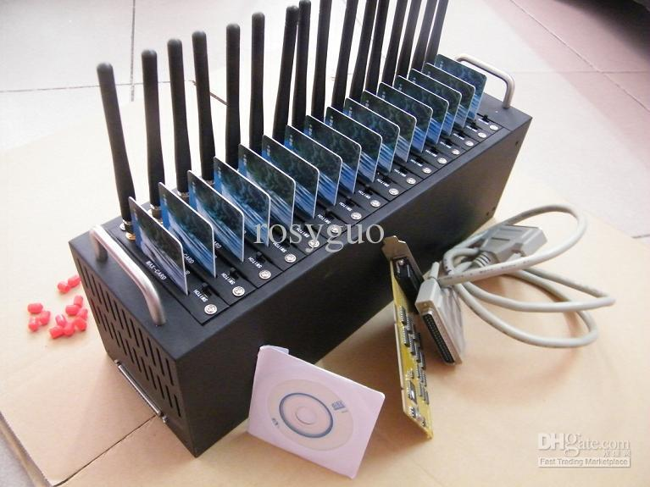
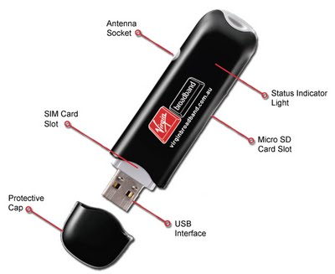
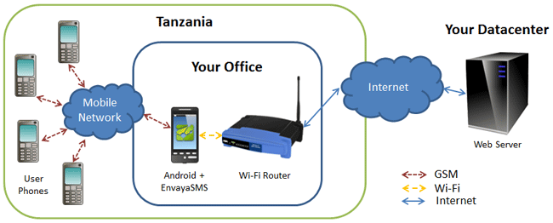
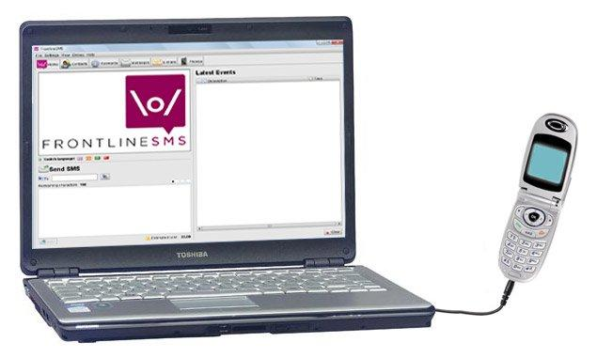
DIY Gateways

Slide 12
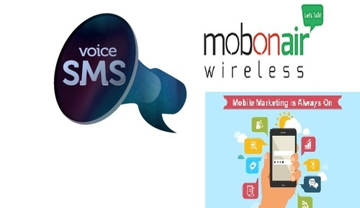
Gateway Services
Companies managing applications for SMS
Sending / Receiving SMS
Managing Telco Relations
Business models
Reselling services
Managing applications and services

Slide 13
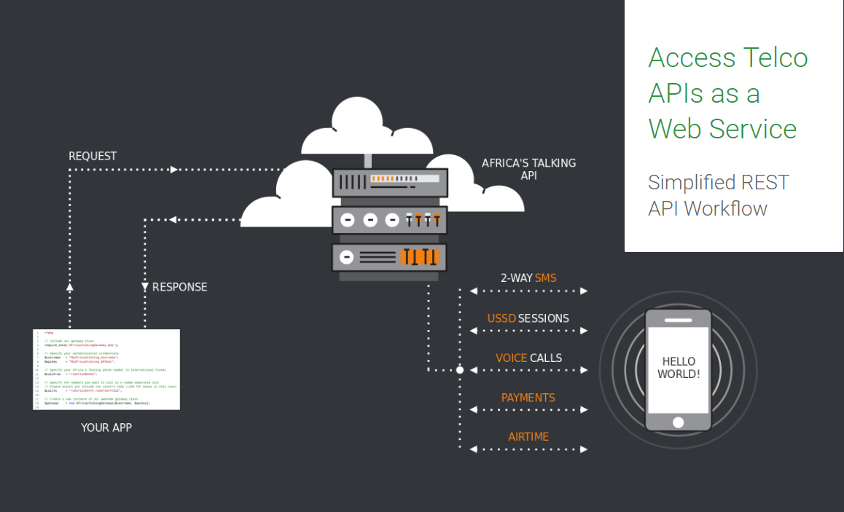

Slide 14
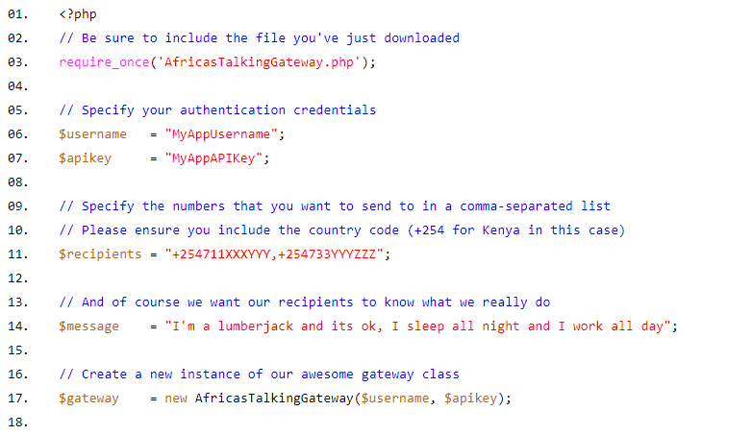
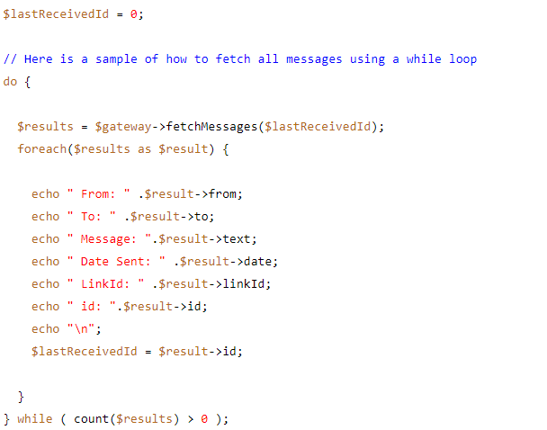
Africa’s Talking API

Slide 15
Gateways vs DIY
DIY for small projects, no-budget projects
Multi country or production projects probably need a Gateway service
Need to factor in cost savings in not having to manage the tech
Telco issues such as managing short codes are problematic
Cost challenges for medium size projects

Slide 16
Thoughts on SMS
Strengths
Universal
Simple messaging can be valuable in an application
Local implementations are possible
Negative
Literacy, Input mechanisms, and Special Formats are a challenge
Carrier issues
Cost

Slide 17
Future of SMS
SMS is being replaced by other messaging platforms
Messaging applications should probably consider multiple technologies
Communication applications platforms
Twilio, Africa’s talking, Telerivit
Later discussion
Chatbots (Messaging + AI)

Slide 18
Interactive Voice Response (IVR)
Voice versus text
Structure of Voice Applications
Examples

