Slide 1
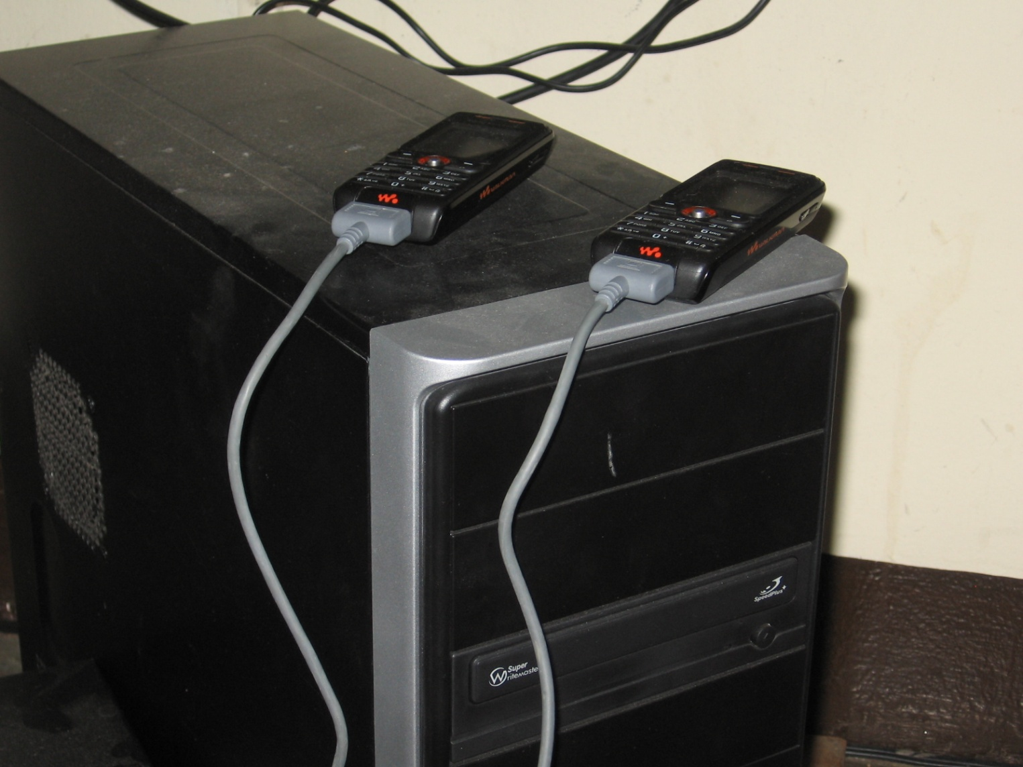
SMS Applications
Lecture 5: CSE 490c

Slide 2
Administrivia
Programming Assignment 1 Posted
Reading Assignment – Ken Banks, FrontlineSMS
Reading Assignment – CGNet Swara

Slide 3
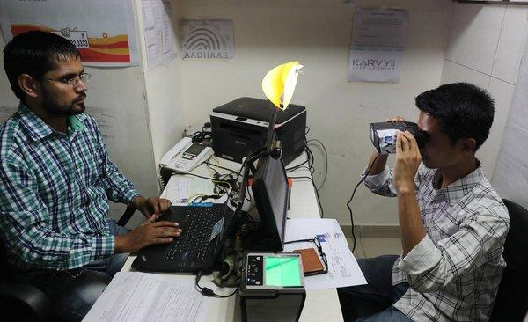
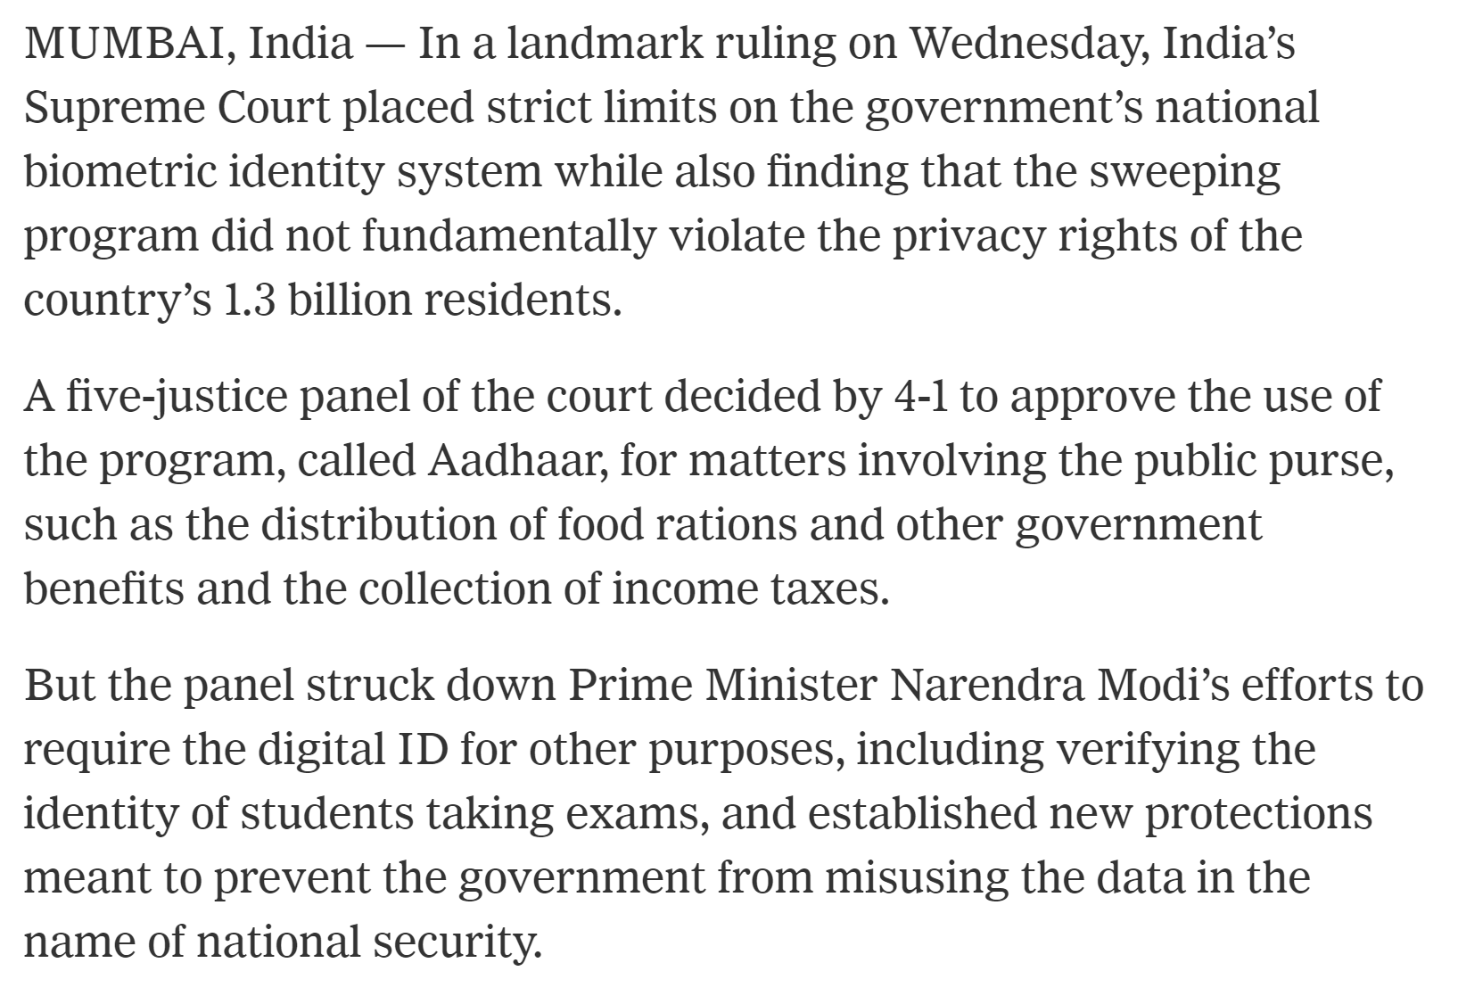
Current Events

Slide 4
SMS Applications
Server capable of sending and receiving SMS messages
Interaction with service through a basic mobile phone
Use cases
SMS Gateway Technology
Practical challenges

Slide 5
Messaging Applications
One way push messages
Sign up for service, receive messages based on customer information
Announcements
Special offers
Adherence reminders
Appointment information
Behavior change messaging
Pregnancy messaging

Slide 6
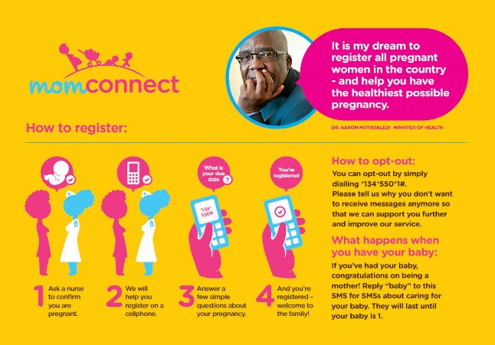
Mom Connect
Text Messages to new and expectant mothers
Managed by South Africa Department of Health
Previously supported by Johnson and Johnson with USAID support
95% of health clinics participate, reaches 2M women
South Africa has a high HIV burden
Prevent transmission to child
Mom Connect has enabled other services
Registration, Text help line, Aggregation and reporting
Multiple Technology Partners

Slide 7
Messaging With Acknowledgement
Add a user response to a basic push message
Adherence reminders
“Have you taken your pill”
“What is the code number in the blister pack”
Special offers
Allow acceptance
Appointment reminders
Confirmation or cancelation

Slide 8
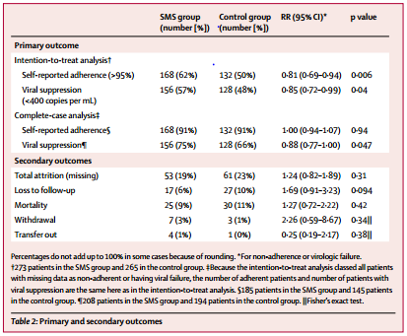
Two Way SMS
Messaging that requests a response
WelTel study – does SMS messaging improve ART adherence for HIV positive patients
Randomized Control Trial (RCT)
Treatment Arm – Receive SMS message once per week
Control Arm – No SMS
Measurement – CD4 count of viral load
Result
Treatment Arm: 156 of 273 suppressed viral load
Control Arm: 128 of 265 suppressed viral load
Statistically significant

Slide 9
WelTel Intervention
Patient receives “Mambo?” text message
“Sawa” (OK)
“Shida” (problem)
No response (after 48 hours)
Clinician calls patient and triages:
Provides counselling
Provides support
Refers to hospital

Slide 10
MWach
Maternal health messaging with requests for response
Managed by nurses who send regular health messages
UW Dept of Global Health Project
Health study – comparing results of multiple study conditions
Several clinics in Kenya
Different versions have targeted different populations
Implementation by UW Graduate student
Multiple iterations of the technology

Slide 11
MWach Platform
Send weekly SMS with questions
Message queue based on events (due date)
Hybrid Human-SMS system
Python-based Django web application
Back end: Africa’s Talking
Threaded chat representation
Substantial feature growth
Message forwarding
Prioritization of messages to respond to

Slide 12
MWach Deployment
Technology Development
Field Use
User Behavior
Health Impact
High use over multiple projects
Messaging Behavior
People usually respond quickly, if at all
Nurses only respond on weekdays (best to send messages early in the week)
Off topic responses most interesting
Highest engagement in messaging around birth
Complex, sometimes multilingual responses
My nxt visit will be on 29th may.na nina sweat sana siku hizi xana xana usiku.can u elaborate on this pliz

Slide 13
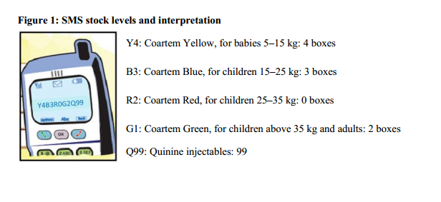
Reporting
Data collection from the field
Regular reporting: Health Indicators from facility reported monthly
Survey: Price of a commodity from different markets
Event reports: Details of Dengue Fever cases
Solution
Send a structured SMS message which is parsed by receiver
Messages can be validated by sender phone number
Example
Malaria stock reporting
SMS for life
Y4B3R0G2Q99

Slide 14
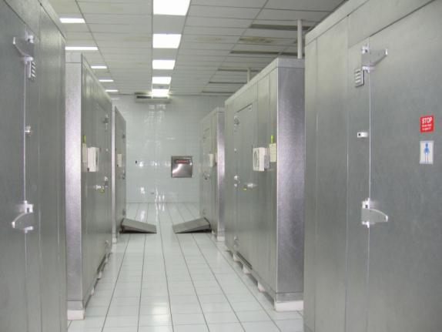
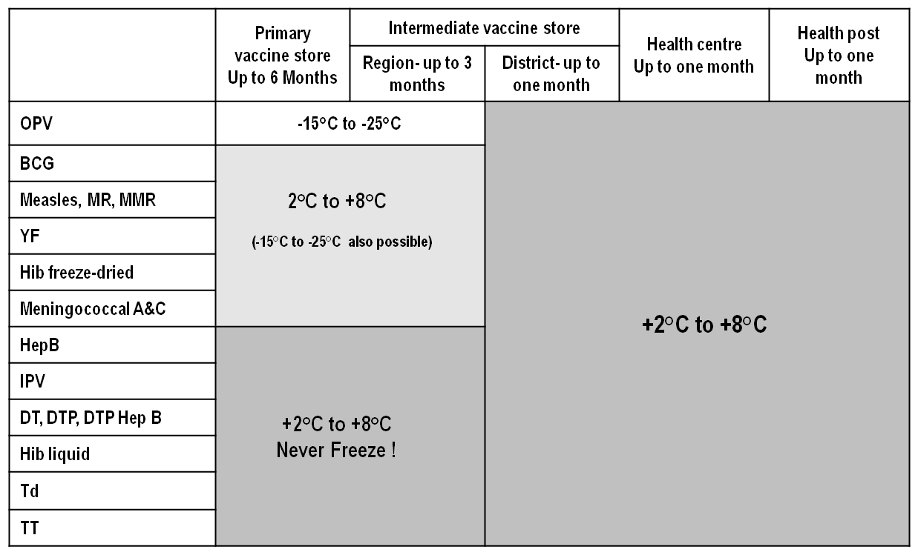
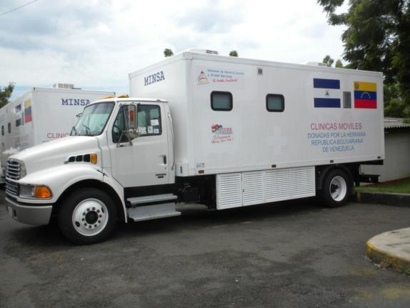
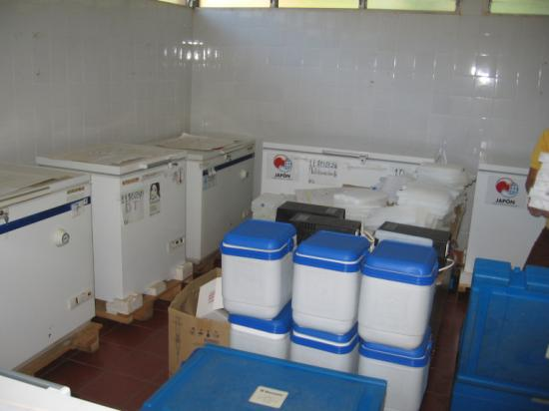
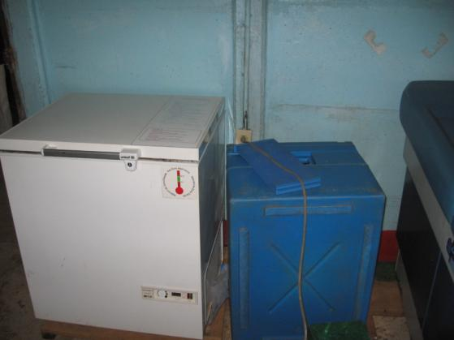
Vaccine Cold Chain
Vaccine Manufacturers
National Vaccine Store
Regional Store
Regional Store
District Store
District Store
District Store
District Store
Health Center
Health Post
Health Post
Health Post

Slide 15
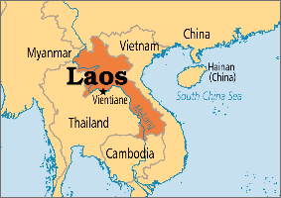
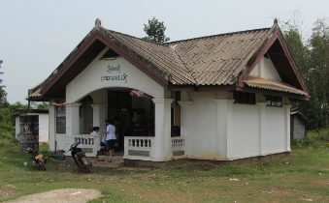
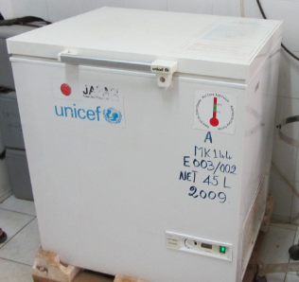
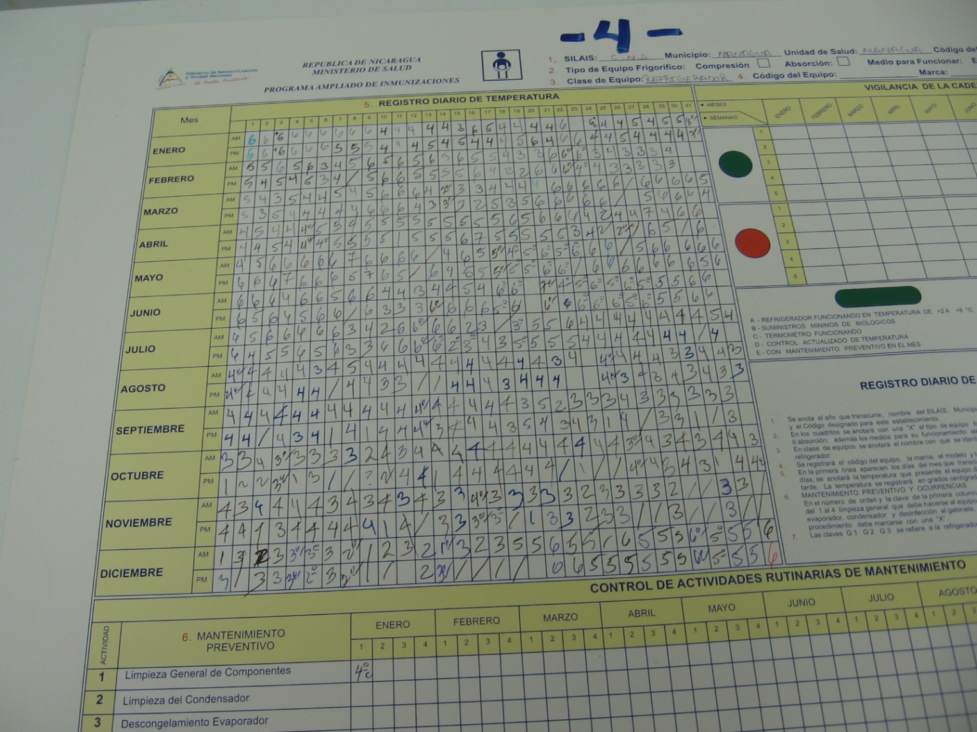
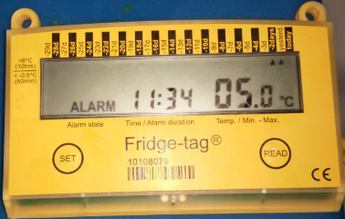
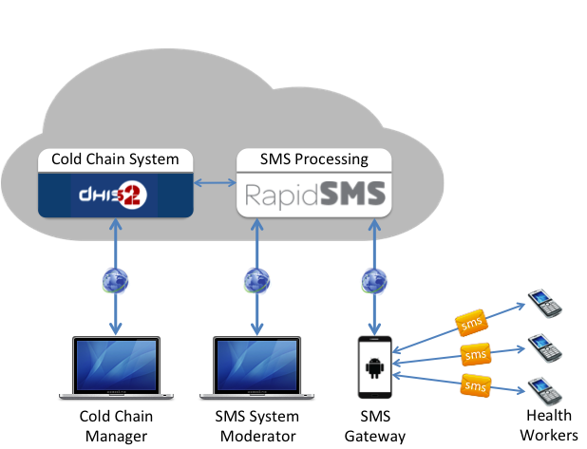
Monthly Temperature Reporting
Problem
Report when refrigerator is too hot or too cold
Laos Solution
Monthly SMS report of number of times refrigerators had high alarms or low alarms (from FridgeTag)
Consultant designed SMS codes
Refrigerators labeled A, B, C etc.
High Alarms followed by low alarms: A10B00C35
If more than 5 alarms, just report 5
Allow reporting 00 with 0, if one refrigerator, A not needed, optional FT
Add stock level SL, followed by letter codes for vaccines and doses on hand
Developed a system with an Android phone running an SMS Gateway

Slide 16
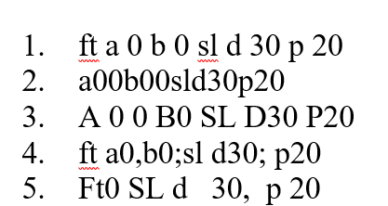
Field lessons
A very flexible input form was designed, including backward compatibility as it evolved
All health worker phones supported Thai, not Lao
All health workers could read Lao written in Thai
65% of health workers could read Lao in Latin script
22% of health workers could read English script
The government prohibited use of Thai
Some confusion in SMS between ‘0’ and ‘O’ and ‘$’ and ‘S’
Complications in tracking phones used by health workers, as people changed phones for various reasons
Phone availability and SMS cost were not issues

Slide 17
Querying
User sends text and system responds
Market price queries
Send commodity name and market, get current price
One bus away
Send route and location, get bus time
Sports scores
Send team and date, get result
Free form
Send question, get answer
Wikipedia
Send keword start of entry
News
Send keyword, get headline associated with keyword

Slide 18
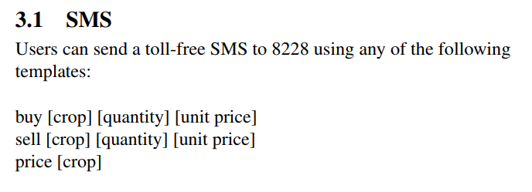
Market matching
Similar to query, but match buyers and sellers
System receives buy and sell messages – many different versions
Kudu:

Slide 19
Programming Assignment 1 Temperature Reporting If I did my own assignments
Design Input Language HCx, SLx, FTx
Include health center number to make it easier to test
Database (or table) of reports, 10 HCs, 12 Months
Create server side form
Implement HC message
Implement Ack and Nag
Implement Next Month
Implement FT and SL parsing and logic
Next Month
Nag Deadbeats
Table of Parsed Values
Messages Received

