Slide 1
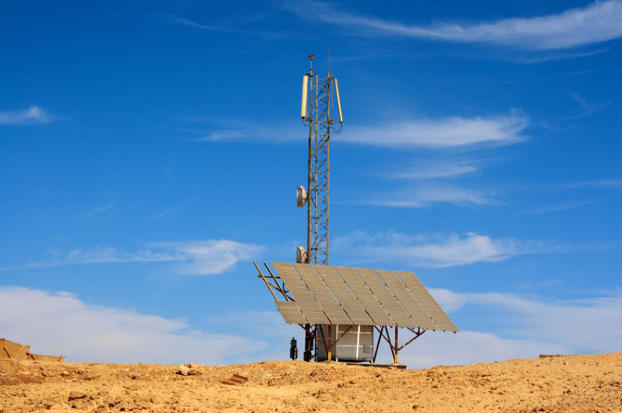
Communications Infrastructure
CSE 490c

Slide 2
Administrivia
Section 490 CB will meet in MGH 058
Homework 2 Available
Programming Assignment 1 Available
Reading Assignment – Ken Banks, FrontlineSMS

Slide 3
Things to cover
How it works – basics of cellular communication
Call data records
Cellular coverage
Telcos – structure of telecommunication companies
Cost models for telcos – how they make money
Cell phone payment – how people cover costs

Slide 4
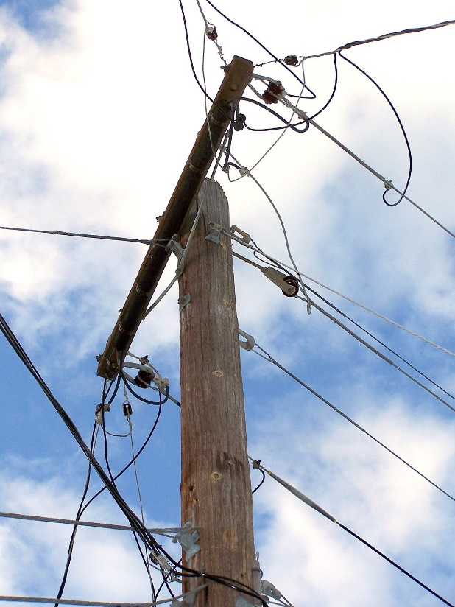
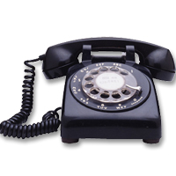
Phone Service
Copper wire to house
Phone connected to wire
Physical exchange to connect calls
Monopoly
Development of standards to allow international calls
Technical
Billing

Slide 5
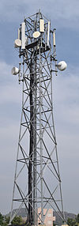
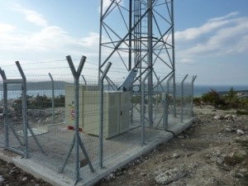
Cellular Service
Cell Tower
Radio transceiver
Power source
Range: Up to 40 miles, limited by
Terrain
Technology
Capacity
Aside
OpenBTS

Slide 6
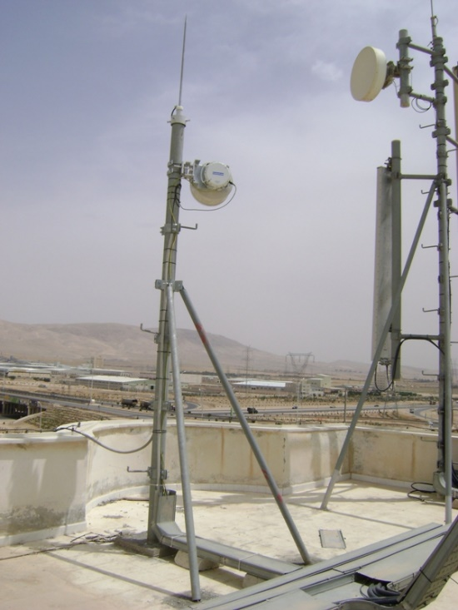
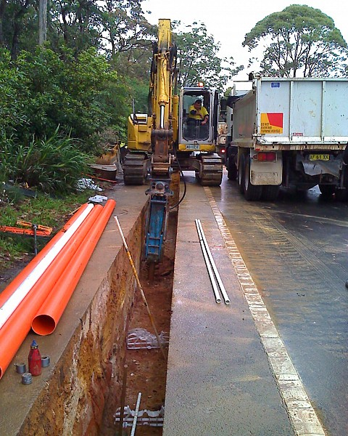
Cellular Technology
Backhaul
Connecting base station to main network
Wired backhaul
Optical Fibre or Copper
Wireless
Microwave radio relay
High capacity radio

Slide 7
Cellular Connections
Cell towers must connect to all phones in radius
Protocol for identifying phones
Needs to know to initiate action to a phone or from a phone
Cell tower handoff
Mobile communication
Connectivity info
Cell tower logs
TAC – type allocation code
Records all (turned on) phones
Not just making calls or on the network
Call Data Records
Data for individual calls
Phone numbers, time, duration, cell tower ids

Slide 8
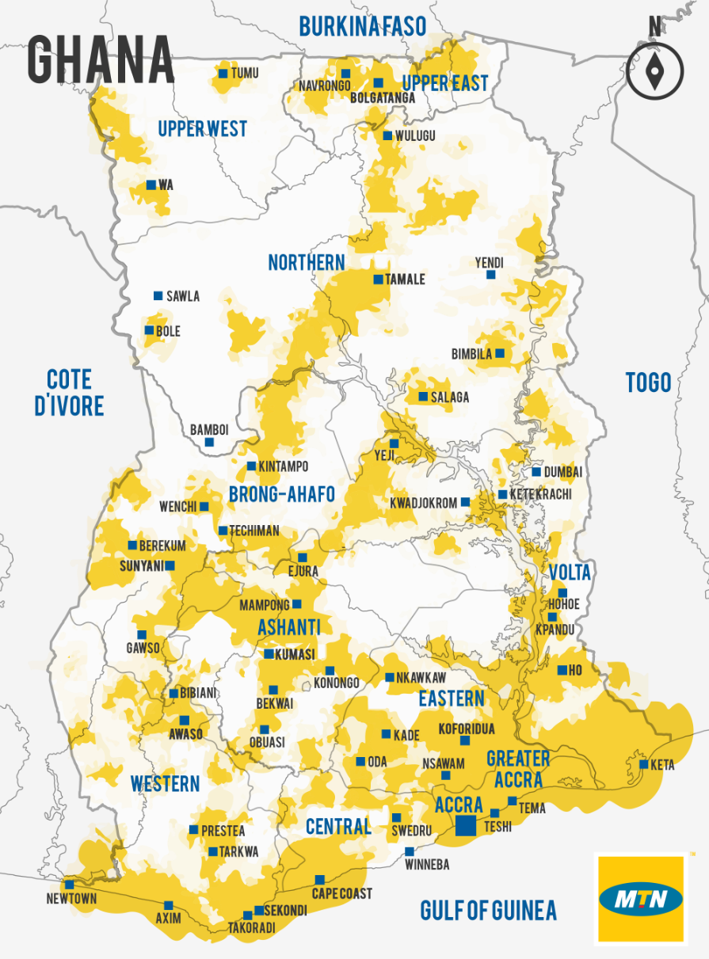
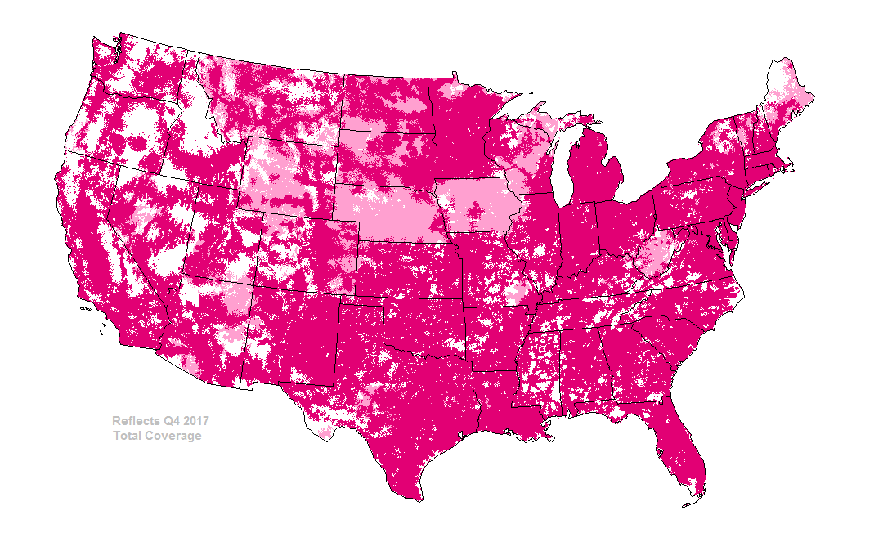
Global Cellular Coverage

Slide 9
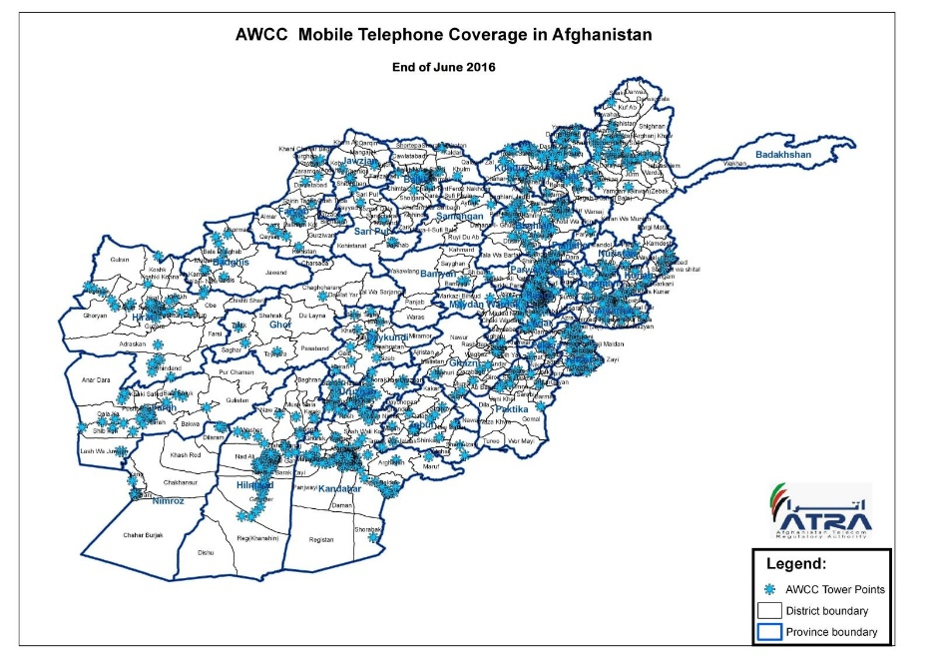
Global Cellular Coverage
Finding good cellular coverage maps is a challenge
Areas with high population will be covered
Low coverage in remote/mountainous areas
Coverage between carriers is highly variable
Often there are carriers focusing urban areas, and carriers with a rural focus
Crowdsourced cellular data not that useful – need telco data

Slide 10
Telcos
Big, global companies
Most countries seem to have about three to five competing mobile operators
Possibly with some government ownership
A few countries have government monopolies
List of top 15 mobile telecommunications company
Companies either focus on one large market or serve many countries
USA barely appears on this list
T-Mobile (Deutsche Telekom)
TracFone (America Movil)
US Based Telcos do not have a global presence
Largest companies (by subscriptions)
China Mobile
Vodaphone Idea (India)
Airtel (India) [20 countries]
Vodaphone (UK) [26 countries]
China Unacom
China Telecom
America Movil (Mex) [22 countries] Claro
Telefonica (Sp) [20 countries] Movistar
Veon (Neth)[14 countries]
Reliance Jio (India)
MTN (SA) [20 countries]
Orange (France) [25 countries]
Telkomsel (Indonesia)
Telenor (Norway) [12 countries]
Deutsche Telekom (Ger) [16 countries] T-Mobile

Slide 11
Charging for Calls and SMS
Telcos want to maximize ARPU
High capital costs
Low cost per call
Charging for service
Call cost
SMS cost
Wide range of costs in different markets
Costs may be very high relative to income
Charging for calls across networks
In-network vs. out of network
Charge incoming and out going
Bundling of handset and services

Slide 12
Paying for calls and SMS Prepaid vs Postpaid
Utilities are often of poor quality in developing countries
Cell phones are different with pre-paid models
Buy credit from vender
Buy scratch card from vendor
Behavior when calls are very expensive (relative to income)

