Slide 1
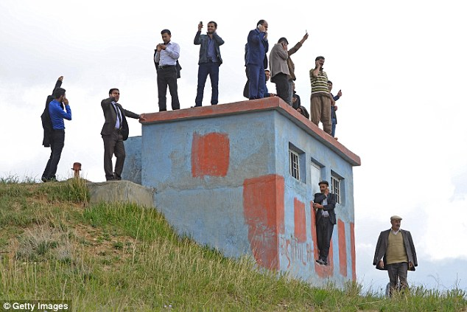
Communications Infrastructure
CSE 490c

Slide 2
Administrivia
Office Hours
Richard Anderson, Wed, 2:30-3:20, CSE 582
Samia Ibtasam, Tues, 4:00-4:50, CSE 007
Naveena Karusala, Mon, 4:00-4:50, CSE 220
Homework #1, Due Wednesday.
Programming Assignment #1, Available Wednesday. To get started, create Twilio account and build Hello World Application
Possibly we will have a lab session for this

Slide 3
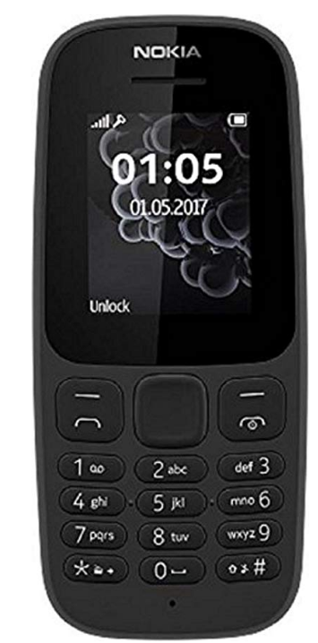
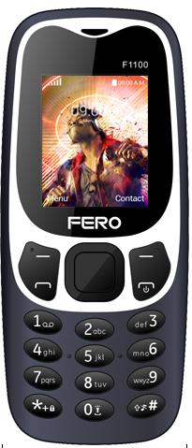
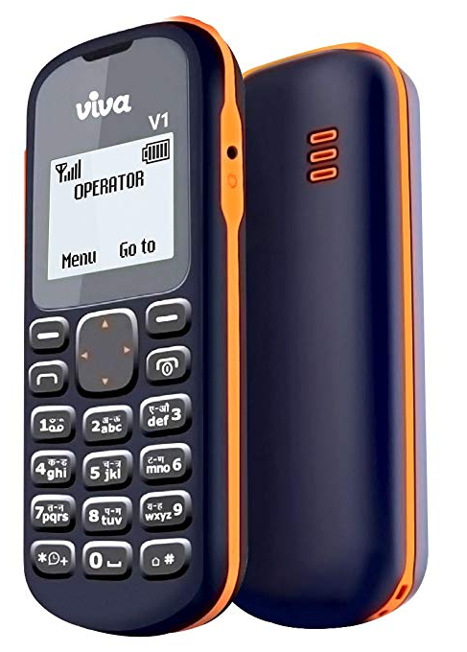
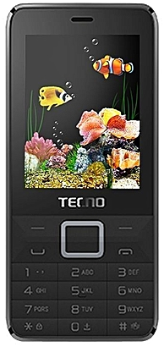
Basic Mobile Phones
Nokia 105
Quad band, GSM, Dual Sim
999 rs
Fero F1100
1.2 MP Camera
900/1800Mhz
GPRS
BlueTooth
1050 Ksh
Viva V1
Single Sim, 2G
Flashlight, Snake
432 rs
Tecno T350
GSM 900 Mhz
Camera, Radio, Facebook, Palmchat
5100 Ngn

Slide 4
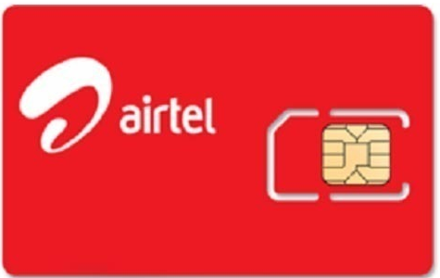
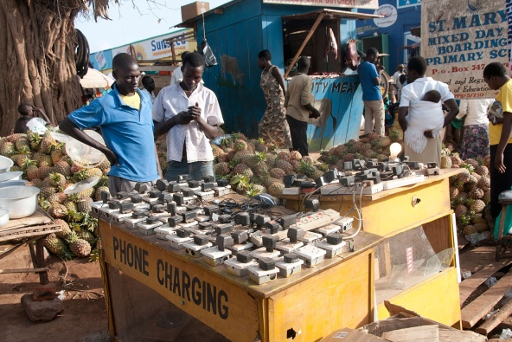
Handset Constraints
Connectivity
Simcard Ownership
Simcard Registration
Airtime Balance
Electrical charging
Handset Cost

Slide 5
Basic Mobile Phones (GSM Standard)
Voice
DTMF
Dual Tone Multi-Frequency
SMS
Short Message Service
USSD
Unstructured Supplementary Service Data

Slide 6
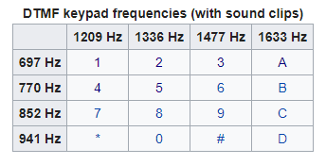
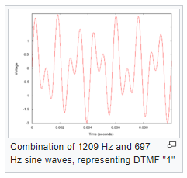
Voice + DTMF
Analog signal for sound waves
Converted by handset to digital data for transmission
Multiple codecs can be used for conversion
Voice Fundamental Frequency:
Male (85 to 180 Hz), Female (165 to 255 Hz)
Speaking frequency 20Hz to 20000 Hz
Audible through 20000 Hz
Telephony: Frequency band 300Hz to 3400 Hz.
Sampling at 8000 Hz

Slide 7
SMS (Short Messaging Service)
Defined in 1985 as part of the GSM Standard
Protocol allows seeing of up to 160 character alpha-numeric messages
The hard thing in designing SMS was getting an agreed upon standard
Deutsche Telekom + France Telecom
The first SMS was sent over Vodafone GSM Network on December 3, 1992 in the UK
Initial growth was very slow, significant growth around 2000
Designed for Engineers
Took off when European Teenagers started using it
SMS Gateway services are very important for building SMS applications – more later
Hack: You can send SMS from email – 206375xxxx@tmomail.net

Slide 8
Trivia
What was the content of the first voice call? (Alexander Graham Bell to Thomas Watson, March 10, 1876)
What was the content of the first text message? (Neil Papworth to Richard Jarvis, December 3, 1992)
Why are SMS messages limited to 160 Characters.

Slide 9
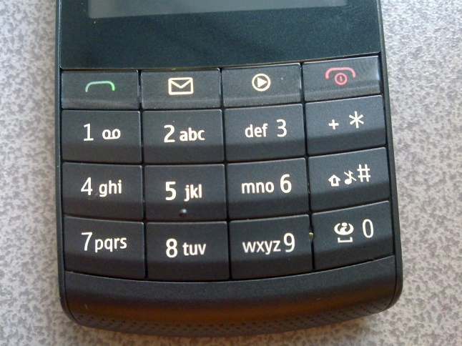
SMS Challenges
Character limitation
Expense
Character Set – restricted to basic Latin characters (7-bit characters)
Unicode extensions require 16 bit – greatly reducing message length
Difficulty of entering letters on a keypad
Reliability

Slide 10
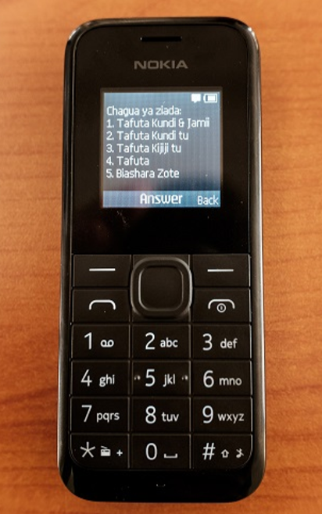
USSD Unstructured Supplementary Service Data
Session based protocol for communicating by text between handset and service provider
Initiated with a short code, e.g., *144# to check Safaricom balance
160 character strings sent back and forth between handset and provider until session is terminated
Key differences from SMS
Synchronized communication
Direct with service provider: better security
Does not leave messages on the phone
Applications
Adding services to cell service
Mobile Money
Yellow Pages Directory

Slide 11
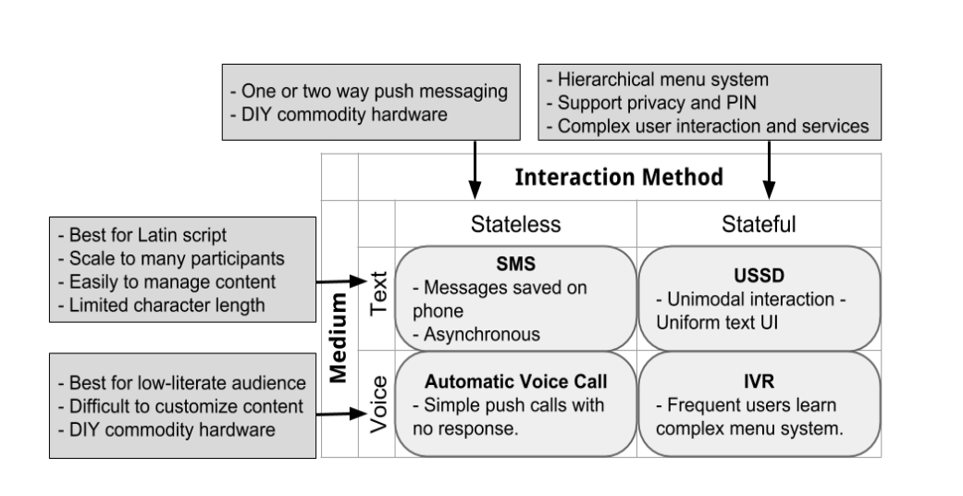
Universal Apps (Trevor Perrier)

