Slide 1
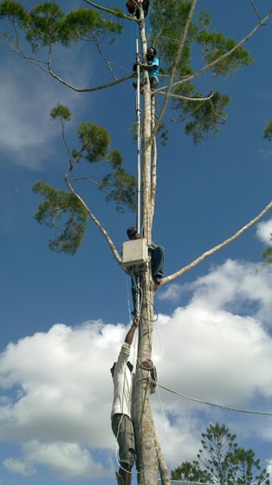
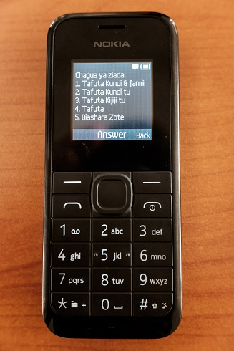
Information and Communication Technology for Development
Autumn 2018
Richard Anderson

Slide 2
Today: Course Overview
What is information and computing for development?
Course organization
Homework 1
Projects
Background

Slide 3
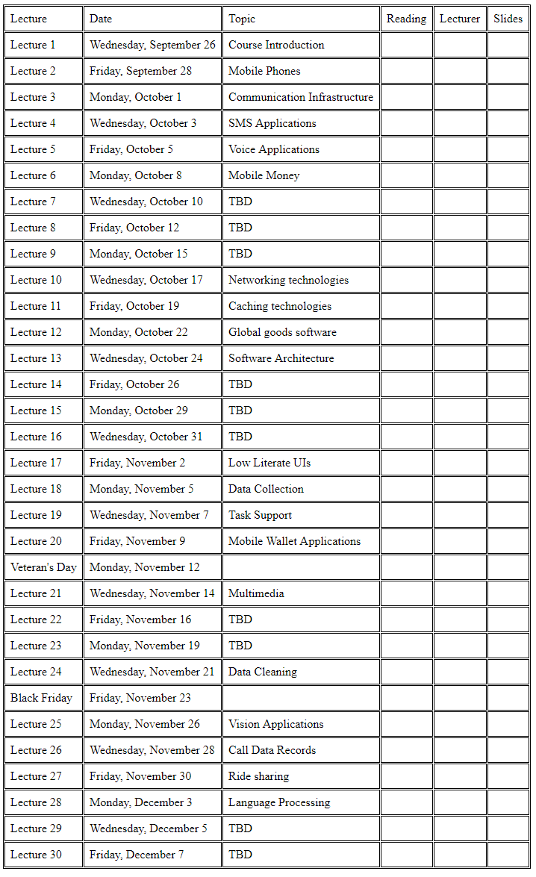
Course organization
Course organized by technology
Other options
By use case
By domain

Slide 4
Course mechanics
Lectures, MWF
Thursday quiz section
TAs: Naveena Karusala and Samia Ibtasam
Short, required readings
Additional optional readings
Weekly assignments
Usually written
Submit online, word or PDF
Four programming assignments
No term project
No final exams
http://courses.cs.washington.edu/courses/cse490c/18au

Slide 5
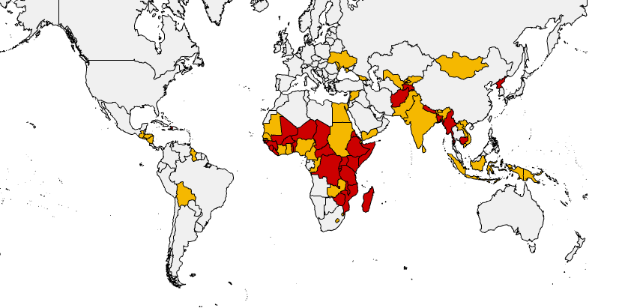
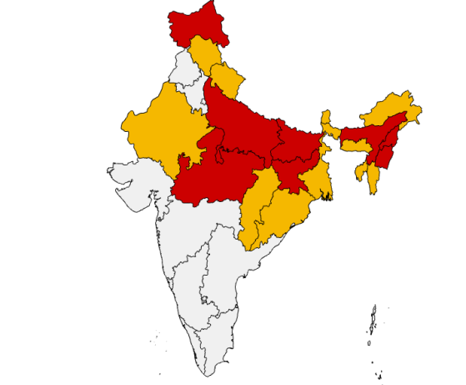
Assignment 1a
Figure out part 1a by quiz section
Assignment posted on website
Pick three countries to become an ‘expert’ on
Assignments will often require specializing questions to countries, so pick countries in advance so you acquire background
Choose LICs (Low income countries) or LMICs (Low-middle income countries) but not UMICs or HICs
If you want to work with India, choose a low income state of India

Slide 6
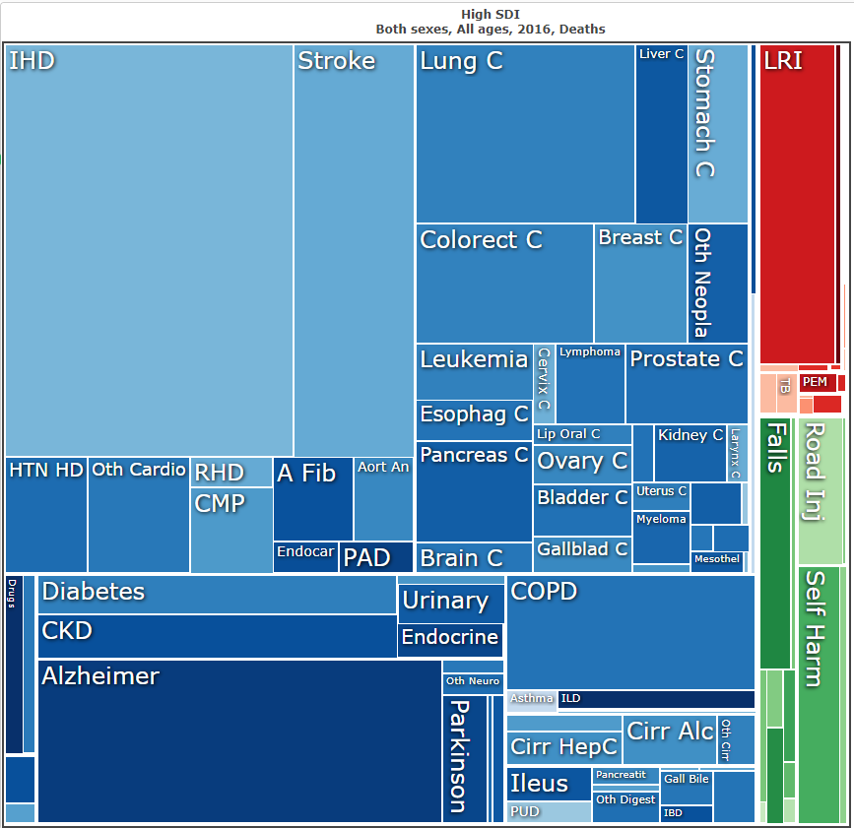
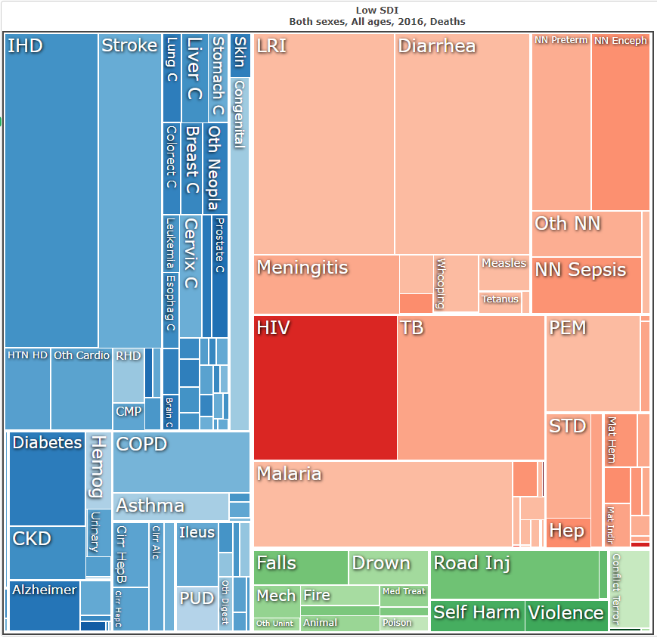
Assignment 1b
Write a summary of the health challenges of your three countries. Compare with a high income country such as the United States. Use IHME’s GBD visualization tool as a data source.
http://www.healthdata.org/results/data-visualizations

Slide 7
Assignment 1c
Conduct an assessment mobile phone usage in your three countries using online resources
Areas of investigation should include
What are the major cell phone companies
How much of the country is covered
What percentage of the population has access to mobile phones
What types of handsets are in use
What is the market share of smart phones
How much is the cost of voice, sms and data

Slide 8
Development Background
Domains of interest
Health, Education, Agriculture, Livelihood, Infrastructure
Infrastructure and Economic constraints
Low connectivity, poor electrical power, limited financial resources, limited literacy, shortage of technological talent
Structure of development
Global development and agendas
Country level
Market driven

Slide 9
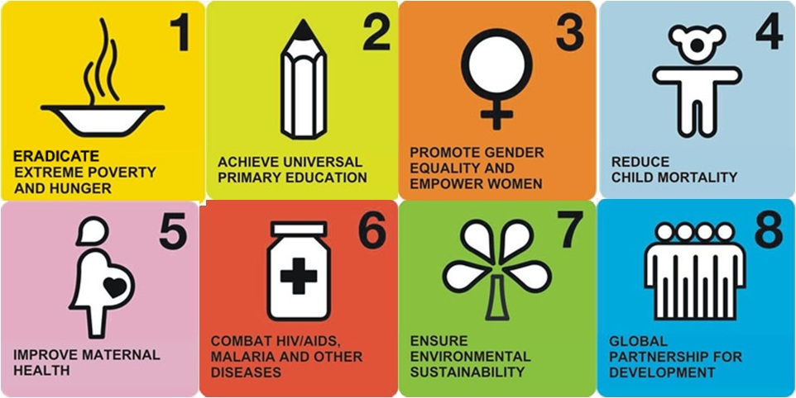
Millennium development goals
International development goals established by United Nations in 2000
Targets results by end of 2015

Slide 10
Millennium development goals
To eradicate extreme poverty and hunger
To achieve universal primary education
To promote gender equality and empower women
To reduce child mortality
To improve maternal health
To combat HIV/AIDS, malaria, and other diseases
To ensure environmental sustainability
To develop a global partnership for development

Slide 11
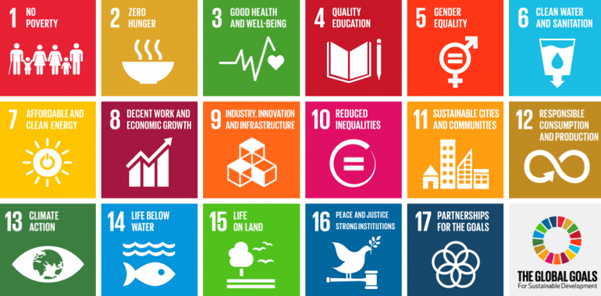
Sustainable Development Goals
New global goals through 2030
17 Goals with 169 Targets

Slide 12
Sustainable Development Goals
End poverty in all its forms everywhere
End hunger, achieve food security and improved nutrition and promote sustainable agriculture
Ensure healthy lives and promote well-being for all at all ages
Ensure inclusive and equitable quality education and promote lifelong learning opportunities for all
Achieve gender equality and empower all women and girls
Ensure availability and sustainable management of water and sanitation for all
Ensure access to affordable, reliable, sustainable and modern energy for all
Promote sustained, inclusive and sustainable economic growth, full and productive employment and decent work for all
Build resilient infrastructure, promote inclusive and sustainable industrialization and foster innovation
Reduce inequality within and among countries
Make cities and human settlements inclusive, safe, resilient and sustainable
Ensure sustainable consumption and production patterns
Take urgent action to combat climate change and its impacts
Conserve and sustainably use the oceans, seas and marine resources for sustainable development
Protect, restore and promote sustainable use of terrestrial ecosystems, sustainably manage forests, combat desertification, and halt and reverse land degradation and halt biodiversity loss
Promote peaceful and inclusive societies for sustainable development, provide access to justice for all and build effective, accountable and inclusive institutions at all levels
Strengthen the means of implementation and revitalize the global partnership for sustainable development

Slide 13
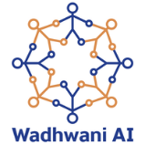
Global Technology and Development Stakeholders
Global Organizations
Donors
Implementing NGOs
Research Establishment
Technology NGOs
Tech Industry
Government
Local NGOs and Civil Society

Slide 14
Unit 1: Mobile Phones and Communication
Mobile phones are the critical computational infrastructure in many settings
Cellular infrastructure
Handsets and networks
Mobile phone applications
Bringing services to people with basic mobile phones

Slide 15
Unit 2: Systems and Software
Computing systems for ICTD
Networking infrastructure and challenges
Global good software
Core applications
Architecture
Open Source

Slide 16
Unit 3: Mobile Computing and HCI
Low cost smart phones are becoming widespread
Mobile Applications
User interface design
Data collection
Task support
Digital Financial Services

Slide 17
Unit 4: AI and Big Data
Managing Data and Data Cleaning
Applications of Computer Vision
Satellite image interpretation
What can be done with cell phone data?
Other applications
Ride sharing
Natural Language Processing

Slide 18
Programming Assignments
Build a two way SMS Application using Twilio
Develop an Immunization Registry (or an another “Global Good”)
Create a low-literate user interface for a mobile money system
Data Science: Most likely an assignment based on satellite image interpretation or call data records

