Slide 1
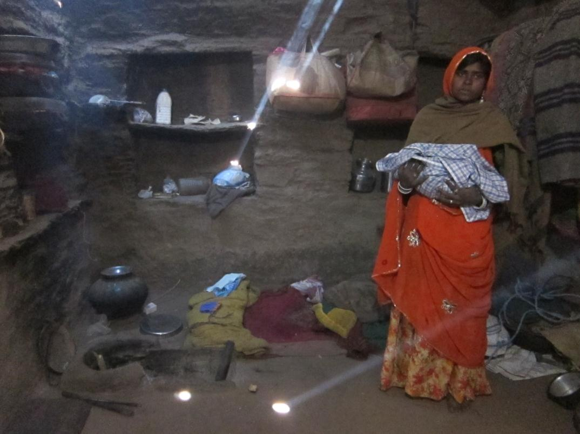
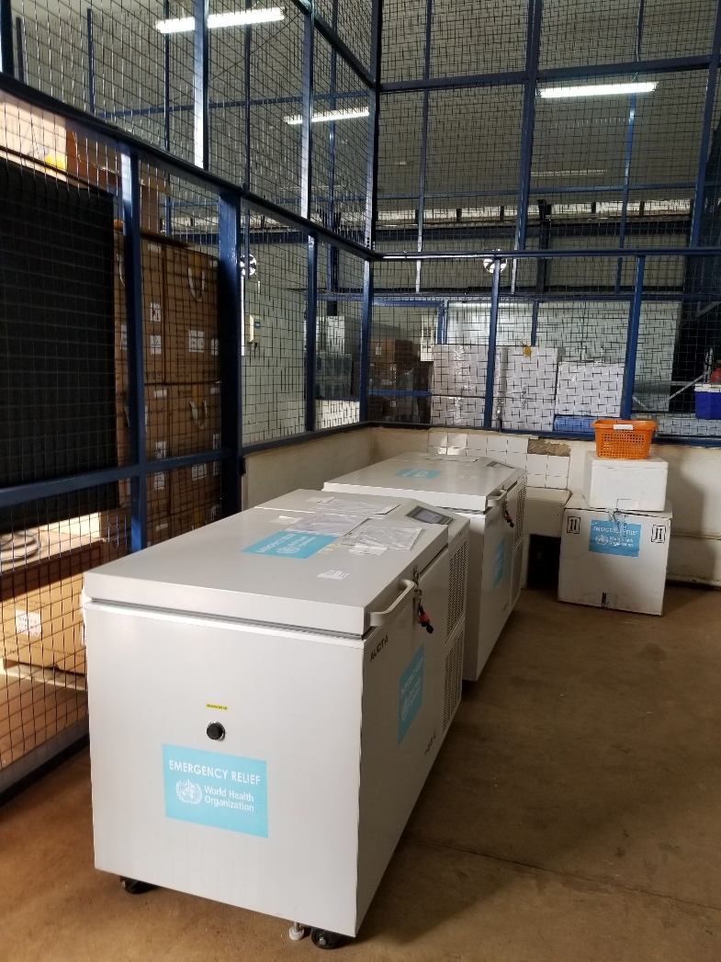
Computing and Global Health
CSE 482b
ICTD Capstone, April 17, 2023
Richard Anderson

Slide 2
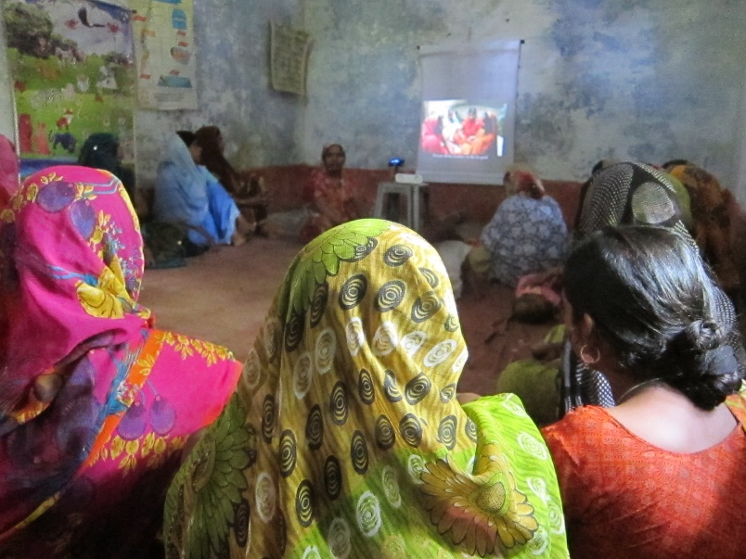
Today
Global Health Overview
Burden of Disease
Health Care Systems
Global Organizations and Funding
Computing and Global Health Projects
Mobile Wellness Toolkit Project
Mobile Midwife Platform
Projecting Health
mPneumonia
Cold Chain Equipment Inventories
mWach
Uganda CCIS

Slide 3
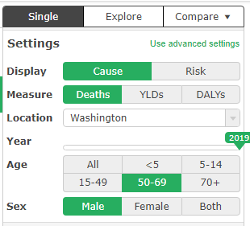
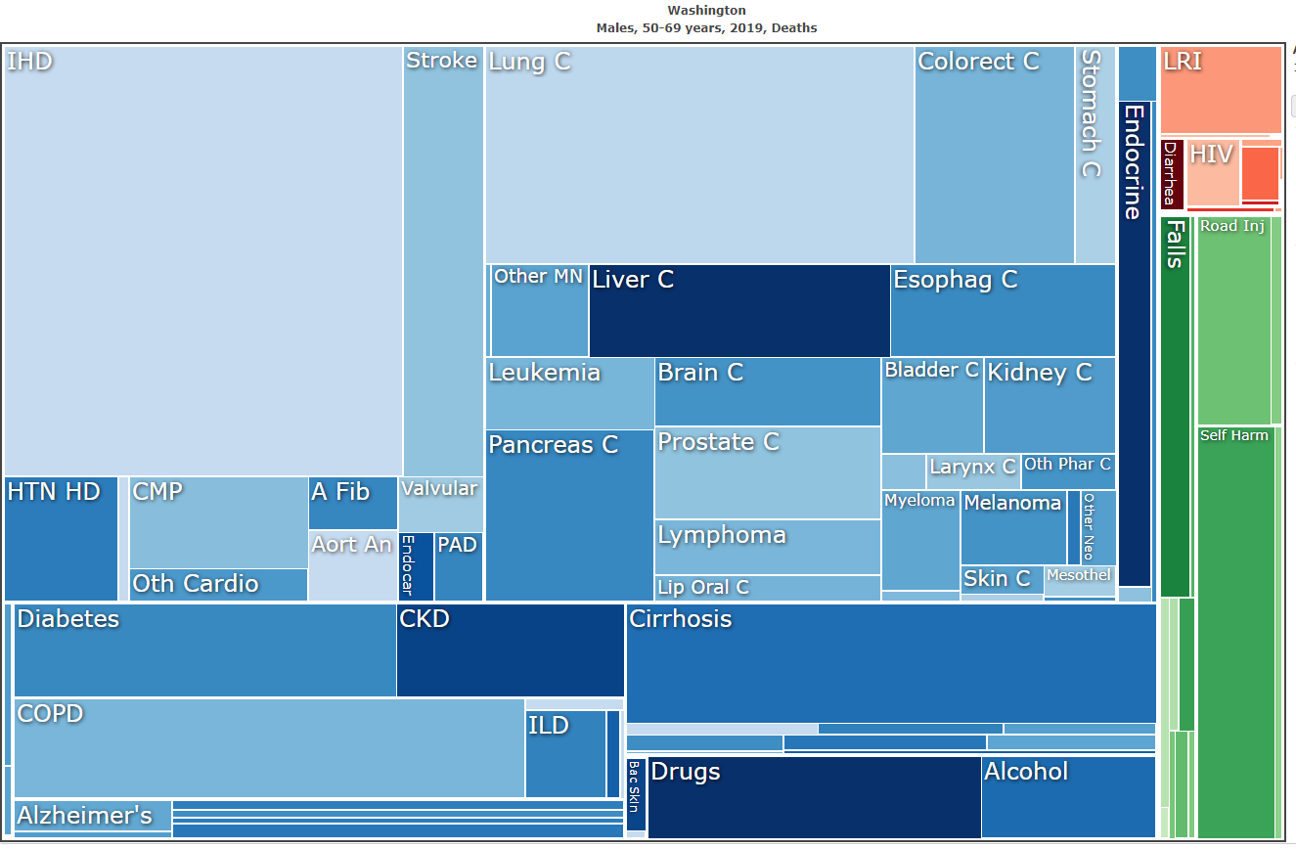
Global Burden of Disease
We are all human – so subject to the same frailties
However, the burdens of disease vary dramatically
IHME Global Burden of Disease
GBD Compare

Slide 4
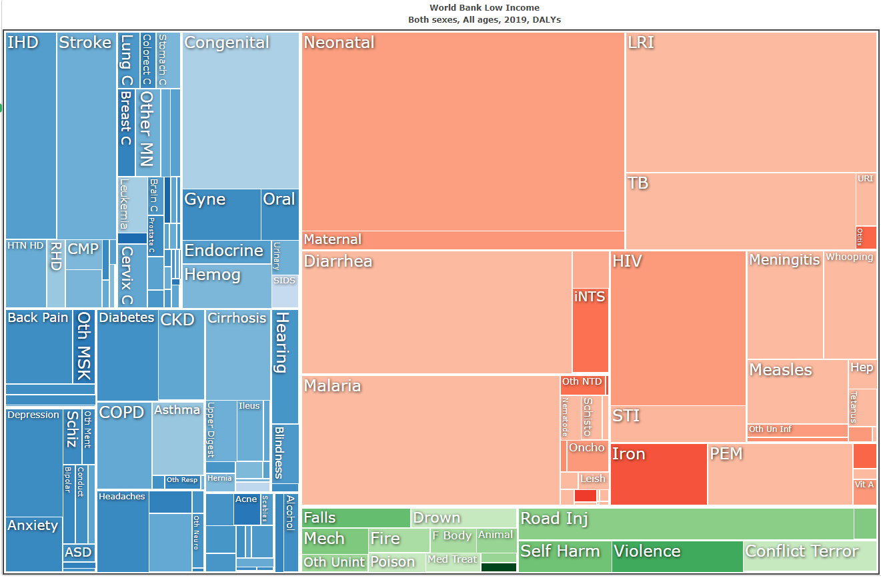

Slide 5
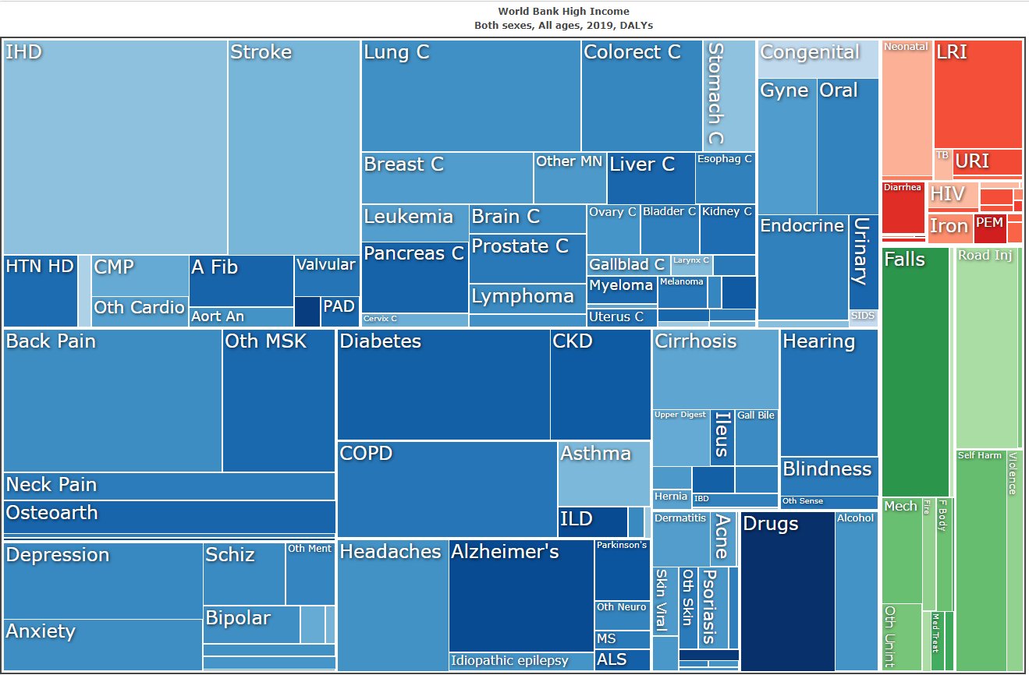

Slide 6
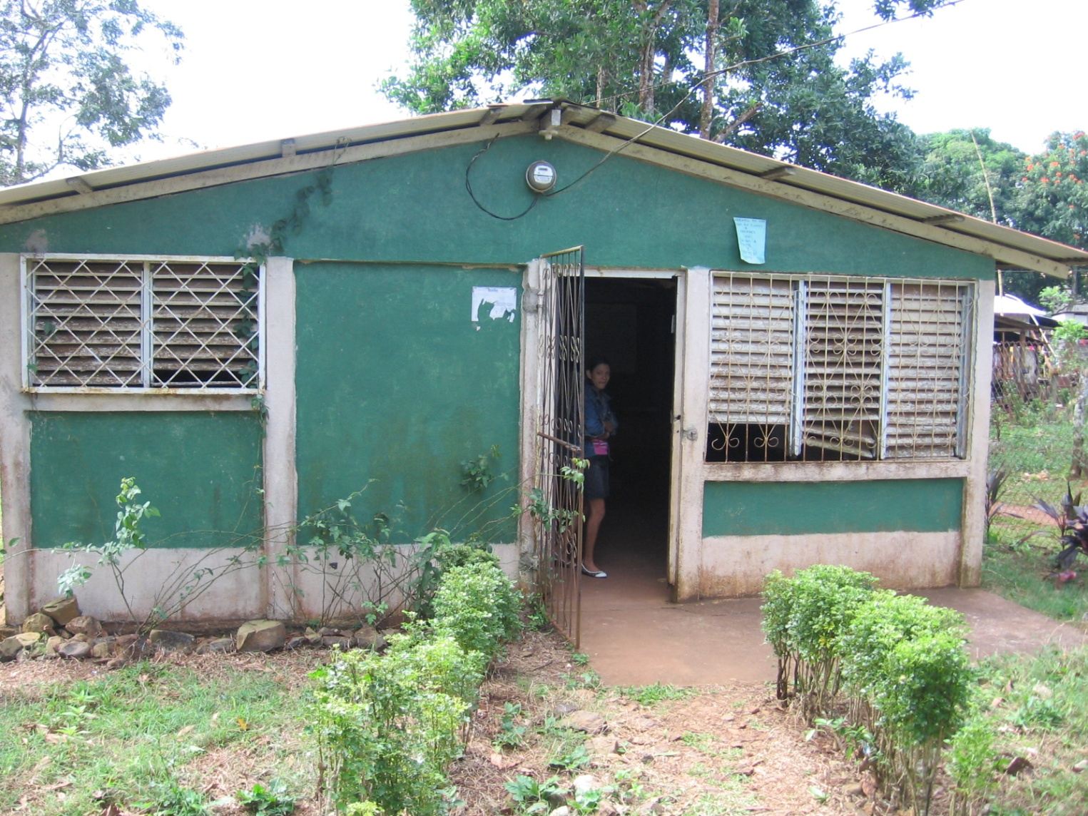
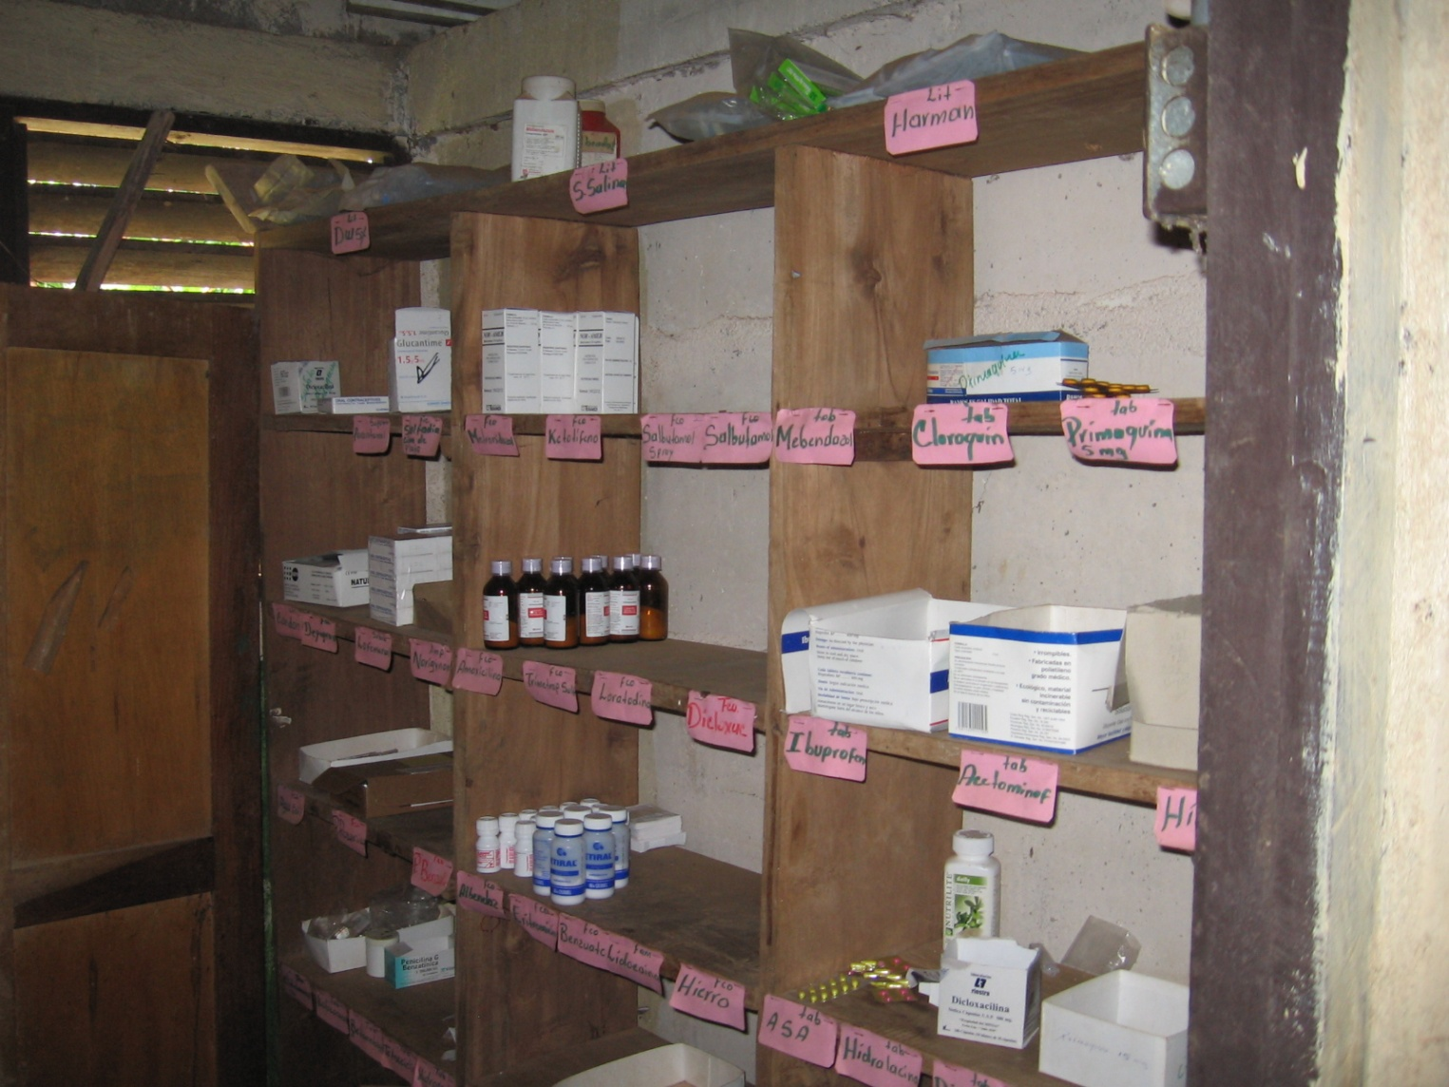
Health Care Systems in LMICs
Public and Private Health Care
Hierarchy of facilities
Major Hospitals, District Hospitals, Health Centers, Health Posts
Under resourced
Limited equipment and supplies
Lack of trained people in rural areas
Limited governmental financial support
Ministry of Health controls policy

Slide 7
Global Organizations and Funding
Global stake holders
Unicef, GAVI, WHO
National Donors
USAID, PEPFAR, CDC, GDZ, DFID, Norad, JICA, . . .
Private Donors
BMGF, Clinton Foundation, . . .
Broad mix of implementing organization
Funding streams determine priorities
Focus on particular diseases

Slide 8
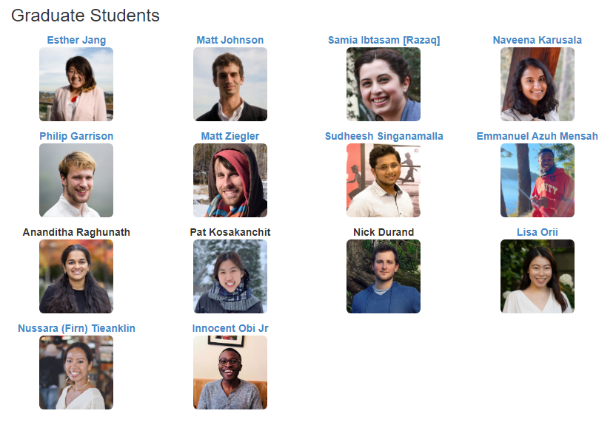
UW ICTD Lab Projects
Research group founded by Richard Anderson and Gaetano Borriello
Kurtis Heimerl joined in 2015, June Lukuyu in ECE is an Affiliate

Slide 9
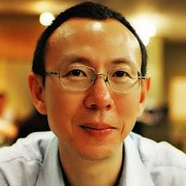
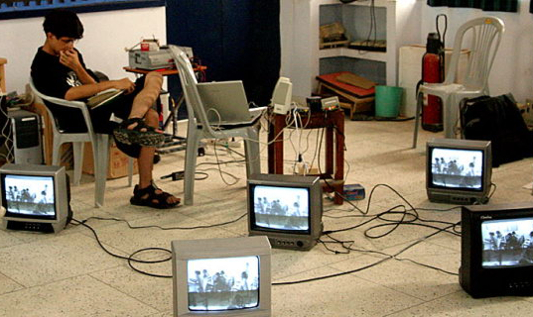
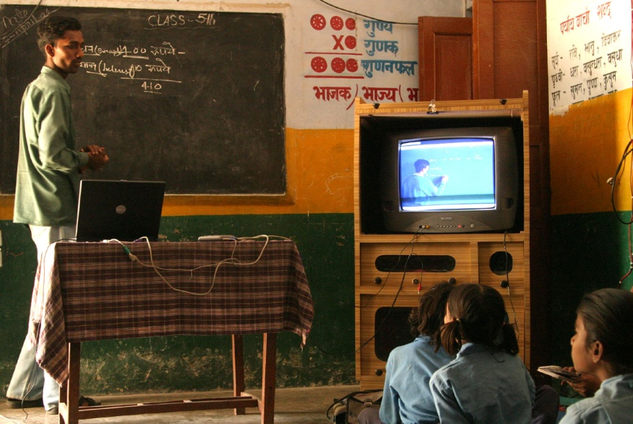
Digital StudyHall
Video based education using Tutored Video Instruction model
Idea was to use mediated video presentation
Benefit of expert content, mediation, and peer discussion
Project was conceived by Randy Wang, a Princeton University professor who left the university to establish the project in Lucknow India
Goal was to provide educational content to rural Indian schools which often lacked qualified teachers
Model – teachers in the schools would “co-teach” with a video lesson filled in a different school
UW Faculty involvement: Richard Anderson, Tom Anderson, Arvind Krishnamurthy, and Kurtis Heimerl (as a student)

Slide 10
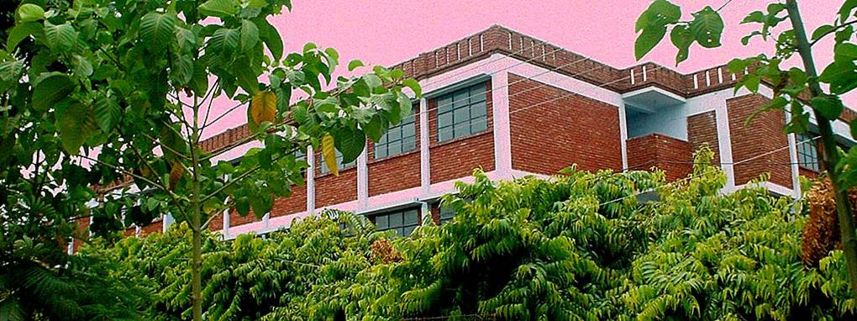
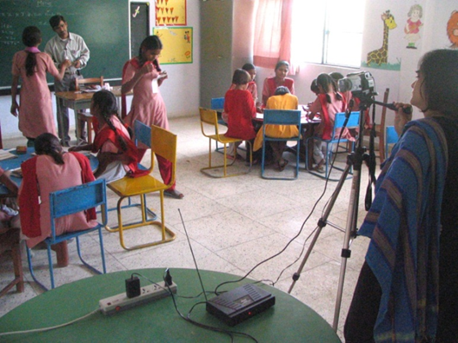
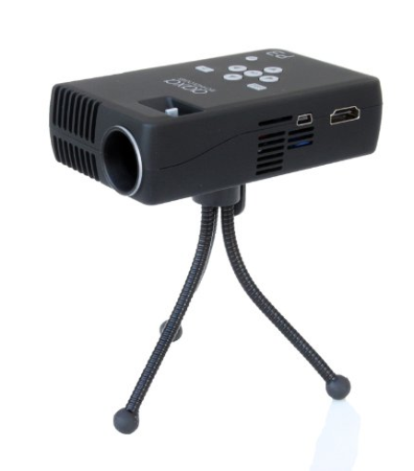
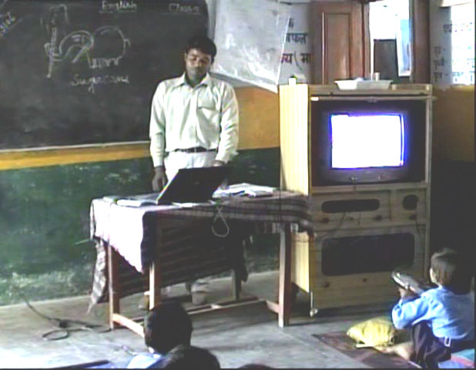
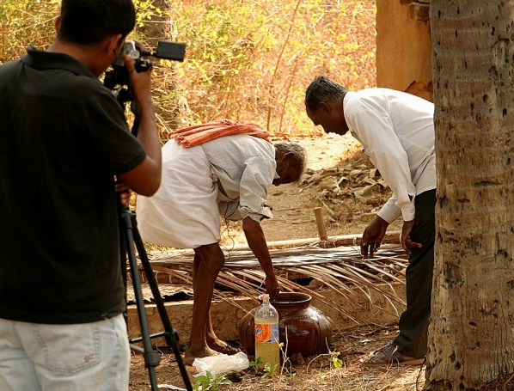
Digital StudyHall
Project was initially technology focused
Viewed as a networking project for distributing content
Secondary project was developing low cost display mechanisms
Education was viewed as the “Application Domain” for the technology
Randy Wang was employed at Microsoft Research India
Spin off project (by Rikin Gandhi) on agricultural education: Digital Green

Slide 11
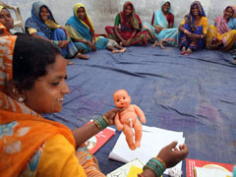
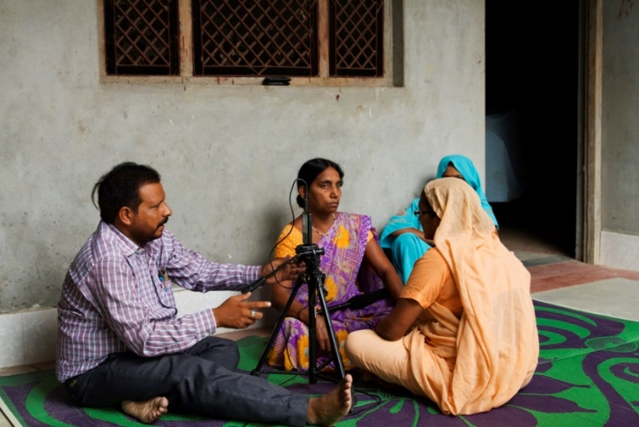
Digital Public Health -> Projecting Health
Application of Digital StudyHall/Digital Green ideas to Public Health
Led by University of Washington and PATH in Uttar Pradesh India
Most similar to Digital Green in technology approach
Video topics had standard messaging based on official guidelines
Far more concerns about getting messaging correct
Implemented community advisory board
Deployment approach
Use by ASHAs (Community Health Workers) leading Mothers’ groups
Local NGO to manage deployment
Social media technology has changed since project wrapped up

Slide 12
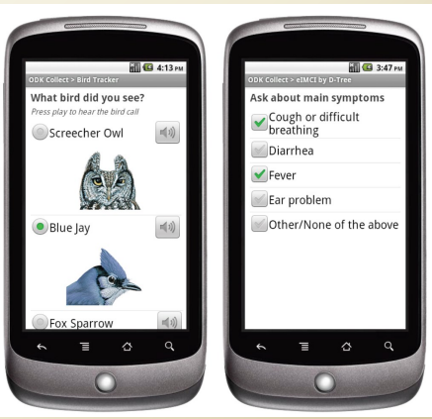
Open Data Kit
Problem: Digital data collection in poorly connected environments
2007 Technologies:
Personal Digital Assistants (PDAs)
Feature Phones
Forms based data collection
Enter data based on individual forms
Forms end up as records in a database
Example: tracking Malaria outbreak in remote villages
Initially University of Washington project, now a widely used system under a number of different brandings

Slide 13
Open Data Kit History
Brainchild of Gaetano Borriello
“Let’s do data collection with Smart Phones in developing countries”
Use of Android Platform
In 2008-2010 there was great skepticism that smart phones would be a feasible device for global work
Initial development by UW PhD students
Open Data Kit: Suite of tools for data collection
Spun out from UW as independent projects

Slide 14
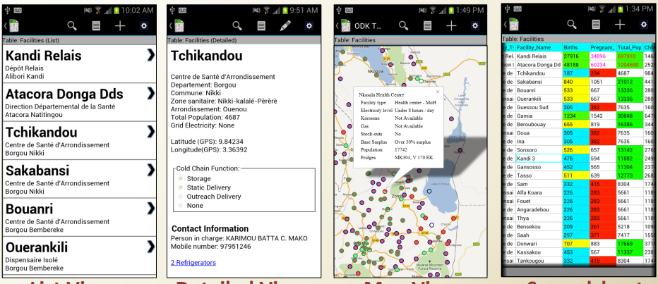
ODK Lessons
Successful bet on future technologies
Reliance on consumer technology
“Market fit” – addressed an important global development use case
Identified different roles in the digital data collection
Deployment architect – manage data collection and forms design, but not systems programming
Enabled organizations with “moderate” technical capacity to manage data collection
Open source allowed multiple organizations to build on platform including commercial organizations

Slide 15
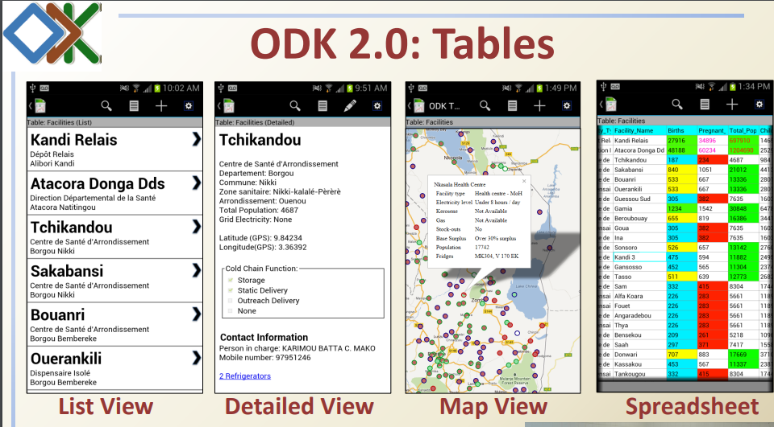
ODK 2 aka ODK-X
ODK 1 – Submission of forms based information from Android Device to Server
ODK 2 – Data management platform with database on both Android Device and Server
Row based synchronization in online/offline environment
Substantial generalization of ODK 1
Platform for research projects

Slide 16
Mobile Wellness Toolkit Project
How do we make low cost consumer technologies available to organizations who implement health and wellness programs?
National Science Foundation project
Partnership between University of Washington and PATH
University of Washington
Richard Anderson, CSE
Gaetano Borriello, CSE
Beth Kolko, HCDE
PostDocs: Brian DeRenzi, Neha Kumar
PATH
David Lubinski, Kiersten Israel-Ballard, Noah Perin

Slide 17
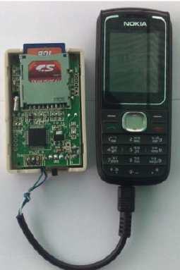
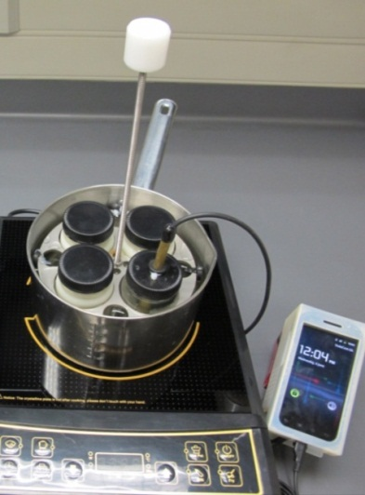
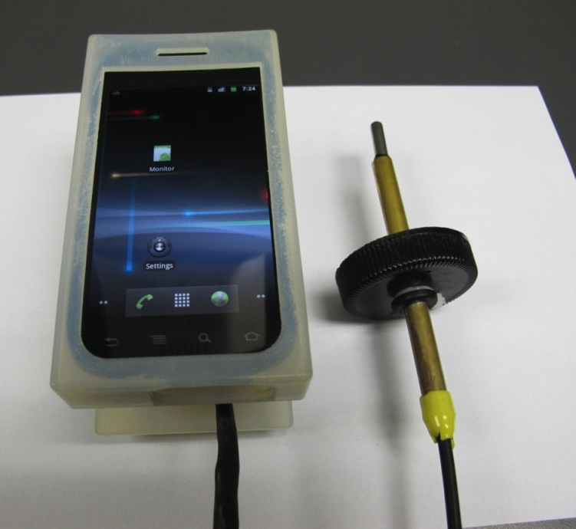
ODK Sensors
Framework for integrating sensors into an ODK2 Application
FoneAstra – sensor bridge for mobile phones
Initially basic phones, but later android phones
Temperature Monitoring for Vaccine Refrigerators
Temperature Monitoring for low cost breast milk pasteurization

Slide 18
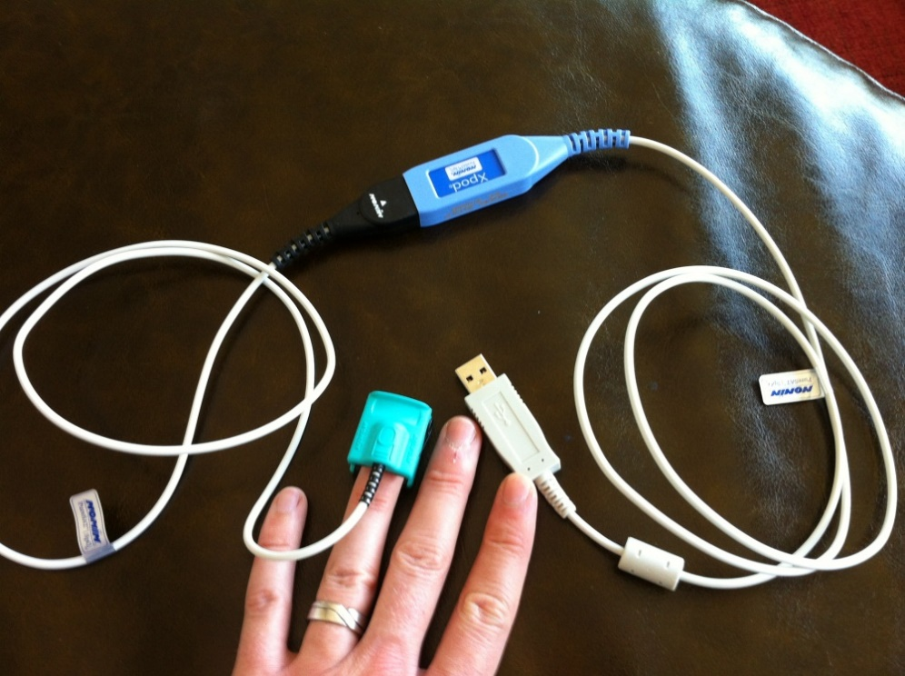
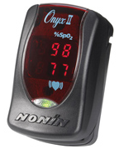
mPneumonia
Pulse Oximetry for detection of childhood pneumonia

Slide 19
Job Aids: Smartphone Apps for health workers

Slide 20
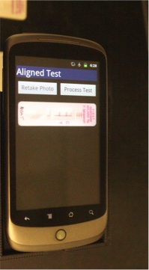
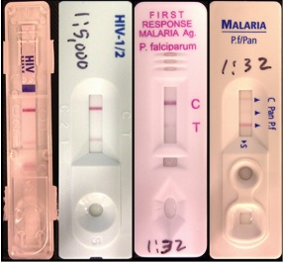
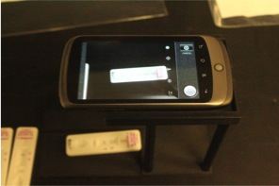
Point of care diagnostics
Rapid diagnostic tests (RDTs) quickly test for conditions based on blood/urine sample
Supportive tools to aid health workers with the administration and interpretation of these tests.

Slide 21
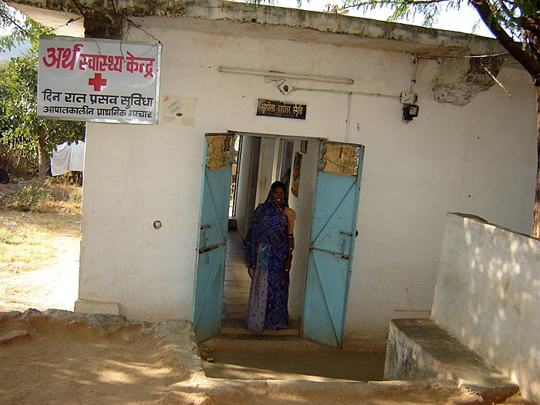
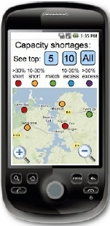
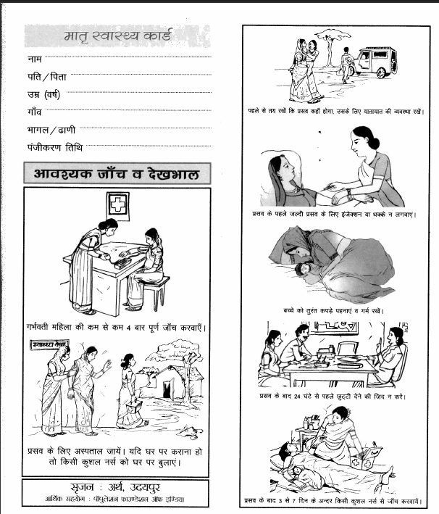
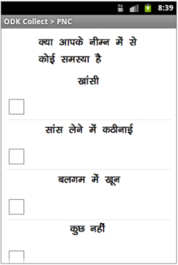
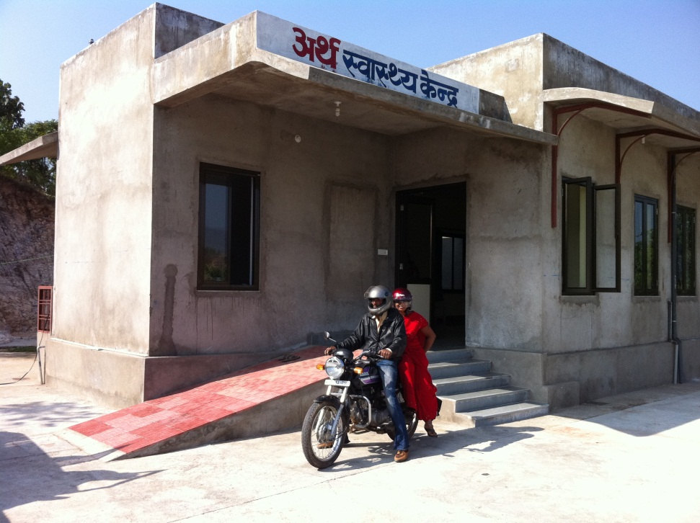
Mobile Midwife Platform
Mobile data collection to support PNC visits
Data collection
Protocol support
Open Data Kit application
Android phones deployed with nurse midwives

Slide 22
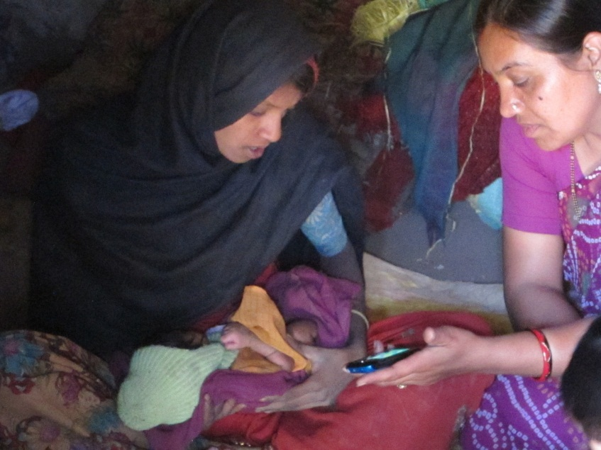
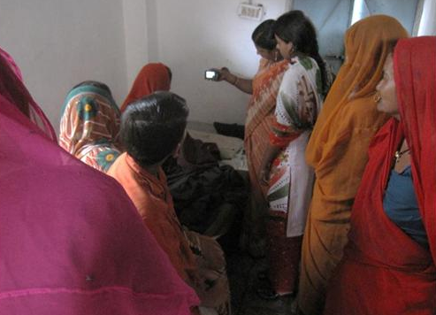
Mobile Videos in MMP
The use of video is feasible in PNC visits
The PNC environment is complicated
Patient education occurs throughout visits with various levels of effort
Multiple settings and participants
Authority and trust
Nurses viewed video as being authoritative and enhancing their communication

Slide 23
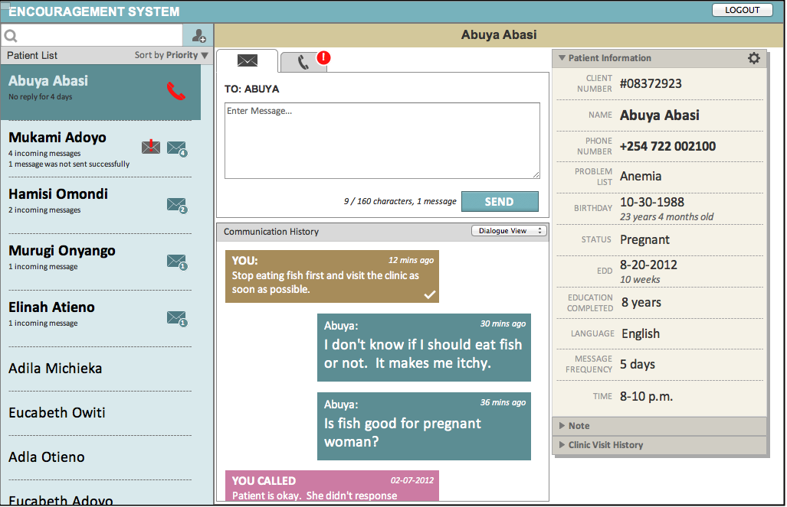
mWACH
Control Group
No intervention.
Two-way SMS
Pregnant woman receives twice-weekly SMS with health information relevant to her health and her stage of pregnancy.
Pregnant woman receives twice-weekly SMS requesting a reply.
One-way SMS
Hypothesis that woman’s reply can be a proxy for engagement and uptake of health services.
Study with Dept of Global Health
SMS Reminders to Pregnant Women in Kenya
Target basic mobile phone users
Innovation was two-way SMS

Slide 24
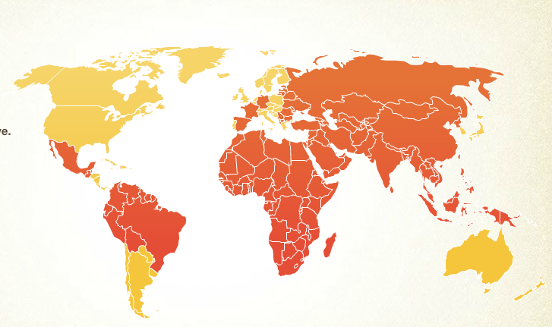
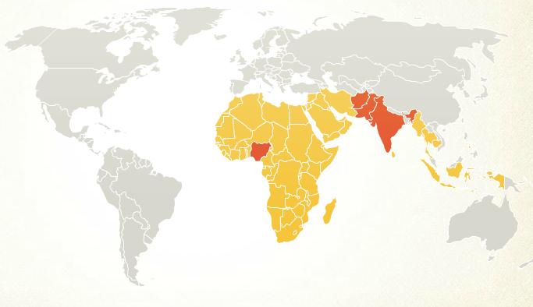
Cold Chain Equipment Inventories
Vaccine Cold Chain: National Storage of Vaccines from import to delivery
Critical for management of national vaccine programs
Expanded Program of Immunization had dramatic impact on reducing childhood deaths
Polio 1990
Polio 2008

Slide 25
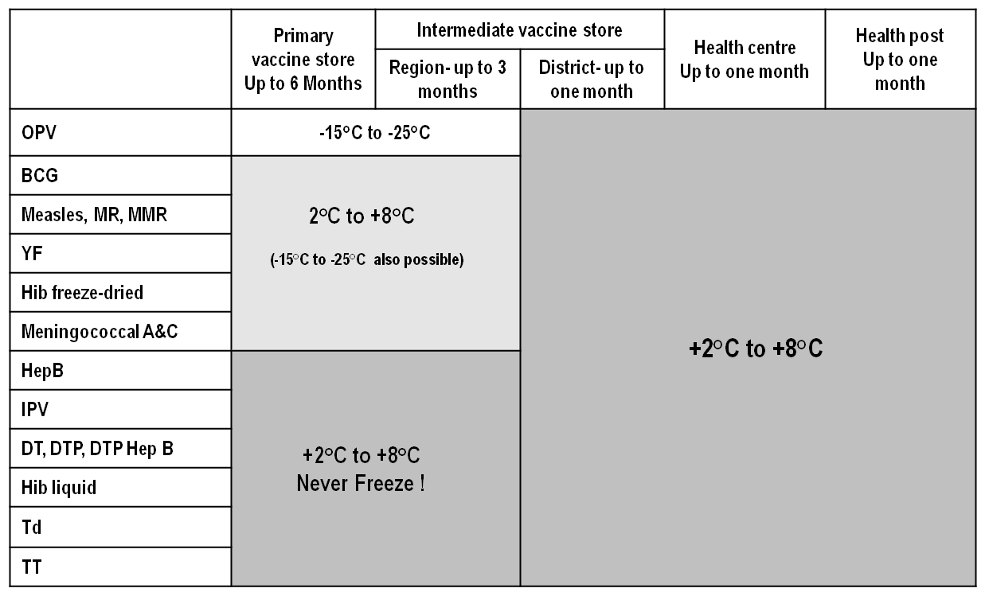
Vaccine Cold Chain Structure
Vaccine Manufacturers
National Vaccine Store
Regional Store
Regional Store
District Store
District Store
District Store
District Store
Health Center
Health Post
Health Post
Health Post

Slide 26
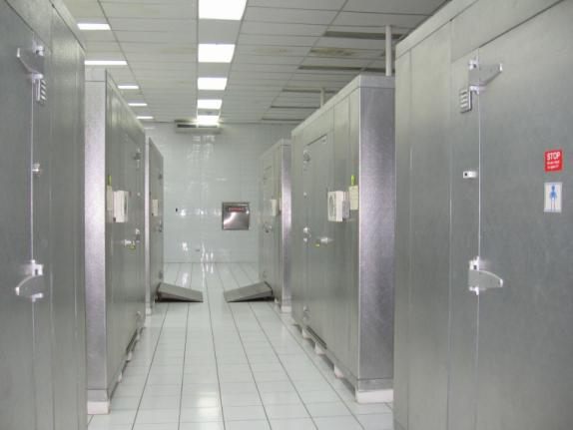
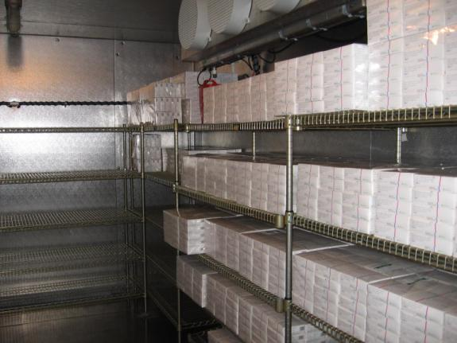
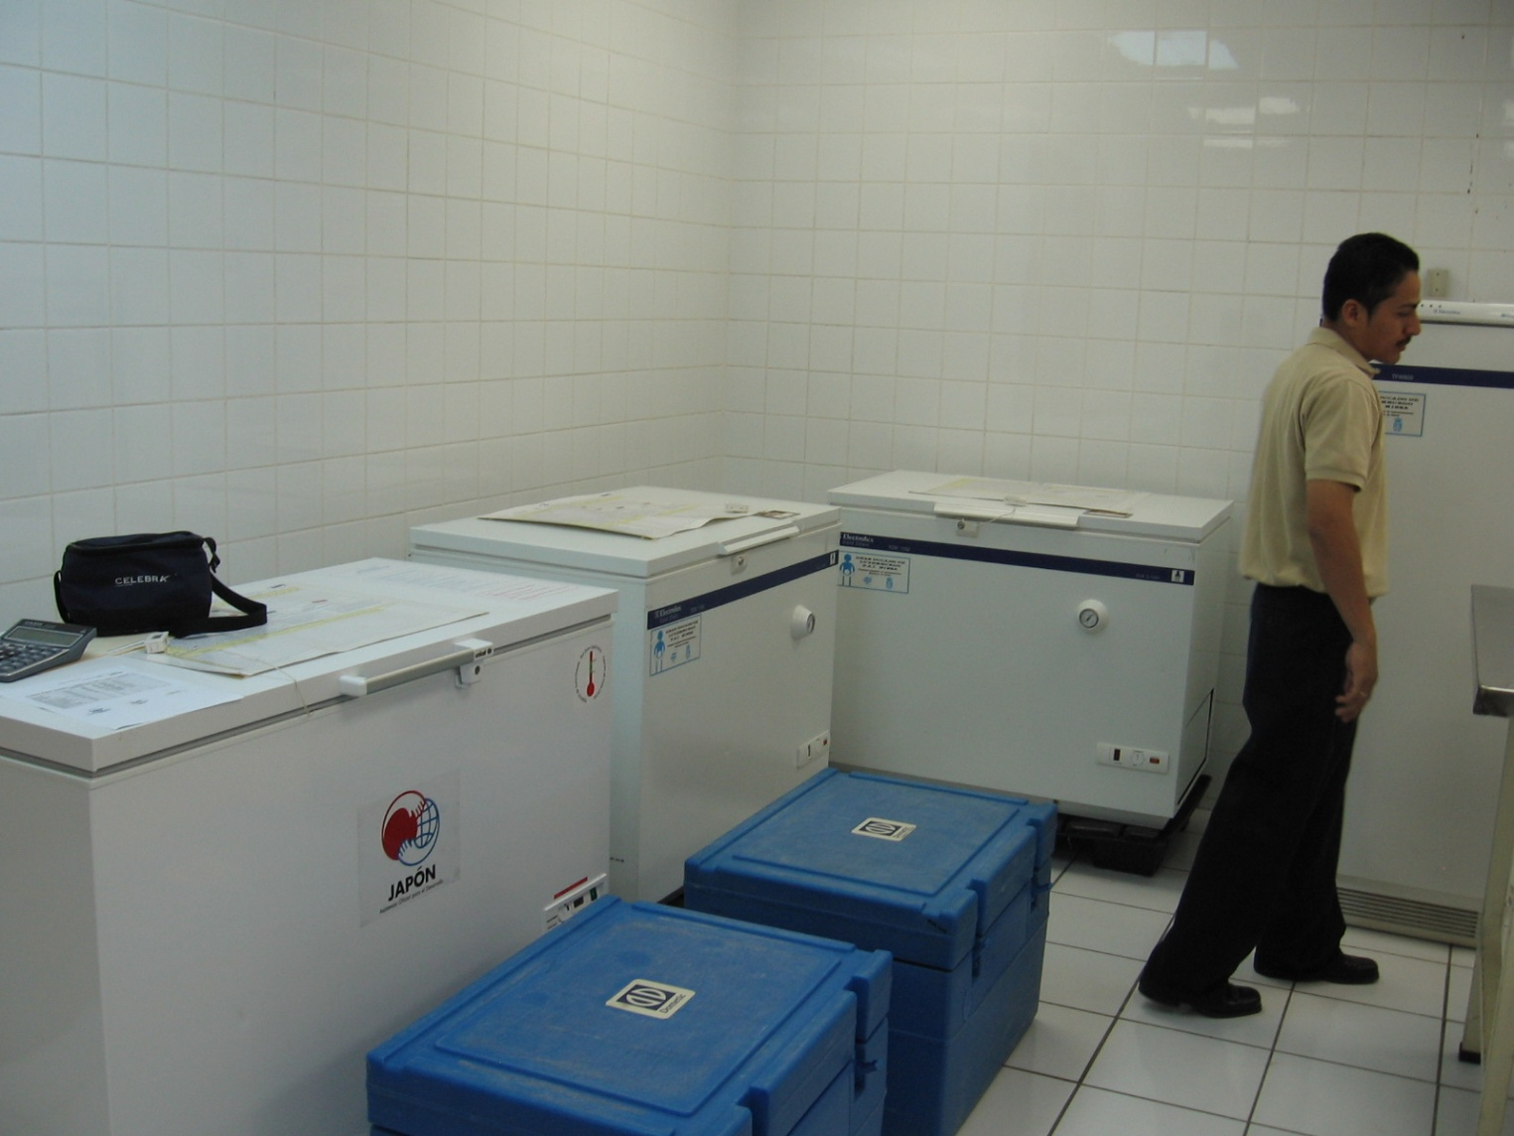
Cold Chain

Slide 27
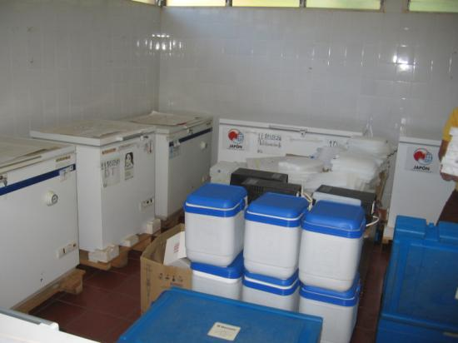
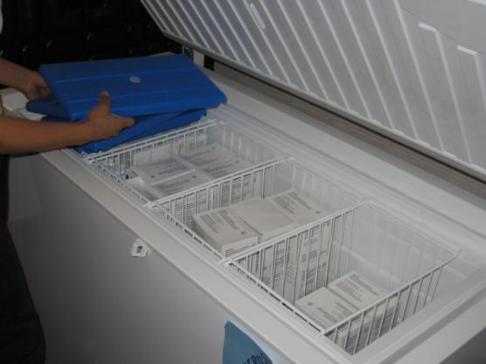
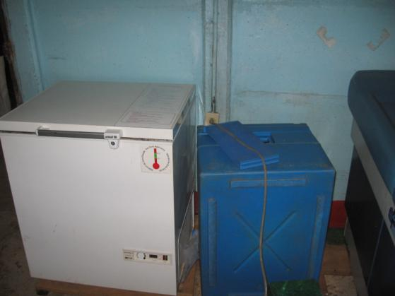
Cold Chain

Slide 28
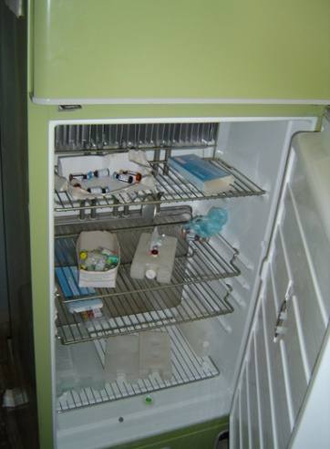
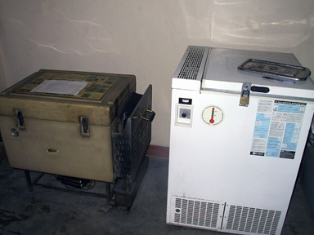
Cold chain equipment

Slide 29
Cold Chain Equipment Manager (CCEM) Software
1/5/2012
Change Seminar
29

Slide 30
Reports

Slide 31
CCEI Data Standards
Goal: Agree on standards to allow tools to interoperate
Wide range of tools available
Data integration problem is central
Need for multiple software tools

Slide 32
Countries

Slide 33
Laos – Integration with SMS reporting

Slide 34
Uganda CCIS Architecture
Global Cold Chain Information System
Dash Board
Database
Report Generation
ODK-X Client
ODK-X Server
Country Database
Local Database
ODK-X Client
Data Bridge
Local Database
CCEM

Slide 35
Uganda Cold Chain Mobile Application
App built on top of the ODK-X platform
Combination of ODK Survey and ODK Tables
Written in Java Script
Manage a database of health facilities and refrigerators associated with facilities

Slide 36
Results: Functionality
Updating CCEI
Data reported from 80.15% of the 394 HCFs in the study districts
Data reported from 80.77% of the 486 CCE in the study districts
Frequency of temperature excursion:
Analysis: CCE functionality
Analysis: CCE temperature performance
Analysis:
60 non-functional CCE out of 489 in study as of July 10,2020
Prioritizing repair:
129 Out of 795 entries showed CCE with either freeze (35) or high alarm (94) data

Slide 37
Questions and Discussion
Richard Anderson anderson@cs.washington.edu

