Slide 1
CSE 482 B
Lecture 04
Global Covid Data and Modeling

Slide 2
Announcements

Slide 3
Covid Pandemic

Slide 4
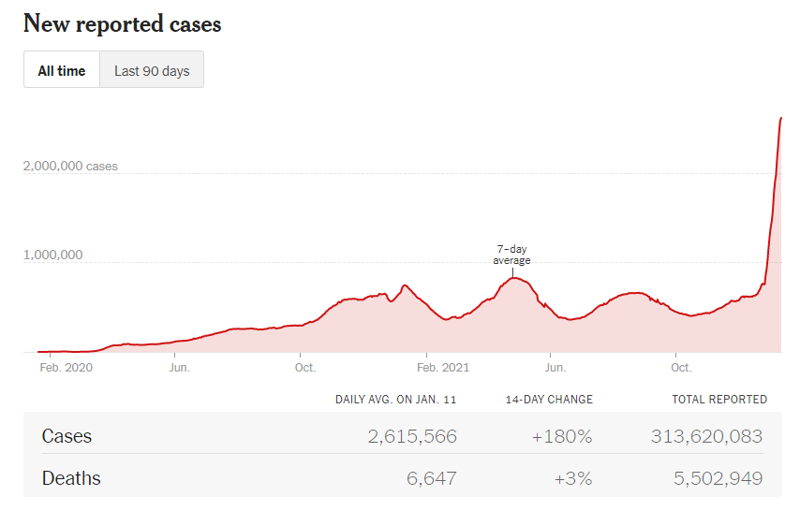
Global Cases

Slide 5
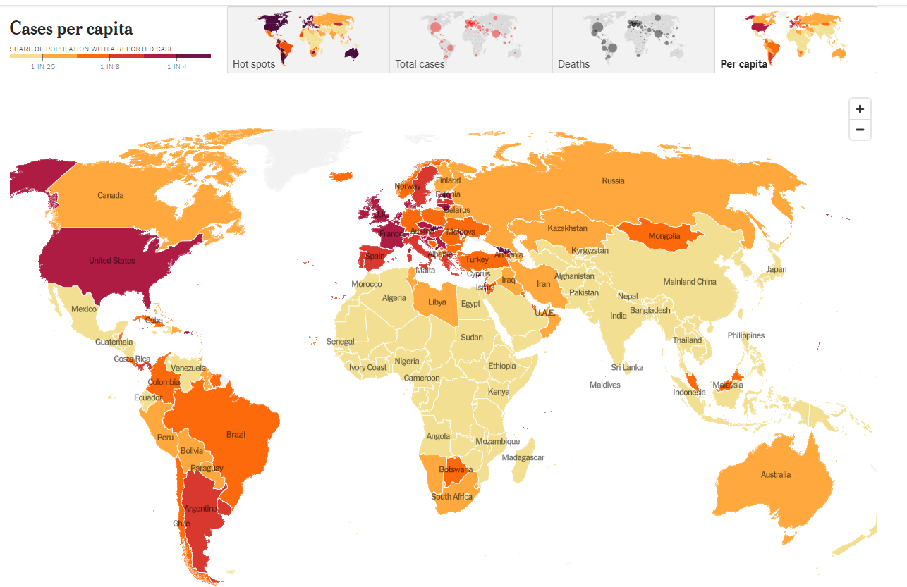

Slide 6
Disease Modelling
Naïve Assumptions
Uniform Population
Three types of people: Susceptible, Infected, Recovered
Disease lasts one unit of time
Each Infected exposes r other people
A person Susceptible person that is exposed becomes infected
Susceptible
Infected
Recovered

Slide 7
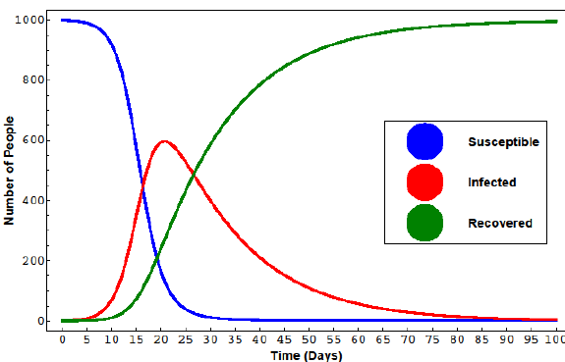
Model predictions
Exponential growth for r > 1
Decline in cases when r < 1
New cases: r ×|I| × (|S| / n)
Effective r value decreases as susceptible population decreases
Decline starts when r = (n / |S|)

Slide 8
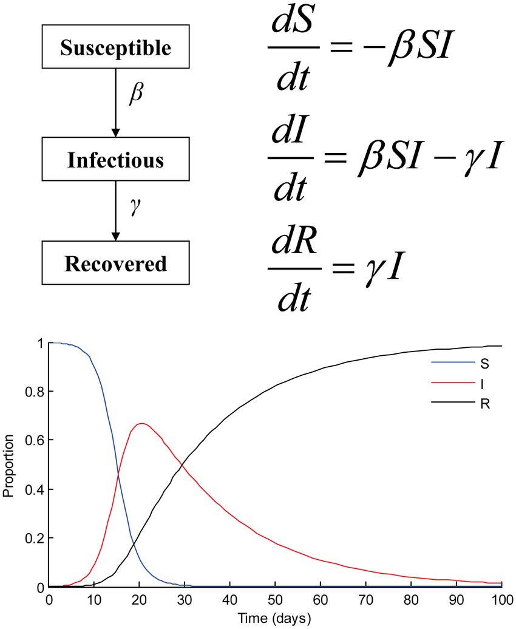
Making the model continuous
Shrink the time interval and allow multiple time periods in I
Parameters β and γ for transition from S to I and from I to R
Time step to zero to make a differential equation

Slide 9
Expanding the models
Susceptible
SIRD – Susceptible, Infectious, Recovered, Dead
SEIRD - Susceptible, Exposed, Infectious, Recovered, and Dead
Adding Vaccines
Adding Reinfection
Infected
Recovered
Vaccinated

Slide 10
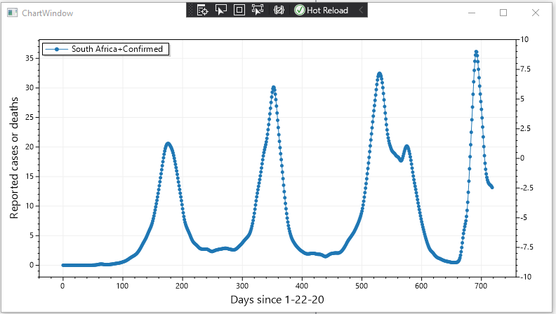
Covid Epidemic: South Africa

Slide 11
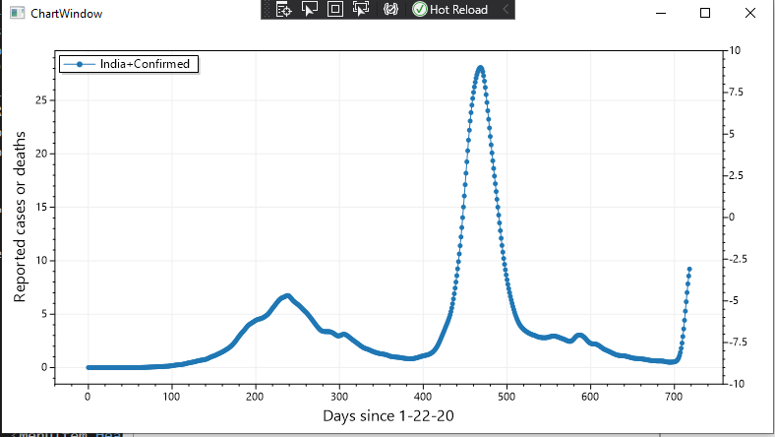
Covid Epidemic: India

Slide 12
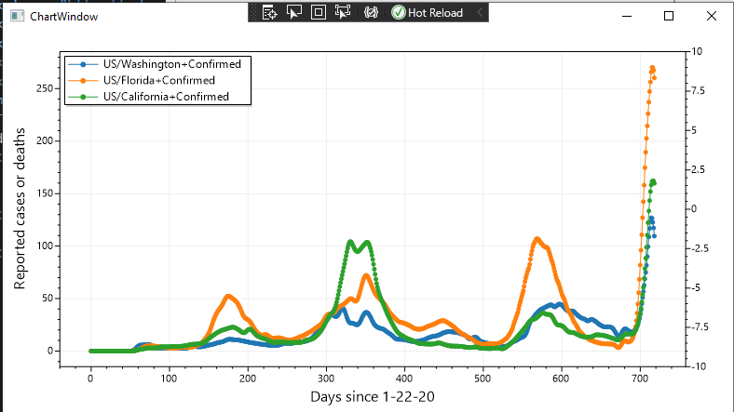
Covid Epidemic – CA, FL, WA

Slide 13
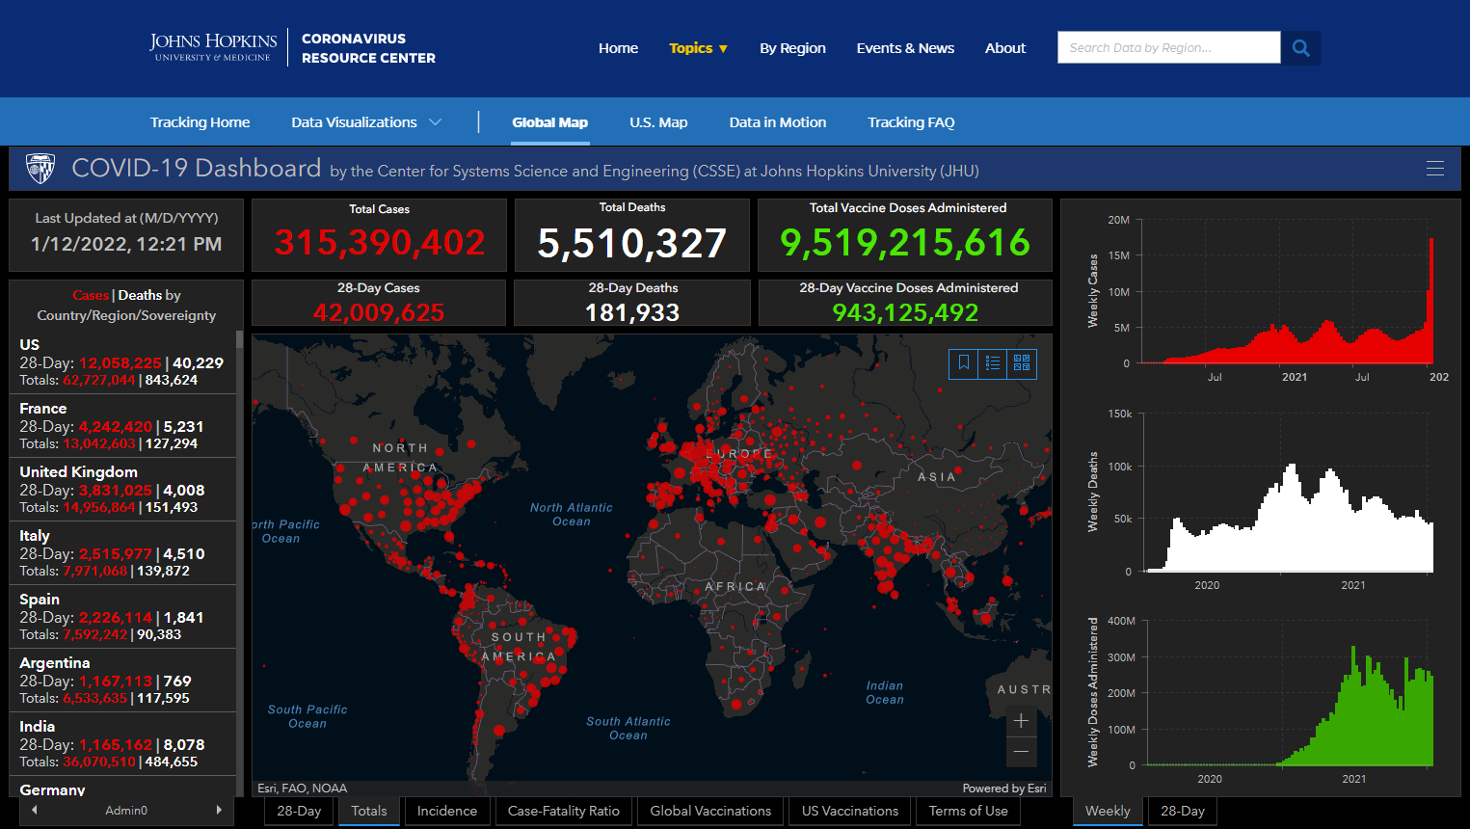

Slide 14
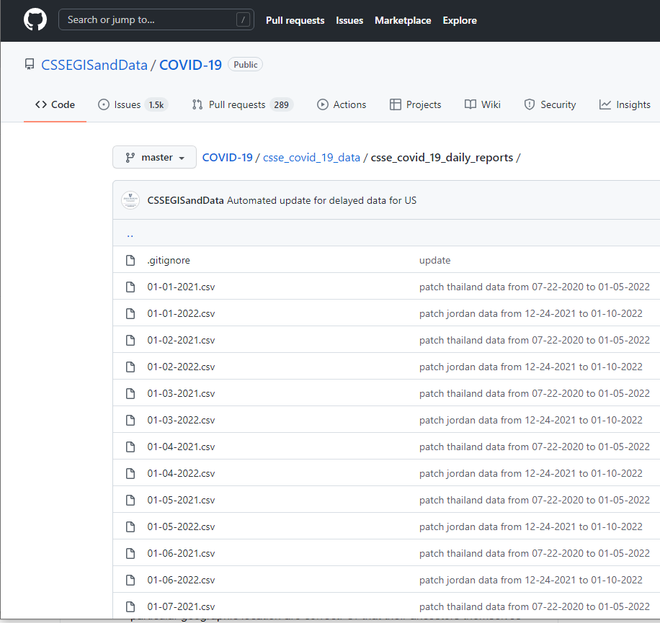
Where does this data come from
Different country reporting strategies and aggregation
Tremendous variation on levels of accuracy and sources of case data
Reported to centralized authorities
Aggregators, such as JHU curate data sets
Labor intensive – group of research assistants collect daily data
Data made available for download
Github or other sources

Slide 15
Data repositories
Johns Hopkins University
Source for majority of dashboards
Our World in Data (Our world in data)
US Specific sources CDC
Other countries
https://coronavirus.data.gov.uk/
https://sacoronavirus.co.za/
Global data: WHO
https://covid19.who.int/

Slide 16
Data types
Case counts and death counts
Vaccine delivery
Quantity of vaccines delivered to countries is know
Reporting of number of immunizations is fairly good
Covid variants – percent of different variants detected around the world
Covid restrictions – time scale of restriction by geography
Excess deaths
Country demographics and maps

Slide 17
Many dashboards and studies are already available
What is left to be done?
How to compete against New York Times or Johns Hopkins University or Institute of Health Metrics and Evaluation
Sources of data exist
Possible to build on top of existing data sets
Infrastructure exists to work with large data sets
Identify specific directions that are not components of these existing tools
Tools give very good overviews and summaries
Opportunity is doing deeper analysis: combining data sources and refining geographical analysis

Slide 18
Applications of modeling
Obviously, predicting the future
When will Omicron peak in Seattle?
This quarter Omicron will sweep round the world
So tools would need to be designed for Omicron – but ready for Pi, Rho, and Sigma
Matching SIR model against previous waves
Picking out previous waves is a start!
Tying modeling to other data sets
Vaccination, Public Health Restrictions

Slide 19
Geographic refinement
Predict and understand the epidemic across geographic areas using data from sub regions (e.g., county level data in the US)
This is missing from the aggregation sources – which give good summaries but tend to be “one dimensional”
Sub-national data is often not on aggregation sources (which was part of the motivation for one of the project areas)
There will be technical challenges in building appropriate data tools
Reasons for paying attention to subnational data
Identify geographic structure in events
Correlations between different data can be stronger at the subnational level

Slide 20
Exploring the interaction of data sources
Significant opportunities to investigate correlations between data sources
Rural-Urban vs impact
Cases vs death rate vs variant
Variant vs wave vs impact
Vaccine status vs public health intervention vs impact
Season vs climate vs wave
Recommendation
Pick a subset of factors with plausible relations and build tools around good data sets
Option of emphasizing either tool building or data exploration
Map based tools or other visualizations could be included

Slide 21
Existing tools (from fall project)
Available on local github, as csv files
Time series processing of JHU case count data
Decomposition of time series into waves with statistics
USA county adjacency map
CDC vaccination data (by county)
Co-variant data by country

