Slide 1
CSE 482 b
Winter 2022
Lecture 03

Slide 2
Announcements
Online for the time being
This week, lectures Tuesday and Thursday
Next week,
Tuesday, January 18 – meetings with groups
Thursday, January 20 – group presentations – initial project pitches
Kichabi groups
Six android phones are available as loaners
Moto G, Play

Slide 3
eKichabi: Information Access through Basic Mobile Phones in Rural Tanzania
Galen Weld, Trevor Perrier, Jenny Aker, Joshua Blumenstock, Brian Dillon, Adalbertus Kamanzi, Editha Kokushubira, Jennifer Webster, Richard Anderson
CHI ‘18 – April 22, 2018
Notes:
Kichabi? Swahili acronym for “Book of Businesses”

Slide 4
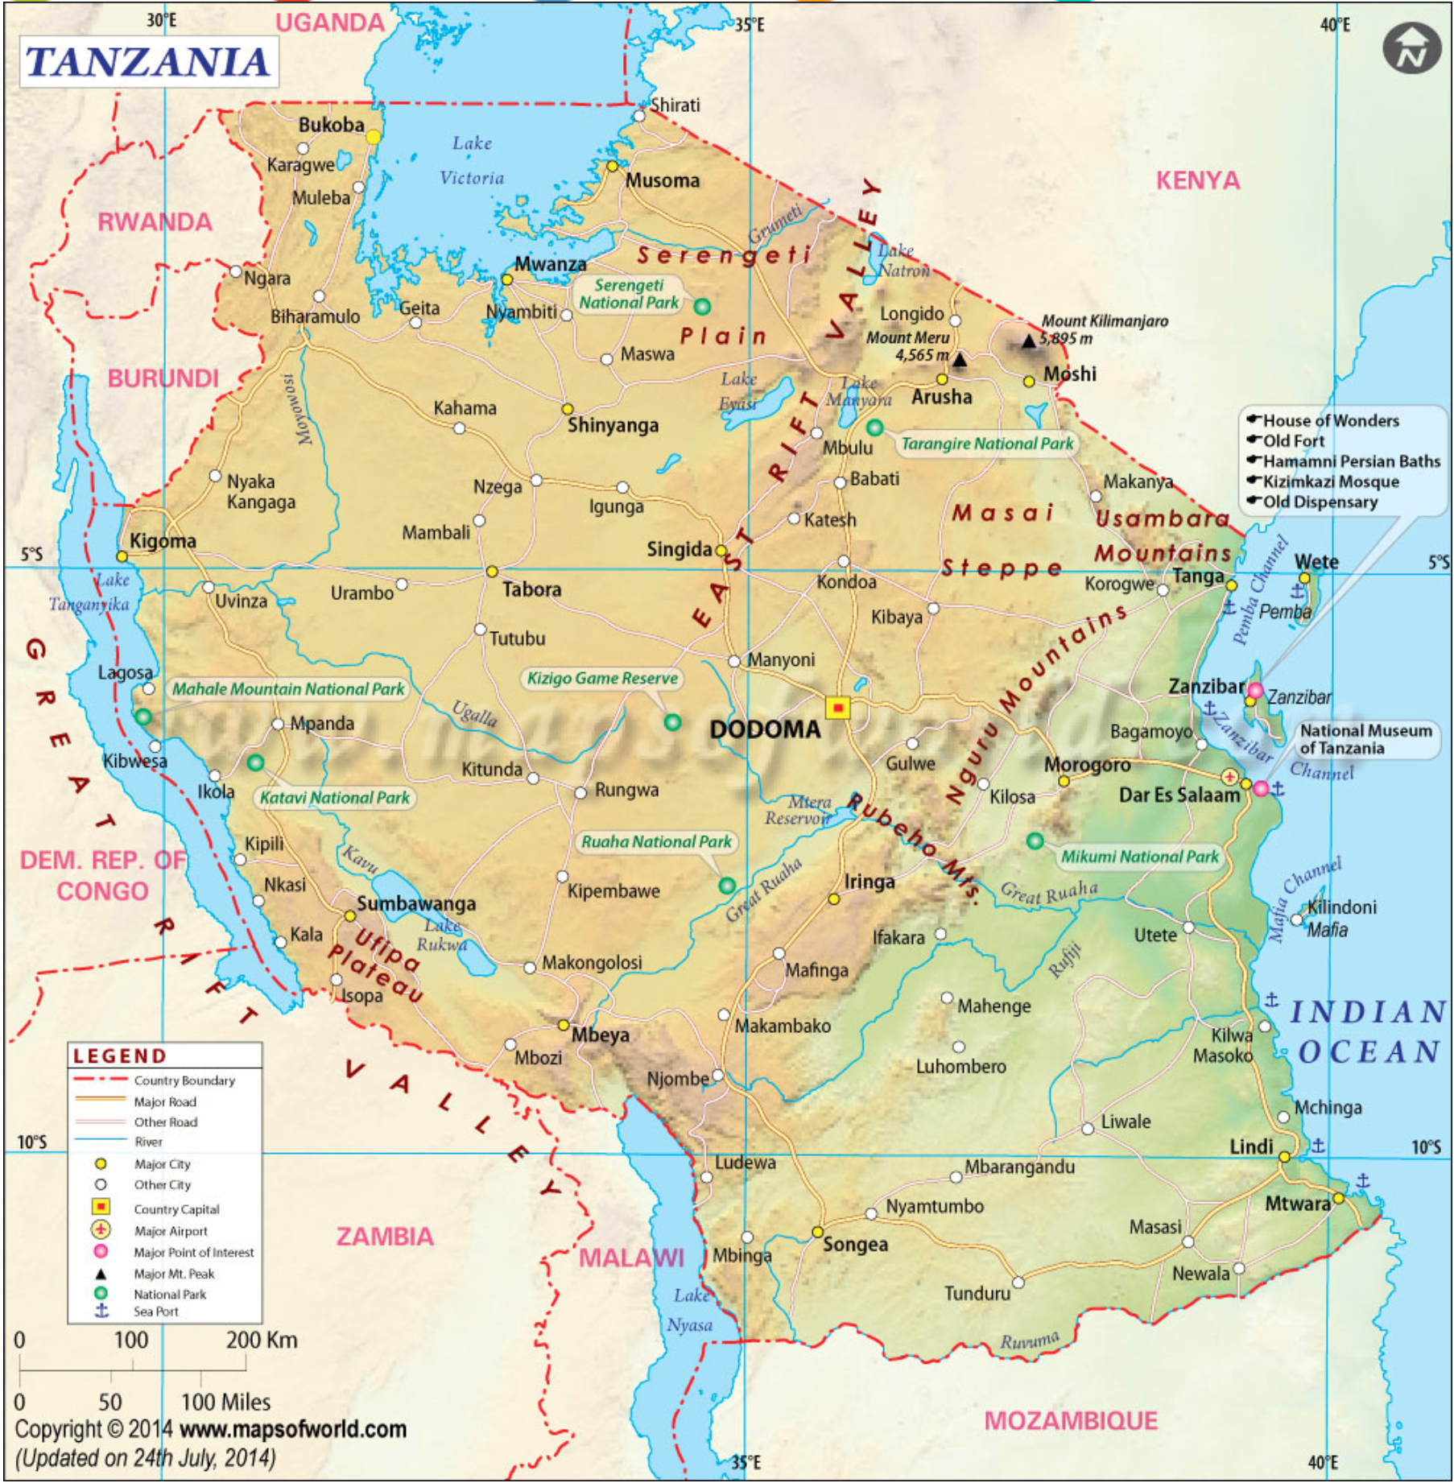
Motivation
In Tanzania, phone ownership is widespread (upwards of 90% in study area), but there’s no way to look up numbers.
How do unknown (to one another) users find one another?
Phonebook!

Slide 5
Previous Work
Brian Dillon, Joshua Blumenstock, Jenny Aker, starting 2014
Survey of ~1500 businesses, distributed paper phone books
Found positive economic effects of having access, and of being listed
This project stems from 2 sources...
Notes:
Technologists interested in infrastructure appropriate implementations
Development economists interested in impact of information

Slide 6
Research Questions
Develop and deploy a electronic phonebook – eKichabi
Assess:
Feasibility – is it possible? Is USSD a suitable technology for deploying a search- and browse-based information service in rural Tanzania?
Usability – is it usable? How well can the target users search for phone numbers, and what are the approaches users take to find a number?
Acceptability – is it viable in the long term? Does the electronic version of the phone directory meet people’s needs, and is it something they will use on a day to day basis?
Notes:
Is USSD a suitable technology for deploying a search- and browse-based information service in rural Tanzania?
How well can the target users search for phone numbers, and what are the approaches users take to find a number?
Does the electronic version of the phone directory meet people’s needs, and is it something they will use on a day to day basis?

Slide 7
Why USSD?
The Third Universal App (Perrier et al.)
In designing for basic mobile phones, a number of options:
SMS – stateless, and text based
IVR – stateful, and voice based
USSD – stateful, and text based – best of both!
Primary considerations: Cost, and Usability

Slide 8
Methodology

Slide 9
June 2017 Phase 0: Application Prototyping
early July 2017 Phase 1: Focus Groups (n≅40)
late July 2017 Phase 2: Initial Deployment (n=107)
early Aug. 2017 Phase 3: Phone Surveys (n=107)

Slide 10
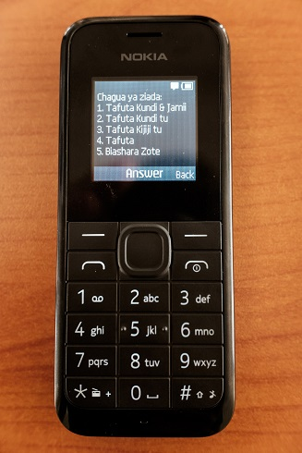
Phase 0: Application Prototyping
Three usage modes:
Browse by Location
Browse by Sector
Search

Slide 11
Select an option:
1.Browse by Location
2.Browse by Sector
3.Search
4.Help
Select District
1.Babati Mjini
2.Chamwino
3.Chemba
4.Dodoma Urban
5.Kiteo
0.Next
99.Back
Select Village
1.Busi
2.Keikei
3.Kinyasi
4.Kiteo
5.Kwadelo
0.Next
99.Back
User Input: 1
User Input: 5
User Input: 4
1.All Businesses (9)
or Select Subvillage
2.Kiteo - Marumba
3.Kiteo - Matinga
4.Kiteo - Muya
5.Kiteo - Nkundusi
99.Back
Select Business
1.Ally Kiosk
2.Amiri Shop
3.Chavai Kiosk
4.Fundi Baiskeli
5.Genge la Mama Mtaa
0.Next
99.Back
Ally Kiosk
--------------------
Location:
Kiteo - Matinga
Phone: T653965711
User Input: 1
User Input: 1
Business Found

Slide 12
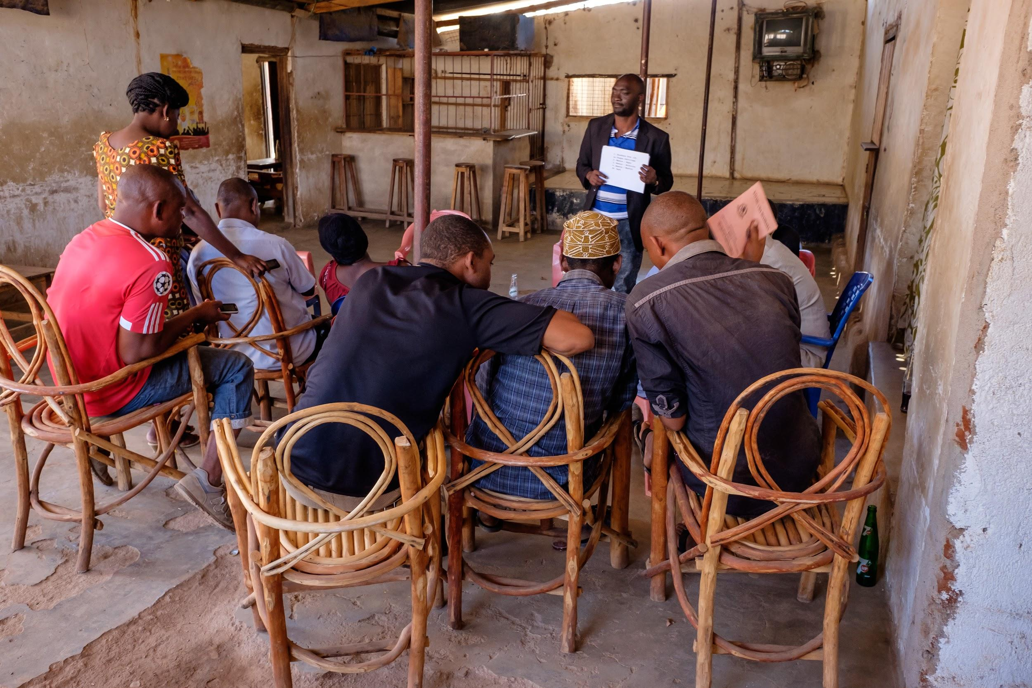
Phase 1: Focus Groups
6 villages over 1 week, several groups per village
3-12 participants per group
Discussed paper and electronic Kichabi
Iterated on application design

Slide 13
Phase 2: Initial Deployment
Four villages, 10-30 participants per village – 107 participants total
Diverse range of ages, genders, literacy, experience with phones
Enrollment: Meeting of ~2 hrs, covering short code, whitelisting, main 3 browsing modes, and plenty of examples
Study lasted 30 days, participants used their own phones

Slide 14
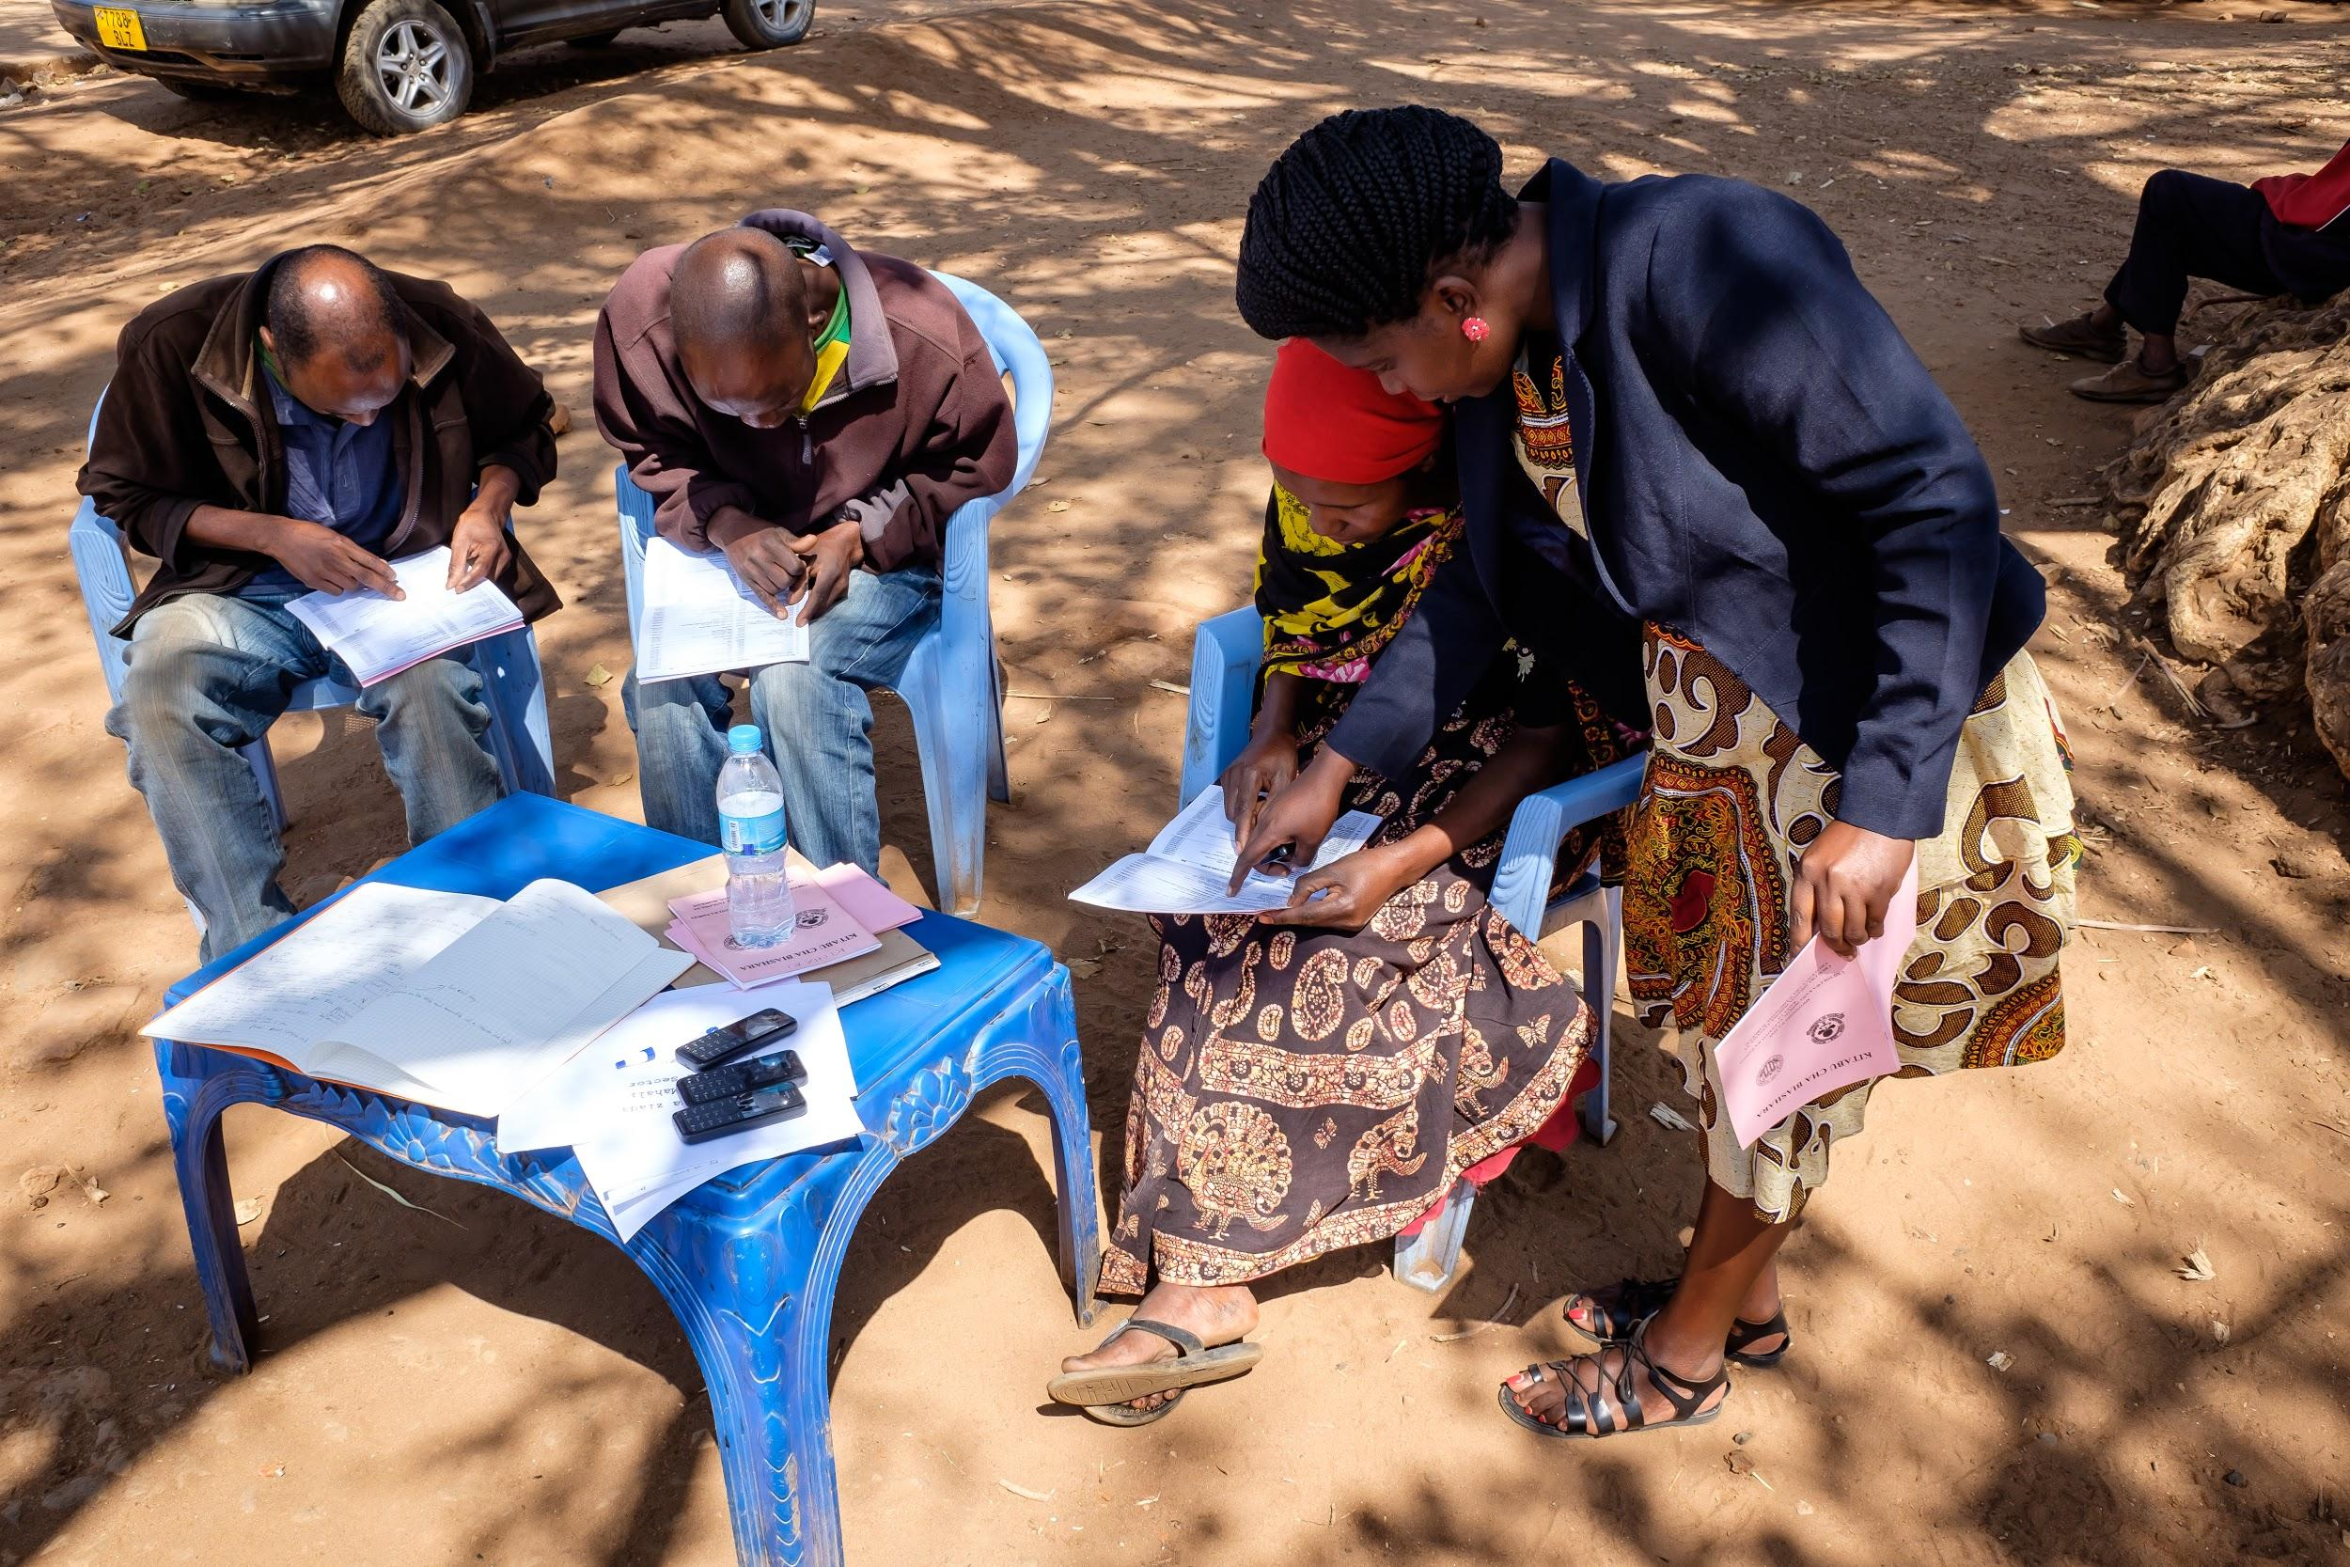
Phase 3: Phone Surveys
Follow-up with deployment participants
Addressed topics unavailable from logging
Gathered anecdotes

Slide 15
Results

Slide 16
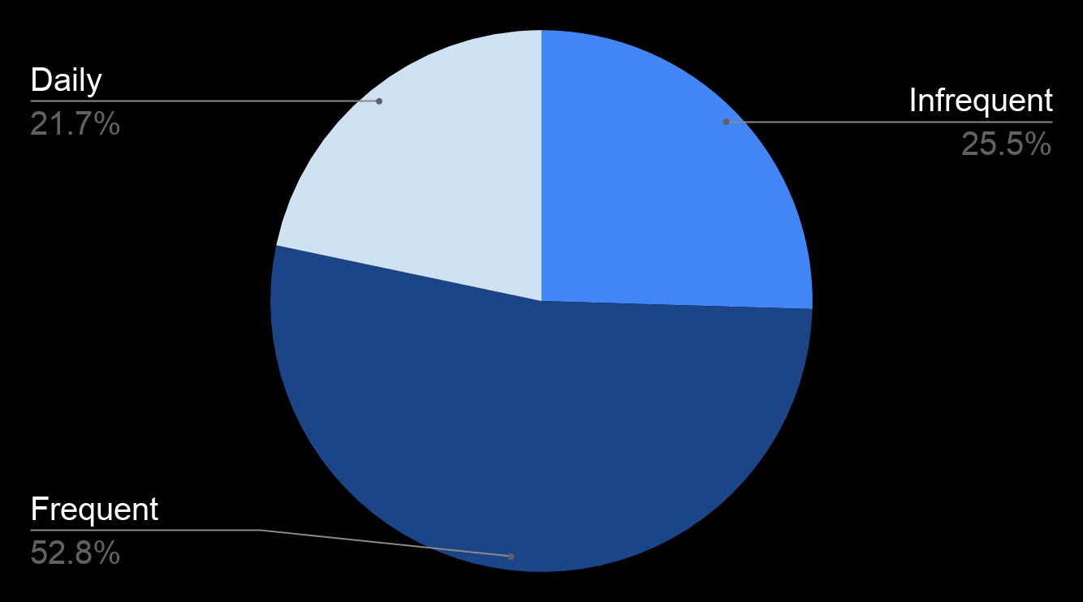
Usage
Session Frequency Per Participant (30 day duration)
Notes:
Histogram of the number of sessions per participant excluding training sessions over the 30 day study period.
25% of users were ‘Infrequent,’ with less than 5 sessions
53% of users ‘Frequent’ accessing the eKichabi every few days, with between 5 and 25 sessions
22% of users were ‘Daily’ users, accessing the eKichabi more than 25 times over the course of the study.

Slide 17
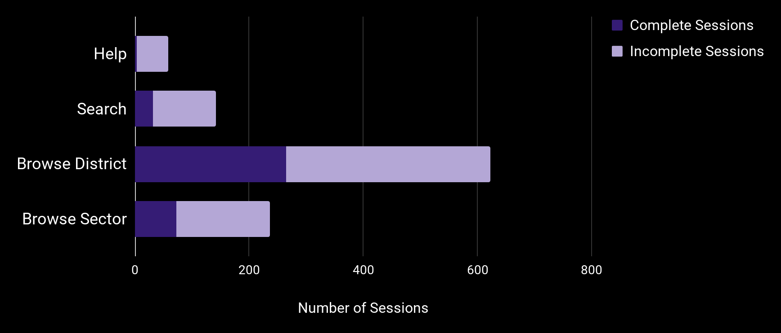
Usage Modes
Number of Sessions by Usage Mode
22%
43%
31%
Notes:
Complete sessions – sessions ending on a business details screen
Browsing modes more popular (75%) overall, and also have higher completion rate
Steeper learning curve of Search
Most participants had clear preferences:
Tafuta (Search) is the best, because you don’t have to choose from so many options.”
Search is best “because it’s short and simple to get to the business you are searching for.”
Participants liked selecting from a list of options.
“The most preferred is Chagua Mahali (Browse by Location) and Chagua Sector (Browse by Sector), because they have so many options to look up that allow any person to choose different villages and sub villages.”
Interesting Result from Phone Survey and Focus Groups – U shaped preferences of Search

Slide 18
Survey Findings
“I looked up the business in Itiso and called a boda boda guy to seek the transport.”
“I am a crop trader, and I called merchants in Dodoma to inquire about prices for my crops. I called several businesses to find who would give me the best prices.”
“I called a seed vendor in Kondoa, and negotiated over the phone, then he drove the seeds [to my village].”
Notes:
Transport to or from unfamiliar locations:
Price comparisons for buying or selling items:
Negotiation of deals without needing to travel:

Slide 19
Application Accessibility
Search – surprising that it was popular!
Potentially easier for those with poor eyesight.
Familiarity with other USSD applications improves fluency
Mobile Money
Airtime Top-up

Slide 20
Conclusion

Slide 21
Feasibility – Successfully demonstrated deployment of USSD-based information seeking application with thousands of entries.
Usability – Application was usable. Scrolling through long lists, and text entry for search were all handled.
Acceptability – Fulfilled an unmet need for business information to participants. Useful in many situations…
Notes:
Session-time outs did not appear to be a major limiting factor, 2,000+ sessions with 10,000+ screen views were hosted with 97% uptime. Time-outs could be improved.
Users reported the application to be usable. Handling of scrolling through long lists, search and text input. Some users were frustrated, and special populations (eg poor eyesight) have greater challenges. Confusion with long menus, and greater “back” discoverability all important room for improvement.

Slide 22
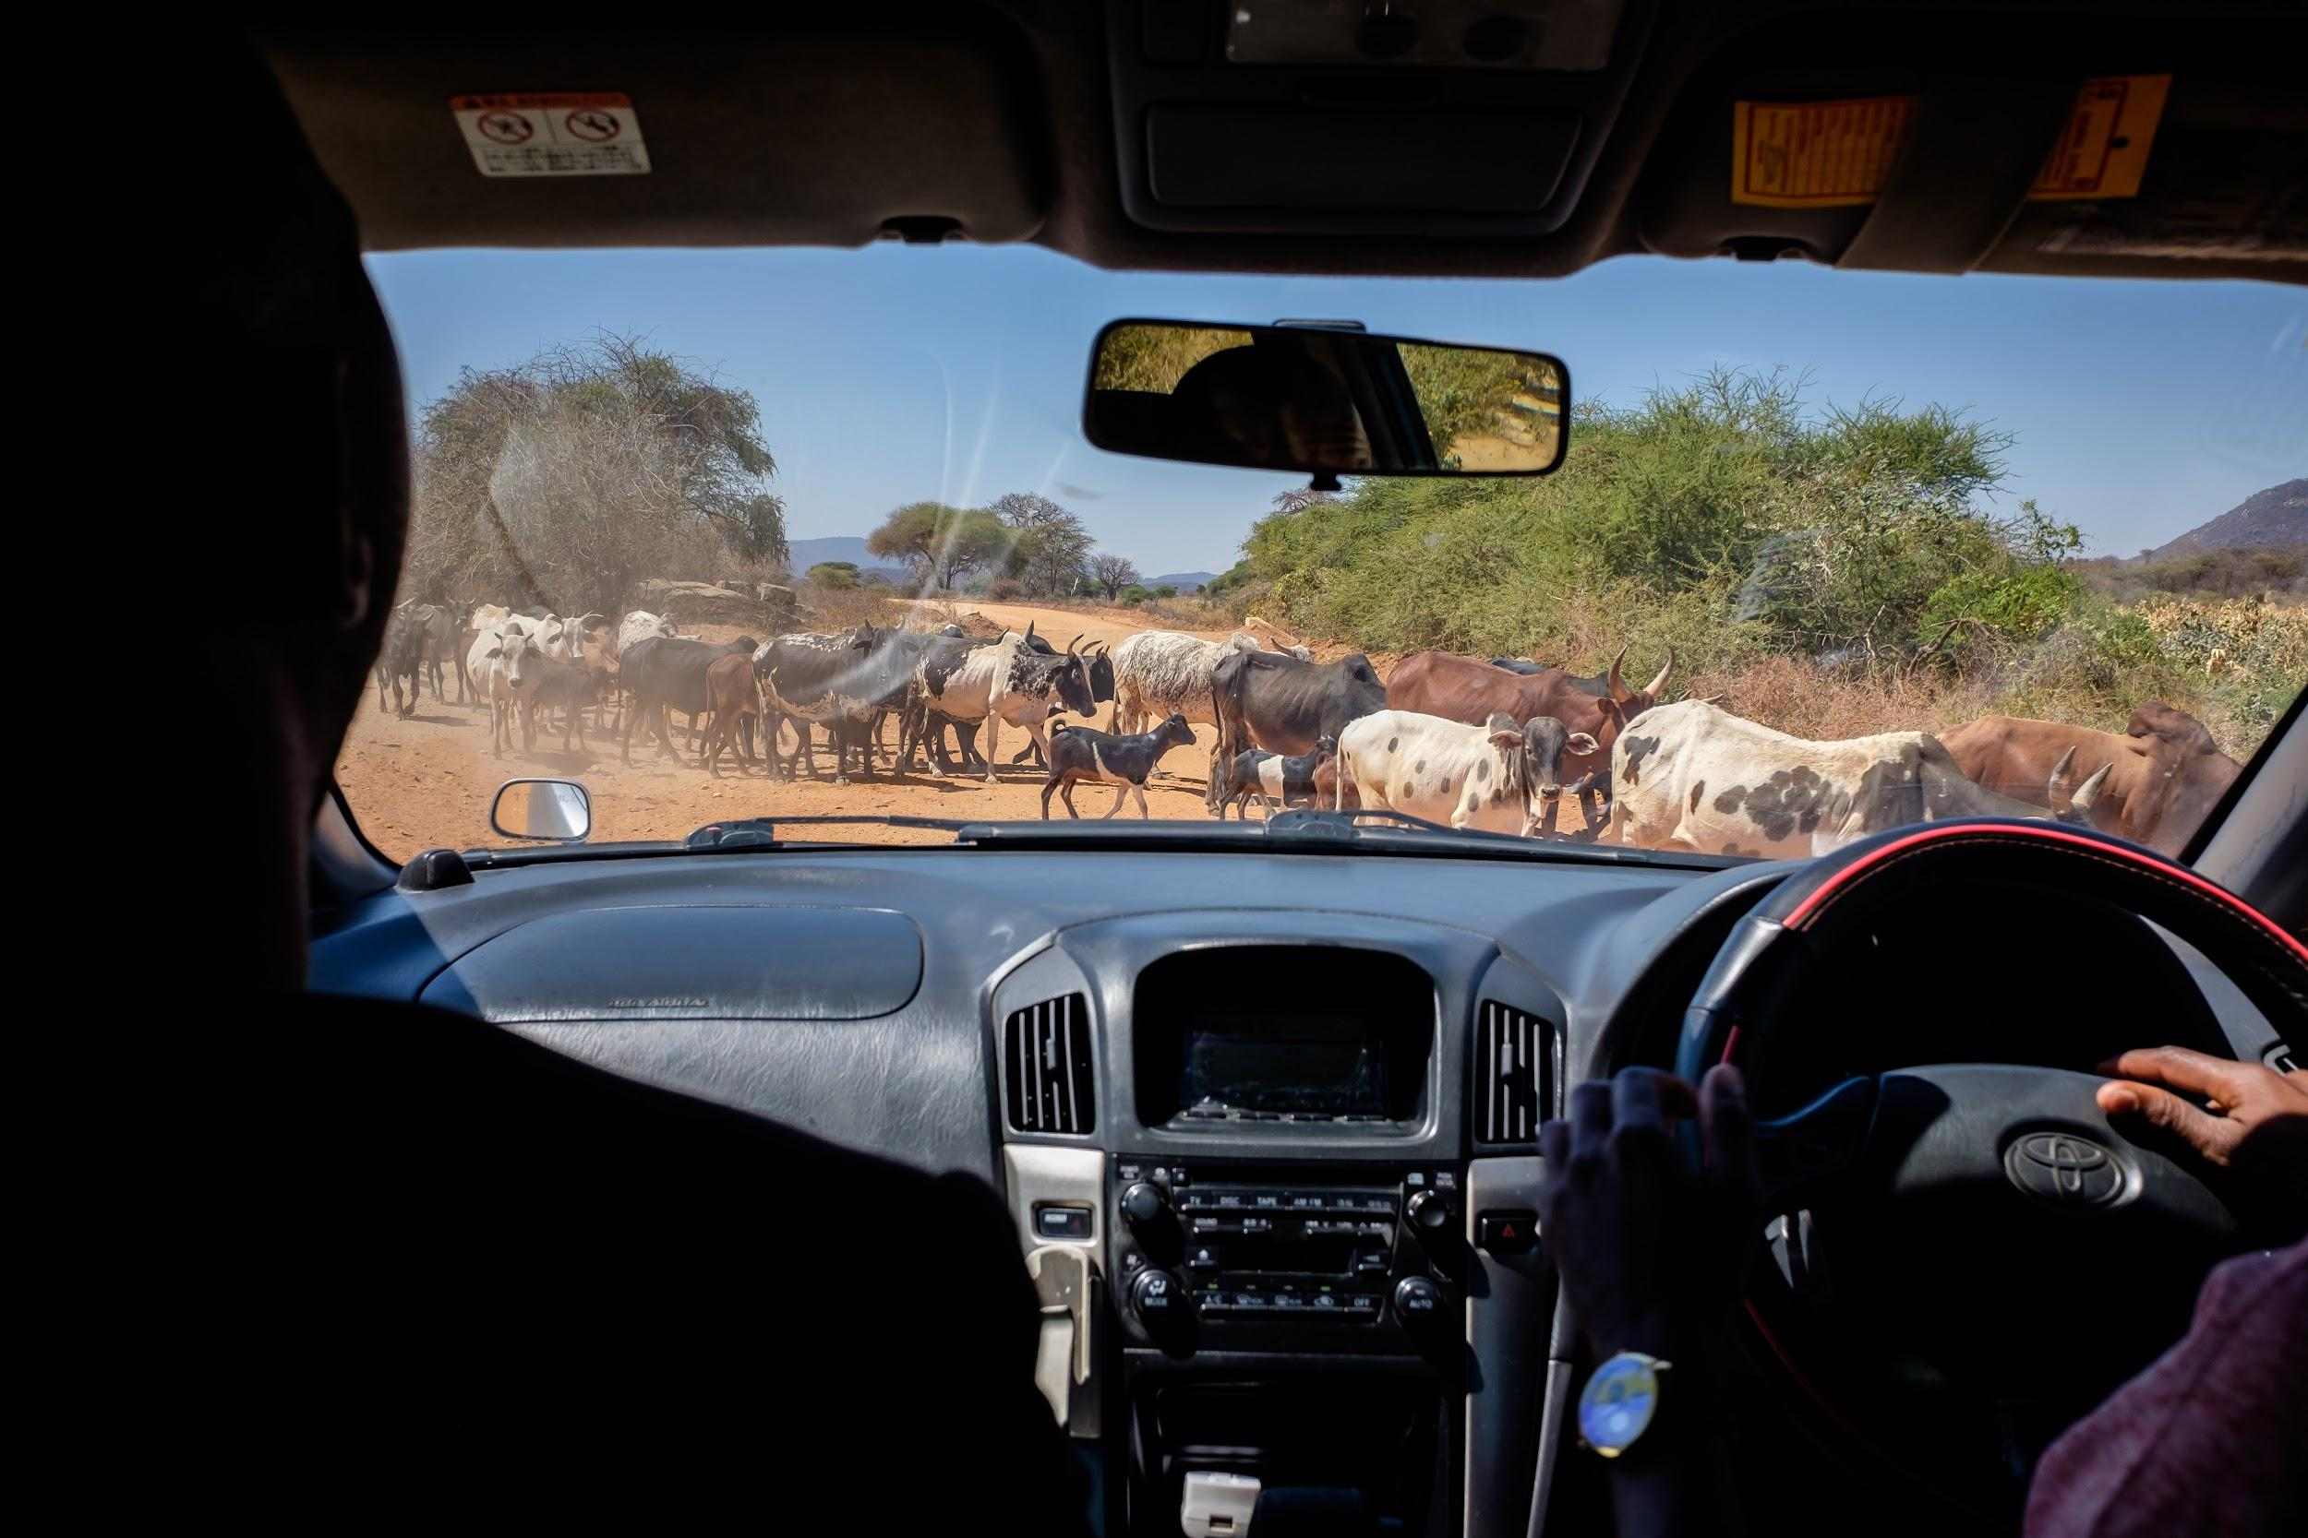
Future Work
Self-enrollment into the system
Scalability – more hierarchy in menus increases confusion
Cost and business models for expansion

Slide 24
Thank You

Slide 25
eKichabi 2.0

Slide 26
Reboot of eKichabi
Initial results demonstrated
Basic directory information is useful and in demand
Basic phone version is feasible
Needs to be low cost
Scalability depends on having a mobile phone version

Slide 27
Mobile phones in Africa
Mobile phone technology leap frogged land lines
Essentially everyone has access to a mobile phone
Smartphones are dominant in urban markets
Data is relatively low cost (2 dollars per GB, pre-paid)
Phone models – lower cost Android models
Some deployment issues around low cost phones
Rural areas are a mix of basic phones and smart phones
There is a big issue around charging phones in areas with poor grid power
Cellular coverage may be inconsistent

Slide 28
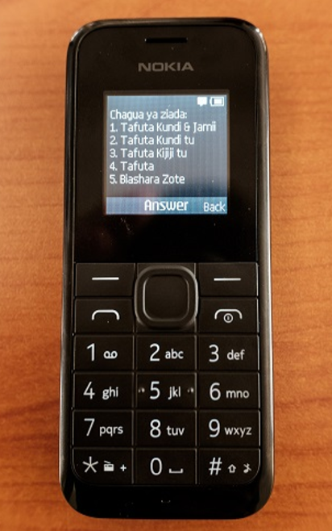
USSD Unstructured Supplementary Service Data
Session based protocol for communicating by text between handset and service provider
Initiated with a short code, e.g., *144# to check Safaricom balance
160 character strings sent back and forth between handset and provider until session is terminated
Key differences from SMS
Synchronized communication
Direct with service provider: better security
Does not leave messages on the phone
Applications
Adding services to cell service
Mobile Money
Yellow Pages Directory

Slide 29
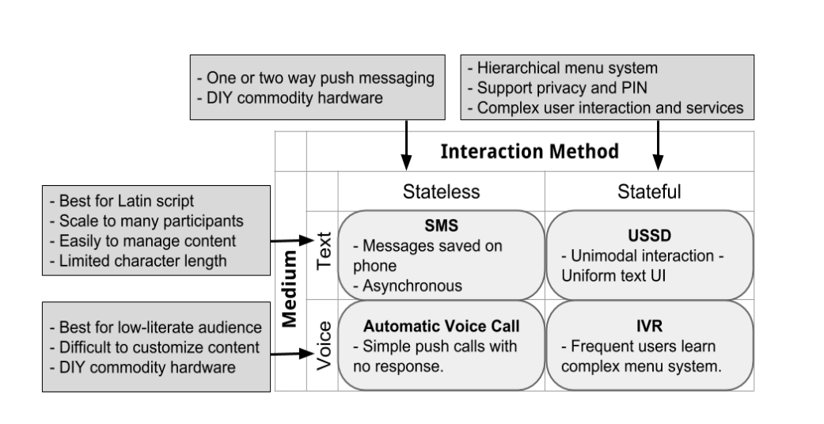
Universal Apps

Slide 30
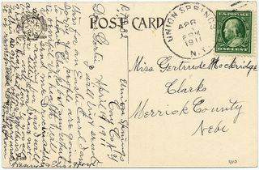
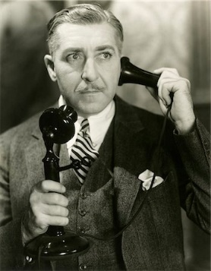
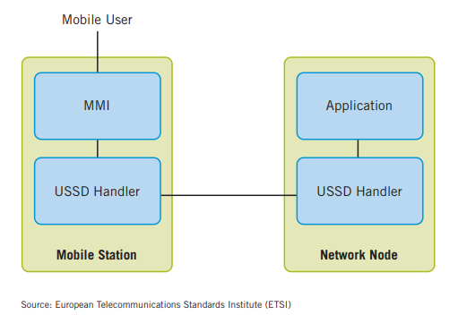
USSD Protocol
Networking: Post cards vs. phone calls
Session opened between mobile operator and handset
Can be opened in either directions
Fixed size messages with header and text payload
Phone number (short code) can trigger USSD app
Timeouts on operations
Session time out

Slide 31
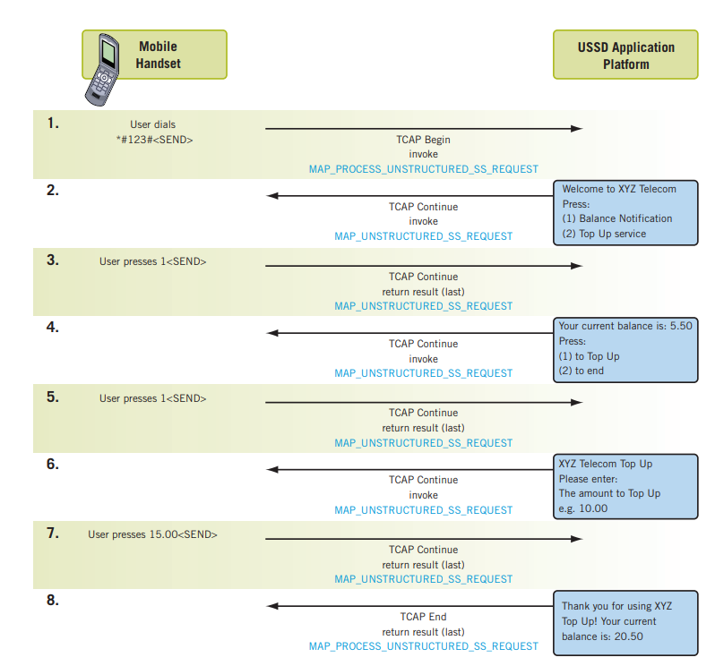
USSD Protocol

Slide 32
Implementation of USSD
Implement through a carrier
Option in US
Implement through a Gateway service
Africa’s Talking
Telerivet

Slide 33
eKichabi 2.0 Plans
Cornell et al.
Establish a team of enumerators in Tanzania to conduct business census in a region
Develop a research protocol on impact of an electronic phone directory
Conduct baseline surveys
Randomize implementations across study area
See what happens
UW
Support development and deployment of directory services
Develop smartphone and USSD version of the system
USSD services a subset of total services

Slide 34
Capstone questions to be addressed by prototypes
Basic system architecture
Mobile client
Basic services
Advanced services
User interface
Integration with USSD
Registration module
Design workflow for scaling
Registration tools (SMS, Web, Mobile App)
Support for managing agents (mobile app)
Verification process

Slide 35
Other possible things to explore and consider
Business opportunities around system
Security issues
Targeting lower literacy users
Multilingual design
Swahili necessary for Tanzania (but google translate is sufficient at this stage)
Develop with an English version as well

