Slide 1
ICTD Capstone Software Design for Underserved Populations
CSE 482b
Course Overview, January 4, 2022
Richard Anderson, Naveena Karusala

Slide 2
Today
Capstone Courses
Project Ideas

Slide 3
Development Engineering
Technological interventions to improve human and economic conditions in low-resource settings
An engineering discipline aimed at addressing global inequity
Develop principles for design, introduction, scaling, and sustainability of Global Good technology

Slide 4
What are the challenges
Domain challenges: Health, Education, Agriculture, Markets, Livelihoods, Infrastructure, Sanitation, Energy, Environmental Degradation
Resource constraints: Finance, Infrastructure, Distance, Education and literacy, Governance
Shocks: Climate Change, Global Pandemics

Slide 5
Setting
Rapid, global economic and technological change
Many technologies are globally accessible
Not just a split between “Developed” and “Developing Countries”, but within countries between “Urban-Affluent” and “Rural/Urban-Poor”
In many ways, the world is getting better
Increasing literacy rates
Decline in maternal mortality rates
Near elimination of diseases such as polio

Slide 6
ICTD, Information and Computing Technologies for Development
Technology with global impact
Appropriate for `low resource’ settings
Target development domains
Health, Education, Livelihood, Agriculture, Disaster Relief
This quarter, two themes:
eKichabi 2.0: prototype for yellow pages service for rural Africa
Global health and Covid-19

Slide 7
CSE Capstone courses
Capstone Goals
Projects must be large enough to require teams of several students to work on over one quarter.
Students must apply concepts from more than one sub-area of CSE (at the 300-level and above).
The work must involve a substantial design effort.
Students must present their work using formal oral presentations and written reports.
Efforts must culminate in an interesting, working artifact.

Slide 8
What I expect in a capstone
Group projects
Four or five people per team
Different roles
Design and Implementation
Multiple check points and expert review
Working, useful software
Reasonable software process
Presentation of results

Slide 9
Learning goals
Working in a team to deliver software
Developing a specification and solution idea
Choosing technologies and an architecture
Working in a team
Domain expertise
General knowledge of problem area
Appropriate applications of technology
Independent acquisition of knowledge

Slide 10
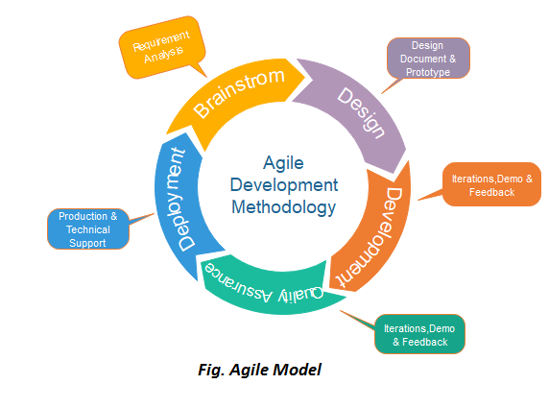
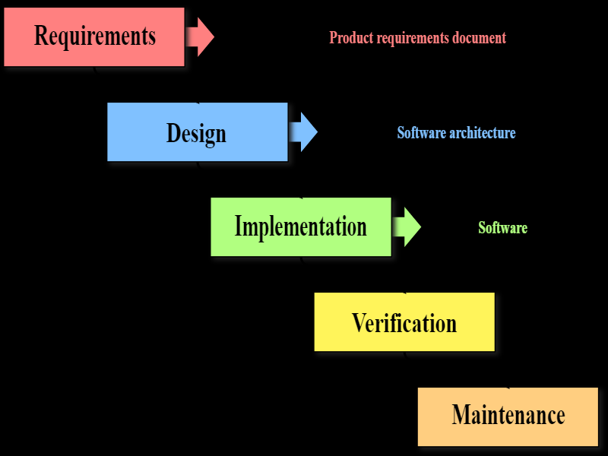
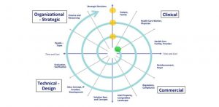
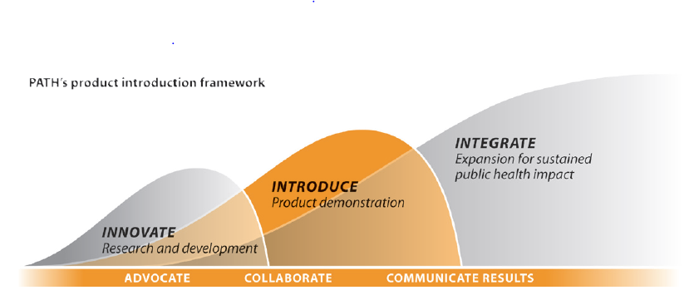
The capstone challenge
Too much stuff to fit into nine weeks in the spring
Focus on Design, Development & Implementation
Choose at start of course from a set of project ideas

Slide 11
Schedule
Today (Jan 4) – present project ideas
Thursday (Jan 6) – establish project groups
Domain Presentation (Jan 11) : Kichabi
Domain Presentation (Jan 13) : Covid, Immunization, Global Health
Schedule (Dates tentative)
Project Pitch | January 18
Progress Report | February 1
Prototype Demo | February 22
Final Presentations | March 8 and March 10
Deliverables due: Code, Writeup | Friday, March 18

Slide 12
Course Mechanics
Group development of projects
Lectures/class meetings for first few weeks
If we are allowed to meet in person: Odegaard 136
Regular group meetings with course staff
Later class sessions for presentations and demos
Specific deliverables will be specified during the quarter
Final turn in will include code and a paper (~10 pages)

Slide 13
Project Ideas
eKichabi
Mobile customer application
Business registration module
Basic Phone Compatibility
Global Health and Covid
Vaccine Campaign Planning and Management
Epidemic Modeling / Vaccine Impact
Epidemic Analysis Tools
Global Data Integration

Slide 14
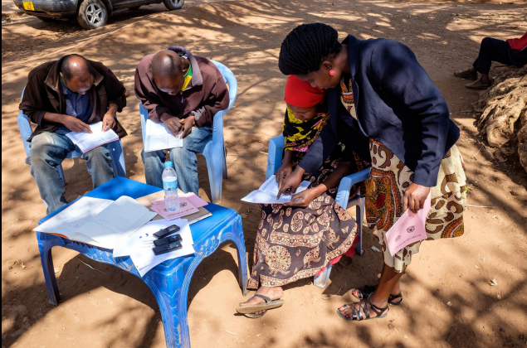
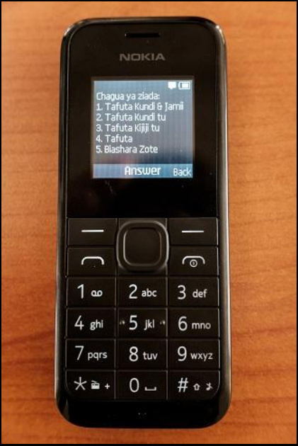
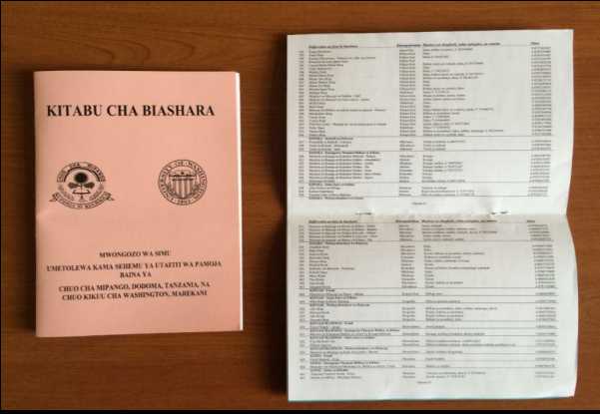
eKichabi
Development economists implemented a paper phone book for a district in Tanzania
Research question: Does information improve livelihood?
UW CSE developed a mobile phone version of the phone book
Technical contribution was the development of a scalable third-party USSD application
Technology paper in CHI, evaluation paper submitted by economists

Slide 15
eKichabi 2.0
Researchers from Cornell are launching a new version of the project in Tanzania
Rural, agricultural area, partially electrified, but with cell coverage
Hire a team to get business data
Smart phones are becoming available, so it makes sense to include a smart phone version
Compatibility with basic phone version required
Android the most common mobile phone
This project domain is to Prototype eKichabi 2.0
So it is not required to get all of the details right

Slide 16
eKichabi Projects
Mobile Application
Mobile client for interacting with Kichabi
Registration
Business registration module
Basic Phone Integration
USSD plus Smart Phone
If there are multiple teams, projects can be loosely integrated or independent

Slide 17
Global Goods Software
Software systems for global development
Health data reporting, medical records, human resource management, health insurance, logistics
Goal of Global Goods software is to have a positive impact
Generally, Open Source, but different models
Many projects depend on donor support
Projects often have a fairly long history
Barriers to entry

Slide 18
Informational Covid Chatbot
Chatbots created to share information about COVID-19, address misinformation, support related health behaviors (e.g., stress management), and answer FAQs
Define specific use cases and consider additional functionalities, such as registration/reminders for vaccines or reporting/evaluating misinformation

Slide 19
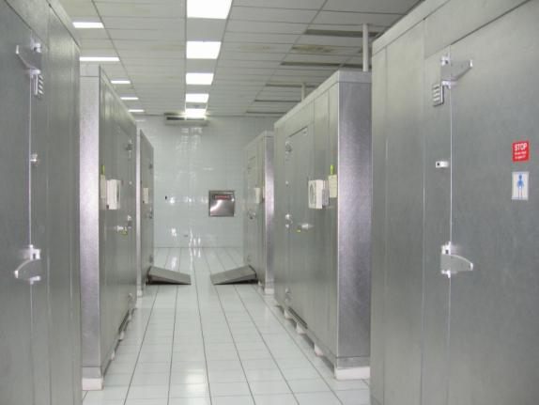
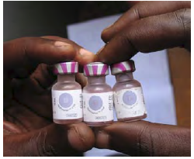
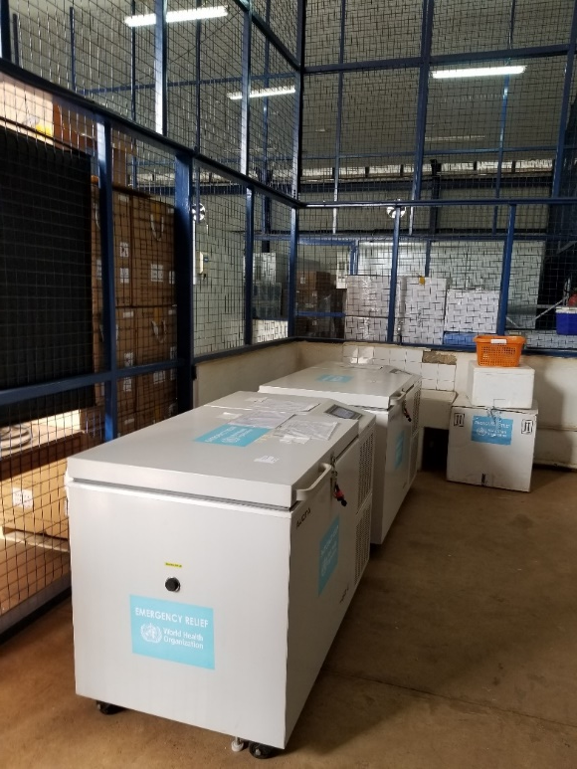
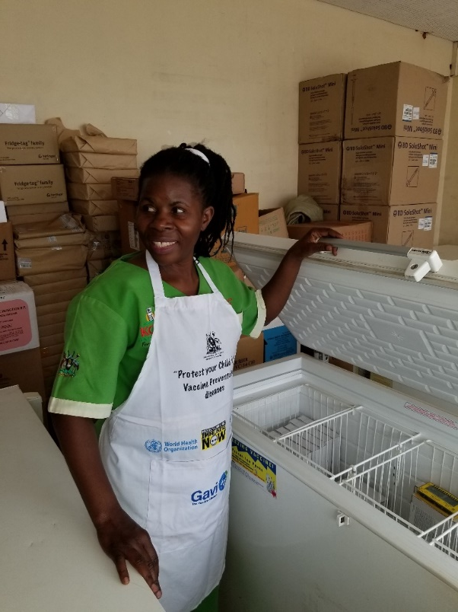
Vaccine Campaign Planning/Support Tool
Countries receive shipments of vaccines (millions of doses) and need to plan campaigns to distribute and use vaccines
Develop a system that manages the information needs for both distribution of vaccines and verification of immunization
The system could involve various existing tools such as DHIS2 and ODK
Focus on system architecture and domain understanding

Slide 20
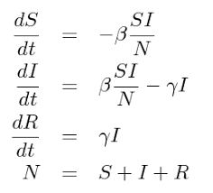
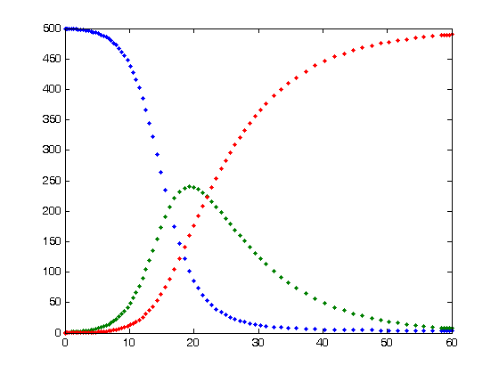
Epidemic Modeling Tools
Develop tools for modeling covid pandemic under different assumption
SIR framework (Susceptible, Infected, Recovered)
Extend models to include demographics and vaccination data
Compare with historical data
Lots of data is available and ready to build on

Slide 21
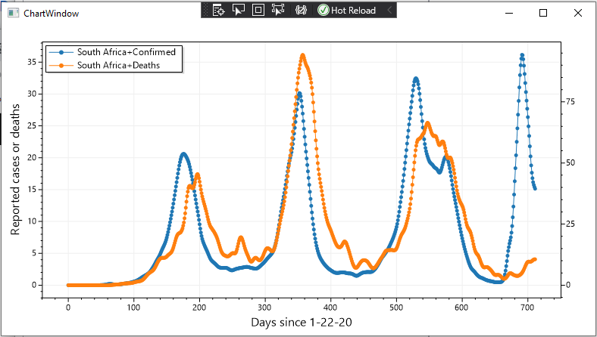
Global disease analysis tools
Very good data sources for covid
https://ourworldindata.org/,
https://github.com/CSSEGISandData/COVID-19
Develop tools for exploring different aspects of global data
Data aggregation
Topic specific analysis tools
Pick a topic area
Rural / urban correlations
Tracking waves of infection

Slide 22
Data Integration
Several different global sources for covid data
National results are aggregated, but sub-national in different sources
Mapping at local level (counties, census tracts) makes it possible to see different trends
General tools for data integration and map visualization would be very useful

Slide 23
Project List
eKichabi 2.0
Mobile client for interacting with Kichabi
Business registration module
Basic Phone Integration: USSD plus Smart Phone
Global Health / Covid-19
Informational Covid Chatbot
Vaccine Campaign Planning software support
Epidemic modeling tools
Global disease analysis tools
Covid data integration

