Slide 1
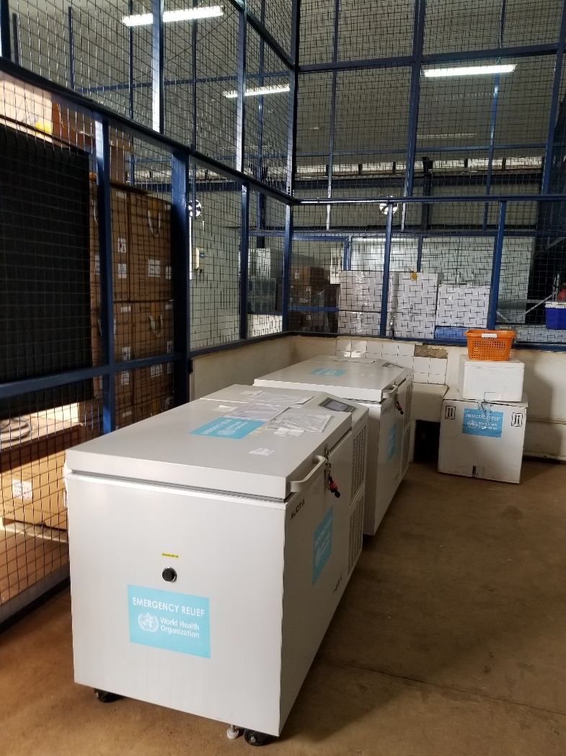
ICTD Capstone Software Design for Underserved Populations
CSE 482b
Cold chain InforMATION SYSTEM, April 13, 2021
Richard Anderson, Samia Ibtasam, Naveena Karusala

Slide 2
Schedule
Today
Cold chain information system
Check in with groups – breakout groups – 5 minutes each
Thursday – Group presentations
10:00 – Group 1: Vaccine Stock Tracker
10:15 – Group 2: Vaccine Passport
10:30 – Group 3: Immunization Campaign Planning
10:45 – Group 4: Notification / Registration Tool
11:00 – Group 5: Vaccine Impact Modelling tool

Slide 3
Admin stuff
Weekly group turn ins through Canvas
This week: Presentation Slides. Progress report.
I have some Android phones for projects who wish to use the Android platform
First presentation, Thursday, April 15
Project pitch
Slides
15 minutes per group
Goal of the course is for students to have a successful experience, as a team, developing software

Slide 4
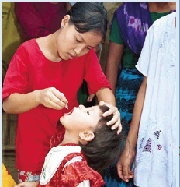
Immunization Domain Background
Vaccines are the same around the world
For many countries – immunization is managed and funded globally
Ministry of Health
National Immunization Program
Logistics

Slide 5
Developing Country Health System Structure
Health System Managed by Ministry of Health
Exception – some large countries such as India, Pakistan, and Nigeria will delegate some authority to the states
Health System divided into a collection of verticals such as infectious diseases and maternal and child health
Immunization is generally a separate vertical
(NIP) National Immunization Program or (EPI) Expanded Program for Immunization
Often a separate health information systems organization
Central Professional Staff with regional immunization officers
Set activities around immunization distribution, budgeting and reporting
Important interactions with global organizations and NGOs

Slide 6
Country immunization programs
Routine immunization programs
Ensure that all children receive all childhood immunizations
Generally results are fairly good – 80-90% vaccination
Children come in to clinics, or nurses hold village immunization days
Many health facilities are public, but there may also be religious, NGO, or private facilities
Immunization Campaigns
Period efforts to vaccinate populations with respect to an outbreak
Vaccinate everybody in the area
Measles (in response to an outbreak)
HPV (School based immunization)
Polio (done as a separate campaign)
Different groups of workers involved
Health program managers (Region, District)
Immunization Logistics
Health workers

Slide 7
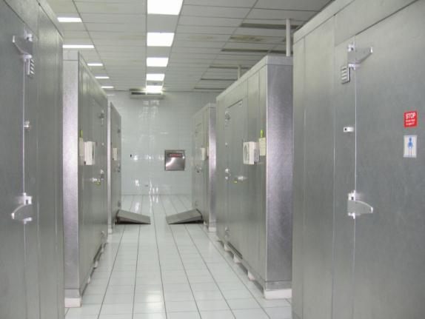
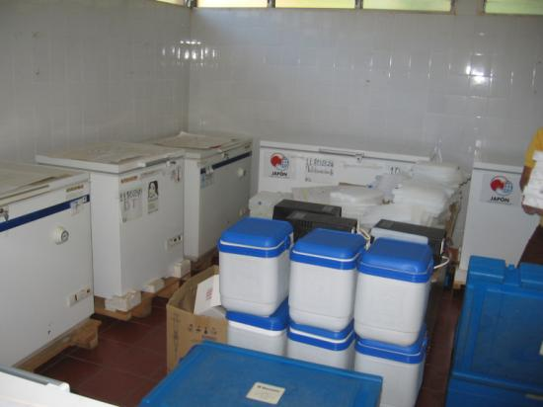
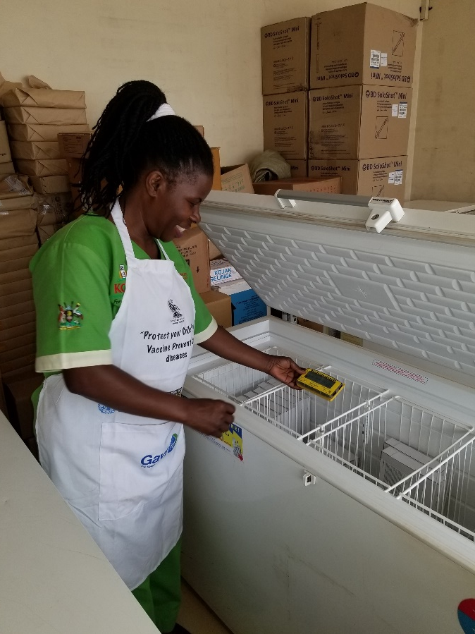
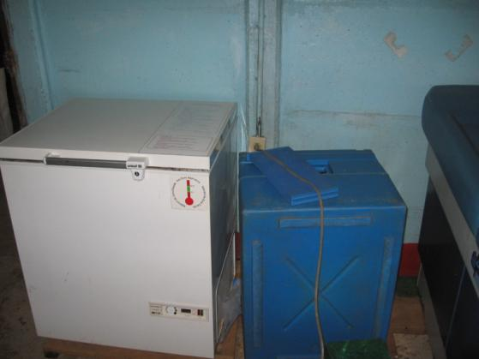
Immunization Cold Chain
Vaccine Manufacturers
National Vaccine Store
Regional Store
Regional Store
District Store
District Store
District Store
District Store
Health Center
Health Post
Health Post
Health Post

Slide 8
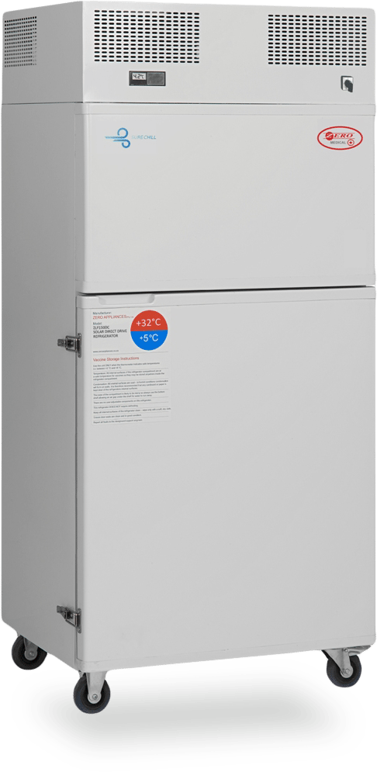
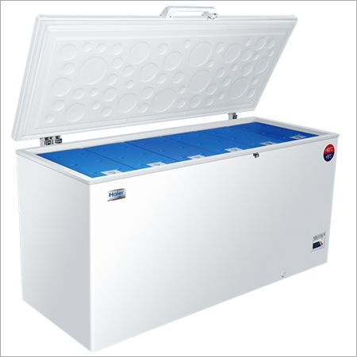
Immunization Cold Chain Challenges
Ensure that all countries have high quality vaccine cold chains
Working equipment at all points in vaccine supply chain
Sufficient capacity for vaccines
Refrigerators need power
Grid power, Solar power, Gas, Kerosene
Many areas suffer from regular power outages
Desire to replace Kerosene / Gas equipment with Solar
Equipment upgrades
Identify needs and determine order size
Remove obsolete equipment
Ensure proper installation
Establish repair infrastructure
Monitoring of equipment condition

Slide 9
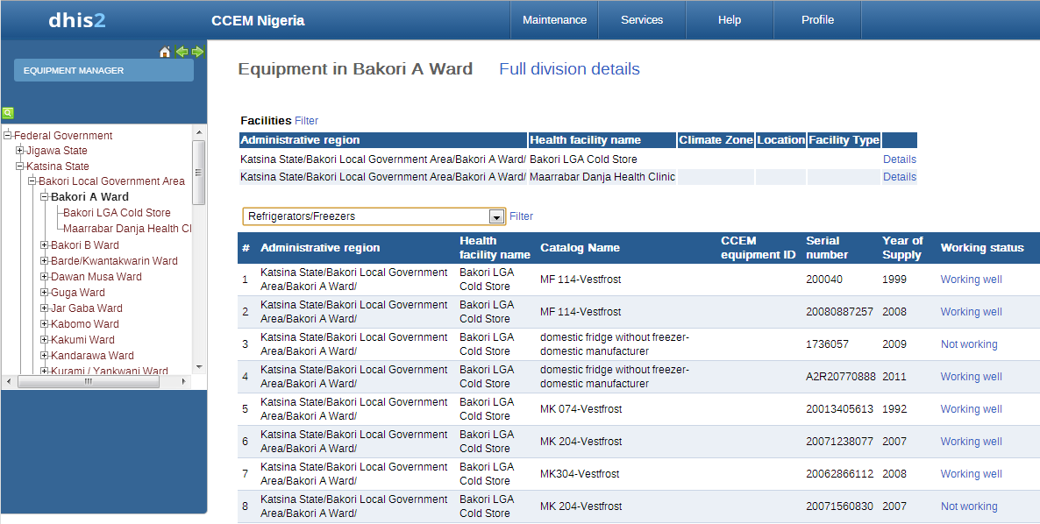
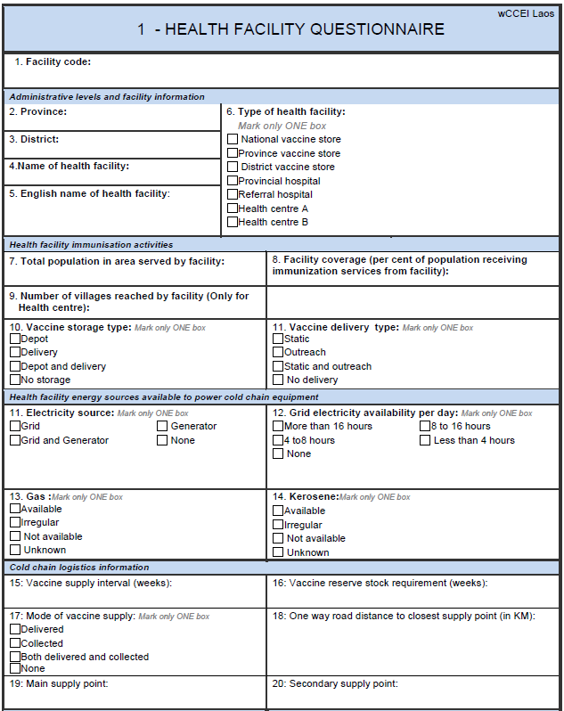
Cold Chain Equipment Inventories
No accurate global equipment inventories
Inconsistent at the country level
Inventories often become out of date
Not updated for equipment changes
Health facility information is also a challenge
Periodic efforts to collect inventory information for reporting
Often restricted to sampling
Fragmented data sources
Different health systems inside a country
Public, Private, NGO, Faith-based

Slide 10
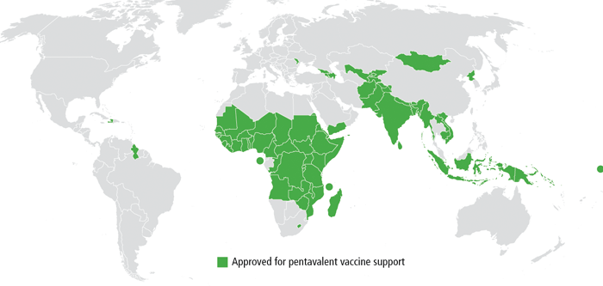
Vision
Country Cold Chain Information System
Global Cold Chain Information System
Country Cold Chain Information System
Country Cold Chain Information System

Slide 11
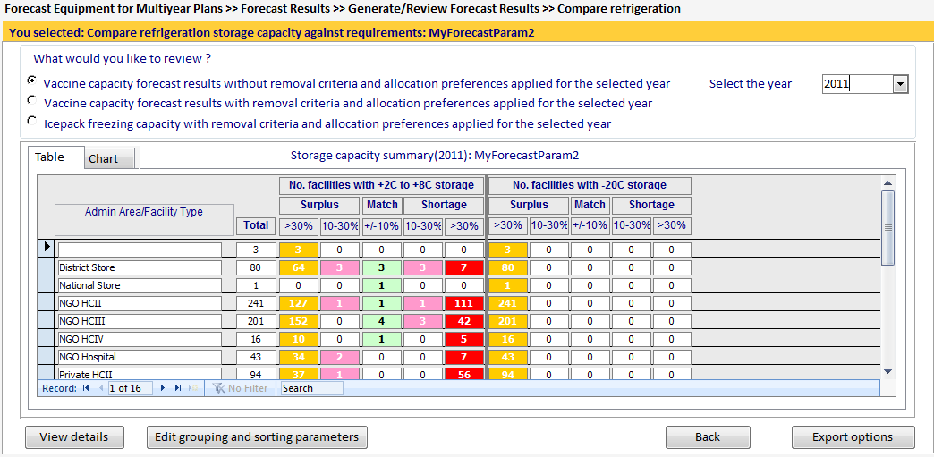
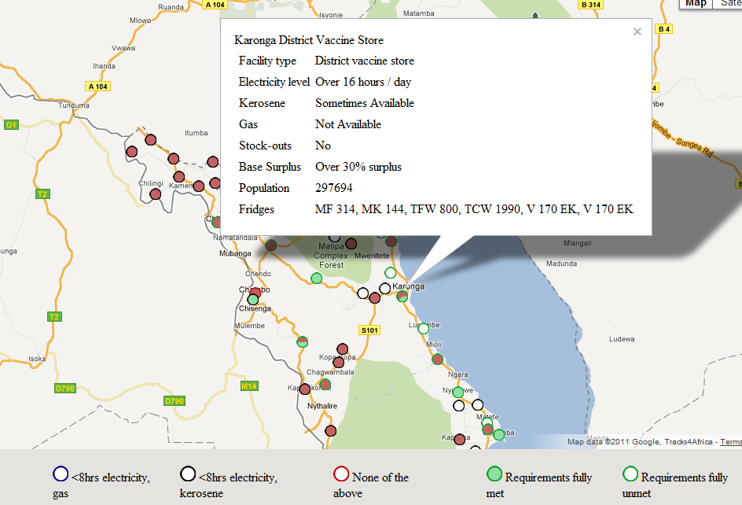
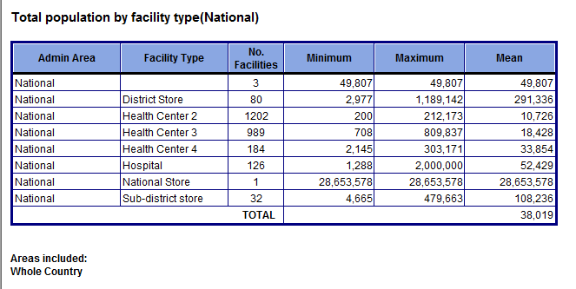
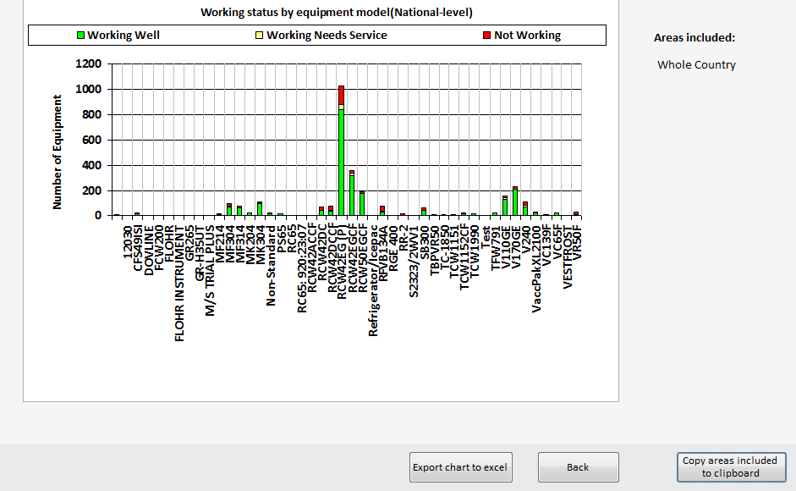
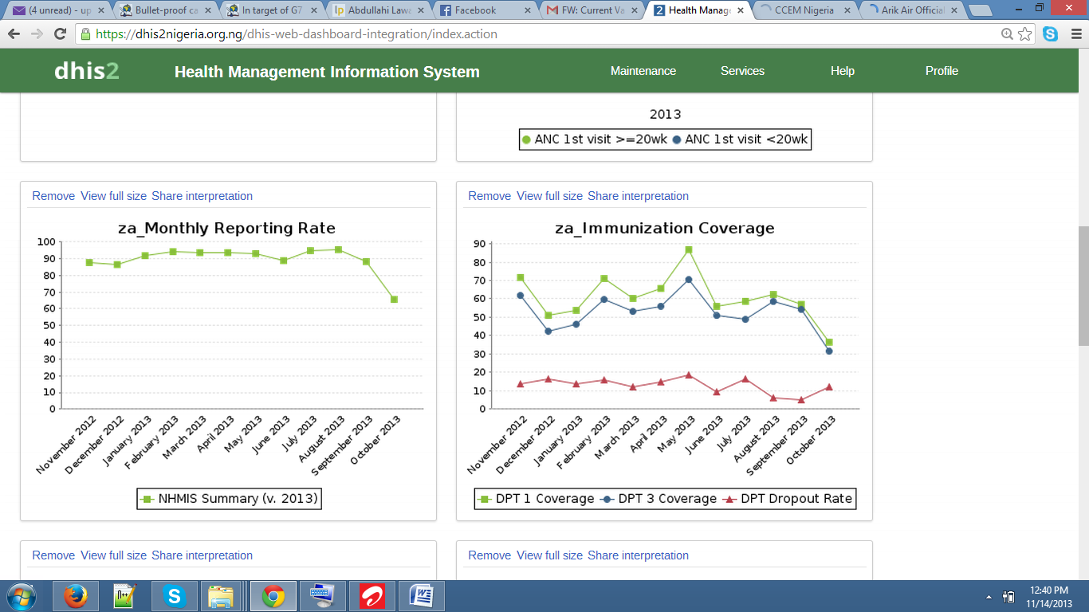
Part I: Visualizing the Cold Chain
Map based visualization
GIS Coords
Regions
Global Management Questions
Country summaries
Equipment trends
Integrated analysis tools and models
Country Cold Chain Management
Equipment management
Allocation
Reporting

Slide 12
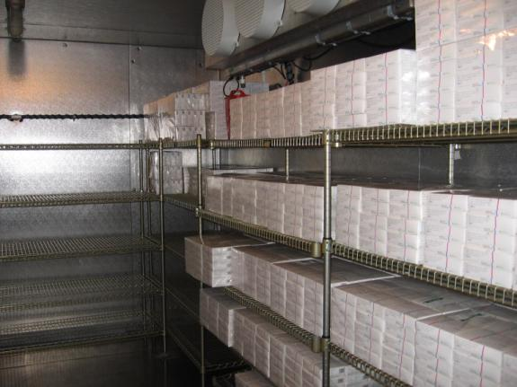
Part II: Data Management
Cold Chain Equipment Inventory
Basic equipment and facility information
Tracking of performance and maintenance
Remote data updates
Keeping data up to date is the critical challenge
District cold chain supervisor responsible for managing equipment
Mobile App is feasible for district supervisors
Integrate with other Health Information Systems
Ownership by the country

Slide 13
ODK-X
Mobile data collection on Android Phones. Project started at University of Washington by Professor Gaetano Borriello
Open Data Kit 1.0 aka ODK
Submission of forms
Open Data Kit 2.0 aka ODK-X
Synchronization with a database
Open source tools. Strong commitment to contributing to global good software

Slide 14
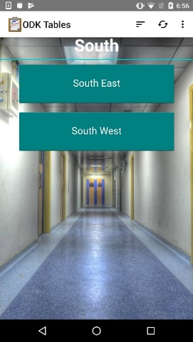
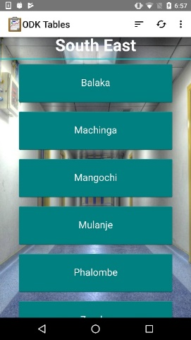
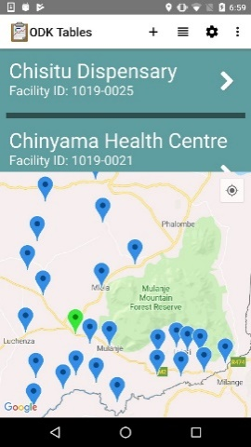
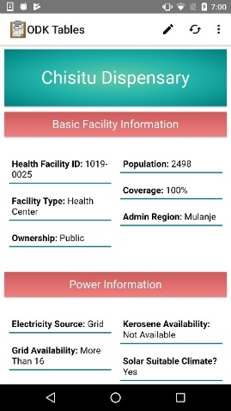
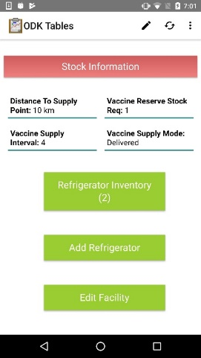
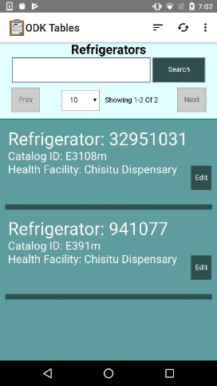
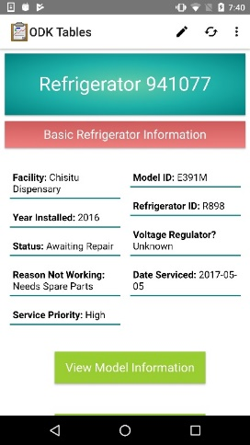
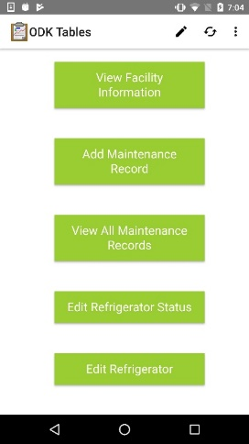
Cold Chain App
App built on top of the ODK-X platform
Combination of ODK Survey and ODK Tables
Written in Java Script
Manage a database of health facilities and refrigerators associated with facilities

Slide 15
Architecture
Global Cold Chain Information System
Dash Board
Database
Report Generation
ODK-X Client
ODK-X Server
Country Database
Local Database
ODK-X Client
Data Bridge
Local Database
CCEM

Slide 16
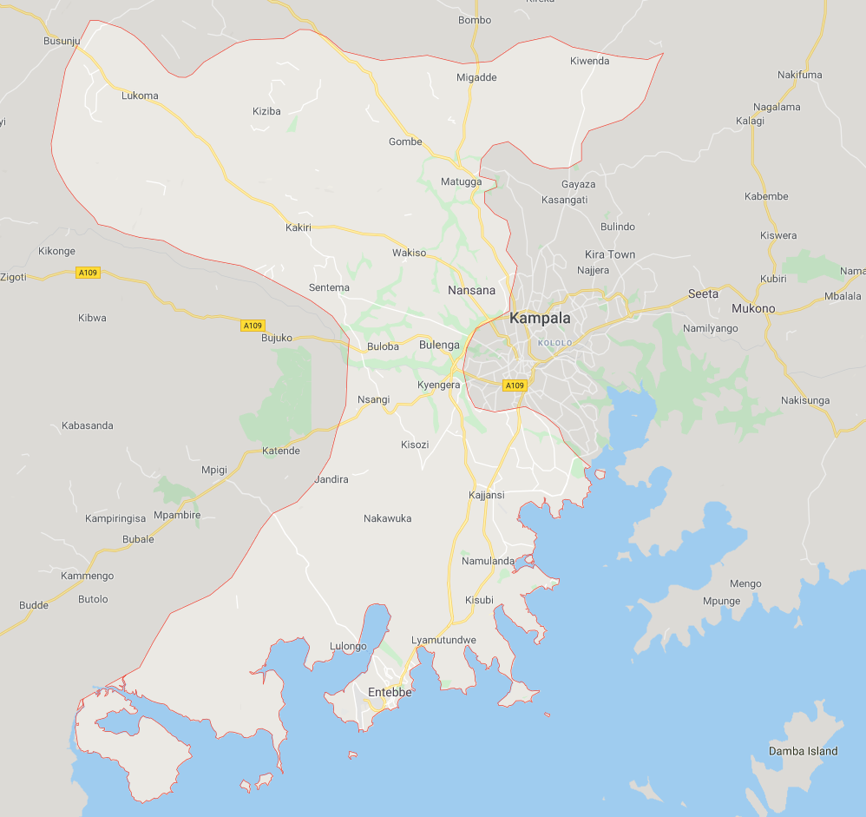
Project Status
Cold Chain Visualization project – team YAASS
Cold Chain App prototype
WHO Deployment
Haiti, Pakistan, DRC, Bangladesh
Sentinel Surveillance officers
GAVI Deployment – Uganda
Two regions - Kampala and Wakiso (13 Districts)
Expansion to national scale underway

Slide 17
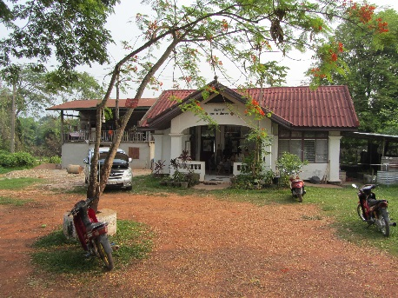
Pilot phase results
Deployment in 14 districts for four months
Usage
Updated cold chain inventory across 14 districts
Feasibility Assessment
Usage
Impact measures
What was done with the data
Update cold chain equipment inventory
Prioritize maintenance and repairs of equipment
Retire obsolete equipment
Potential long term impact
Strengthen vaccine cold chain

Slide 18
Results: Functionality
Updating CCEI
Data reported from 80.15% of the 394 HCFs in the study districts
Data reported from 80.77% of the 486 CCE in the study districts
Frequency of temperature excursion:
Analysis: CCE functionality
Analysis: CCE temperature performance
Analysis:
60 non-functional CCE out of 489 in study as of July 10,2020
Prioritizing repair:
129 Out of 795 entries showed CCE with either freeze (35) or high alarm (94) data

Slide 19
Results: Functionality
Reporting maintenance and repair
Analysis: Spare parts
Type of maintenance | Frequency reported
Preventive | 133
Repair | 3
Other | 5
Blank | 12
TOTAL | 153
Spare part | No.
Thermostat controller | 2
Voltage stabilizer | 12
Solar related part (unknown) | 1
Analysis: No. maintenance activities performed at each visit
Analysis: Preventative maintenance activities
Notes:
See here for data analysis & source
Note the spare parts data comes from a mix of the “actions taken” column and “spare parts” columns.

Slide 20
Results: Acceptability
ODK-X advantages | ODK-X challenges
Very easy to use with clear questions Reduces resource requirements for reporting Simplifies work processes (e.g., sending monthly report on vaccine fridges). It reduced to burden of dealing with reports hard copies and their space for storage. User friendly and saved time. I liked the ability to change only what needed to be updated. Clear, accurate, accessible data set: it enabled us to know what is expected at a facility, be able to tell what is missing, and review maintenance records. CCE inventories to all facilities is kept readily available and retrievable at all times. Timely, simple reporting: it eases the movement of data from facilities to the ministry and allows for faster repair & replacements. Monthly Temperature reporting is quite simplified and can be timely. Helps track CCE movement Features: Easy to locate facilities on map; works offline; easy to access data, e.g., fridge maintenance records and status really stands out | No vaccine storage information. For example capturing data with in the vaccine and injection material control book. Also it does not cater for monthly Vaccine utilization and monitoring yet it's also essential. HCF codes: Some DCCT/As do not know the healthcare facility codes, which could lead to inaccurate data Adjust permissions so DCCT/A only sees facilities within their catchment area The number of pages are many. If possible, they should summarize on the pages Since it was a new tool sometimes the phone would freeze and loose all data which would require to start afresh Relying on network to sync data Delay in picking geographical coordinates and accuracy In temperature reports at the section of number of days +8, to some facilities the data charted is far different from the fridge tag data when retrieved from it using the attached USB in computer. Entering Maintenance activities performed on the cold chain equipment [is a challenge] because some words and parts seem to be particularly for DCCTs than DCCAs.

Slide 21
Scaling
Deploy at national scale
All 140 districts
Transfer ownership to Ministry of Health
Made possible by strong partnership with a Global Health NGO

Slide 22
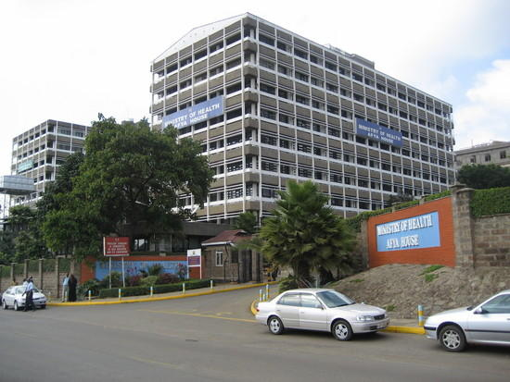
Transfer to country ownership
Goal: Project fully managed and owned by country at the end of one year
Steps:
Infrastructure managed by country
Build technical team to run the project
Capacity development
Implementation:
Develop transfer plan at the start of the project
Identify components that are country managed at start, such as managing servers
Country concern
Technical capacity to run the project in the future
Global goods model consistent with country ownership

Slide 23
Scaling the application
Technical questions
What is the server requirement for a national deployment
What are the other issues / concerns as the number of users increase?
A useful thought experiment for scaling is to thinking about how teaching a 20 person class is similar/different from teaching a 200 person class

Slide 24
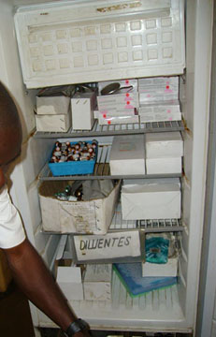
National scale roll out
Finalize application
Finalize data set
Establish technical teams
Configure national infrastructure
Phased training
Workshop training by region
Training has multiple components
App use
Platform (ODK-X) use
Workflow
Policies

Slide 25
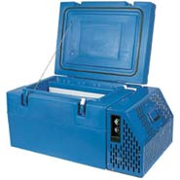
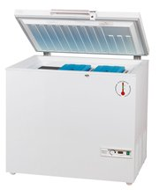
Device management
Project requires each technician to have an Android Phone
This is now a feasible requirements
Strategies
Provision devices to all workers
Personally owned devices
Risk to project
Project becomes a device management project
Overhead of account/credential management

Slide 26
Data configuration
Surprising challenge: Getting good data
Need to have a national list of health facilities with administrative regions and geocodes
Multiple lists of health facilities
Administrative regions change

Slide 27
Health Information System Software as a Political Process
Multiple systems are present in an information system
Different goals of technical managers
Desire for a ``rational’’ system
Importance of system alignment and integration
Stakeholders: Donors, Global Orgs, MoH IT, Health Departments
Sahay, Sundeep; Monteiro, Eric; and Aanestad, Margunn (2009) "Configurable Politics and Asymmetric Integration: Health e-Infrastructures in India," Journal of the Association for Information Systems: Vol. 10 : Iss. 5 , Article 4. DOI: 10.17705/1jais.00198. Available at: https://aisel.aisnet.org/jais/vol10/iss5/4

Slide 28
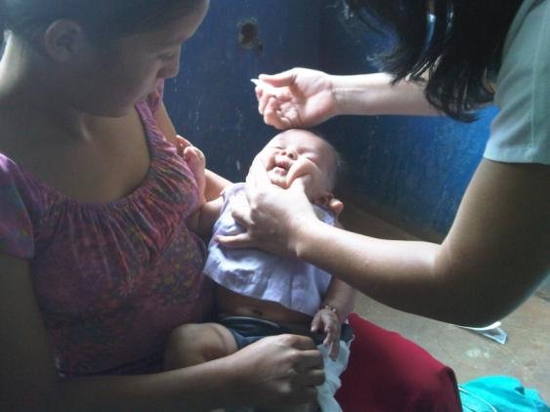
Evaluation at scale
What will success look like?
Success as a product
Sales and customer use
Is the Android Application used by 90% of cold chain technicians after 3 years
Success as a system intervention – impact on the vaccine cold chain
Cold chain equipment inventory
Quality of cold chain equipment
Maintenance metrics
Success on public health
Hard to measure as this is contributing to the immunization program is responsible for impact

Slide 29
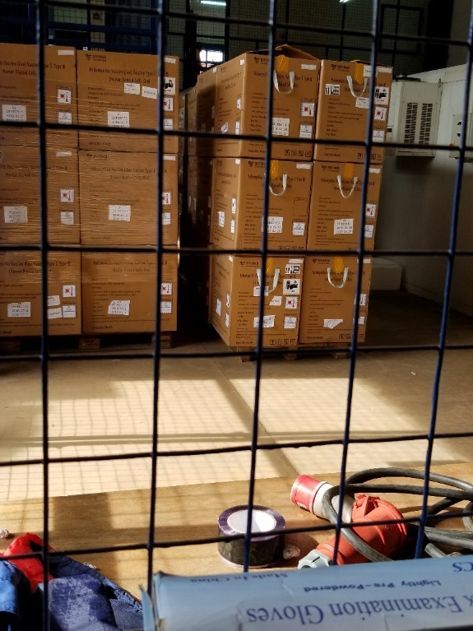
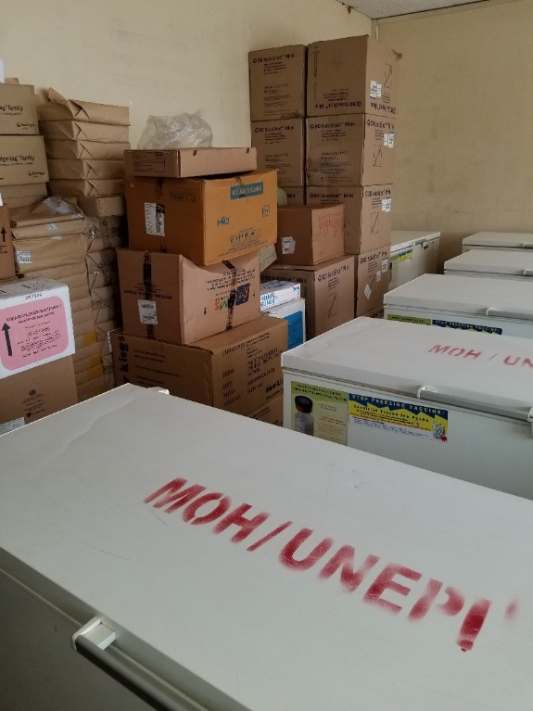
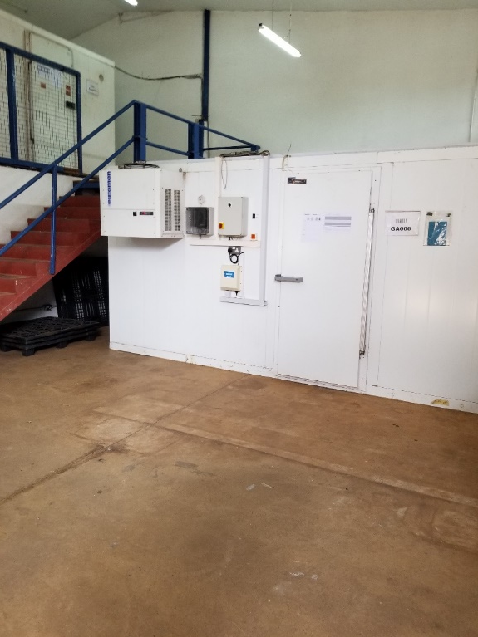
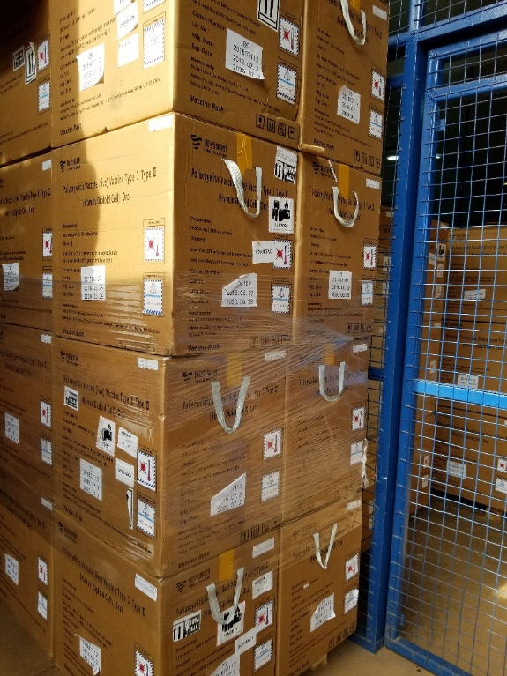
Questions and Discussion
Richard Anderson anderson@cs.washington.edu

