Slide 1
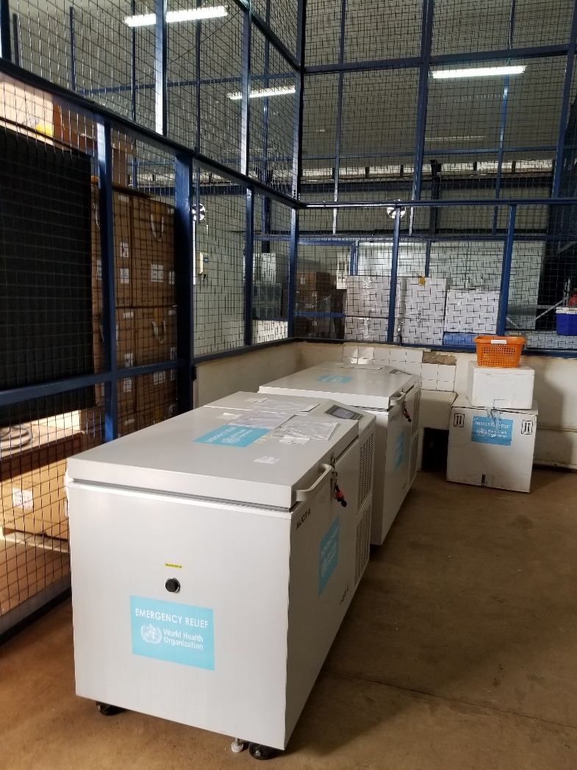
ICTD Capstone Software Design for Underserved Populations
CSE 482b
Covid Vaccines, April 5, 2021
Richard Anderson, Samia Ibtasam, Naveena Karusala

Slide 2
Schedule
Today
Covid-19 vaccine background
10:40 - Meeting with Group 1: Vaccine Stock Tracker
11:00 - Meeting with Group 5: Vaccine Impact Modeling tool
Thursday
10:00 – Meeting with Group 2: Vaccine Passport
10:25 – Meeting with Group 3: Immunization Campaign Planning
10:50 – Meeting with Group 4: Notification / Registration Tool

Slide 3
Projects
Vaccine Stock Tracker
Vaccine Passport
Immunization Campaign Planning System
Notification / Registration tool
Vaccine Impact Modelling tool

Slide 4
Admin stuff
Weekly group turn ins through Canvas
This week: Use cases. Progress report.
First presentation, Thursday April 15
Project pitch
Slides
15 minutes per group
Review slides from 4/1 for course mechanics
Goal of the course is for students to have a successful experience, as a team, developing software

Slide 5
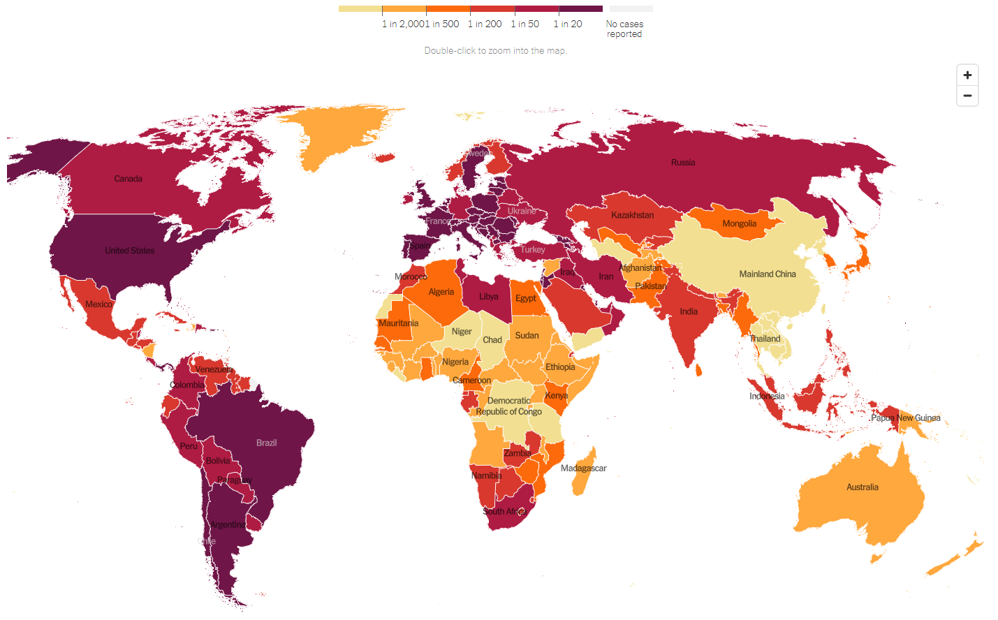
Global impact of Covid
New York Times

Slide 6
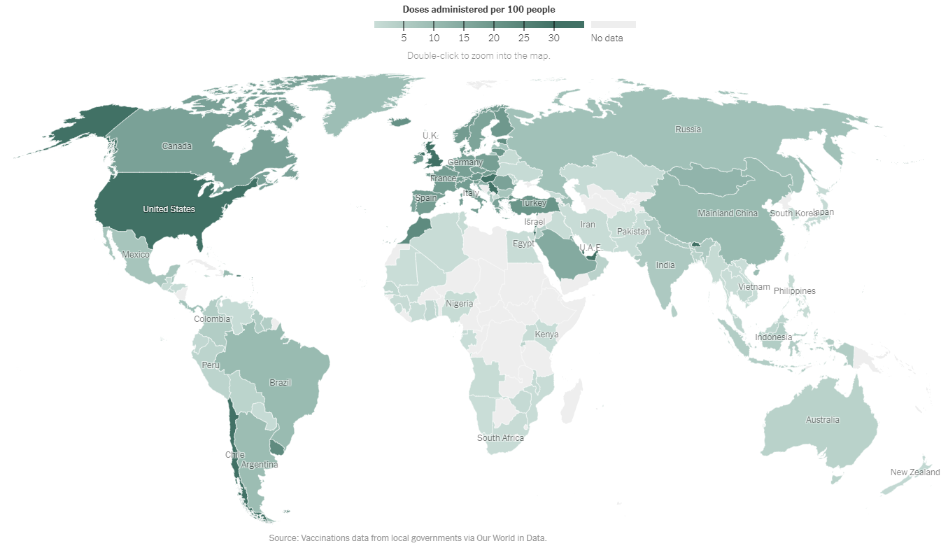
Background on Covid-19 Vaccines
New York Times

Slide 7
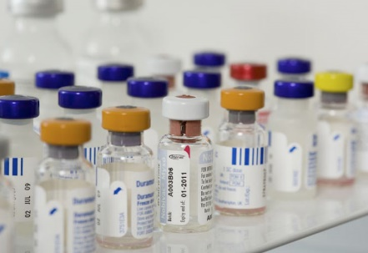
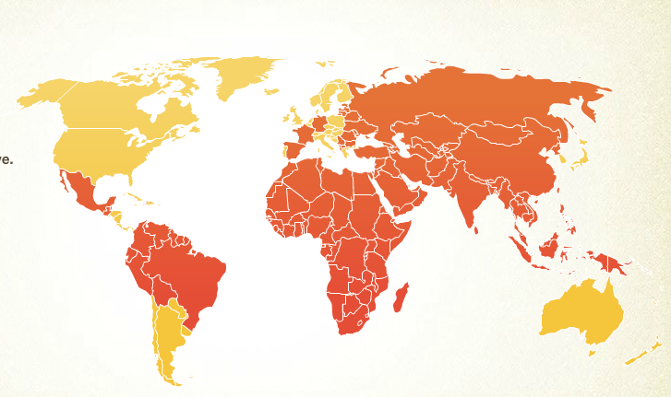
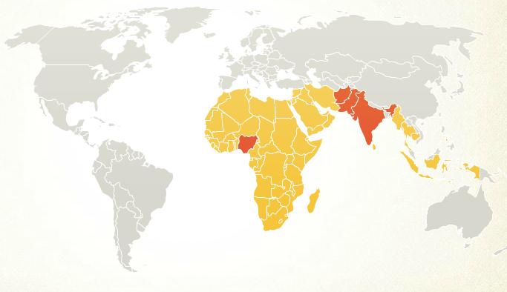
Immunization is one of the world’s most effective health interventions
Wide coverage of basic vaccines
Diphtheria, Pertussis, Tetanus: 77% in poorest countries
Tremendous reduction in deaths
Some diseases close to elimination
Polio (2018), 3 endemic countries, 29 cases of wild polio
Polio 1990
Polio 2008

Slide 8
How do vaccines work
Antibodies – body “learns” how to defend itself from diseases
Vaccination history from small pox
Weak version of the disease leads to immunity
Gradual evolution in technique
Low grade exposure
Weakened version of the disease
Dead version of the disease
Genetically engineered to target aspects of the disease
mRNA vaccines

Slide 9
Covid Vaccines
13 Authorized/approved vaccines (As of April 1, 2021), about 50 in development
mRNA
Pfizer
Moderna
Viral vector
AstraZeneca
Sputnik (Russia)
Johnson and Johnson
Inactivated
Beijing Institute of Biological Products
Sinopharm
Covaxin (India)

Slide 10
Vaccine development and approval
Vaccine development is a well understood process
Usually, vaccine development is very slow and requires multiple types of approval
Standard trial regime: Phase 1, Phase 2, Phase 3
Lots of things are evaluated in release of a new vaccine, or new formulation of a vaccine
Efficacy, side effects, dosage, stability
All this takes a long, long time
However, in an emergency, things move faster, such as the Ebola vaccine
All approved Covid vaccines have been approved under emergency use provisions
Companies had been working on vaccines for other SARS type viruses
So when Covid happened, lots of the work had been one
Lots of uncertainty about how well vaccines and vaccine programs actually work

Slide 11
Global Development
Global organizations set policy
Donors
Country ministries

Slide 12
Global Organizations
UNICEF
Support for immunization programs
WHO
Support for health programs
Global health governance
GAVI
Global vaccine alliance
Financial support for vaccines in low and middle income countries
DONORS
Supply the money and influence programs
NGOs
Global implementation

Slide 13
Funding Covid Vaccines
Covid vaccine cost between $8 and $30 per dose
10 dose vials
Most vaccines require two doses
Rich countries pre-ordered vast supplies of vaccines
Poor countries lack resources to buy adequate supplies and immunization has generally been supported globally
Strong moral argument for global immunization
And the pandemic will only be controlled with global immunization
Covax is the funding organization set up by Gavi for supporting Covid vaccines

Slide 14
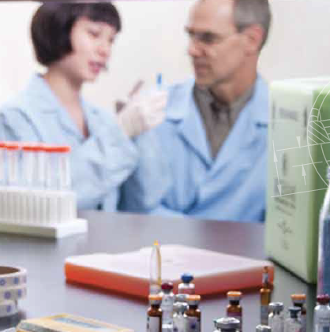
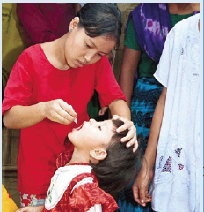
Immunization Domain Background
Vaccines are the same around the world
For many countries – immunization is managed and funded globally
Ministry of Health
National Immunization Program
Logistics

Slide 15
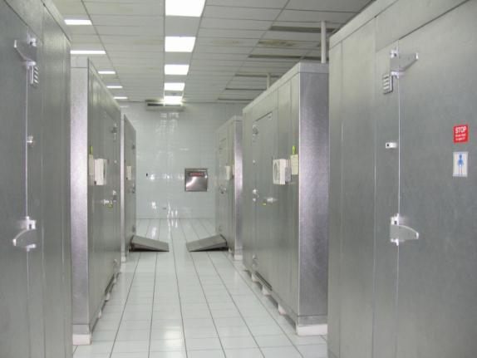
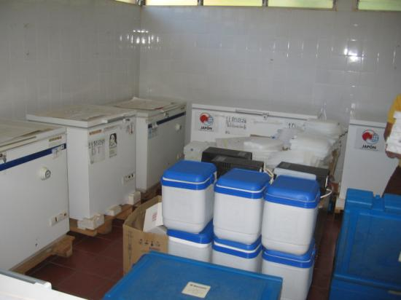
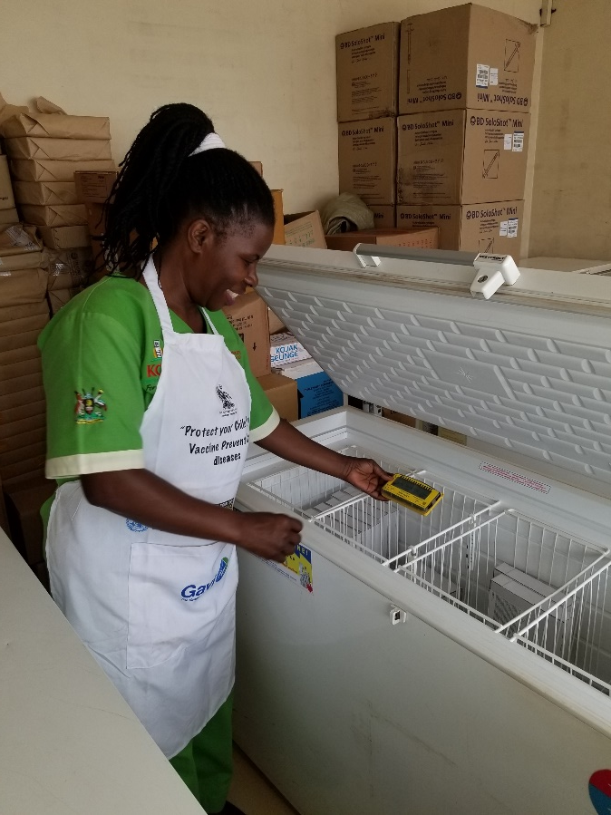
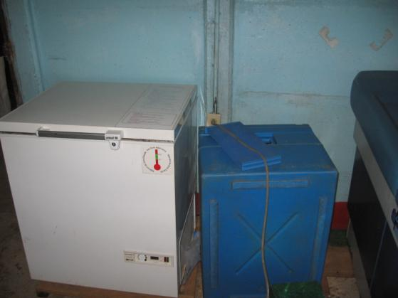
Immunization Cold Chain
Vaccine Manufacturers
National Vaccine Store
Regional Store
Regional Store
District Store
District Store
District Store
District Store
Health Center
Health Post
Health Post
Health Post

Slide 16
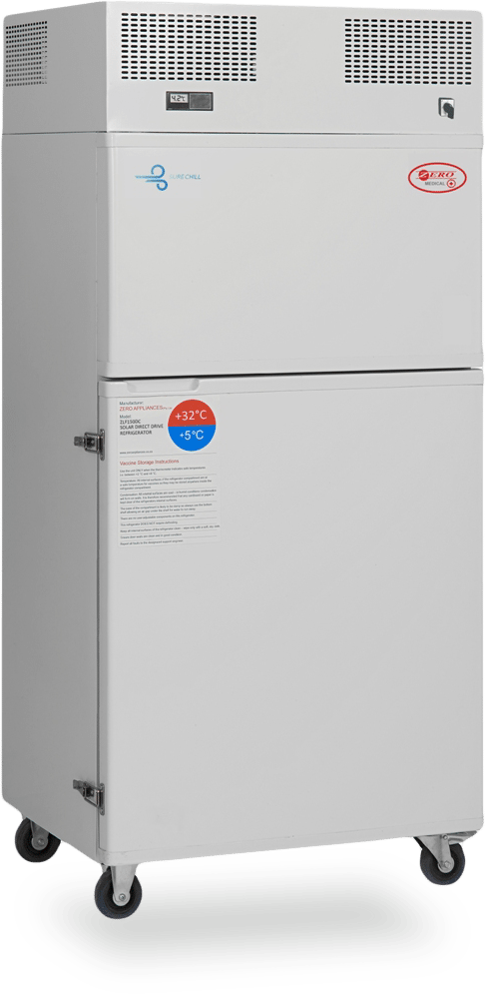
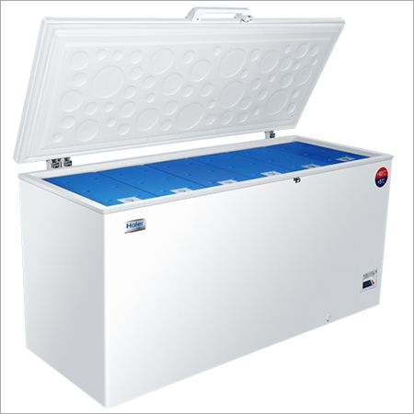
Immunization Cold Chain Challenges
Ensure that all countries have high quality vaccine cold chains
Working equipment at all points in vaccine supply chain
Sufficient capacity for vaccines
Refrigerators need power
Grid power, Solar power, Gas, Kerosene
Many areas suffer from regular power outages
Desire to replace Kerosene / Gas equipment with Solar
Equipment upgrades
Identify needs and determine order size
Remove obsolete equipment
Ensure proper installation
Establish repair infrastructure
Monitoring of equipment condition

Slide 17
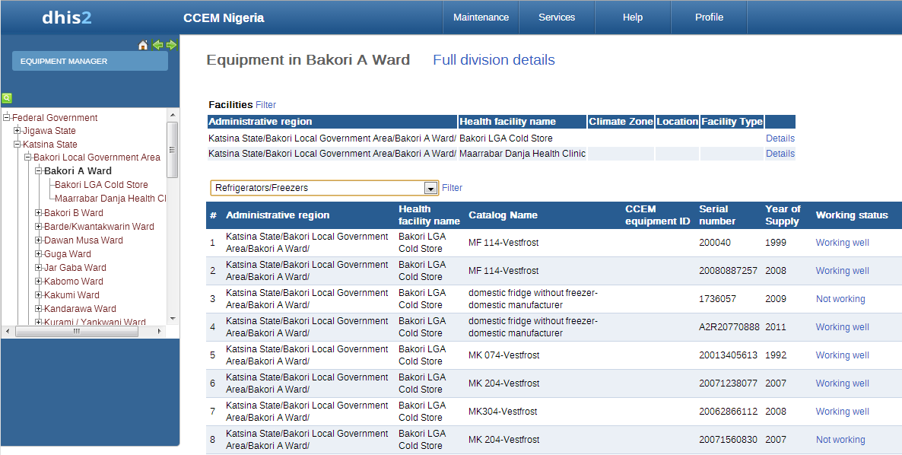
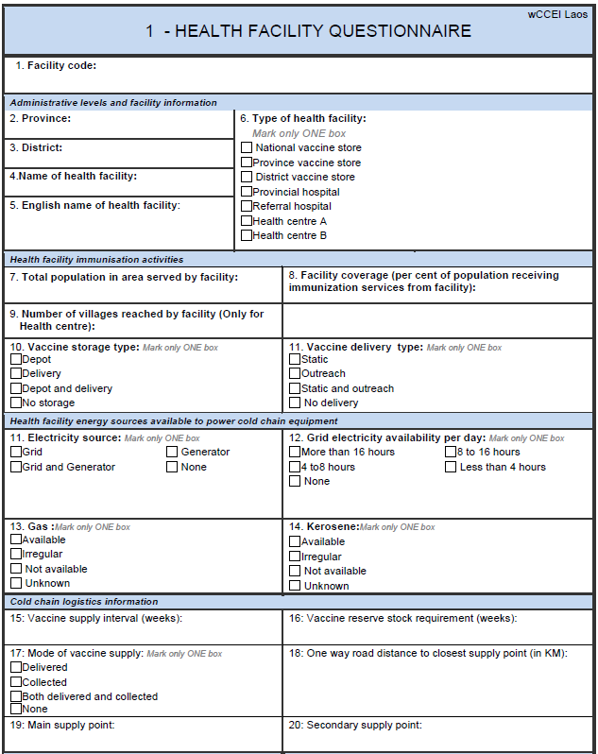
Cold Chain Equipment Inventories
No accurate global equipment inventories
Inconsistent at the country level
Inventories often become out of date
Not updated for equipment changes
Health facility information is also a challenge
Periodic efforts to collect inventory information for reporting
Often restricted to sampling
Fragmented data sources
Different health systems inside a country
Public, Private, NGO, Faith-based

Slide 18
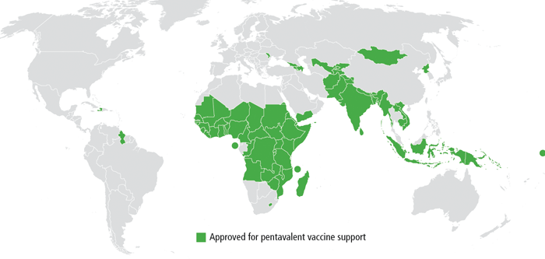
Vision
Country Cold Chain Information System
Global Cold Chain Information System
Country Cold Chain Information System
Country Cold Chain Information System

Slide 19
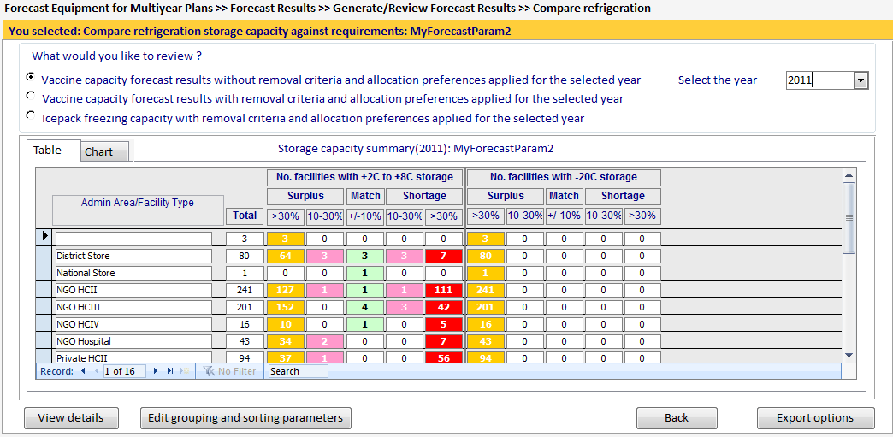
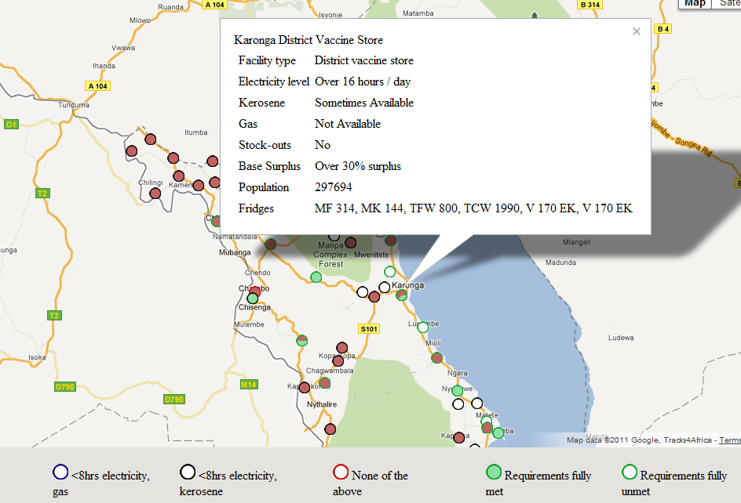
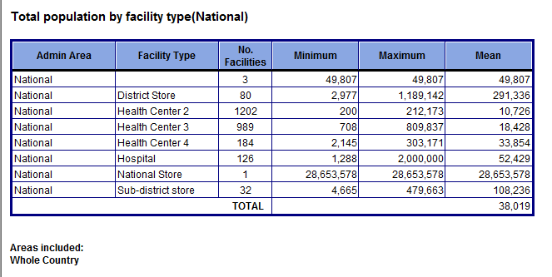
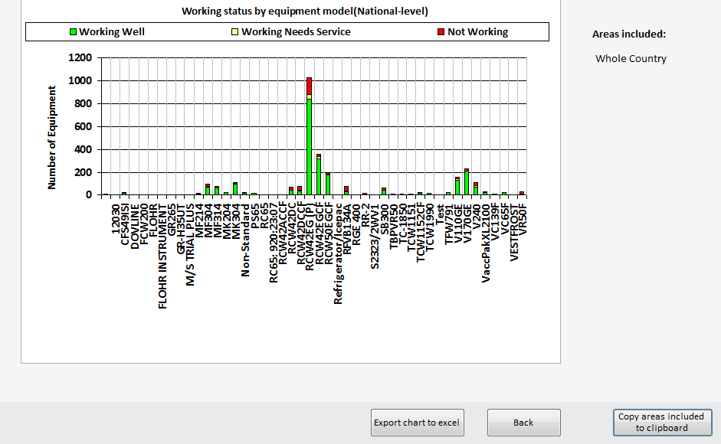
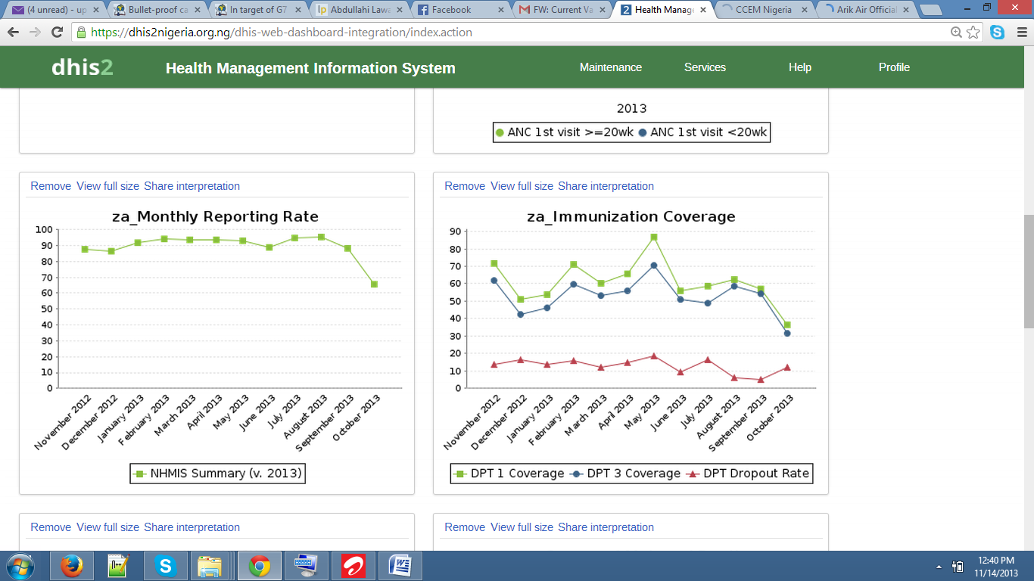
Part I: Visualizing the Cold Chain
Map based visualization
GIS Coords
Regions
Global Management Questions
Country summaries
Equipment trends
Integrated analysis tools and models
Country Cold Chain Management
Equipment management
Allocation
Reporting

Slide 20
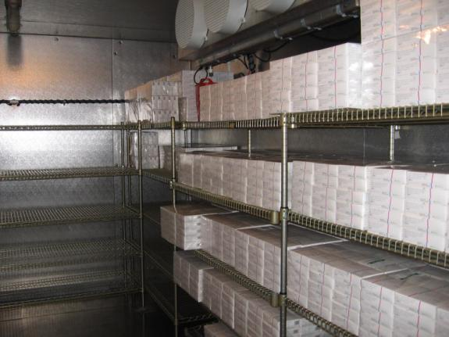
Part II: Data Management
Cold Chain Equipment Inventory
Basic equipment and facility information
Tracking of performance and maintenance
Remote data updates
Keeping data up to date is the critical challenge
District cold chain supervisor responsible for managing equipment
Mobile App is feasible for district supervisors
Integrate with other Health Information Systems
Ownership by the country

Slide 21
ODK-X
Mobile data collection on Android Phones. Project started at University of Washington by Professor Gaetano Borriello
Open Data Kit 1.0 aka ODK
Submission of forms
Open Data Kit 2.0 aka ODK-X
Synchronization with a database
Open source tools. Strong commitment to contributing to global good software

Slide 22
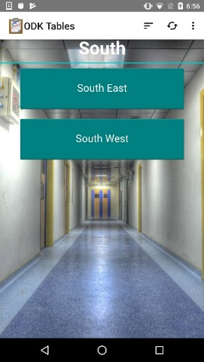
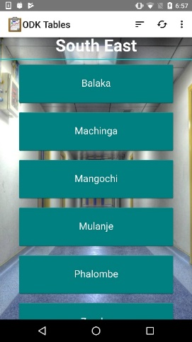
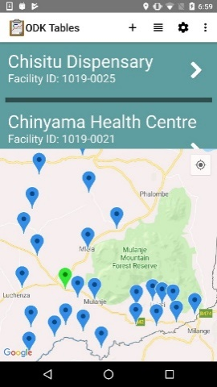
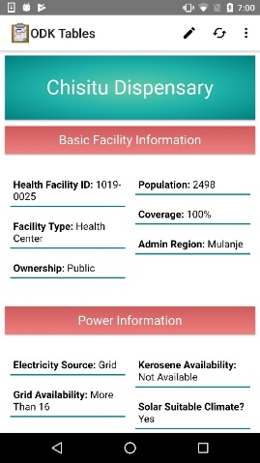
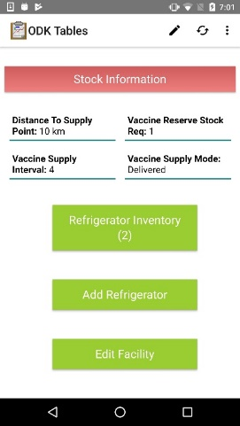
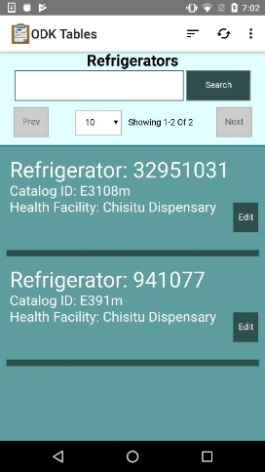
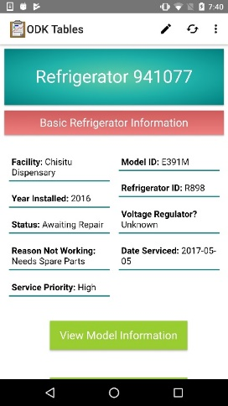
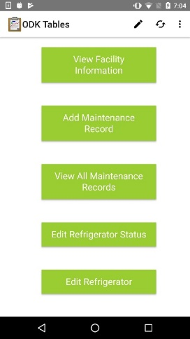
Cold Chain App
App built on top of the ODK-X platform
Combination of ODK Survey and ODK Tables
Written in Java Script
Manage a database of health facilities and refrigerators associated with facilities

Slide 23
Architecture
Global Cold Chain Information System
Dash Board
Database
Report Generation
ODK-X Client
ODK-X Server
Country Database
Local Database
ODK-X Client
Data Bridge
Local Database
CCEM

Slide 24
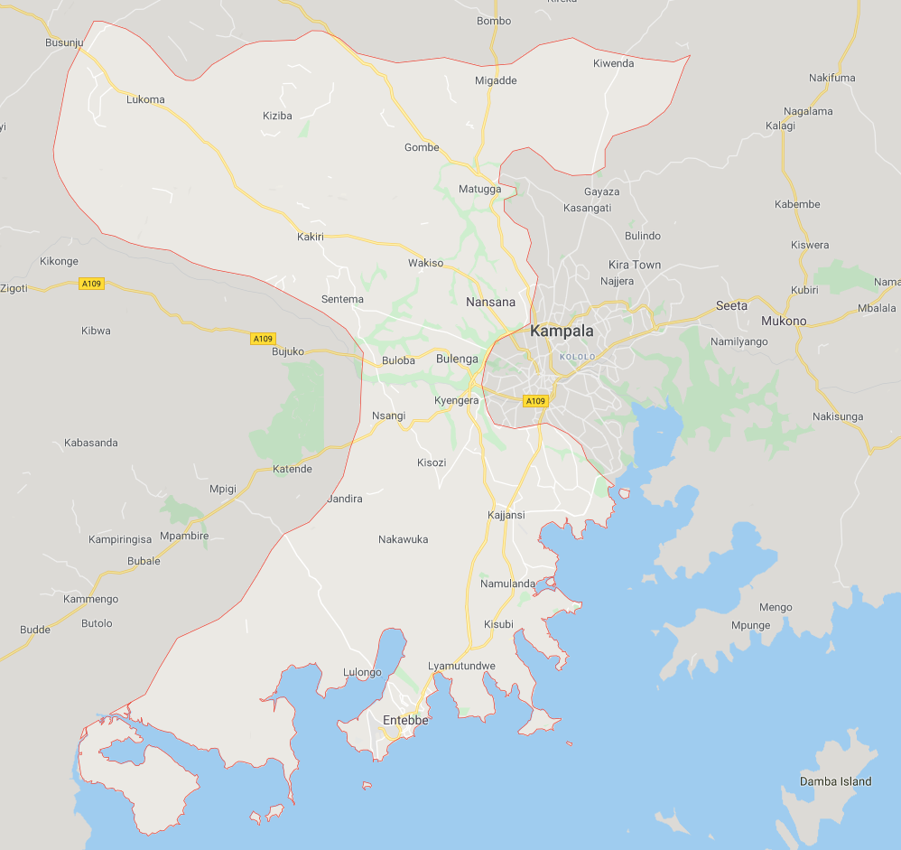
Project Status
Cold Chain Visualization project – team YAASS
Cold Chain App prototype
WHO Deployment
Haiti, Pakistan, DRC, Bangladesh
Sentinel Surveillance officers
GAVI Deployment – Uganda
Two regions - Kampala and Wakiso (13 Districts)
Expansion to national scale underway

Slide 25
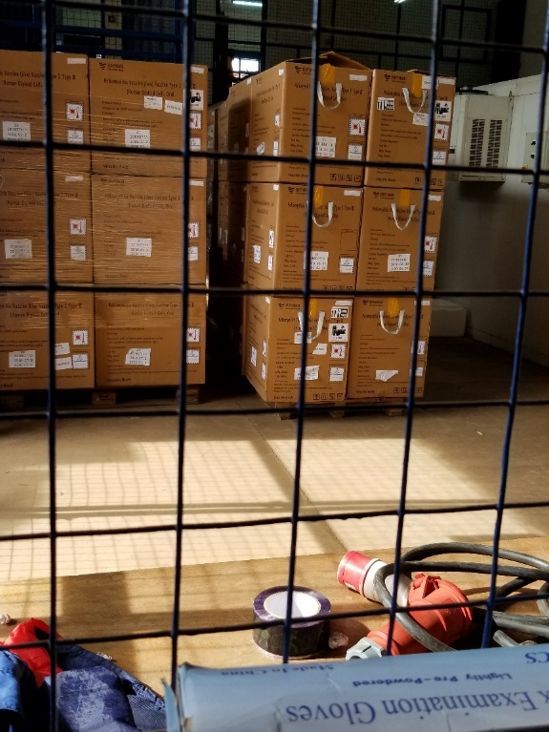
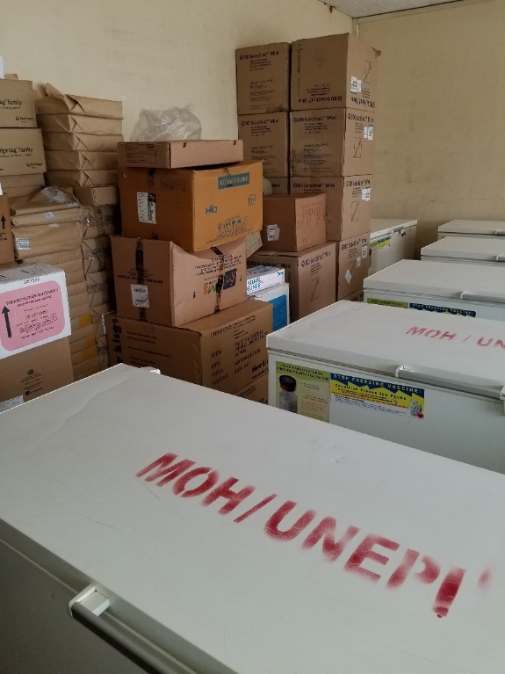
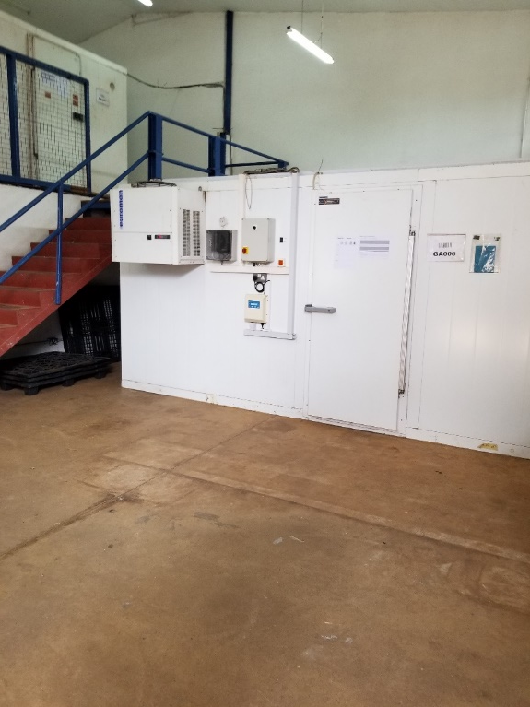
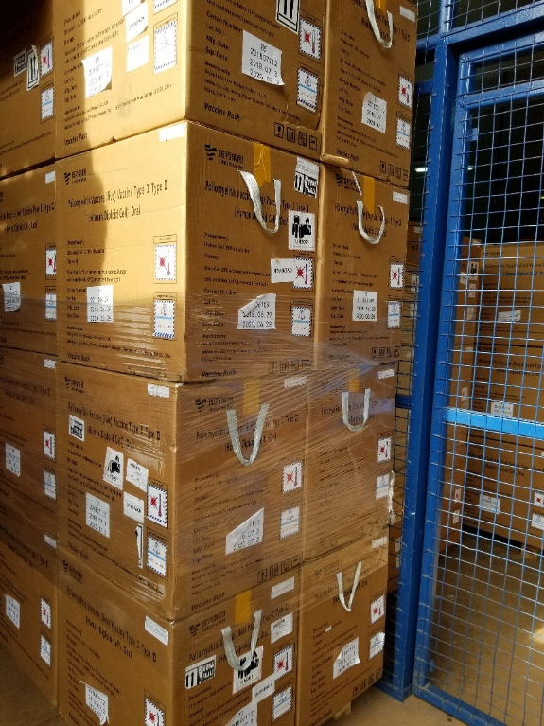
Questions and Discussion
Richard Anderson anderson@cs.washington.edu

