Slide 1
ICTD Capstone Software Design for Underserved Populations
CSE 482b
Course Overview, March 31, 2021
Richard Anderson, Samia Ibtasam, Naveena Karusala

Slide 2
Today
Capstone Courses
Project Ideas
My background

Slide 3
Development Engineering
Technological interventions to improve human and economic conditions in low-resource settings
An engineering discipline aimed at addressing global inequity
Develop principles for design, introduction, scaling, and sustainability of Global Good technology

Slide 4
What are the challenges
Domain challenges: Health, Education, Agriculture, Markets, Livelihoods, Infrastructure, Sanitation, Energy, Environmental Degradation
Resource constraints: Finance, Infrastructure, Distance, Education and literacy, Governance
Shocks: Climate Change, Global Pandemics

Slide 5
Setting
Rapid, global economic and technological change
Many technologies are globally accessible
Not just a split between “Developed” and “Developing Countries”, but within countries between “Urban-Affluent” and “Rural/Urban-Poor”
In many ways, the world is getting better
Increasing literacy rates
Decline in maternal mortality rates
Near elimination of diseases such as polio

Slide 6
ICTD, Information and Computing Technologies for Development
Technology with global impact
Appropriate for `low resource’ settings
Target development domains
Health, Education, Livelihood, Agriculture, Disaster Relief
This quarter – many of the proposed projects around global Covid-19 immunization

Slide 7
CSE Capstone courses
Capstone Goals
Projects must be large enough to require teams of several students to work on over one quarter.
Students must apply concepts from more than one sub-area of CSE (at the 300-level and above).
The work must involve a substantial design effort.
Students must present their work using formal oral presentations and written reports.
Efforts must culminate in an interesting, working artifact.

Slide 8
What I expect in a capstone
Group projects
About five people
Different roles
Design and Implementation
Multiple check points and expert review
Working, useful software
Reasonable software process
Presentation of results

Slide 9
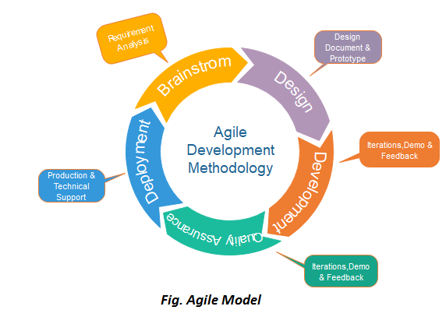
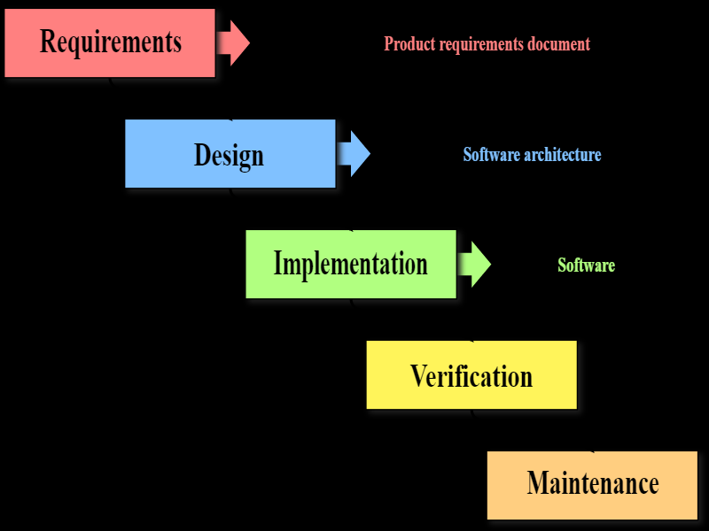
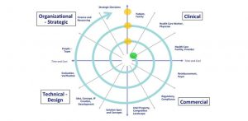
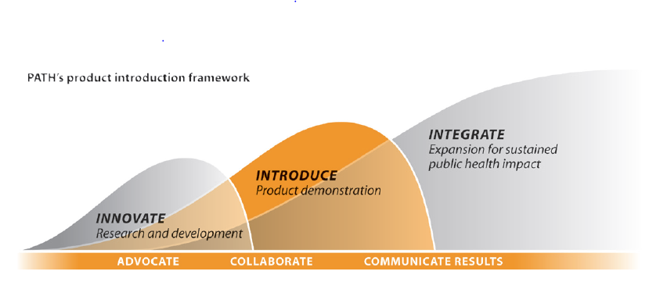
The capstone challenge
Too much stuff to fit into nine weeks in the spring
Focus on Design, Development & Implementation
Choose at start of course from a set of project ideas

Slide 10
Schedule
Today – present project ideas
Thursday – establish project groups
Schedule (Dates tentative)
Project Pitch
Progress Report and Prototype
Final Presentations
Deliverables due: Code, Writeup

Slide 11
Course Mechanics
Group development of projects
Lectures/class meetings for first few weeks
Regular group meetings with course staff
Later class sessions for presentations and demos
Specific deliverables will be specified during the quarter
Final turn in will include code and a paper (~10 pages)

Slide 12
Project Ideas
Vaccine Stock Tracker
Vaccine Passport
Immunization Campaign Planning System
Notification / Registration tool.
Vaccine Impact Modelling tool.
Speed Test App for Tacoma Community Cellular Network
Red Cross Data Reporting Tool

Slide 13
1. Vaccine Stock Tracker
Problem: A country needs to keep track of vaccines as they are used in immunization campaigns
This is going to be particularly important for Covid vaccines as they are expensive, limited in availability, and are likely to supplied irregularly
Tracking vaccines needed for initial allocation as well as collecting unused vaccines after a campaign
This project could be integrated into our existing Cold-Chain Information System
Mobile application for vaccine logisticians
Dashboard for ministry of health
Deployment in Uganda underway
Vaccine Passport

Slide 14
2. Vaccine Passport
Allow verification of vaccination status
Basic model allows established authorities to enter vaccine information and others to verify credentials
Should have some basis in cryptography or digital signatures
Could involve mobile apps for vaccinated and/or verifiers
Need to consider multiple different components of the system

Slide 15
3. Immunization Campaign Planning Tool
Developing countries will likely rely on campaigns for Covid immunization
Identify population group and locations
Plan for campaign with supplies and schedule
Required data: demographics and health system information
Create various web based planning tools
Will require some background research and domain knowledge
Possible applications of Algorithms or AI

Slide 16
4. Notification and registration tool
Tool to support tracking of individuals for immunization
Target needs of a developing country (such as Uganda)
Multi-dose vaccines complicate this problem
Integrate across multiple messaging technologies

Slide 17
5. Vaccine impact modelling tool
Develop framework for modeling impact of Covid vaccination
Framework would allow various different models to be used
Fairly naïve models could be implemented initially with a mechanism for domain experts to add models later
Scenario: tracking progress of global immunization and predicting impacts of different immunization approaches and coverages
Variables to consider: Vaccine type, populations, coverage by dose, efficacy on different strains
Possibly set up as a global modelling tool

Slide 18
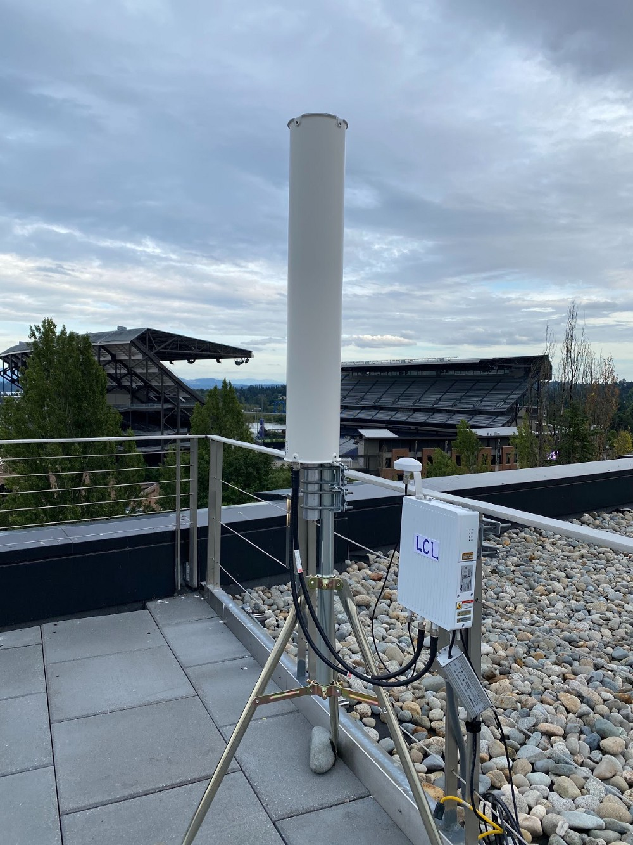
6. Local Connectivity Lab
Non-profit partnering with UW to increase free/low-cost broadband access in higher-need areas throughout the city
Makes use of existing UW and city network infrastructure such as buildings and fiber-optic cables to extend coverage
4G LTE networks, powered by open5gs, operating in the Citizen’s Band Radio Service frequency spectrum (band 48)
Test LTE network on UW campus

Slide 19
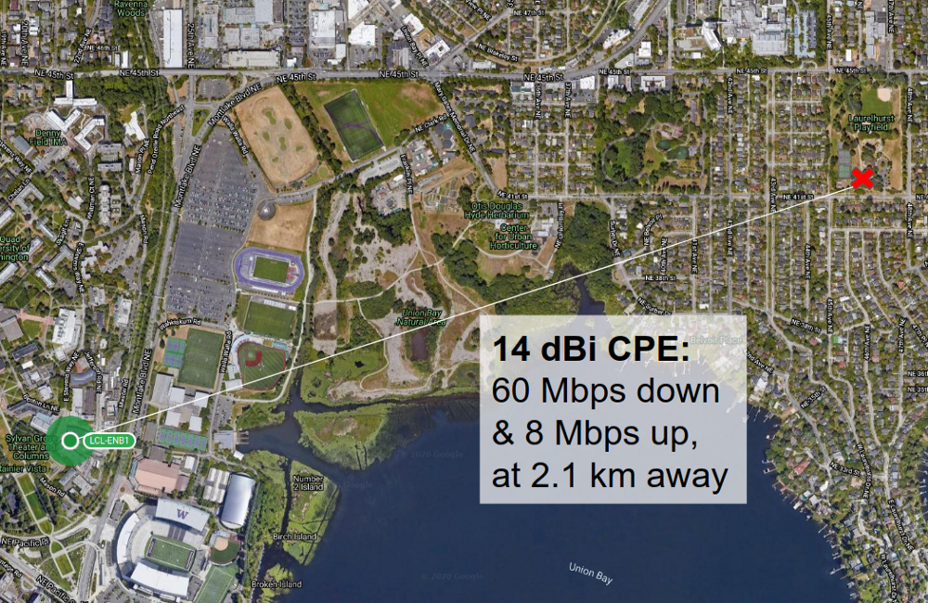
6. Performance Measurement App
BaiCells Nova 233 CBRS basestations can support 96 simultaneous users with a peak bandwidth of 116 Mbps per link
Project goal: measure network performance over time, especially how it changes with more users and under backhaul saturation
Potential for gamification
Report to a server
Some level of anonymity to protect privacy
Skills: Android app development; user interface design
Early example: Line-of-sight performance of LTE test network at UW, with Baicells 14 dBi Consumer Premises Equipment receiver.

Slide 20
7. Red Cross Data Reporting Tool
UW has collaborated with IFRC to develop RC2, and ODK-X app for disaster response
https://media.ifrc.org/ifrc/rc2-relief-tool/
Mobile application for tracking distribution of aid
Challenge in making use of the data and customizing reporting during field deployments
Project would develop user-configurable system to process system information

Slide 21
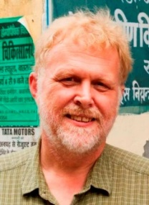
My background
PhD, Stanford (1985)
Thesis: The Complexity of Parallel Algorithms
Post Doc (1985-86) Mathematical Science Research Institute, Berkeley
University of Washington (since 1986)
Broad range of work: Algorithms, Software Engineering, Educational Technology, Computing for Development
Sabbatical 1993-1994
Indian Institute of Science, Bangalore
Parallel Algorithms
Sabbatical 2001-2002
Microsoft Research, Redmond
Learning Science and Technology
Sabbatical 2008-2009
PATH, Seattle
Digital Health

Slide 22
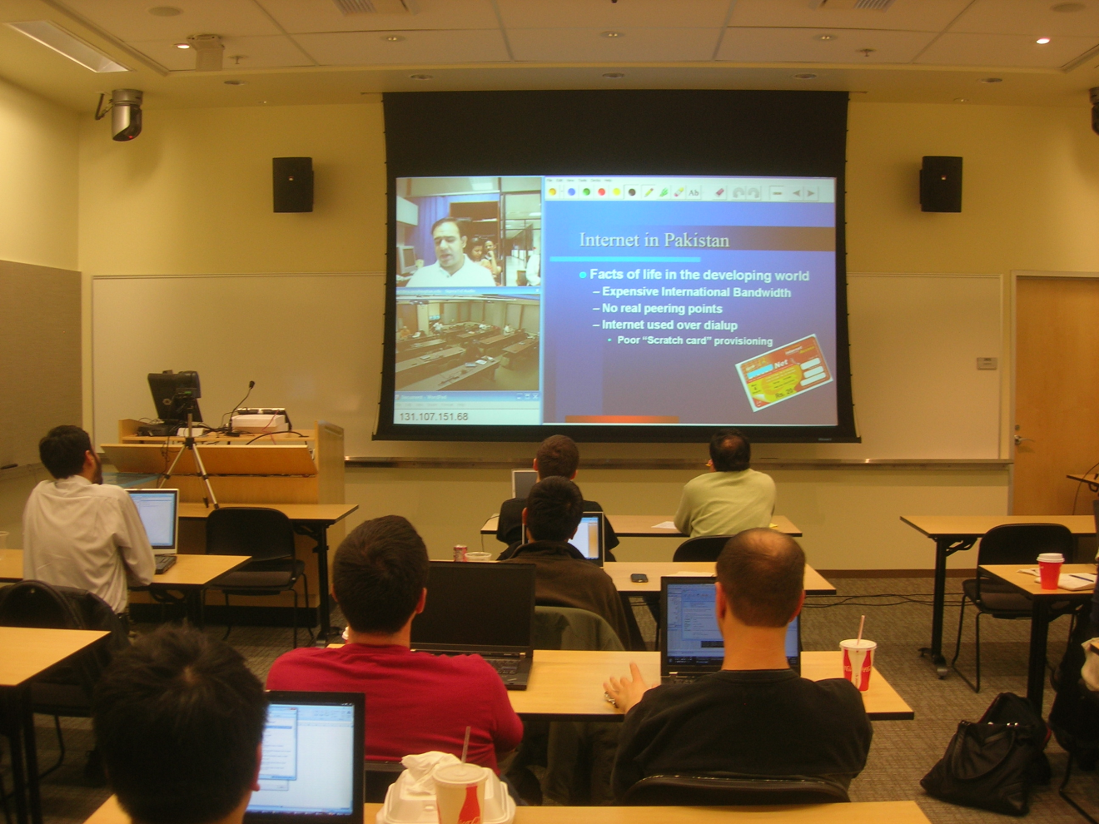
Distance Education (2001-2008)
Sabbatical at Microsoft to develop ConferenceXP technology
Basis of UW PMP Distance Learning
Multisite courses including UW-Redmond-Pakistan
Tablet PC Technology
Classroom Presenter
Interactive Classroom Activities

Slide 23
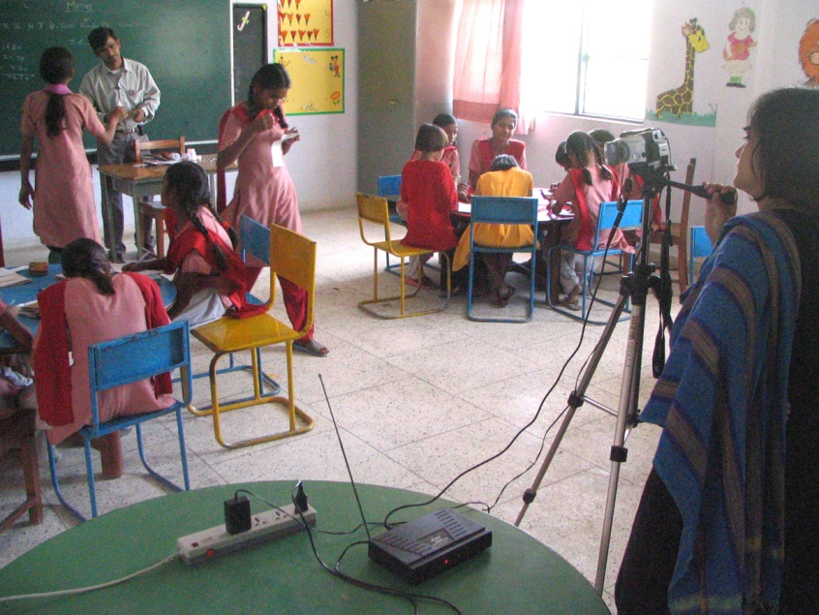
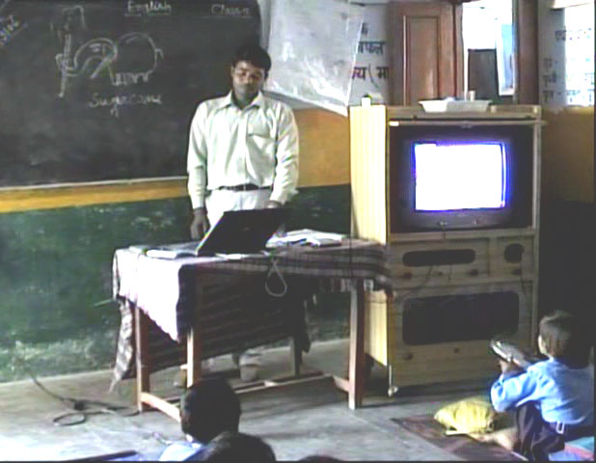
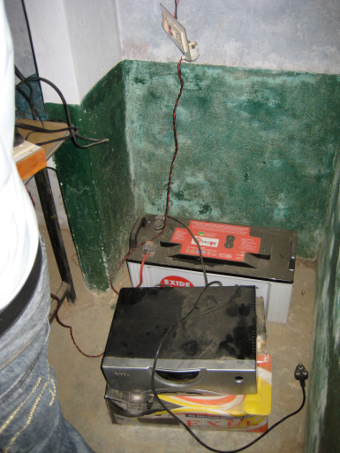
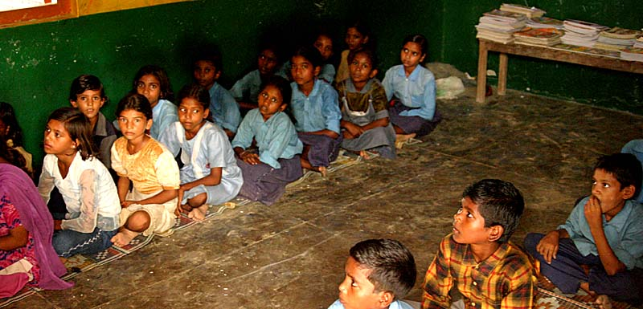
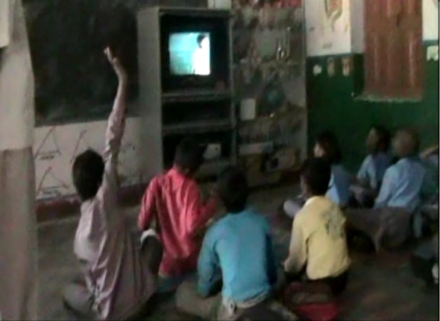
Digital StudyHall (Lucknow, India)
Tutored Video Instruction Pedagogy
Target: Rural schools in India
Model
Lesson videos recorded at hub school
Training of facilitators
Facilitation model
Cost realism in technology deployment

Slide 24
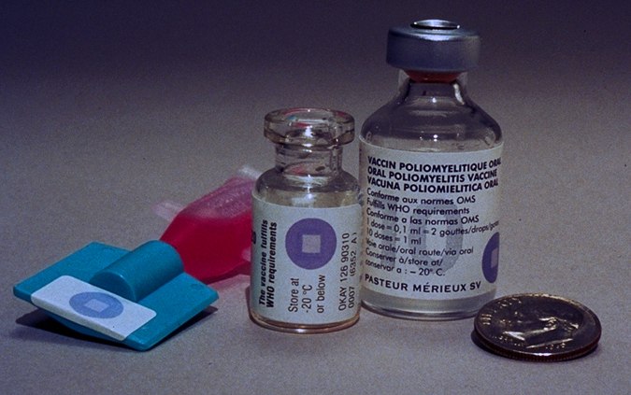
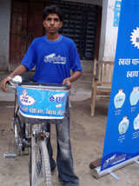
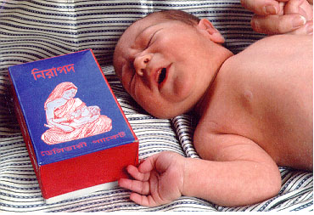
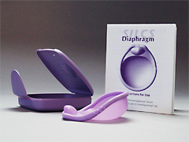
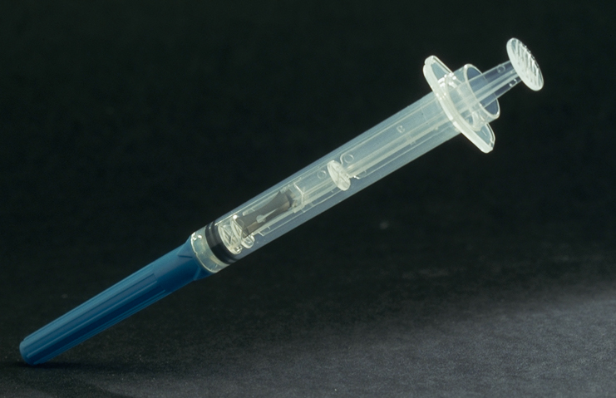
Digital Health at PATH
Global Health NGO Based in Seattle
Development of health technologies
Global advocacy
Implementation of global programs
Increased emphasis on Digital Health
Promotion of Global Good software
24

Slide 25
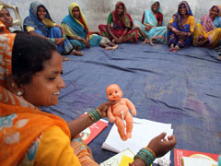
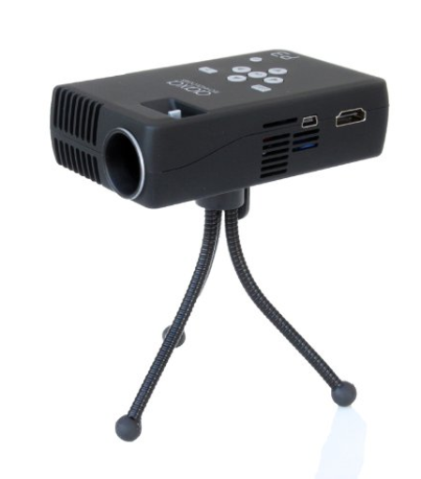
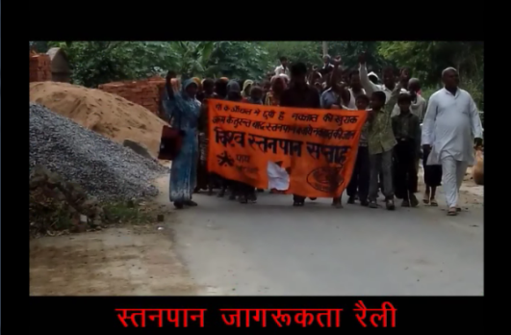
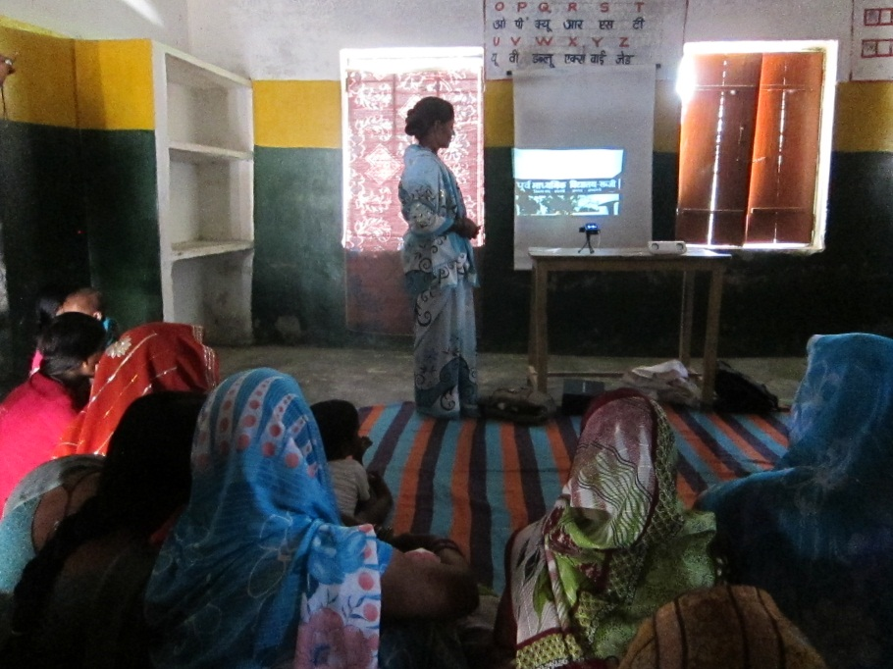
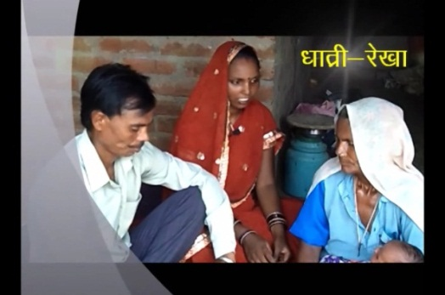
Projecting Health
Video based education in Health
Implementation with PATH
Community created video content
Facilitated showing in Mothers’ groups
Broad range of health messaging
Maternal Health
Immunization
Family Planning
Infectious diseases
Sanitation

Slide 26
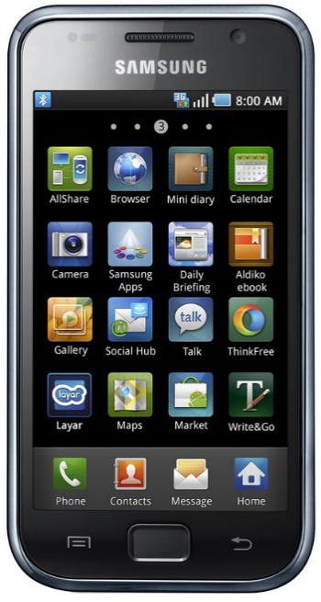
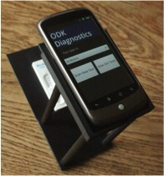
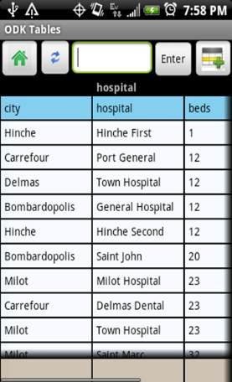
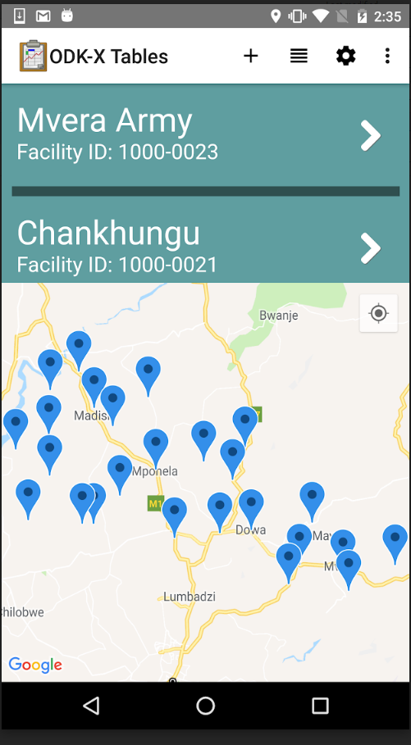
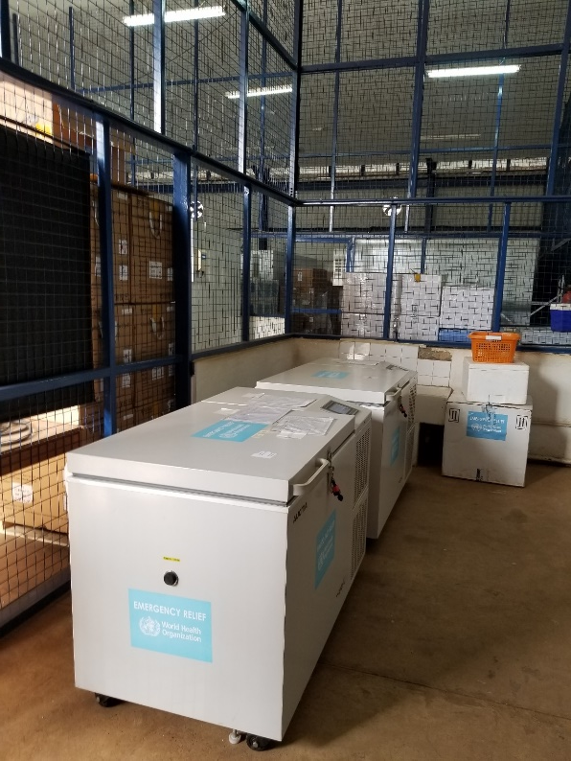
Open Data Kit
Digital Data Collection on Android Phones
Launched by Gaetano Borriello (2008)
Took over project in 2014
ODK 1.0 Forms based data collection
Spun out as independent Open Source Project
ODK-X Mobile Data Management
Multiple current projects in immunization and with International Red Cross

Slide 27
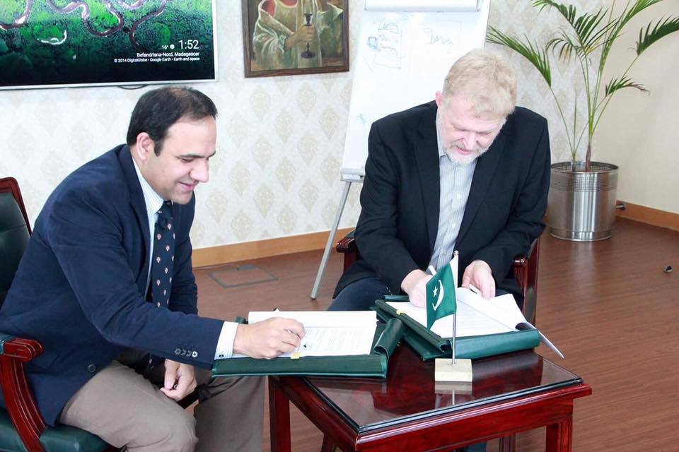
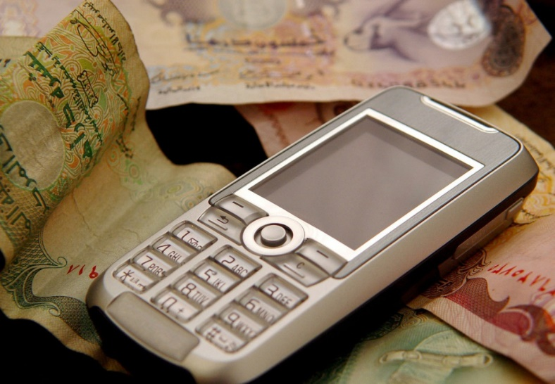
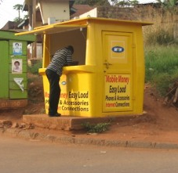
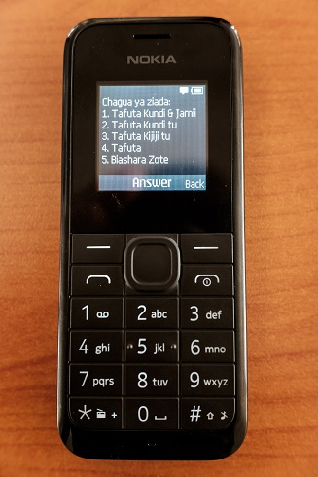
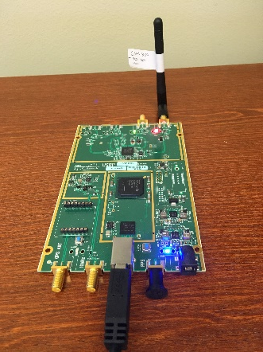
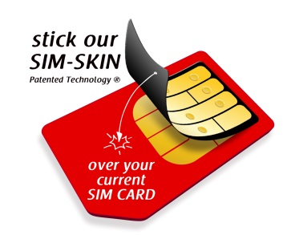
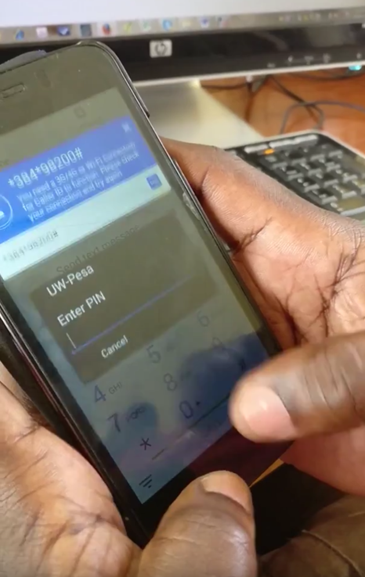
Digital Financial Services
Project with BMGF
Funded to investigate technological challenges to adoption of Digital Financial Services
Project Areas
Security and Fraud
USSD Technology
Technological Inclusion
Established center in Lahore, Pakistan
Waseela-e-haq program ki taraf se apkay Rs.25200 rupay aya hain.apka ye number03314311169BISP mein register tha.ap is number per 03017073199 call karein
Improved access to financial services is critical for raising people out of poverty

Slide 28
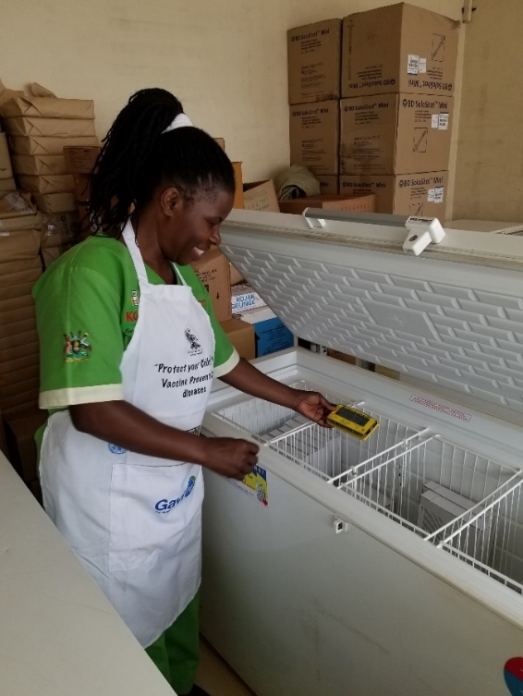
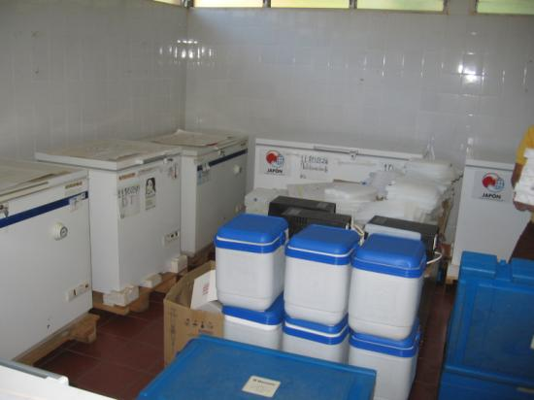
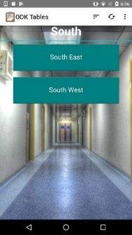
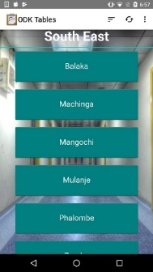
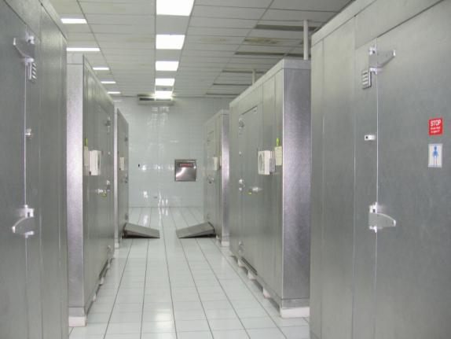
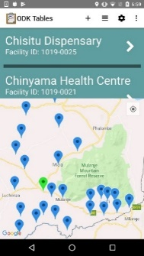
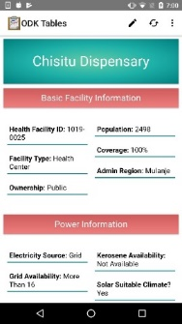
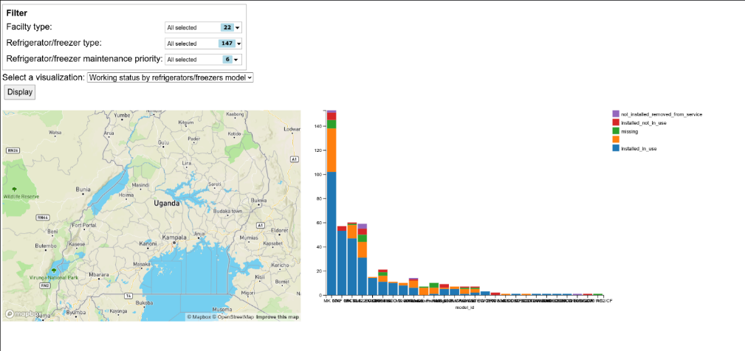
Cold Chain Information System
Track information about country vaccine cold chains
Status of vaccine refrigerators and cold rooms
ODK-X Application for immunization logisticians
Dashboard for country managers
Deployment in multiple countries with Gavi and WHO

