Slide 1
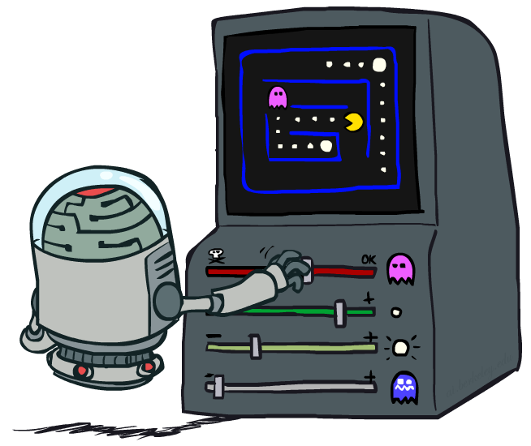
Reinforcement Learning II
CSE 473: Introduction to Artificial Intelligence
James Weichert (jpw@cs)
cs.uw.edu/473
acknowledgements
Welcome!
What was your favorite thing to learn?
sli.do #cse473

Slide 2

Administrivia
Test 1 grades will be released soon
Project 2 due tomorrow (7.16)
Homework 2 due next week (7.23)

Slide 3

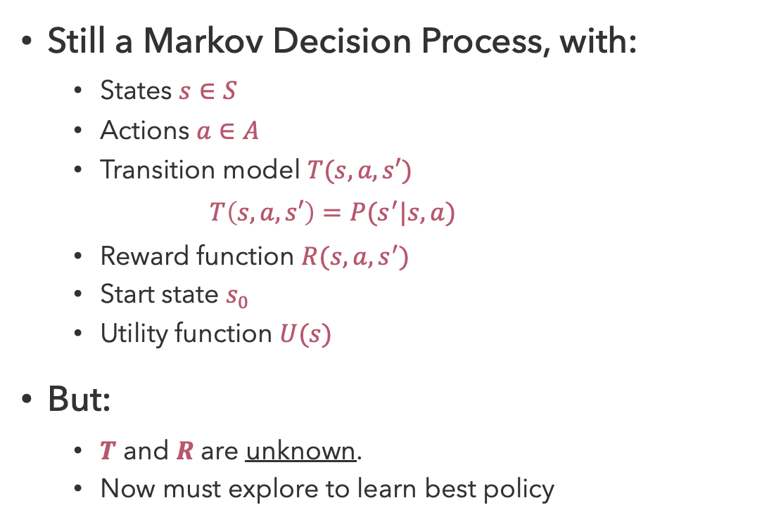
Recap: Reinforcement Learning
Still a Markov Decision Process, with:
  States $s∈S$
  Actions $a∈A$
  Transition model $T(s,a,s′)$
    $$T\left(s,a,s′\right)=P(s^{′}|s,a)$$
  Reward function $R(s,a,s^{′})$
  Start state $s_{0}$
  Utility function $U(s)$
But:
  $T$ and $R$ are unknown.
  Now must explore to learn best policy
Agent
Sensors
percepts
?
Environment
Actuators
actions

Slide 4

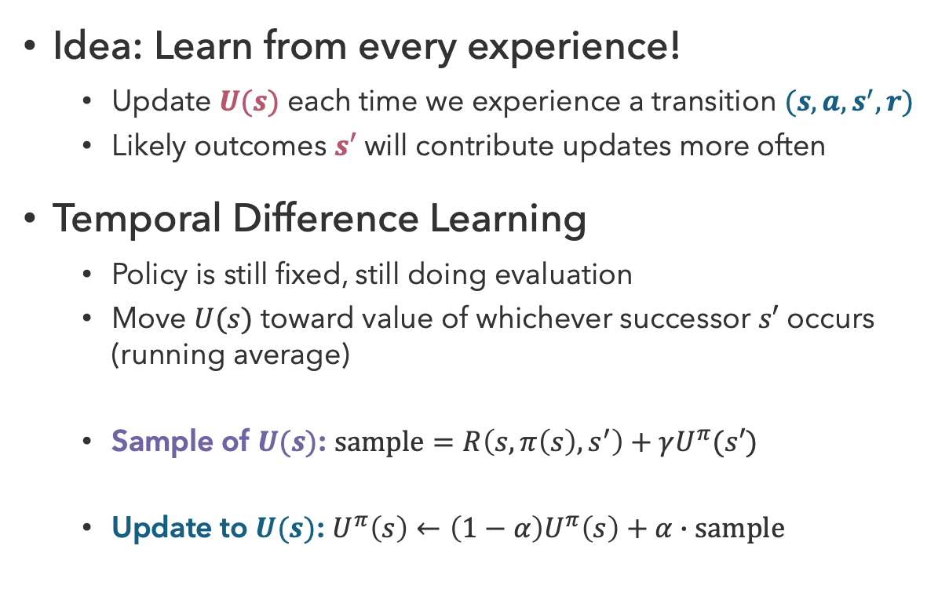


Recap: Temporal Difference Learning
Idea: Learn from every experience!
  Update $U(s)$ each time we experience a transition $(s,a,s^{′},r)$
  Likely outcomes $s′$ will contribute updates more often
Temporal Difference Learning
  Policy is still fixed, still doing evaluation
  Move $U(s)$ toward value of whichever successor $s′$ occurs (running average)
  Sample of $U(s)$: $sample=R\left(s,π\left(s\right),s^{′}\right)+γU^{π}(s′)$
  Update to $U(s)$: $U^{π}\left(s\right)←\left(1−α\right)U^{π}\left(s\right)+α∙sample$
s
$$π(s)$$
s, $π(s)$
s,$π(s)$,s’,r
s’

Slide 5
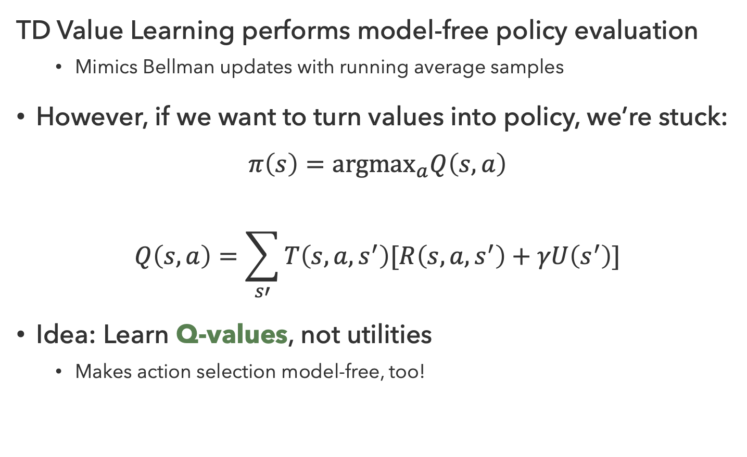
Problems with TD Value Learning
TD Value Learning performs model-free policy evaluation
  Mimics Bellman updates with running average samples
However, if we want to turn values into policy, we’re stuck:
$$π\left(s\right)={argmax}_{a}Q\left(s,a\right)$$
$$Q\left(s,a\right)=\sum_{s′}{T\left(s,a,s^{′}\right)[R\left(s,a,s^{′}\right)+γU\left(s^{′}\right)]}$$
Idea: Learn Q-values, not utilities
  Makes action selection model-free, too!
s
a
s,a
s,a,s’
s’

Slide 6
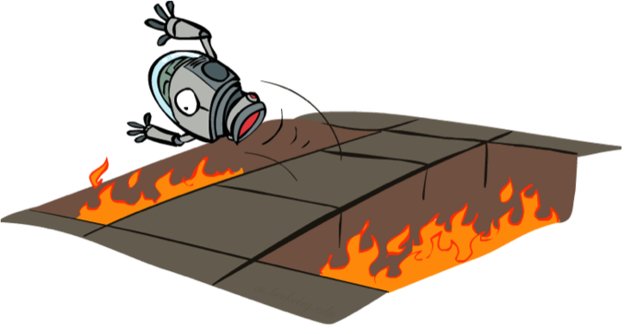
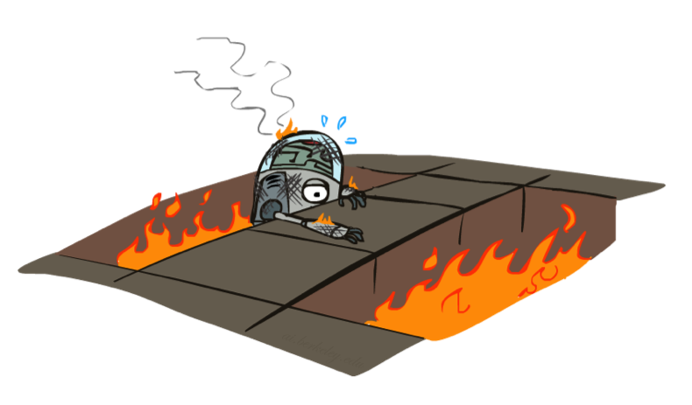
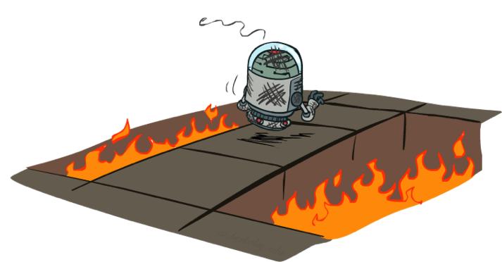
A More Hands-On Approach…

Slide 7
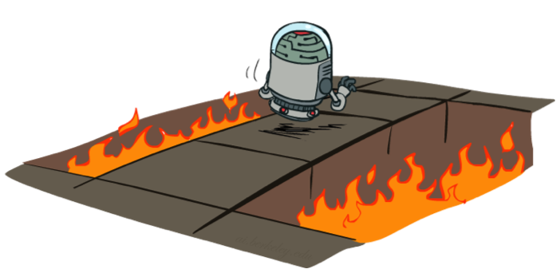
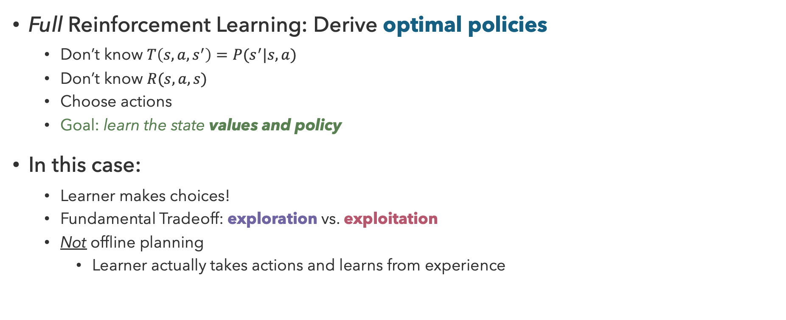
Active Reinforcement Learning
Full Reinforcement Learning: Derive optimal policies
  Don’t know $T\left(s,a,s^{′}\right)=P(s^{′}|s,a)$
  Don’t know $R(s,a,s)$
  Choose actions
  Goal: learn the state values and policy
In this case:
  Learner makes choices!
  Fundamental Tradeoff: exploration vs. exploitation
  Not offline planning
    Learner actually takes actions and learns from experience

Slide 8
Questions (1)

Slide 9
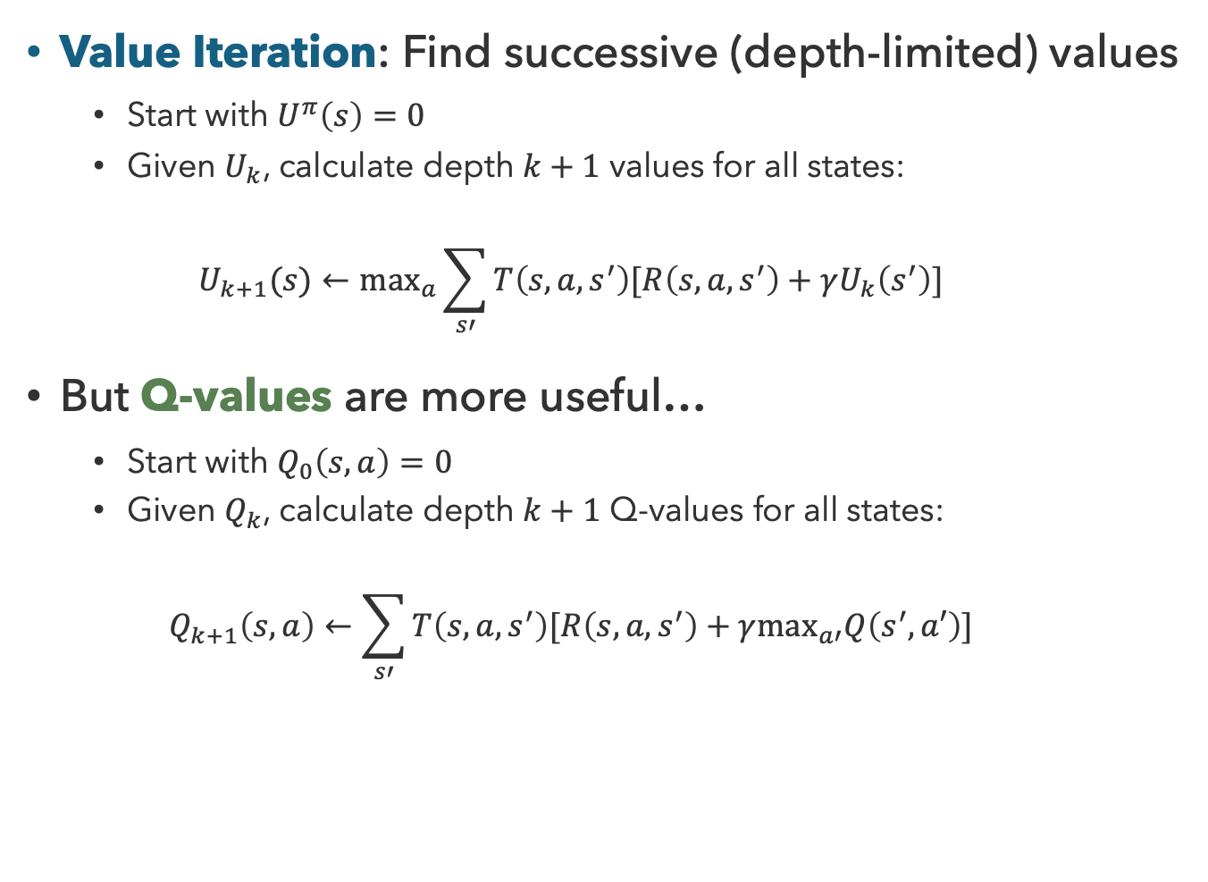
But First: Q-Value Iteration
Value Iteration: Find successive (depth-limited) values
  Start with $U^{π}\left(s\right)=0$
  Given $U_{k}$, calculate depth $k+1$ values for all states:
  $$U_{k+1}(s)←\max_{a}\sum_{s′}{T\left(s,a,s^{′}\right)[R\left(s,a,s^{′}\right)+γU_{k}\left(s^{′}\right)]}$$
But Q-values are more useful…
  Start with $Q_{0}\left(s,a\right)=0$
  Given $Q_{k}$, calculate depth $k+1$ Q-values for all states:
  $$Q_{k+1}\left(s,a\right)←\sum_{s′}{T\left(s,a,s^{′}\right)[R\left(s,a,s^{′}\right)+γ\max_{a′}Q\left(s^{′},a′\right)]}$$
s
a
Q(s,a)
s,a,s’
s’

Slide 10
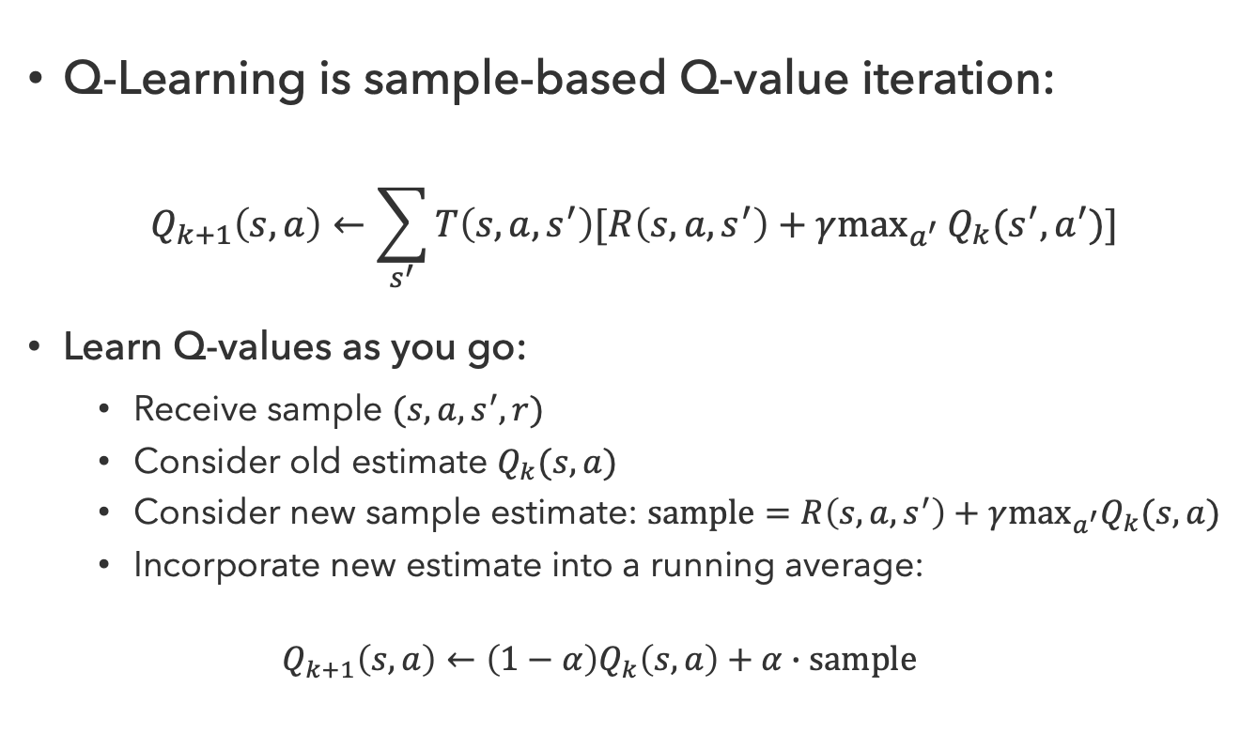
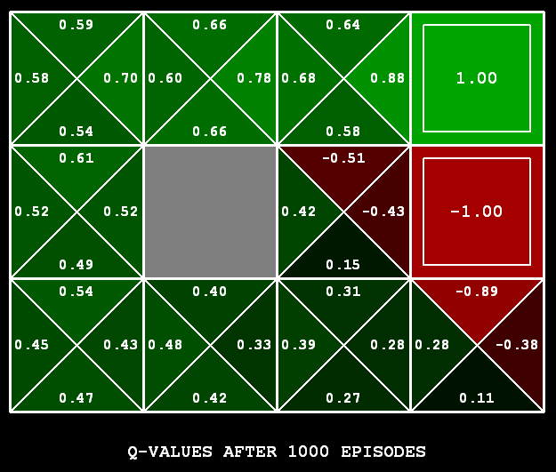
Q-Learning
Q-Learning is sample-based Q-value iteration:
$$Q_{k+1}\left(s,a\right)←\sum_{s^{′}}{T\left(s,a,s^{′}\right)[R\left(s,a,s^{′}\right)+γ\max_{a^{′}}}Q_{k}(s^{′},a^{′})]$$
Learn Q-values as you go:
  Receive sample $(s,a,s^{′},r)$
  Consider old estimate $Q_{k}(s,a)$
  Consider new sample estimate: $sample=R\left(s,a,s^{′}\right)+γ\max_{a^{′}}Q_{k}(s,a)$
  Incorporate new estimate into a running average:
  $$Q_{k+1}\left(s,a\right)←\left(1−α\right)Q_{k}\left(s,a\right)+α∙sample$$
Notes:
Can anyone tell me why the terminal states only have one value?

Slide 11

Properties of Q-Learning
Off-Policy Learning
Q-Learning converges to optimal policy, even if you’re acting suboptimally!
Caveats:
  Must explore enough
  Must eventually make the learning rate small enough
  In the limit, it doesn’t matter how actions are selected

Slide 12
Questions (2)

Slide 13
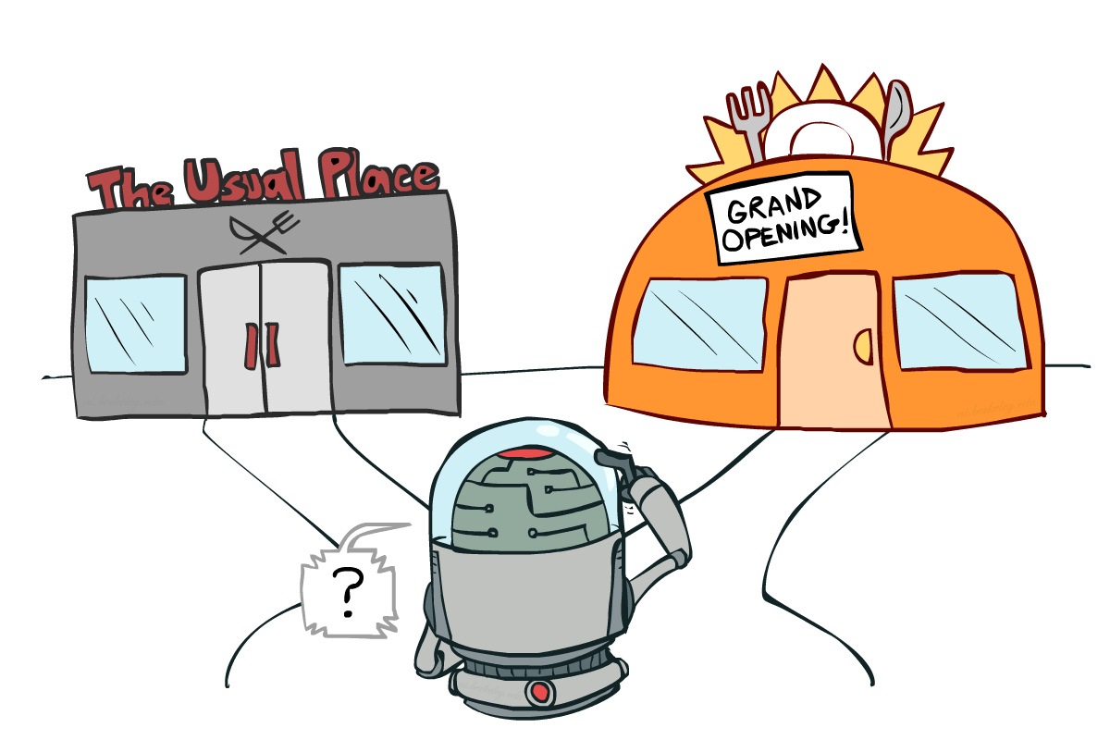
Exploration vs. Exploitation

Slide 14

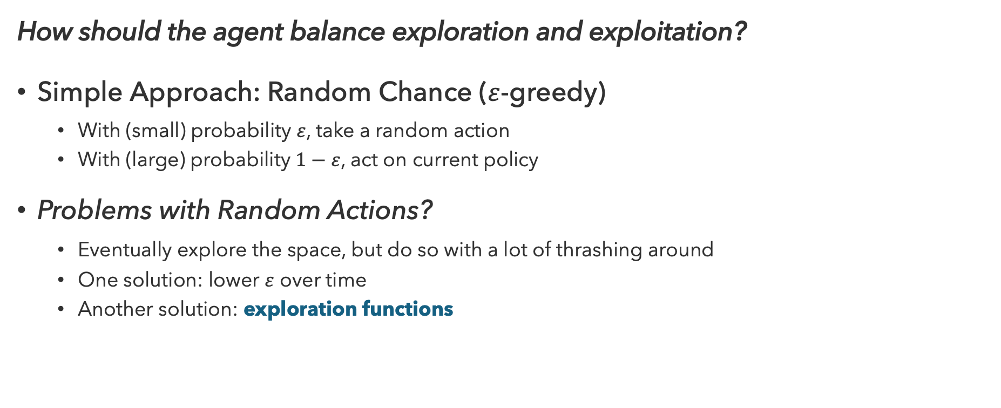
How to Explore?
How should the agent balance exploration and exploitation?
Simple Approach: Random Chance ($ε$-greedy)
  With (small) probability $ε$, take a random action
  With (large) probability $1−ε$, act on current policy
Problems with Random Actions?
  Eventually explore the space, but do so with a lot of thrashing around
  One solution: lower $ε$ over time
  Another solution: exploration functions

Slide 15
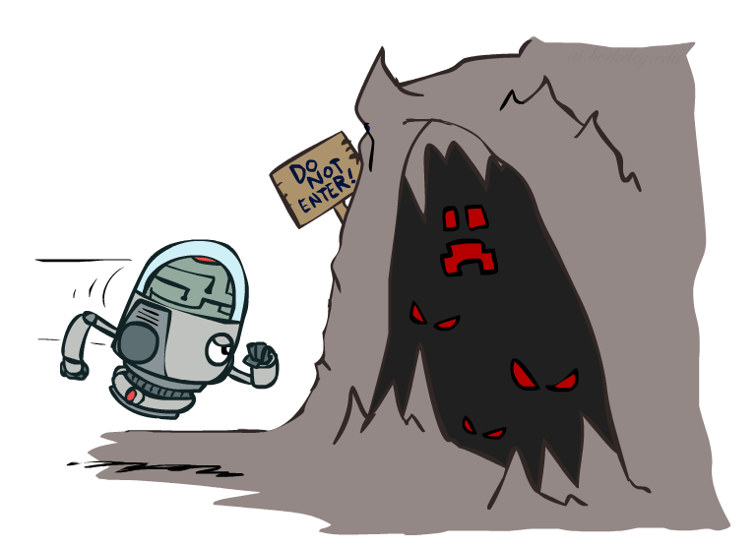
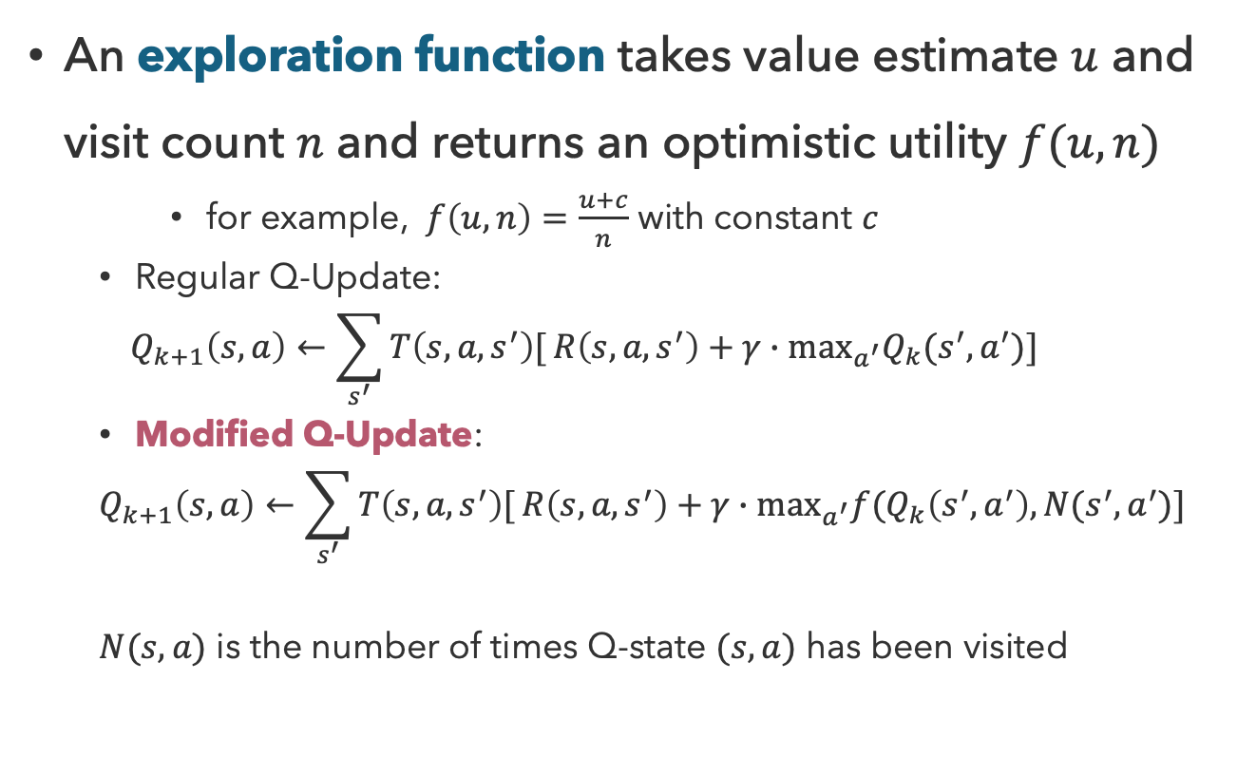
Exploration Functions
An exploration function takes value estimate $u$ and visit count $n$ and returns an optimistic utility $f(u,n)$
    for example, $f\left(u,n\right)=\frac{u+c}{n}$ with constant $c$
  Regular Q-Update:
  $$Q_{k+1}\left(s,a\right)←\sum_{s^{′}}{T\left(s,a,s^{′}\right)[}R\left(s,a,s^{′}\right)+γ∙\max_{a^{′}}Q_{k}(s^{′},a^{′})]$$
  Modified Q-Update:
  $$Q_{k+1}\left(s,a\right)←\sum_{s^{′}}{T\left(s,a,s^{′}\right)[}R\left(s,a,s^{′}\right)+γ∙\max_{a^{′}}f(Q_{k}\left(s^{′},a^{′}\right),N(s^{′},a^{′})]$$
  $N(s,a)$ is the number of times Q-state $(s,a)$ has been visited
Notes:
What would a higher u motivate?
What would a higher n motivate?

Slide 16
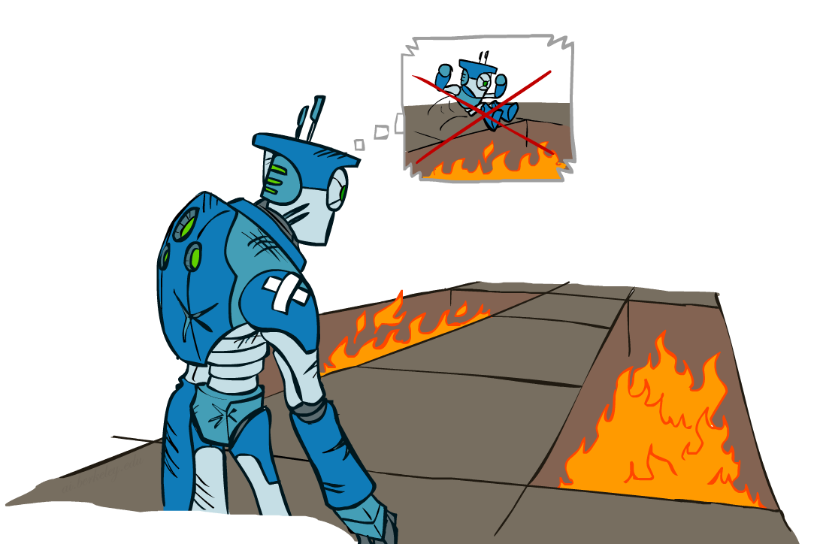
Regret
Even if you learn the optimal policy, you will make mistakes along the way!
Regret is a measure of the total mistake cost
  Difference between (expected) rewards (including
  early suboptimality), and optimal (expected) rewards
  For example, random exploration incurs more regret
  than exploring with exploration functions
Minimizing regret applies optimization to the
process of learning to be optimal

Slide 17

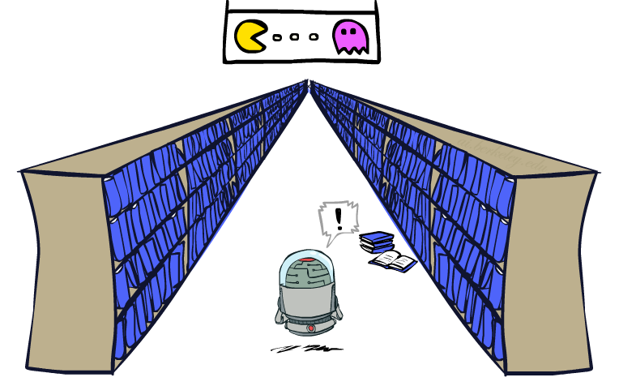
Generalizing Across States
Naïve Q-Learning keeps track of all Q-states
  But in realistic situations, we cannot possibly learn about every single state!
    Too many states to visit them all in training
    Too many states to track in memory
Instead, we want to generalize:
  Learn about some small number of states from experience
  Generalize experiences to new, but similar situations
Generalizing learning is a fundamental challenge in AI!

Slide 18
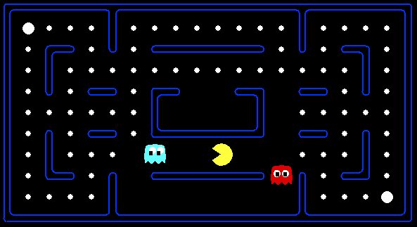



Poor Generalization
With naïve Q-learning, learning from experience in this state…
…doesn’t provide information about this state…
…or even this state!…

Slide 19
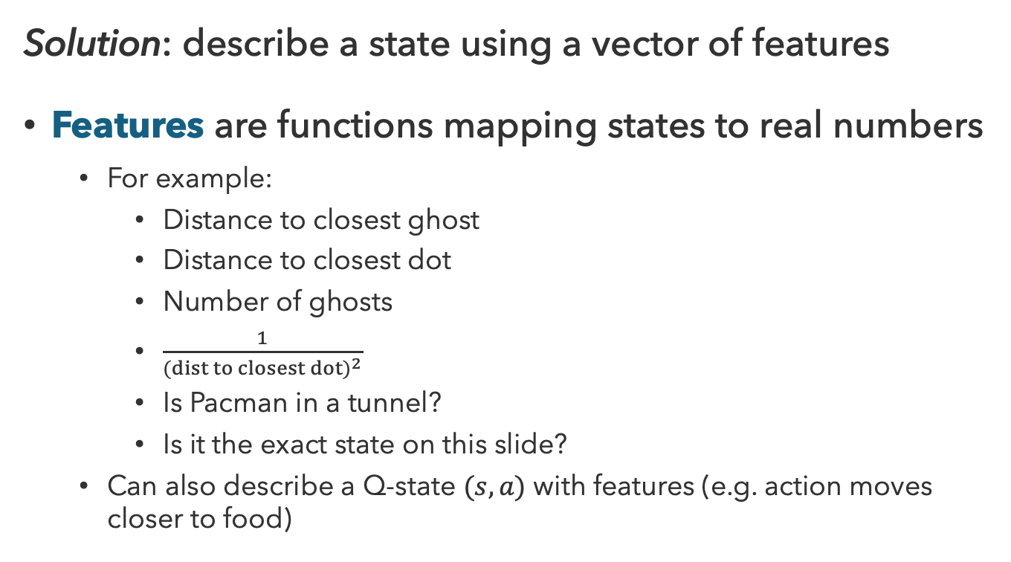
Feature-Based Learning
Solution: describe a state using a vector of features
Features are functions mapping states to real numbers
  For example:
    Distance to closest ghost
    Distance to closest dot
    Number of ghosts
    $\frac{1}{(dist to closest dot)^{2}}$
    Is Pacman in a tunnel?
    Is it the exact state on this slide?
  Can also describe a Q-state $(s,a)$ with features (e.g. action moves closer to food)

Slide 20
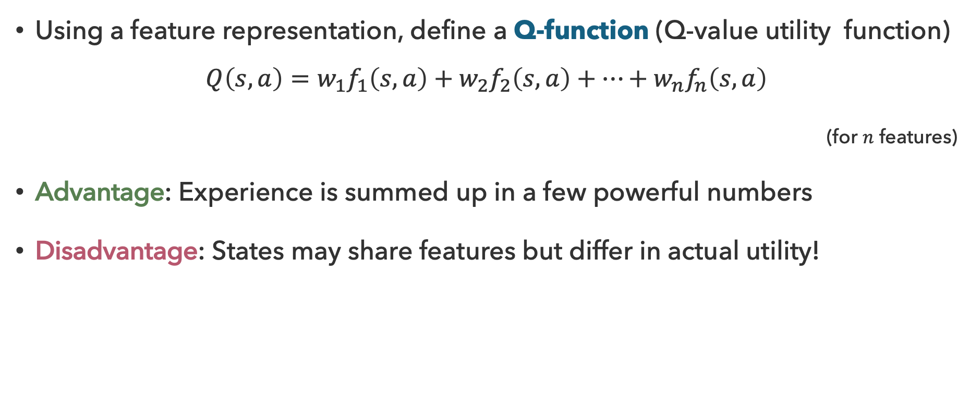
Linear Value Functions
Using a feature representation, define a Q-function (Q-value utility function)
$$Q\left(s,a\right)=w_{1}f_{1}\left(s,a\right)+w_{2}f_{2}\left(s,a\right)+…+w_{n}f_{n}\left(s,a\right)$$
(for $n$ features)
Advantage: Experience is summed up in a few powerful numbers
Disadvantage: States may share features but differ in actual utility!

Slide 21
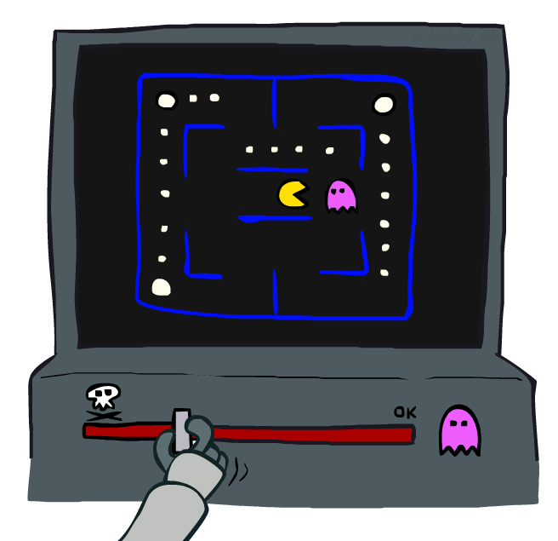
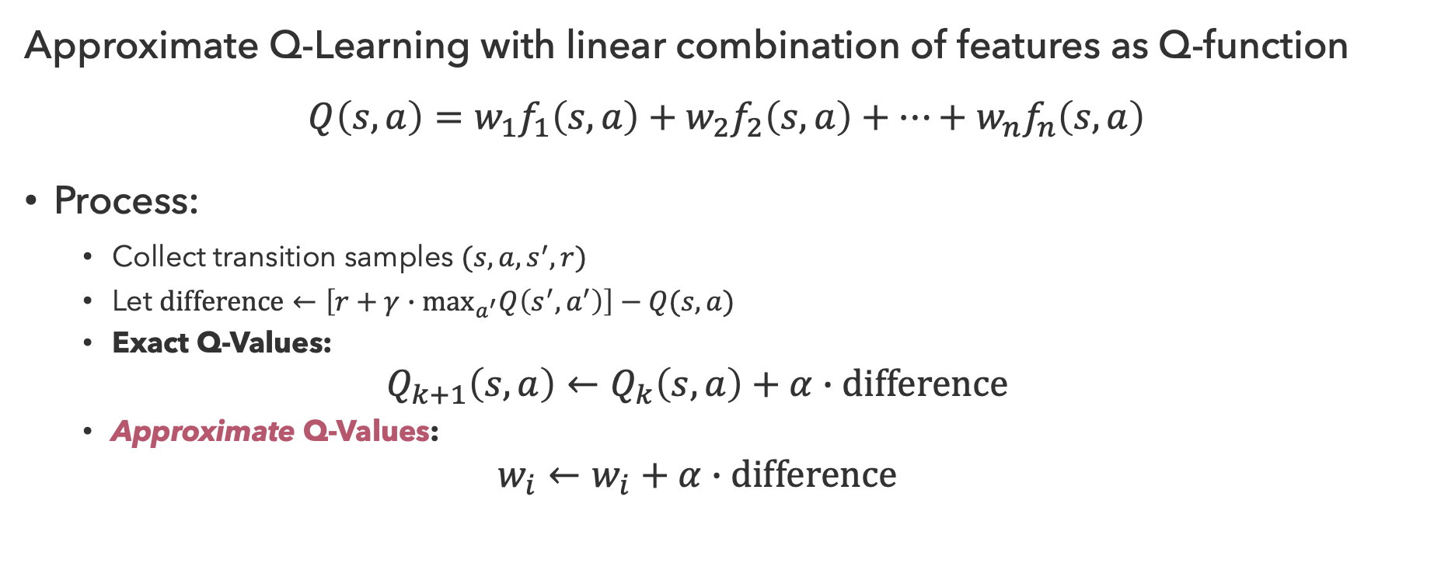
Approximate Q-Learning
Approximate Q-Learning with linear combination of features as Q-function
$$Q\left(s,a\right)=w_{1}f_{1}\left(s,a\right)+w_{2}f_{2}\left(s,a\right)+…+w_{n}f_{n}\left(s,a\right)$$
Process:
  Collect transition samples $(s,a,s^{′},r)$
  Let $difference←\left[r+γ∙\max_{a^{′}}Q\left(s^{′},a^{′}\right)\right]−Q(s,a)$
  Exact Q-Values:
  $$Q_{k+1}\left(s,a\right)←Q_{k}\left(s,a\right)+α∙difference$$
  Approximate Q-Values:
  $$w_{i}←w_{i}+α∙difference$$

Slide 22
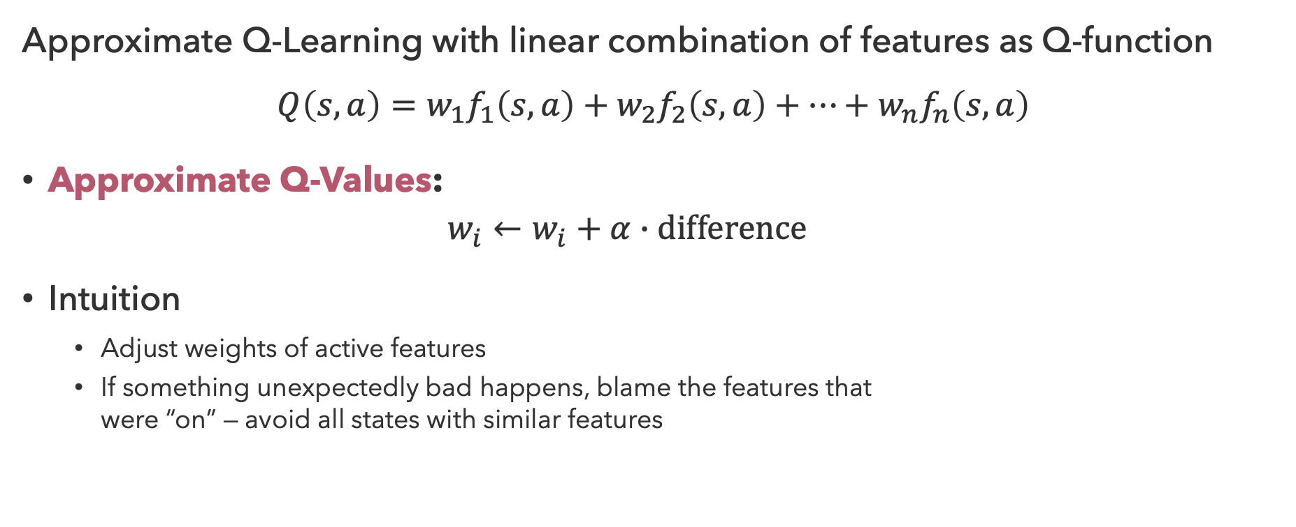
Intuition Behind Q-Learning
Approximate Q-Learning with linear combination of features as Q-function
$$Q\left(s,a\right)=w_{1}f_{1}\left(s,a\right)+w_{2}f_{2}\left(s,a\right)+…+w_{n}f_{n}\left(s,a\right)$$
Approximate Q-Values:
  $$w_{i}←w_{i}+α∙difference$$
Intuition
  Adjust weights of active features
  If something unexpectedly bad happens, blame the features that
  were “on” — avoid all states with similar features

Slide 23
Questions (3)

Slide 24
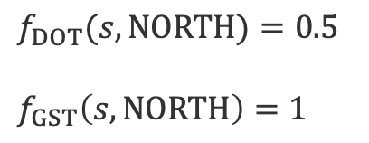

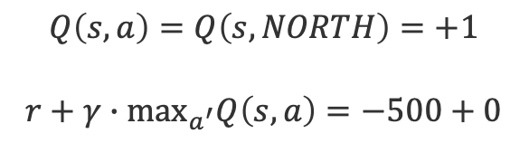

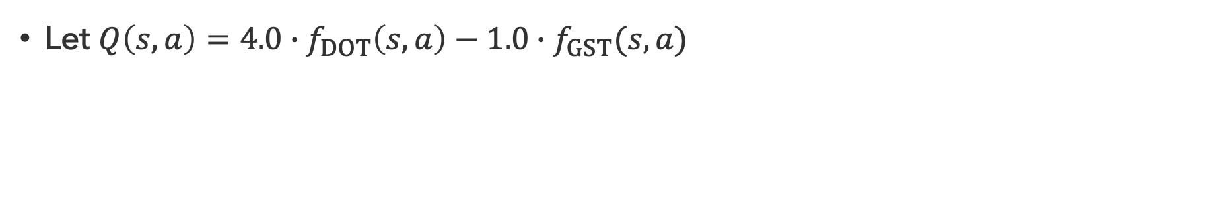

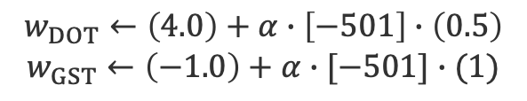



Q-Pacman (1)
Let $Q\left(s,a\right)=4.0∙f_{DOT}\left(s,a\right)−1.0∙f_{GST}(s,a)$
$$a=NORTH$$
$$f_{DOT}(s,NORTH)=0.5$$
$$f_{GST}\left(s,NORTH\right)=1$$
$$s$$
$$s′$$
$$r=−500$$
$$Q\left(s,a\right)=Q\left(s,NORTH\right)=+1$$
$$r+γ∙\max_{a^{′}}Q\left(s,a\right)=−500+0$$
$$Q\left(s,∙\right)=0$$
$$difference=−501$$
$$w_{DOT}←\left(4.0\right)+α∙\left[−501\right]∙\left(0.5\right)$$
$$w_{GST}←\left(−1.0\right)+α∙[−501]∙(1)$$

Slide 25

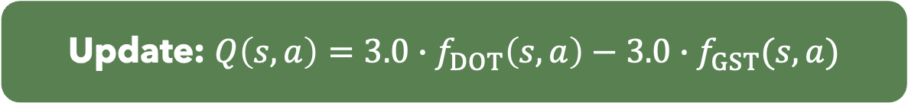
Q-Pacman (2)
Let $Q\left(s,a\right)=4.0∙f_{DOT}\left(s,a\right)−1.0∙f_{GST}(s,a)$
$$a=NORTH$$
$$f_{DOT}(s,NORTH)=0.5$$
$$f_{GST}\left(s,NORTH\right)=1$$
$$s$$
$$s′$$
$$r=−500$$
$$Q\left(s,a\right)=Q\left(s,NORTH\right)=+1$$
$$r+γ∙\max_{a^{′}}Q\left(s,a\right)=−500+0$$
$$Q\left(s,∙\right)=0$$
Update: $Q\left(s,a\right)=3.0∙f_{DOT}\left(s,a\right)−3.0∙f_{GST}(s,a)$
with $α≈0.004$

Slide 26
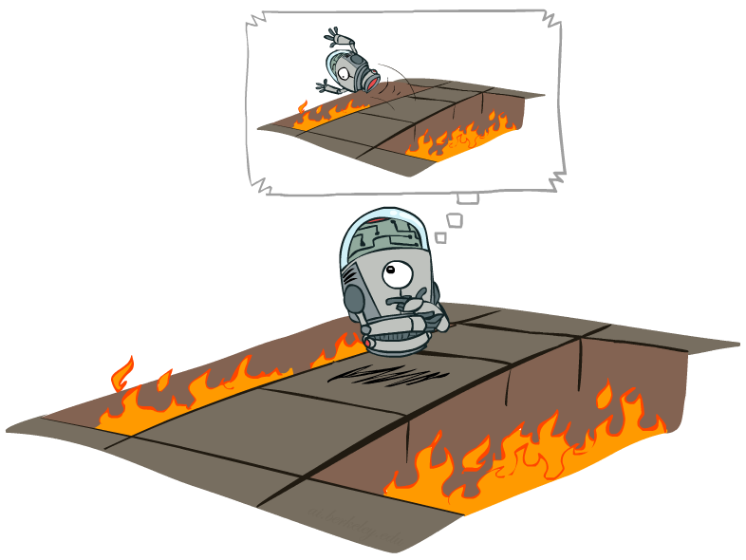
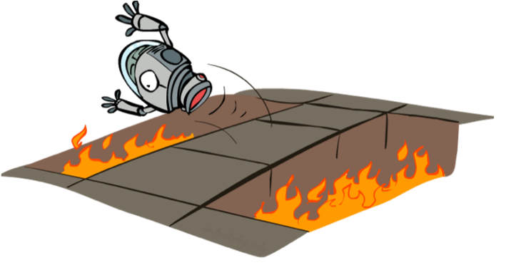
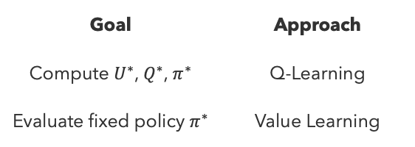
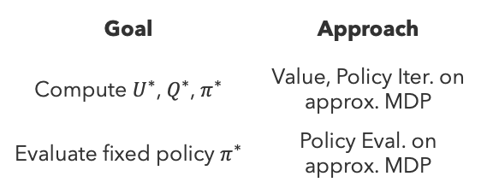
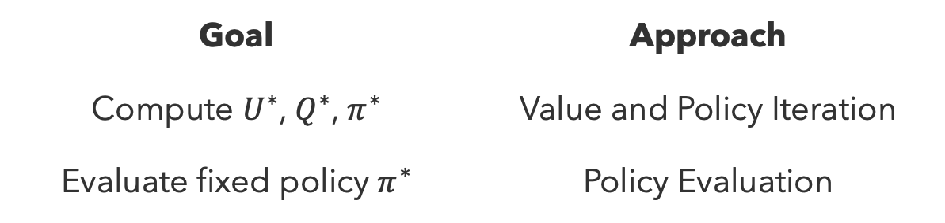
Summary: Reinforcement Learning
Goal | Approach
Compute $U^{∗}$, $Q^{∗}$, $π^{∗}$ | Value and Policy Iteration
Evaluate fixed policy $π^{∗}$ | Policy Evaluation
Offline Learning
Known MDP
Model-Based
Model-Free
Goal | Approach
Compute $U^{∗}$, $Q^{∗}$, $π^{∗}$ | Value, Policy Iter. on approx. MDP
Evaluate fixed policy $π^{∗}$ | Policy Eval. on approx. MDP
Goal | Approach
Compute $U^{∗}$, $Q^{∗}$, $π^{∗}$ | Q-Learning
Evaluate fixed policy $π^{∗}$ | Value Learning
Online Learning
Unknown MDP

Slide 27
Questions (4)

Slide 28
that’s it for today!
Q-Learning
Exploration vs. Exploitation Tradeoff
Feature-Based Approximation
Reinforcement Learning in Practice
Complete Practice Problem 9
Do Project 2 (due 7.16)
Do Homework 2 (due 7.23)

