Slide 1

Reinforcement Learning
CSE 473: Introduction to Artificial Intelligence
James Weichert (jpw@cs)
cs.uw.edu/473
acknowledgements
Welcome!
What’s something you had to learn by doing?
sli.do #cse473

Slide 2

Administrivia
Test 1 grades will be released soon
Project 2 due Thursday (7.16)
Homework 2 due next week (7.23)

Slide 3
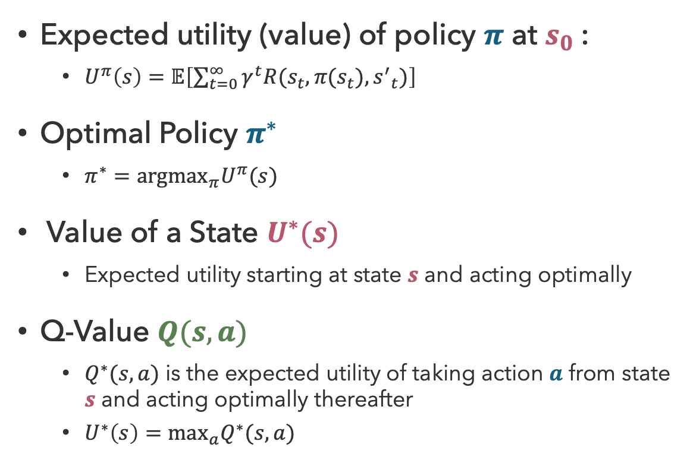
Recap: MDP Search Trees
Expected utility (value) of policy $π$ at $s_{0}$:
  $U^{π}\left(s\right)=𝔼\left[\sum_{t=0}^{∞}{γ^{t}R(s_{t},π(s_{t}),{s^{′}}_{t})}\right]$
Optimal Policy $π^{∗}$
  $π^{∗}={argmax}_{π}U^{π}(s)$
Value of a State $U^{∗}(s)$
  Expected utility starting at state $s$ and acting optimally
Q-Value $Q(s,a)$
  $Q^{∗}(s,a)$ is the expected utility of taking action $a$ from state $s$ and acting optimally thereafter
  $U^{∗}\left(s\right)=\max_{a}Q^{∗}(s,a)$
state
s
a
Q(s,a)
Q-state
transition
s,a,s’
s’

Slide 4

Reinforcement Learning: Learning by Doing

Slide 5
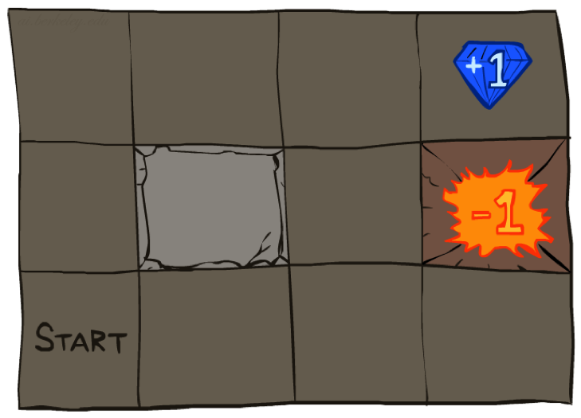




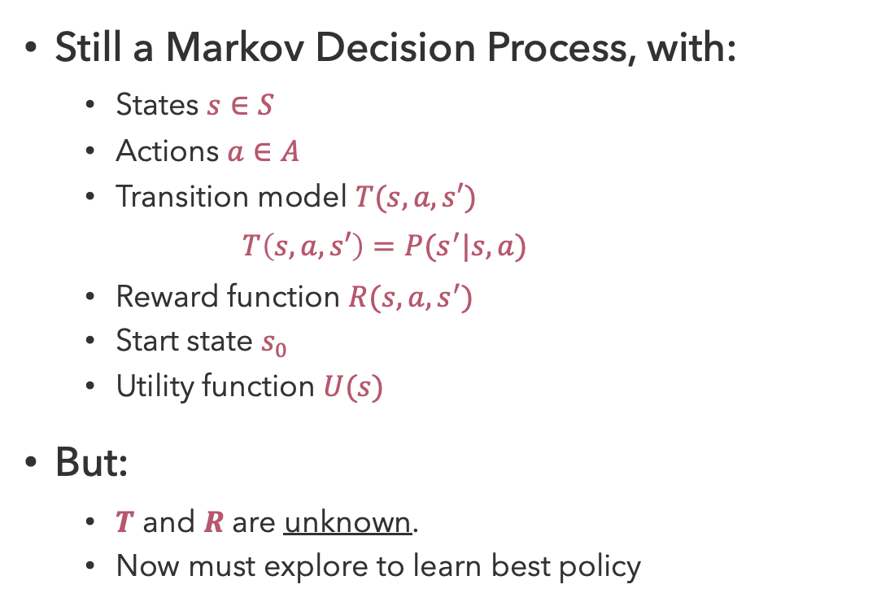
Reinforcement Learning Problems
Still a Markov Decision Process, with:
  States $s∈S$
  Actions $a∈A$
  Transition model $T(s,a,s′)$
    $$T\left(s,a,s′\right)=P(s^{′}|s,a)$$
  Reward function $R(s,a,s^{′})$
  Start state $s_{0}$
  Utility function $U(s)$
But:
  $T$ and $R$ are unknown.
  Now must explore to learn best policy
Agent
Sensors
percepts
?
Environment
Actuators
actions
Notes:
Model-free

Slide 6
Reinforcement Learning Approaches
state s, reward r
Agent
Sensors
percepts
?
Environment
Actuators
actions a
actions
Exploration: try unknown actions to gain information
Exploitation: eventually, you have to use what you know
Sampling: repeat many times to get good estimates
Generalization: what you learn in one state may apply to others, too

Slide 7
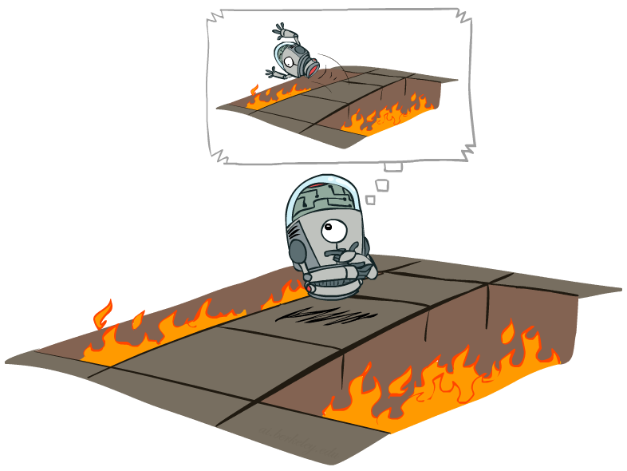
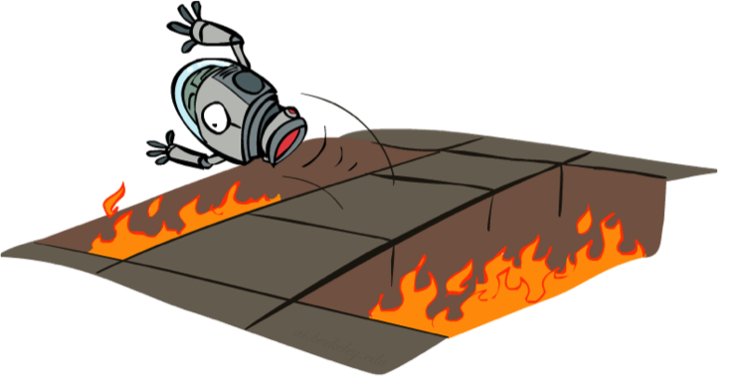
Offline vs. Online Learning
Offline Solution (MDPs)
Online Learning (RL)

Slide 8
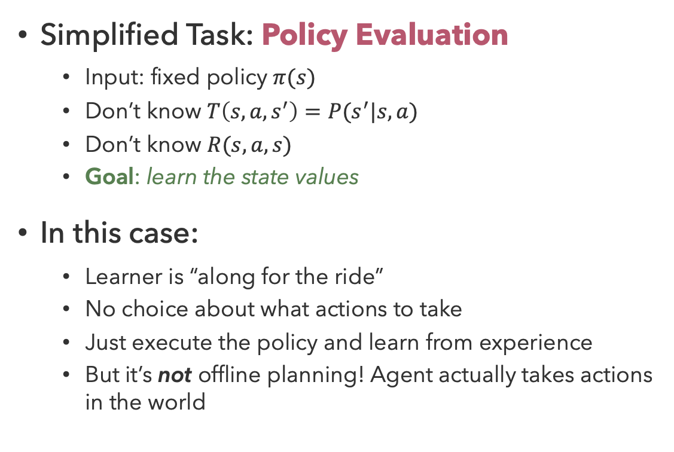
Passive Reinforcement Learning
Simplified Task: Policy Evaluation
  Input: fixed policy $π(s)$
  Don’t know $T\left(s,a,s^{′}\right)=P(s^{′}|s,a)$
  Don’t know $R(s,a,s)$
  Goal: learn the state values
In this case:
  Learner is “along for the ride”
  No choice about what actions to take
  Just execute the policy and learn from experience
  But it’s not offline planning! Agent actually takes actions in the world

Slide 9
Questions (1)

Slide 10


‘Active’ Reinforcement Learning
Model-Based Learning
Model-Free Learning

Slide 11


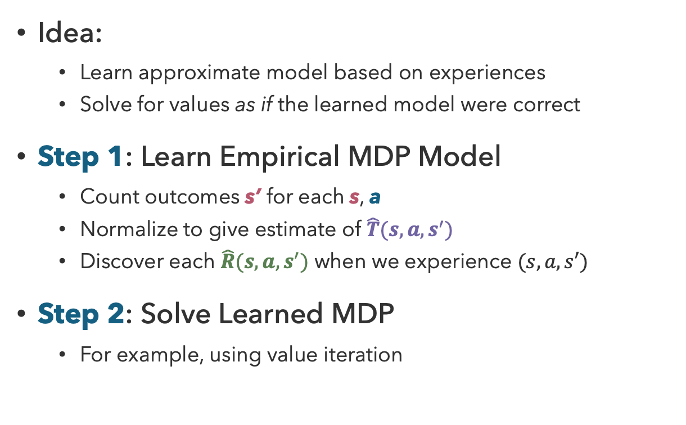
Model-Based Learning
Idea:
  Learn approximate model based on experiences
  Solve for values as if the learned model were correct
Step 1: Learn Empirical MDP Model
  Count outcomes s’ for each s, a
  Normalize to give estimate of $\hat{T}(s,a,s^{′})$
  Discover each $\hat{R}(s,a,s^{′})$ when we experience $(s,a,s′)$
Step 2: Solve Learned MDP
  For example, using value iteration

Slide 12
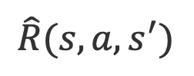
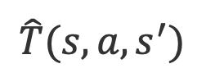
Model-Based Learning Example
Observed Episodes (Training)
Learned Model
Input Policy π
Episode 1
Episode 2
$$\hat{T}(s,a,s^{′})$$
 | A
B | C | D
 | E
B, east, C, -1
C, east, D, -1
D, exit, x, +10
B, east, C, -1
C, east, D, -1
D, exit, x, +10
T(B, east, C) = 1.00
T(C, east, D) = 0.75
T(C, east, A) = 0.25
Episode 3
Episode 4
$$\hat{R}(s,a,s^{′})$$
E, north, C, -1
C, east, D, -1
D, exit, x, +10
E, north, C, -1
C, east, A, -1
A, exit, x, -10
R(B, east, C) = -1
R(C, east, D) = -1
R(D, exit, x) = +10
R(C, east, A) = -1
R(A, exit, x) = -10
Assume: γ = 1
Notes:
Interrogate the values of the learned model!

Slide 13
Model-Based Learning: Pros and Cons
Advantage
  Makes efficient use of experiences
Disadvantage
  May not scale to large state spaces
    Learns to model one state-action pair at a time (this is fixable)
    Cannot solve MDP for very large | S |

Slide 14
Questions (2)

Slide 15
Model-Free Learning

Slide 16
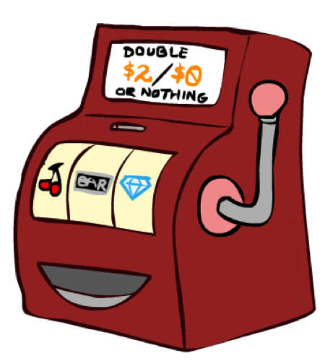
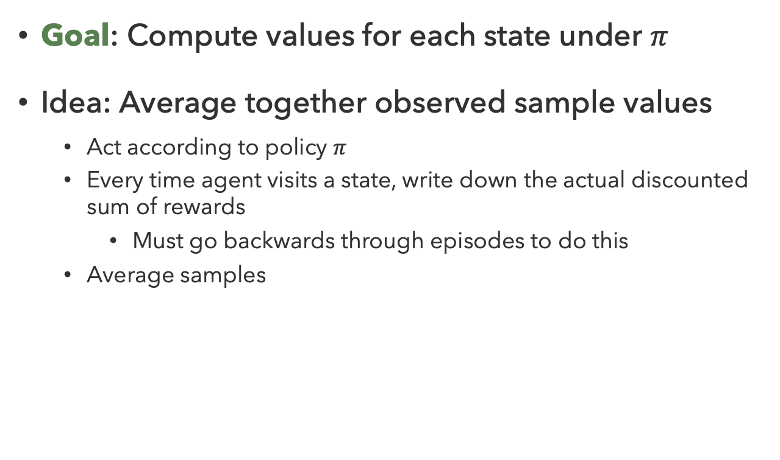
Direct Evaluation
Goal: Compute values for each state under $π$
Idea: Average together observed sample values
  Act according to policy $π$
  Every time agent visits a state, write down the actual discounted sum of rewards
    Must go backwards through episodes to do this
  Average samples

Slide 17
Direct Evaluation Example (1)
Observed Episodes (Training)
Output Values
Input Policy π
Episode 1
Episode 2
 | A
B | C | D
 | E
 | A
B | C | D
 | E
B, east, C, -1
C, east, D, -1
D, exit, x, +10
B, east, C, -1
C, east, D, -1
D, exit, x, +10
Episode 3
Episode 4
E, north, C, -1
C, east, D, -1
D, exit, x, +10
E, north, C, -1
C, east, A, -1
A, exit, x, -10
U^{π}(s) = average(returns(s))
Assume: γ = 1
Notes:
Need to be more clear here

Slide 18
Direct Evaluation Example (2)
Observed Episodes (Training)
Output Values
Input Policy π
Episode 1
Episode 2
 | A
B | C | D
 | E
-10
 | A
B | C | D
 | E
B, east, C, -1
C, east, D, -1
D, exit, x, +10
B, east, C, -1
C, east, D, -1
D, exit, x, +10
+8
+4
+10
-2
Episode 3
Episode 4
E, north, C, -1
C, east, D, -1
D, exit, x, +10
E, north, C, -1
C, east, A, -1
A, exit, x, -10
U^{π}(D) = 3/3 * 10 = 10
U^{π}(A) = 1/1 * -10 = -10
U^{π}(B) = 2/2 * (-1 + -1 + 10) = 8
U^{π}(C) = 3/4 * (-1 + 10) +
1/4 (-1 + - 10) = 4
U^{π}(E) = 1/2 * (-1 + -1 + 10) +
1/2 (-1 + -1 + - 10) = -2
Assume: γ = 1
Notes:
How many times do we start in C? (4)
How many of those give the same sum of rewards? (3) -> -1 + 10
(1) -> -1 + -10

Slide 19
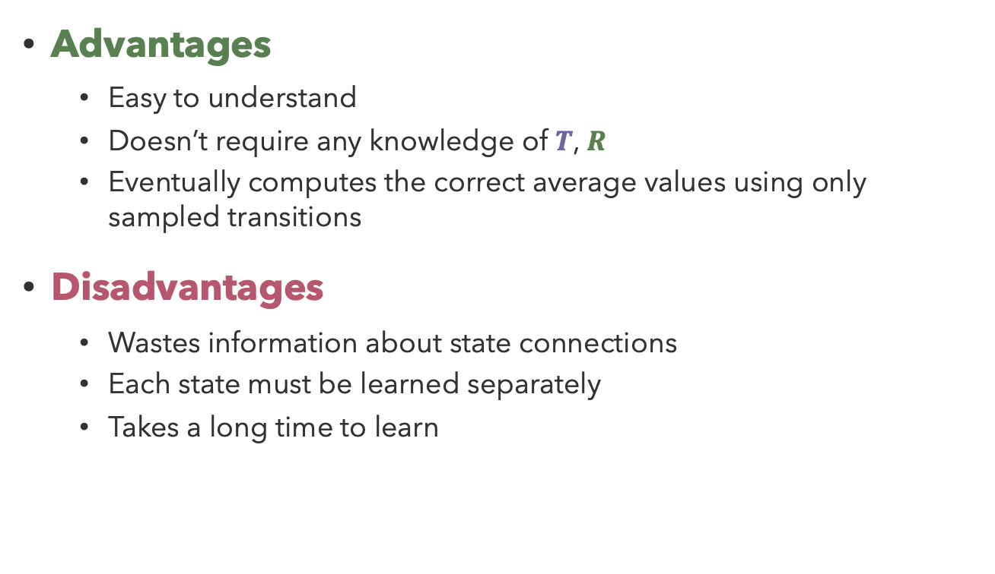
Problems with Direct Evaluation
Output Values
Advantages
  Easy to understand
  Doesn’t require any knowledge of $T$, $R$
  Eventually computes the correct average values using only sampled transitions
Disadvantages
  Wastes information about state connections
  Each state must be learned separately
  Takes a long time to learn
 | A
B | C | D
 | E
-10
+8
+4
+10
-2
If B and E both go to C under this policy, how can their values be different?

Slide 20
Questions (3)

Slide 21

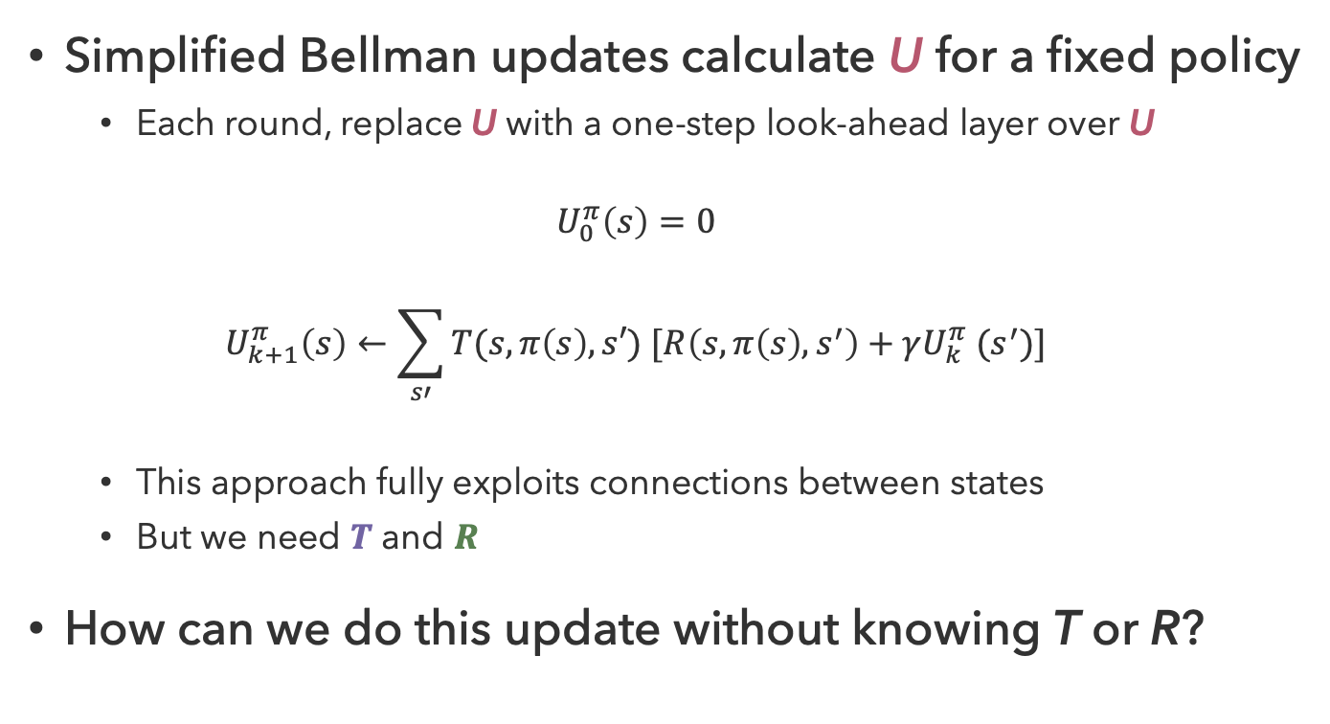


Why Not Use Policy Evaluation?
Simplified Bellman updates calculate U for a fixed policy
  Each round, replace U with a one-step look-ahead layer over U
  $$U_{0}^{π}\left(s\right)=0$$
  $$U_{k+1}^{π}\left(s\right)←\sum_{s′}{T(s,π\left(s\right),s′) [R\left(s,π\left(s\right),s^{′}\right)+γU_{k}^{π} (s^{′})]}$$
  This approach fully exploits connections between states
  But we need $T$ and $R$
How can we do this update without knowing T or R?
s
$$π(s)$$
s, $π(s)$
s,$π(s)$,s’
s’

Slide 22
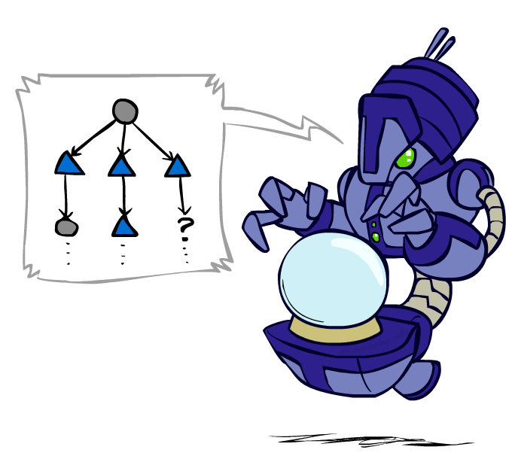
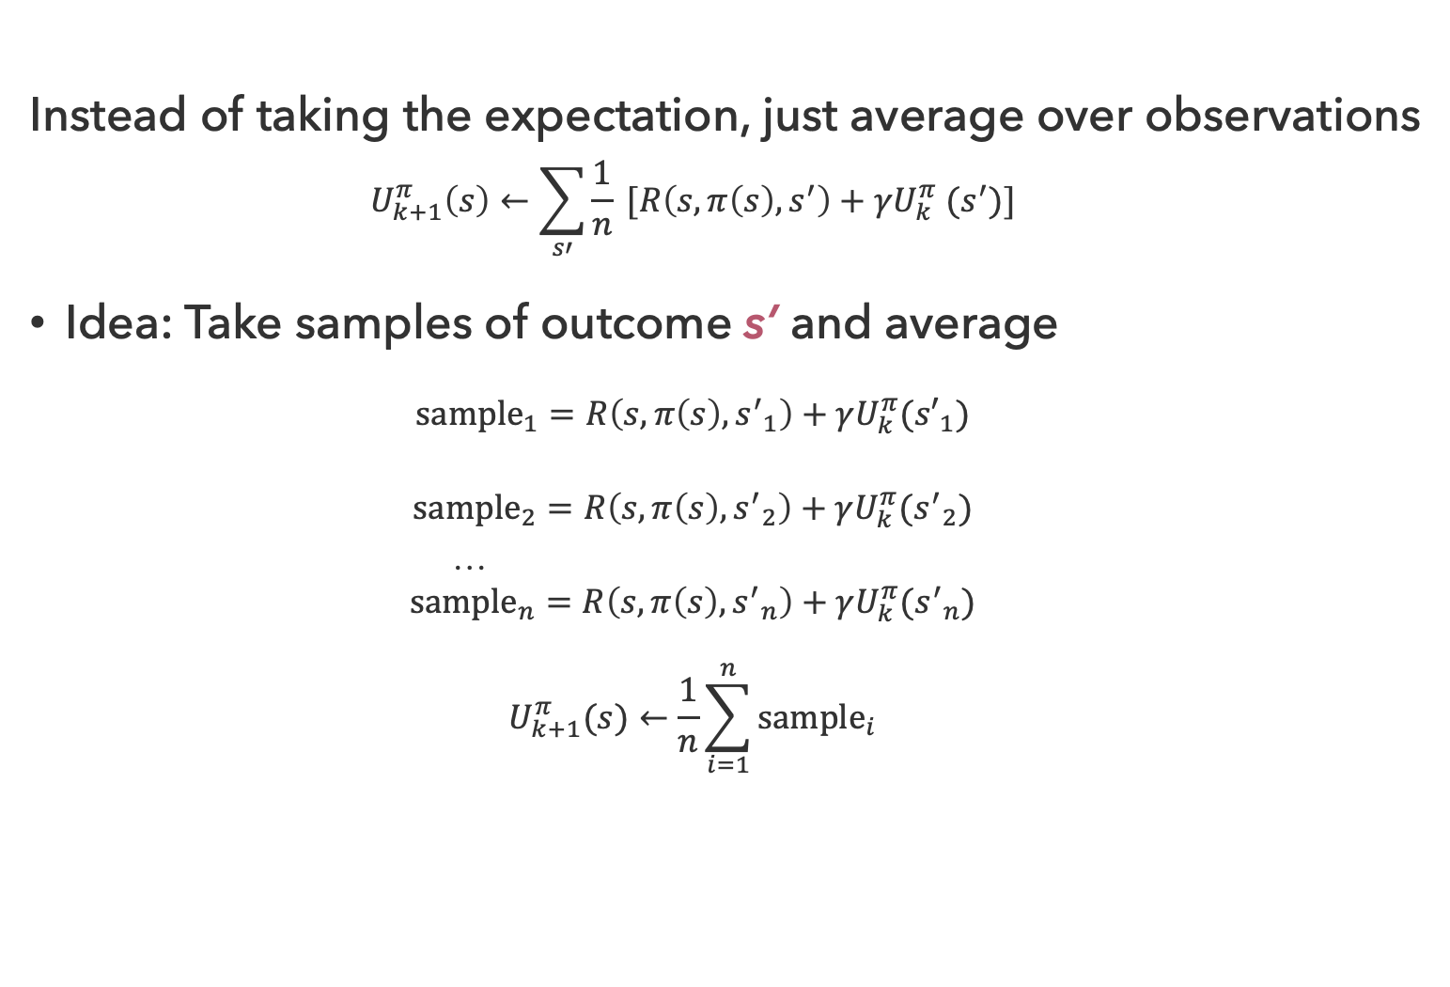
Sample-Based Policy Evaluation?
Instead of taking the expectation, just average over observations
  $$U_{k+1}^{π}\left(s\right)←\sum_{s′}{\frac{1}{n} [R\left(s,π\left(s\right),s^{′}\right)+γU_{k}^{π} (s^{′})]}$$
Idea: Take samples of outcome s’ and average
  $${sample}_{1}=R\left(s,π\left(s\right),{s^{′}}_{1}\right)+γU_{k}^{π}({s′}_{1})$$
  $${sample}_{2}=R\left(s,π\left(s\right),{s^{′}}_{2}\right)+γU_{k}^{π}({s^{′}}_{2})$$
  …
  $${sample}_{n}=R\left(s,π\left(s\right),{s^{′}}_{n}\right)+γU_{k}^{π}({s^{′}}_{n})$$
  $$U_{k+1}^{π}(s)←\frac{1}{n}\sum_{i=1}^{n}{{sample}_{i}}$$

Slide 23
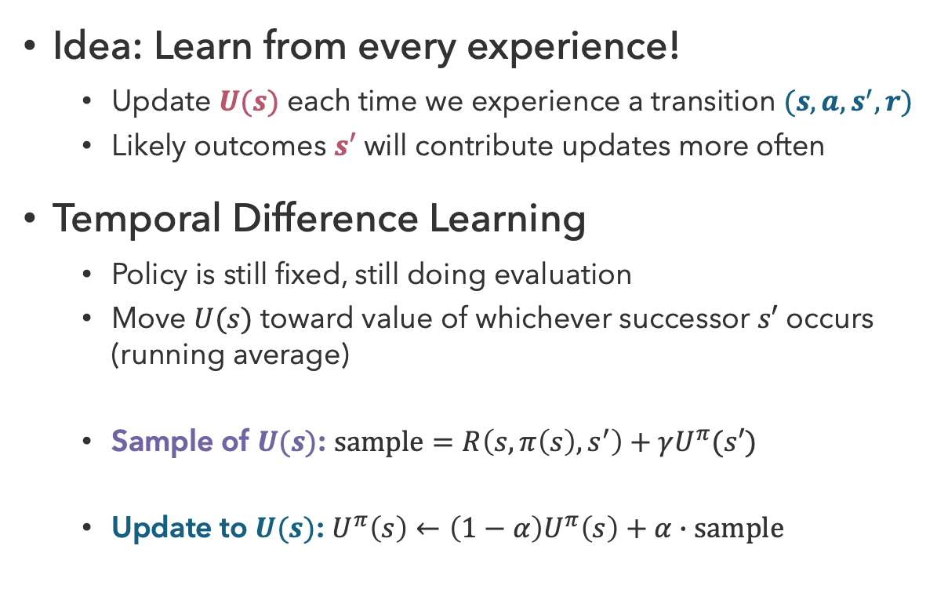

Temporal Difference Learning
Idea: Learn from every experience!
  Update $U(s)$ each time we experience a transition $(s,a,s^{′},r)$
  Likely outcomes $s′$ will contribute updates more often
Temporal Difference Learning
  Policy is still fixed, still doing evaluation
  Move $U(s)$ toward value of whichever successor $s′$ occurs (running average)
  Sample of $U(s)$: $sample=R\left(s,π\left(s\right),s^{′}\right)+γU^{π}(s′)$
  Update to $U(s)$: $U^{π}\left(s\right)←\left(1−α\right)U^{π}\left(s\right)+α∙sample$
s
$$π(s)$$
s, $π(s)$
s,$π(s)$,s’,r
s’

Slide 24
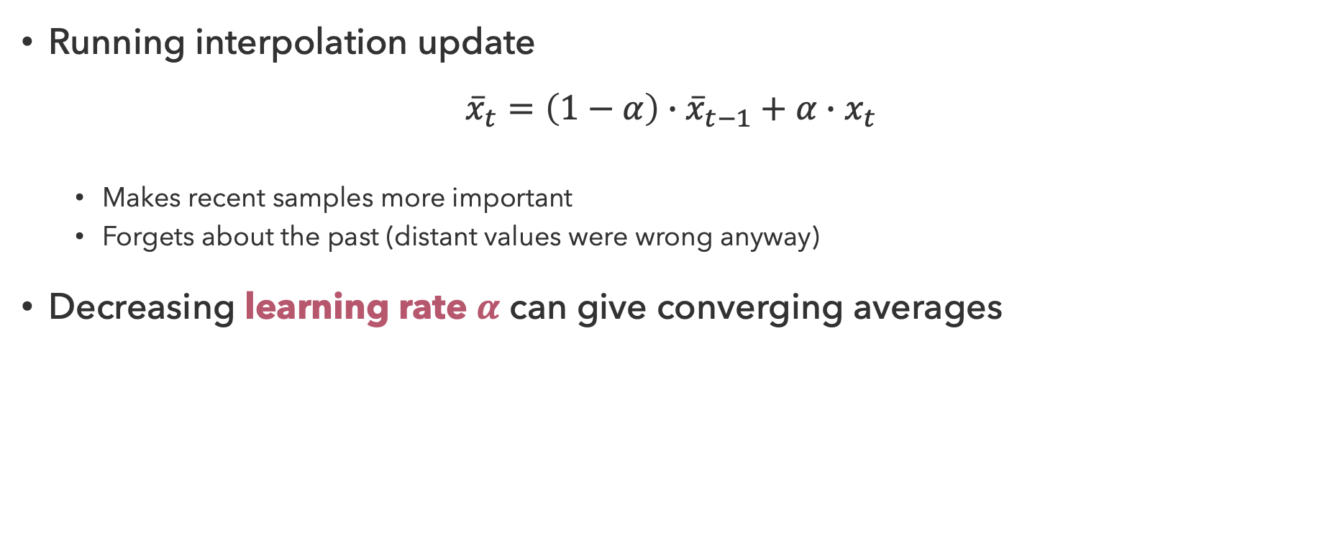
Exponential Moving Average
Running interpolation update
$${\overline{x}}_{t}=\left(1−α\right)∙{\overline{x}}_{t−1}+α∙x_{t}$$
  Makes recent samples more important
  Forgets about the past (distant values were wrong anyway)
Decreasing learning rate $α$ can give converging averages

Slide 25

TDL Example (1)
Assume: $γ$ = 1, $α$ = 0.5
States
Observed Transitions
B, east, C, -2
C, east, D, -2
 | A
B | C | D
 | E
 | 0
0 | 0 | 8
 | 0
 | 0
-1 | 0 | 8
 | 0
 | 0
-1 | 3 | 8
 | 0
$$U^{π}\left(s\right)←\left(1−α\right)U^{π}\left(s\right)+α[R\left(s,π\left(s\right),s^{′}\right)+γU^{π}\left(s^{′}\right)]$$

Slide 26
TDL Example (2)
Assume: $γ$ = 1, $α$ = 0.5
Observed Transitions
D, exit, , +10
B, east, C, -2
C, east, D, -2
 | 0
-1 | 3 | 8
 | 0
 | 0
-1 | 3 | 9
 | 0
 | 0
0 | 3 | 9
 | 0
 | 0
0 | 5 | 9
 | 0
U^{𝜋} (D) ← (1/2)U^{𝜋}(D) +
1/2 [+10]
← 9
U^{𝜋} (B) ← (1/2)U^{𝜋}(B) +
1/2 [-2 + U^{𝜋}(C)]
← -1/2+1/2 = 0
U^{𝜋} (C) ← (1/2)U^{𝜋}(C) +
1/2 [-2 + U^{𝜋}(D)]
← 1.5 + 3.5 = 5

Slide 27
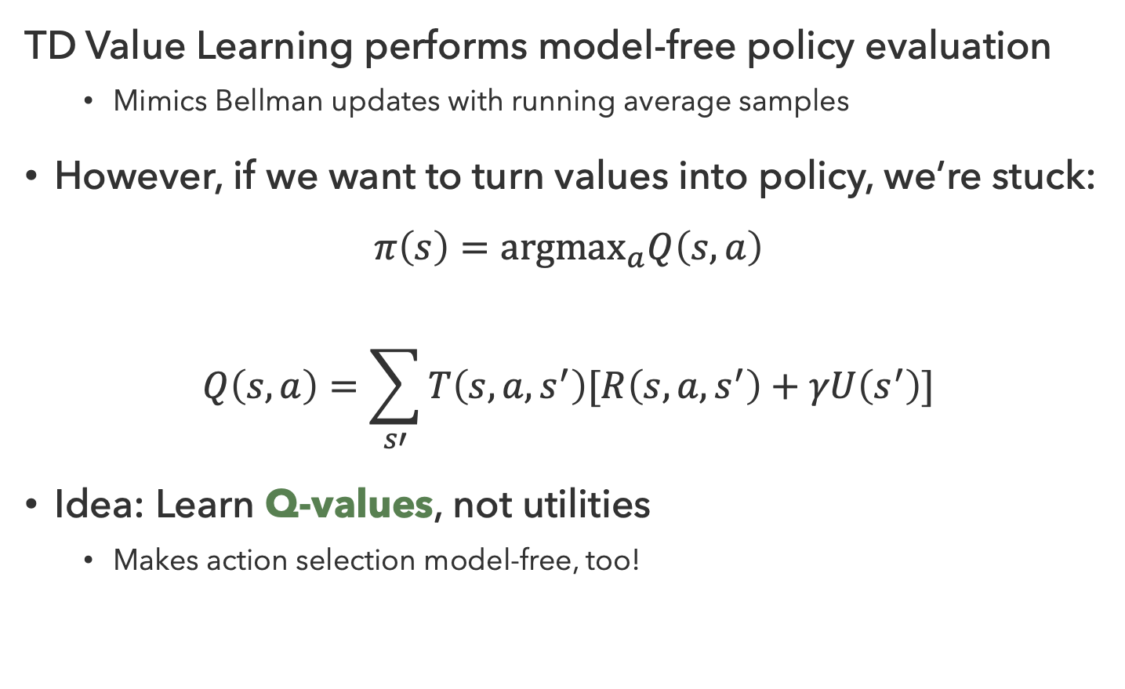
Problems with TD Value Learning
TD Value Learning performs model-free policy evaluation
  Mimics Bellman updates with running average samples
However, if we want to turn values into policy, we’re stuck:
$$π\left(s\right)={argmax}_{a}Q\left(s,a\right)$$
$$Q\left(s,a\right)=\sum_{s′}{T\left(s,a,s^{′}\right)[R\left(s,a,s^{′}\right)+γU\left(s^{′}\right)]}$$
Idea: Learn Q-values, not utilities
  Makes action selection model-free, too!
s
a
s,a
s,a,s’
s’

Slide 28
Questions (4)

Slide 29
that’s it for today!
Value iteration computes values by taking the max over possible actions
Policy iteration considers a fixed policy, then improves the policy using calculated values
Q-Learning
More Reinforcement Learning
Complete Practice Problem 8
Do Project 2 (due 7.16)

