Slide 1
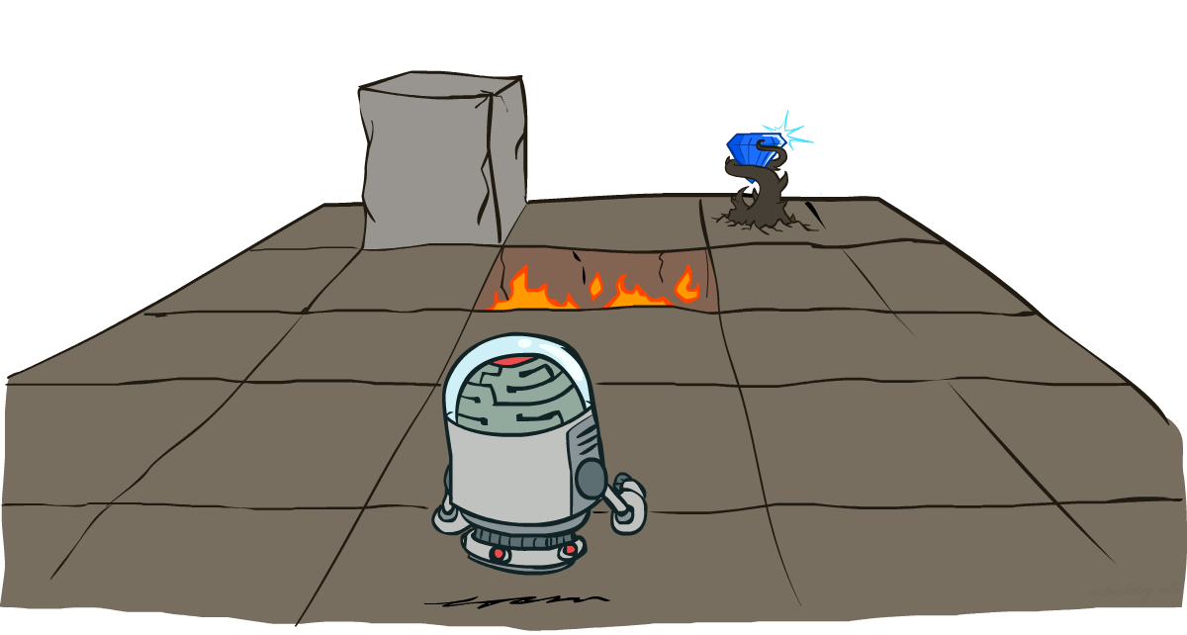
Markov Decision Processes II
CSE 473: Introduction to Artificial Intelligence
James Weichert (jpw@cs)
cs.uw.edu/473
acknowledgements
Welcome!
How is Project 1 going?
sli.do #cse473

Slide 2
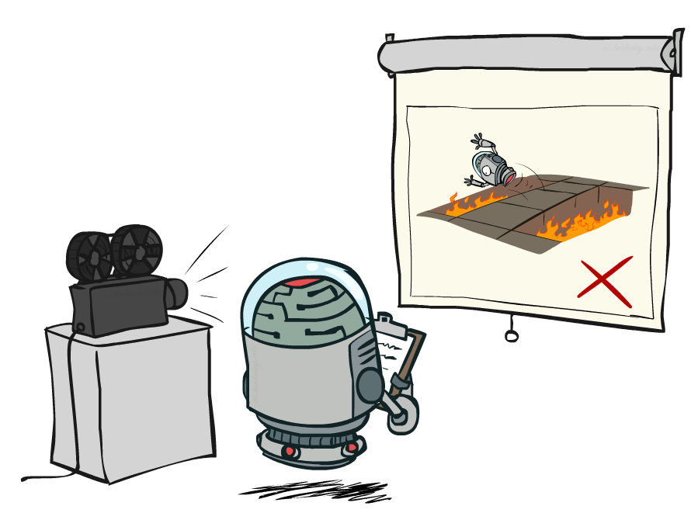
Administrivia
For each project, make sure to fill out the AI usage reflection (cs.uw.edu/473/projects)
Test 1 on Friday
  One double-sided 8.5x11” note sheet allowed
Project 1 due tomorrow! (7.9)
Homework 2 releases Friday
  due in two weeks (7.23)

Slide 3
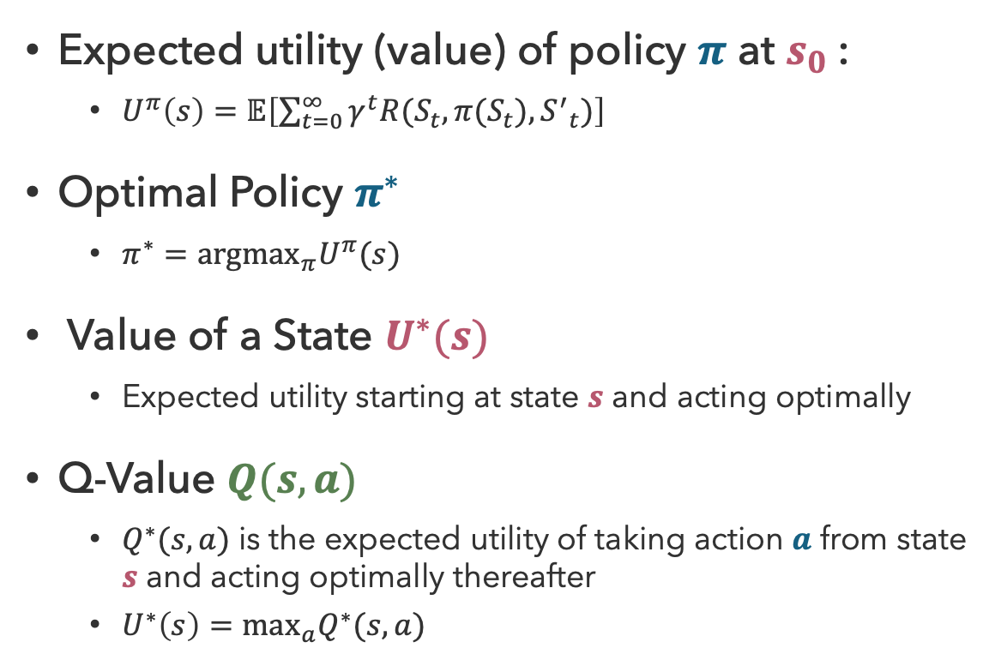
Recap: Optimal Quantities
Expected utility (value) of policy $π$ at $s_{0}$:
  $U^{π}\left(s\right)=𝔼\left[\sum_{t=0}^{∞}{γ^{t}R(S_{t},π(S_{t}),{S^{′}}_{t})}\right]$
Optimal Policy $π^{∗}$
  $π^{∗}={argmax}_{π}U^{π}(s)$
Value of a State $U^{∗}(s)$
  Expected utility starting at state $s$ and acting optimally
Q-Value $Q(s,a)$
  $Q^{∗}(s,a)$ is the expected utility of taking action $a$ from state $s$ and acting optimally thereafter
  $U^{∗}\left(s\right)=\max_{a}Q^{∗}(s,a)$
state
s
a
Q(s,a)
Q-state
transition
s,a,s’
s’

Slide 4
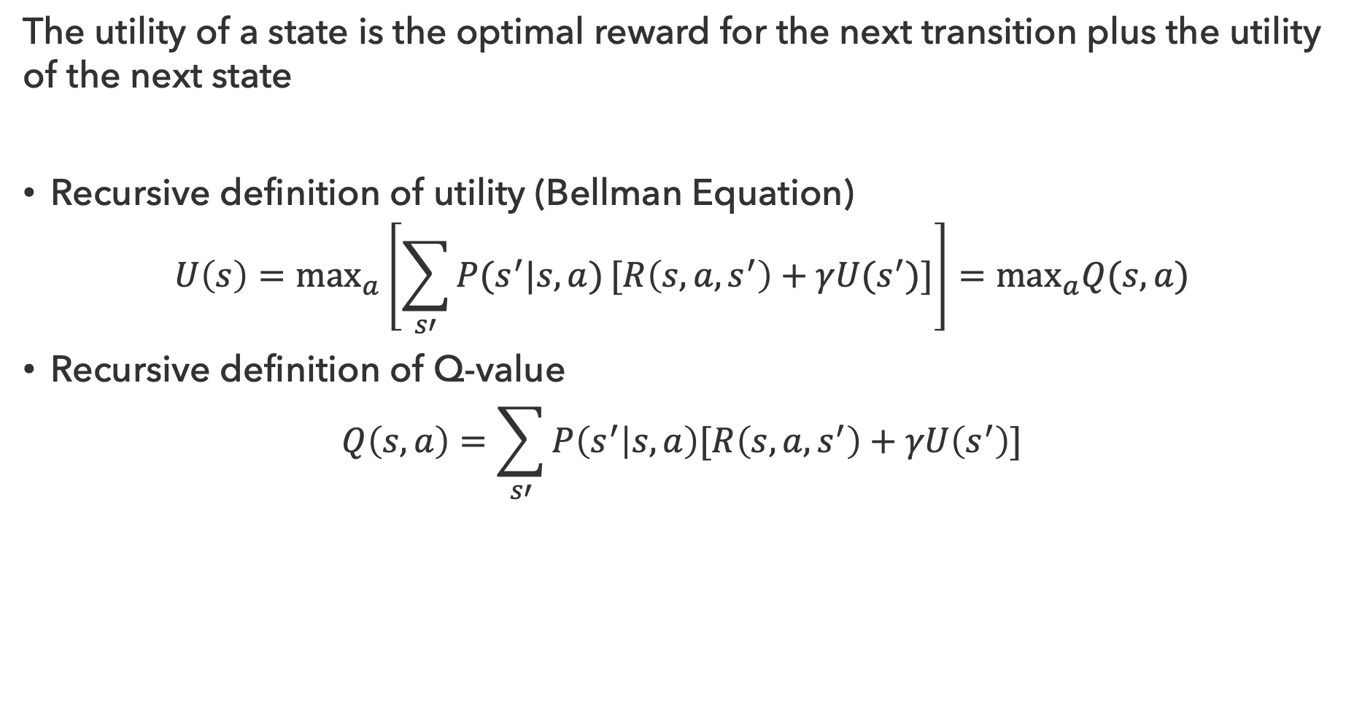
Recap: Bellman Equations
The utility of a state is the optimal reward for the next transition plus the utility of the next state
Recursive definition of utility (Bellman Equation)
$$U\left(s\right)=\max_{a}\left[\sum_{s′}{P(s^{′}|s,a)}[R\left(s,a,s^{′}\right)+γU(s^{′})]\right]=\max_{a}Q(s,a)$$
Recursive definition of Q-value
$$Q\left(s,a\right)=\sum_{s′}{P\left(s^{′} | s,a\right)[R\left(s,a,s^{′}\right)+γU\left(s^{′}\right)]}$$

Slide 5

It’s Pretty Simple…
How to be optimal:
Step 1: Take correct first action
Step 2: Keep being optimal

Slide 6
How to find U*(s)?

Slide 7

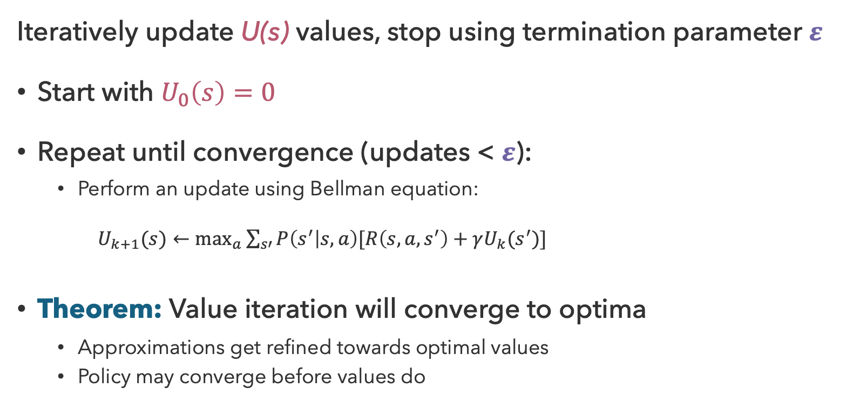
Value Iteration
Iteratively update U(s) values, stop using termination parameter $ε$
Start with $U_{0}\left(s\right)=0$
Repeat until convergence (updates < $ε$):
  Perform an update using Bellman equation:
  $U_{k+1}(s)←\max_{a}\sum_{s′}{P\left(s^{′} | s,a\right)[R\left(s,a,s^{′}\right)+γU_{k}(s^{′})]}$
Theorem: Value iteration will converge to optima
  Approximations get refined towards optimal values
  Policy may converge before values do

Slide 8
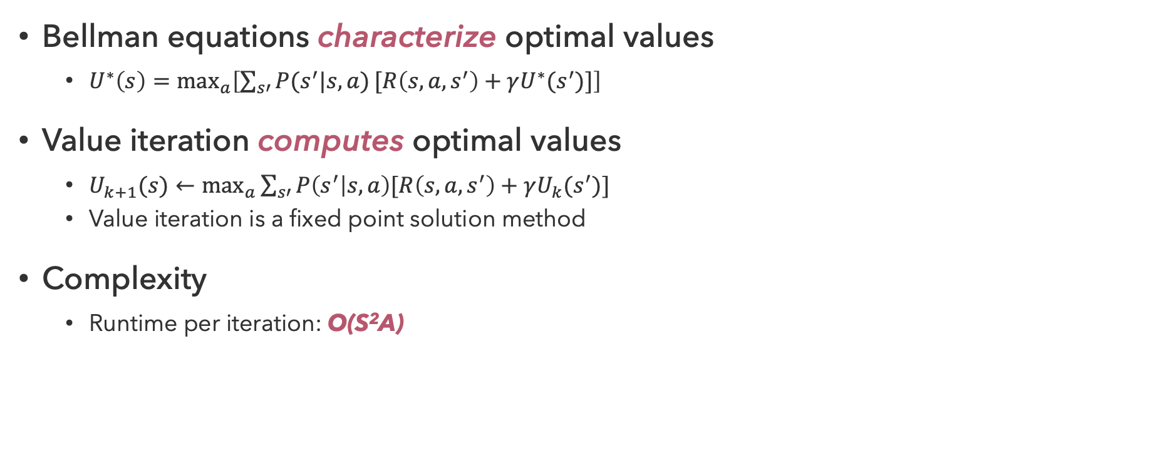
Properties of Value Iteration
Bellman equations characterize optimal values
  $U^{∗}\left(s\right)=\max_{a}\left[\sum_{s′}{P(s^{′}|s,a)}[R\left(s,a,s^{′}\right)+γU^{∗}(s^{′})]\right]$
Value iteration computes optimal values
  $U_{k+1}(s)←\max_{a}\sum_{s′}{P\left(s^{′} | s,a\right)[R\left(s,a,s^{′}\right)+γU_{k}(s^{′})]}$
  Value iteration is a fixed point solution method
Complexity
  Runtime per iteration: O(S²A)
s
a
s, a
s,a,s’
s’
A

Slide 9
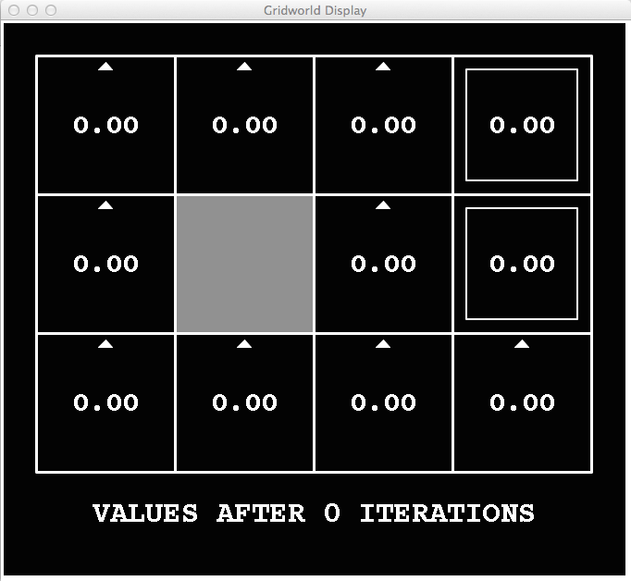
Grid World Value Iteration (k = 0)
Noise = 0.2
Discount = 0.9
Living Reward = 0

Slide 10
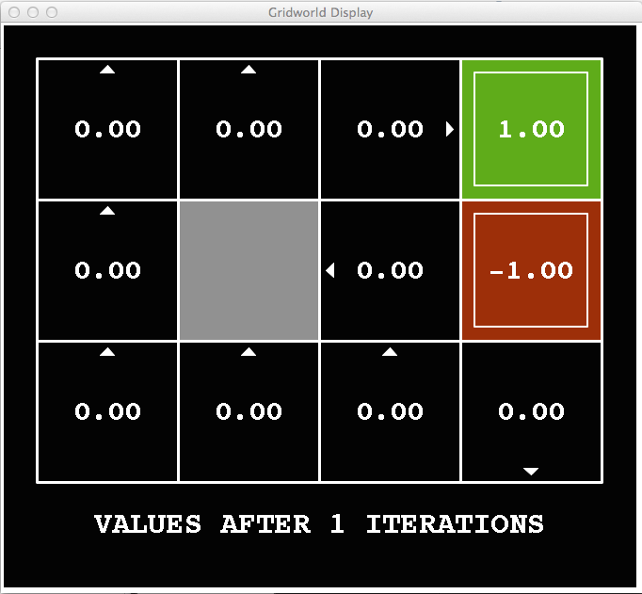
Grid World Value Iteration (k = 1)
Noise = 0.2
Discount = 0.9
Living Reward = 0

Slide 11
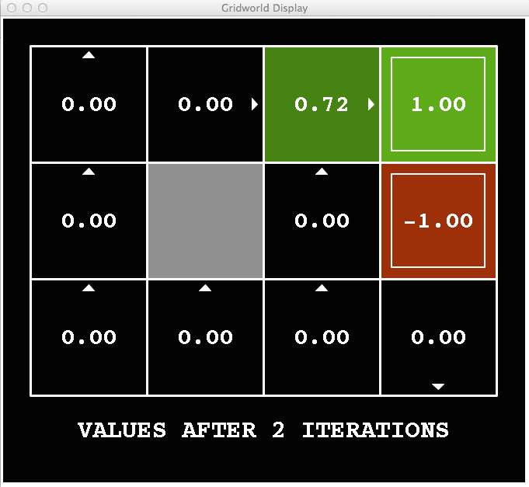
Grid World Value Iteration (k = 2)
Noise = 0.2
Discount = 0.9
Living Reward = 0

Slide 12
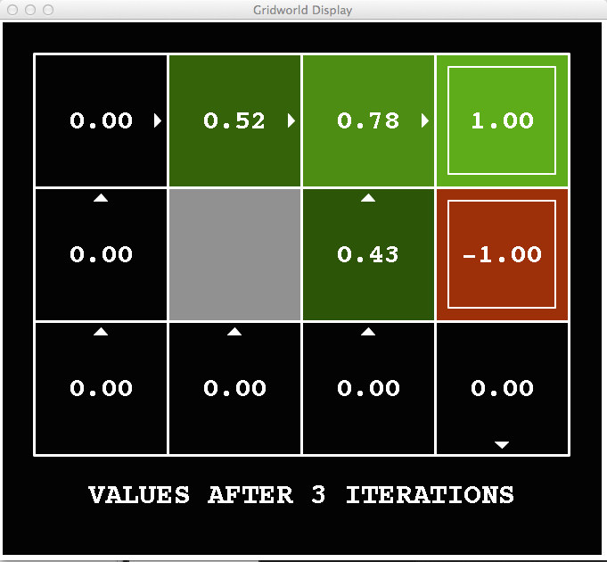
Grid World Value Iteration (k = 3)
Noise = 0.2
Discount = 0.9
Living Reward = 0

Slide 13
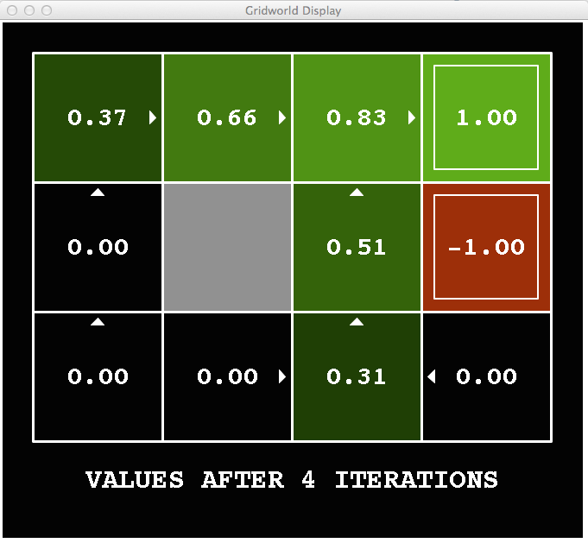
Grid World Value Iteration (k = 4)
Noise = 0.2
Discount = 0.9
Living Reward = 0

Slide 14
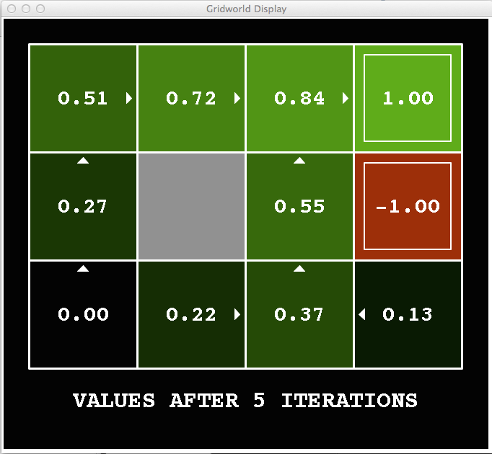
Grid World Value Iteration (k = 5)
Noise = 0.2
Discount = 0.9
Living Reward = 0

Slide 15
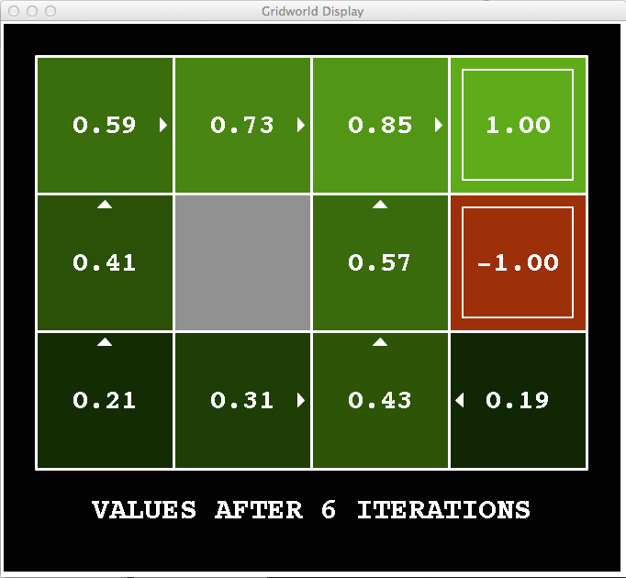
Grid World Value Iteration (k = 6)
Noise = 0.2
Discount = 0.9
Living Reward = 0

Slide 16
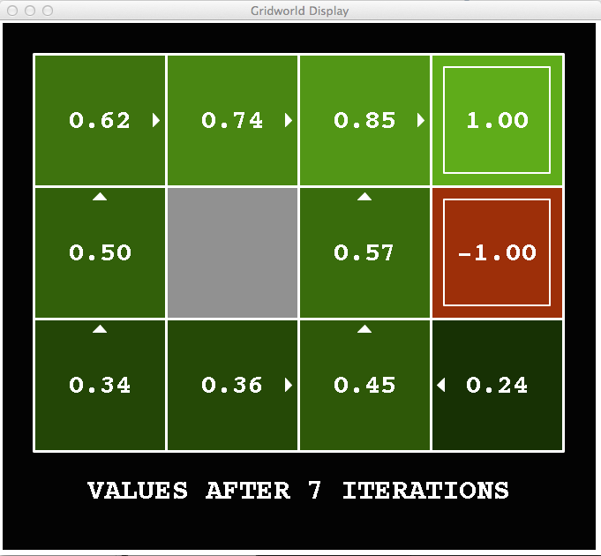
Grid World Value Iteration (k = 7)
Noise = 0.2
Discount = 0.9
Living Reward = 0

Slide 17
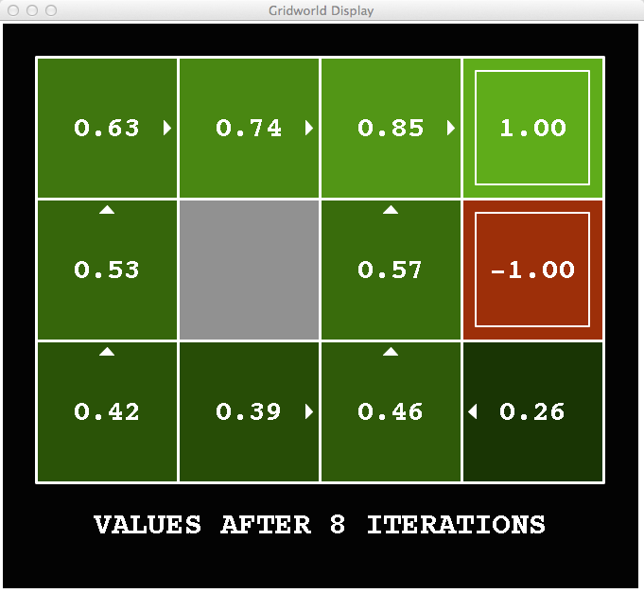
Grid World Value Iteration (k = 8)
Noise = 0.2
Discount = 0.9
Living Reward = 0

Slide 18
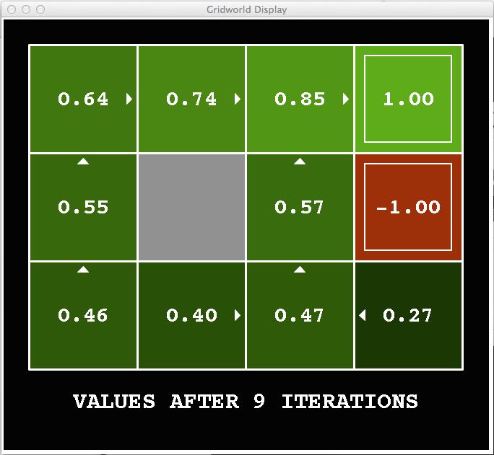
Grid World Value Iteration (k = 9)
Noise = 0.2
Discount = 0.9
Living Reward = 0

Slide 19

Grid World Value Iteration (k = 10)
Noise = 0.2
Discount = 0.9
Living Reward = 0

Slide 20
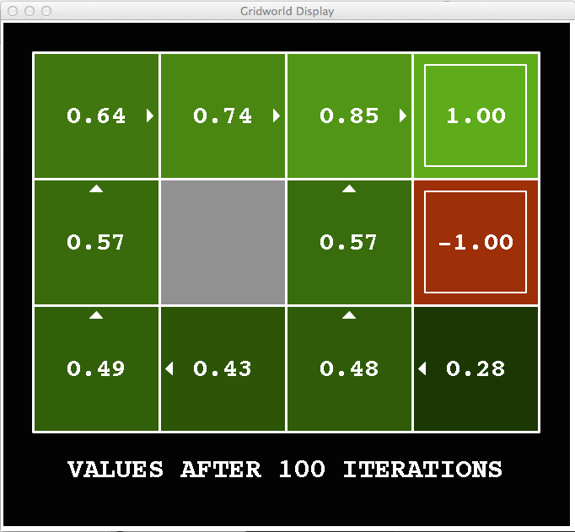
Grid World Value Iteration (k = 100)
Noise = 0.2
Discount = 0.9
Living Reward = 0

Slide 21
Questions (1)

Slide 22
How to find policy from values?

Slide 23
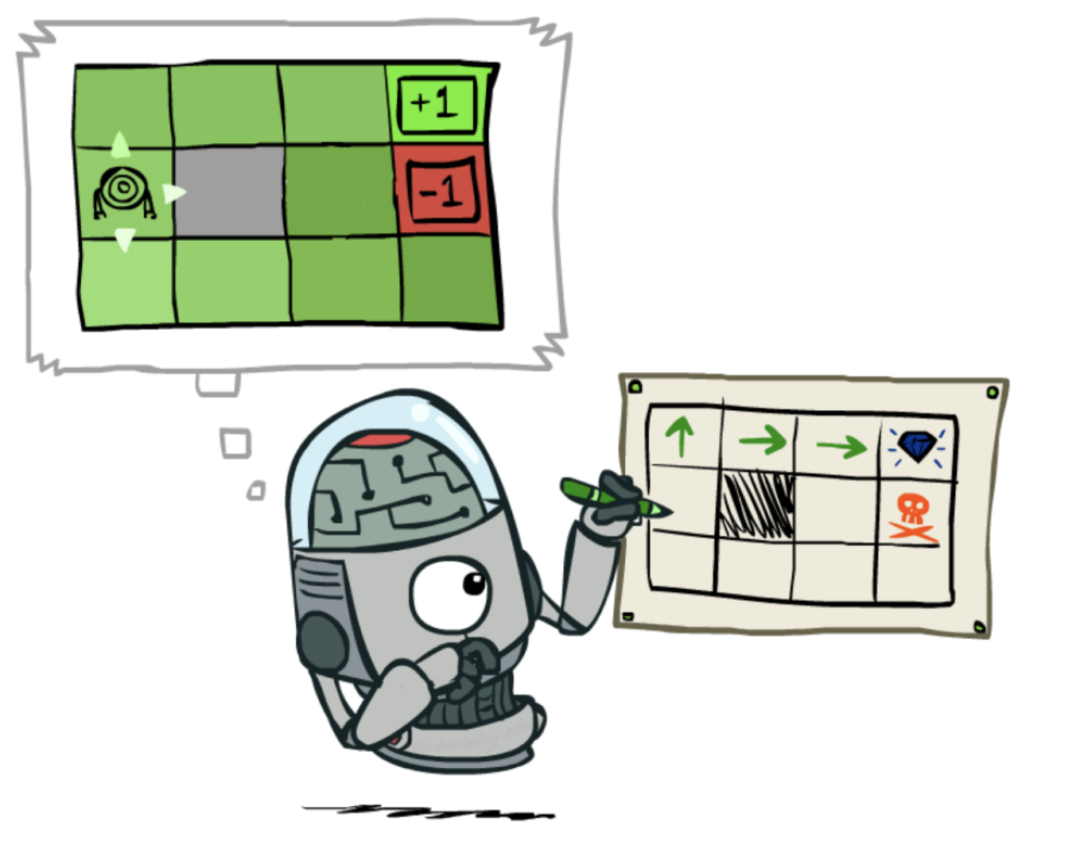
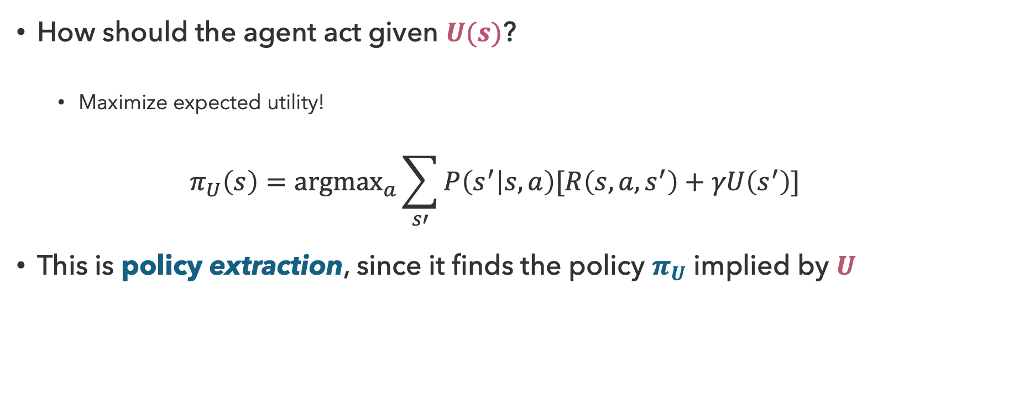
Policy Extraction
How should the agent act given $U(s)$?
  Maximize expected utility!
  $$π_{U}\left(s\right)={argmax}_{a}\sum_{s′}{P\left(s^{′} | s,a\right)[R\left(s,a,s^{′}\right)+γU\left(s^{′}\right)]}$$
This is policy extraction, since it finds the policy $π_{U}$ implied by $U$

Slide 24
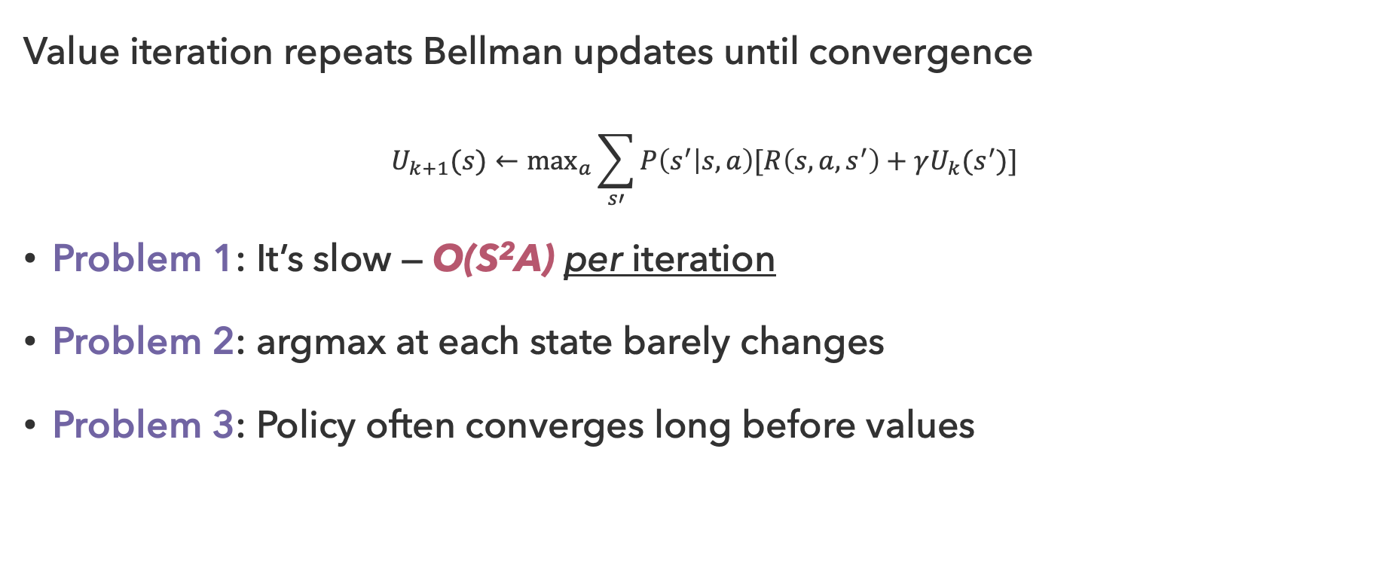
Problems with Value Iteration
Value iteration repeats Bellman updates until convergence
$$U_{k+1}(s)←\max_{a}\sum_{s′}{P\left(s^{′} | s,a\right)[R\left(s,a,s^{′}\right)+γU_{k}(s^{′})]}$$
Problem 1: It’s slow — O(S²A) per iteration
Problem 2: argmax at each state barely changes
Problem 3: Policy often converges long before values

Slide 25
Questions (2)

Slide 26

A Better Apporach…

Slide 27

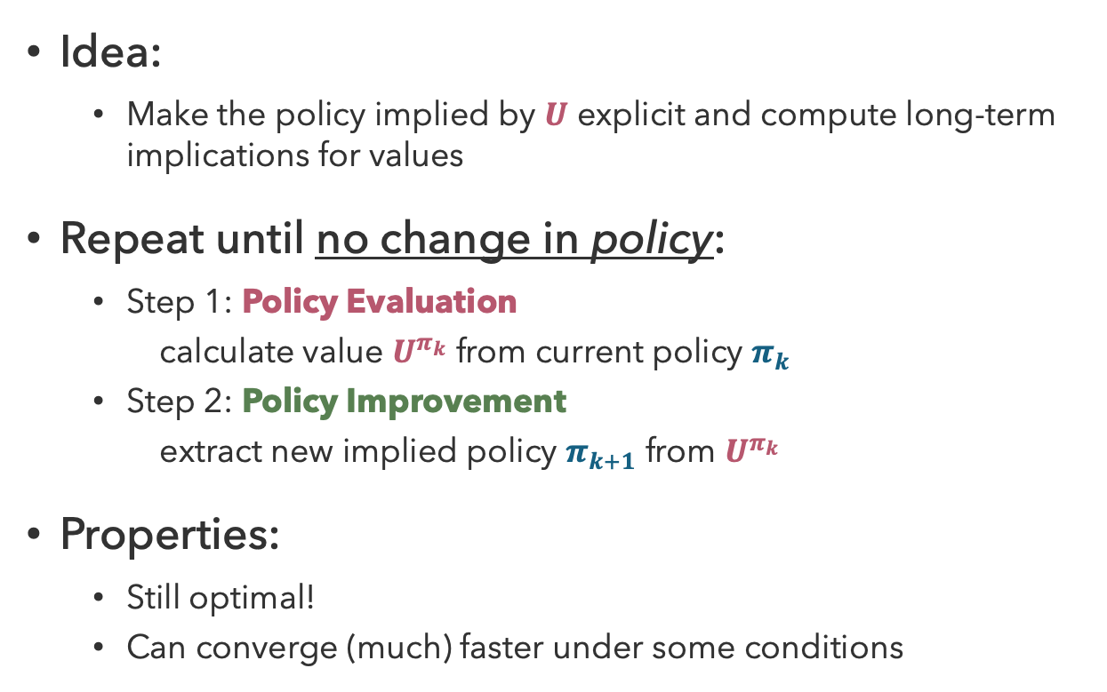
Policy Iteration
Idea:
  Make the policy implied by $U$ explicit and compute long-term implications for values
Repeat until no change in policy:
  Step 1: Policy Evaluation
  calculate value $U^{π_{k}}$ from current policy $π_{k}$
  Step 2: Policy Improvement
    extract new implied policy $π_{k+1}$ from $U^{π_{k}}$
Properties:
  Still optimal!
  Can converge (much) faster under some conditions

Slide 28

How to Evaluate Policies?

Slide 29
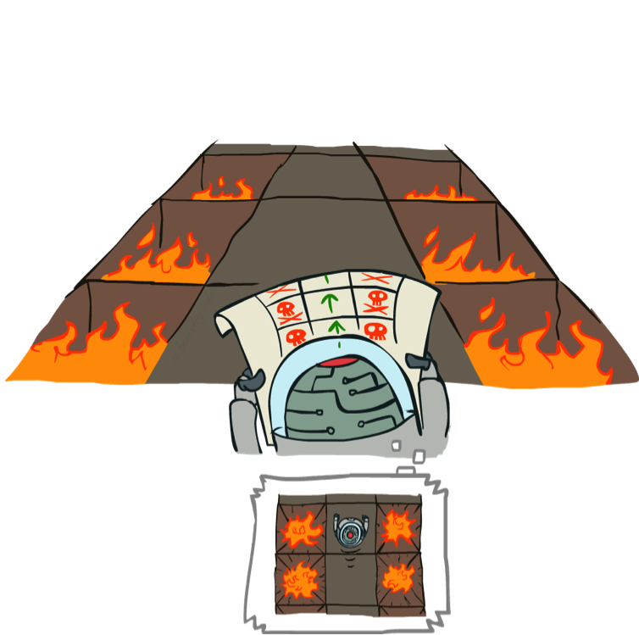
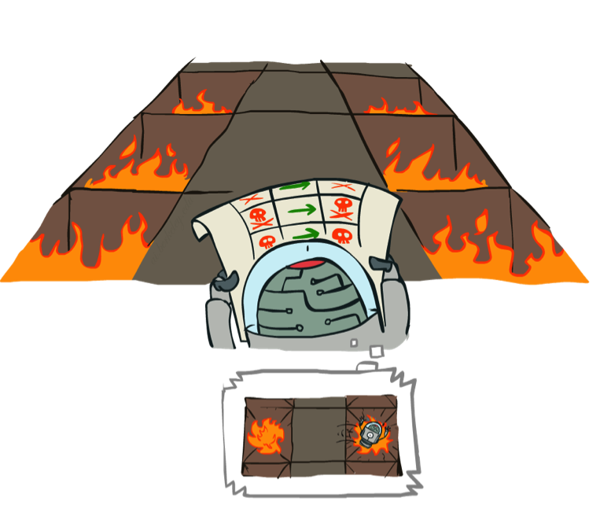
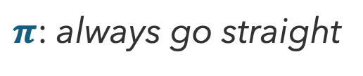
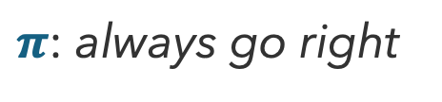
Evaluating Policies
$π$: always go right
$π$: always go straight

Slide 30
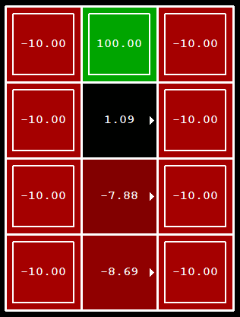
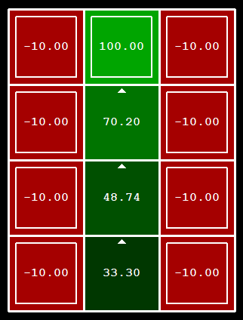
Evaluating Policies from Utilities
$π$: always go right
$π$: always go straight

Slide 31





Fixed Policies
s
s
Optimal Action
Fixed Policy $π$
a
$$π(s)$$
s, a
s, $π(s)$
s,a,s’
s,$π(s)$,s’
s’
s’
Expectimax over all actions is complicated
If we fixed some policy $π(s)$ per state, the tree would be much simpler…

Slide 32

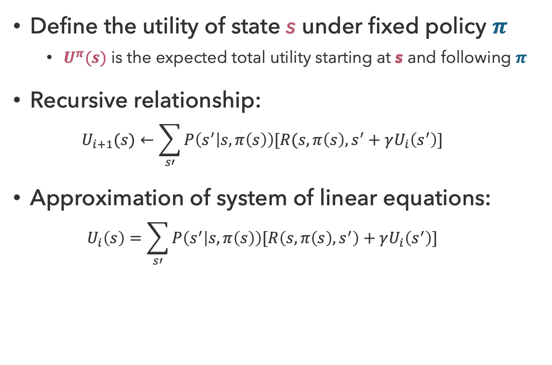



Fixed Policy Utilities
Fixed Policy $π$
Define the utility of state s under fixed policy $π$
  $U^{π}(s)$ is the expected total utility starting at s and following $π$
Recursive relationship:
  $$U_{i+1}(s)←\sum_{s′}{P\left(s^{′} | s,π\left(s\right)\right)[R(s,π\left(s\right),s^{′}+γU_{i}\left(s^{′}\right)]}$$
Approximation of system of linear equations:
  $$U_{i}\left(s\right)=\sum_{s′}{P\left(s^{′} | s,π\left(s\right)\right)[R\left(s,π\left(s\right),s^{′}\right)+γU_{i}\left(s^{′}\right)]}$$
s
$$π(s)$$
s, $π(s)$
s,$π(s)$,s’
s’

Slide 33
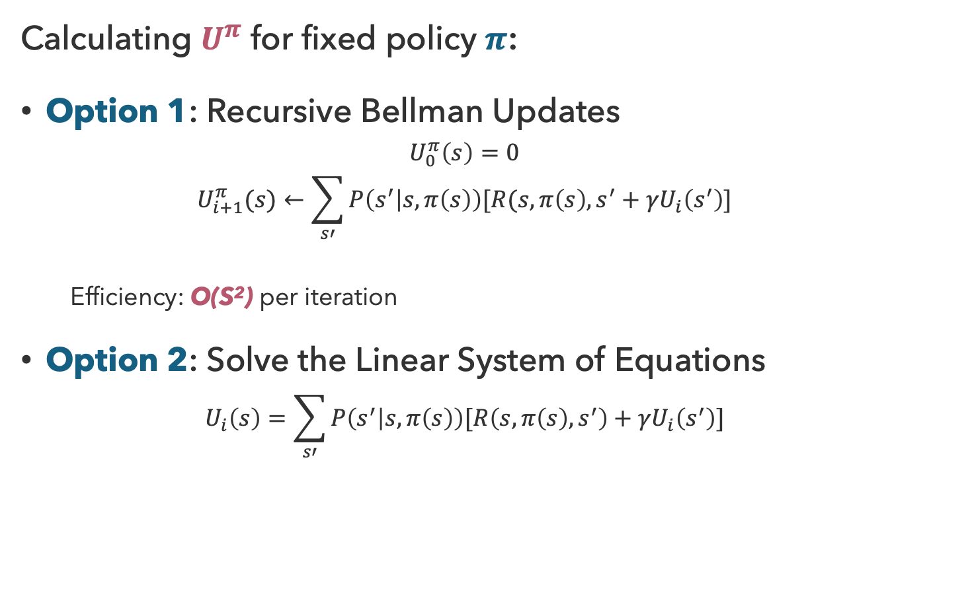
Policy Evaluation
Fixed Policy $π$
Calculating $U^{π}$ for fixed policy $π$:
Option 1: Recursive Bellman Updates
  $$U_{0}^{π}\left(s\right)=0$$
  $$U_{i+1}^{π}(s)←\sum_{s′}{P\left(s^{′} | s,π\left(s\right)\right)[R(s,π\left(s\right),s^{′}+γU_{i}\left(s^{′}\right)]}$$
  Efficiency: O(S²) per iteration
Option 2: Solve the Linear System of Equations
  $$U_{i}\left(s\right)=\sum_{s′}{P\left(s^{′} | s,π\left(s\right)\right)[R\left(s,π\left(s\right),s^{′}\right)+γU_{i}\left(s^{′}\right)]}$$
s
$$π(s)$$
s, $π(s)$
s,$π(s)$,s’
s’

Slide 34
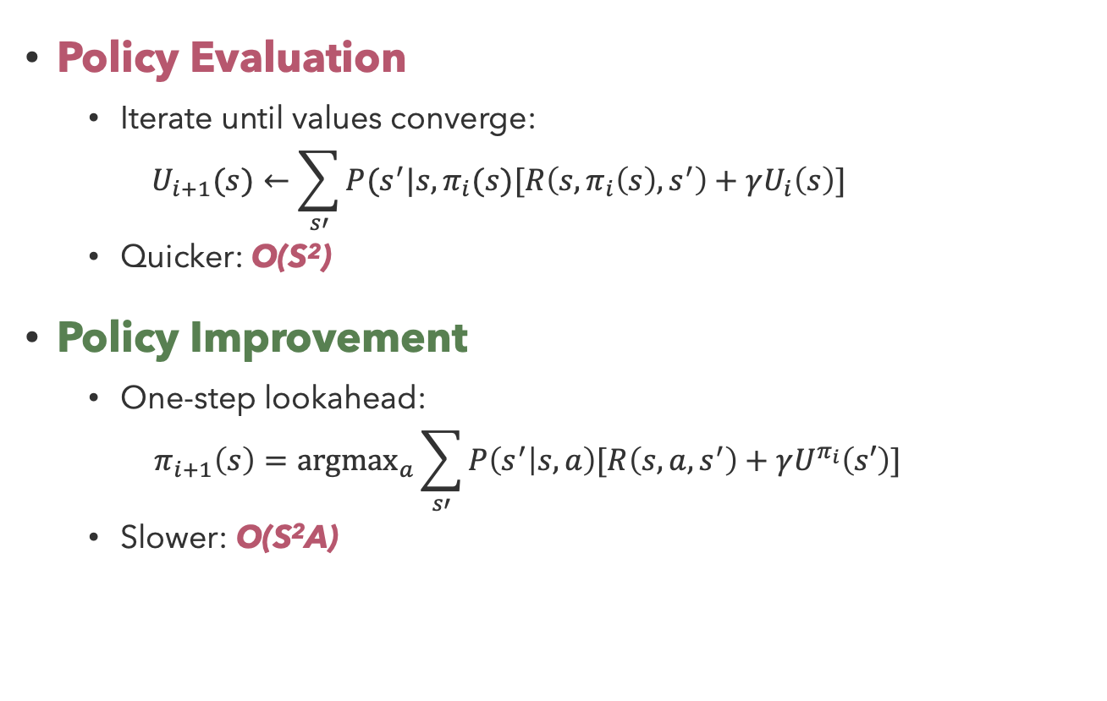
Policy Iteration Updates
Policy Evaluation
  Iterate until values converge:
    $$U_{i+1}(s)←\sum_{s′}{P(s^{′}|s,π_{i}(s)[R\left(s,π_{i}\left(s\right),s^{′}\right)+γU_{i}\left(s\right)]}$$
  Quicker: O(S²)
Policy Improvement
  One-step lookahead:
  $$π_{i+1}\left(s\right)={argmax}_{a}\sum_{s′}{P\left(s^{′} | s,a\right)[R\left(s,a,s^{′}\right)+γU^{π_{i}}\left(s′\right)]}$$
  Slower: O(S²A)

Slide 35
Questions (3)

Slide 36
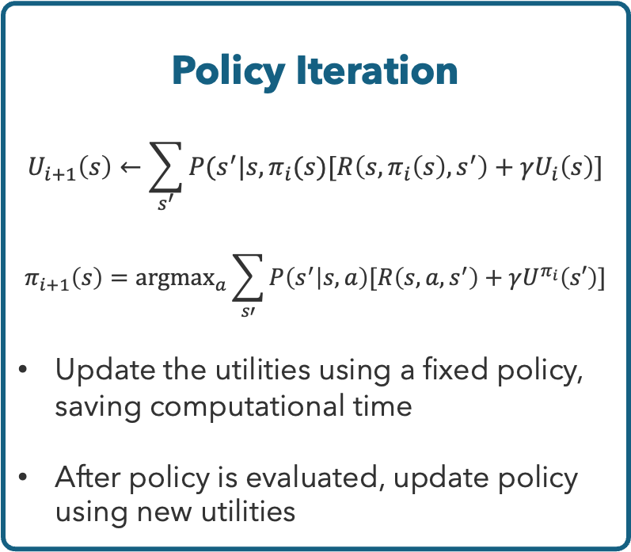
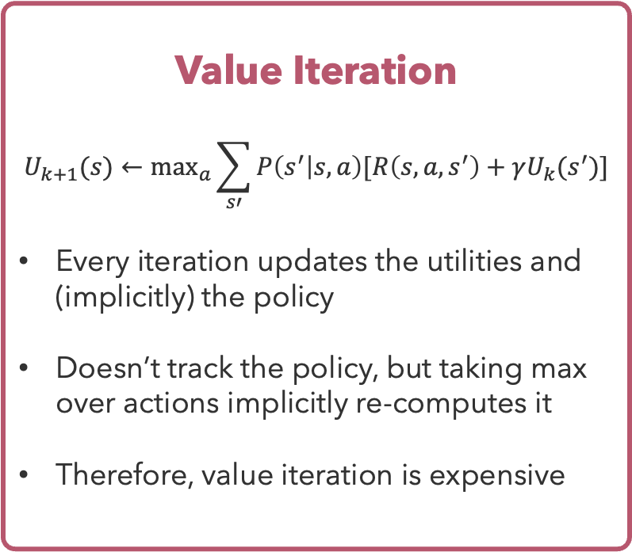
Comparison: Value vs. Policy Iteration
Value Iteration
$$U_{k+1}(s)←\max_{a}\sum_{s′}{P\left(s^{′} | s,a\right)[R\left(s,a,s^{′}\right)+γU_{k}(s^{′})]}$$
Every iteration updates the utilities and (implicitly) the policy
Doesn’t track the policy, but taking max over actions implicitly re-computes it
Therefore, value iteration is expensive
Policy Iteration
$$U_{i+1}\left(s\right)←\sum_{s^{′}}{P(s^{′}|s,π_{i}(s)[R\left(s,π_{i}\left(s\right),s^{′}\right)+γU_{i}\left(s\right)]}$$
$$π_{i+1}\left(s\right)={argmax}_{a}\sum_{s′}{P\left(s^{′} | s,a\right)[R\left(s,a,s^{′}\right)+γU^{π_{i}}\left(s′\right)]}$$
Update the utilities using a fixed policy, saving computational time
After policy is evaluated, update policy using new utilities

Slide 37
that’s it for today!
Value iteration computes values by taking the max over possible actions
Policy iteration considers a fixed policy, then improves the policy using calculated values
Reinforcement Learning: learning by doing!
Complete Practice Problem 7
Do Project 1 (due 7.9)

