Slide 1
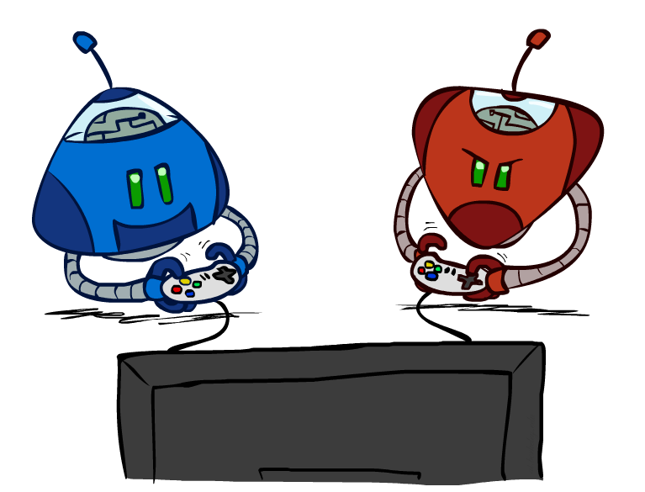
Adversarial Search
CSE 473: Introduction to Artificial Intelligence
James Weichert (jpw@cs)
cs.uw.edu/473
acknowledgements
Welcome!
Is cereal a soup?
sli.do #cse473

Slide 2
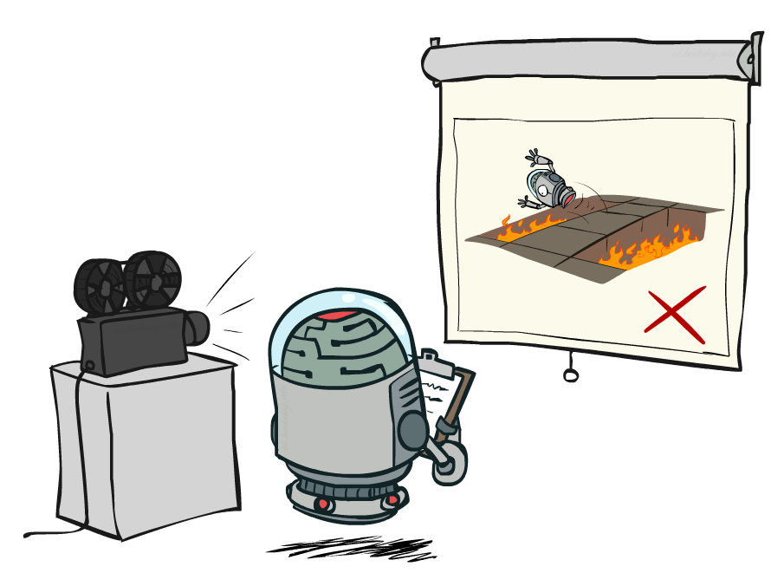
Administrivia
For each project, make sure to fill out the AI usage reflection (cs.uw.edu/473/projects)
Test 1 next Friday
No class this Friday (holiday)
Homework 1 due Friday (7.3)
Project 1 due in next Thursday (7.9)

Slide 3
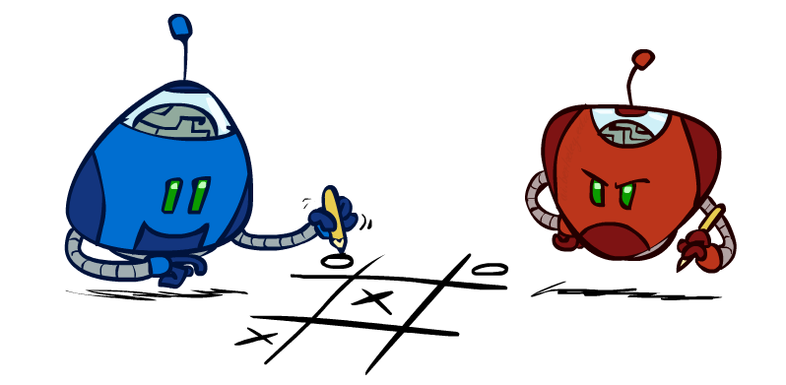
Games

Slide 4
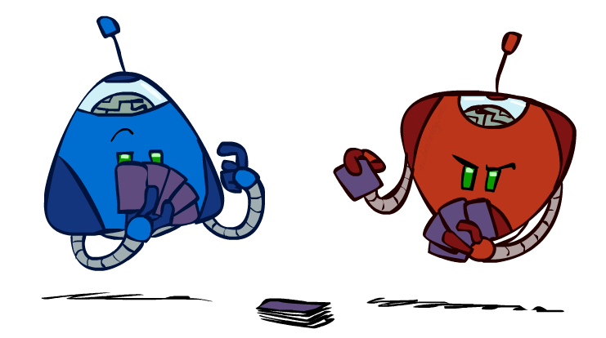
Types of Games
Games model environments with more than one agent
Characteristics
  deterministic vs stochastic?
  fully observable vs. partially observable?
  number of players?
  turn-taking vs. simultaneous?
  zero sum?
How to plan around opponent’s moves?

Slide 5
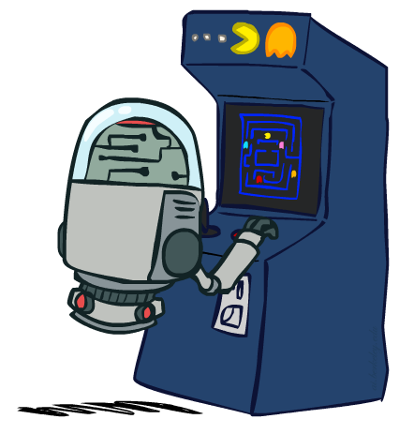
”Standard” Games
Deterministic, observable, two-player, turn-taking, and zero sum games
Game Formulation
  Initial state: s₀
  Players: player(s) indicating turn
  Actions: actions(s) for player on move
  Transition model: T(s, a)
  Terminal (goal) test: terminal-test(s)
  Terminal values: utility(s, p)

Slide 6
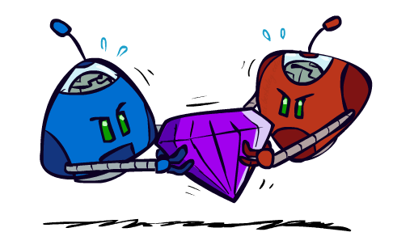
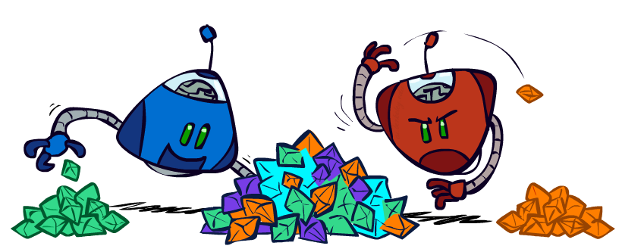
Zero-Sum Games
Zero-Sum Games
General Games
Agents have opposite utilities
One agent maximizes,
the other minimizes
Agents have independent utilities
Cooperation, indifference, competition, etc. are all possible

Slide 7
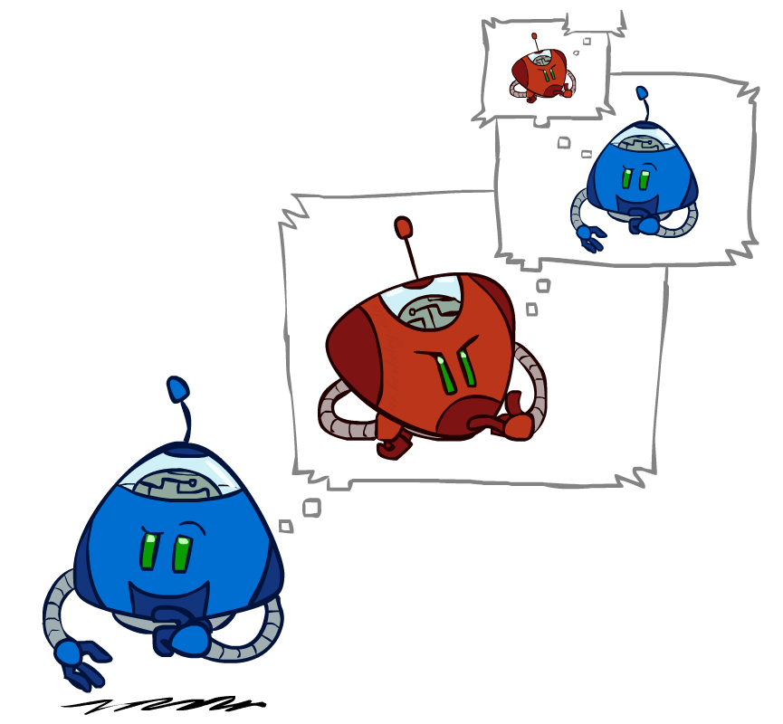
Adversarial Thinking

Slide 8
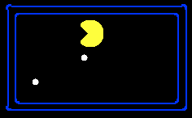
Single-Agent Trees
8
2
0
2
6
4
6

Slide 9
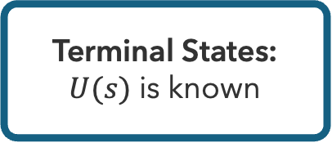
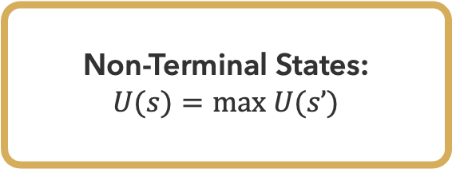
Utility
Non-Terminal States:
$U(s)=max U(s’)$
Utility is the best achievable outcome (value) from that state
8
2
0
2
6
4
6
Terminal States:
$U(s)$ is known

Slide 10

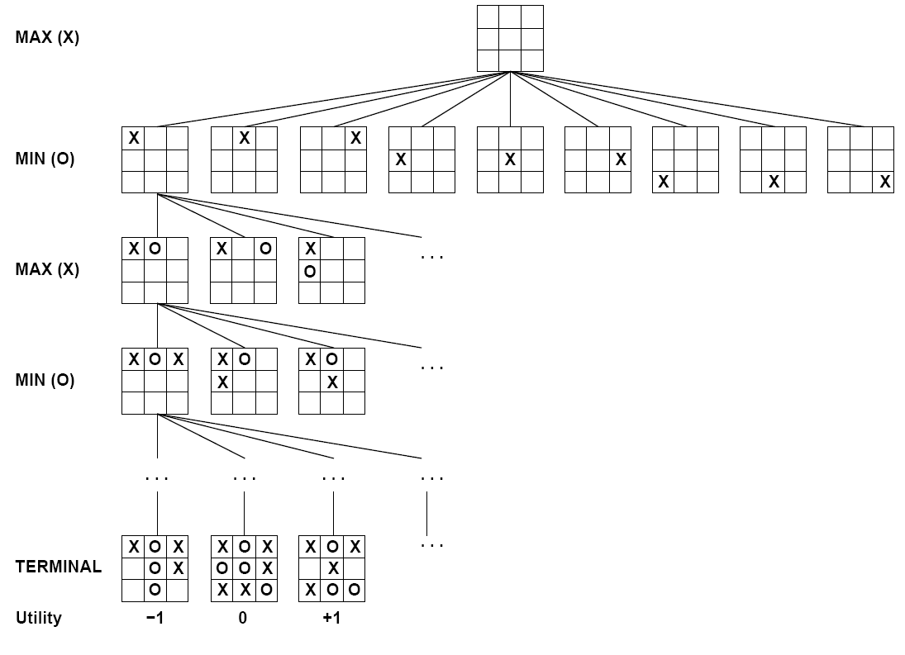

Tic-Tac-Toe

Slide 11


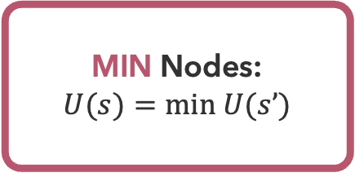

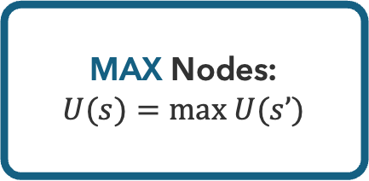
Minimax Values
-8
-8
-10
-8
-5
-10
+8
MAX Nodes:
$U(s)=max U(s’)$
MIN Nodes:
$U(s)=min U(s’)$
$$s’∈successors(s)$$
$$s’∈successors(s)$$

Slide 12
Minimax Tree
3
3
2
2
3
12
8
2
4
6
14
5
2

Slide 13
Minimax
function MINIMAX(s) returns action
return action a in actions(s) with highest minimax-values(T(s,a))
function MINIMAX-VALUES(s) returns value
if terminal-test(s) then return utility(s)
if player(s) == MAX then return max _{a in actions(s)} minimax-values(T(s,a))
if player(s) == MIN then return min _{a in actions(s)} minimax-values(T(s,a))

Slide 14
Questions (1)

Slide 15
Is It Efficient?
How efficient is minimax?
  Operates just like (exhaustive) DFS
  Time Complexity: O(b^{m})
  Space Complexity: O(bm)
Example: Chess
  b ≈ 35, m ≈ 100
  Completely infeasible
  Is this how humans play chess?

Slide 16
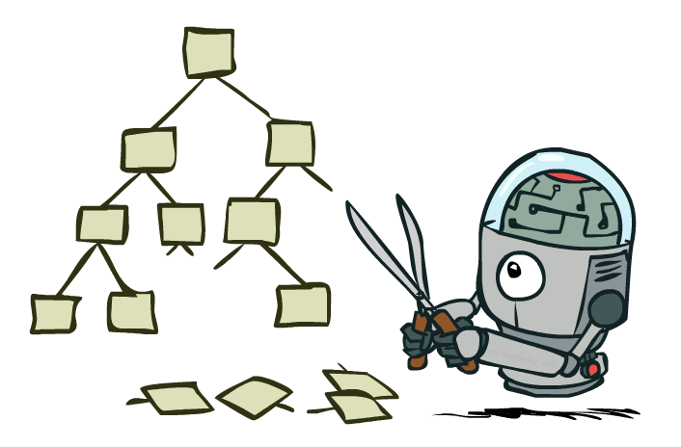
Avoiding Unnecessary Work

Slide 17
Pruning
MAX node must be at least 3
What about this MIN node?
?
?
?
3
2*
3
12
8
2
4
6
14
5
2
MIN node must no greater than 2
Remaining children are irrelevant → prune

Slide 18

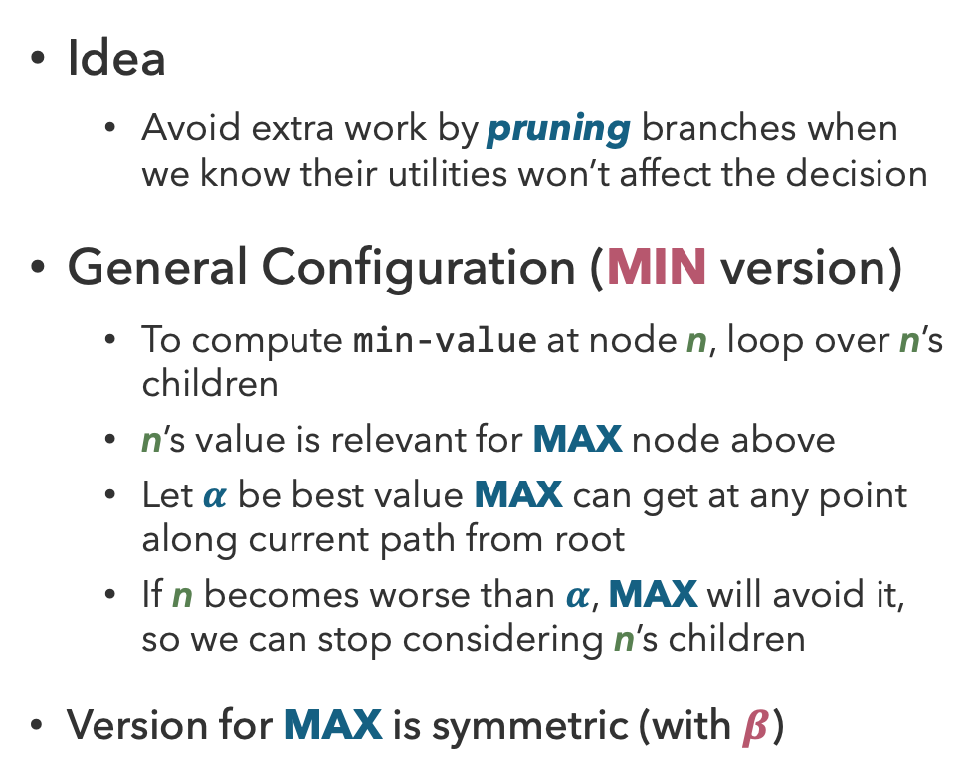
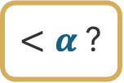
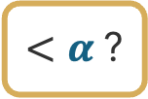
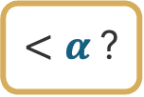
Alpha-Beta Pruning
$$α$$
Idea
  Avoid extra work by pruning branches when we know their utilities won’t affect the decision
General Configuration (MIN version)
  To compute min-value at node n, loop over n’s children
  n’s value is relevant for MAX node above
  Let $α$ be best value MAX can get at any point along current path from root
  If n becomes worse than $α$, MAX will avoid it, so we can stop considering n’s children
Version for MAX is symmetric (with $β$)
n
?
?
?
$<α$?
$<α$?
$<α$?

Slide 19
Alpha-Beta Implementation
function MINIMAX-DECISION(s) returns action
return action a in actions(s) with highest max-value(T(s,a),-∞,+∞)
function MAX-VALUE(s, α, β) returns value
v ← -∞
for each s’ in successors(s)
v = max(v, min-value(s’, α, β))
if v >= β
return v
α = max(α,v)
return v
function MIN-VALUE(s, α, β) returns value
v ← +∞
for each s’ in successors(s)
v = min(v, max-value(s’, α, β))
if v <= α
return v
β = max(β,v)
return v

Slide 20
Pruning Example
Which nodes get pruned? What are the $α$ and $β$ values at the end?
a
h
b
e
i
l
c
d
f
g
j
k
m
n
10
6
90
8
1
2
20
4

Slide 21
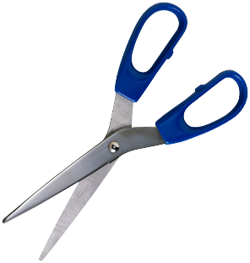
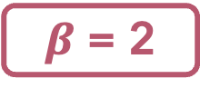
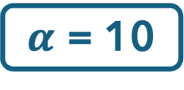
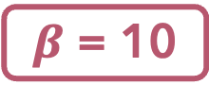
Pruning Example (Solution)
Which nodes get pruned? What are the $α$ and $β$ values?
$α$ = 10
a
h
$β$ = 10
$β$ = 2
b
e
i
c
d
f
j
k
10
6
90
1
2

Slide 22
Properties of Alpha-Beta Pruning
Theorem: Alpha-Beta pruning has no effect on computed minimax value
Good child ordering improves efficiency
With “perfect ordering”:
  Time complexity drops to O(b^{m/2})
  Doubles the solvable depth!
Example of metareasoning
  Reasoning about reasoning
For chess
  Only 35⁵⁰ instead of 35¹⁰⁰
?
?
?

Slide 23
Questions (2)

Slide 24
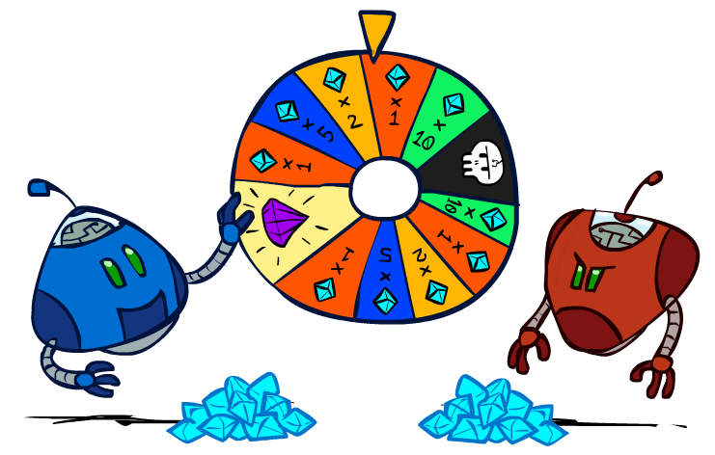
Games with Uncertainty

Slide 25
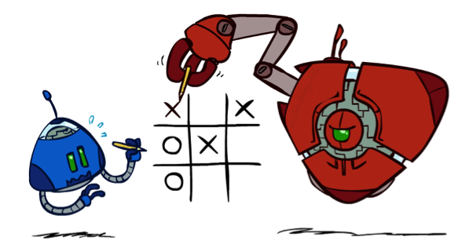
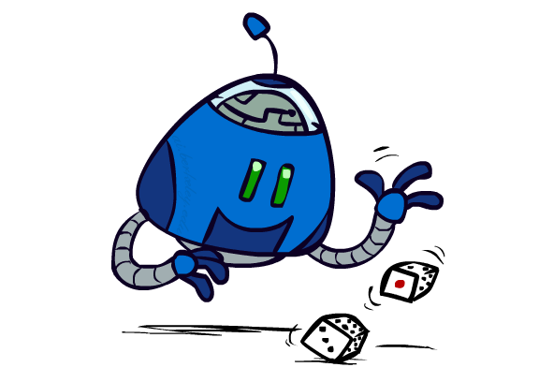

Chance Outcomes in Trees
10
10
9
20
10
10
9
20
10
9
10
9
10
20
Minimax
Expectimax
Expectiminimax

Slide 26
Expectiminimax
function DECISION(s) returns action
return action a in actions(s) with highest value(T(s,a))
function VALUE(s) returns value
if terminal-test(s) then return utility(s)
if player(s) == MAX then return max _{a in actions(s)} value(T(s,a))
if player(s) == MIN then return min _{a in actions(s)} value(T(s,a))
if player(s) == CHANCE then return sum _{a in actions(s)} P(a) * value(T(s,a))

Slide 27
Expectimax
8
8
4
7
3
12
9
2
4
6
15
6
0

Slide 28
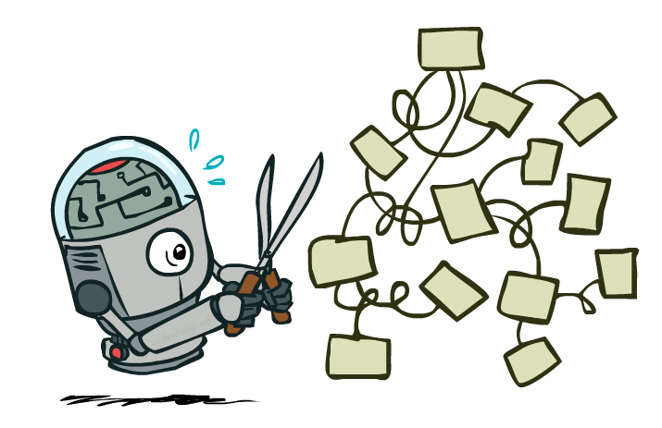
Expectimax Pruning?
8
8
?
3
12
9
2

Slide 29
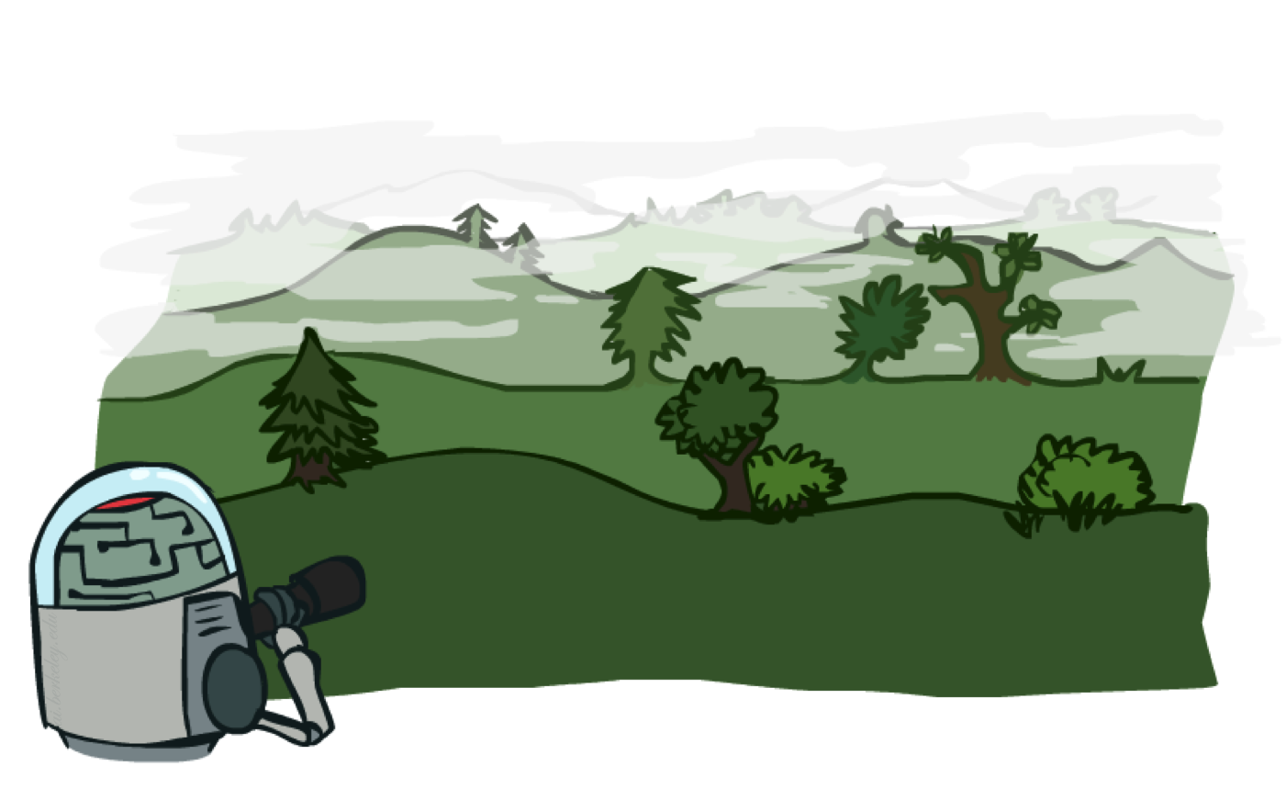
Resource Limits

Slide 30
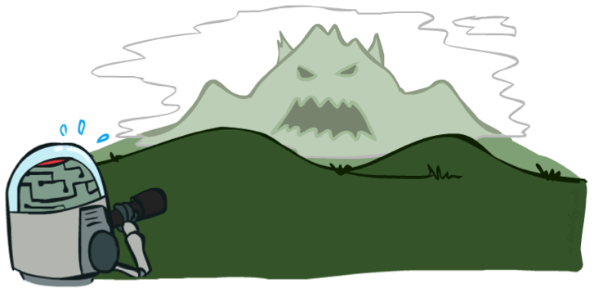
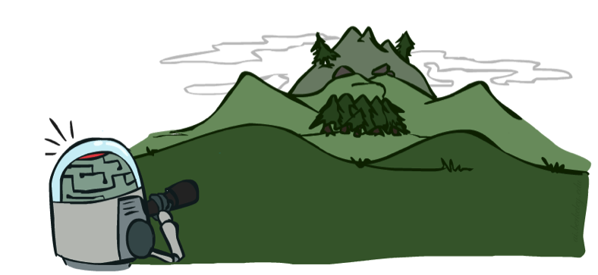
Real-World Constraints
Problem: In realistic games, searching to leaves is infeasible
Solution: Bounded Lookahead
  Search only to a preset depth limit (horizon)
  Use an evaluation function for non-terminal utilities
  Guarantee of optimality is gone
  Marginal increase in depth makes a big difference!
Tradeoff
  Deeper search (usually) leads to better play,
  but is considerably more costly
  Complexity of features vs. complexity of computation

Slide 31
Questions (3)

Slide 32
that’s it for today!
Multi-Agent Search
Adversarial search via minimax
When transitions are deterministic and players play optimally, pruning is possible
Modeling Stochasticity
Reinforcement Learning
Complete Practice Problem 5
Do Homework 1 (due 7.3)
Do Project 1 (due 7.9)

