Slide 1

Looking Forward
CSE 473: Introduction to Artificial Intelligence
James Weichert (jpw@cs)
cs.uw.edu/473
acknowledgements
Welcome!
What was your favorite CSE 473 topic?
sli.do #cse473

Slide 2


Administrivia
Course Evaluation!
Submit Homework 4 by tonight!
  No late period — HW4 must be turned in by 8.21
uw.iasystem.org/survey/328718

Slide 3
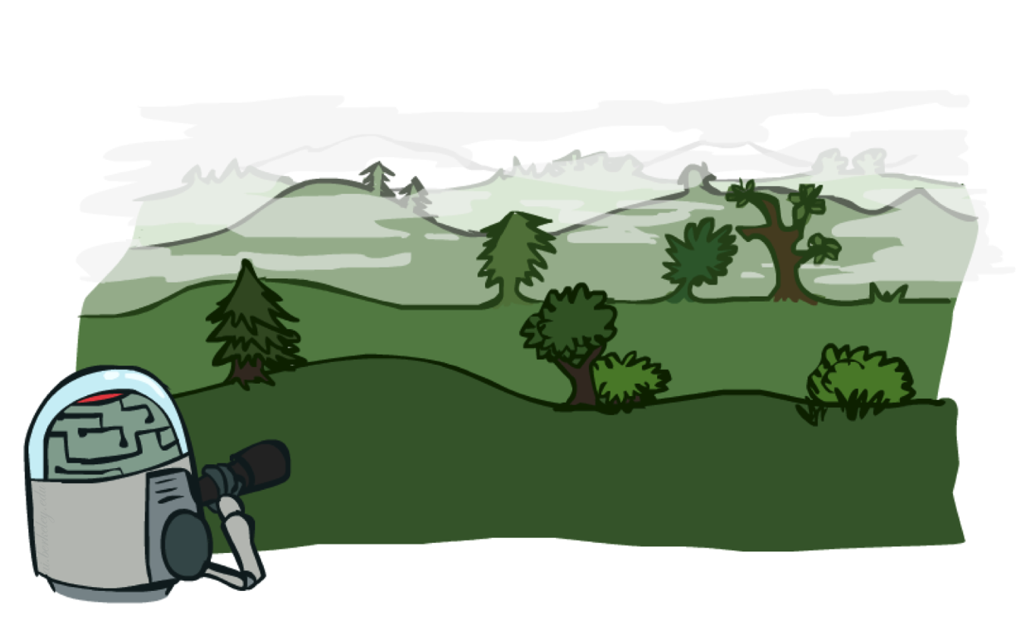

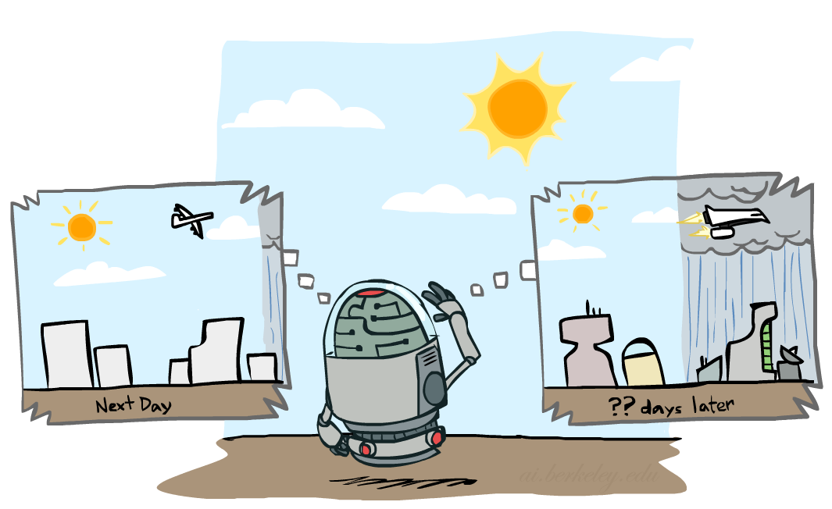
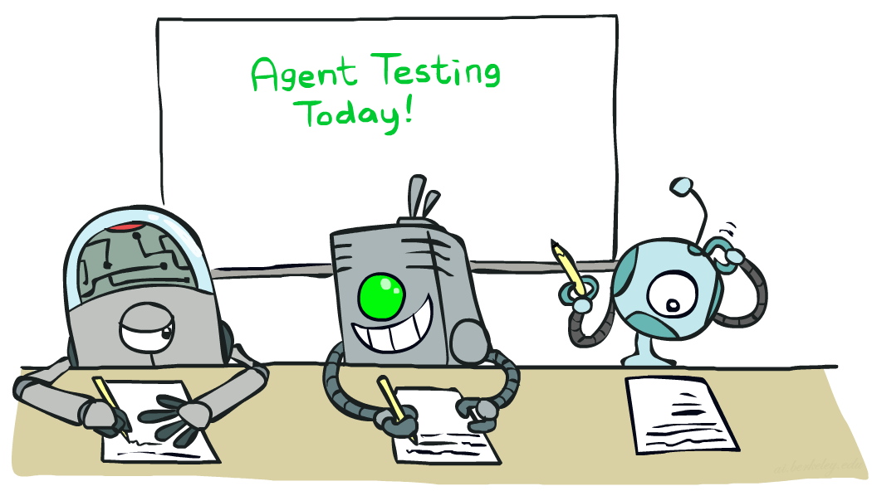
CSE 473: A Summary
Search
Reinforcement Learning
Modeling
Machine Learning

Slide 4


Minecraft Pathfinding

Slide 5
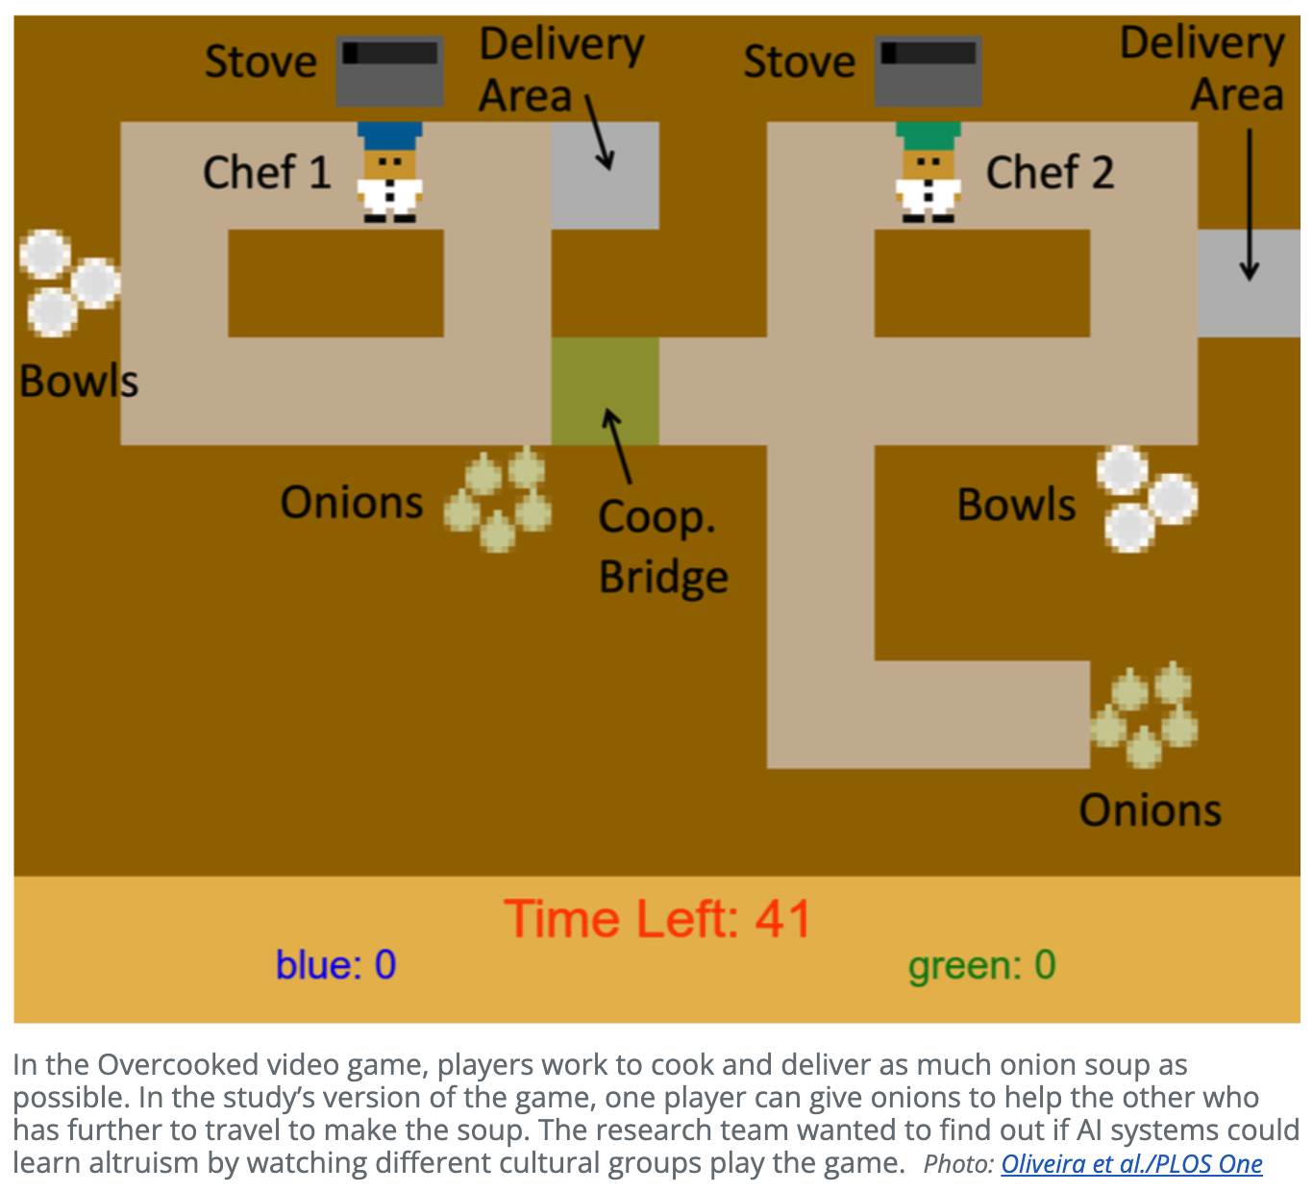
Inferring Values with Inverse RL
“Culturally-attuned AI: Implicit learning of altruistic cultural values through inverse reinforcement learning”
Oliveira et al. (2025)

Slide 6
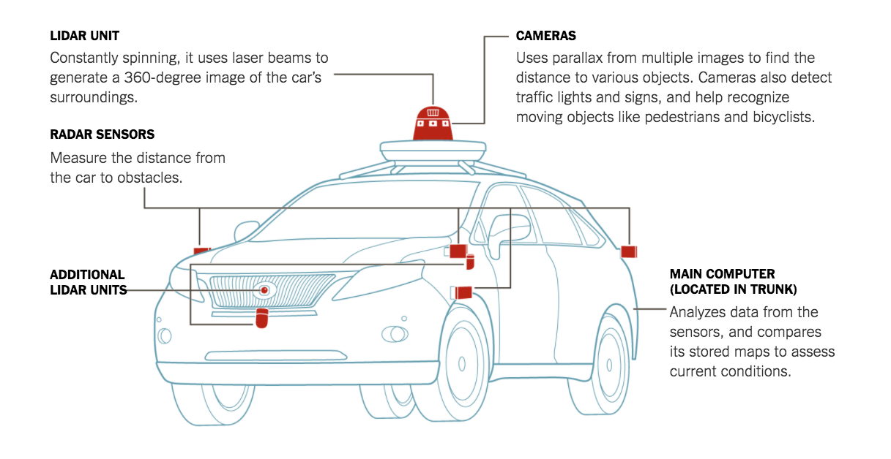
Self-Driving
The New York Times

Slide 7
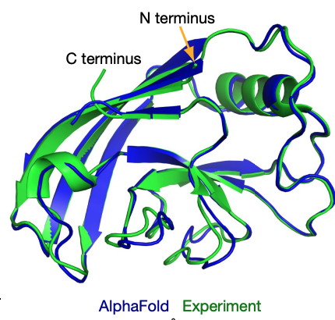
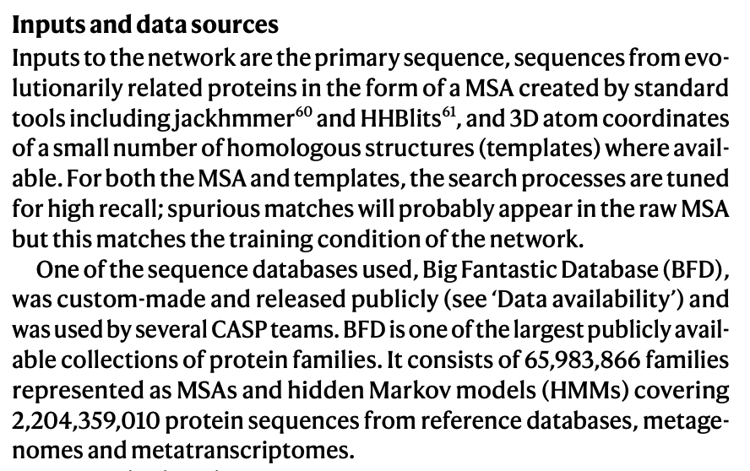
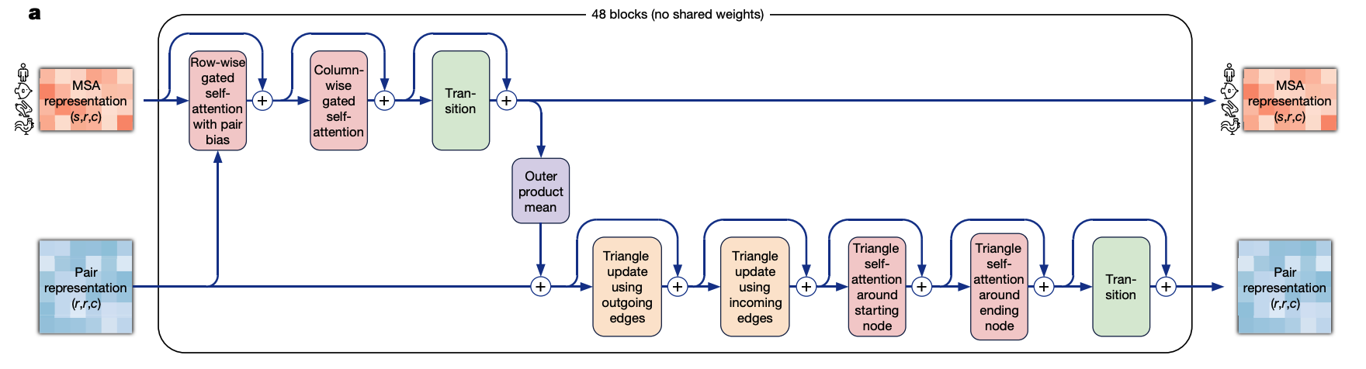
Alpha Fold
Jumper et al. (2021)

Slide 8
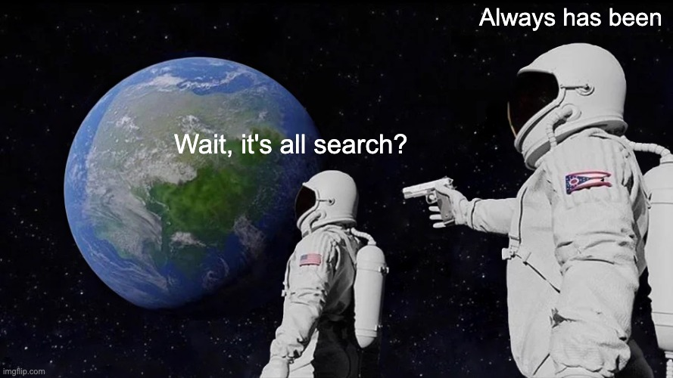


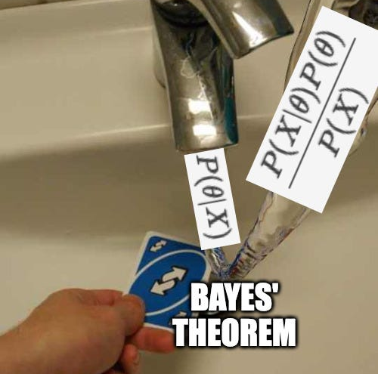
CSE 473 in Memes

Slide 9

What’s Next for AI?

Slide 10
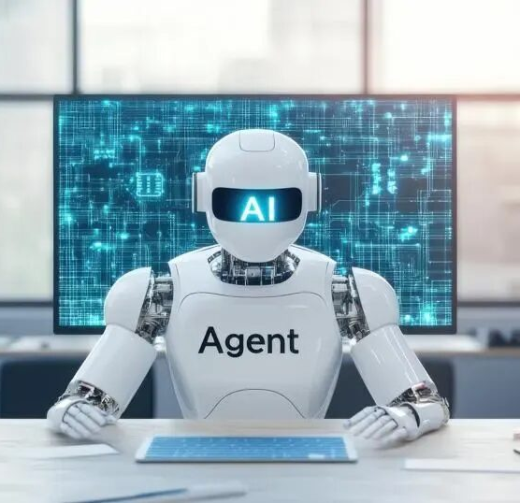
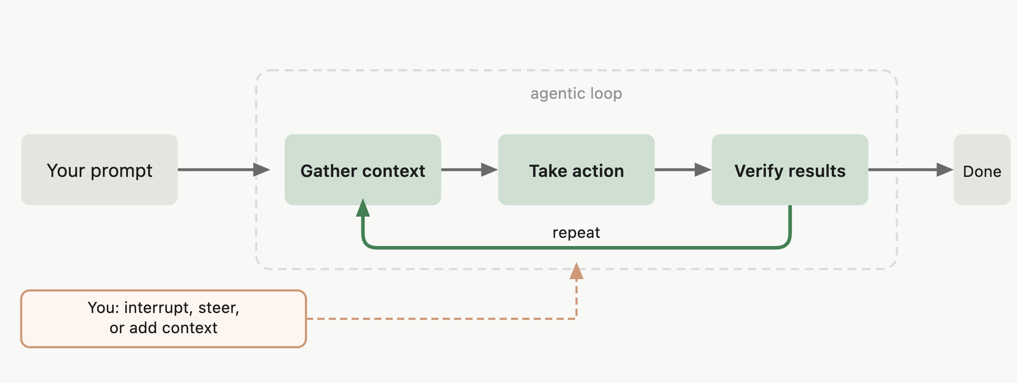
“Agentic” AI
What people think it is…
What it actually is…

Slide 11





Pushing the Boundaries

Slide 12



“AI for Science”

Slide 13
What’s Next for You?
CSE 542
Reinforcement Learning
CSE 446/546
Machine Learning
CSE 493G1/543
Deep Learning
CSE 447
NLP
CSE 547
ML for Big Data
CSE 478
Autonomous Robotics
CSE 493/554
Systems for ML
CSE 473
Introduction to AI
CSE 480
Computer Ethics
CSE 574
Explainable AI
CSE 493
Human-AI Interaction
CSE 582
Ethics in AI

Slide 14
Open Questions in AI

Slide 15
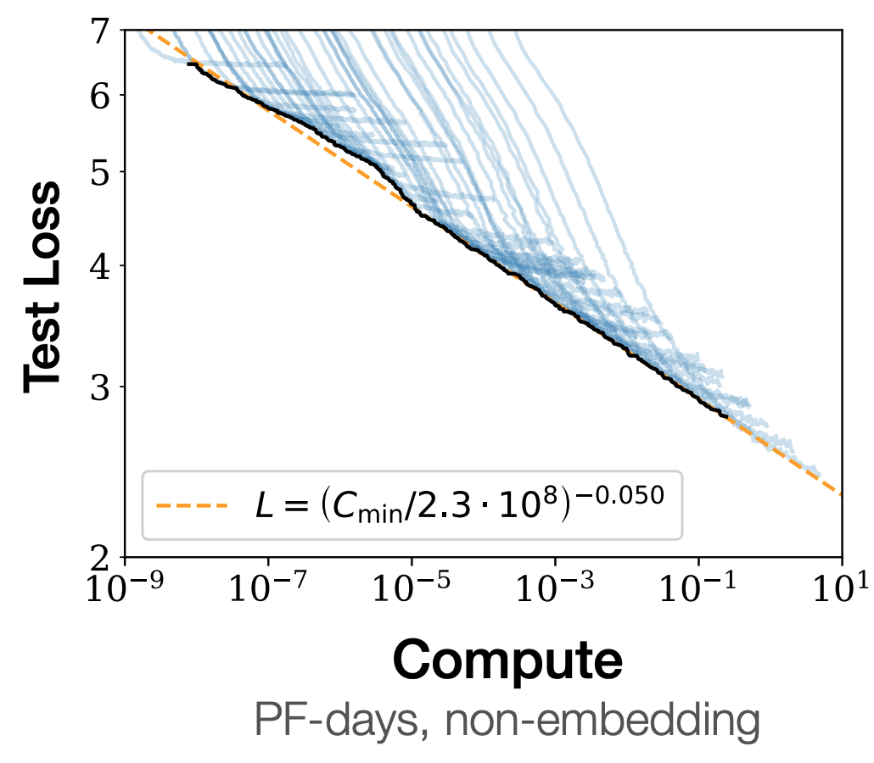
Scaling
Are “scaling laws” actually “laws”?
Kaplan et al. (2020)

Slide 16
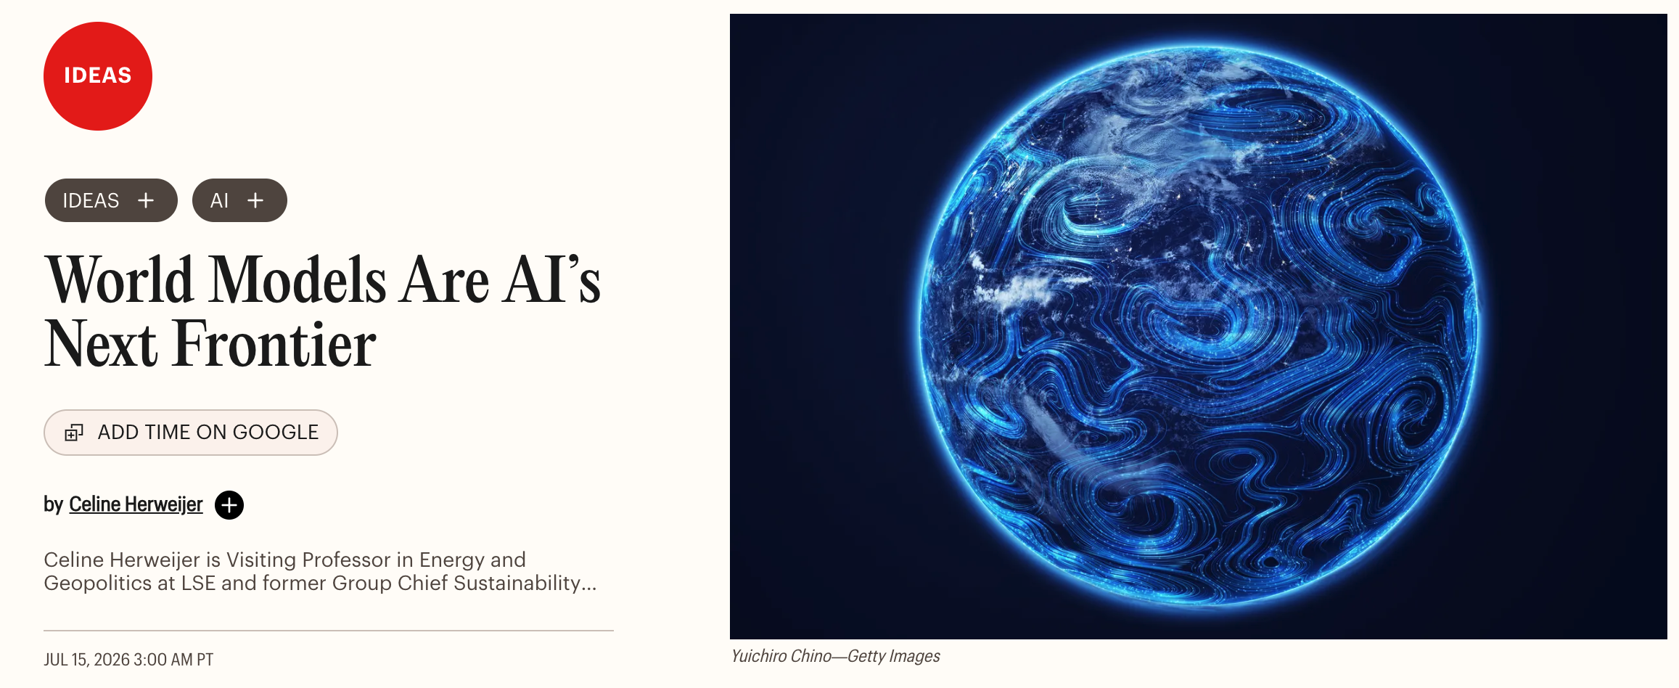
Real—World Grounding
How far can we go with a data-only approach?
TIME (2026)

Slide 17
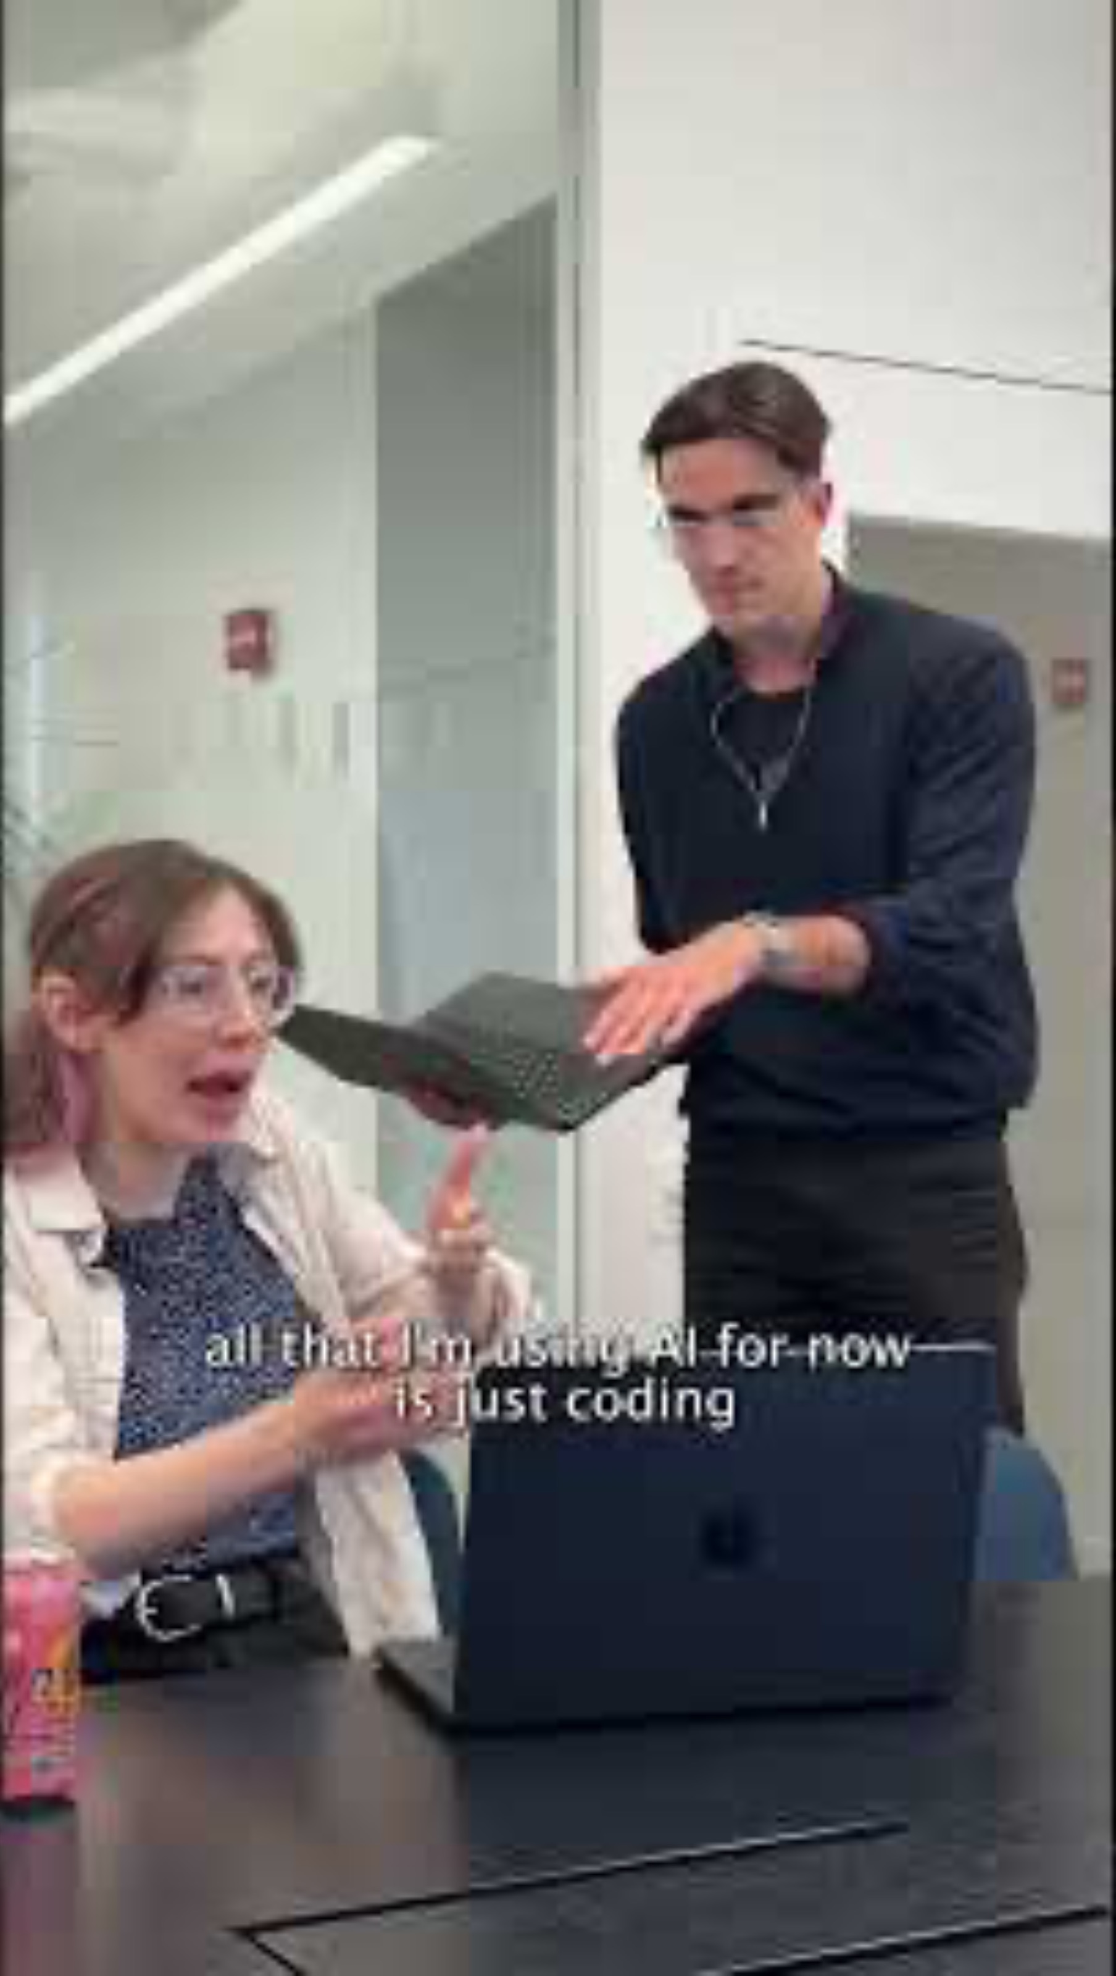
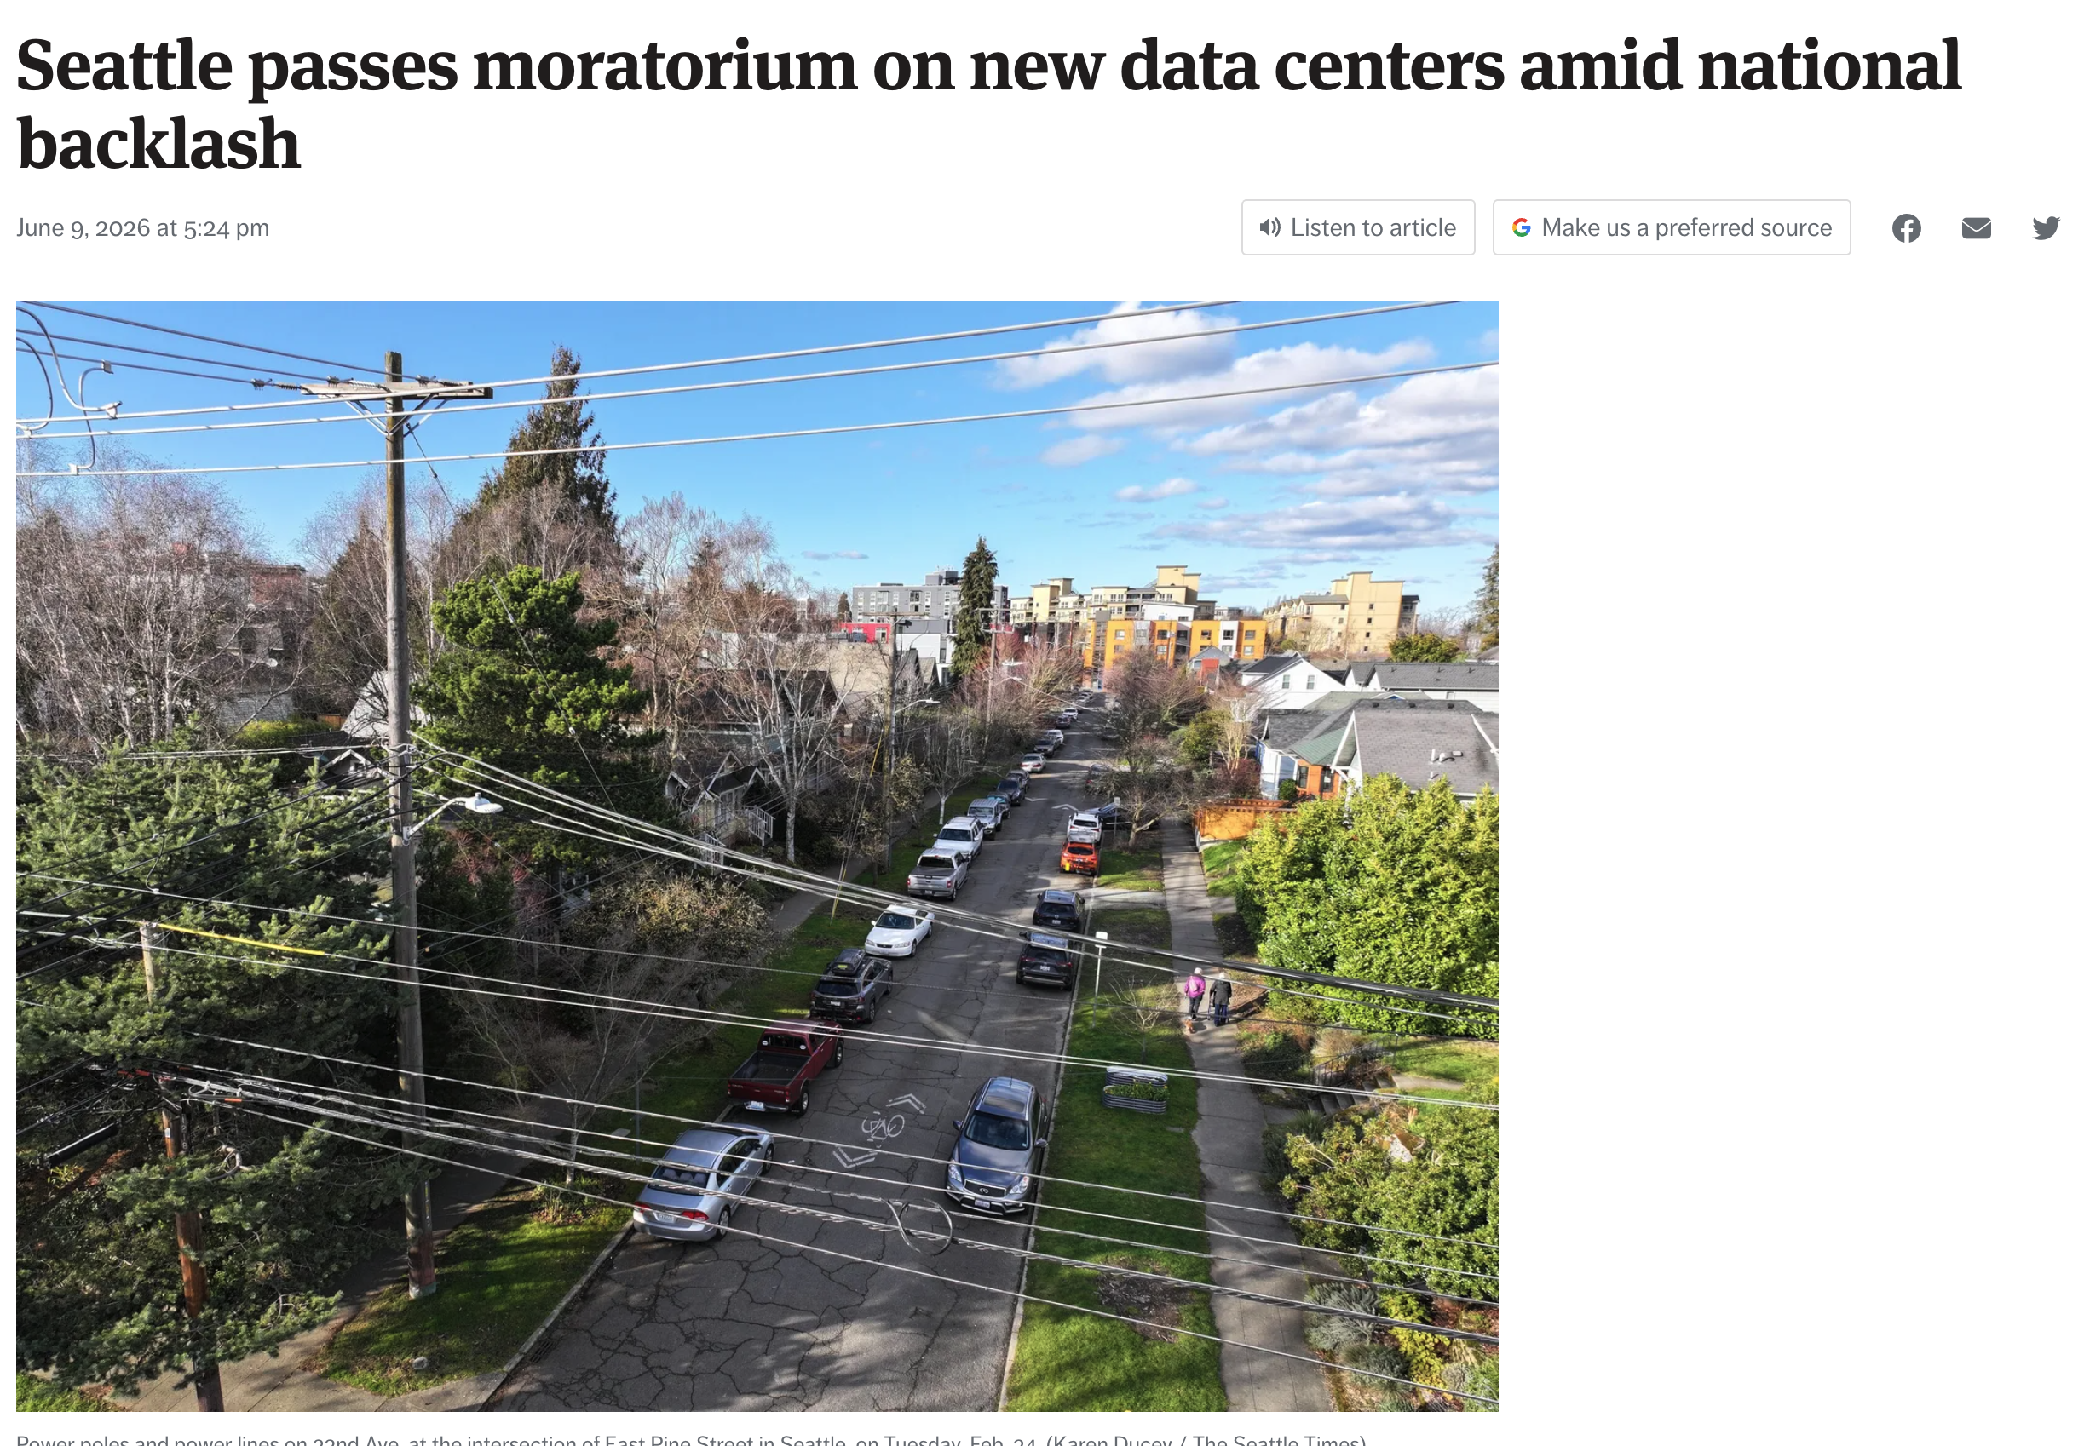
Resource Efficient AI
How much of our resources do we want to dedicate to AI?

Slide 18
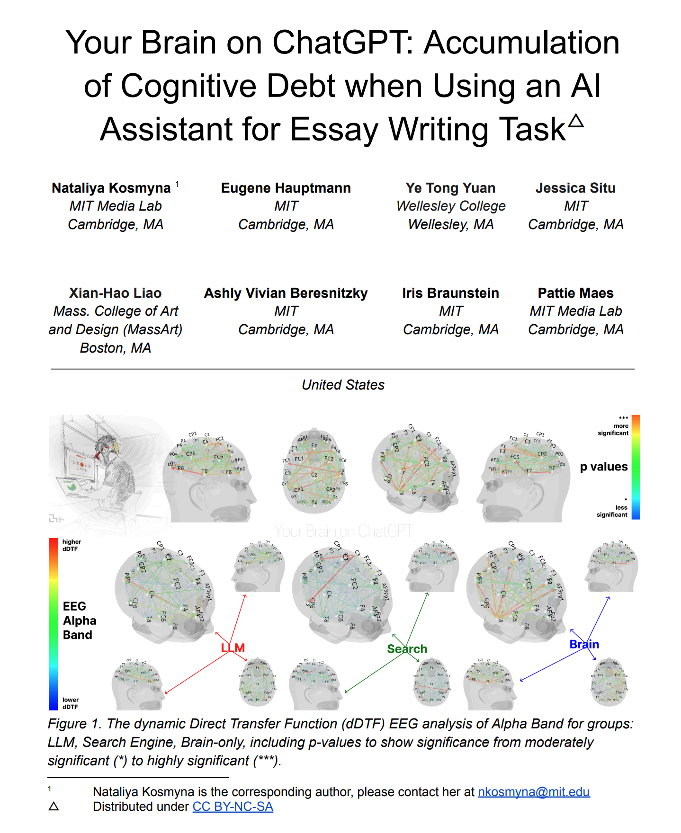
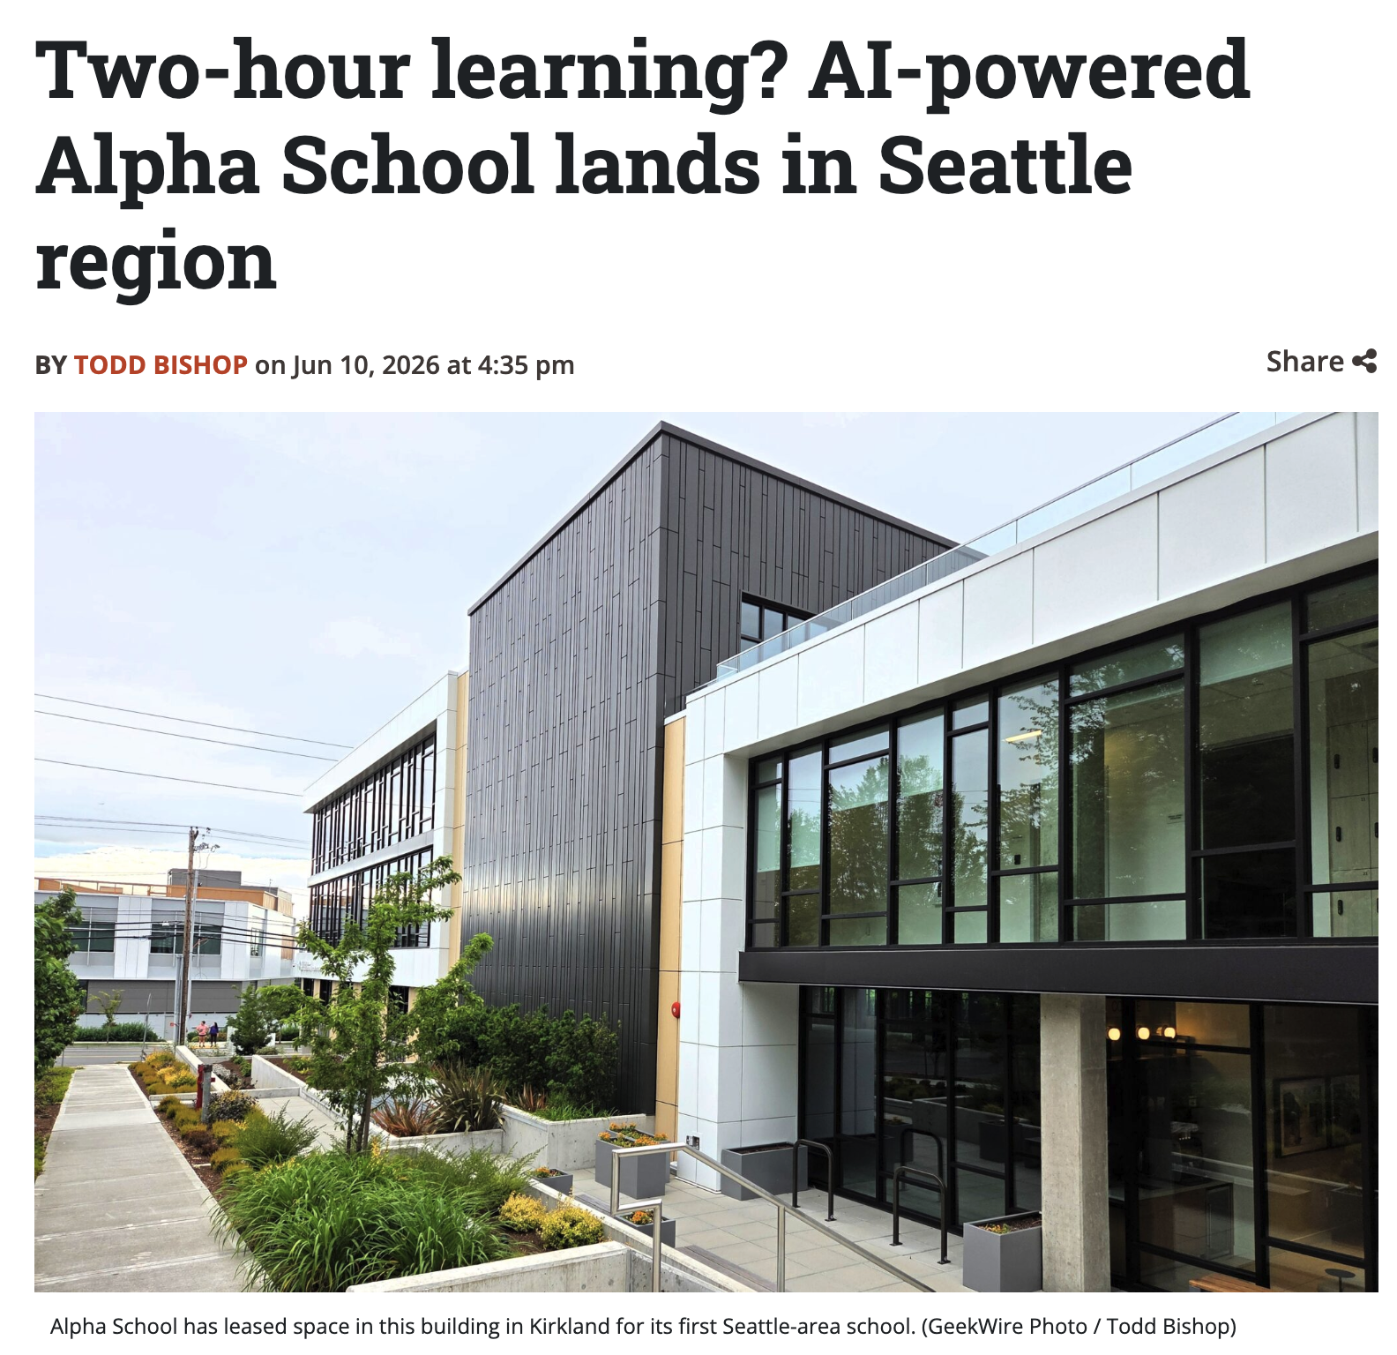
Long-Term Consequences
What happens when everything is AI?

Slide 19
Chat’s Take…
 | Claude | GPT | Gemini
Scaling Laws? | ✅ | ✅ | ✅
Capable autonomy? | ✅
Alignment? | ✅ | ✅ | ✅
Economy and Labor? | ✅ | ✅ | ✅
Regulation? |  | ✅
Grounding? |  |  | ✅

Slide 20
Ask Me (Almost) Anything

Slide 21
that’s it for 473!
uw.iasystem.org/survey/328718
Applications
AI’s Roadmap
Open Questions
It’s up to you now!
Complete Practice Problem 23
Fill out your Course Evaluation!
Do Homework 4 (submit by 8.21)
James Weichert (jpw@cs | jpw.info)
cs.uw.edu/473
acknowledgements

