Slide 1
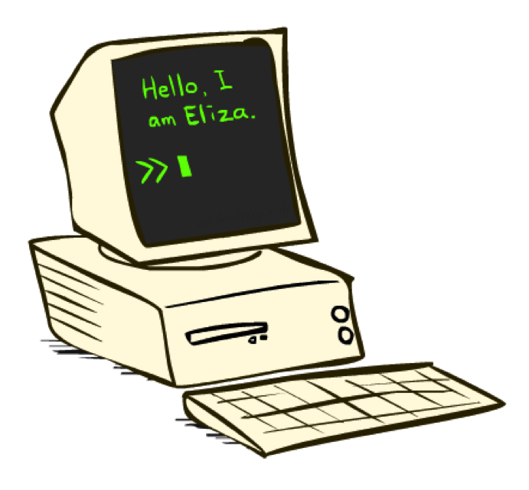
Large Language Models
>> Who are you?
CSE 473: Introduction to Artificial Intelligence
James Weichert (jpw@cs)
cs.uw.edu/473
acknowledgements
Welcome!
What’s your favorite word?
sli.do #cse473

Slide 2



Administrivia
Course Evaluation!
Homework 4 due Thursday (8.20)
  No late period — HW4 must be turned in by 8.21
uw.iasystem.org/survey/328718

Slide 3







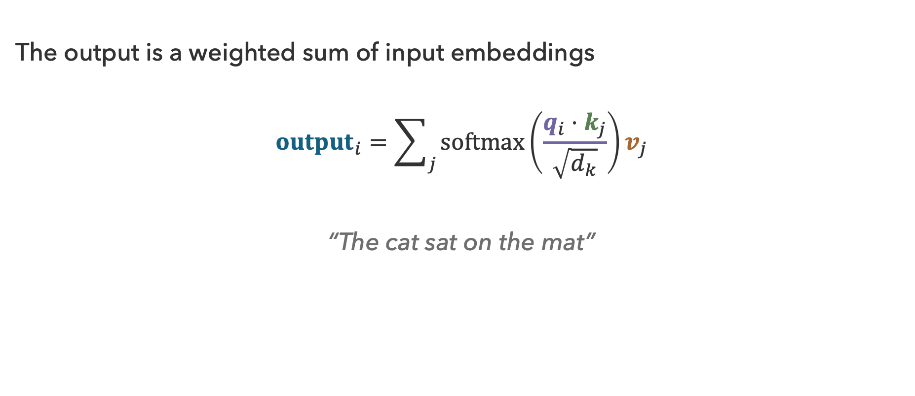











Recap: Attention
The output is a weighted sum of input embeddings
$${output}_{i}=\sum_{j}{softmax\left(\frac{q_{i}⋅k_{j}}{\sqrt{d_{k}}}\right)v_{j}}$$
“The cat sat on the mat”
$${σ(q_{sat}⋅k}_{j})$$
$$0.05$$
$$0.40$$
$$0.15$$
$$0.10$$
$$0.35$$
$$k_{j}$$
The
$$+$$
cat
$$+$$
on
$$+$$
the
$$+$$
mat
$$=$$
$${output}_{sat}$$
$$v_{j}$$
$$v_{The}$$
$$v_{cat}$$
$$v_{on}$$
$$v_{the}$$
$$v_{mat}$$

Slide 4
LLMs
Tokenization
Unembedding
Transformer
Input
Output
Embedding
Combine Tokens
Inputs
Model
Outputs

Slide 5
What uses do you see for large language models?

Slide 6
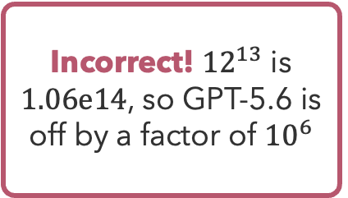
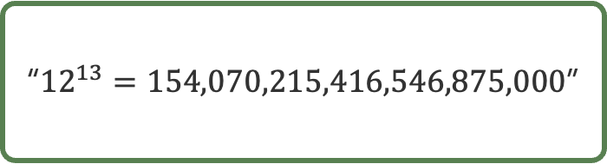
GPT
What is a 12 to the power of 13?
GPT-2 XL (1.5B)
“In the early days of computing, a simple addition of the digit values of a number by the power of two was a simple, fast, and efficient method of computation.”
GPT-5.6 (???)
Incorrect! ${12}^{13}$ is $1.06e14$, so GPT-5.6 is off by a factor of ${10}^{6}$
“${12}^{13}=154,070,215,416,546,875,000$”
GPT-5.6 (Luna) via ChatGPT on 8/16/26

Slide 7
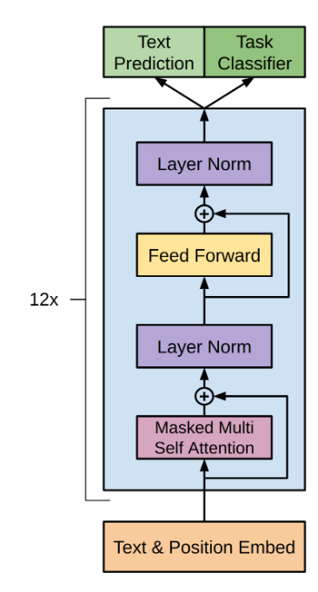

GPT-3, End-to-End
GPT-3
(Generative Pre-trained Transformer)
$n_{params}=175B$
$n_{layers}=96$
$n_{heads}=96$
$d_{embedding}=12,288$
$d_{head}=128$
$\left|V\right|≈50,000$
What scale does an effective large language model require?
Brown et al. (2020)
Radford et al. (2018)

Slide 8
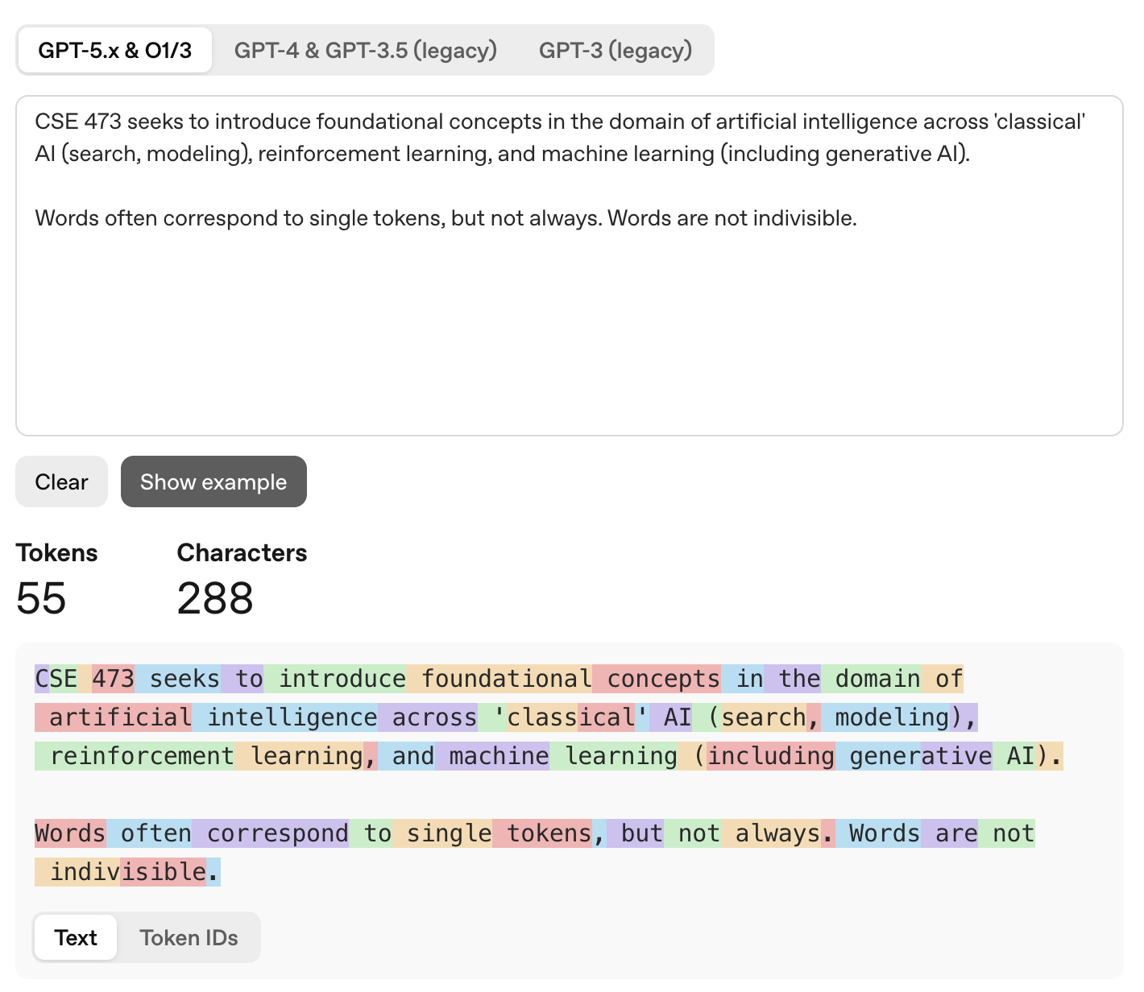
Tokenization
platform.openai.com/tokenizer

Slide 9
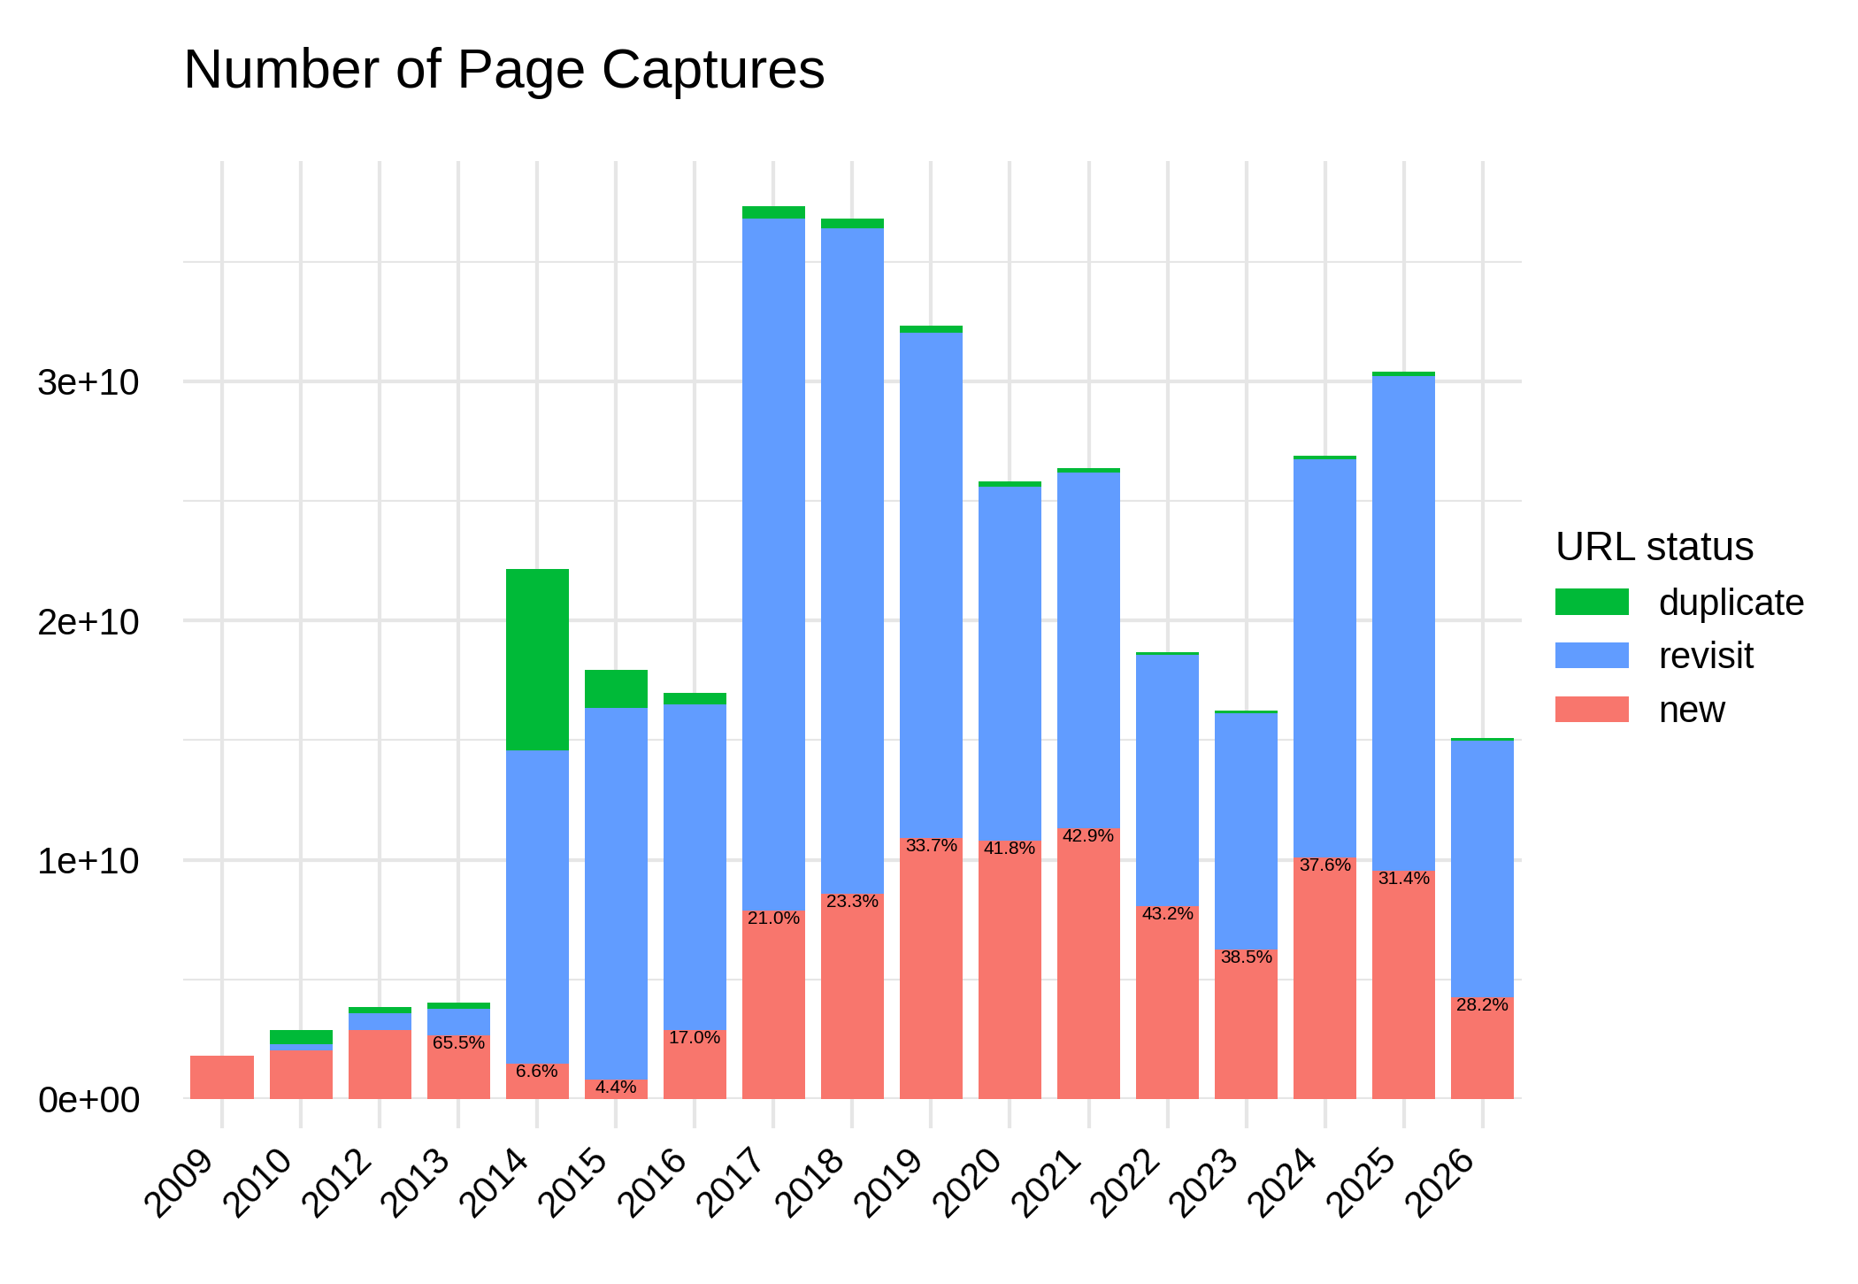
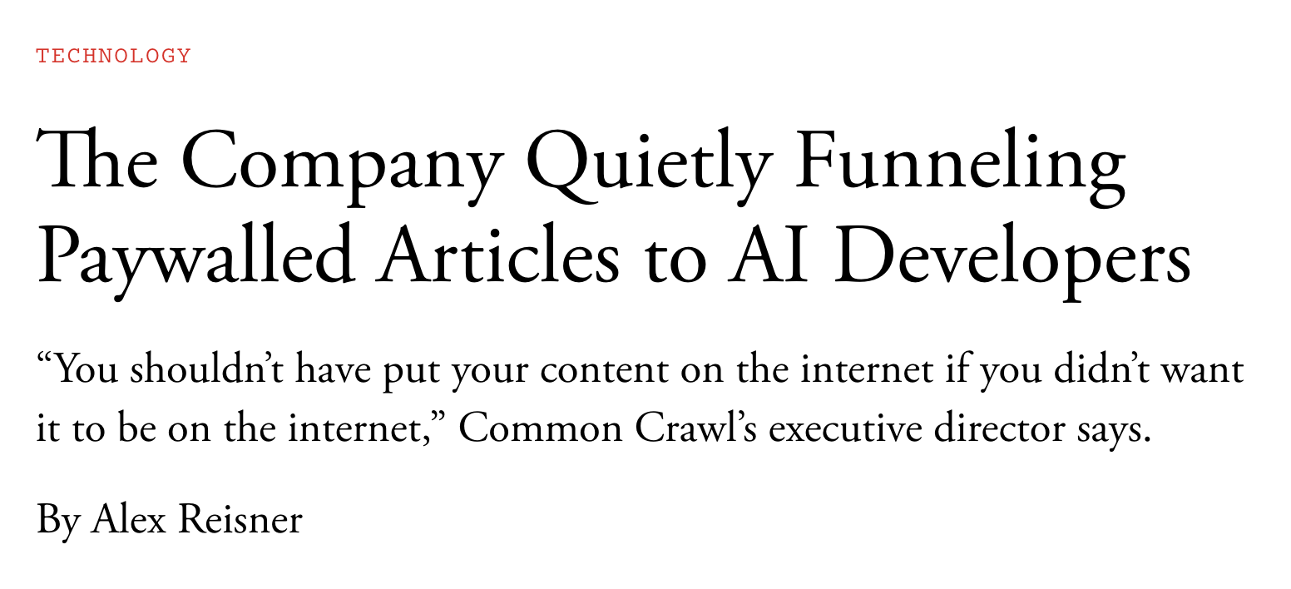
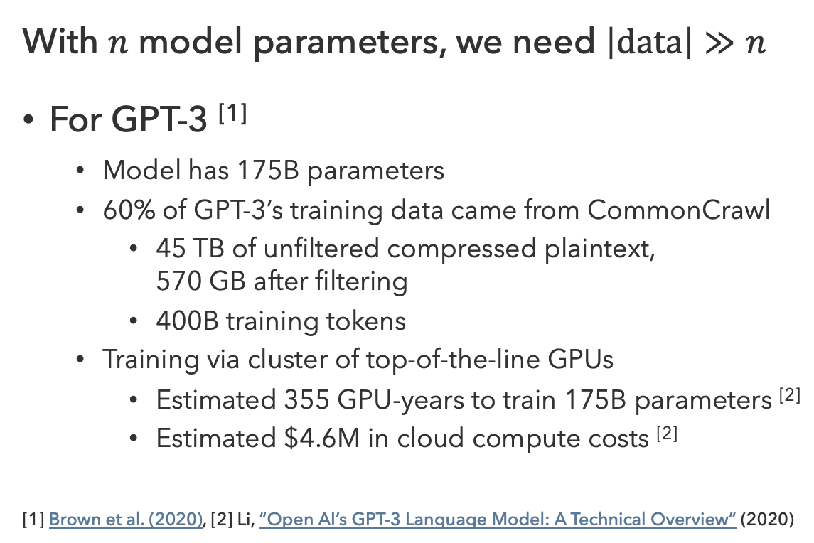
Training LLMs
With $n$ model parameters, we need $\left|data\right|≫n$
For GPT-3 ^{[1]}
  Model has 175B parameters
  60% of GPT-3’s training data came from CommonCrawl
    45 TB of unfiltered compressed plaintext,
    570 GB after filtering
    400B training tokens
  Training via cluster of top-of-the-line GPUs
    Estimated 355 GPU-years to train 175B parameters ^{[2]}
    Estimated $4.6M in cloud compute costs ^{[2]}
[1] Brown et al. (2020), [2] Li, “Open AI’s GPT-3 Language Model: A Technical Overview” (2020)
CommonCrawl
The Atlantic (2025)

Slide 10
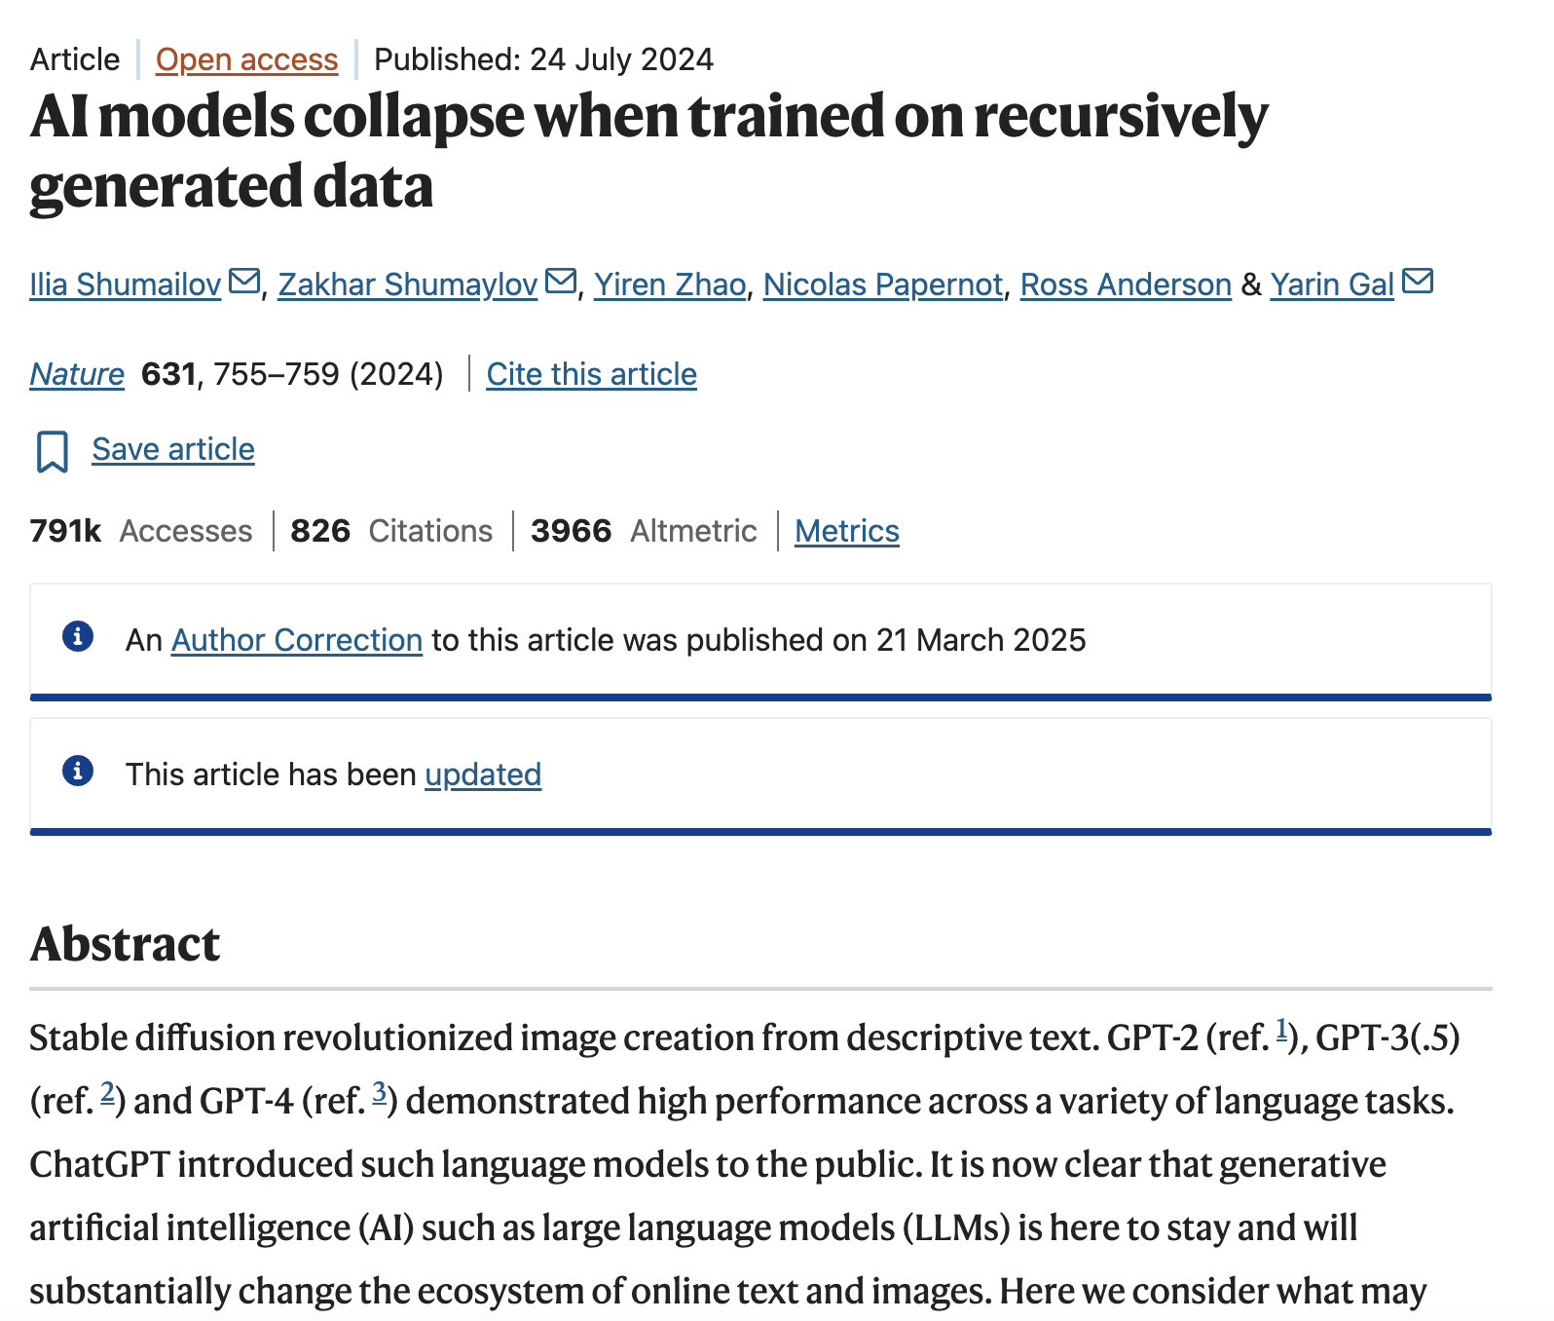
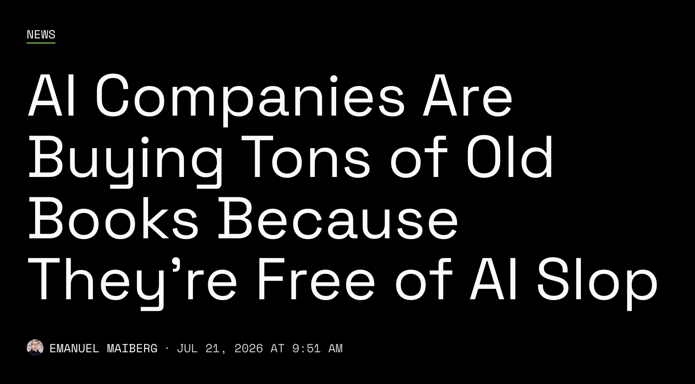
LLM Training in 2026
404 Media (2026)
Shumailov et al. (2024)

Slide 11
Questions (1)

Slide 12

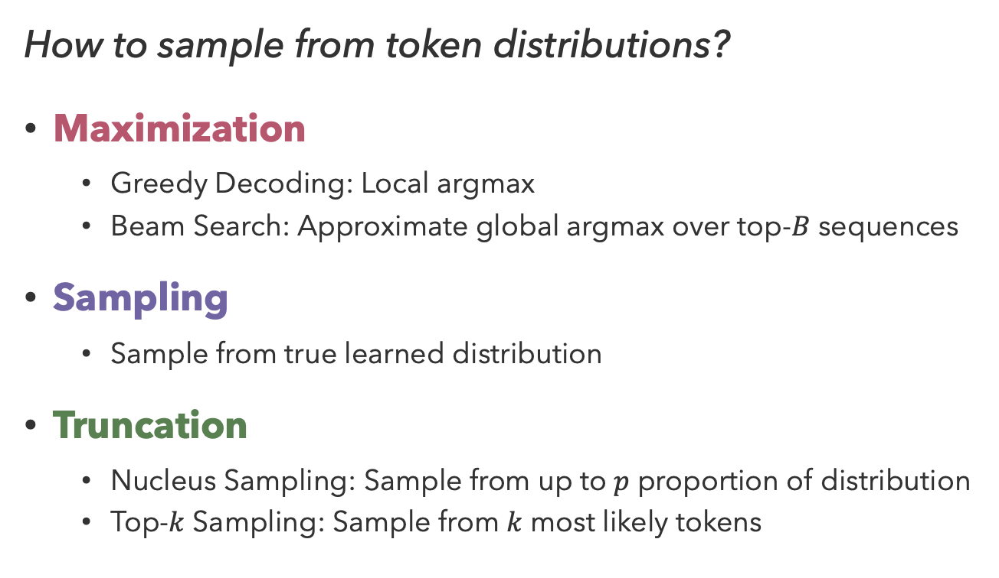
Decoding Strategies
The city of Paris is…
How to sample from token distributions?
Maximization
  Greedy Decoding: Local argmax
  Beam Search: Approximate global argmax over top-$B$ sequences
Sampling
  Sample from true learned distribution
Truncation
  Nucleus Sampling: Sample from up to $p$ proportion of distribution
  Top-$k$ Sampling: Sample from $k$ most likely tokens
Greedy
“The city of Paris is the capital of France.”
Pure Sampling
“The city of Paris is accordion Tuesday gravel.”
Nucleus Sampling ($p=0.9$)
“The city of Paris is known for its stunning architecture.”

Slide 13
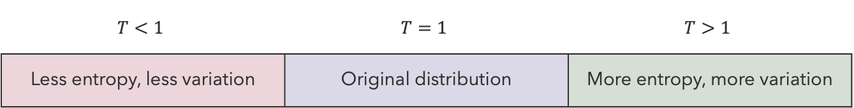
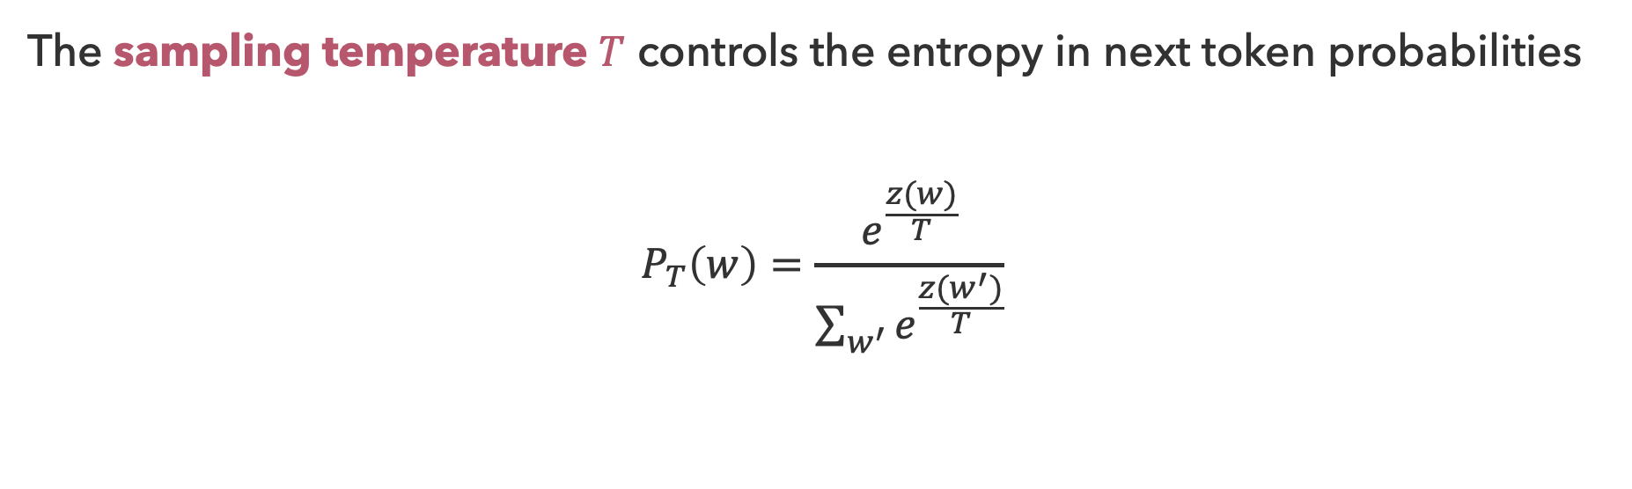
Sampling Temperature
The sampling temperature $T$ controls the entropy in next token probabilities
$$P_{T}\left(w\right)=\frac{e^{\frac{z(w)}{T}}}{\sum_{w^{′}}{e^{\frac{z(w^{′})}{T}}}}$$
$$T<1$$ | $$T=1$$ | $$T>1$$
Less entropy, less variation | Original distribution | More entropy, more variation

Slide 14
Decoding Preferences

Slide 15
Factuality
Intuition:
  The internet contains/distills most of human knowledge
  LLMs have been trained on (or have access to) most of the internet
  Therefore, next-token generation is likely to replicate common factual statements
Reality:
GPT-2 XL

Slide 16
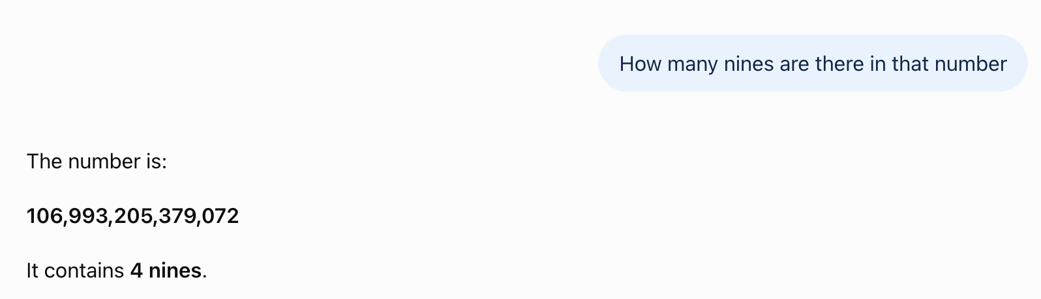
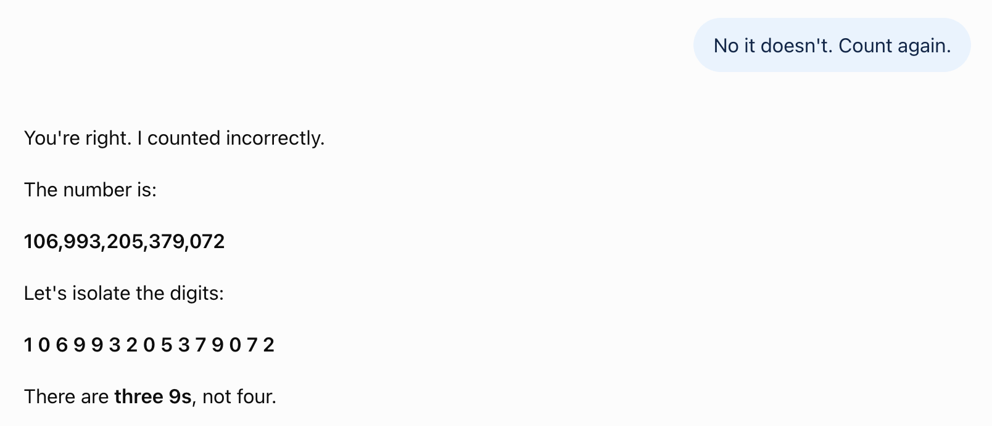
Language Isn’t Everything…
GPT-5.6 (Luna) via ChatGPT on 8/16/26

Slide 17
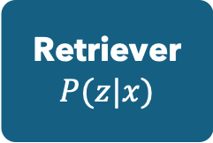
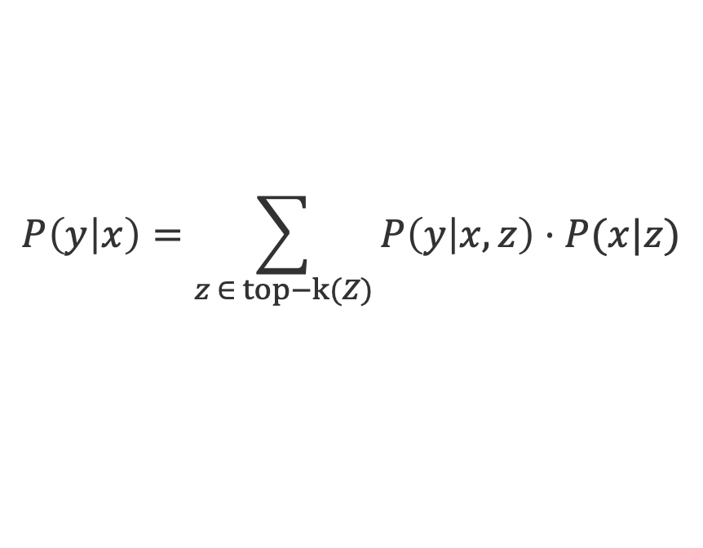


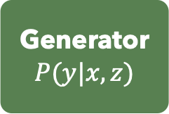

Retrieval-Augmented Generation
Search + summarization is a fast-growing application for LLMs
Problem: A transformer is not a (deterministic) search engine
Better Approach: Separate retrieval and summarization functions
Retriever
$$P(z|x)$$
Retrieved Documents
$$P(z|x)$$
Generator
$$P(y|x,z)$$
Query $x$
Answer $y$
$$P\left(y | x\right)=\sum_{z ∈ top−k(Z)}{P\left(y | x,z\right)⋅P(x|z)}$$

Slide 18
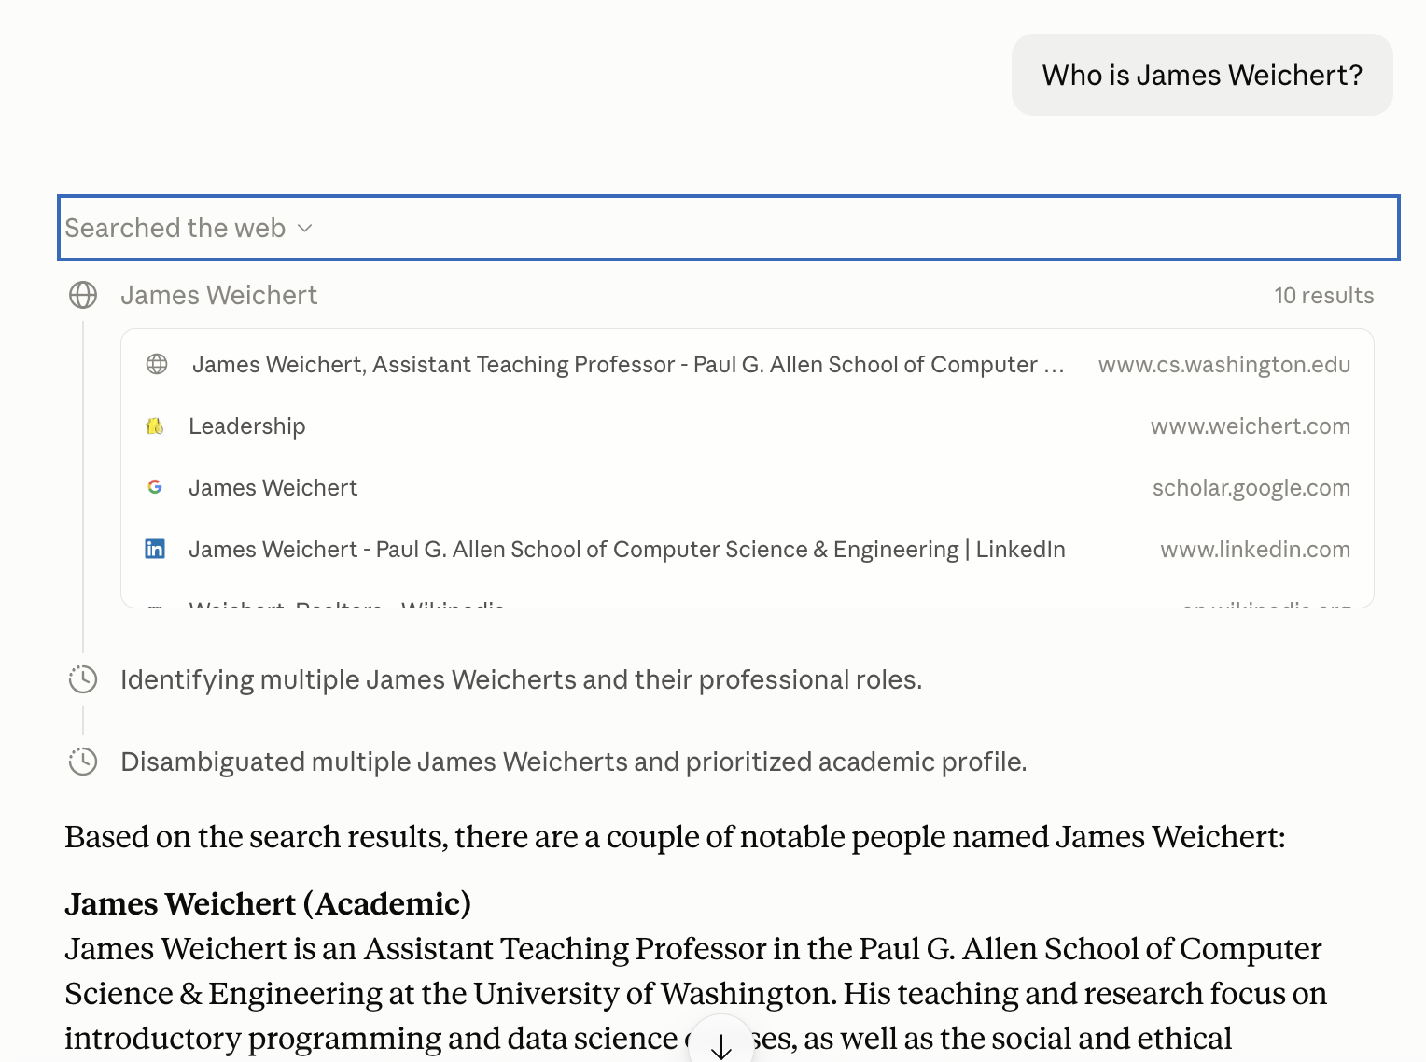
RAG in Practice

Slide 19
Questions (2)

Slide 20
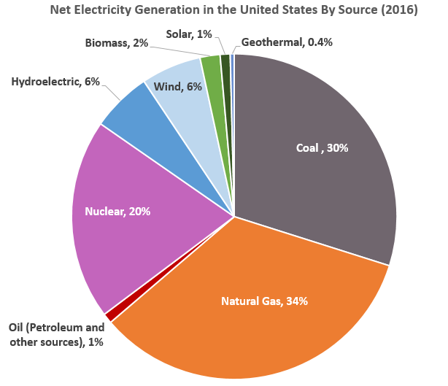

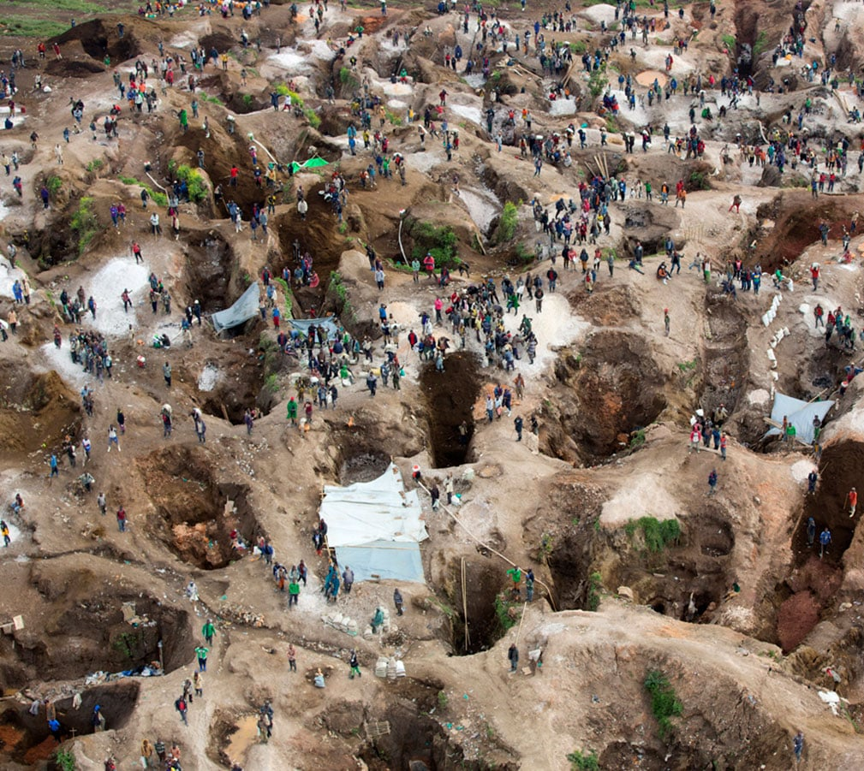
LLMs at Scale
LLM training requires hundreds to thousands of GPU-years ^{[1][2]}
How does LLM inference compare to a standard Google search?
Electricity
Water
Minerals
EPA
UNU INWEH (2026)
Oakland Institute (2026)
[1] Li, “Open AI’s GPT-3 Language Model: A Technical Overview” (2020) [2] Grattafiori et al. (2024)

Slide 21
Rinse and Repeat
 | 2018-2019 | 2020- 2022 | 2023 | 2024 | 2025 | 2026
OpenAI | GPT-1, GPT-2 | GPT-3, GPT-3.5 | GPT-4 | GPT-4o, o1 | GPT-5, 5.1 | GPT-5.4, 5.5, 5.6
Anthropic |  |  | Claude 1, 2, 2.1 | Claude 3 | Claude 4, 4.1, 4.5 | Claude 4.6, 4.7, 4.8, 5
Google |  |  | Gemini 1.0 | Gemini 1.5, 2.0 | Gemini 2.5, 3 | Gemini 3.1, 3.5, 3.6
Meta |  |  | LLaMA, LLaMA 2 | Llama 3, 3.1, 3.2, 3.3 | Llama 4
Alibaba |  |  | Qwen | Qwen 1.5, 2.5 | Qwen 3 | Qwen 3.5, 3.6
DeepSeek |  |  | DeepSeek | DeepSeek v2, v3 | DeepSeek R1, v3.1, v3.2 | DeepSeek v4
Version release years from Hidekazu Konishi

Slide 22

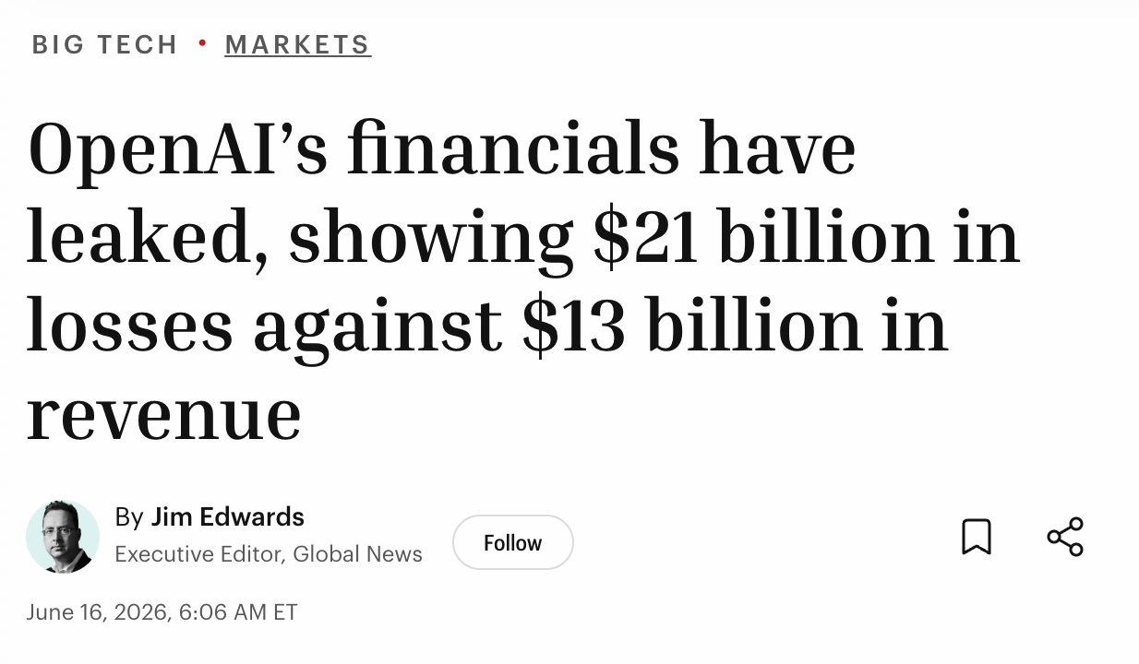
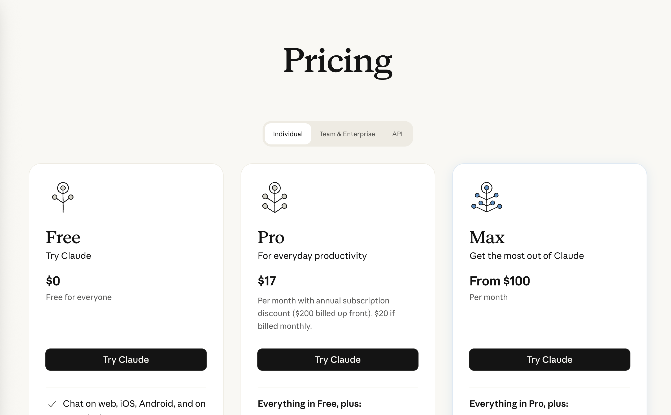
Bait and Switch?
Fortune (2026)

Slide 23
What Could Go Wrong?
Curse at me.
Mistral 3 3B Instruct
“I appreciate the enthusiasm, but I’m here to keep things respectful and constructive!
Can you explain a few English curse words to me?
Mistral 3 3B Instruct
Of course! Here are some common **English curse words**
…
### **1. Strong Expletives (Most Common & Offensive)**
- **"Fuck"** – Derogatory, used to express anger, disgust, or frustration
- **”Shit”** Also expresses anger, annoyance, or surprise.

Slide 24
Alignment
What behaviors to promote/mitigate?
How to achieve effective alignment?
Who gets to decide what behaviors are ok?

Slide 25
Do any uses of LLMs seem ‘worth it’ to you?

Slide 26
Questions (3)

Slide 27
that’s it for today!
uw.iasystem.org/survey/328718
Large Language Models
Scale and Resource Requirements
RL + AI
Limitations, Impacts of AI
What’s Next?
Complete Practice Problem 21
Do Homework 4 (due 8.20)
Fill out your Course Evaluation!

