Slide 1
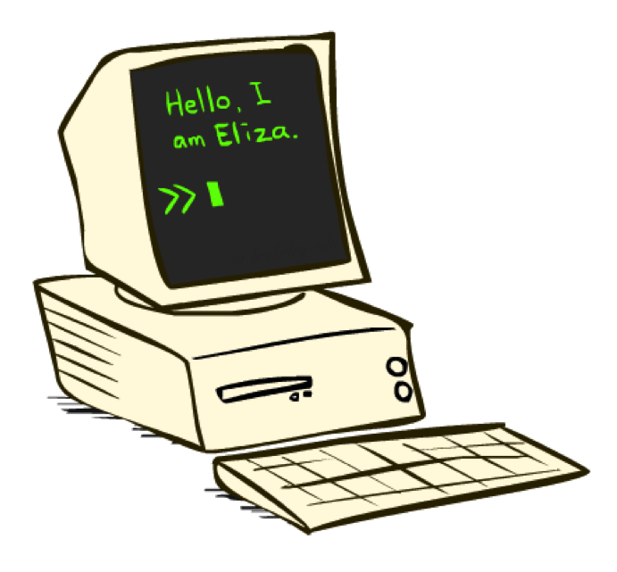
Language Modeling, Transformers
>> Who are you?
CSE 473: Introduction to Artificial Intelligence
James Weichert (jpw@cs)
cs.uw.edu/473
acknowledgements
Welcome!
What’s your favorite word?
sli.do #cse473

Slide 2

Administrivia
CSE 473 stickers!
Homework 4 due next week (8.20)
  No late period — HW4 must be turned in by 8.21

Slide 3
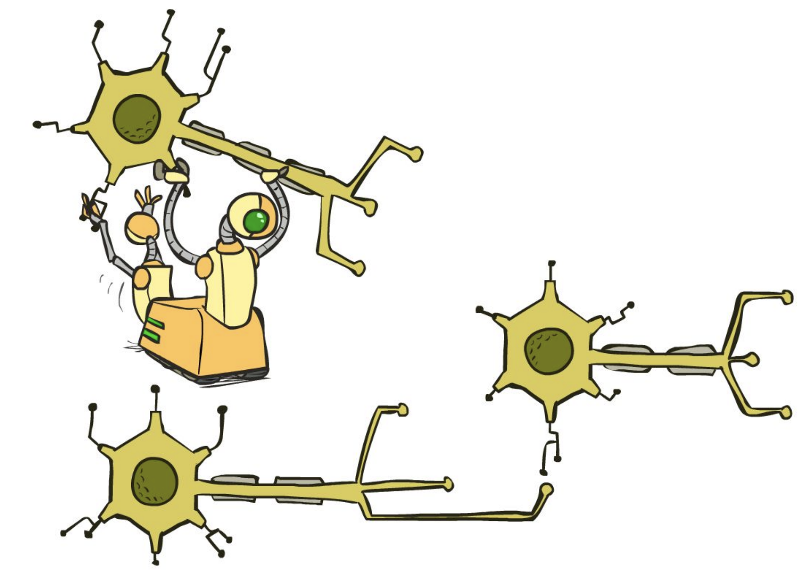
Recurrent Networks

Slide 4














Dependent Sequences
Prediction at time $t$ depends on prediction at time $t−1$, etc.
Time series data, moving images, language
$$y_{1}$$
$$y_{2}$$
$$y_{3}$$
$$y_{t}$$
$$h_{0}$$
$$h_{1}$$
$$h_{2}$$
$$h_{3}$$
$$h_{t}$$
$$x_{1}$$
$$x_{2}$$
$$x_{3}$$
$$x_{t}$$

Slide 5






Recurrent Neural Networks
Recurrent Neural Networks include backwards (recurrent) connections
$$x_{1}$$
$$x_{2}$$
$$x_{3}$$
$$\hat{y}$$
$$x_{4}$$
$$x_{n}$$

Slide 6














Long Short Term Memory (LSTM)
$$h_{t}$$
Forget Gate
$$c_{t−1}$$
$$×$$
$$+$$
$$c_{t}$$
$$×$$
$$tanh$$
$$×$$
$$σ$$
$$σ$$
$$tanh$$
$$σ$$
$$h_{t−1}$$
$$h_{t}$$
$$X_{t}$$
Input Gate
Output Gate

Slide 7
LSTM Text Generation
“[dogs are] the companion animal most frequently reported for exposure to support earlier findings that pet ownership is each year, a common breeding practice for pet dogs are dispersed less likely to be found within the hunter of every dogs.”
LSTM model code generated by Claude Code
Generated using text from the Wikipedia article on “Dog”

Slide 8
Problems with Sequential Processing
Vanishing Gradients
Memory Bottleneck
Training Speed
Gradients shrink over long sequences
Hidden state (memory) has fixed size
Cannot parallelize training across time steps
Mitigated with LSTMs

Slide 9
Questions (1)

Slide 10
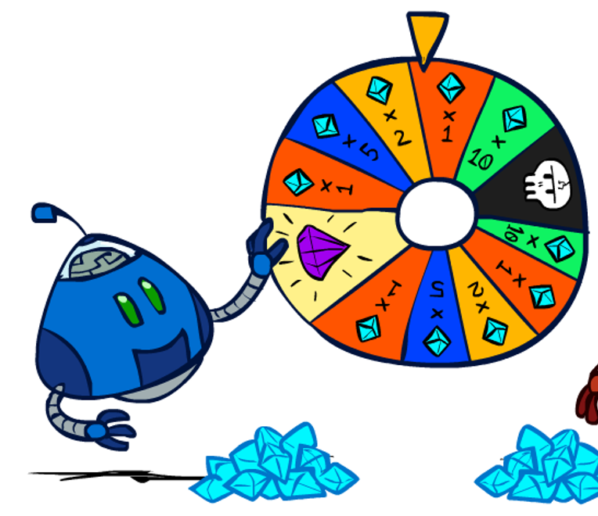
Modeling Language
mat
cat
sat
the
dog
a
lab
hat
tap
ate

Slide 11
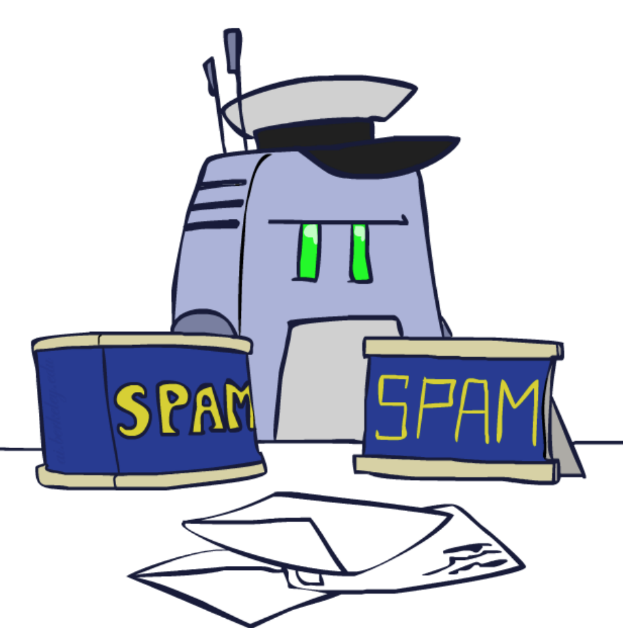



Bag of Words Modeling
Model language generation as a naïve Bayes network where words are conditionally independent of each other.
$$C$$
Maybe good enough for classification, not effective for generation
$$W_{1}$$
$$W_{2}$$
…
$$W_{n}$$

Slide 12






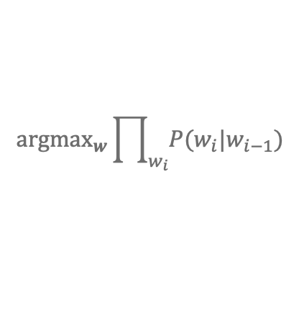



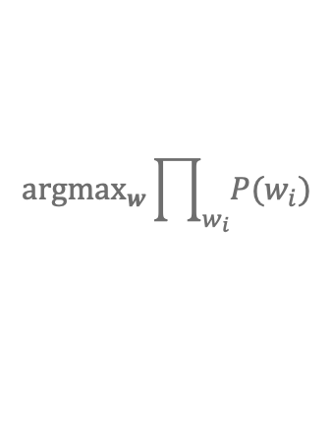




N-Gram Models
Leverage Markov assumption to model words as dependent only on a subset of prior words.
$$W_{0}$$
$$W_{1}$$
$$W_{2}$$
Search Problems!
$${argmax}_{w}\prod_{w_{i}}{P(w_{i})}$$
Unigram
$$P(W_{0})$$
$$P(W_{1})$$
$$P(W_{2})$$
Bigram
$$P(W_{0})$$
$$P(W_{1}|W_{0})$$
$$P(W_{2}|W_{1})$$
$${argmax}_{w}\prod_{w_{i}}{P(w_{i}|w_{i−1})}$$
Trigram
$$P(W_{0})$$
$$P(W_{1}|W_{0})$$
$$P(W_{2}|W_{1},W_{0})$$
$${argmax}_{w}\prod_{w_{i}}{P(w_{i}|w_{i−1}, w_{i−2})}$$

Slide 13
N-Grams in Action
Bigram
”[dogs] are the dog population is dominated by the dog among its closest extant relatives”
Trigram
”[dogs are] a source of zoonoses for humans”
Generated using text from the Wikipedia article on “Dog”

Slide 14
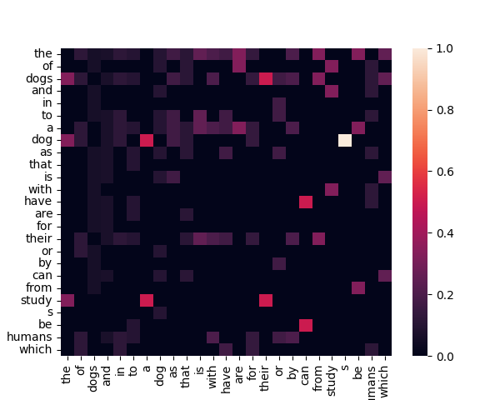
Problems with N-Grams
Tracking, Storing N-Grams
Sparse N-Grams
Poor Long-Term Context
Heatmap of bigrams for top-25 words in Wikipedia article on “Dog”

Slide 15
Questions (2)

Slide 16
Sentence Context
the
cat
sat
on
the
mat
vs.
Matt
sat
on
the
cat

Slide 17
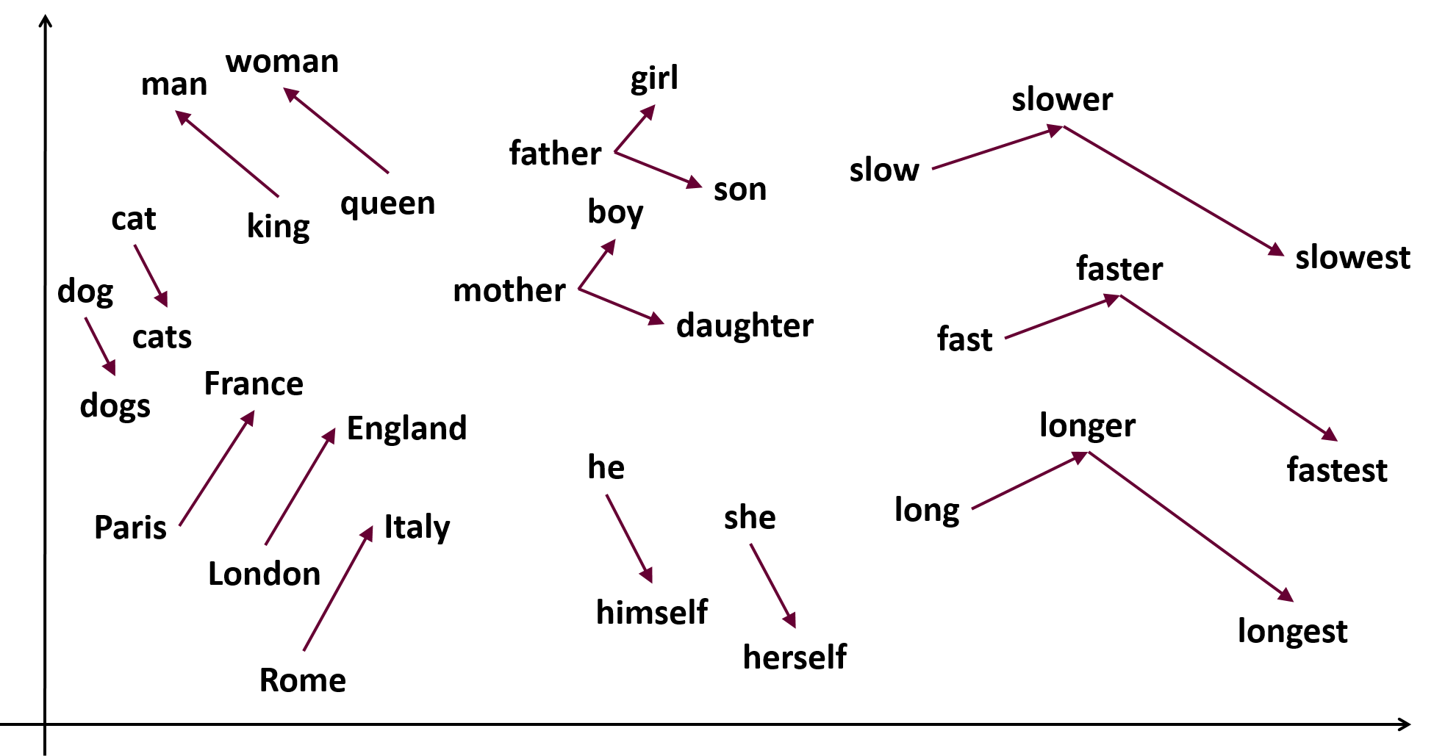
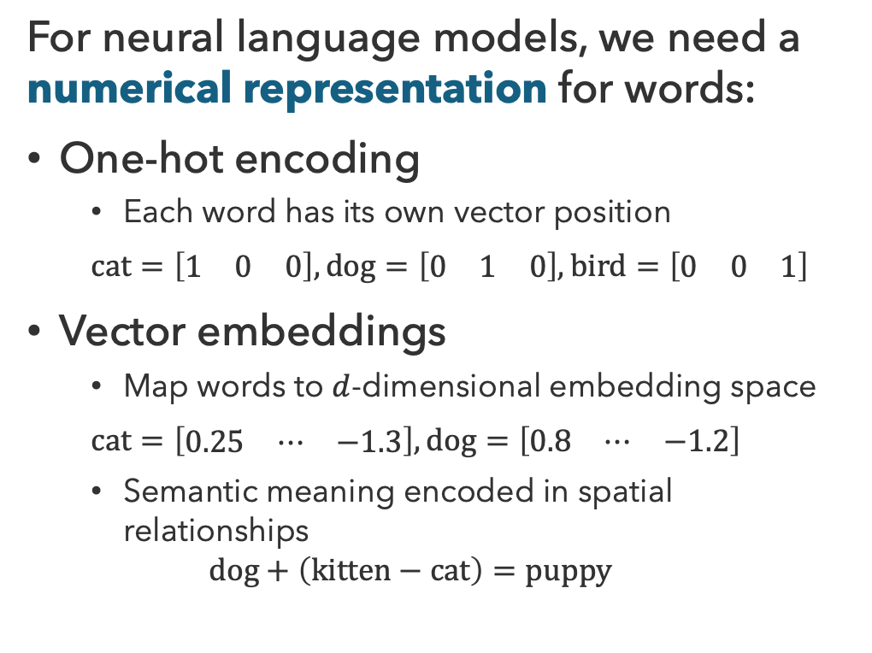
Word Embeddings
For neural language models, we need a numerical representation for words:
One-hot encoding
  Each word has its own vector position
  $$cat=\left[\begin{matrix}1 & 0 & 0\end{matrix}\right], dog=\left[\begin{matrix}0 & 1 & 0\end{matrix}\right], bird=\left[\begin{matrix}0 & 0 & 1\end{matrix}\right]$$
Vector embeddings
  Map words to $d$-dimensional embedding space
  $$cat=\left[\begin{matrix}0.25 & ⋯ & −1.3\end{matrix}\right], dog=\left[\begin{matrix}0.8 & ⋯ & −1.2\end{matrix}\right]$$
  Semantic meaning encoded in spatial relationships
  $$dog+\left(kitten−cat\right)=puppy$$

Slide 18
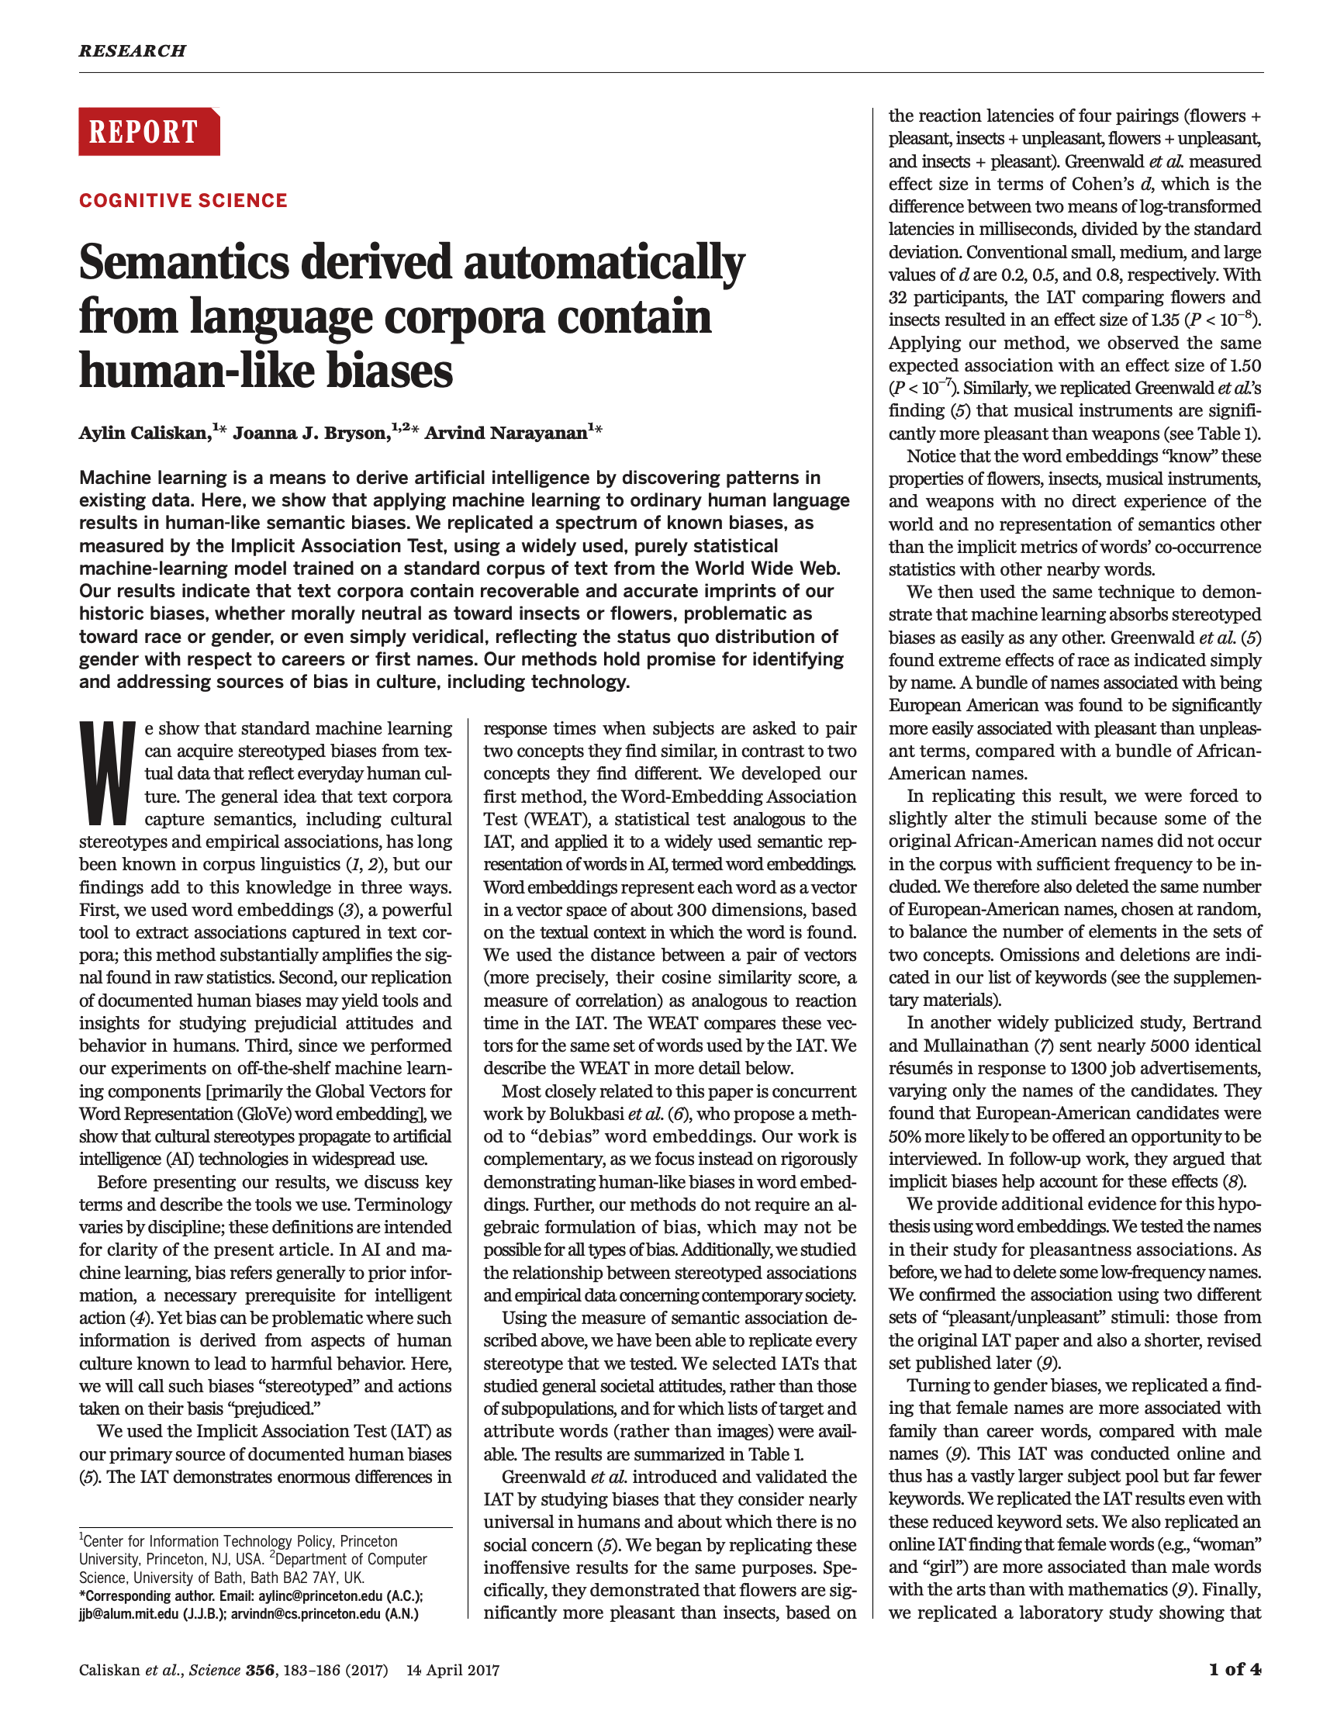
Embeddings Embed Societal Bias
Caliskan et al. (2017)

Slide 19
Adaptive Context
you
have
to
square
the
root
it
was
snowing
as
i
walked
across
red
square
my
first
day
as
a
professor
i
went
to
red
square

Slide 20




Embeddings + Context
context $v_{2}$
context $v_{3}$
context $v_{1}$
input $x$
input with context

Slide 21
Questions (3)

Slide 22
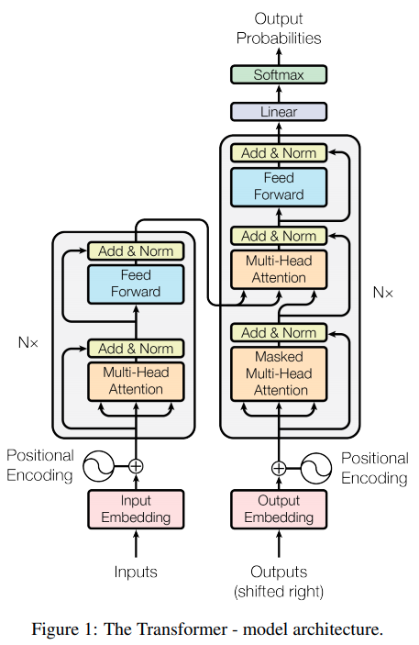
Transformer Models
Vaswani et al. (2017)

Slide 23




Attention
The attention mechanism scales outputs $V$ by relevance of key $K$ to query $Q$
$$Attention\left(Q,K,V\right)=softmax\left(\frac{QK^{⊤}}{\sqrt{d_{k}}}\right)∙V$$
Query $Q$
“What am I looking for?”
Current token’s information needs
Key $K$
“What do I contain?”
Summarizes information offered by token
Value $V$
“What do I provide?”
Actual information provided by token

Slide 24







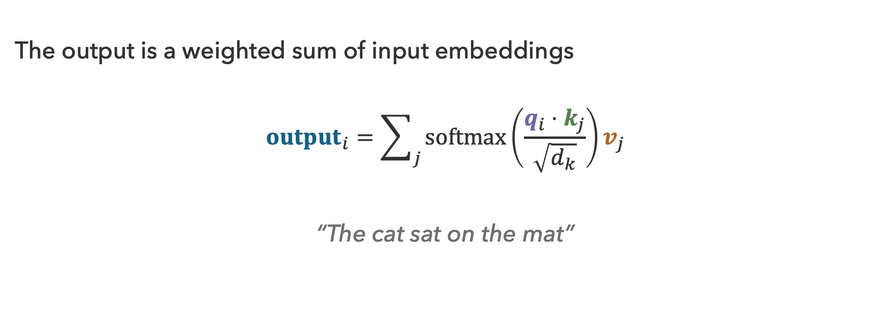











Attention Outputs
The output is a weighted sum of input embeddings
$${output}_{i}=\sum_{j}{softmax\left(\frac{q_{i}⋅k_{j}}{\sqrt{d_{k}}}\right)v_{j}}$$
“The cat sat on the mat”
$${σ(q_{sat}⋅k}_{j})$$
$$0.05$$
$$0.40$$
$$0.15$$
$$0.10$$
$$0.35$$
$$k_{j}$$
The
$$+$$
cat
$$+$$
on
$$+$$
the
$$+$$
mat
$$=$$
$${output}_{sat}$$
$$v_{j}$$
$$v_{The}$$
$$v_{cat}$$
$$v_{on}$$
$$v_{the}$$
$$v_{mat}$$

Slide 25


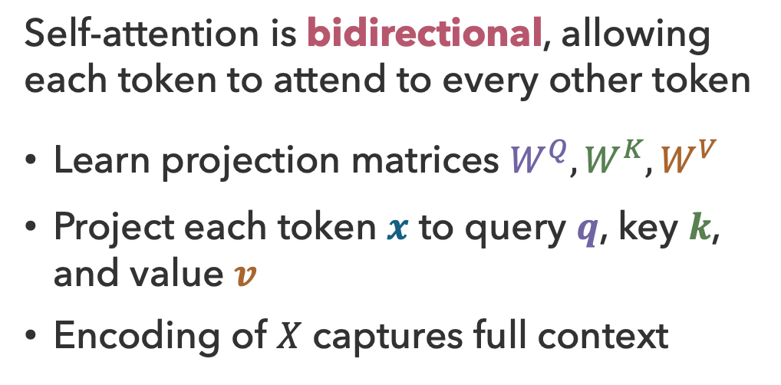
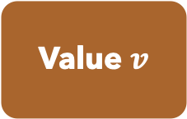

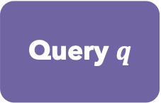

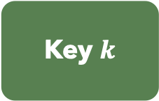

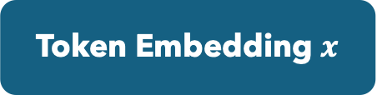

Self-Attention
Self-attention is bidirectional, allowing each token to attend to every other token
Learn projection matrices $W^{Q}, W^{K}, W^{V}$
Project each token $x$ to query $q$, key $k$, and value $v$
Encoding of $X$ captures full context
Token Embedding $x$
$$W^{Q}$$
$$W^{K}$$
$$W^{V}$$
Query $q$
Key $k$
Value $v$
 | The | cat | sat | on | the | mat
The | 1.00 | 0.10 | 0.05 | 0.05 | 0.00 | 0.10
cat | 0.10 | 1.00 | 0.40 | 0.10 | 0.05 | 0.30
sat | 0.05 | 0.40 | 1.00 | 0.15 | 0.05 | 0.35
on | 0.05 | 0.10 | 0.15 | 1.00 | 0.40 | 0.50
the | 0.00 | 0.05 | 0.05 | 0.40 | 1.00 | 0.30
mat | 0.10 | 0.30 | 0.35 | 0.50 | 0.30 | 1.00
$$q=xW^{Q}$$
$$k=xW^{K}$$
$$v=xW^{V}$$

Slide 26
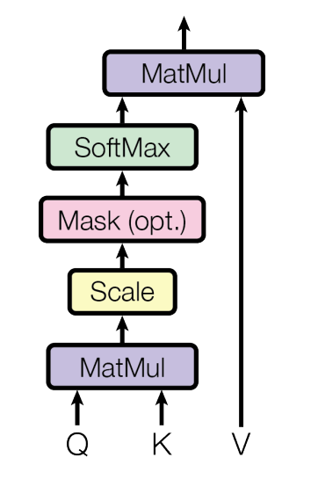
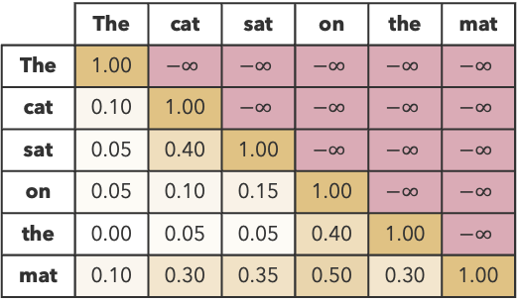



Masked Attention
Problem: When predicting tokens, we don’t want the network to attend to future tokens
Solution: Mask out future tokens
$${Attention}_{M}\left(Q,K,V\right)=softmax\left(\frac{QK^{⊤}+M}{\sqrt{d_{k}}}\right)⋅V$$
  $M=\left\{\begin{matrix}0, j≤i \\ −∞, j>i\end{matrix}\right.$
$$j$$
 | The | cat | sat | on | the | mat
The | 1.00 | $$−∞$$ | $$−∞$$ | $$−∞$$ | $$−∞$$ | $$−∞$$
cat | 0.10 | 1.00 | $$−∞$$ | $$−∞$$ | $$−∞$$ | $$−∞$$
sat | 0.05 | 0.40 | 1.00 | $$−∞$$ | $$−∞$$ | $$−∞$$
on | 0.05 | 0.10 | 0.15 | 1.00 | $$−∞$$ | $$−∞$$
the | 0.00 | 0.05 | 0.05 | 0.40 | 1.00 | $$−∞$$
mat | 0.10 | 0.30 | 0.35 | 0.50 | 0.30 | 1.00
$$i$$
Vaswani et al. (2017)

Slide 27
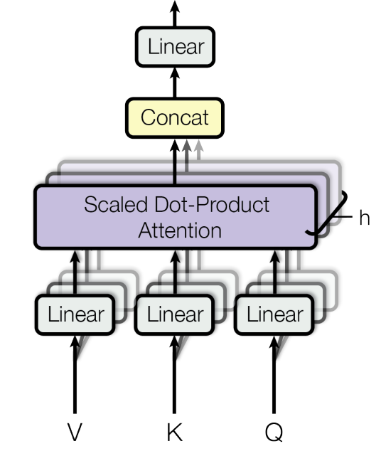
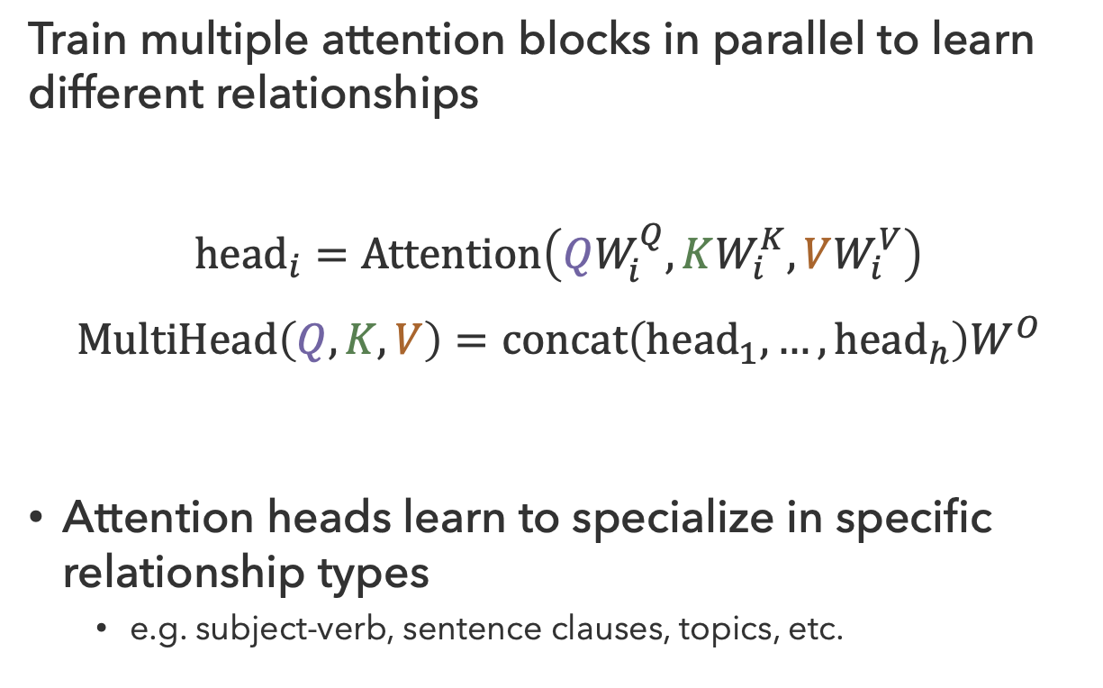
Multi-Head Attention
Train multiple attention blocks in parallel to learn different relationships
$${head}_{i}=Attention\left(QW_{i}^{Q},KW_{i}^{K}, VW_{i}^{V}\right)$$
$$MultiHead\left(Q,K,V\right)=concat\left({head}_{1},…,{head}_{h}\right)W^{O}$$
Attention heads learn to specialize in specific relationship types
  e.g. subject-verb, sentence clauses, topics, etc.
Vaswani et al. (2017)

Slide 28
Questions (4)

Slide 29
Transformers
The Transformer model uses an encoder-decoder architecture, useful when input and output sequences have different lengths
Encoder
  Multi-head self-attention to learn input context representation
Decoder
  Autoregressive model — uses previous output as input
  Masked multi-head attention to generate output
  Multi-head cross-attention combines encoder (keys and values)
  with decoder (query)
Vaswani et al. (2017)

Slide 30
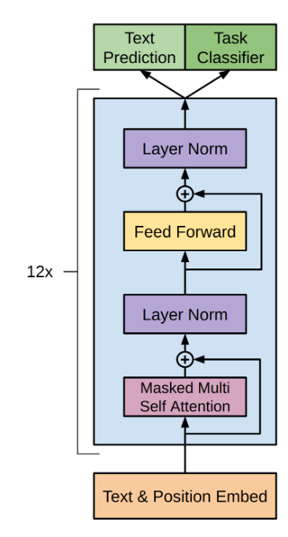

GPT
GPT-3
(Generative Pre-trained Transformer)
$n_{params}=175B$
$n_{layers}=96$
$n_{heads}=96$
$d_{embedding}=12,288$
$d_{head}=128$
$\left|V\right|≈50,000$
Decoder-only model suffices for text generation
Brown et al. (2020)
Radford et al. (2018)

Slide 31
ChatGPT…
“[My first day as a professor, I was walking across Red Square] in Moscow when I realized I was about to enter a world I had spent years preparing for—and absolutely no amount of preparation could tell me what would happen next.”

Slide 32
Questions (5)

Slide 33

Bigram Model?

Slide 34
that’s it for today!
Language is complex, requiring flexible ’focus’
N-gram models encode conditional distributions over short subsequences
The attention mechanism solves the context problem by weighting prior tokens according to their relevance
Large Language Models
The Frontier of AI
Complete Practice Problem 20
Do Homework 4 (due 8.20)

