Slide 1
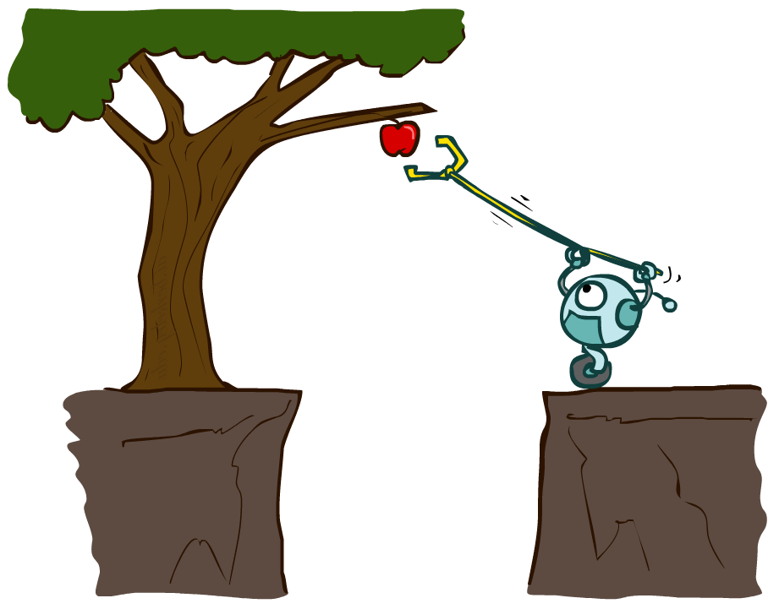
Agents and Environments
CSE 473: Introduction to Artificial Intelligence
James Weichert (jpw@cs)
cs.uw.edu/473
acknowledgements
Welcome!
Favorite fruit?
sli.do #cse473

Slide 2
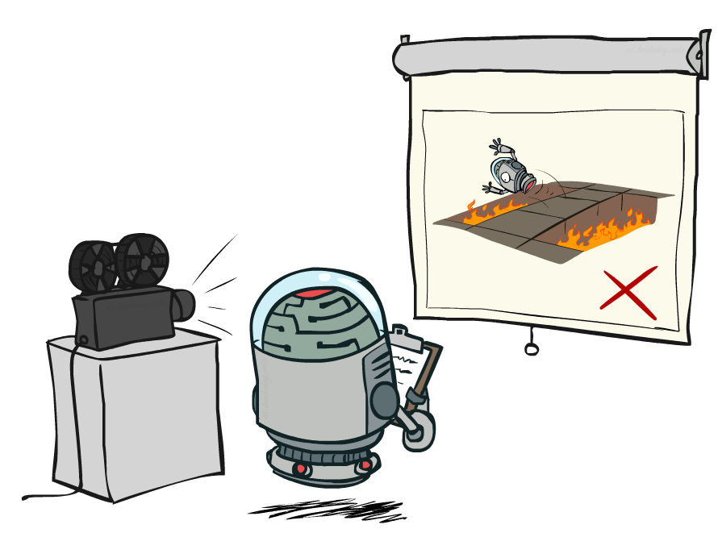
Administrivia
Make sure you can access
Ed, Gradescope, Panopto
Remember to complete the practice problems for each lecture
Project 0 (optional) is out!
  due Thursday (6.25)
Homework 1 released Friday
  due next Thursday (7.2)
Project 1 released Friday
  due in two weeks (7.9)

Slide 3
How should we model the world?

Slide 4
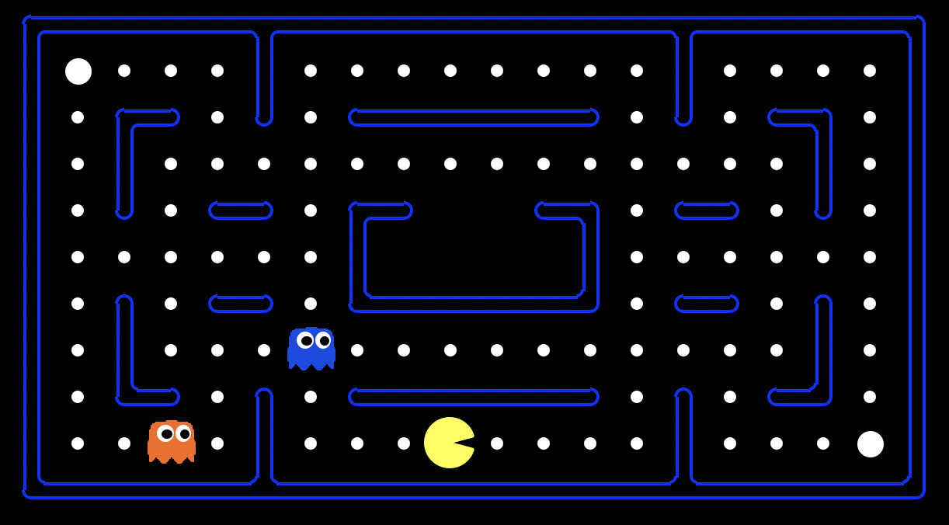
Modeling Pacman

Slide 5
Working Definition of AI
(WORKING) DEFINITION
AI comprises computer systems that demonstrate the ability to achieve specified objectives through independent action.

Slide 6
Agents
One approach is to model the interactions of individual agents
An agent perceives its environment through sensors and acts on it through actuators.
Agent
percepts
Sensors
?
Environment
Actuators
actions

Slide 7
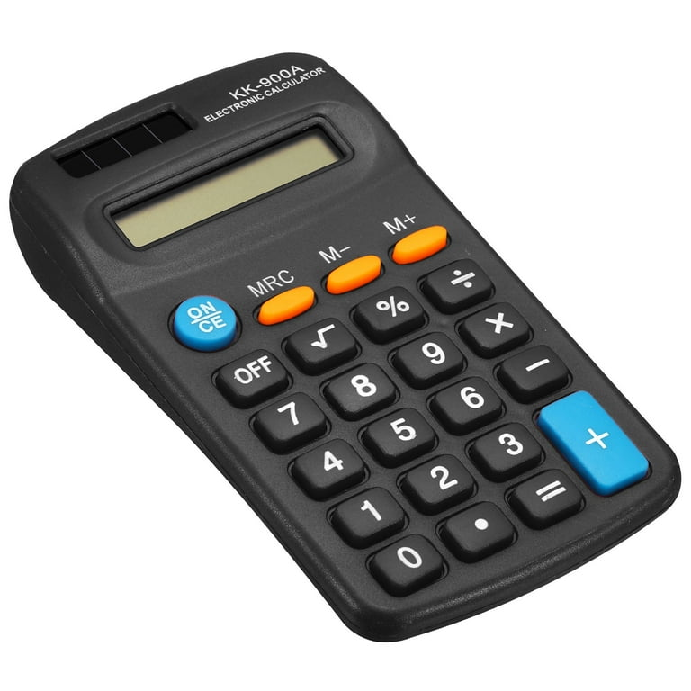
Agents?
Do the following fit our definition?
Pacman navigating a maze
  Sensors: position, position of dots and ghosts
  Actuators: NSEW movements (really, directions)
Humans
  Sensors: vision, sound, touch, smell, taste
  Actuators: muscles, secretions, brain state
Pocket calculators
  Sensors: key press sensors, light sensor
  Actuators: digit display
✅
👤
✅
✅

Slide 8
Now What?
We’ve modeled the (simplified) world. So we’re done, right?
Finding the agent function that maps percepts to actions is very hard.
This is the challenge for artificial intelligence.
Agent
percepts
Sensors
?
Environment
Actuators
actions

Slide 9
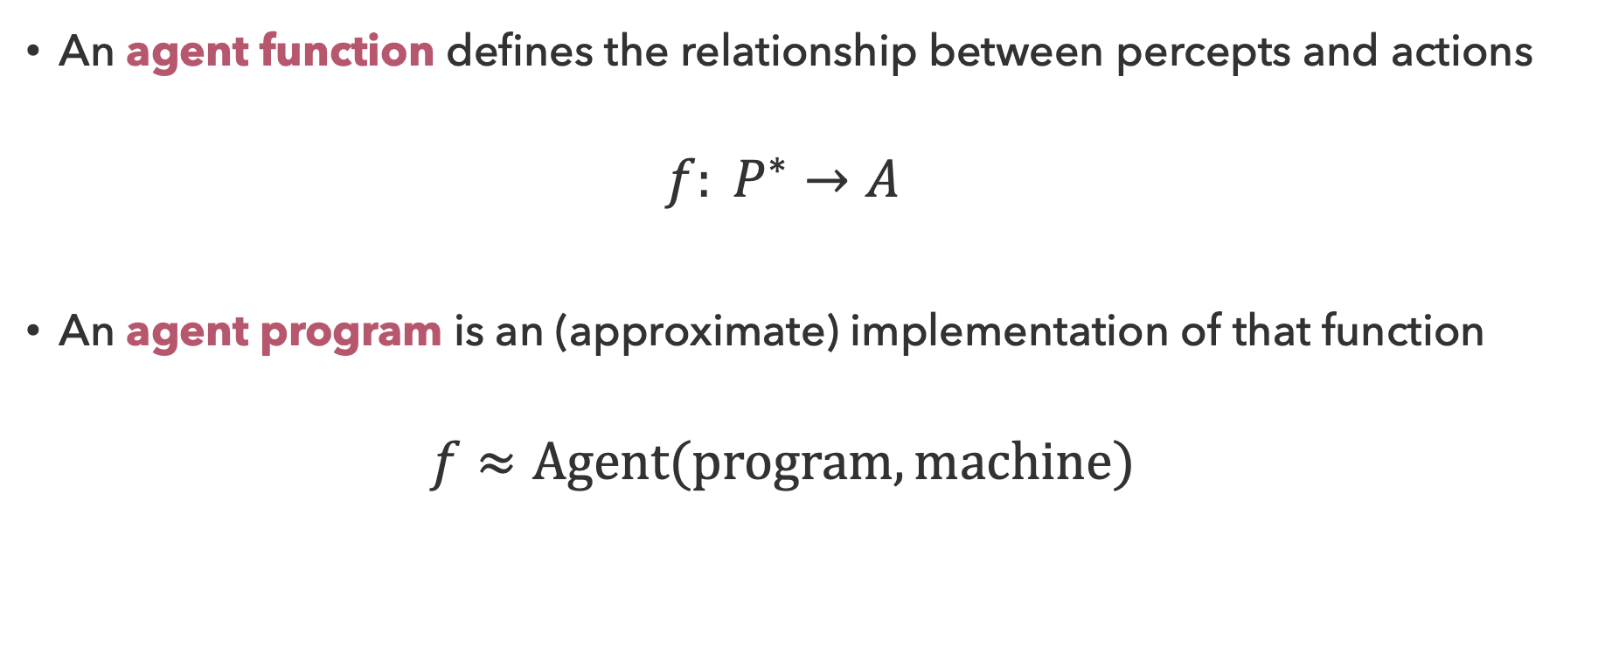
Agent Functions and Programs
An agent function defines the relationship between percepts and actions
  $$f: P^{∗}→A$$
An agent program is an (approximate) implementation of that function
  $$f≈Agent(program, machine)$$

Slide 10
Questions (1)

Slide 11
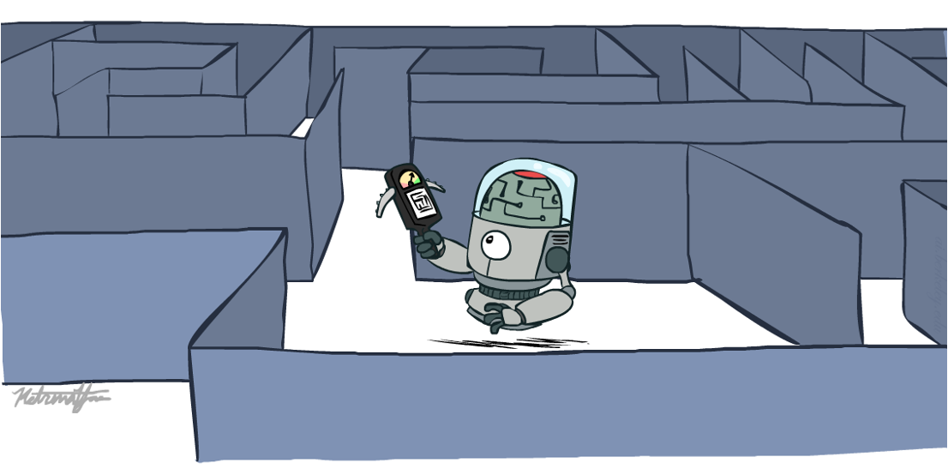
Rationality
A rational agent selects actions that maximize its expected utility

Slide 12
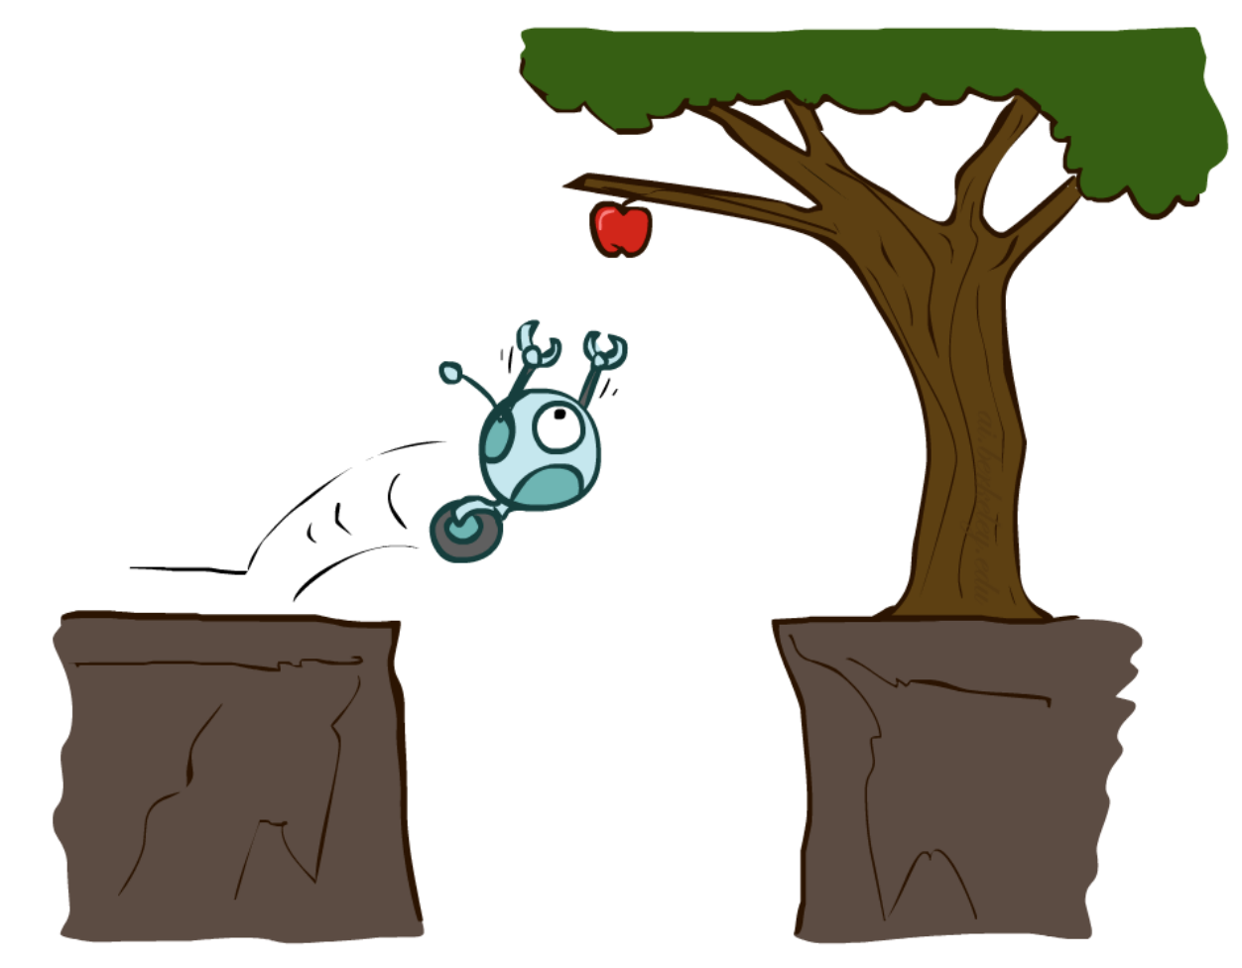
Reflex Agents
Reflex agents consider how the world is, without planning
  Choose action based on current percept
  May have memory or model of world’s
  current state
  Do not consider future consequences of
  their actions
Can reflex agents be rational?
Yes!

Slide 13
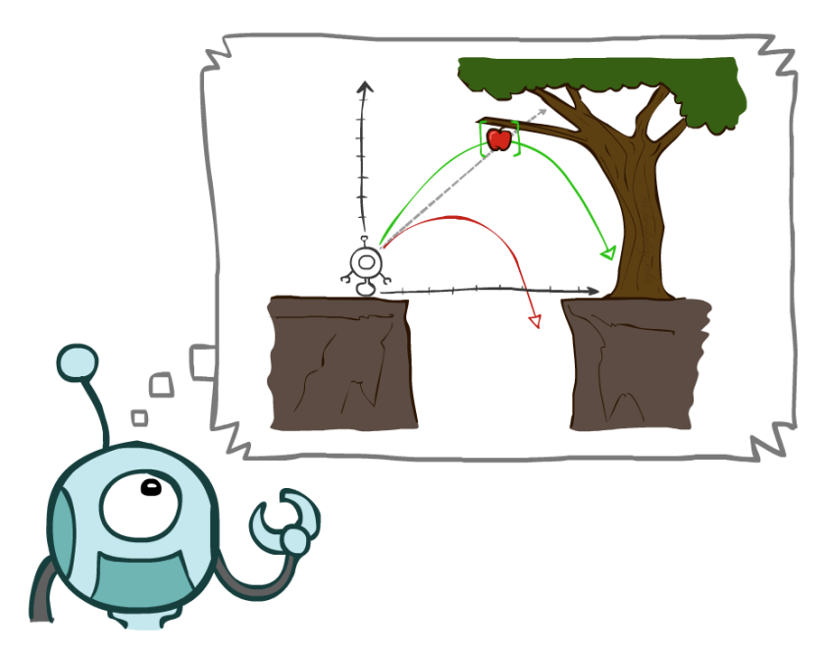
Planning Agents
Planning agents forecast to consider how the world would be
  Choose action based on (hypothesized) consequences of actions
  Must have a model of the world and how it evolves in response to actions
  Must formulate and check for a goal
Why not just plan everything?
Randomness, Complexity

Slide 14
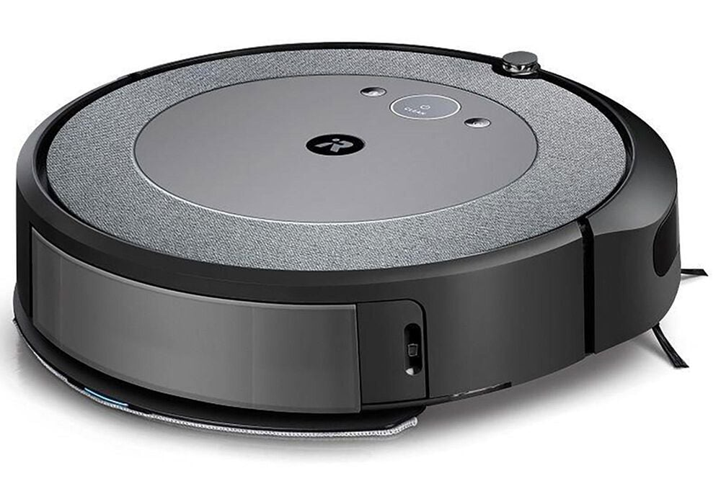
Vacuum World
What forms could this vacuuming agent take? What could go wrong?
Reflex Agent
Planning Agent

Slide 15
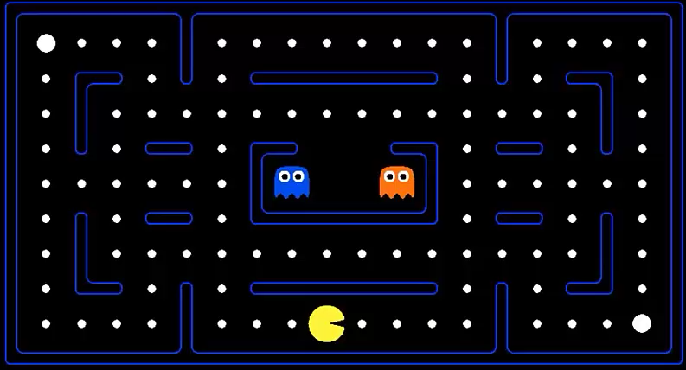
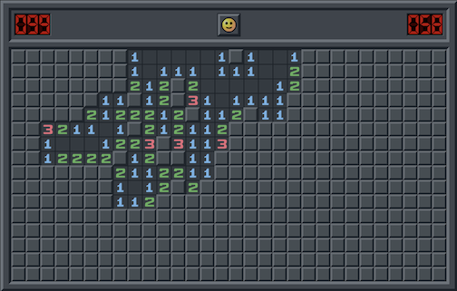
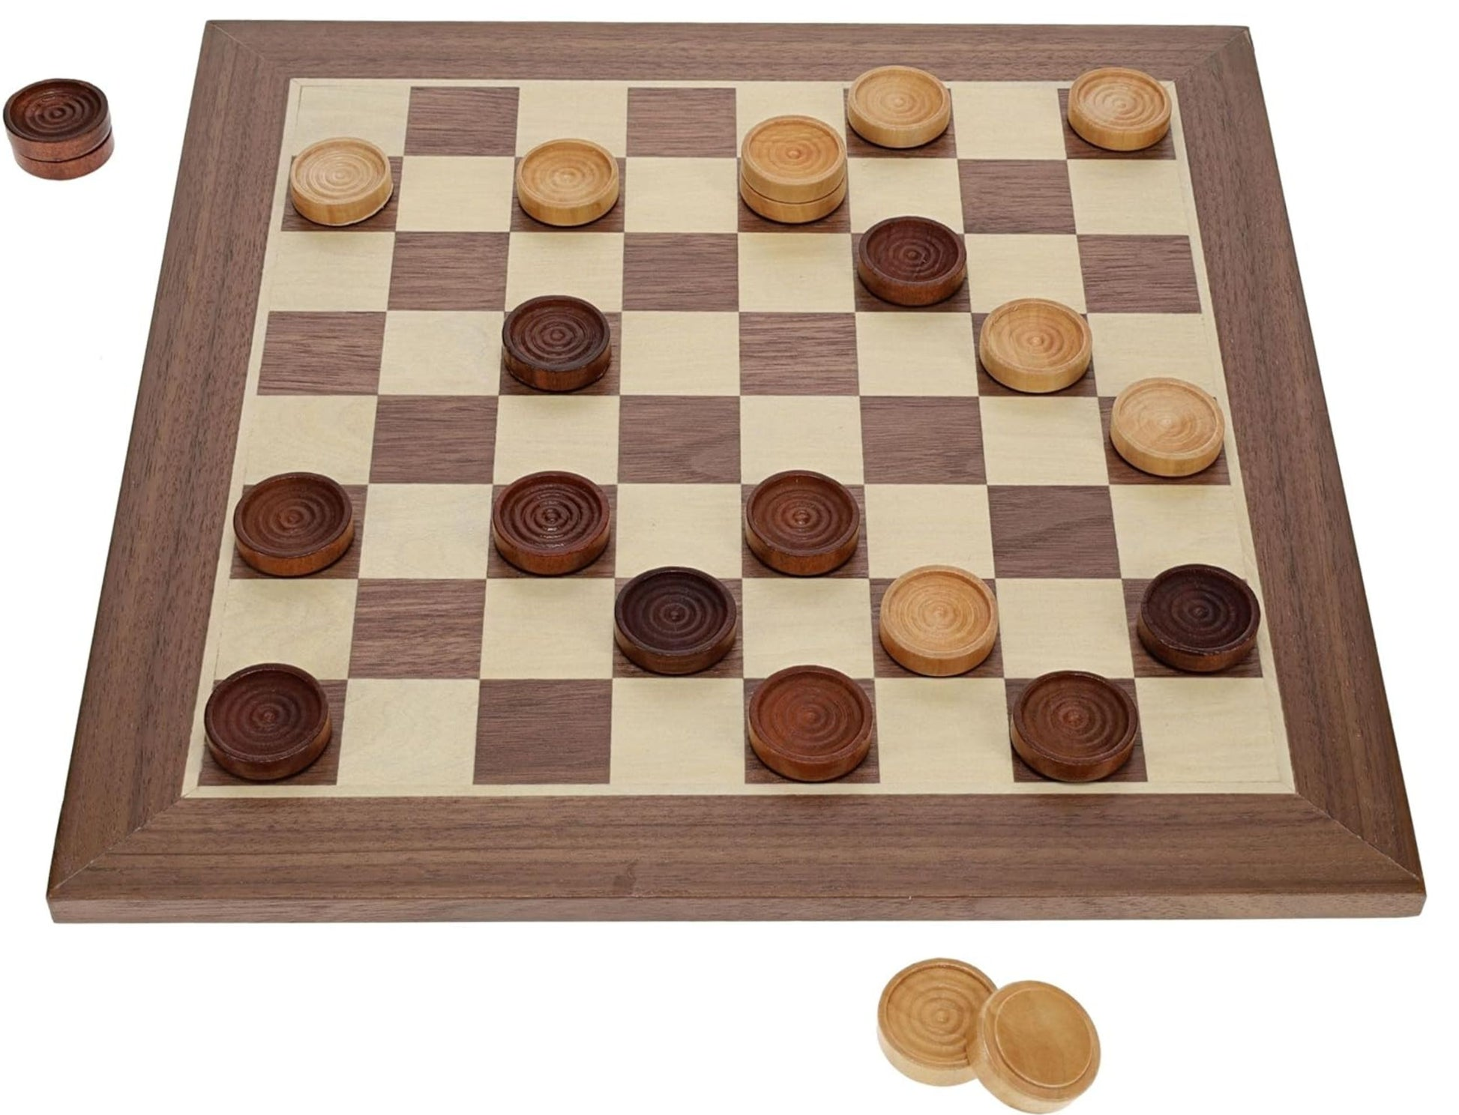
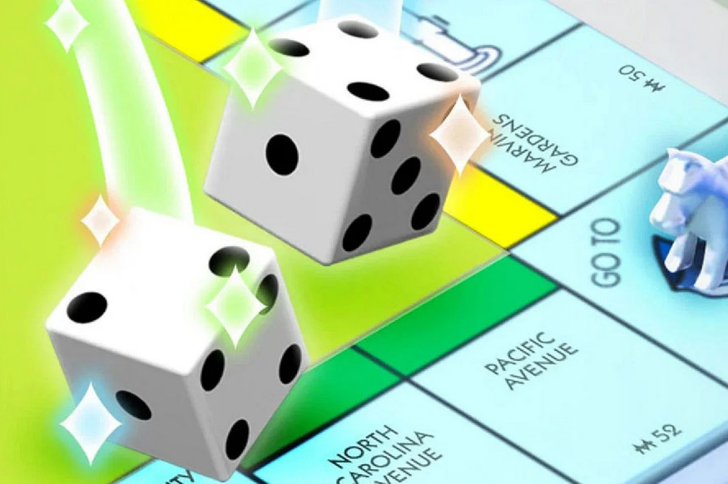
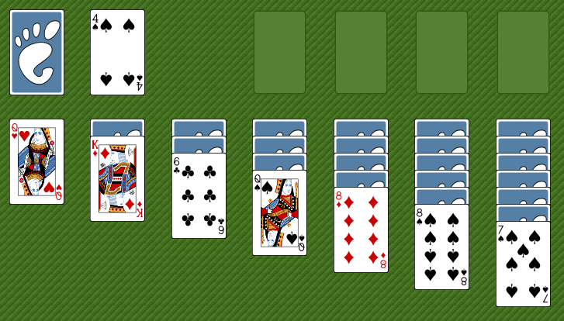
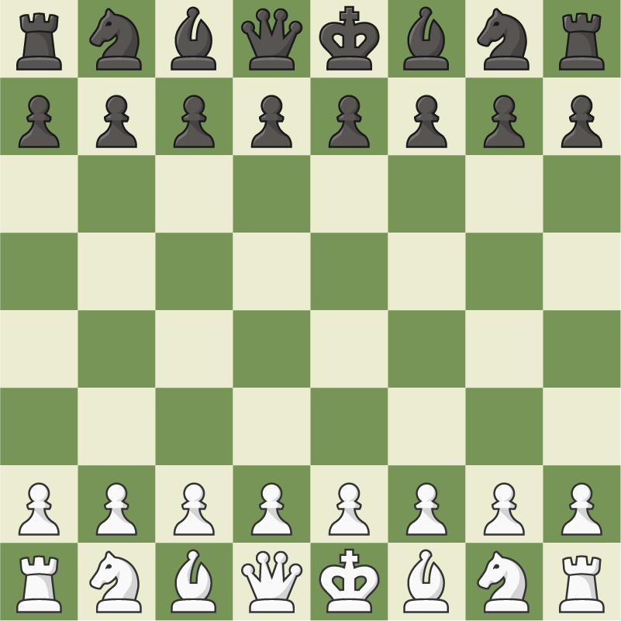

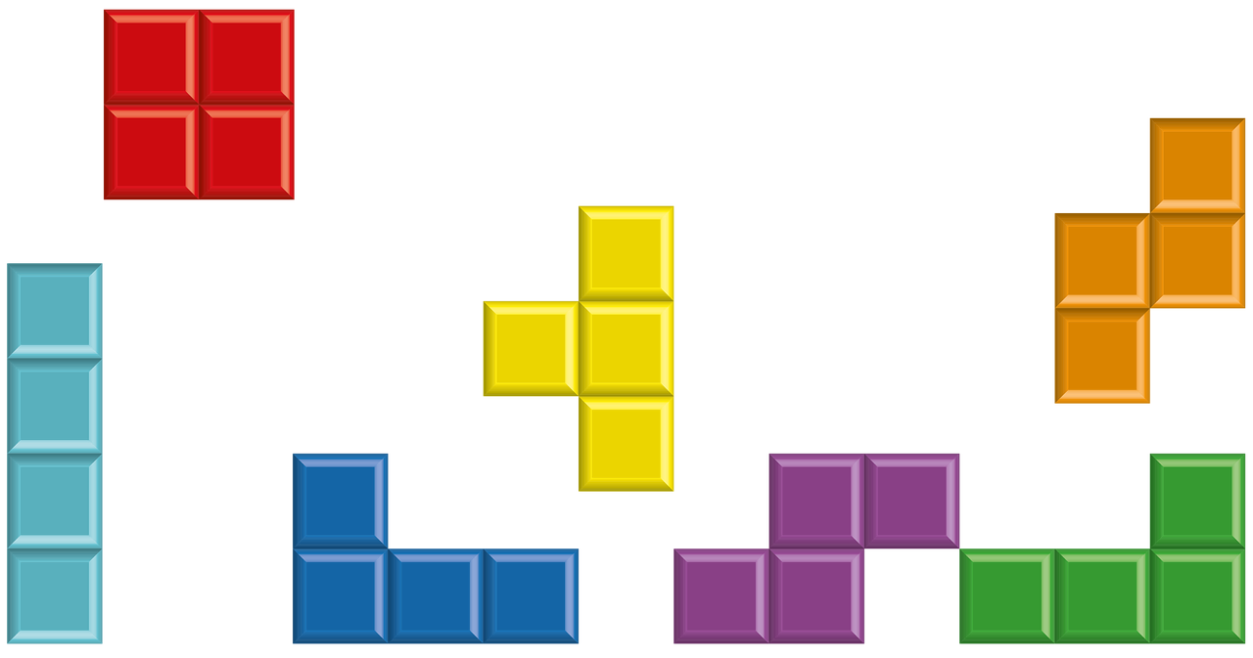
Environments
What kind of environment is the agent dealing with?
fully observable vs. partially observable
deterministic vs. stochastic
single agent vs. multi-agent
static vs. sequential

Slide 16
Pacman Environment
fully observable vs. partially observable
deterministic vs. stochastic
single agent vs. multi-agent
  Project 1: single agent (maze navigation)
  Project 2: multi-agent (Pacman + ghosts)
static vs. sequential

Slide 17
Questions (2)

Slide 18
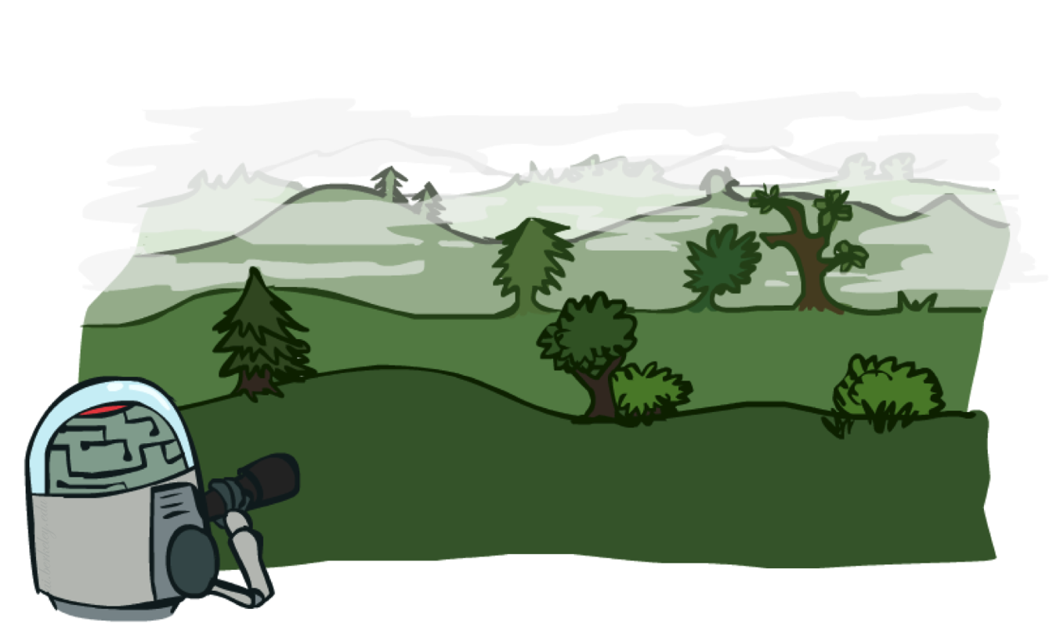
Search

Slide 19
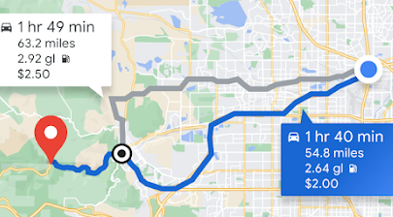
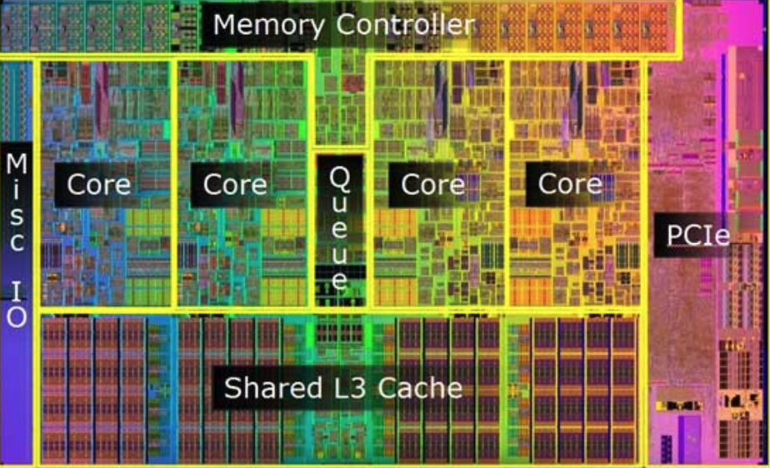

Search: It’s Not Just For Mazes™

Slide 20

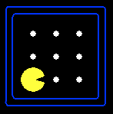





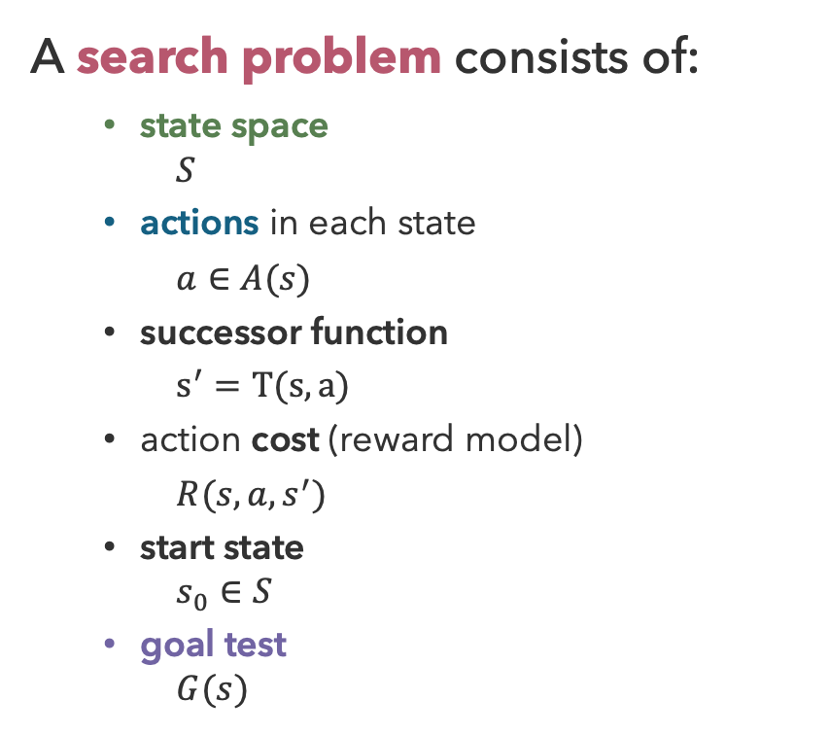
Search Problems
A search problem consists of:
  state space
    $$S$$
  actions in each state
  $a∈A(s)$
  successor function
  $s^{′}=T(s, a)$
  action cost (reward model)
  $R(s, a, s^{′})$
  start state
    $$s_{0}∈S$$
  goal test
    $$G(s)$$
N
+1
E
+1
G( ) = false
G( ) = true

Slide 21
Search Problems Solutions
A search problem consists of:
  state space
    $$S$$
  actions in each state
  $a∈A(s)$
  successor function
  $s^{′}=T(s, a)$
  action cost (reward model)
  $R(s, a, s^{′})$
  start state
    $$s_{0}∈S$$
  goal test
    $$G(s)$$
A solution to a search problem is a sequence of actions that reaches a goal state
An optimal solution has the least cost among all solutions

Slide 22
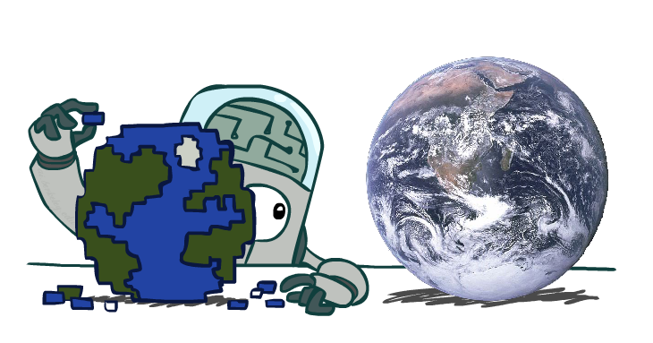
Search Problems are Models

Slide 23
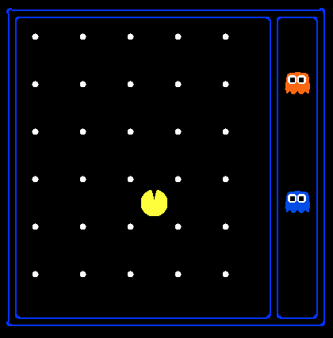
State Space
world state size = 120 (2³⁰) (12²) 4
The world state includes every detail of the environment
The search state space tracks only the details needed for planning
Pathing
Eat All Dots
states: (x, y) location n = 120
actions: NSEW n = 4
successor: location update
goal test: (x, y) = END
states: {(x, y), dot booleans} n = ?
actions: NSEW n = 4
successor: location, dot update
goal test: dots all false
search space size = 120
search space size = 120 (2³⁰)

Slide 24
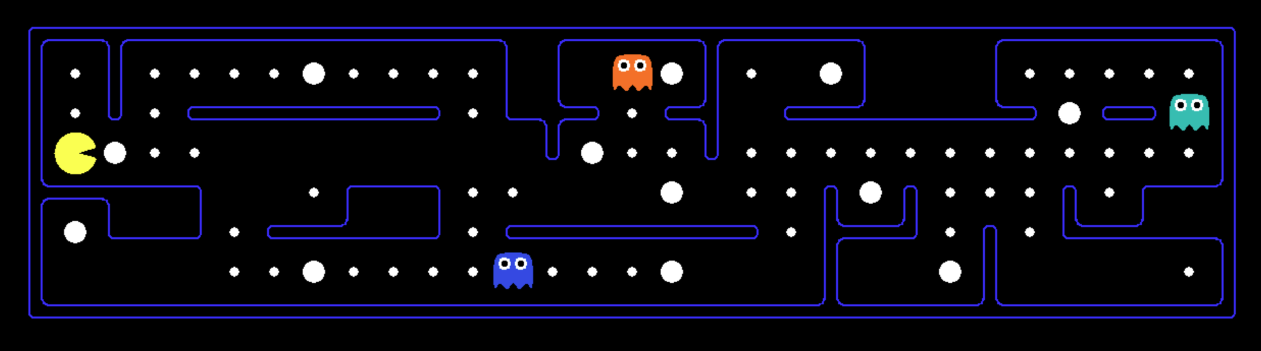
Scared Ghosts
Problem: Eat all dots while keeping the ghosts constantly scared
requires knowing Pacman position, dot booleans, power pellet Booleans, remaining scared time

Slide 25
Questions (3)

Slide 26
that’s it for today!
What’s hard about modeling the world?
Agents and Agent Types
Rational Behavior
Environments and State Spaces
Uninformed Search Algorithms
Search with Heuristics
Check Ed, Gradescope access
Complete Practice Problem 2
Do Project 0 (recommended!)

