Slide 1
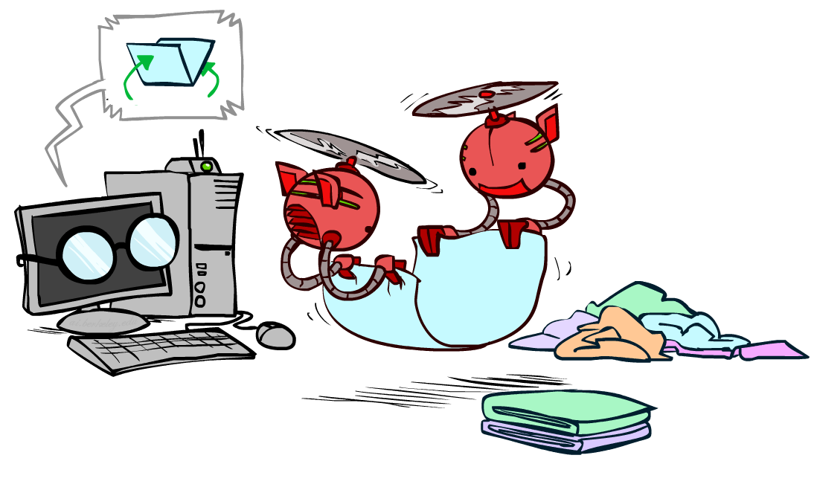
Deep Learning
CSE 473: Introduction to Artificial Intelligence
James Weichert (jpw@cs)
cs.uw.edu/473
acknowledgements
Welcome!
What’s a deep thought you had recently?
sli.do #cse473

Slide 2

Administrivia
Test 2 released
Project 4 due tomorrow (8.13)
Homework 4 due next week (8.20)
  No late period — HW4 must be turned in by 8.21

Slide 3











Neural Network Learning
Compute the effect of a weight $w$ on the loss function (i.e. $\frac{∂ℒ}{∂w}$) by propagating the error backwards through the network, combining with chain rule
$$\frac{∂}{∂W^{\left(l\right)}}ℒ\left(\vec{x},y\right)=\frac{∂ℒ}{∂{\vec{z}}^{(l)}}⋅\frac{∂{\vec{z}}^{\left(l\right)}}{∂W^{\left(l\right)}}=\frac{∂ℒ}{∂{\vec{z}}^{\left(l\right)}}⋅{({\vec{a}}^{(l−1)})}^{⊤}$$
$$\frac{∂}{∂A}A\vec{x}={\vec{x}}^{⊤}$$
$$a_{1}^{(l−1)}$$
$$a_{1}^{(l+1)}$$
$$a_{1}^{(l)}$$
$$a_{2}^{(l−1)}$$
$$a_{2}^{(l+1)}$$
$$\hat{y}$$
$$a_{m}^{(l)}$$
$$a_{n}^{(l−1)}$$
$$a_{k}^{(l+1)}$$

Slide 4
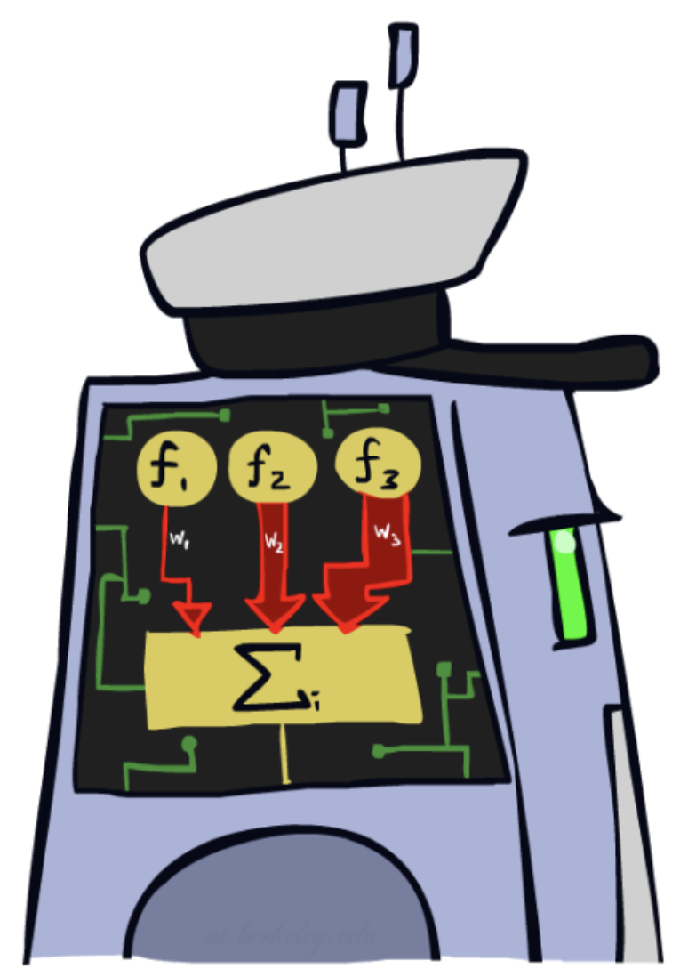
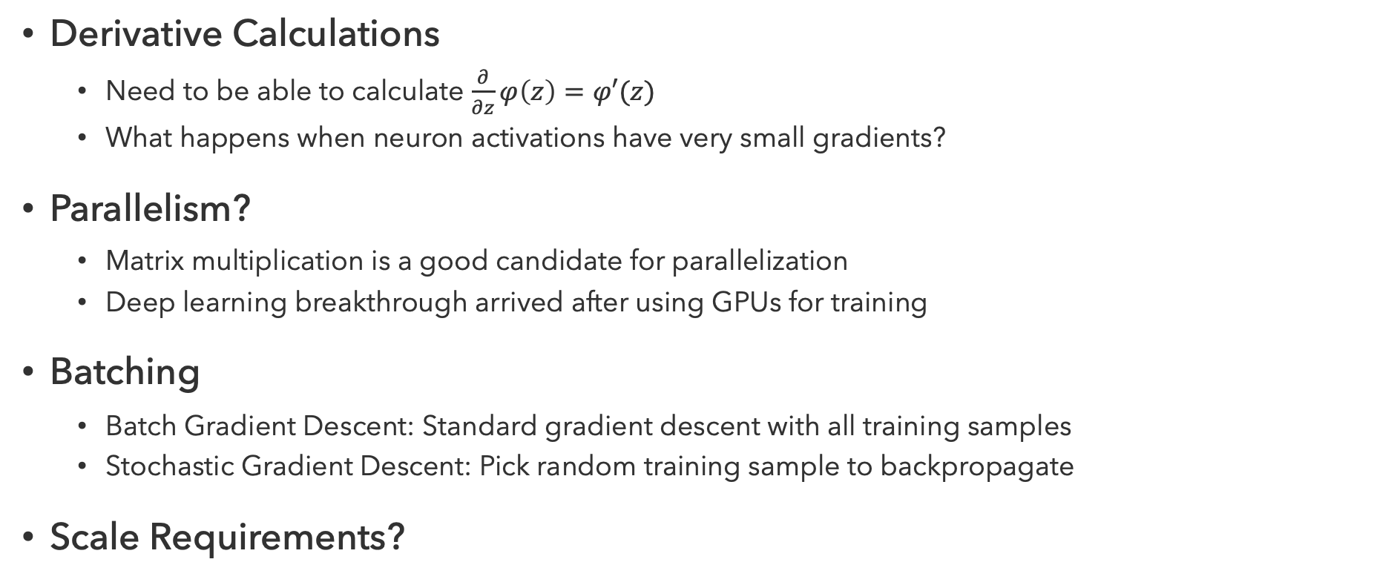
Practical Considerations
Derivative Calculations
  Need to be able to calculate $\frac{∂}{∂z}φ\left(z\right)=φ′(z)$
  What happens when neuron activations have very small gradients?
Parallelism?
  Matrix multiplication is a good candidate for parallelization
  Deep learning breakthrough arrived after using GPUs for training
Batching
  Batch Gradient Descent: Standard gradient descent with all training samples
  Stochastic Gradient Descent: Pick random training sample to backpropagate
Scale Requirements?

Slide 5
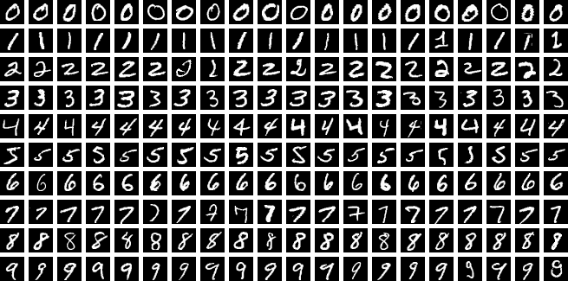
MLP Performance
How do these models compare?
Model | Test Acc. | Train Time | Test Time
Logistic Reg. | 92.55% | 176.6s | 0.01s
SVM (RBF) | 96.85% | 2.9s | 7.74s
Decision Tree | 87.58% | 8.2s | 0.01s
kNN (k=5) | 96.88% | 0.1s | 3.58s
MLP | 97.92% | 45.9s | 0.06s
One-shot benchmark using standard sklearn implementations (no hyperparameter tuning). Python notebook generated by Claude Code.
Benchmark experiment Inspired by Michael Nielsen

Slide 6
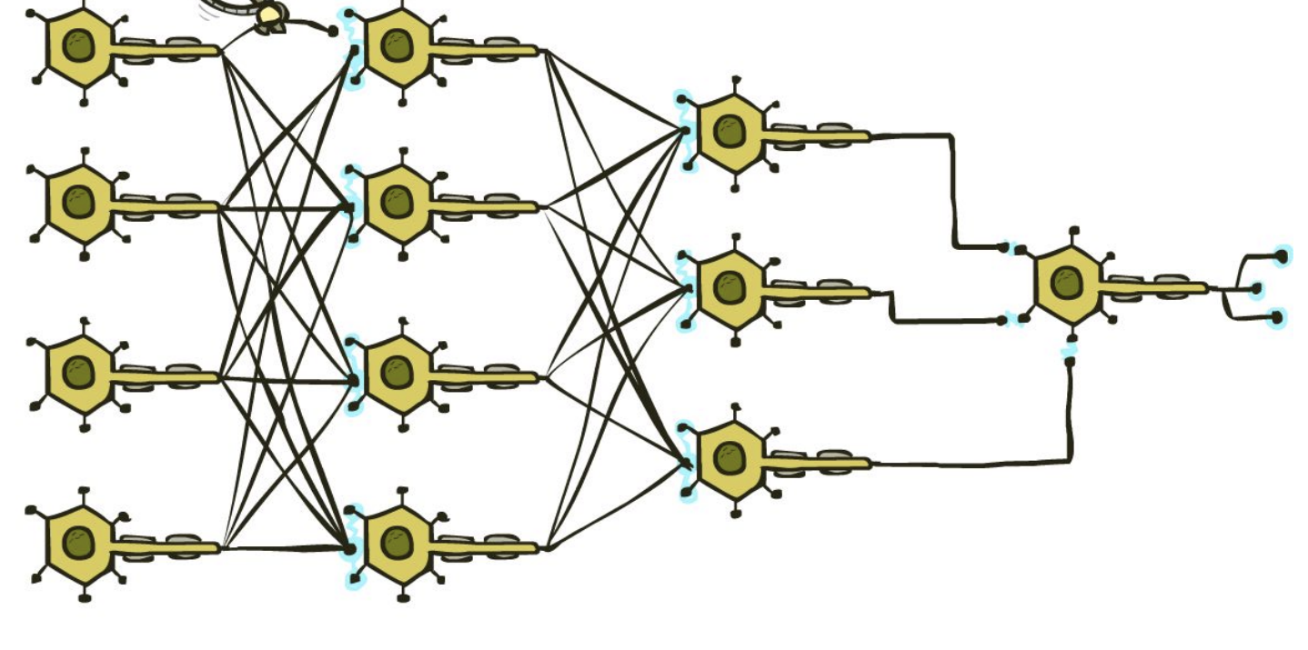
Deep Networks

Slide 7
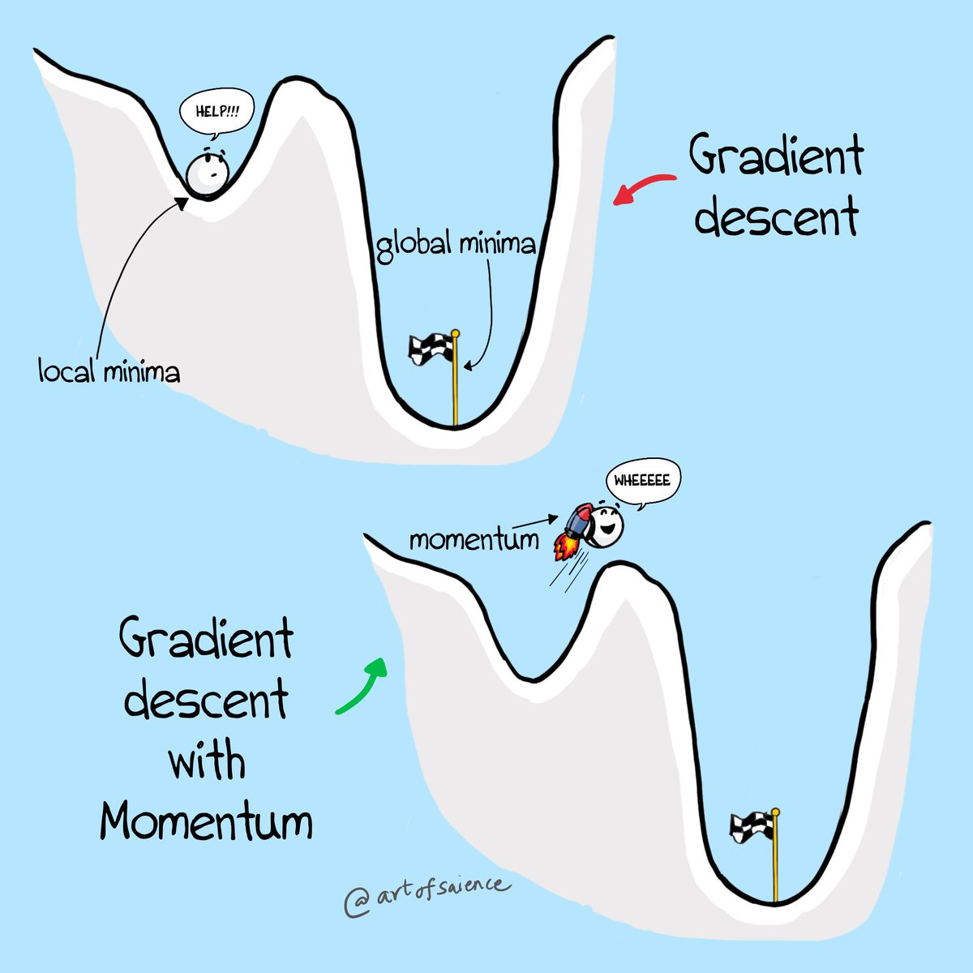
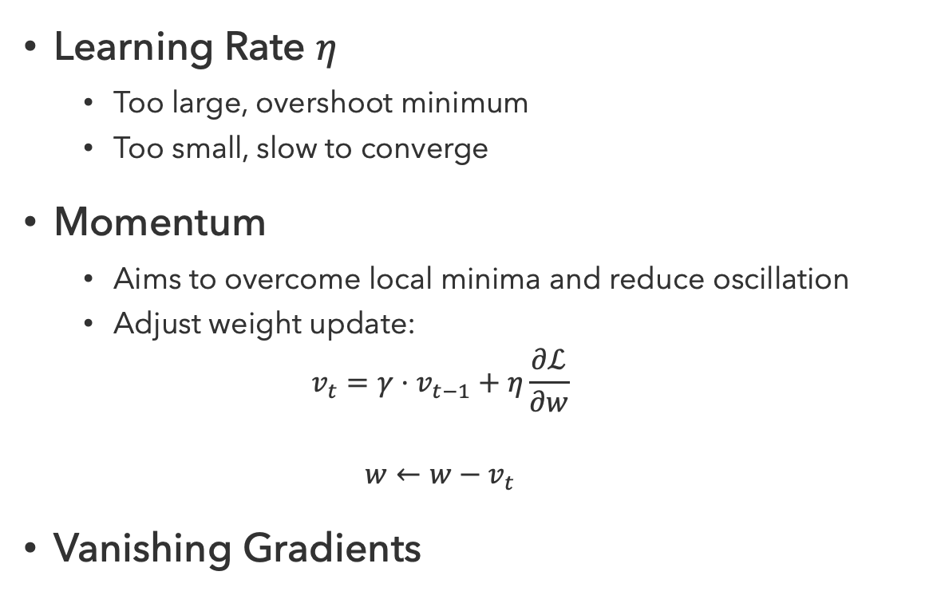
Deep Network Training in Practice
Learning Rate $η$
  Too large, overshoot minimum
  Too small, slow to converge
Momentum
  Aims to overcome local minima and reduce oscillation
  Adjust weight update:
  $$v_{t}=γ⋅v_{t−1}+η\frac{∂ℒ}{∂w}$$
  $$w←w−v_{t}$$
Vanishing Gradients

Slide 8
Questions (1)

Slide 9

Computer Vision

Slide 10
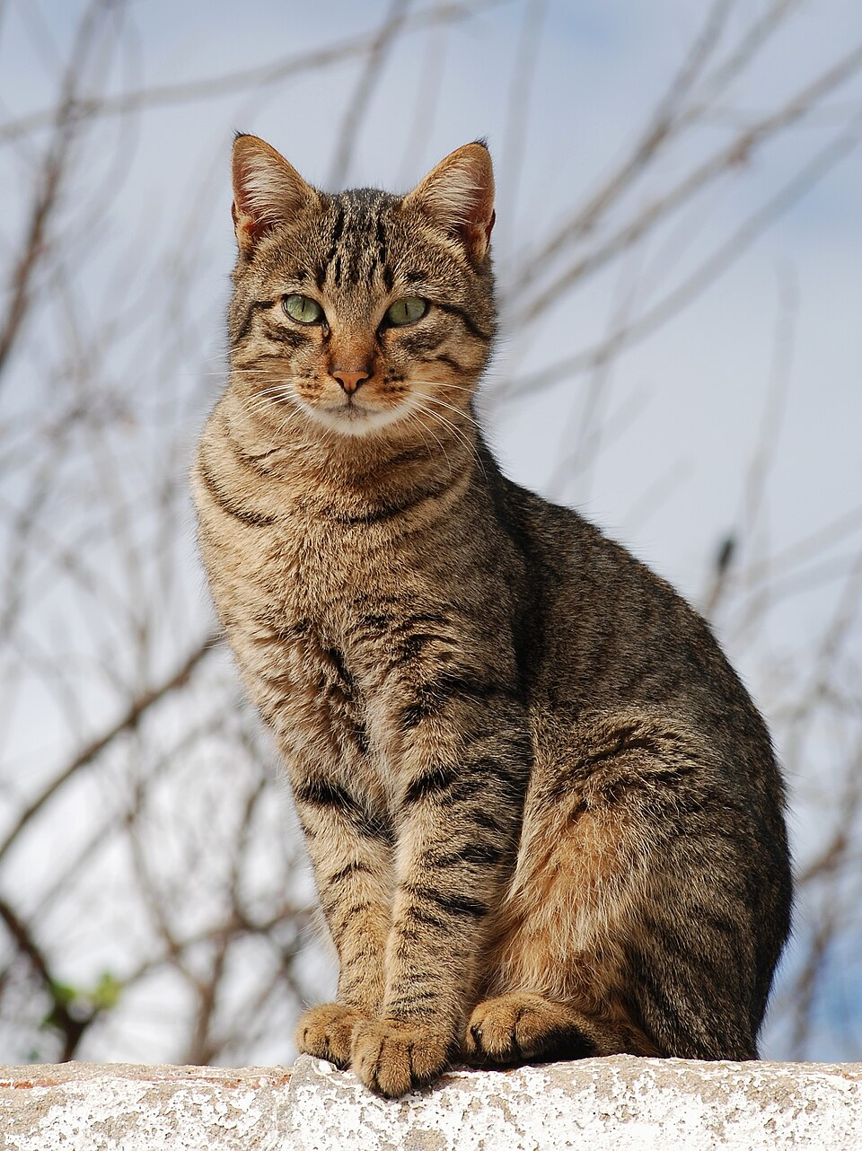
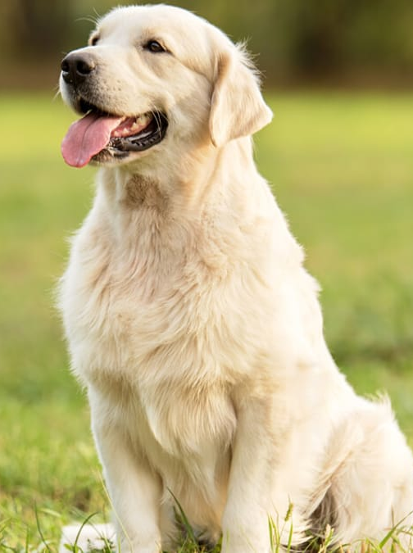
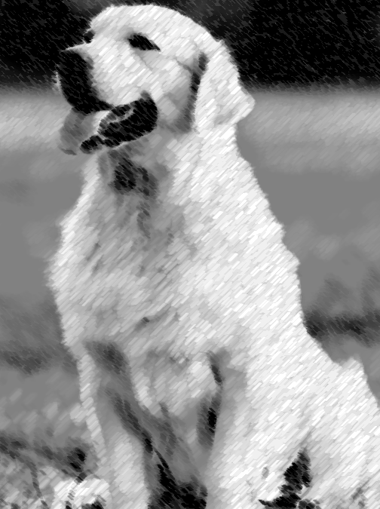
Cat or Dog?

Slide 11
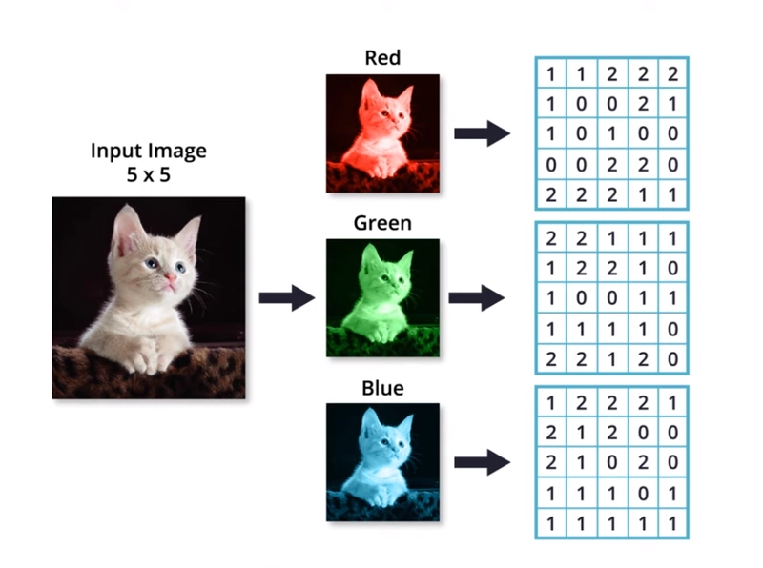
Images
Images are extremely high-dimensional data
  Each pixel represents a part of the input
  For greyscale images, pixels encode brightness values for each x, y position
  For color (RGB) images, there are three input values per pixel representing each color channel
A 4032 x 3024 pixel smartphone photo has 36.5m input values
Goal: Leverage structure of images to reduce complexity

Slide 12
Image Features

Slide 13
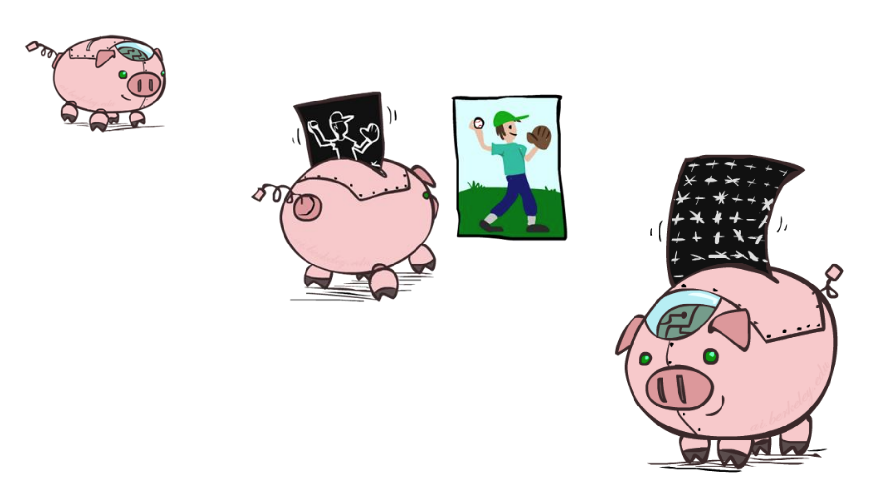
Manual Feature Engineering Is Hard…

Slide 14
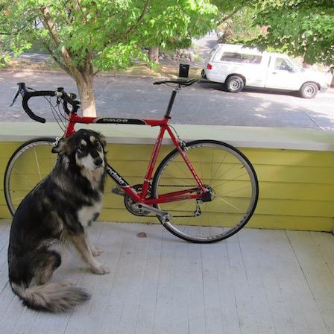
Image Transformation

Slide 15
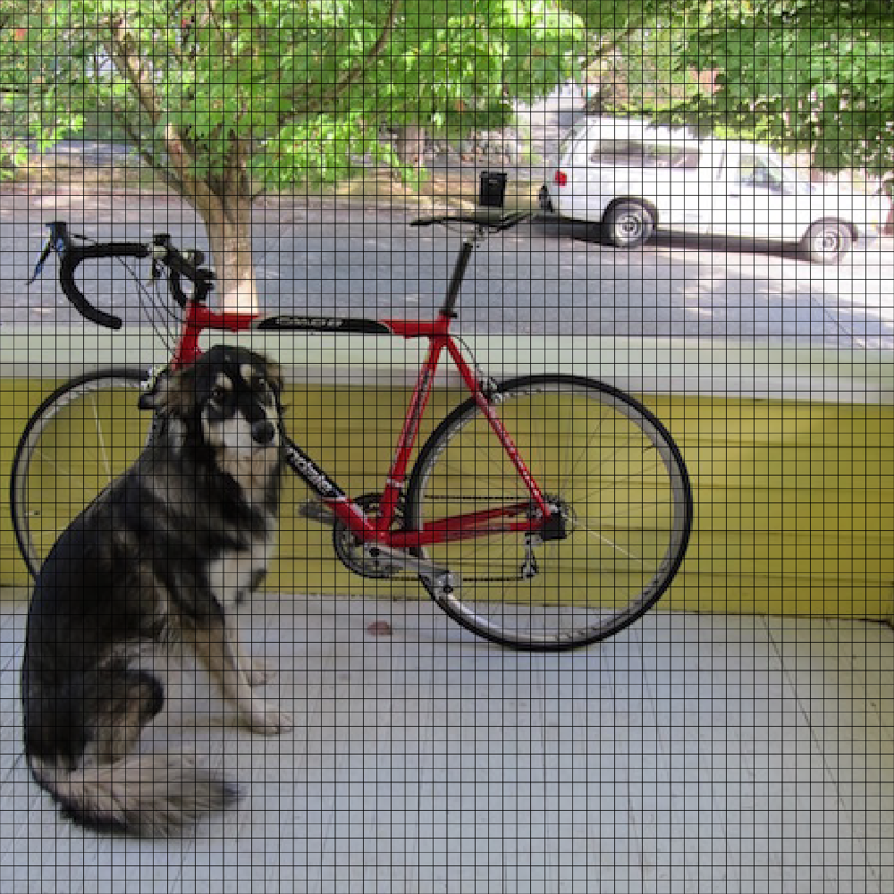

Downsampling

Slide 16
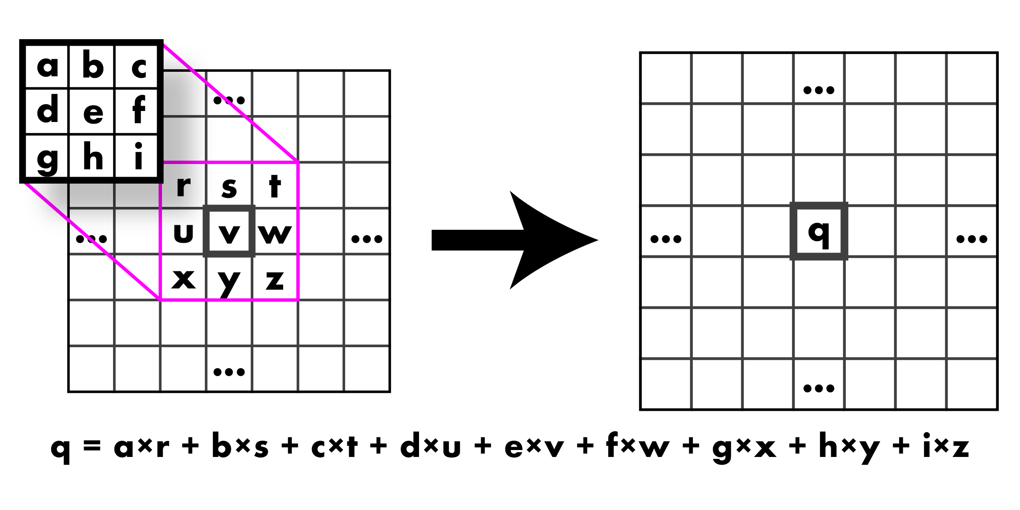
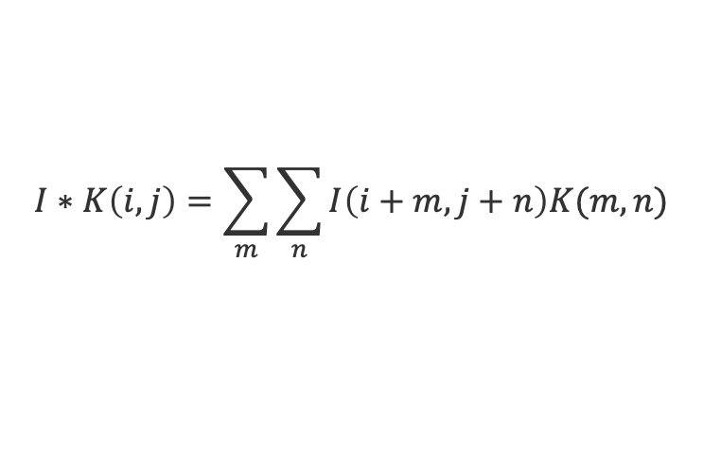
Convolution
In computer vision, a convolution is an image transformation operation that involves sliding a small kernel (filter) over the image
$$I∗K\left(i,j\right)=\sum_{m}{\sum_{n}{I\left(i+m,j+n\right)K(m,n)}}$$

Slide 17
Questions (2)

Slide 18
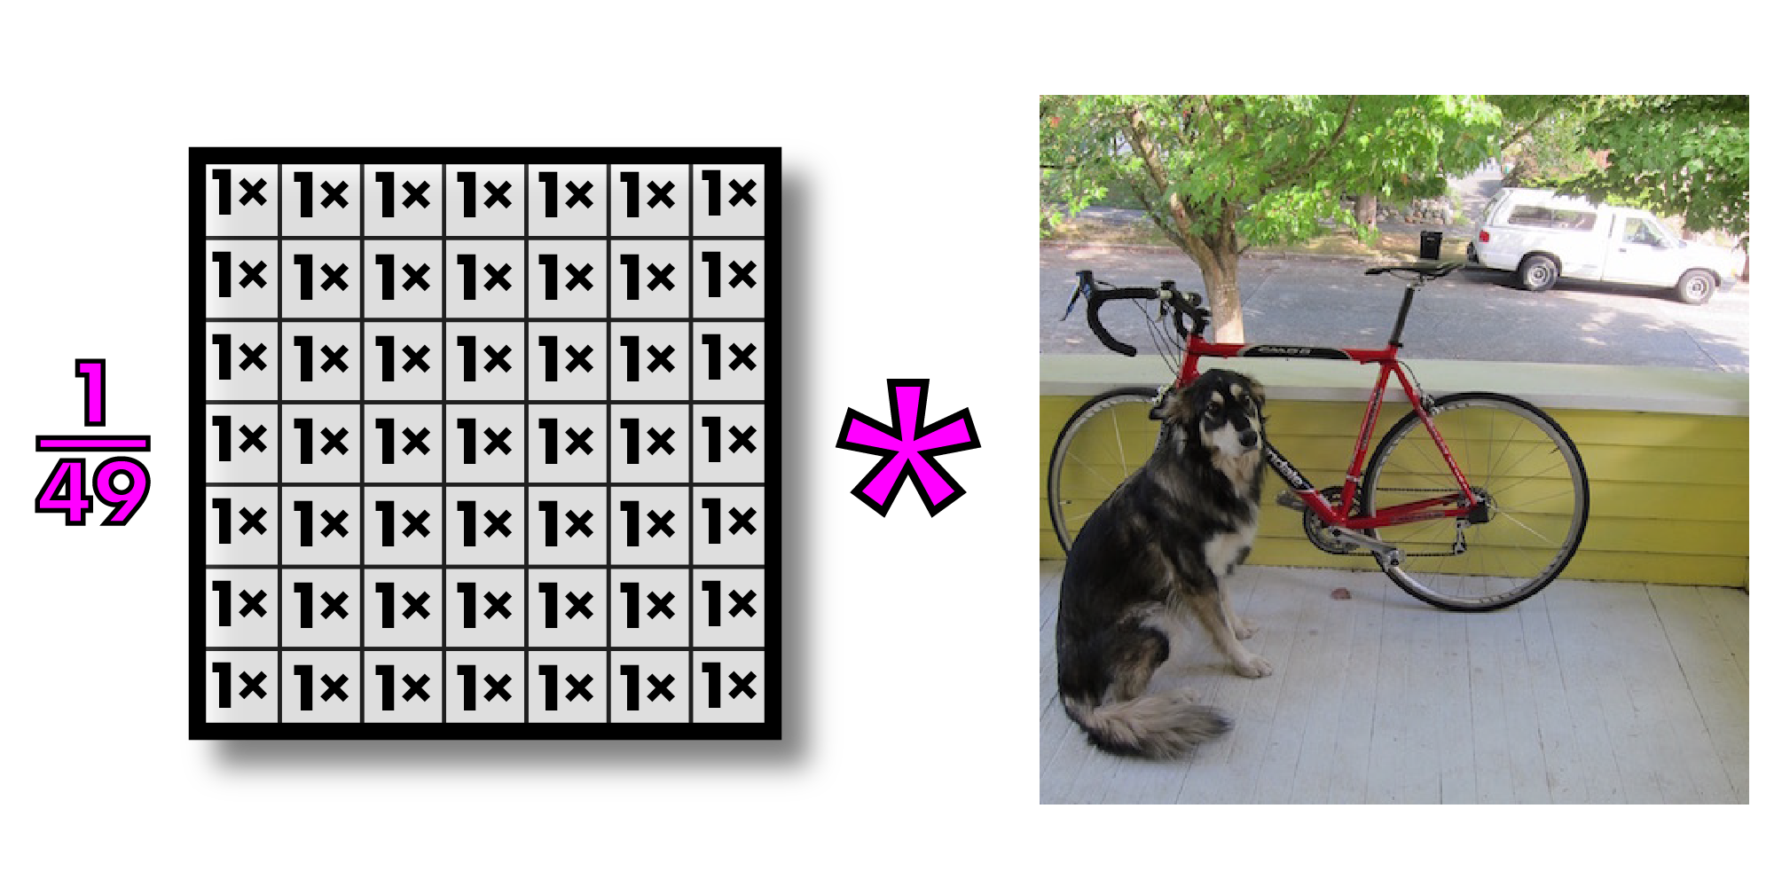

Blurry Image

Slide 19
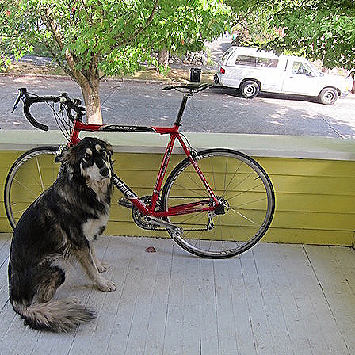
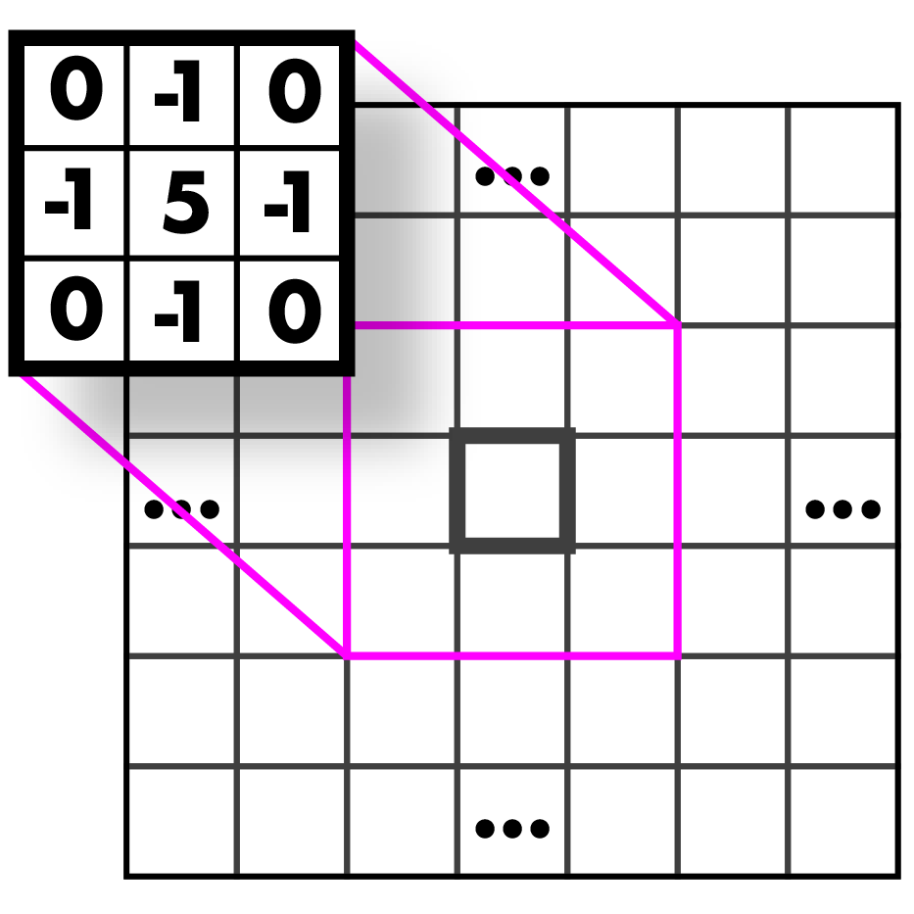
Mystery Kernel
Amplify current pixel, add opposite of adjacent pixels
Sharpen

Slide 20
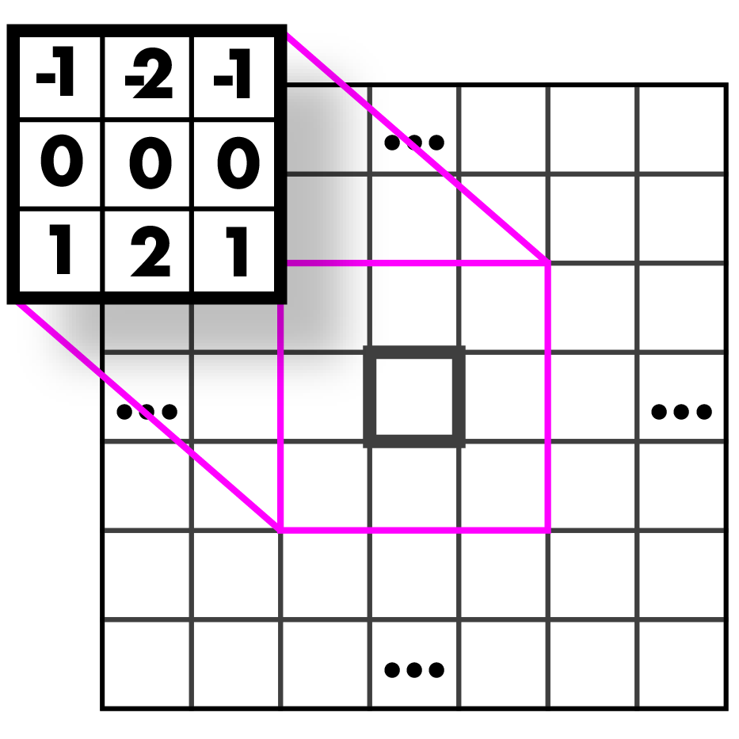
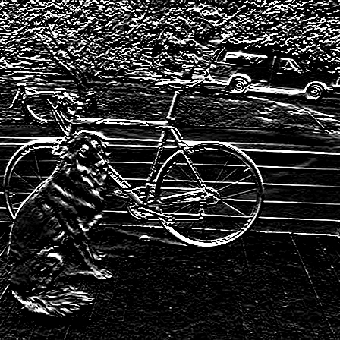
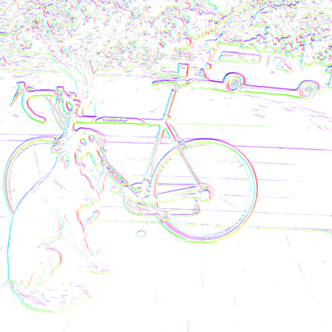

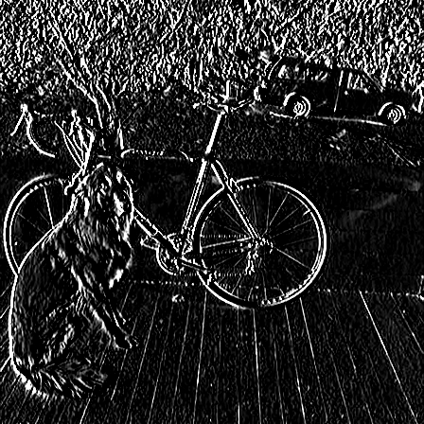
Abstracting Images
Sobel Kernels

Slide 21
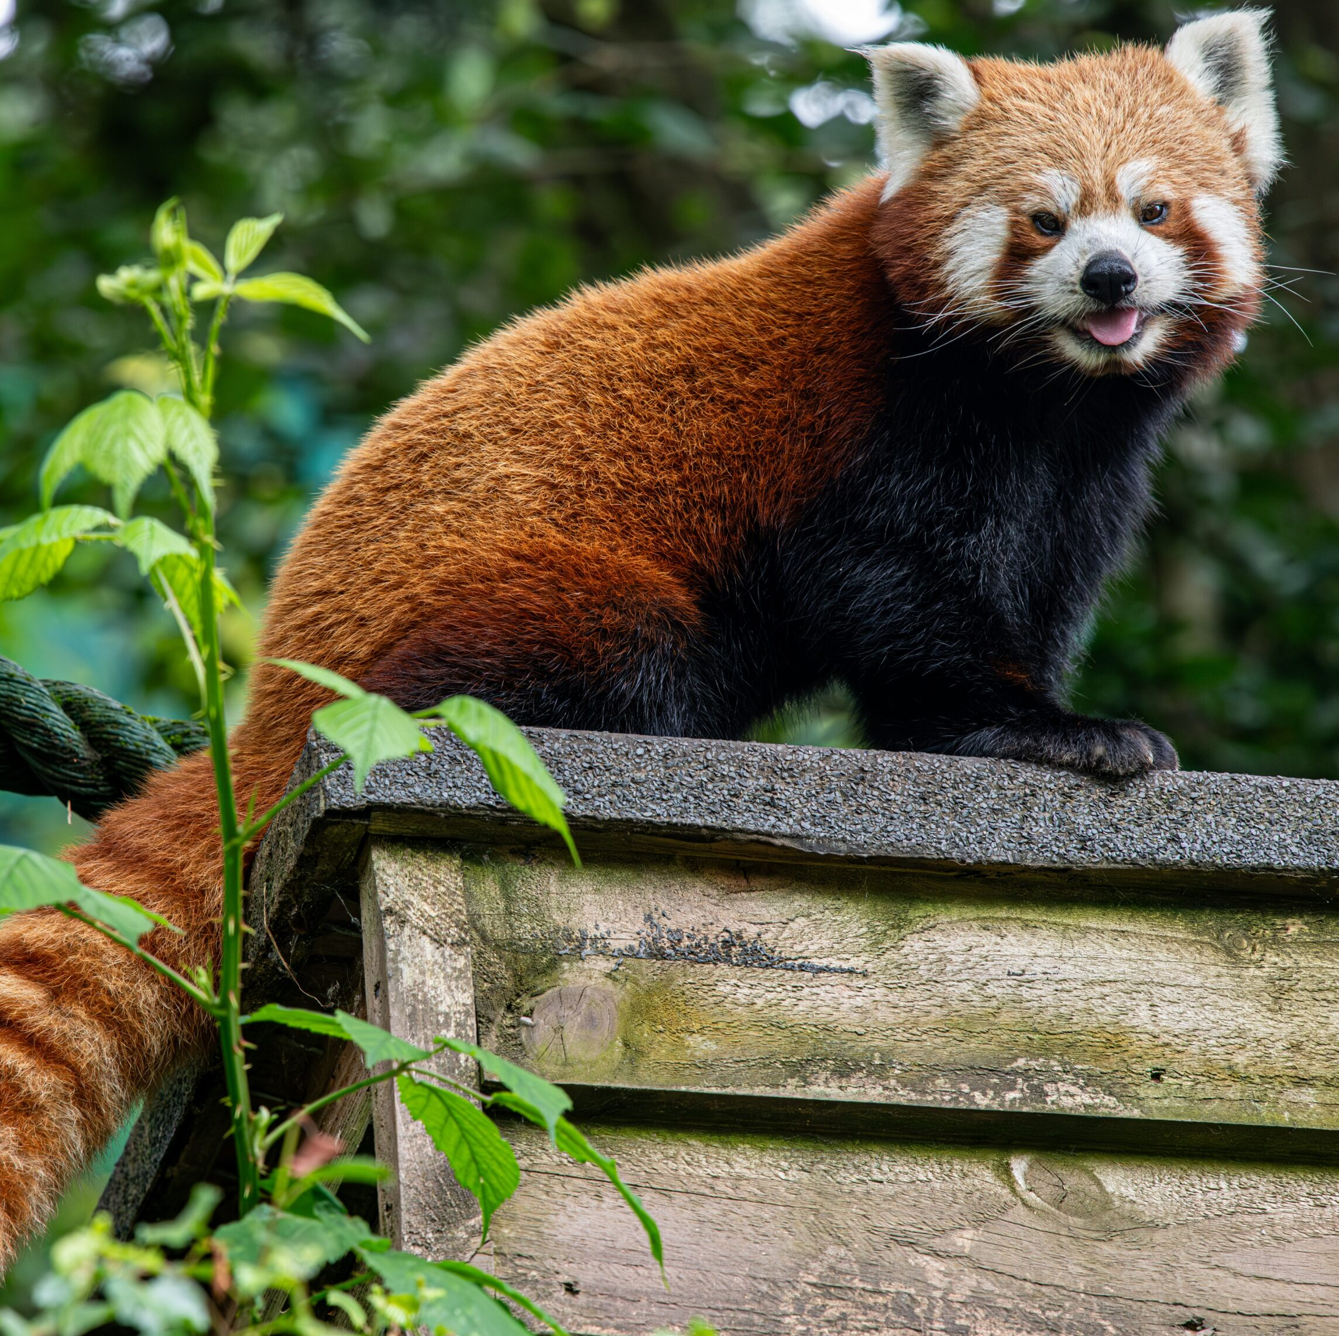
Convolutional Neural Networks
Input
Convolutional Layers
Fully Connected Layers
Pooling
Pooling
Giant Panda
Red Panda
Convolution + Nonlinearity
Convolution + Nonlinearity
Convolution + Nonlinearity
Feature Extraction
Classification

Slide 22
Pooling
Pooling downsizes the input by aggregating values in each region
12 | 20 | 30 | 0
8 | 12 | 2 | 0
34 | 70 | 37 | 4
112 | 100 | 25 | 12
20 | 30
112 | 37
13 | 8
79 | 20
Max Pooling
Average Pooling

Slide 23
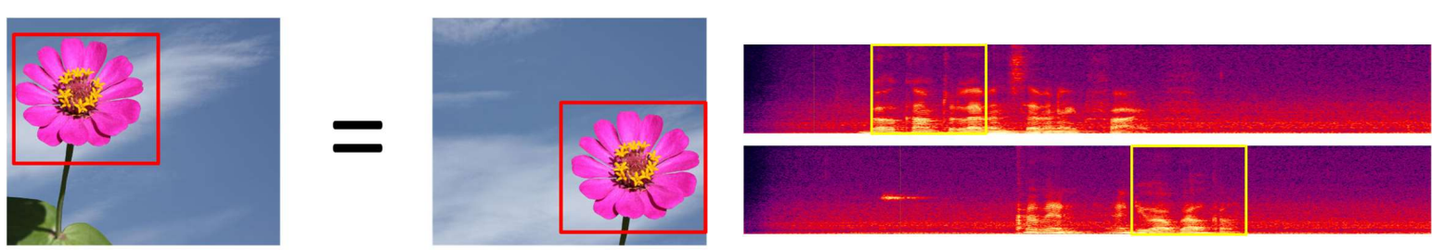
Shift Invariance

Slide 24
AlexNet
“ImageNet Classification with Deep Convolutional Neural Networks” by Krizhevsky, Sutskever, and Hinton (2012) kickstarted a deep learning revolution
Data
Large Model
GPU Training
Deep Learning
+
+
=

Slide 25
CNN Performance
How do these models compare?
Model | Test Acc. | Train Time | Test Time
Logistic Reg. | 92.55% | 176.6s | 0.01s
SVM (RBF) | 96.85% | 2.9s | 7.74s
Decision Tree | 87.58% | 8.2s | 0.01s
kNN (k=5) | 96.88% | 0.1s | 3.58s
MLP | 97.92% | 45.9s | 0.06s
CNN | 98.95% | 31.0s | 0.42s
One-shot CNN benchmark using PyTorch implementation (no hyperparameter tuning). Python notebook generated by Claude Code.
Benchmark experiment Inspired by Michael Nielsen

Slide 26
Questions (3)

Slide 27
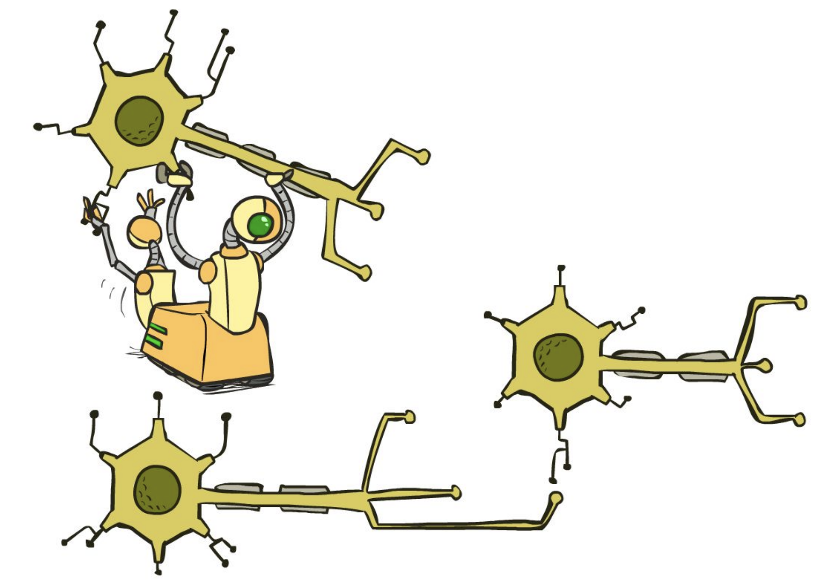
Recurrent Networks

Slide 28














Dependent Sequences
Prediction at time $t$ depends on prediction at time $t−1$, etc.
Time series data, moving images, language
$$y_{1}$$
$$y_{2}$$
$$y_{3}$$
$$y_{t}$$
$$h_{0}$$
$$h_{1}$$
$$h_{2}$$
$$h_{3}$$
$$h_{t}$$
$$x_{1}$$
$$x_{2}$$
$$x_{3}$$
$$x_{t}$$

Slide 29






Recurrent Neural Networks
Recurrent Neural Networks include backwards (recurrent) connections
$$x_{1}$$
$$x_{2}$$
$$x_{3}$$
$$\hat{y}$$
$$x_{4}$$
$$x_{n}$$

Slide 30














Long Short Term Memory (LSTM)
$$h_{t}$$
Forget Gate
$$c_{t−1}$$
$$×$$
$$+$$
$$c_{t}$$
$$×$$
$$tanh$$
$$×$$
$$σ$$
$$σ$$
$$tanh$$
$$σ$$
$$h_{t−1}$$
$$h_{t}$$
$$X_{t}$$
Input Gate
Output Gate

Slide 31
Questions (4)

Slide 32
that’s it for today!
CNNs learn convolutional kernels to extract local features from images to use in fully connected layers
Recurrent networks use previous outputs to influence subsequent predictions
Language is complex, requiring flexible ’focus’
Natural Language Processing
Large Language Models
Complete Practice Problem 19
Do Project 4 (due 8.13)
Do Homework 4 (due 8.20)

