Slide 1
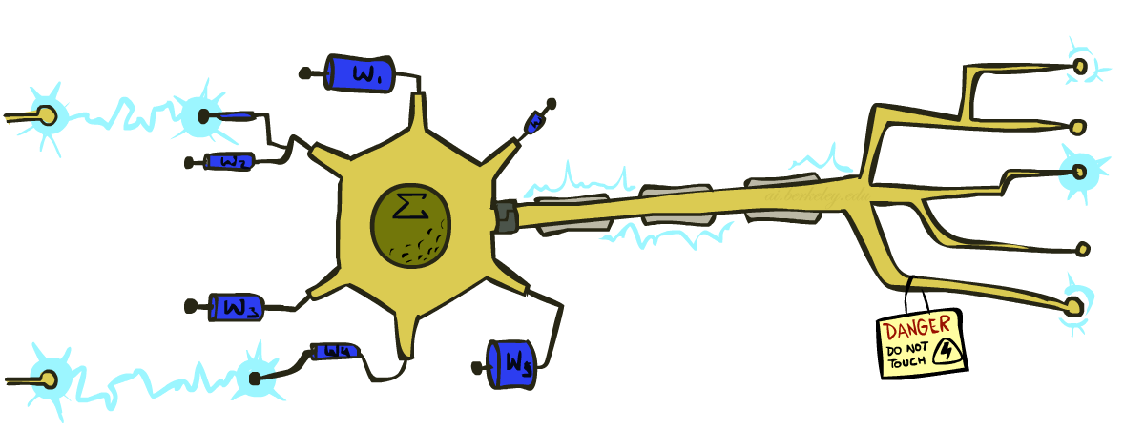
Neural Networks
CSE 473: Introduction to Artificial Intelligence
James Weichert (jpw@cs)
cs.uw.edu/473
acknowledgements
Welcome!
What’s your favorite summertime activity?
sli.do #cse473

Slide 2

Administrivia
Test 2 scores will be released this afternoon
Project 4 due this Thursday (8.13)
Homework 4 due next week (8.20)
  No late period — HW4 must be turned in by 8.21

Slide 3
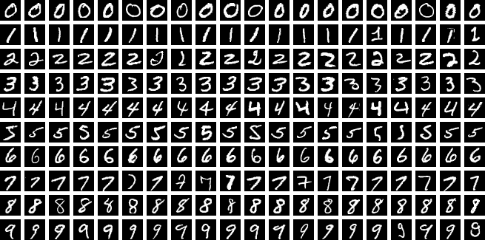
Taking Stock
How do these models compare?
Model | Test Acc. | Train Time | Test Time
Logistic Reg. | 92.55% | 176.6s | 0.01s
SVM (RBF) | 96.85% | 2.9s | 7.74s
Decision Tree | 87.58% | 8.2s | 0.01s
kNN (k=5) | 96.88% | 0.1s | 3.58s
Neural Net. | ? | ? | ?
One-shot benchmark using standard sklearn implementations (no hyperparameter tuning). Python notebook generated by Claude Code.
Benchmark experiment Inspired by Michael Nielsen

Slide 4
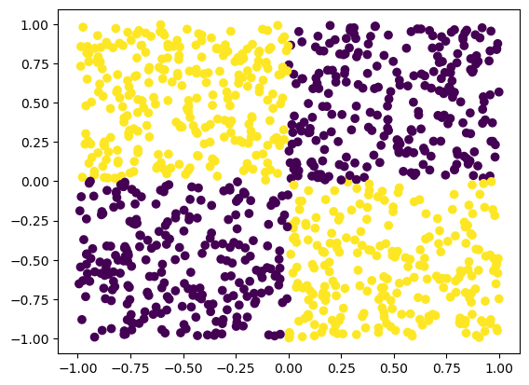

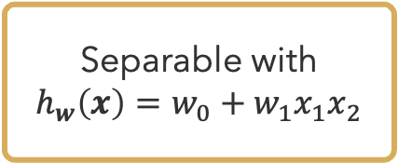
Motivation
Separable with $h_{w}\left(x\right)=w_{0}+w_{1}x_{1}x_{2}$
Shouldn’t the model do the feature engineering?
$$XOR$$

Slide 5


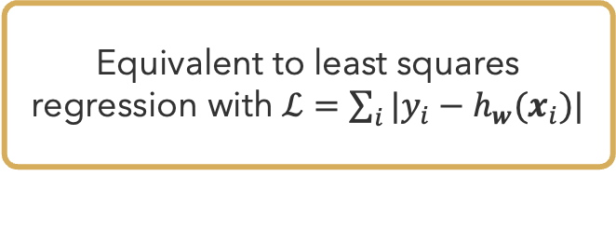
Recap: Perceptrons
Perceptrons output $h_{w}\left(x\right)=w∙x$
Repeat while not converged ($∃i y_{i}≠h_{w}(x_{i})$):
For each data point $i$ do:
  $w←w−η(y_{i}−h_{w}(x_{i}))x_{i}$
Gradient
Equivalent to least squares regression with $ℒ=\sum_{i}{|y_{i}−h_{w}(x_{i})|}$

Slide 6
How does the human brain learn?

Slide 7












Generalizing the Perceptron
Neuron
Nonlinearity
Weights
Bias/Threshold
$$x_{1}$$
$$w_{1}$$
$$w_{0}$$
$$w_{2}$$
$$Σ$$
$$z={\vec{w}}^{⊤}\vec{x}$$
$$φ$$
$$a=φ(z)$$
$$x_{2}$$
$$⋮$$
Transfer Function
Activation Function
$$x_{n}$$
$$w_{n}$$
Linear Perceptron
Inputs

Slide 8


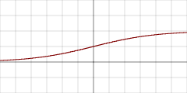
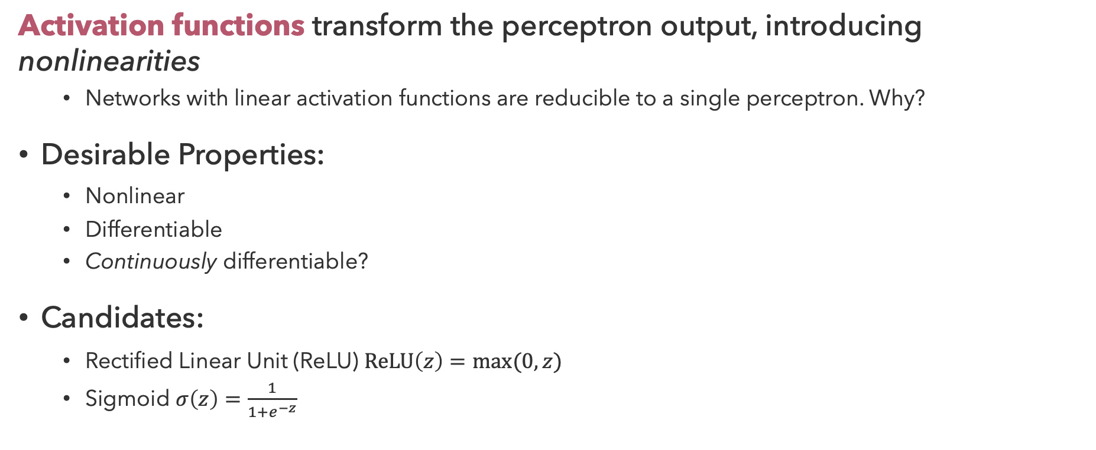
Activation Functions
Activation functions transform the perceptron output, introducing nonlinearities
  Networks with linear activation functions are reducible to a single perceptron. Why?
Desirable Properties:
  Nonlinear
  Differentiable
  Continuously differentiable?
Candidates:
  Rectified Linear Unit (ReLU) $ReLU\left(z\right)=max⁡(0, z)$
  Sigmoid $σ\left(z\right)=\frac{1}{1+e^{−z}}$

Slide 9
Questions (1)

Slide 10
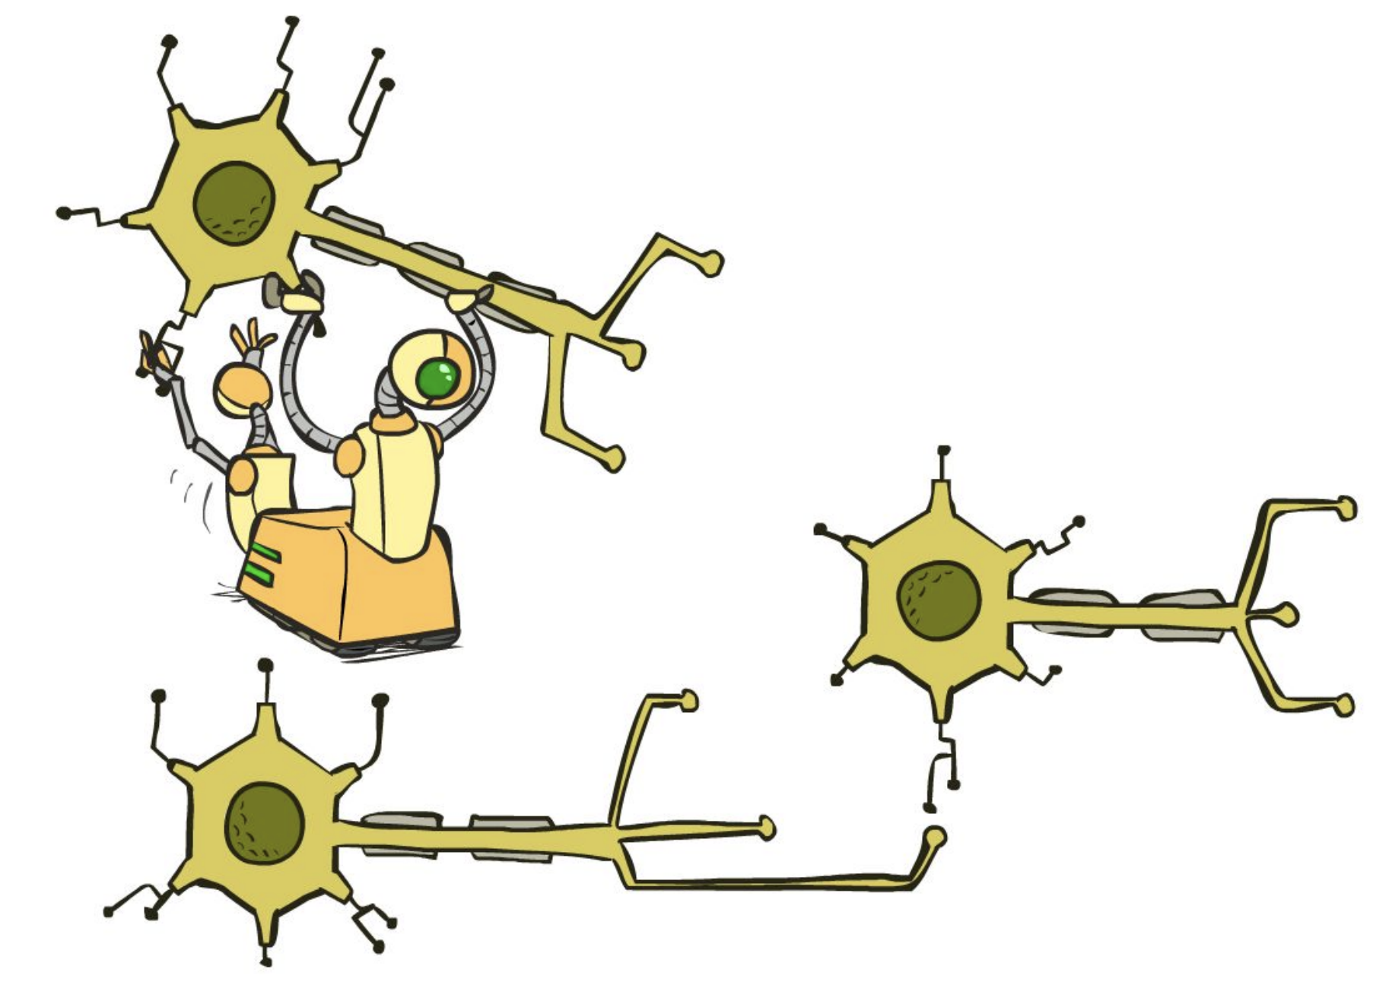







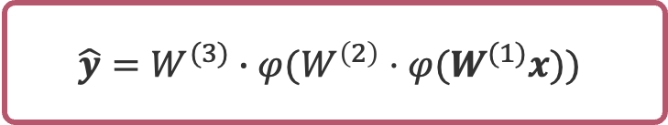









Multilayer Perceptron
$$\hat{y}=W^{(3)}∙φ(W^{\left(2\right)}⋅φ(W^{(1)}x))$$
Input Layer
Hidden Layers
Output Layer
$$x_{1}$$
$$a_{1}^{(1)}$$
$$x_{2}$$
$$a_{1}^{(2)}$$
$$a_{2}^{(1)}$$
$$x_{3}$$
$$a_{2}^{(2)}$$
$$\hat{y}$$
$$a_{3}^{(1)}$$
$$x_{4}$$
$$a_{k}^{(2)}$$
$$a_{m}^{(1)}$$
$$x_{n}$$
$$W^{(1)}∈ℝ^{m×n}$$
$$W^{(2)}∈ℝ^{k×m}$$
$$W^{(3)}∈ℝ^{1×k}$$

Slide 11

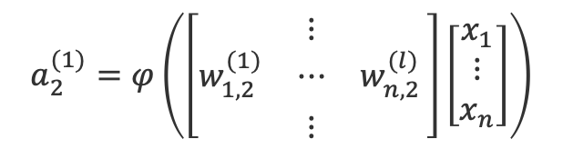




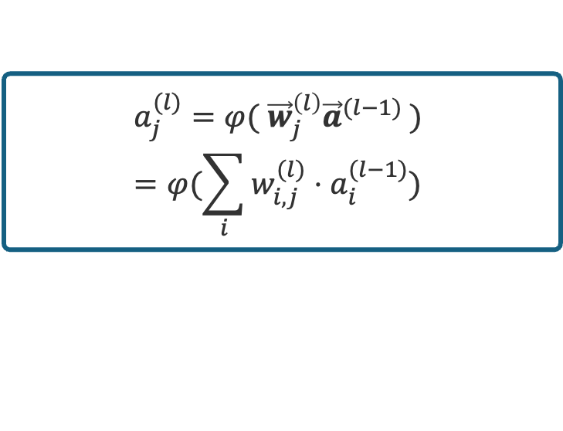

Forward Propagation
$$\hat{y}=W^{(3)}∙φ(W^{\left(2\right)}⋅φ(W^{(1)}x))$$
Input Layer
Hidden Layers
Output Layer
$$x_{1}$$
$$w_{1,2}^{(1)}$$
$$a_{1}^{(1)}$$
$$a_{2}^{(1)}=φ\left(\left[\begin{matrix} & ⋮ & \\ w_{1,2}^{(1)} & ⋯ & w_{n,2 }^{(l)} \\ & ⋮ & \end{matrix}\right]\left[\begin{matrix}x_{1} \\ ⋮ \\ x_{n}\end{matrix}\right]\right)$$
$$x_{2}$$
$$w_{2,2}^{(1)}$$
$$a_{1}^{(2)}$$
$$w_{3,2}^{(1)}$$
$$a_{2}^{(1)}$$
$$x_{3}$$
$$a_{2}^{(2)}$$
$$\hat{y}$$
$$a_{2}^{(1)}=φ( {\vec{w}}_{2}^{\left(1\right)}\vec{x} )=φ(\sum_{i}{w_{i, 2}^{(1)}⋅x_{i}})$$
$$w_{4,2}^{(1)}$$
$$a_{3}^{(1)}$$
$$x_{4}$$
$$a_{k}^{(2)}$$
$$w_{n,2}^{(1)}$$
$$a_{j}^{(l)}=φ( {\vec{w}}_{j}^{\left(l\right)}{\vec{a}}^{(l−1)} )=φ(\sum_{i}{w_{i, j}^{(l)}⋅a_{i}^{(l−1)}})$$
$$a_{m}^{(1)}$$
$$x_{n}$$
$$W^{(1)}∈ℝ^{m×n}$$
$$W^{(2)}∈ℝ^{k×m}$$
$$W^{(3)}∈ℝ^{1×k}$$

Slide 12






Classifier Output
$$\hat{y}={argmax}_{c}{ \hat{y}}_{c}$$
Input Layer
Hidden Layers
Output Layer
$$x_{1}$$
$$a_{1}^{(1)}$$
$$x_{2}$$
${\hat{y}}_{1},…,{\hat{y}}_{c}$ are called logits
Normalize by sum?
$$\frac{{\hat{y}}_{i}}{\sum_{c}{{\hat{y}}_{c}}}$$
Problem: logits can be negative…
Solution: Softmax function
$${σ(\vec{z})}_{i}=\frac{e^{z_{i}}}{\sum_{c}{e^{z_{c}}}}$$
$$a_{1}^{(2)}$$
$${\hat{y}}_{1}$$
$$a_{2}^{(1)}$$
$$x_{3}$$
$$a_{2}^{(2)}$$
$${\hat{y}}_{2}$$
$$a_{3}^{(1)}$$
$$x_{4}$$
$$a_{k}^{(2)}$$
$${\hat{y}}_{c}$$
$$a_{m}^{(1)}$$
$$x_{n}$$
$$W^{(1)}∈ℝ^{m×n}$$
$$W^{(2)}∈ℝ^{k×m}$$
$$W^{(3)}∈ℝ^{c×k}$$

Slide 13
Questions (2)

Slide 14


Learning XOR
Can we learn XOR?
$$XOR\left(x_{1},x_{2}\right)=OR(AND\left(x_{1}, NOT\left(x_{2}\right)), AND(NOT\left(x_{1}\right), x_{2}\right))$$
Need to learn:
  $AND(x_{1}, NOT\left(x_{2}\right))$
  $AND\left(NOT\left(x_{1}\right), x_{2}\right)$
  $OR(x_{1}, x_{2})$
AND
What perceptron weights $w_{0},w_{1},w_{2}$ approximate these functions?
OR
AND

Slide 15
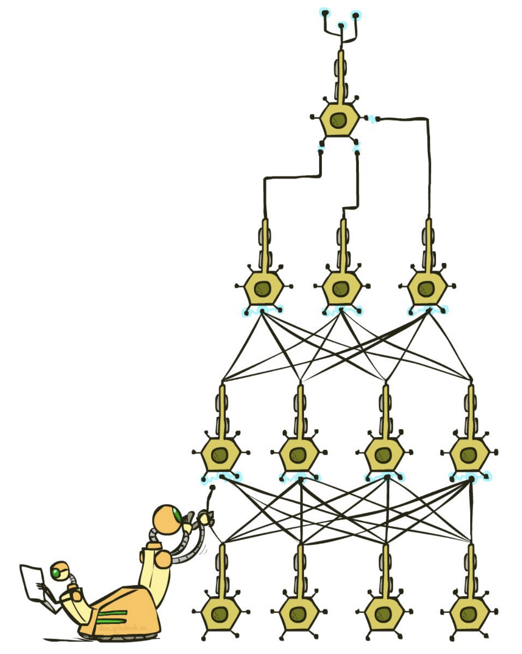
Neural Network
Neural networks consist of neurons connected by weighted edges in some architecture
Multilayer perceptrons are the classic neural networks
  MLPs are an instance of a type of NN called feed-forward networks
Hyperparameters:
  Network Structure:
    Number of hidden layers
    Hidden layer sizes
    Connections between neurons
  Activation Function
  …

Slide 16
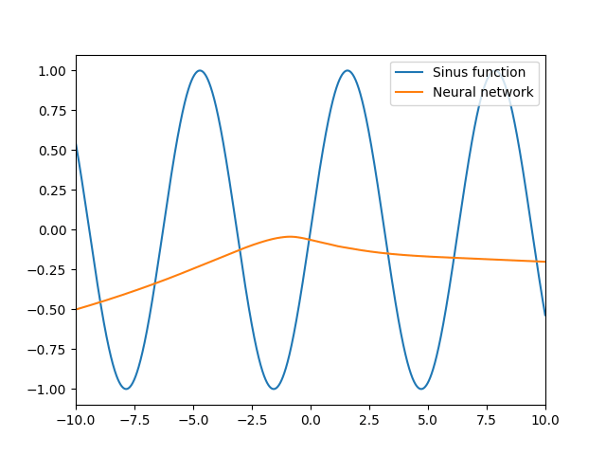
Universal Approximation Theorem
Theorem: A one-layer feed-forward neural network of sufficient width and a nonlinear activation function can model an arbitrary continuous function

Slide 17

Learning XOR: Revisited
Can we learn XOR with a shallow network??
$$XOR\left(x_{1},x_{2}\right)= ?$$
?
Yes, but no longer as a composition of functions
?
XOR
TensorFlow Playground Example
?

Slide 18
Questions (3)

Slide 19

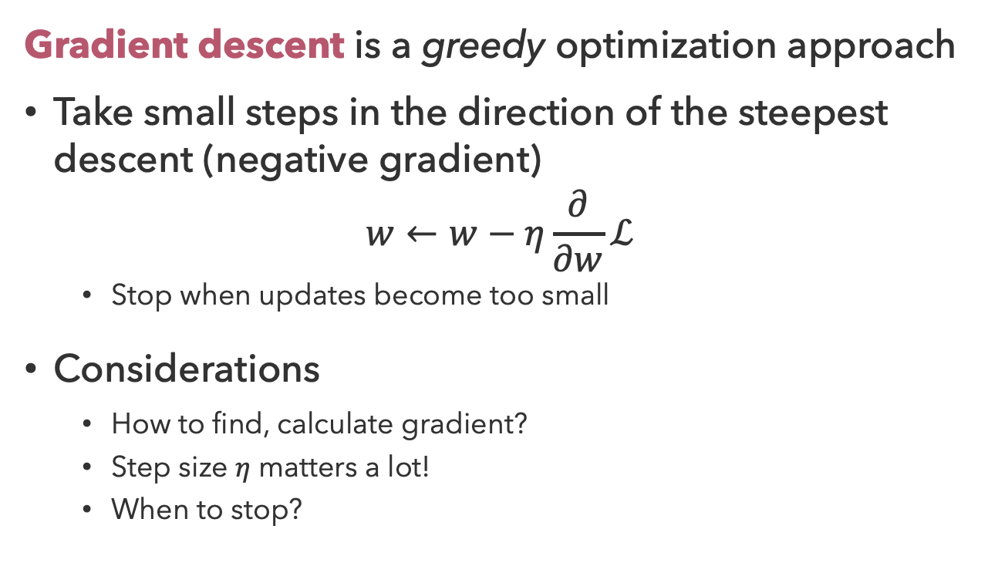
Gradient Descent
Gradient descent is a greedy optimization approach
Take small steps in the direction of the steepest descent (negative gradient)
$$w←w−η\frac{∂}{∂w}ℒ$$
  Stop when updates become too small
Considerations
  How to find, calculate gradient?
  Step size $η$ matters a lot!
  When to stop?

Slide 20
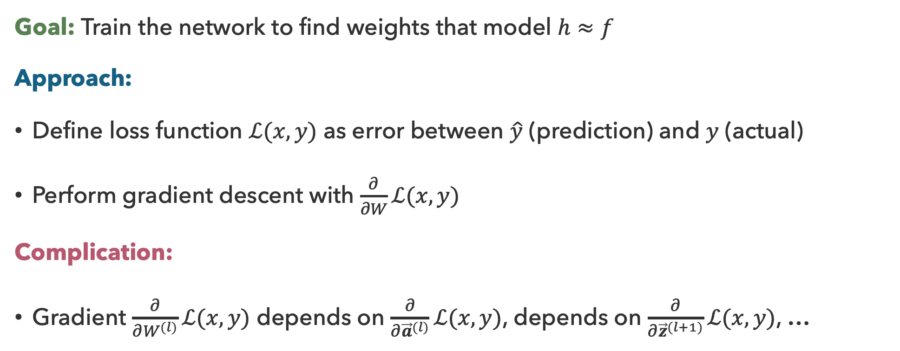
Neural Network Learning
Goal: Train the network to find weights that model $h≈f$
Approach:
Define loss function $ℒ(x,y)$ as error between $\hat{y}$ (prediction) and $y$ (actual)
Perform gradient descent with $\frac{∂}{∂W}ℒ(x,y)$
Complication:
Gradient $\frac{∂}{∂W^{(l)}}ℒ(x,y)$ depends on $\frac{∂}{∂{\vec{a}}^{(l)}}ℒ(x,y)$, depends on $\frac{∂}{∂{\vec{z}}^{(l+1)}}ℒ(x,y)$, …

Slide 21




Chain Rule
Standard formulation:
$$\frac{∂}{∂x}g\left(f\left(x\right)\right)=g^{′}\left(f\left(x\right)\right)⋅f^{′}(x)$$
Equivalent (but more powerful) formulation:
$$\frac{∂z}{∂x}=\frac{∂z}{∂y}⋅\frac{∂y}{∂x}$$
$$x$$
$$y$$
$$z$$

Slide 22





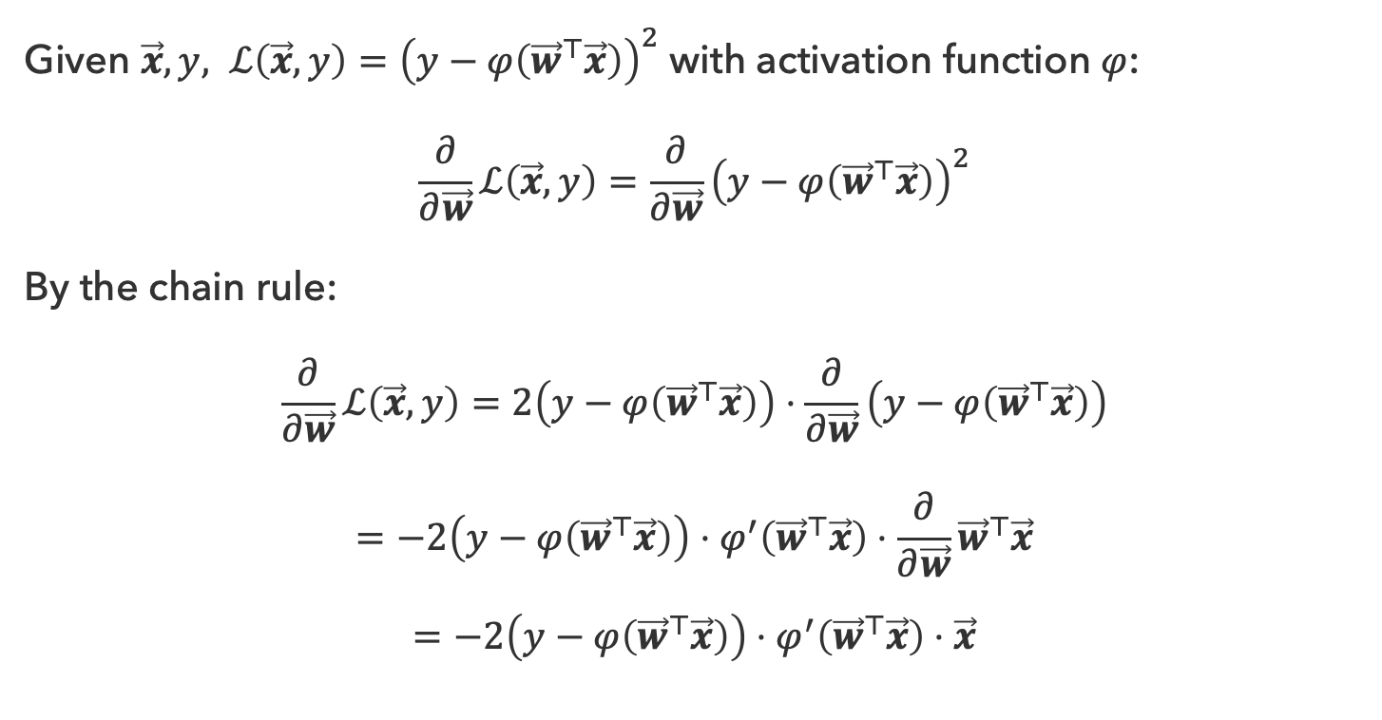






Training a Single Neuron
Given $\vec{x}, y, ℒ\left(\vec{x},y\right)={\left(y−φ\left({\vec{w}}^{⊤}\vec{x}\right)\right)}^{2}$ with activation function $φ$:
$$\frac{∂}{∂\vec{w}}ℒ\left(\vec{x},y\right)=\frac{∂}{∂\vec{w}}{\left(y−φ\left({\vec{w}}^{⊤}\vec{x}\right)\right)}^{2}$$
By the chain rule:
$$\frac{∂}{∂\vec{w}}ℒ\left(\vec{x},y\right)=2\left(y−φ\left({\vec{w}}^{⊤}\vec{x}\right)\right)⋅\frac{∂}{∂\vec{w}}\left(y−φ\left({\vec{w}}^{⊤}\vec{x}\right)\right)$$
$$=−2\left(y−φ\left({\vec{w}}^{⊤}\vec{x}\right)\right)⋅φ^{′}\left({\vec{w}}^{⊤}\vec{x}\right)⋅\frac{∂}{∂\vec{w}}{\vec{w}}^{⊤}\vec{x}$$
$$=−2\left(y−φ\left({\vec{w}}^{⊤}\vec{x}\right)\right)⋅φ^{′}\left({\vec{w}}^{⊤}\vec{x}\right)⋅\vec{x}$$
$$x_{1}$$
$$z={\vec{w}}^{⊤}\vec{x}$$
$$x_{2}$$
$$Σ$$
$$φ$$
$$⋮$$
$$a=φ(z)$$
$$x_{n}$$
$$\frac{∂L}{∂a}$$
$$\frac{∂a}{∂z}$$
$$\frac{∂z}{∂w}$$

Slide 23



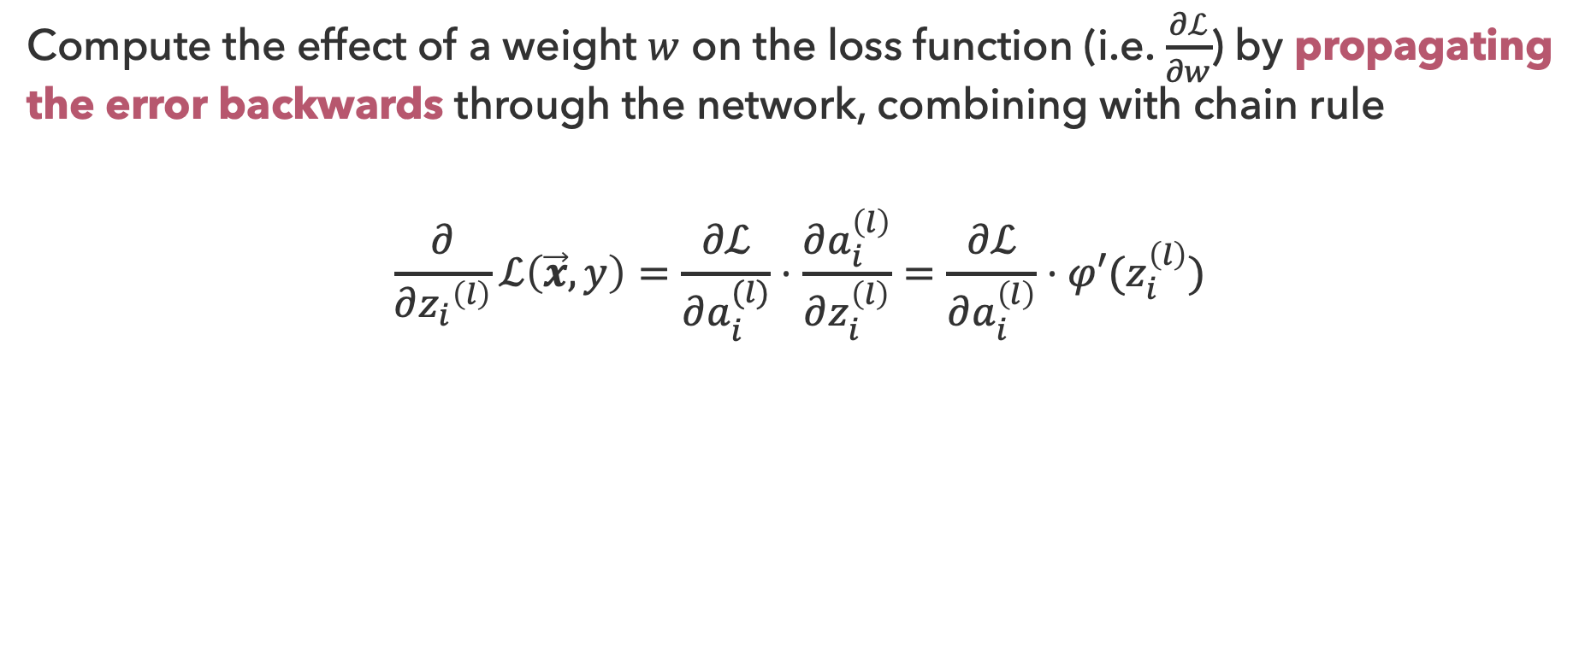






Backpropagation
Compute the effect of a weight $w$ on the loss function (i.e. $\frac{∂ℒ}{∂w}$) by propagating the error backwards through the network, combining with chain rule
$$\frac{∂}{∂{z_{i}}^{\left(l\right)}}ℒ\left(\vec{x},y\right)=\frac{∂ℒ}{∂a_{i}^{(l)}}⋅\frac{∂a_{i}^{\left(l\right)}}{∂z_{i}^{\left(l\right)}}=\frac{∂ℒ}{∂a_{i}^{\left(l\right)}}⋅φ′(z_{i}^{\left(l\right)})$$
$$a_{1}^{(l−1)}$$
$$a_{1}^{(l+1)}$$
$$a_{1}^{(l)}$$
$$a_{2}^{(l−1)}$$
$$a_{2}^{(l+1)}$$
$$\hat{y}$$
$$a_{m}^{(l)}$$
$$a_{n}^{(l−1)}$$
$$a_{k}^{(l+1)}$$

Slide 24
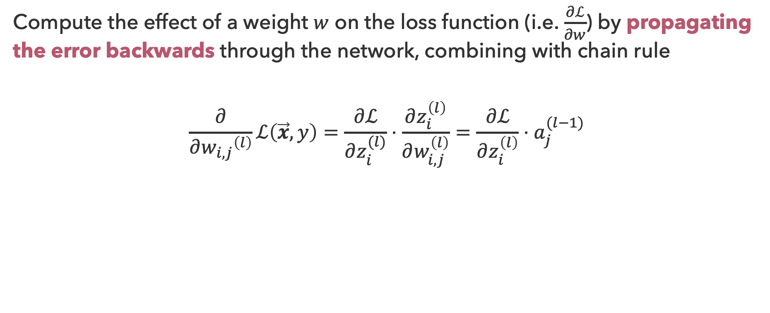
Backpropagation (2)
Compute the effect of a weight $w$ on the loss function (i.e. $\frac{∂ℒ}{∂w}$) by propagating the error backwards through the network, combining with chain rule
$$\frac{∂}{∂{w_{i,j}}^{\left(l\right)}}ℒ\left(\vec{x},y\right)=\frac{∂ℒ}{∂z_{i}^{(l)}}⋅\frac{∂z_{i}^{\left(l\right)}}{∂w_{i,j}^{\left(l\right)}}=\frac{∂ℒ}{∂z_{i}^{\left(l\right)}}⋅a_{j}^{(l−1)}$$
$$a_{1}^{(l−1)}$$
$$a_{1}^{(l+1)}$$
$$a_{1}^{(l)}$$
$$a_{2}^{(l−1)}$$
$$a_{2}^{(l+1)}$$
$$\hat{y}$$
$$a_{m}^{(l)}$$
$$a_{n}^{(l−1)}$$
$$a_{k}^{(l+1)}$$

Slide 25


Weight Gradients
Compute the effect of a weight $w$ on the loss function (i.e. $\frac{∂ℒ}{∂w}$) by propagating the error backwards through the network, combining with chain rule
$$\frac{∂}{∂W^{\left(l\right)}}ℒ\left(\vec{x},y\right)=\frac{∂ℒ}{∂{\vec{z}}^{(l)}}⋅\frac{∂{\vec{z}}^{\left(l\right)}}{∂W^{\left(l\right)}}=\frac{∂ℒ}{∂{\vec{z}}^{\left(l\right)}}⋅{({\vec{a}}^{(l−1)})}^{⊤}$$
$$\frac{∂}{∂A}A\vec{x}={\vec{x}}^{⊤}$$
$$a_{1}^{(l−1)}$$
$$a_{1}^{(l+1)}$$
$$a_{1}^{(l)}$$
$$a_{2}^{(l−1)}$$
$$a_{2}^{(l+1)}$$
$$\hat{y}$$
$$a_{m}^{(l)}$$
$$a_{n}^{(l−1)}$$
$$a_{k}^{(l+1)}$$

Slide 26

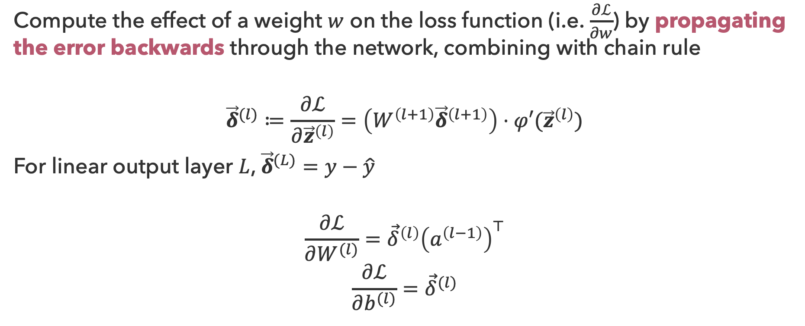
Backpropagation: Recursive Formulation
Compute the effect of a weight $w$ on the loss function (i.e. $\frac{∂ℒ}{∂w}$) by propagating the error backwards through the network, combining with chain rule
$${\vec{δ}}^{(l)}≔\frac{∂ℒ}{∂{\vec{z}}^{\left(l\right)}}=\left(W^{\left(l+1\right)}{\vec{δ}}^{\left(l+1\right)}\right)⋅φ′({\vec{z}}^{\left(l\right)})$$
For linear output layer $L$, ${\vec{δ}}^{(L)}=y−\hat{y}$
$$\frac{∂ℒ}{∂W^{(l)}}={\vec{δ}}^{\left(l\right)}{\left(a^{\left(l−1\right)}\right)}^{⊤}$$
$$\frac{∂ℒ}{∂b^{(l)}}={\vec{δ}}^{(l)}$$
Element-wise product

Slide 27
Questions (4)

Slide 28
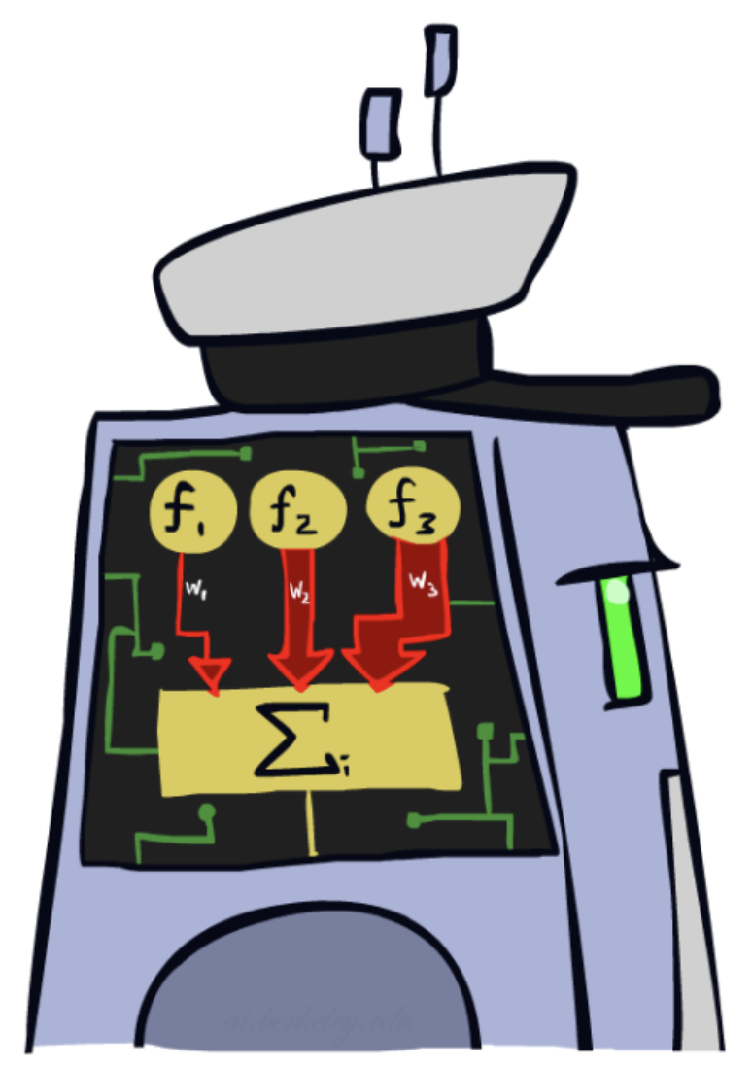
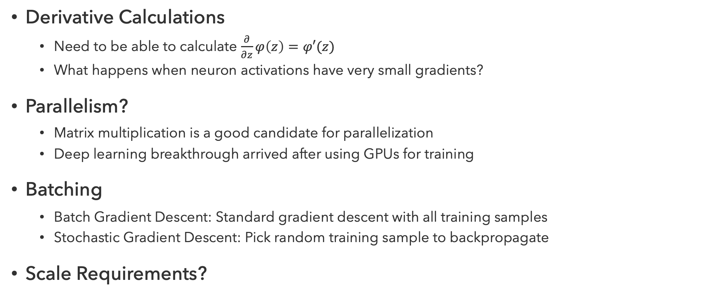
Practical Considerations
Derivative Calculations
  Need to be able to calculate $\frac{∂}{∂z}φ\left(z\right)=φ′(z)$
  What happens when neuron activations have very small gradients?
Parallelism?
  Matrix multiplication is a good candidate for parallelization
  Deep learning breakthrough arrived after using GPUs for training
Batching
  Batch Gradient Descent: Standard gradient descent with all training samples
  Stochastic Gradient Descent: Pick random training sample to backpropagate
Scale Requirements?

Slide 29
MLP Performance
How do these models compare?
Model | Test Acc. | Train Time | Test Time
Logistic Reg. | 92.55% | 176.6s | 0.01s
SVM (RBF) | 96.85% | 2.9s | 7.74s
Decision Tree | 87.58% | 8.2s | 0.01s
kNN (k=5) | 96.88% | 0.1s | 3.58s
Neural Net. | 97.92% | 45.9s | 0.06s
One-shot benchmark using standard sklearn implementations (no hyperparameter tuning). Python notebook generated by Claude Code.
Benchmark experiment Inspired by Michael Nielsen

Slide 30
Questions (5)

Slide 31
that’s it for today!
Neural networks consist of layers of neurons (perceptrons with nonlinear activation functions)
Neural networks are trained via gradient descent, using backpropagation (chain rule) to calculate gradients
Deep Learning
Natural Language Processing
Large Language Models
Complete Practice Problem 18
Do Project 4 (due 8.13)
Do Homework 4 (due 8.20)

