Slide 1
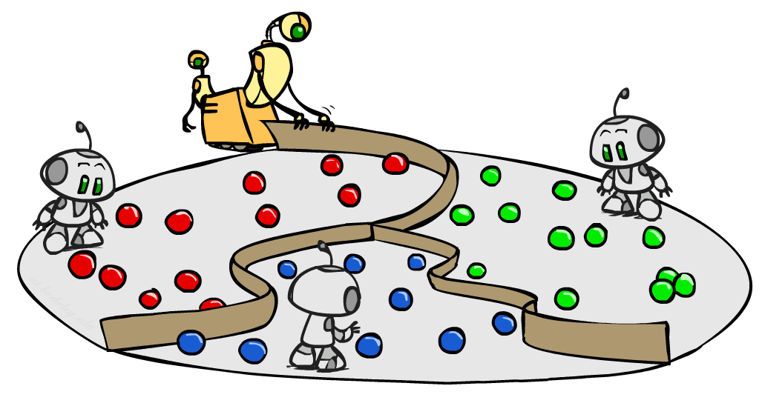
Machine Learning III: Classification
CSE 473: Introduction to Artificial Intelligence
James Weichert (jpw@cs)
cs.uw.edu/473
acknowledgements
Welcome!
What’s your favorite summertime activity?
sli.do #cse473

Slide 2

Administrivia
Test 2 Friday
  One double-sided 8.5x11” note sheet allowed
  Focus on RL and probabilistic inference
  One question on basic ML
Homework 3 due tomorrow (8.6)
Project 4 due next week (8.13)

Slide 3
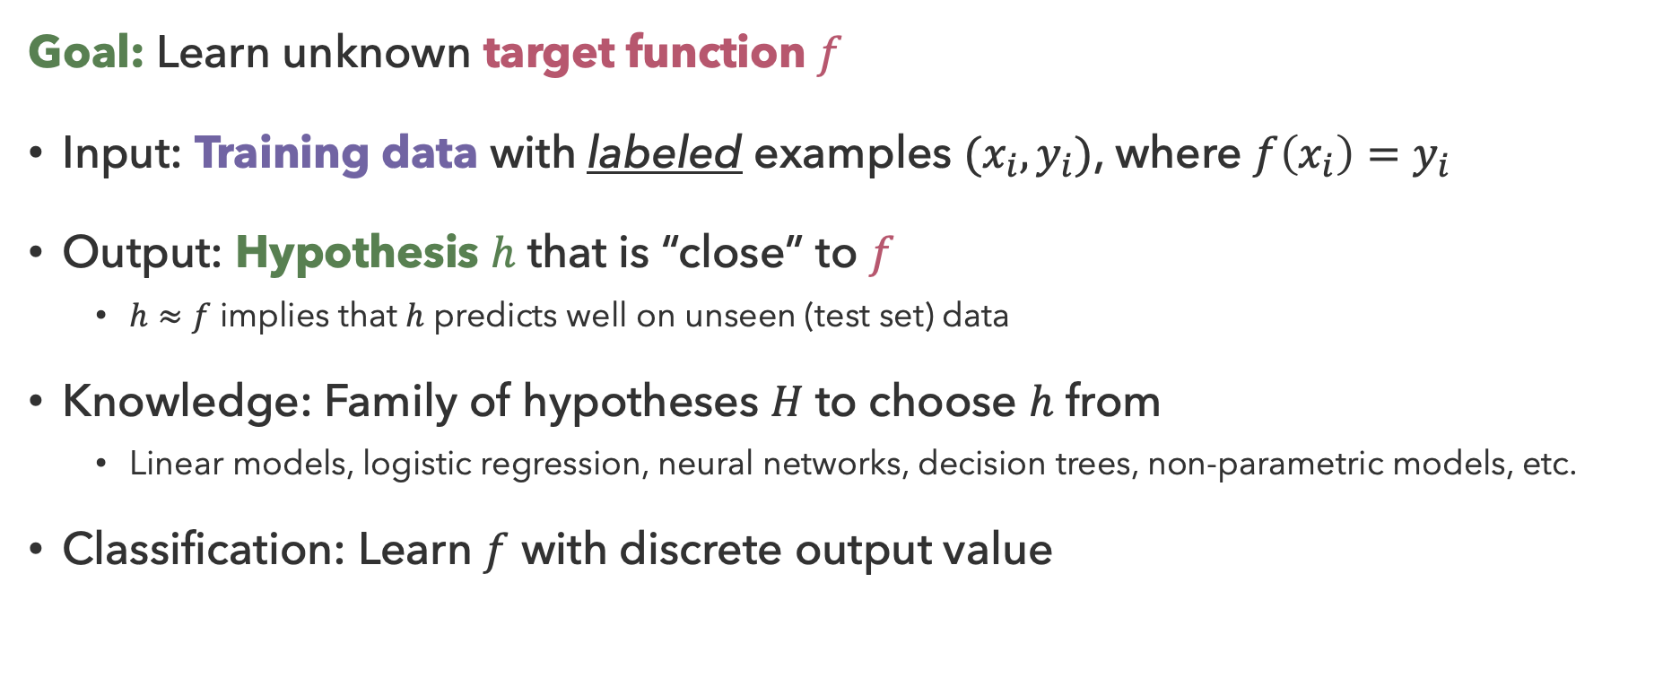
Recap: Supervised Learning
Goal: Learn unknown target function $f$
Input: Training data with labeled examples $(x_{i},y_{i})$, where $f\left(x_{i}\right)=y_{i}$
Output: Hypothesis $h$ that is “close” to $f$
  $h≈f$ implies that $h$ predicts well on unseen (test set) data
Knowledge: Family of hypotheses $H$ to choose $h$ from
  Linear models, logistic regression, neural networks, decision trees, non-parametric models, etc.
Classification: Learn $f$ with discrete output value

Slide 4
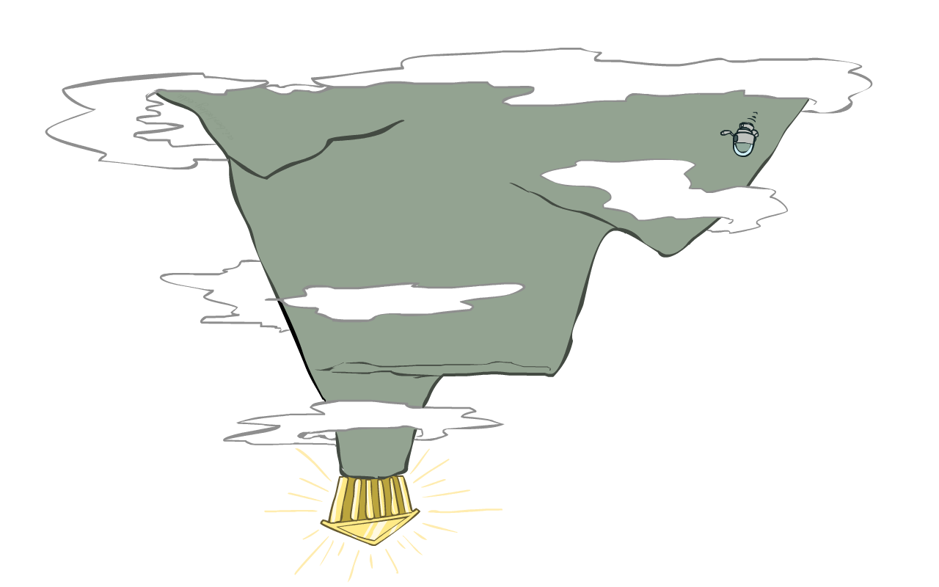
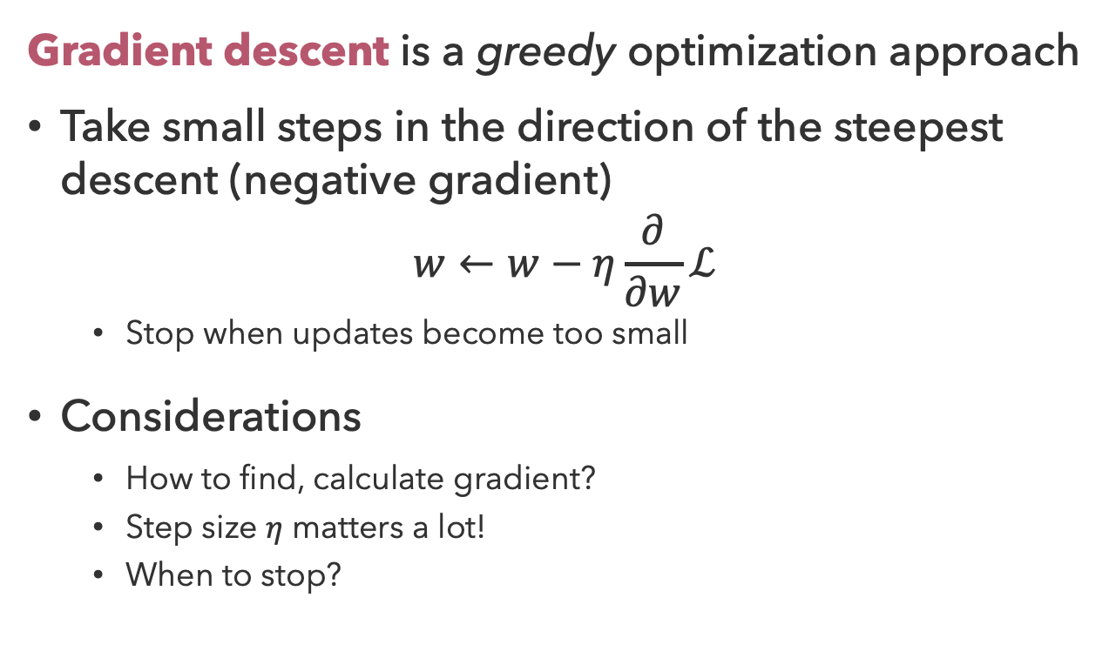
Gradient Descent
Gradient descent is a greedy optimization approach
Take small steps in the direction of the steepest descent (negative gradient)
$$w←w−η\frac{∂}{∂w}ℒ$$
  Stop when updates become too small
Considerations
  How to find, calculate gradient?
  Step size $η$ matters a lot!
  When to stop?

Slide 5
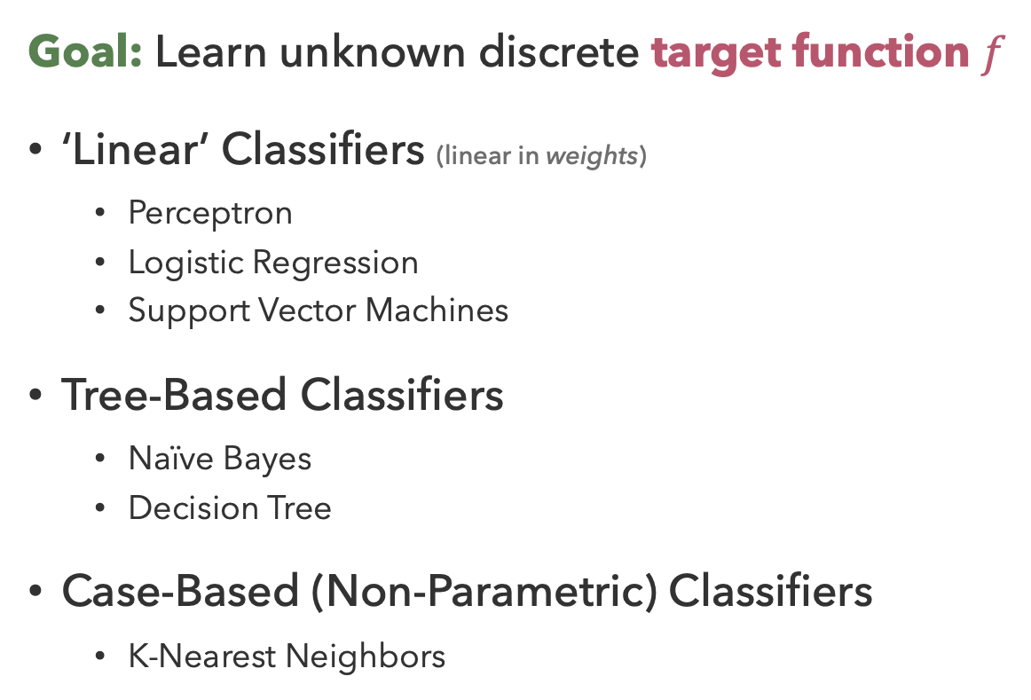
Classification Approaches
Goal: Learn unknown discrete target function $f$
‘Linear’ Classifiers (linear in weights)
  Perceptron
  Logistic Regression
  Support Vector Machines
Tree-Based Classifiers
  Naïve Bayes
  Decision Tree
Case-Based (Non-Parametric) Classifiers
  K-Nearest Neighbors
Machine Learning
Supervised Learning
Regression
Learn likeliest hypothesis given data
Classification
Linear
Tree-Based
Case-Based
Unsupervised Learning

Slide 6
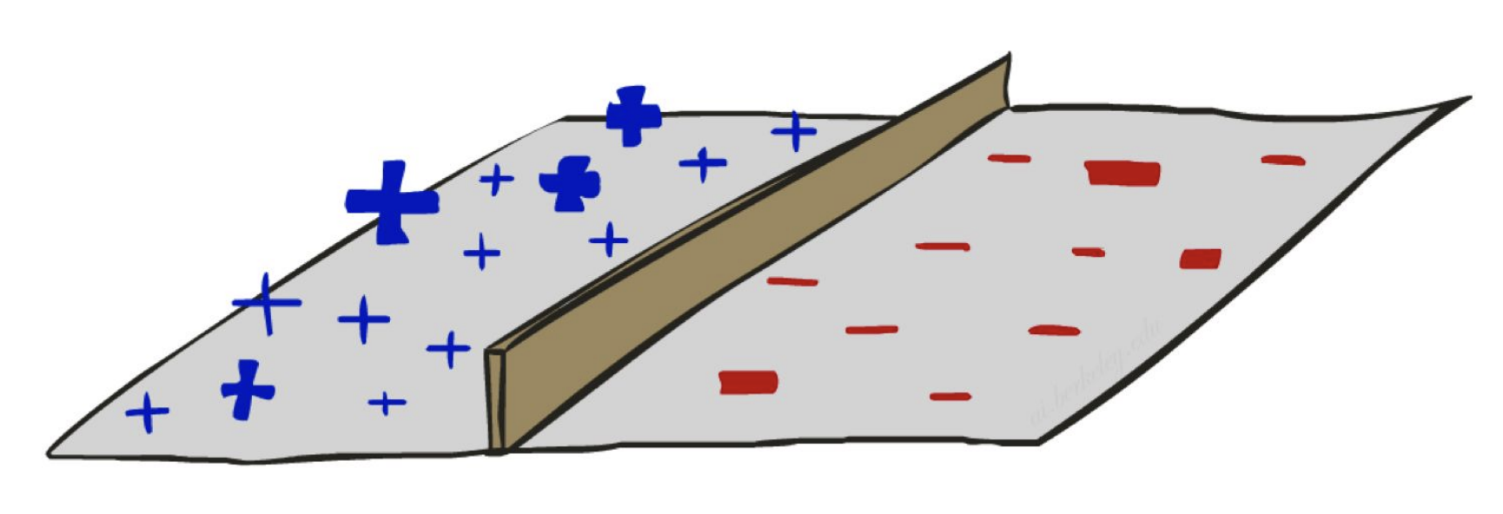
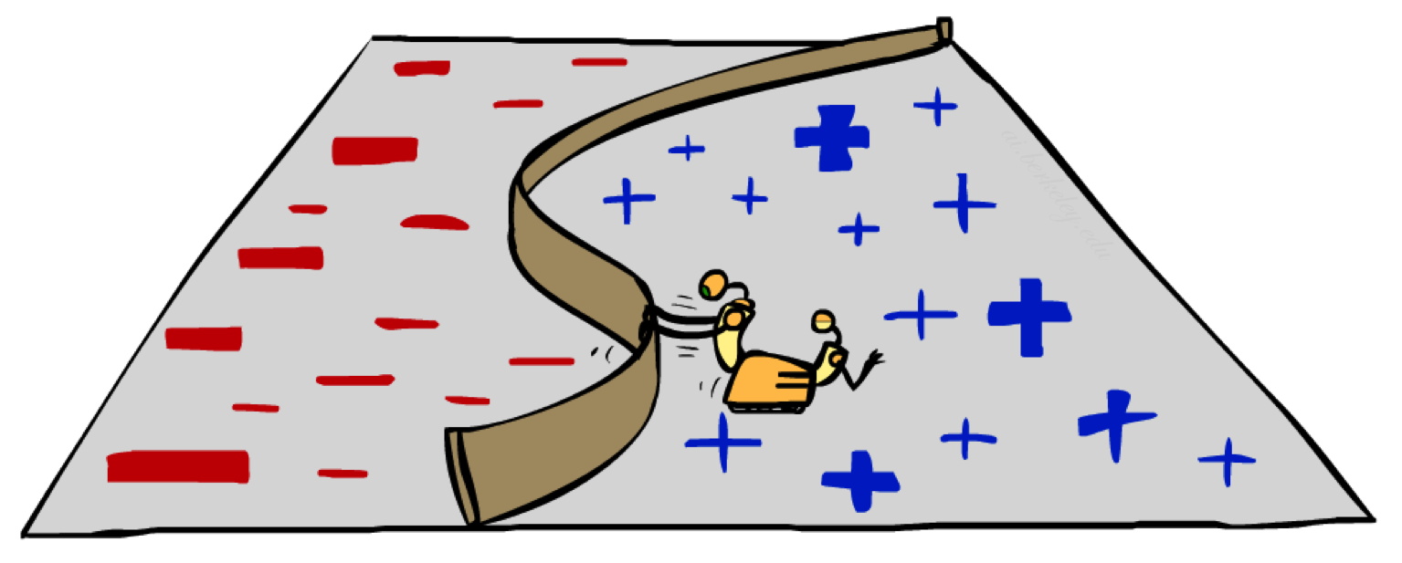
Separability
What happens when classes are not (linearly) separable?

Slide 7
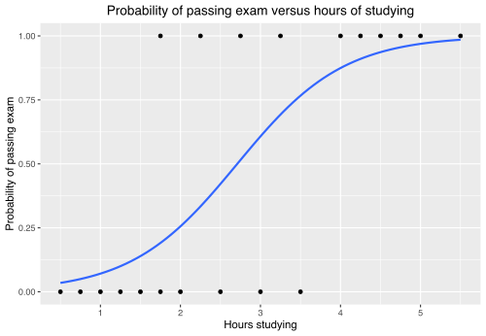
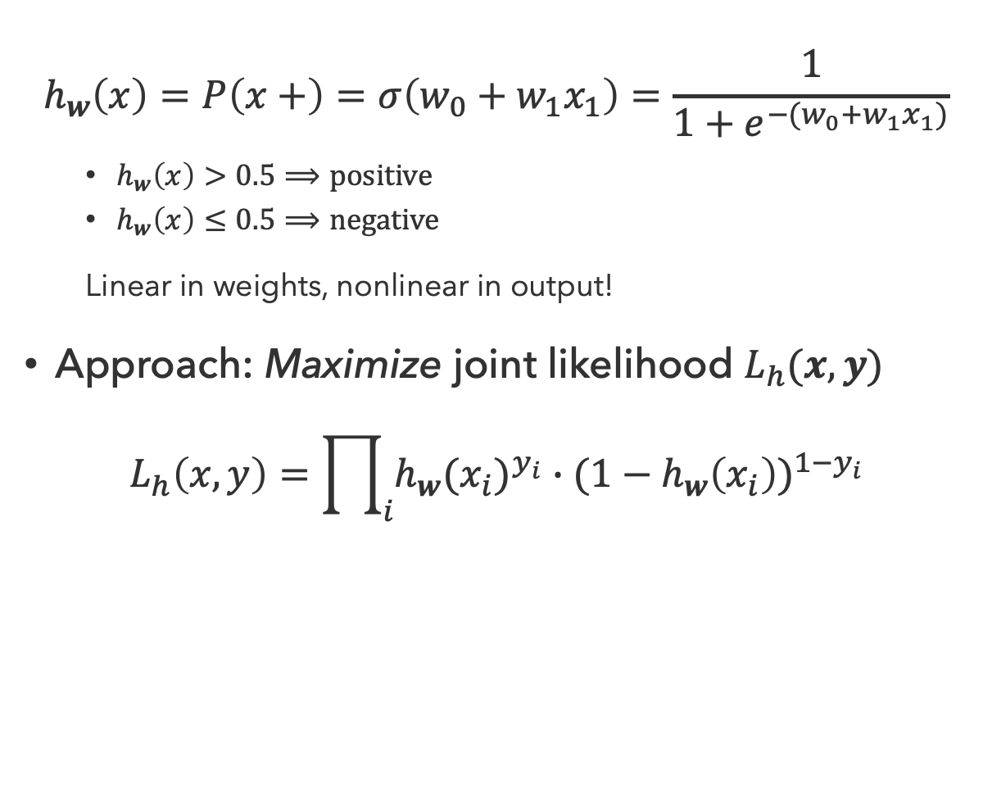


Logistic Regression
Logistic regression is a classification model that fits (regresses) a sigmoid curve to approximate the class probabilities
$$h_{w}\left(x\right)=P\left(x+\right)=σ\left(w_{0}+w_{1}x_{1}\right)=\frac{1}{1+e^{−(w_{0}+w_{1}x_{1})}}$$
  $h_{w}\left(x\right)>0.5⟹positive$
  $h_{w}\left(x\right)≤0.5⟹negative$
  Linear in weights, nonlinear in output!
Approach: Maximize joint likelihood $L_{h}(x,y)$
$$L_{h}\left(x,y\right)=\prod_{i}{h_{w}(x_{i})^{y_{i}}∙(1−h_{w}\left(x_{i}\right))^{1−y_{i}}}$$
$$y_{i}=1$$
$$y_{i}=0$$

Slide 8
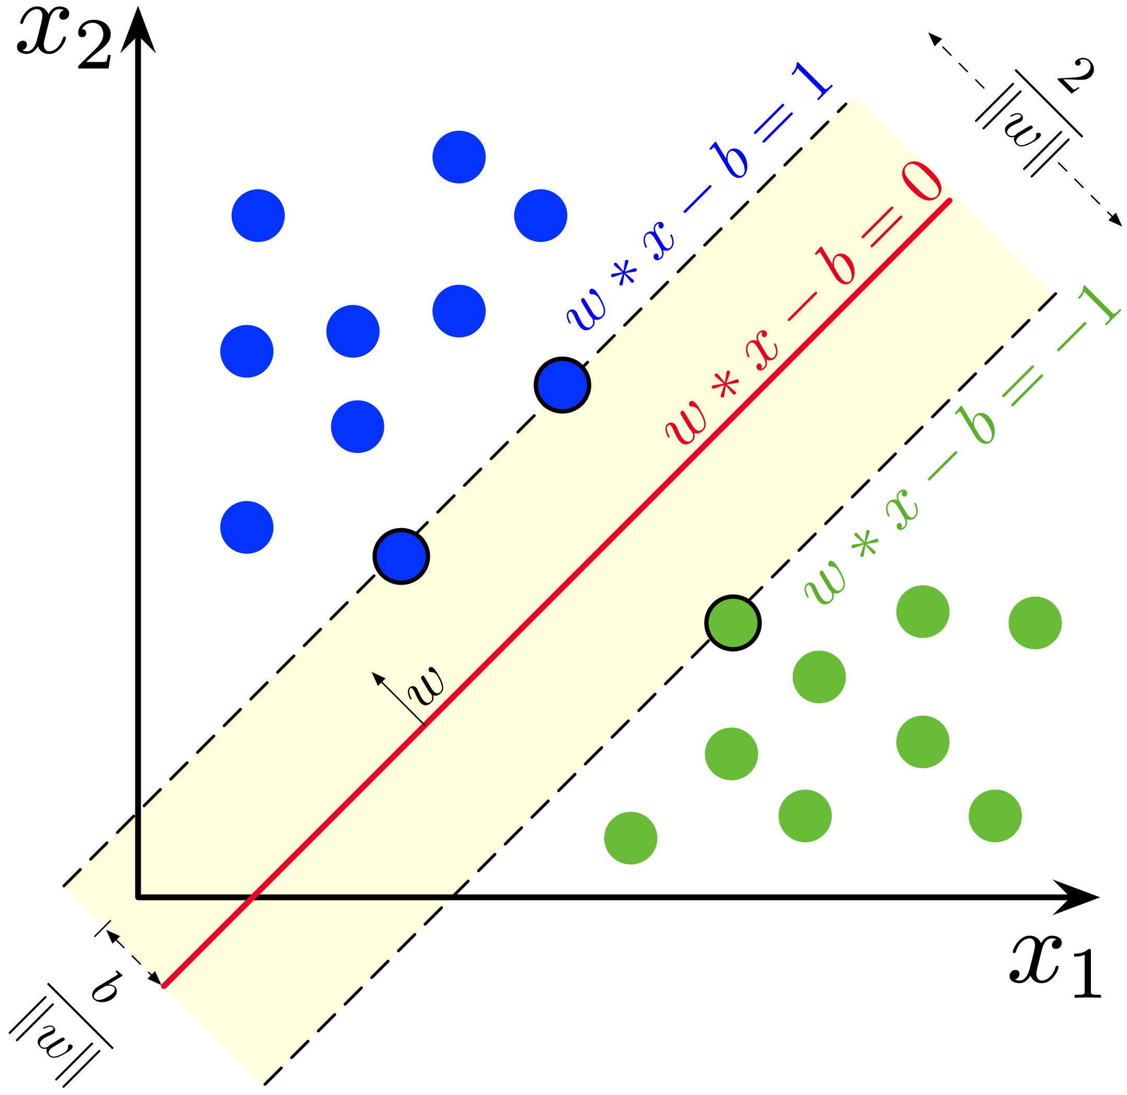
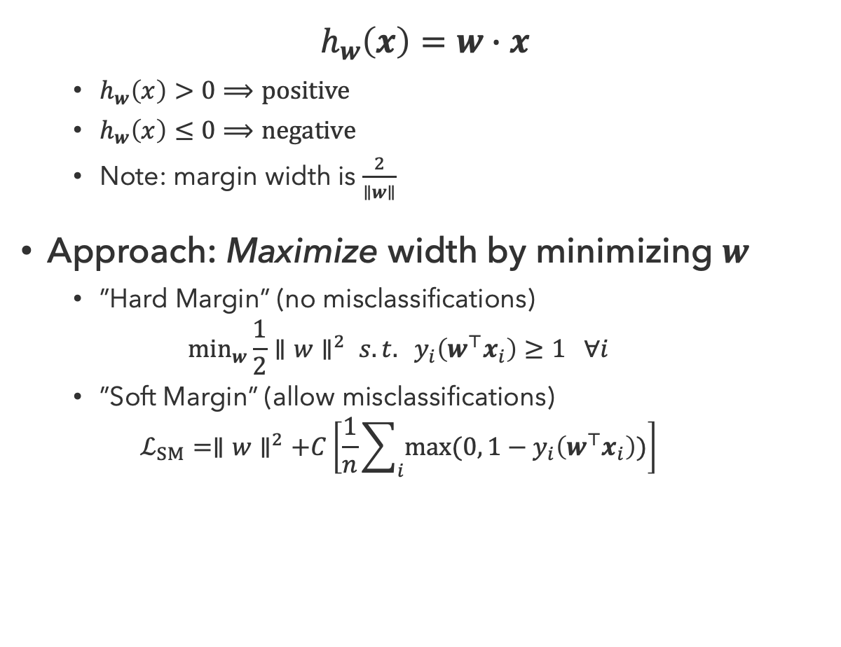
Support Vector Machines
SVMs maximize the margin between the decision boundary and data points
$$h_{w}\left(x\right)=w∙x$$
  $h_{w}\left(x\right)>0⟹positive$
  $h_{w}\left(x\right)≤0⟹negative$
  Note: margin width is $\frac{2}{∥w∥}$
Approach: Maximize width by minimizing $w$
  ”Hard Margin” (no misclassifications)
  $$\min_{w}\frac{1}{2}∥w∥^{2} s.t. y_{i}\left(w^{⊤}x_{i}\right)≥1 ∀i$$
  ”Soft Margin” (allow misclassifications)
  $$ℒ_{SM}=∥w∥^{2}+C\left[\frac{1}{n}\sum_{i}{max⁡(0, 1−y_{i}\left(w^{⊤}x_{i}\right))}\right]$$

Slide 9
Questions (1)

Slide 10
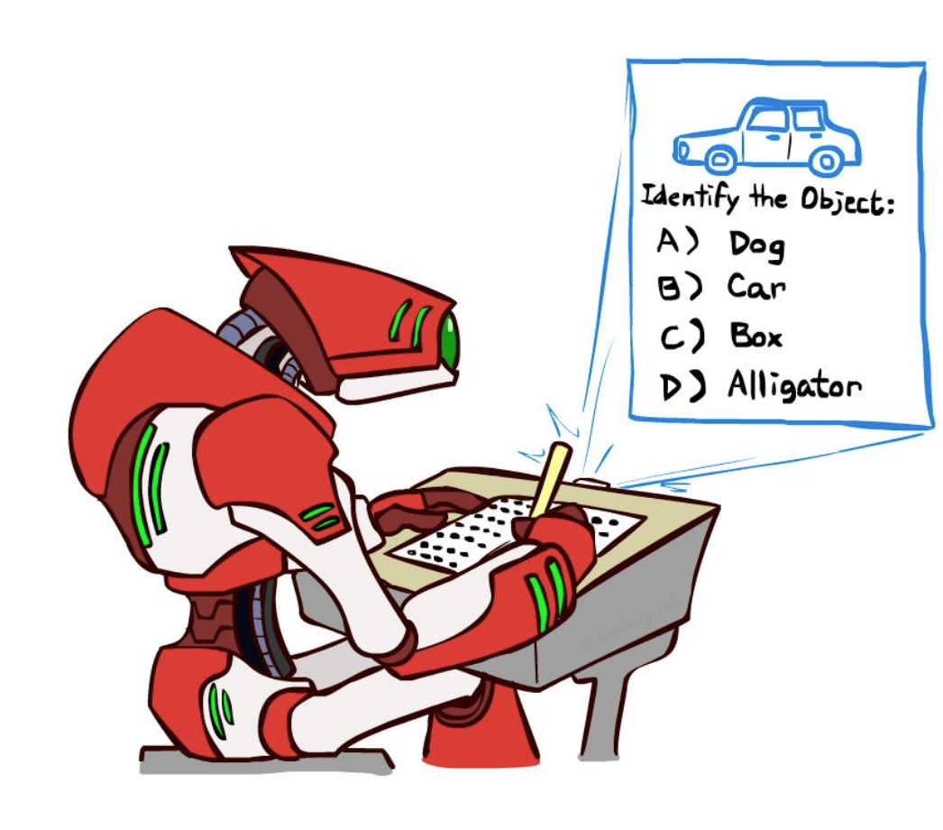
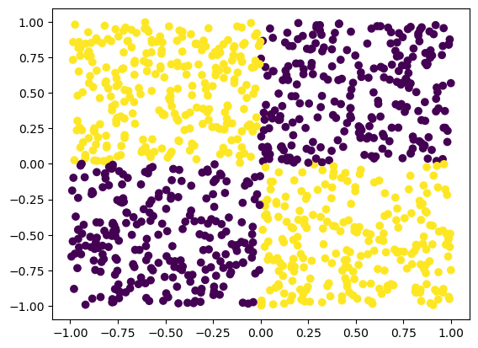

More Complicated Classifications
What about more than two classes?
What if features are not independent?
$$XOR$$

Slide 11
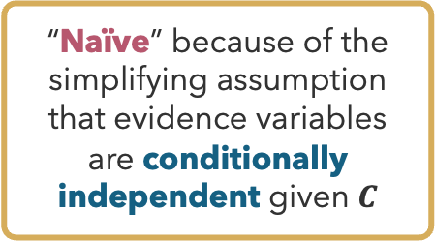
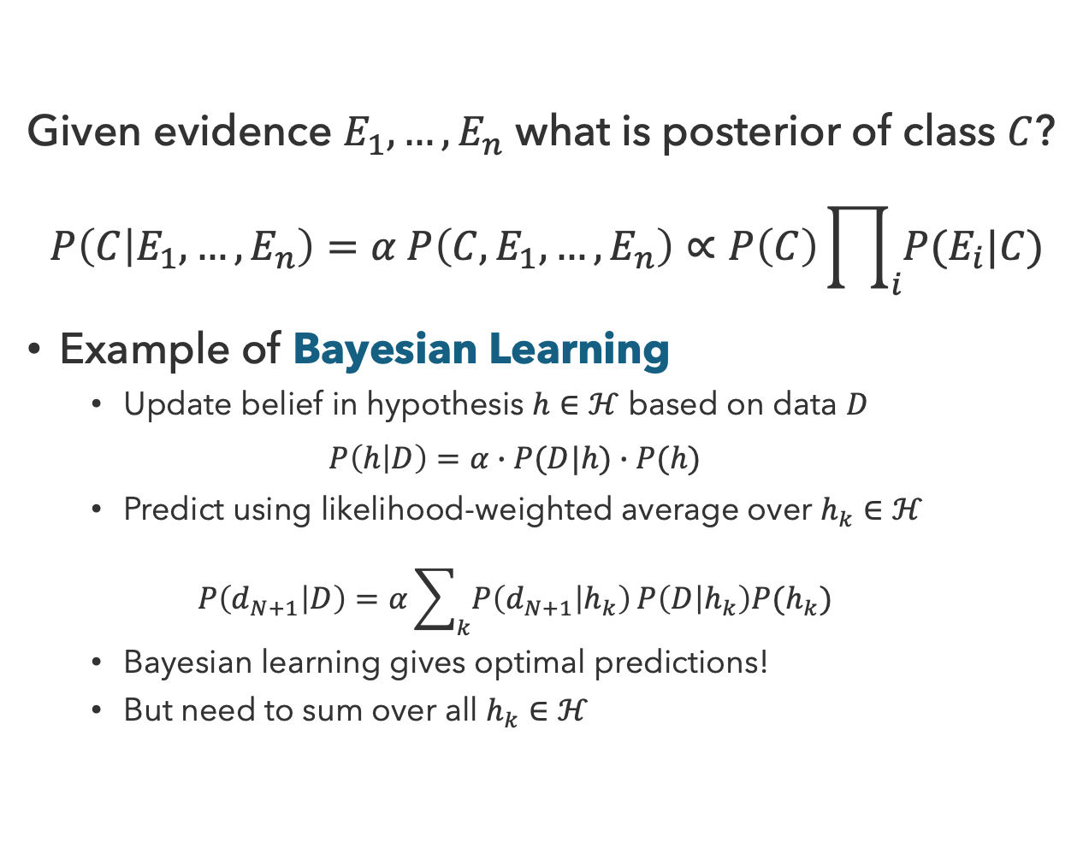
Naïve Bayes
“Naïve” because of the simplifying assumption that evidence variables are conditionally independent given $C$
Given evidence $E_{1},…,E_{n}$ what is posterior of class $C$?
$$P\left(C | E_{1},…,E_{n}\right)=α P\left(C,E_{1},…,E_{n}\right)∝P\left(C\right)\prod_{i}{P(E_{i}|C)}$$
Example of Bayesian Learning
  Update belief in hypothesis $h∈ℋ$ based on data $D$
  $$P\left(h | D\right)=α∙P(D|h)∙P(h)$$
  Predict using likelihood-weighted average over $h_{k}∈ℋ$
  $$P\left(d_{N+1} | D\right)=α\sum_{k}{P\left(d_{N+1} | h_{k}\right)}P\left(D | h_{k}\right)P(h_{k})$$
  Bayesian learning gives optimal predictions!
  But need to sum over all $h_{k}∈ℋ$
$$C$$
$$E_{1}$$
$$E_{2}$$
…
$$E_{n}$$

Slide 12


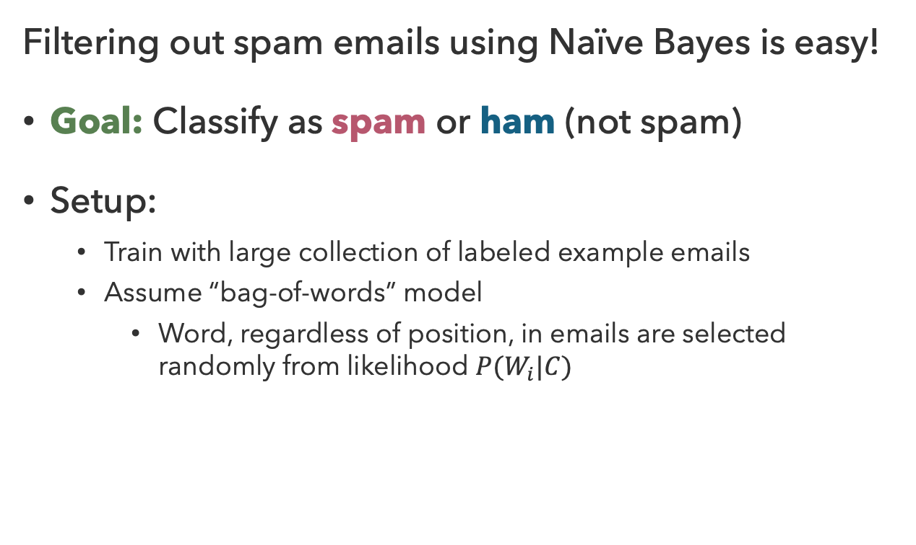



Spam Filtering
Filtering out spam emails using Naïve Bayes is easy!
Goal: Classify as spam or ham (not spam)
Setup:
  Train with large collection of labeled example emails
  Assume “bag-of-words” model
    Word, regardless of position, in emails are selected randomly from likelihood $P(W_{i}|C)$
Dear Sir.
First, I must solicit your confidence in this transaction, this is by virture of its nature as being utterly confidencial and top secret. ...
$$C$$
Can you meet tomorrow to discuss the project? Need to get your thoughts on a few things…
$$W_{1}$$
$$W_{2}$$
…
$$W_{n}$$

Slide 13
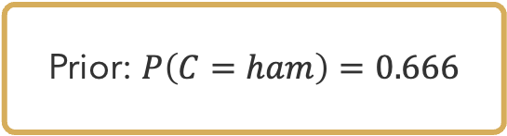
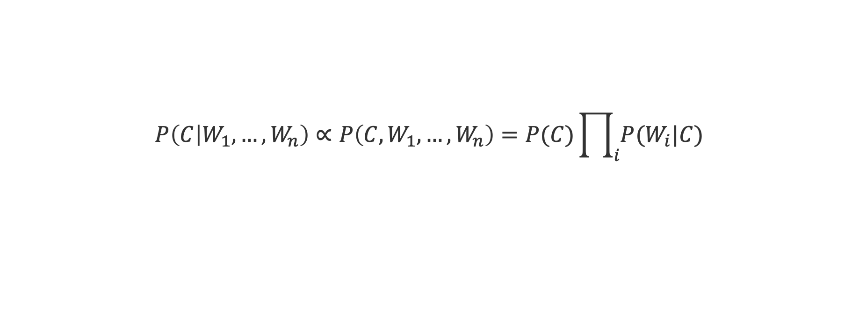
Spam or Ham?
Prior: $P\left(C=ham\right)=0.666$
$$P\left(C | W_{1},…,W_{n}\right)∝P\left(C,W_{1},…,W_{n}\right)=P(C)\prod_{i}{P(W_{i}|C)}$$
$$W$$ | $$P(W|spam)$$ | $$P(W|ham)$$ | $$P(spam,W_{1},…,W_{k})$$ | $$P(ham, W_{1},…,W_{k})$$
[PRIOR] |  |  | 0.333 | 0.666

Slide 14
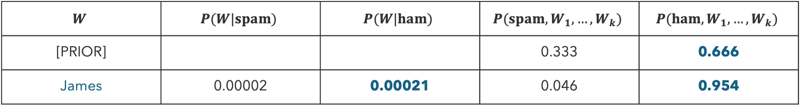
Spam or Ham? (1)
Prior: $P\left(C=ham\right)=0.666$
$$P\left(C | W_{1},…,W_{n}\right)∝P\left(C,W_{1},…,W_{n}\right)=P(C)\prod_{i}{P(W_{i}|C)}$$
$$W$$ | $$P(W|spam)$$ | $$P(W|ham)$$ | $$P(spam,W_{1},…,W_{k})$$ | $$P(ham, W_{1},…,W_{k})$$
[PRIOR] |  |  | 0.333 | 0.666
James | 0.00002 | 0.00021 | 0.046 | 0.954

Slide 15
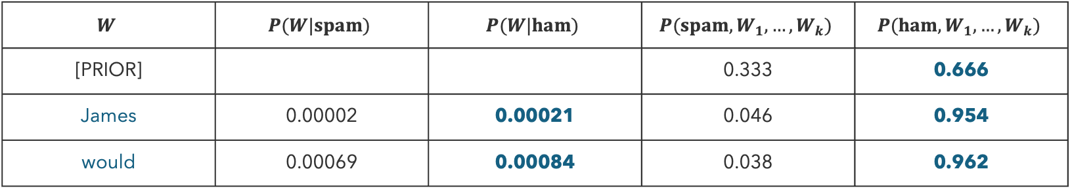
Spam or Ham? (2)
Prior: $P\left(C=ham\right)=0.666$
$$P\left(C | W_{1},…,W_{n}\right)∝P\left(C,W_{1},…,W_{n}\right)=P(C)\prod_{i}{P(W_{i}|C)}$$
$$W$$ | $$P(W|spam)$$ | $$P(W|ham)$$ | $$P(spam,W_{1},…,W_{k})$$ | $$P(ham, W_{1},…,W_{k})$$
[PRIOR] |  |  | 0.333 | 0.666
James | 0.00002 | 0.00021 | 0.046 | 0.954
would | 0.00069 | 0.00084 | 0.038 | 0.962

Slide 16
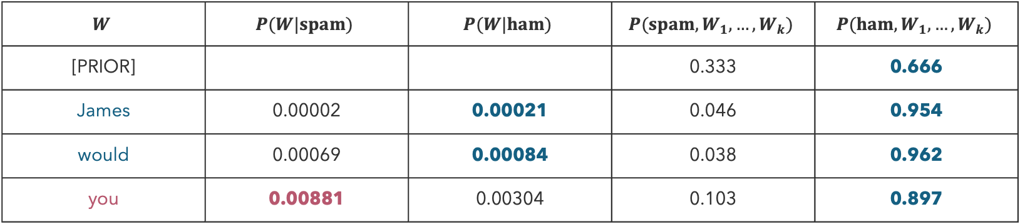
Spam or Ham? (3)
Prior: $P\left(C=ham\right)=0.666$
$$P\left(C | W_{1},…,W_{n}\right)∝P\left(C,W_{1},…,W_{n}\right)=P(C)\prod_{i}{P(W_{i}|C)}$$
$$W$$ | $$P(W|spam)$$ | $$P(W|ham)$$ | $$P(spam,W_{1},…,W_{k})$$ | $$P(ham, W_{1},…,W_{k})$$
[PRIOR] |  |  | 0.333 | 0.666
James | 0.00002 | 0.00021 | 0.046 | 0.954
would | 0.00069 | 0.00084 | 0.038 | 0.962
you | 0.00881 | 0.00304 | 0.103 | 0.897

Slide 17
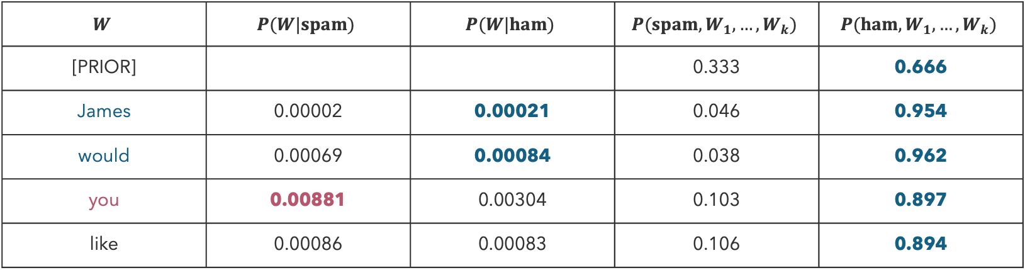
Spam or Ham? (4)
Prior: $P\left(C=ham\right)=0.666$
$$P\left(C | W_{1},…,W_{n}\right)∝P\left(C,W_{1},…,W_{n}\right)=P(C)\prod_{i}{P(W_{i}|C)}$$
$$W$$ | $$P(W|spam)$$ | $$P(W|ham)$$ | $$P(spam,W_{1},…,W_{k})$$ | $$P(ham, W_{1},…,W_{k})$$
[PRIOR] |  |  | 0.333 | 0.666
James | 0.00002 | 0.00021 | 0.046 | 0.954
would | 0.00069 | 0.00084 | 0.038 | 0.962
you | 0.00881 | 0.00304 | 0.103 | 0.897
like | 0.00086 | 0.00083 | 0.106 | 0.894

Slide 18
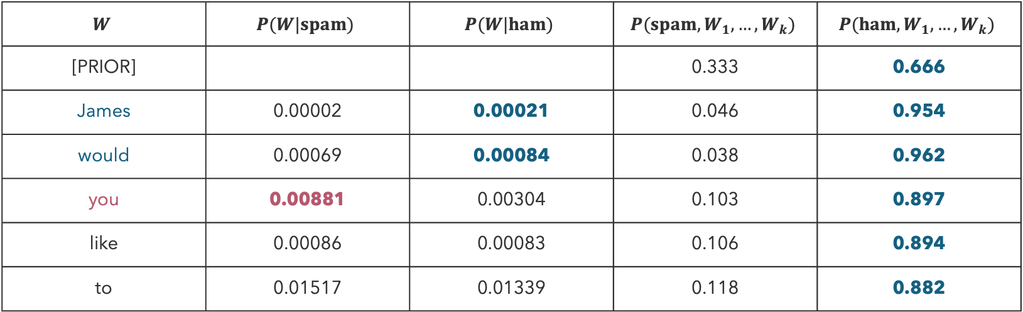
Spam or Ham? (5)
Prior: $P\left(C=ham\right)=0.666$
$$P\left(C | W_{1},…,W_{n}\right)∝P\left(C,W_{1},…,W_{n}\right)=P(C)\prod_{i}{P(W_{i}|C)}$$
$$W$$ | $$P(W|spam)$$ | $$P(W|ham)$$ | $$P(spam,W_{1},…,W_{k})$$ | $$P(ham, W_{1},…,W_{k})$$
[PRIOR] |  |  | 0.333 | 0.666
James | 0.00002 | 0.00021 | 0.046 | 0.954
would | 0.00069 | 0.00084 | 0.038 | 0.962
you | 0.00881 | 0.00304 | 0.103 | 0.897
like | 0.00086 | 0.00083 | 0.106 | 0.894
to | 0.01517 | 0.01339 | 0.118 | 0.882

Slide 19
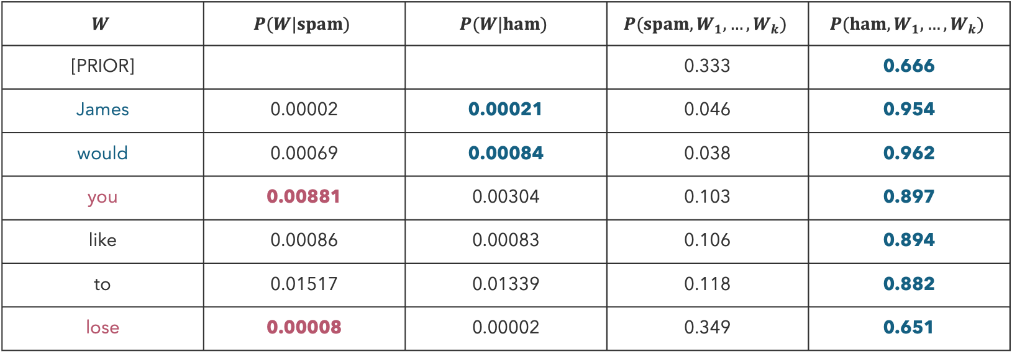
Spam or Ham? (6)
Prior: $P\left(C=ham\right)=0.666$
$$P\left(C | W_{1},…,W_{n}\right)∝P\left(C,W_{1},…,W_{n}\right)=P(C)\prod_{i}{P(W_{i}|C)}$$
$$W$$ | $$P(W|spam)$$ | $$P(W|ham)$$ | $$P(spam,W_{1},…,W_{k})$$ | $$P(ham, W_{1},…,W_{k})$$
[PRIOR] |  |  | 0.333 | 0.666
James | 0.00002 | 0.00021 | 0.046 | 0.954
would | 0.00069 | 0.00084 | 0.038 | 0.962
you | 0.00881 | 0.00304 | 0.103 | 0.897
like | 0.00086 | 0.00083 | 0.106 | 0.894
to | 0.01517 | 0.01339 | 0.118 | 0.882
lose | 0.00008 | 0.00002 | 0.349 | 0.651

Slide 20
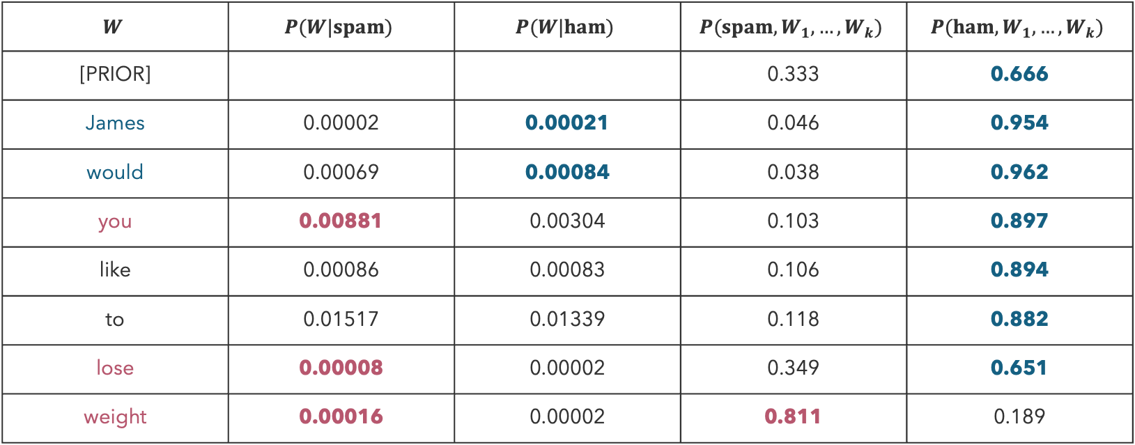
Spam or Ham? (7)
Prior: $P\left(C=ham\right)=0.666$
$$P\left(C | W_{1},…,W_{n}\right)∝P\left(C,W_{1},…,W_{n}\right)=P(C)\prod_{i}{P(W_{i}|C)}$$
$$W$$ | $$P(W|spam)$$ | $$P(W|ham)$$ | $$P(spam,W_{1},…,W_{k})$$ | $$P(ham, W_{1},…,W_{k})$$
[PRIOR] |  |  | 0.333 | 0.666
James | 0.00002 | 0.00021 | 0.046 | 0.954
would | 0.00069 | 0.00084 | 0.038 | 0.962
you | 0.00881 | 0.00304 | 0.103 | 0.897
like | 0.00086 | 0.00083 | 0.106 | 0.894
to | 0.01517 | 0.01339 | 0.118 | 0.882
lose | 0.00008 | 0.00002 | 0.349 | 0.651
weight | 0.00016 | 0.00002 | 0.811 | 0.189

Slide 21
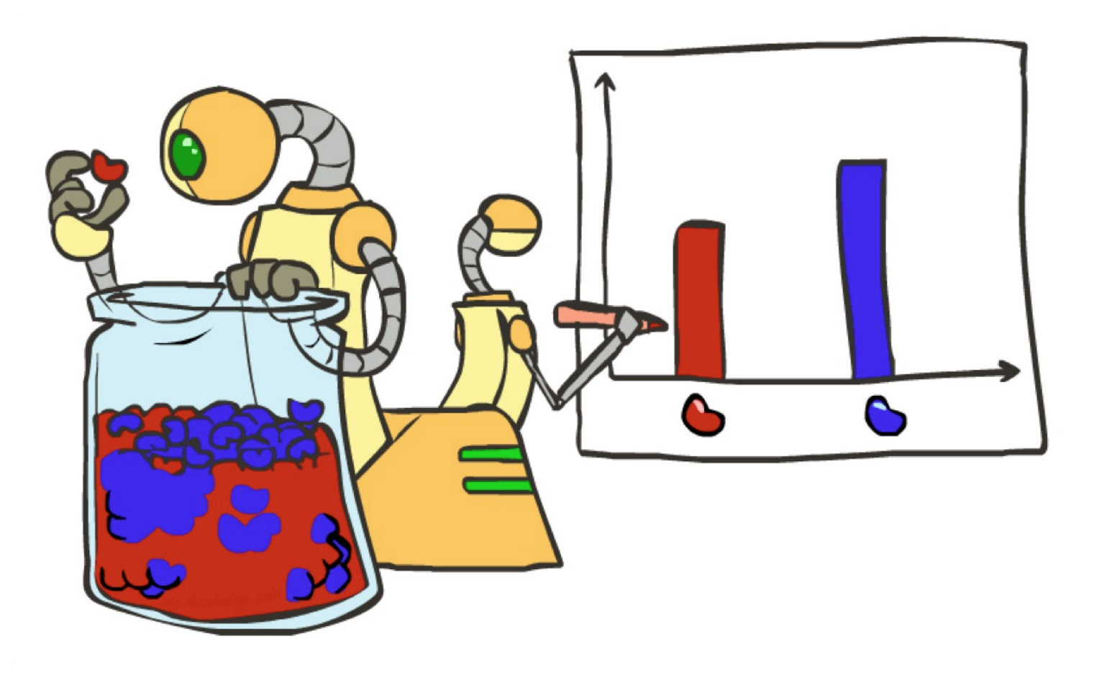
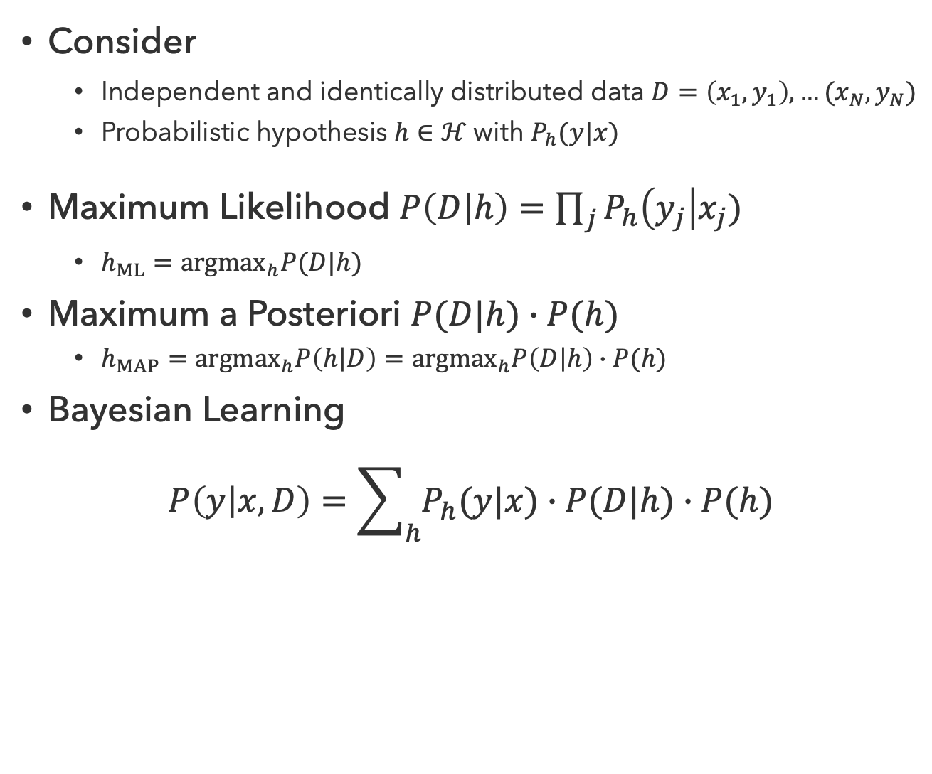
Statistical Learning
Consider
  Independent and identically distributed data $D=\left(x_{1},y_{1}\right),…(x_{N}, y_{N})$
  Probabilistic hypothesis $h∈ℋ$ with $P_{h}(y|x)$
Maximum Likelihood $P\left(D | h\right)=\prod_{j}{P_{h}\left(y_{j}\right|x_{j})}$
  $h_{ML}={argmax}_{h}P(D|h)$
Maximum a Posteriori $P(D|h)∙P(h)$
  $h_{MAP}={argmax}_{h}P\left(h | D\right)={argmax}_{h}P\left(D | h\right)∙P(h)$
Bayesian Learning
$$P\left(y | x, D\right)=\sum_{h}{P_{h}(y|x)∙P(D|h)∙P(h)}$$

Slide 22
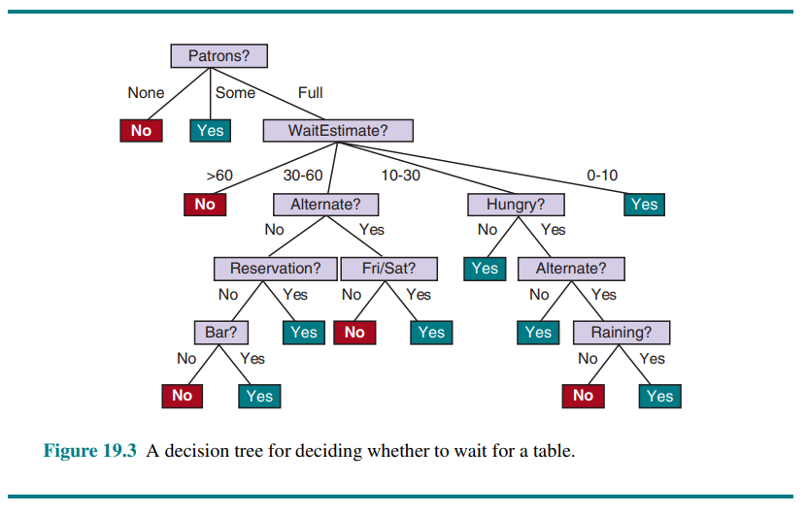
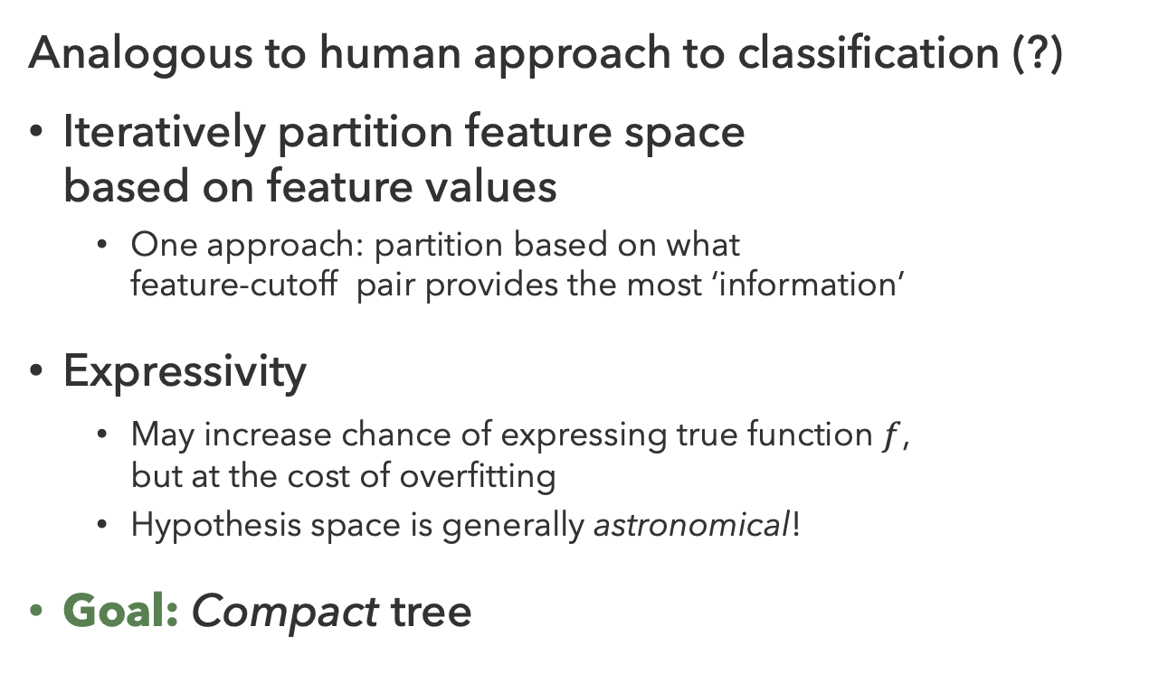
Decision Trees
Analogous to human approach to classification (?)
Iteratively partition feature space
based on feature values
  One approach: partition based on what
  feature-cutoff pair provides the most ‘information’
Expressivity
  May increase chance of expressing true function $f$,
  but at the cost of overfitting
  Hypothesis space is generally astronomical!
Goal: Compact tree

Slide 23
Questions (3)

Slide 24
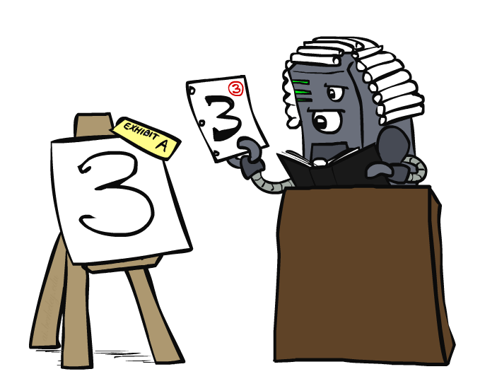
Case-Based Learning

Slide 25
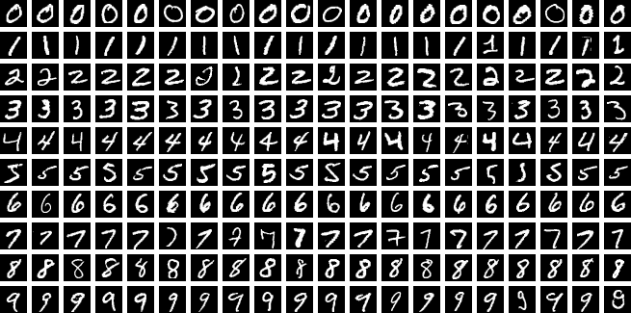
Digit Classification
The MNIST handwritten digit dataset contains 70,000 28x28 images of digits

Slide 26
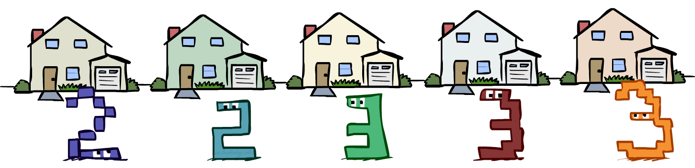
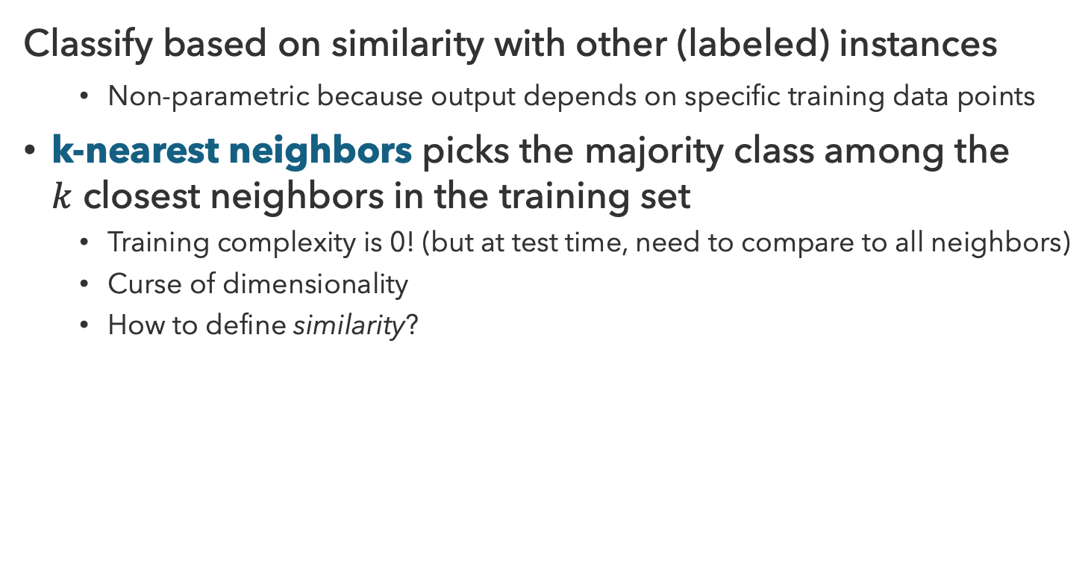
Nearest Neighbors
Classify based on similarity with other (labeled) instances
  Non-parametric because output depends on specific training data points
k-nearest neighbors picks the majority class among the
$k$ closest neighbors in the training set
  Training complexity is 0! (but at test time, need to compare to all neighbors)
  Curse of dimensionality
  How to define similarity?

Slide 27

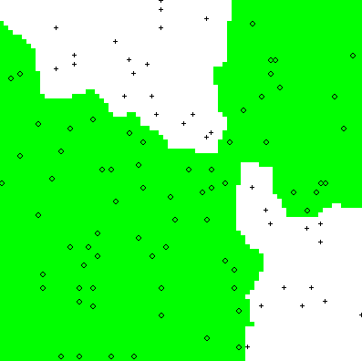
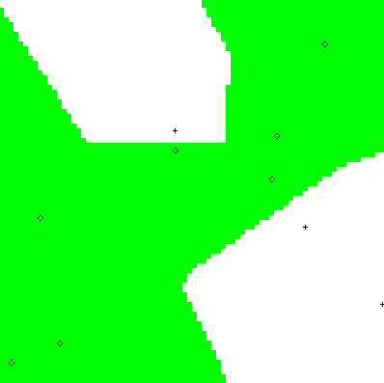
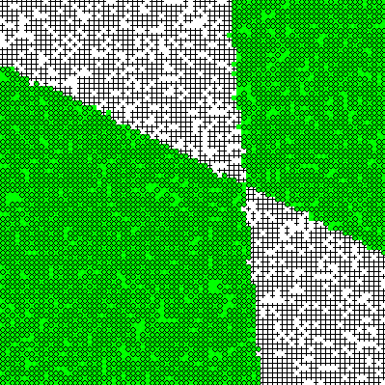

Parametric vs. Non-Parametric
Parametric Models
  Fixed set of parameters, don’t depend on data
  More data means more learning, better accuracy
Non-Parametric Models
  Model output depends on specific training data
  Complexity of the classifier increases with data
  Better in the limit, often worse in the non-limit
Ground Truth
2 Examples
10 Examples
100 Examples
10000 Examples

Slide 28
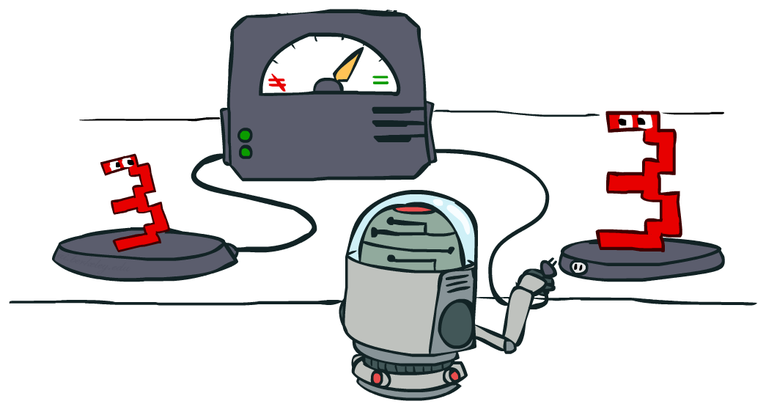

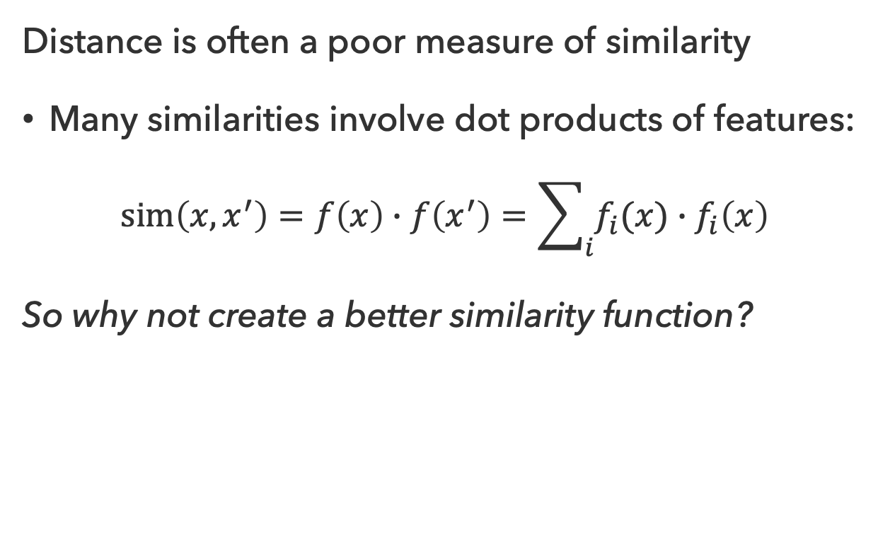

Similarity
Distance is often a poor measure of similarity
Many similarities involve dot products of features:
$$sim\left(x,x^{′}\right)=f\left(x\right)∙f\left(x^{′}\right)=\sum_{i}{f_{i}(x)∙f_{i}\left(x\right)}$$
So why not create a better similarity function?

Slide 29


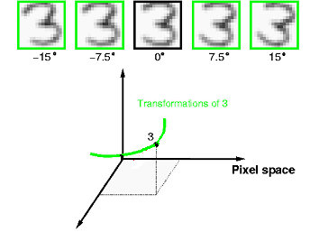
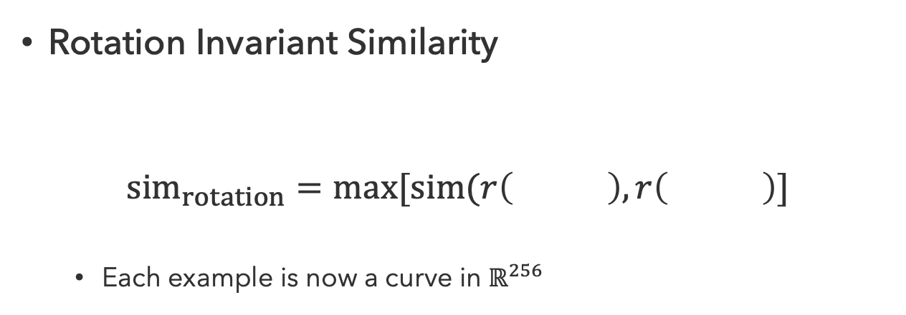
Invariant Metrics
Better similarity functions for digit classification use knowledge about vision
Invariant metrics make similarity invariant under certain transformations
Rotation Invariant Similarity
$${sim}_{rotation}=\max{[sim(r\left( \right),r\left( \right)]}$$
  Each example is now a curve in $ℝ^{256}$

Slide 30
Questions (4)

Slide 31
Taking Stock
How do these models compare?
Model | Test Acc. | Train Time | Test Time
Logistic Reg. | 92.55% | 176.6s | 0.01s
SVM (RBF) | 96.85% | 2.9s | 7.74s
Decision Tree | 87.58% | 8.2s | 0.01s
kNN (k=5) | 96.88% | 0.1s | 3.58s
Neural Net. | ? | ? | ?
One-shot benchmark using standard sklearn implementations (no hyperparameter tuning). Python notebook generated by Claude Code.
Benchmark experiment Inspired by Michael Nielsen

Slide 32
that’s it for today!
Linear, tree-based, and case-based approaches to classification
Tradeoffs in expressivity, training/inference time, interpretability
Test 2
Neural Networks
Complete Practice Problem 17
Do Homework 3 (due 8.6)
Do Project 4 (due 8.13)

