Slide 1
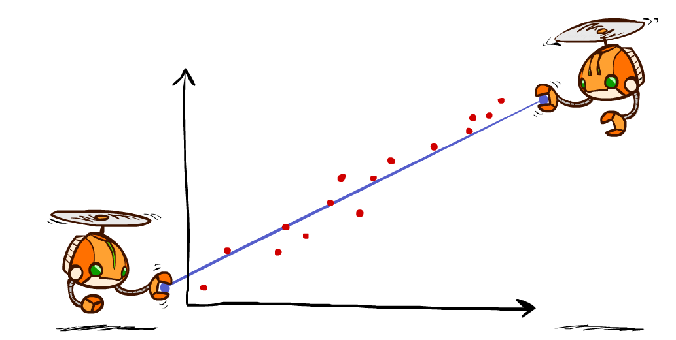
Machine Learning II: Regression
CSE 473: Introduction to Artificial Intelligence
James Weichert (jpw@cs)
cs.uw.edu/473
acknowledgements
Welcome!
What’s your favorite summertime activity?
sli.do #cse473

Slide 2

Administrivia
Test 2 this Friday
  One double-sided 8.5x11” note sheet allowed
  Focus on RL and probabilistic inference
  One question on basic ML
Homework 3 due this Thursday (8.6)
Project 4 due next week (8.13)

Slide 3
Mapping Machine Learning
Artificial Intelligence
Machine Learning
Supervised Learning
Regression
Classification
Unsupervised Learning

Slide 4
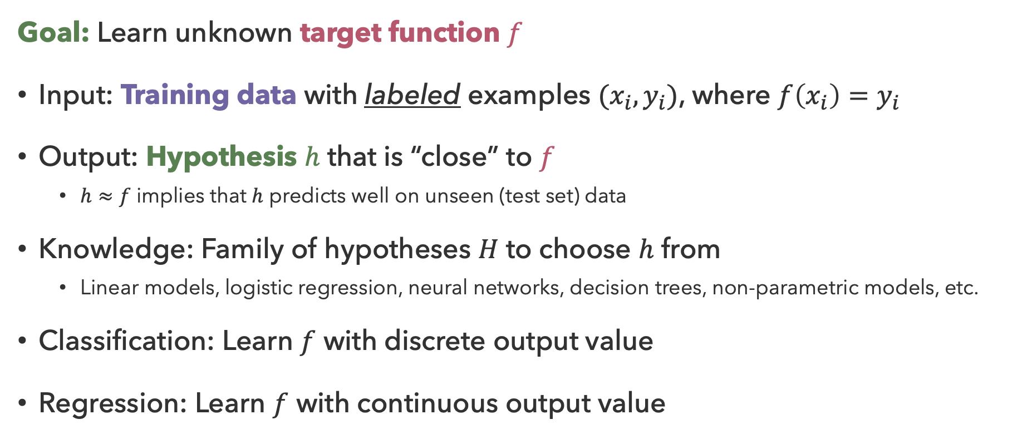
Supervised Learning
Goal: Learn unknown target function $f$
Input: Training data with labeled examples $(x_{i},y_{i})$, where $f\left(x_{i}\right)=y_{i}$
Output: Hypothesis $h$ that is “close” to $f$
  $h≈f$ implies that $h$ predicts well on unseen (test set) data
Knowledge: Family of hypotheses $H$ to choose $h$ from
  Linear models, logistic regression, neural networks, decision trees, non-parametric models, etc.
Classification: Learn $f$ with discrete output value
Regression: Learn $f$ with continuous output value

Slide 5
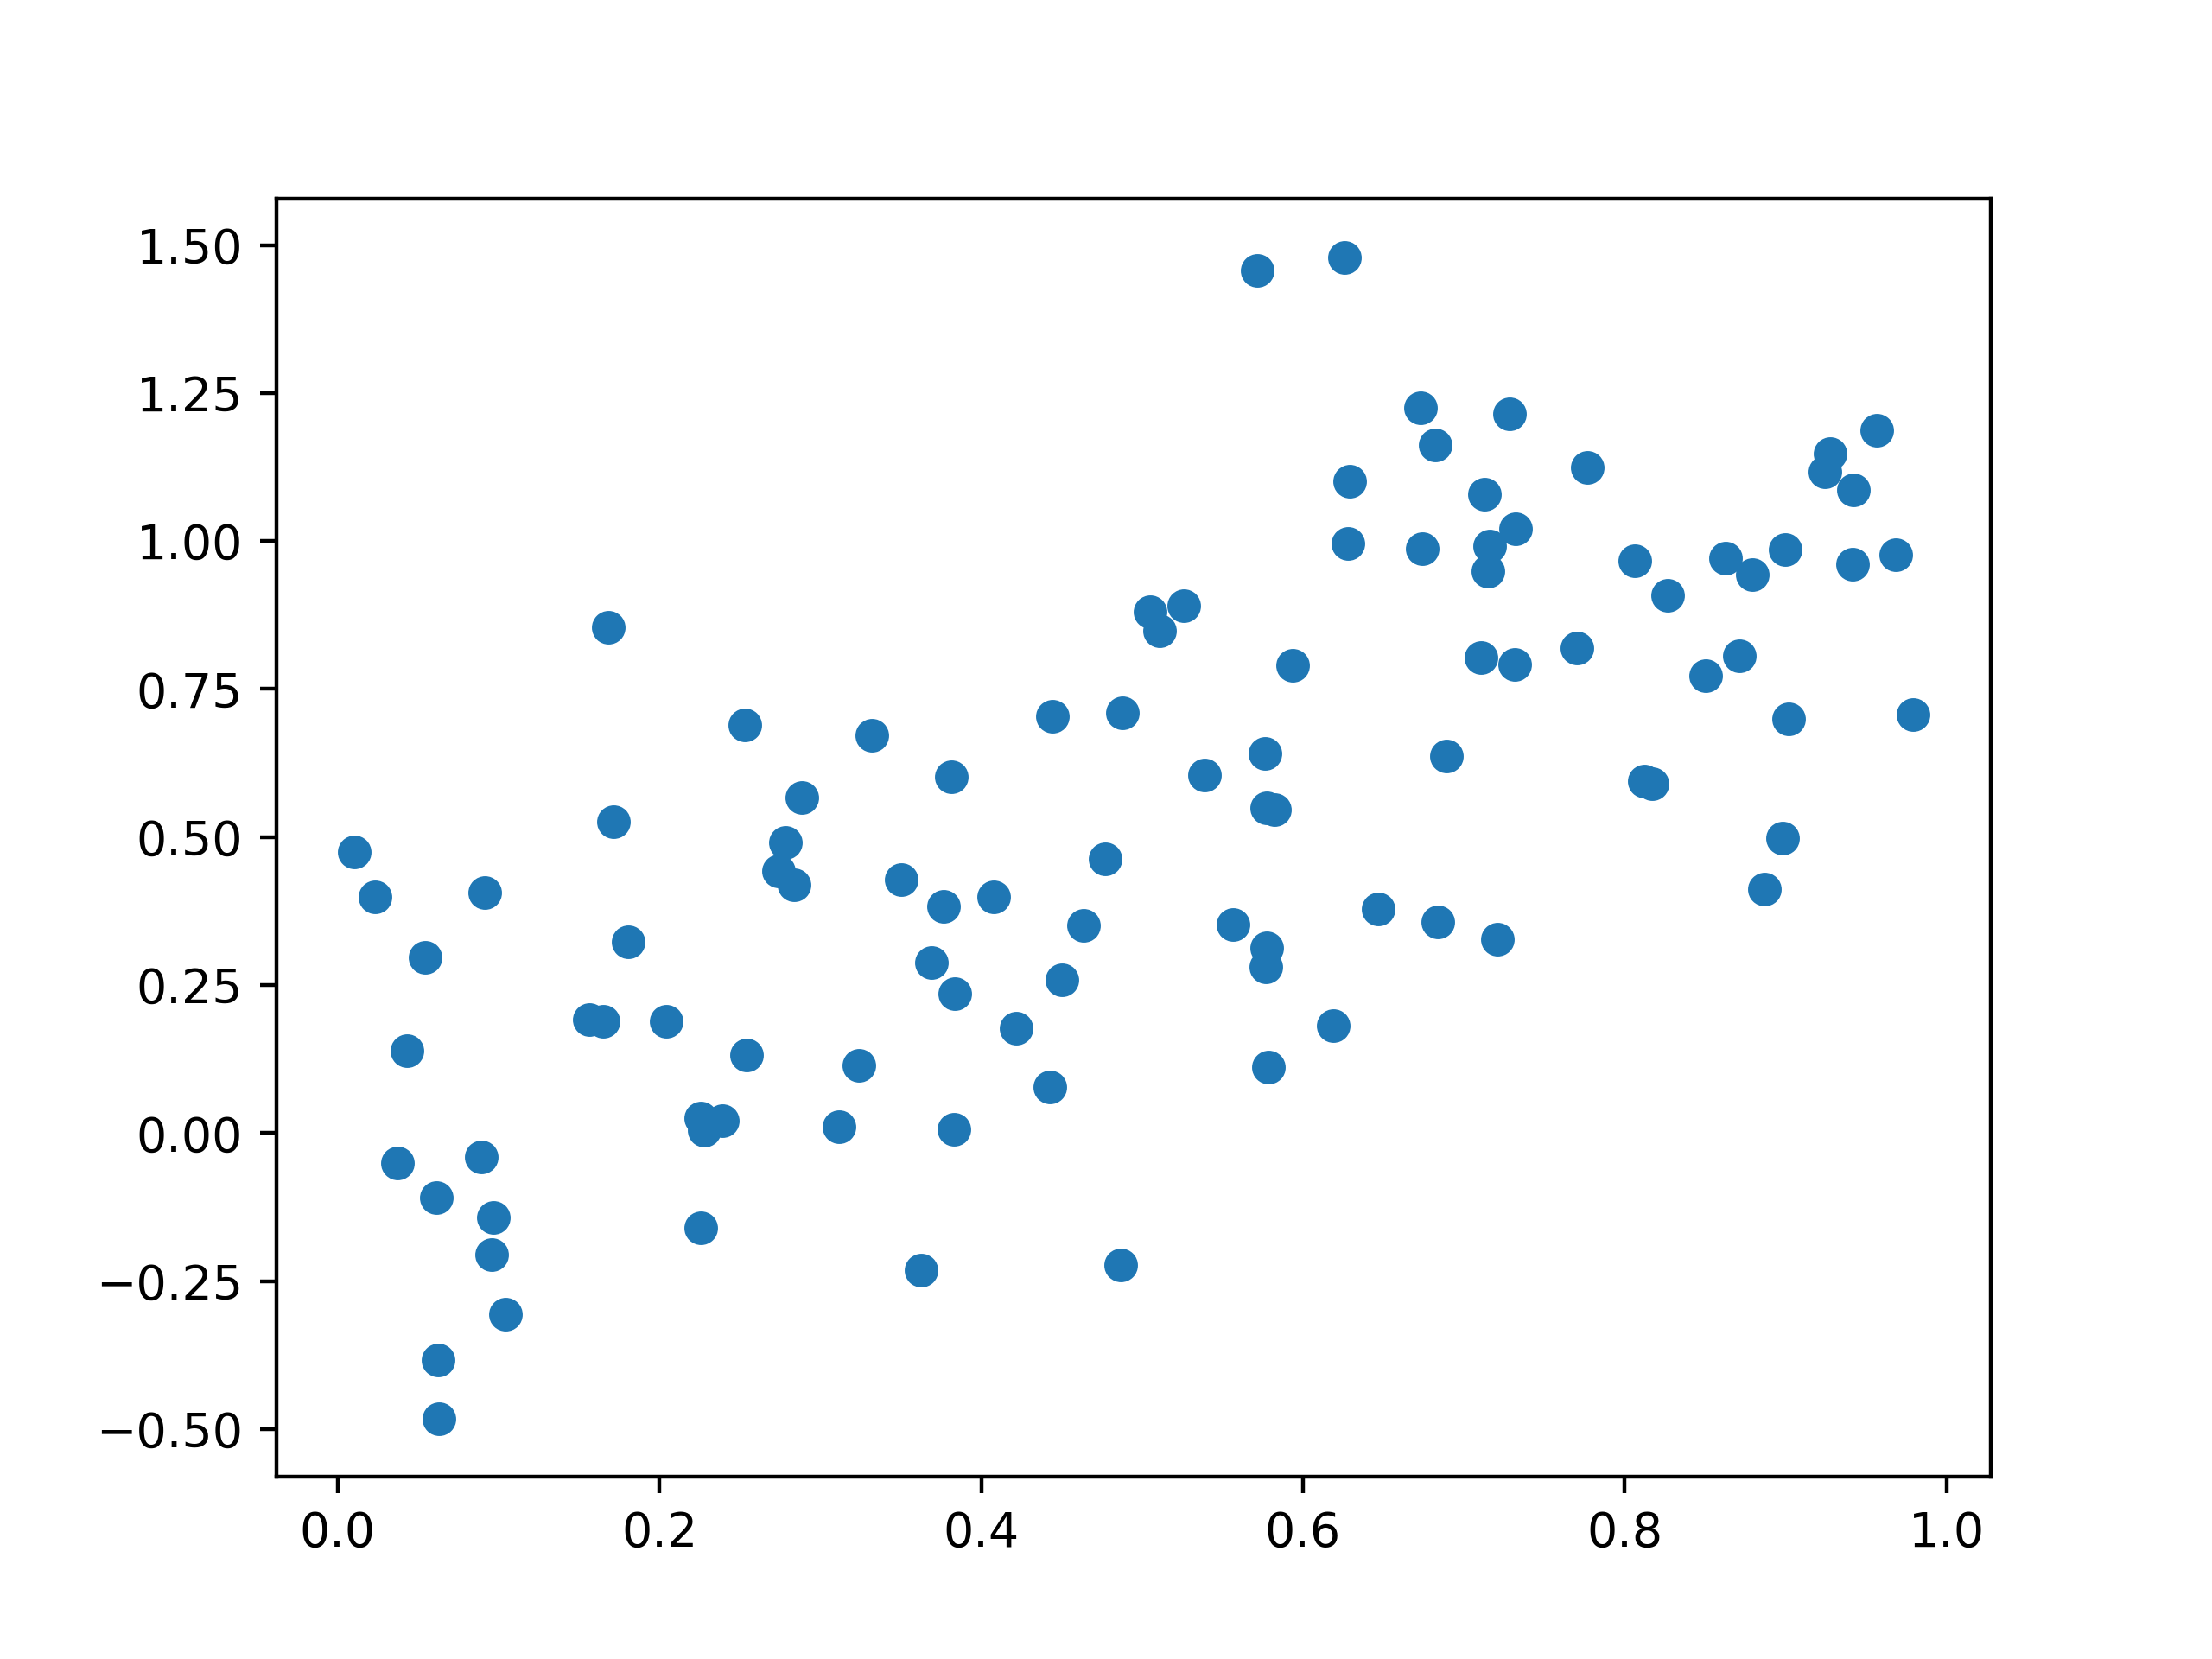
What is the best fit?

Slide 6

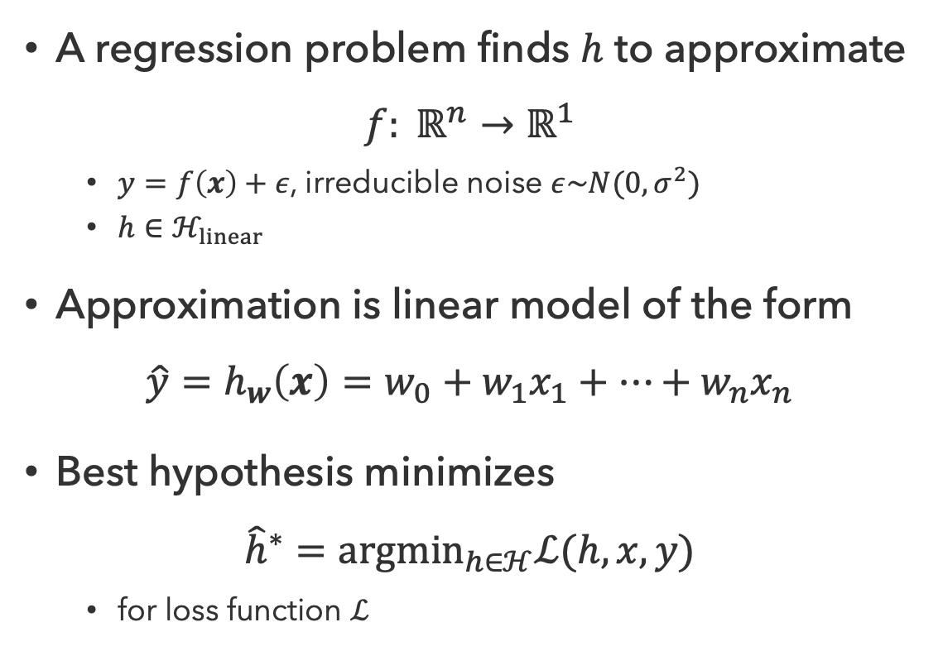


Regression
40
$$h(x)$$
A regression problem finds $h$ to approximate
$$f: ℝ^{n}→ℝ^{1}$$
  $y=f\left(x\right)+ε$, irreducible noise $ε\sim N(0,σ^{2})$
  $h∈ℋ_{linear}$
Approximation is linear model of the form
$$\hat{y}=h_{w}\left(x\right)=w_{0}+w_{1}x_{1}+…+w_{n}x_{n}$$
Best hypothesis minimizes
$${\hat{h}}^{∗}={argmin}_{h∈ℋ}ℒ(h, x, y)$$
  for loss function $ℒ$
$$\hat{y}$$
20
0
0
20
$$x$$
26
24
22
20
30
40
20
30
10
10
20
0
0

Slide 7
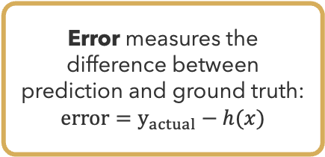
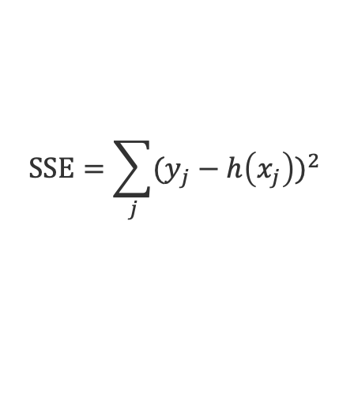
Measuring Loss
Error measures the difference between prediction and ground truth:
$$error=y_{actual}−h(x)$$
Loss describes the total (unsigned) deviation from the desired values
$$SSE=\sum_{j}{(y_{j}−h\left(x_{j}\right))^{2}}$$

Slide 8
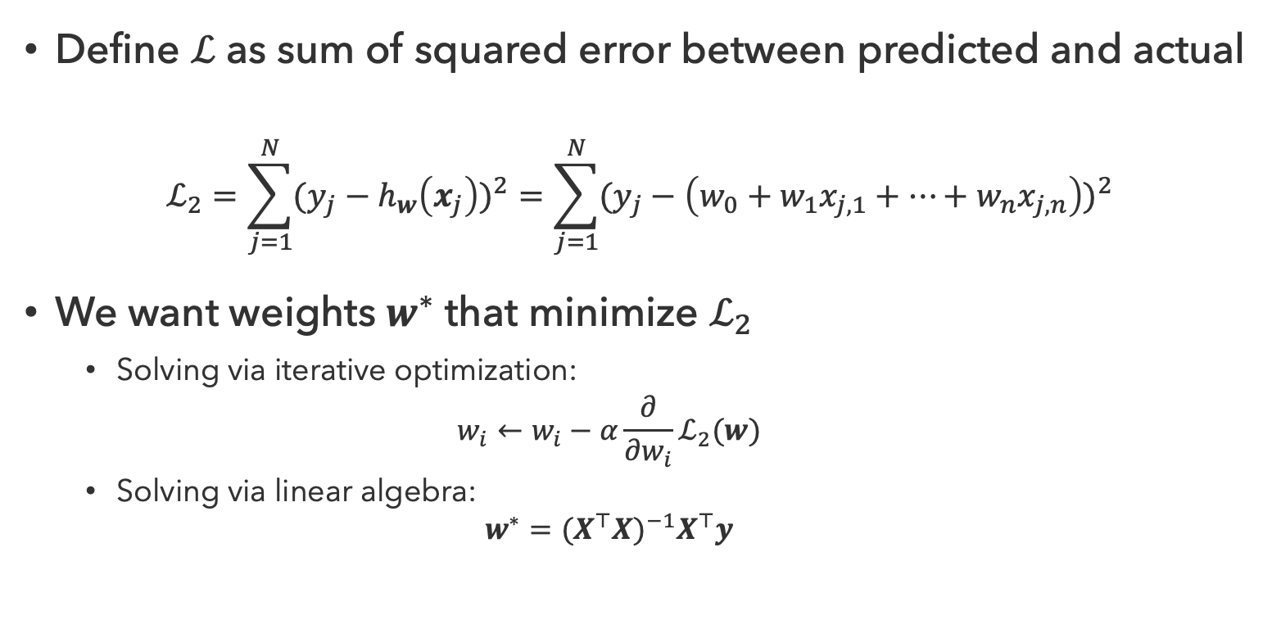
Least Squares Regression
Define $ℒ$ as sum of squared error between predicted and actual
$$ℒ_{2}=\sum_{j=1}^{N}{(y_{j}−h_{w}\left(x_{j}\right))^{2}}=\sum_{j=1}^{N}{(y_{j}−\left(w_{0}+w_{1}x_{j,1}+…+w_{n}x_{j, n}\right))^{2}}$$
We want weights $w^{∗}$ that minimize $ℒ_{2}$
  Solving via iterative optimization:
  $$w_{i}←w_{i}−α\frac{∂}{∂w_{i}}ℒ_{2}(w)$$
  Solving via linear algebra:
  $$w^{∗}=(X^{⊤}X)^{−1}X^{⊤}y$$

Slide 9
Questions (1)

Slide 10
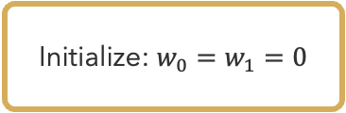



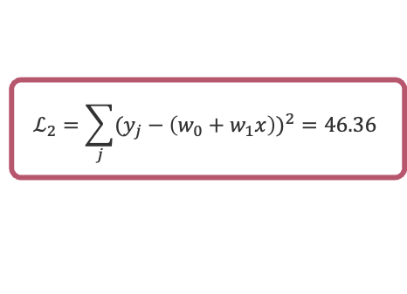
Least Squares in Action
Initialize: $w_{0}=w_{1}=0$
$$ℒ_{2}=\sum_{j}{(y_{j}−\left(w_{0}+w_{1}x\right))^{2}}=46.36$$
$$\frac{∂}{∂w_{1}}ℒ_{2}=−69.5$$
$$w_{1}←w_{1}−\left(0.005\right)∙\left(−69.5\right)=0.35$$
$$w_{0}←w_{0}−\left(0.01\right)∙\frac{∂}{∂w_{0}}ℒ_{2}=0.53$$

Slide 11




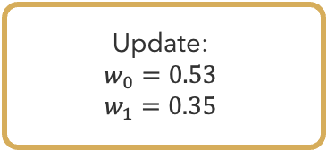
Least Squares in Action (2)
Update:
$$w_{0}=0.53$$
$$w_{1}=0.35$$
$$ℒ_{2}=\sum_{j}{(y_{j}−\left(w_{0}+w_{1}x\right))^{2}}=17.07$$
$$\frac{∂}{∂w_{1}}ℒ_{2}=6.72$$
$$w_{1}←w_{1}−\left(0.005\right)∙\left(6.72\right)=0.32$$
$$w_{0}←w_{0}−\left(0.005\right)∙\frac{∂}{∂w_{0}}ℒ_{2}=0.35$$

Slide 12





Least Squares in Action (3)
Update:
$$w_{0}=0.35$$
$$w_{1}=0.32$$
$$ℒ_{2}=\sum_{j}{(y_{j}−\left(w_{0}+w_{1}x\right))^{2}}=14.14$$
$$\frac{∂}{∂w_{1}}ℒ_{2}=−13.3$$
$$w_{1}←w_{1}−\left(0.005\right)∙\left(−13.3\right)=0.39$$
$$w_{0}←w_{0}−\left(0.005\right)∙\frac{∂}{∂w_{0}}ℒ_{2}=0.36$$

Slide 13
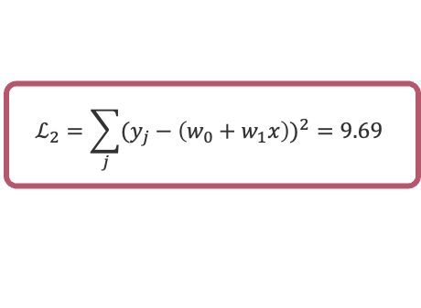
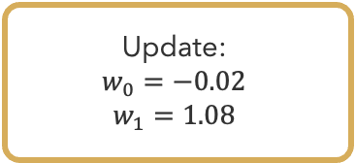
Least Squares in Action (100)
Update:
$$w_{0}=−0.02$$
$$w_{1}=1.08$$
$$ℒ_{2}=\sum_{j}{(y_{j}−\left(w_{0}+w_{1}x\right))^{2}}=9.69$$

Slide 14
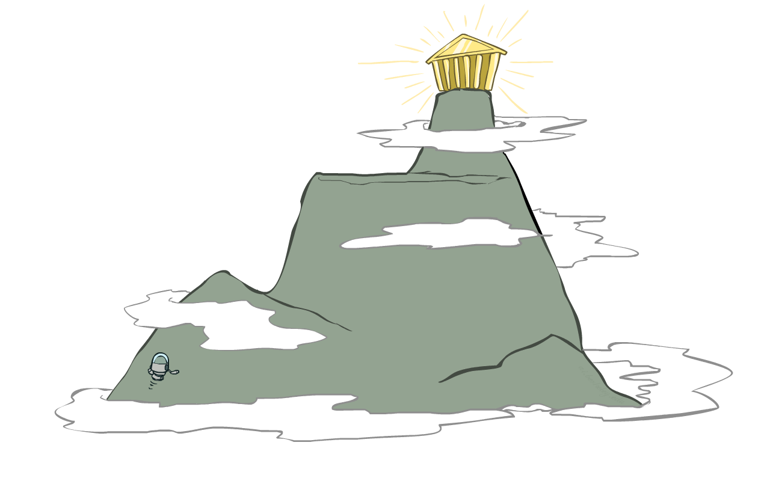
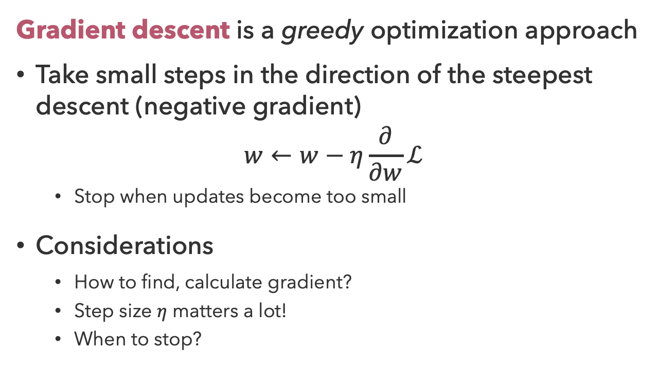
Gradient Descent
Gradient descent is a greedy optimization approach
Take small steps in the direction of the steepest descent (negative gradient)
$$w←w−η\frac{∂}{∂w}ℒ$$
  Stop when updates become too small
Considerations
  How to find, calculate gradient?
  Step size $η$ matters a lot!
  When to stop?

Slide 15
Questions (2)

Slide 16
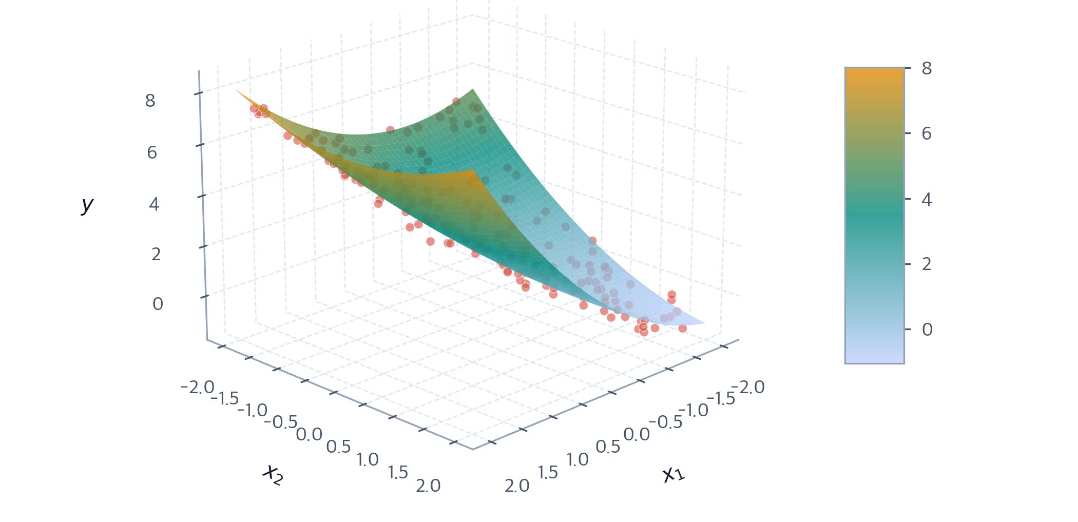

Polynomial Regression
Goal: Find the curve (surface) that minimizes the loss function
Model is polynomial, coefficients are still linear
$$h\left(x\right)=w_{0}+w_{1}x+w_{2}x^{2}+w_{3}x^{3}=w_{0}+w_{1}x+w_{2}z_{2}\left(x\right)+w_{3}z_{3}(x)$$

Slide 17
What is the best “fit”?
30
degree 15 polynomial
25
20
degree 2 polynomial
15
10
5
0
-5
-10
-15
0
2
4
6
8
10
12
14
16
18
20

Slide 18
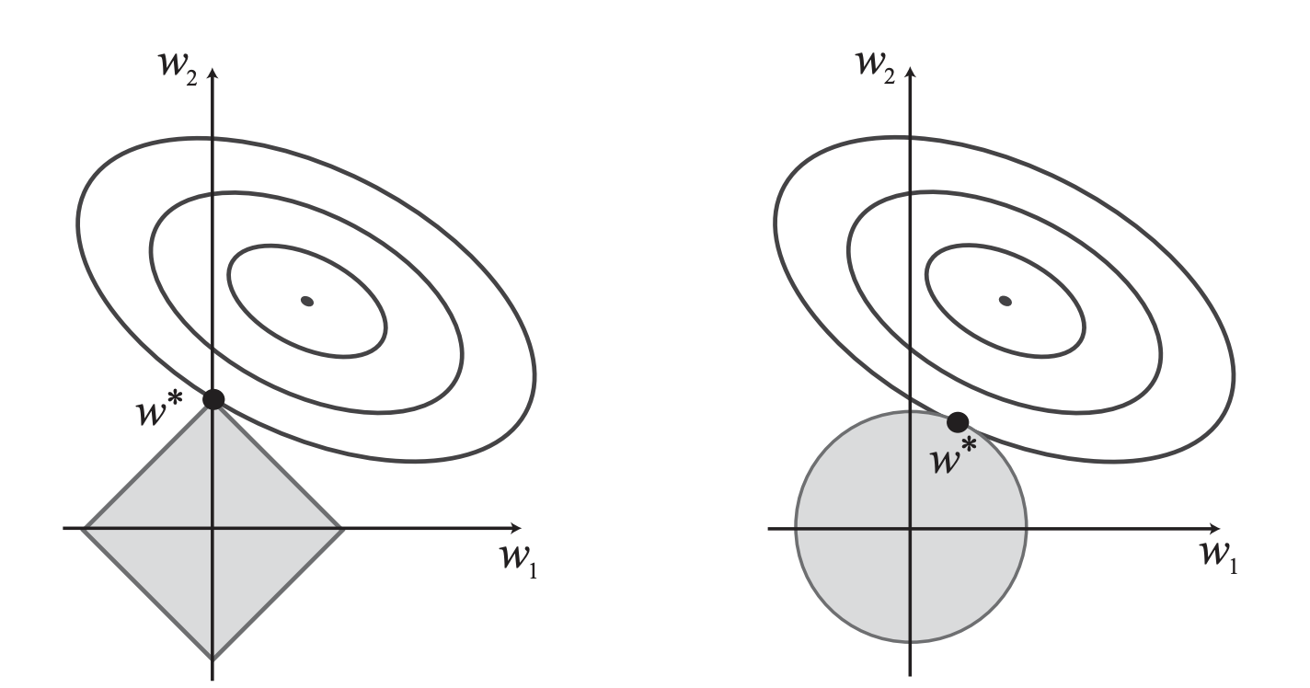

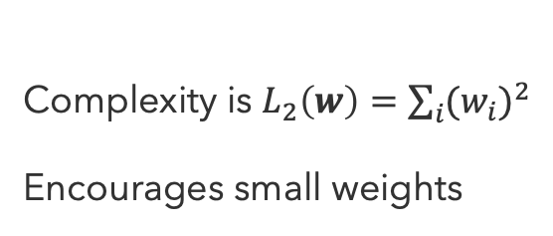
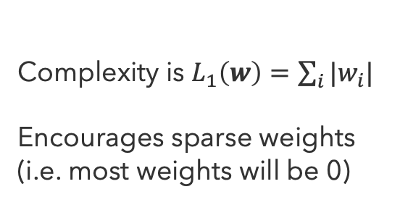
Regularization
Regularization limits overfitting (variance) by constraining parameter values
$ℒ_{regularized}=ℒ_{error}+λ∙Complexity$
LASSO
Ridge
Complexity is $L_{1}\left(w\right)=\sum_{i}{|w_{i}|}$
Encourages sparse weights (i.e. most weights will be 0)
Complexity is $L_{2}\left(w\right)=\sum_{i}{(w_{i})^{2}}$
Encourages small weights

Slide 19
Questions (3)

Slide 20
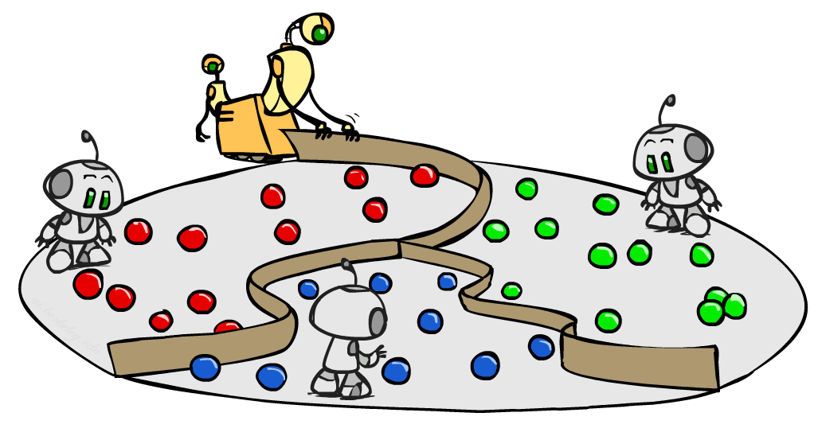
From Continuous to Discrete

Slide 21
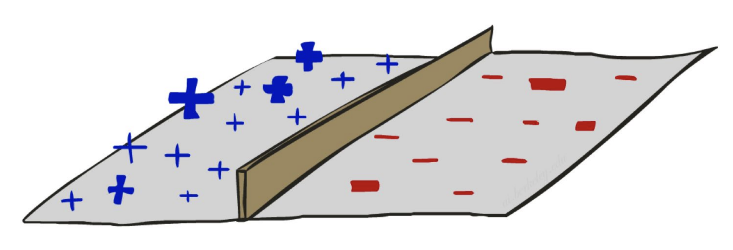
Decision Boundaries
A decision boundary demarcates where in the feature space the classification changes
  Small movements to either side of the boundary changes the classification
  Not necessarily parametric

Slide 22
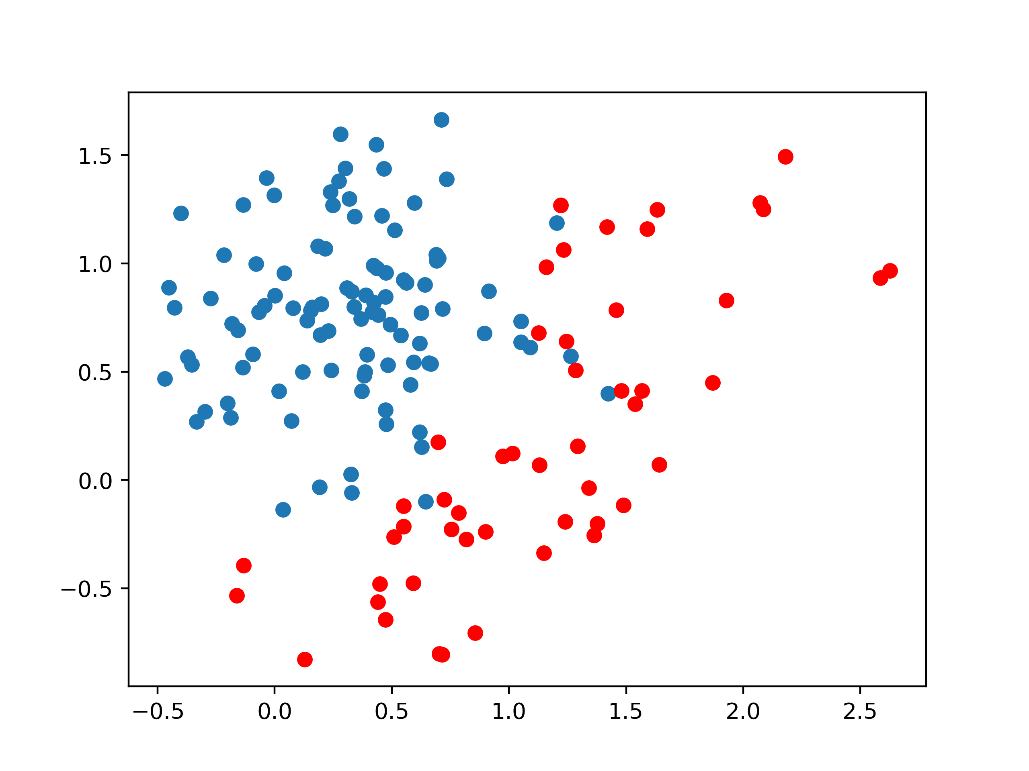
What is the best “fit”?
Feature 2
Feature 1

Slide 23
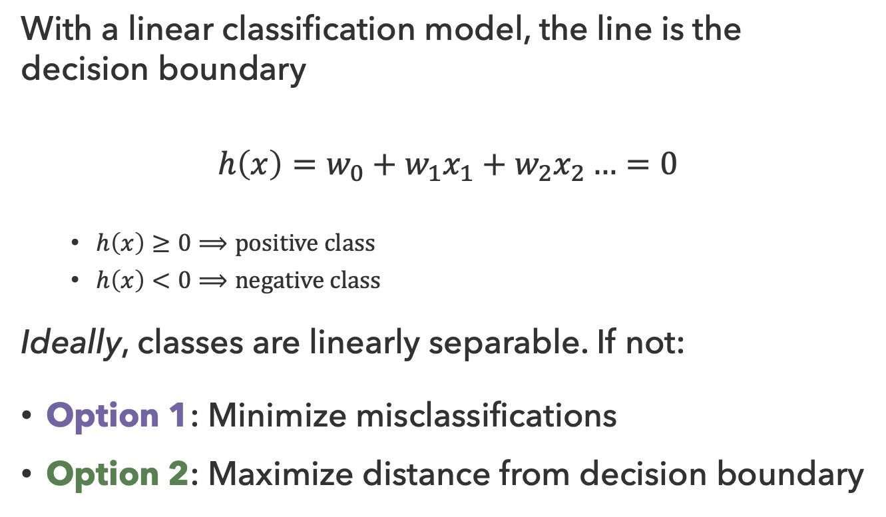
Binary Classification
With a linear classification model, the line is the decision boundary
$$h\left(x\right)=w_{0}+w_{1}x_{1}+w_{2}x_{2}…=0$$
  $h\left(x\right)≥0⟹positive class$
  $h\left(x\right)<0⟹negative class$
Ideally, classes are linearly separable. If not:
Option 1: Minimize misclassifications
Option 2: Maximize distance from decision boundary

Slide 24
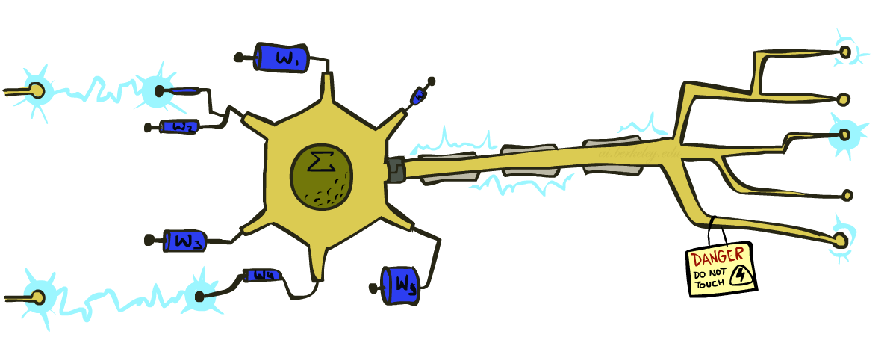
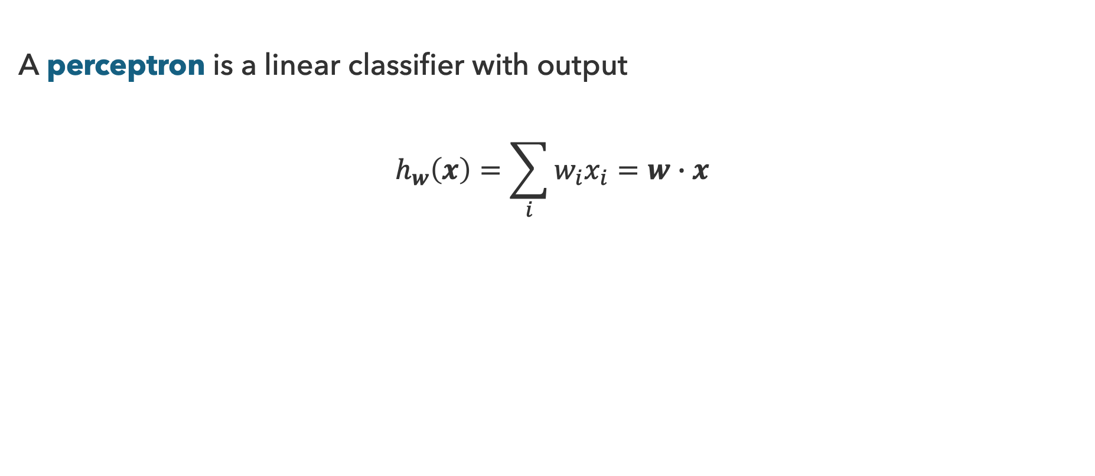
Perceptron
A perceptron is a linear classifier with output
$$h_{w}\left(x\right)=\sum_{i}{w_{i}x_{i}}=w∙x$$

Slide 25


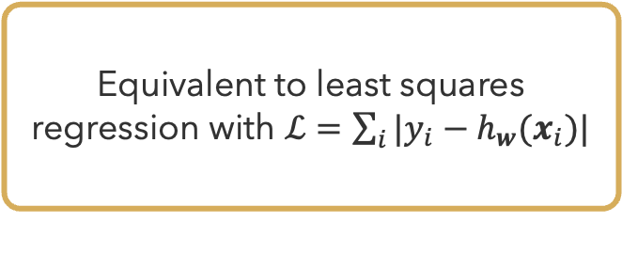
Perceptron Learning
Repeat while not converged ($∃i y_{i}≠h_{w}(x_{i})$):
For each data point $i$ do:
  $w←w−η(y_{i}−h_{w}(x_{i}))x_{i}$
Gradient
Equivalent to least squares regression with $ℒ=\sum_{i}{|y_{i}−h_{w}(x_{i})|}$

Slide 26

Convergence?
Depends on linear separability
If data are separable:
  Perceptron learning will eventually converge to a separator with no misclassifications
If data are not separable:
  Perceptron learning will converge to a minimum-error solution (provided learning rate is decayed)

Slide 27

Non-Linear Separators
Goal: Map original feature space to higher-dimensional feature space where training set is separable
$$Φ:x→φ(x)$$
adapted from Ray Mooney, UT

Slide 28
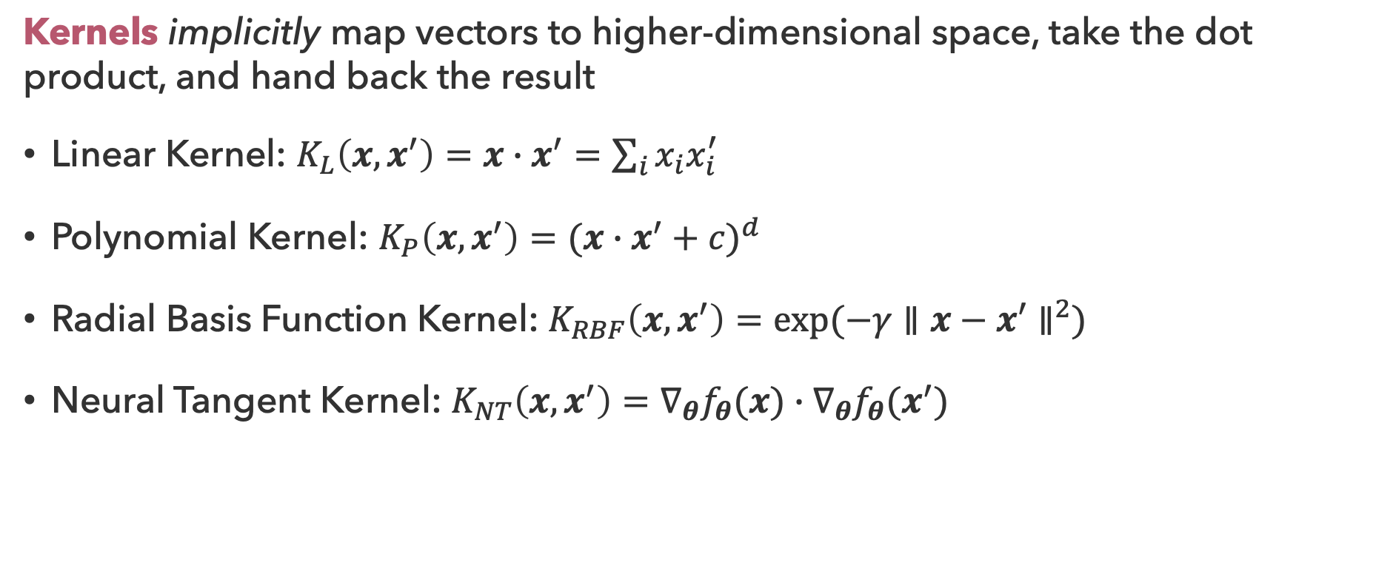
Kernels
Kernels implicitly map vectors to higher-dimensional space, take the dot product, and hand back the result
Linear Kernel: $K_{L}\left(x,x^{′}\right)=x∙x^{′}=\sum_{i}{x_{i}x_{i}^{′}}$
Polynomial Kernel: $K_{P}\left(x,x^{′}\right)=(x∙x^{′}+c)^{d}$
Radial Basis Function Kernel: $K_{RBF}\left(x,x^{′}\right)=exp⁡(−γ∥x−x′∥^{2})$
Neural Tangent Kernel: $K_{NT}\left(x,x^{′}\right)=∇_{θ}f_{θ}(x)∙∇_{θ}f_{θ}(x^{′})$

Slide 29
Questions (4)

Slide 30
that’s it for today!
Regression is an optimization problem with the goal of minimizing the loss function
Regularization limits overfitting by controlling parameter sizes
The same optimization process can be used to fit a decision boundary
Classification
Neural Networks
Complete Practice Problem 16
Do Homework 3 (due 8.6)
Test 2 on Friday (8.7)
Do Project 4 (due 8.13)

