Slide 1
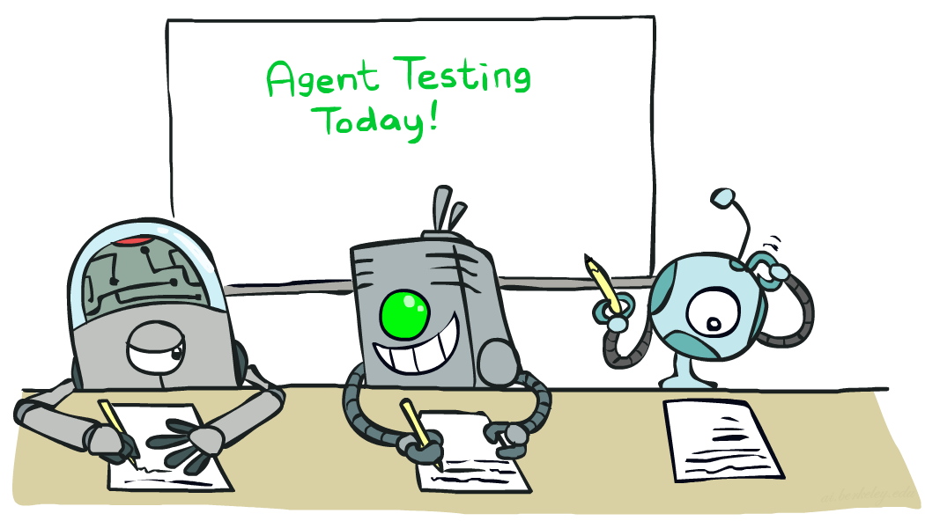
Machine Learning
CSE 473: Introduction to Artificial Intelligence
James Weichert (jpw@cs)
cs.uw.edu/473
acknowledgements
Welcome!
What’s your favorite summertime activity?
sli.do #cse473

Slide 2

Administrivia
Test 2 next Friday
  One double-sided 8.5x11” note sheet allowed
Homework 3 due next Thursday (8.6)
Project 4 due in two weeks (8.13)

Slide 3
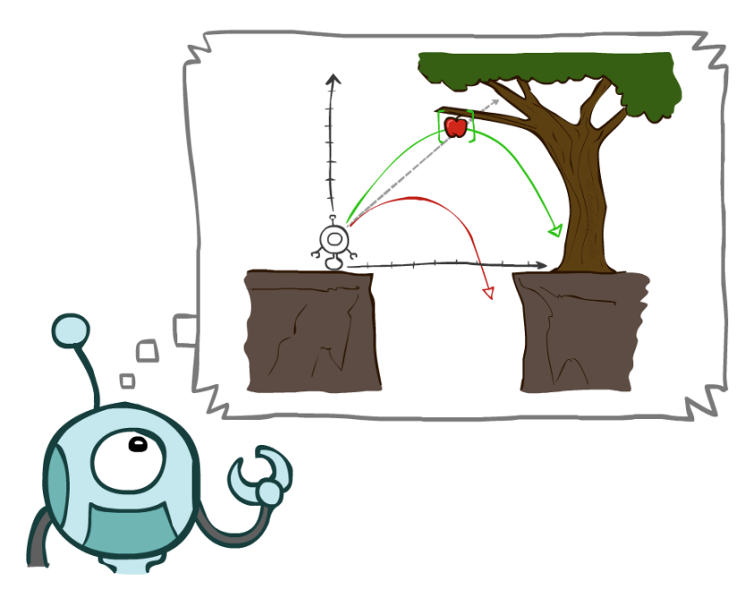
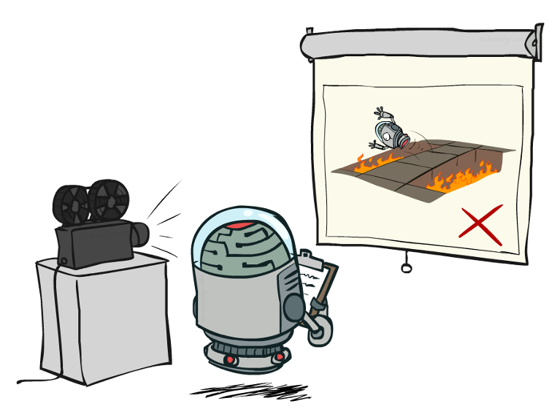

Taking Stock

Slide 4
Machine Learning?
How to construct a model of the world from data or experience
Learn Parameters
Learn Structure
Learn Patterns

Slide 5
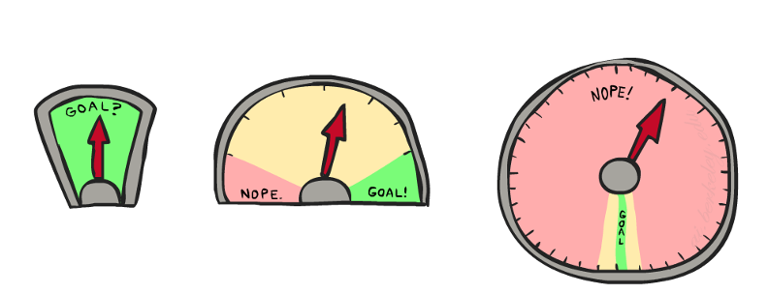
Learning
Learning involves improving an agent’s performance through experience
How to define performance?
How to improve? How to tell if the agent is improving?
What constitutes experience? How to relate to new experiences?

Slide 6
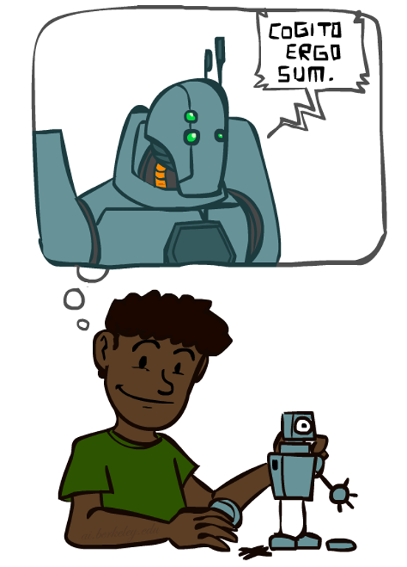
Why ”Learning”?

Slide 7

Learning Agents
Learning involves improving an agent’s performance through experience
How does performance relate to the agent’s design?
How does improvement in performance manifest?
What data are relevant to that part of the system?
What knowledge is available or assumed?

Slide 8
Contextualizing CSE 473 So Far
Agent | Component | Representation | Feedback | Knowledge
Adversarial Search | Evaluation function | Linear polynomial | Win/loss utility | Rules of game
Planning Agent | Transition model | Successor transitions | Action outcomes | Available actions
Weather Model | Graph model | Bayesian network | Observations | Topology assumptions
Localization | Sensor model | Hidden Markov model | Sensor readings | Sensor information
Image Classifier | Classification model | Naïve Bayes classifier | Training labels | Network architecture
Language Model | N-gram model | Markov Chain | Word frequencies | Value of n

Slide 9
Questions (1)

Slide 10
A Broad Segmentation
Artificial Intelligence
Machine Learning
Supervised Learning
Unsupervised Learning

Slide 11
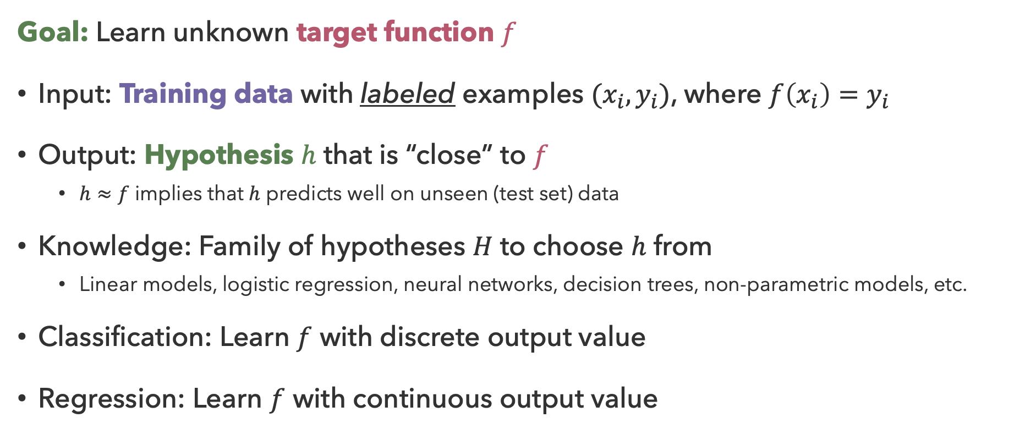
Supervised Learning
Goal: Learn unknown target function $f$
Input: Training data with labeled examples $(x_{i},y_{i})$, where $f\left(x_{i}\right)=y_{i}$
Output: Hypothesis $h$ that is “close” to $f$
  $h≈f$ implies that $h$ predicts well on unseen (test set) data
Knowledge: Family of hypotheses $H$ to choose $h$ from
  Linear models, logistic regression, neural networks, decision trees, non-parametric models, etc.
Classification: Learn $f$ with discrete output value
Regression: Learn $f$ with continuous output value

Slide 12
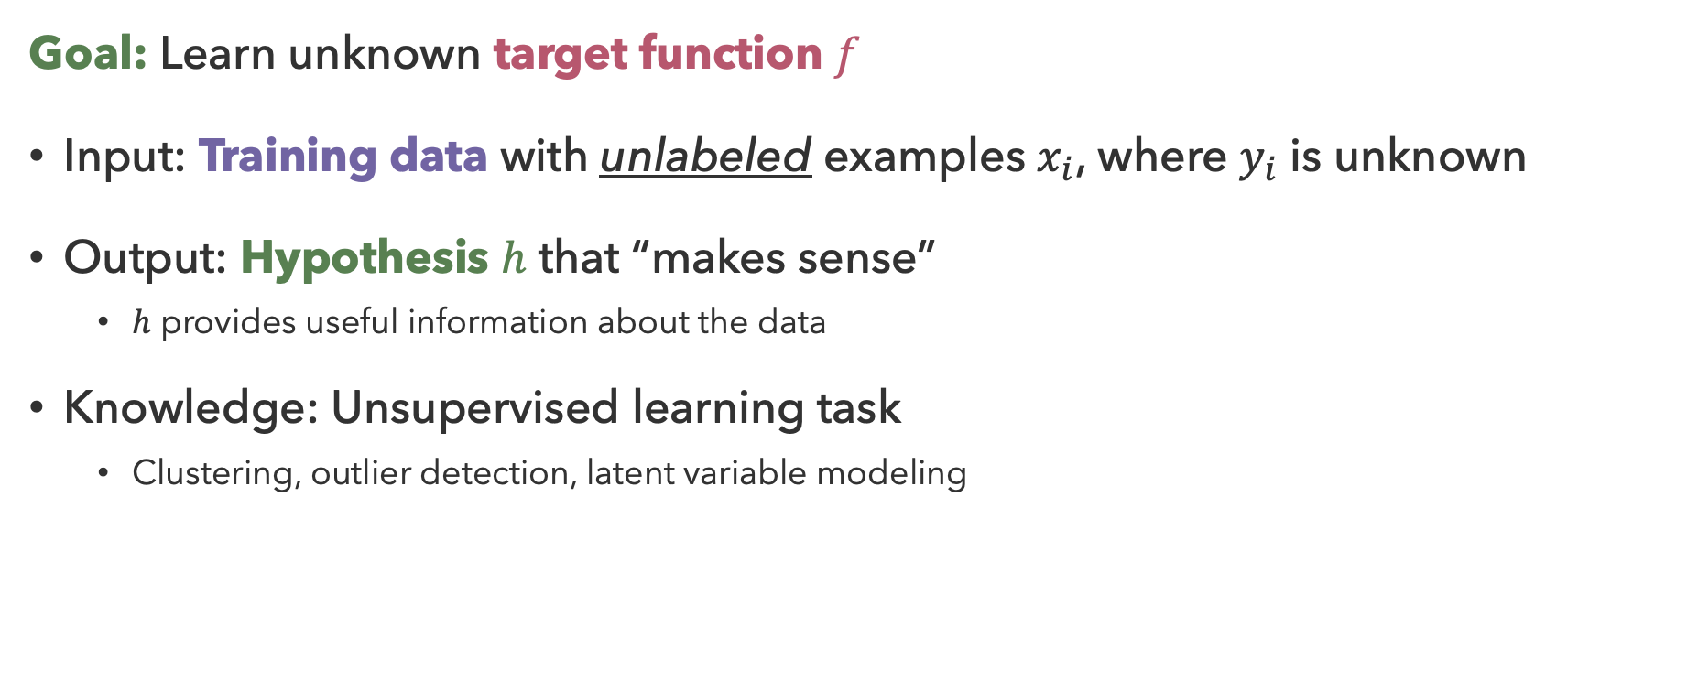
Unsupervised Learning
Goal: Learn unknown target function $f$
Input: Training data with unlabeled examples $x_{i}$, where $y_{i}$ is unknown
Output: Hypothesis $h$ that “makes sense”
  $h$ provides useful information about the data
Knowledge: Unsupervised learning task
  Clustering, outlier detection, latent variable modeling

Slide 13
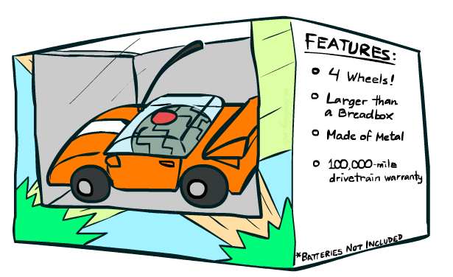

Features
Features ${\overset{⃑}{x}}_{i}$ describe item (observation) $i$
What should the features be?

Slide 14
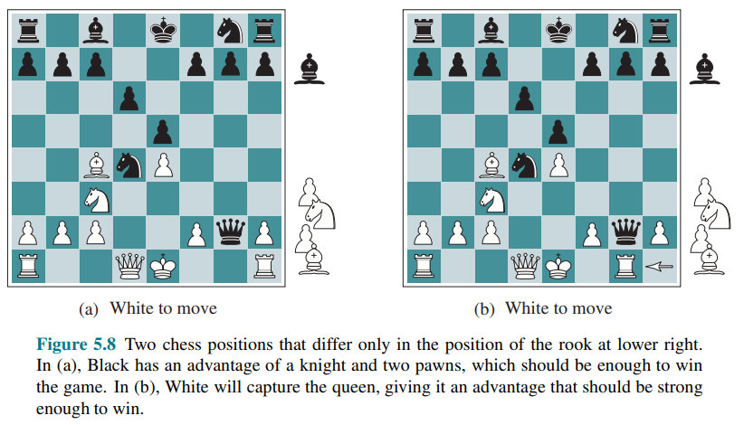
Feature Extraction

Slide 15
Questions (2)

Slide 16
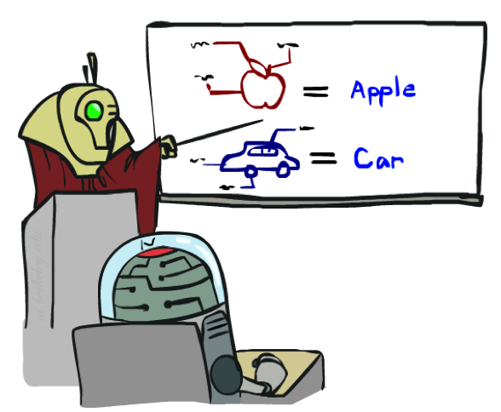


The Learning Process
Learn
Double Check
‘Real Deal’
Training
Validation
Testing

Slide 17



Model Training
Data: labeled instances
  Split into training, validation, and test sets
Features: attribute-value pairs
Experimentation Cycle:
  Learn parameters on training set
  Tune hyperparameters on validation set
  Only when done, open test set “vault”
How to evaluate performance?
Training
Validation
Test

Slide 18
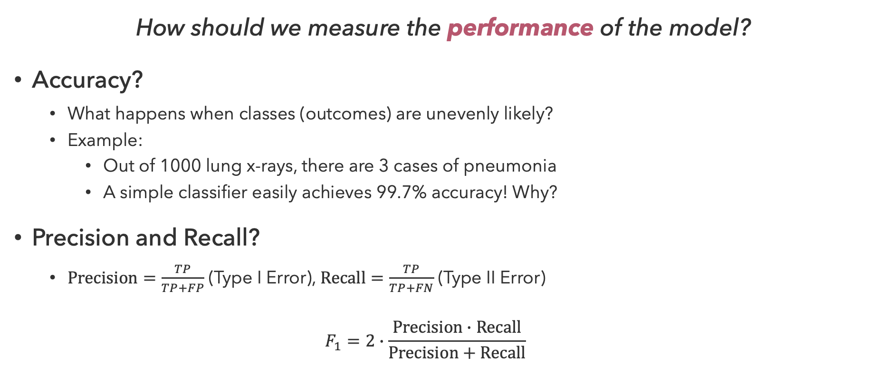
Evaluating Performance
How should we measure the performance of the model?
Accuracy?
  What happens when classes (outcomes) are unevenly likely?
  Example:
    Out of 1000 lung x-rays, there are 3 cases of pneumonia
    A simple classifier easily achieves 99.7% accuracy! Why?
Precision and Recall?
  $Precision=\frac{TP}{TP+FP}$ (Type I Error), $Recall=\frac{TP}{TP+FN}$ (Type II Error)
  $$F_{1}=2∙\frac{Precision∙Recall}{Precision+Recall}$$
guessed +
actual +

Slide 19

The Dark Side of Accuracy
30
25
Degree 15 polynomial
20
15
10
5
0
-5
-10
-15
0
2
4
6
8
10
12
14
16
18
20

Slide 20


Overfitting and Generalization
The variance of the model’s predictions should also be evaluated
  Models that do no generalize to unseen data are not “good”

Slide 21
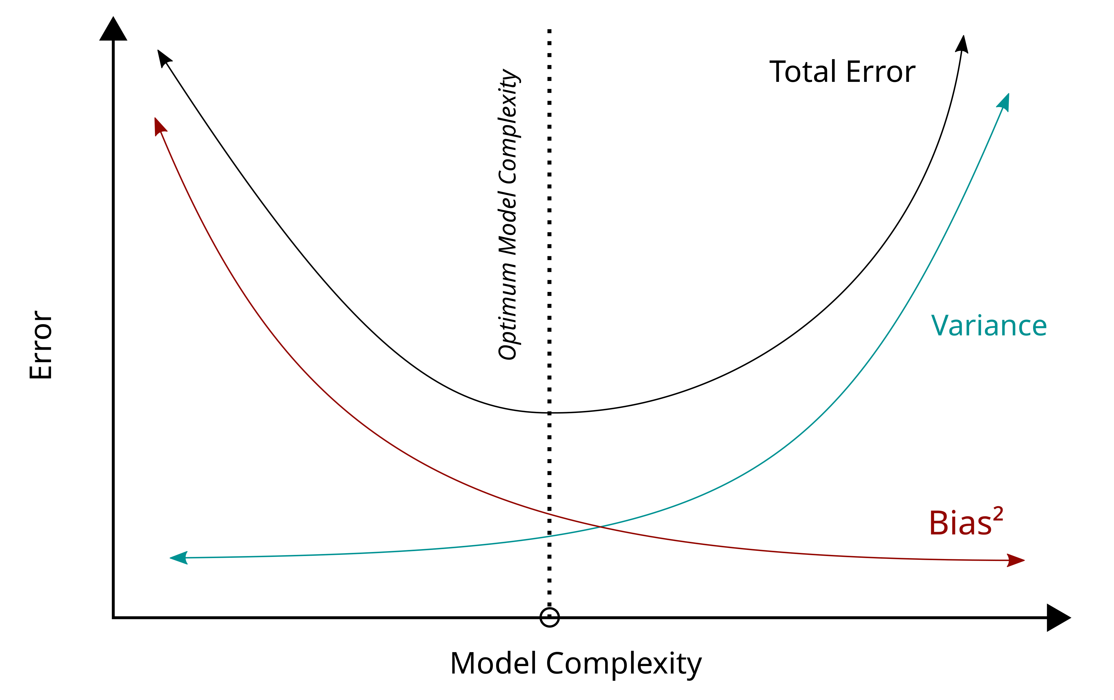
Bias-Variance Tradeoff
Bias (accuracy) and variance both constitute forms of model error
  Minimizing the combined error is tricky, and there is some amount of error that is irreducible

Slide 22
Other evaluation criteria?

Slide 23
Questions (3)

Slide 24
Unsupervised Learning Process?
Learn
Check?
Training

Slide 25
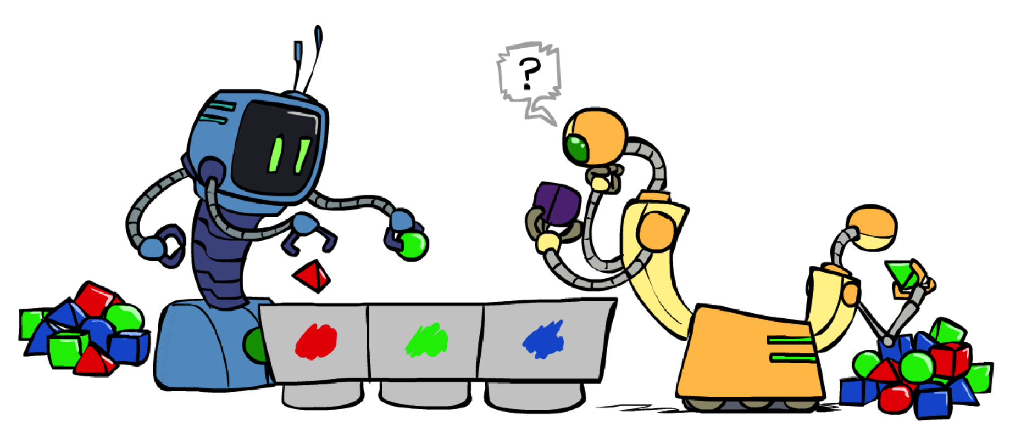
Clustering
Goal: Group together “similar” instances

Slide 26
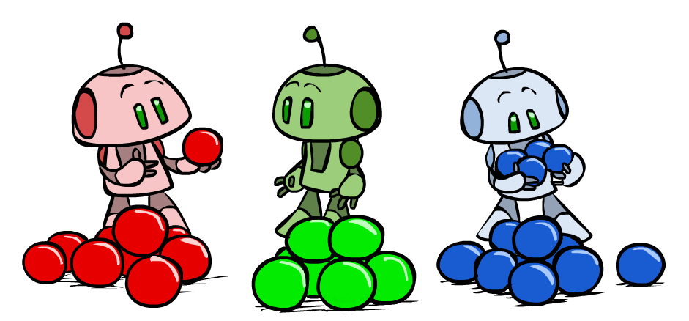
K-Means Clustering
Define similarity as distance between points in feature space
Pick k random points as cluster means
Iterate until convergence (no changes):
  Assign data points to closest cluster mean
  Update cluster means to be the average of the data points in the cluster

Slide 27
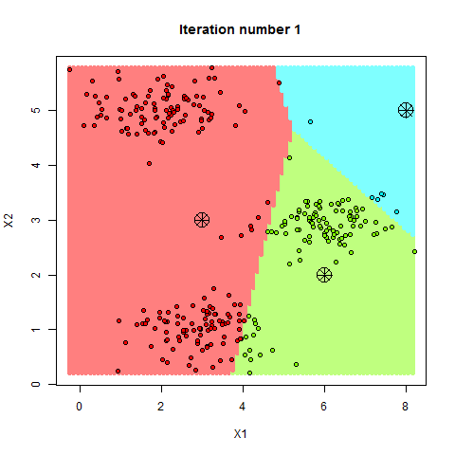
K-Means Example

Slide 28
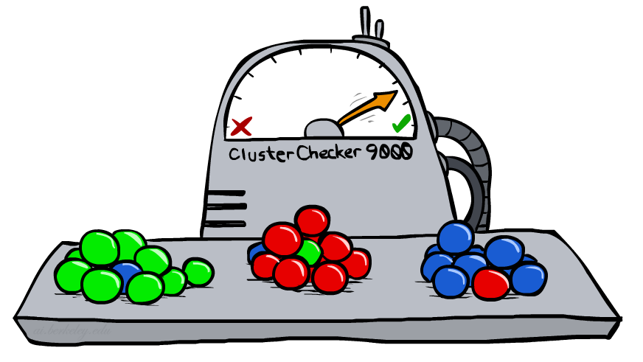
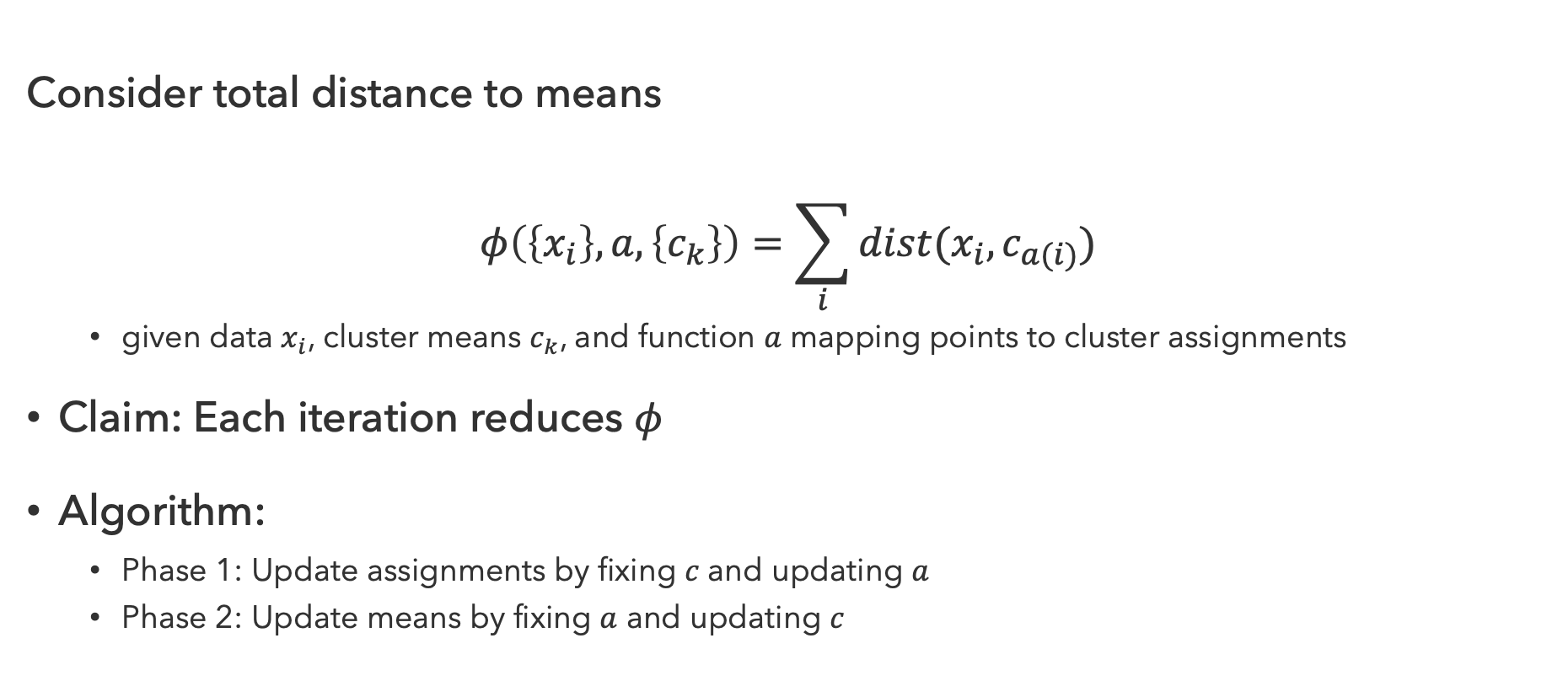
K-Means as Optimization
Consider total distance to means
$$φ\left(\left\{x_{i}\right\}, a, \left\{c_{k}\right\}\right)=\sum_{i}{dist(x_{i}, c_{a(i)}})$$
  given data $x_{i}$, cluster means $c_{k}$, and function $a$ mapping points to cluster assignments
Claim: Each iteration reduces $φ$
Algorithm:
  Phase 1: Update assignments by fixing $c$ and updating $a$
  Phase 2: Update means by fixing $a$ and updating $c$

Slide 29
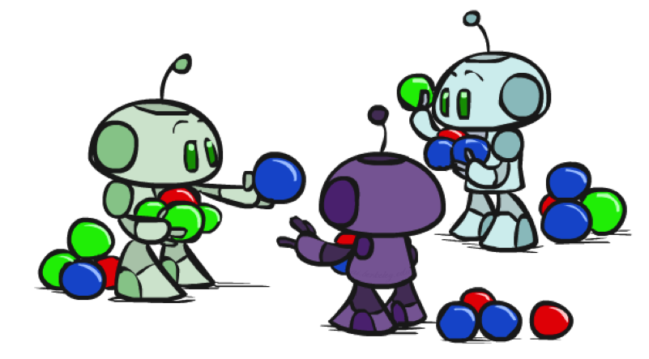
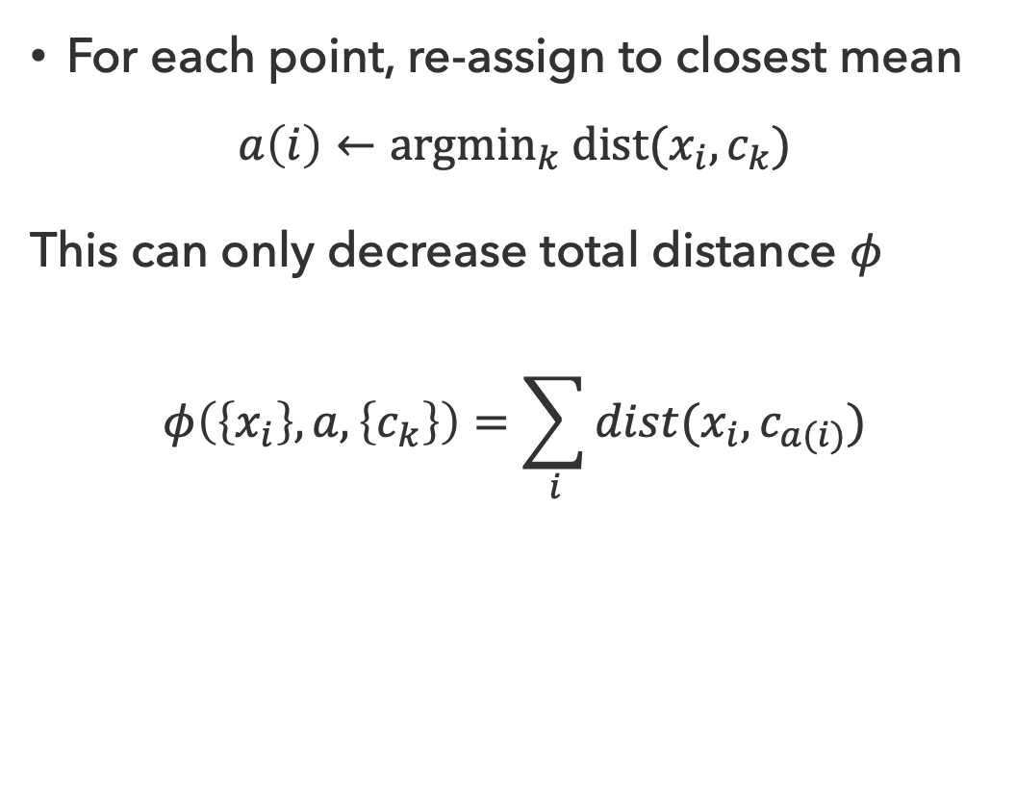
Phase 1: Update Assignments
For each point, re-assign to closest mean
$$a\left(i\right)←{argmin}_{k} dist(x_{i}, c_{k})$$
This can only decrease total distance $φ$
$$φ\left(\left\{x_{i}\right\}, a, \left\{c_{k}\right\}\right)=\sum_{i}{dist(x_{i}, c_{a(i)}})$$

Slide 30
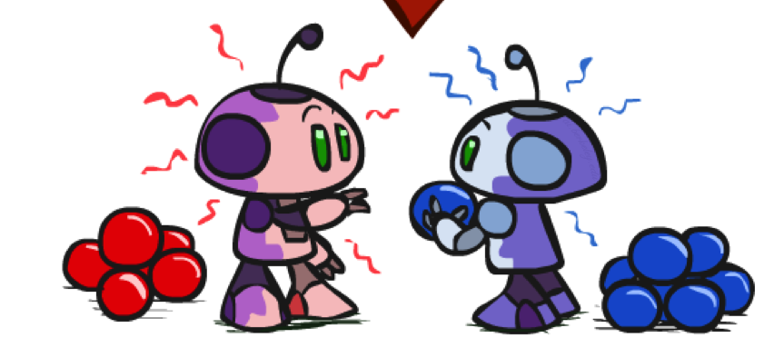
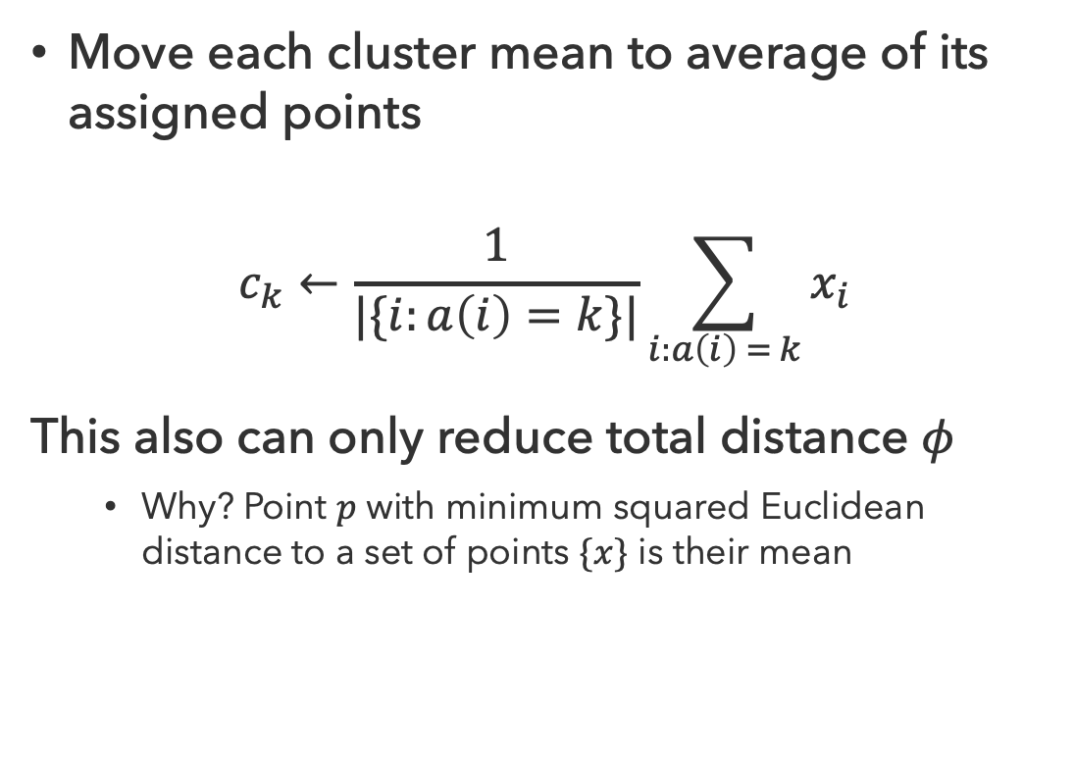
Phase 2: Update Means
Move each cluster mean to average of its assigned points
$$c_{k}←\frac{1}{|\{i:a\left(i\right)=k\}|}\sum_{i:a\left(i\right) = k}{x_{i}}$$
This also can only reduce total distance $φ$
  Why? Point $p$ with minimum squared Euclidean distance to a set of points $\{x\}$ is their mean

Slide 31
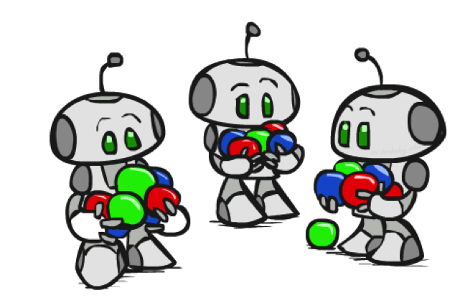
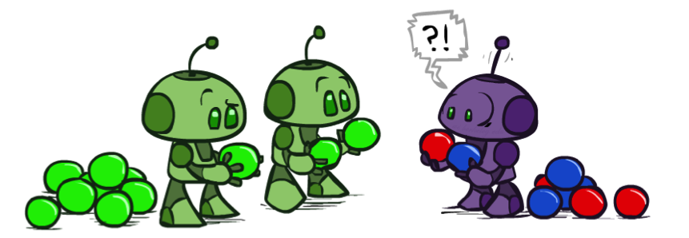
Initialization
K-Means is non-deterministic
  Initialization of means affects outcome

Slide 32
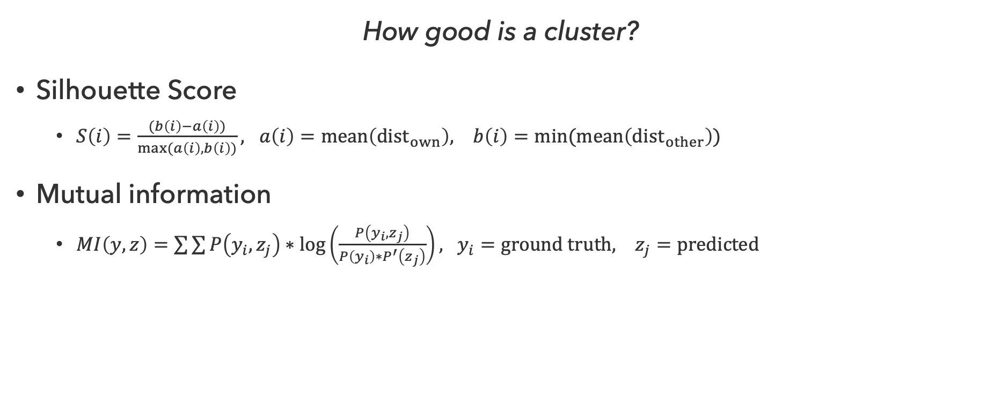
Clustering Performance
How good is a cluster?
Silhouette Score
  $S\left(i\right)=\frac{(b\left(i\right)−a\left(i\right))}{max⁡(a\left(i\right),b\left(i\right))}, a\left(i\right)=mean\left(dist_{own}\right), b\left(i\right)=min⁡(mean\left(dist_{other}\right))$
Mutual information
  $MI\left(y,z\right)=\sum{\sum{P\left(y_{i},z_{j}\right)∗\log\left(\frac{P\left(y_{i},z_{j}\right)}{P\left(y_{i}\right)∗P^{′}\left(z_{j}\right)}\right), y_{i}=ground truth, z_{j}=predicted}}$

Slide 33
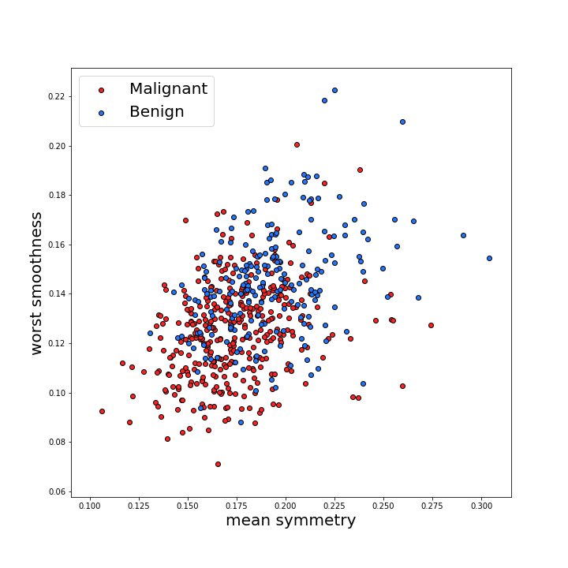
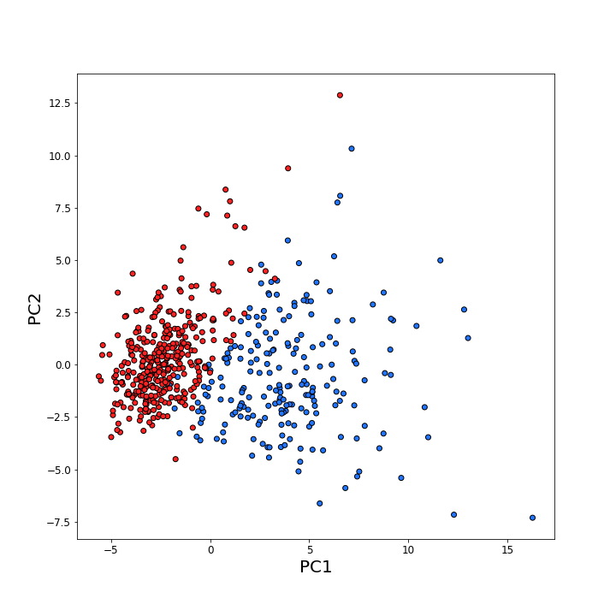
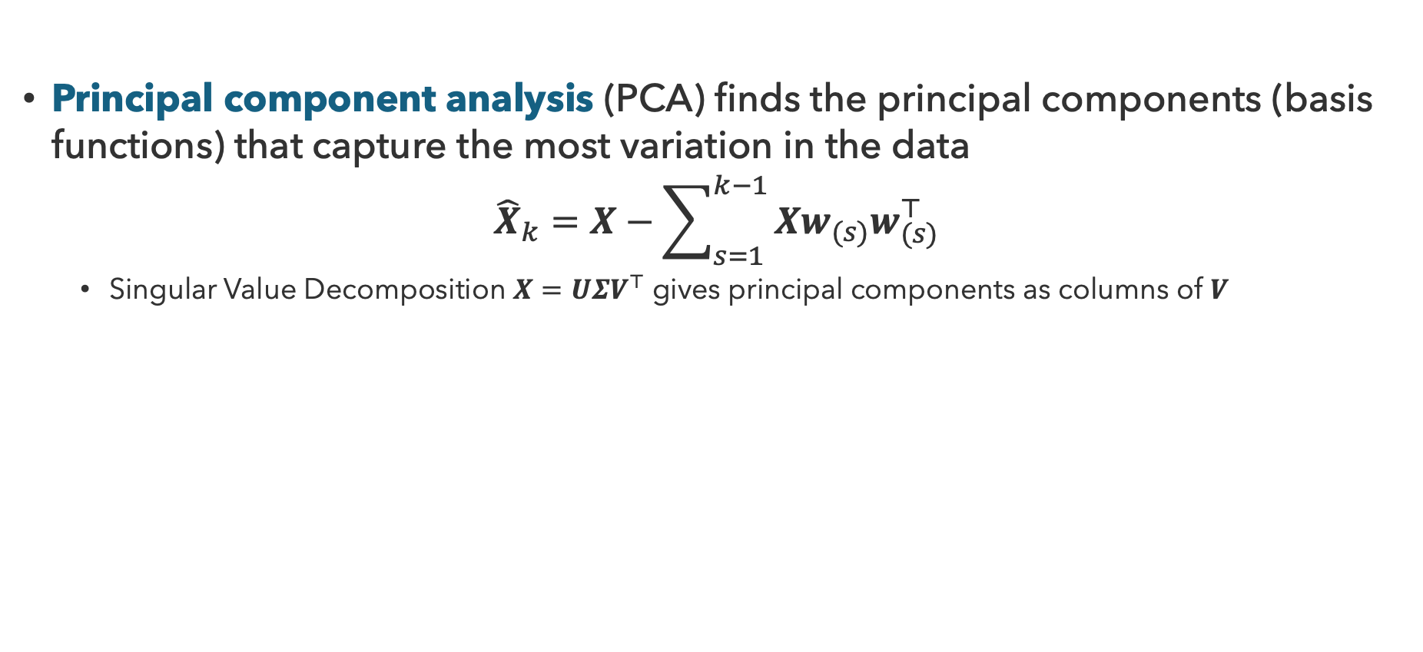
Dimensionality Reduction
Principal component analysis (PCA) finds the principal components (basis functions) that capture the most variation in the data
$${\hat{X}}_{k}=X−\sum_{s=1}^{k−1}{{Xw}_{(s)}w_{(s)}^{⊤}}$$
  Singular Value Decomposition $X=U{ΣV}^{⊤}$ gives principal components as columns of $V$

Slide 34
Questions (4)

Slide 35
that’s it for today!
Learning is essential in unknown environments, useful in many others
Learning process depends on agent design, evaluation metric, data, prior knowledge
Clustering involves finding patterns in unlabeled data
Regression
Classification
Complete Practice Problem 15
Do Homework 3 (due 8.6)
Do Project 4 (due 8.13)

