Slide 1

Markov Models, Particle Filters
CSE 473: Introduction to Artificial Intelligence
James Weichert (jpw@cs)
cs.uw.edu/473
acknowledgements
Welcome!
What’s your favorite summertime activity?
sli.do #cse473

Slide 2

Administrivia
Test 2 next Friday
Project 3 due tomorrow (7.30)
Homework 3 due next Thursday (8.6)

Slide 3




Uncertainty and Time
So far, we’ve focused on arbitrary arrangements of random variables
What about scenarios involving sequences of observations?
Applications
  Forecasting
  Speech recognition
  Robot localization
  User attention
  Medical monitoring
$$C$$
$$S$$
$$r$$
$$W$$
All involve reasoning over ‘time’

Slide 4



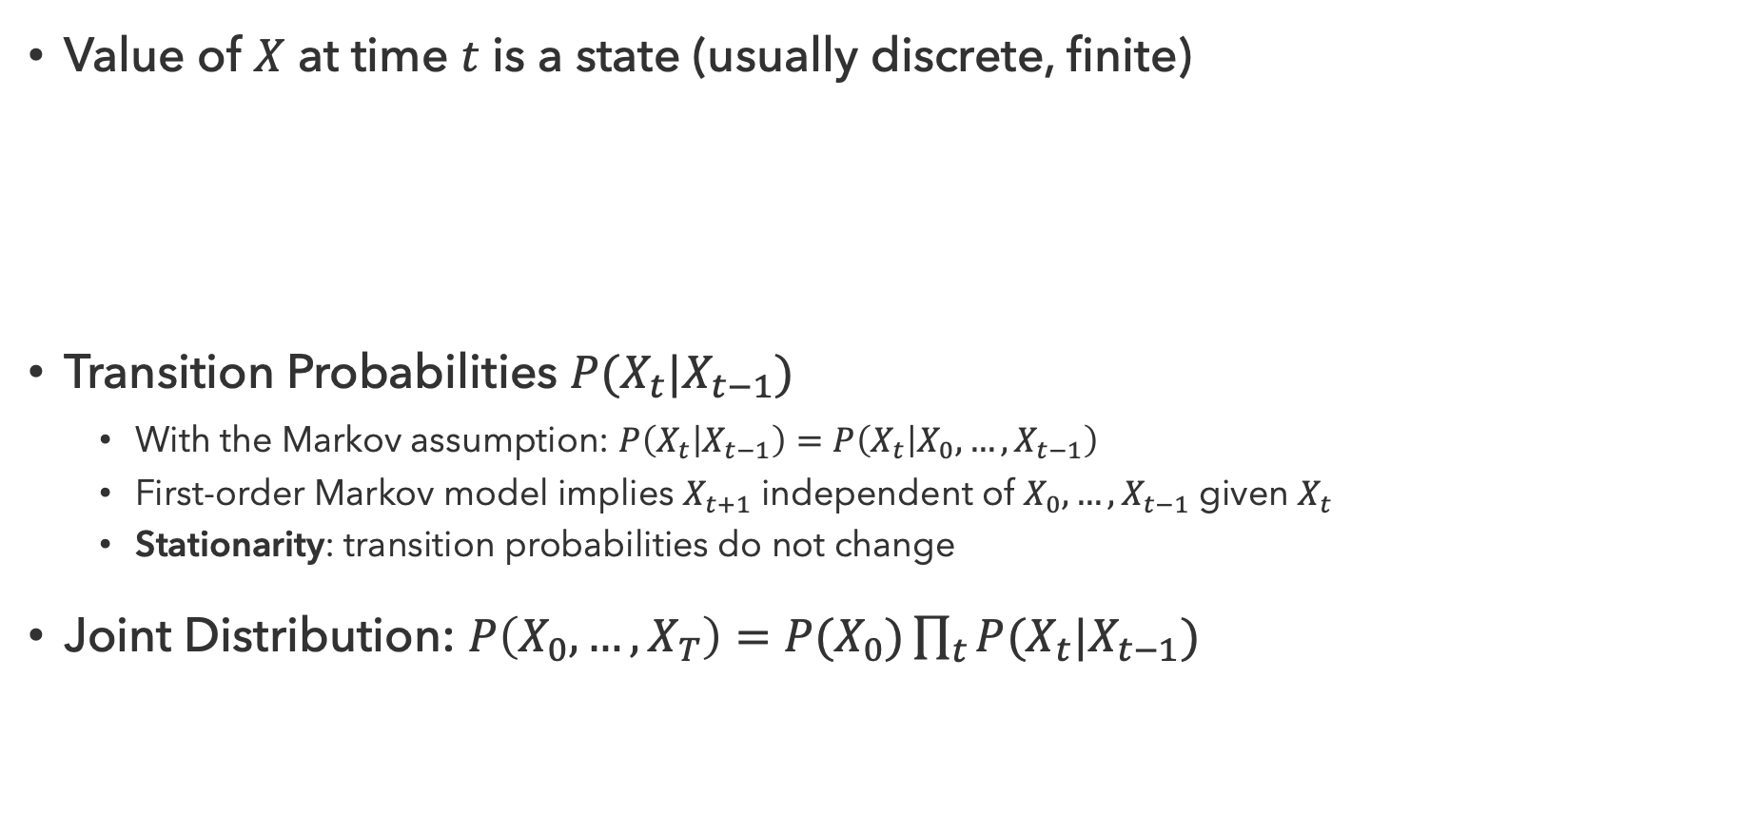



Markov Models
Value of $X$ at time $t$ is a state (usually discrete, finite)
Transition Probabilities $P(X_{t}|X_{t−1})$
  With the Markov assumption: $P\left(X_{t} | X_{t−1}\right)=P\left(X_{t} | X_{0},…,X_{t−1}\right)$
  First-order Markov model implies $X_{t+1}$ independent of $X_{0},…,X_{t−1}$ given $X_{t}$
  Stationarity: transition probabilities do not change
Joint Distribution: $P\left(X_{0},…,X_{T}\right)=P(X_{0})\prod_{t}{P(X_{t}|X_{t−1})}$
$$X_{0}$$
$$X_{1}$$
$$X_{2}$$
$$P(X_{0})$$
$$P(X_{1}|X_{0})$$
$$P(X_{2}|X_{1})$$

Slide 5







Bayes Nets and Markov Models
$$C$$
Similarities
Directed acyclic graphs
Infer joint probabilities from conditional distributions
Markov independence
$$S$$
$$R$$
$$W$$
Differences
Markov models can involve infinitely many variables
Repetition of transition model not part of BN syntax
$$X_{0}$$
$$X_{1}$$
$$X_{2}$$

Slide 6
Questions (1)

Slide 7
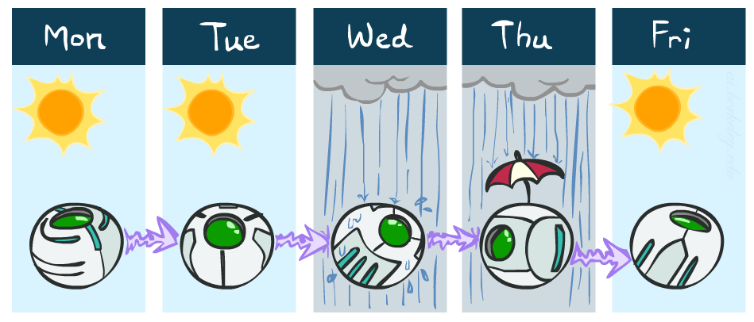



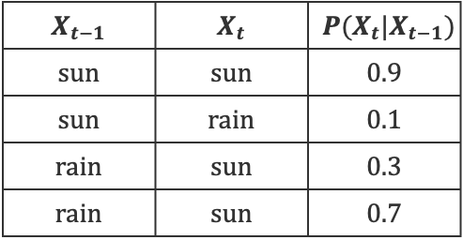
Weather
Goal: What’s the weather like tomorrow?
States: $\{rain,sun\}$
Initial Distribution
  $P\left(X_{0}=rain\right)=0.5$
  $P\left(X_{0}=sun\right)=0.5$
Transition Model $P(X_{t}|X_{t−1})$
0.3
0.7
0.9
$$rain$$
$$sun$$
$$X_{t−1}$$ | $$X_{t}$$ | $$P(X_{t}|X_{t−1})$$
$$sun$$ | $$sun$$ | $$0.9$$
$$sun$$ | $$rain$$ | $$0.1$$
$$rain$$ | $$sun$$ | $$0.3$$
$$rain$$ | $$sun$$ | $$0.7$$
0.1

Slide 8
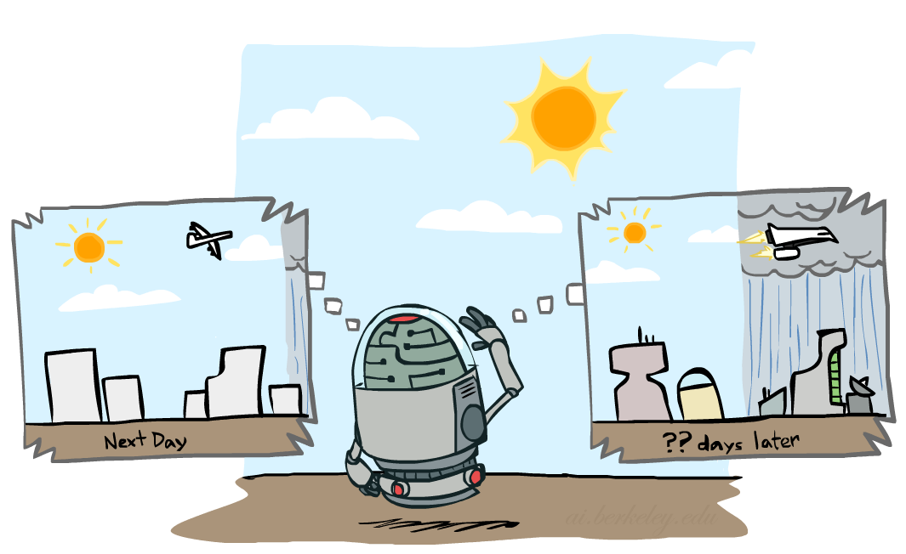
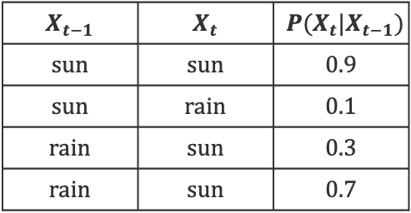

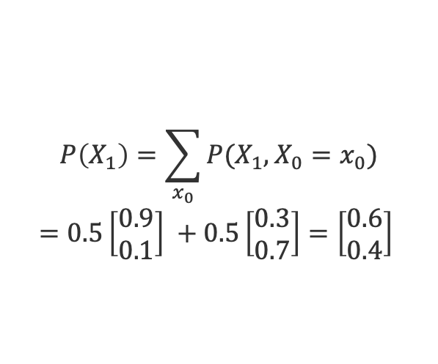
Weather Prediction (1)
Goal: What’s the weather at time 1?
Initial Distribution
  $P\left(X_{0}=rain\right)=0.5$
  $P\left(X_{0}=sun\right)=0.5$
Transition Model $P(X_{t}|X_{t−1})$
$$X_{t−1}$$ | $$X_{t}$$ | $$P(X_{t}|X_{t−1})$$
$$sun$$ | $$sun$$ | $$0.9$$
$$sun$$ | $$rain$$ | $$0.1$$
$$rain$$ | $$sun$$ | $$0.3$$
$$rain$$ | $$sun$$ | $$0.7$$
$$P\left(X_{1}\right)=\sum_{x_{0}}{P(X_{1},X_{0}=x_{0})}$$
$$=0.5\left[\begin{matrix}0.9 \\ 0.1\end{matrix}\right] +0.5\left[\begin{matrix}0.3 \\ 0.7\end{matrix}\right]=\left[\begin{matrix}0.6 \\ 0.4\end{matrix}\right]$$

Slide 9

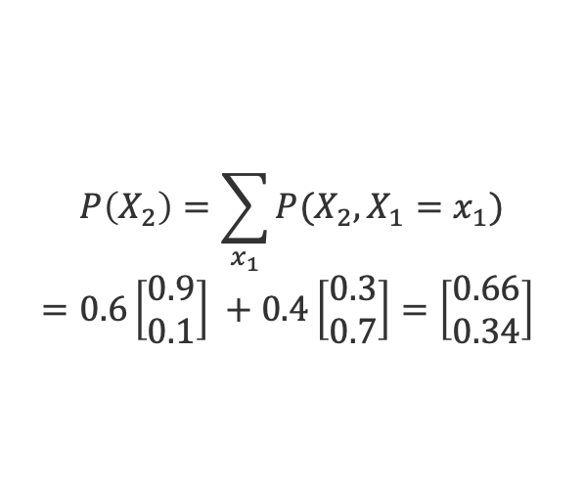
Weather Prediction (2)
Goal: What’s the weather at time 2?
Initial Distribution
  $P\left(X_{0}=rain\right)=0.5$
  $P\left(X_{0}=sun\right)=0.5$
Transition Model $P(X_{t}|X_{t−1})$
$$X_{t−1}$$ | $$X_{t}$$ | $$P(X_{t}|X_{t−1})$$
$$sun$$ | $$sun$$ | $$0.9$$
$$sun$$ | $$rain$$ | $$0.1$$
$$rain$$ | $$sun$$ | $$0.3$$
$$rain$$ | $$sun$$ | $$0.7$$
$$P\left(X_{2}\right)=\sum_{x_{1}}{P(X_{2},X_{1}=x_{1})}$$
$$=0.6\left[\begin{matrix}0.9 \\ 0.1\end{matrix}\right] +0.4\left[\begin{matrix}0.3 \\ 0.7\end{matrix}\right]=\left[\begin{matrix}0.66 \\ 0.34\end{matrix}\right]$$

Slide 10

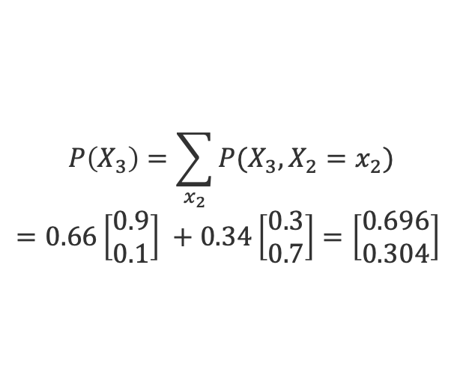
Weather Prediction (3)
Goal: What’s the weather at time 3?
Initial Distribution
  $P\left(X_{0}=rain\right)=0.5$
  $P\left(X_{0}=sun\right)=0.5$
Transition Model $P(X_{t}|X_{t−1})$
$$X_{t−1}$$ | $$X_{t}$$ | $$P(X_{t}|X_{t−1})$$
$$sun$$ | $$sun$$ | $$0.9$$
$$sun$$ | $$rain$$ | $$0.1$$
$$rain$$ | $$sun$$ | $$0.3$$
$$rain$$ | $$sun$$ | $$0.7$$
$$P\left(X_{3}\right)=\sum_{x_{2}}{P(X_{3},X_{2}=x_{2})}$$
$$=0.66\left[\begin{matrix}0.9 \\ 0.1\end{matrix}\right] +0.34\left[\begin{matrix}0.3 \\ 0.7\end{matrix}\right]=\left[\begin{matrix}0.696 \\ 0.304\end{matrix}\right]$$

Slide 11

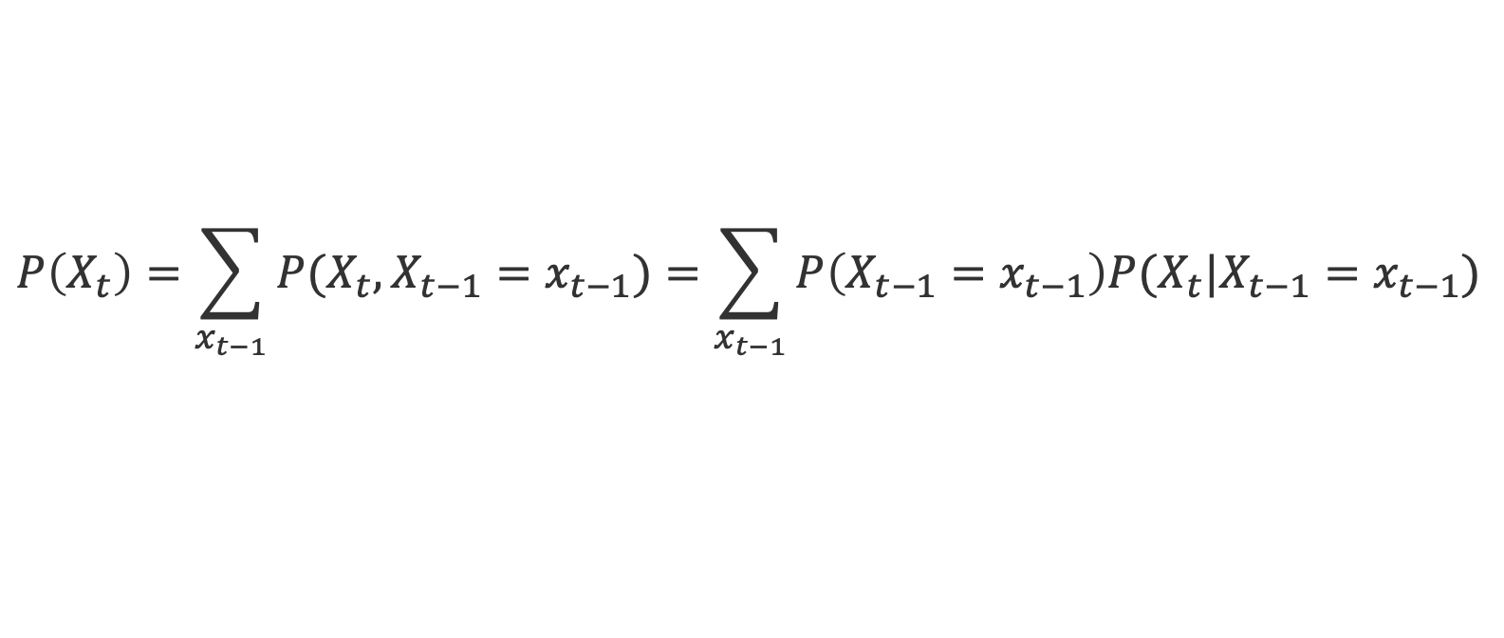
Forward Algorithm
Iterate update step starting at $t=0$:
Prior Belief
Transition Model
$$P\left(X_{t}\right)=\sum_{x_{t−1}}{P(X_{t}, X_{t−1}=x_{t−1})}=\sum_{x_{t−1}}{P\left(X_{t−1}=x_{t−1}\right)P(X_{t}|X_{t−1}=x_{t−1})}$$

Slide 12
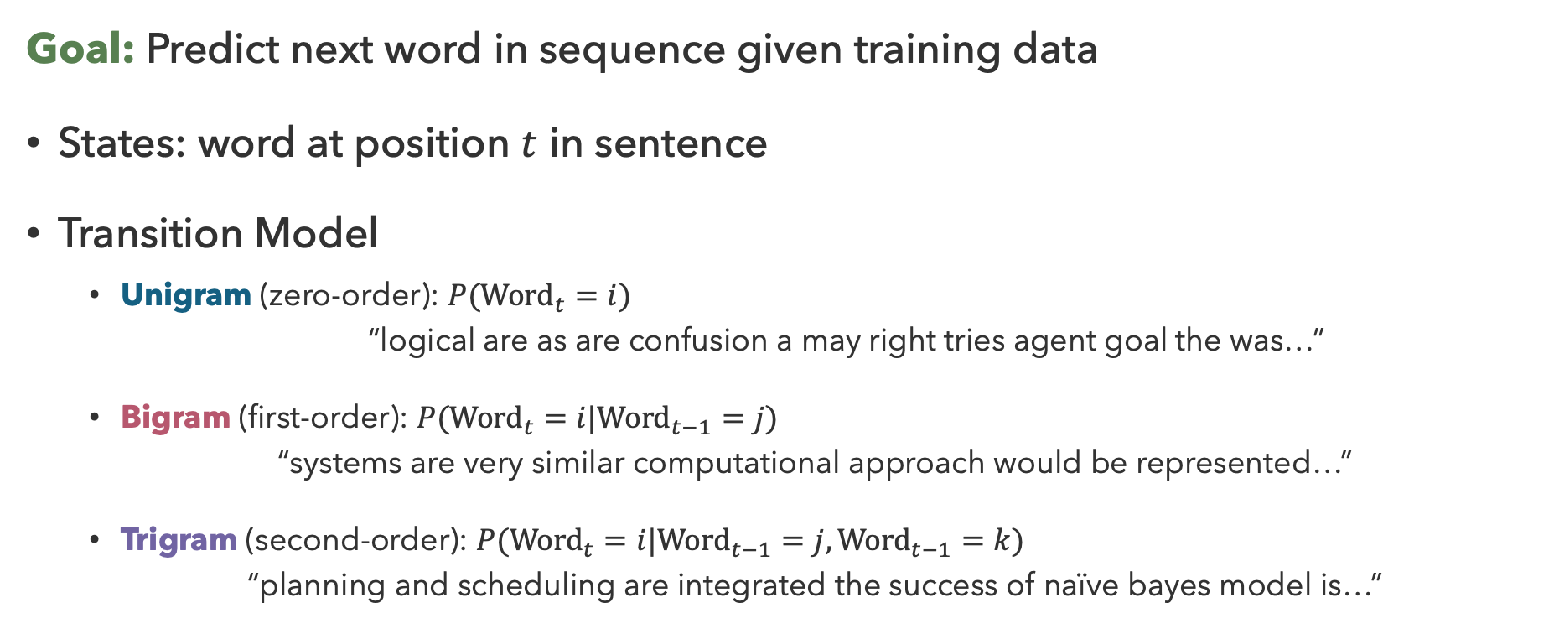
N-Gram Models
Goal: Predict next word in sequence given training data
States: word at position $t$ in sentence
Transition Model
  Unigram (zero-order): $P({Word}_{t}=i)$
    “logical are as are confusion a may right tries agent goal the was…”
  Bigram (first-order): $P({Word}_{t}=i|{Word}_{t−1}=j)$
  “systems are very similar computational approach would be represented…”
  Trigram (second-order): $P({Word}_{t}=i|{Word}_{t−1}=j, {Word}_{t−1}=k)$
  “planning and scheduling are integrated the success of naïve bayes model is…”

Slide 13

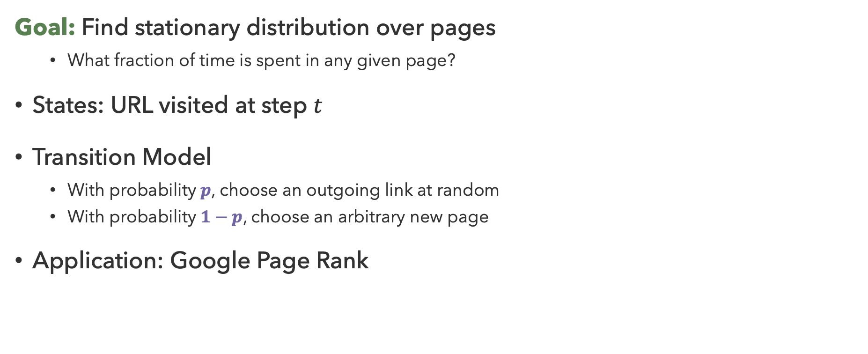
Web Browsing
Goal: Find stationary distribution over pages
  What fraction of time is spent in any given page?
States: URL visited at step $t$
Transition Model
  With probability $p$, choose an outgoing link at random
  With probability $1−p$, choose an arbitrary new page
Application: Google Page Rank

Slide 14

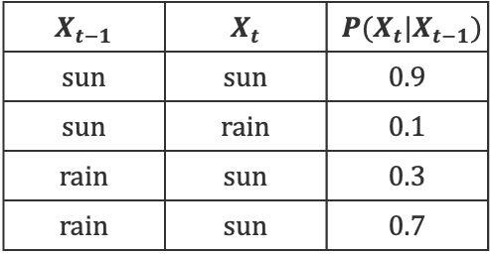
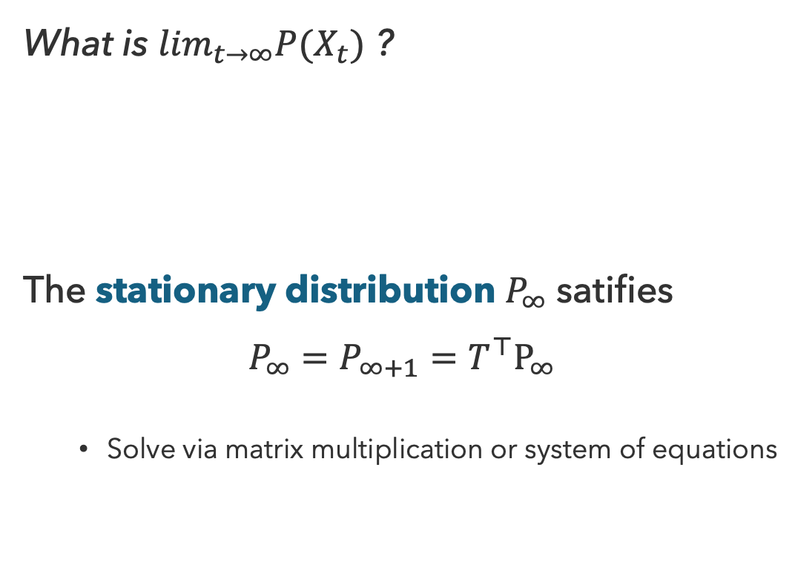


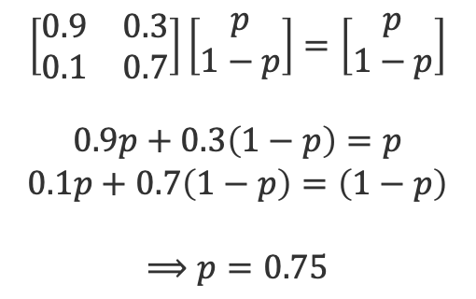

Stationary Distributions
What is $\lim_{t→∞}P(X_{t})$ ?
The stationary distribution $P_{∞}$ satifies
$$P_{∞}=P_{∞+1}=T^{⊤}P_{∞}$$
  Solve via matrix multiplication or system of equations
$$X_{0}$$
$$X_{1}$$
$$X_{2}$$
$$X_{t−1}$$ | $$X_{t}$$ | $$P(X_{t}|X_{t−1})$$
$$sun$$ | $$sun$$ | $$0.9$$
$$sun$$ | $$rain$$ | $$0.1$$
$$rain$$ | $$sun$$ | $$0.3$$
$$rain$$ | $$sun$$ | $$0.7$$
$$\left[\begin{matrix}0.9 & 0.3 \\ 0.1 & 0.7\end{matrix}\right]\left[\begin{matrix}p \\ 1−p\end{matrix}\right]=\left[\begin{matrix}p \\ 1−p\end{matrix}\right]$$
$$0.9p+0.3\left(1−p\right)=p$$
$$0.1p+0.7\left(1−p\right)=\left(1−p\right)$$
$$⟹p=0.75$$

Slide 15
Questions (2)

Slide 16

Partially Observable Models

Slide 17








Hidden Markov Models
Hidden Markov Models (HMMs) describe problems where the (true) state is not observed directly
  Underlying Markov chain over states $X_{t}$
  Observe evidence $E_{t}$ at each time step
  $X_{t}$ is (usually) a discrete variable, $E_{t}$ may be continuous
  and may consist of several variables
$$X_{0}$$
$$X_{1}$$
$$X_{2}$$
$$X_{3}$$
$$E_{1}$$
$$E_{2}$$
$$E_{3}$$

Slide 18



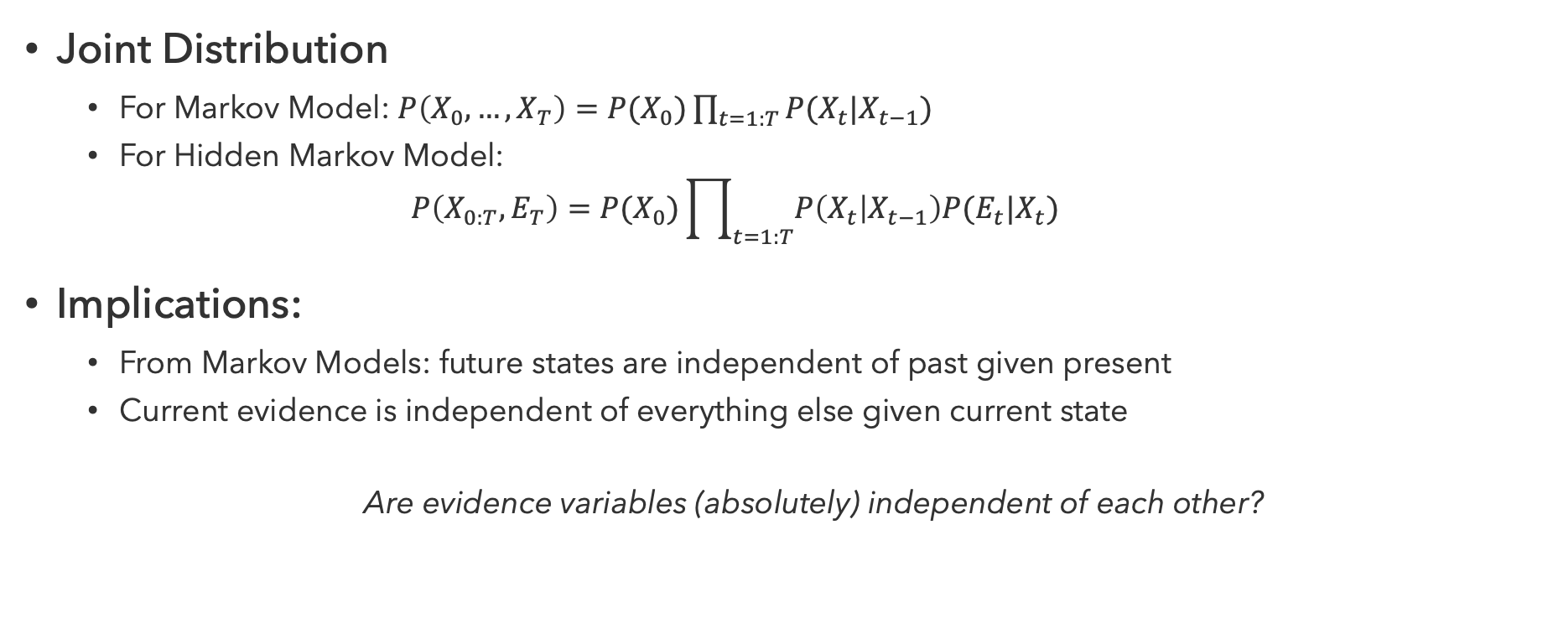


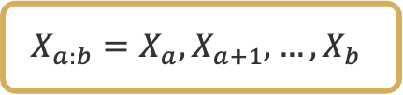


HMM Probability Model
$$X_{0}$$
$$X_{1}$$
$$X_{2}$$
$$X_{3}$$
Joint Distribution
  For Markov Model: $P\left(X_{0},…,X_{T}\right)=P(X_{0})\prod_{t=1:T}{P(X_{t}|X_{t−1})}$
  For Hidden Markov Model:
  $P\left(X_{0:T},E_{T}\right)=P(X_{0})\prod_{t=1:T}{P\left(X_{t} | X_{t−1}\right)P(E_{t}|X_{t})}$
Implications:
  From Markov Models: future states are independent of past given present
  Current evidence is independent of everything else given current state
  Are evidence variables (absolutely) independent of each other?
$$E_{1}$$
$$E_{2}$$
$$E_{3}$$
Likelihood
Transition Model
$$X_{a:b}=X_{a},X_{a+1},…,X_{b}$$

Slide 19




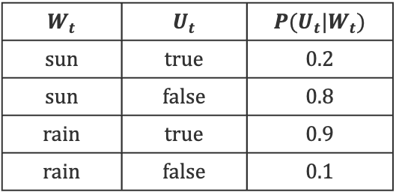


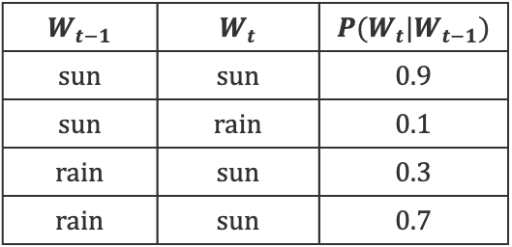



Weather Hidden Markov Model
Hidden variable $W_{t}=\{sun,rain\}$
Observations $U_{t}=\{true,false\}$
$$W_{t−1}$$ | $$W_{t}$$ | $$P(W_{t}|W_{t−1})$$
$$sun$$ | $$sun$$ | $$0.9$$
$$sun$$ | $$rain$$ | $$0.1$$
$$rain$$ | $$sun$$ | $$0.3$$
$$rain$$ | $$sun$$ | $$0.7$$
$$W_{0}$$
$$W_{1}$$
$$W_{2}$$
$$W_{3}$$
$$U_{1}$$
$$U_{2}$$
$$U_{3}$$
$$W_{t}$$ | $$U_{t}$$ | $$P(U_{t}|W_{t})$$
$$sun$$ | $$true$$ | $$0.2$$
$$sun$$ | $$false$$ | $$0.8$$
$$rain$$ | $$true$$ | $$0.9$$
$$rain$$ | $$false$$ | $$0.1$$

Slide 20
Other HMM Examples
Speech Recognition
  Observations are acoustic signals (continuous)
  States are specific positions in specific words
Machine Translation
  Observations are words
  States are translation options
Robot Tracking
  Observations are range readings (continuous)
  States are positions on a map (continuous)

Slide 21
Questions (3)

Slide 22
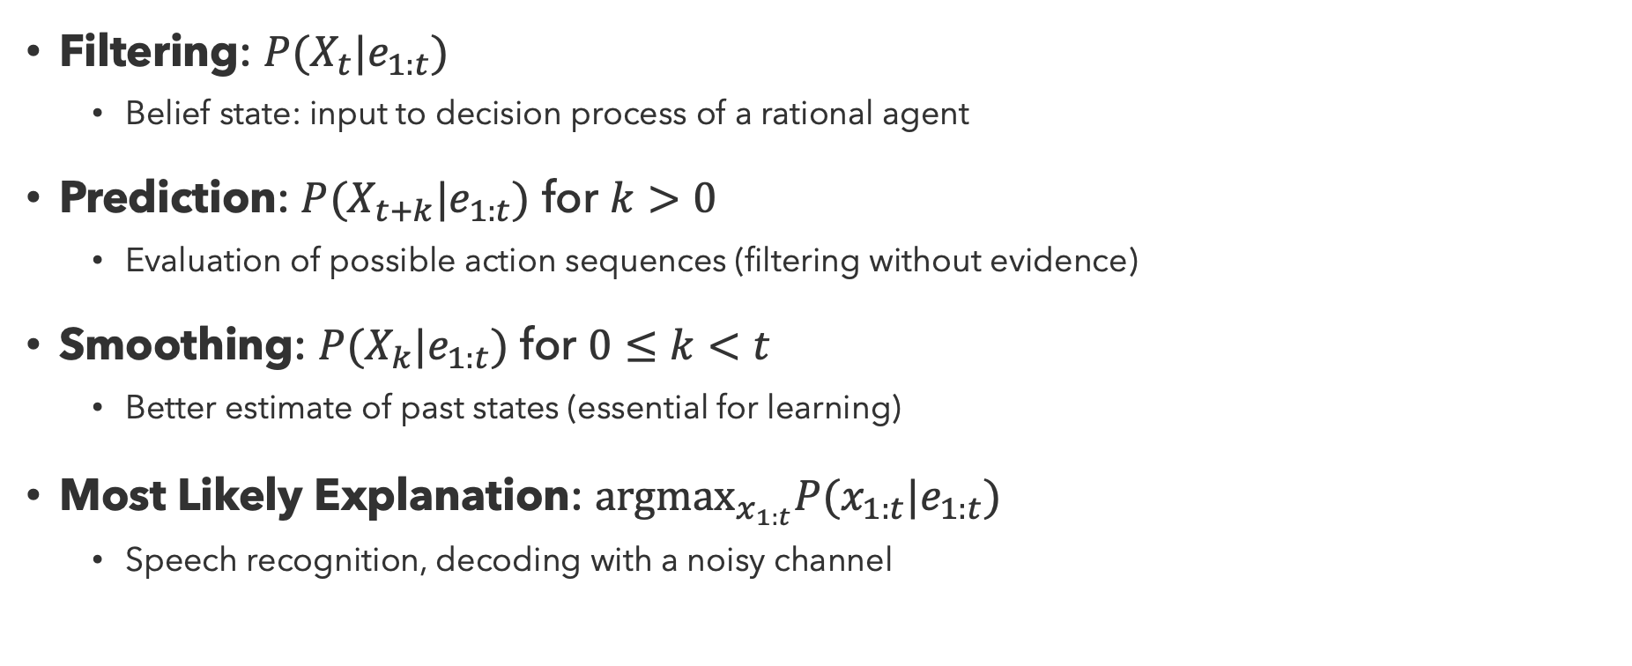
Inference Tasks
Filtering: $P(X_{t}|e_{1:t})$
  Belief state: input to decision process of a rational agent
Prediction: $P(X_{t+k}|e_{1:t})$ for $k>0$
  Evaluation of possible action sequences (filtering without evidence)
Smoothing: $P(X_{k}|e_{1:t})$ for $0≤k<t$
  Better estimate of past states (essential for learning)
Most Likely Explanation: ${argmax}_{x_{1:t}}P(x_{1:t}|e_{1:t})$
  Speech recognition, decoding with a noisy channel

Slide 23








Filtering
Filtering (or monitoring or state estimation) is the task of maintaining the distribution $f_{1:t}=P(X_{t}|e_{1:t})$
Start with $f_{0}$ in an initial setting, usually uniform
Fundamental task in many engineering and science domains
$$X_{0}$$
$$X_{1}$$
$$X_{2}$$
$$X_{3}$$
$$E_{1}$$
$$E_{2}$$
$$E_{3}$$

Slide 24
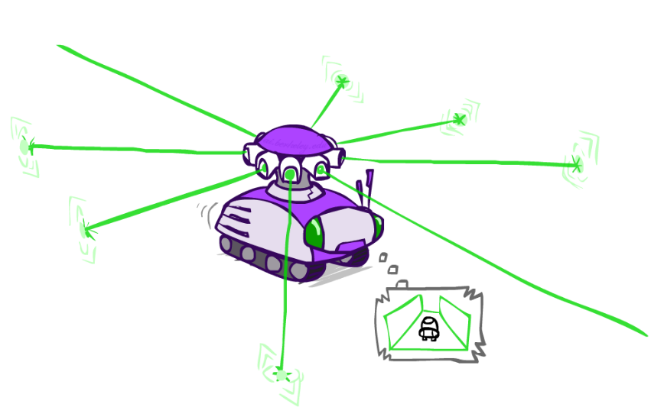
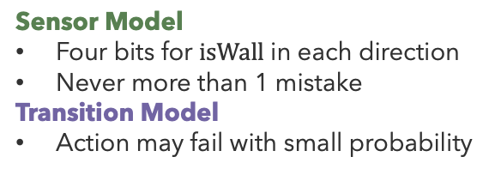
Robot Localization
Probability
0
1
Sensor Model
Four bits for $isWall$ in each direction
Never more than 1 mistake
Transition Model
Action may fail with small probability
Example from Michael Pfeiffer

Slide 25

Robot Localization (1)
$$t=1$$
Probability
0
1
Lighter grey: possible to get reading, but less likely
(requires 1 mistake)
Example from Michael Pfeiffer

Slide 26

Robot Localization (2)
$$t=2$$
Probability
0
1
Example from Michael Pfeiffer

Slide 27

Robot Localization (3)
$$t=3$$
Probability
0
1
Example from Michael Pfeiffer

Slide 28

Robot Localization (4)
$$t=4$$
Probability
0
1
Example from Michael Pfeiffer

Slide 29

Robot Localization (5)
$$t=5$$
Probability
0
1
Example from Michael Pfeiffer

Slide 30
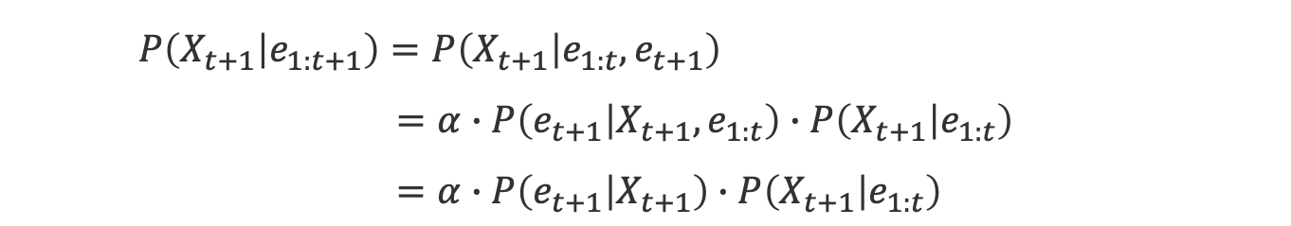
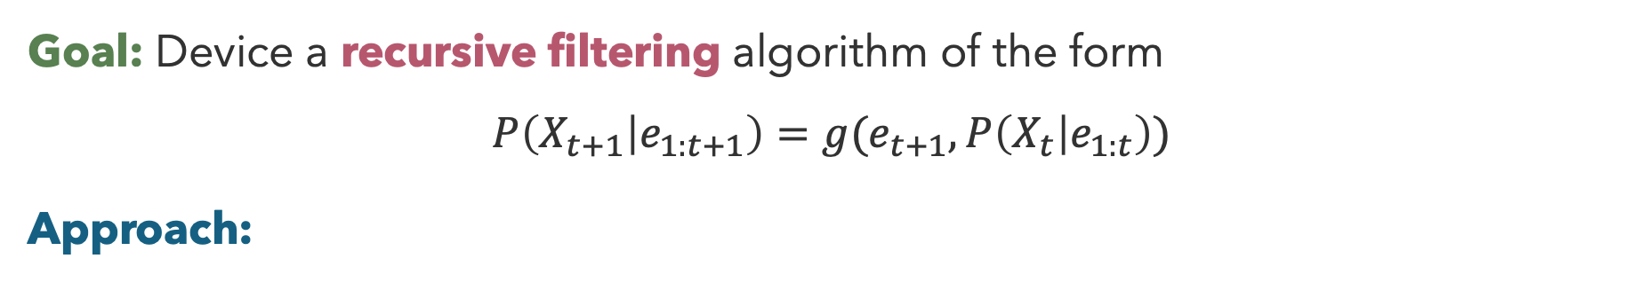
Filtering Algorithm
Goal: Device a recursive filtering algorithm of the form
$$P\left(X_{t+1} | e_{1:t+1}\right)=g(e_{t+1}, P\left(X_{t} | e_{1:t}\right))$$
Approach:
  $P\left(X_{t+1} | e_{1:t+1}\right)=P\left(X_{t+1} | e_{1:t},e_{t+1}\right)$
  $=α∙P\left(e_{t+1} | X_{t+1},e_{1:t}\right)∙P\left(X_{t+1} | e_{1:t}\right)$
  $=α∙P\left(e_{t+1} | X_{t+1}\right)∙P\left(X_{t+1} | e_{1:t}\right)$
apply Bayes rule
apply conditional independence
Likelihood
Prior Prediction

Slide 31
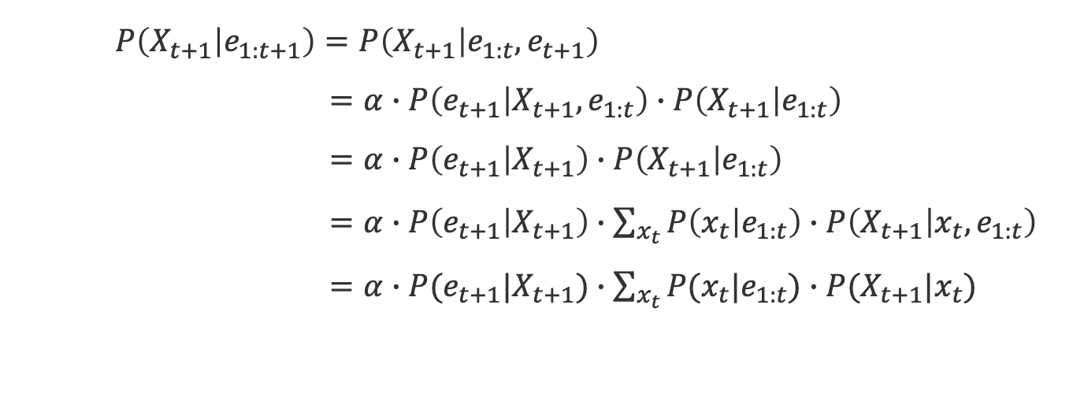
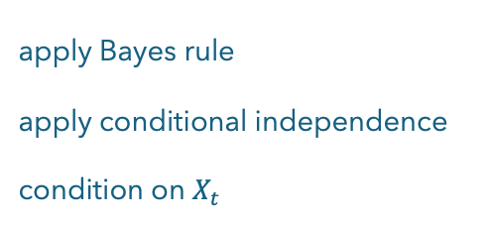
Filtering Algorithm (2)
Goal: Device a recursive filtering algorithm of the form
$$P\left(X_{t+1} | e_{1:t+1}\right)=g(e_{t+1}, P\left(X_{t} | e_{1:t}\right))$$
Approach:
  $P\left(X_{t+1} | e_{1:t+1}\right)=P\left(X_{t+1} | e_{1:t},e_{t+1}\right)$
  $=α∙P\left(e_{t+1} | X_{t+1},e_{1:t}\right)∙P\left(X_{t+1} | e_{1:t}\right)$
  $=α∙P\left(e_{t+1} | X_{t+1}\right)∙P\left(X_{t+1} | e_{1:t}\right)$
  $=α∙P\left(e_{t+1} | X_{t+1}\right)∙\sum_{x_{t}}{P\left(x_{t} | e_{1:t}\right)∙P\left(X_{t+1} | x_{t},e_{1:t}\right)}$
  $=α∙P(e_{t+1}|X_{t+1})∙\sum_{x_{t}}{P(x_{t}|e_{1:t})∙P(X_{t+1}|x_{t})}$
apply Bayes rule
apply conditional independence
condition on $X_{t}$
apply conditional independence
Likelihood
Recursive
Transition Prob.

Slide 32
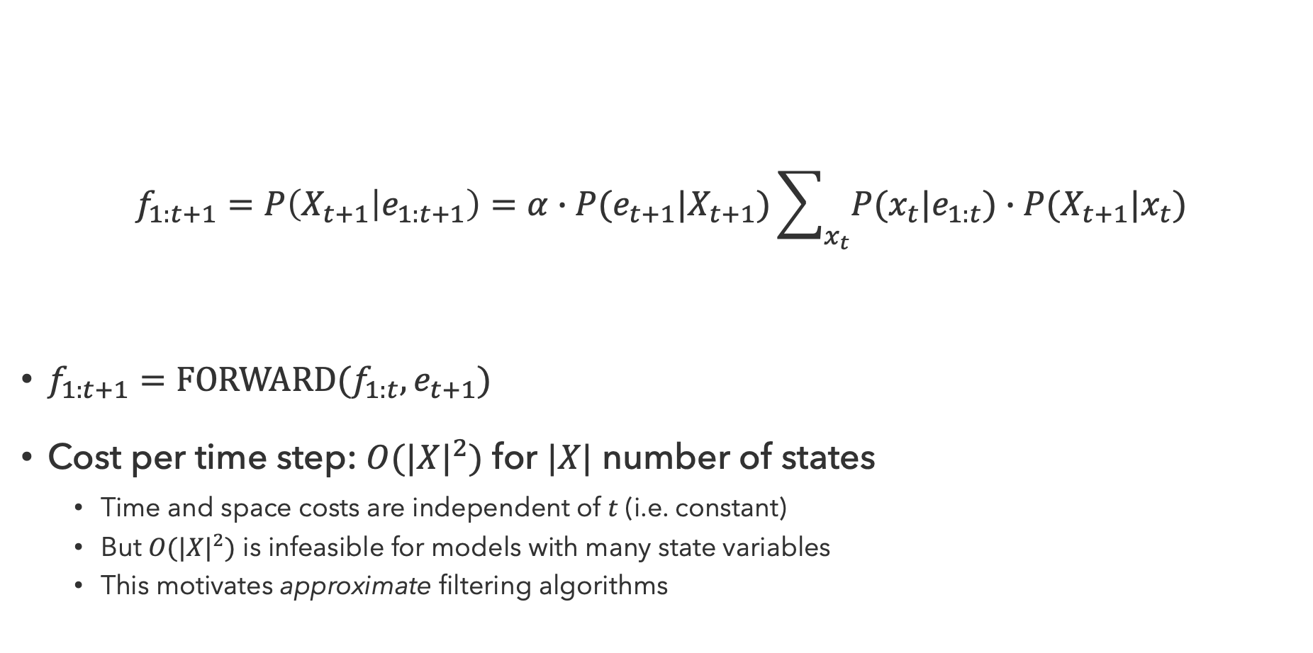
Filtering Properties
$$f_{1:t+1}=P\left(X_{t+1} | e_{1:t+1}\right)=α∙P(e_{t+1}|X_{t+1})\sum_{x_{t}}{P(x_{t}|e_{1:t})∙P(X_{t+1}|x_{t})}$$
$f_{1:t+1}=FORWARD(f_{1:t},e_{t+1})$
Cost per time step: $O(|X|^{2})$ for $|X|$ number of states
  Time and space costs are independent of $t$ (i.e. constant)
  But $O(|X|^{2})$ is infeasible for models with many state variables
  This motivates approximate filtering algorithms
Update
Predict

Slide 33
Questions (4)

Slide 34
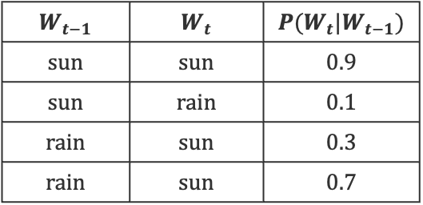
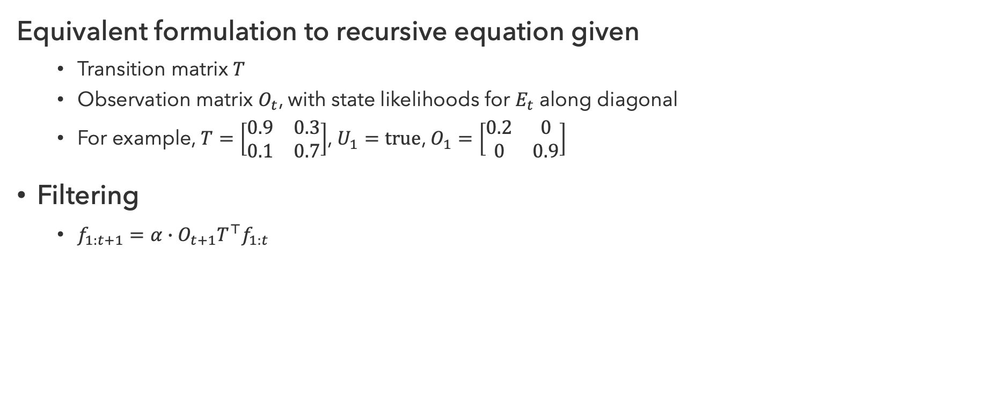
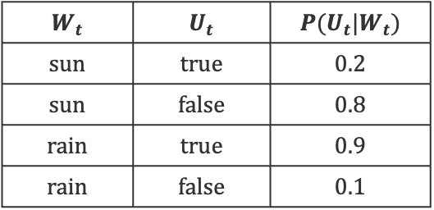
Matrix Formulation
Equivalent formulation to recursive equation given
  Transition matrix $T$
  Observation matrix $O_{t}$, with state likelihoods for $E_{t}$ along diagonal
  For example, $T=\left[\begin{matrix}0.9 & 0.3 \\ 0.1 & 0.7\end{matrix}\right]$, $U_{1}=true$, $O_{1}=\left[\begin{matrix}0.2 & 0 \\ 0 & 0.9\end{matrix}\right]$
Filtering
  $f_{1:t+1}=α∙O_{t+1}T^{⊤}f_{1:t}$
$$W_{t−1}$$ | $$W_{t}$$ | $$P(W_{t}|W_{t−1})$$
$$sun$$ | $$sun$$ | $$0.9$$
$$sun$$ | $$rain$$ | $$0.1$$
$$rain$$ | $$sun$$ | $$0.3$$
$$rain$$ | $$sun$$ | $$0.7$$
$$W_{t}$$ | $$U_{t}$$ | $$P(U_{t}|W_{t})$$
$$sun$$ | $$true$$ | $$0.2$$
$$sun$$ | $$false$$ | $$0.8$$
$$rain$$ | $$true$$ | $$0.9$$
$$rain$$ | $$false$$ | $$0.1$$

Slide 35

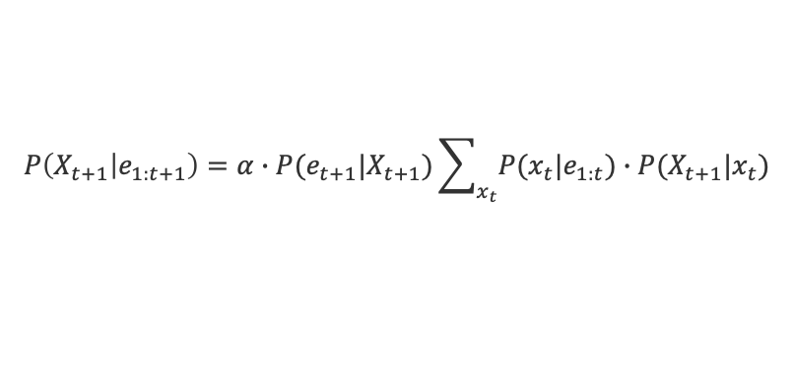
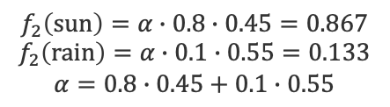



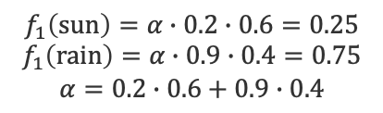








Weather Filtering
$$P\left(X_{t+1} | e_{1:t+1}\right)=α∙P(e_{t+1}|X_{t+1})\sum_{x_{t}}{P(x_{t}|e_{1:t})∙P(X_{t+1}|x_{t})}$$
$$W_{0}$$
$$W_{1}$$
$$W_{2}$$
$$W_{3}$$
$$W_{t−1}$$ | $$W_{t}$$ | $$P(W_{t}|W_{t−1})$$
$$sun$$ | $$sun$$ | $$0.9$$
$$sun$$ | $$rain$$ | $$0.1$$
$$rain$$ | $$sun$$ | $$0.3$$
$$rain$$ | $$sun$$ | $$0.7$$
$$f_{0}\left(sun\right)=0.5$$
$$f_{0}\left(rain\right)=0.5$$
$$U_{1}$$
$$U_{2}$$
$$U_{3}$$
$$U_{1}=true$$
$$U_{2}=false$$
Predict
Predict
$$P\left(s_{1} | W_{0}\right)=0.5∙0.9+0.5∙0.3=0.6$$
$$P\left(r_{1} | W_{0}\right)=0.5∙0.1+0.5∙0.7=0.4$$
$$P\left(s_{2} | W_{1}\right)=0.25∙0.9+0.75∙0.3=0.45$$
$$P\left(r_{2} | W_{1}\right)=0.25∙0.1+0.75∙0.7=0.55$$
$$W_{t}$$ | $$U_{t}$$ | $$P(U_{t}|W_{t})$$
$$sun$$ | $$true$$ | $$0.2$$
$$sun$$ | $$false$$ | $$0.8$$
$$rain$$ | $$true$$ | $$0.9$$
$$rain$$ | $$false$$ | $$0.1$$
Update
Update
$$f_{1}\left(sun\right)=α∙0.2∙0.6=0.25$$
$$f_{1}\left(rain\right)=α∙0.9∙0.4=0.75$$
$$α=0.2∙0.6+0.9∙0.4$$
$$f_{2}\left(sun\right)=α∙0.8∙0.45=0.867$$
$$f_{2}\left(rain\right)=α∙0.1∙0.55=0.133$$
$$α=0.8∙0.45+0.1∙0.55$$

Slide 36


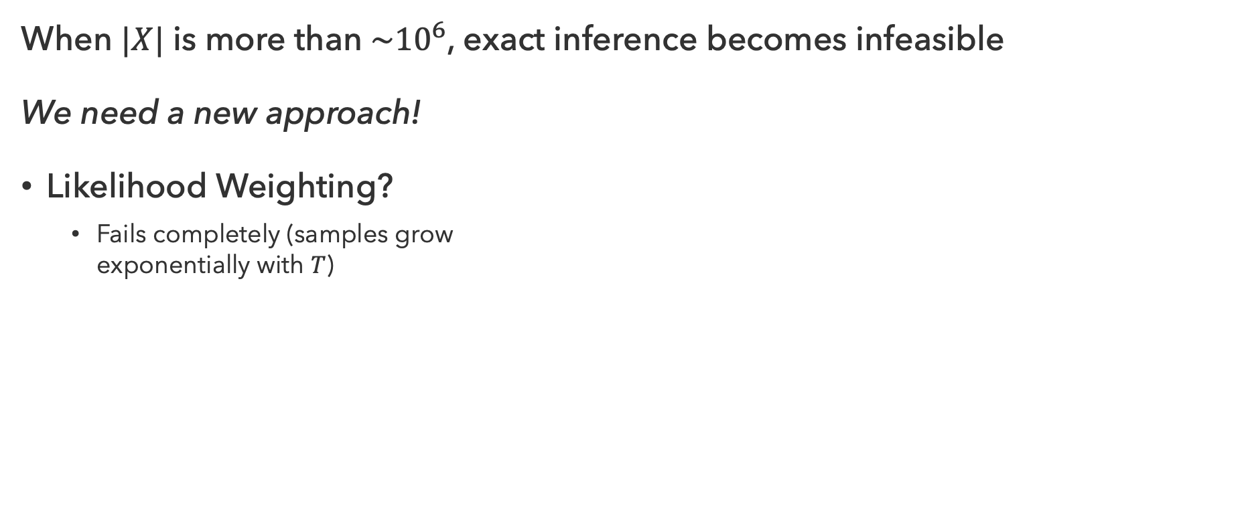






Approximate Inference
When $|X|$ is more than $\sim {10}^{6}$, exact inference becomes infeasible
We need a new approach!
Likelihood Weighting?
  Fails completely (samples grow
  exponentially with $T$)
$$X_{0}$$
$$X_{1}$$
$$X_{2}$$
$$X_{3}$$
$$E_{1}$$
$$E_{2}$$
$$E_{3}$$
$$t=2$$
$$t=7$$
Solution: Eliminate ‘bad’ samples, make more ‘good’ samples

Slide 37
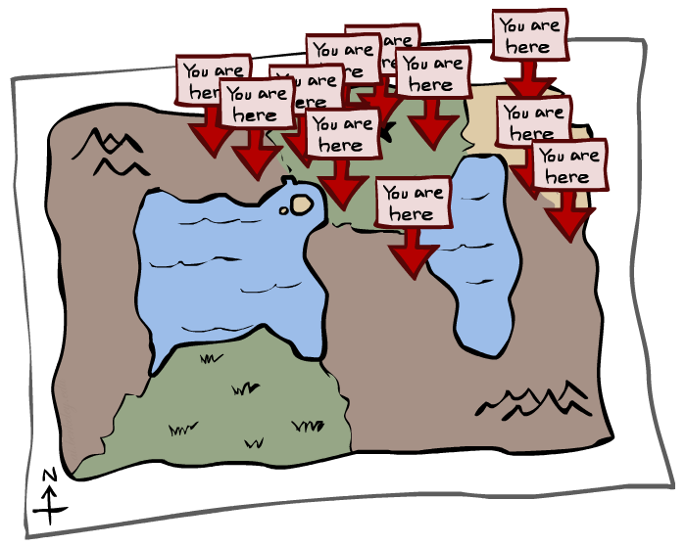
Particle Filtering
0
0.1
0
Represent belief state by a set of samples
  Samples are also called particles
  Time per step is linear in the number of samples…
    …but number needed may be large
  Store list of particles, not states!
0
0
0.2
0
0.2
0.5

Slide 38
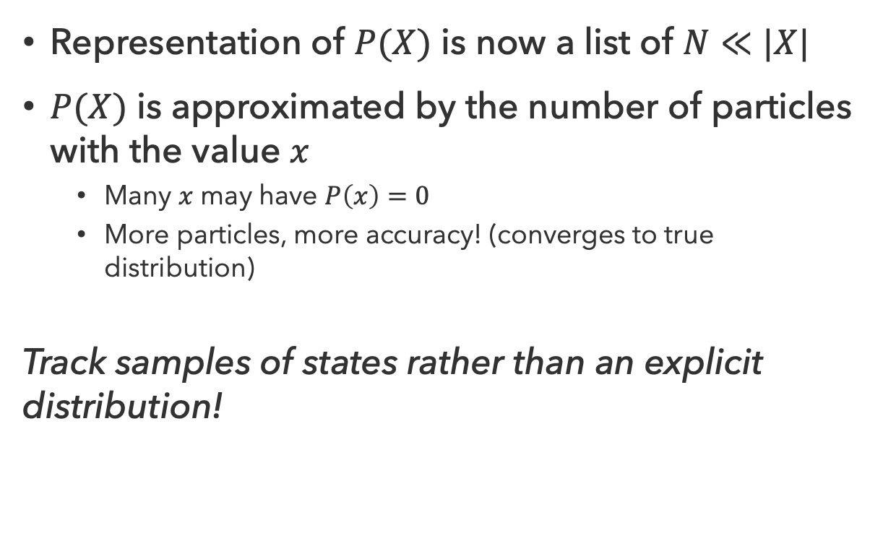
Particles
Representation of $P(X)$ is now a list of $N≪|X|$
$P(X)$ is approximated by the number of particles with the value $x$
  Many $x$ may have $P\left(x\right)=0$
  More particles, more accuracy! (converges to true distribution)
Track samples of states rather than an explicit distribution!
Particles
(3,3)
(2,3)
(3,3)
(3,2)
(3,3)
(3,2)
(1,2)
(3,3)
(3,3)
(2,3)

Slide 39
Questions (5)

Slide 40
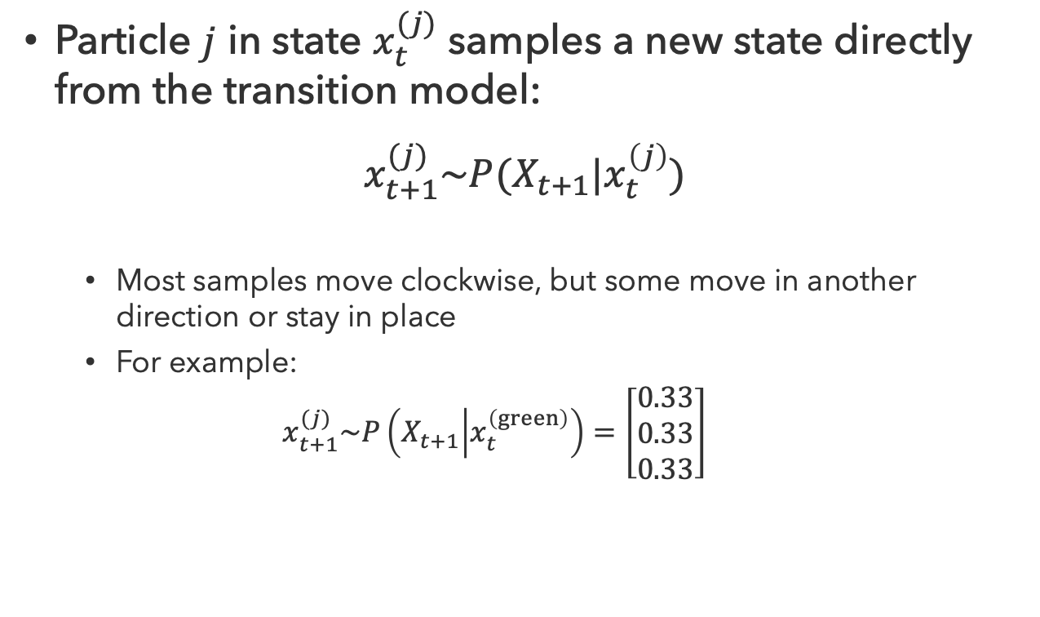
Particle Filtering Prediction
Particles
(3,3)
(2,3)
(3,3)
(3,2)
(3,3)
(3,2)
(1,2)
(3,3)
(3,3)
(2,3)
Particle $j$ in state $x_{t}^{(j)}$ samples a new state directly from the transition model:
$$x_{t+1}^{(j)}\sim P(X_{t+1}|x_{t}^{\left(j\right)})$$
  Most samples move clockwise, but some move in another direction or stay in place
  For example:
  $$x_{t+1}^{(j)}\sim P\left(X_{t+1} | x_{t}^{\left(green\right)}\right)=\left[\begin{matrix}0.33 \\ 0.33 \\ 0.33\end{matrix}\right]$$
Particles
(3,2)
(2,3)
(3,2)
(3,1)
(3,3)
(3,2)
(1,3)
(2,3)
(3,2)
(2,2)

Slide 41
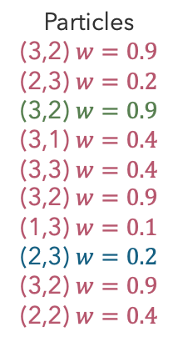
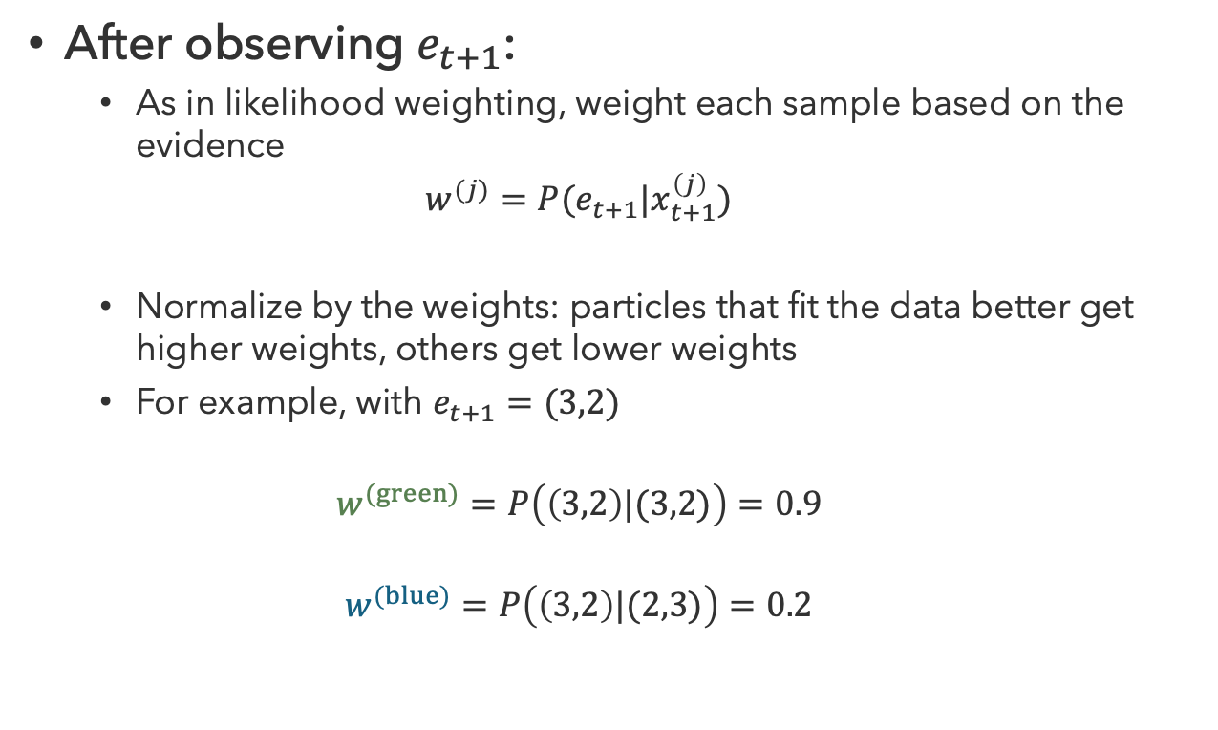
Particle Filtering Update
Particles
(3,3)
(2,3)
(3,3)
(3,2)
(3,3)
(3,2)
(1,2)
(3,3)
(3,3)
(2,3)
After observing $e_{t+1}$:
  As in likelihood weighting, weight each sample based on the evidence
  $$w^{(j)}=P(e_{t+1}|x_{t+1}^{\left(j\right)})$$
  Normalize by the weights: particles that fit the data better get higher weights, others get lower weights
  For example, with $e_{t+1}=(3,2)$
  $$w^{(green)}=P\left(\left(3,2\right)|(3,2)\right)=0.9$$
  $$w^{(blue)}=P\left(\left(3,2\right)|(2,3)\right)=0.2$$
Particles
(3,2) $w=0.9$
(2,3) $w=0.2$
(3,2) $w=0.9$
(3,1) $w=0.4$
(3,3) $w=0.4$
(3,2) $w=0.9$
(1,3) $w=0.1$
(2,3) $w=0.2$
(3,2) $w=0.9$
(2,2) $w=0.4$

Slide 42


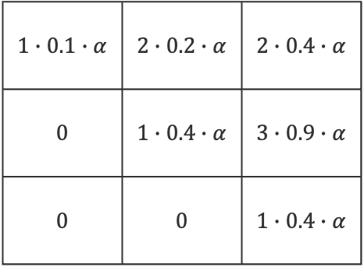
Particle Filtering Resampling
Particles
(3,2) $w=0.9$
(2,3) $w=0.2$
(3,2) $w=0.9$
(3,1) $w=0.4$
(3,3) $w=0.4$
(3,2) $w=0.9$
(1,3) $w=0.1$
(2,3) $w=0.2$
(3,2) $w=0.9$
(2,2) $w=0.4$
Rather than tracking weighted samples, resample
  Choose from weighted sample distribution $N$ times
  (draw with replacement)
  $$x_{t+1}^{(j)}\sim α∙Num\left(X_{t+1} | e_{1:t}\right)∙W(X_{t+1}|e_{1:t})$$
$$1∙0.1∙α$$ | $$2∙0.2∙α$$ | $$2∙0.4∙α$$
$$0$$ | $$1∙0.4∙α$$ | $$3∙0.9∙α$$
$$0$$ | $$0$$ | $$1∙0.4∙α$$
Particles
(3,1)
(2,3)
(3,2)
(3,2)
(3,3)
(3,2)
(3,1)
(2,2)
(3,2)
(3,2)

Slide 43
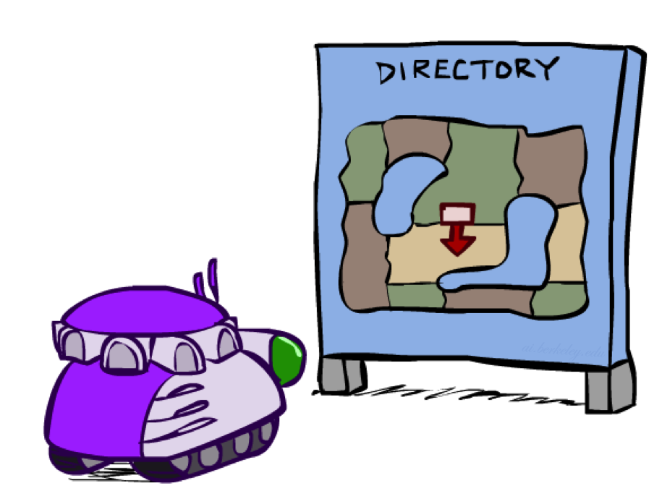
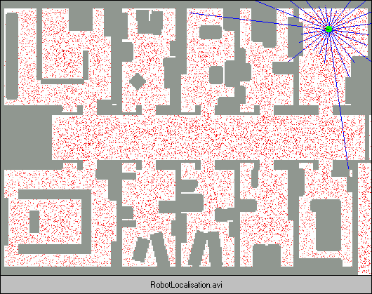
Localization
In a robot localization problem:
  We know the map, but not the robot’s position
  Observations may be vectors of range finder readings
  State space and readings are typically continuous
    Large problem size motivates particle filtering

Slide 44

Particle Filter Localization

Slide 45
Questions (6)

Slide 46
that’s it for today!
Markov chains model sequential observations
Hidden Markov Models use evidence to infer unobservable state
Filtering involves updating belief given evidence
Machine Learning
Complete Practice Problem 14
Do Project 3 (due 7.30)
Do Homework 3 (due 8.6)

