Slide 1
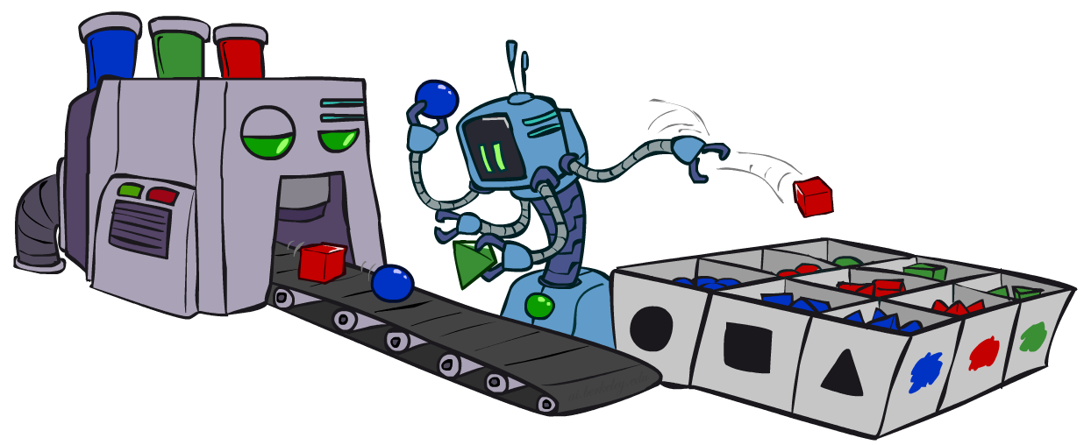
Bayes Nets III: Sampling
CSE 473: Introduction to Artificial Intelligence
James Weichert (jpw@cs)
cs.uw.edu/473
acknowledgements
Welcome!
What should the CSE 473 logo/mascot be?
sli.do #cse473

Slide 2

Administrivia
Test 2 next Friday
Project 3 due this Thursday (7.30)
Homework 3 due next Thursday (8.6)

Slide 3

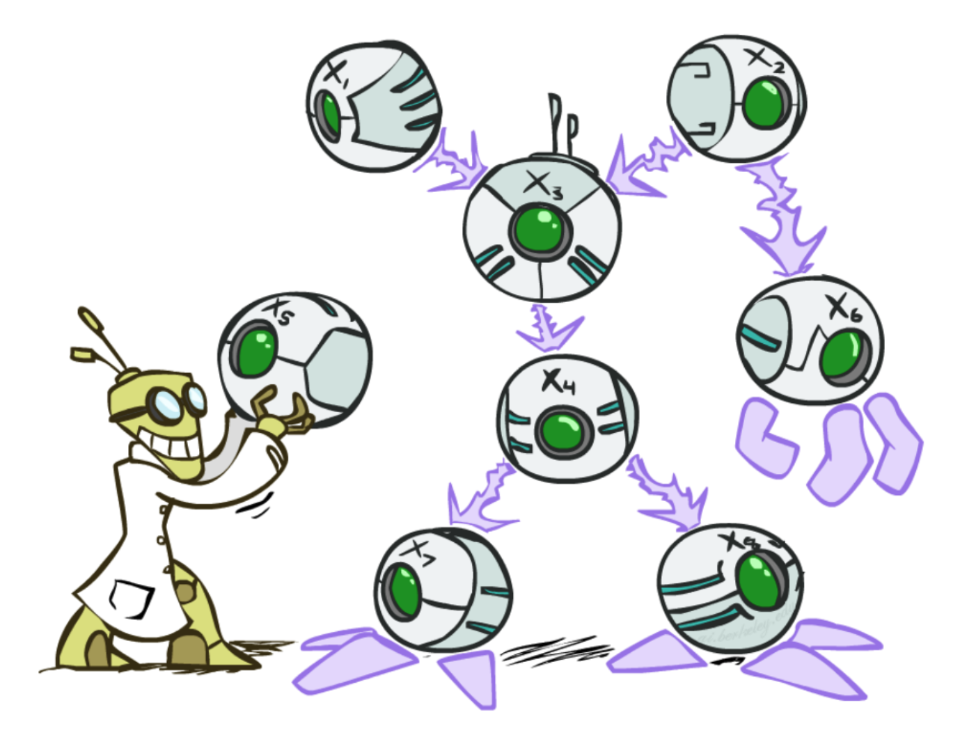
Bayes Nets
Bayes Nets provide a technique describing complex joint distributions using simple conditional distributions
  Use local causality / conditional independence
  Trading expressivity of joint distributions for efficiency of conditional distributions
Representation
Inference
Sampling
Wednesday
Friday
Today

Slide 4

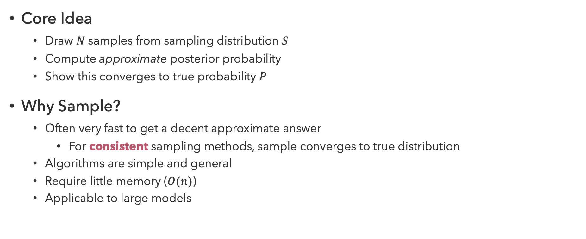
Sampling
Core Idea
  Draw $N$ samples from sampling distribution $S$
  Compute approximate posterior probability
  Show this converges to true probability $P$
Why Sample?
  Often very fast to get a decent approximate answer
    For consistent sampling methods, sample converges to true distribution
  Algorithms are simple and general
  Require little memory ($O(n)$)
  Applicable to large models

Slide 5
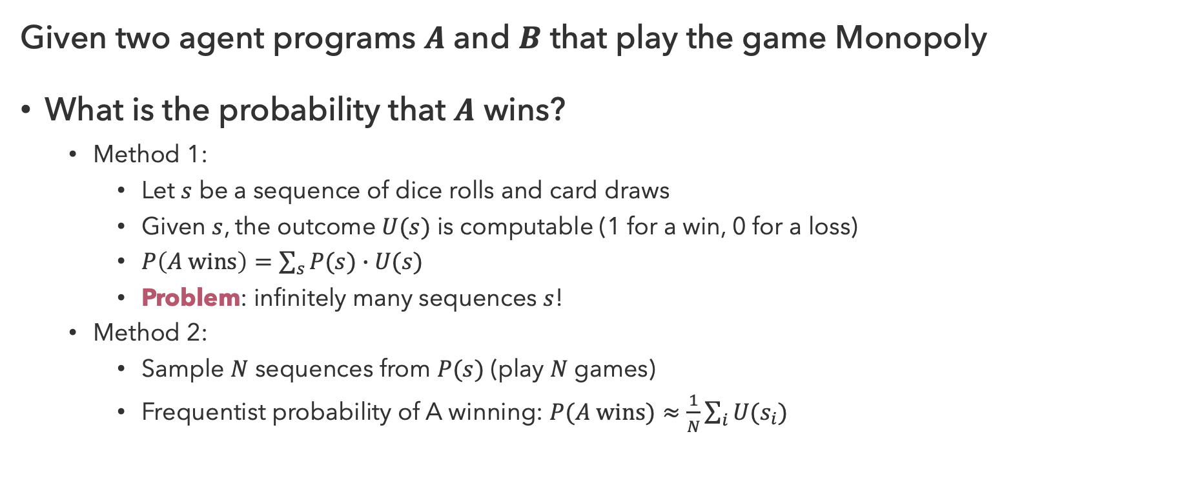
Sampling Scenario
Given two agent programs $A$ and $B$ that play the game Monopoly
What is the probability that $A$ wins?
  Method 1:
    Let $s$ be a sequence of dice rolls and card draws
    Given $s$, the outcome $U(s)$ is computable (1 for a win, 0 for a loss)
    $P\left(A wins\right)=\sum_{s}{P(s)∙U(s)}$
    Problem: infinitely many sequences $s$!
  Method 2:
    Sample $N$ sequences from $P(s)$ (play $N$ games)
    Frequentist probability of A winning: $P(A wins)≈\frac{1}{N}\sum_{i}{U(s_{i})}$

Slide 6
Sampling Implementation
function RANDOM-SAMPLE(outcomes, probabilities) returns outcome
r ← uniformly random number on [0, 1)
cumulative ← 0
for outcome, probability in outcomes, probabilities do
cumulative ← cumulative + probability
if r < cumulative then
return outcome

Slide 7
Questions (1)

Slide 8
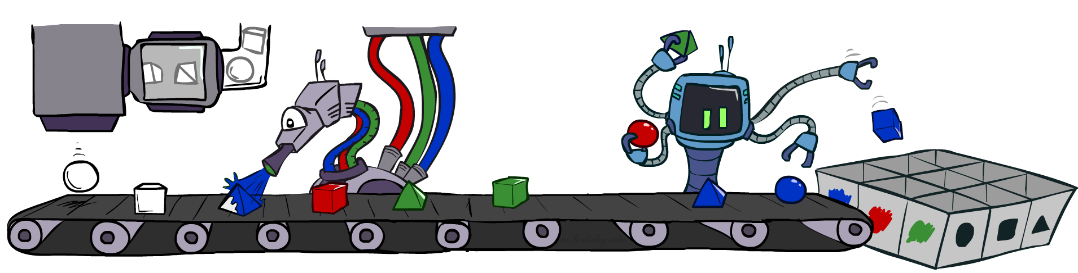


Prior Sampling
Work through network in topological order
Sample $x_{i}$ from distribution $P\left(X_{i} | x_{p_{1}},…,x_{p_{k}}\right)$
  $x_{p_{1}},…,x_{p_{k}}$ are the sampled values for $parents(X_{i})$
Exact Inference Analogy:
$$P(Q)$$

Slide 9
Prior Sampling Pseudocode
function PRIOR-SAMPLE(nodes) returns sample
n ← NUM(nodes)
sample ← ()
for i = 1 to n in topological order do
sample[i] ← sample from P(nodes[i] | sample[PARENTS(nodes[i])])
return sample

Slide 10






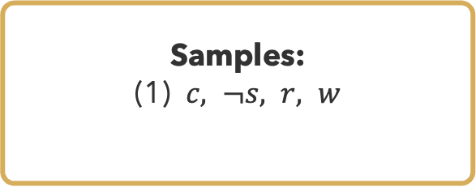






Prior Sampling Example (1)
$$P(S|C)$$
$$P(C)$$
$$C$$ | $$S$$ | $$P(S|C)$$
$$c$$ | $$s$$ | $$0.1$$
 | $$¬s$$ | $$0.9$$
$$¬c$$ | $$s$$ | $$0.5$$
 | $$¬s$$ | $$0.5$$
$$C$$ | $$P(C)$$
$$c$$ | $$0.5$$
$$¬c$$ | $$0.5$$
$$C$$
Cloudy
$$P(R|C)$$
$$C$$ | $$R$$ | $$P(R|C)$$
$$c$$ | $$r$$ | $$0.8$$
 | $$¬r$$ | $$0.2$$
$$¬c$$ | $$r$$ | $$0.2$$
 | $$¬r$$ | $$0.8$$
$$P(W|S,R)$$
$$S$$
$$R$$
$$S$$ | $$R$$ | $$W$$ | $$P(W|S,R)$$
$$s$$ | $$r$$ | $$w$$ | $$0.99$$
 |  | $$¬w$$ | $$0.01$$
 | $$¬r$$ | $$w$$ | $$0.90$$
 |  | $$¬w$$ | $$0.10$$
$$¬s$$ | $$r$$ | $$w$$ | $$0.90$$
 |  | $$¬w$$ | $$0.10$$
 | $$¬r$$ | $$w$$ | $$0.01$$
 |  | $$¬w$$ | $$0.99$$
Sprinkler
Rain
Samples:
(1) $c, ¬s, r, w$
$$W$$
Wet Grass

Slide 11
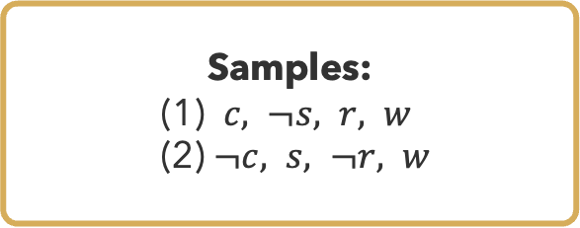
Prior Sampling Example (2)
$$P(S|C)$$
$$P(C)$$
$$C$$ | $$S$$ | $$P(S|C)$$
$$c$$ | $$s$$ | $$0.1$$
 | $$¬s$$ | $$0.9$$
$$¬c$$ | $$s$$ | $$0.5$$
 | $$¬s$$ | $$0.5$$
$$C$$ | $$P(C)$$
$$c$$ | $$0.5$$
$$¬c$$ | $$0.5$$
$$C$$
Cloudy
$$P(R|C)$$
$$C$$ | $$R$$ | $$P(R|C)$$
$$c$$ | $$r$$ | $$0.8$$
 | $$¬r$$ | $$0.2$$
$$¬c$$ | $$r$$ | $$0.2$$
 | $$¬r$$ | $$0.8$$
$$P(W|S,R)$$
$$S$$
$$R$$
$$S$$ | $$R$$ | $$W$$ | $$P(W|S,R)$$
$$s$$ | $$r$$ | $$w$$ | $$0.99$$
 |  | $$¬w$$ | $$0.01$$
 | $$¬r$$ | $$w$$ | $$0.90$$
 |  | $$¬w$$ | $$0.10$$
$$¬s$$ | $$r$$ | $$w$$ | $$0.90$$
 |  | $$¬w$$ | $$0.10$$
 | $$¬r$$ | $$w$$ | $$0.01$$
 |  | $$¬w$$ | $$0.99$$
Sprinkler
Rain
Samples:
(1) $c, ¬s, r, w$
(2) $¬c, s, ¬r, w$
$$W$$
Wet Grass

Slide 12
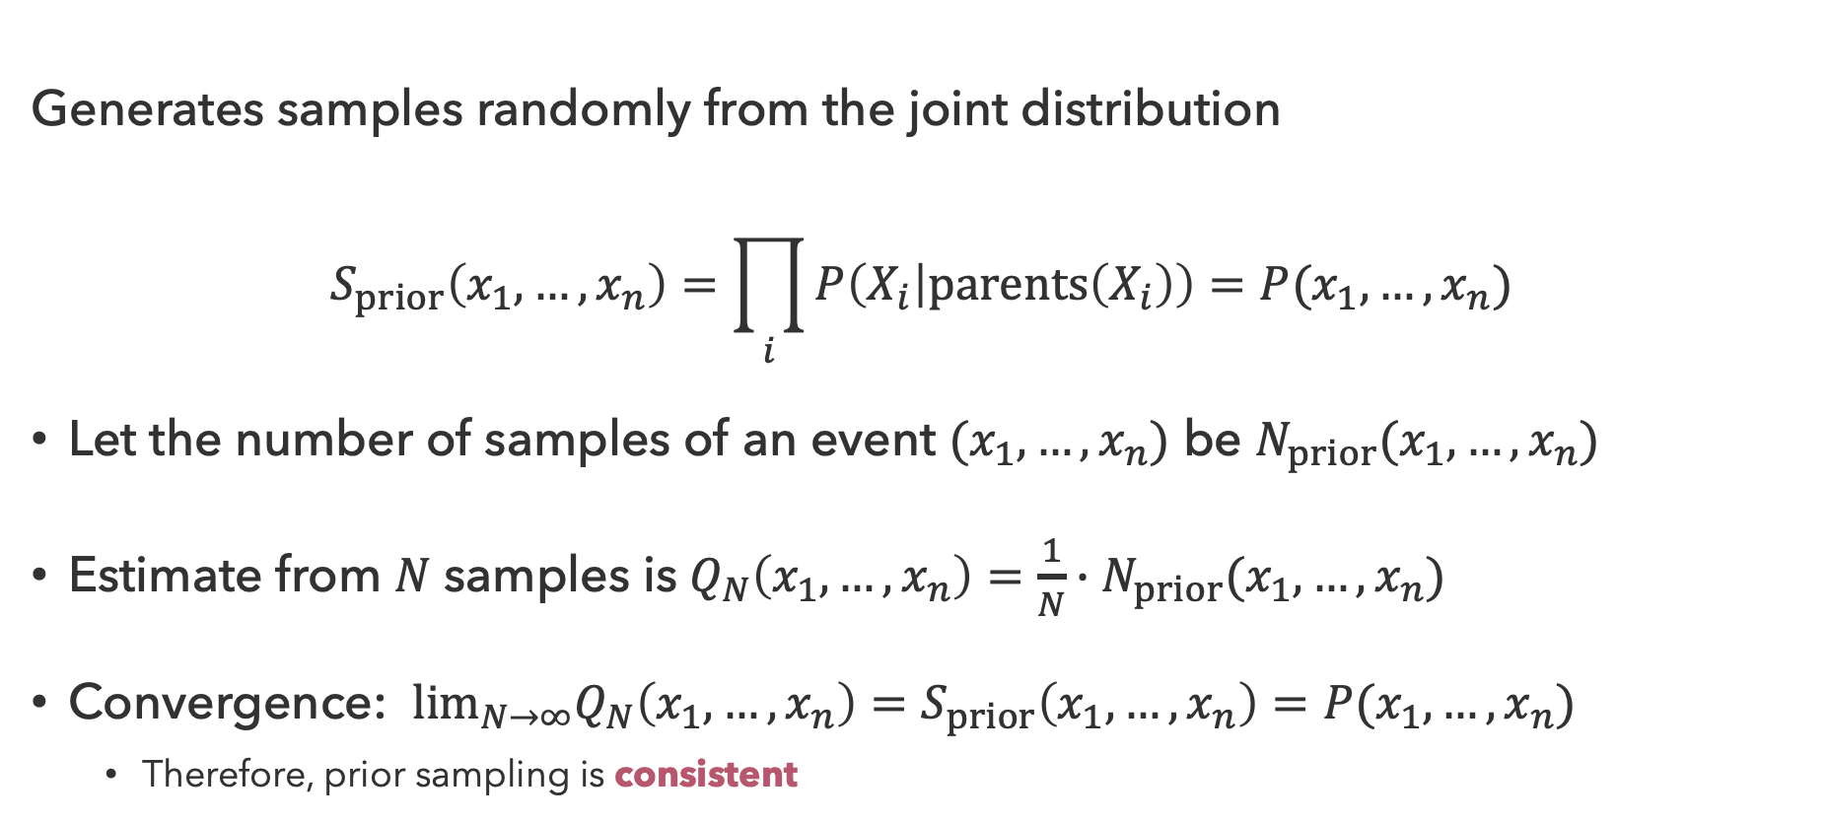
Prior Sampling Properties
Generates samples randomly from the joint distribution
$$S_{prior}\left(x_{1},…,x_{n}\right)=\prod_{i}{P\left(X_{i} | parents\left(X_{i}\right)\right)}=P(x_{1},…,x_{n})$$
Let the number of samples of an event $(x_{1},…,x_{n})$ be $N_{prior}(x_{1},…,x_{n})$
Estimate from $N$ samples is $Q_{N}\left(x_{1},…,x_{n}\right)=\frac{1}{N}∙N_{prior}(x_{1},…,x_{n})$
Convergence: $\lim_{N→∞}Q_{N}\left(x_{1},…,x_{n}\right)=S_{prior}\left(x_{1},…,x_{n}\right)=P(x_{1},…,x_{n})$
  Therefore, prior sampling is consistent

Slide 13
Questions (2)

Slide 14
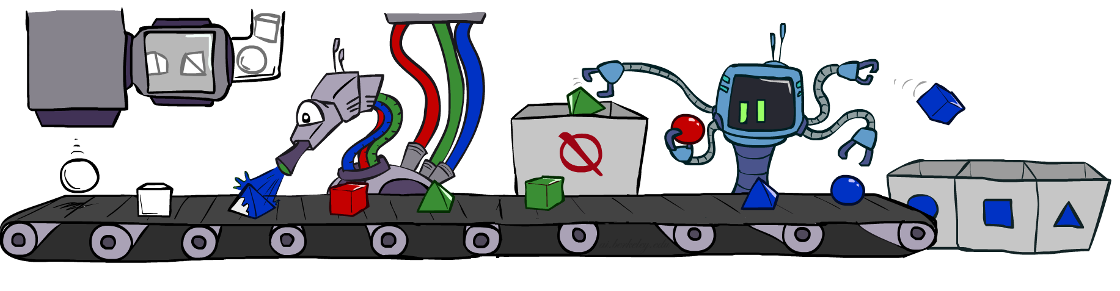


Rejection Sampling
Given evidence $e_{1},…,e_{k}$
  Only count samples consistent with the evidence
  But if evidence is unlikely, reject most samples…
Exact Inference Analogy:
$$P(Q|e_{1},…,e_{k})$$

Slide 15
Rejection Sampling Pseudocode
function REJECTION-SAMPLE(nodes, evidence) returns sample or failure
n ← NUM(nodes)
sample ← ()
for i = 1 to n in topological order do
x_i ← sample from P(nodes[i] | sample[PARENTS(nodes[i])])
if x_i not consistent with evidence then
return without sample
else sample[i] ← x_i
return sample

Slide 16
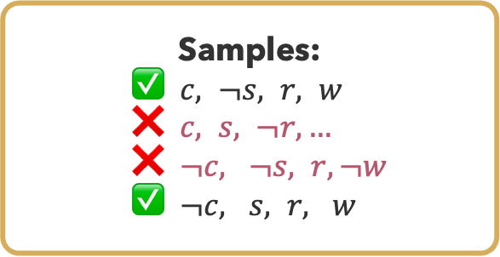
Rejection Sampling Example
$$P(S|C)$$
$$P(C)$$
$$C$$ | $$S$$ | $$P(S|C)$$
$$c$$ | $$s$$ | $$0.1$$
 | $$¬s$$ | $$0.9$$
$$¬c$$ | $$s$$ | $$0.5$$
 | $$¬s$$ | $$0.5$$
$$C$$ | $$P(C)$$
$$c$$ | $$0.5$$
$$¬c$$ | $$0.5$$
$$C$$
Cloudy
$$P(R|C)$$
$$C$$ | $$R$$ | $$P(R|C)$$
$$c$$ | $$r$$ | $$0.8$$
 | $$¬r$$ | $$0.2$$
$$¬c$$ | $$r$$ | $$0.2$$
 | $$¬r$$ | $$0.8$$
$$P(W|S,R)$$
$$S$$
$$R$$
$$S$$ | $$R$$ | $$W$$ | $$P(W|S,R)$$
$$s$$ | $$r$$ | $$w$$ | $$0.99$$
 |  | $$¬w$$ | $$0.01$$
 | $$¬r$$ | $$w$$ | $$0.90$$
 |  | $$¬w$$ | $$0.10$$
$$¬s$$ | $$r$$ | $$w$$ | $$0.90$$
 |  | $$¬w$$ | $$0.10$$
 | $$¬r$$ | $$w$$ | $$0.01$$
 |  | $$¬w$$ | $$0.99$$
Sprinkler
Rain
Samples:
✅ $c, ¬s, r, w$
❌ $c, s, ¬r,…$
❌ $¬c, ¬s, r, ¬w$
✅ $¬c, s, r, w$
$$W$$
Wet Grass

Slide 17
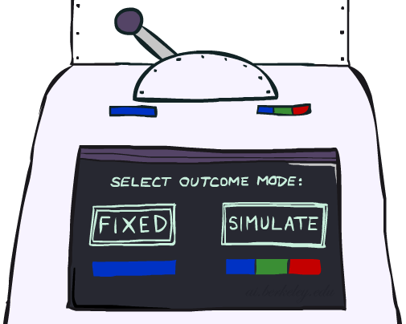
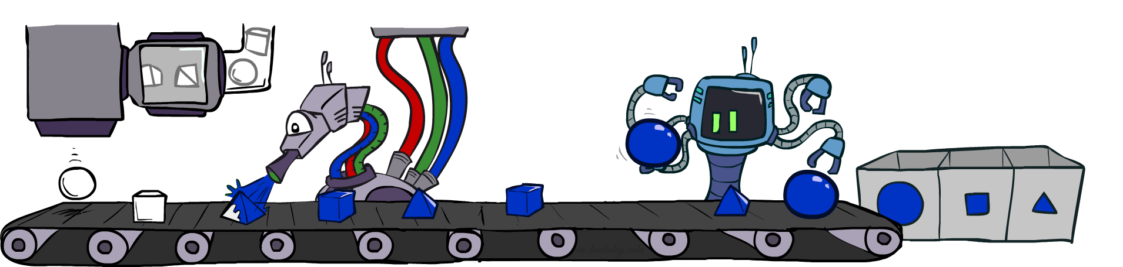
Likelihood Weighting
Improve on rejection sampling by fixing evidence
  Problem: now the sampling distribution is inconsistent (does not converge to true distribution)
  Solution: weight each sample by the probability of evidence given parents

Slide 18
Likelihood Weighting Pseudocode
function LIKELIHOOD-WEIGHTING(nodes, evidence) returns sample, weight
n ← NUM(nodes)
w ← 1.0
sample ← ()
for i = 1 to n in topological order do
if nodes[i] in evidence then
sample[i] ← evidence[i]
w ← w * P(sample[i] | sample[PARENTS(nodes[i])])
else
sample[i] ← sample from P(nodes[i] | sample[PARENTS(nodes[i])])
return sample, w

Slide 19
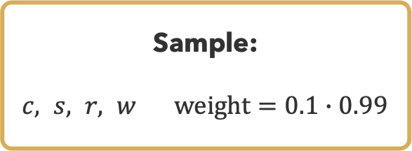
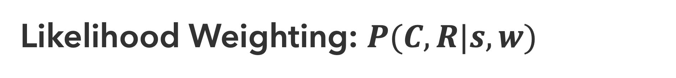
Likelihood Weighting: $P(C,R|s,w)$
$$P(S|C)$$
$$P(C)$$
$$C$$ | $$S$$ | $$P(S|C)$$
$$c$$ | $$s$$ | $$0.1$$
 | $$¬s$$ | $$0.9$$
$$¬c$$ | $$s$$ | $$0.5$$
 | $$¬s$$ | $$0.5$$
$$C$$ | $$P(C)$$
$$c$$ | $$0.5$$
$$¬c$$ | $$0.5$$
$$C$$
Cloudy
$$P(R|C)$$
$$C$$ | $$R$$ | $$P(R|C)$$
$$c$$ | $$r$$ | $$0.8$$
 | $$¬r$$ | $$0.2$$
$$¬c$$ | $$r$$ | $$0.2$$
 | $$¬r$$ | $$0.8$$
$$P(W|S,R)$$
$$S$$
$$R$$
$$S$$ | $$R$$ | $$W$$ | $$P(W|S,R)$$
$$s$$ | $$r$$ | $$w$$ | $$0.99$$
 |  | $$¬w$$ | $$0.01$$
 | $$¬r$$ | $$w$$ | $$0.90$$
 |  | $$¬w$$ | $$0.10$$
$$¬s$$ | $$r$$ | $$w$$ | $$0.90$$
 |  | $$¬w$$ | $$0.10$$
 | $$¬r$$ | $$w$$ | $$0.01$$
 |  | $$¬w$$ | $$0.99$$
Sprinkler
Rain
Sample:
$c, s, r, w$ $weight=0.1∙0.99$
$$W$$
Wet Grass

Slide 20
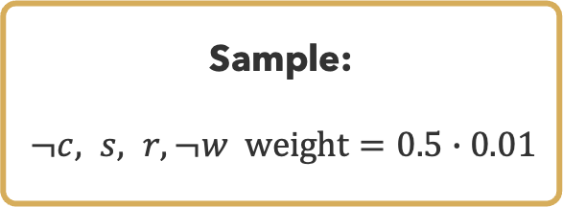
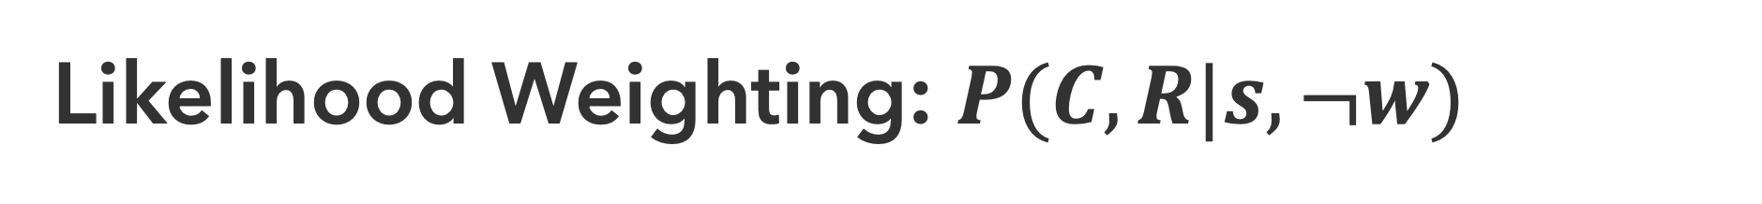
Likelihood Weighting: $P(C,R|s,¬w)$
$$P(S|C)$$
$$P(C)$$
$$C$$ | $$S$$ | $$P(S|C)$$
$$c$$ | $$s$$ | $$0.1$$
 | $$¬s$$ | $$0.9$$
$$¬c$$ | $$s$$ | $$0.5$$
 | $$¬s$$ | $$0.5$$
$$C$$ | $$P(C)$$
$$c$$ | $$0.5$$
$$¬c$$ | $$0.5$$
$$C$$
Cloudy
$$P(R|C)$$
$$C$$ | $$R$$ | $$P(R|C)$$
$$c$$ | $$r$$ | $$0.8$$
 | $$¬r$$ | $$0.2$$
$$¬c$$ | $$r$$ | $$0.2$$
 | $$¬r$$ | $$0.8$$
$$P(W|S,R)$$
$$S$$
$$R$$
$$S$$ | $$R$$ | $$W$$ | $$P(W|S,R)$$
$$s$$ | $$r$$ | $$w$$ | $$0.99$$
 |  | $$¬w$$ | $$0.01$$
 | $$¬r$$ | $$w$$ | $$0.90$$
 |  | $$¬w$$ | $$0.10$$
$$¬s$$ | $$r$$ | $$w$$ | $$0.90$$
 |  | $$¬w$$ | $$0.10$$
 | $$¬r$$ | $$w$$ | $$0.01$$
 |  | $$¬w$$ | $$0.99$$
Sprinkler
Rain
Sample:
$¬c, s, r, ¬w weight=0.5∙0.01$
$$W$$
Wet Grass

Slide 21
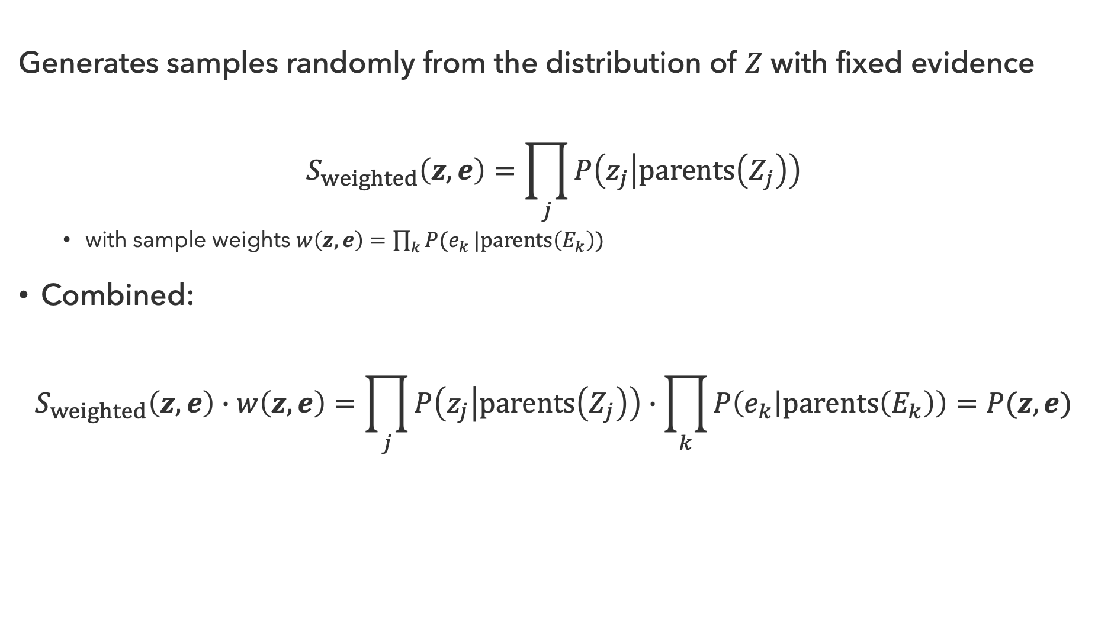
Likelihood Weighting Properties
Generates samples randomly from the distribution of $Z$ with fixed evidence
$$S_{weighted}\left(z, e\right)=\prod_{j}{P\left(z_{j} | parents\left(Z_{j}\right)\right)}$$
  with sample weights $w\left(z,e\right)=\prod_{k}{P(e_{k}}|parents\left(E_{k}\right))$
Combined:
$$S_{weighted}\left(z,e\right)∙w\left(z,e\right)=\prod_{j}{P\left(z_{j} | parents\left(Z_{j}\right)\right)}∙\prod_{k}{P\left(e_{k} | parents\left(E_{k}\right)\right)}=P(z,e)$$
all other variables
evidence variables

Slide 22
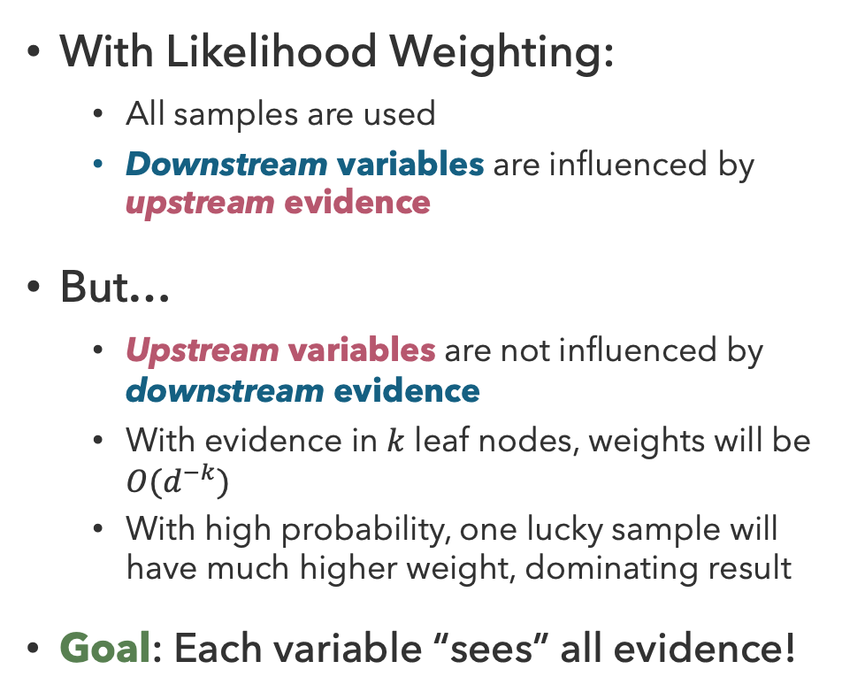
Impact of Evidence
With Likelihood Weighting:
  All samples are used
  Downstream variables are influenced by upstream evidence
But…
  Upstream variables are not influenced by downstream evidence
  With evidence in $k$ leaf nodes, weights will be $O(d^{−k})$
  With high probability, one lucky sample will have much higher weight, dominating result
Goal: Each variable “sees” all evidence!
Upstream Evidence
Downstream Evidence
Hidden Variables | Evidence
Hidden Variables | Sample
Query Variable
Hidden Variable Weighted by Query, Evidence

Slide 23
Questions (3)

Slide 24
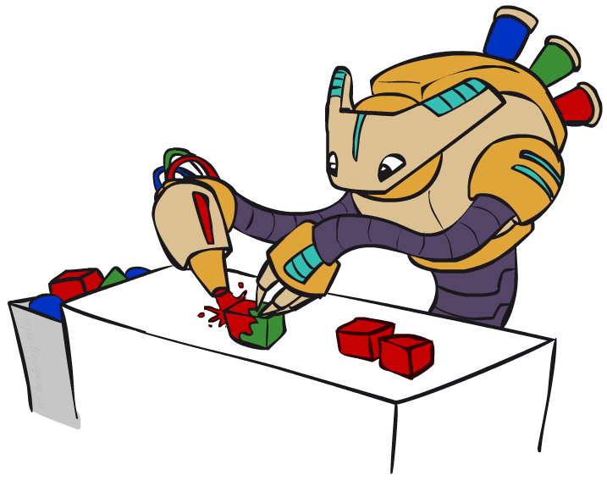
A Different Approach: Gibbs Sampling

Slide 25

Markov Chain Monte Carlo
Monte Carlo algorithms provide sampling methods with some probability of producing an incorrect answer
Markov Chain Monte Carlo is family of randomized algorithms for approximating some quantity over very large state spaces
  A Markov chain involves a sequence of randomly chosen states (“random walk”), where each state is chosen conditioned (only) on the previous state
  In short: MCMC involves wandering around for a bit, then taking the average of observations

Slide 26
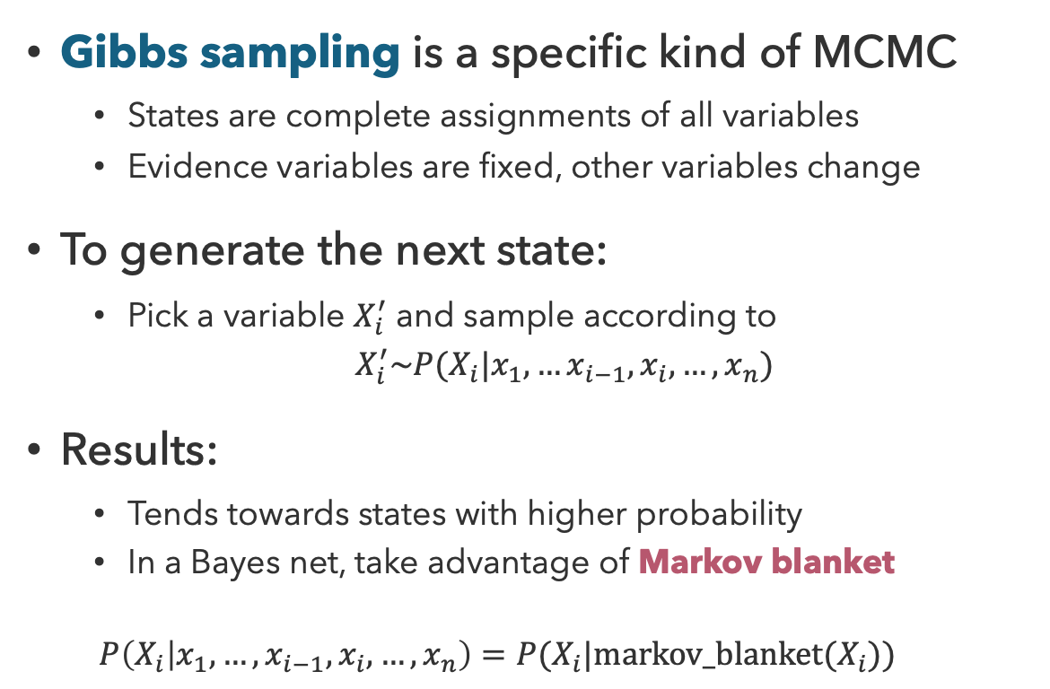
Gibbs Sampling
Gibbs sampling is a specific kind of MCMC
  States are complete assignments of all variables
  Evidence variables are fixed, other variables change
To generate the next state:
  Pick a variable $X_{i}^{′}$ and sample according to
  $X_{i}^{′}\sim P(X_{i}|x_{1},…x_{i−1},x_{i},…,x_{n})$
Results:
  Tends towards states with higher probability
  In a Bayes net, take advantage of Markov blanket
  $$P\left(X_{i} | x_{1},…,x_{i−1},x_{i},…,x_{n}\right)=P(X_{i}|markov_blanket(X_{i}))$$

Slide 27
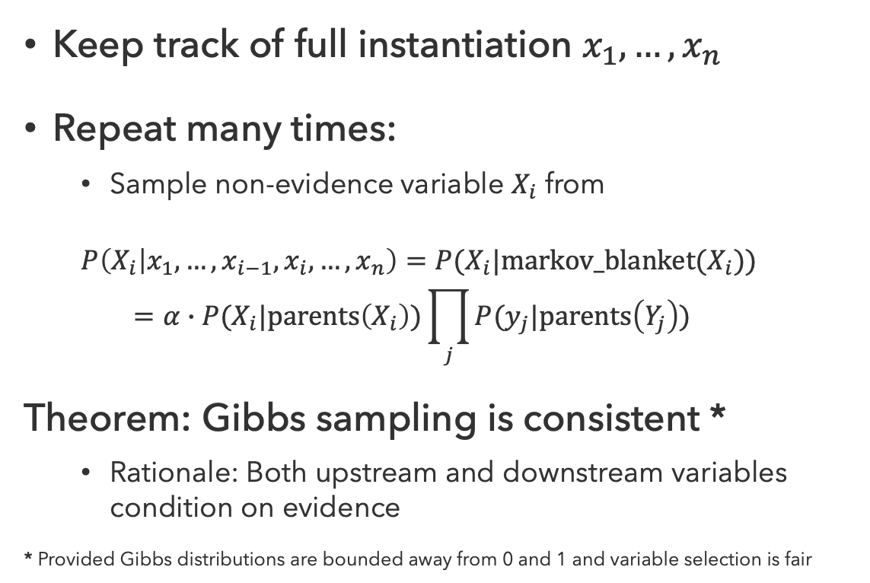
Implementing Gibbs Sampling
Keep track of full instantiation $x_{1},…,x_{n}$
Repeat many times:
  Sample non-evidence variable $X_{i}$ from
  $$P\left(X_{i} | x_{1},…,x_{i−1},x_{i},…,x_{n}\right)=P(X_{i}|markov_blanket(X_{i}))$$
  $$=α∙P(X_{i}|parents\left(X_{i}\right))\prod_{j}{P(y_{j}|parents\left(Y_{j}\right))}$$
Theorem: Gibbs sampling is consistent *
  Rationale: Both upstream and downstream variables condition on evidence
* Provided Gibbs distributions are bounded away from 0 and 1 and variable selection is fair

Slide 28

Influence of Evidence
Samples soon begin to reflect all evidence in the network
Eventually, samples are being drawn from the true posterior $P(X|e)$!
Evidence
Samples drawn and conditioned on Evidence

Slide 29
Questions (4)

Slide 30









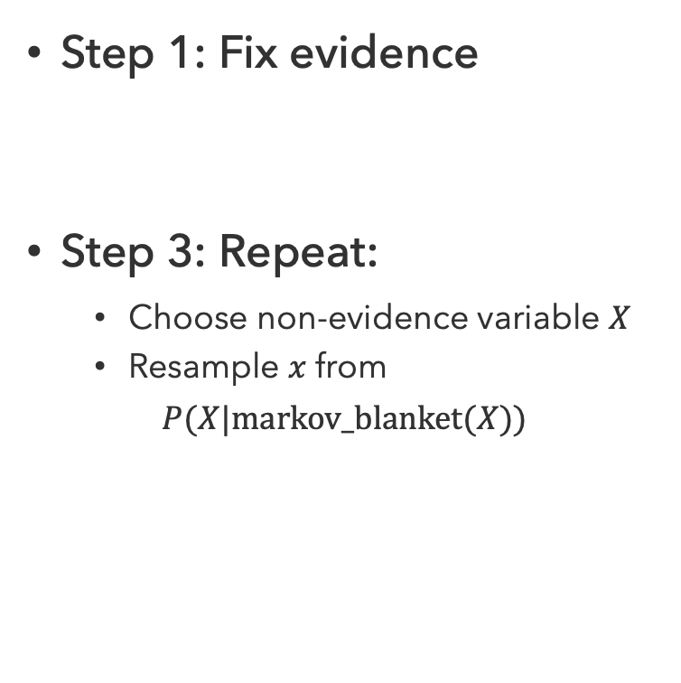














Gibbs Sampling: $P(S|r)$
$$C$$
$$C$$
Step 1: Fix evidence
Step 3: Repeat:
  Choose non-evidence variable $X$
  Resample $x$ from
  $P(X|markov_blanket(X))$
Step 2: Initialize other variables
$$S$$
$$r$$
$$S$$
$$r$$
$$W$$
$$W$$
$$C$$
$$C$$
$$C$$
$$S$$
$$r$$
$$S$$
$$r$$
$$S$$
$$r$$
$$W$$
$$W$$
$$W$$
sample $S\sim P(S|c,r,¬w)$
sample $C\sim P(C|s,r)$
sample $W\sim P(W|s,r)$

Slide 31


A Timely Connection…
How large must $N$ be for MCMC to converge to the true distribution?
CSE Prof. Oveis Gharan’s research on this problem recently contributed to his winning the 2026 IMU Abacus Medal:
“Oveis Gharan…answered this question, thereby resolving the Mihail-Vazirani conjecture, which had been open for three decades. Oveis Gharan et al established a bound on how long the algorithm needs to run to sample sufficiently. That they found exactly the right bound is extraordinary”
- A. Jackson, IMU Write-Up
Shayan Oveis Gharan
CSE Professor

Slide 32

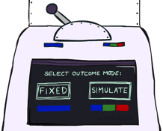






Sampling Summary
Prior Sampling
Rejection Sampling
$$P(Q)$$
$$P(Q|e)$$
Likelihood Weighting
Gibbs Sampling
$$P(Q|e)$$
$$P(Q|e)$$

Slide 33
Questions (5)

Slide 34
that’s it for today!
Achieve approximate inference results by sampling from local distributions
With consistent sampling method, sample converges to true query distribution
Markov Models
Particle Filters
Complete Practice Problem 13
Do Project 3 (due 7.30)
Do Homework 3 (due 8.6)

