Slide 1
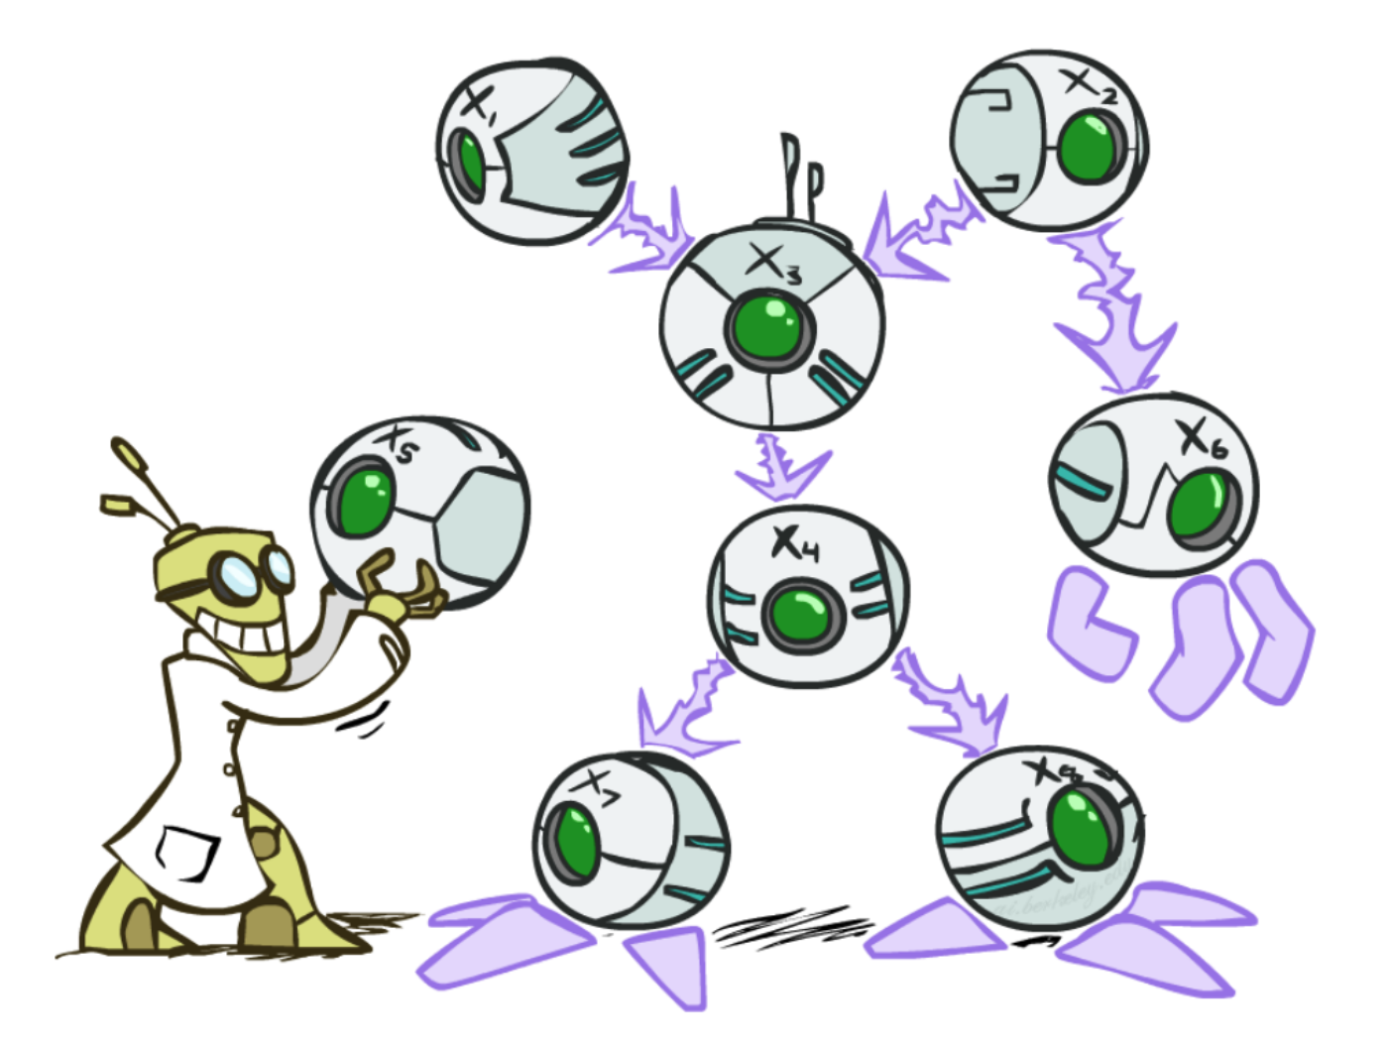
Bayes Nets
CSE 473: Introduction to Artificial Intelligence
James Weichert (jpw@cs)
cs.uw.edu/473
acknowledgements
Welcome!
What should the CSE 473 logo/mascot be?
sli.do #cse473

Slide 2


Administrivia
Mid-Quarter Feedback Survey :)
Test 1 scores released, regrade requests due tomorrow
Complete the Mid-Quarter Feedback survey!
Homework 2 due tomorrow (7.23)
Project 3 due next Thursday (7.30)

Slide 3
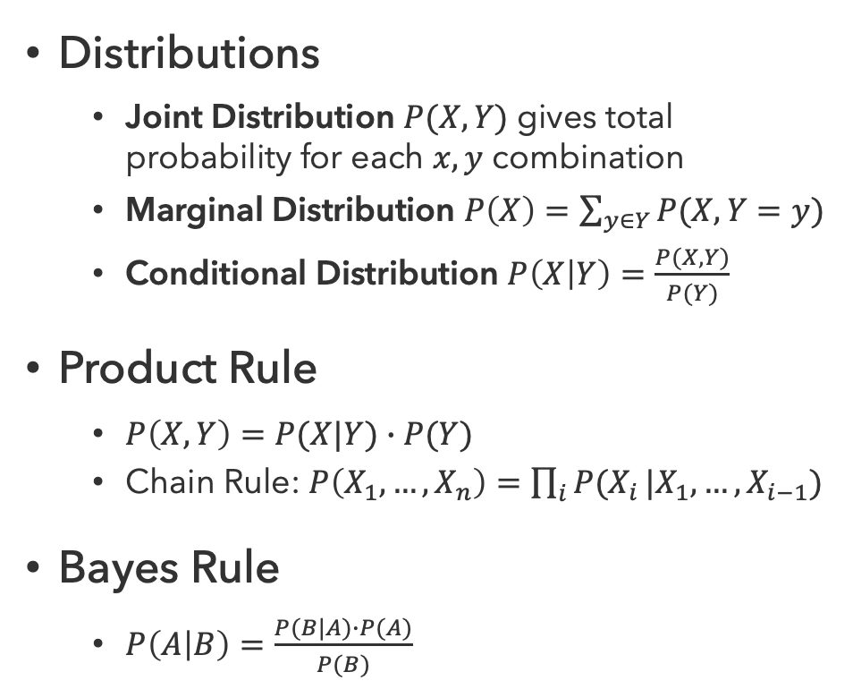
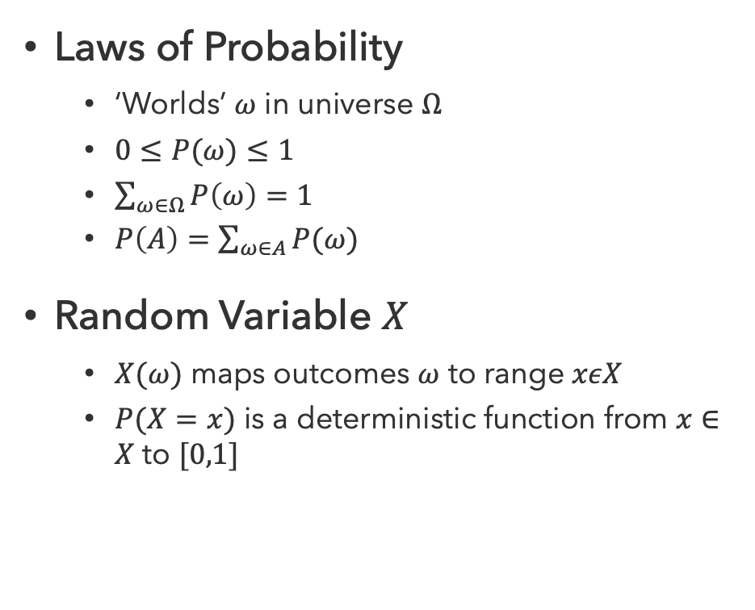
Probability Recap
Laws of Probability
  ‘Worlds’ $ω$ in universe $Ω$
  $0≤P(ω)≤1$
  $\sum_{ω∈Ω}{P\left(ω\right)=1}$
  $P\left(A\right)=\sum_{ω∈A}{P(ω)}$
Random Variable $X$
  $X(ω)$ maps outcomes $ω$ to range $xεX$
  $P(X=x)$ is a deterministic function from $x∈X$ to $[0,1]$
Distributions
  Joint Distribution $P(X,Y)$ gives total probability for each $x,y$ combination
  Marginal Distribution $P\left(X\right)=\sum_{y∈Y}{P(X,Y=y)}$
  Conditional Distribution $P\left(X | Y\right)=\frac{P(X,Y)}{P(Y)}$
Product Rule
  $P\left(X,Y\right)=P(X|Y)∙P(Y)$
  Chain Rule: $P\left(X_{1},…,X_{n}\right)=\prod_{i}{P(X_{i}}|X_{1},…,X_{i−1})$
Bayes Rule
  $P\left(A | B\right)=\frac{P(B|A)∙P(A)}{P(B)}$

Slide 4
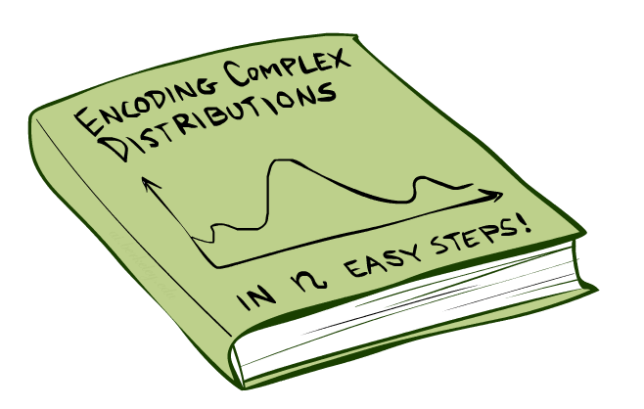
How to manage complex probability distributions?

Slide 5

Bayesian Networks
Bayes Nets provide a technique describing complex joint distributions using simple conditional distributions
  Subset of a general class of graphical models
  Also called “belief networks”
Use local causality / conditional independence
  The world is composed of many variables
  Each interacting locally with a few others
Expressivity vs. Efficiency
  While conditional probabilities are less expressive
  (comprehensive) than joint probabilities, they are faster
  and more space-efficient to work with

Slide 6
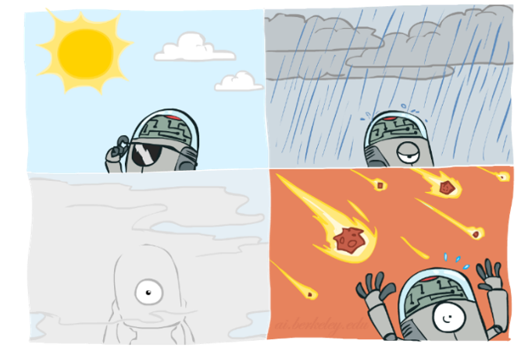


Graphical Models
Nodes: Variables
  Assigned (observed)
  Unassigned (unobserved)
Arcs: Interactions
  Indicate “direct influence” between variables
  Formally: encode conditional (in)dependence
$$T$$
$$W$$

Slide 7





Coin Flips
$N$ independent coin flips
No interactions between variables $⟹$ absolute independence
$$X_{1}$$
$$X_{2}$$
…
$$X_{n}$$

Slide 8
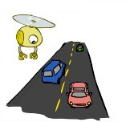
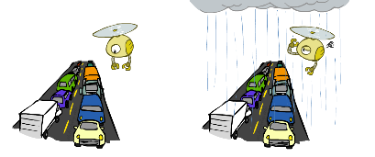
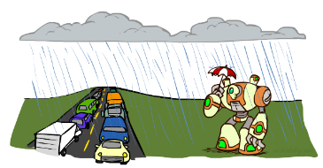




Traffic
Variables
  $R$ it rains
  $T$ there’s traffic
  $U$ I’m holding my umbrella
$$R$$
$$T$$
$$U$$

Slide 9
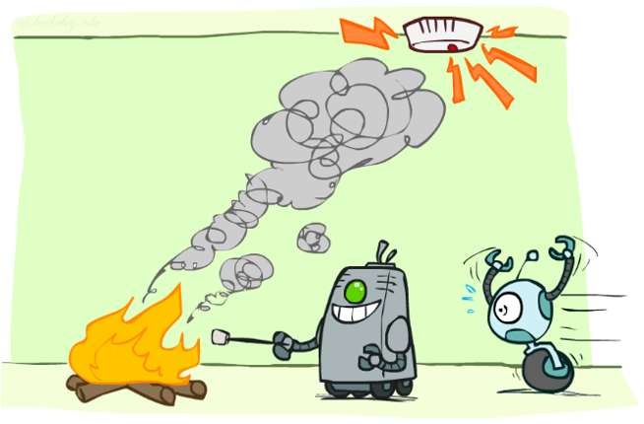




Smoke Alarm
$$F$$
Variables
  $F$ there is a fire
  $S$ there is smoke
  $A$ alarm sounds
$$S$$
$$A$$

Slide 10
Car Insurance

Slide 11

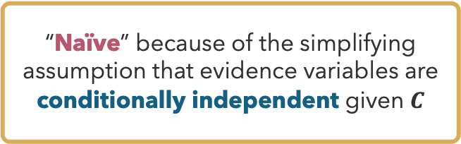




Naïve Bayes
“Naïve” because of the simplifying assumption that evidence variables are conditionally independent given $C$
Variables
  $C$ class we want to predict
  $E_{1},…,E_{n}$ evidence (or features)
$$C$$
$$E_{1}$$
$$E_{2}$$
…
$$E_{n}$$

Slide 12
Questions (1)

Slide 13
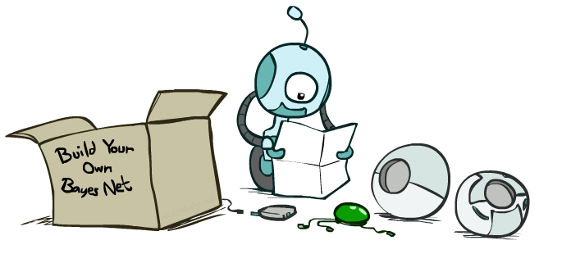
Syntax and Semantics

Slide 14
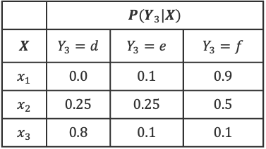

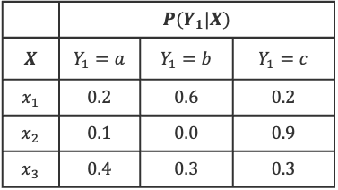
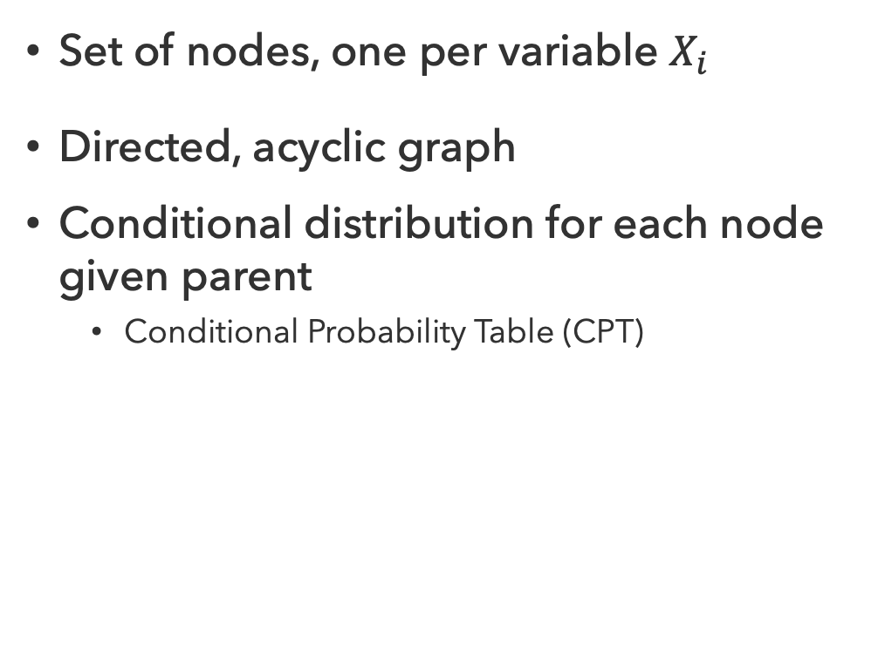



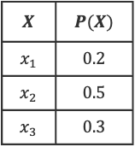
Bayes Net Syntax
$$X$$ | $$P(X)$$
$$x_{1}$$ | $$0.2$$
$$x_{2}$$ | $$0.5$$
$$x_{3}$$ | $$0.3$$
$$X$$
Set of nodes, one per variable $X_{i}$
Directed, acyclic graph
Conditional distribution for each node given parent
  Conditional Probability Table (CPT)
$$Y_{1}$$
$$Y_{2}$$
$$Y_{3}$$
 | $$P(Y_{1}|X)$$
$$X$$ | $$Y_{1}=a$$ | $$Y_{1}=b$$ | $$Y_{1}=c$$
$$x_{1}$$ | $$0.2$$ | $$0.6$$ | $$0.2$$
$$x_{2}$$ | $$0.1$$ | $$0.0$$ | $$0.9$$
$$x_{3}$$ | $$0.4$$ | $$0.3$$ | $$0.3$$
 | $$P(Y_{3}|X)$$
$$X$$ | $$Y_{3}=d$$ | $$Y_{3}=e$$ | $$Y_{3}=f$$
$$x_{1}$$ | $$0.0$$ | $$0.1$$ | $$0.9$$
$$x_{2}$$ | $$0.25$$ | $$0.25$$ | $$0.5$$
$$x_{3}$$ | $$0.8$$ | $$0.1$$ | $$0.1$$
Bayes Net = Graph + Local Probability Tables

Slide 15
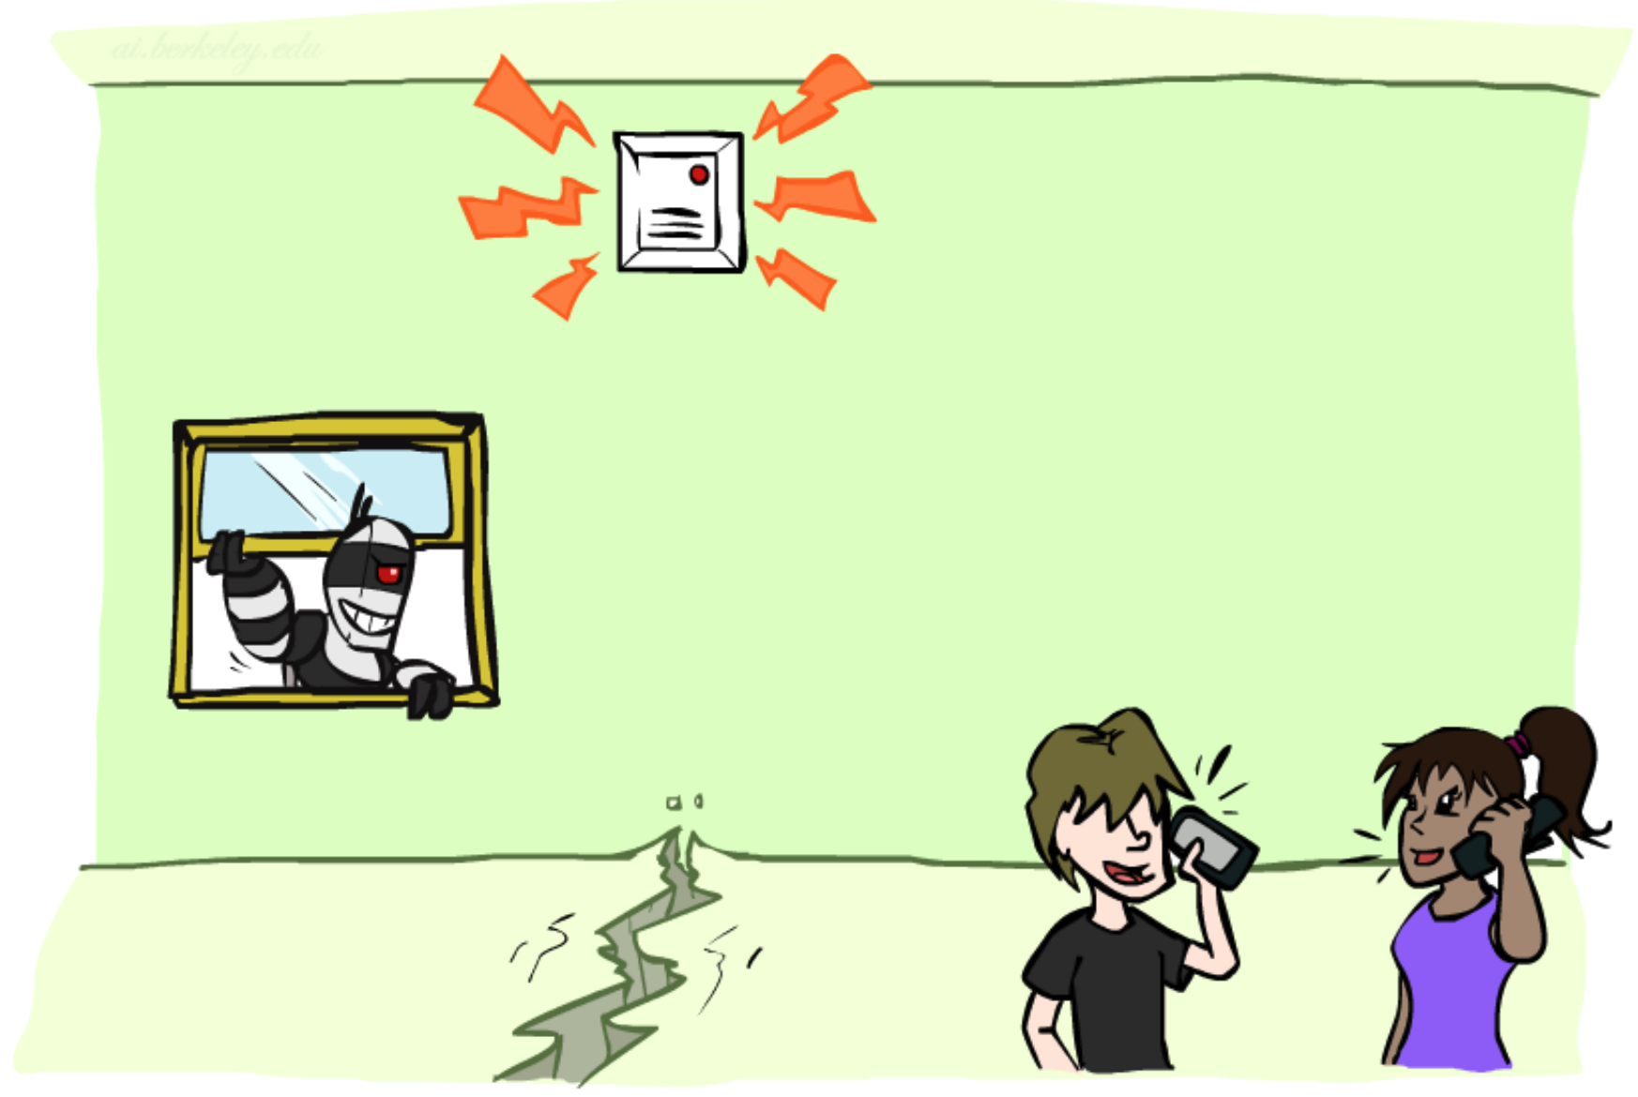
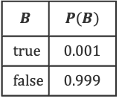



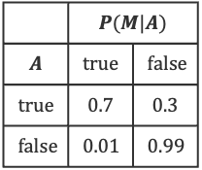

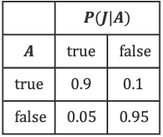

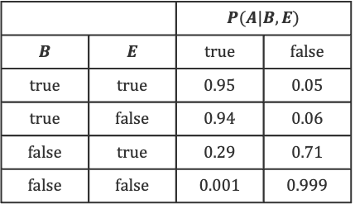

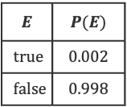
Alarm Bayes Net
$$B$$ | $$P(B)$$
$$true$$ | $$0.001$$
$$false$$ | $$0.999$$
$$E$$ | $$P(E)$$
$$true$$ | $$0.002$$
$$false$$ | $$0.998$$
$$B$$
$$E$$
Burglary
Earthquake
 |  | $$P(A|B,E)$$
$$B$$ | $$E$$ | $$true$$ | $$false$$
$$true$$ | $$true$$ | $$0.95$$ | $$0.05$$
$$true$$ | $$false$$ | $$0.94$$ | $$0.06$$
$$false$$ | $$true$$ | $$0.29$$ | $$0.71$$
$$false$$ | $$false$$ | $$0.001$$ | $$0.999$$
$$A$$
Factor Size per CPT:
$$=d_{c} \prod_{i∈parents(X_{c})}{d_{i}}$$
Alarm
 | $$P(J|A)$$
$$A$$ | $$true$$ | $$false$$
$$true$$ | $$0.9$$ | $$0.1$$
$$false$$ | $$0.05$$ | $$0.95$$
 | $$P(M|A)$$
$$A$$ | $$true$$ | $$false$$
$$true$$ | $$0.7$$ | $$0.3$$
$$false$$ | $$0.01$$ | $$0.99$$
$$J$$
$$M$$
Jan Calls
Maria Calls

Slide 16
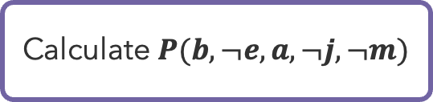
Alarm Bayes Net Practice
$$B$$ | $$P(B)$$
$$true$$ | $$0.001$$
$$false$$ | $$0.999$$
$$E$$ | $$P(E)$$
$$true$$ | $$0.002$$
$$false$$ | $$0.998$$
$$B$$
$$E$$
Burglary
Earthquake
 |  | $$P(A|B,E)$$
$$B$$ | $$E$$ | $$true$$ | $$false$$
$$true$$ | $$true$$ | $$0.95$$ | $$0.05$$
$$true$$ | $$false$$ | $$0.94$$ | $$0.06$$
$$false$$ | $$true$$ | $$0.29$$ | $$0.71$$
$$false$$ | $$false$$ | $$0.001$$ | $$0.999$$
$$A$$
Calculate $P(b, ¬e, a,¬j, ¬m)$
Alarm
 | $$P(J|A)$$
$$A$$ | $$true$$ | $$false$$
$$true$$ | $$0.9$$ | $$0.1$$
$$false$$ | $$0.05$$ | $$0.95$$
 | $$P(M|A)$$
$$A$$ | $$true$$ | $$false$$
$$true$$ | $$0.7$$ | $$0.3$$
$$false$$ | $$0.01$$ | $$0.99$$
$$J$$
$$M$$
Jan Calls
Maria Calls

Slide 17
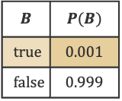
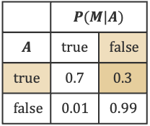
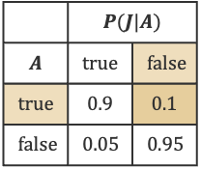
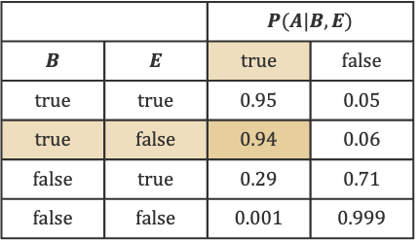
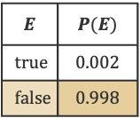
Alarm Bayes Net Practice (1)
$$B$$ | $$P(B)$$
$$true$$ | $$0.001$$
$$false$$ | $$0.999$$
$$E$$ | $$P(E)$$
$$true$$ | $$0.002$$
$$false$$ | $$0.998$$
$$B$$
$$E$$
Burglary
Earthquake
 |  | $$P(A|B,E)$$
$$B$$ | $$E$$ | $$true$$ | $$false$$
$$true$$ | $$true$$ | $$0.95$$ | $$0.05$$
$$true$$ | $$false$$ | $$0.94$$ | $$0.06$$
$$false$$ | $$true$$ | $$0.29$$ | $$0.71$$
$$false$$ | $$false$$ | $$0.001$$ | $$0.999$$
$$A$$
Calculate $P(b, ¬e, a,¬j, ¬m)$
Alarm
 | $$P(J|A)$$
$$A$$ | $$true$$ | $$false$$
$$true$$ | $$0.9$$ | $$0.1$$
$$false$$ | $$0.05$$ | $$0.95$$
 | $$P(M|A)$$
$$A$$ | $$true$$ | $$false$$
$$true$$ | $$0.7$$ | $$0.3$$
$$false$$ | $$0.01$$ | $$0.99$$
$$J$$
$$M$$
Jan Calls
Maria Calls

Slide 18



Alarm Bayes Net Practice (2)
$$B$$ | $$P(B)$$
$$true$$ | $$0.001$$
$$false$$ | $$0.999$$
$$E$$ | $$P(E)$$
$$true$$ | $$0.002$$
$$false$$ | $$0.998$$
$$B$$
$$E$$
Burglary
Earthquake
 |  | $$P(A|B,E)$$
$$B$$ | $$E$$ | $$true$$ | $$false$$
$$true$$ | $$true$$ | $$0.95$$ | $$0.05$$
$$true$$ | $$false$$ | $$0.94$$ | $$0.06$$
$$false$$ | $$true$$ | $$0.29$$ | $$0.71$$
$$false$$ | $$false$$ | $$0.001$$ | $$0.999$$
$$A$$
Calculate $P(b, ¬e, a,¬j, ¬m)$
Alarm
 | $$P(M|A)$$
$$A$$ | $$true$$ | $$false$$
$$true$$ | $$0.7$$ | $$0.3$$
$$false$$ | $$0.01$$ | $$0.99$$
$$=P(b)∙P(¬e)⋯$$
 | $$P(J|A)$$
$$A$$ | $$true$$ | $$false$$
$$true$$ | $$0.9$$ | $$0.1$$
$$false$$ | $$0.05$$ | $$0.95$$
$$J$$
$$M$$
$$∙P(a|b,¬e)⋯$$
$$∙P(¬j|a)∙P(¬m|a)⋯$$
Jan Calls
Maria Calls
$$=0.001∙0.998∙0.94∙0.1∙0.3=0.000028$$

Slide 19
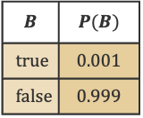
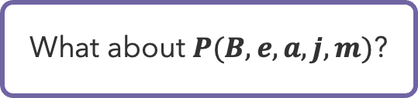
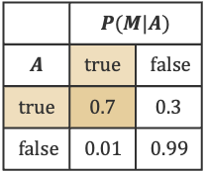
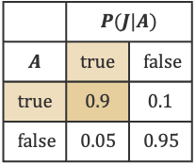
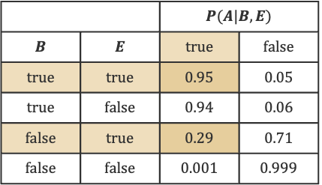
Alarm Bayes Net Practice (3)
$$B$$ | $$P(B)$$
$$true$$ | $$0.001$$
$$false$$ | $$0.999$$
$$E$$ | $$P(E)$$
$$true$$ | $$0.002$$
$$false$$ | $$0.998$$
$$B$$
$$E$$
Burglary
Earthquake
 |  | $$P(A|B,E)$$
$$B$$ | $$E$$ | $$true$$ | $$false$$
$$true$$ | $$true$$ | $$0.95$$ | $$0.05$$
$$true$$ | $$false$$ | $$0.94$$ | $$0.06$$
$$false$$ | $$true$$ | $$0.29$$ | $$0.71$$
$$false$$ | $$false$$ | $$0.001$$ | $$0.999$$
$$A$$
What about $P(B, e, a,j, m)$?
Alarm
 | $$P(J|A)$$
$$A$$ | $$true$$ | $$false$$
$$true$$ | $$0.9$$ | $$0.1$$
$$false$$ | $$0.05$$ | $$0.95$$
 | $$P(M|A)$$
$$A$$ | $$true$$ | $$false$$
$$true$$ | $$0.7$$ | $$0.3$$
$$false$$ | $$0.01$$ | $$0.99$$
$$J$$
$$M$$
Jan Calls
Maria Calls

Slide 20
Questions (2)

Slide 21
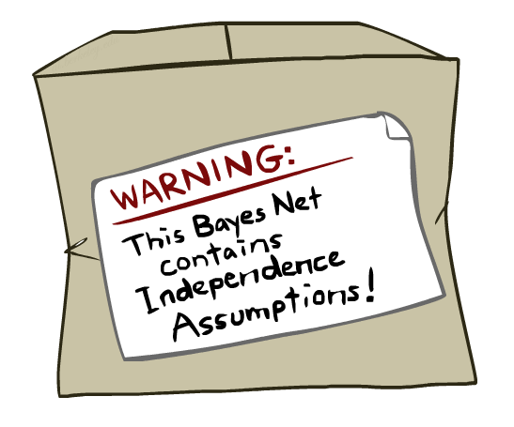
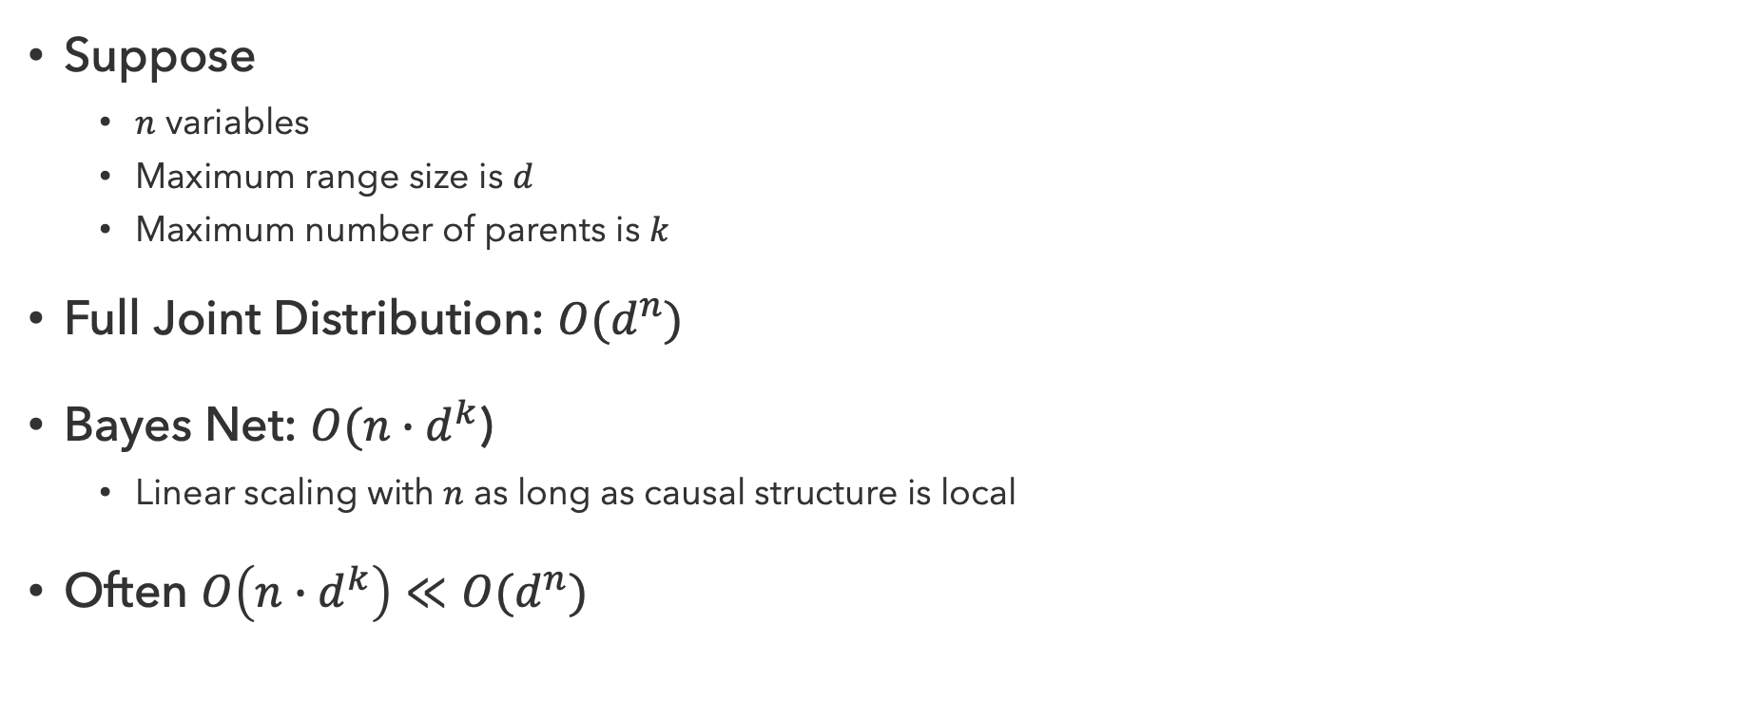
Sparse Bayes Nets
Suppose
  $n$ variables
  Maximum range size is $d$
  Maximum number of parents is $k$
Full Joint Distribution: $O(d^{n})$
Bayes Net: $O(n∙d^{k}$)
  Linear scaling with $n$ as long as causal structure is local
Often $O\left(n∙d^{k}\right)≪O(d^{n})$

Slide 22
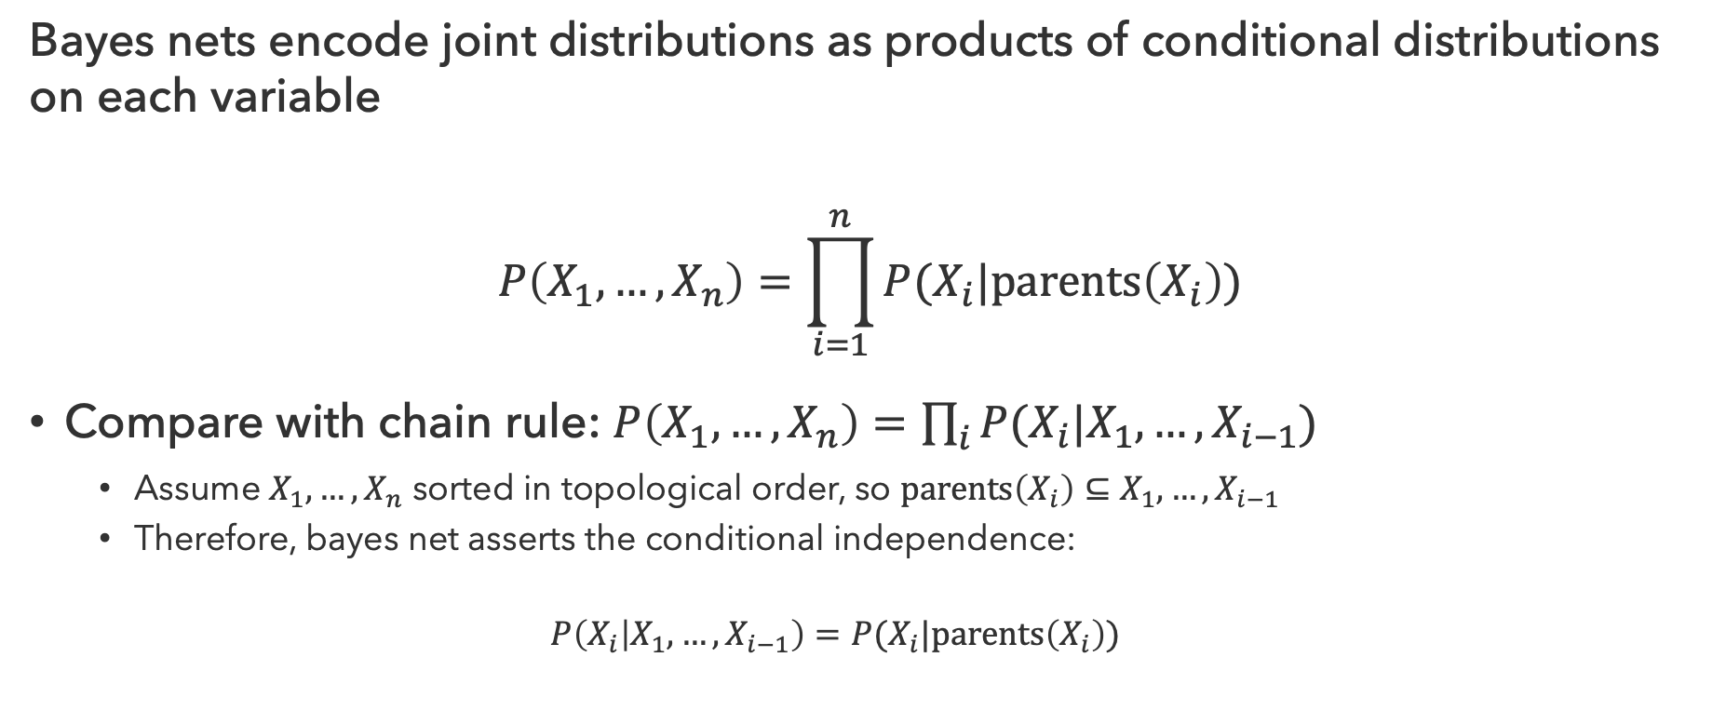
Bayes Net Semantics
Bayes nets encode joint distributions as products of conditional distributions on each variable
$$P\left(X_{1},…,X_{n}\right)=\prod_{i=1}^{n}{P(X_{i}|parents\left(X_{i}\right))}$$
Compare with chain rule: $P\left(X_{1},…,X_{n}\right)=\prod_{i}{P(X_{i}|X_{1},…,X_{i−1})}$
  Assume $X_{1},…,X_{n}$ sorted in topological order, so $parents\left(X_{i}\right)⊆X_{1},…,X_{i−1}$
  Therefore, bayes net asserts the conditional independence:
  $$P\left(X_{i} | X_{1},…,X_{i−1}\right)=P(X_{i}|parents\left(X_{i}\right))$$

Slide 23
Questions (3)

Slide 24
Conditional Independence
Every variable is conditionally independent of its non-descendants, given its parents

Slide 25
Markov Blanket
Compare with Markov Assumption
  “The future is independent of the past, given the present”
Similar Formulation
  Markov blanket consists of a node’s parents, children, and children’s other parents
  Every variable is conditionally independent of all other variables, given its Markov blanket

Slide 26
Questions (4)

Slide 27

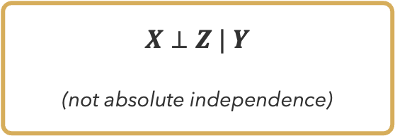


$X$ independent of $Z$?
$$X$$
$$Y$$
$$Z$$
$X⊥Z | Y$
(not absolute independence)

Slide 28
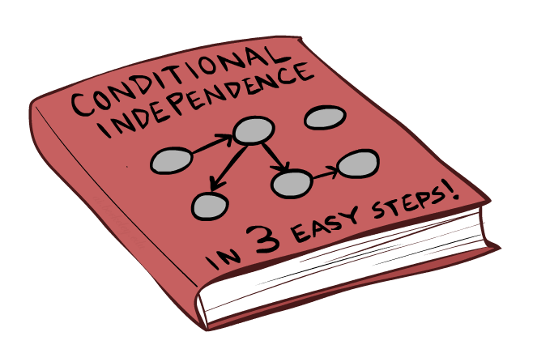
absolute independence?

Slide 29
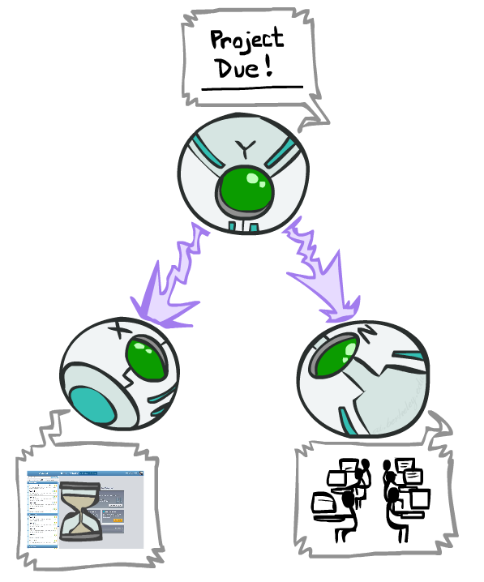
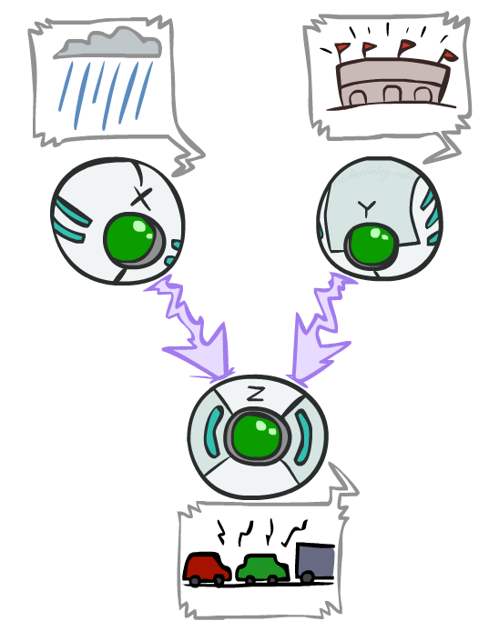
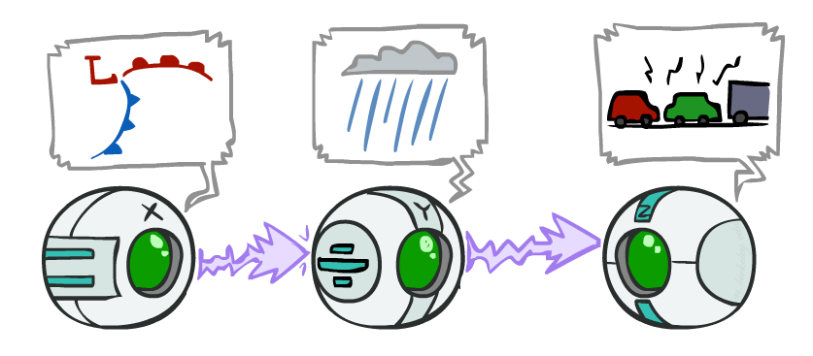












Node Triples
How can three nodes be arranged?
$$Y$$
$$X$$
$$Y$$
$$X$$
$$Z$$
$$Z$$
$$X$$
$$Y$$
$$Z$$
Causal Chain
Common Cause
Common Effect
$$P(X,Y,Z)=P(X)∙P(Y|X)∙P(Z|Y)$$
$$P(X,Y,Z)=P(Y)∙P(X|Y)∙P(Z|Y)$$
$$P(X,Y,Z)=P(X)∙P(Y)∙P(Z|X,Y)$$

Slide 30
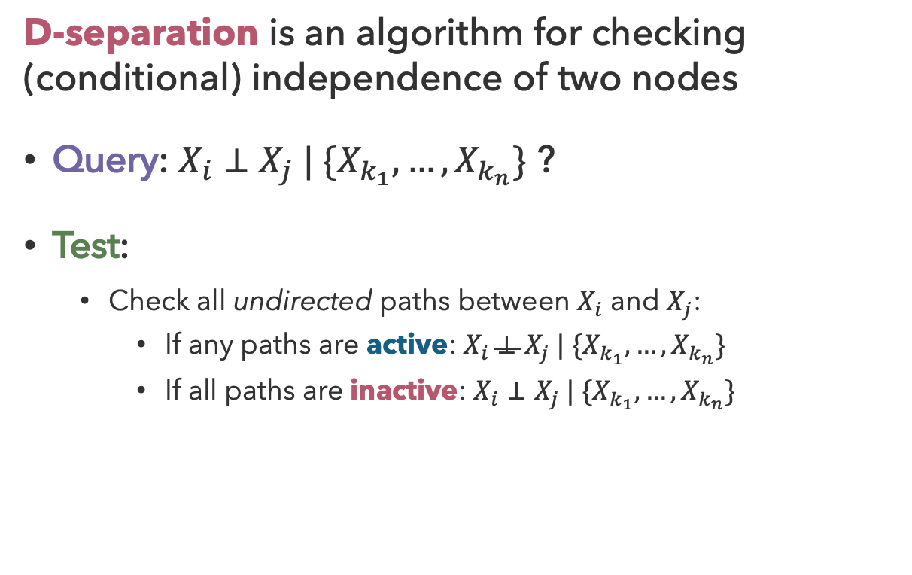
D-Separation
Active Triples
Inactive Triples
D-separation is an algorithm for checking (conditional) independence of two nodes
Query: $X_{i}⊥X_{j} | \{X_{k_{1}},…,X_{k_{n}}\}$ ?
Test:
  Check all undirected paths between $X_{i}$ and $X_{j}$:
    If any paths are active: $X_{i}⊥X_{j} | \{X_{k_{1}},…,X_{k_{n}}\}$
    If all paths are inactive: $X_{i}⊥X_{j} | \{X_{k_{1}},…,X_{k_{n}}\}$

Slide 31
Questions (5)

Slide 32
that’s it for today!
Implications of independence and conditional independence
Bayes nets encode joint distributions by tracking conditional probabilities
How to compute conditional probabilities of queries given evidence?
Complete Practice Problem 11
Fill out the Mid-Quarter Feedback Survey
Do Homework 2 (due 7.23)
Do Project 3 (due 7.30)

