Slide 1
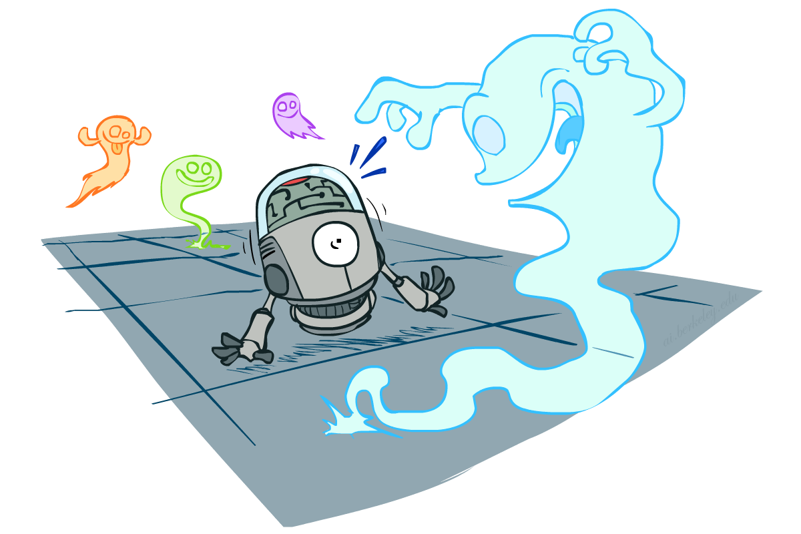
Probability
CSE 473: Introduction to Artificial Intelligence
James Weichert (jpw@cs)
cs.uw.edu/473
acknowledgements
Welcome!
What is something you’re uncertain about?
sli.do #cse473

Slide 2

Administrivia
Test 1 scores released, regrade requests due Thursday
Homework 2 due Thursday (7.23)
Project 3 due next Thursday (7.30)

Slide 3
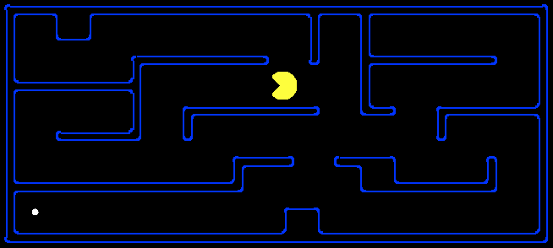
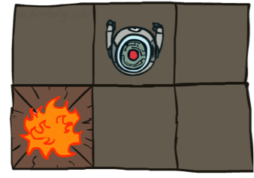
Taking Stock
S
s
d
e
p
a
b
c
e
h
r
q
s, a
a
a
h
r
p
q
f
s,a,s’
p
q
f
q
c
G
s’
q
c
G
a
Deterministic
Stochastic

Slide 4
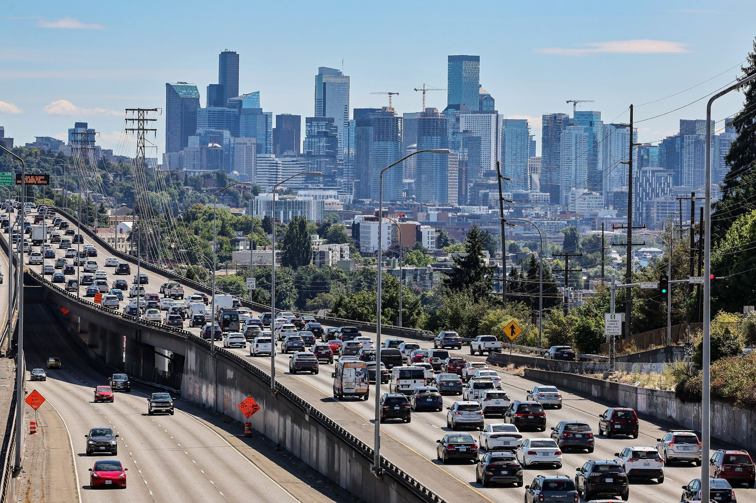
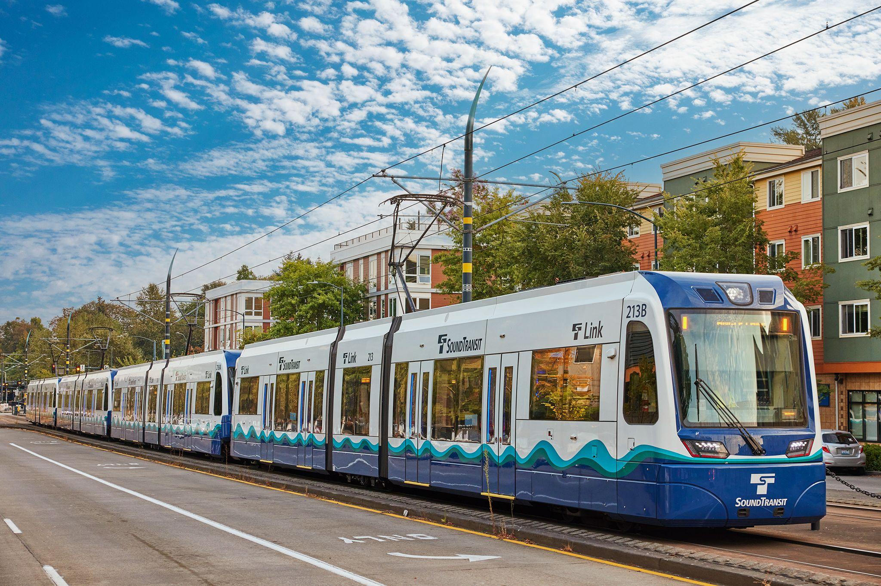
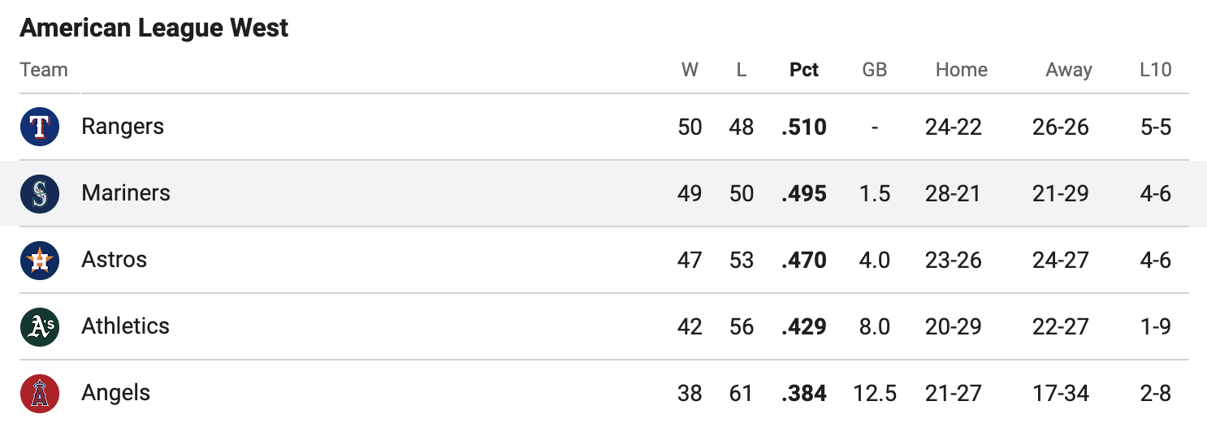
Randomness
The real world is rife with uncertainty!
Goal: Maximize expected utility!

Slide 5



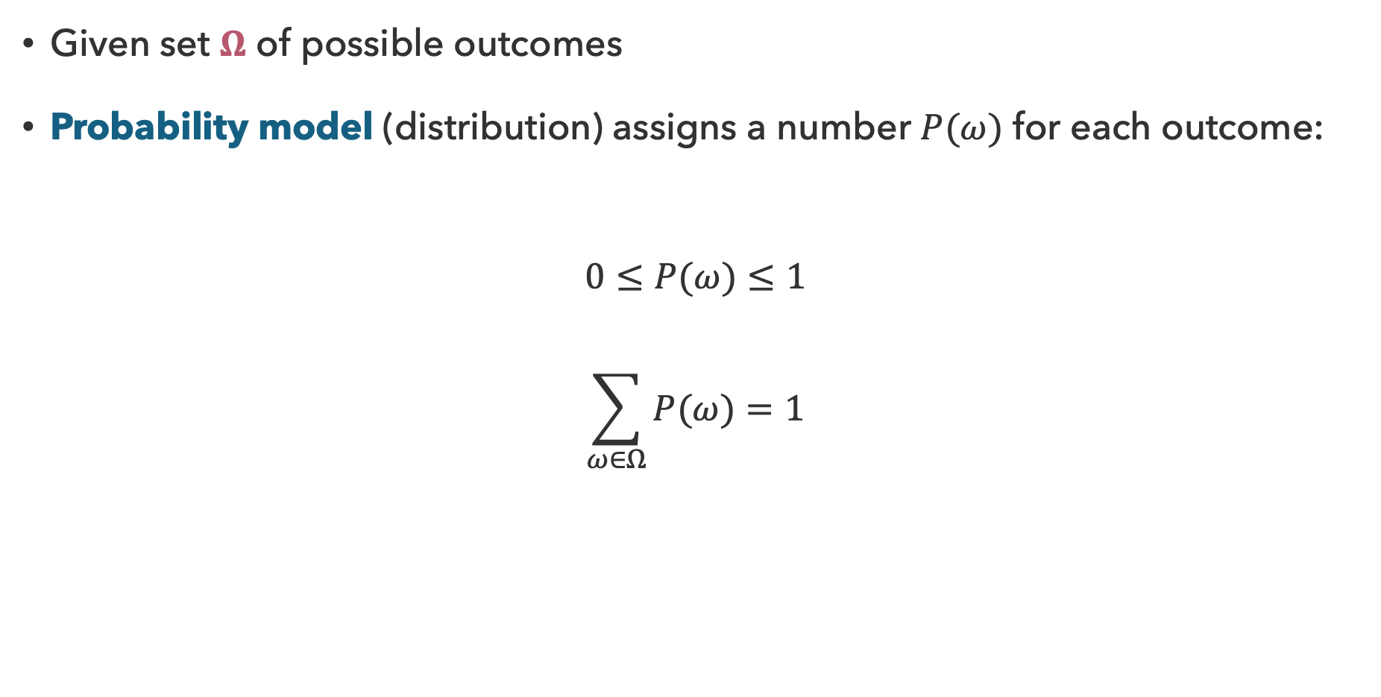



Modeling Uncertainty
Given set $Ω$ of possible outcomes
Probability model (distribution) assigns a number $P(ω)$ for each outcome:
$$0≤P(ω)≤1$$
$$\sum_{ω∈Ω}{P(ω)}=1$$
$$\frac{1}{6}$$
$$\frac{1}{6}$$
$$\frac{1}{6}$$
$$\frac{1}{6}$$
$$\frac{1}{6}$$
$$\frac{1}{6}$$

Slide 6









Probabilities
An event is a subset of possible outcomes of $Ω$
The probability of an event A is the sum of probabilities over the outcomes
  All outcomes $ω$ that satisfy the definition of event $A$
$$P\left(A\right)=\sum_{ω∈A}{P(ω)}$$
$$\frac{1}{6}$$
$$\frac{1}{6}$$
$$\frac{1}{6}$$
$$\frac{1}{6}$$
$$\frac{1}{6}$$
$$\frac{1}{6}$$
$$P\left(Even\right)=\frac{1}{2}$$
$$P\left(Odd\right)=\frac{1}{2}$$

Slide 7

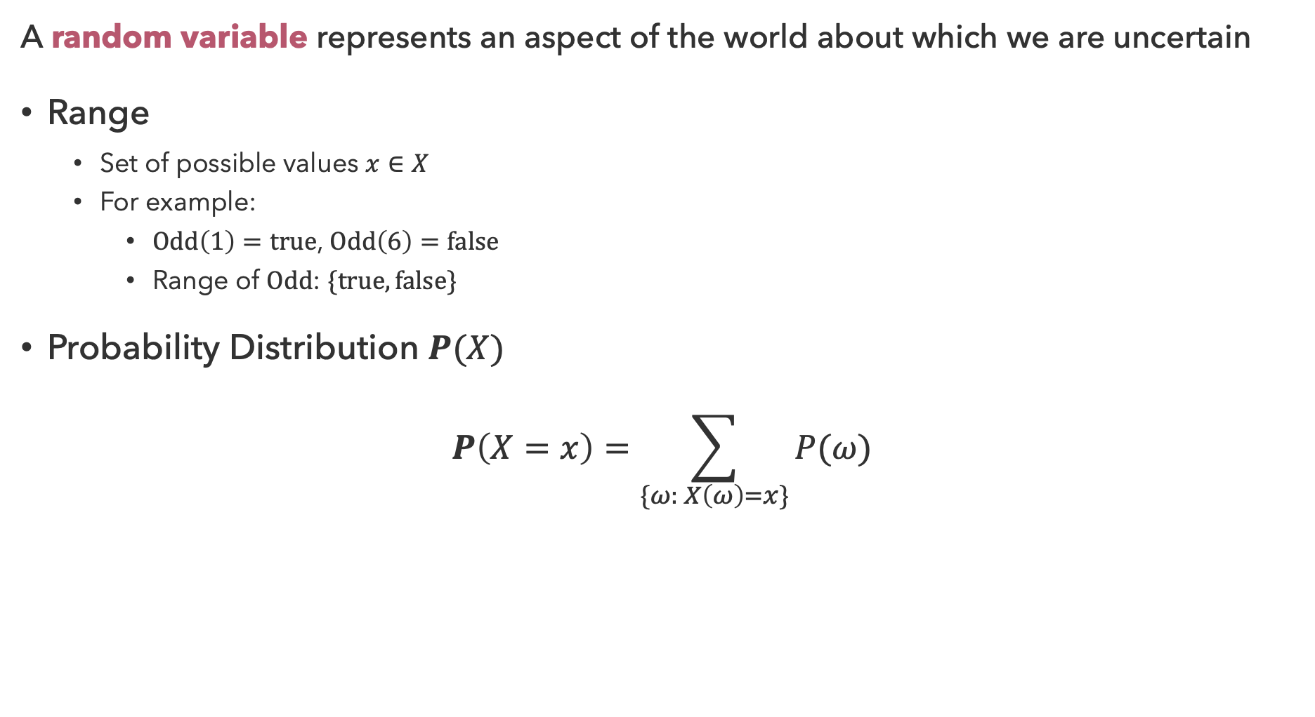
Random Variables
A random variable represents an aspect of the world about which we are uncertain
Range
  Set of possible values $x∈X$
  For example:
    $Odd\left(1\right)=true$, $Odd\left(6\right)=false$
    Range of $Odd$: $\{true, false\}$
Probability Distribution $P(X)$
$$P\left(X=x\right)=\sum_{\{ω: X\left(ω\right)=x\}}{P(ω)}$$

Slide 8
Questions (1)

Slide 9
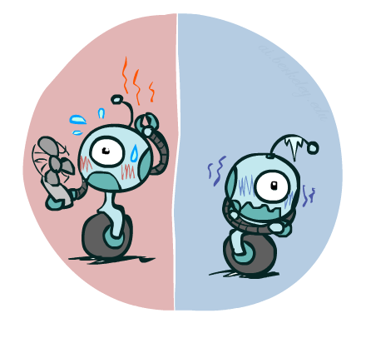
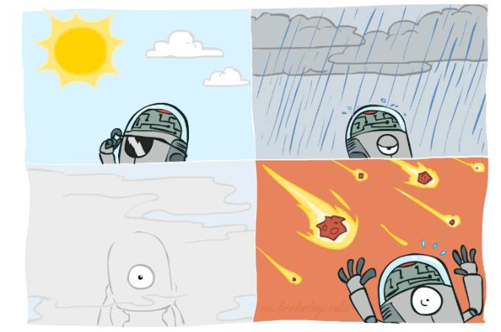
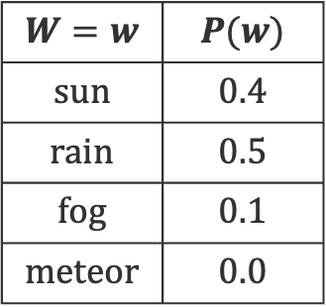
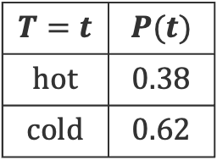


Probability Distributions
Probability distributions describe probabilities for each outcome in the range
$$T:\{hot, cold\}$$
$$W:\{sun, rain, fog, meteor\}$$
$$W=w$$ | $$P(w)$$
$$sun$$ | $$0.4$$
$$rain$$ | $$0.5$$
$$fog$$ | $$0.1$$
$$meteor$$ | $$0.0$$
$$T=t$$ | $$P(t)$$
$$hot$$ | $$0.38$$
$$cold$$ | $$0.62$$

Slide 10
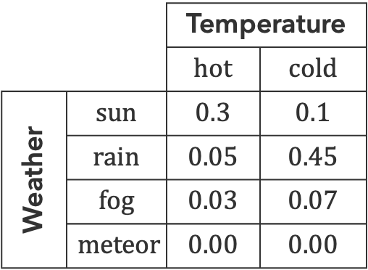


Joint Probabilities
$P(A∩B)$ is the probability of events A and B both occurring
Joint distribution $P(X,Y)$
  describes all combinations of values for the random variables $X$ and $Y$
 |  | Temperature
 |  | $$hot$$ | $$cold$$
Weather | $$sun$$ | $$0.3$$ | $$0.1$$
 | $$rain$$ | $$0.05$$ | $$0.45$$
 | $$fog$$ | $$0.03$$ | $$0.07$$
 | $$meteor$$ | $$0.00$$ | $$0.00$$
Size of distribution for $n$ variables with range $d$: $O(d^{n}$)

Slide 11
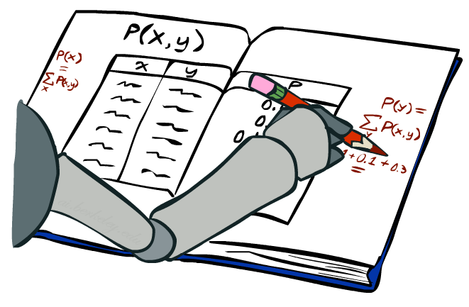
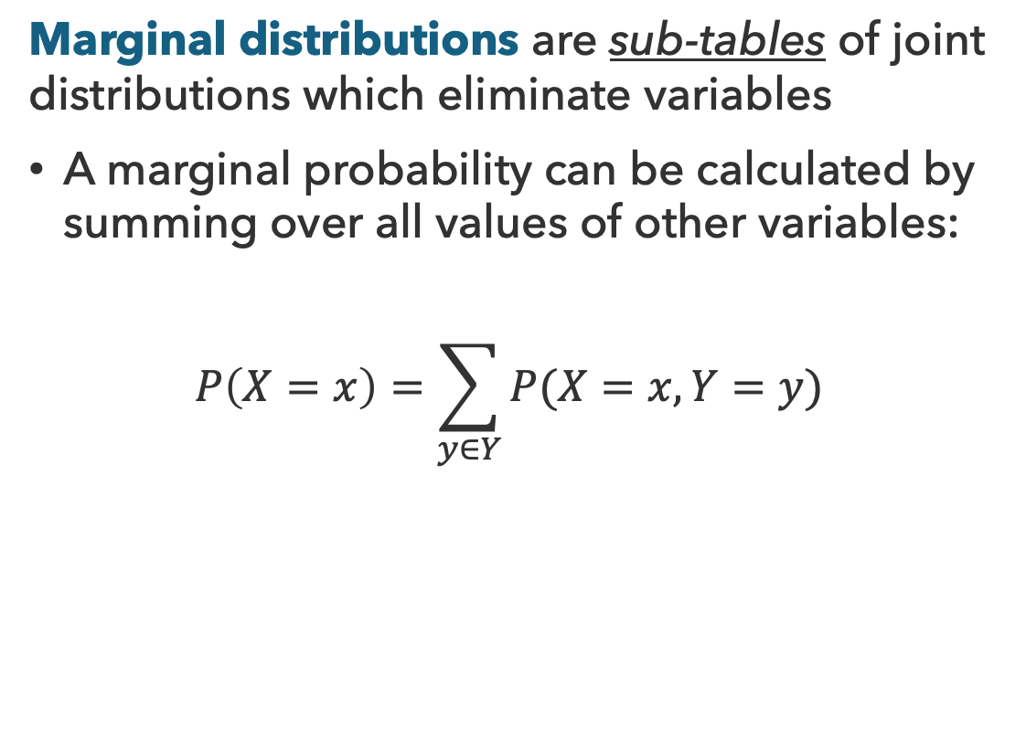


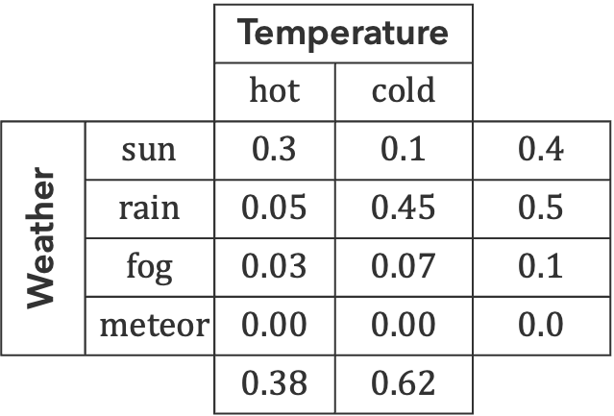
Marginal Distributions
Marginal distributions are sub-tables of joint distributions which eliminate variables
A marginal probability can be calculated by summing over all values of other variables:
$$P\left(X=x\right)=\sum_{y∈Y}{P(X=x, Y=y)}$$
 |  | Temperature
 |  | $$hot$$ | $$cold$$
Weather | $$sun$$ | $$0.3$$ | $$0.1$$ | $$0.4$$
 | $$rain$$ | $$0.05$$ | $$0.45$$ | $$0.5$$
 | $$fog$$ | $$0.03$$ | $$0.07$$ | $$0.1$$
 | $$meteor$$ | $$0.00$$ | $$0.00$$ | $$0.0$$
 |  | $$0.38$$ | $$0.62$$
$$P(W)$$
$$P(T)$$

Slide 12

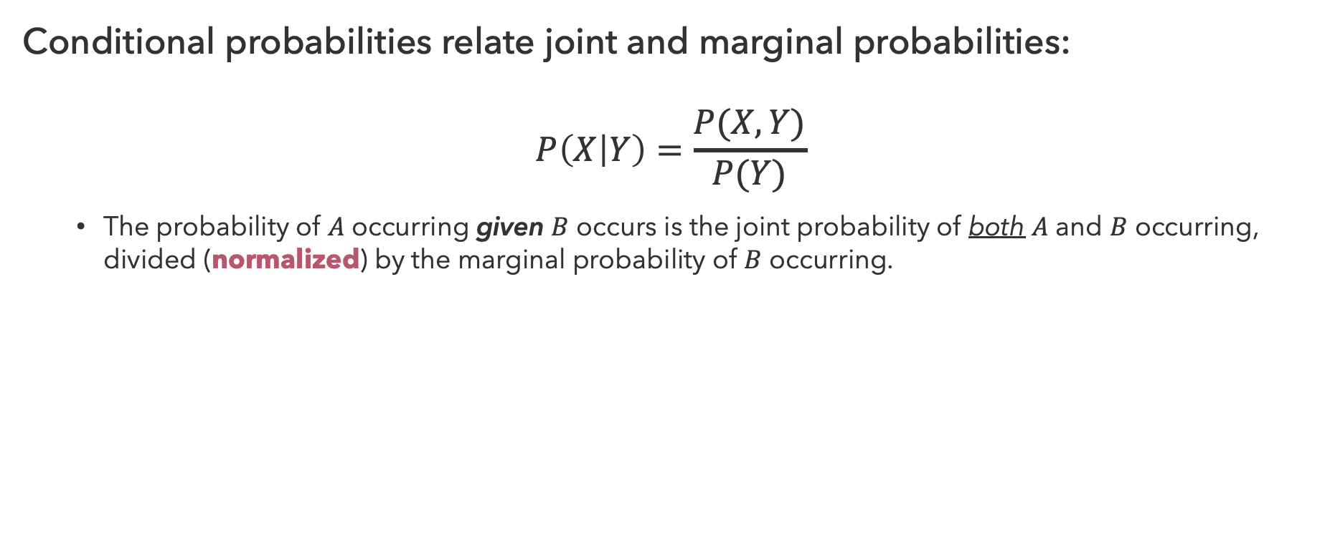


Conditional Probabilities
Conditional probabilities relate joint and marginal probabilities:
$$P\left(X | Y\right)=\frac{P(X,Y)}{P(Y)}$$
  The probability of $A$ occurring given $B$ occurs is the joint probability of both $A$ and $B$ occurring, divided (normalized) by the marginal probability of $B$ occurring.
$$P(A,B)$$
$$P(A)$$
$$P(B)$$

Slide 13
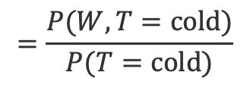
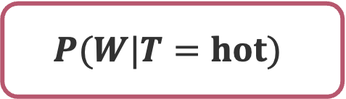
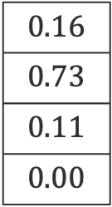
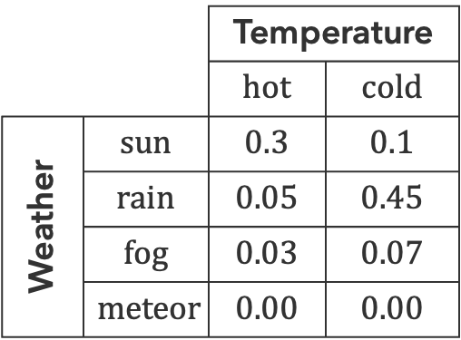
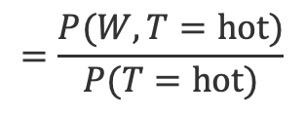
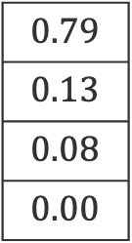

Determining Conditional Probabilities
Proportional, but not equal to, the joint probability with fixed evidence
$$P(W|T=hot)$$
 |  | Temperature
 |  | $$hot$$ | $$cold$$
Weather | $$sun$$ | $$0.3$$ | $$0.1$$
 | $$rain$$ | $$0.05$$ | $$0.45$$
 | $$fog$$ | $$0.03$$ | $$0.07$$
 | $$meteor$$ | $$0.00$$ | $$0.00$$
$$P(W|T=cold)$$
$$0.79$$
$$0.13$$
$$0.08$$
$$0.00$$
$$0.16$$
$$0.73$$
$$0.11$$
$$0.00$$
$$=\frac{P(W, T=hot)}{P(T=hot)}$$
$$=\frac{P(W, T=cold)}{P(T=cold)}$$

Slide 14
Questions (2)

Slide 15
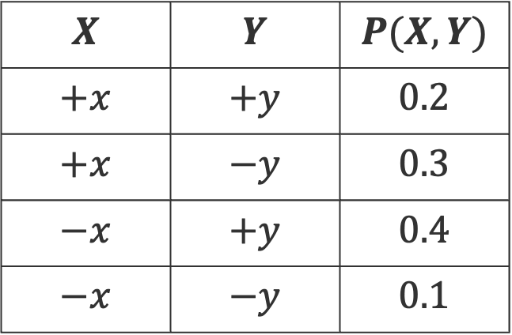
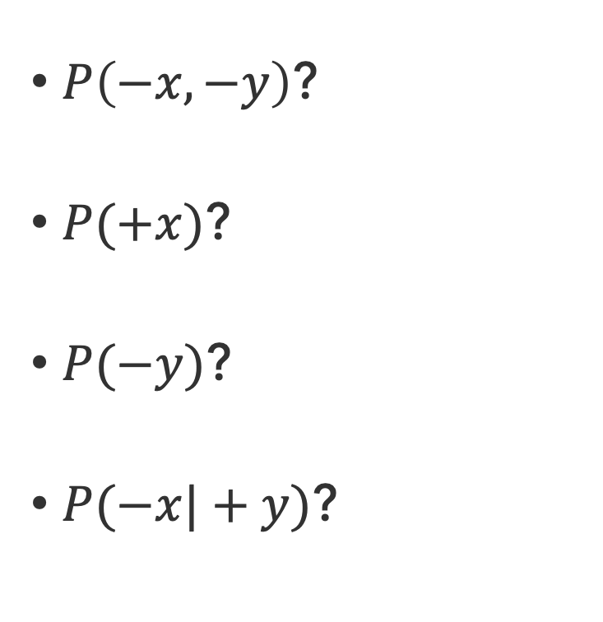
Probability Examples
$P\left(−x,−y\right)$?
$P(+x)$?
$P(−y)$?
$P(−x|+y)$?
$$X$$ | $$Y$$ | $$P(X,Y)$$
$$+x$$ | $$+y$$ | $$0.2$$
$$+x$$ | $$−y$$ | $$0.3$$
$$−x$$ | $$+y$$ | $$0.4$$
$$−x$$ | $$−y$$ | $$0.1$$

Slide 16
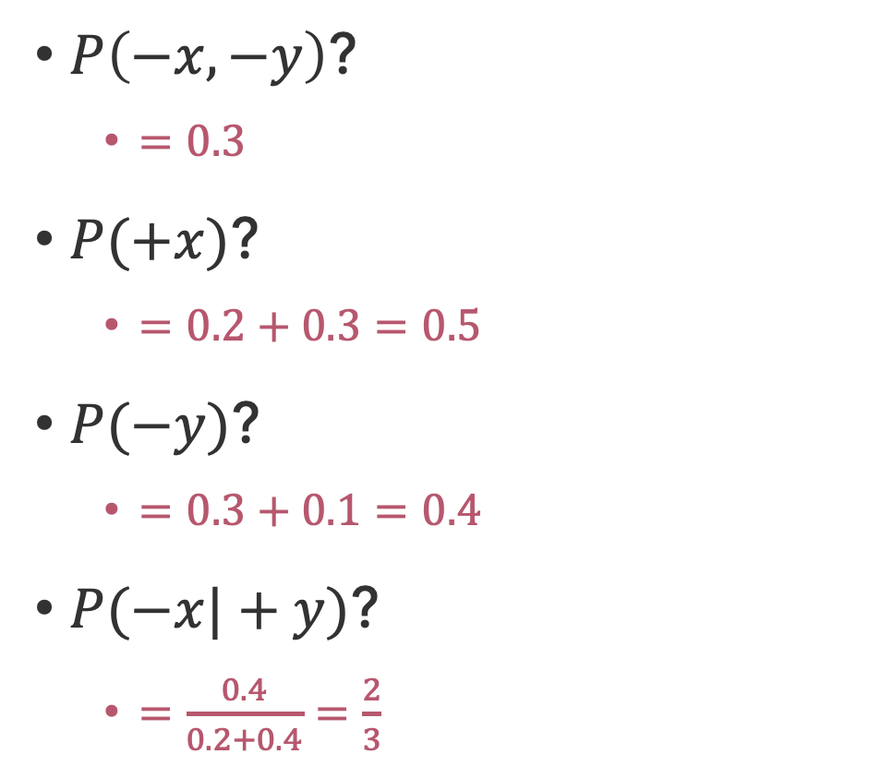
Probability Examples (Solutions)
$P\left(−x,−y\right)$?
  $=0.3$
$P(+x)$?
  $=0.2+0.3=0.5$
$P(−y)$?
  $=0.3+0.1=0.4$
$P(−x|+y)$?
  $=\frac{0.4}{0.2+0.4}=\frac{2}{3}$
$$X$$ | $$Y$$ | $$P(X,Y)$$
$$+x$$ | $$+y$$ | $$0.2$$
$$+x$$ | $$−y$$ | $$0.3$$
$$−x$$ | $$+y$$ | $$0.4$$
$$−x$$ | $$−y$$ | $$0.1$$

Slide 17
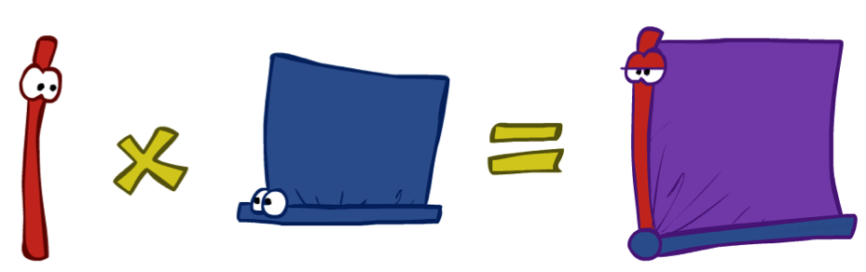
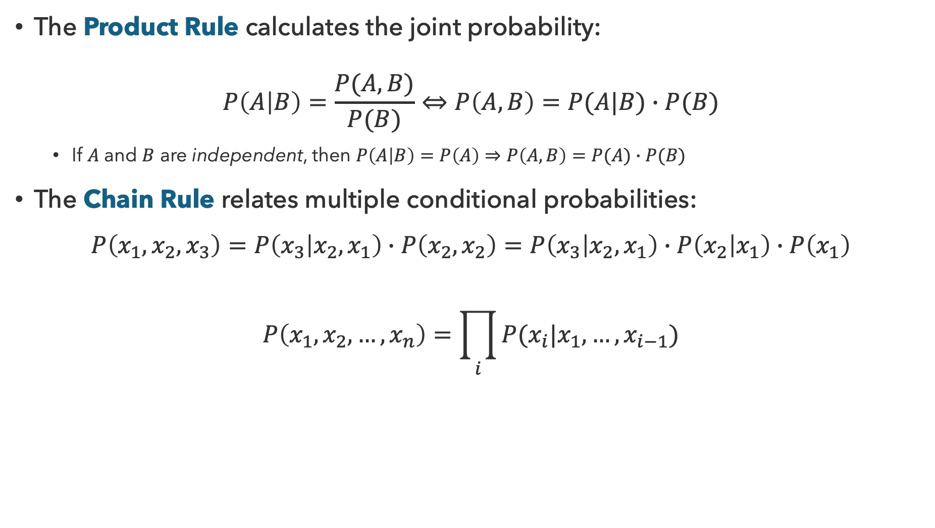
Using Conditional Probabilities
The Product Rule calculates the joint probability:
$$P\left(A | B\right)=\frac{P(A,B)}{P(B)}⇔P\left(A,B\right)=P(A|B)∙P(B)$$
  If $A$ and $B$ are independent, then $P\left(A | B\right)=P\left(A\right)⇒P\left(A,B\right)=P(A)∙P(B)$
The Chain Rule relates multiple conditional probabilities:
$$P\left(x_{1},x_{2},x_{3}\right)=P\left(x_{3} | x_{2},x_{1}\right)∙P\left(x_{2},x_{2}\right)=P\left(x_{3} | x_{2},x_{1}\right)∙P\left(x_{2} | x_{1}\right)∙P\left(x_{1}\right)$$
$$P\left(x_{1}, x_{2},…,x_{n}\right)=\prod_{i}{P(x_{i}|x_{1},…,x_{i−1})}$$

Slide 18

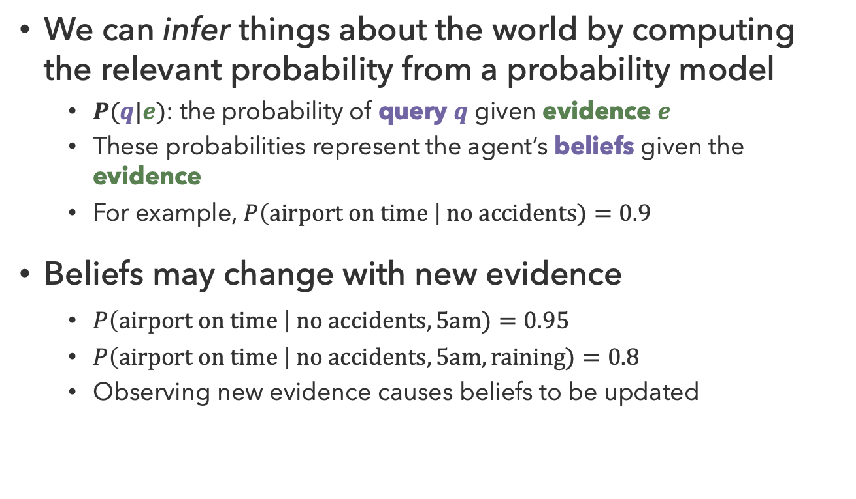
Probabilistic Inference
We can infer things about the world by computing the relevant probability from a probability model
  $P(q|e)$: the probability of query $q$ given evidence $e$
  These probabilities represent the agent’s beliefs given the evidence
  For example, $P\left(airport on time \right| no accidents)=0.9$
Beliefs may change with new evidence
  $P\left(airport on time \right| no accidents, 5am)=0.95$
  $P\left(airport on time \right| no accidents, 5am, raining)=0.8$
  Observing new evidence causes beliefs to be updated

Slide 19
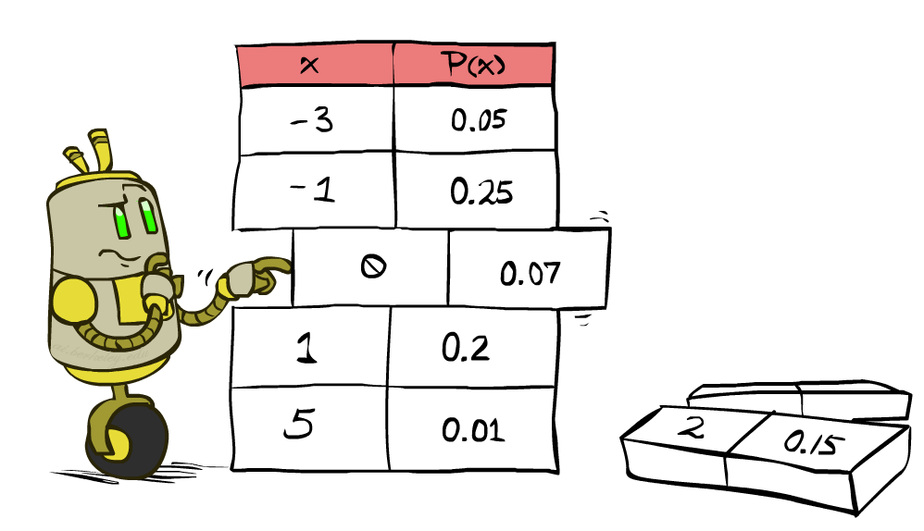
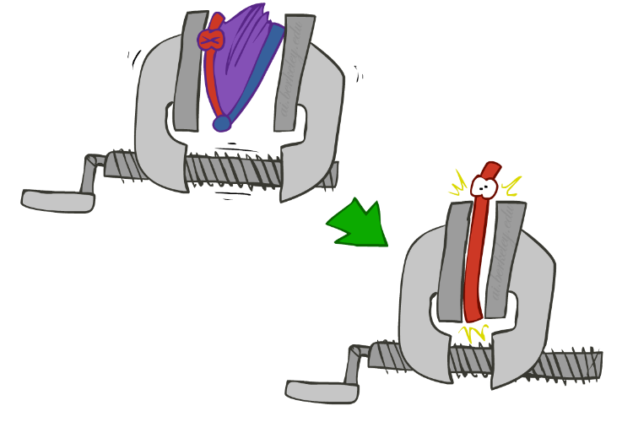
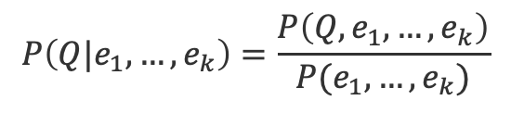
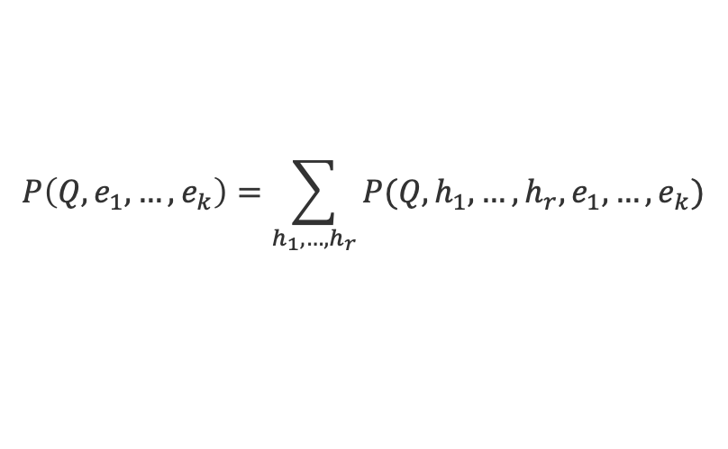


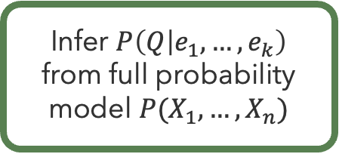
Inference by Enumeration
Calculate probability of query $Q$ given:
  Observations about evidence variables $E_{1},…,E_{k}=e_{1},…,e_{k}$
  Hidden (unobserved) variables $H_{1},…,H_{r}$
Infer $P\left(Q | e_{1},…,e_{k}\right)$
from full probability model $P(X_{1},…,X_{n})$
$$P\left(Q|e_{1},…,e_{k}\right)=\frac{P\left(Q,e_{1},…,e_{k}\right)}{P(e_{1},…,e_{k})}$$
$$P\left(Q, e_{1},…,e_{k}\right)=\sum_{h_{1},…,h_{r}}{P(Q,h_{1},…,h_{r},e_{1},…,e_{k})}$$
$$P(Q,h_{1},…,h_{r},e_{1},…,e_{k})$$
Select model entries consistent with evidence
Sum out hidden variables to calculate joint probability
Normalize by joint probability of the evidence

Slide 20
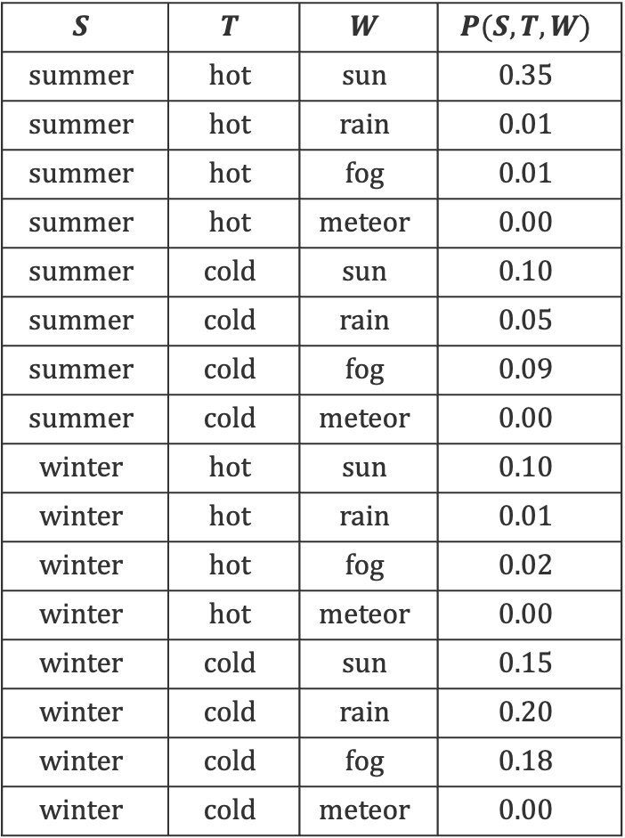
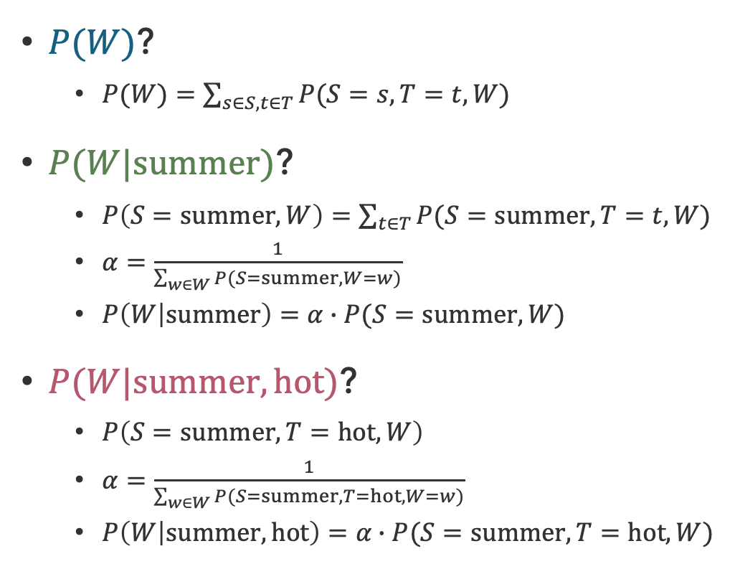
Inferring the Weather
$$S$$ | $$T$$ | $$W$$ | $$P(S,T,W)$$
$$summer$$ | $$hot$$ | $$sun$$ | $$0.35$$
$$summer$$ | $$hot$$ | $$rain$$ | $$0.01$$
$$summer$$ | $$hot$$ | $$fog$$ | $$0.01$$
$$summer$$ | $$hot$$ | $$meteor$$ | $$0.00$$
$$summer$$ | $$cold$$ | $$sun$$ | $$0.10$$
$$summer$$ | $$cold$$ | $$rain$$ | $$0.05$$
$$summer$$ | $$cold$$ | $$fog$$ | $$0.09$$
$$summer$$ | $$cold$$ | $$meteor$$ | $$0.00$$
$$winter$$ | $$hot$$ | $$sun$$ | $$0.10$$
$$winter$$ | $$hot$$ | $$rain$$ | $$0.01$$
$$winter$$ | $$hot$$ | $$fog$$ | $$0.02$$
$$winter$$ | $$hot$$ | $$meteor$$ | $$0.00$$
$$winter$$ | $$cold$$ | $$sun$$ | $$0.15$$
$$winter$$ | $$cold$$ | $$rain$$ | $$0.20$$
$$winter$$ | $$cold$$ | $$fog$$ | $$0.18$$
$$winter$$ | $$cold$$ | $$meteor$$ | $$0.00$$
$P(W)$?
  $P(W)=\sum_{s∈S,t∈T}{P(S=s,T=t,W)}$
$P(W|summer)$?
  $P\left(S=summer, W\right)=\sum_{t∈T}{P(S=summer,T=t,W)}$
  $α=\frac{1}{\sum_{w∈W}{P(S=summer,W=w)}}$
  $P\left(W | summer\right)=α∙P(S=summer, W)$
$P(W|summer,hot)$?
  $P\left(S=summer,T=hot, W\right)$
  $α=\frac{1}{\sum_{w∈W}{P(S=summer,T=hot,W=w)}}$
  $P\left(W | summer,hot\right)=α∙P(S=summer,T=hot,W)$

Slide 21
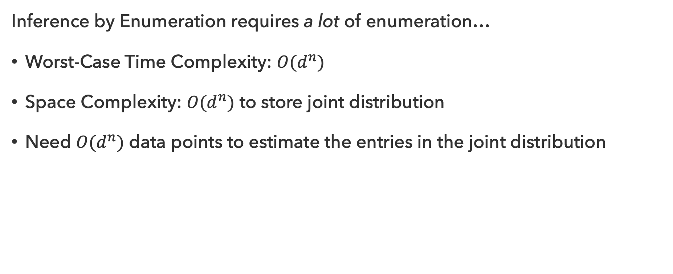
Problems with Inference by Enumeration
Inference by Enumeration requires a lot of enumeration…
Worst-Case Time Complexity: $O(d^{n})$
Space Complexity: $O(d^{n})$ to store joint distribution
Need $O(d^{n})$ data points to estimate the entries in the joint distribution

Slide 22
Questions (3)

Slide 23
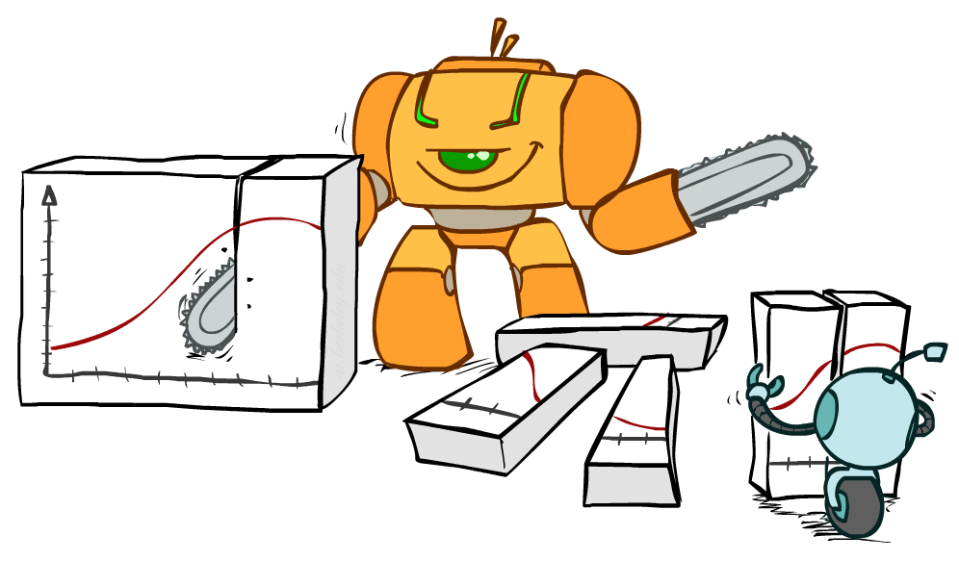
A Better Approach?

Slide 24
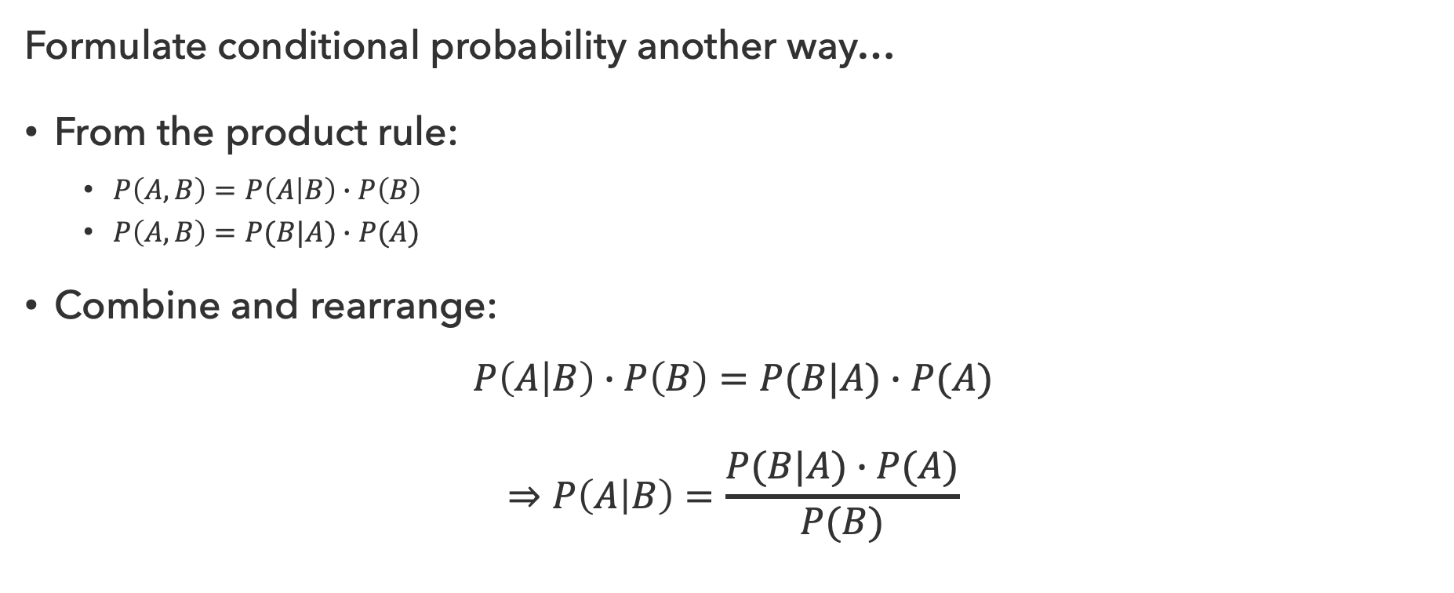
Bayes’ Rule
Formulate conditional probability another way…
From the product rule:
  $P\left(A,B\right)=P\left(A | B\right)∙P\left(B\right)$
  $P\left(A,B\right)=P(B|A)∙P(A)$
Combine and rearrange:
$$P\left(A | B\right)∙P\left(B\right)=P(B|A)∙P(A)$$
$$⇒P\left(A | B\right)=\frac{P(B|A)∙P(A)}{P(B)}$$

Slide 25
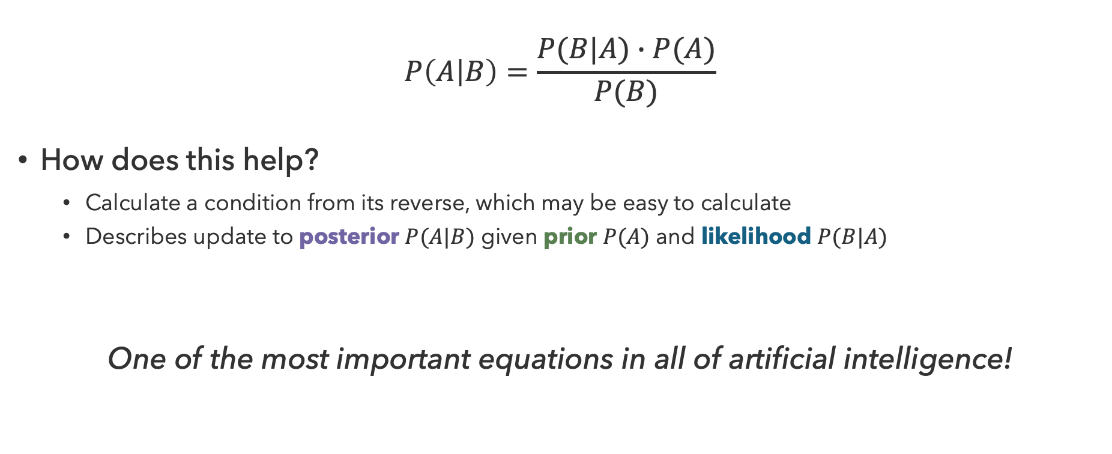
Implications of Bayes’ Rule
$$P\left(A | B\right)=\frac{P(B|A)∙P(A)}{P(B)}$$
How does this help?
  Calculate a condition from its reverse, which may be easy to calculate
  Describes update to posterior $P(A|B)$ given prior $P(A)$ and likelihood $P(B|A)$
One of the most important equations in all of artificial intelligence!

Slide 26
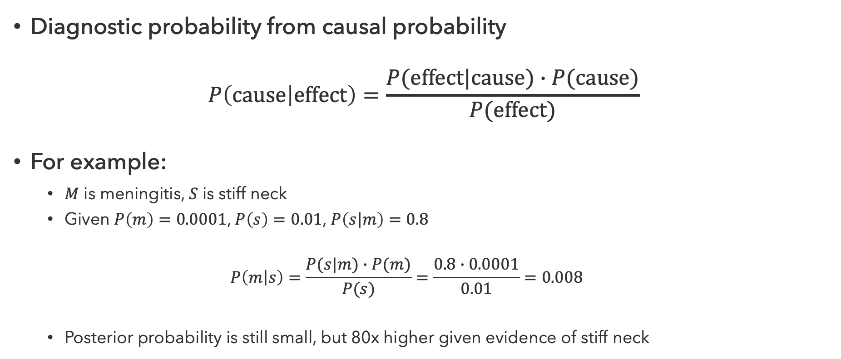
Inference with Bayes’ Rule
Diagnostic probability from causal probability
$$P\left(cause | effect\right)=\frac{P(effect|cause)∙P(cause)}{P(effect)}$$
For example:
  $M$ is meningitis, $S$ is stiff neck
  Given $P\left(m\right)=0.0001$, $P\left(s\right)=0.01$, $P\left(s | m\right)=0.8$
  $$P\left(m | s\right)=\frac{P(s|m)∙P(m)}{P(s)}=\frac{0.8∙0.0001}{0.01}=0.008$$
  Posterior probability is still small, but 80x higher given evidence of stiff neck

Slide 27

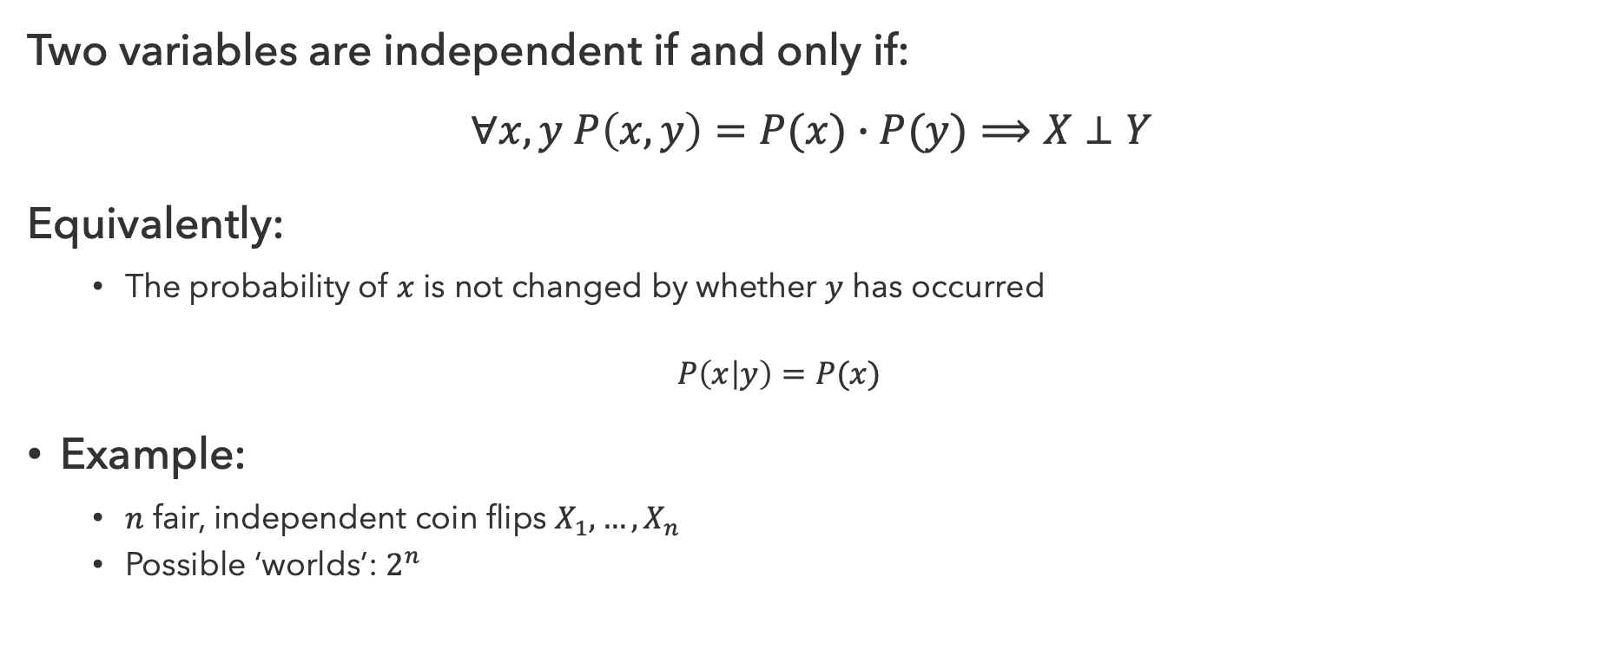
Independence
Two variables are independent if and only if:
$$∀x,y P\left(x,y\right)=P(x)∙P(y)⟹X⊥Y$$
Equivalently:
  The probability of $x$ is not changed by whether $y$ has occurred
  $$P\left(x | y\right)=P(x)$$
Example:
  $n$ fair, independent coin flips $X_{1},…,X_{n}$
  Possible ‘worlds’: $2^{n}$

Slide 28
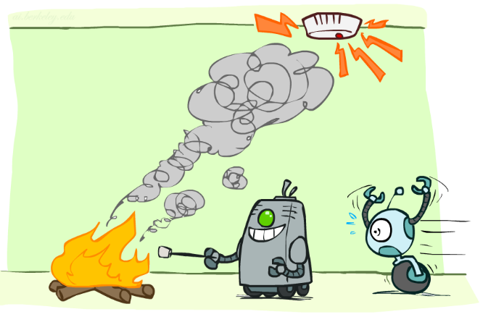
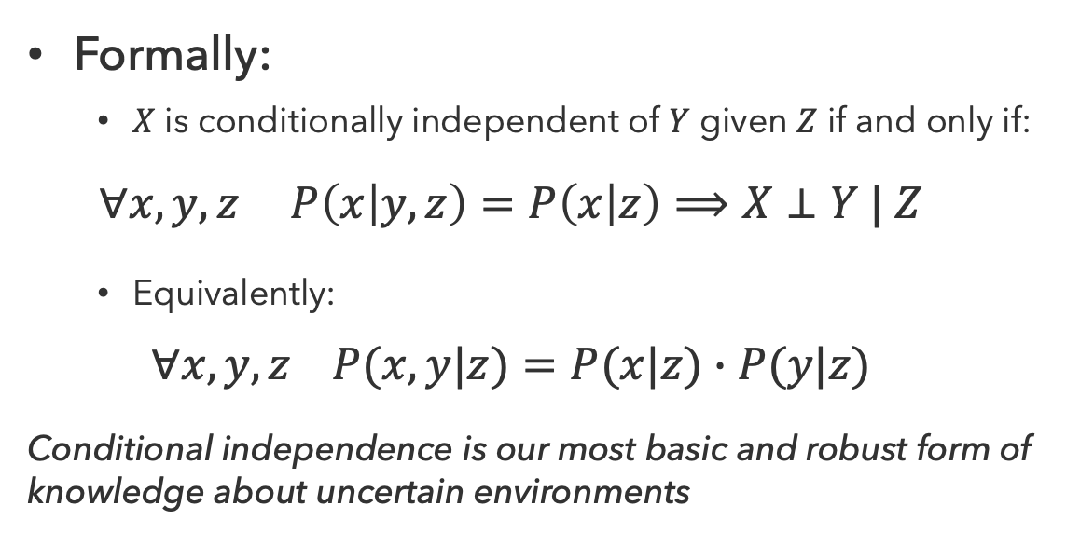
Conditional Independence
If two variables are conditionally independent, observing one won’t influence our prediction of the other, provided we already know a third piece of information
Formally:
  $X$ is conditionally independent of $Y$ given $Z$ if and only if:
  $$∀x,y,z P\left(x | y,z\right)=P\left(x | z\right)⟹X⊥Y | Z$$
  Equivalently:
  $$∀x,y,z P(x,y|z)=P(x|z)∙P(y|z)$$
Conditional independence is our most basic and robust form of knowledge about uncertain environments

Slide 29
Questions (4)

Slide 30
that’s it for today!
Probability Review
Rules of Probability
Inference by Enumeration
Bayes’ Rule
Modeling with Probabilities
Complete Practice Problem 10
Do Homework 2 (due 7.23)
Do Project 3 (due 7.30)

