Slide 1
Introduction
CSE 473: Introduction to Artificial Intelligence
James Weichert (jpw@cs)
cs.uw.edu/473
acknowledgements
Welcome!
What are you excited about this summer?
sli.do #cse473

Slide 2

Overview
Introductions
What is Artificial Intelligence?
What is CSE 473?
Course Logistics
Week 1 Preview
Illustrations by Ketrina Yim

Slide 3

About Me
James Weichert
Assistant Teaching Professor
he/him
First quarter teaching CSE 473!
Computing interests: CS, data, and AI education; AI ethics and policy
Free time activities: traveling, cooking, playing Minecraft :)
Office hours: Tue, Wed 9:30-10:30 AM (CSE 456)

Slide 4

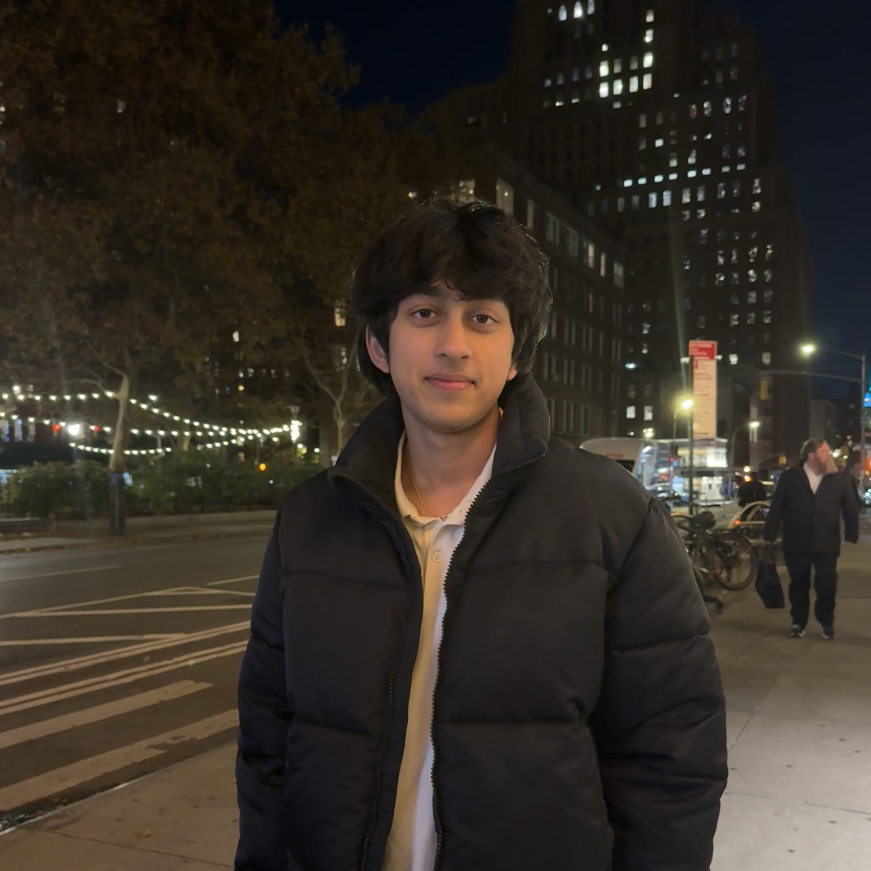
Teaching Assistants
Rongwu Xu
Krish Jain

Slide 5
Getting to Know You
First, introduce yourself to your neighbor and talk about:
  Why you’re taking CSE 473
  Your experiences with and attitudes towards AI
Then, fill out the course welcome survey
  Gradescope: Practice Problems: Lecture 1 (counts as the practice problem for Lecture 1)
  Part 1: About You (non-anonymized)
  Part 2: AI + You (anonymized)

Slide 6
What is Artificial Intelligence?

Slide 7
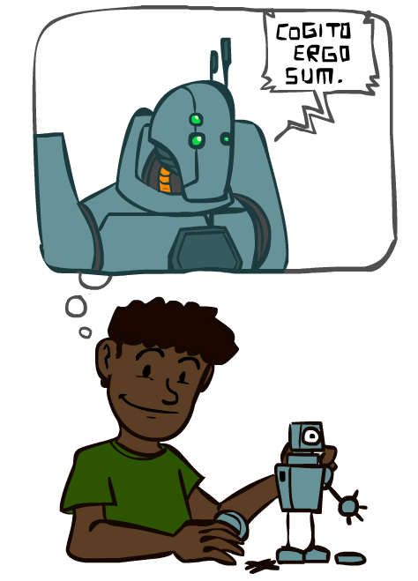
Conceptions of Intelligence
What does it mean for X to be intelligent?
  Philosophy (what constitutes knowledge?)
  Neuroscience, Biology (how do brains process information?)
  Economics (do intelligent agents act rationally?)
  Psychology, Sociology (how do agents learn and interact?)
  Linguistics (how do agents communicate?)
  Mathematics, Computer Science (how to represent information?)
So how should we define artificial intelligence?

Slide 8
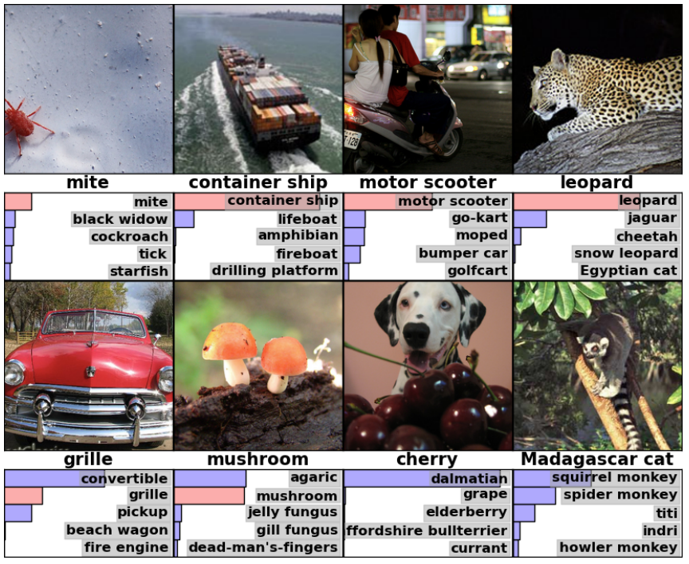
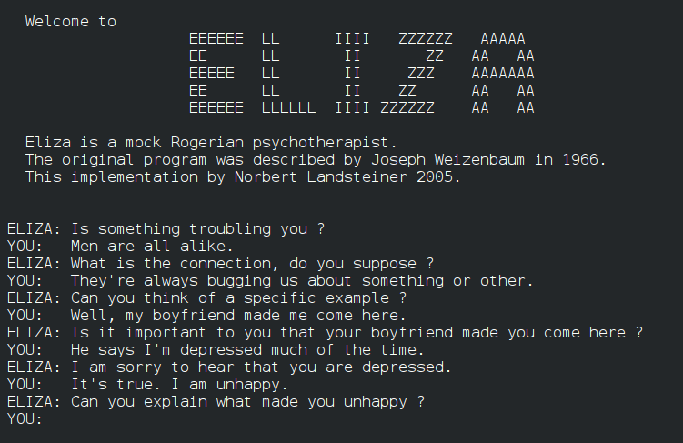
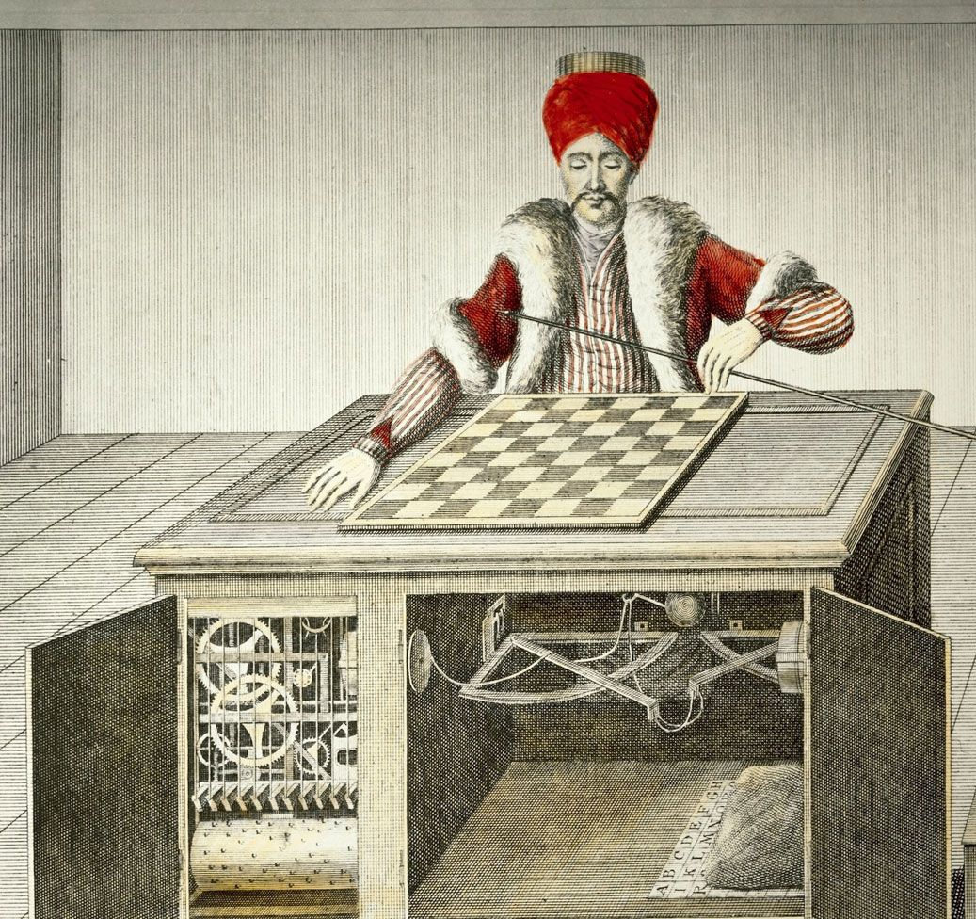
Artificial Intelligence?
AlexNet Image Classification (2012)
ELIZA Chatbot (1966)
“Mechanical Turk” Chess Player (1770)

Slide 9
1956: The Birth of “Artificial Intelligence”
“An attempt will be made to find how to make machines use language, form abstractions and concepts, solve kinds of problems now reserved for humans, and improve themselves.
We think that a significant advance can be made if we work on it together for a summer.”
McCarthy, Minksy, Rochester, and Shannon
Dartmouth Workshop Proposal (1955)

Slide 10
Histories of Artificial Intelligence
Intellectual
Beginnings
Early Days
AI Winter
Resurgence
Big Data, Big Compute
Commercial
2001: A Space Odyssey
Her
Societal
World War II
Cold War
1940s
1960s
1980s
2000s
2020s

Slide 11

A Short History of Artificial Intelligence
1940s - 1950s: Beginnings
  1943: McCulloch and Pitts: Boolean circuit model of the brain (early neural networks)
  1950: Turing publishes “Computing Machinery and Intelligence” (Turing Test)
1956 - 1960s: Birth of “AI”, Early Days
  1950s: Early AI programs: chess, checkers, theorem proving
  1956: Dartmouth workshop on AI
1970s - 1980s: AI Winter, Knowledge-Based Approaches
  1960s: Research on perceptrons, machine translation plateaus
  1970s: Funding for AI research dries up, industry turns to knowledge-based systems
1990s - 2010s: Statistical Approaches
  1990s – : Focus on uncertainty, probabilistic approaches
2012 – Present: Big Data, Big Compute
  2010s: Research (e.g. “AlexNet”) shows GPUs can be used to make neural networks effective
  2017: Vaswani et al. publish “Attention Is All You Need” (transformer architecture)
  2022: OpenAI publishes ChatGPT
Recommended Reading:
Karen Hao, Empire of AI (Ch. 4)

Slide 12
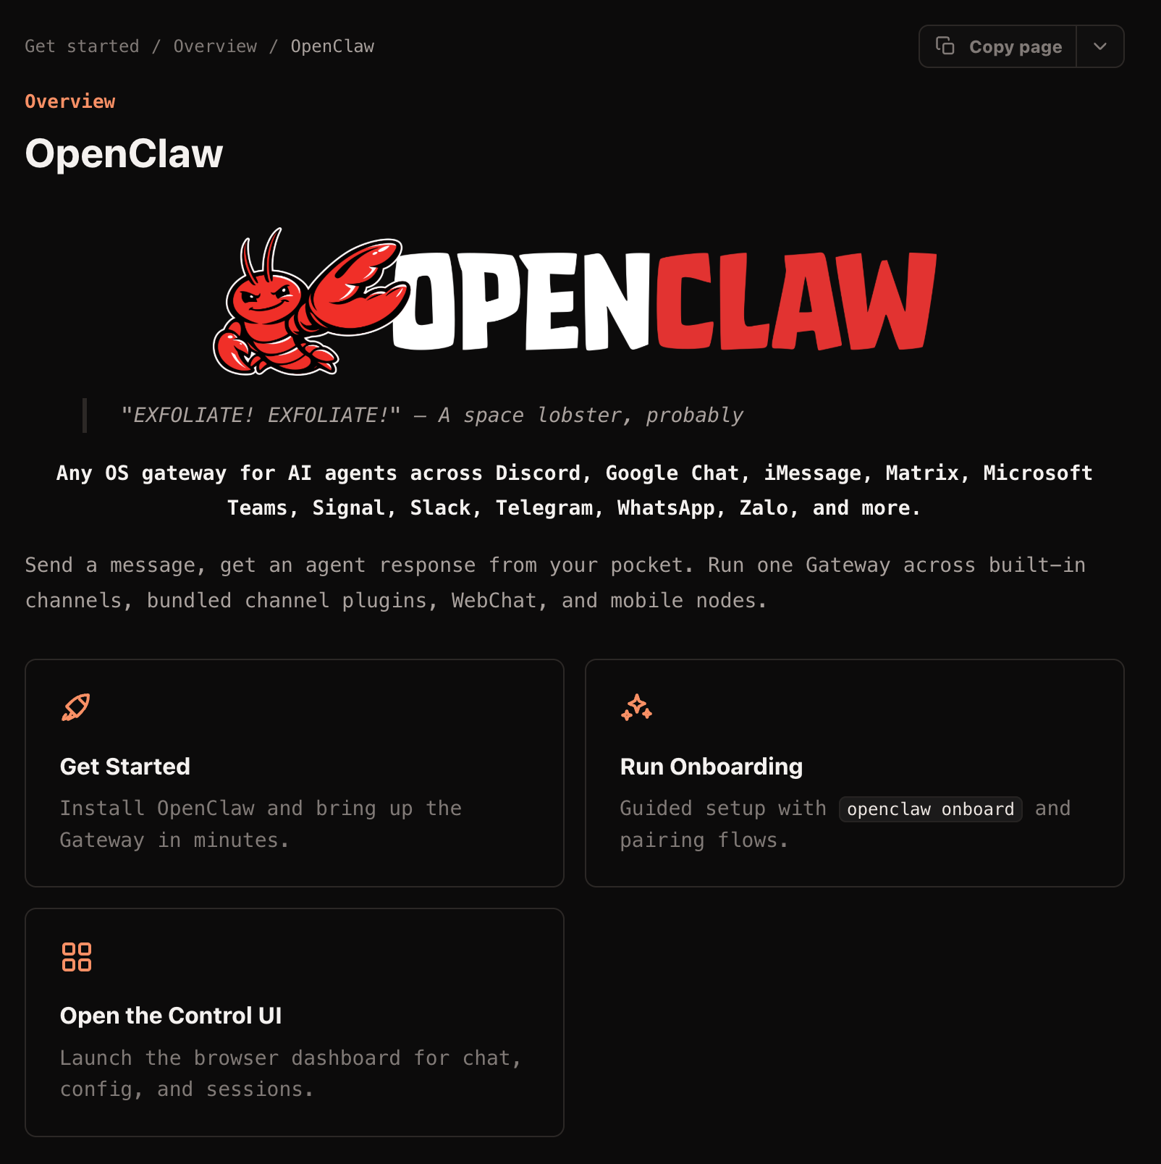
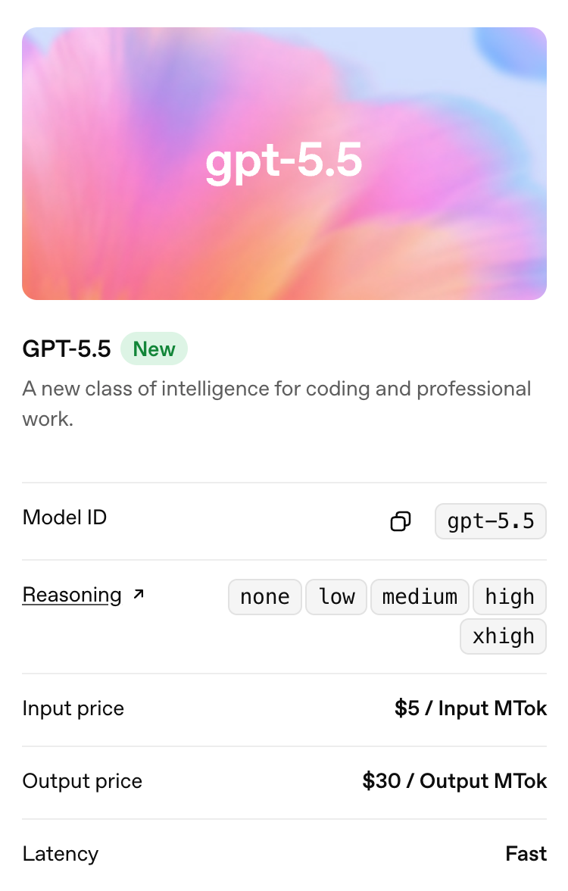
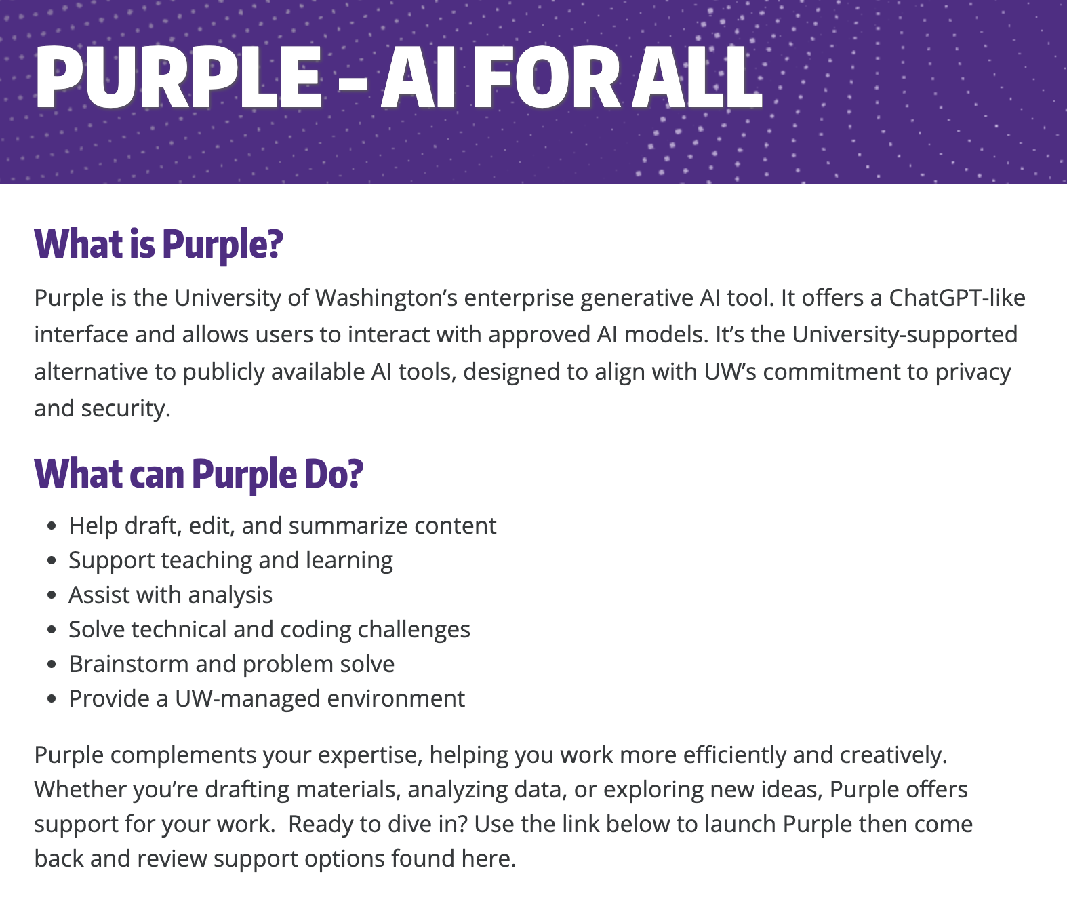
AI in 2026
OpenClaw (f.k.a. ClawdBot)
OpenAI GPT 5.5
UW Purple

Slide 13
Defining “Artificial Intelligence”
In relation to human intelligence:
  “how to make machines…solve kinds of problems now reserved for humans” (McCarthy et al. 1955)
  Machines that can “think humanly” and/or “act humanly” (Russell and Norvig)
  “AI tasks are often considered ‘intelligent’ because we can imagine humans doing them well; non-AI tasks are usually ones that (most) humans are terrible at.” (UW CSE)
A working definition:
A class of computer systems that demonstrate the ability to achieve specified objectives through independent action.

Slide 14
Questions (1)

Slide 15
CSE 473: Introduction to AI
Search
Reinforcement Learning
How to find an optimal solution?
How to learn from experience?
Modeling
Machine Learning
How to deal with uncertainty?
How to find patterns in data?

Slide 16
Why Take CSE 473?

Slide 17
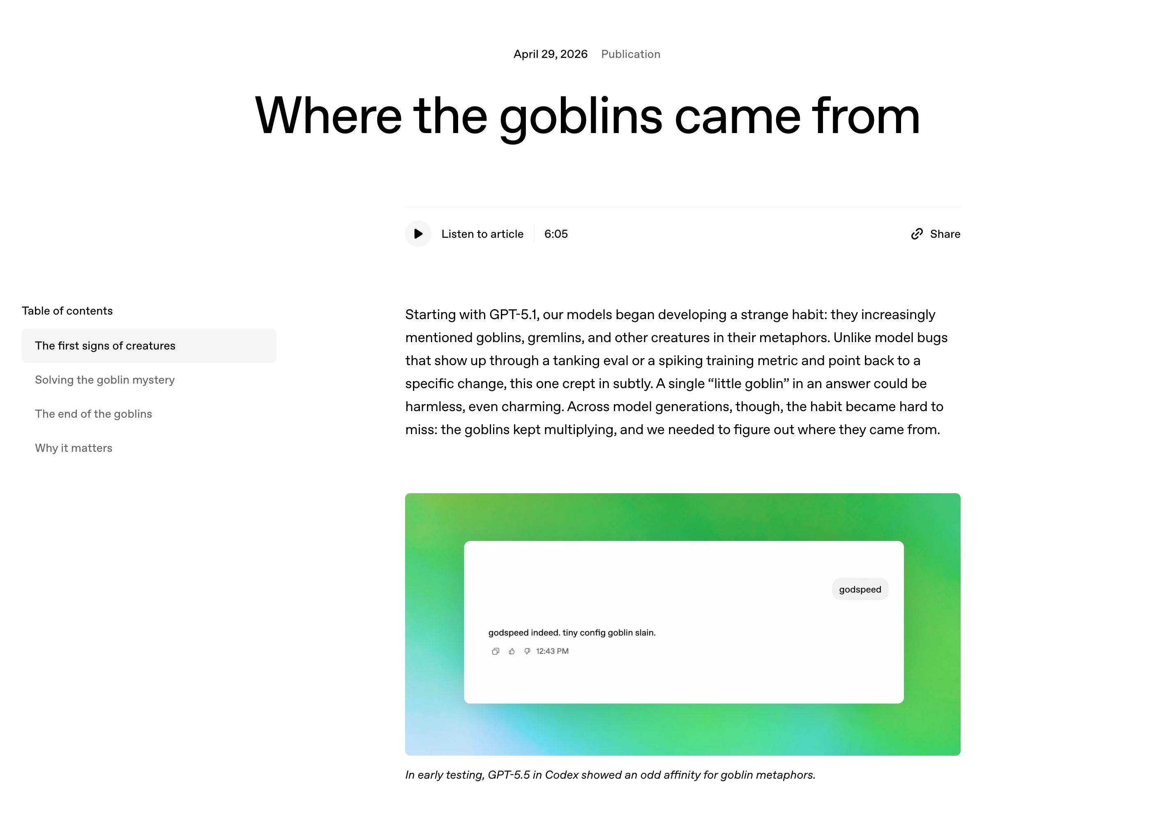
”Where the goblins come from” (OpenAI)

Slide 18
Questions (2)

Slide 19
Course Components
Lectures
Homeworks
Introduce concepts
Establish context
Provide examples
Check your understanding with practice problems
Assess your understanding of key concepts
Hosted on Gradescope
Due approximately two weeks after release
Projects
Tests
Apply your knowledge
Specifications on course website, submissions through Gradescope
Fully autograded
Assess your ability to apply fundamentals to new problems
Test 1: Friday, July 10
Test 2: Friday, August 7
Higher test score weighs more

Slide 20
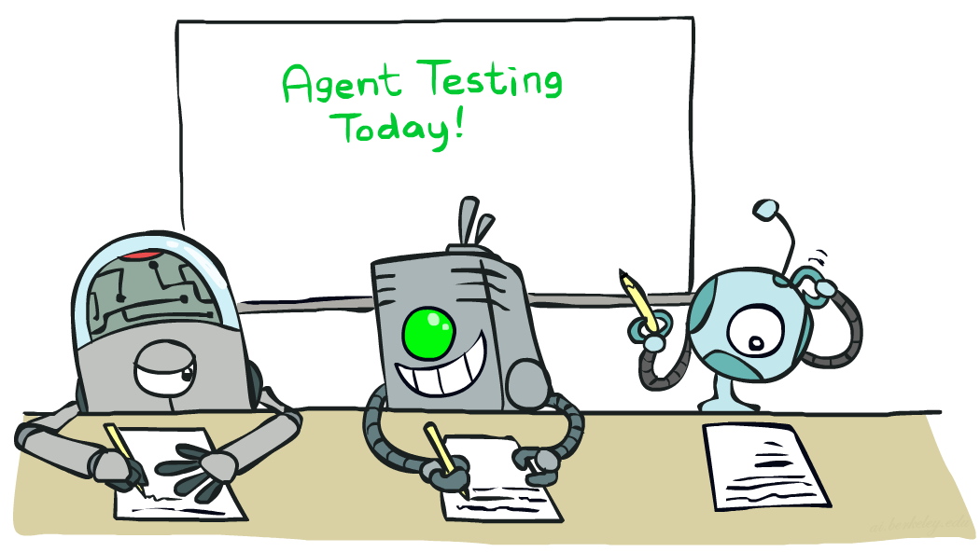
Course Policies
Read the syllabus! (cs.uw.edu/473/syllabus)
Course Infrastructure
  cs.uw.edu/473 for course information
  EdStem for communications and Q&A
  Gradescope for assignments
  Panopto for lecture recordings
Textbook (pdf on EdStem)
  Artificial Intelligence: A Modern Approach
Late Work
  Homeworks and projects may be submitted up to 2 days late without penalty
  Late penalty of 20% for each additional day
Grading
  40%: Homework Assignments (x4)
  30%: Projects (x4)
  20%: Higher Test Score
  10%: Lower Test Score
+ up to 4% extra from practice problem completion

Slide 21
Collaboration and AI Use
The goal of this course is to cultivate and assess your ability
to understand and apply core concepts in AI.
Collaboration
  Encouraged towards understanding course concepts
  All assignments must be completed individually — all work must be your own
  Sharing or accessing solutions (including code) is prohibited
AI Use
Prohibited on practice problems, homework assignments, or tests.
Permitted on projects to understand or debug—but not copy—code.
* Any student work found by CSSC to be in violation of course policies will receive a score of 0 (0.0 for the course for repeated violations)
* All tools and sources must be cited and accompanied by a short AI usage reflection.

Slide 22
Support and Accommodations
Disability Accommodations
  Established via Disability Resources for Students (DRS)
  Email James (jpw@cs) to discuss accommodations
Religious Accommodations
  Requested within the first two weeks using the Religious Accommodations Request Form
General Support
  Having questions or getting stuck is expected! Use OH, Ed, and your peers as a first stop
  If you have extenuating circumstances, make a private Ed post or email James (jpw@cs)

Slide 23
Question (3)

Slide 24
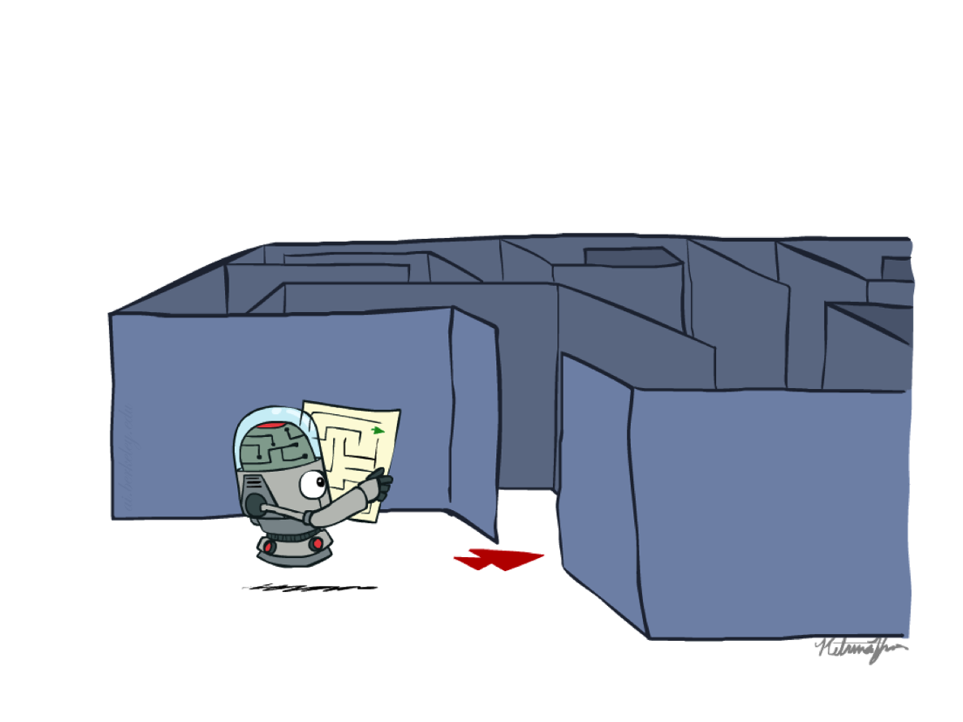
Preview: Search
How to find an optimal solution…
…efficiently?
…with imperfect information?

Slide 25
that’s it for today!
What is AI?
Why Take CSE 473?
Course Logistics
Agents and Environments
Search Problems
Search Algorithms
Fill out welcome survey!
Check Ed, Gradescope access
Project 0 (optional) released

