Slide 1
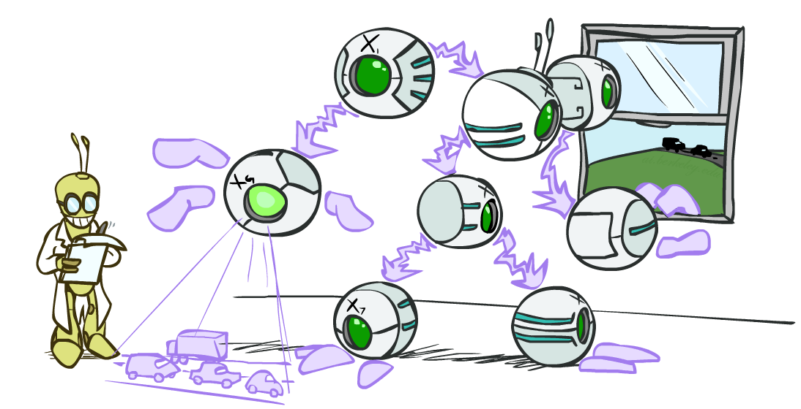
Bayes Nets II: Inference
CSE 473: Introduction to Artificial Intelligence
Megan Hazen (mh75@cs)
cs.uw.edu/473
acknowledgements
Welcome!
What decisions do you make to play the odds?

Slide 2
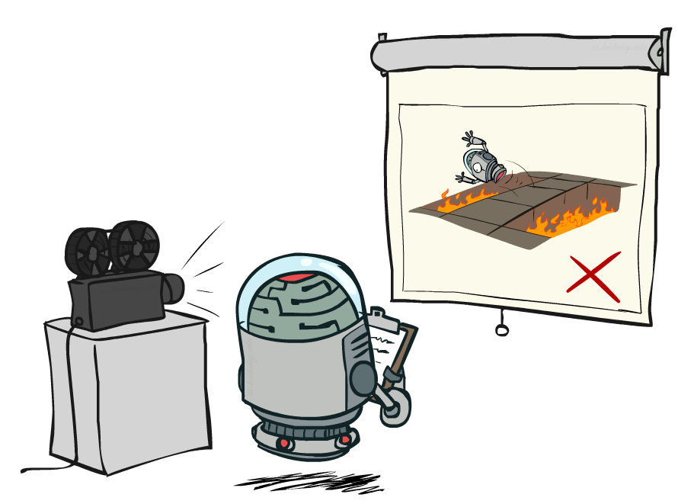
Administrivia
Assessment 1 grades out
  Regrades open until next Friday
Homework 3 released today, due in two weeks (8.6)
Project 3 released Friday

Slide 3

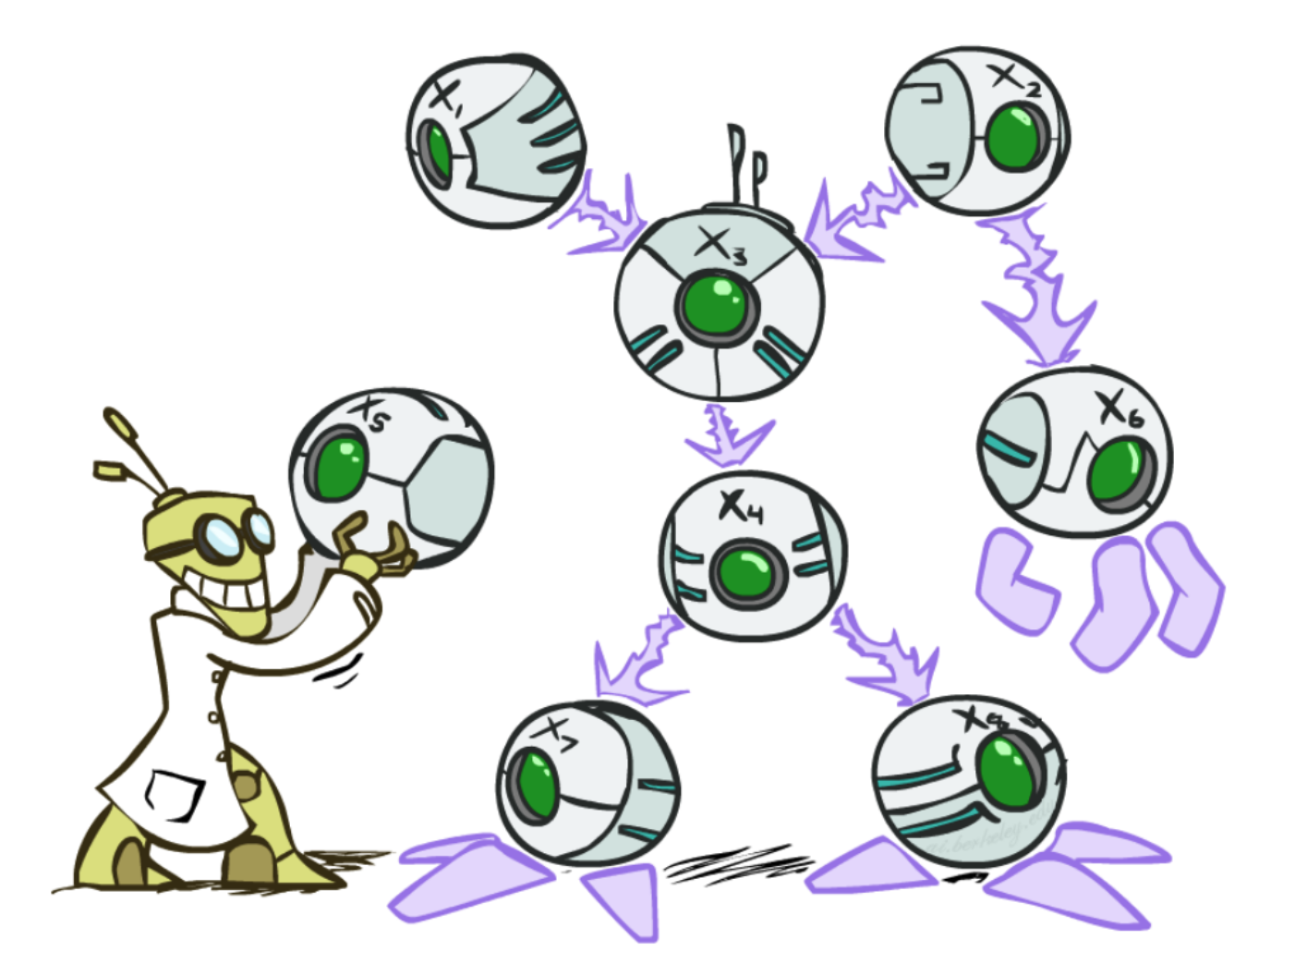
Bayes Nets
Bayes Nets provide a technique describing complex joint distributions using simple conditional distributions
  Use local causality / conditional independence
  Trading expressivity of joint distributions for efficiency of conditional distributions
Representation
Inference
Sampling
Monday
Today
Friday

Slide 4

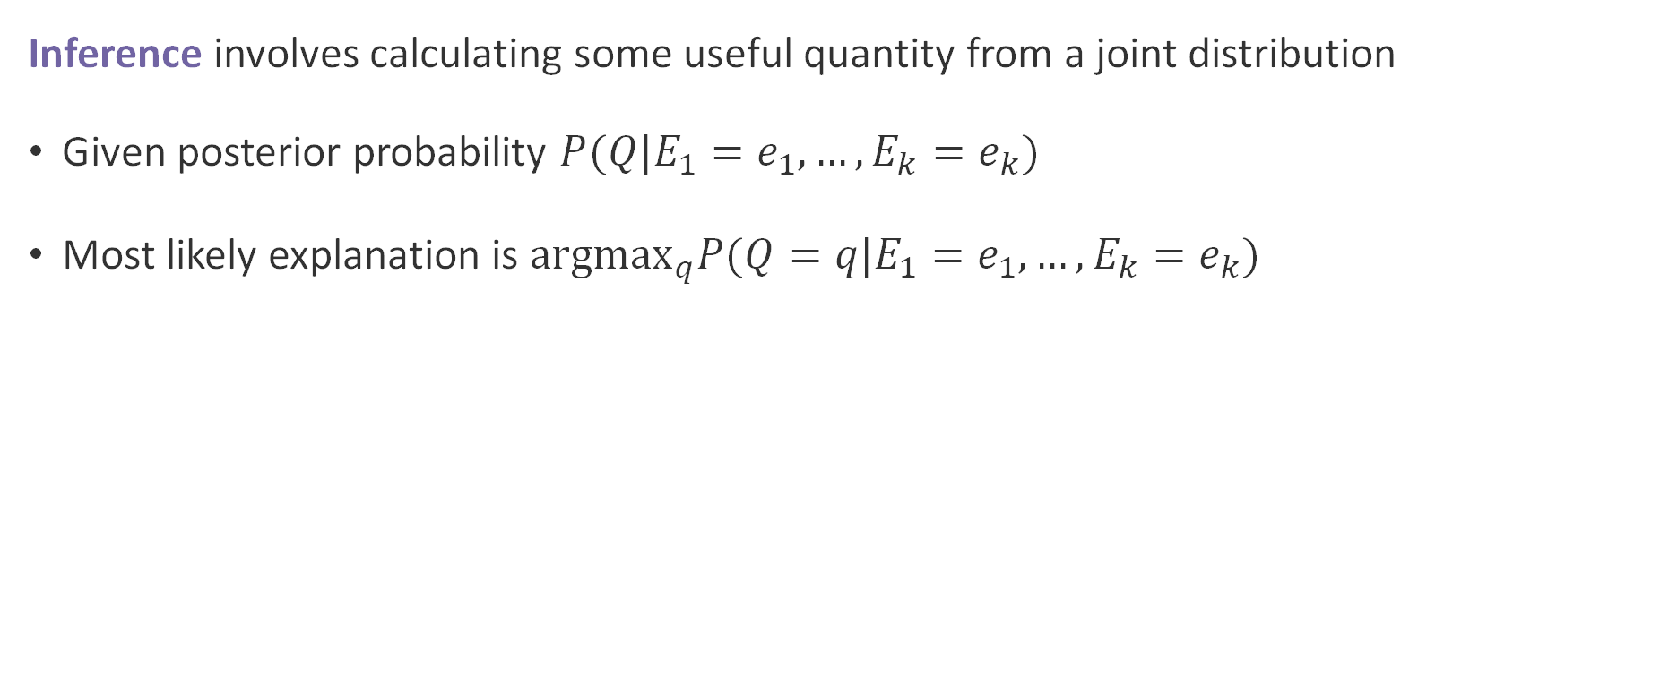
Inference
Inference involves calculating some useful quantity from a joint distribution
Given posterior probability $P(Q|E_{1}=e_{1},…,E_{k}=e_{k})$
Most likely explanation is ${argmax}_{q}P(Q=q|E_{1}=e_{1},…,E_{k}=e_{k})$
Notes:
We can infer Q from the evidence.

Slide 5
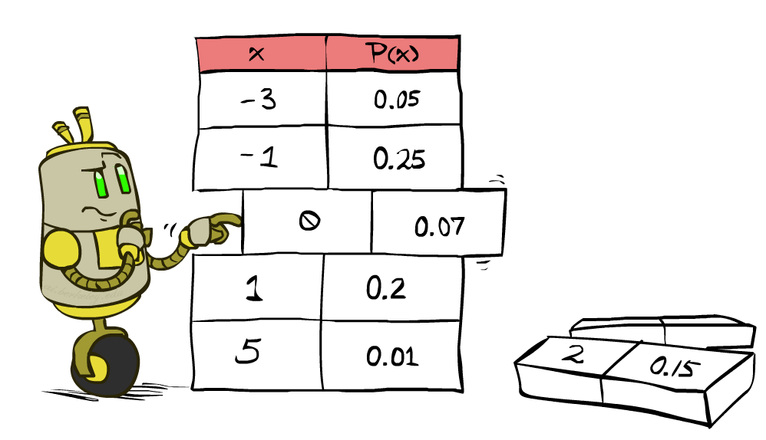
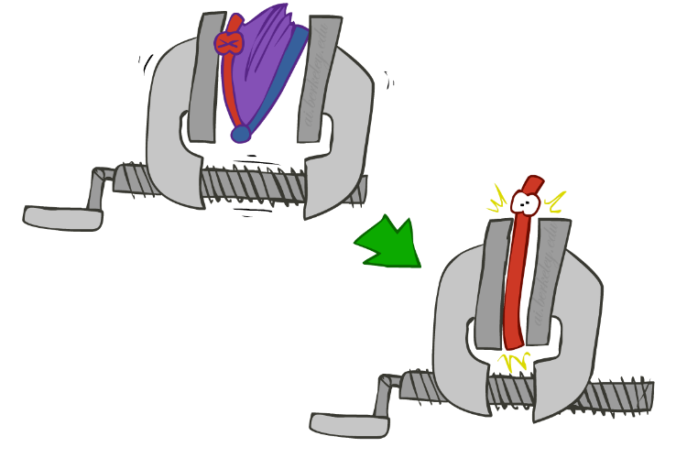
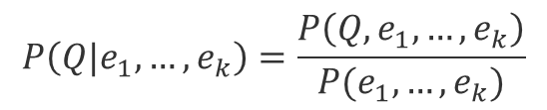
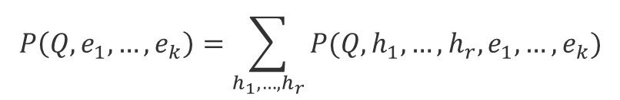
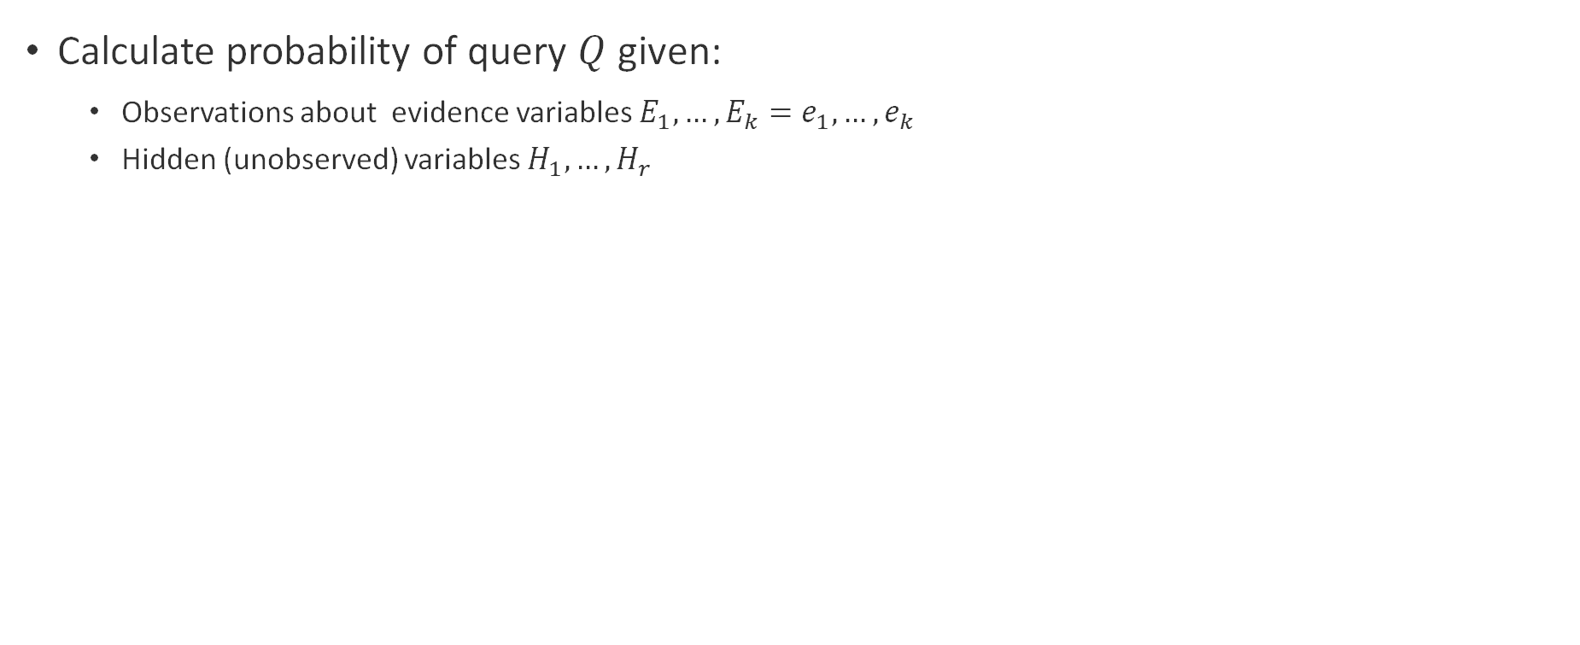

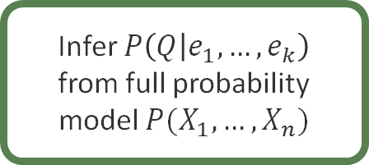
Inference by Enumeration
Calculate probability of query $Q$ given:
  Observations about evidence variables $E_{1},…,E_{k}=e_{1},…,e_{k}$
  Hidden (unobserved) variables $H_{1},…,H_{r}$
Infer $P\left(Q | e_{1},…,e_{k}\right)$
from full probability model $P(X_{1},…,X_{n})$
$$P\left(Q|e_{1},…,e_{k}\right)=\frac{P\left(Q,e_{1},…,e_{k}\right)}{P(e_{1},…,e_{k})}$$
$$P\left(Q, e_{1},…,e_{k}\right)=\sum_{h_{1},…,h_{r}}{P(Q,h_{1},…,h_{r},e_{1},…,e_{k})}$$
$$P(Q,h_{1},…,h_{r},e_{1},…,e_{k})$$
Select model entries consistent with evidence
Sum out hidden variables to calculate joint probability
Normalize by joint probability of the evidence

Slide 6


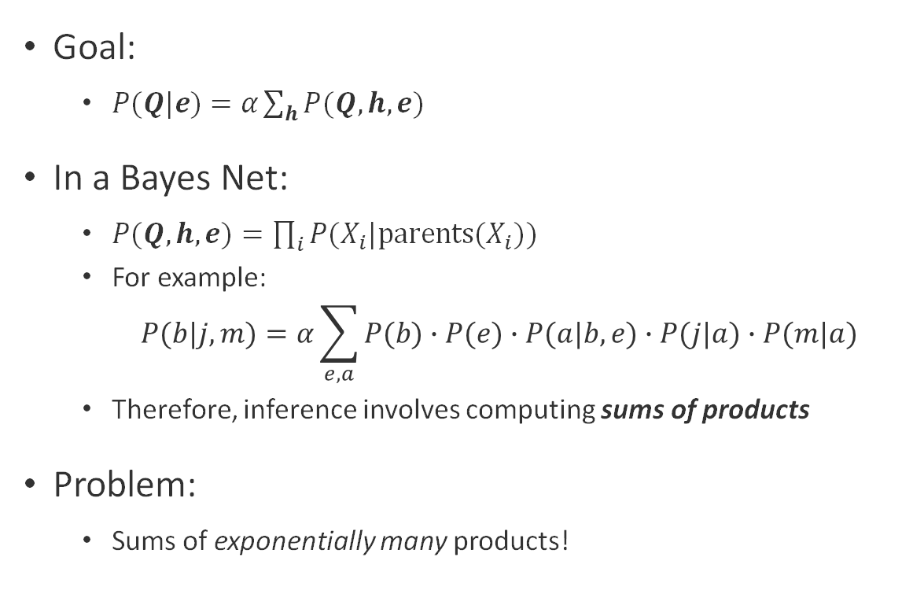



Bayes Net Inference by Enumeration
Goal:
  $P(Q|e)=α\sum_{h}{P(Q,h,e)}$
In a Bayes Net:
  $P(Q,h,e)=\prod_{i}{P(X_{i}|parents(X_{i}))}$
  For example:
    $$P(b|j,m)=α\sum_{e,a}{P(b)∙P(e)∙P(a|b,e)∙P(j|a)∙P(m|a)}$$
  Therefore, inference involves computing sums of products
Problem:
  Sums of exponentially many products!
$$B$$
$$E$$
Burglary
Earthquake
$$A$$
Alarm
$$J$$
$$M$$
Jan Calls
Maria Calls

Slide 7
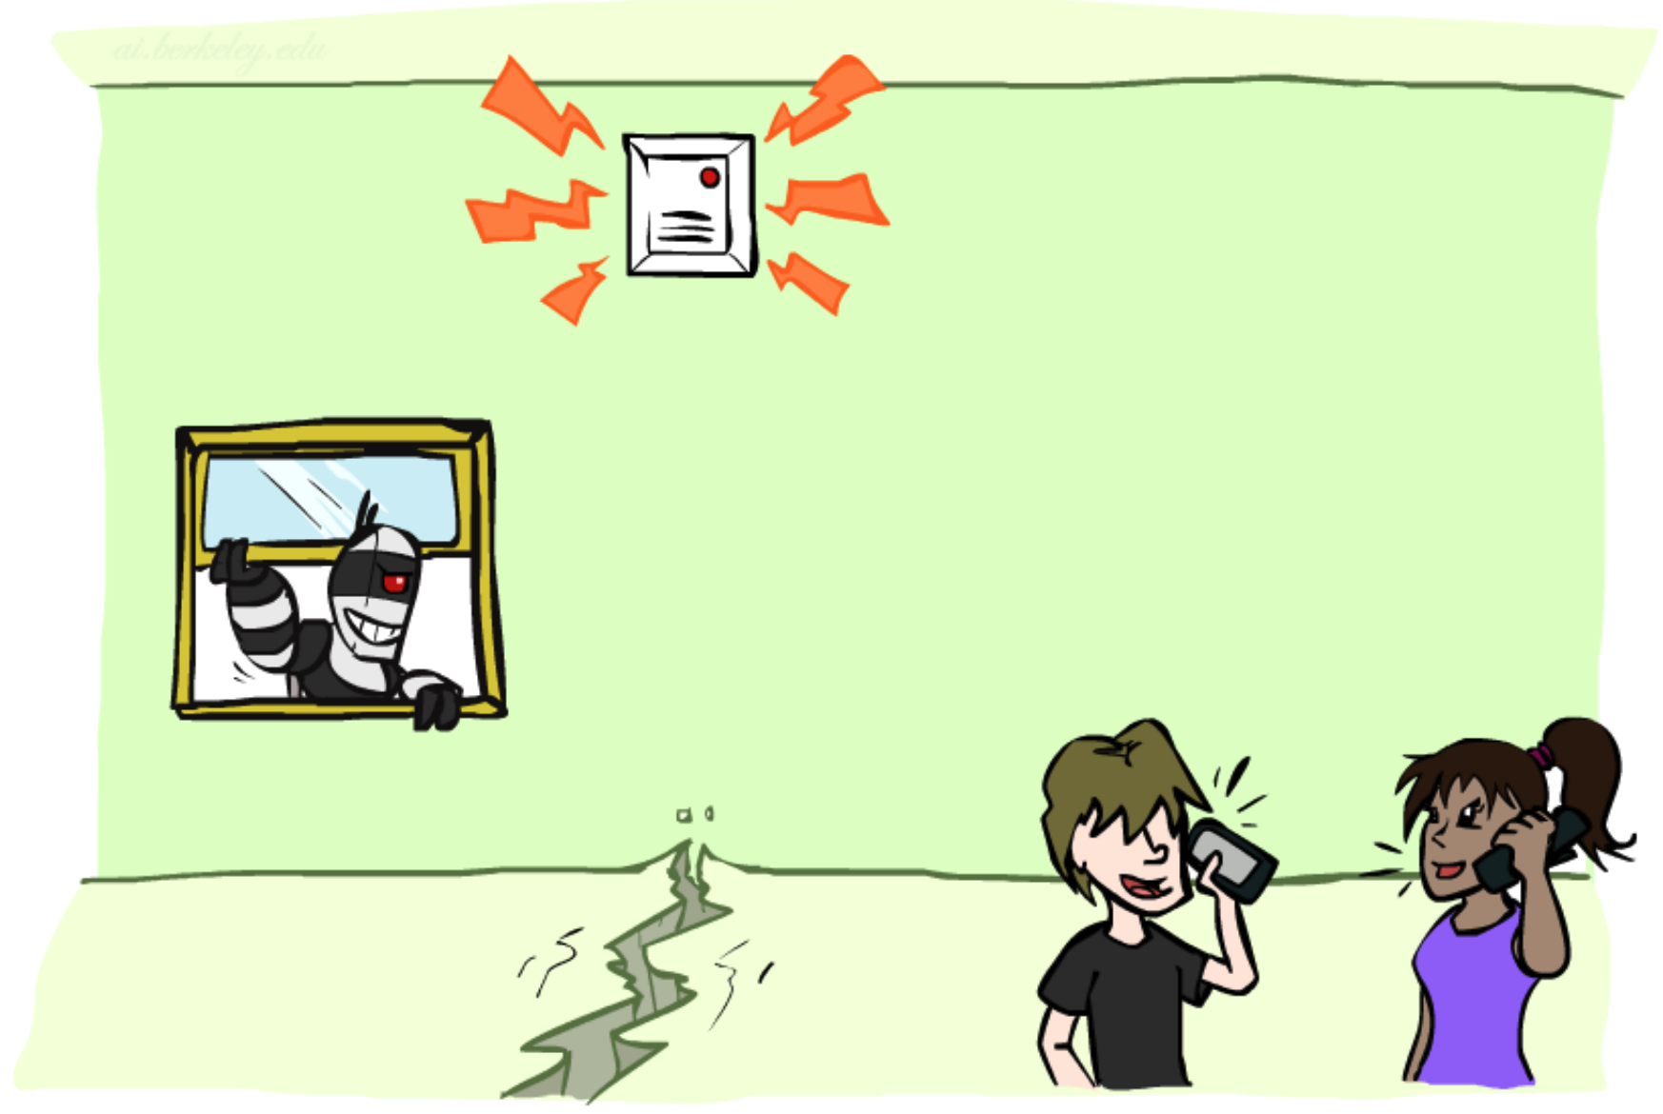

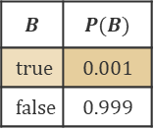
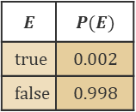
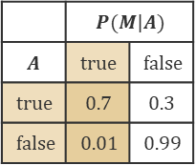
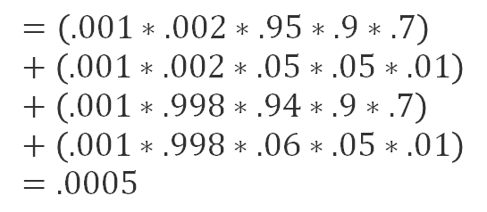


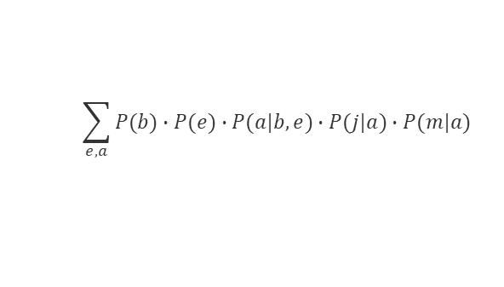
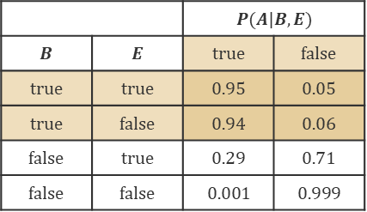


Alarm Bayes Net Practice
$$B$$ | $$P(B)$$
$$true$$ | $$0.001$$
$$false$$ | $$0.999$$
$$E$$ | $$P(E)$$
$$true$$ | $$0.002$$
$$false$$ | $$0.998$$
$$B$$
$$E$$
Burglary
Earthquake
 |  | $$P(A|B,E)$$
$$B$$ | $$E$$ | $$true$$ | $$false$$
$$true$$ | $$true$$ | $$0.95$$ | $$0.05$$
$$true$$ | $$false$$ | $$0.94$$ | $$0.06$$
$$false$$ | $$true$$ | $$0.29$$ | $$0.71$$
$$false$$ | $$false$$ | $$0.001$$ | $$0.999$$
$$A$$
What about $P(b, j, m)$?
Alarm
$$\sum_{e,a}{P(b)∙P(e)∙P(a|b,e)∙P(j|a)∙P(m|a)}$$
 | $$P(J|A)$$
$$A$$ | $$true$$ | $$false$$
$$true$$ | $$0.9$$ | $$0.1$$
$$false$$ | $$0.05$$ | $$0.95$$
 | $$P(M|A)$$
$$A$$ | $$true$$ | $$false$$
$$true$$ | $$0.7$$ | $$0.3$$
$$false$$ | $$0.01$$ | $$0.99$$
$$J$$
$$M$$
$$=\left(.001∗.002∗.95∗.9∗.7\right)+\left(.001∗.002∗.05∗.05∗.01\right)+\left(.001∗.998∗.94∗.9∗.7\right)+\left(.001∗.998∗.06∗.05∗.01\right)=.0005$$
Jan Calls
Maria Calls
Notes:
We can note here – this is essentially adding up four sub probabilities: One each for +e+a, +e-a, -e+a, -e-a

Slide 8
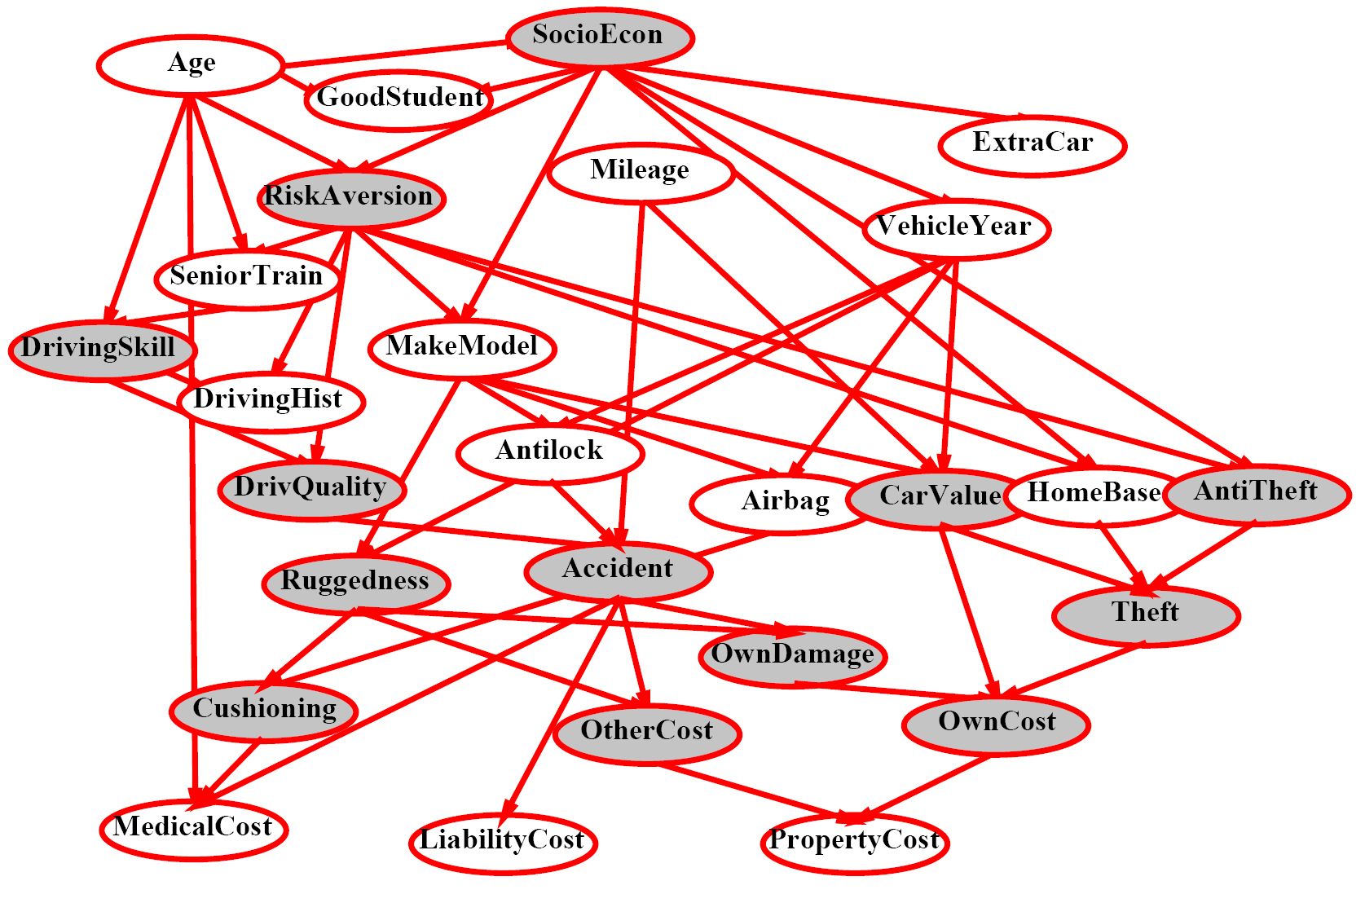
$P(Antilock|observed variables)$?

Slide 9
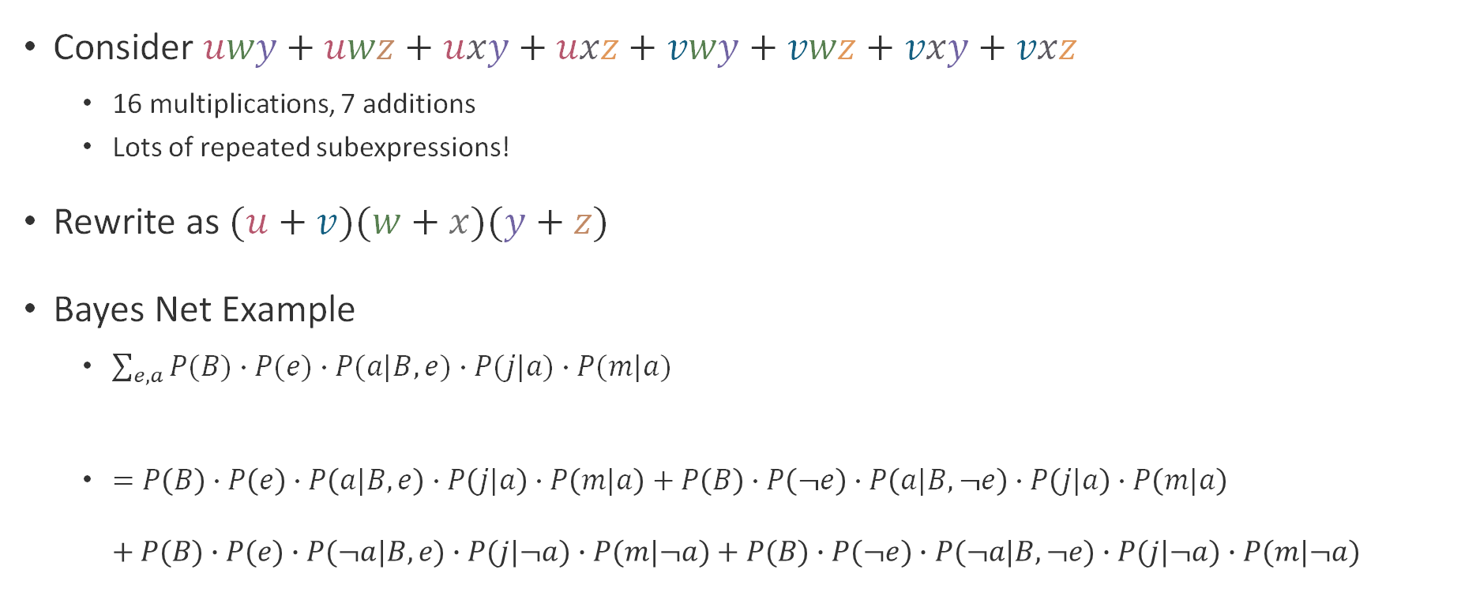
Can We Do Better?
Consider $uwy+uwz+uxy+uxz+vwy+vwz+vxy+vxz$
  16 multiplications, 7 additions
  Lots of repeated subexpressions!
Rewrite as $(u+v)(w+x)(y+z)$
Bayes Net Example
  $\sum_{e,a}{P(B)∙P(e)∙P(a|B,e)∙P(j|a)∙P(m|a)}$
  $=P\left(B\right)∙P\left(e\right)∙P\left(a|B,e\right)∙P\left(j|a\right)∙P\left(m|a\right)+P\left(B\right)∙P\left(¬e\right)∙P\left(a|B,¬e\right)∙P\left(j|a\right)∙P\left(m|a\right)$
  $+ P(B)∙P(e)∙P(¬a|B,e)∙P(j|¬a)∙P(m|¬a)+P(B)∙P(¬e)∙P(¬a|B,¬e)∙P(j|¬a)∙P(m|¬a)$

Slide 10
Questions (1)

Slide 11
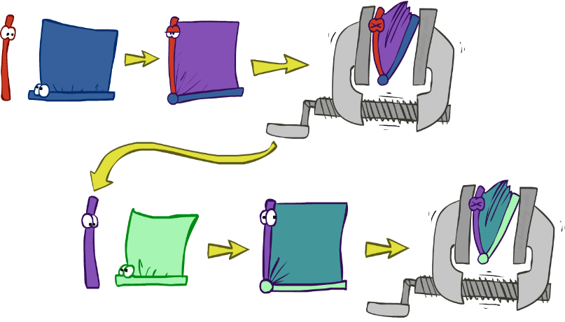
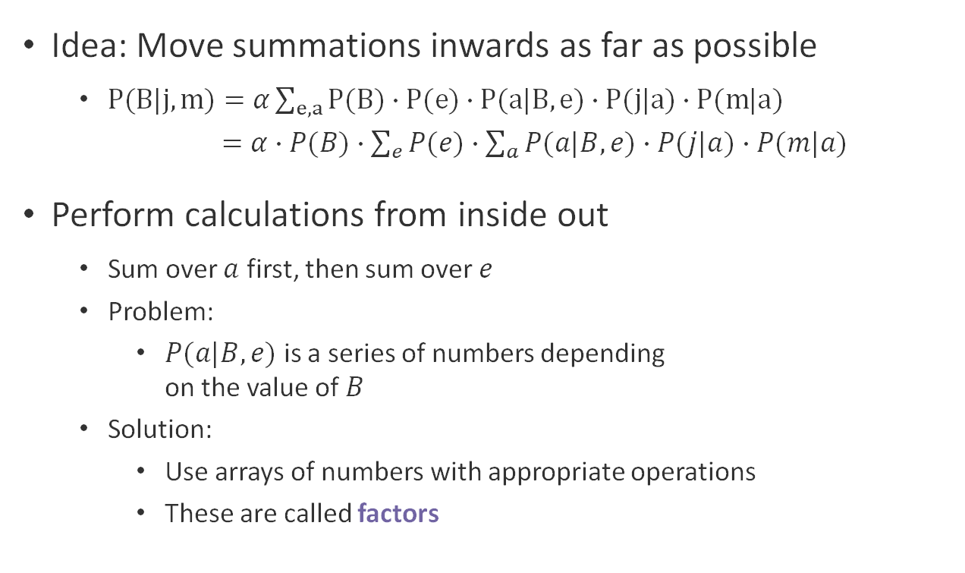
Variable Elimination
Idea: Move summations inwards as far as possible
  $P(B|j,m)=α\sum_{e,a}{P(B)∙P(e)∙P(a|B,e)∙P(j|a)∙P(m|a})$
      $=α∙P(B)∙\sum_{e}{P(e)∙\sum_{a}{P(a|B,e)∙P(j|a)∙P(m|a)}}$
Perform calculations from inside out
  Sum over $a$ first, then sum over $e$
  Problem:
    $P(a|B,e)$ is a series of numbers depending
    on the value of $B$
  Solution:
    Use arrays of numbers with appropriate operations
    These are called factors

Slide 12
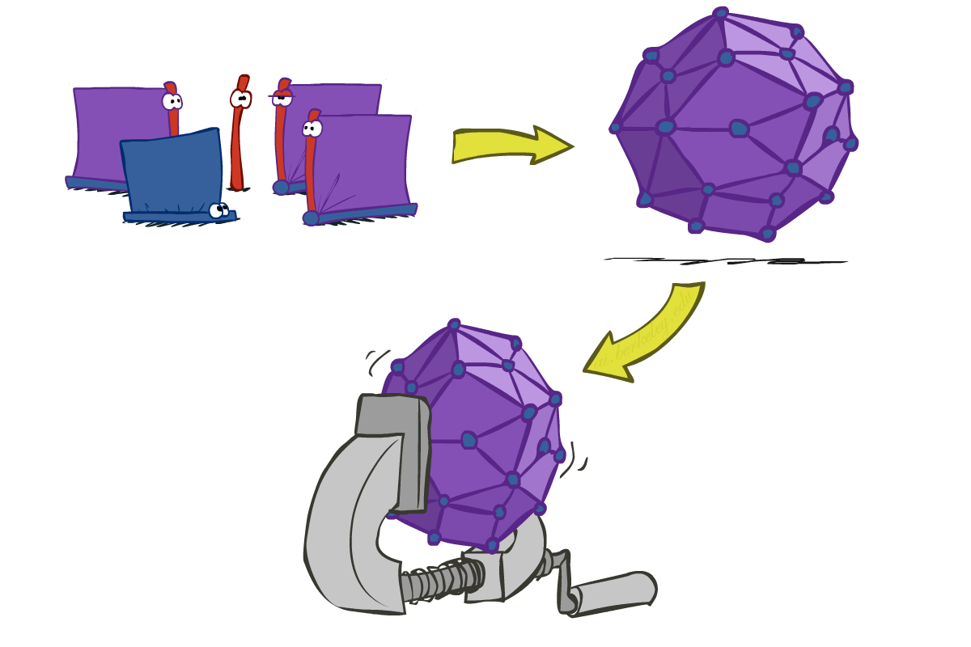

Inference by Enumeration vs. Variable Elimination
Inference by Enumeration
Variable Elimination
join, then marginalize
marginalize as you go

Slide 13
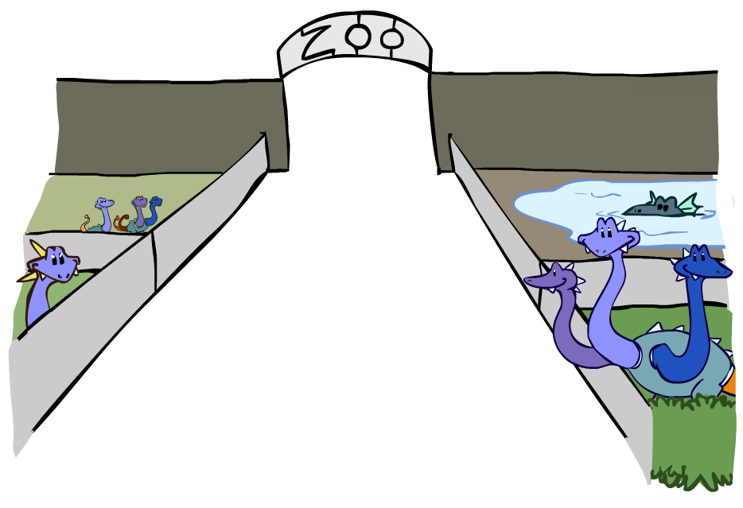
Factor Zoo

Slide 14


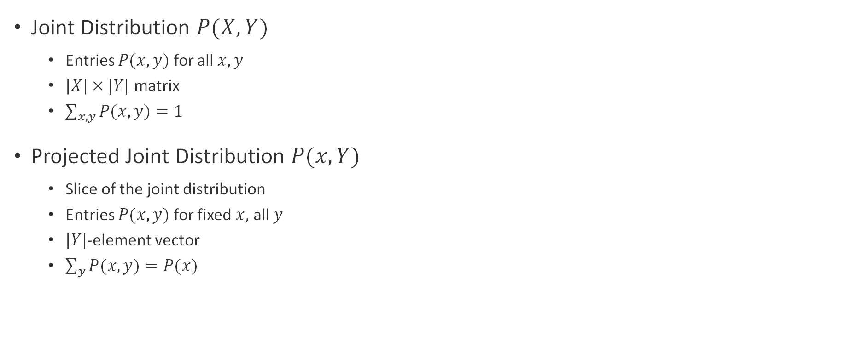


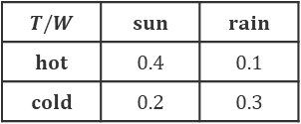
Joint Factors
Joint Distribution $P(X,Y)$
  Entries $P(x,y)$ for all $x,y$
  $\left|X\right| × |Y|$ matrix
  $\sum_{x,y}{P(x,y)}=1$
Projected Joint Distribution $P(x,Y)$
  Slice of the joint distribution
  Entries $P(x,y)$ for fixed $x$, all $y$
  $\left|Y\right|$-element vector
  $\sum_{y}{P(x,y)}=P(x)$
$$P(T,W)$$
$$T/W$$ | $$sun$$ | $$rain$$
$$hot$$ | $$0.4$$ | $$0.1$$
$$cold$$ | $$0.2$$ | $$0.3$$
$$P(cold,W)$$
$$T/W$$ | $$sun$$ | $$rain$$
$$cold$$ | $$0.2$$ | $$0.3$$
Number of variables (capital letters) = dimensionality

Slide 15
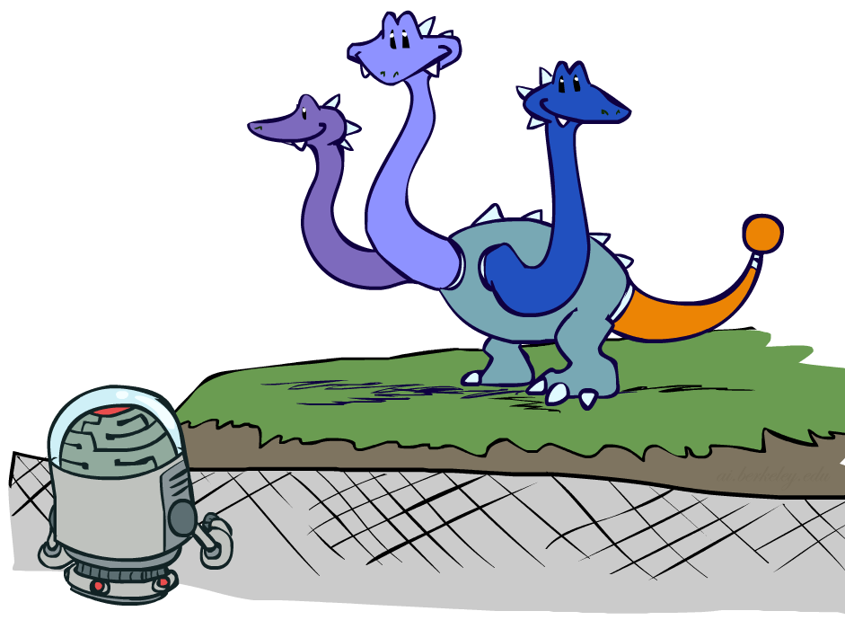
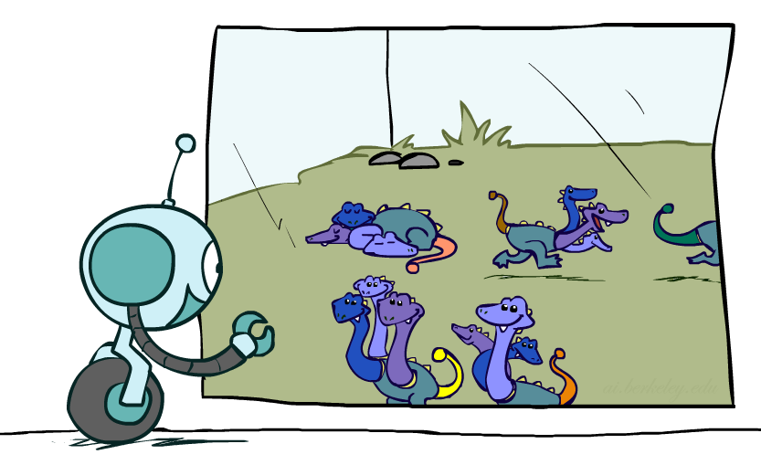
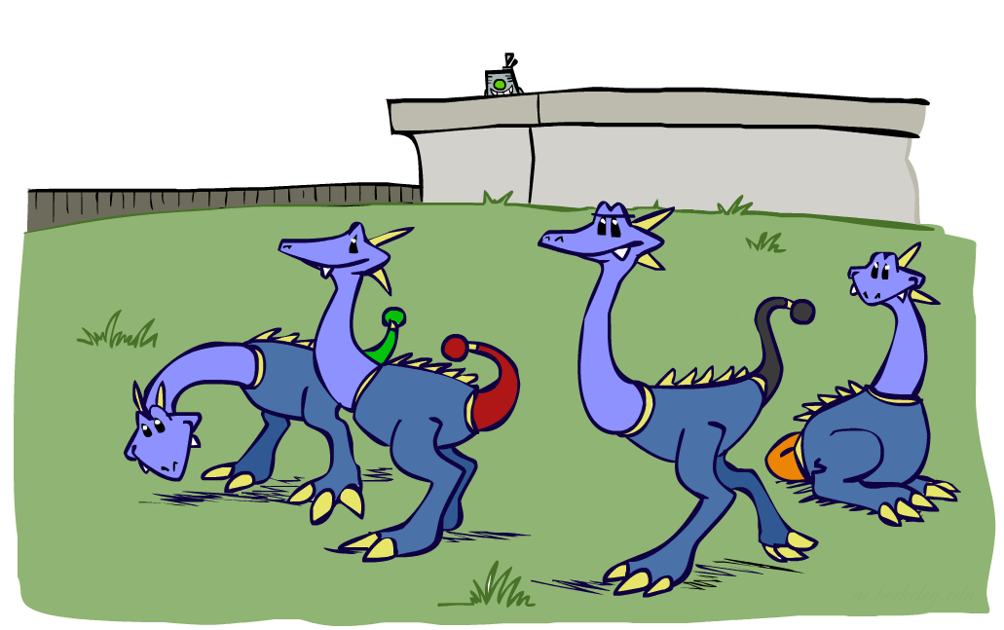

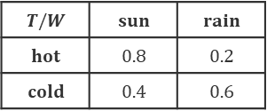

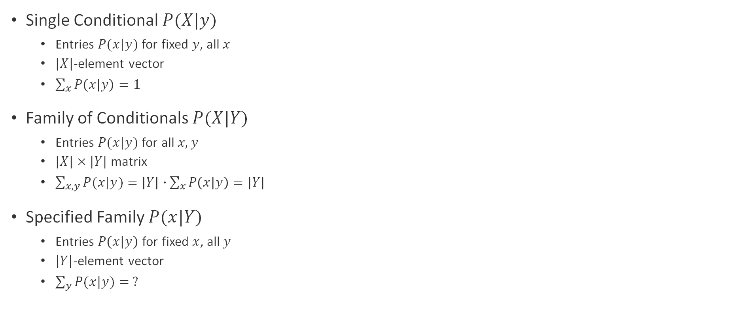

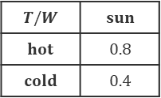



Conditional Factors
Single Conditional $P(X|y)$
  Entries $P(x|y)$ for fixed $y$, all $x$
  $\left|X\right|$-element vector
  $\sum_{x}{P\left(x | y\right)}=1$
Family of Conditionals $P(X|Y)$
  Entries $P(x|y)$ for all $x,y$
  $\left|X\right| × |Y|$ matrix
  $\sum_{x,y}{P(x|y)}=\left|Y\right|∙\sum_{x}{P\left(x | y\right)}=|Y|$
Specified Family $P(x|Y)$
  Entries $P\left(x | y\right)$ for fixed $x$, all $y$
  $|Y|$-element vector
  $\sum_{y}{P(x|y)}= ?$
$$P(W|cold)$$
$$T/W$$ | $$sun$$ | $$rain$$
$$cold$$ | $$0.4$$ | $$0.6$$
$$P(W|T)$$
$$T/W$$ | $$sun$$ | $$rain$$
$$hot$$ | $$0.8$$ | $$0.2$$
$$cold$$ | $$0.4$$ | $$0.6$$
$$P(W|hot)$$
$$P(W|cold)$$
$$P(sun|T)$$
$$T/W$$ | $$sun$$
$$hot$$ | $$0.8$$
$$cold$$ | $$0.4$$

Slide 16
Questions (2)

Slide 17

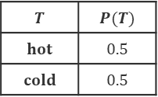
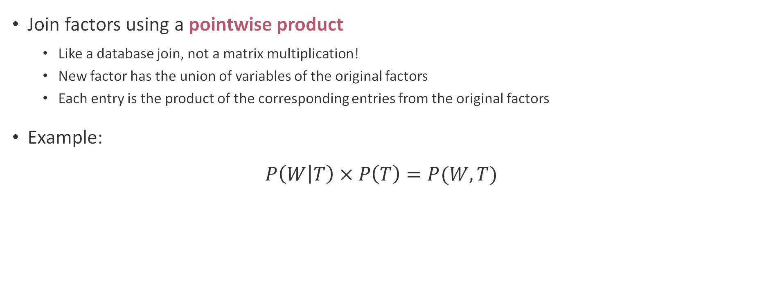
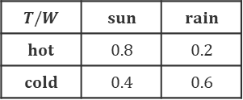

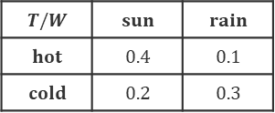

Operation 1: Pointwise Product
Join factors using a pointwise product
  Like a database join, not a matrix multiplication!
  New factor has the union of variables of the original factors
  Each entry is the product of the corresponding entries from the original factors
Example:
$$P\left(W | T\right) × P\left(T\right)=P(W,T)$$
$$P(T)$$
$$P(W|T)$$
$$P(T,W)$$
$$T$$ | $$P(T)$$
$$hot$$ | $$0.5$$
$$cold$$ | $$0.5$$
$$×$$
$$T/W$$ | $$sun$$ | $$rain$$
$$hot$$ | $$0.8$$ | $$0.2$$
$$cold$$ | $$0.4$$ | $$0.6$$
$$T/W$$ | $$sun$$ | $$rain$$
$$hot$$ | $$0.4$$ | $$0.1$$
$$cold$$ | $$0.2$$ | $$0.3$$

Slide 18



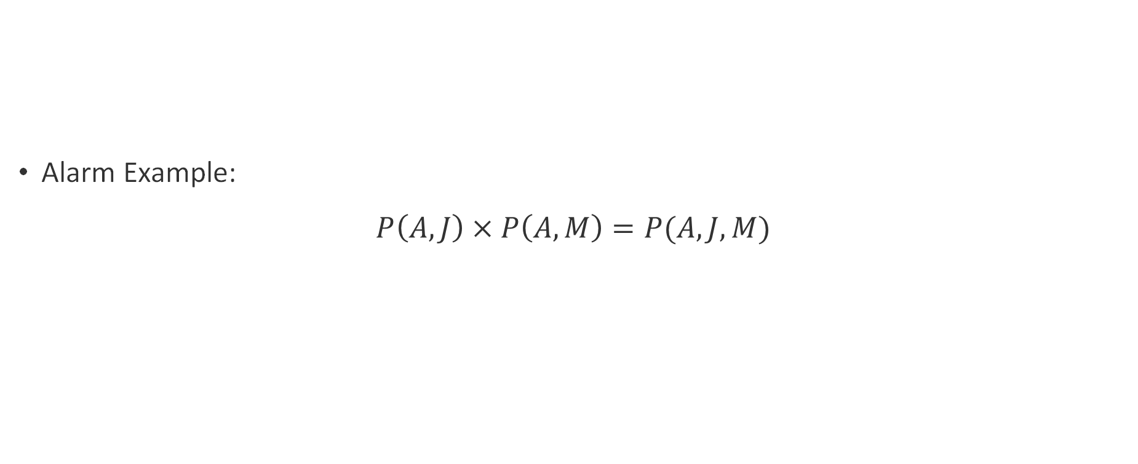
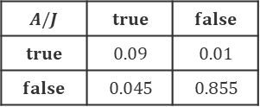

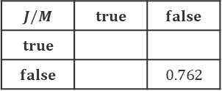


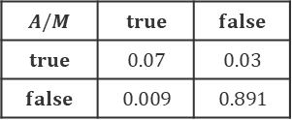
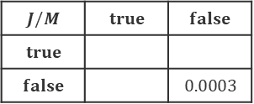

Making Larger Factors
Alarm Example:
$$P\left(A,J\right) × P\left(A,M\right)=P(A,J,M)$$
$$P(A,J)$$
$$P(A,M)$$
$$P(A,J,M)$$
$$A/J$$ | $$true$$ | $$false$$
$$true$$ | $$0.09$$ | $$0.01$$
$$false$$ | $$0.045$$ | $$0.855$$
$$A/M$$ | $$true$$ | $$false$$
$$true$$ | $$0.07$$ | $$0.03$$
$$false$$ | $$0.009$$ | $$0.891$$
$$J/M$$ | $$true$$ | $$false$$
$$true$$
$$false$$ |  | $$0.762$$
$$×$$
$$J/M$$ | $$true$$ | $$false$$
$$true$$
$$false$$ |  | $$0.0003$$
$$A=false$$
$$A=true$$

Slide 19
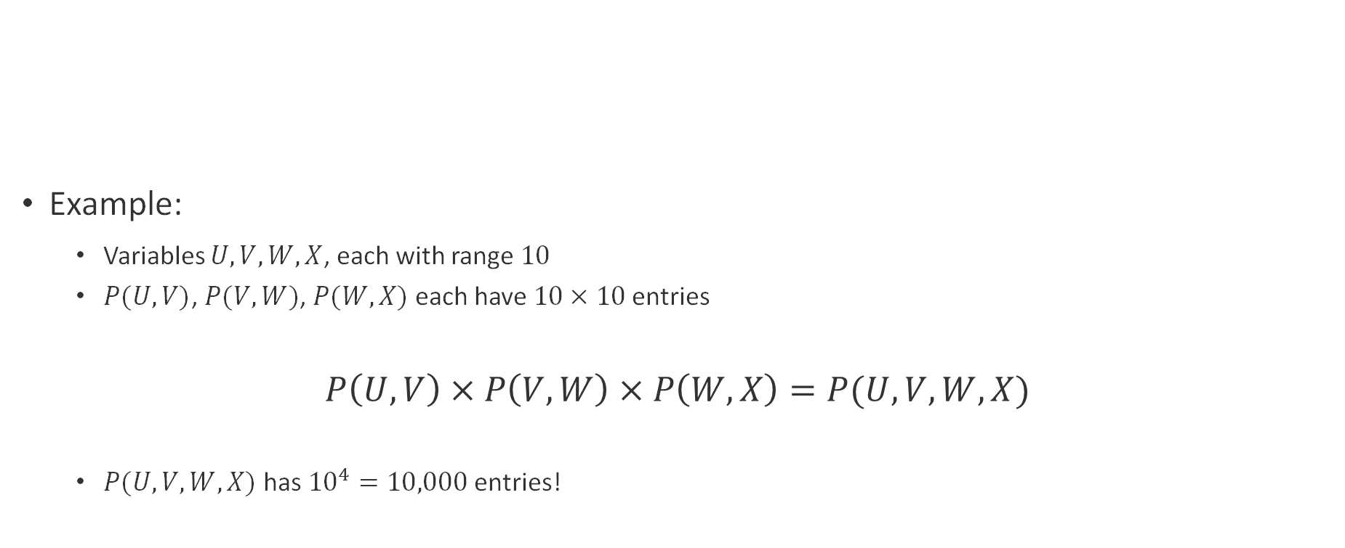
Beware of Large Factors!
Example:
  Variables $U, V, W, X$, each with range $10$
  $P(U,V)$, $P(V,W)$, $P(W,X)$ each have $10 × 10$ entries
$$P\left(U,V\right) × P\left(V,W\right) × P\left(W,X\right)=P(U,V,W,X)$$
  $P(U,V,W,X)$ has ${10}^{4}=10,000$ entries!

Slide 20
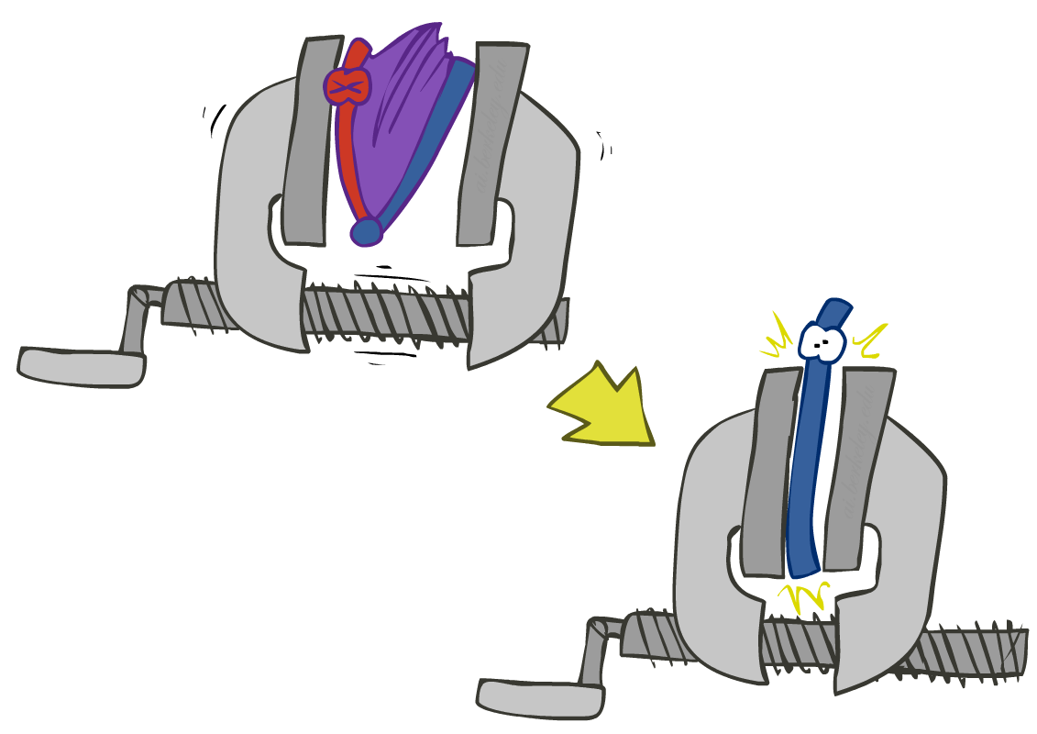
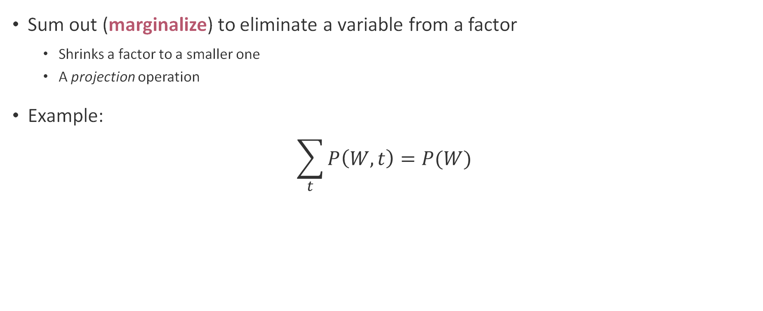

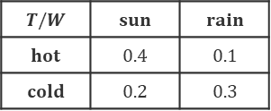

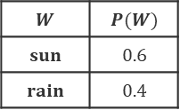
Operation 2: Marginalize
Sum out (marginalize) to eliminate a variable from a factor
  Shrinks a factor to a smaller one
  A projection operation
Example:
$$\sum_{t}{P\left(W,t\right)=P(W)}$$
$$P(W,T)$$
$$P(W)$$
$$T/W$$ | $$sun$$ | $$rain$$
$$hot$$ | $$0.4$$ | $$0.1$$
$$cold$$ | $$0.2$$ | $$0.3$$
$$W$$ | $$P(W)$$
$$sun$$ | $$0.6$$
$$rain$$ | $$0.4$$

Slide 21
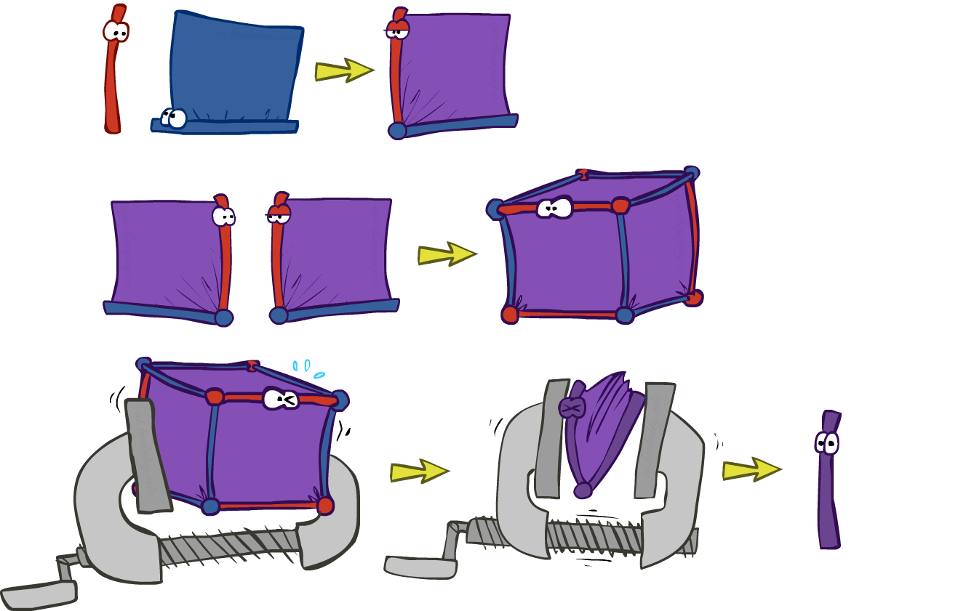
‘Long’ Way: Inference by Enumeration

Slide 22

Shortcut: Variable Elimination

Slide 23

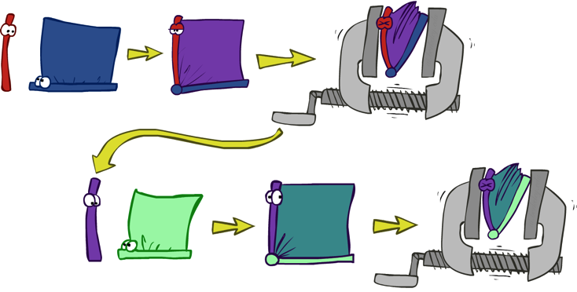

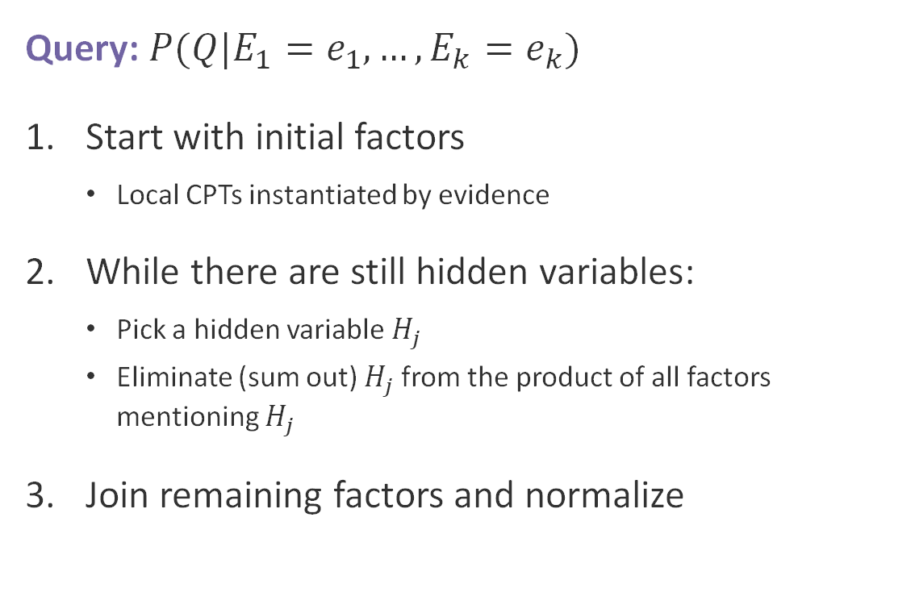
Variable Elimination Implementation
Query: $P(Q|E_{1}=e_{1},…,E_{k}=e_{k})$
Start with initial factors
  Local CPTs instantiated by evidence
While there are still hidden variables:
  Pick a hidden variable $H_{j}$
  Eliminate (sum out) $H_{j}$ from the product of all factors mentioning $H_{j}$
Join remaining factors and normalize

Slide 24
Questions (3)

Slide 25
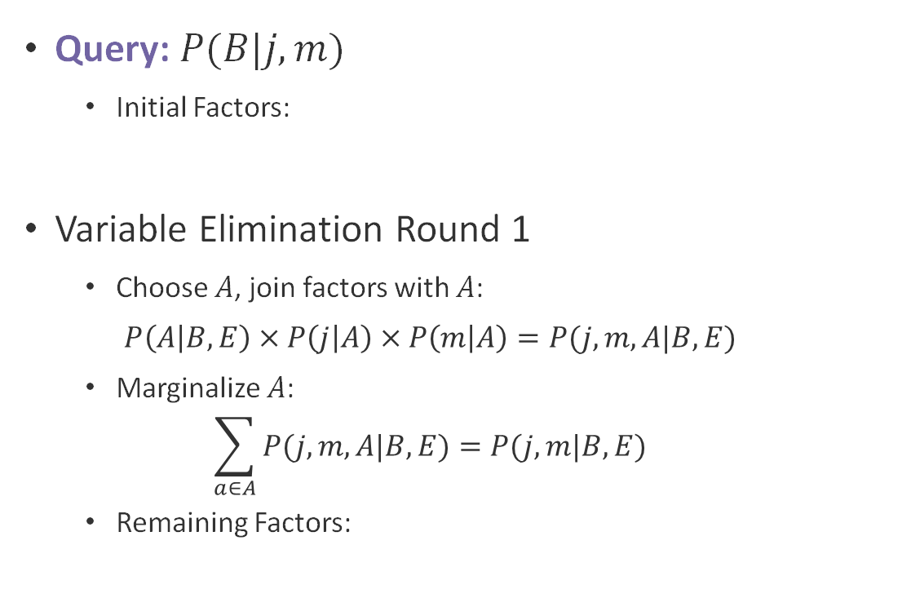

Alarm Variable Elimination (1)
Query: $P(B|j,m)$
  Initial Factors:
Variable Elimination Round 1
  Choose $A$, join factors with $A$:
  $$P\left(A | B,E\right) × P\left(j | A\right) × P\left(m | A\right)=P(j,m,A|B,E)$$
  Marginalize $A$:
  $$\sum_{a∈A}{P(j,m,A|B,E)}=P(j,m|B,E)$$
  Remaining Factors:
$$B$$
$$E$$
$$P(B)$$ | $$P(E)$$ | $$P(A|B,E)$$ | $$P(j|A)$$ | $$P(m|A)$$
Burglary
Earthquake
$$A$$
Alarm
$$J$$
$$M$$
$$P(B)$$ | $$P(E)$$ | $$P(j,m|B,E)$$
Jan Calls
Maria Calls

Slide 26



Alarm Variable Elimination (2)
Query: $P(B|j,m)$
  Current Factors:
Variable Elimination Round 2
  Choose $E$, join factors with $E$:
  $$P(E) × P\left(j,m | B,E\right)=P(j,m,E|B)$$
  Marginalize $E$:
  $$\sum_{e∈E}{P(j,m,E|B)}=P(j,m|B)$$
  Remaining Factors:
$$B$$
$$E$$
$$P(B)$$ | $$P(E)$$ | $$P(j,m|B,E)$$
Burglary
Earthquake
$$A$$
Alarm
$$J$$
$$M$$
$$P(B)$$ | $$P(j,m|B)$$
Jan Calls
Maria Calls

Slide 27


Alarm Variable Elimination (3)
Query: $P(B|j,m)$
  Current Factors:
  Note $P\left(B | j,m\right)∝P(j,m,B)$
Variable Elimination Round 3
  Choose $B$, join factors with $B$:
  $$P(B) × P\left(j,m | B\right)=P(j,m,B)$$
  Normalize by $P(j,m)$:
  $$α=\sum_{b∈B}{P\left(j,m,b\right)}=P(j,m)$$
  Final Factor: $P\left(B | j,m\right)=\frac{1}{α}∙P(j,m,B)$
$$B$$
$$E$$
$$P(B)$$ | $$P(j,m|B)$$
Burglary
Earthquake
$$A$$
Alarm
$$J$$
$$M$$
Jan Calls
Maria Calls
Notes:
P(x|y)=p(x,y)/p(y)
(combining factors follows the product rule that we established)

Slide 28








Common Cause Variable Elimination
Query: $P(X_{3}|y_{1},y_{2},y_{3})$
  Initial Factors:
Variable Elimination
  Eliminate $X_{1}$: $f_{1}\left(Z,y_{1}\right)=\sum_{x_{1}}{P(x_{1}|Z)∙P(y_{1}|x_{1})}$
  Eliminate $X_{2}$: $f_{2}\left(Z,y_{2}\right)=\sum_{x_{2}}{P(x_{2}|Z)∙P(y_{2}|x_{2})}$
  Eliminate $Z$: $f_{3}\left(X_{3},y_{1},y_{2}\right)=\sum_{z}{P(z)∙f_{1}(Z,y_{1})∙f_{2}(Z,y_{2})∙P(X_{3}|z)}$
  Join remaining factors:
  $$f_{4}\left(X_{3},y_{1},y_{2},y_{3}\right)=P\left(X_{3},y_{1},y_{2},y_{3}\right)=P(y_{3}|X_{3})∙f_{3}(X_{3},y_{1},y_{2})$$
  Normalize over $X_{3}$:
  $$P\left(X_{3} | y_{1},y_{2},y_{3}\right)=\frac{f_{4}(X_{3},y_{1},y_{2},y_{3})}{\sum_{x_{3}}{f_{4}(x_{3},y_{1},y_{2},y_{3})}}$$
$$Z$$
$$P(Z)$$ | $$P(X_{1}|Z)$$ | $$P(X_{2}|Z)$$ | $$P(X_{3}|Z)$$ | $$P(y_{1}|X_{1})$$ | $$P(y_{2}|X_{2})$$ | $$P(y_{3}|X_{3})$$
$$X_{1}$$
$$X_{2}$$
$$X_{3}$$
$$y_{1}$$
$$y_{2}$$
$$y_{3}$$

Slide 29
Questions (4)

Slide 30











Try It Yourself
$$A$$ | $$P(A)$$
$$a_{1}$$ | $$0.2$$
$$a_{2}$$ | $$0.8$$
$$B$$ | $$P(B)$$
$$b_{1}$$ | $$0.6$$
$$b_{2}$$ | $$0.4$$
Evidence
  $C=c_{1}$, $B=b_{2}$
Initial Factors
What is$P(A,b_{2},c_{1},D)$?
What is $P(E|c_{1},b_{2})$?
$$A$$
$$B$$
$$A/C$$ | $$c_{1}$$ | $$c_{2}$$
$$a_{1}$$ | $$0.3$$ | $$0.7$$
$$a_{2}$$ | $$0.5$$ | $$0.5$$
$$P(A)$$ | $$P(b_{2})$$ | $$P(c_{1}|A)$$ | $$P(D|A,b_{2})$$ | $$P(E|c_{1},D)$$
$$C$$
$$D$$
$$C$$ | $$D$$ | $$E$$ | $$P(E|C,E)$$
$$c_{1}$$ | $$d_{1}$$ | $$e_{1}$$ | $$0.5$$
$$c_{1}$$ | $$d_{1}$$ | $$e_{2}$$ | $$0.5$$
$$c_{1}$$ | $$d_{2}$$ | $$e_{1}$$ | $$0.7$$
$$c_{1}$$ | $$d_{2}$$ | $$e_{2}$$ | $$0.3$$
$$c_{2}$$ | $$d_{1}$$ | $$e_{1}$$ | $$0.6$$
$$c_{2}$$ | $$d_{1}$$ | $$e_{2}$$ | $$0.4$$
$$c_{2}$$ | $$d_{2}$$ | $$e_{1}$$ | $$1$$
$$c_{2}$$ | $$d_{2}$$ | $$e_{2}$$ | $$0$$
$$A$$ | $$B$$ | $$D$$ | $$P(D|A,B)$$
$$a_{1}$$ | $$b_{1}$$ | $$d_{1}$$ | $$0$$
$$a_{1}$$ | $$b_{1}$$ | $$d_{2}$$ | $$1$$
$$a_{1}$$ | $$b_{2}$$ | $$d_{1}$$ | $$0.9$$
$$a_{1}$$ | $$b_{2}$$ | $$d_{2}$$ | $$0.1$$
$$a_{2}$$ | $$b_{1}$$ | $$d_{1}$$ | $$0.25$$
$$a_{2}$$ | $$b_{1}$$ | $$d_{2}$$ | $$0.75$$
$$a_{2}$$ | $$b_{2}$$ | $$d_{1}$$ | $$0.5$$
$$a_{2}$$ | $$b_{2}$$ | $$d_{2}$$ | $$0.5$$
$$E$$
Notes:
First one: P(b2)*P(D|A,b2) = P(D,b2|A) = P(D|A)

Slide 31





Try It Yourself
$$A$$ | $$P(A)$$
$$a_{1}$$ | $$0.2$$
$$a_{2}$$ | $$0.8$$
$$B$$ | $$P(B)$$
$$b_{1}$$ | $$0.6$$
$$b_{2}$$ | $$0.4$$
Given: $C=c_{1}$, $B=b_{2}$
$$P(A,b_{2},c_{1},D,E)=P(A)P(b_{2})P(c_{1}|A)P(D|A,b_{2})P(E|c_{1},D)$$
What is $P(A,b_{2},c_{1},D)$?
  $\sum_{E}{P(A)P(b_{2})P(c_{1}|A)P(D|A,b_{2})P(E|c_{1},D) }=P(A)P(b_{2})P(c_{1}|A)P(D|A,b_{2})$
$$A$$
$$B$$
$$P(A)$$ | $$P(b_{2})$$ | $$P(c_{1}|A)$$ | $$P(D|A,b_{2})$$ | $$P(E|c_{1},D)$$
$$A/C$$ | $$c_{1}$$ | $$c_{2}$$
$$a_{1}$$ | $$0.3$$ | $$0.7$$
$$a_{2}$$ | $$0.5$$ | $$0.5$$
$$C$$
$$D$$
$$C$$ | $$D$$ | $$E$$ | $$P(E|C,E)$$
$$c_{1}$$ | $$d_{1}$$ | $$e_{1}$$ | $$0.5$$
$$c_{1}$$ | $$d_{1}$$ | $$e_{2}$$ | $$0.5$$
$$c_{1}$$ | $$d_{2}$$ | $$e_{1}$$ | $$0.7$$
$$c_{1}$$ | $$d_{2}$$ | $$e_{2}$$ | $$0.3$$
$$c_{2}$$ | $$d_{1}$$ | $$e_{1}$$ | $$0.6$$
$$c_{2}$$ | $$d_{1}$$ | $$e_{2}$$ | $$0.4$$
$$c_{2}$$ | $$d_{2}$$ | $$e_{1}$$ | $$1$$
$$c_{2}$$ | $$d_{2}$$ | $$e_{2}$$ | $$0$$
$$A$$ | $$B$$ | $$D$$ | $$P(D|A,B)$$
$$a_{1}$$ | $$b_{1}$$ | $$d_{1}$$ | $$0$$
$$a_{1}$$ | $$b_{1}$$ | $$d_{2}$$ | $$1$$
$$a_{1}$$ | $$b_{2}$$ | $$d_{1}$$ | $$0.9$$
$$a_{1}$$ | $$b_{2}$$ | $$d_{2}$$ | $$0.1$$
$$a_{2}$$ | $$b_{1}$$ | $$d_{1}$$ | $$0.25$$
$$a_{2}$$ | $$b_{1}$$ | $$d_{2}$$ | $$0.75$$
$$a_{2}$$ | $$b_{2}$$ | $$d_{1}$$ | $$0.5$$
$$a_{2}$$ | $$b_{2}$$ | $$d_{2}$$ | $$0.5$$
$$A/D$$ | $$d_{1}$$ | $$d_{2}$$
$$a_{1}$$ | $$.2∙.4∙.3∙.9=.022$$ | $$.2∙.4∙.3∙.1=.0024$$
$$a_{2}$$ | $$.8∙.4∙.3∙.5=.048$$ | $$.8∙.4∙.3∙.5=.048$$
$$E$$
Notes:
First one: P(b2)*P(D|A,b2) = P(D,b2|A) = P(D|A)

Slide 32



Try It Yourself
$$A$$ | $$P(A)$$
$$a_{1}$$ | $$0.2$$
$$a_{2}$$ | $$0.8$$
$$B$$ | $$P(B)$$
$$b_{1}$$ | $$0.6$$
$$b_{2}$$ | $$0.4$$
Given: $C=c_{1}$, $B=b_{2}$
$$P(A,b_{2},c_{1},D,E)=P(A)P(b_{2})P(c_{1}|A)P(D|A,b_{2})P(E|c_{1},D)$$
What is $P(E|c_{1},b_{2})$
$=\frac{P(E,c_{1},b_{2})}{P(c_{1},b_{2})}=\frac{\sum_{A,D}{Joint}}{\sum_{A,D,E}{Joint}}$
$N=P(b_{2})\sum_{A}{P(A)P(c_{1}|A)\sum_{D}{P(D|A,b_{2})P(E|c_{1},D)}}$
D$=P(b_{2})\sum_{A}{P(A)P(c_{1}|A)\sum_{D}{P(D|A,b_{2}) }\sum_{E}{P(E|c_{1},D)}}$
$=P(b_{2})\sum_{A}{P(A)P(c_{1}|A) }=P(b_{2})P(c_{1})$
$=\frac{P(b_{2})\sum_{A}{P(A)P(c_{1}|A)\sum_{D}{P(D|A,b_{2})P(E|c_{1},D)}}}{P(b_{2})P(c_{1}) }$
$=$ $\sum_{A}{P(A|c_{1})\sum_{D}{P(D|A,b_{2})P(E|c_{1},D)}}$
$P(E|c_{1},b_{2})=\left\langle e_{1}=\sim .59 | e_{2}=\sim .41\right\rangle$
$$A$$
$$B$$
$$P(A)$$ | $$P(b_{2})$$ | $$P(c_{1}|A)$$ | $$P(D|A,b_{2})$$ | $$P(E|c_{1},D)$$
$$A/C$$ | $$c_{1}$$ | $$c_{2}$$
$$a_{1}$$ | $$0.3$$ | $$0.7$$
$$a_{2}$$ | $$0.5$$ | $$0.5$$
$$C$$
$$D$$
$$C$$ | $$D$$ | $$E$$ | $$P(E|C,E)$$
$$c_{1}$$ | $$d_{1}$$ | $$e_{1}$$ | $$0.5$$
$$c_{1}$$ | $$d_{1}$$ | $$e_{2}$$ | $$0.5$$
$$c_{1}$$ | $$d_{2}$$ | $$e_{1}$$ | $$0.7$$
$$c_{1}$$ | $$d_{2}$$ | $$e_{2}$$ | $$0.3$$
$$c_{2}$$ | $$d_{1}$$ | $$e_{1}$$ | $$0.6$$
$$c_{2}$$ | $$d_{1}$$ | $$e_{2}$$ | $$0.4$$
$$c_{2}$$ | $$d_{2}$$ | $$e_{1}$$ | $$1$$
$$c_{2}$$ | $$d_{2}$$ | $$e_{2}$$ | $$0$$
$$A$$ | $$B$$ | $$D$$ | $$P(D|A,B)$$
$$a_{1}$$ | $$b_{1}$$ | $$d_{1}$$ | $$0$$
$$a_{1}$$ | $$b_{1}$$ | $$d_{2}$$ | $$1$$
$$a_{1}$$ | $$b_{2}$$ | $$d_{1}$$ | $$0.9$$
$$a_{1}$$ | $$b_{2}$$ | $$d_{2}$$ | $$0.1$$
$$a_{2}$$ | $$b_{1}$$ | $$d_{1}$$ | $$0.25$$
$$a_{2}$$ | $$b_{1}$$ | $$d_{2}$$ | $$0.75$$
$$a_{2}$$ | $$b_{2}$$ | $$d_{1}$$ | $$0.5$$
$$a_{2}$$ | $$b_{2}$$ | $$d_{2}$$ | $$0.5$$
$$E$$
Notes:
First one: P(b2)*P(D|A,b2) = P(D,b2|A) = P(D|A)

Slide 33








Order Matters
Query: $P(C)$
With elimination ordering $A$, $B$, $Z$:
  $P\left(C\right)=α\sum_{z,b,a}{P(z)∙P(a|z)∙P(b|z)∙P(C|z)}$
    $= α\sum_{z}{P\left(z\right)∙[\sum_{b}{P\left(b | z\right)∙\left[\sum_{a}{P\left(a | z\right)∙P\left(C | z\right)}\right]}]}$
  Largest factor has two variables $\left(C,Z\right)$
With elimination ordering $Z$, $A$, $B$:
  $P\left(C\right)=α\sum_{b,a,z}{P(z)∙P(a|z)∙P(b|z)∙P(C|z)}$
  $=α\sum_{b}{[\sum_{a}{[\sum_{z}{P\left(z\right)∙P\left(a | z\right)∙P\left(b | z\right)∙P(C|z)}]}]}$
$$Z$$
$$f_{1}(C,Z)$$
$$f_{2}(C,Z)$$
$$f_{3}(C)$$
$$A$$
$$B$$
$$C$$
$$f_{1}(A,B,C)$$
$$f_{2}(B,C)$$
$$f_{3}(C)$$

Slide 34

Properties of Variable Elimination
The computational and space complexity of variable elimination is determined by the largest factor
Elimination ordering greatly affects the size of the largest factor
  In the shallow tree scenario:
    $d^{n}$ when eliminating the root first
    $d^{k}$ when eliminating leaves first, where $k$ is the number of variables involves in the query
Does there always exist an ordering that only results in small factors?
  No. Such an ordering cannot be guaranteed. Sometimes the network structure will require a large factor

Slide 35
Questions (5)

Slide 36
that’s it for today!
Implications of independence and conditional independence
Bayes nets encode joint distributions by tracking conditional probabilities
How to compute conditional probabilities of queries given evidence?
Start Homework 3

