Slide 1
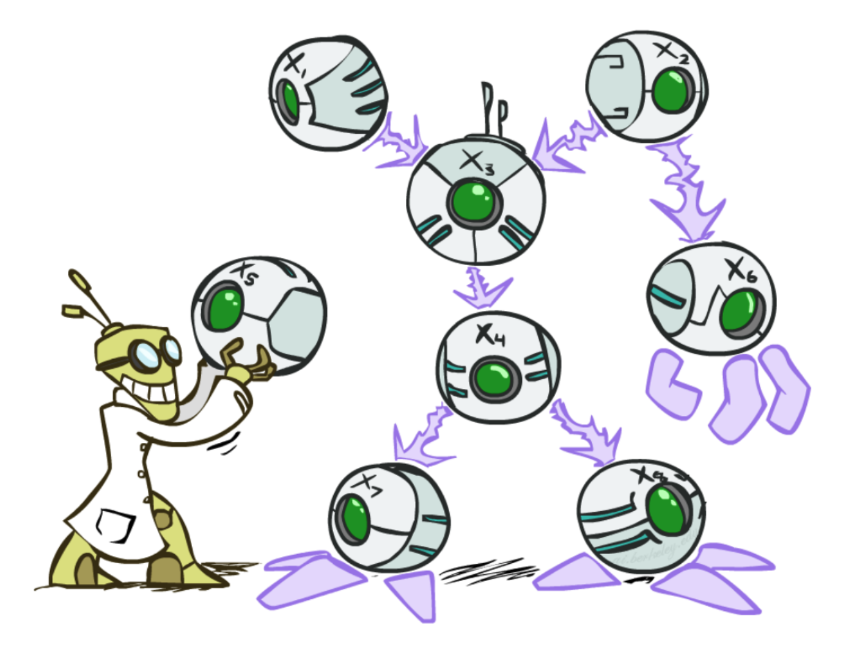
Bayes Nets
CSE 473: Introduction to Artificial Intelligence
Megan Hazen(mh75@cs)
cs.uw.edu/473
acknowledgements
Welcome!
Do the drawings enhance the slides?

Slide 2
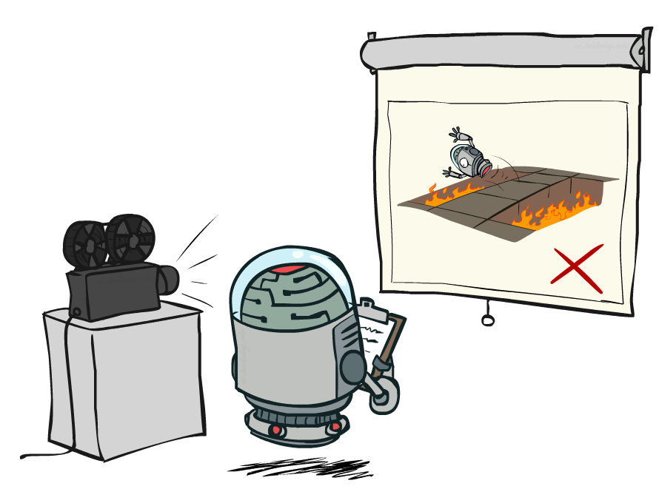
Administrivia
Test 1 scores released today
Project 2 due tonight
Homework 3 posted, due Mon 11/16
Project 3 posted Wednesday

Slide 3
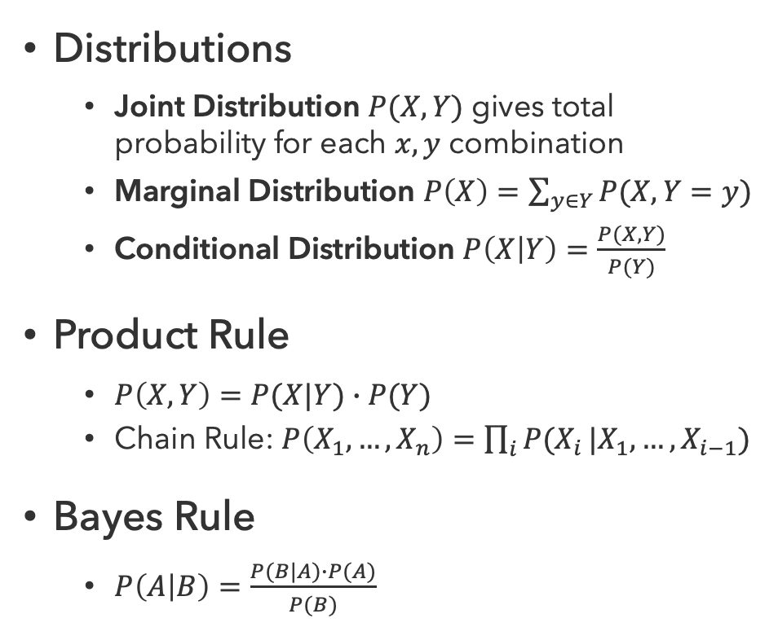
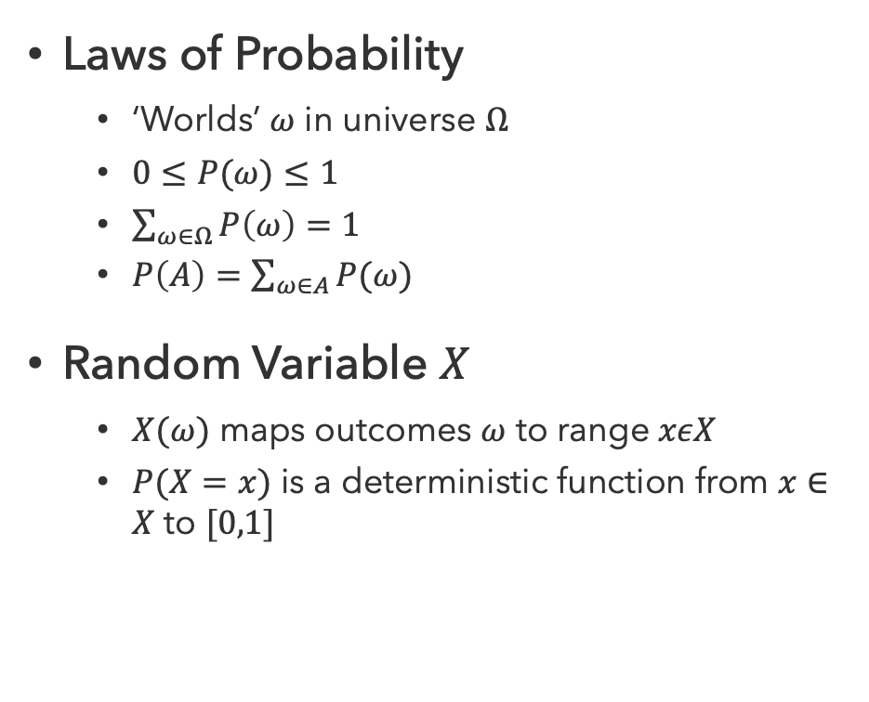
Probability Recap
Laws of Probability
  ‘Worlds’ $ω$ in universe $Ω$
  $0≤P(ω)≤1$
  $\sum_{ω∈Ω}{P\left(ω\right)=1}$
  $P\left(A\right)=\sum_{ω∈A}{P(ω)}$
Random Variable $X$
  $X(ω)$ maps outcomes $ω$ to range $xεX$
  $P(X=x)$ is a deterministic function from $x∈X$ to $[0,1]$
Distributions
  Joint Distribution $P(X,Y)$ gives total probability for each $x,y$ combination
  Marginal Distribution $P\left(X\right)=\sum_{y∈Y}{P(X,Y=y)}$
  Conditional Distribution $P\left(X | Y\right)=\frac{P(X,Y)}{P(Y)}$
Product Rule
  $P\left(X,Y\right)=P(X|Y)∙P(Y)$
  Chain Rule: $P\left(X_{1},…,X_{n}\right)=\prod_{i}{P(X_{i}}|X_{1},…,X_{i−1})$
Bayes Rule
  $P\left(A | B\right)=\frac{P(B|A)∙P(A)}{P(B)}$

Slide 4
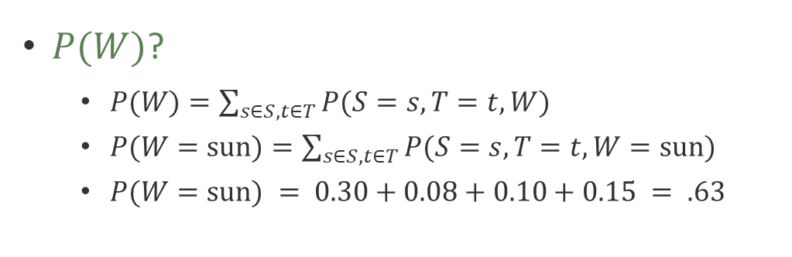
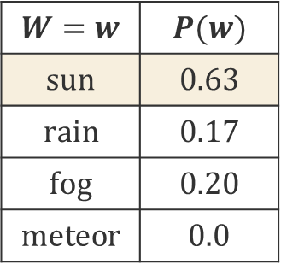
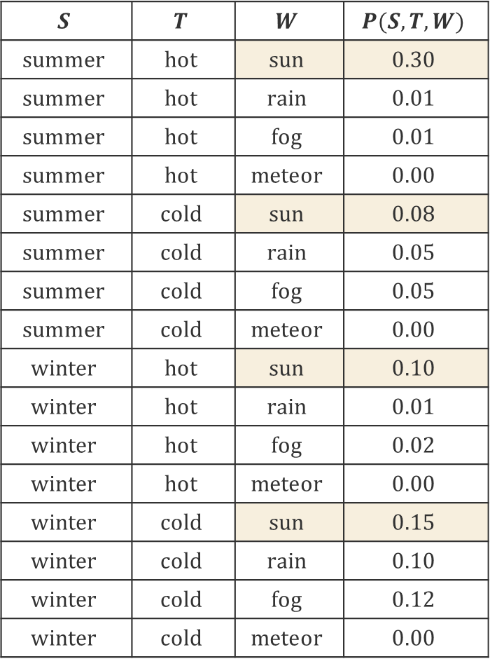
Inferring the Weather 1
$$S$$ | $$T$$ | $$W$$ | $$P(S,T,W)$$
$$summer$$ | $$hot$$ | $$sun$$ | $$0.30$$
$$summer$$ | $$hot$$ | $$rain$$ | $$0.01$$
$$summer$$ | $$hot$$ | $$fog$$ | $$0.01$$
$$summer$$ | $$hot$$ | $$meteor$$ | $$0.00$$
$$summer$$ | $$cold$$ | $$sun$$ | $$0.08$$
$$summer$$ | $$cold$$ | $$rain$$ | $$0.05$$
$$summer$$ | $$cold$$ | $$fog$$ | $$0.05$$
$$summer$$ | $$cold$$ | $$meteor$$ | $$0.00$$
$$winter$$ | $$hot$$ | $$sun$$ | $$0.10$$
$$winter$$ | $$hot$$ | $$rain$$ | $$0.01$$
$$winter$$ | $$hot$$ | $$fog$$ | $$0.02$$
$$winter$$ | $$hot$$ | $$meteor$$ | $$0.00$$
$$winter$$ | $$cold$$ | $$sun$$ | $$0.15$$
$$winter$$ | $$cold$$ | $$rain$$ | $$0.10$$
$$winter$$ | $$cold$$ | $$fog$$ | $$0.12$$
$$winter$$ | $$cold$$ | $$meteor$$ | $$0.00$$
$P(W)$?
  $P(W)=\sum_{s∈S,t∈T}{P(S=s,T=t,W)}$
  $P(W=sun)=\sum_{s∈S,t∈T}{P(S=s,T=t,W=sun)}$
  $P(W=sun) = 0.30+0.08+0.10+0.15 = .63$
$$W=w$$ | $$P(w)$$
$$sun$$ | $$0.63$$
$$rain$$ | $$0.17$$
$$fog$$ | $$0.20$$
$$meteor$$ | $$0.0$$
Notes:
P(sun|winter) = (0.1+0.15)/0.5 = .25/.5=.5

Slide 5
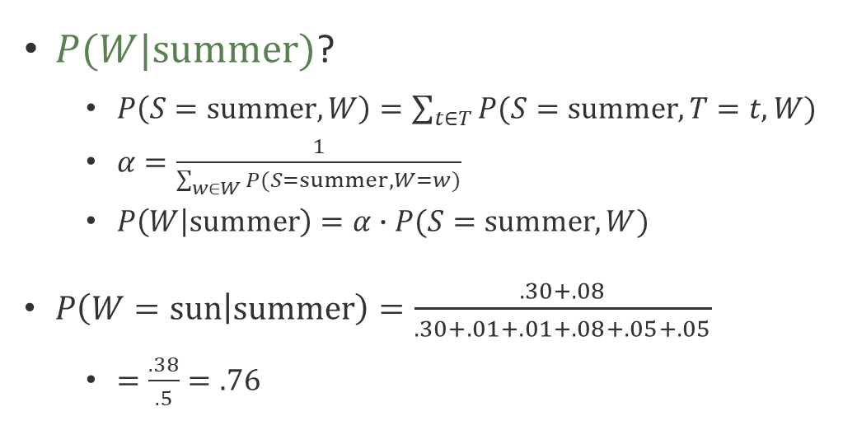
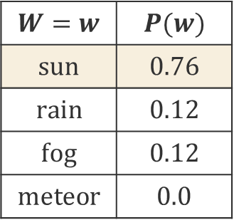
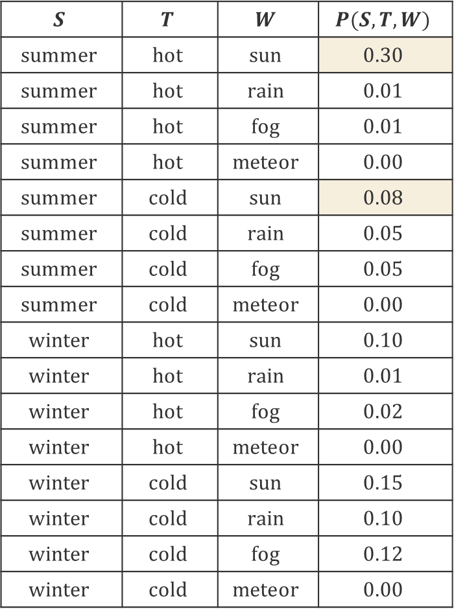
Inferring the Weather 2
$$S$$ | $$T$$ | $$W$$ | $$P(S,T,W)$$
$$summer$$ | $$hot$$ | $$sun$$ | $$0.30$$
$$summer$$ | $$hot$$ | $$rain$$ | $$0.01$$
$$summer$$ | $$hot$$ | $$fog$$ | $$0.01$$
$$summer$$ | $$hot$$ | $$meteor$$ | $$0.00$$
$$summer$$ | $$cold$$ | $$sun$$ | $$0.08$$
$$summer$$ | $$cold$$ | $$rain$$ | $$0.05$$
$$summer$$ | $$cold$$ | $$fog$$ | $$0.05$$
$$summer$$ | $$cold$$ | $$meteor$$ | $$0.00$$
$$winter$$ | $$hot$$ | $$sun$$ | $$0.10$$
$$winter$$ | $$hot$$ | $$rain$$ | $$0.01$$
$$winter$$ | $$hot$$ | $$fog$$ | $$0.02$$
$$winter$$ | $$hot$$ | $$meteor$$ | $$0.00$$
$$winter$$ | $$cold$$ | $$sun$$ | $$0.15$$
$$winter$$ | $$cold$$ | $$rain$$ | $$0.10$$
$$winter$$ | $$cold$$ | $$fog$$ | $$0.12$$
$$winter$$ | $$cold$$ | $$meteor$$ | $$0.00$$
$P(W|summer)$?
  $P\left(S=summer, W\right)=\sum_{t∈T}{P(S=summer,T=t,W)}$
  $α=\frac{1}{\sum_{w∈W}{P(S=summer,W=w)}}$
  $P\left(W | summer\right)=α∙P(S=summer, W)$
$P\left(W=sun | summer\right)=\frac{.30+.08}{.30+.01+.01+.08+.05+.05}$
  $=\frac{.38}{.5}=.76$
$$W=w$$ | $$P(w)$$
$$sun$$ | $$0.76$$
$$rain$$ | $$0.12$$
$$fog$$ | $$0.12$$
$$meteor$$ | $$0.0$$
Notes:
P(sun|winter) = (0.1+0.15)/0.5 = .25/.5=.5

Slide 6
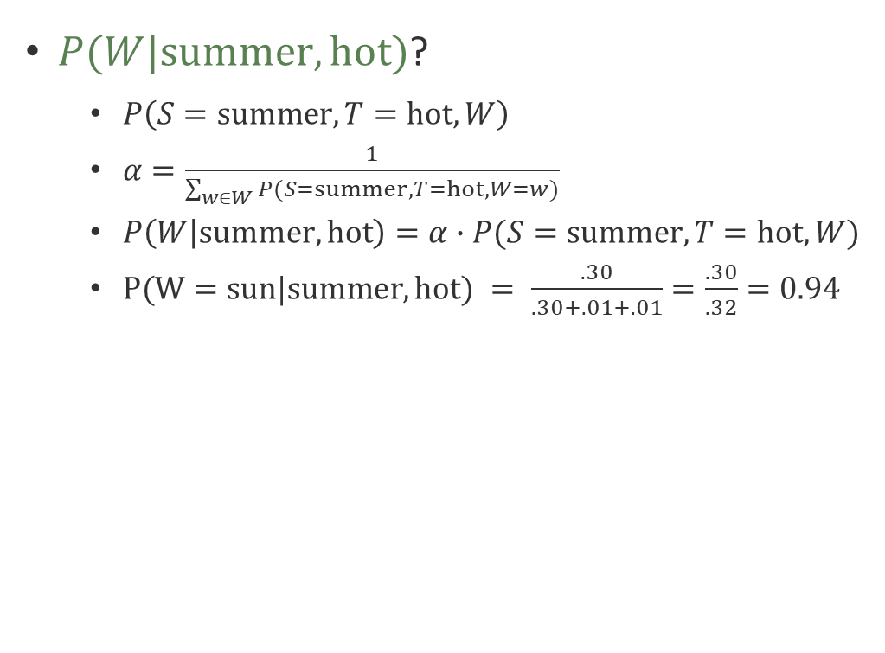
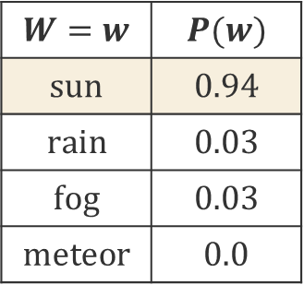
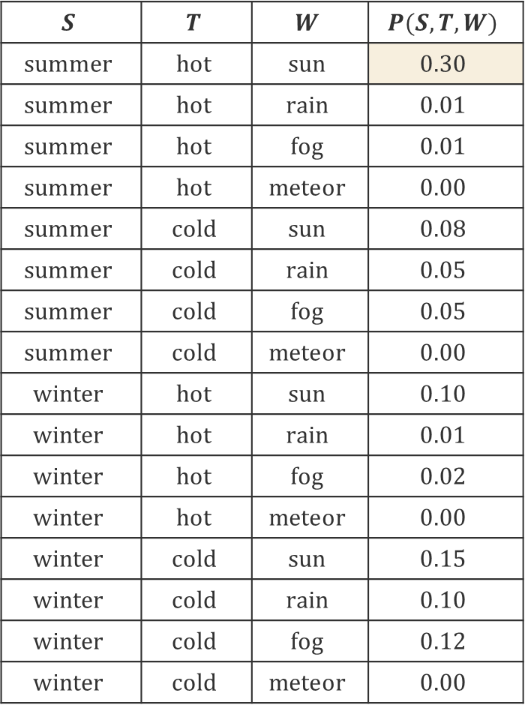
Inferring the Weather 3
$$S$$ | $$T$$ | $$W$$ | $$P(S,T,W)$$
$$summer$$ | $$hot$$ | $$sun$$ | $$0.30$$
$$summer$$ | $$hot$$ | $$rain$$ | $$0.01$$
$$summer$$ | $$hot$$ | $$fog$$ | $$0.01$$
$$summer$$ | $$hot$$ | $$meteor$$ | $$0.00$$
$$summer$$ | $$cold$$ | $$sun$$ | $$0.08$$
$$summer$$ | $$cold$$ | $$rain$$ | $$0.05$$
$$summer$$ | $$cold$$ | $$fog$$ | $$0.05$$
$$summer$$ | $$cold$$ | $$meteor$$ | $$0.00$$
$$winter$$ | $$hot$$ | $$sun$$ | $$0.10$$
$$winter$$ | $$hot$$ | $$rain$$ | $$0.01$$
$$winter$$ | $$hot$$ | $$fog$$ | $$0.02$$
$$winter$$ | $$hot$$ | $$meteor$$ | $$0.00$$
$$winter$$ | $$cold$$ | $$sun$$ | $$0.15$$
$$winter$$ | $$cold$$ | $$rain$$ | $$0.10$$
$$winter$$ | $$cold$$ | $$fog$$ | $$0.12$$
$$winter$$ | $$cold$$ | $$meteor$$ | $$0.00$$
$P(W|summer,hot)$?
  $P\left(S=summer,T=hot, W\right)$
  $α=\frac{1}{\sum_{w∈W}{P(S=summer,T=hot,W=w)}}$
  $P\left(W | summer,hot\right)=α∙P(S=summer,T=hot,W)$
  $P(W=sun|summer,hot) = \frac{.30}{.30+.01+.01}=\frac{.30}{.32}=0.94$
$$W=w$$ | $$P(w)$$
$$sun$$ | $$0.94$$
$$rain$$ | $$0.03$$
$$fog$$ | $$0.03$$
$$meteor$$ | $$0.0$$

Slide 7
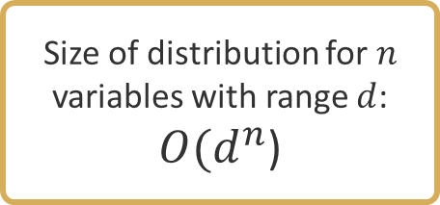
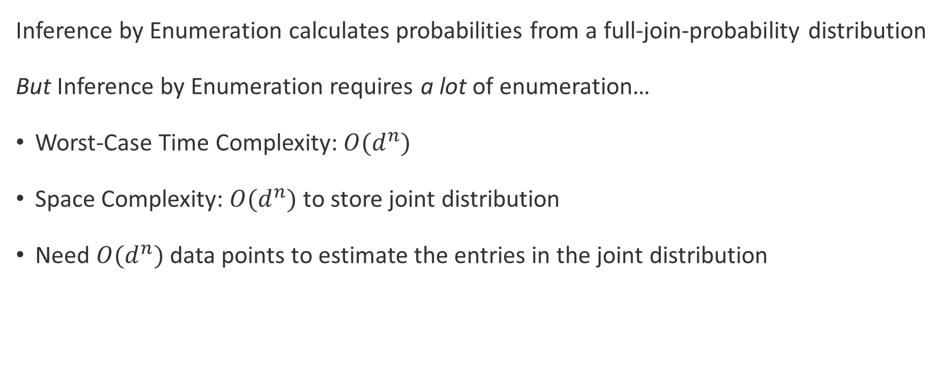
Problems with Inference by Enumeration
Inference by Enumeration calculates probabilities from a full-join-probability distribution
But Inference by Enumeration requires a lot of enumeration…
Worst-Case Time Complexity: $O(d^{n})$
Space Complexity: $O(d^{n})$ to store joint distribution
Need $O(d^{n})$ data points to estimate the entries in the joint distribution
Size of distribution for $n$ variables with range $d$: $O(d^{n}$)

Slide 8
Questions (3)

Slide 9
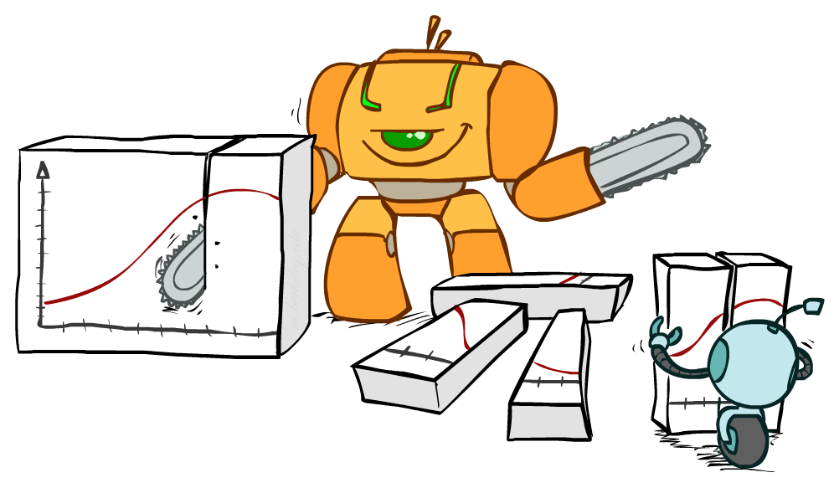
A Better Approach?

Slide 10
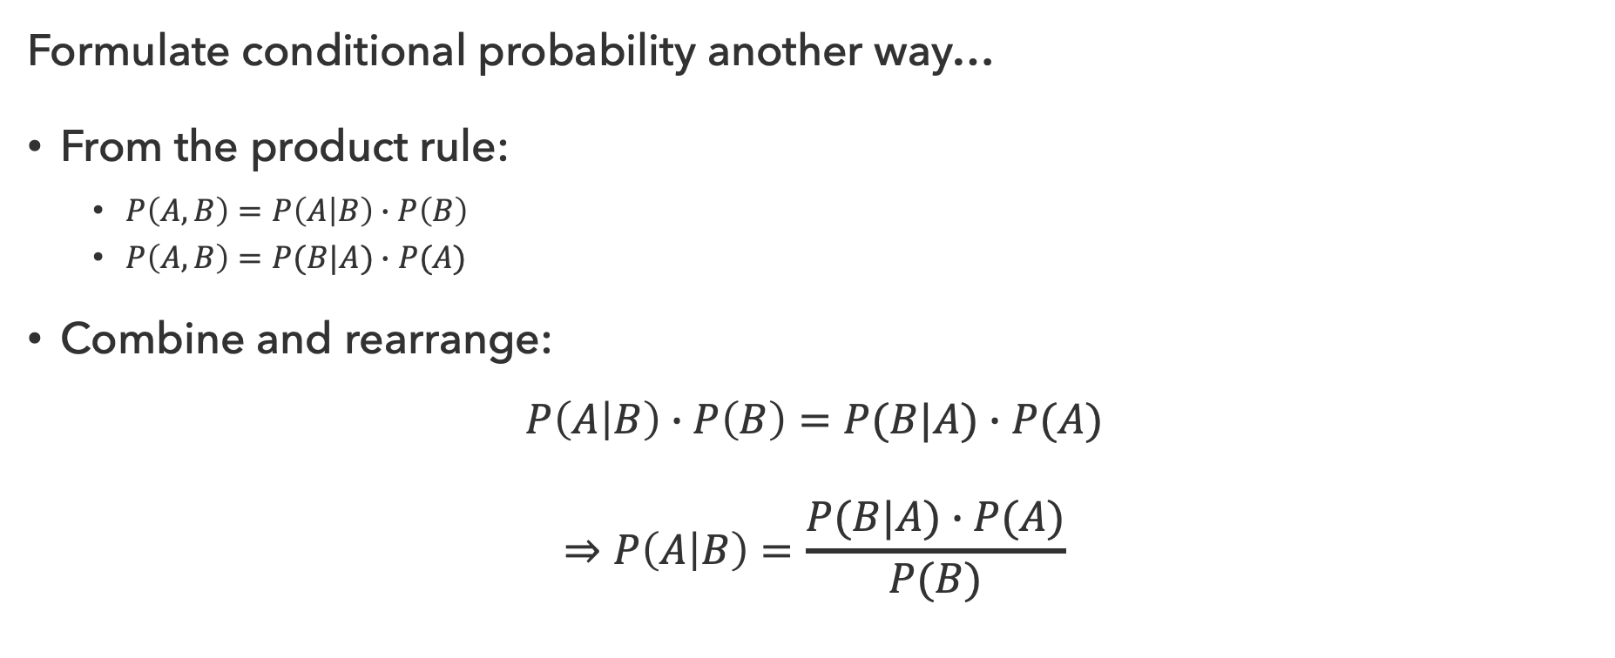
Bayes’ Rule
Formulate conditional probability another way…
From the product rule:
  $P\left(A,B\right)=P\left(A | B\right)∙P\left(B\right)$
  $P\left(A,B\right)=P(B|A)∙P(A)$
Combine and rearrange:
$$P\left(A | B\right)∙P\left(B\right)=P(B|A)∙P(A)$$
$$⇒P\left(A | B\right)=\frac{P(B|A)∙P(A)}{P(B)}$$

Slide 11
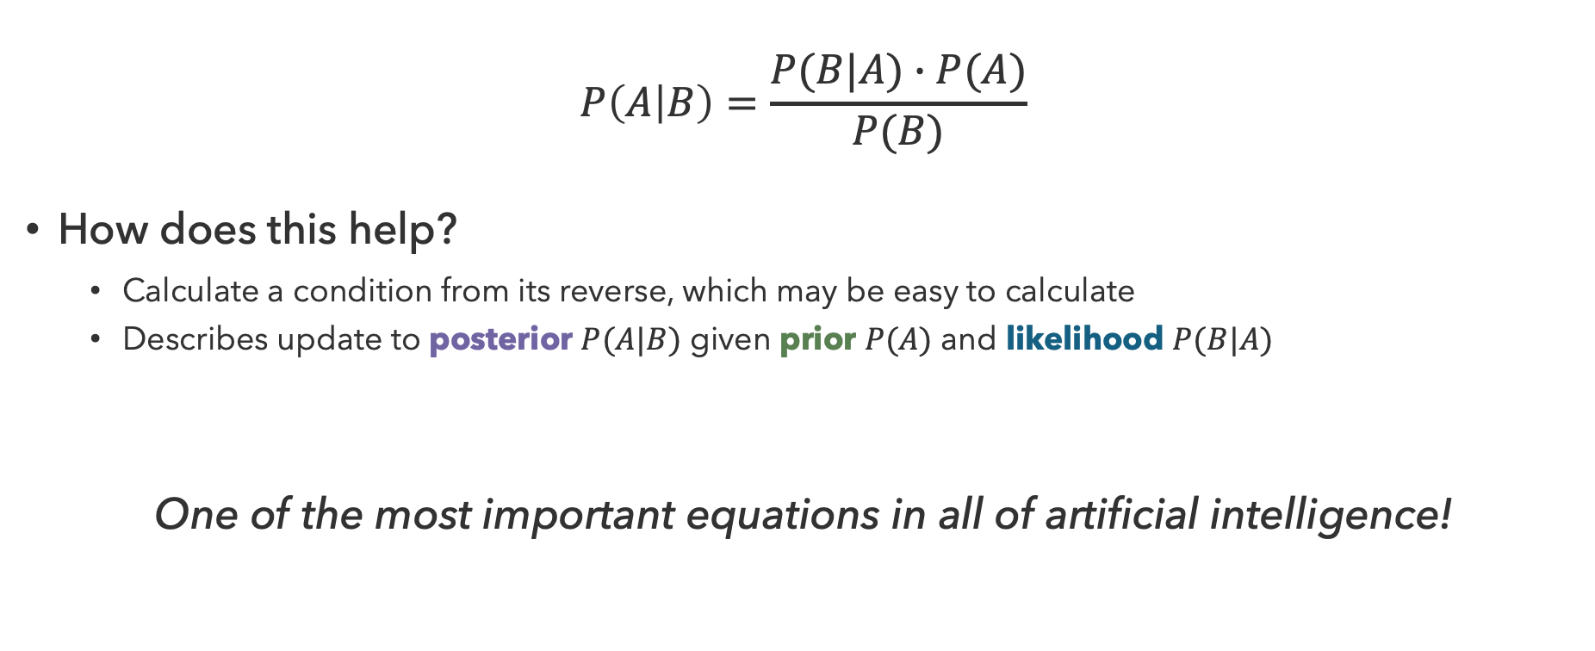
Implications of Bayes’ Rule
$$P\left(A | B\right)=\frac{P(B|A)∙P(A)}{P(B)}$$
How does this help?
  Calculate a condition from its reverse, which may be easy to calculate
  Describes update to posterior $P(A|B)$ given prior $P(A)$ and likelihood $P(B|A)$
One of the most important equations in all of artificial intelligence!

Slide 12
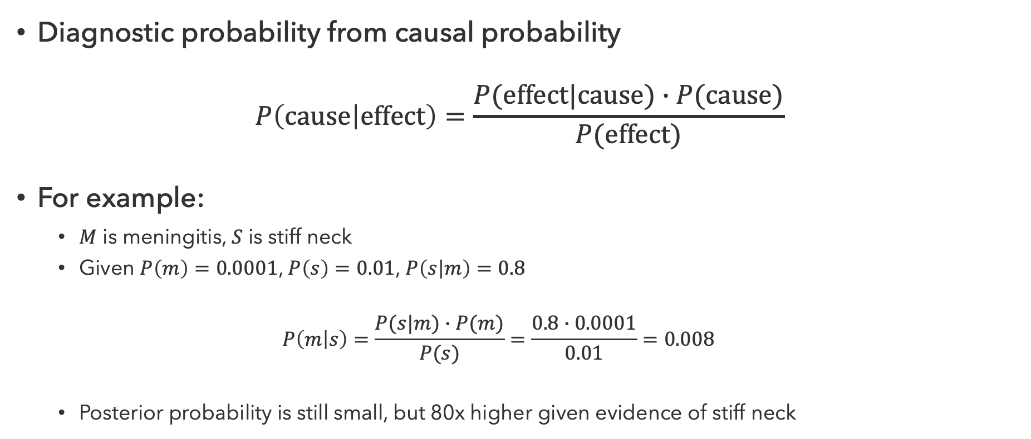
Inference with Bayes’ Rule
Diagnostic probability from causal probability
$$P\left(cause | effect\right)=\frac{P(effect|cause)∙P(cause)}{P(effect)}$$
For example:
  $M$ is meningitis, $S$ is stiff neck
  Given $P\left(m\right)=0.0001$, $P\left(s\right)=0.01$, $P\left(s | m\right)=0.8$
  $$P\left(m | s\right)=\frac{P(s|m)∙P(m)}{P(s)}=\frac{0.8∙0.0001}{0.01}=0.008$$
  Posterior probability is still small, but 80x higher given evidence of stiff neck

Slide 13
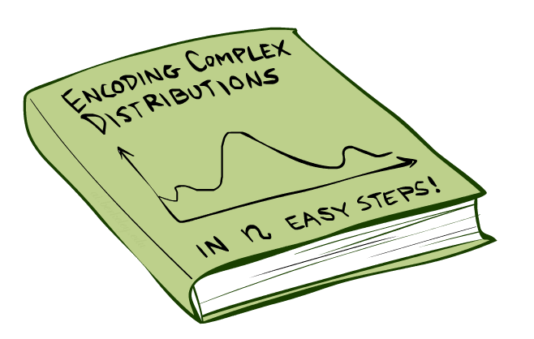
How to manage complex probability distributions?

Slide 14

Bayesian Networks
Bayes Nets provide a technique describing complex joint distributions using simple conditional distributions
  Subset of a general class of graphical models
  Also called “belief networks”
Use local causality / conditional independence
  The world is composed of many variables
  Each interacting locally with a few others
Expressivity vs. Efficiency
  While conditional probabilities are less expressive
  (comprehensive) than joint probabilities, they are faster
  and more space-efficient to work with

Slide 15
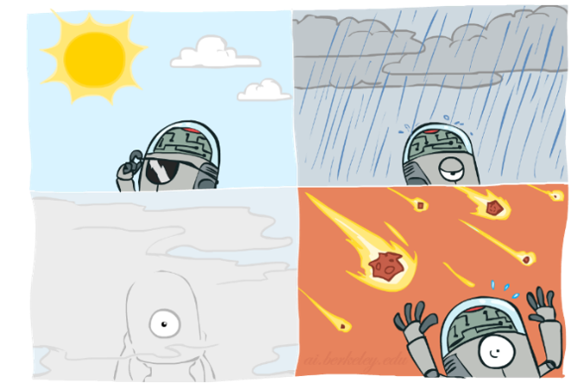


Graphical Models
Nodes: Variables
  Assigned (observed)
  Unassigned (unobserved)
Arcs: Interactions
  Indicate “direct influence” between variables
  Formally: encode conditional (in)dependence
$$T$$
$$W$$

Slide 16

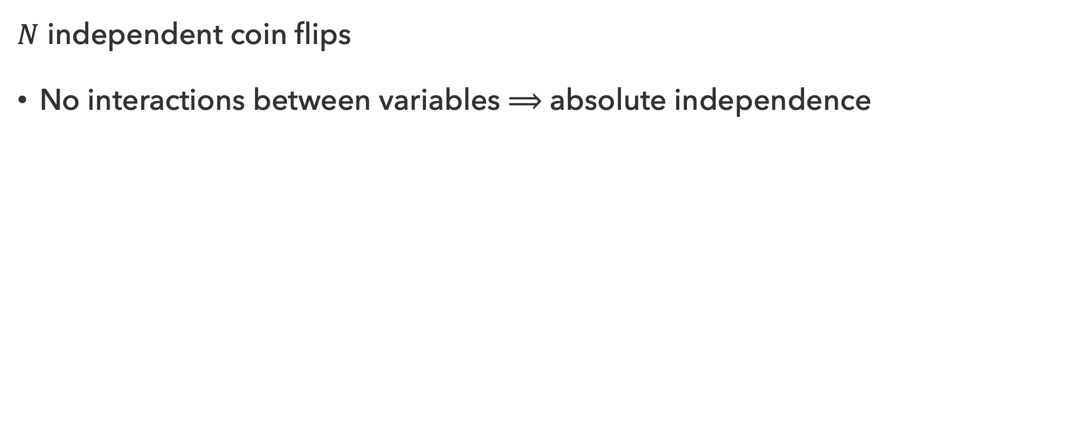



Coin Flips
$N$ independent coin flips
No interactions between variables $⟹$ absolute independence
$$X_{1}$$
$$X_{2}$$
…
$$X_{n}$$

Slide 17
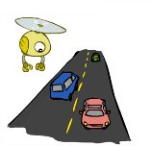
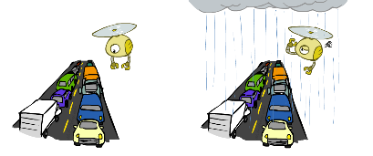
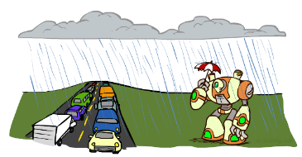

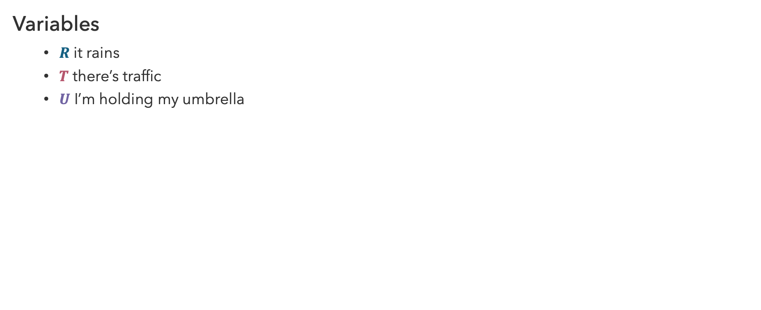


Traffic
Variables
  $R$ it rains
  $T$ there’s traffic
  $U$ I’m holding my umbrella
$$R$$
$$T$$
$$U$$

Slide 18
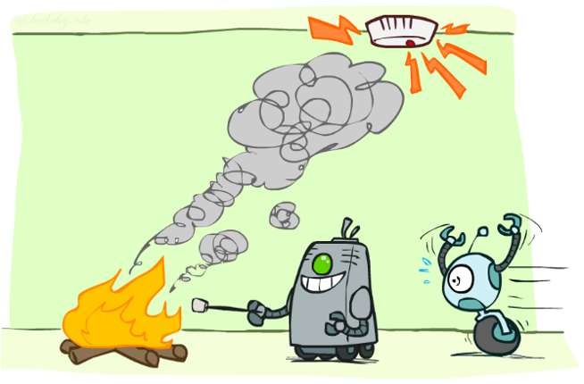
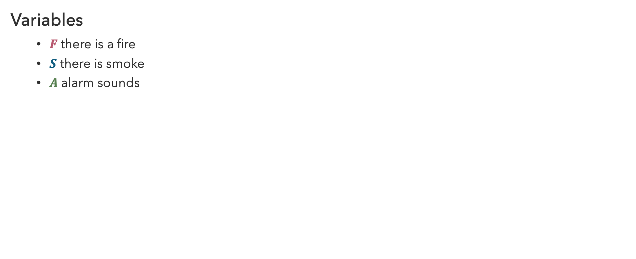



Smoke Alarm
$$F$$
Variables
  $F$ there is a fire
  $S$ there is smoke
  $A$ alarm sounds
$$S$$
$$A$$

Slide 19
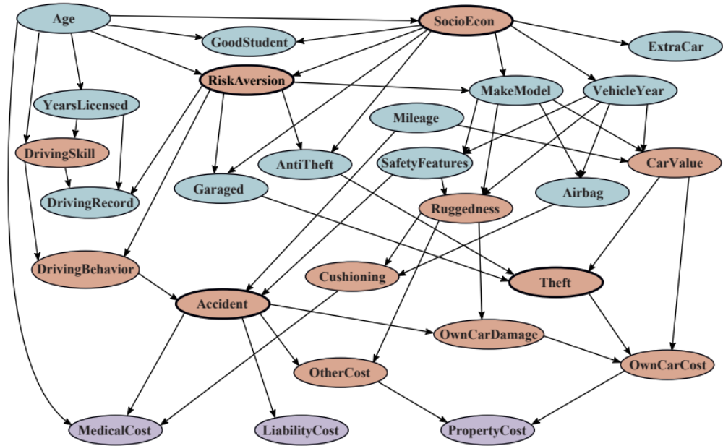
Car Insurance

Slide 20

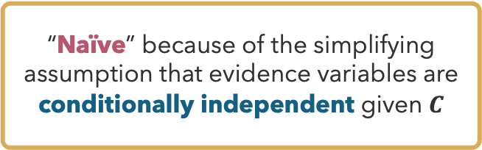
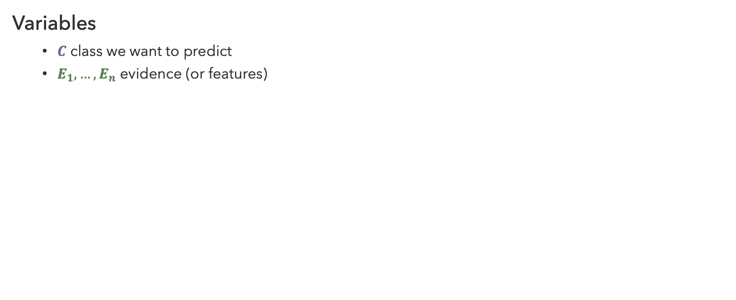



Naïve Bayes
“Naïve” because of the simplifying assumption that evidence variables are conditionally independent given $C$
Variables
  $C$ class we want to predict
  $E_{1},…,E_{n}$ evidence (or features)
$$C$$
$$E_{1}$$
$$E_{2}$$
…
$$E_{n}$$

Slide 21
Questions (1)

Slide 22
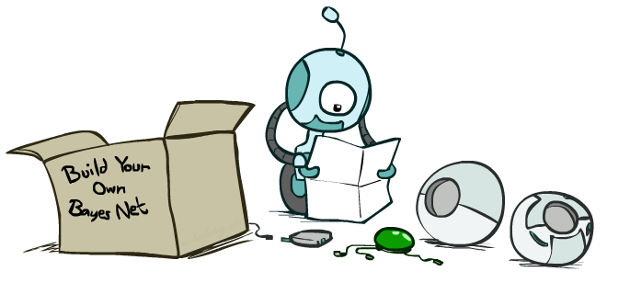
Syntax and Semantics

Slide 23
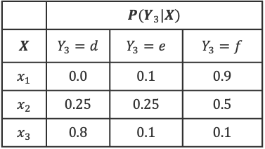

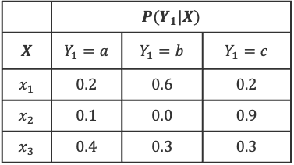
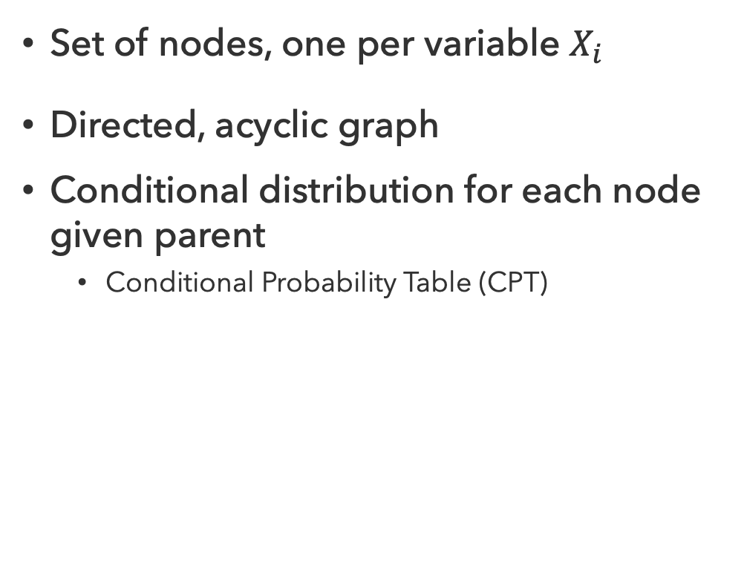


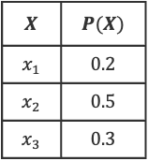

Bayes Net Syntax
$$X$$ | $$P(X)$$
$$x_{1}$$ | $$0.2$$
$$x_{2}$$ | $$0.5$$
$$x_{3}$$ | $$0.3$$
$$X$$
Set of nodes, one per variable $X_{i}$
Directed, acyclic graph
Conditional distribution for each node given parent
  Conditional Probability Table (CPT)
$$Y_{1}$$
$$Y_{2}$$
$$Y_{3}$$
 | $$P(Y_{1}|X)$$
$$X$$ | $$Y_{1}=a$$ | $$Y_{1}=b$$ | $$Y_{1}=c$$
$$x_{1}$$ | $$0.2$$ | $$0.6$$ | $$0.2$$
$$x_{2}$$ | $$0.1$$ | $$0.0$$ | $$0.9$$
$$x_{3}$$ | $$0.4$$ | $$0.3$$ | $$0.3$$
 | $$P(Y_{3}|X)$$
$$X$$ | $$Y_{3}=d$$ | $$Y_{3}=e$$ | $$Y_{3}=f$$
$$x_{1}$$ | $$0.0$$ | $$0.1$$ | $$0.9$$
$$x_{2}$$ | $$0.25$$ | $$0.25$$ | $$0.5$$
$$x_{3}$$ | $$0.8$$ | $$0.1$$ | $$0.1$$
Bayes Net = Graph + Local Probability Tables

Slide 24
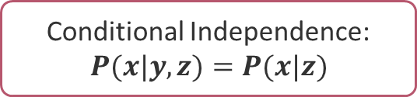
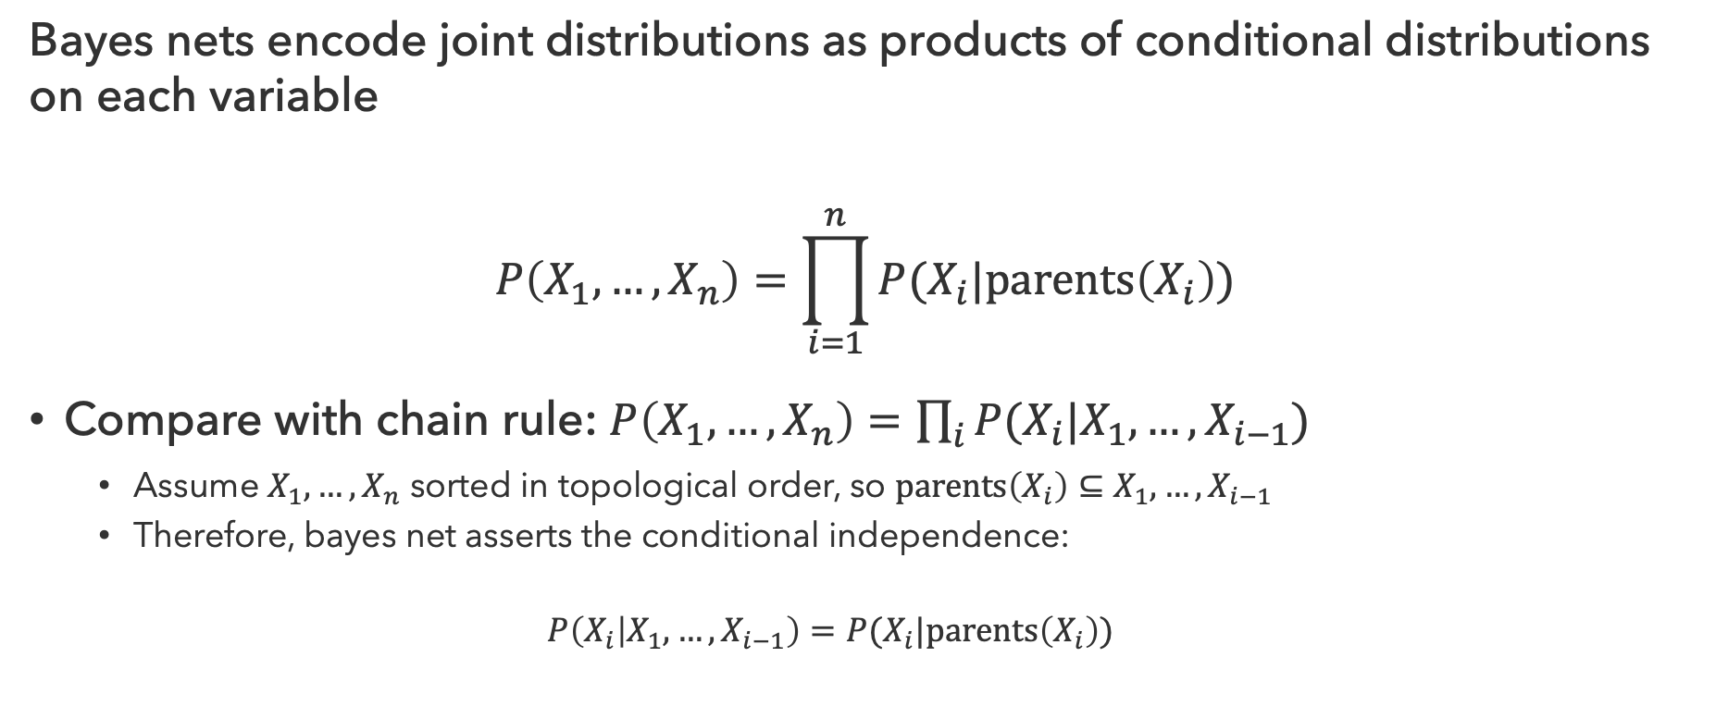
Bayes Net Semantics
Bayes nets encode joint distributions as products of conditional distributions on each variable
$$P\left(X_{1},…,X_{n}\right)=\prod_{i=1}^{n}{P(X_{i}|parents\left(X_{i}\right))}$$
Compare with chain rule: $P\left(X_{1},…,X_{n}\right)=\prod_{i}{P(X_{i}|X_{1},…,X_{i−1})}$
  Assume $X_{1},…,X_{n}$ sorted in topological order, so $parents\left(X_{i}\right)⊆X_{1},…,X_{i−1}$
  Therefore, bayes net asserts the conditional independence:
  $$P\left(X_{i} | X_{1},…,X_{i−1}\right)=P(X_{i}|parents\left(X_{i}\right))$$
Conditional Independence: $P(x|y,z)=P(x|z)$

Slide 25
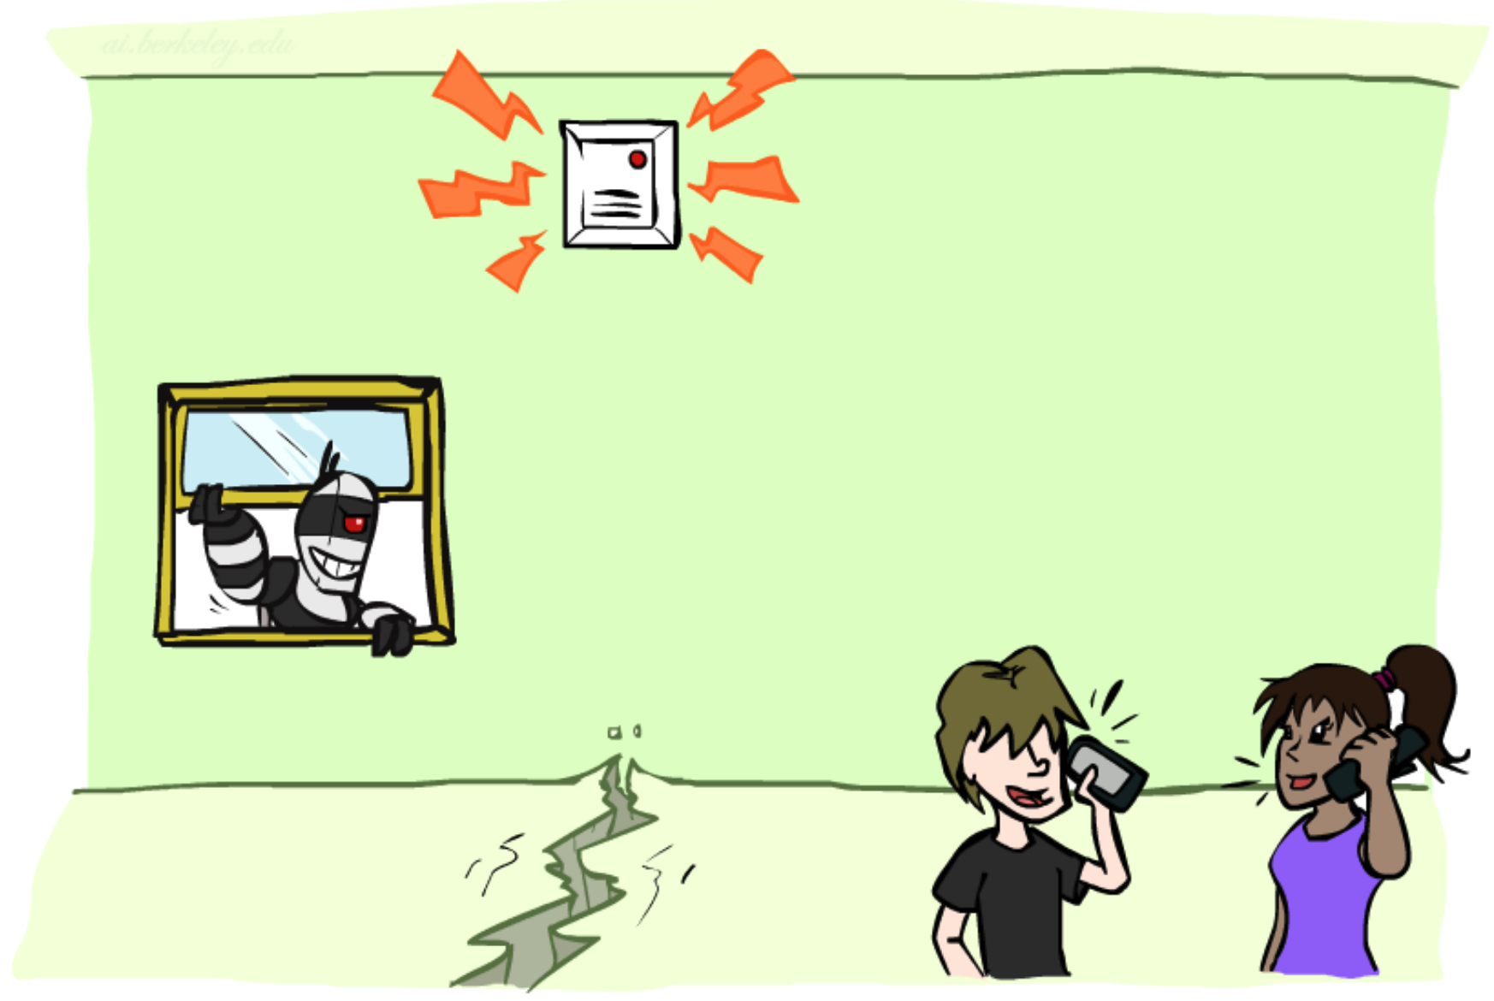
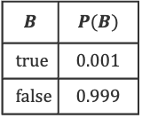


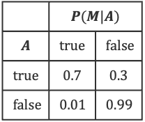
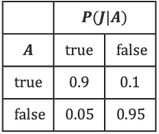


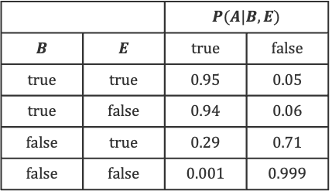

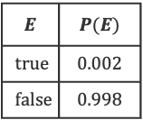
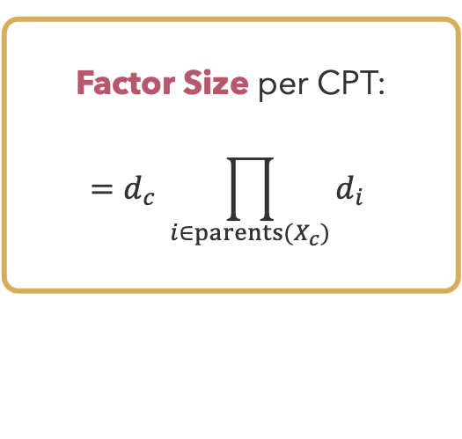
Alarm Bayes Net
$$B$$ | $$P(B)$$
$$true$$ | $$0.001$$
$$false$$ | $$0.999$$
$$E$$ | $$P(E)$$
$$true$$ | $$0.002$$
$$false$$ | $$0.998$$
$$B$$
$$E$$
Burglary
Earthquake
 |  | $$P(A|B,E)$$
$$B$$ | $$E$$ | $$true$$ | $$false$$
$$true$$ | $$true$$ | $$0.95$$ | $$0.05$$
$$true$$ | $$false$$ | $$0.94$$ | $$0.06$$
$$false$$ | $$true$$ | $$0.29$$ | $$0.71$$
$$false$$ | $$false$$ | $$0.001$$ | $$0.999$$
$$A$$
Factor Size per CPT:
$$=d_{c} \prod_{i∈parents(X_{c})}{d_{i}}$$
Alarm
 | $$P(J|A)$$
$$A$$ | $$true$$ | $$false$$
$$true$$ | $$0.9$$ | $$0.1$$
$$false$$ | $$0.05$$ | $$0.95$$
 | $$P(M|A)$$
$$A$$ | $$true$$ | $$false$$
$$true$$ | $$0.7$$ | $$0.3$$
$$false$$ | $$0.01$$ | $$0.99$$
$$J$$
$$M$$
Jan Calls
Maria Calls

Slide 26
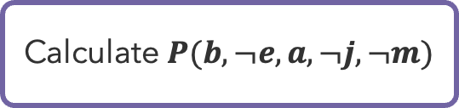
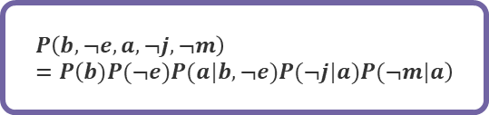
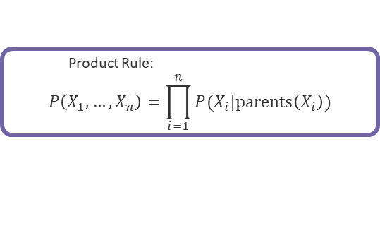
Alarm Bayes Net Practice
$$B$$ | $$P(B)$$
$$true$$ | $$0.001$$
$$false$$ | $$0.999$$
$$E$$ | $$P(E)$$
$$true$$ | $$0.002$$
$$false$$ | $$0.998$$
$$B$$
$$E$$
Burglary
Earthquake
 |  | $$P(A|B,E)$$
$$B$$ | $$E$$ | $$true$$ | $$false$$
$$true$$ | $$true$$ | $$0.95$$ | $$0.05$$
$$true$$ | $$false$$ | $$0.94$$ | $$0.06$$
$$false$$ | $$true$$ | $$0.29$$ | $$0.71$$
$$false$$ | $$false$$ | $$0.001$$ | $$0.999$$
$$A$$
Calculate $P(b, ¬e, a,¬j, ¬m)$
Alarm
  Product Rule:
$$P\left(X_{1},…,X_{n}\right)=\prod_{i=1}^{n}{P(X_{i}|parents\left(X_{i}\right))}$$
 | $$P(J|A)$$
$$A$$ | $$true$$ | $$false$$
$$true$$ | $$0.9$$ | $$0.1$$
$$false$$ | $$0.05$$ | $$0.95$$
 | $$P(M|A)$$
$$A$$ | $$true$$ | $$false$$
$$true$$ | $$0.7$$ | $$0.3$$
$$false$$ | $$0.01$$ | $$0.99$$
$$J$$
$$M$$
$$P\left(b, ¬e, a,¬j, ¬m\right)=P\left(b)P(¬e)P(a|b,¬e)P(¬j|a)P(¬m|a\right)$$
Jan Calls
Maria Calls

Slide 27
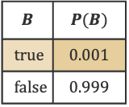
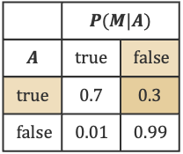




Alarm Bayes Net Practice (1)
$$B$$ | $$P(B)$$
$$true$$ | $$0.001$$
$$false$$ | $$0.999$$
$$E$$ | $$P(E)$$
$$true$$ | $$0.002$$
$$false$$ | $$0.998$$
$$B$$
$$E$$
Burglary
Earthquake
 |  | $$P(A|B,E)$$
$$B$$ | $$E$$ | $$true$$ | $$false$$
$$true$$ | $$true$$ | $$0.95$$ | $$0.05$$
$$true$$ | $$false$$ | $$0.94$$ | $$0.06$$
$$false$$ | $$true$$ | $$0.29$$ | $$0.71$$
$$false$$ | $$false$$ | $$0.001$$ | $$0.999$$
$$A$$
Calculate $P(b, ¬e, a,¬j, ¬m)$
Alarm
$$P\left(b, ¬e, a,¬j, ¬m\right)=P\left(b)P(¬e)P(a|b,¬e)P(¬j|a)P(¬m|a\right)$$
 | $$P(J|A)$$
$$A$$ | $$true$$ | $$false$$
$$true$$ | $$0.9$$ | $$0.1$$
$$false$$ | $$0.05$$ | $$0.95$$
 | $$P(M|A)$$
$$A$$ | $$true$$ | $$false$$
$$true$$ | $$0.7$$ | $$0.3$$
$$false$$ | $$0.01$$ | $$0.99$$
$$J$$
$$M$$
Jan Calls
Maria Calls

Slide 28



Alarm Bayes Net Practice (2)
$$B$$ | $$P(B)$$
$$true$$ | $$0.001$$
$$false$$ | $$0.999$$
$$E$$ | $$P(E)$$
$$true$$ | $$0.002$$
$$false$$ | $$0.998$$
$$B$$
$$E$$
Burglary
Earthquake
 |  | $$P(A|B,E)$$
$$B$$ | $$E$$ | $$true$$ | $$false$$
$$true$$ | $$true$$ | $$0.95$$ | $$0.05$$
$$true$$ | $$false$$ | $$0.94$$ | $$0.06$$
$$false$$ | $$true$$ | $$0.29$$ | $$0.71$$
$$false$$ | $$false$$ | $$0.001$$ | $$0.999$$
$$A$$
Calculate $P(b, ¬e, a,¬j, ¬m)$
Alarm
 | $$P(M|A)$$
$$A$$ | $$true$$ | $$false$$
$$true$$ | $$0.7$$ | $$0.3$$
$$false$$ | $$0.01$$ | $$0.99$$
$$=P(b)∙P(¬e)⋯$$
 | $$P(J|A)$$
$$A$$ | $$true$$ | $$false$$
$$true$$ | $$0.9$$ | $$0.1$$
$$false$$ | $$0.05$$ | $$0.95$$
$$J$$
$$M$$
$$∙P(a|b,¬e)⋯$$
$$∙P(¬j|a)∙P(¬m|a)⋯$$
Jan Calls
Maria Calls
$$=0.001∙0.998∙0.94∙0.1∙0.3=0.000028$$

Slide 29







Alarm Bayes Net Practice (3)
$$B$$ | $$P(B)$$
$$true$$ | $$0.001$$
$$false$$ | $$0.999$$
$$E$$ | $$P(E)$$
$$true$$ | $$0.002$$
$$false$$ | $$0.998$$
$$B$$
$$E$$
Burglary
Earthquake
 |  | $$P(A|B,E)$$
$$B$$ | $$E$$ | $$true$$ | $$false$$
$$true$$ | $$true$$ | $$0.95$$ | $$0.05$$
$$true$$ | $$false$$ | $$0.94$$ | $$0.06$$
$$false$$ | $$true$$ | $$0.29$$ | $$0.71$$
$$false$$ | $$false$$ | $$0.001$$ | $$0.999$$
$$A$$
What about $P(B, e, a,j, m)$?
Alarm
 | $$P(J|A)$$
$$A$$ | $$true$$ | $$false$$
$$true$$ | $$0.9$$ | $$0.1$$
$$false$$ | $$0.05$$ | $$0.95$$
 | $$P(M|A)$$
$$A$$ | $$true$$ | $$false$$
$$true$$ | $$0.7$$ | $$0.3$$
$$false$$ | $$0.01$$ | $$0.99$$
$$B$$ | $$P(B)$$
$$true$$ | $$=.001∙.002∙0.95∙0.9∙0.7=0.000001$$
$$false$$ | $$=.999∙.002∙0.29∙0.9∙0.7=0.00036$$
$$J$$
$$M$$
Jan Calls
Maria Calls

Slide 30
Questions (2)

Slide 31


Sparse Bayes Nets
Suppose
  $n$ variables
  Maximum range size is $d$
  Maximum number of parents is $k$
Full Joint Distribution: $O(d^{n})$
Bayes Net: $O(n∙d^{k}$)
  Linear scaling with $n$ as long as causal structure is local
Often $O\left(n∙d^{k}\right)≪O(d^{n})$

Slide 32

Conditional Independence
Every variable is conditionally independent of its non-descendants, given its parents
$$F$$
$$S$$
$$A$$
Notes:
To picture this, if we have a fire, we expect to have a greater chance of the alarm going on. But if we have smoke, that causes the alarm to go off – the presence of smoke gives all the information about the likelihood of an alarm, and we no longer care about the fire. A ind. Of F given S.

Slide 33

Markov Blanket
Compare with Markov Assumption
  “The future is independent of the past, given the present”
Similar Formulation
  Markov blanket consists of a node’s parents, children, and children’s other parents
  Every variable is conditionally independent of all other variables, given its Markov blanket

Slide 34
Questions (4)

Slide 35




$X$ independent of $Z$?
$$X$$
$$Y$$
$$Z$$
$X⊥Z | Y$
(not absolute independence)

Slide 36

absolute independence?

Slide 37















Node Triples
How can three nodes be arranged?
$$Y$$
$$X$$
$$Y$$
$$X$$
$$Z$$
$$Z$$
$$X$$
$$Y$$
$$Z$$
Causal Chain
Common Cause
Common Effect
$$P(X,Y,Z)=P(X)∙P(Y|X)∙P(Z|Y)$$
$$P(X,Y,Z)=P(Y)∙P(X|Y)∙P(Z|Y)$$
$$P(X,Y,Z)=P(X)∙P(Y)∙P(Z|X,Y)$$

Slide 38

D-Separation
Active Triples
Inactive Triples
D-separation is an algorithm for checking (conditional) independence of two nodes
Query: $X_{i}⊥X_{j} | \{X_{k_{1}},…,X_{k_{n}}\}$ ?
Test:
  Check all undirected paths between $X_{i}$ and $X_{j}$:
    If any paths are active: $X_{i}⊥X_{j} | \{X_{k_{1}},…,X_{k_{n}}\}$
    If all paths are inactive: $X_{i}⊥X_{j} | \{X_{k_{1}},…,X_{k_{n}}\}$
Why?:
  Read dependence information off a knowledge graph
  Determine which variables must be observed to determine a value
Observed
variable

Slide 39
Questions (5)

Slide 40
that’s it for today!
Implications of independence and conditional independence
Bayes nets encode joint distributions by tracking conditional probabilities
How to compute conditional probabilities of queries given evidence?
Homework 3 posted
Project 2 due tonight

