Slide 1

Reinforcement Learning II
CSE 473: Introduction to Artificial Intelligence
Megan Hazen(mh75@cs)
cs.uw.edu/473
acknowledgements
Welcome!
What was your favorite thing to learn?

Slide 2
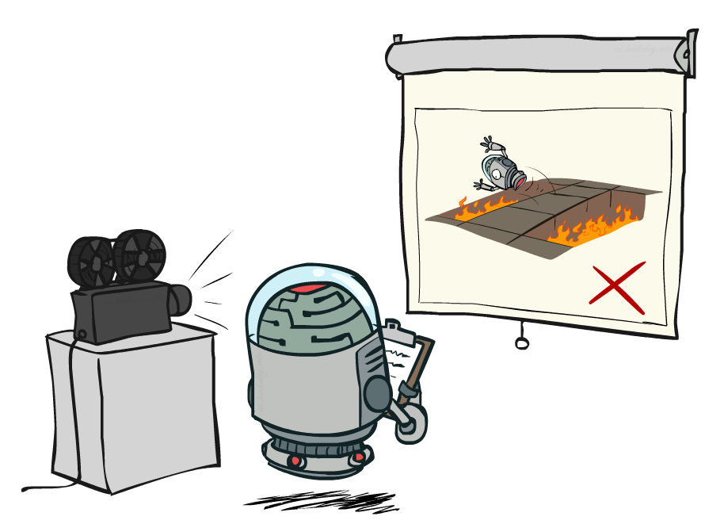
Administrivia
HW 1 regrades in process
Test 1 grades will be released this week
Homework 2 due next week (10.30)
Project 2 due 11.2

Slide 3

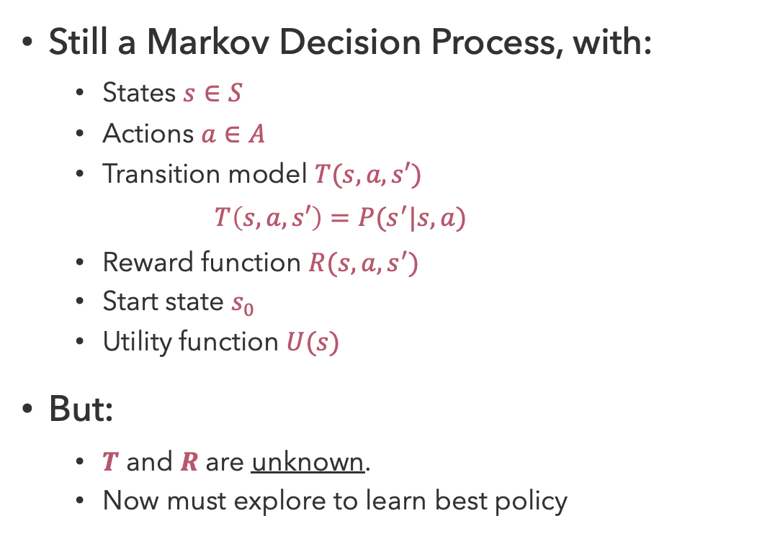
Recap: Reinforcement Learning
Still a Markov Decision Process, with:
  States $s∈S$
  Actions $a∈A$
  Transition model $T(s,a,s′)$
    $$T\left(s,a,s′\right)=P(s^{′}|s,a)$$
  Reward function $R(s,a,s^{′})$
  Start state $s_{0}$
  Utility function $U(s)$
But:
  $T$ and $R$ are unknown.
  Now must explore to learn best policy
Agent
Sensors
percepts
?
Environment
Actuators
actions

Slide 4

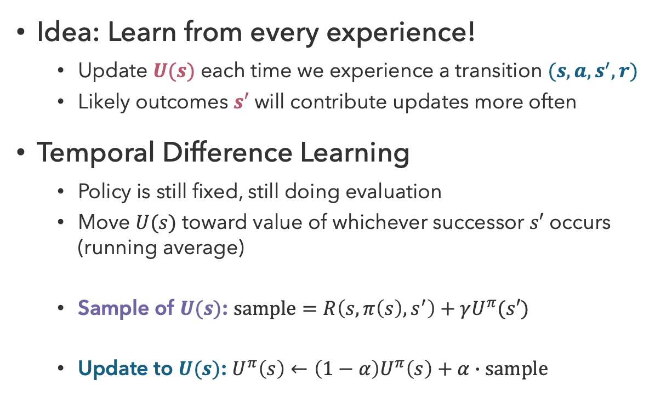


Recap: Temporal Difference Learning
Idea: Learn from every experience!
  Update $U(s)$ each time we experience a transition $(s,a,s^{′},r)$
  Likely outcomes $s′$ will contribute updates more often
Temporal Difference Learning
  Policy is still fixed, still doing evaluation
  Move $U(s)$ toward value of whichever successor $s′$ occurs (running average)
  Sample of $U(s)$: $sample=R\left(s,π\left(s\right),s^{′}\right)+γU^{π}(s′)$
  Update to $U(s)$: $U^{π}\left(s\right)←\left(1−α\right)U^{π}\left(s\right)+α∙sample$
s
$$π(s)$$
s, $π(s)$
s,$π(s)$,s’,r
s’

Slide 5
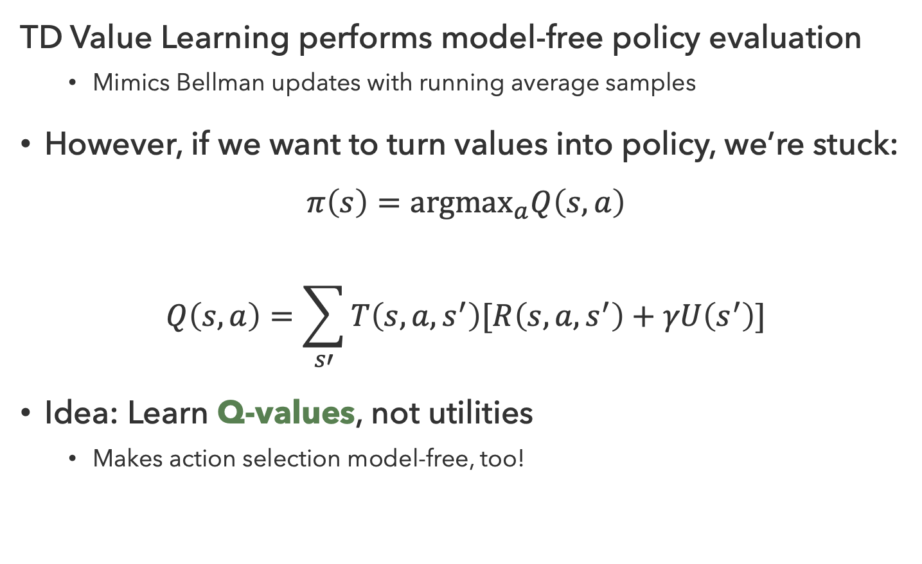
Problems with TD Value Learning
TD Value Learning performs model-free policy evaluation
  Mimics Bellman updates with running average samples
However, if we want to turn values into policy, we’re stuck:
$$π\left(s\right)={argmax}_{a}Q\left(s,a\right)$$
$$Q\left(s,a\right)=\sum_{s′}{T\left(s,a,s^{′}\right)[R\left(s,a,s^{′}\right)+γU\left(s^{′}\right)]}$$
Idea: Learn Q-values, not utilities
  Makes action selection model-free, too!
s
a
s,a
s,a,s’
s’

Slide 6
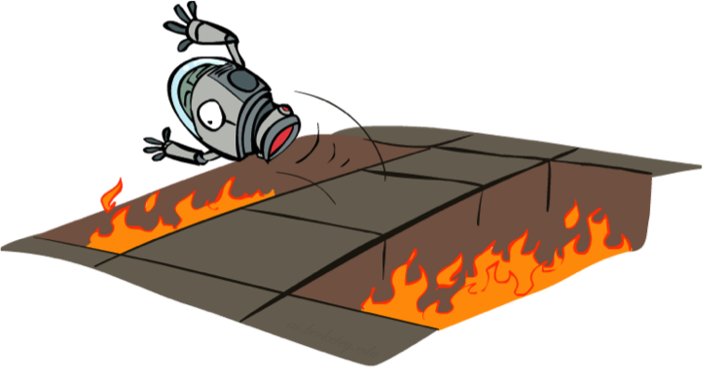
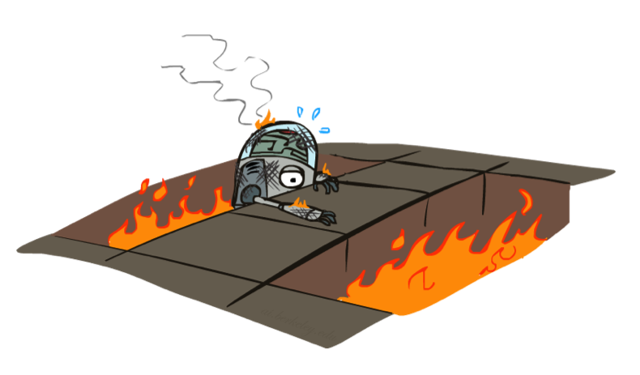
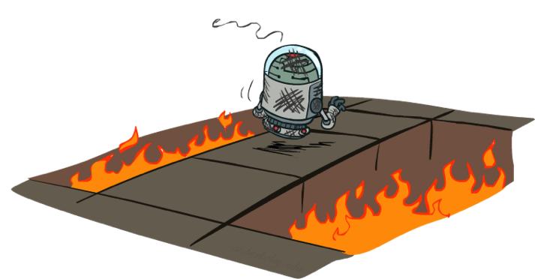
A More Hands-On Approach…

Slide 7
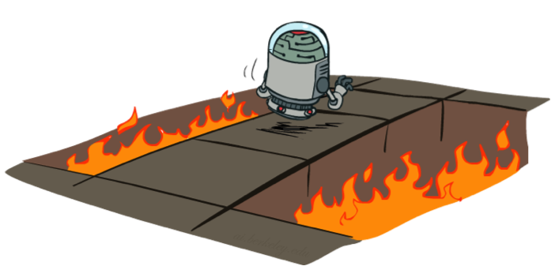
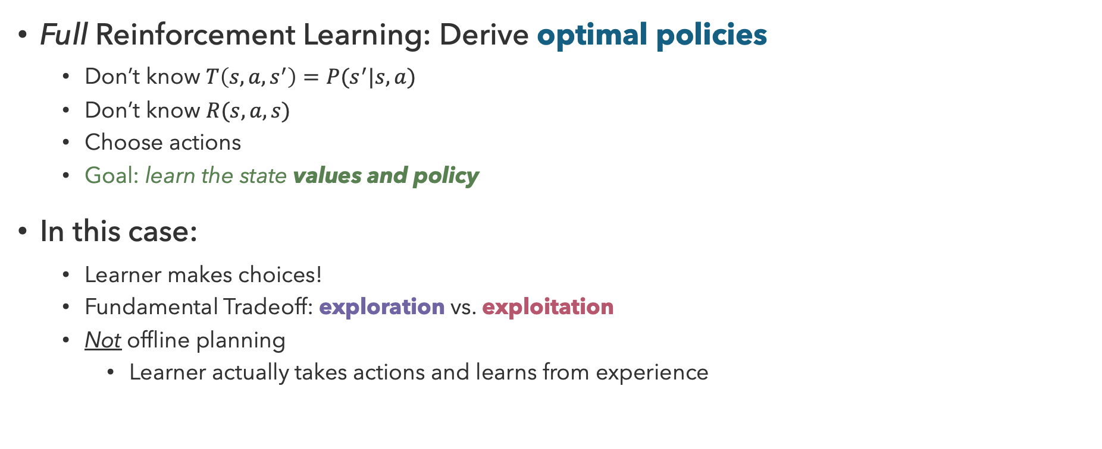
Active Reinforcement Learning
Full Reinforcement Learning: Derive optimal policies
  Don’t know $T\left(s,a,s^{′}\right)=P(s^{′}|s,a)$
  Don’t know $R(s,a,s)$
  Choose actions
  Goal: learn the state values and policy
In this case:
  Learner makes choices!
  Fundamental Tradeoff: exploration vs. exploitation
  Not offline planning
    Learner actually takes actions and learns from experience

Slide 8
Questions (1)

Slide 9
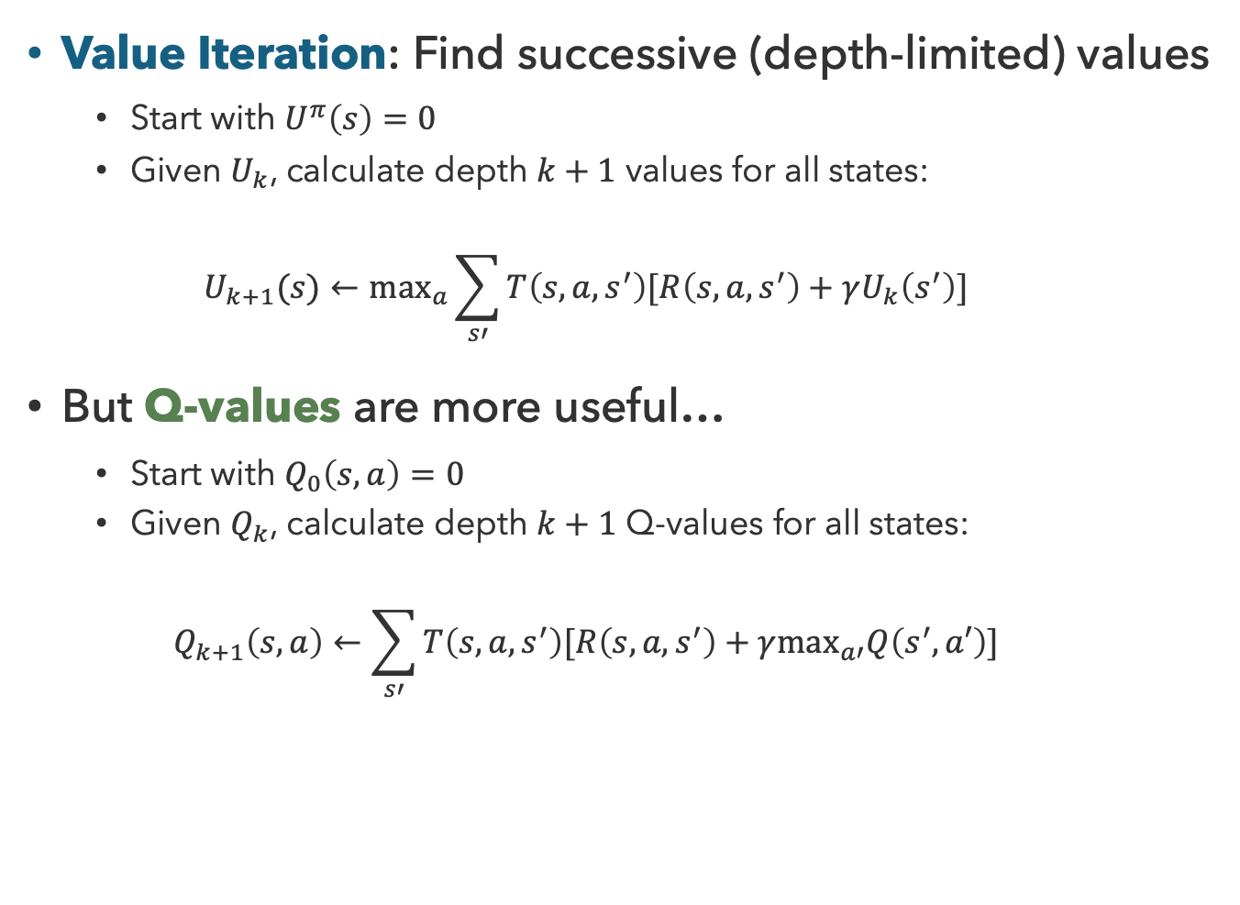
But First: Q-Value Iteration
Value Iteration: Find successive (depth-limited) values
  Start with $U^{π}\left(s\right)=0$
  Given $U_{k}$, calculate depth $k+1$ values for all states:
  $$U_{k+1}(s)←\max_{a}\sum_{s′}{T\left(s,a,s^{′}\right)[R\left(s,a,s^{′}\right)+γU_{k}\left(s^{′}\right)]}$$
But Q-values are more useful…
  Start with $Q_{0}\left(s,a\right)=0$
  Given $Q_{k}$, calculate depth $k+1$ Q-values for all states:
  $$Q_{k+1}\left(s,a\right)←\sum_{s′}{T\left(s,a,s^{′}\right)[R\left(s,a,s^{′}\right)+γ\max_{a′}Q\left(s^{′},a′\right)]}$$
s
a
Q(s,a)
s,a,s’
s’

Slide 10
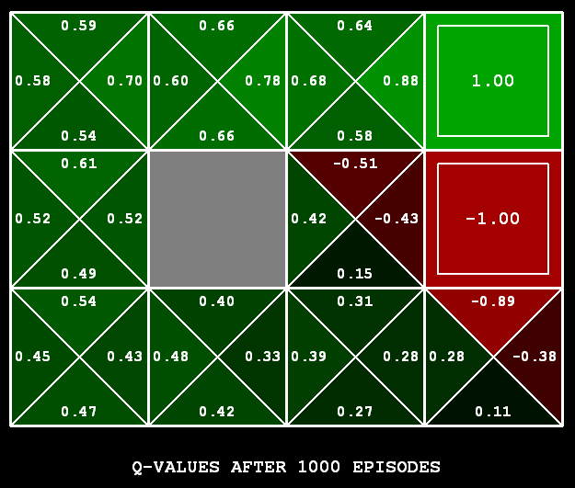
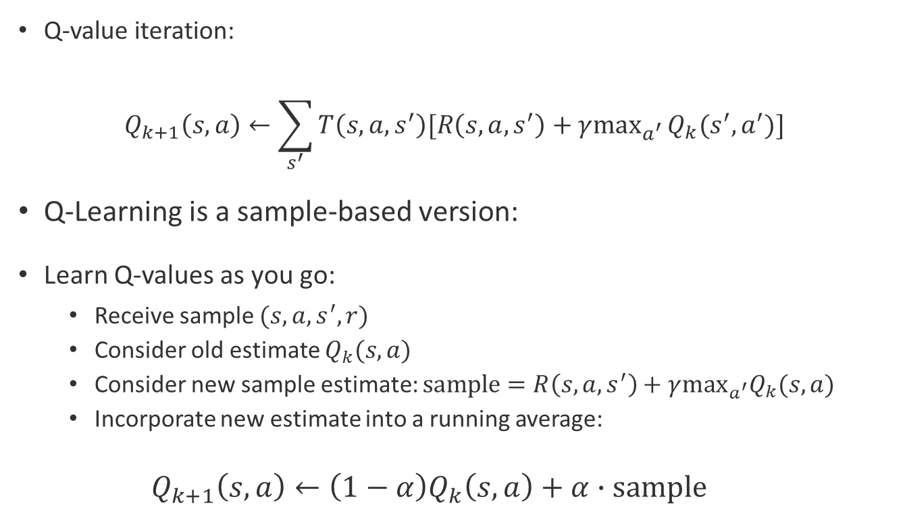
Q-Learning
Q-value iteration:
$$Q_{k+1}\left(s,a\right)←\sum_{s^{′}}{T\left(s,a,s^{′}\right)[R\left(s,a,s^{′}\right)+γ\max_{a^{′}}}Q_{k}(s^{′},a^{′})]$$
Q-Learning is a sample-based version:
Learn Q-values as you go:
  Receive sample $(s,a,s^{′},r)$
  Consider old estimate $Q_{k}(s,a)$
  Consider new sample estimate: $sample=R\left(s,a,s^{′}\right)+γ\max_{a^{′}}Q_{k}(s,a)$
  Incorporate new estimate into a running average:
  $$Q_{k+1}\left(s,a\right)←\left(1−α\right)Q_{k}\left(s,a\right)+α∙sample$$

Slide 11

Properties of Q-Learning
Off-Policy Learning
Q-Learning converges to optimal policy, even if you’re acting sub-optimally!
Caveats:
  Must explore enough
  Must eventually make the learning rate small enough
  In the limit, it doesn’t matter how actions are selected

Slide 12
Questions (2)

Slide 13
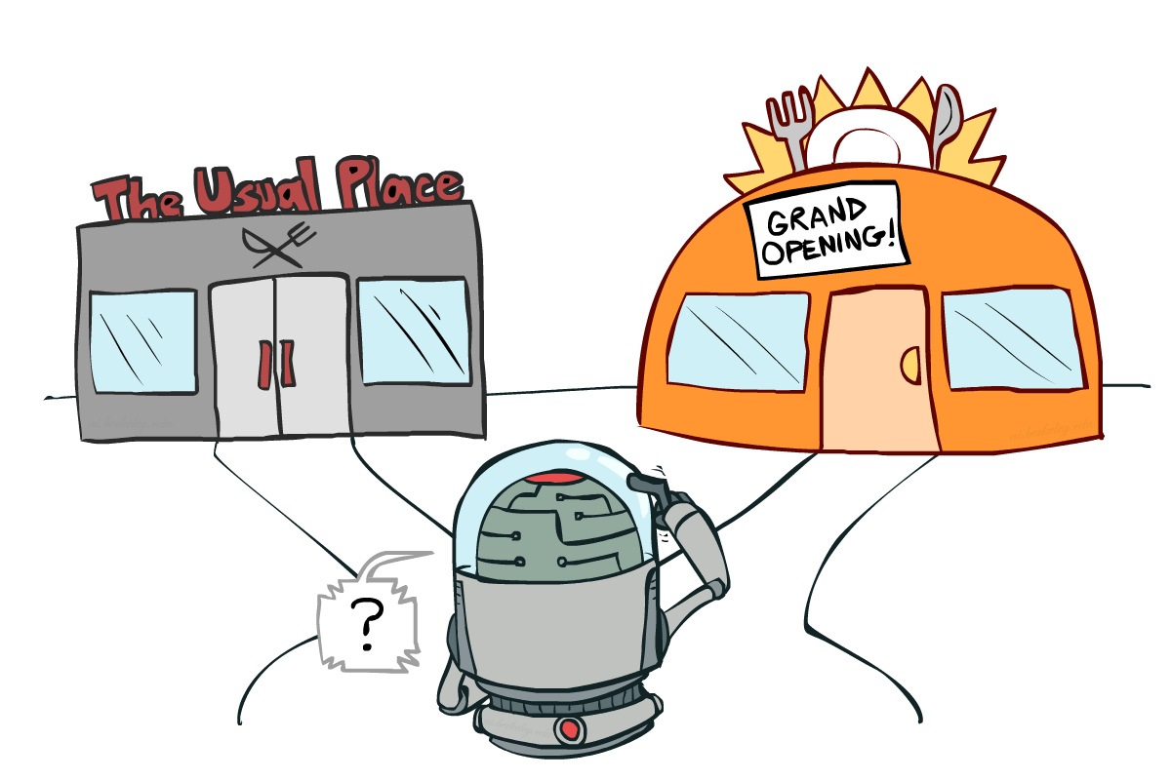
Exploration vs. Exploitation

Slide 14

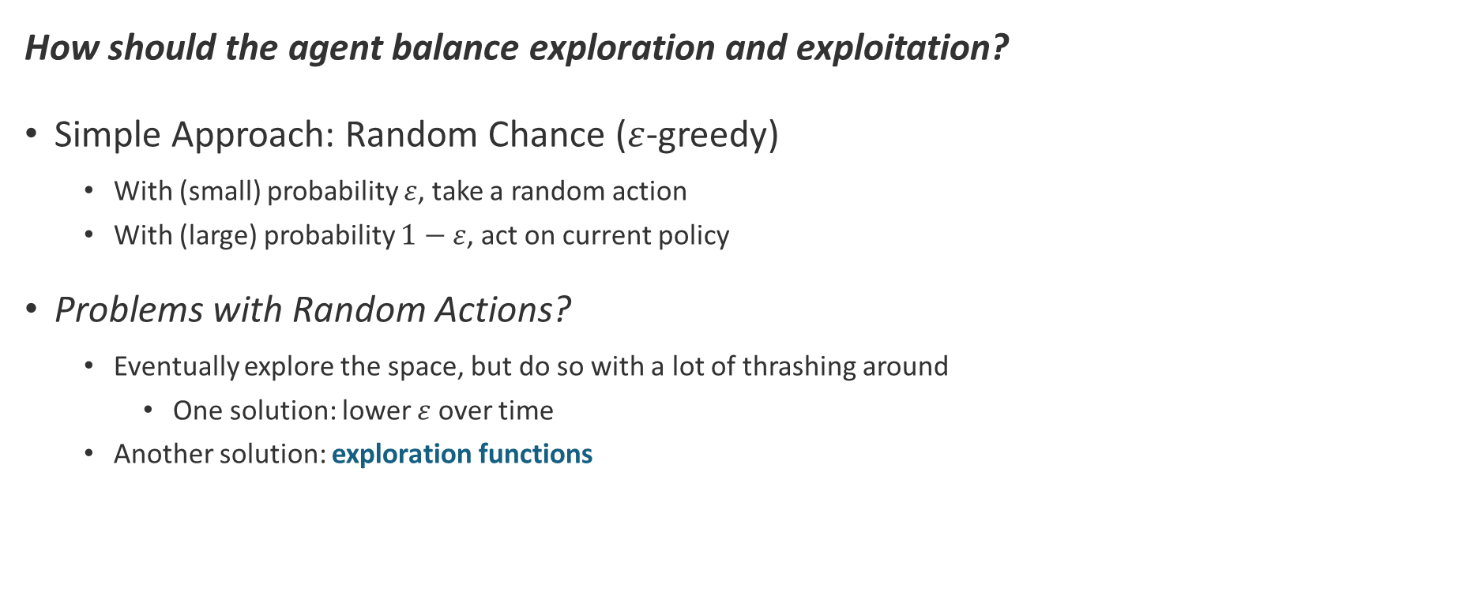
How to Explore?
How should the agent balance exploration and exploitation?
Simple Approach: Random Chance ($ε$-greedy)
  With (small) probability $ε$, take a random action
  With (large) probability $1−ε$, act on current policy
Problems with Random Actions?
  Eventually explore the space, but do so with a lot of thrashing around
    One solution: lower $ε$ over time
  Another solution: exploration functions

Slide 15
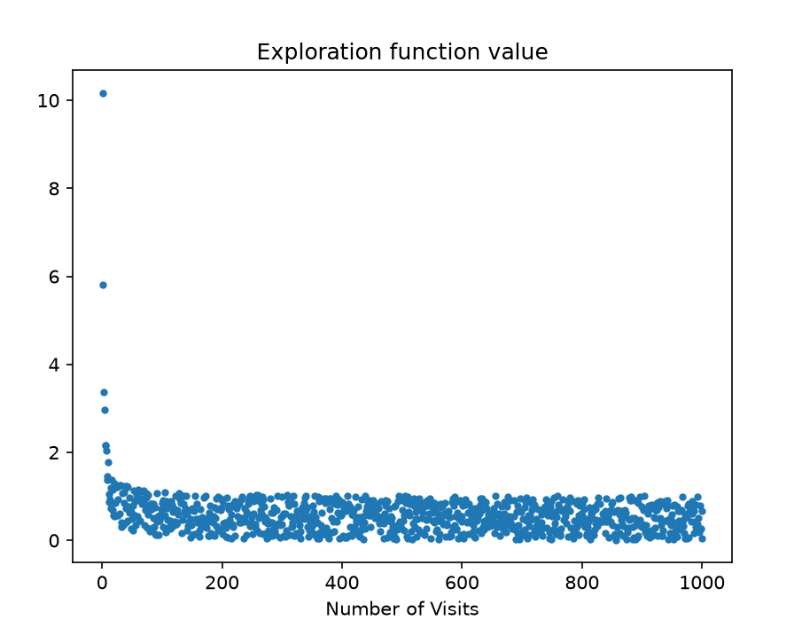
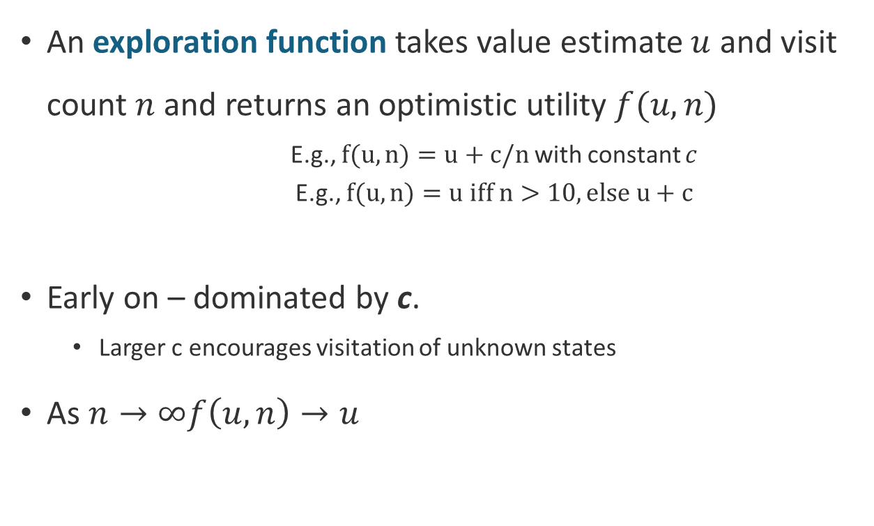
Exploration Functions
An exploration function takes value estimate $u$ and visit count $n$ and returns an optimistic utility $f(u,n)$
    E.g., $f(u,n)=u+c/n$with constant $c$
    E.g., $f(u,n)=u iff n>10, else u+c$
Early on – dominated by c.
  Larger c encourages visitation of unknown states
As $n→∞f\left(u,n\right)→u$
Notes:
Notable features of the exploration function:
It converges to the measure U as n->inf.
The constant is pre-chosen, and may be the optimal max U
Another way to write this would be U_max iff n<N, else U

Slide 16
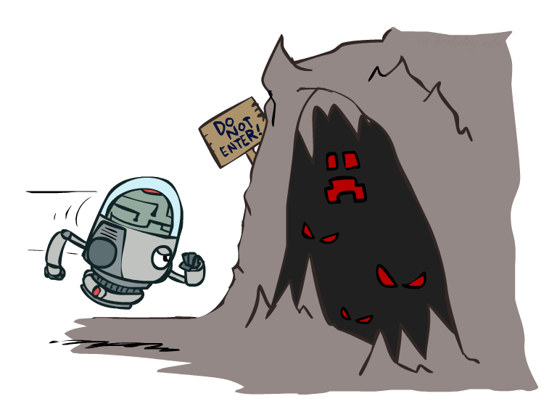
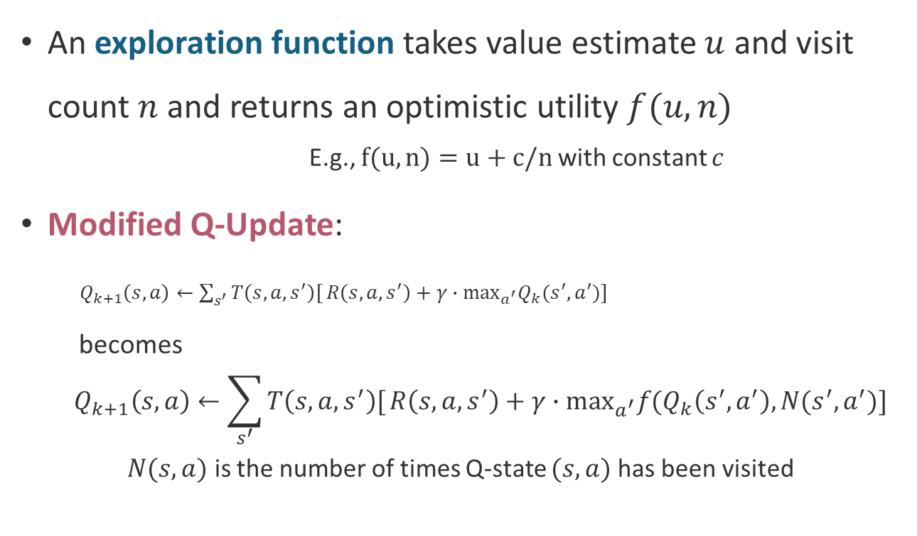
Exploration Functions in Q-learning
An exploration function takes value estimate $u$ and visit count $n$ and returns an optimistic utility $f(u,n)$
    E.g., $f(u,n)=u+c/n$with constant $c$
Modified Q-Update:
$Q_{k+1}\left(s,a\right)←\sum_{s^{′}}{T\left(s,a,s^{′}\right)[}R\left(s,a,s^{′}\right)+γ∙\max_{a^{′}}Q_{k}(s^{′},a^{′})]$
becomes
  $$Q_{k+1}\left(s,a\right)←\sum_{s^{′}}{T\left(s,a,s^{′}\right)[}R\left(s,a,s^{′}\right)+γ∙\max_{a^{′}}f(Q_{k}\left(s^{′},a^{′}\right),N(s^{′},a^{′})]$$
  $N(s,a)$ is the number of times Q-state $(s,a)$ has been visited
Notes:
Notable features of the exploration function:
It converges to the measure U as n->inf.
The constant is pre-chosen, and may be the optimal max U
Another way to write this would be U_max iff n<N, else U

Slide 17
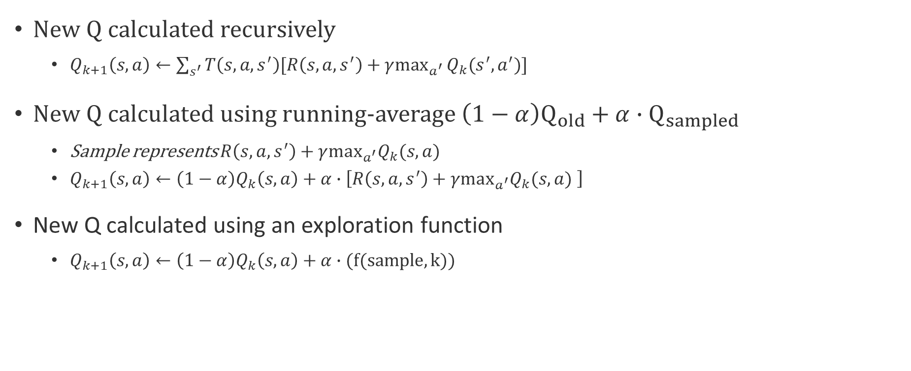
Q-value calculations
New Q calculated recursively
  $Q_{k+1}\left(s,a\right)←\sum_{s^{′}}{T\left(s,a,s^{′}\right)[R\left(s,a,s^{′}\right)+γ\max_{a^{′}}}Q_{k}(s^{′},a^{′})]$
New Q calculated using running-average $\left(1−α\right)Q_{old}+α∙Q_{sampled}$
  Sample represents $R\left(s,a,s^{′}\right)+γ\max_{a^{′}}Q_{k}(s,a)$
  $Q_{k+1}\left(s,a\right)←\left(1−α\right)Q_{k}\left(s,a\right)+α∙\left[R\left(s,a,s^{′}\right)+γ\max_{a^{′}}Q_{k}(s,a) \right]$
New Q calculated using an exploration function
  $Q_{k+1}\left(s,a\right)←\left(1−α\right)Q_{k}\left(s,a\right)+α∙(f(sample, k))$

Slide 18
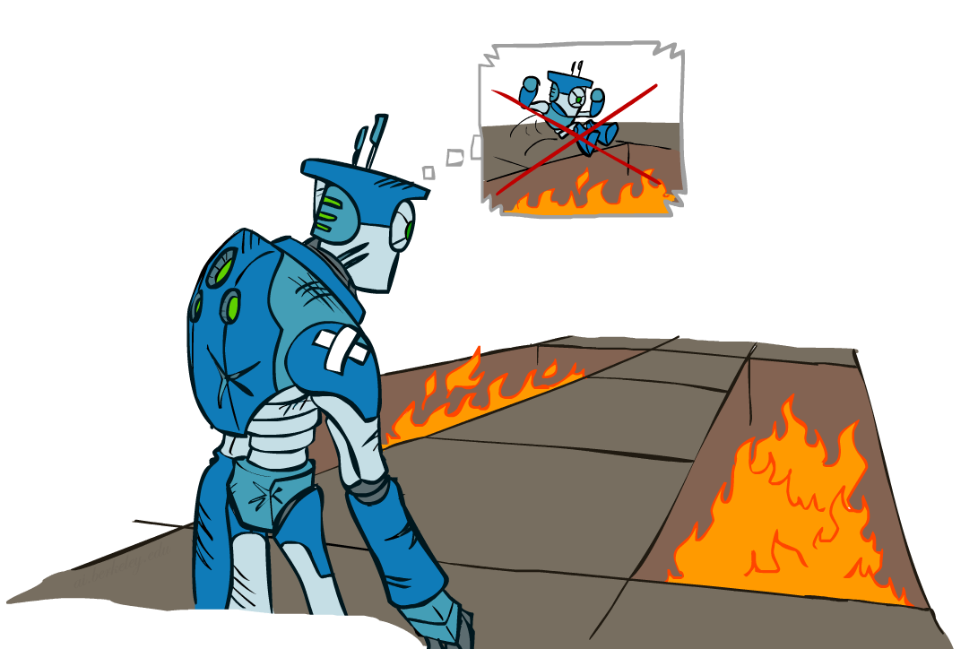
Regret
Even if you learn the optimal policy, you will make mistakes along the way!
Regret is a measure of the total mistake cost
  Difference between (expected) rewards (including
  early suboptimality), and optimal (expected) rewards
  For example, random exploration incurs more regret
  than exploring with exploration functions
Minimizing regret applies optimization to the
process of learning to be optimal
Notes:
Because it keeps randomly selecting routes even if we know very well they are bad. If we explore a space well enough to know its bad with exploration functions we stop considering it.

Slide 19


Generalizing Across States
Naïve Q-Learning keeps track of all Q-states
  But in realistic situations, we cannot possibly learn about every single state!
    Too many states to visit them all in training
    Too many states to track in memory
Instead, we want to generalize:
  Learn about some small number of states from experience
  Generalize experiences to new, but similar situations
Generalizing learning is a fundamental challenge in AI!

Slide 20
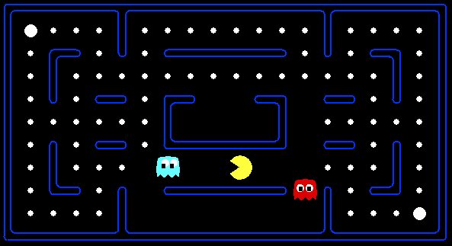



Poor Generalization
With naïve Q-learning, learning from experience in this state…
…doesn’t provide information about this state…
…or even this state!…

Slide 21
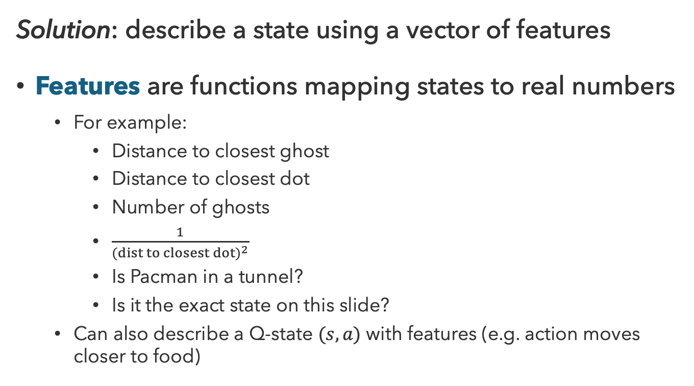
Feature-Based Learning
Solution: describe a state using a vector of features
Features are functions mapping states to real numbers
  For example:
    Distance to closest ghost
    Distance to closest dot
    Number of ghosts
    $\frac{1}{(dist to closest dot)^{2}}$
    Is Pacman in a tunnel?
    Is it the exact state on this slide?
  Can also describe a Q-state $(s,a)$ with features (e.g. action moves closer to food)

Slide 22
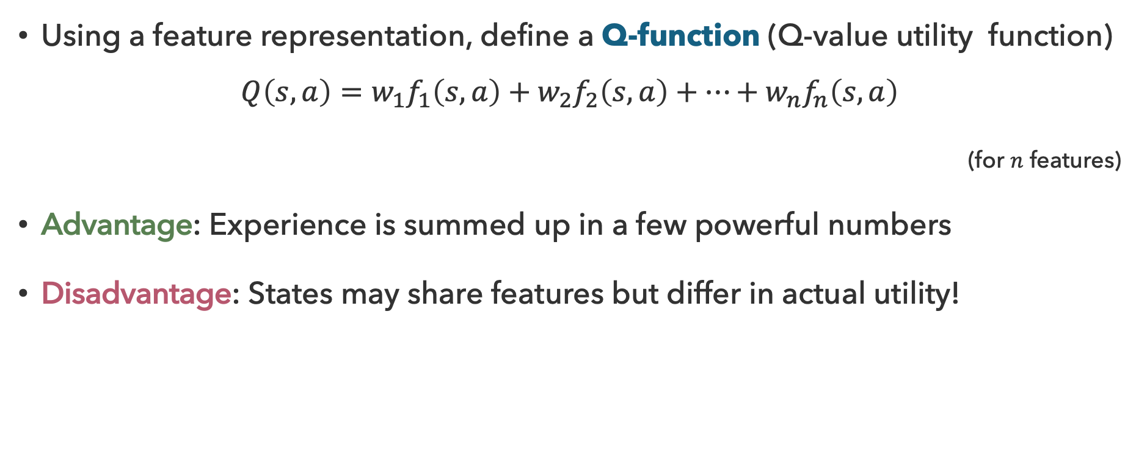
Linear Value Functions
Using a feature representation, define a Q-function (Q-value utility function)
$$Q\left(s,a\right)=w_{1}f_{1}\left(s,a\right)+w_{2}f_{2}\left(s,a\right)+…+w_{n}f_{n}\left(s,a\right)$$
(for $n$ features)
Advantage: Experience is summed up in a few powerful numbers
Disadvantage: States may share features but differ in actual utility!

Slide 23

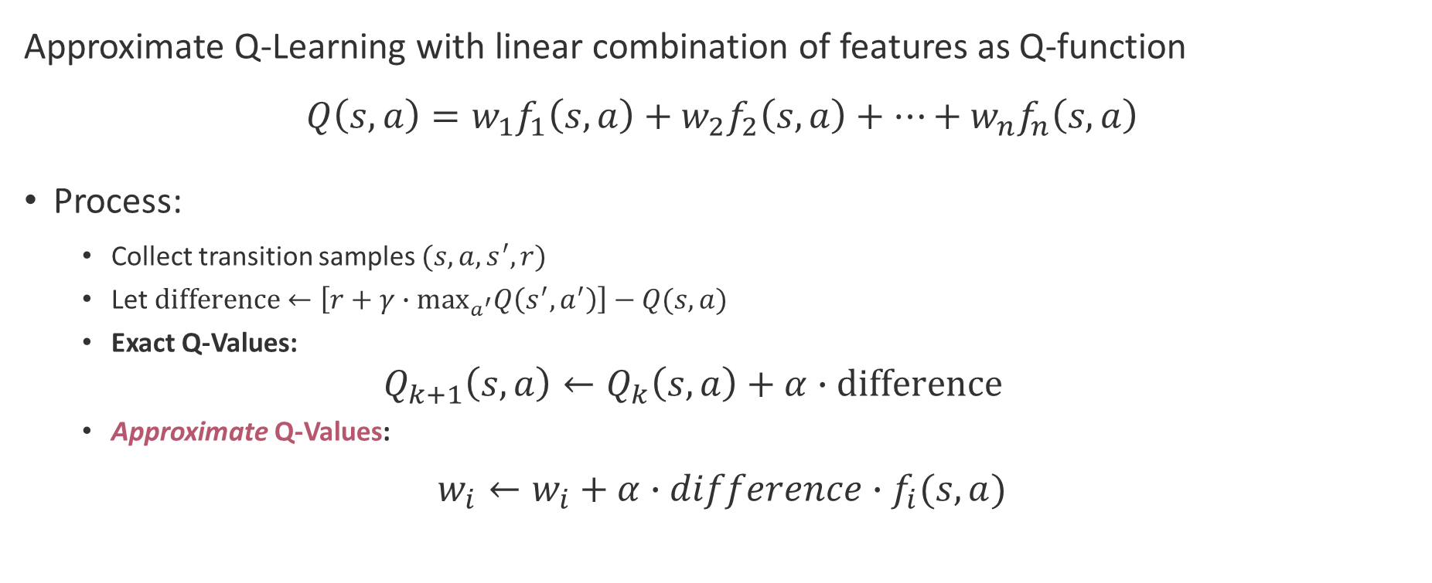
Approximate Q-Learning
Approximate Q-Learning with linear combination of features as Q-function
$$Q\left(s,a\right)=w_{1}f_{1}\left(s,a\right)+w_{2}f_{2}\left(s,a\right)+…+w_{n}f_{n}\left(s,a\right)$$
Process:
  Collect transition samples $(s,a,s^{′},r)$
  Let $difference←\left[r+γ∙\max_{a^{′}}Q\left(s^{′},a^{′}\right)\right]−Q(s,a)$
  Exact Q-Values:
  $$Q_{k+1}\left(s,a\right)←Q_{k}\left(s,a\right)+α∙difference$$
  Approximate Q-Values:
$$w_{i}←w_{i}+α∙difference∙f_{i}(s,a)$$

Slide 24
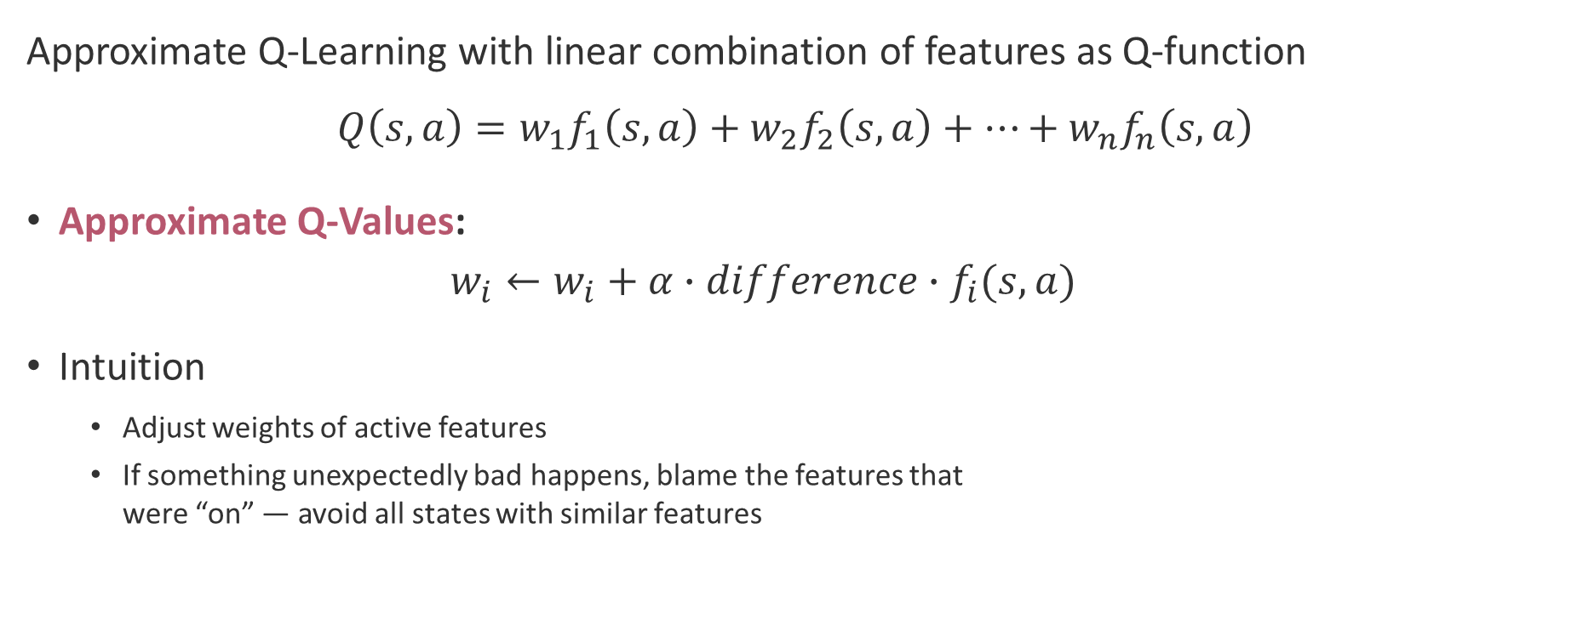
Intuition Behind Approximate Q-Learning
Approximate Q-Learning with linear combination of features as Q-function
$$Q\left(s,a\right)=w_{1}f_{1}\left(s,a\right)+w_{2}f_{2}\left(s,a\right)+…+w_{n}f_{n}\left(s,a\right)$$
Approximate Q-Values:
  $$w_{i}←w_{i}+α∙difference∙f_{i}(s,a)$$
Intuition
  Adjust weights of active features
  If something unexpectedly bad happens, blame the features that
  were “on” — avoid all states with similar features

Slide 25
Questions (3)

Slide 26

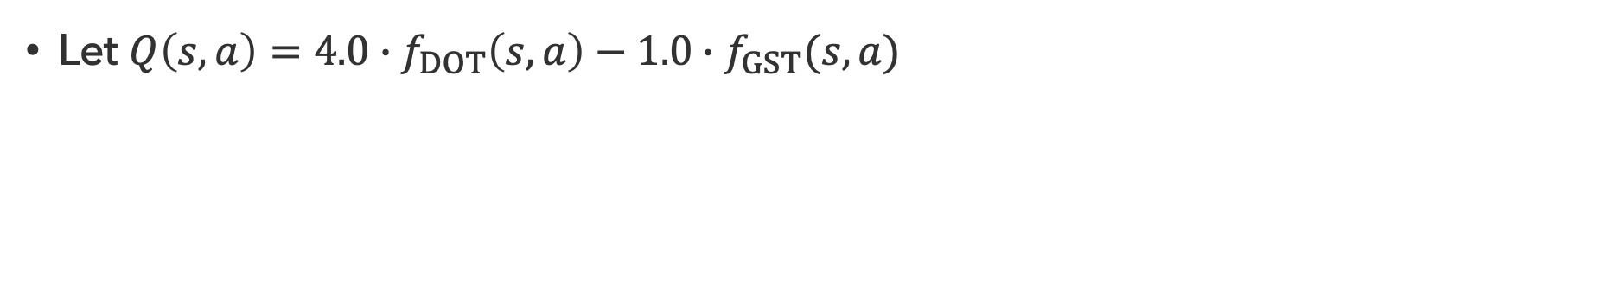

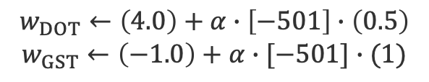



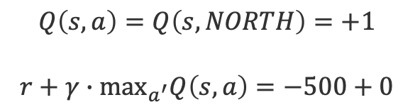
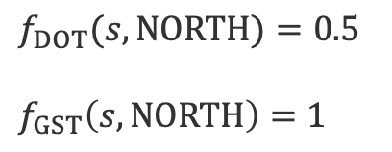

Q-Pacman (1)
Let $Q\left(s,a\right)=4.0∙f_{DOT}\left(s,a\right)−1.0∙f_{GST}(s,a)$
$$a=NORTH$$
$$f_{DOT}(s,NORTH)=0.5$$
$$f_{GST}\left(s,NORTH\right)=1$$
$$s$$
$$s′$$
$$r=−500$$
$$Q\left(s,a\right)=Q\left(s,NORTH\right)=+1$$
$$r+γ∙\max_{a^{′}}Q\left(s,a\right)=−500+0$$
$$Q\left(s,∙\right)=0$$
$$difference=−501$$
$$w_{DOT}←\left(4.0\right)+α∙\left[−501\right]∙\left(0.5\right)$$
$$w_{GST}←\left(−1.0\right)+α∙[−501]∙(1)$$
Notes:
F_dot = 1/distance to next big dot?
F_gst = 1/distance to ghost.

Slide 27


Q-Pacman (2)
Let $Q\left(s,a\right)=4.0∙f_{DOT}\left(s,a\right)−1.0∙f_{GST}(s,a)$
$$a=NORTH$$
$$f_{DOT}(s,NORTH)=0.5$$
$$f_{GST}\left(s,NORTH\right)=1$$
$$s$$
$$s′$$
$$r=−500$$
$$Q\left(s,a\right)=Q\left(s,NORTH\right)=+1$$
$$r+γ∙\max_{a^{′}}Q\left(s,a\right)=−500+0$$
$$Q\left(s,∙\right)=0$$
Update: $Q\left(s,a\right)=3.0∙f_{DOT}\left(s,a\right)−3.0∙f_{GST}(s,a)$
with $α≈0.004$

Slide 28
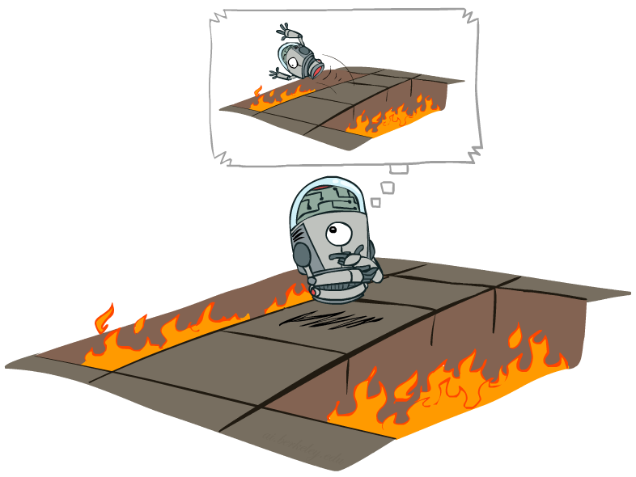
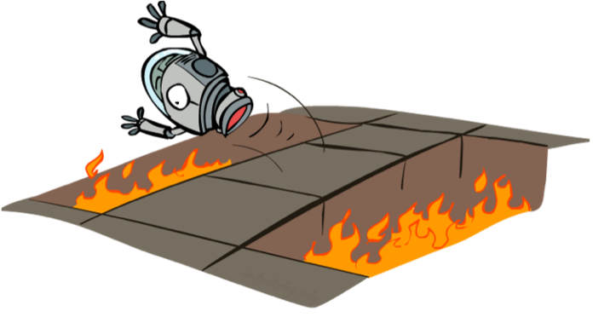
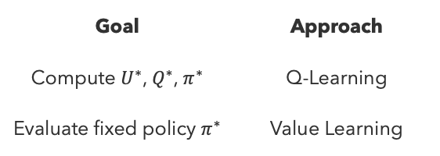
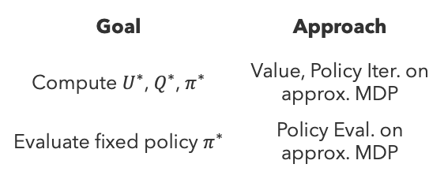
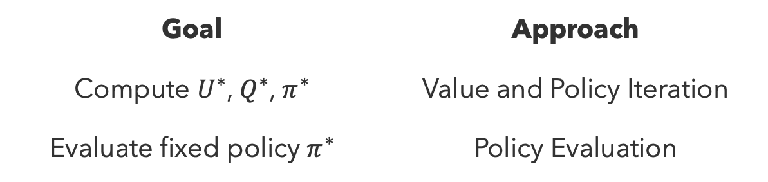
Summary: Reinforcement Learning
Goal | Approach
Compute $U^{∗}$, $Q^{∗}$, $π^{∗}$ | Value and Policy Iteration
Evaluate fixed policy $π^{∗}$ | Policy Evaluation
Offline Learning
Known MDP
Model-Based
Model-Free
Goal | Approach
Compute $U^{∗}$, $Q^{∗}$, $π^{∗}$ | Value, Policy Iter. on approx. MDP
Evaluate fixed policy $π^{∗}$ | Policy Eval. on approx. MDP
Goal | Approach
Compute $U^{∗}$, $Q^{∗}$, $π^{∗}$ | Q-Learning
Evaluate fixed policy $π^{∗}$ | Value Learning
Online Learning
Unknown MDP

Slide 29
Questions (4)

Slide 30

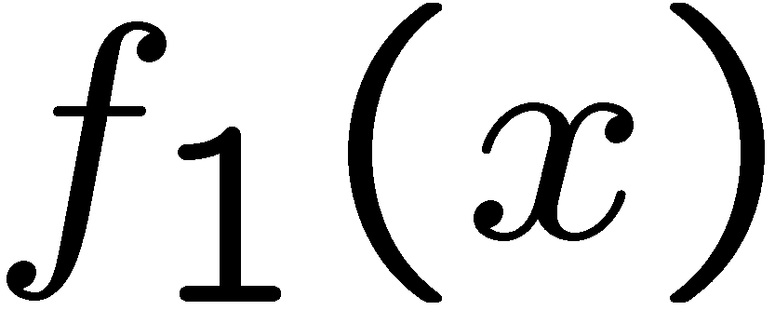


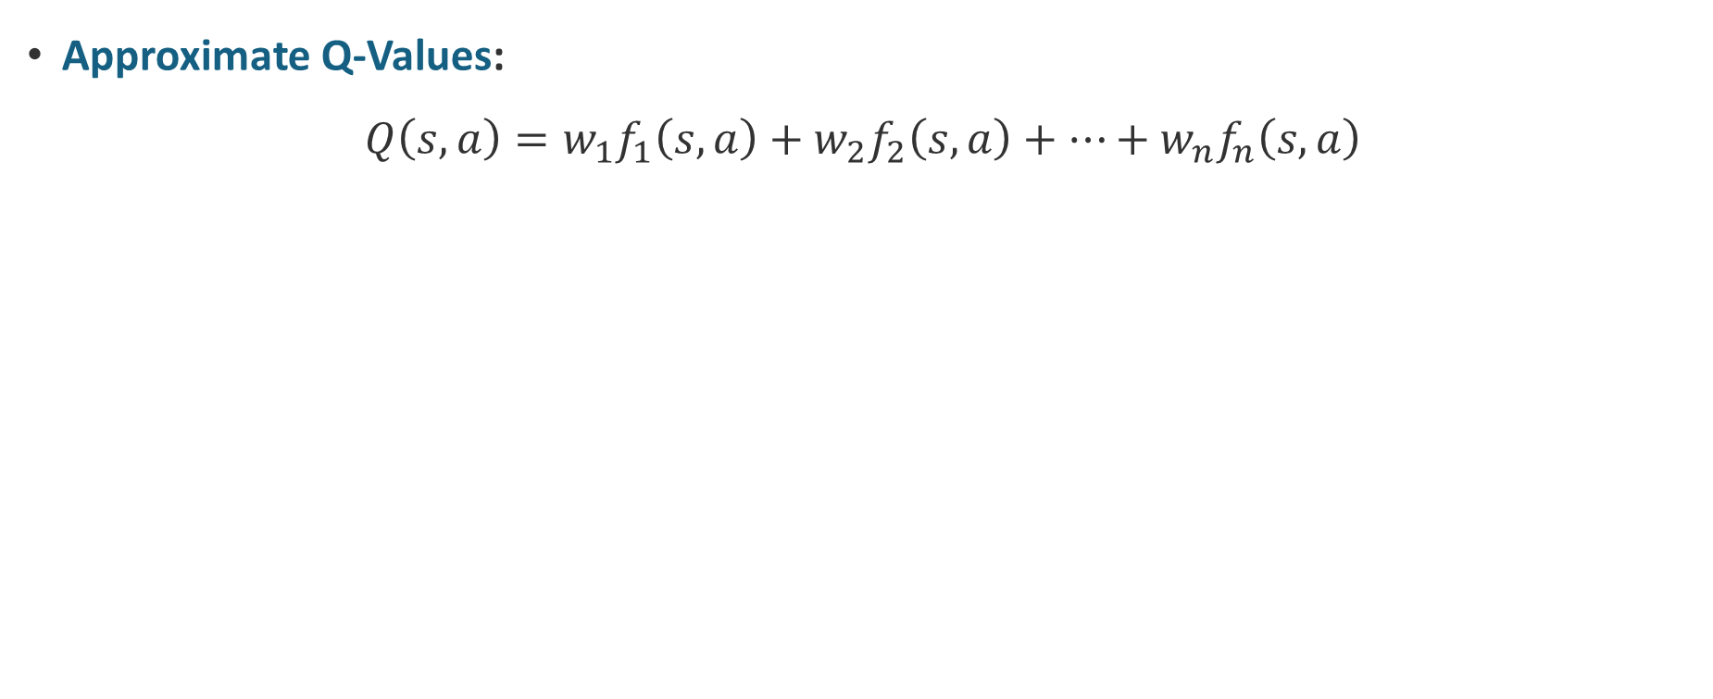
Approximate Q-Learning Least Squares
Approximate Q-Values:
$$Q\left(s,a\right)=w_{1}f_{1}\left(s,a\right)+w_{2}f_{2}\left(s,a\right)+…+w_{n}f_{n}\left(s,a\right)$$
40
$$\hat{y}=w_{0}+w_{1}f_{1}(x)$$
26
24
22
20
20
30
20
40
10
20
30
0
0
10
0
0
20
$$\hat{y}=w_{0}+w_{1}f_{1}(x)+w_{2}f_{2}(x)$$

Slide 31

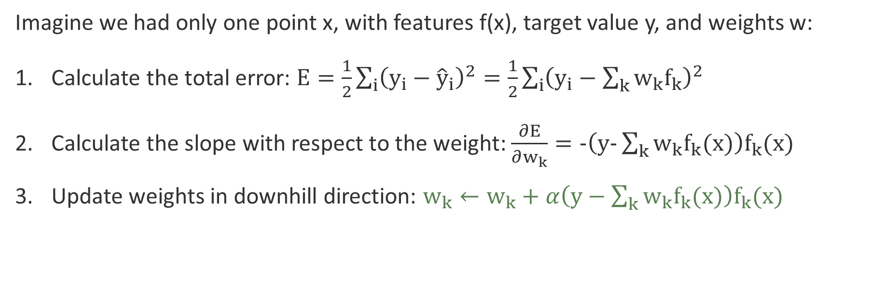
Least Squares Minimizing Error
Imagine we had only one point x, with features f(x), target value y, and weights w:
Calculate the total error: $E=\frac{1}{2}\sum_{i}{{\left(y_{i}−{\hat{y}}_{i}\right)}^{2}}=\frac{1}{2}\sum_{i}{{\left(y_{i}−\sum_{k}{w_{k}f_{k}}\right)}^{2}}$
Calculate the slope with respect to the weight: $\frac{∂E}{∂w_{k}}=-\left(y-\sum_{k}{w_{k}f_{k}(x)}\right)f_{k}(x)$
Update weights in downhill direction: $w_{k}←w_{k}+α\left(y−\sum_{k}{w_{k}f_{k}(x)}\right)f_{k}(x)$
40
$$\hat{y}=w_{0}+w_{1}f_{1}(x)$$
20
0
0
20
Notes:
Do this for each of the parameters!
Y – the sum is what we called the differences!
If we had the real values… we could run linear regression with stochastic gradient descent (this)!

Slide 32
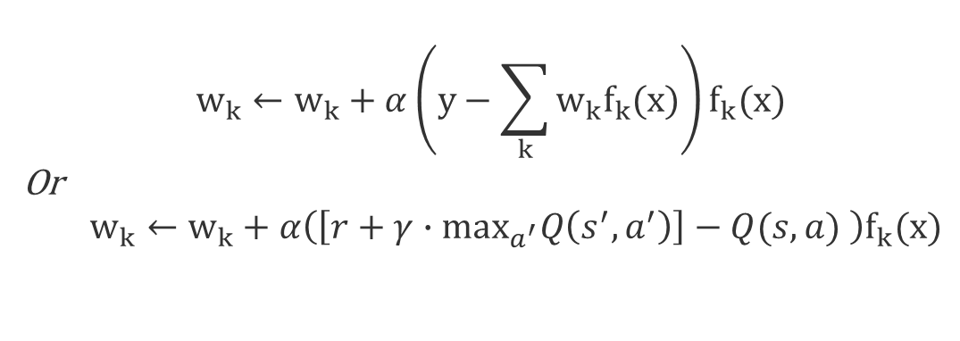
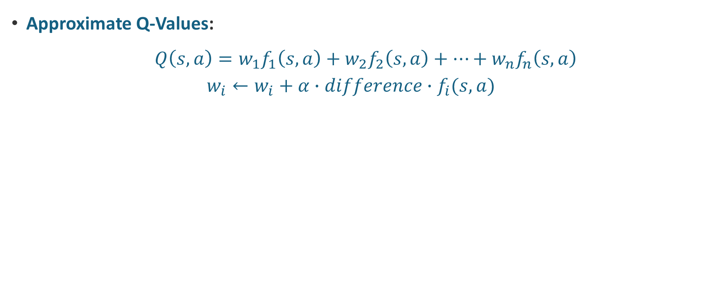

Update Q-values or Least-square weights
Approximate Q-Values:
$$Q\left(s,a\right)=w_{1}f_{1}\left(s,a\right)+w_{2}f_{2}\left(s,a\right)+…+w_{n}f_{n}\left(s,a\right)$$
  $$w_{i}←w_{i}+α∙difference∙f_{i}(s,a)$$
40
$$w_{k}←w_{k}+α\left(y−\sum_{k}{w_{k}f_{k}(x)}\right)f_{k}(x)$$
Or
  $$w_{k}←w_{k}+α\left(\left[r+γ∙\max_{a^{′}}Q\left(s^{′},a^{′}\right)\right]−Q(s,a) \right)f_{k}(x)$$
20
0
0
20
$$\hat{y}=w_{0}+w_{1}f_{1}(x)$$
Notes:
So, we get a difference term, yi is the same as the measured Q value, and y-hat is the old Q value.

Slide 33
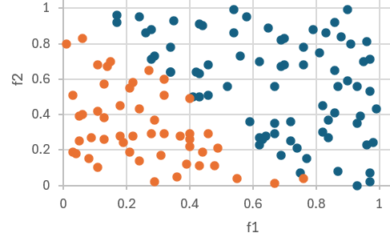
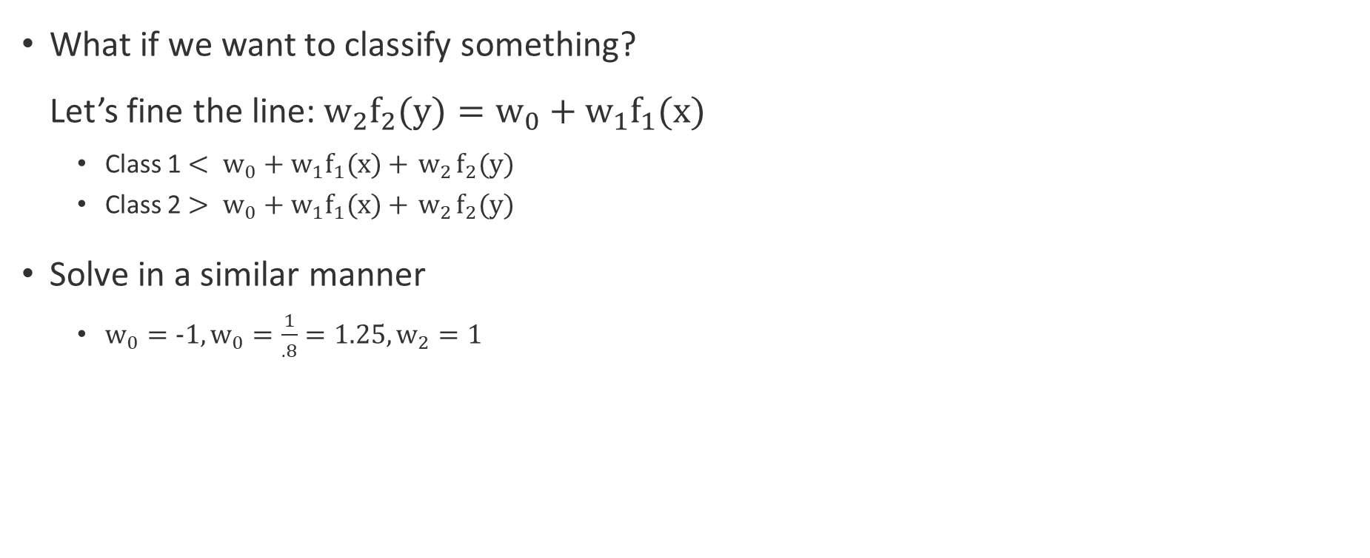
Linear Separable Classes
What if we want to classify something?
Let’s fine the line:${ w}_{2}f_{2}(y)=w_{0}+w_{1}f_{1}(x)$
  Class 1 $< w_{0}+w_{1}f_{1}(x)+{ w}_{2}f_{2}(y)$
  Class 2 $> w_{0}+w_{1}f_{1}(x)+{ w}_{2}f_{2}(y)$
Solve in a similar manner
  $w_{0}=-1,w_{0}=\frac{1}{.8}=1.25,w_{2}=1$
?
f₁
Σ
>1?
f₂
?
Notes:
We can do this by choosing a transfer step function at 1, or by adding a bias node of -1
Think-pair-share – how would you calculate these weights?? Write down your answer if you reach a specific one.

Slide 34
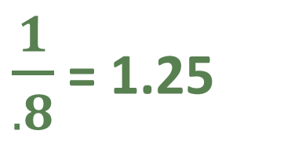
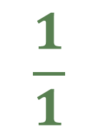
Linear Separable Classes
$\frac{1}{.8}$ = 1.25
f₁
Σ
>1?
f₂
$$\frac{1}{1}$$
Notes:
We can actually do this by inspection because we are just defining that line. Note – this is just linear regression.

Slide 35
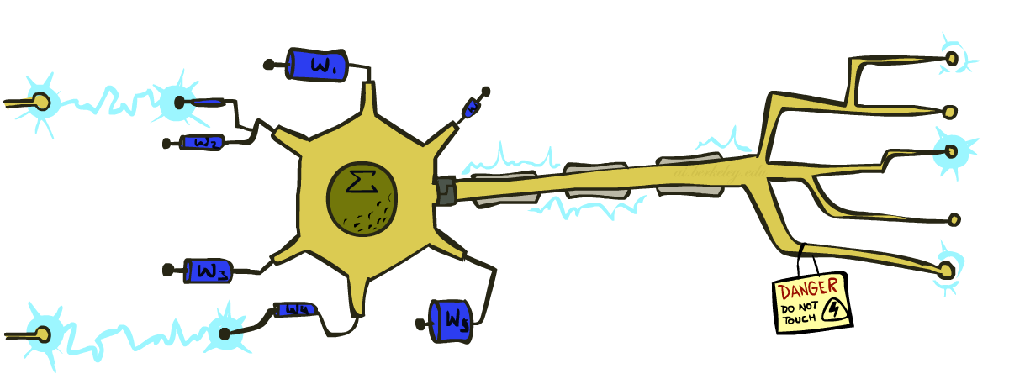
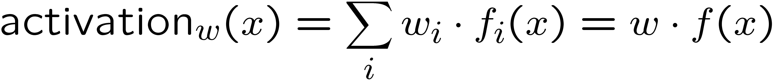
Perceptrons (spoiler!)
Inputs are feature values
Each feature has a weight
Sum is the activation
If the activation is:
  Positive, output +1
  Negative, output -1
w₁
f₁
Σ
w₂
>0?
f₂
w₃
f₃

Slide 36
that’s it for today!
Q-Learning
Exploration vs. Exploitation Tradeoff
Feature-Based Approximation
Reinforcement Learning in Practice
Statistical modeling
Finish Homework 2 (due Friday)

