Slide 1
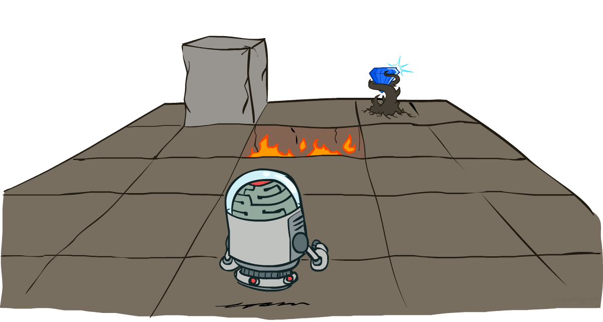
Markov Decision Processes
CSE 473: Introduction to Artificial Intelligence
Megan Hazen (mh75@cs)
cs.uw.edu/473
acknowledgements
Welcome!
What’s something that didn’t go to plan?

Slide 2
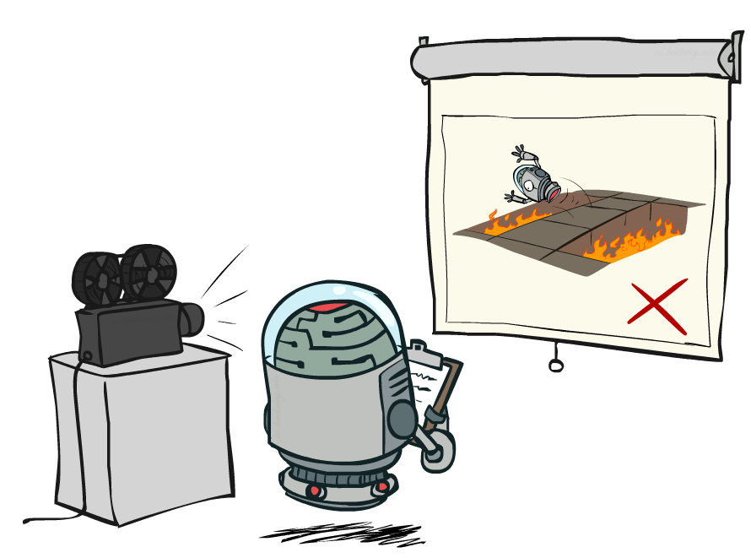
Administrivia
Test 1 next Friday
  One double-sided 8.5x11” note sheet allowed
Project 1 due Monday (10.19)
Homework 2 releasing early

Slide 3
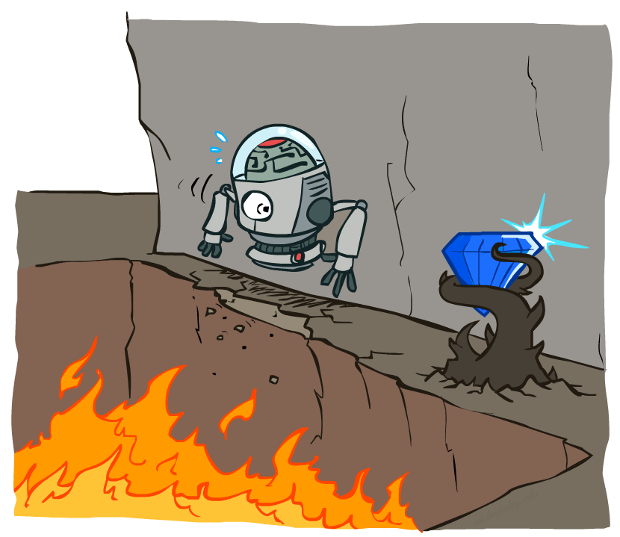
Non-Deterministic Search

Slide 4
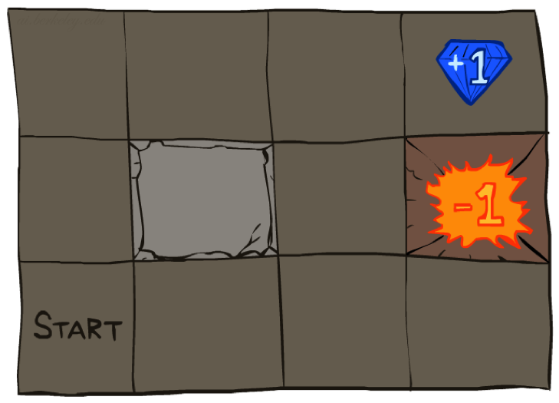




Grid World
Maze-Like Environment
Noisy Movement
  Actions don’t always go as planned
  e.g. 80% of time, NORTH action takes the agent north, 10% of time agent ends up going west, 10% of time agent ends up going east
  If there’s a wall in the direction the agent would have gone, the agent doesn’t move
Reward
  Agent receives small living reward r (maybe negative)
  Big rewards at terminal states
Goal: maximize sum of rewards

Slide 5
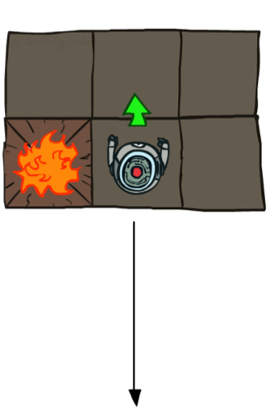
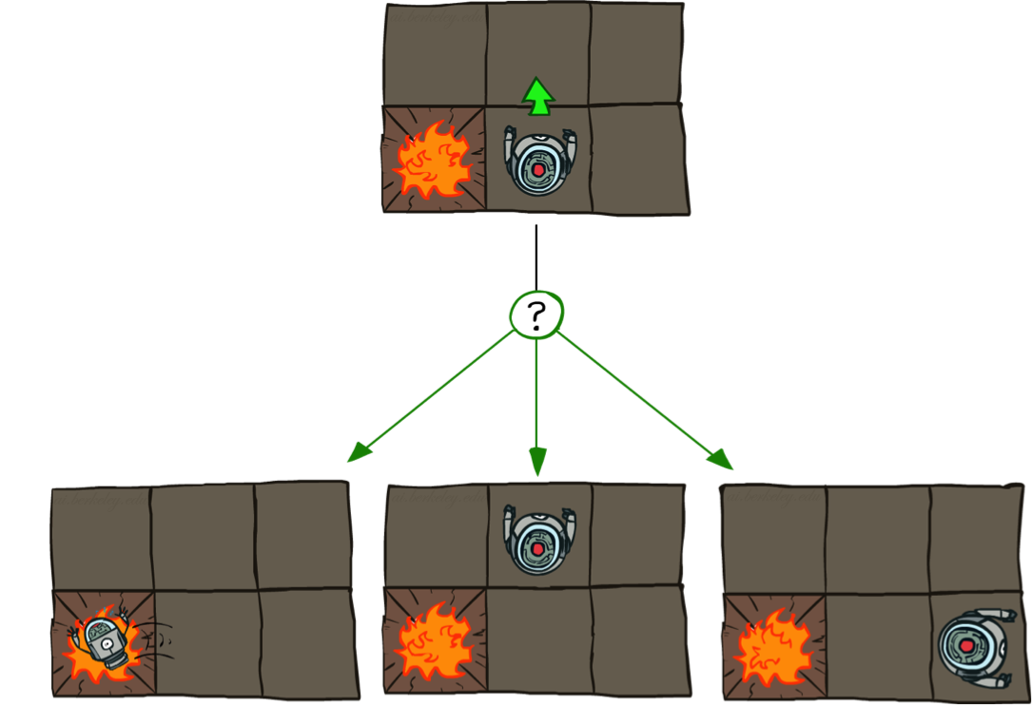
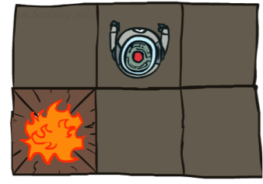
Grid World Actions
Deterministic
Stochastic

Slide 6







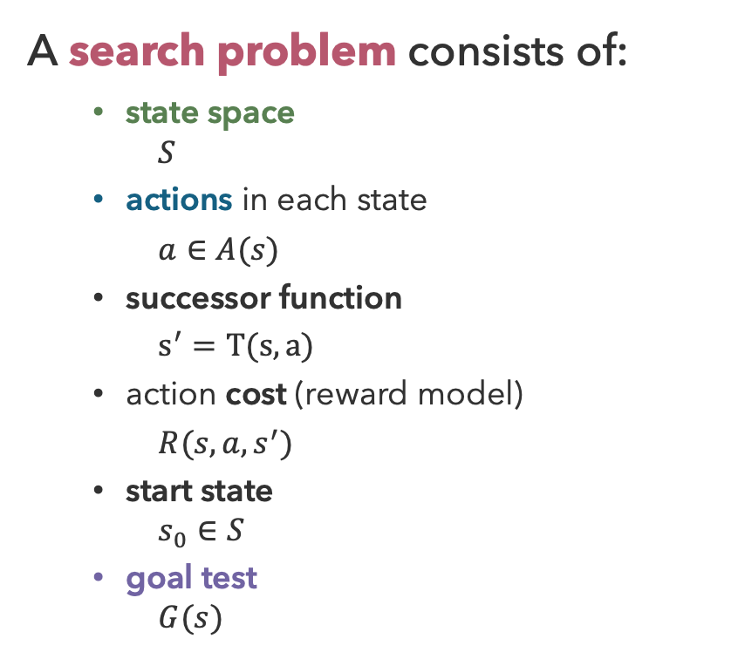
Search Problems
A search problem consists of:
  state space
    $$S$$
  actions in each state
  $a∈A(s)$
  successor function
  $s^{′}=T(s, a)$
  action cost (reward model)
  $R(s, a, s^{′})$
  start state
    $$s_{0}∈S$$
  goal test
    $$G(s)$$
N
+1
E
+1
G( ) = false
G( ) = true

Slide 7
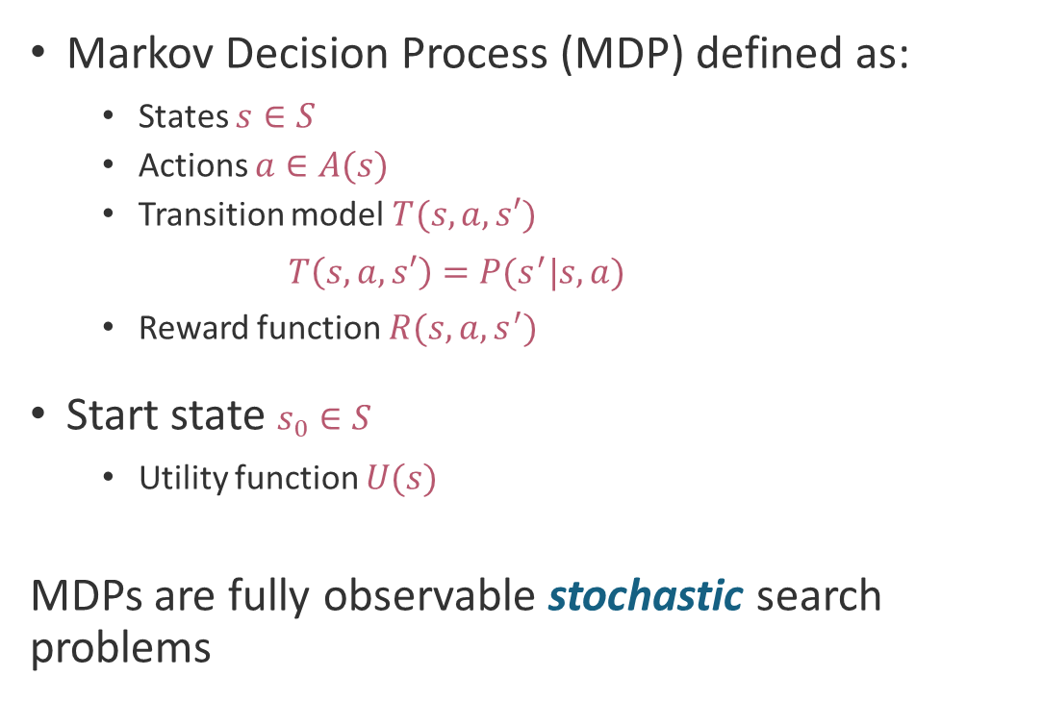
Markov Decision Process
Markov Decision Process (MDP) defined as:
  States $s∈S$
  Actions $a∈A(s)$
  Transition model $T(s,a,s′)$
    $$T\left(s,a,s′\right)=P(s^{′}|s,a)$$
  Reward function $R(s,a,s^{′})$
Start state $s_{0}∈S$
  Utility function $U(s)$
MDPs are fully observable stochastic search problems
Agent
Sensors
percepts
?
Environment
Actuators
actions

Slide 8
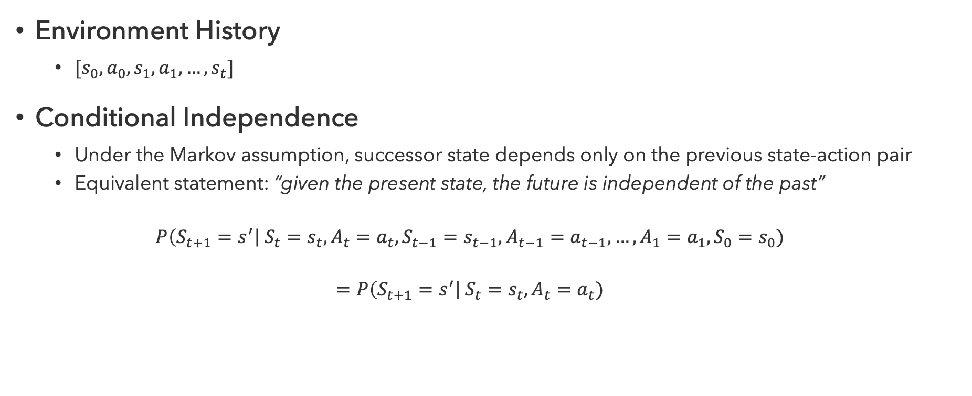
Markov Assumption
Environment History
  $[s_{0},a_{0},s_{1},a_{1},…,s_{t}]$
Conditional Independence
  Under the Markov assumption, successor state depends only on the previous state-action pair
  Equivalent statement: “given the present state, the future is independent of the past”
  $$P\left(S_{t+1}=s^{′}\right| S_{t}=s_{t}, A_{t}=a_{t}, S_{t−1}=s_{t−1},A_{t−1}=a_{t−1},…,A_{1}=a_{1},S_{0}=s_{0})$$
  $$=P\left(S_{t+1}=s^{′}\right| S_{t}=s_{t}, A_{t}=a_{t})$$

Slide 9

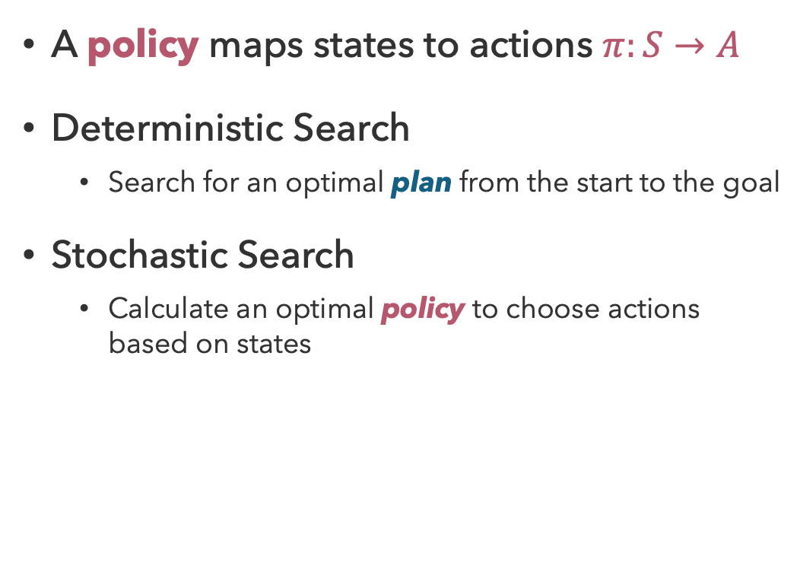
Policies
A policy maps states to actions $π:S→A$
Deterministic Search
  Search for an optimal plan from the start to the goal
Stochastic Search
  Calculate an optimal policy to choose actions based on states

Slide 10
Questions (1)

Slide 11
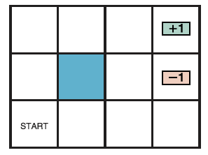
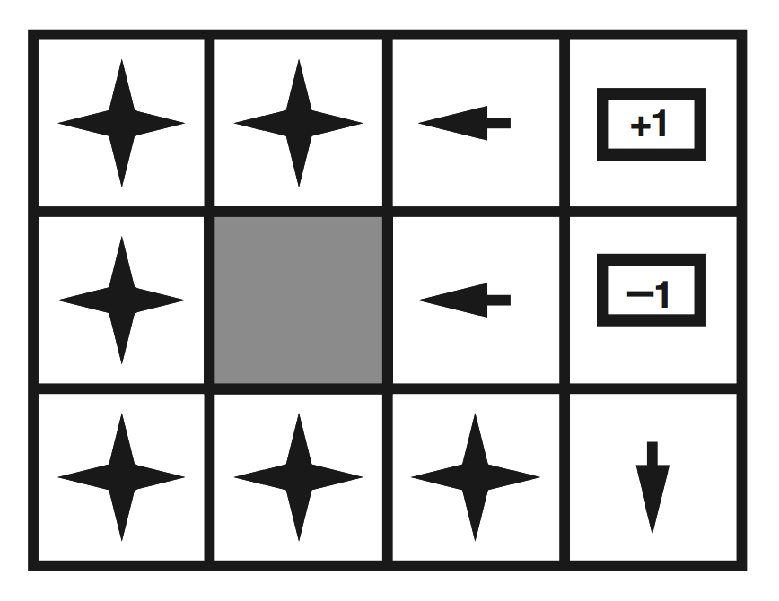
Optimal Policies
r > 0
r > 0

Slide 12
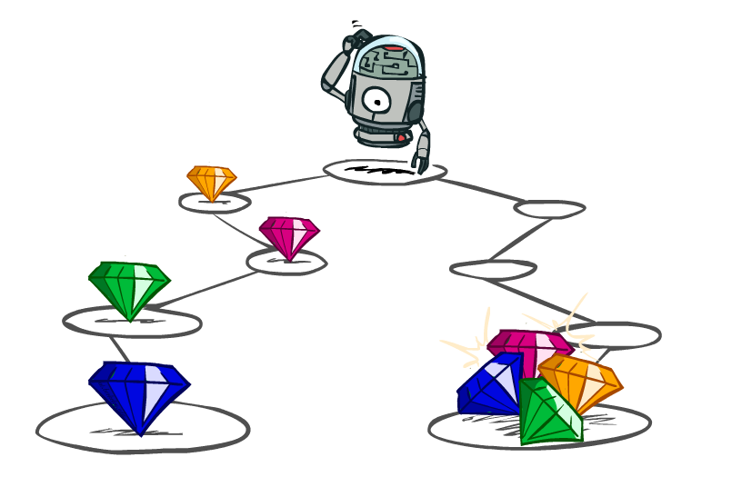
Sequential Utilities

Slide 13
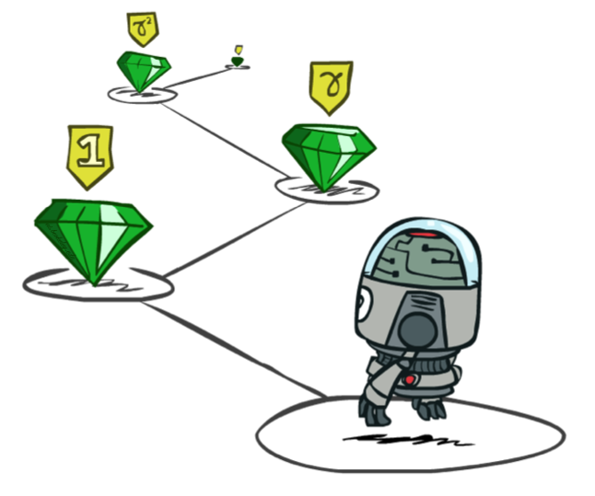
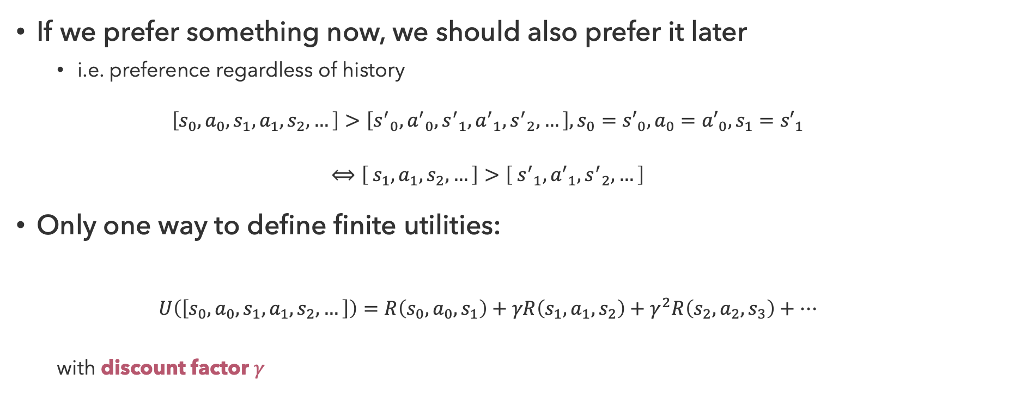
Stationary Preferences
If we prefer something now, we should also prefer it later
  i.e. preference regardless of history
  $$\left[s_{0},a_{0},s_{1},a_{1},s_{2},…\right]>\left[{s^{′}}_{0},{a^{′}}_{0},{s^{′}}_{1},{a^{′}}_{1},{s^{′}}_{2},…\right], s_{0}={s′}_{0},a_{0}={a′}_{0},s_{1}={s′}_{1}$$
  $$⟺\left[ s_{1},a_{1},s_{2},…\right]>\left[ {s^{′}}_{1},{a^{′}}_{1},{s^{′}}_{2},…\right]$$
Only one way to define finite utilities:
  $$U\left(\left[s_{0},a_{0},s_{1},a_{1},s_{2},…\right]\right)=R\left(s_{0},a_{0},s_{1}\right)+γR\left(s_{1},a_{1},s_{2}\right)+γ^{2}R\left(s_{2},a_{2},s_{3}\right)+…$$
  with discount factor $γ$

Slide 14

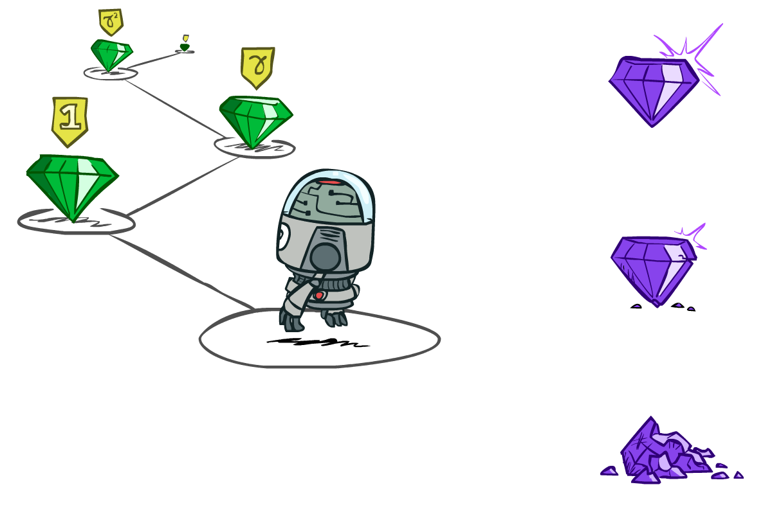
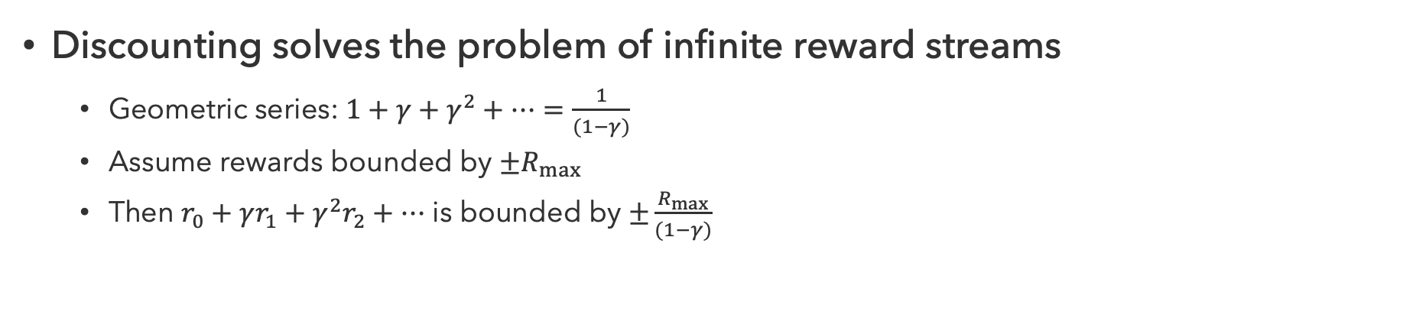



Discounting
worth$r$ now
worth $γr$ next step
worth $γ^{2}r$ in two steps
Discounting solves the problem of infinite reward streams
  Geometric series: $1+γ+γ^{2}+…=\frac{1}{(1−γ)}$
  Assume rewards bounded by $±R_{max}$
  Then $r_{0}+γr_{1}+γ^{2}r_{2}+…$ is bounded by $±\frac{R_{max}}{(1−γ)}$

Slide 15
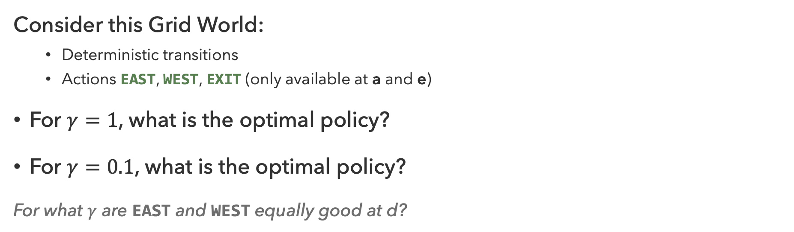
Discounting Practice
10 |  |  |  | 1
a | b | c | d | e
← | ← | ← | ← | ←
10 | 1*10 | 1*10 | 1*10 | 1
a | b | c | d | e
Consider this Grid World:
  Deterministic transitions
  Actions EAST, WEST, EXIT (only available at a and e)
For $γ=1$, what is the optimal policy?
For $γ=0.1$, what is the optimal policy?
For what $γ$ are EAST and WEST equally good at d?
← | ← | ← | → | →
10 | 0.1*10 | 0.01*10 | 0.1*1 | 1
a | b | c | d | e
Notes:
Quiz 1: left, left, left
Quiz 2: left, left, right
Quiz 3: \gamma^3 * 10 = \gamma, \gamma = 0.1^1/2

Slide 16
Questions (2)

Slide 17
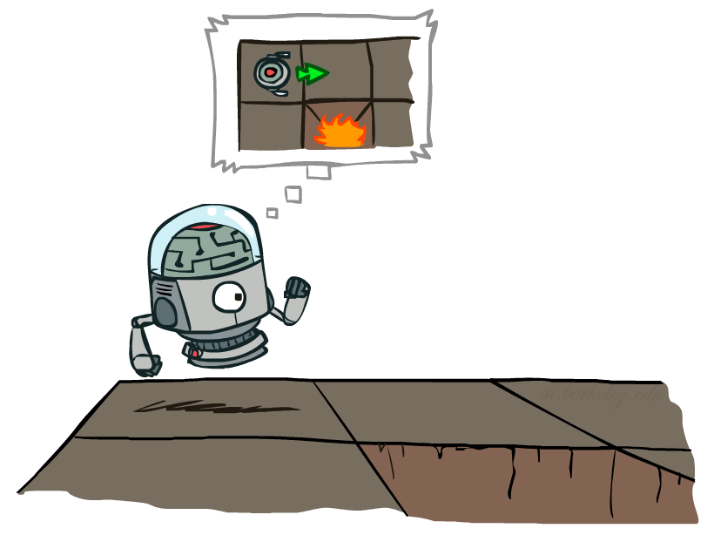
MDP Search Trees
MDPs can be represented as expectimax search trees
s
The children of state nodes are state-action pairs
a
Each state-action pair is a chance node
s, a
s,a,s’
The children of chance nodes are successor nodes
s’

Slide 18

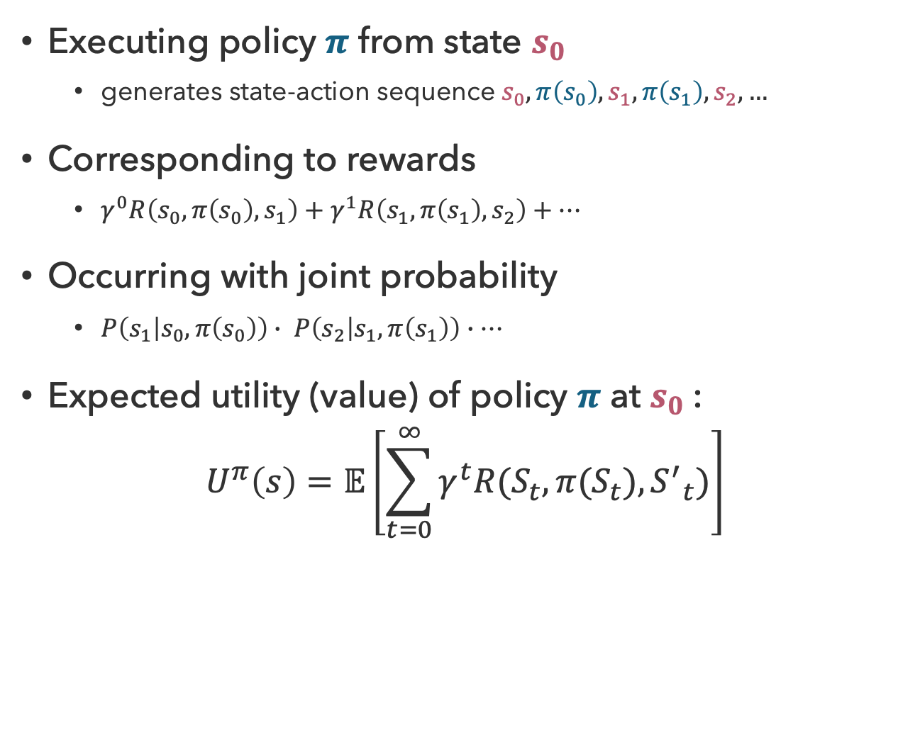

Utility of a Policy
s₀
Executing policy $π$ from state $s_{0}$
  generates state-action sequence $s_{0},π\left(s_{0}\right),s_{1},π\left(s_{1}\right),s_{2},…$
Corresponding to rewards
  $γ^{0}R\left(s_{0},π\left(s_{0}\right),s_{1}\right)+γ^{1}R\left(s_{1},π\left(s_{1}\right),s_{2}\right)+…$
Occurring with joint probability
  $P\left(s_{1} | s_{0},π\left(s_{0}\right)\right)∙ P\left(s_{2} | s_{1},π\left(s_{1}\right)\right)∙…$
Expected utility (value) of policy $π$ at $s_{0}$:
$$U^{π}\left(s\right)=𝔼\left[\sum_{t=0}^{∞}{γ^{t}R(S_{t},π(S_{t}),{S^{′}}_{t})}\right]$$
$$π(s_{0})$$
s₀, a₀
s₀,$π(s_{0})$,s₁
s₁

Slide 19
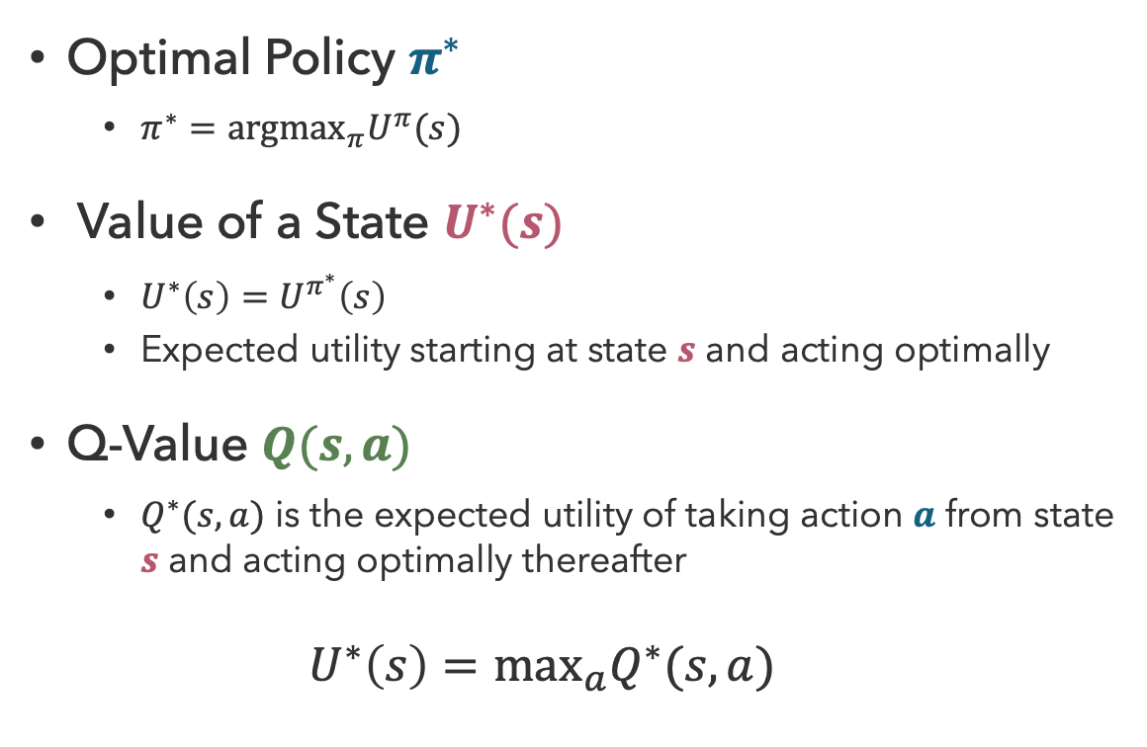
Optimal Quantities
state
s
Optimal Policy $π^{∗}$
  $π^{∗}={argmax}_{π}U^{π}(s)$
Value of a State $U^{∗}(s)$
  $U^{∗}\left(s\right)=U^{π^{∗}}\left(s\right)$
  Expected utility starting at state $s$ and acting optimally
Q-Value $Q(s,a)$
  $Q^{∗}(s,a)$ is the expected utility of taking action $a$ from state $s$ and acting optimally thereafter
  $$U^{∗}\left(s\right)=\max_{a}Q^{∗}(s,a)$$
a
Q(s,a)
Q-state
transition
s,a,s’
s’

Slide 20
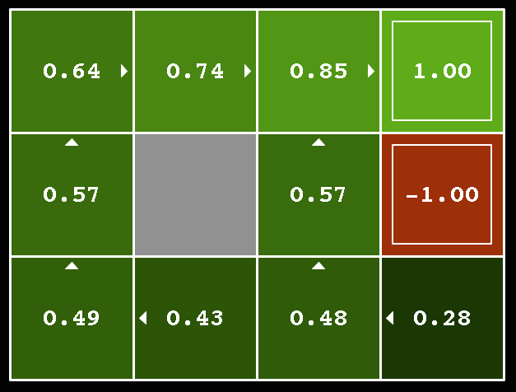
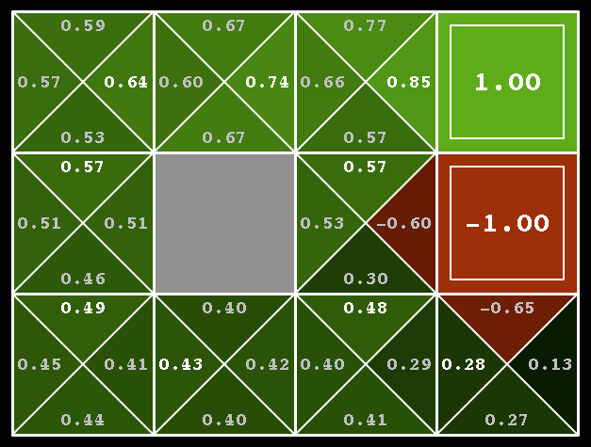
Grid World Values
U*(s)
Q*(s,a)

Slide 21
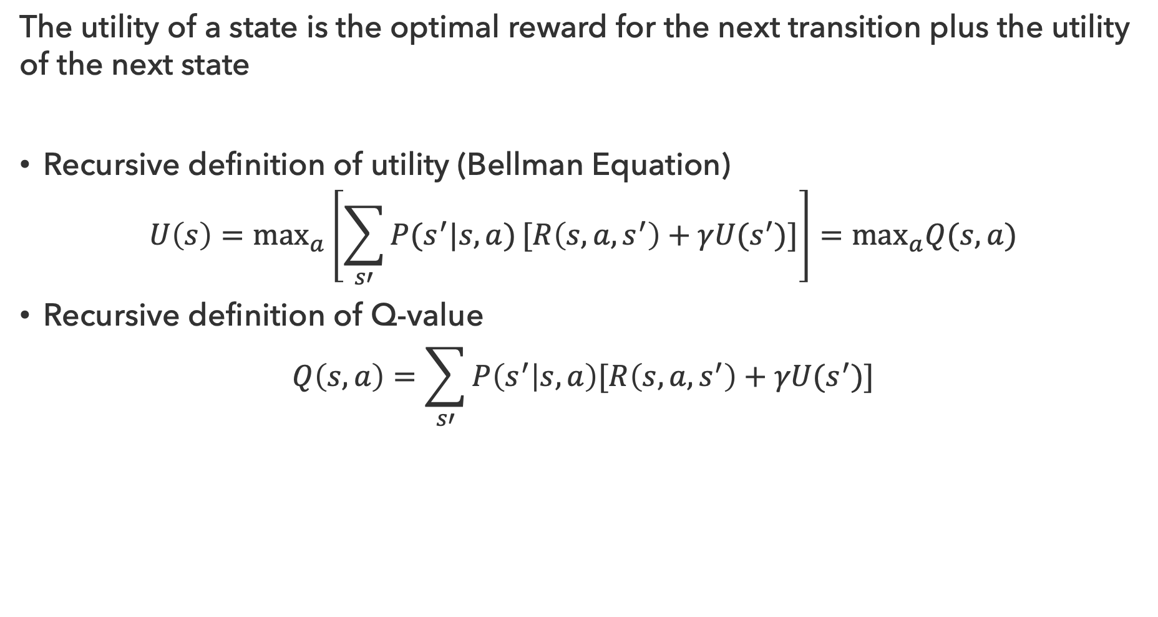
Bellman Equations
The utility of a state is the optimal reward for the next transition plus the utility of the next state
Recursive definition of utility (Bellman Equation)
$$U\left(s\right)=\max_{a}\left[\sum_{s′}{P(s^{′}|s,a)}[R\left(s,a,s^{′}\right)+γU(s^{′})]\right]=\max_{a}Q(s,a)$$
Recursive definition of Q-value
$$Q\left(s,a\right)=\sum_{s′}{P\left(s^{′} | s,a\right)[R\left(s,a,s^{′}\right)+γU(s^{′})}]$$

Slide 22

It’s Pretty Simple…
How to be optimal:
Step 1: Take correct first action
Step 2: Keep being optimal

Slide 23
Questions (3)

Slide 24
that’s it for today!
MDPs are fully observable stochastic search problems
Discounting prevents infinite rewards
MDPs are expectimax search trees with states and Q-states
Value Iteration
Policy Iteration
Assessment 1 next Friday

