Slide 1

Constraint
Satisfaction
CSE 473: Introduction to Artificial Intelligence
Megan Hazen (mh75@cs)
cs.uw.edu/473
acknowledgements
Welcome!
Early to bed or early to rise?

Slide 2
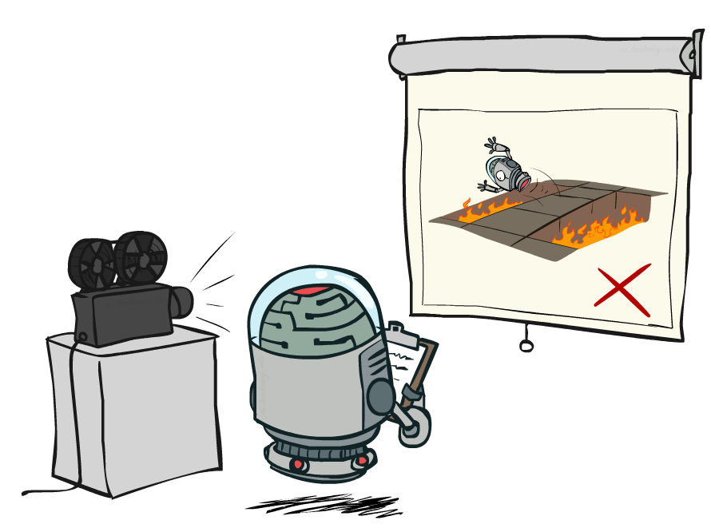
Administrivia
Homework 1 due Wednesday
Project 1 due next Monday (10.19)

Slide 3
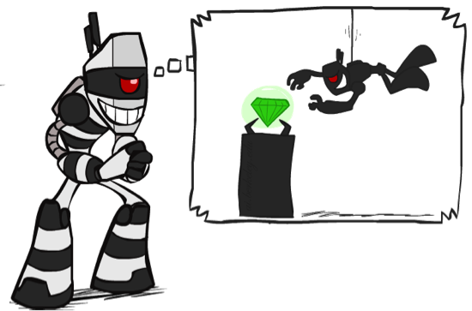

What is Search For?
Assumptions about the world: a single agent (?), deterministic actions (?), fully observed state, discrete state space
Planning: sequences of actions
  The path to the goal is the important thing
  Paths have various costs, depths
  Heuristics give problem-specific guidance
  In games, a path may be a sequence of plays
Identification: assignments to variables
  The goal itself is important, not the path
  All paths at the same depth (for some formulations)
  CSPs are specialized for identification problems
Notes:
These are search problems, so we can now take a look at different problems we can use search for
Before we had planning:
agent knows where the goal is, but not how to get there
Identification (related to local search):
agent wants to know where the goal is – the goal is important, not the path; what is the depth?

Slide 4


Constraint Satisfaction Problems
Standard search problems:
  State is a “black box”: arbitrary data structure
  Goal test can be any function over states
  Successor function can also be anything
Constraint satisfaction problems (CSPs):
  A special subset of search problems
  State is defined by variables X_{i} with values from a domain D (sometimes D_{i} depends on i)
    A partially solved problem
  A successor function is assigning a value to a variable
  Goal test is a set of constraints specifying allowable combinations of values for subsets of variables
Allows useful general-purpose algorithms with more power than standard search algorithms
Notes:
Before: states were nodes, no structure, just a set, they could be anything
Goal test – like a judge; just makes decisions; you don’t know how; - you were either there, or not.
Now: Goal test has structure, it ‘s more like a manual describing a set of constraints that have to hold true
Atomic vs. factored representation – sub-parts may work.
- still have an agent, still have a search state and a world state.

Slide 5
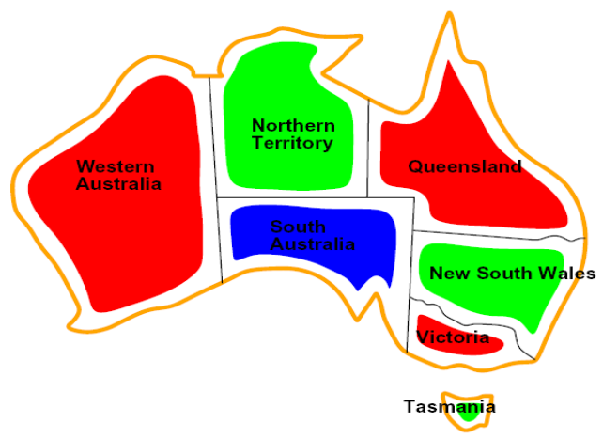


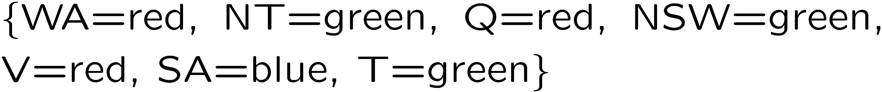
Example: Map Coloring
Variables:
Domains:
Constraints: adjacent regions must have different colors
Solutions are assignments satisfying all constraints, e.g.:
Implicit:
Explicit:
Notes:
How do you specify constraints in code/math?
Implicit vs explicit.
What is an example of an explicit constraint?

Slide 6
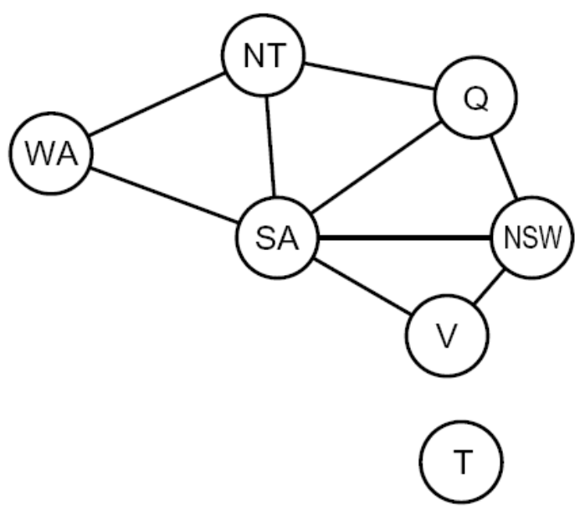
Constraint Graphs
Binary CSP: each constraint relates (at most) two variables
Binary constraint graph: nodes are variables, arcs show constraints
General-purpose CSP algorithms use the graph structure to speed up search. E.g., Tasmania is an independent sub-problem!
Notes:
Demo:
Run constraint.jar or constraint.exe, load the 5 queens problem.
Demo is just showing the n-queens applet as illustration of constraint graph, but later in lecture we’ll interact with the applet.
aispace.org will have the latest version

Slide 7


Varieties of CSPs
Discrete Variables
  Finite domains
    Size d means O(d^{n}) complete assignments
    E.g., Boolean CSPs, including Boolean satisfiability (NP-complete)
  Infinite domains (integers, strings, etc.)
    E.g., job scheduling, variables are start/end times for each job
    Linear constraints solvable, nonlinear undecidable
Continuous variables
  E.g., start/end times for Hubble Telescope observations
  Linear constraints solvable in polynomial time by LP methods (see cs170 for a bit of this theory)

Slide 8



Varieties of Constraints
Varieties of Constraints
  Unary constraints involve a single variable (equivalent to reducing domains), e.g.:
  Binary constraints involve pairs of variables, e.g.:
  Higher-order constraints involve 3 or more variables:
Preferences (soft constraints):
  E.g., red is better than green
  Often represented by a cost for each variable assignment
  Gives constrained optimization problems
  (We’ll ignore these until we get to Bayes’ nets)

Slide 9


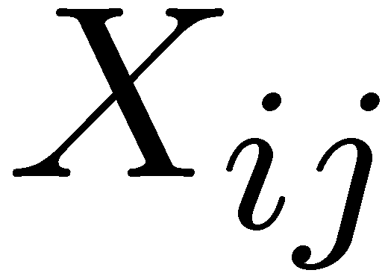

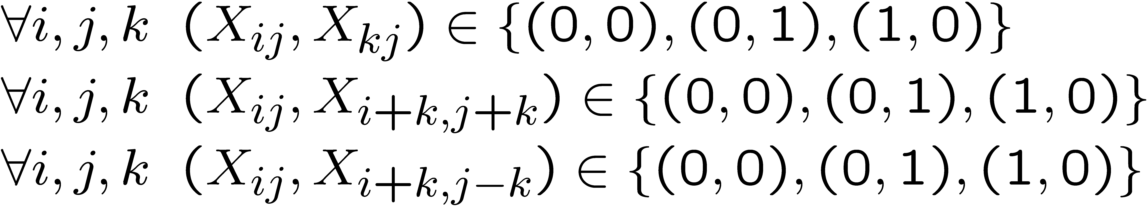
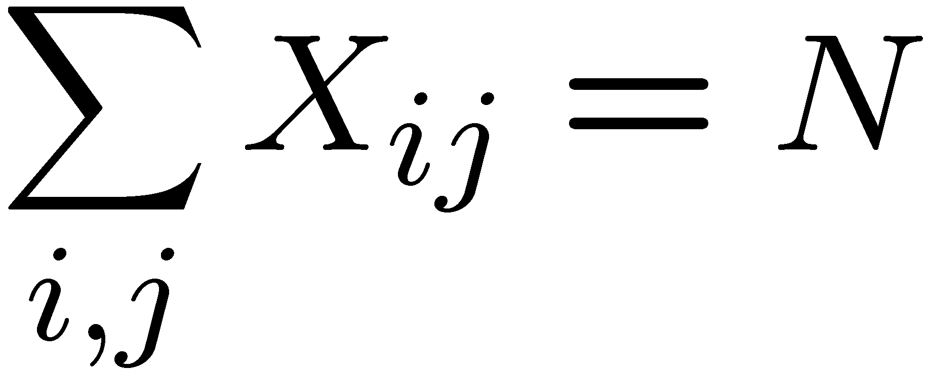
Example: N-Queens
Formulation 1:
  Variables:
  Domains:
  Constraints
Same…
row
column
diagonal
number
domain
Notes:
Are these constraints enough? No, there should be N queens there.
(row, column)
Each Xij represents a grid position on our N ×N chessboard, with i
and j specifying the row and column number respectively

Slide 10

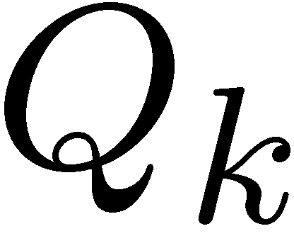


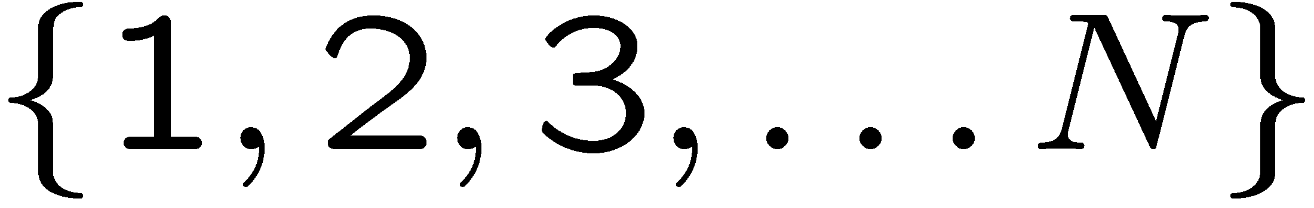


Example: N-Queens (simpler?)
Formulation 2:
  Variables:
        (rows)
  Domains:
        (column in row)
  Constraints:
Implicit:
Explicit:
Notes:
come up with some constraints!
For all I,j (Q_i != Q_j), and |i-j| !=|Qi – Qj|

Slide 11

Solving CSPs

Slide 12
Standard Search Formulation
Standard search formulation of CSPs
States defined by the values assigned so far (partial assignments)
  Initial state: the empty assignment, {}
  Successor function: assign a value to an unassigned variable
  Goal test: the current assignment is complete and satisfies all constraints
We’ll start with the straightforward, naïve approach, then improve it

Slide 13

Backtracking Search

Slide 14

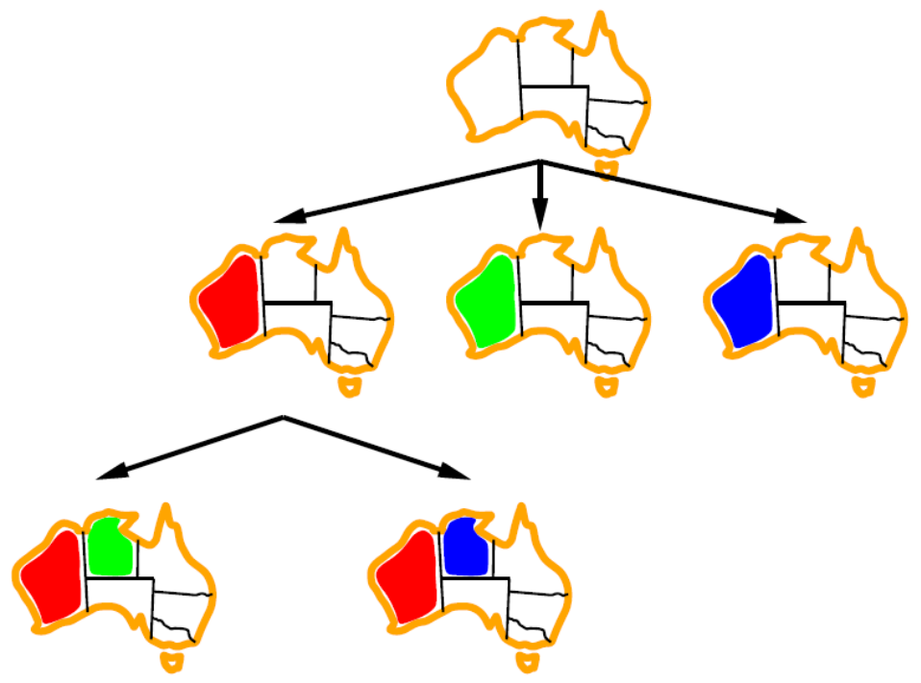
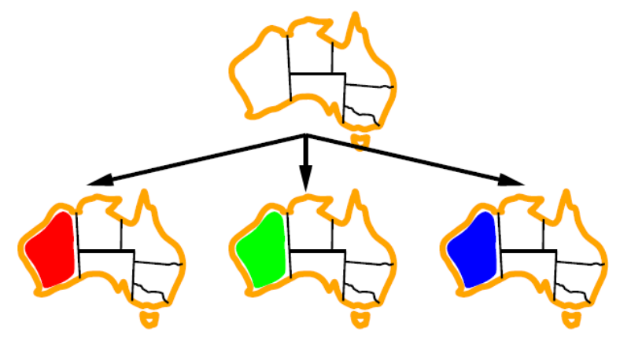
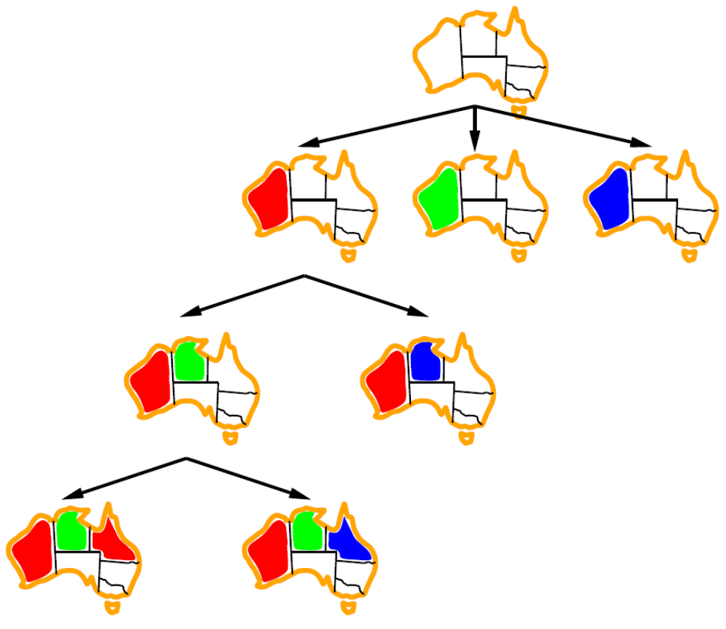
Backtracking Search Conceptually
Use a DFS
Fix the ordering of variable assignment
  Variable assignments are commutative
  Each depth only considers one variable
Check the constraints as you go
  Similar to pruning?
Notes:
Idea 1: One variable at a time
Variable assignments are commutative, so fix ordering -> better branching factor!
E.g., [WA = red then NT = green] same as [NT = green then WA = red]
Only need to consider assignments to a single variable at each step
Idea 2: Check constraints as you go
E.g., consider only values which do not conflict previous assignments
Might have to do some computation to check the constraints
“Incremental goal test”

Slide 15
Backtracking Search Algorithm
function BACKTRACKING-SEARCH(csp) returns solution or failure
return RECURSIVE-BACKTRACKING({}, csp)
function RECURSIVE-BACKTRACKING(assignment, csp) returns solution or failure
if assignment is complete then return assignment
var ← SELECT-UNASSIGNED-VARIABLE (VARIABLES[csp], assignment, csp)
for each value in ORDER-DOMAIN-VALUES(var, assignment, csp) do
if value is consistent with assignment given CONSTRAINTS[csp] then
add {var = value} to assignment
var ← RECURSIVE-BACKTRACKING(assignment, csp)
if result ≠ failure then return result
remove {var = value} from assignment
return failure
Notes:
We haven’t talked about the ordering, so lets just assume its some random ordering for now.
Which variable to assign next, which order to try them
Ask: How do we improve backtracking search? E.g. what if a choice now doesn’t have an affect until much later, not just the next decision?

Slide 16
Improving Backtracking Search
function BACKTRACKING-SEARCH(csp) returns solution or failure
return RECURSIVE-BACKTRACKING({}, csp)
function RECURSIVE-BACKTRACKING(assignment, csp) returns solution or failure
if assignment is complete then return assignment
var ← SELECT-UNASSIGNED-VARIABLE (VARIABLES[csp], assignment, csp)
for each value in ORDER-DOMAIN-VALUES(var, assignment, csp) do
if value is consistent with assignment given CONSTRAINTS[csp] then
add {var = value} to assignment
var ← RECURSIVE-BACKTRACKING(assignment, csp)
if result ≠ failure then return result
remove {var = value} from assignment
return failure
Which order should we assign values to variables in?
Can we detect failure early?
Notes:
We haven’t talked about the ordering, so lets just assume its some random ordering for now.
Which variable to assign next, which order to try them
Ask: How do we improve backtracking search? E.g. what if a choice now doesn’t have an affect until much later, not just the next decision?

Slide 17

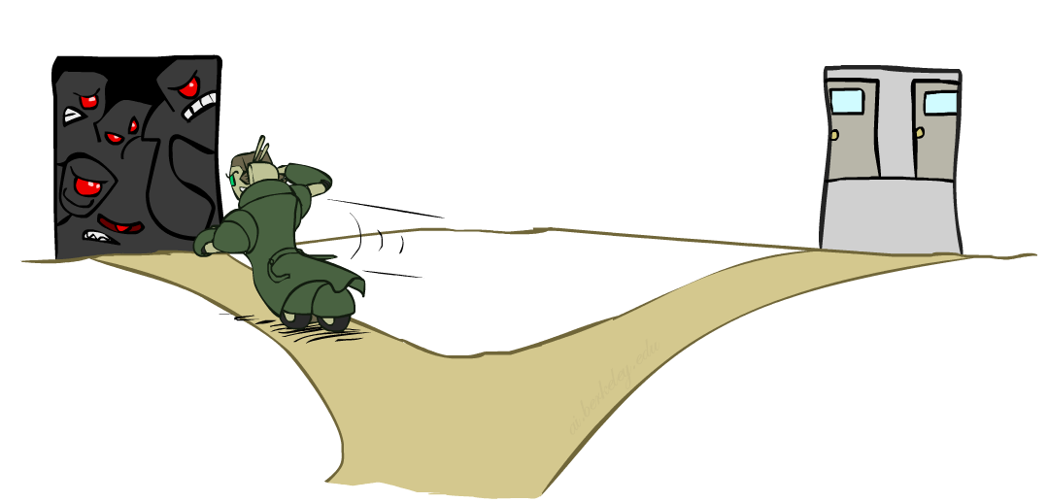
Ordering: Minimum Remaining Values
Variable Ordering: Minimum remaining values (MRV):
  Choose the variable with the fewest legal left values in its domain
Why min rather than max?
Also called “most constrained variable”
“Fail-fast” ordering
Notes:
don’t procrastinate
This is a given of the csp at the moment, the values we get to pick!

Slide 18
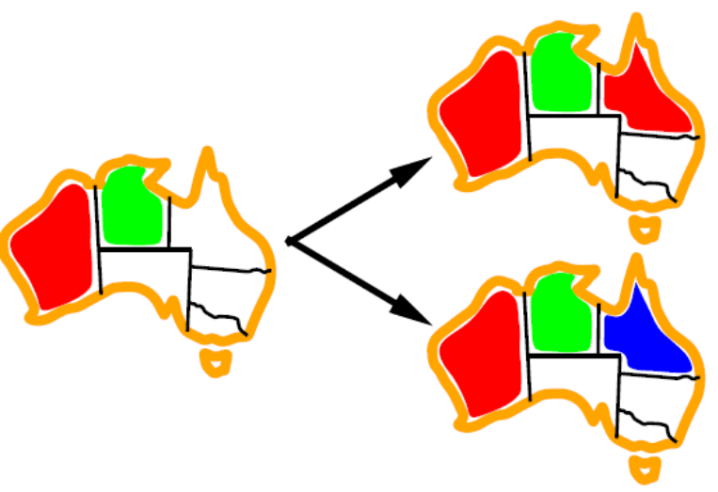
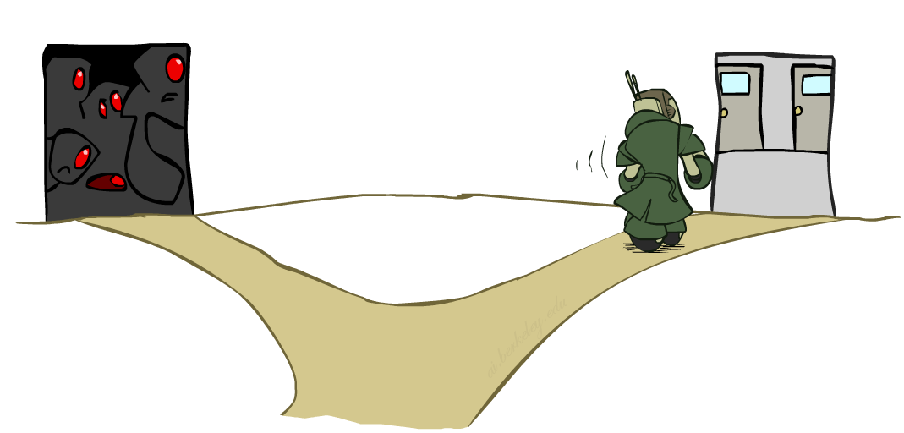
Ordering: Least Constraining Value
Value Ordering: Least Constraining Value
  Given a choice of variable, choose the least constraining value
  I.e., the one that rules out the fewest values in the remaining variables
  Note that it may take some computation to determine this! (E.g., rerunning filtering)
Why least rather than most?
Notes:
Least rather than most because more opportunities for failure is not a good thing! We don’t want to explore those parts of the space

Slide 19
Back-tracking tree soln for 4 queens.
Q₁,Q₂,Q₃,Q₄ = ?
D_{i}={1,2,3,4}
D₂={3,4}, D₃={2,4}, D₄={2,3}
Q₁=1
D₂={4}, D₃={1,3}, D₄={1,3,4}
Q₁=2
Q₁=3
Q₁ =4
D₃={}, D₄={2}
Q₁=1, Q₂ =3
Q₁=1, Q₂ =4
D₃={2}, D₄={4}
Q₁=2, Q₂ =4
D₃={1}, D₄={1,4}
D₄={0}
Q₁=1, Q₂ =4, Q₃ =2
Q₁=2, Q₂ =4, Q₃=1
D₄={4}
Q₁=2, Q₂ =4, Q₃=1, Q₄=3

Slide 20

Filtering
Keep track of domains for unassigned variables and cross off bad options
Notes:
Again not sure how much I like this crim

Slide 21
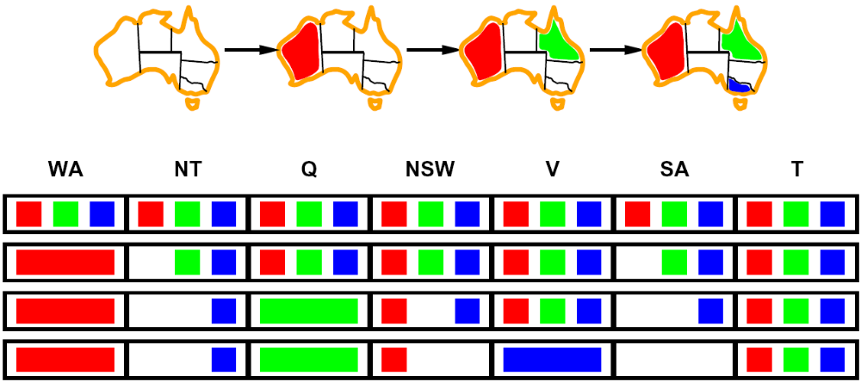
Filtering: Forward Checking
Filtering: Keep track of domains for unassigned variables and cross off bad options
Forward checking: Cross off values that violate a constraint when added to the existing assignment
WA
NT
Q
SA
NSW
V
Notes:
Demo:
Settings:
Graph = Simple
Algorithm = Backtracking
Ordering = None
Filtering = Forward Checking
But it made the same mistakes as before?! Why wasn’t it better than simple backtracking?

Slide 22
Back-tracking soln using forward checking.
Q₁,Q₂,Q₃,Q₄ = ?
D_{i}={1,2,3,4}
D₂={3,4}, D₃={2,4}, D₄={2,3}
Q₁=1
D₂={4}, D₃={1,3}, D₄={1,3,4}
Q₁=2
Q₁=3
Q₁ =4
D₃={}, D₄={2}
Q₁=1, Q₂ =3
Q₁=1, Q₂ =4
D₃={2}, D₄={4}
Q₁=2, Q₂ =4
D₃={1}, D₄={1,4}
D₄={0}
Q₁=1, Q₂ =4, Q₃ =2
Q₁=2, Q₂ =4, Q₃=1
D₄={4}
Q₁=2, Q₂ =4, Q₃=1, Q₄=3
Without forward checking would also try Q₂=1, Q₂=2 etc.

Slide 23
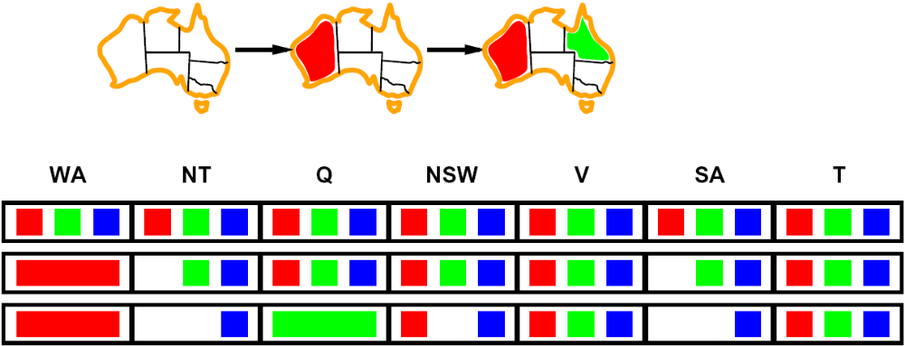
Filtering: Constraint Propagation
Forward checking propagates information from assigned to unassigned variables, but doesn't provide early detection for all failures:
NT and SA cannot both be blue!
Why didn’t we detect this yet?
Constraint propagation: reason from constraint to constraint
NT
Q
WA
SA
NSW
V
Notes:
We’ve already failed, but forward checking does not detect that.

Slide 24
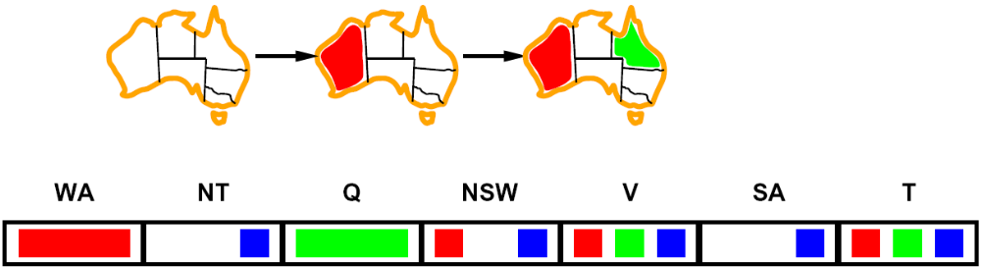
Consistency of A Single Arc
An arc X → Y is consistent if and only if for every x in the tail there is some y in the head which could be assigned without violating a constraint
NT
Q
WA
SA
NSW
V
Assign a value to Queensland and run forward checking
Notes:
Consistency is unidirectional!
But it is enforeced appropriately here so in the next slide we then add the value of queensland, having already removed

Slide 25
Arc Consistency of an Entire CSP
A simple form of propagation makes sure all arcs are consistent
Let’s run arc consistency on this CSP:
Important: If X loses a value, neighbors of X need to be rechecked!
Arc consistency detects failure earlier than forward checking
Can be run as a preprocessor or after each assignment
What’s the downside of enforcing arc consistency?
  It’s expensive!
NT
Q
WA
SA
NSW
V
Remember: Delete from the tail!
Notes:
reminds you of a* - heuristic takes time
You could theoretically revisit the entire graph depending on which variables you enforce consistency on first!

Slide 26
Enforcing Arc Consistency in a CSP
function AC-3(csp) returns false if an inconsistency is found and true otherwise
queue ← a queue of arcs, initially all the arcs in csp
while queue is not empty do
(X_{i},X_{j}) ← POP(queue)
if REVISE(csp, X_{i},X_{j} ) then
if sizeof D_{i} =0 then return false
for each X_{k} in X_{i}.NEIGHBORS – {X_{j}} do
queue. PUSH(X_{k},X_{i})
return true
function REVISE(assignment, csp) returns true if domain of X_{i} is revised
revised ← false
for each x in D_{i} do
if no y in D_{j} allows (x,y) to satisfy constraint between (X_{i},X_{j}) then
delete x from D_{i}
revised ← true
return revised
Runtime: O(n²d³), can be reduced to O(n²d²) (outer loop might add an arc back to the queue at most d times if poorly ordered)
… but detecting all possible future problems is NP-hard – why?
Notes:
Which one is the tail, X_i or X_j?
Reduce by ordering of arcs
Why is it hard? Well we’ll see with k-consistency but you can think of it as with forward checking, the problems become more and more complex…we end up trying to do the backtracking we are attempting to avoid. Exponential in N
AC-3 is an algorithm name
Auto-consistency (note initially nothing gets deleted/pruned since there are consistent options for all constraints for initial variable domains)
Flashes whenever something needs to be re-checked

Slide 27
Arc consistency for 4 queens.
Q₁,Q₂,Q₃,Q₄ = ?
D_{i}={1,2,3,4}
D₂={3,4}, D₃={2,4}, D₄={2,3}
Q₁=1
All the arcs
Q₂→Q₁ Q₃→Q₁ Q₄→Q₁
Q₁→Q₂ Q₃→Q₂ Q₄→Q₂
Q₁→Q₃ Q₂→Q₃ Q₄→Q₃
Q₁→Q₄ Q₂→Q₄ Q₃→Q₄
Starting Domains
D₁={1,2,3,4} D₂={1,2,3,4} D₃={1,2,3,4} D₄={1,2,3,4}
Filtered Domains
D₁={1}
D₂={3,4}
D₃={2,4}
D₄={2,3}
AC-3 Domains
D₁={1}
D₂={3,4}
D₃={2}
D₄={}

Slide 28


Limitations of Arc Consistency
After enforcing arc consistency:
  Can have one solution left
  Can have multiple solutions left
  Can have no solutions left
  (and not know it)
Arc consistency may still run inside a backtracking search!
Notes:
Consider these two examples.
What will arc consistency say of the first?
Of the second?
Demo:
CS188 javascript demos -> source -> exercises -> csps -> CSPs demos -> CSPs demos.html
Settings:
Graph = Complex
Algorithm = Backtracking
Ordering = None
Filtering = Forward Checking (first) / Arc Consistency (second)
Comments on demos:
Forward checking doesn’t look far enough into future
Arc consistency can still run into problems backtracking but not as much usually

Slide 29
Solution: K-Consistency
Increasing degrees of consistency
  1-Consistency (Node Consistency): Each single node’s domain has a value which meets that node’s unary constraints
  2-Consistency (Arc Consistency): For each pair of nodes, any consistent assignment to one can be extended to the other
  3-Consistency (Path Consistency iff binary): For every set of three nodes, any consistent assignment to two can be extended to the third
  K-Consistency: For each k nodes, any consistent assignment to k-1 can be extended to the k^{th} node.
Higher k more expensive to compute
(You need to know the k=2 case: arc consistency)
Notes:
http://www.dcs.gla.ac.uk/~pat/cpM/papers/CP_Handbook-20060315-final.pdf
See chapter three from “The Handbook on Constraint Programming” 2006
“As observed by Dechter [46], even if 3-consistency has strong similarities with (2-)path
consistency, it is not equivalent. Indeed, 3-consistency ensures that any instantiation of
length 2 can be extended to an instantiation involving any third variable without violating
any constraint, whereas (2-)path consistency only guarantees that binary constraints are
not violated.”

Slide 30
Strong K-Consistency
Strong k-consistency: also k-1, k-2, … 1 consistent
Claim: strong n-consistency means we can solve without backtracking!
  (where n is the size of entire CSP)
Why?
  Choose any assignment to any variable
  Choose a new variable
  By 2-consistency, there is a choice consistent with the first
  Choose a new variable
  By 3-consistency, there is a choice consistent with the first 2
  …
Lots of middle ground for algorithms between arc consistency and
n-consistency!
  (e.g. k=3, called path consistency)
Runtime?
  After enforcing consistency must enumerate values
    … O(n²d)
  Enforcing strong-k consistency is NP-complete
    …O(n^{k} d^{k})
Notes:
https://gki.informatik.uni-freiburg.de/teaching/ss12/csp/csp04-handout.pdf
“First, we choose a consistent value for X1. We are then guaranteed to be able to choose a value for X2 because the graph is 2-consistent, for X3 because it is 3-consistent, and so on. For each variable Xi, we need only search through the d values in the domain to find a value consistent with X1, . . . ,Xi−1. The total run time is only O(n2d). “
This is what the book says on the enumeration of values… but I see it as O(nd)

Slide 31
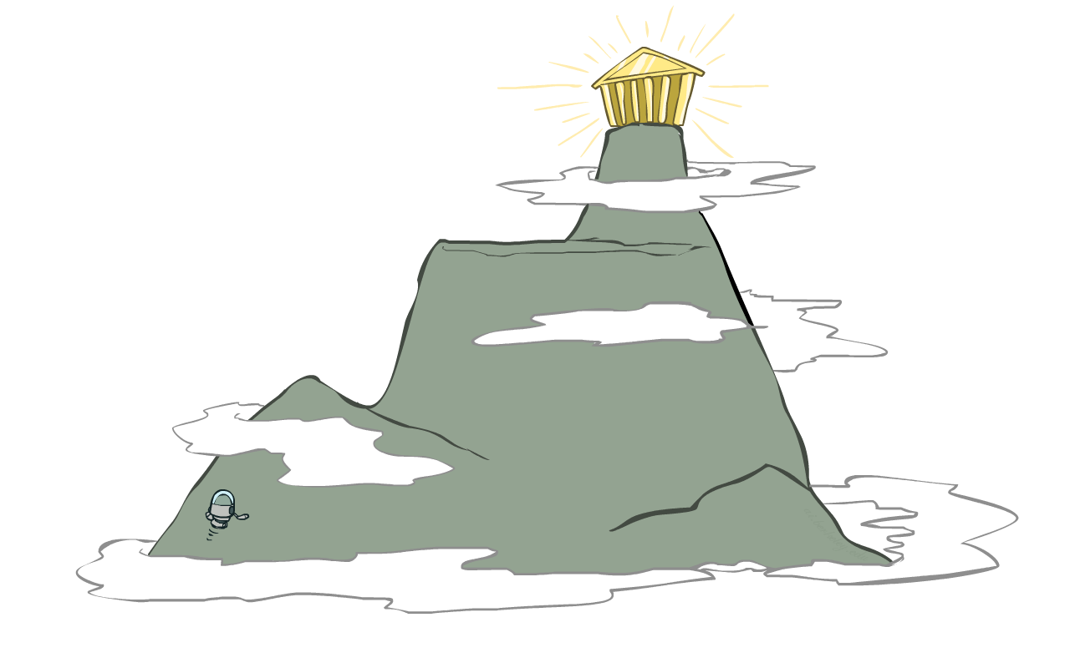
Iterative Algorithms for CSPs
Local search methods typically work with “complete” states, i.e., all variables assigned
To apply to CSPs:
  Take an assignment with unsatisfied constraints
  Operators reassign variable values
  No fringe! Live on the edge.
Algorithm: While not solved,
  Variable selection: randomly select any conflicted variable
  Value selection: min-conflicts heuristic:
    Choose a value that violates the fewest constraints
    I.e., hill climb with h(x) = total number of violated constraints
Notes:
Show min conflicts on

Slide 32
that’s it for today!
Constraint Satisfaction Problems
Solve via DFS with improvements
But other solutions, such as global search algorithms, can be applied
Modeling Stochasticity
Reinforcement Learning
Do Project 1

