Slide 1
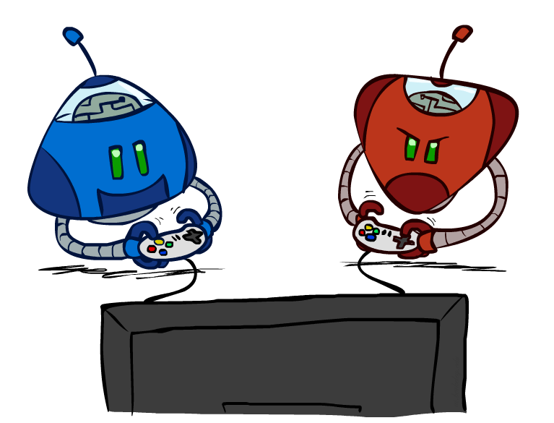
Adversarial Search
CSE 473: Introduction to Artificial Intelligence
Megan Hazen (mh75@cs)
cs.uw.edu/473
acknowledgements
Welcome!
Is cereal a soup?

Slide 2
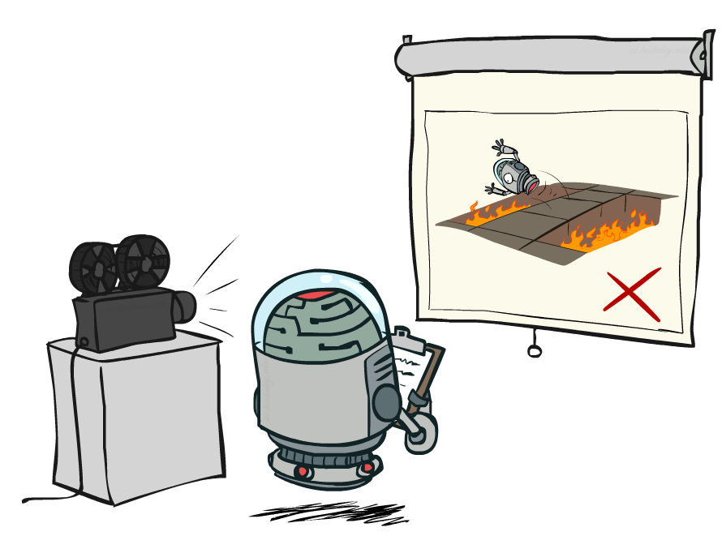
Administrivia
Office hours increased!
Small change to practice problem scoring to allow 2 sick days
You may work with friends (or come to office hours and work with new friends!) – but makes sure you can understand and complete everything you turn in yourself.
Homework 1 due Monday (10.12)
Project 1 due next Monday (10.19)

Slide 3
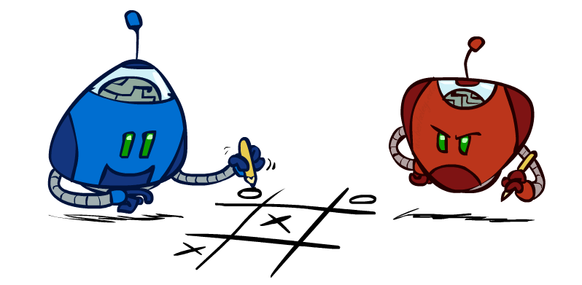
Games

Slide 4
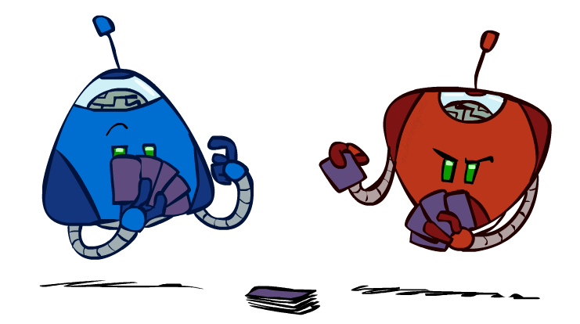
Types of Games
Games model environments with more than one agent
Characteristics
  deterministic vs stochastic?
  fully observable vs. partially observable?
  number of players?
  turn-taking vs. simultaneous?
  zero sum?
How to plan around opponent’s moves?

Slide 5
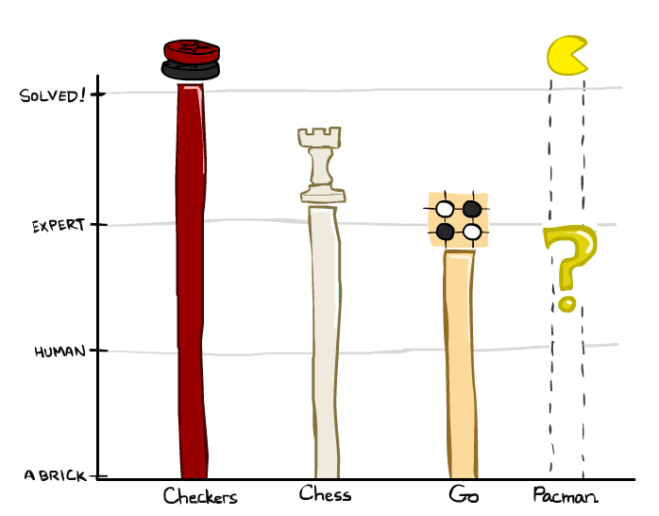

A brief history
Checkers:
  1950: First computer player.
  1959: Samuel’s self-taught program.
  1994: First computer world champion: Chinook defeats Tinsley
  2007: Checkers solved! Endgame database of 39 trillion states
Chess:
  1945-1960: Zuse, Wiener, Shannon, Turing, Newell & Simon, McCarthy.
  1960s onward: gradual improvement under “standard model”
  1997: Deep Blue defeats human champion Gary Kasparov
  2021: Stockfish rating 3551 (vs 2870 for Magnus Carlsen).
Go:
  1968: Zobrist’s program plays legal Go, barely (b>300!)
  1968-2005: various ad hoc approaches tried, novice level
  2005-2014: Monte Carlo tree search -> strong amateur
  2016-2017: AlphaGo defeats human world champions
Pacman
Notes:
Tinsley lost only 5 games to humans in 42 years; has been known to solve 60-ply problems

Slide 6
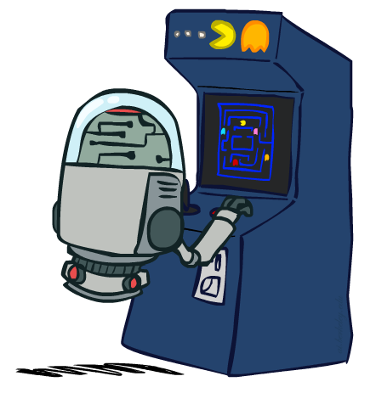
”Standard” Games
Deterministic, observable, two-player, turn-taking, and zero-sum games
Game Formulation
  Initial state: s₀
  Players: player(s) indicating turn
  Actions: actions(s) for player on move
  Transition model: T(s, a)
  Terminal (goal) test: terminal-test(s)
  Terminal values: utility(s, p)

Slide 7
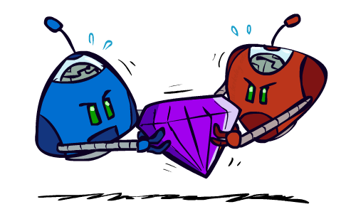
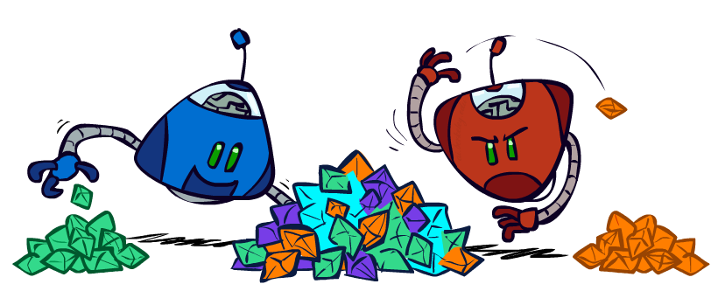
Zero-Sum Games
Zero-Sum Games
General Games
Agents have opposite utilities
One agent maximizes,
the other minimizes
Agents have independent utilities
Cooperation, indifference, competition, etc. are all possible

Slide 8
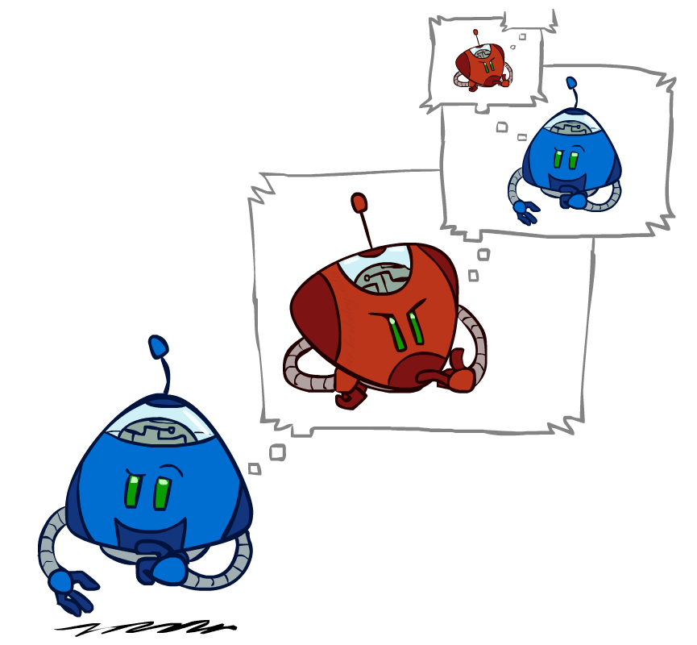
Adversarial Thinking

Slide 9
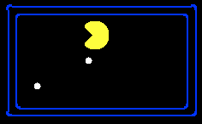
Single-Agent Trees
8
2
0
2
6
4
6

Slide 10
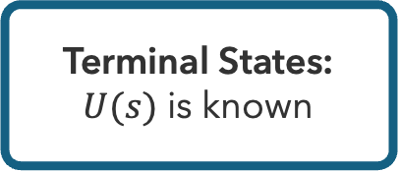
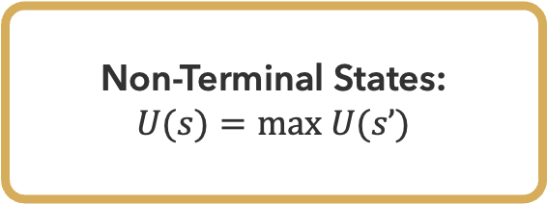
Utility
Non-Terminal States:
$U(s)=max U(s’)$
Utility is the best achievable outcome (value) from that state
8
2
0
2
6
4
6
Terminal States:
$U(s)$ is known

Slide 11

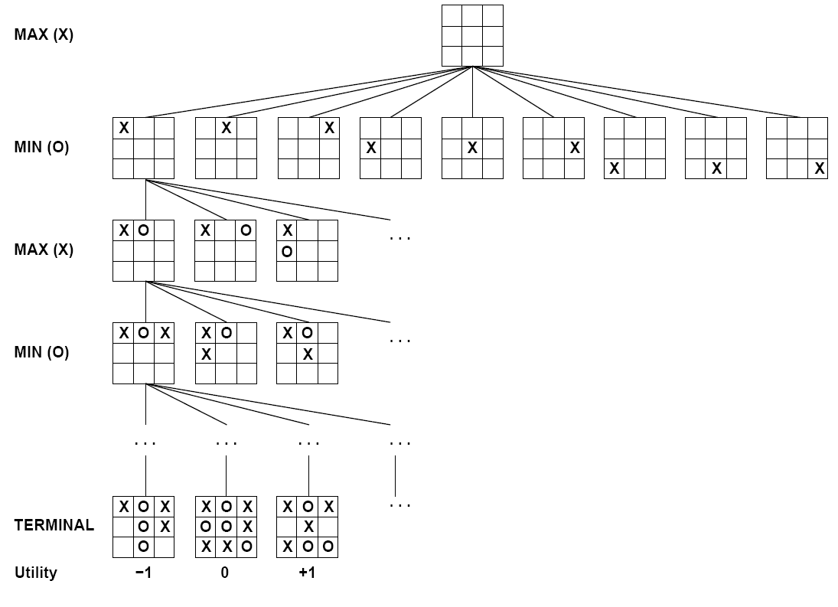

Tic-Tac-Toe

Slide 12


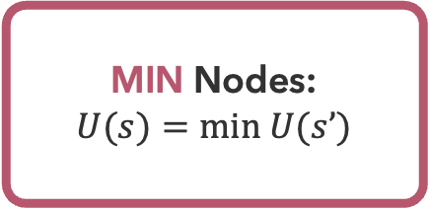

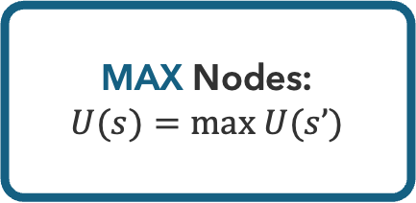
Minimax Values
-8
-8
-10
-8
-5
-10
+8
MAX Nodes:
$U(s)=max U(s’)$
MIN Nodes:
$U(s)=min U(s’)$
$$s’∈successors(s)$$
$$s’∈successors(s)$$

Slide 13
Minimax Tree
3
3
2
2
3
12
8
2
4
6
14
5
2

Slide 14
Minimax
function MINIMAX(s) returns action
return action a in actions(s) with highest minimax-values(T(s,a))
function MINIMAX-VALUES(s) returns value
if terminal-test(s) then return utility(s)
if player(s) == MAX then return max _{a in actions(s)} minimax-values(T(s,a))
if player(s) == MIN then return min _{a in actions(s)} minimax-values(T(s,a))

Slide 15
Questions (1)

Slide 16
Is It Efficient?
How efficient is minimax?
  Operates just like (exhaustive) DFS
  Time Complexity: O(b^{m})
  Space Complexity: O(bm)
Example: Chess
  b ≈ 35, m ≈ 100
  Completely infeasible
  Is this how humans play chess?

Slide 17
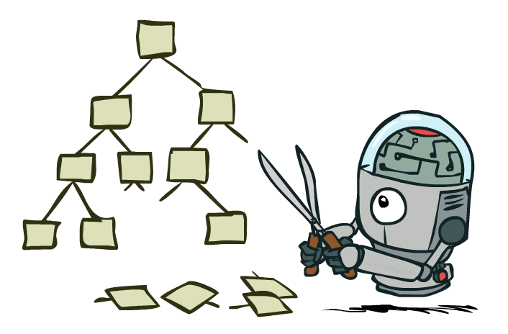
Avoiding Unnecessary Work

Slide 18
Pruning
MAX node must be at least 3
What about this MIN node?
?
?
?
3
2*
3
12
8
2
4
6
14
5
2
MIN node must no greater than 2
Remaining children are irrelevant → prune

Slide 19

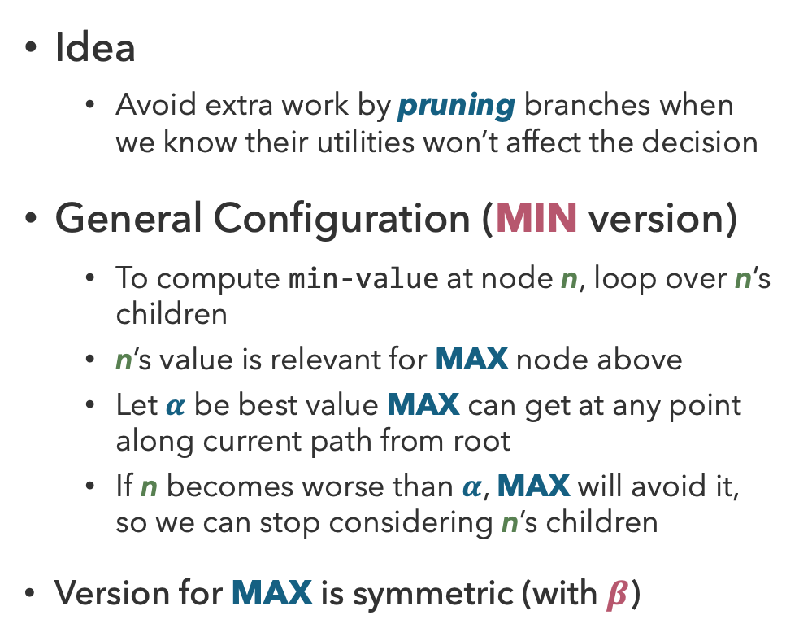
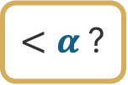
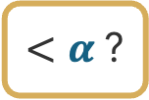
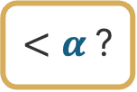
Alpha-Beta Pruning
$$α$$
Idea
  Avoid extra work by pruning branches when we know their utilities won’t affect the decision
General Configuration (MIN version)
  To compute min-value at node n, loop over n’s children
  n’s value is relevant for MAX node above
  Let $α$ be best value MAX can get at any point along current path from root
  If n becomes worse than $α$, MAX will avoid it, so we can stop considering n’s children
Version for MAX is symmetric (with $β$)
n
?
?
?
$<α$?
$<α$?
$<α$?

Slide 20
Alpha-Beta Implementation
function MINIMAX-DECISION(s) returns action
return action a in actions(s) with highest max-value(T(s,a),-∞,+∞)
function MAX-VALUE(s, α, β) returns value
v ← -∞
for each s’ in successors(s)
v = max(v, min-value(s’, α, β))
if v >= β
return v
α = max(α,v)
return v
function MIN-VALUE(s, α, β) returns value
v ← +∞
for each s’ in successors(s)
v = min(v, max-value(s’, α, β))
if v <= α
return v
β = max(β,v)
return v

Slide 21
Pruning Example
Which nodes get pruned? What are the $α$ and $β$ values at the end?
a
h
b
e
i
l
c
d
f
g
j
k
m
n
10
6
90
8
1
2
20
4

Slide 22
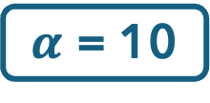

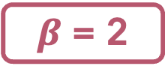
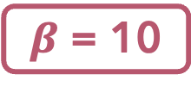
Pruning Example (Solution)
Which nodes get pruned? What are the $α$ and $β$ values?
$α$ = 10
a
h
$β$ = 10
$β$ = 2
b
e
i
c
d
f
j
k
10
6
90
1
2

Slide 23
Properties of Alpha-Beta Pruning
Theorem: Alpha-Beta pruning has no effect on computed minimax value
Good child ordering improves efficiency
With “perfect ordering”:
  Time complexity drops to O(b^{m/2})
  Doubles the solvable depth!
Example of metareasoning
  Reasoning about reasoning
For chess
  Only 35⁵⁰ instead of 35¹⁰⁰
?
?
?

Slide 24
Questions (2)

Slide 25
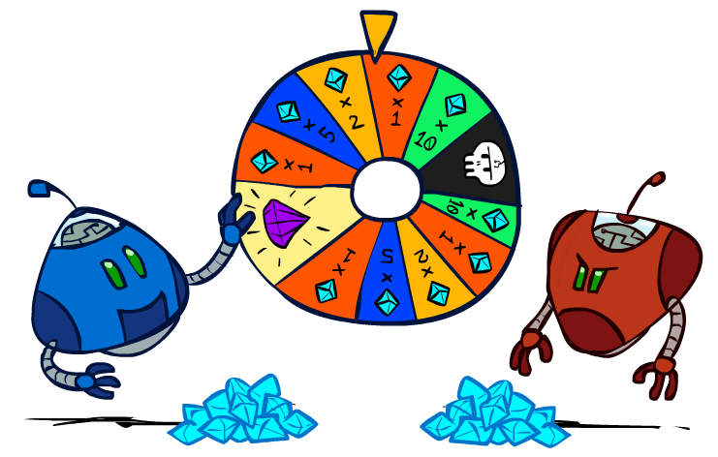
Games with Uncertainty

Slide 26
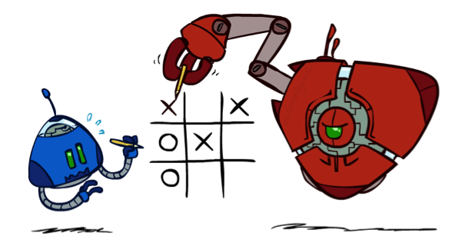
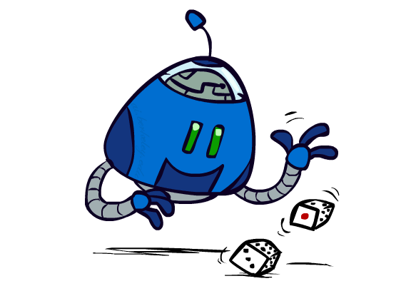

Chance Outcomes in Trees
10
10
9
20
10
10
9
20
10
9
10
9
10
20
Minimax
Expectimax
Expectiminimax

Slide 27
Expectiminimax
function DECISION(s) returns action
return action a in actions(s) with highest value(T(s,a))
function VALUE(s) returns value
if terminal-test(s) then return utility(s)
if player(s) == MAX then return max _{a in actions(s)} value(T(s,a))
if player(s) == MIN then return min _{a in actions(s)} value(T(s,a))
if player(s) == CHANCE then return sum _{a in actions(s)} P(a) * value(T(s,a))

Slide 28
Expectimax
8
8
4
7
3
12
9
2
4
6
15
6
0

Slide 29
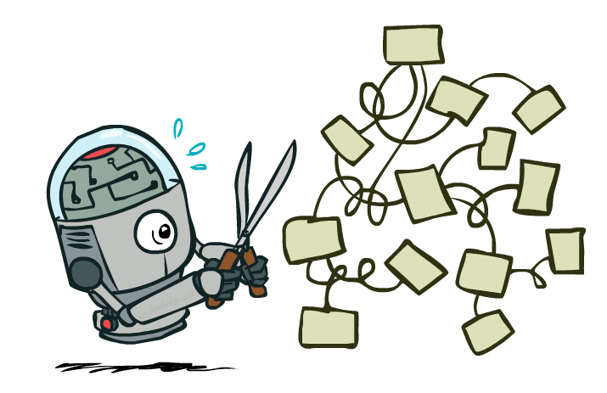
Expectimax Pruning?
8
8
?
3
12
9
2

Slide 30

Resource Limits

Slide 31
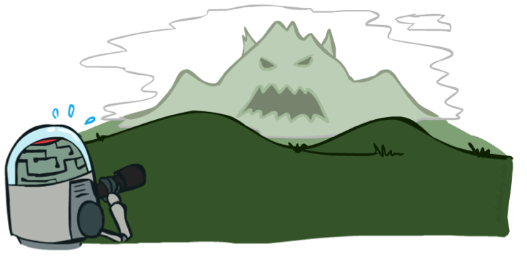

Real-World Constraints
Problem: In realistic games, searching to leaves is infeasible
Solution: Bounded Lookahead
  Search only to a preset depth limit (horizon)
  Use an evaluation function for non-terminal utilities
  Guarantee of optimality is gone
  Marginal increase in depth makes a big difference!
Tradeoff
  Deeper search (usually) leads to better play,
  but is considerably more costly
  Complexity of features vs. complexity of computation

Slide 32
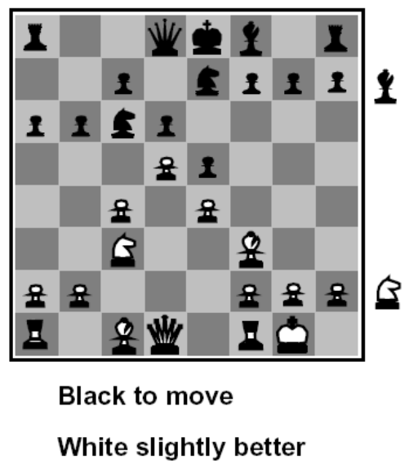
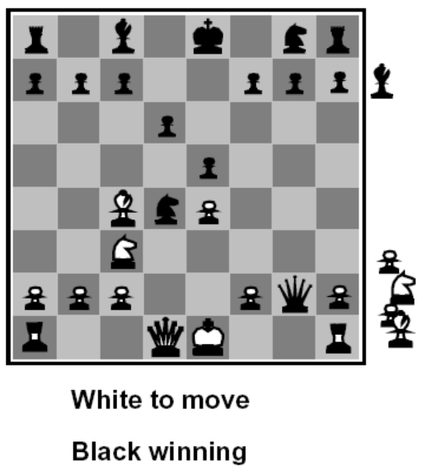
Evaluation Functions
Evaluation functions score non-terminals in depth-limited search
Typically weighted linear sum of features:
  EVAL(s) = w₁ f₁(s) + w₂ f₂(s) + …. + w_{n} f_{n}(s)
  E.g., w₁ = 9, f₁(s) = (num white queens – num black queens), etc.
Or a more complex nonlinear function (e.g., NeuralNet) trained by self-play RL
Terminate search only in quiescent positions, i.e., no major
changes expected in feature values
Notes:
Note connections with 446
Pawn is 1, bishop 3, rook 5, queen 9
About to capture a queen = not quiescent

Slide 33
Questions (3)

Slide 34
that’s it for today!
Multi-Agent Search
Adversarial search via minimax
When transitions are deterministic and players play optimally, pruning is possible
Modeling Stochasticity
Reinforcement Learning
Do Homework 1
Do Project 1

