Slide 1
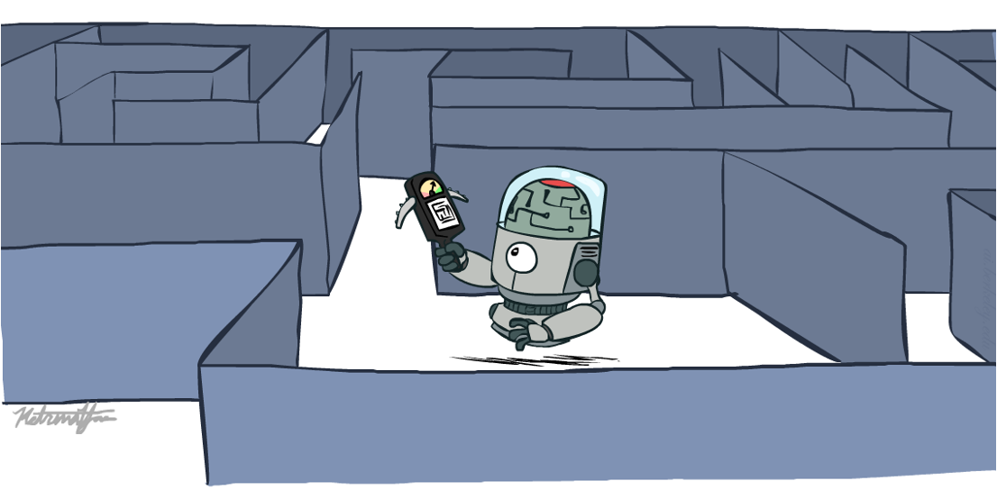
Informed Search
CSE 473: Introduction to Artificial Intelligence
Megan Hazen (mh75@cs)
cs.uw.edu/473
acknowledgements
Welcome!

Slide 2
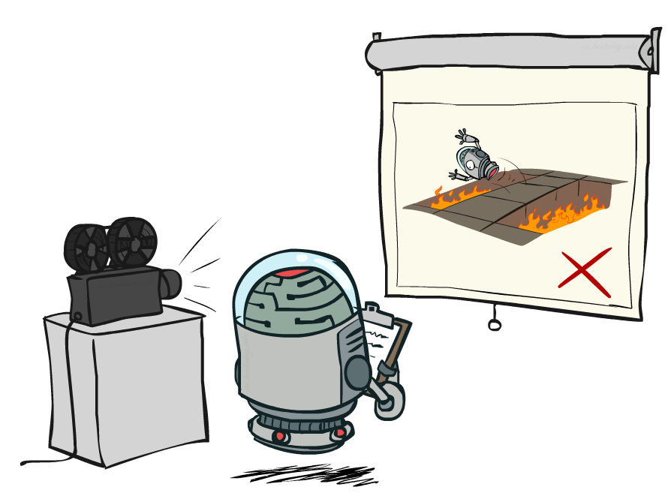
Administrivia
Past quizzes, exams available on course website resources tab
Homework 1 due Monday (10/12)
Project 1 due next Monday (10/19)

Slide 3

Search

Slide 4
DFS vs. BFS
Depth-First Search
Breadth-First Search
Fringe grows linearly with depth
Fringe grows exponentially with depth
S
S
d
e
p
d
e
p
b
c
e
h
r
q
b
c
e
h
r
q
a
a
h
r
p
q
f
a
a
h
r
p
q
f
p
q
f
q
c
G
p
q
f
q
c
G
depth s
q
c
G
a
q
c
G
a
~ depth m
a
a
Space Complexity: O(bm)
Space Complexity: O(b^{s})

Slide 5
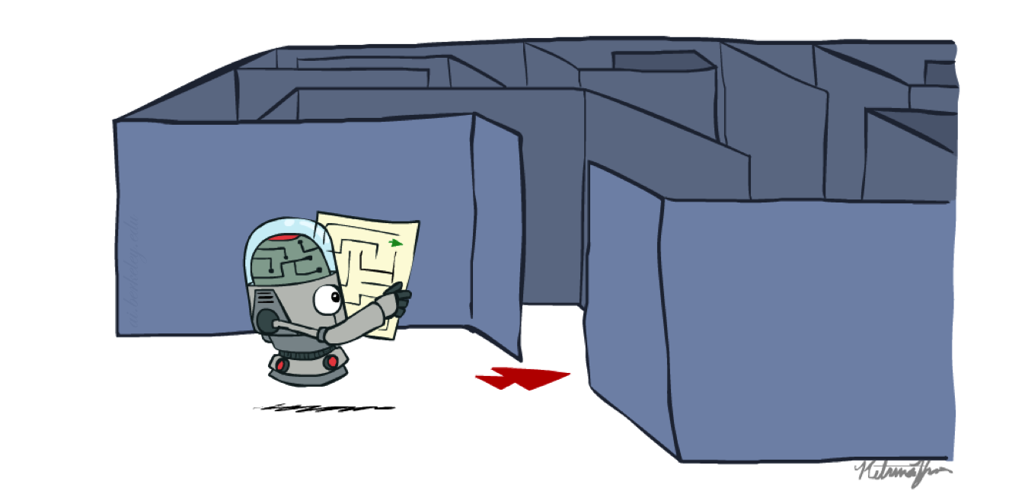
Pacman Wayfinding

Slide 6

What’s Next?
dead end
can we avoid it?
2
a
1
G
b
c
3
1
8
2
2
e
3
d
f
9
8
2
S
1
h
1
1
p
r
q
1
15
Notes:
The question is, can we be more efficient about which paths we explore? Can we avoid the local minima?

Slide 7
Directed Search
Guide search in the direction of the goal, not in all directions
start
goal
Informed
Uninformed

Slide 8
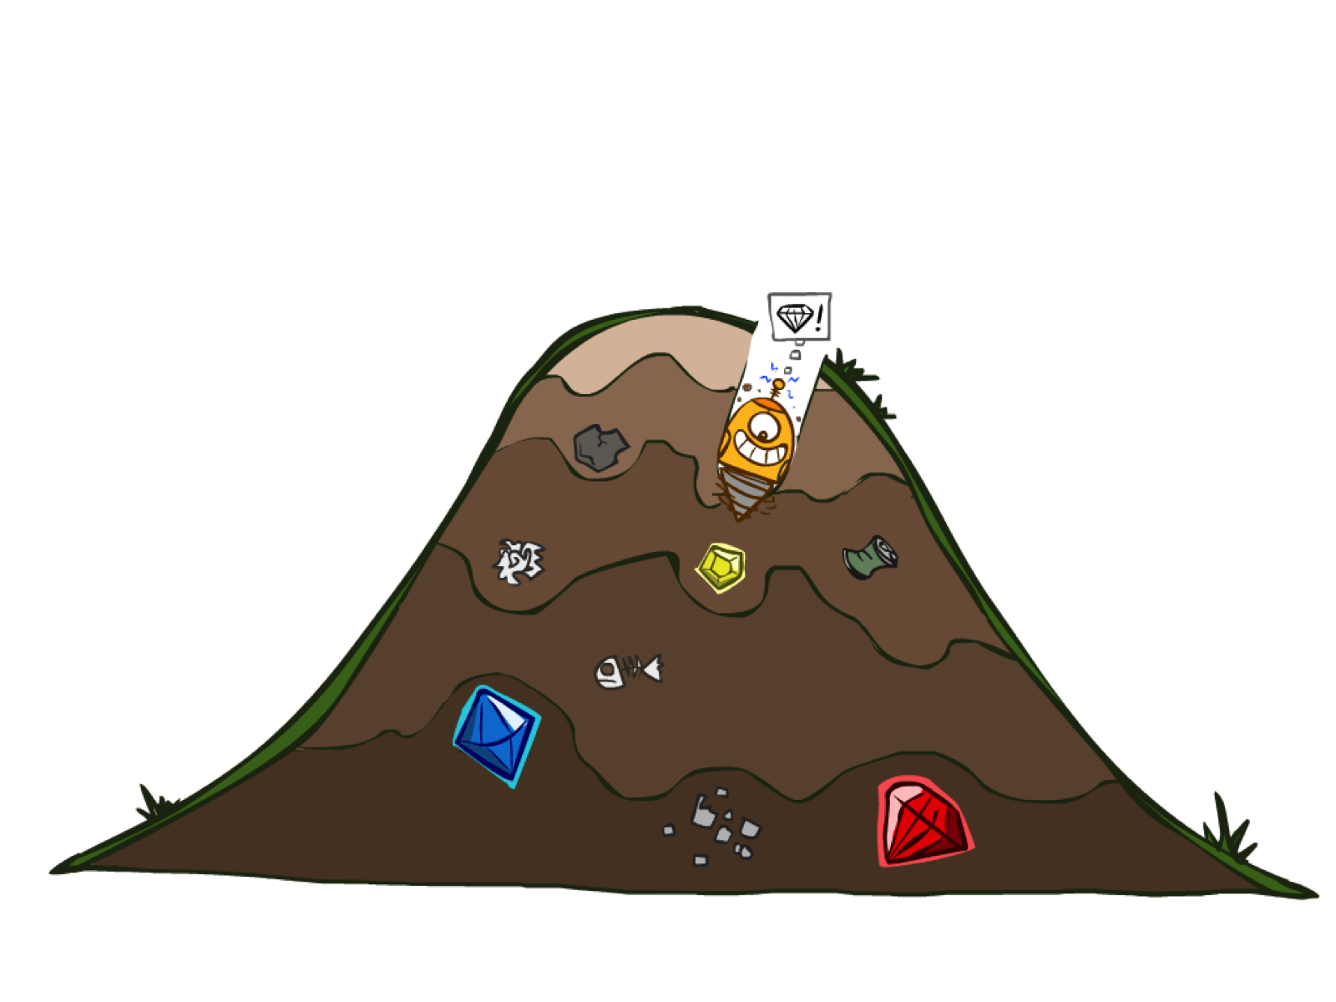
Greedy Search
2
a
1
G
b
c
3
1
8
2
d
7
e
Strategy
  Expand the node you think is closest to the goal
Implementation
  Use heuristics to estimate forward cost
3
f
S
9
8
2
1
h
1
1
p
q
r
15
1
S
d
e
p
b
c
e
h
r
q
a
a
h
r
p
q
f
p
q
f
q
c
G
q
c
G
a
a
more directed, but not optimal

Slide 9
Properties of Greedy Search
Strategy
  Expand the node you think is closest to the goal
  Use heuristics to estimate forward cost
Common Case
  Expand straight to the (suboptimal) goal
Worst Case
  Search around optimal goal
  Like a poorly-guided DFS
b
…

Slide 10
Questions (1)

Slide 11
We’re getting closer, though…

Slide 12



Combining UCS and Greedy Search
Uniform Cost Search
Greedy Search
A* Search

Slide 13
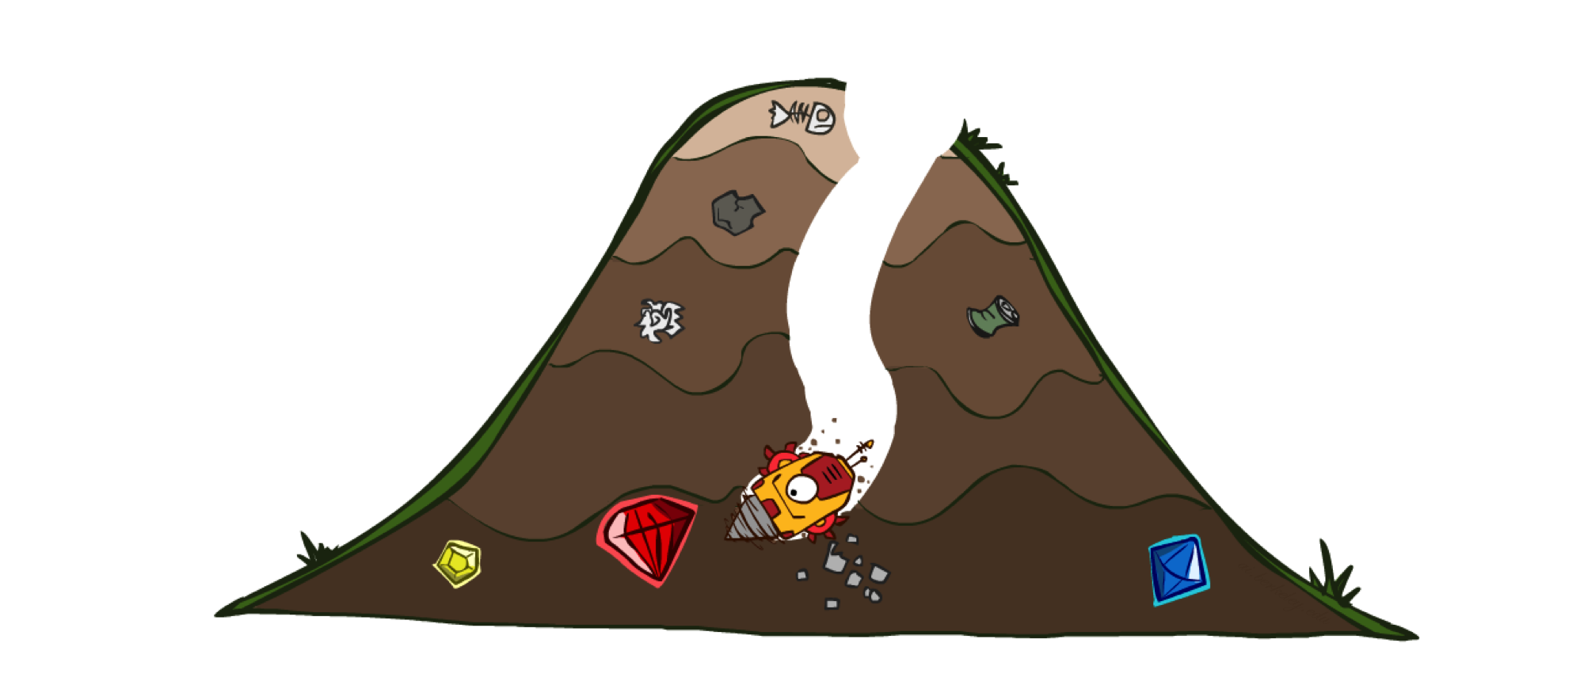
A* Search
h = 12
h = 11
1
c
b
Goal
  Avoid unnecessary searching (and backtracking)
Strategy
  Expand the node most likely to be on the optimal path
  Combine UCS and Greedy Search
Implementation
  g(n) = cost from root to n
  h(n) = heuristic estimate of cost from n to goal
  Use priority queue with f(n) = g(n) + h(n)
h = 2
3
1
8
2
S
a
d
G
h = 10
1
h = 0
e
9
h = 3
Key: good heuristic

Slide 14
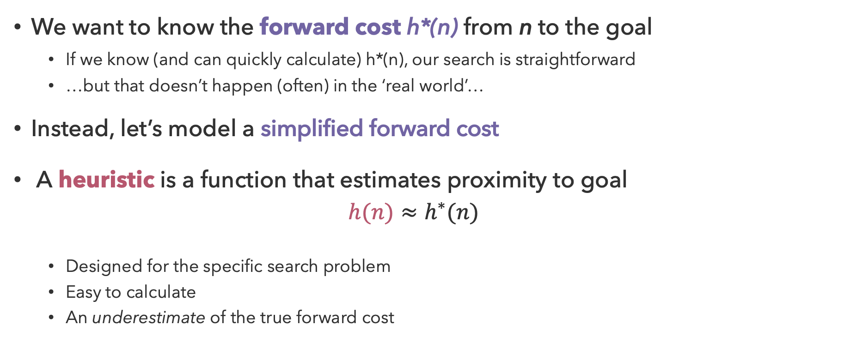
Heuristics
We want to know the forward cost h*(n) from n to the goal
  If we know (and can quickly calculate) h*(n), our search is straightforward
  …but that doesn’t happen (often) in the ‘real world’…
Instead, let’s model a simplified forward cost
A heuristic is a function that estimates proximity to goal
  $$h(n)≈h^{∗}(n)$$
  Designed for the specific search problem
  Easy to calculate
  An underestimate of the true forward cost
Notes:
Notably, if we knew the true cost it would imply that we also knew the solution

Slide 15
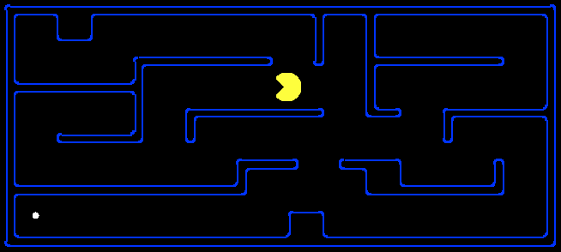
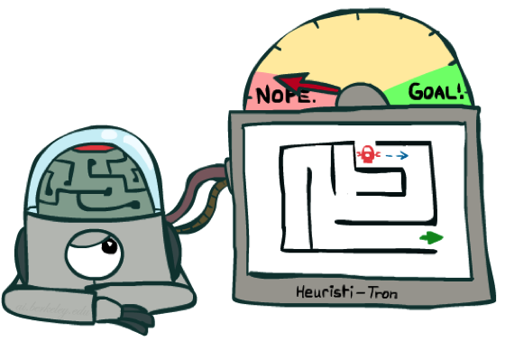
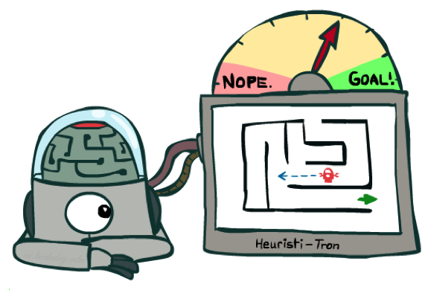
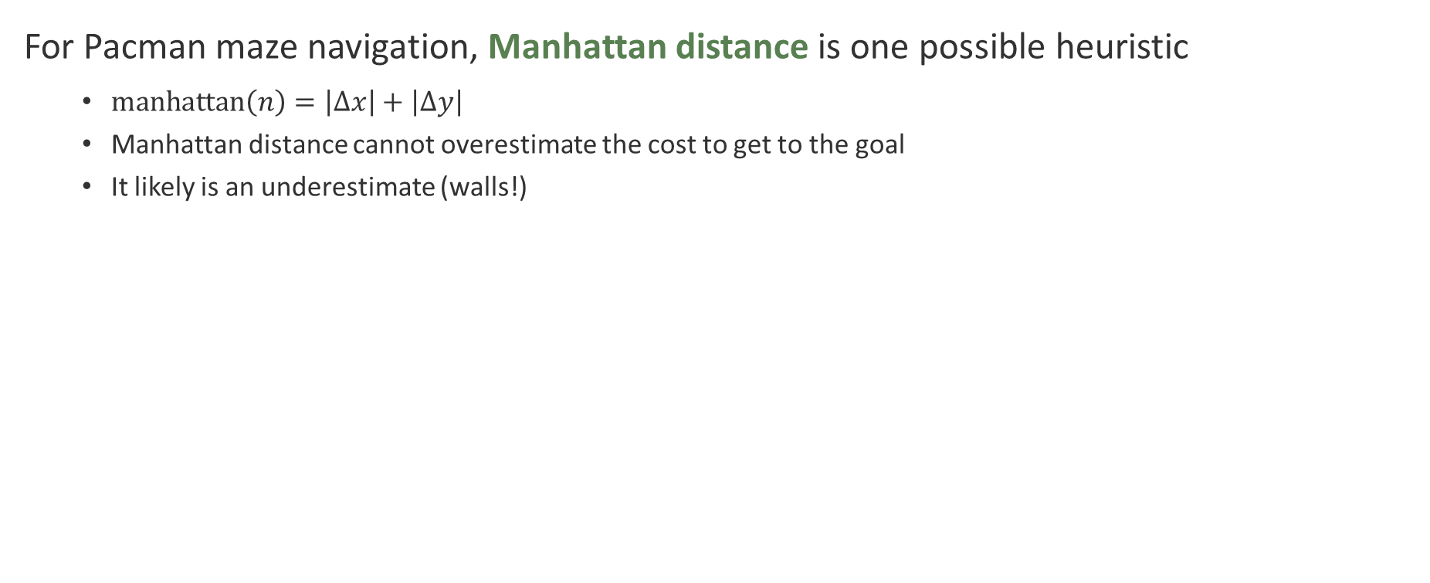
Pacman Pathing
For Pacman maze navigation, Manhattan distance is one possible heuristic
  $manhattan\left(n\right)=\left|Δx\right|+\left|Δy\right|$
  Manhattan distance cannot overestimate the cost to get to the goal
  It likely is an underestimate (walls!)

Slide 16
When to Dequeue Goal States? (1)
h = 2
A
2
2
S
G
h = 3
h = 0
Fringe
2
B
3
S (0 + 3)
h = 1

Slide 17
When to Dequeue Goal States? (2)
h = 2
A
2
2
S
G
h = 3
h = 0
Fringe
2
B
3
S-A (2 + 2), S-B (2 + 1)
h = 1

Slide 18
When to Dequeue Goal States? (3)
h = 2
A
2
2
S
G
Stay in order!
h = 3
h = 0
Fringe
2
B
3
S-A (2 + 2), S-B-G (5 + 0)
h = 1

Slide 19
When to Dequeue Goal States? (4)
h = 2
A
2
2
S
G
h = 3
h = 0
Fringe
2
B
3
S-B-G (5 + 0), S-A-G (4 + 0)
h = 1

Slide 20
When to Dequeue Goal States? (5)
h = 2
Only perform a goal test after dequeuing a node!
A
2
2
S
G
h = 3
h = 0
Fringe
Solution
2
B
3
S-B-G (5 + 0)
S-A-G (4)
h = 1

Slide 21
Questions (2)

Slide 22
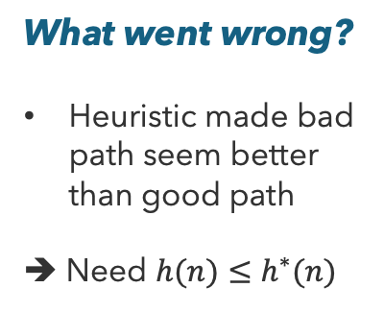
Horrible Heuristics
What went wrong?
Heuristic made bad path seem better than good path
➔ Need $h(n)≤h^{∗}(n)$
h = 5
f(A) = 1 + 5 = 6
1
A
3
S
G
5
h = 6
h = 0
f(G) = 0 + 5 = 5

Slide 23
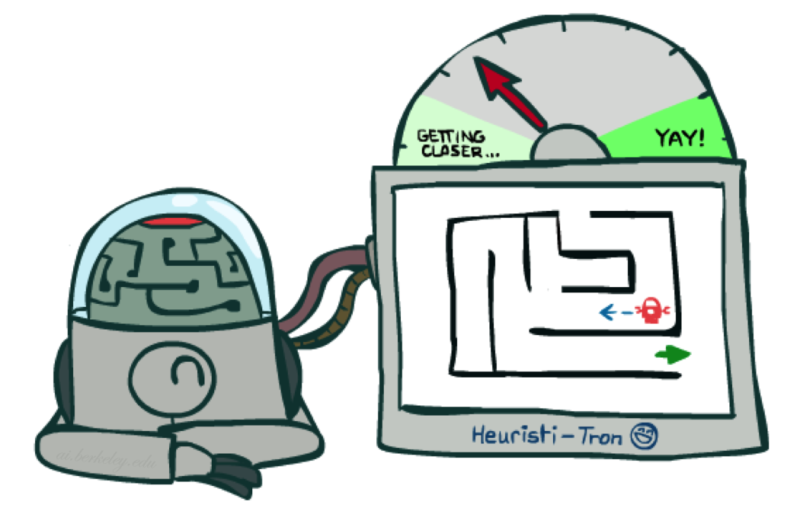
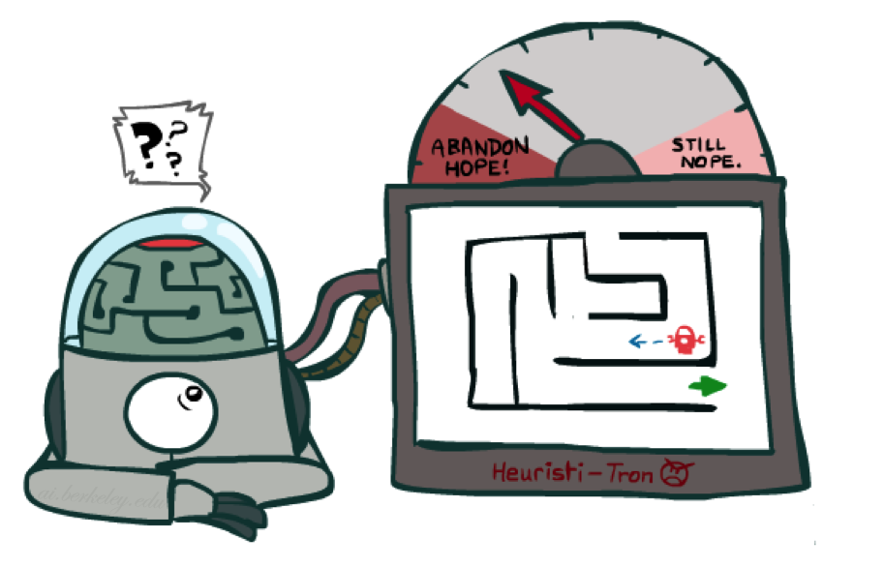
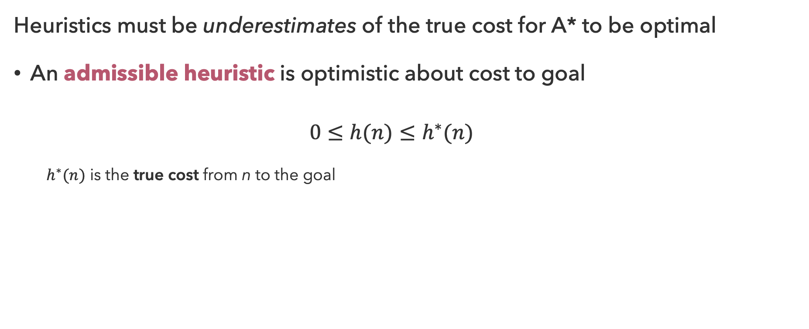
Admissibility
Heuristics must be underestimates of the true cost for A* to be optimal
An admissible heuristic is optimistic about cost to goal
  $$0≤h(n)≤h^{∗}(n)$$
  $h^{∗}(n)$ is the true cost from n to the goal
Admissible heuristics slow down bad paths but never outweigh the true cost
Inadmissible heuristics trap good plans on the fringe, breaking optimality

Slide 24

Claim: A* Search is Optimal!

Slide 25
Optimality of A* Tree Search
Assume
  A is an optimal goal node
  B is a suboptimal goal node
  h is admissible
Claim
  A will be chosen for expansion before B
…
A
B

Slide 26
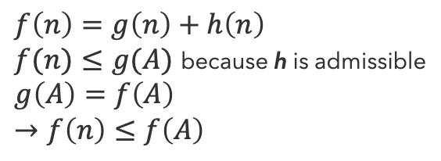
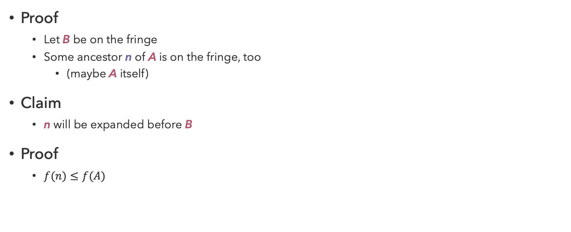
Optimality of A* Tree Search (1)
Proof
  Let B be on the fringe
  Some ancestor n of A is on the fringe, too
    (maybe A itself)
Claim
  n will be expanded before B
Proof
  $f(n)≤f(A)$
…
n
$$f\left(n\right)=g\left(n\right)+h\left(n\right)$$
$f(n)≤g(A)$ because h is admissible
$$g\left(A\right)=f\left(A\right)$$
$$→f\left(n\right)≤f\left(A\right)$$
B

Slide 27
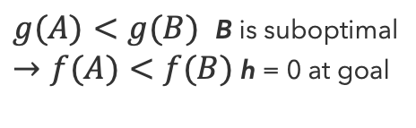
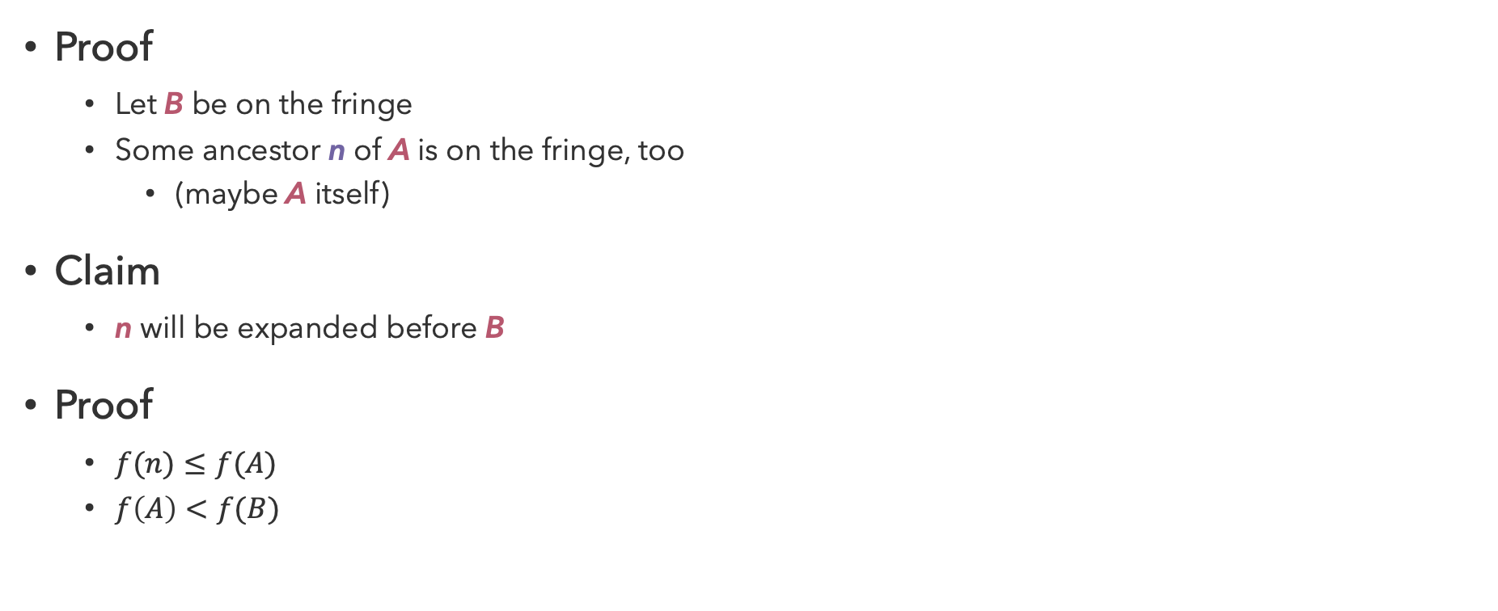
Optimality of A* Tree Search (2)
Proof
  Let B be on the fringe
  Some ancestor n of A is on the fringe, too
    (maybe A itself)
Claim
  n will be expanded before B
Proof
  $f(n)≤f(A)$
  $f\left(A\right)<f(B)$
…
n
A
$g(A)<g(B)$ B is suboptimal
$→f(A)<f(B)$ h = 0 at goal
B

Slide 28
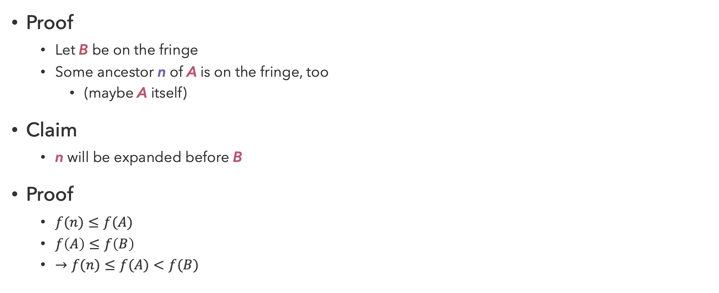
Optimality of A* Tree Search (3)
Proof
  Let B be on the fringe
  Some ancestor n of A is on the fringe, too
    (maybe A itself)
Claim
  n will be expanded before B
Proof
  $f(n)≤f(A)$
  $f\left(A\right)≤f\left(B\right)$
  $→f(n)≤f(A)<f(B)$
…
n
A
B

Slide 29
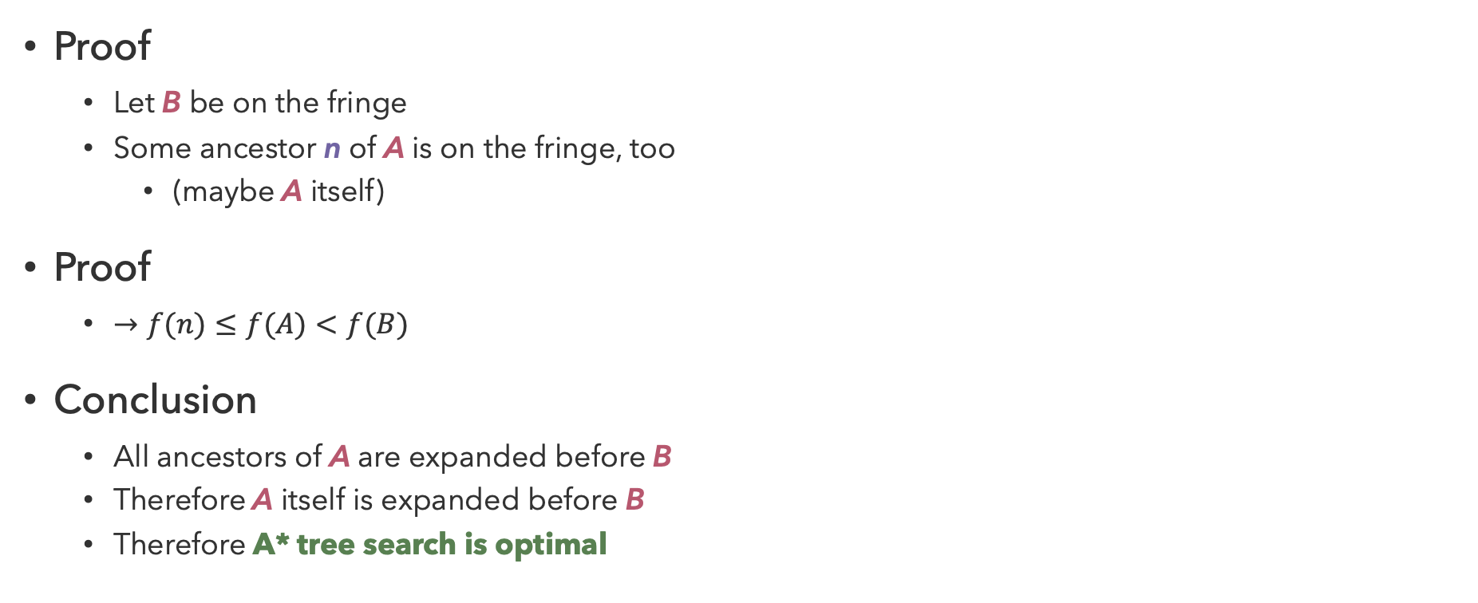
Optimality of A* Tree Search (4)
Proof
  Let B be on the fringe
  Some ancestor n of A is on the fringe, too
    (maybe A itself)
Proof
  $→f(n)≤f(A)<f(B)$
Conclusion
  All ancestors of A are expanded before B
  Therefore A itself is expanded before B
  Therefore A* tree search is optimal
…
n
A
B
Notes:
Question: How does UCS compare to A*?

Slide 30
Questions (3)

Slide 31
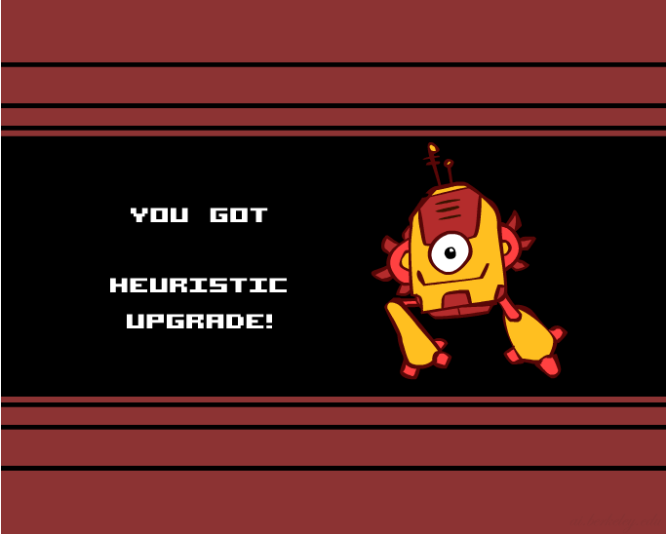
Creating Heuristics
Most of the work in solving hard search problems involves finding admissible heuristics
Often, admissible heuristics are solutions to relaxed problems where new actions are available
Inadmissible heuristics can be useful too
Notes:
Some inadmissible heuristics only overestimate the cost on clearly suboptimal solutions, or overestimate the cost but not enough to make the estimate higher than suboptimal solutions.
We could also use an inadmissible heuristic if we are willing to sacrifice absolute optimality (get close enough).

Slide 32
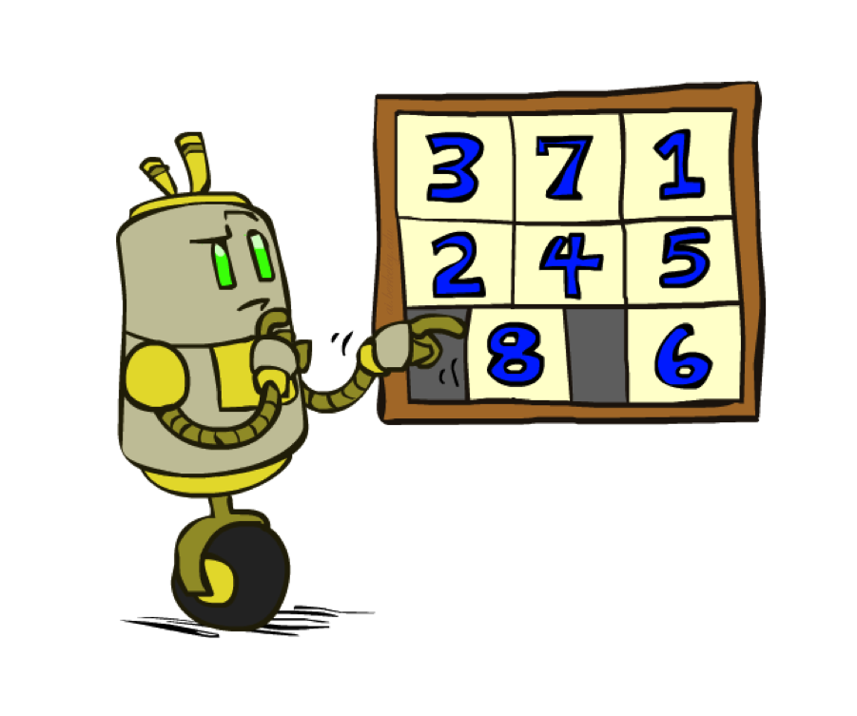
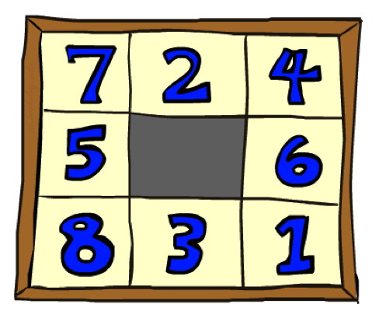
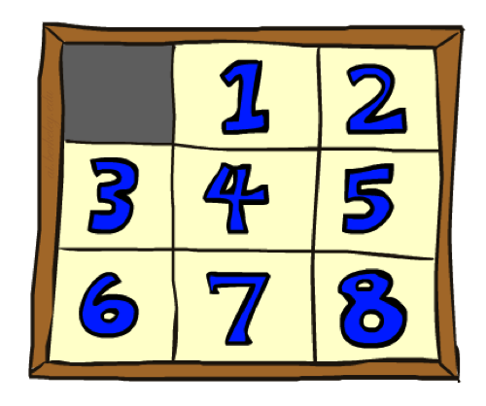
8 Puzzle
Start State
Goal State

Slide 33
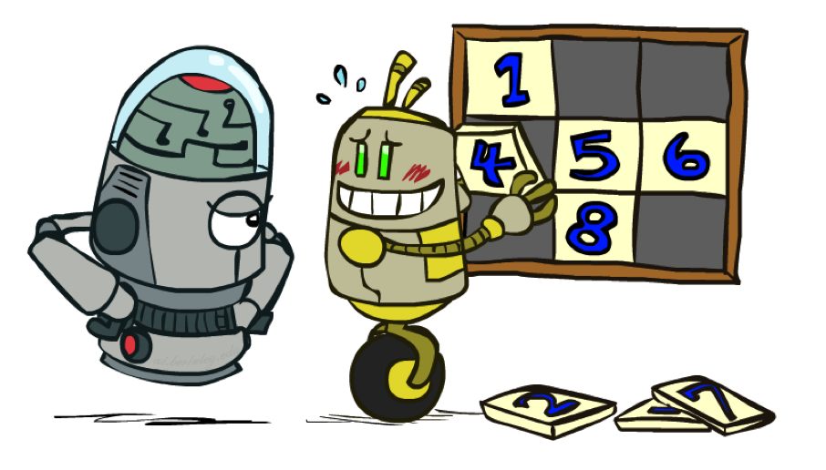
8 Puzzle: Heuristic
Heuristic: number of misplaced tiles
  Admissible? Yes, because putting tiles in correct position requires at least as many moves
Start State
Goal State

Slide 34
General Graph Search
function GRAPH-SEARCH(problem, strategy) returns solution or failure
closed ← empty set
initialize fringe using initial state of problem
loop do
if fringe empty then return failure
node ← remove node from fringe
if node is goal state then return corresponding solution
if node not in closed then
expand node and add resulting nodes to fringe
add node to closed
end

Slide 35
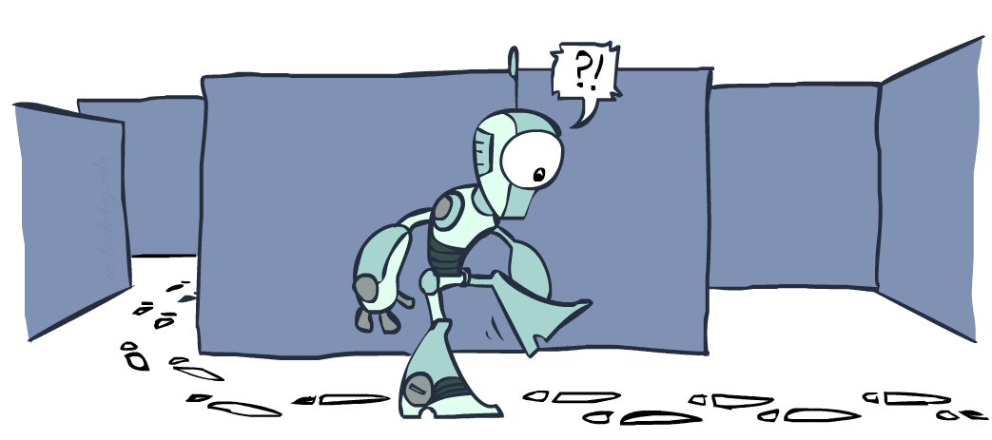
Is A* Graph Search Optimal?

Slide 36
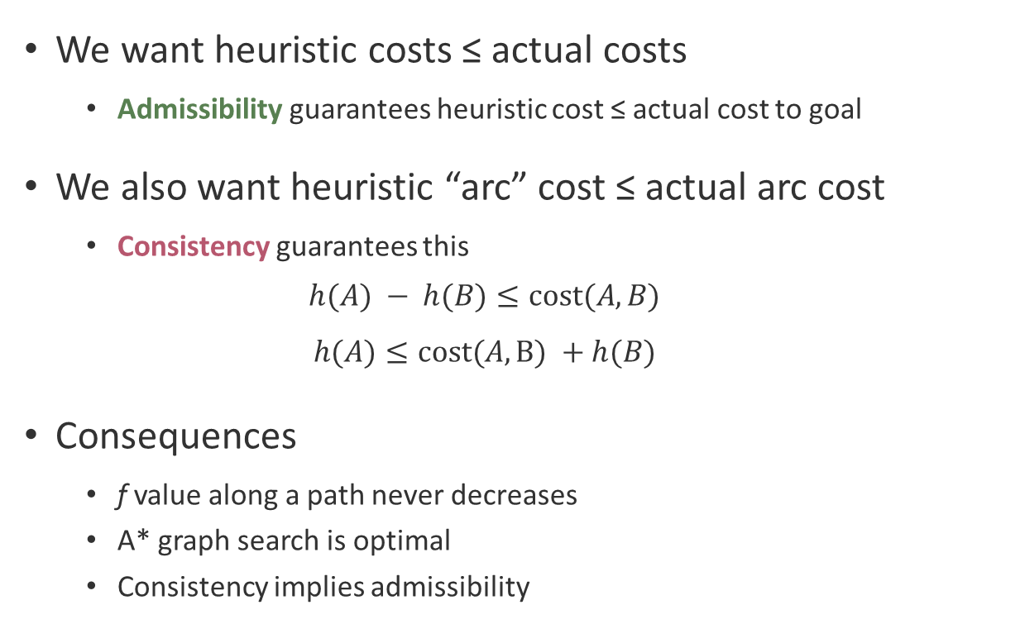

Consistency
h = 3
h = 1
A
h = 1
1
We want heuristic costs ≤ actual costs
  Admissibility guarantees heuristic cost ≤ actual cost to goal
We also want heuristic “arc” cost ≤ actual arc cost
  Consistency guarantees this
  $$h(A) − h(B)≤cost(A,B)$$
  $$h(A)≤cost(A,B) +h(B)$$
Consequences
  f value along a path never decreases
  A* graph search is optimal
  Consistency implies admissibility
B
h = 4
3
Triangle Inequality
G
h = 0
  $$h\left(A\right)≤cost\left(A,C\right)+h\left(C\right)$$
  $$4≤1+1$$
Notes:
(Why? The difference between tree search and graph search is the inclusion of the closed list. You may end up reaching an ‘internal node (I)’ – or a node mid-way along the path from two different routes. If the heuristic is not consistent, then we lose the proof that the path from the root to to I is optimal. In tree search it doesn’t matter because we can re-evaluate I on a different branch, and we still have the proof that the entire branch is optimal. But in graph search once we visit I we won’t re-evaluate based on a different route, so we may be stuck with the sub-optimal root-I path as part of our final path.)

Slide 37
Questions (4)

Slide 38
Search Algorithms
Depth First – memory efficient, good for solutions at maximum depth
Breadth first – optimal
Uniform cost search – optimal if cost varies
  (BFS is just UCS with cost of always 1)
A* search – adds heuristic to guide search direction
  (UCS is A* with a heuristic of 0!)
Graph searches maintain a list of expanded nodes and don’t re-expand
  Implementing graph searches can prevent cycles from occurring.
How does all this relate to Dijkstra’s algorithm?

Slide 39
that’s it for today!
Informing the direction of our search with heuristics
Consequences of heuristic admissibility and consistency
Multi-Agent Search
Hand-in Practice Problem
Do Homework 1
Do Project 1

