Slide 1
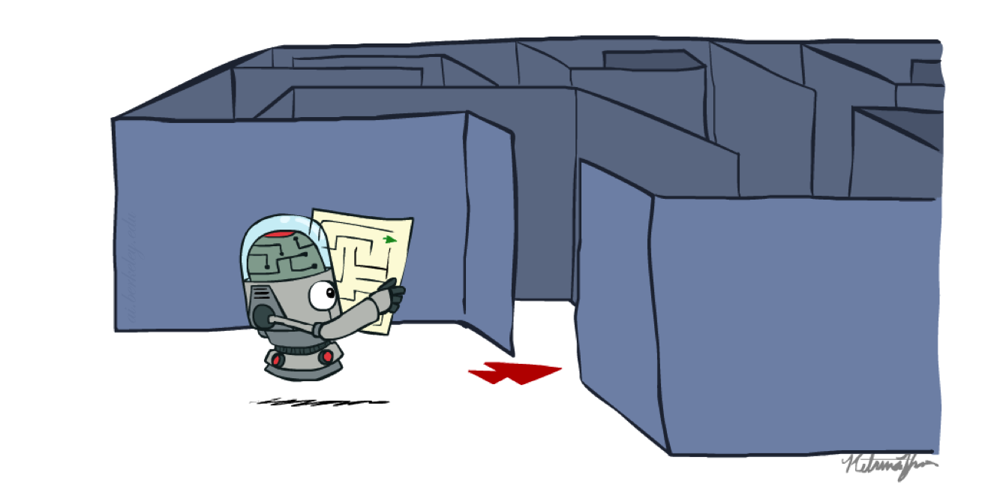
Uninformed Search
CSE 473: Introduction to Artificial Intelligence
Megan Hazen (mh75@cs)
cs.uw.edu/473
acknowledgements
Welcome!
Place in Washington you want to visit?

Slide 2

Administrivia
Office hours updated on schedule
Remember to complete the practice problems for each lecture
For each project, make sure to fill out the AI usage reflection (cs.uw.edu/473/projects)
Homework 1 released today
  due next Monday (10/12)
Project 1 released today
  due in two weeks (10/19)

Slide 3

Search

Slide 4

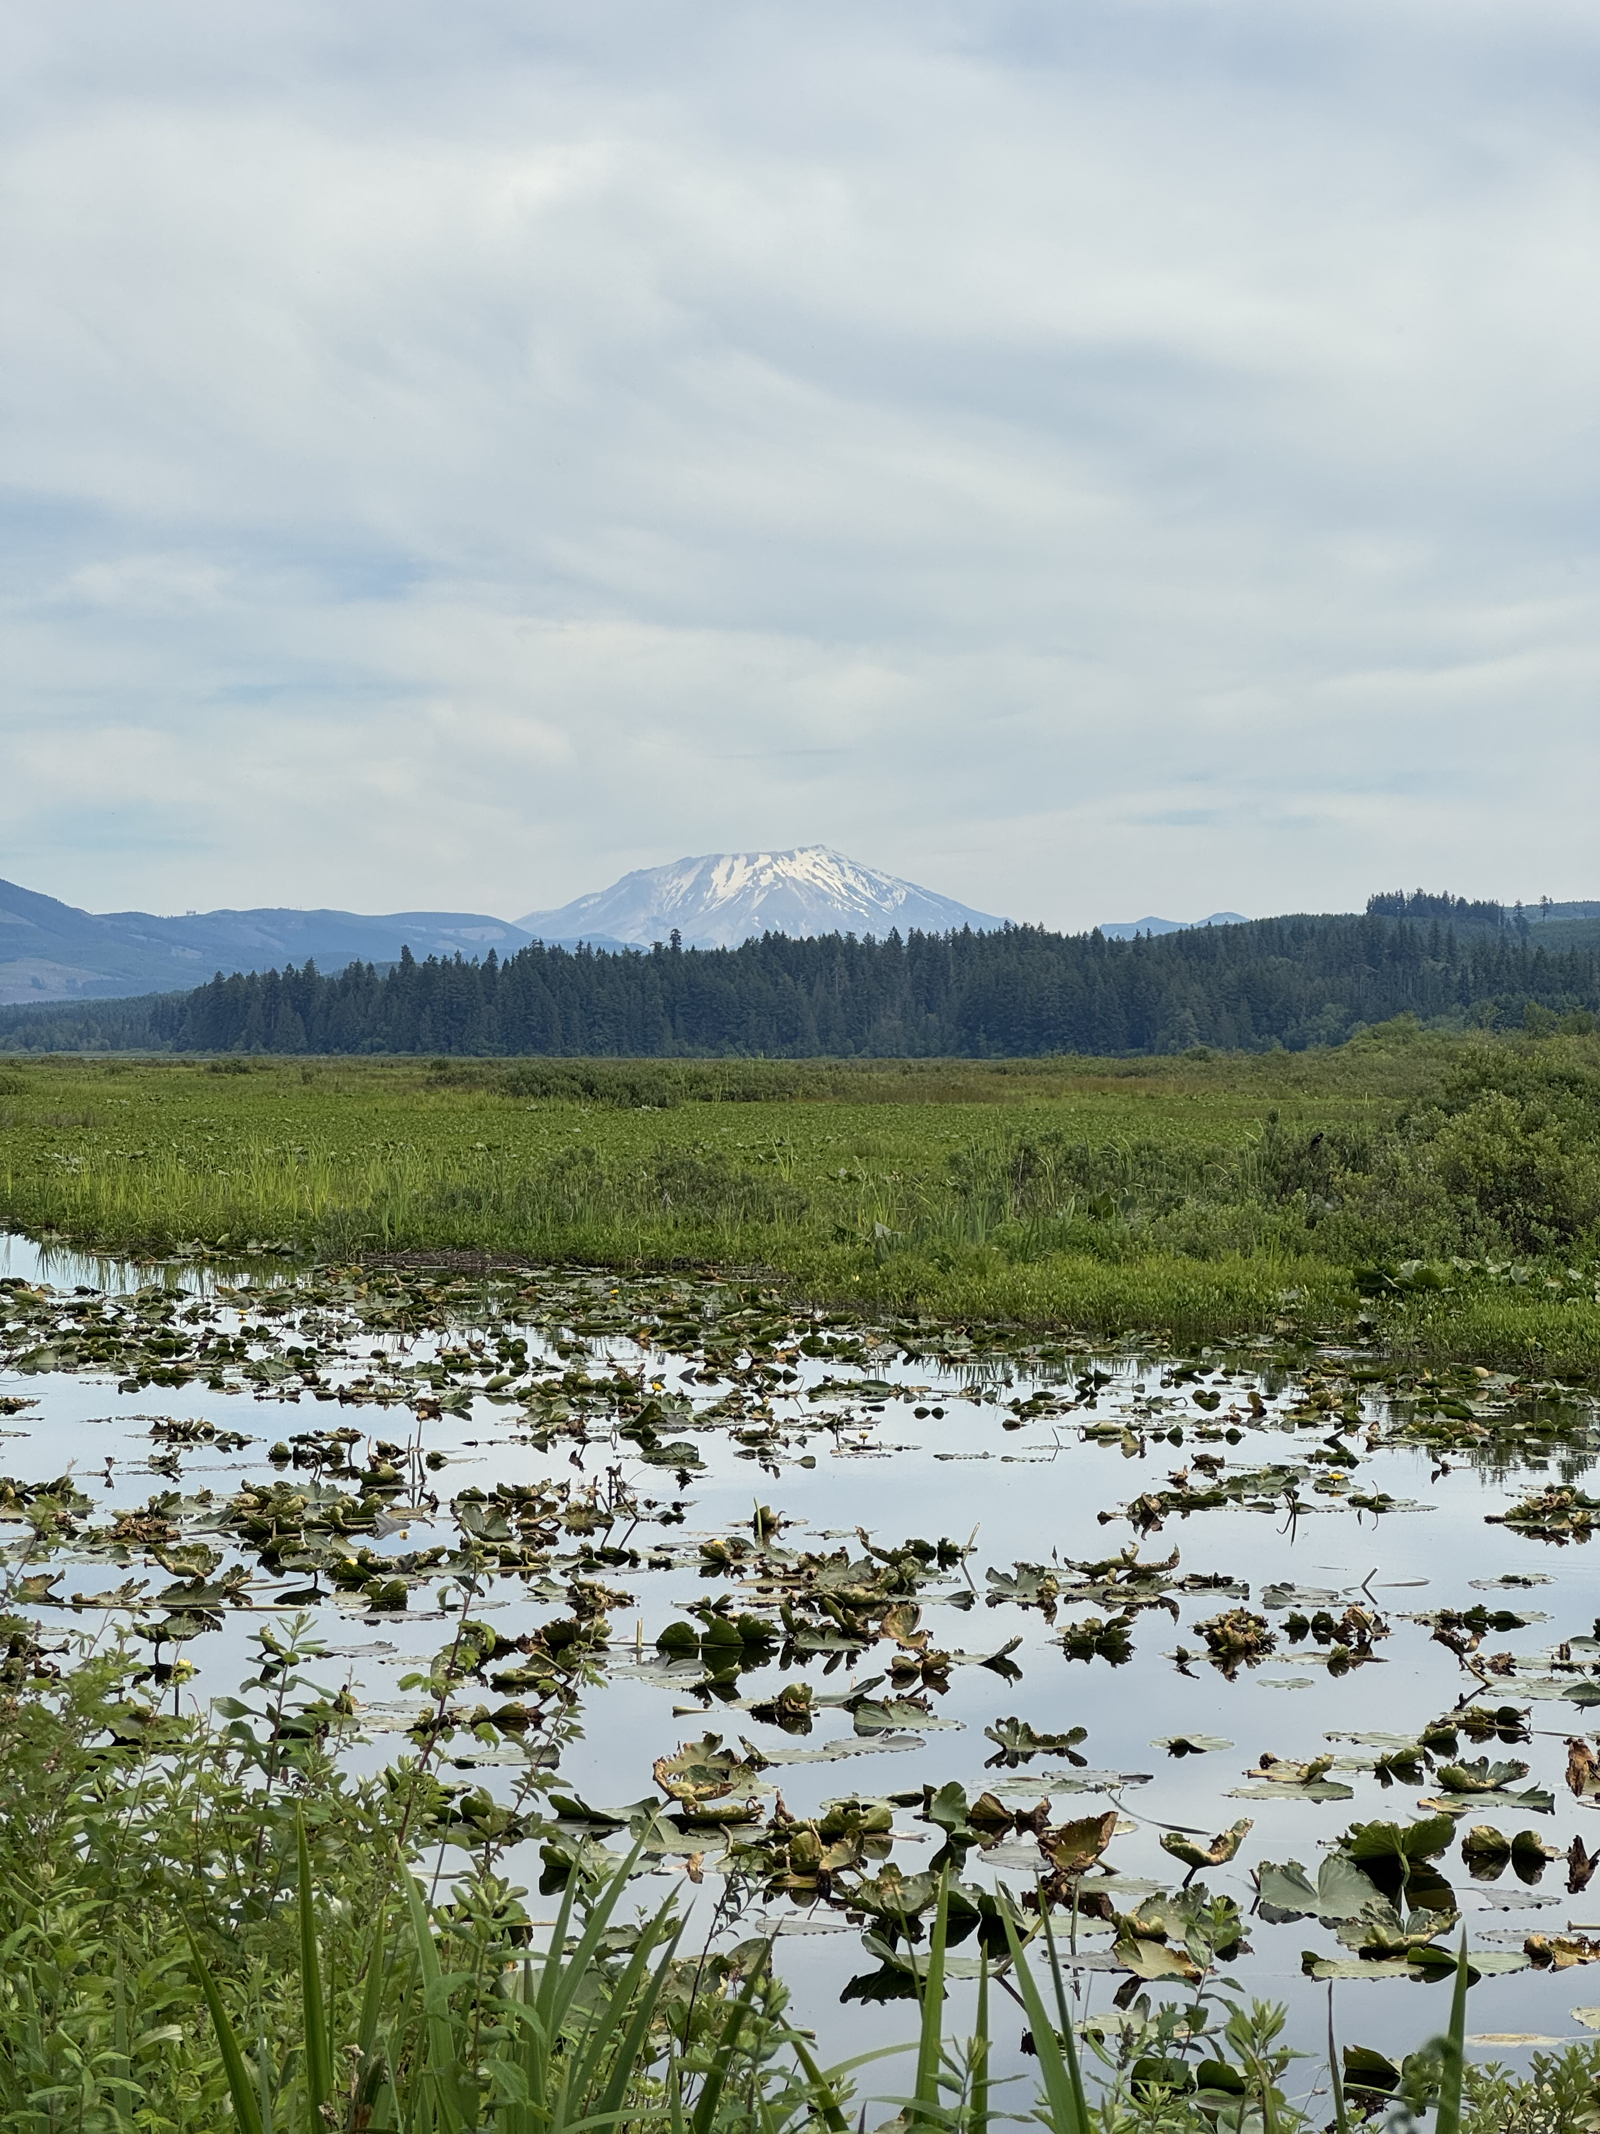
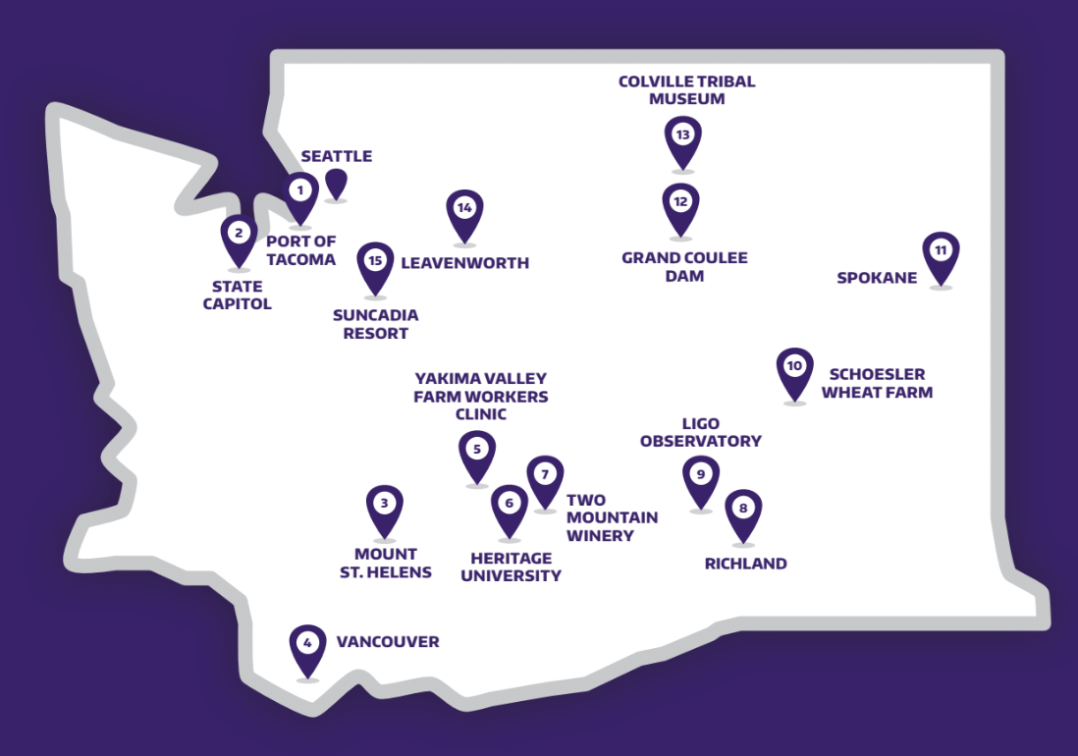


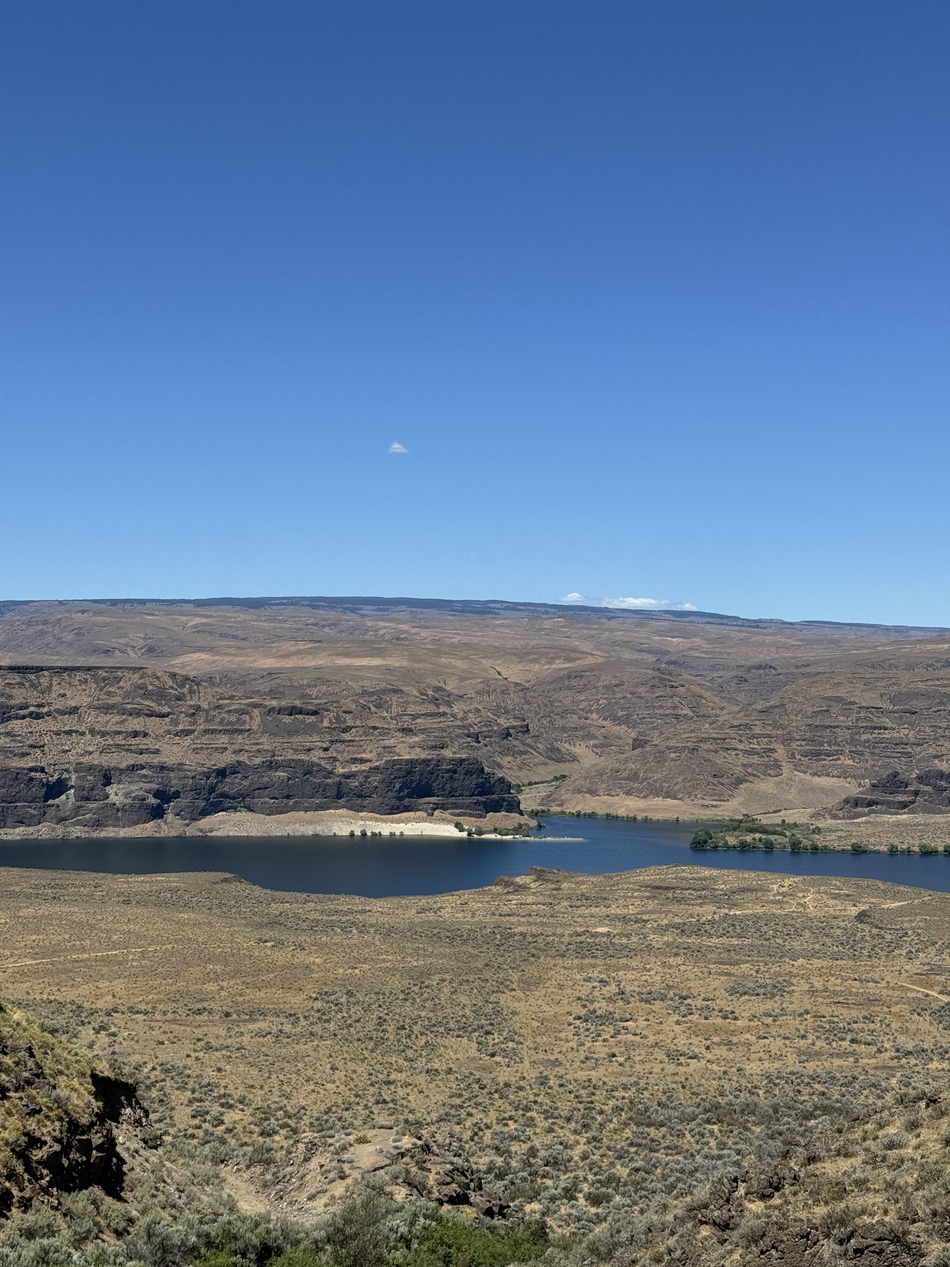
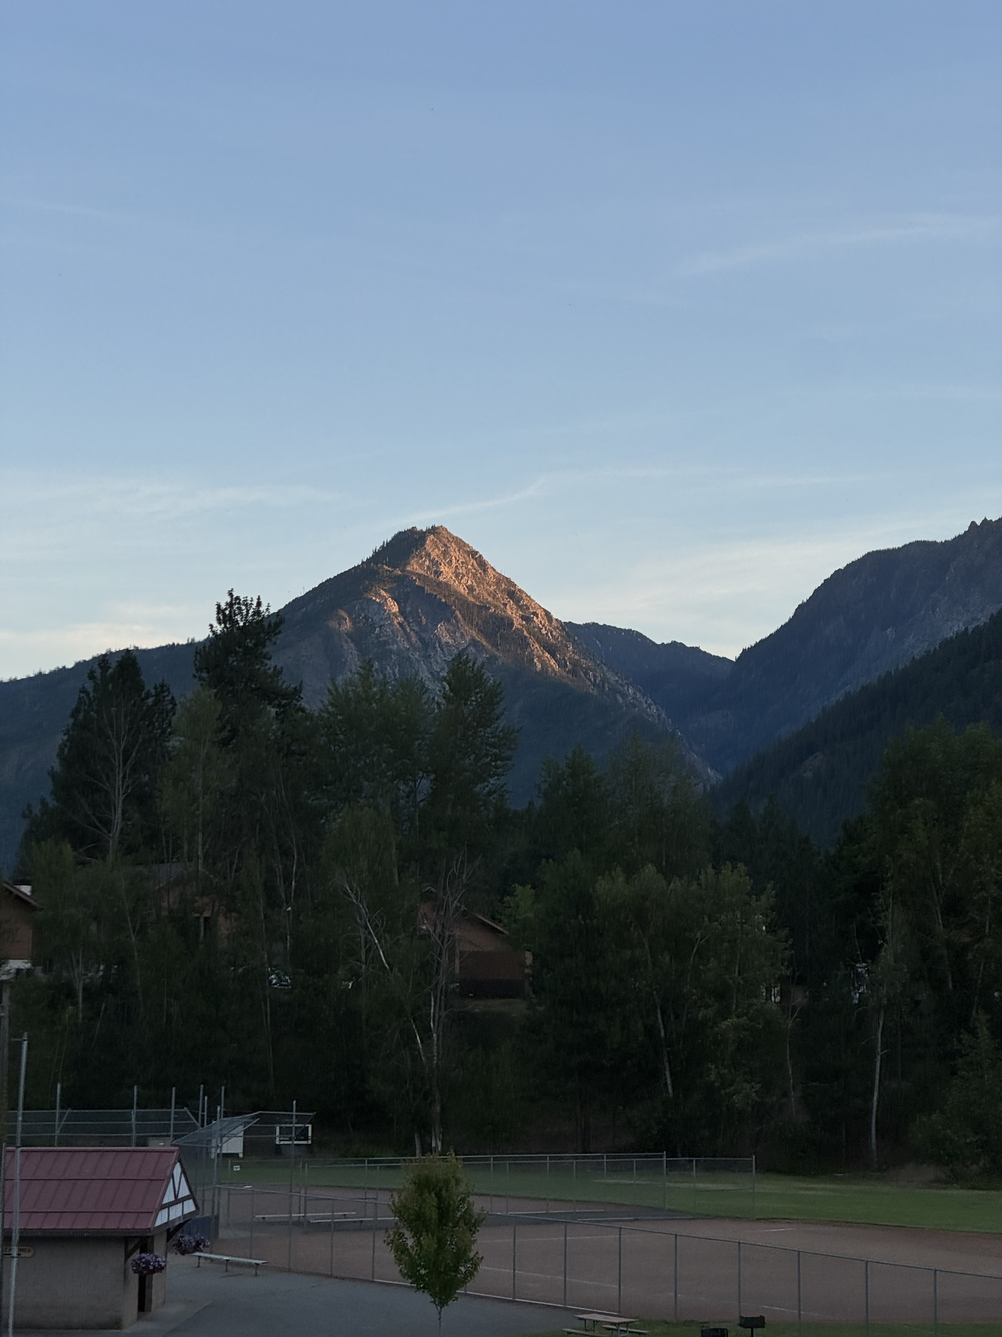
Washington Search Problem

Slide 5

Spokane to Seattle
state space
  cities
successor function
  roads connect adjacent cities with cost = travel time
start state
  Spokane
goal test
  state == Seattle?
Seattle
Grand Coulee
2.4
2
1.6
Spokane
Leavenworth
2.3
Olympia
1.3
2.3
Ritzville
1
1
Yakima
2.2
Mt. St. Helens
3
1.3
1.2
Richland
1.6
3.4
Vancouver

Slide 6
Touring Washington
state space
  Cities & (visited boolean array)
successor function
  roads connect adjacent cities with cost = travel time
start state
  Seattle
goal test
  visited is all true and
  city == Seattle
Seattle
Grand Coulee
2.4
2
1.6
Spokane
Leavenworth
2.3
Olympia
1.3
2.3
Ritzville
1
1
Yakima
2.2
Mt. St. Helens
3
1.3
1.2
Richland
1.6
3.4
Vancouver

Slide 7
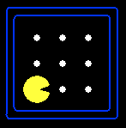


State Space Graphs
Represent transitions between states as a graph
  Nodes are states
  Arcs represent successors (action results)
  Goals are a set of nodes
  Each state is represented once
Can we build the full graph?
Can’t usually fit in memory

Slide 8
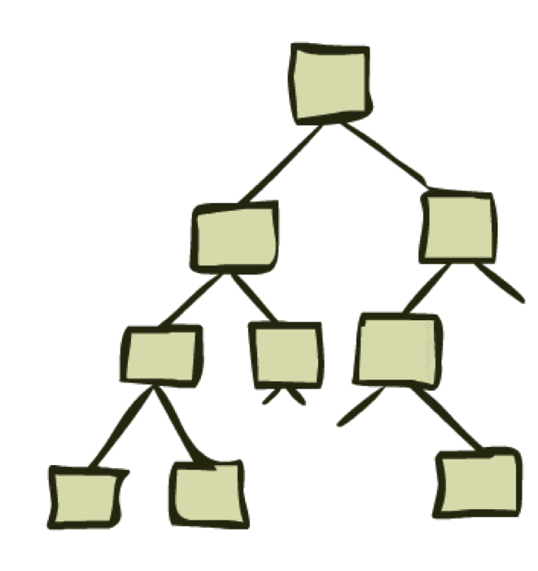
Search Trees
Represent sequences of actions on paths to root
  Nodes are states
  Children represent successors (action results)
  States can be repeated
Can we build the full tree?
Not always possible…
Notes:
When isn’t it possible? (Cycles in graph = inf tree.)

Slide 9
Graphs vs. Trees
State Space Graph
Search Tree
Each node in a search tree represents an entire path from the root.
S
a
G
d
e
p
b
c
b
c
e
h
r
q
d
e
Trees get very large, so we construct on demand and as little as possible.
f
a
a
h
r
p
q
f
S
h
p
q
f
q
c
G
p
q
r
q
c
G
a
a
Notes:
For example, there are multiple different ways to get to Node a. In the graph, a appears once and we can discover different paths. In the tree, a appears many times – one at the leaf node of each path that ends at a.

Slide 10
Graph vs. Tree
The tree is infinitely big because the graph has a cycle.
a
a
b
b
G
a
G
S
G
a
G
b
G
b
…
…

Slide 11
Questions (1)

Slide 12
Tree Search
Tree search is a search algorithm that maintains a fringe (or frontier) of nodes to consider exploring
  Nodes on the fringe are expanded to find new nodes
unexplored nodes
expanded nodes
fringe nodes

Slide 13
General Tree Search
function TREE-SEARCH(problem, strategy) returns solution or failure
initialize fringe using initial state of problem
loop do
if fringe empty then return failure
node ← remove node from fringe according to strategy
if node is goal state then return corresponding solution
expand node and add resulting nodes to fringe
end

Slide 14
Strategy: How to order fringe?

Slide 15
Random Exploration: Step 1
S
a
G
d
e
p
b
c
b
c
e
h
r
q
e
d
f
a
a
h
r
p
q
f
S
p
q
f
q
c
G
h
p
q
r
q
c
G
a
a
Expanded
Fringe
S

Slide 16
Random Exploration: Step 2
S
a
G
d
e
p
b
c
b
c
e
h
r
q
e
d
f
a
a
h
r
p
q
f
S
p
q
f
q
c
G
h
p
q
r
q
c
G
a
a
Expanded
Fringe
Expand
S
S
d, e, p

Slide 17
Random Exploration: Step 3
S
a
G
d
e
p
b
c
b
c
e
h
r
q
e
d
f
a
a
h
r
p
q
f
S
p
q
f
q
c
G
h
p
q
r
q
c
G
a
a
Expanded
Fringe
Expand
e
S, e
d, p, h, r

Slide 18
Random Exploration: Step 4
S
a
G
d
e
p
b
c
b
c
e
h
r
q
e
d
f
a
a
h
r
p
q
f
S
p
q
f
q
c
G
h
p
q
r
q
c
G
a
a
Expanded
Fringe
Expand
p
S, e, p
d, h, r, q

Slide 19
Random Exploration: Step 5
S
a
G
d
e
p
b
c
b
c
e
h
r
q
e
d
f
a
a
h
r
p
q
f
S
p
q
f
q
c
G
h
p
q
r
q
c
G
a
a
Expanded
Fringe
Expand
r
S, e, p, r
d, h, q, f

Slide 20
Random Exploration: Step 6
S
a
G
d
e
p
b
c
b
c
e
h
r
q
e
d
f
a
a
h
r
p
q
f
S
p
q
f
q
c
G
h
p
q
r
q
c
G
a
a
Expanded
Fringe
Expand
f
S, e, p, r, f
d, h, q, c, G

Slide 21
Random Exploration: Step 7
S
a
G
d
e
p
b
c
b
c
e
h
r
q
e
d
f
a
a
h
r
p
q
f
S
p
q
f
q
c
G
h
p
q
r
q
c
G
a
a
Expanded
Fringe
“Expand”
G
S, e, p, r, f
d, h, q, c

Slide 22
Questions (2)

Slide 23
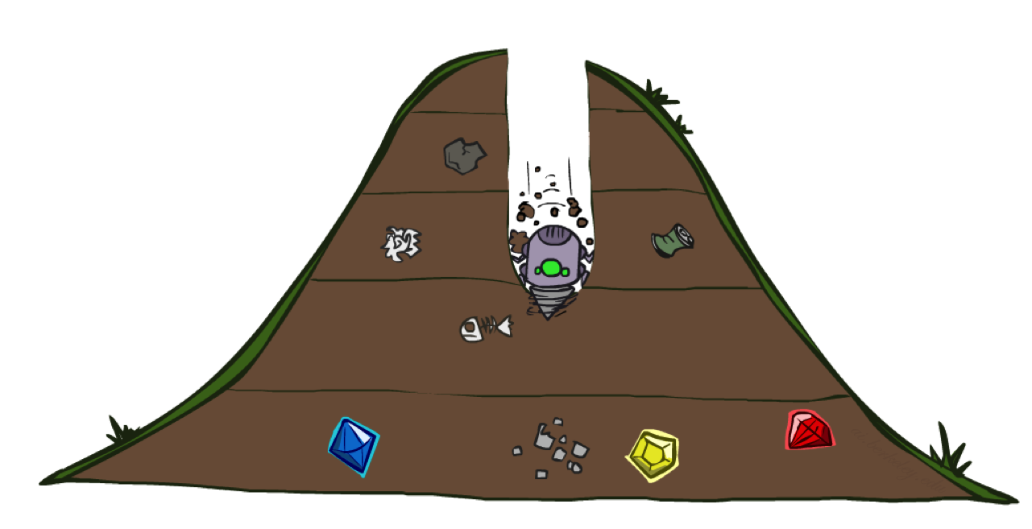
Depth-First Search
a
G
b
c
d
e
Strategy
  Expand deepest (most recently added) node first
Implementation
  Fringe is a LIFO stack
  Usually break ties alphabetically
f
S
h
p
q
r
S
d
e
p
b
c
e
h
r
q
a
a
h
r
p
q
f
p
q
f
q
c
G
q
c
G
a
a
“oooooo, shiny!”

Slide 24
Properties of DFS
Complete: guaranteed to find a solution if it exists.
Complete?
  m could be infinite, so only if no cycles
Optimal?
  No. DFS does not care about cost!
Time Complexity
  O(b^{m}) if m is finite
Space Complexity
  O(bm)
1 node
b
…
b nodes
Optimal: finds lowest cost solution
b² nodes
m tiers
b^{m} nodes

Slide 25
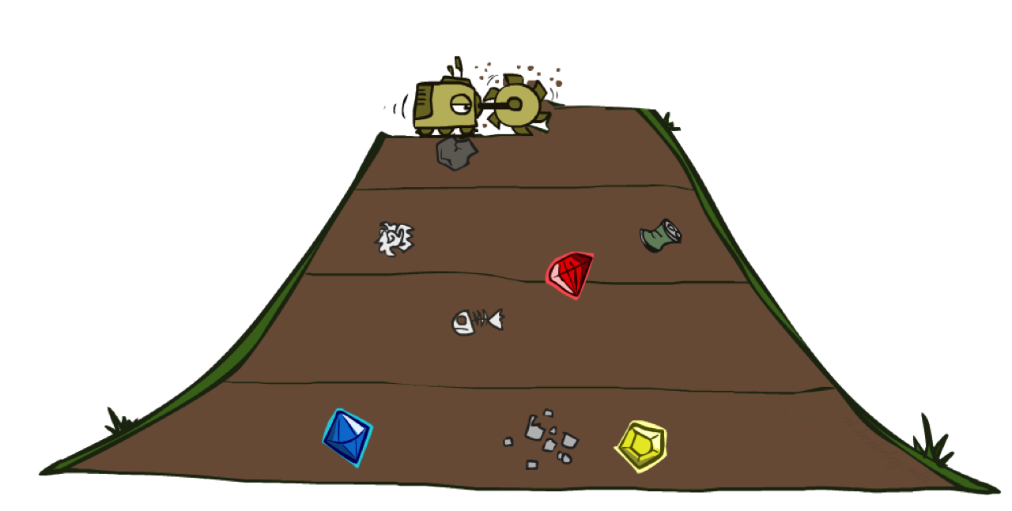
Breadth-First Search
a
G
b
c
d
e
Strategy
  Expand shallowest (oldest) node first
Implementation
  Fringe is a FIFO queue
  Usually break ties alphabetically
f
S
h
p
q
r
S
d
e
p
b
c
e
h
r
q
a
a
h
r
p
q
f
p
q
f
q
c
G
q
c
G
a
a
“wait your turn!”

Slide 26
Properties of BFS
s = depth of shallowest solution
Complete?
  Yes (s must be finite for a solution to exist)
Optimal?
  Only if costs are all 1
Time Complexity
  O(b^{s})
Space Complexity
  O(b^{s}) (roughly all nodes in tier s)
1 node
b
…
b nodes
b² nodes
s tiers
b^{s} nodes
b^{m} nodes

Slide 27
DFS vs. BFS?
Notes:
Do question #2 now.
DFS = no, O(bm), O(b^m), BFS = yes, O(b^s), O(b^s)
DFS could be used when s~=m, BFS when s << m. But, also, most searches are based on BFS.

Slide 28
Iterative Deepening
s = depth of shallowest solution
Idea
  Combine space advantage of DFS with BFS time advantage
Implementation
  Run DFS with depth 1
  Run DFS with depth 2
  Run DFS with depth 3
  …
1 node
b
…
b nodes
b² nodes
s tiers
b^{s} nodes
b^{m} nodes

Slide 29
Actions Have Costs…
Seattle
Grand Coulee
How to find the lowest cost path?
2.4
2
1.6
Spokane
Leavenworth
2.3
Olympia
1.3
2.3
Ritzville
1
1
Yakima
2.2
Mt. St. Helens
3
1.3
1.2
Richland
1.6
3.4
Vancouver

Slide 30
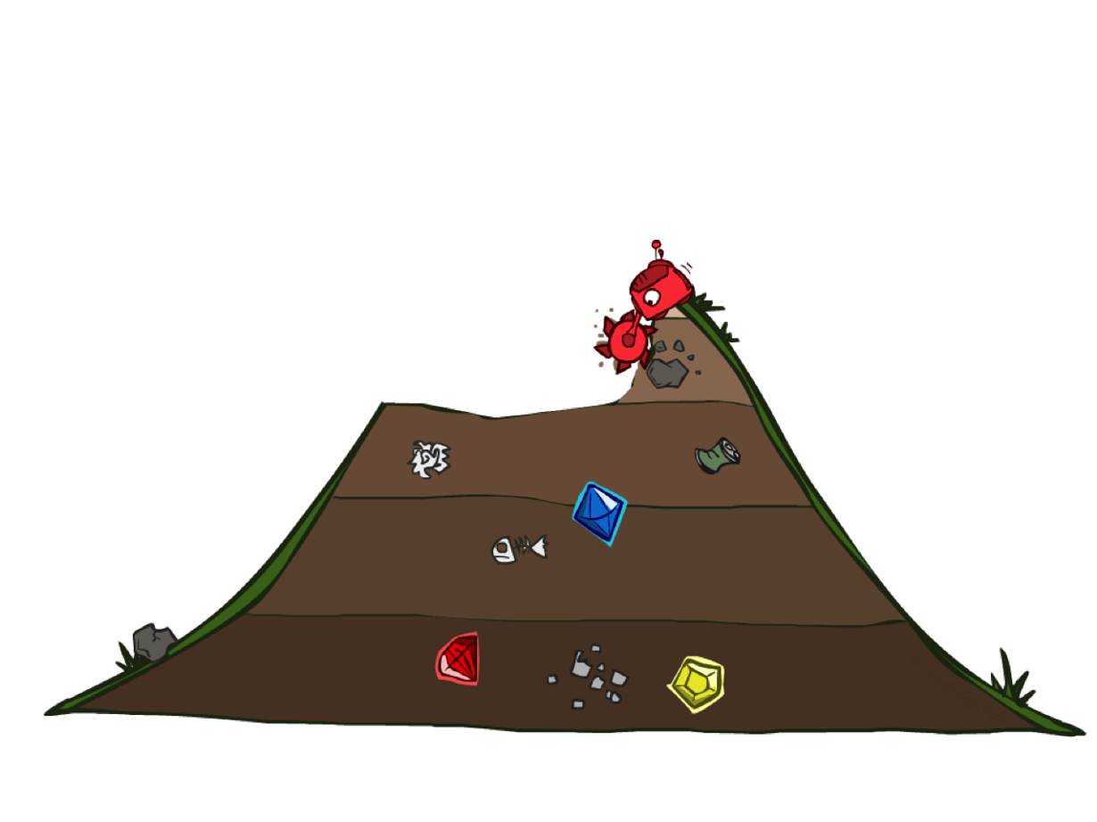
Uniform Cost Search
2
a
1
G
b
c
3
1
8
2
d
2
e
Strategy
  Expand cheapest (least cost) node first
Implementation
  Fringe is a priority queue
  Usually break ties alphabetically
3
f
S
9
8
2
1
h
1
1
p
q
r
15
1
S
d
e
p
b
c
e
h
r
q
a
a
h
r
p
q
f
p
q
f
q
c
G
q
c
G
a
a
“how much does it cost?”

Slide 31
Properties of UCS
g(n) = cost from root to node n
C* = solution cost
ε = minimum arc cost
effective depth = C*/ ε
Complete?
  Yes (assuming C* is finite and ε > 0)
Optimal?
  Yes!
Time Complexity
  O(b^{C*/ ε})
Space Complexity
  O(b^{C*/ ε}) (roughly last tier)
b
g ≤ 1
…
g ≤ 2
g ≤ 3
C*/ ε tiers

Slide 32
Optimality of UCS Tree Search
Assume
  A is an optimal goal node
  B is a suboptimal goal node
Claim
  A will be chosen for expansion before B
…
A
B
Notes:
And, note here, BFS is UCS if all costs are 1.

Slide 33
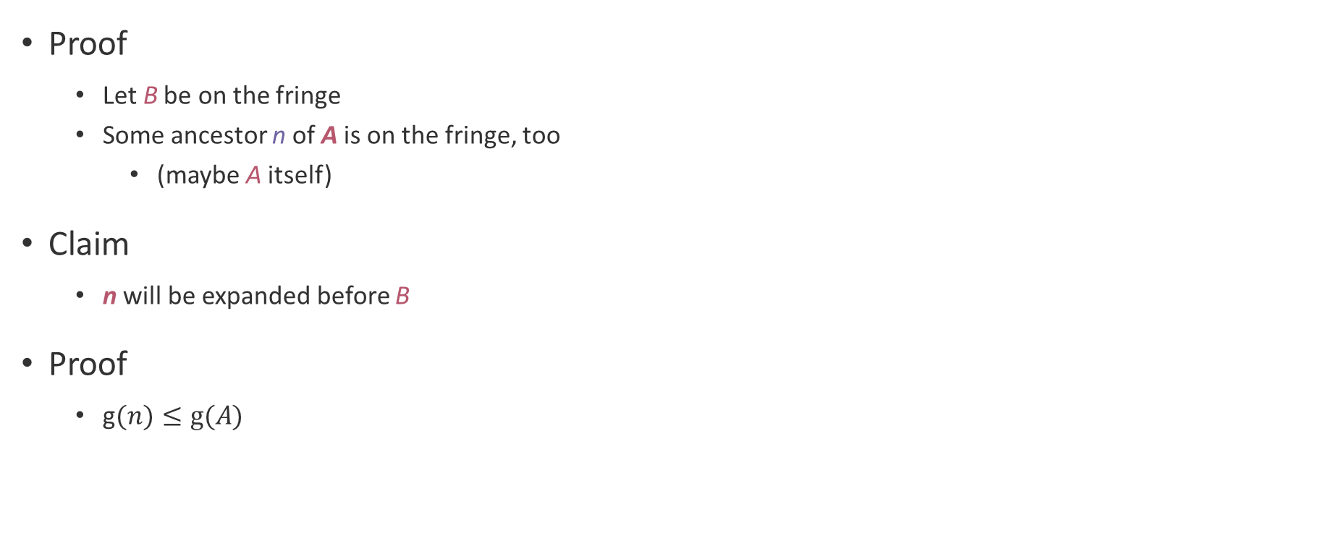
Optimality of UCS Tree Search (1)
Proof
  Let B be on the fringe
  Some ancestor n of A is on the fringe, too
    (maybe A itself)
Claim
  n will be expanded before B
Proof
  g$(n)≤g(A)$
…
n
ε > 0
B
Notes:
Remember, g(n) is the cost from the root to node n

Slide 34
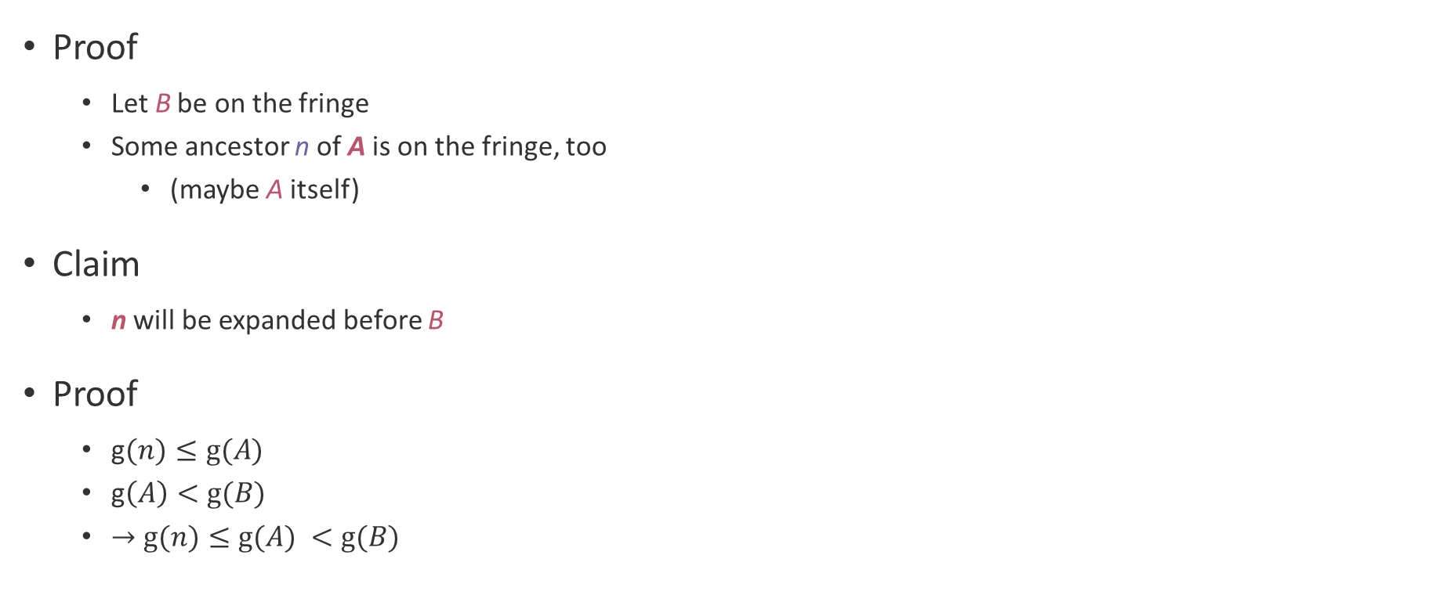
Optimality of UCS Tree Search (2)
Proof
  Let B be on the fringe
  Some ancestor n of A is on the fringe, too
    (maybe A itself)
Claim
  n will be expanded before B
Proof
  g$(n)≤g(A)$
  g$\left(A\right)<g(B)$
  $→g(n)≤g(A) <g(B)$
…
n
A
B
B is suboptimal

Slide 35
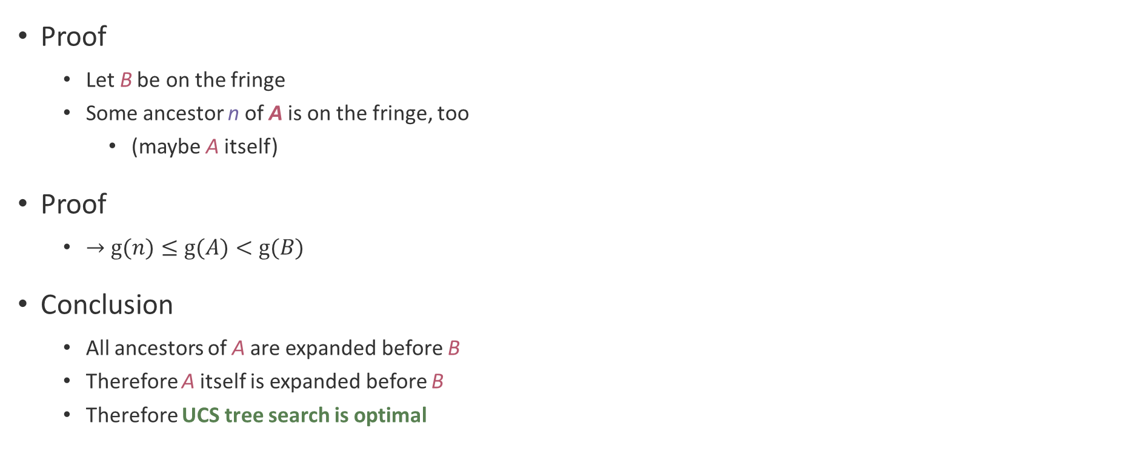
Optimality of UCS Tree Search (3)
Proof
  Let B be on the fringe
  Some ancestor n of A is on the fringe, too
    (maybe A itself)
Proof
  $→g(n)≤g(A)<g(B)$
Conclusion
  All ancestors of A are expanded before B
  Therefore A itself is expanded before B
  Therefore UCS tree search is optimal
…
n
A
B

Slide 36
Questions (3)

Slide 37
Pacman Wayfinding

Slide 38

The One (Priority) Queue

Slide 39
General Graph Search
function GRAPH-SEARCH(problem, strategy) returns solution or failure
closed ← empty set
initialize fringe using initial state of problem
loop do
if fringe empty then return failure
node ← remove node from fringe
if node is goal state then return corresponding solution
if node not in closed then
expand node and add resulting nodes to fringe
add node to closed
end

Slide 40
General Tree Search
function TREE-SEARCH(problem, strategy) returns solution or failure
initialize fringe using initial state of problem
loop do
if fringe empty then return failure
node ← remove node from fringe according to strategy
if node is goal state then return corresponding solution
expand node and add resulting nodes to fringe
end
Notes:
Notice that the difference is in marking the node as expanded. Can we do that in tree search? (Yes, because the subtree below a node is constant no matter when it is expanded, and we know the first time a node is expanded it is the optimal route from the root to the node via the optimality proof.)

Slide 41

What’s Next?
dead end
can we avoid it?
2
a
1
G
b
c
3
1
8
2
2
e
3
d
f
9
8
2
S
1
h
1
1
p
r
q
1
15

Slide 42
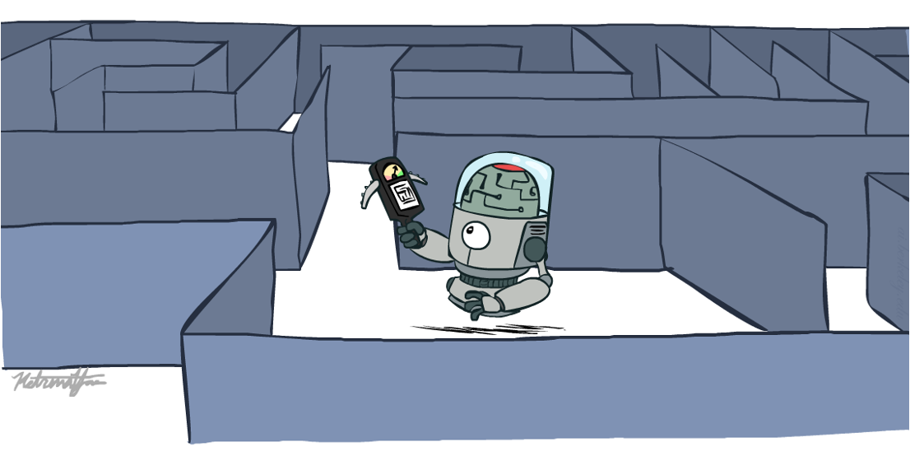
Can We Inform Our Search?

Slide 43
that’s it for today!
Which fringe nodes to expand?
DFS (stack) vs. BFS (queue)
vs. UCS (priority queue)
Search with Heuristics
Multi-Agent Search
Complete Practice Problem 3
Do Homework 1 (due 7.2)
Do Project 1 (due 7.9)

